Slide 1
Introduction to UNIX®
…with focus on linux HPC

Slide 2

UNIX
An operating system originally designed at AT&T
Very popular among scientist and engineers, especially those engaged in scientific computing
  Consists of kernel, file system structure, and commands
What is the difference between Unix, Linux, BSD and GNU?
  Different implementations of Portable Operating System Interface (POSIX)
  Strictly speaking linux is just a kernel, so it usually goes with GNU/linux
  GNU is a set of rules philosophies that govern free software; BSD is another one
  UNIX/BSD are "older" implementations of POSIX
  There are now only minor differences between these different implementations so they are mostly used interchangeably
Shell: command interpreters
  There are different "flavors" of Unix available today, which means different command interpreters (‘shells’) handle your input in their own unique way
  Popular shells: C, Bourne, Bash (‘Bourne Again Shell’; a replacement for Bourne; e.g. Mac OS)
  echo $SHELL (‘$’ signifies environmental variables)
  When you type in a command from a terminal or virtual terminal, the shell is responsible for translating it into something the OS understands (usually in C++)
Command syntax: command [flags] argument1 argument2 ...
  Arguments are usually ‘files’ (in UNIX, directories and files can both be called ‘files’)
Some controls for terminal outputs: ctrl-C (abort), ctrl-z (suspend a running program), bg (push to background), fg (push to foreground; won’t work if you’ve lost the terminal)
Online help: man <cmd>
Notes:
Demo dir: /sciclone/home10/yinglong/vims20/NCKU/RUN02g/Nudge

Slide 3
Set up environment
Login files
  .cshrc or .bashrc: invoked after every successful login; you can put your favorite cmd’s, aliases etc here
  .login: only invoked during first successful login
  Others: .Xauthority, .ssh,…
Important root dir: /bin (or dirs that contain ‘bin’)
  When you want the system to execute a command, you almost never have to give the full path to that command. Why so?
e.g.: [yinglong@comet-ln3 ~]$ ls /bin
arch dbus-uuidgen iptables-xml mv sort awk dd iptables-xml-1.4.7 nano sty basename df kbd_mode netstat su bash dmesg keyctl nice sync cat dnsdomainname kill nisdomainname tar
cgclassify domainname ksh ping taskset cgcreate dumpkeys ksh93 ping6 tcsh
cgdelete echo link plymouth touch chgrp false ls red true cp
Environment variables: env (list all)
  Start with a ‘$’

Slide 4
Set up environment
So how does the shell know where to find the cmd’s? A special env var $PATH takes care of this
  echo $PATH: /opt/local/bin:/usr/X11R6/bin:/usr/bin:/usr/sbin/:/bin (note the search starts from 1st to last)
  If multiple copies of a program are found in the path, the 1st got executed
  ‘which‘ cmd
  e.g.: which mv; which –a mv (find all copies)
  You can append the $PATH to easily execute your favorate customized cmd‘s from your own dir
  e.g.: export PATH=$PATH:~/bin (bash)
  If 2 users have different orders of paths, the same cmd may mean different things
  Avoid accidentally overwriting system cmd‘s!
$LD_LIBRARY_PATH – determines what libraries are available at run time; useful for HPC applications
Some important configuration files in etc/
  aliases: mail aliases file for use with the Sendmail and Postfix mail server
  apache: config files for the Apache web server
  cshrc (bashrc): system-wide configuration file for the shell
  crontab and the cron.* dir: configuration of tasks that need to be executed periodically - backups, updates of the system databases, cleaning of the system, rotating logs etc.
  group: configuration file for user groups
  hosts: A list of machines that can be contacted using the network, but without the need for a domain name service (i.e., shorthand like hurricane instead of hurricane@sciclone....)
  mail: Directory containing instructions for the behavior of the mail server
  X11: Settings for the graphical server, X

Slide 5
File and directory structure
Absolute pathnames begin with a slash, /, and start at the root directory
e.g. /sciclone/home10/yinglong/vims20/CA_DWR/
A relative pathname begins with the directory you are in (commonly referred to as working directory), and either go up (parent, grandparent …) or down. ‘.’ is the current dir.
e.g. /sciclone/home10/yinglong/vims20/CA_DWR% pwd
/sciclone/data10/yinglong/vims20/CA_DWR
/sciclone/home10/yinglong/vims20/CA_DWR% ls ../
BlackSea LINK SURA CA_DWR MPAS Test_ICE
ChesapeakeBay nam Test_MOI
/sciclone/home10/yinglong/vims20/CA_DWR% ls RUN71 <-same as ./RUN71/
bctides.in manning.gr3 run71_out.tgz
ccfb_gate.th midr_culvert_l.th run_whirlwind
Generally file and directory names should be composed only of letters of the alphabet, digits, ".", ‘-’, and "_“ (underscore)
In many vendor distributions of linux, colored schemes are used to differentiate different types of files (dir, file, socket, link etc)

Slide 6
Special characters
Some characters have special functions in UNIX and are ‘reserved’
  ’?’: wild card, matching any single char exactly 1 time (e.g. echo schout_[0-9]???_*.nc)
  ’*’: wild card (matching all or none): echo schout_[0-9]*.nc
  ‘.’: current dir (when at the start)
  ‘/’: used in dir path to separate parts
  ‘~’: home dir (can be followed by a uid e.g. ~yinglong/)
  ‘$’: env variables
  ‘[ ]’: range
  ‘>’, ‘<‘, ‘>>’: redirection operators that redirect in/out from standard screen I/O
  ‘|’ (pipe): a convenient way to channel the output of one command into the input of another without creating an intermediate file
  e.g.: ps -aux | sort
  ps -aux | sort | more
  " ` { } #, &
There is a way to use these special characters in dir/file names, by using a backslash ‘\’, but this is not recommended (a common origin for these dir/file names is transfers from Windows)
  Backslash is commonly called escape char, and is useful in remote cmd’s
History cmd: ‘!’
  !$: last argument of last cmd
  !<char>: last cmd that starts with <char>
Push cmd to background: & (same as ctrl-z; bg)
  Use ps cmd to find out running processes, and kill cmd to kill a process (however, better way is to use ps -u)

Slide 7
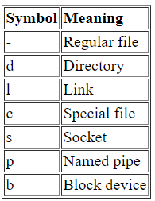
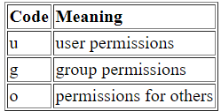
File and directory structure
A period is often used to add a suffix on to a base filename, e.g. FORTRAN programs are named .f, .F, .F90 etc
Hidden files/dirs
  Starts with a period ‘.’
  Serves special functions (e.g. login files, version control files etc)
  Use ls –la to see them
File types and permission
  Use ls –al (or ‘ll –a’ as an alias) to view permissions
  e.g. /sciclone/home10/yinglong% ll -al
  total 337372
  drwxr-sr-x. 46 yinglong vims1 4096 Jun 9 19:01 .
  drwxr-xr-x. 124 root root 4096 Apr 11 2017 ..
  drwxrwxr-x. 21 yinglong vims1 4096 Jun 6 2012 AMB24Stuff
  -rw-r--r--. 1 yinglong ohsuf 617 Mar 6 2017 .bash_history
  -rw-r--r--. 1 yinglong vims1 190 Jun 22 2017 .bash_profile
  -rw-rw-r--. 1 yinglong vims1 623 Jul 7 2003 bathymetry.color
  Another useful cmd is: ll –ltr (to sort in time)
  Find your group(s): id
  Change permission: chmod
    -a = -ugo
    To ‘hide’ a file from others: chmod go-r <file>
    To expose all files in a dir and all subdir (‘recursive): chmod –R a+rX .
    Alternatively, set universal permission for all of your dirs in login files via umask
  chown (change owner) and chgrp (change group) commands: chown (-R) newuser file
A dir has to be ‘executable’ in order to be readable
Hidden file

Slide 8
Find and view files
find
e.g.: find . -name "*.tmp” (will search subdirs)
locate: e.g. locate acroread (simpler but less powerful)
grep: very powerful cmd to filter input lines and returning certain patterns to the output
grep “<pattern>” <files> (can be piped with find/locate): ps -aux | grep “RUN06”
‘less is more’: less allows scroll back, highlighting of search string etc (e.g. ncdump .nc | less)
head/tail: display the n first/last lines of file(s) respectively
Links: shorts
  Most useful is softlink (‘symbolic link’), essentially a pointer (much like in C; we’ll cover pointer in FORTRAN as well later)
  The links are of very small size compared to target
  Use ll to find links (some systems also color them differently)
  Creation: ln -s targetfile linkname (target can be a dir!); this is much faster than cp/rsync!
  Use ‘-f’ to force overwrite
  Chain of links: change ONE, change ALL! (live updates)
  Symlinks are great tool for software engineering (provenance), but edit it with caution!!
  Pitfalls: too many levels of link; implications for other cmd’s (e.g. cp, rsync..)
symlinks
file1
file2
file3
file4
Notes:
Demo dir: /sciclone/home10/yinglong/vims20/TMP/RUN03a

Slide 9
Login and file transfer
ssh <your ID>@<hostname>
  Add ‘-X’ or ‘-Y’ to tunnel X window (for GUI)
Transfer files within a system
  cp, mv: use ‘-i’ to avoid accidentally overwrite files; use ‘-f’ to force overwrite; use ‘-r’ for recursive transfer (for mv this is implied); ‘-L’ for copying target not link
  rsync: same as cp but only copy the difference so more efficient
    Flags: -a, -z, -L ..
Transfer files across different systems
  ftp, scp, rcp…
  Best is rsync (if enabled), with a password, especially for large files
  e.g.: rsync -aLz bin yinglong@chinook.sciclone.wm.edu:bin/comet_bin
tar: archiving (very useful to compress multiple files/dirs into a tarball before transfer; e.g. rsync)
  -v: verbose
  -t: test, shows content of a tarball
  -x: extract archive
  -c: create archive
  -h: follow symlink
  -f: specify destination
  -z: compress (with gzip)
  During creation, ../ will be stripped out (so be careful!)
Globus is getting popular, but requires the systems be mounted there

Slide 10
Some useful commands
hostname: reminder of which system you are on
date: system clock (day light saving adjusted)
cat: simply dump a file to standard output (screen)
df –h: find out which disk the current dir is mounted on and how full the disk is
diff: compare 2 files and display the differences (for non ASCII files, only returns true/false)
history: of cmd’s (try to use with grep)
alias: a nice way to shorten long and/or often typed commands (e.g. alias h history)
setenv/export: set env vars (e.g. shorthands like $SCH_SVN)
awk, sed: powerful 1 liners
A few hints on optional flags
  -r (readable; recursive); -l (long); -L (symlink); -h (human readable or symlink); -i (interactive); -v (verbose)
Modules: indispensable for HPC
  avail, load, list, switch, purge, show…

Slide 11
Exercise
Play with symlinks

Slide 12
Processes
Interactive processes
  Initialized and controlled through a terminal session
  Can be run on the foreground or background
  Foreground job: terminal will be fully occupied by the job (no other jobs can start until this is done)
  Background job: only useful if it does not require user inputs; multiple jobs run on same time (beware interferences!)
    Initiated with a ‘&”, or foreground job followed by ctrl-z and bg; use fg to pop it back, but this may be tricky with multiple bg jobs
    Job control is needed: ps, top, kill. Parallel jobs need to be killed using special cmd’s
    Hanging bg jobs (e.g. waiting for further instructions)
    Use >,< to redirect output/inputs. ‘>&’ combined with stdout (overwrite in C shell). Use >> to append
    Automatic processes
      Daemons: server processes that run continuously (e.g., system processes; crontab jobs like daily forecast)
      Batch jobs: controlled by batch scripts
Memory management
  When the currently running processes expect more memory than the system has physically available, a Linux system will not crash; it will start paging, or swapping, meaning the process uses the memory on disk or in swap space, moving contents of the physical memory (pieces of running programs or entire programs in the case of swapping) to disk, thus reclaiming the physical memory to handle more processes. This slows the system down enormously since access to disk is much slower than access to memory
  Use top to find out if this is the case. If so, you’d consider killing the job (or you’ll receive a nice reminder from system manager)
I/O contention: modern HPC systems consist of multiple disks and some use lustre stripes; consider moving jobs to another disk
Scheduling jobs: at; sleep; cron scripts; batch scripts (PBS, SLURM)

Slide 13
Editing
Emacs, nano: optional packages
vi: basic yet powerful and widely available
  a will append: it moves the cursor one position to the right before switching to insert mode
  i will insert
  o will insert a blank line under the current cursor position and move the cursor to that line.
  n dd will delete n lines starting from the current cursor position.
  n dw will delete n words at the right side of the cursor.
  x will delete the character on which the cursor is positioned
  :n moves to line n of the file.
  :w will save (write) the file
  :q will exit the editor.
  :q! forces the exit when you want to quit a file containing unsaved changes.
  :wq or :x will save and exit
  :w newfile will save the text to newfile.
  :wq! overrides read-only permission (if you have the permission to override permissions, for instance when you are using the root account)
  /astring will search the string in the file and position the cursor on the first match below its position.
  ?astring: search backward
  / or ? will perform the same search again, moving the cursor to the next match (or simply press ‘n’)
  :1, $s/word/anotherword/g will replace word with another word throughout the file.
  yy will copy a line of text. Use :n1,n2 y to yank from lines n1 to n2
  p will paste the yanked lines
  u,^r: undo/redo
  :r <file> append a file below current line
  :recover will recover a file after an unexpected interruption.

Slide 14
House keeping tips
Make a bin directory for your favorite program files and scripts (and consider adding bin to the $PATH)
Organize non-executable files in appropriate directories, and give them descriptive names (so you can easily guess what content they have by just looking at the names)
Use symlinks to save space and also keep provenance and automatic updates
Compress files that need to be archived (tar, gzip …)
Manage startup default env
  Use env vars as shortcuts
    setenv VARIABLE value (csh) or export VARIABLE=value (bash); echo $VARIABLE to see its content
    Env vars can be used just as ordinary vars
  Put these into .cshrc or .bashrc (so they are defined upon startup)
  Also load modules and set aliases (your favorite cmds) in those files

Slide 15
HPC specific cmd’s
Batch scripts
  Sciclone uses Torque (PBS) to schedule and run jobs
Submission: qsub, sbatch <batch script>
  Submitting jobs to compute nodes from head node
  You can see the list of compute nodes used in your stdout (e.g. err2.out below)
  System messages may be also found in <job name>.[eo]<jid>
  Can also be used to launch a lot of serial jobs
Job control: qstat, qdel, qalter…
#!/usr/bin/tcsh
#PBS -N R01a
#Use vims1 queue for jobs up to 500 hours
###PBS -q vims1
#PBS -l walltime=8:00:00
###whirlwind for WW; hurricane for HU
#PBS -l nodes=3:hurricane:ppn=8
##PBS -M yjzhang@vims.edu
##PBS -m be
cd $PBS_O_WORKDIR
##For HU (turn off affinity)
mvp2run -a -v -C 0.05 ./pschism_WHIRLWIND_Intel_VL >& err2.out

Slide 16
Version control

Slide 17
SVN: sub version
What Is Subversion?
Subversion is a free/open source version control system (VCS).
Manages files and directories, and the changes made to them, over time (like your own secretary)
Allows you to recover older versions of your data or examine the history of how your data changed; like a “time machine”
Subversion can operate across networks, which allows it to be used by people on different computers
The ability for various people to modify and manage the same set of data from their respective locations fosters collaboration
Progress can occur more quickly without a single conduit through which all modifications must occur
Because the work is versioned, you need not fear that quality is the trade-off for losing that conduit—if some incorrect change is made to the data, just undo that change
Git is another popular version control system

Slide 18
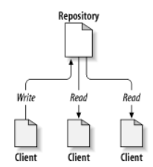
SVN: repository
Client/server system
Repo address is simply a url
SVN allows a single repo (while git allows many, distributed)
Clients must have access (read/write) privilege to central repo
Clients communicate with repo via svn cmd’s

Slide 19
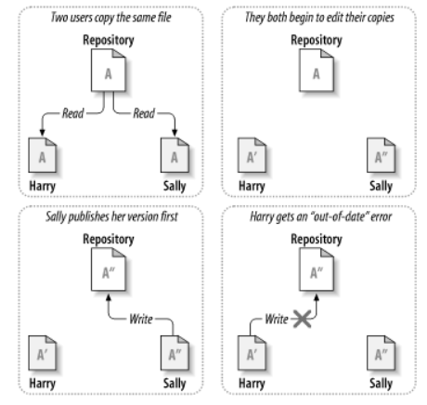
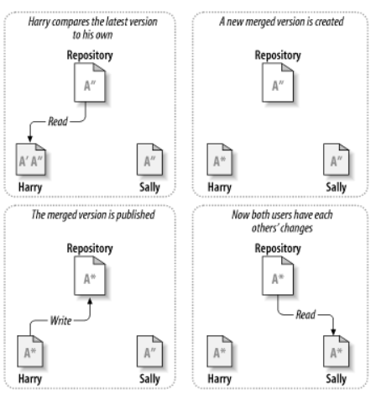
SVN: how does it work?
The copy-modify-merge solution
‘Update’ to merge
Conflict!

Slide 20
SVN: how does it work?
Subversion client commits (that is, communicates the changes made to) any number of files and directories as a single atomic transaction, i.e. either all of the changes are accepted into the repository, or none of them is (to avoid system interruption etc)
Working copy
  Ordinary directory tree on your local system, containing a collection of files
  You can edit these files however you wish, and if they're source code files, you can compile your program from them in the usual way
  Your working copy is your own private work area: Subversion will never incorporate other people's changes, nor make your own changes available to others, until you explicitly tell it to do so
  You can even have multiple working copies of the same repo
  After you've made some changes to the files in your working copy and verified that they work properly, Subversion provides you with commands to “publish” your changes to the other people working with you on your project (by writing to the repository).
  If other people publish their own changes, Subversion provides you with commands to merge those changes into your working copy (by reading from the repository)
Repo
write
read
Client

Slide 21
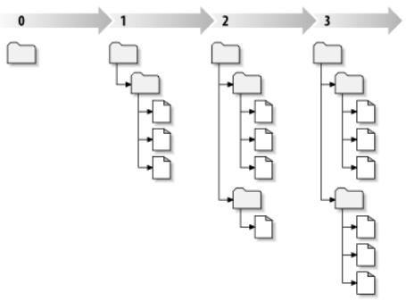
SVN: status
Revision: Each time the repository accepts a commit, this creates a new state of the file system tree, called a revision. Each revision is assigned a unique natural number, one greater than the number assigned to the previous revision
Revision # is global (i.e. for entire repo)
Revisions (‘snapshots’)
/sciclone/home10/yinglong/SCHISM/svn/trunk% svn status -u .
? mk/Make.defs.local
M * 4731 mk/include_modules
* 4731 src/Fabm/fabm_schism.F90
M src/schism_init.F90

Slide 22
SVN: status
Svn will compare your working copy with repo and tell which of the following four states a working file is in:
  Unchanged, and current
  The file is unchanged in the working directory, and no changes to that file have been committed to the repository since its working revision. An svn commit of the file will do nothing, and an svn update of the file will do nothing
  Locally changed, and current
  The file has been changed in the working directory, and no changes to that file have been committed to the repository since you last updated. There are local changes that have not been committed to the repository; thus an svn commit of the file will succeed in publishing your changes, and an svn update of the file will do nothing
  Unchanged, and out of date
  The file has not been changed in the working directory, but it has been changed in the repository. The file should eventually be updated in order to make it current with the latest public revision. An svn commit of the file will do nothing, and an svn update of the file will fold the latest changes into your working copy
  Locally changed, and out of date (you are bad and lazy; keep up!)
  The file has been changed both in the working directory and in the repository. An svn commit of the file will fail with an “out-of-date” error. The file should be updated first; an svn update command will attempt to merge the public changes with the local changes. If Subversion can't complete the merge in a plausible way automatically, it leaves it to the user to resolve the conflict

Slide 23
SVN: basic mode
%whoami
yinglong
%svn co https://.../foo.c (checkout a copy of foo.c from repo and bring it to version control)
A foo.c
Checked out revision 56
foo.c is now your own working copy!
Edit it and test
When ready to ‘publish’, commit it
%svn ci foo.c –m “work on foo.c”
Sending foo.c
Transmitting file data .
Committed revision 59. <-why not 57?
Now everyone who has access to repo knows you have changed foo.c. They may want to merge their own copy with this ‘official’ version
%whoami
feiye
%svn up
Updating '.':
U foo.c
Updated to revision 59.
Now both users are ‘in sync’ with each other and with repo
In general, it’s a good practice for all users to remain in sync (even for highly experimental work; more on branching later)

Slide 24
SVN: commands
%pwd
/sciclone/home10/yinglong/SCHISM/svn/
%svn ls $SCH_SVN
%svn co $SCH_SVN/trunk
%svn up (update to get others’ commits) (repo master is usually in charge of gatekeeping)
%cd trunk; (do your own editing/changes)
%svn status –u . (good to check status for all changes before ci!)
%svn ci (publish all your changes in trunk; note I’ve set default commit editor as vi in my .cshrc)
%svn log (examine previous commit messages)
%svn diff … (look at differences between working copy and repo, or even 2 versions of repo)
Now branching off (for your dev work)
%svn cp $SCH_SVN/trunk/ $SCH_SVN/branches/branch1
svn co $SCH_SVN/branches/branch1 (get a local copy so you cam work on it
....
svn merge -r 100:101 $SCH_SVN/trunk/ (merge the differences of 2 releases in trunk to branch, so branch and trunk are in sync)
After you are happy with branch, merge it back to trunk and close out the branch
cd ../trunk/
svn merge --reintegrate $SCH_SVN/branches/branch1
svn ci
svn delete $SCH_SVN/branches/branch1
Caveat
svn is sensitive to dir tree so try not to mess with the dir structure.
If you have to rename/change dir struc, better use svn cp to work directly on repo (not working copy) and then re-check out from repo
When conflicts occur, you have to resolve it yourself – you can avoid a lot of pain by staying in sync!

Slide 25
SVN: exercise
$SCH_SVN/drill2/

