Slide 1
Unstructured grid: an introduction

Slide 2
Overview
Mesh and manifold
Unstructured grids; visualization
Data structures for UG
Delauney and Voronoi diagram
UG connectivity

Slide 3
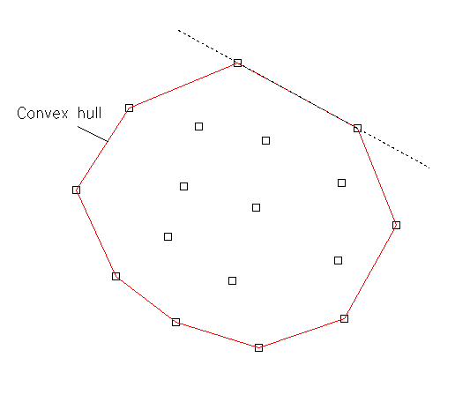
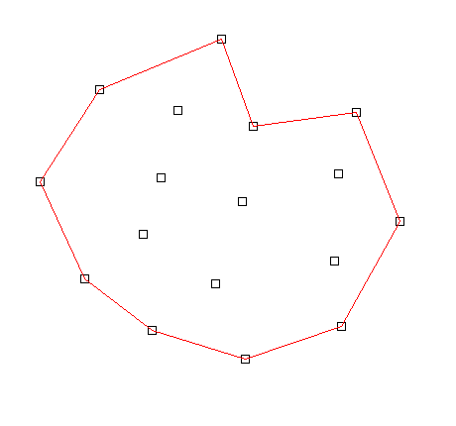
General definitions
Convex hull: the convex outline of a given set of points S in 2D or 3D space (R² and R³), denoted as Conv(S).

Slide 4
Simplex
Simplest possible shape in N-dimension (triangles in 2D, tetrahedron in 3D etc)
Covering-up of a domain by simplices:
Let S be a set of points in space, then T is a simplicial covering-up of Conv(S) if:
  The set of element vertices in T is exactly S;
  The union of elements (i.e., the simplices) in T is exactly Conv(S);
  The interior of every element is non-empty;
  The intersection of the interior of any 2 elements is an empty set (no overlapping)
  Note T may not be well formed

Slide 5
Mesh
Mesh: M is a mesh of domain Ω if:
  The union of elements in M is exactly Ω;
  The interior of every element is non-empty;
  The intersection of the interior of any 2 elements is an empty set.
Note that the set of points are not given beforehand and the elements may not be simplices.

Slide 6
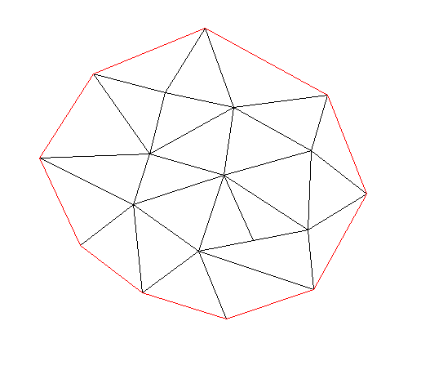
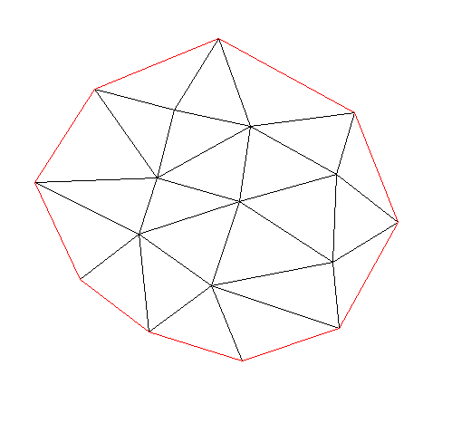
Triangulation
Triangulation: a conformal covering-up of the domain in which the intersection of any 2 elements is either the empty set, or a vertex, or an edge or a face (3D).
Covering-up
Triangulation

Slide 7
General definitions
Conformal mesh: a mesh in which the intersection of any 2 elements is either empty set, a vertex, an edge or a face.
Manifold: a conformal mesh in which the internal edges are shared exactly by 2 elements and the boundary edges are shared by only one element. Manifolds are geometrically and topologically valid meshes.
We usually refer to manifold as ‘mesh’ with the understanding that the latter is well formed
Manifold Conformal mesh Mesh

Slide 8
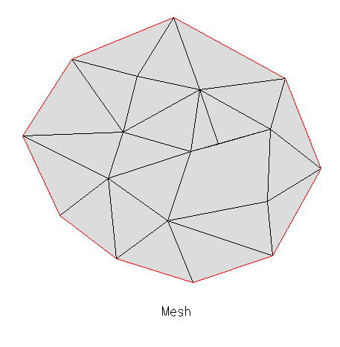
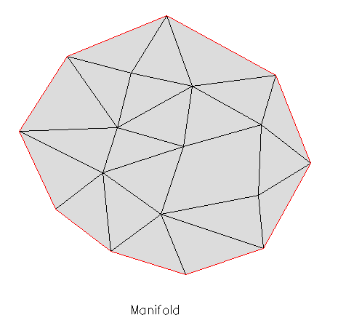
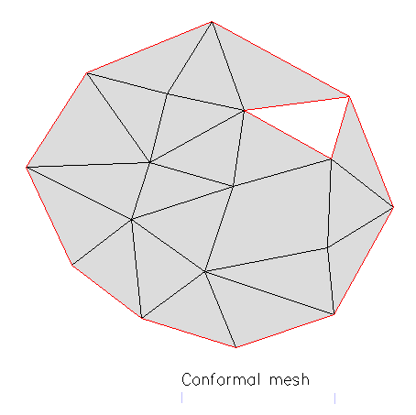

Slide 9
General definitions
Connectivity: connection between mesh vertices (we follow counterclockwise convention)
Structured mesh: a finite-difference-type mesh, where the connectivity information etc. can be accessed easily via a set of integers (element indices). Sometimes it is also called a grid.
Unstructured mesh.
Mixed mesh: really just UG
Finite element mesh: mesh enriched by some ingredients like d.o.f., interpolation scheme etc. Nodes may be different from supporting mesh vertices.
3
4
3
2
1
2
1

Slide 10
UG
A sample grid file
44343 24025
1 -90.4293 30.1689 0.30
2 -90.4313 30.1625 0.30
3 -90.4327 30.1559 0.20
4 -90.4320 30.1498 0.20
………………………………………
………………………………………
1 3 1 2 3
2 3 2 4 5
3 3 15943 16197 15942
………………………………………
………………………………………
List of node location
List of elem connectivity

Slide 11
Visualization of UG
xmgredit5

Slide 12
Data structures and algorithms
Why data structure:
In UG operations, various queries like “which element contains a given point?” are frequently encountered.
This raises the question of how various types geometrical entities (e.g., elements, vertices, edges, boundary) can be effectively stored in a computer to facilitate future queries.

Slide 13
Data structures and algorithms
Algorithm + Data structures = Program (Wirth 1986)
Usually the more complex a data structure, the simpler the algorithm will be, but the memory requirements may be penalized.
Suitable data structure should be chosen for different applications taking into consideration of computer memory constraint.

Slide 14
One-dimensional data structure
Array: requires fixed amount of contiguous memory and allows direct access to its element. Easiest to access
a(1), a(2), a(3),…
List: items are stored in a “linear” way, and each is linked to its neighbors by pointers. More expensive to search than arrays
A double linked list
NULL
NULL
head
tail

Slide 15
One-dimensional data structure
Stack: a last-in-first-out list (LIFO). Only the last item is directly accessible.
Queue: a first-in-first-out structure (FIFO).
Stack
Queue
out
in
in
3
3
2
2
1
1
out

Slide 16
One-dimensional data structure
Priority queue: each entry is endowed with a priority for processing.
Binary tree: a tree structure whose nodes contain a key and 2 pointers to its 2 children, and the keys also obey some ordering relationship.
0
root
5
1
Internal
node
1
17
2
2
12
19
3
4
23
leaf
4
1

Slide 17
One-dimensional data structure
Hashing: a dictionary in which each address contains several items.
e.g., h(x,y)=[x+y] for each node in a grid.
It handles and speeds up queries of the presence of an item in a set, but not the neighborhood information.
Keys
U

Slide 18
Two-dimensional data structure
Used to facilitate queries in mesh generation.
Grid-based data structures:
  Uniform grid:

Slide 19
Two-dimensional data structure
  Hierarchy of uniform grids:
Topological data structures: mesh entities form a hierarchy of topological structures.
points edges faces elements region

Slide 20
Topological data structure
k = neigh(i,j),
(i=1,…ne, j=1,2,3)
E = elem(i,j),
(i=1,…np, j=1,…,nnei(i))
3
K₂
K₁
E₄
E₃
K
1
2
E₅
i
E₂
K₃
E₆
E₁
Notes:
1.Ball of a vertex.

Slide 21
Delauney triangulation
Main idea: given a boundary discretization and a set of field points, find a triangulation that has these points as vertices and also satisfies certain condition.
Delauney triangulation: given a set of points S, a triangulation is called a Delauney triangulation if the open circumcircles (balls, discs) of each element contain no point of S. The empty-circle criterion is also known as Delauney criterion.
B_{P}
B_{Q}
P
Q

Slide 22
Voronoi diagram
let S be a finite set of points P_{i}, (i=1,…,N), then the Voronoi diagram for S is the set of cells V_{i} defined as:
i.e., V_{i} is the set of points closer to P_{i} than any other point in S. V_{i}’s are necessarily non-overlapping convex polygons that tile the space and constitute a Voronoi diagram.

Slide 23
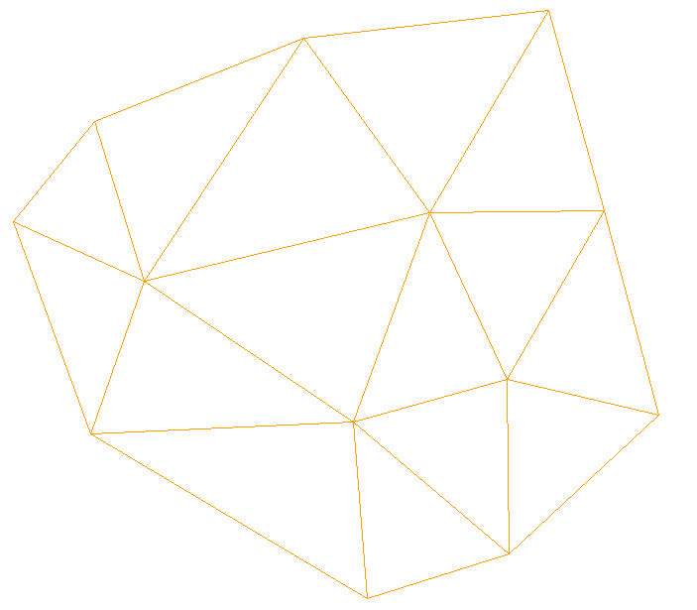
Voronoi diagram

Slide 24
Theoretical issues
Duality between Voronoi diagram and Delauney traingulation.
Delauney triangulation of a set of points exists and moreover, it is unique.
Symmetry of Delauney criterion:
B_{P}
B_{Q}
P
Q

Slide 25
General Lemma of Delauney
A triangulation T is a Delauney triangulation if for each and every pair of elements in it, the empty circle criterion holds.

Slide 26
Search operation
The most expensive operation is to search for the “parent” triangle a given point falls in. Efficient data structure for this operation includes quad-tree neighborhood space, sweepline algorithm, bucket sort (using 2D data struc) etc.

Slide 27
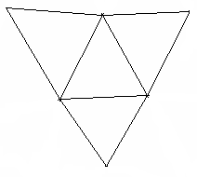

Neighborhood in UG
Grid is well formed (manifold)
A N-polygonal elem consists of N nodes and N sides
  Surrounded by N elem
A side (edge) consists of 2 end nodes
A node is surrounded by arbitrary # of sides/elem/nodes (‘ball’)
  Internal ball: # of elem = # of nodes
  Boundary ball: # of elem < # of nodes
A side is surrounded by 1 (boundary) or 2 (internal) elements; arbitrary # of sides
Relationship btw ne,np,ns
3
Side 1
Side 2
Internal ball
Boundary ball
3
1
Side 3
2
3
2
2
2
1
i
2
N_{i}
1
N_{i}
1
1
2
N_{i}
i
1
3
N_{i}
1

Slide 28
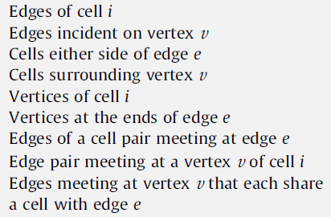

UG operations
UG code relies on many mapping arrays (exchange memory consumption for speed): 99% of the operations can be accomplished in a neighborhood (implication for parallel computing)
Cache loss due to non-consecutive memory access (space filling curve)
Grid adaptivity is relatively easy in UG, but tradeoff btw memory and speed can be tricky; also has implication for parallelization
Directional split in UG is harder than SG. A commonly used local frame is the side frame
y_{s}
1
x_{s}
i
2

