Slide 1
Parallel computing

Slide 2
OpenMP
Shared memory computing

Slide 3
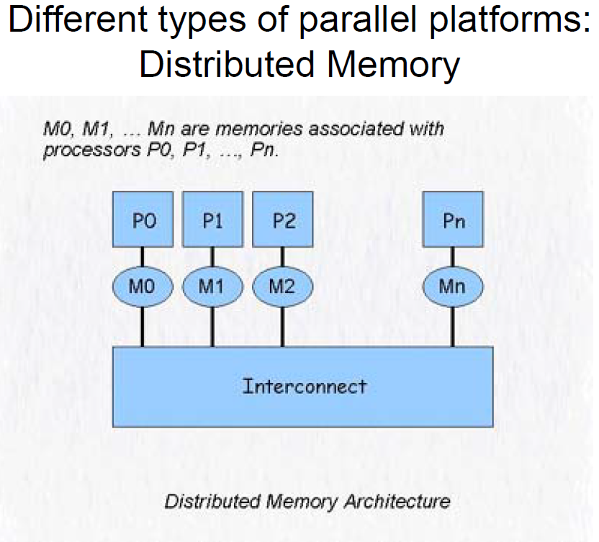
MPI

Slide 4
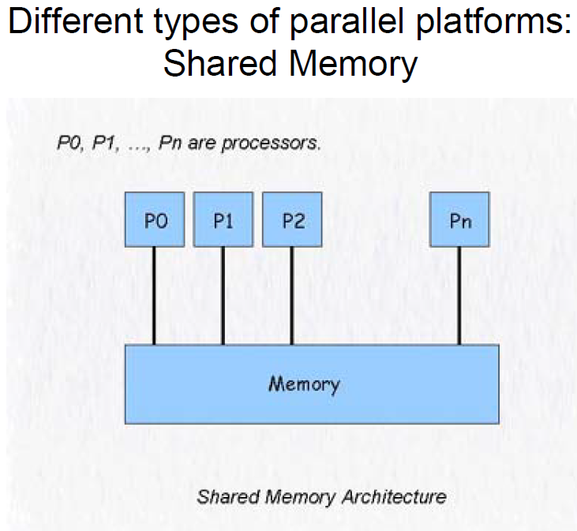
openMP

Slide 5
Shared Memory Programming
SysV
memory manipulationOne can actually create, manipulate, shared memory spaces.
Pthreads (Posix Threads)
Lower level Unix library to build multi-threaded programs
OpenMP (www.openmp.org)
Protocol designed to provide automatic parallelization through compiler pragmas.
Mainly loop driven parallelism
Best suited to desktop and small SMP computers

Slide 6
OpenMP
OpenMP is designed for shared memory systems.
OpenMP is easy to use
achieve parallelism through compiler directives
or the occasional function call
OpenMP is a “quick and dirty” way of parallelizing a program.
OpenMP is usually used on existing serial programs to achieve moderate parallelism with relatively little effort
Caution: Race Conditions
When two threads are changing the same memory location at the same time.

Slide 7
Pros of OpenMP
Because it takes advantage of shared memory, the programmer does not need to worry (that much) about data placement
Programming model is “serial-like” and thus conceptually simpler than message passing
Incremental implementation is possible (unlike MPI)
Compiler directives are generally simple and easy to use
Legacy serial code does not need to be rewritten

Slide 8
Cons of OpenMP
Codes can only be run in shared memory environments!
In general, shared memory machines beyond ~8 CPUs are more expensive than distributed memory ones
On many-core systems, the ‘scalability’ (parallel efficiency) is limited
Compiler must support OpenMP
Whereas MPI can be installed anywhere
However, gcc 4.2 now supports OpenMP (intel/pg already have)
Add –qopenmp on Sciclone using ifort

Slide 9
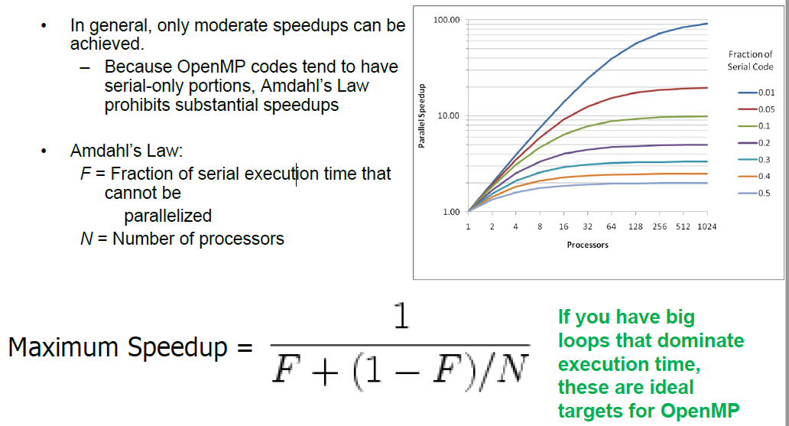
Cons of OpenMP

Slide 10
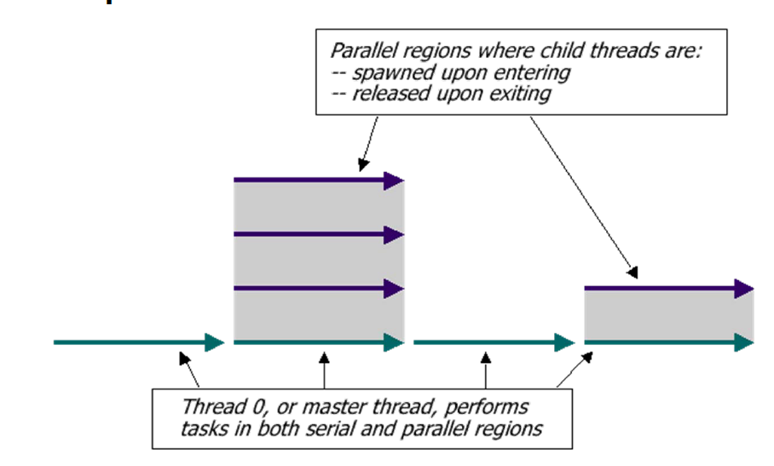
OpenMP execution model
In OpenMP, execution begins only on the master thread. Child threads are spawned and released as needed.
Threads are spawned when program enters a parallel region.
Threads are released when program exits a parallel region

Slide 11
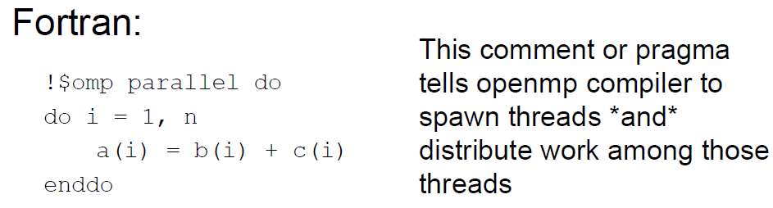
OpenMP example
$omp end parallel do
Important: user can NOT control the order of execution with OMP!

Slide 12
Running OpenMP
OMP_NUM_THREADS environment variable sets the number of processors the OpenMP program will have at its disposal.
#!/bin/tcsh
setenv OMP_NUM_THREADS 4
./mycode < my.in > my.out

Slide 13
Pitfall #1: Data dependencies
Consider the following code:
a(1) = 1;
do i=1,5
a(i) = i + a(i-1)
enddo
There are dependencies between loop iterations.
Sections of loops split between threads will not necessarily execute in order
Out of order loop execution will result in undefined behavior

Slide 14
Pitfall #2: race condition
$OMP parallel do
do i=1,10
temp=2*a(i)
a(i)=temp
b(i)=temp/c(i)
enddo !i
$OMP end parallel do
By default, all threads share a common address space. Therefore, all threads will be modifying temp simultaneously, resulting in race condition (which may corrupt memory in the worst scenario!)
Race condition is the most common bug in openMP and is also the trickiest to find, as program may actually work properly most of time and the errors are random (welcome to the parallel world)
Solution is to declare temp as a private var (i.e. each thread has different copy of it (in memory))
Note the iteration var is always private!! Arrays are usually shared
$OMP parallel do default(shared) private(i,temp)
do i=1,10
temp=2*a(i)
a(i)=temp
b(i)=temp/c(i)
enddo !i
$OMP end parallel do

Slide 15
Private variables
Caution: The value of any variable specified as private is undefined both upon entering and leaving the construct in which it is specified
Use firstprivate and lastprivate clauses to retain values of variables declared as private
Make sure you also check procedures called within parallel regions for data dependencies!
Each thread goes into procedures independently
May be more convenient to use default(private) to allow easy use of private scalars in routines

Slide 16
Reduction operations
It’s a common task to find max/min, sum etc of arrays etc
Making intermediate var private only solves part of the problem, as we still need to find a global value from all private copies
openMP provides reduction operators that go with loops
Reduction vars are always shared
Outside parallel region
sum1=0
!$OMP parallel default(shared) private(i)
!$OMP do reduction(+: sum1)
do i=1,n
sum1=sum1+a(i)
enddo !i
$OMP end do
$OMP end parallel
Spawning threads
Destroying threads

Slide 17
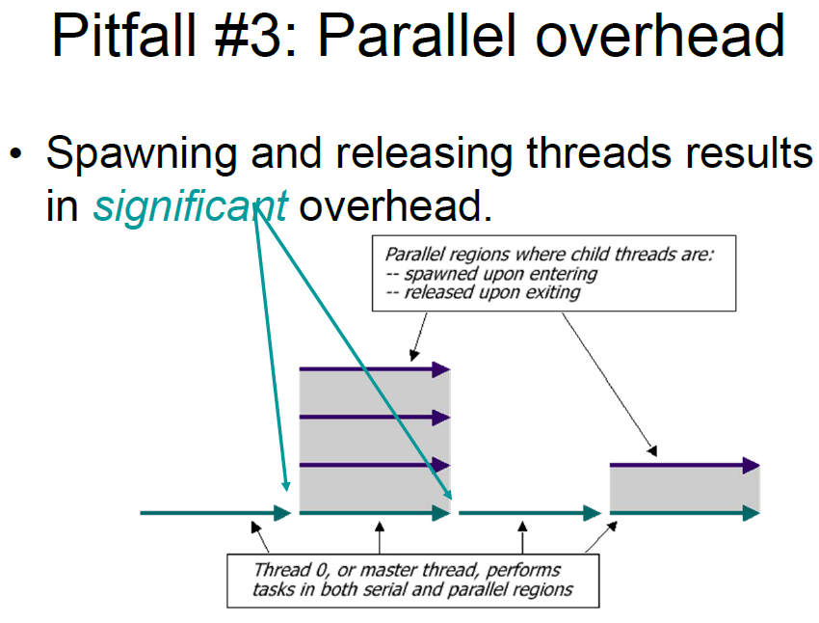

Slide 18
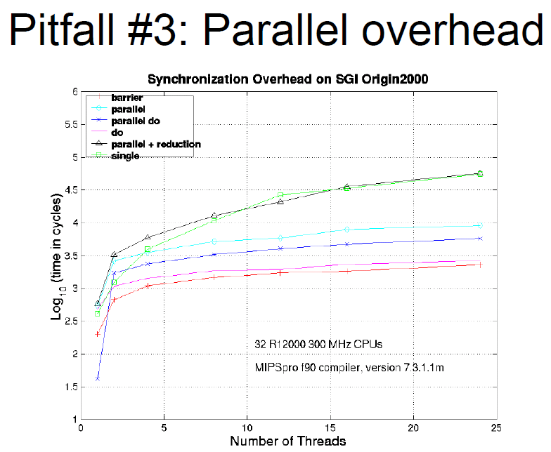

Slide 19
Pitfall #3: Parallel Overhead
Spawning and releasing threads results in significant overhead
Therefore, you want to make your parallel regions as large as possible
Parallelize over the largest loop that you can (even though it will involve more work to declare all of the private variables and eliminate dependencies)
Coarse granularity is your friend!
We showed how to separate ‘parallel’ and ‘do’ clauses
Useful directives to avoid releasing and spawning threads
nowait: enddo implies thread destruction; use nowait to avoid
!$OMP master: only master thread executes
$OMP single: only 1 thread executes
!$OMP barrier: rendezvous of all threads (like mpi_barrier)

Slide 20
Scheduling
default
!$OMP do schedule(static|dynamic|guided|runtime [chunksize])
Static
Divides workload into equal-sized chunks
Default chunksize is Nwork/Nthreads
Setting chunksize to less than this will result in chunks being assigned in an interleaved manner
Lowest overhead
Least optimal workload distribution
Dynamic
Dynamically assigned chunks to threads
Default chunksize is 1
Highest overhead
Optimal workload distribution
Guided
Starts with big chunks proportional to (number of unassigned iterations)/(number of threads), then makes them progressively smaller until chunksize is reached
Attempts to seek a balance between overhead and workload optimization
Runtime
Scheduling can also be selected at runtime using OMP_SCHEDULE
e.g. setenv OMP_SCHEDULE “guided, 100”

Slide 21
Homework
Use openMP to parallelize the serial programs you wrote previously, and study scaling

Slide 22
Message Passing Interface (MPI)

Slide 23
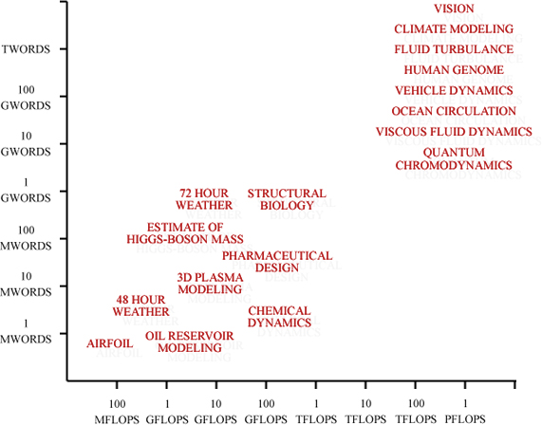
Current needs
Current
Desktop
Domain
Which axis is most important?

Slide 24
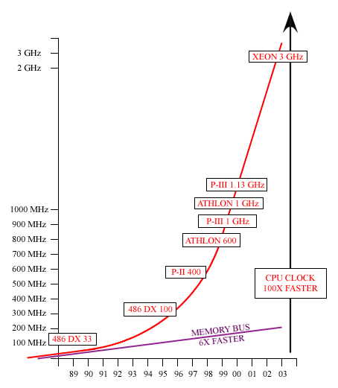
Most popular culprit: CPU vs. DRAM
This is limiting the percentage of “speed of light” performance that you can expect to get from any one processor especially for scientific codes. This is why every workshop going has an “Optimization” talk that gets into these dirty details.

Slide 25
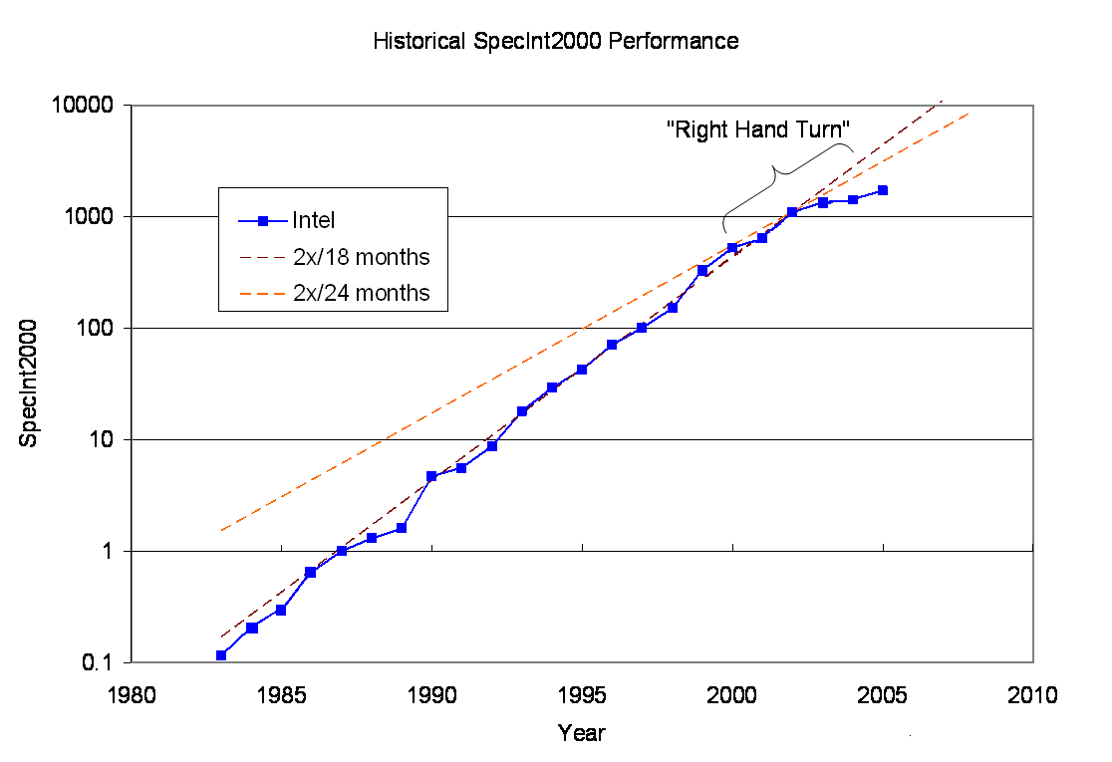
Next culprit: Single thread performance is falling off
Moors Law
Source: published SPECInt data

Slide 26
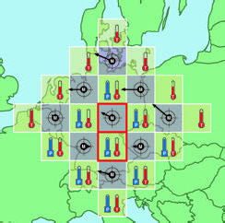
Weather forecast problem
Richardson's Computation, 1917
Courtesy John Burkhardt, Virginia Tech

Slide 27
Flynn’s Taxonomy
SISD (Single-instruction single-data): serial
SIMD (Single-instruction multi-data)
Single CPU, multiple subordinate ALU
MISD (Multi-instruction single-data)
Vectorization
MIMD (Multi-instruction multi-data)
Each CPU has its own data
Shared-memory vs distributed-memory systems

Slide 28
MIMD
#include <stdio.h>
#include "mpi.h"
main(int argc, char** argv){
int my_PE_num;
MPI_Init(&argc, &argv);
MPI_Comm_rank(MPI_COMM_WORLD, &my_PE_num);
printf("Hello from %d.\n", my_PE_num);
MPI_Finalize();
}
#include <stdio.h>
#include "mpi.h"
main(int argc, char** argv){
int my_PE_num;
MPI_Init(&argc, &argv);
MPI_Comm_rank(MPI_COMM_WORLD, &my_PE_num);
printf("Hello from %d.\n", my_PE_num);
MPI_Finalize();
}
#include <stdio.h>
#include "mpi.h"
main(int argc, char** argv){
int my_PE_num;
MPI_Init(&argc, &argv);
MPI_Comm_rank(MPI_COMM_WORLD, &my_PE_num);
printf("Hello from %d.\n", my_PE_num);
MPI_Finalize();
}
#include <stdio.h>
#include "mpi.h"
main(int argc, char** argv){
int my_PE_num;
MPI_Init(&argc, &argv);
MPI_Comm_rank(MPI_COMM_WORLD, &my_PE_num);
printf("Hello from %d.\n", my_PE_num);
MPI_Finalize();
}
Hello from 5.
Hello from 3.
Hello from 1.
Hello from 2.
Hello from 7.
Hello from 0.
Hello from 6.
Hello from 4.
#include <stdio.h>
#include "mpi.h"
main(int argc, char** argv){
int my_PE_num;
MPI_Init(&argc, &argv);
MPI_Comm_rank(MPI_COMM_WORLD, &my_PE_num);
printf("Hello from %d.\n", my_PE_num);
MPI_Finalize();
}
#include <stdio.h>
#include "mpi.h"
main(int argc, char** argv){
int my_PE_num;
MPI_Init(&argc, &argv);
MPI_Comm_rank(MPI_COMM_WORLD, &my_PE_num);
printf("Hello from %d.\n", my_PE_num);
MPI_Finalize();
}
#include <stdio.h>
#include "mpi.h"
main(int argc, char** argv){
int my_PE_num;
MPI_Init(&argc, &argv);
MPI_Comm_rank(MPI_COMM_WORLD, &my_PE_num);
printf("Hello from %d.\n", my_PE_num);
MPI_Finalize();
}
#include <stdio.h>
#include "mpi.h"
main(int argc, char** argv){
int my_PE_num;
MPI_Init(&argc, &argv);
MPI_Comm_rank(MPI_COMM_WORLD, &my_PE_num);
printf("Hello from %d.\n", my_PE_num);
MPI_Finalize();
}

Slide 29
Why Use MPI?
Has been around a longtime (~20 years inc. PVM)
Dominant
Will be around a longtime (on all new platforms/roadmaps)
Lots of libraries
Lots of algorithms
Very scalable (100K+ cores right now)
Portable
Works with hybrid models
Explicit parallel routines force the programmer to address parallelization from the beginning, not as an afterthought
Automatic parallelization has been “a few years away” for the past 20 years.
Therefore:
A good long term learning investment
Good/possible to understand whether you are coder or a manager

Slide 30
Introduction to MPI
What is MPI? The Message-Passing Interface Standard(MPI) is a library that allows you to do problems in parallel using message-passing to communicate between processes.
Library It is not a language (like FORTRAN 90, UPC or HPF), or even an extension to a language. Instead, it is a library that your native, standard, serial compiler (f77, f90, cc, CC) uses.
Message Passing Message passing is sometimes referred to as a paradigm itself. But it is really just a method of passing data between processes that is flexible enough to implement most paradigms (Data Parallel, Work Sharing, etc.) with it. It can be defined as having independent processors, with no shared data, communicate through subroutine calls.
Communicate This communication may be via a dedicated MPP torus network, or merely an office LAN. To the MPI programmer, it looks much the same (agnostic).
MPI Processes These can be 4000 PEs on BigBen, or 4 processes on a single workstation. In most cases, MPI processes are mapped to PE (Processing Element, such as a CPU) (exception: hyper threading; logical processes)

Slide 31
Basic MPI
In order to do parallel programming, you require some basic functionality, namely, the ability to:
Start Processes
Send Messages
Receive Messages
Synchronize
With these four capabilities, you can construct any program. We will look at the basic versions of the MPI routines that implement this. Of course, MPI offers over 125 functions. Many of these are more convenient and efficient for certain tasks. However, with what we learn here, we will be able to implement just about any algorithm. Moreover, the vast majority of MPI codes are built using primarily these routines.

Slide 32
Hello World: Fortran Code
Here is the Fortran version:
program shifter
include 'mpif.h'
integer my_pe_num, errcode
call MPI_INIT(errcode)
call MPI_COMM_RANK(MPI_COMM_WORLD, my_pe_num, errcode)
print *, 'Hello from ', my_pe_num,'.'
call MPI_FINALIZE(errcode)
end

Slide 33
Compiling and Running
Before we think about what exactly is happening when this executes, let’s compile and run this thing - just so you don’t think you are missing any magic. We compile using a normal ANSI C or Fortran 90 compiler (many other languages are also available). While logged in to pople.psc.edu:
For C codes:
icc –lmpi hello.c
For Fortran codes:
ifort -lmpi hello.f
We now have an executable called a.out (the default – we could choose anything).

Slide 34
Running
To run an MPI executable we must tell the machine how many copies we wish to run at runtime. On our Altix, you can choose any number up to 4K. We'll try 8. On the Altix the exact command is mpirun:
mpirun –np 8 a.out
Hello from 5.
Hello from 3.
Hello from 1.
Hello from 2.
Hello from 7.
Hello from 0.
Hello from 6.
Hello from 4.
Which is (almost) what we desired when we started.
Most HPC systems support batch scheduling

Slide 35
Important MPI routines
mpi_init(ierr): init MPI env (ierr is the returned error code: 0 for no error)
mpi_comm_dup(MPI_COMM_WORLD,comm,ierr): duplicate the comm world and isolate it in your application (so it won’t interfere with other ‘worlds’)
mpi_comm_size(comm,nproc,ierr): return # of MPI processes. Each process is assigned a ‘rank’, from 0 to nproc-1
mpi_comm_rank(comm,myrank,ierr): get the rank for the calling process
mpi_barrier(comm,ierr): all rank must arrive at this barrier before proceeding (i.e. synchronization; useful for debug also)
mpi_abort(comm,error,ierror): fatal error. ‘error’ is a predefined code like MPI_SUCCESS
mpi_finalize(ierr): finalize MPI env and exit

Slide 36
Sending/receiving messages
mpi_irecv( void *buf, int count, MPI_Datatype datatype, int source, int tag, MPI_Comm comm, MPI_Request *request, int ierr) – nonblock receive
Inputs: buf - initial address of receive buffer (choice); (e.g. 1st entry of an array)
count - number of elements in receive buffer (integer); (e.g., # of entries in an array)
datatype - datatype of each receive buffer element (handle); (e.g., MPI_REAL8, MPI_INT etc)
source - rank of source (integer). This is the originating rank where the message comes from
Tag - message tag (integer)
comm - communicator (handle).
Output:
request - communication request (handle), used for checking status (pending, processing, finished etc)
ierr: error code
After non-block receive, need to check if all ‘requests’ are successful
mpi_waitall(nn,request,rstat,ierr)
nn: dimension of request()
request(nn): from irecv
Output: rstat(MPI_STATUS_SIZE,nn), array of status

Slide 37
Sending/receiving messages
MPI_Isend( void *buf, int count, MPI_Datatype datatype, int dest, int tag, MPI_Comm comm, MPI_Request *request, int ierr) – non-block send
Inputs: buf - initial address of send buffer (choice);
count - number of elements in send buffer (integer);
datatype - datatype of each send buffer element (handle);
dest - rank of destination (integer);
tag - message tag (integer);
comm - communicator (handle).
Output: request - communication request (handle).
After non-block receive, need to check if all ‘requests’ are successful
mpi_waitall(nn,request,sstat,ierr)
nn: dimension of request()
request(nn): from isend
Output: rstat(MPI_STATUS_SIZE,nn), array of status
e.g.:
integer :: comm,rqst(1)
real*8 :: aa
If(myrank/=2) then
mpi_irecv(aa,1,MPI_REAL8, 2,comm,rqst,ierr)
Else
mpi_isend()
endif

Slide 38
Global reduction routines
MPI_Allreduce ( void *sendbuf, void *recvbuf, int count, MPI_Datatype datatype, MPI_Op op, MPI_Comm comm, int ierr) – Combines values from all processes and distribute the result back to all processes
Inputs:
sendbuf - starting address of send buffer (choice);
count - number of elements in send buffer (integer). Also the size of the output (i.e., ith elements from each processor are summed up and returned as ith element of output);
datatype - data type of elements of send buffer (handle);
op - operation (handle) (e.g., MPI_SUM, MPI_LOR);
comm - communicator (handle).
Output: recvbuf - starting address of receive buffer (choice).
e.g.:
call mpi_allreduce(q_block_lcl,q_block,nhtblocks,MPI_REAL8,MPI_SUM,comm,ierr)

Slide 39
Do Not Make Any Assumptions!
Do not make any assumptions about the mechanics of the actual message- passing. Remember that MPI is designed to operate not only on fast MPP networks, but also on Internet size meta-computers. As such, the order and timing of messages may be considerably skewed.
MPI makes only one guarantee: two messages sent from one process to another process will arrive in that relative order. However, a message sent later from another process may arrive before, or between, those two messages
Remember that buffer sizes, as well as the data chunks you want to communicate, can change greatly from one platform or run to the next. You may have to use the non-blocking calls to accommodate these limits and avoid deadlocks.

Slide 40
Networks
Infiniband, Myrinet, GigE, …
Networks that are more designed to run on a small number of processors
Seastar (Cray), Federation (IBM), Constellation (Sun), NUMALink (SGI)…
Networks designed to scale to tens of thousands of processors.

Slide 41
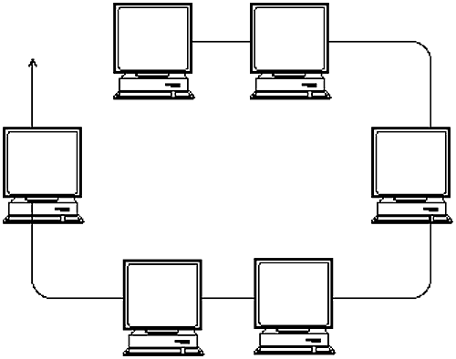
Ethernet with Workstations

Slide 42
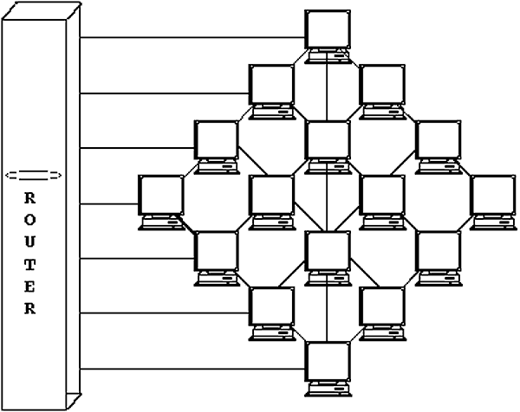
Hypercube (CM-2 version)
Not remotely drawn properly.

Slide 43
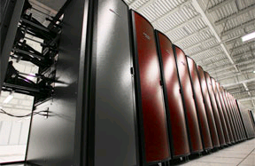
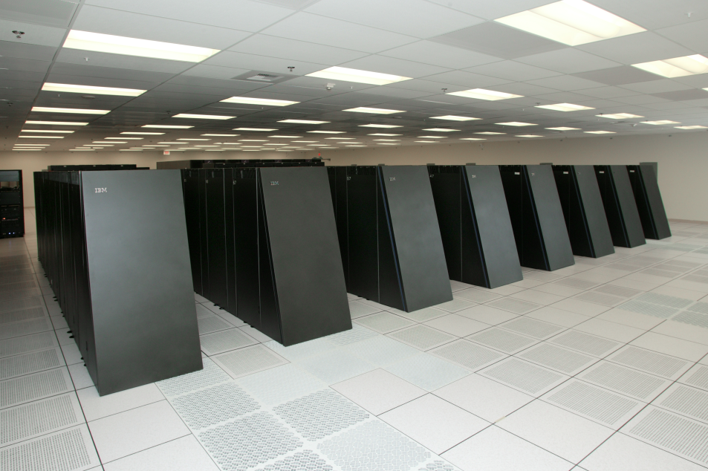
MPPs (Massively Parallel Processors)
Distributed memory at largest scale. Often shared memory
at lower hierarchies.
IBM BlueGene/L (LLNL)
131,072 700 Mhz processors
256 MB or RAM per processor
Balanced compute speed with interconnect
Red Storm (Sandia National Labs)
12,960 Dual Core 2.4 Ghz Opterons
4 GB of RAM per processor
Proprietary SeaStar interconnect

Slide 44
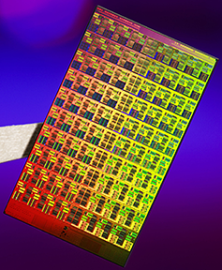
The exotic future is here!
Intel's 80 core Polaris research chip (now Knights Landing)
http://techresearch.intel.com/articles/ Tera-Scale/1449.htm
Followed by their 24-48 core production chip,
Larabee (2009, 2010 for 48 core); Skylake (40 cores on dual socket).

Slide 45
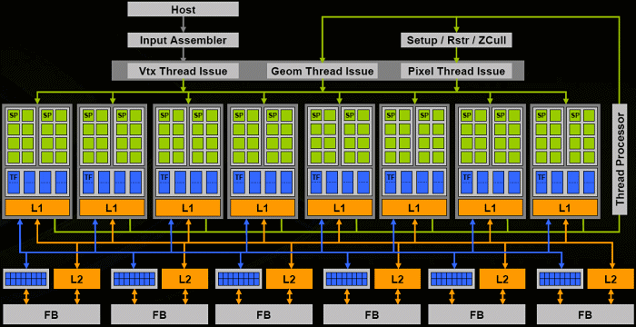
Alternatives: General-Purpose GPU Computing
GPU performance has doubled about every 6 months since the 1990s, much better than CPU performance gains. This is made possible by the explicit parallelism exposed in the graphics hardware and algorithms (just add more pipelines).
Very SIMD oriented. Limited to algorithms that can be done in a very, very data parallel fashion. Also not really designed to move data on and off board very quickly.

Slide 46
Capacity vs. Capability
Capacity computing
Creating large supercomputers to facilitate large throughput of small parallel jobs (HTC)
Cheaper, slower interconnects
Clusters running Linux, OS X, or Windows
Easy to build
Capability computing (HPC)
Creating large supercomputers to enable computation on large scale
Running the entire machine to perform one task
Good fast interconnect and balanced performance important
Usually specialized hardware and operating systems

Slide 47
How parallel is a code?
Parallel performance is defined in terms of scalability
Strong Scalability
Can we get faster for a
given problem size?
Weak Scalability
How big of a problem can we do?

Slide 48
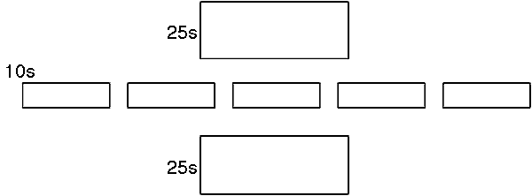
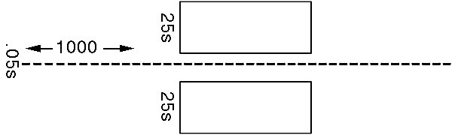
Amdahl’s Law
If we run this on a parallel machine with five processors:
Our code now takes about 60s. We have sped it up by about 40%.
Let’s say we use a thousand processors:
We have now sped our code by about a factor of two. Is this a big enough win?

Slide 49
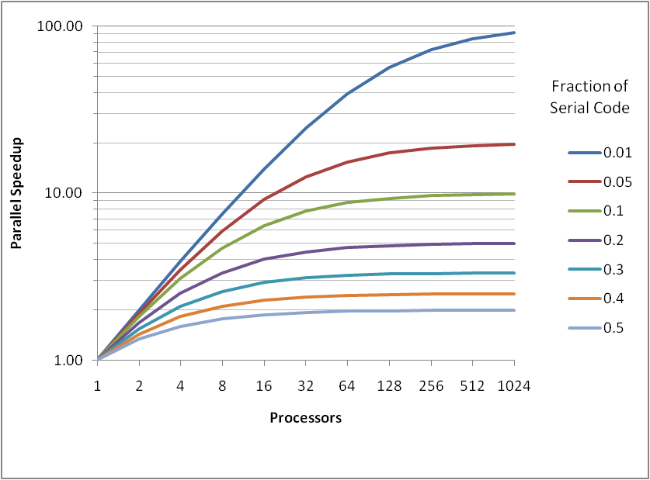
Amdahl’s Law
If there is x% of serial component, speedup cannot be better than 100/x.
If you decompose a problem into many parts, then the parallel time cannot be less than the largest of the parts.
If the critical path through a computation is T, you cannot complete in less time than T, no matter how many processors you use
Therefore… you must parallelize ALL parts of a code to gain full benefit of a scalable code
In reality, communications between processors are often a bottleneck for parallel code
Communication is critical dependent on network speed

Slide 50
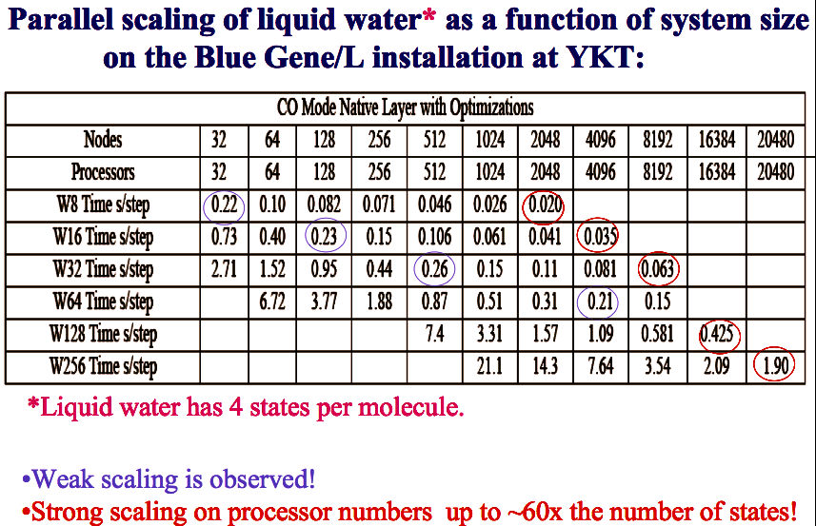
Weak vs. Strong scaling
More processors
Scalability ≠ efficiency

Slide 51
In short…
Do not make assumptions on the order – it’s out of your control (for your own good)
Some degree of randomness is expected
Start the parallelization process as early as possible instead of as an after-thought
Need to parallelize all parts of your code
There are parallel debuggers out there… writing out from each process often helps (especially when you are stuck)… use blocking calls if necessary for debugging

Slide 52
Summary
You now understand reasons why these machines look the way they do
Serial boxes can’t get to PFLOPs
Need to spread out the processors
Need to communicate between these spread out processors
What you might not understand is how to use (program) these piles of processors
Many approaches
Many issues
MPI or hybrids are the way to go

Slide 53
Homework
Parallelize the 1D advection solver using MPI, and study scaling
Hint: print out intermediate arrays to see how each MPI rank ‘sees’ the data

