Slide 1
Grid generation for SCHISM with SMS

Slide 2
Overview of The GG process
Know your domain and target physics
Understand SCHISM numerics
Usually it’s easy to get ‘reasonable’ results without much effort with GG
You cannot take full advantage of SCHISM features unless you understand its physics and numerics
Elevation and contour data preparation
Digitize or determine boundary (ideally as shape files from Arc)
Import and refine conceptual model
Identify critical features/contours
Identify resolution/density
Create polygons and patch/pave locations
Generate the mesh
Populate mesh elevations (depths)
Mesh quality and bathymetric metrics
Performance and accuracy metrics
Clip mesh as necessary for subdomains of interest

Slide 3
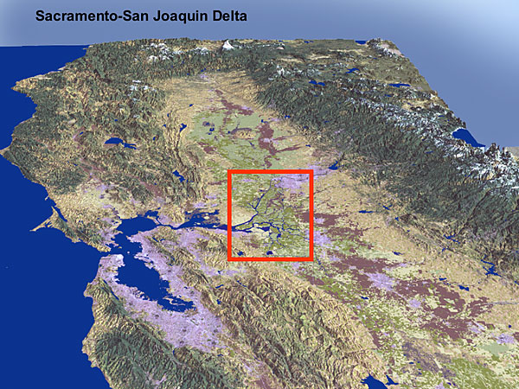
(Ocean)-Bay-Delta
Delta
Redding
San
Francisco
San
Francisco
Confluence of Sacramento and San Joaquin Rivers
47% of California’s runoff passes through Delta
Los Angeles
San Diego

Slide 4
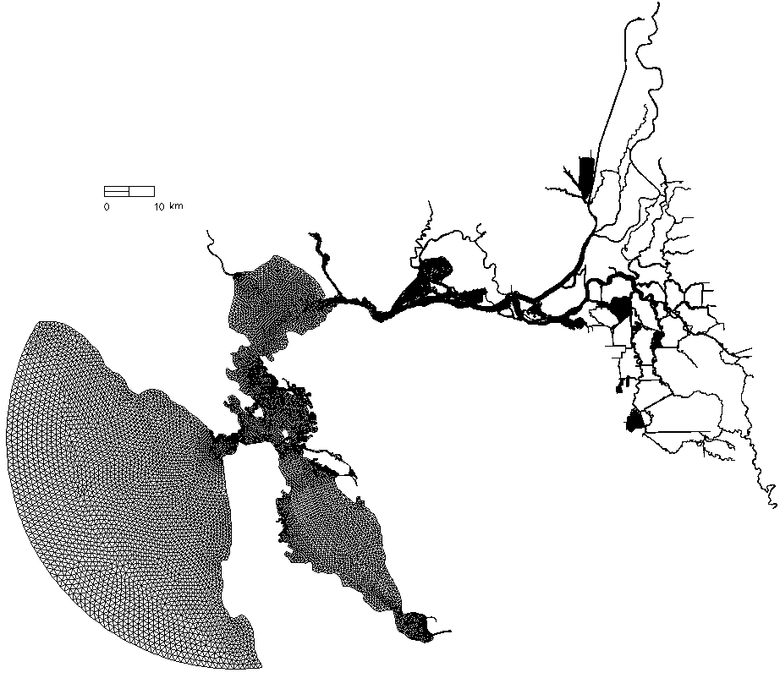
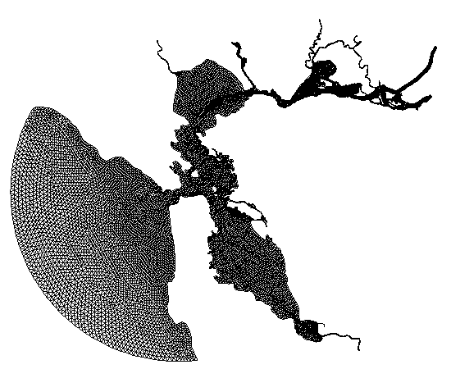
SCHISM Bay-Delta and Bay Subdomain
Bay-Delta SCHISM:
~180,000 nodes
~360,000 elements
Bay SCHISM
Notes:
This kind of clipping is now partially automated by scripts, so that when you update the full mesh all the subdomains can be automated
Delta coming soon

Slide 5
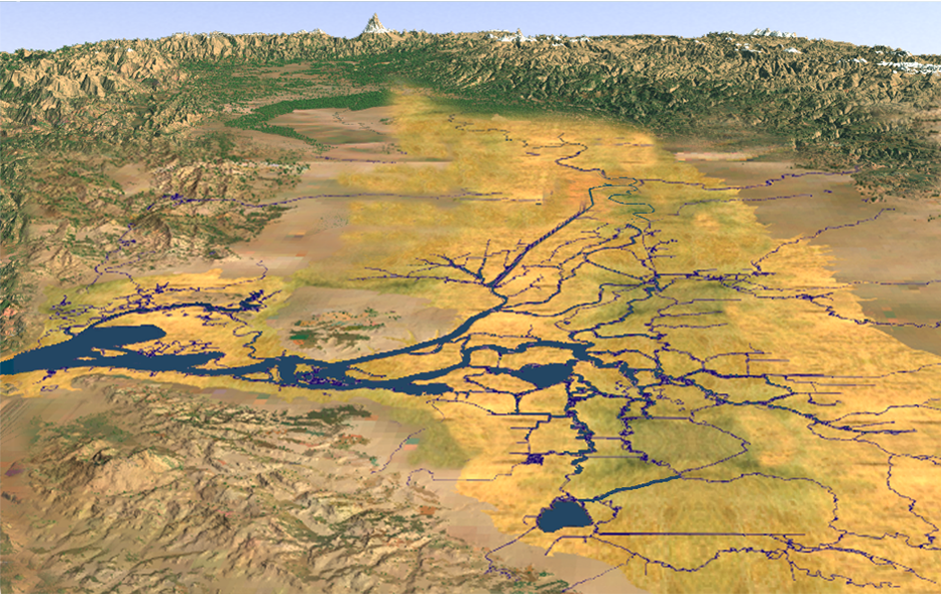
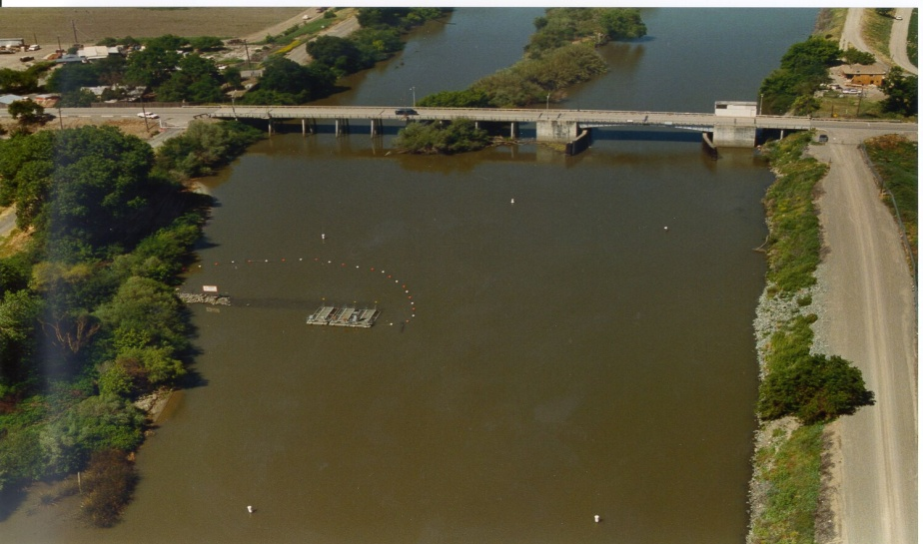
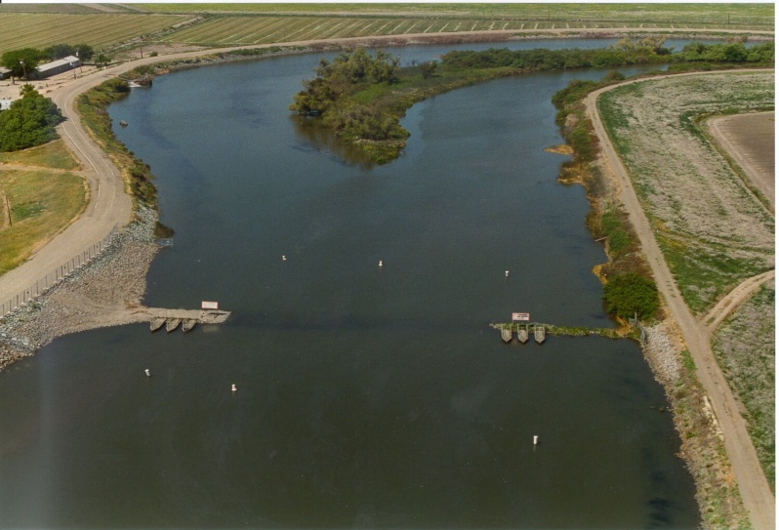
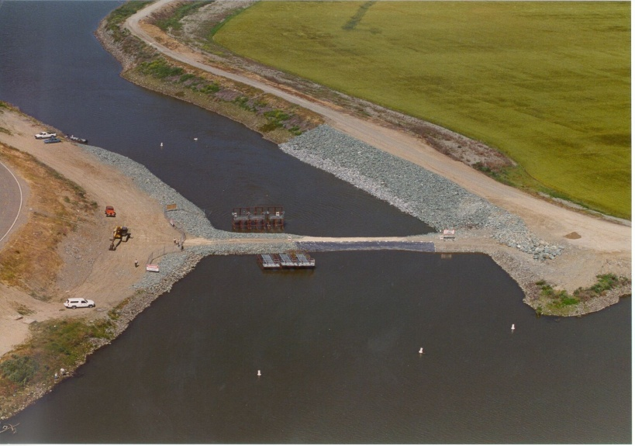
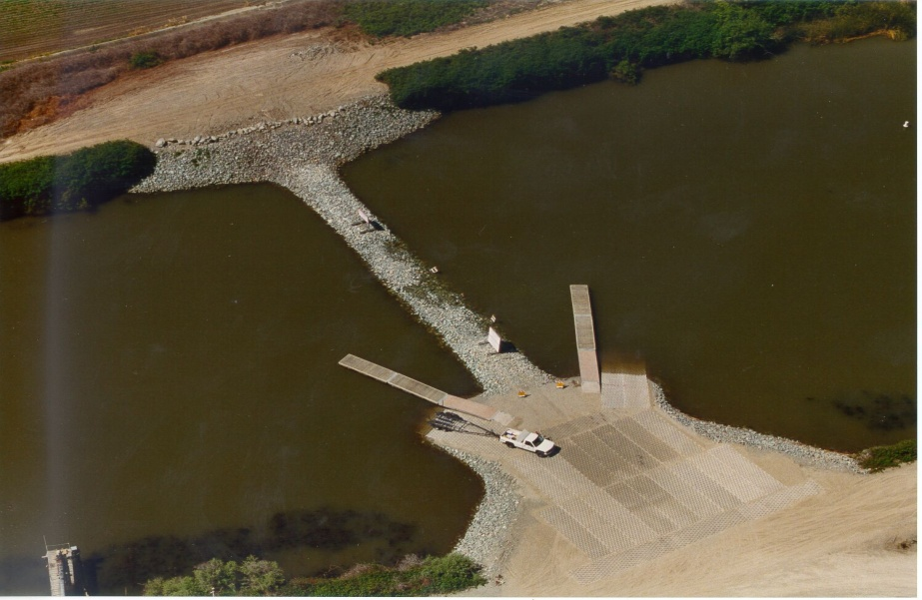
South Delta Temporary Barriers
Grant Line Canal
Middle River
Head of Old River
Stockton
Jones Tract
Roberts
Island
●
Clifton Court Forebay
Union Island
Old River at Tracy
Fabian Tract

Slide 6
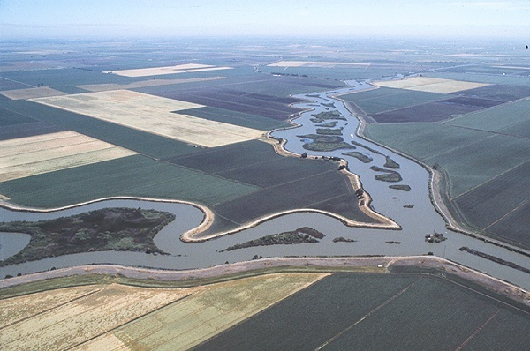
Delta
Channelized, levees
Levees and “islands”
3D challenges beyond estuary processes
Extensive tidal influence

Slide 7
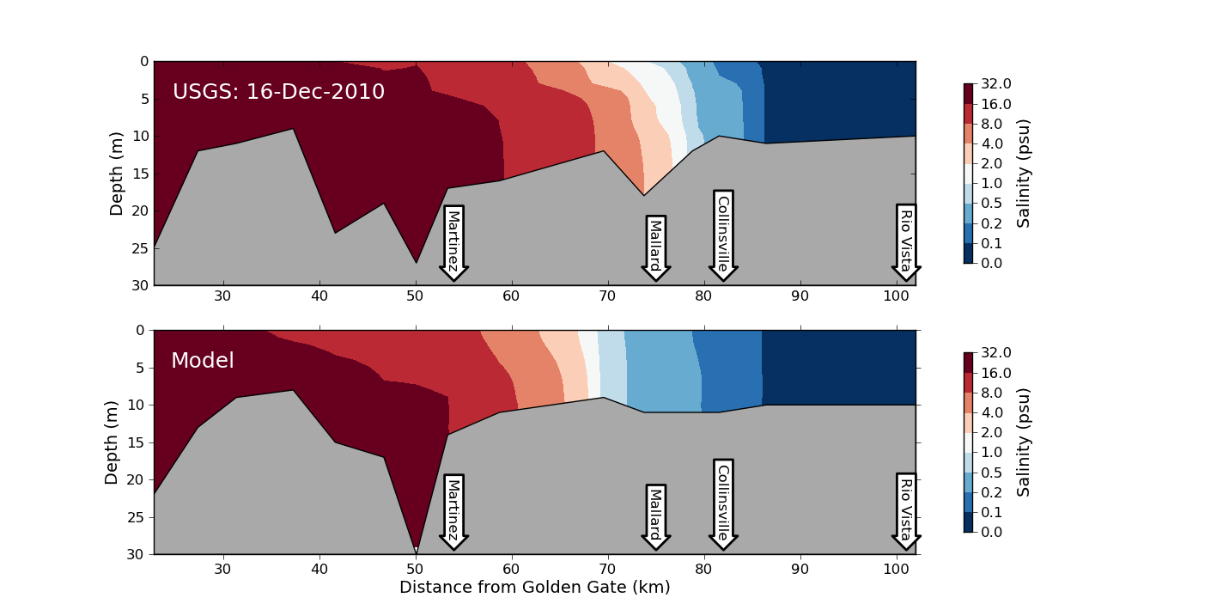
Estuary Transport (3D)

Slide 8
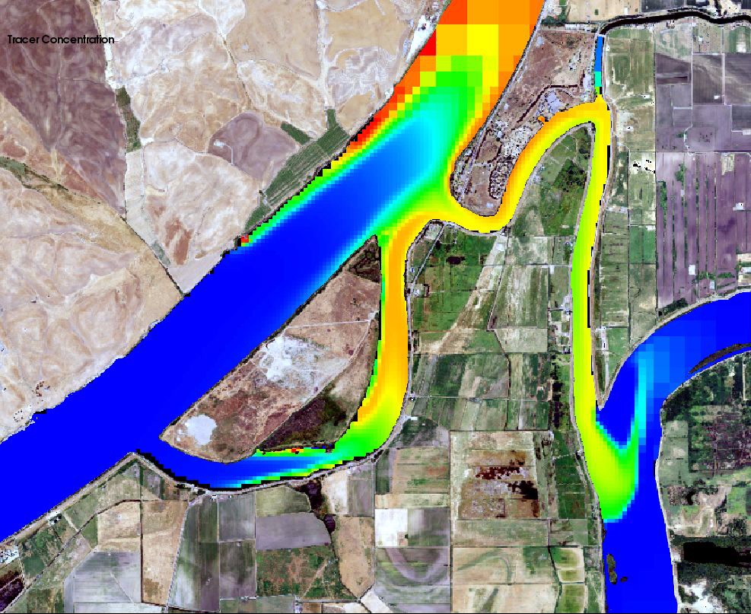
Shear Dispersion
From REALM,
An adaptive mesh code
Notes:
This animation is from an adaptive mesh model (REALM) that illustrates how different resolutions look in a channel. The simulation shows the transport of a fictitious tracer and were designed to illustrate mixing. If you play it you can find moments when the effects of shear dispersion (fast in the middle, slow at sides) is very obvious. The larger grid cells at the top will miss this mixing because they don’t resolve the velocity and concentration differences over the channel. The finest cells are 16 times smaller and are probably overkill for this part of the Sacramento. 4-8 seems just about right.
Our goal with SCHISM is to be 1) medium resolution and 2) global. For important channels we use the length scale of shear dispersion to guide resolution in the horizontal direction. For smaller channels that contribute less to global accuracy, we sometimes elect to underresolve mixing details.

Slide 9
Tools
Recommend SMS using “conceptual maps”
Good advantage of terrain
Patch/pave comparison
Bugs, high level of manual work
Triangle is a good free product
Driven mostly by exterior (2D shore)
Janet: expensive, orthogonality not needed
DistMesh: Beautiful introduction to density functions, curvature. Not all the good stuff is in the software.
Holleman et al 2013: Flow-aligned mesh and numerical diffusion, but orthogonal

Slide 10
SMS Resources
SMS/Aquaveo website
Todd Wood Masters Thesis:
Can be viewed from wiki (www.schism.wiki)
Very good step-by-step
Honest account of debugging such as “bisection” to find bad spots

Slide 11
General rules
Unlike explicit models, you’ll find G.G. for SCHISM is more ‘intuitive’ and ‘freer’
Implicit model allows you to focus on physics instead of numerics (CFL…)
You are freer to resolve important features without worrying about cost/instability
SCHISM is not picky about grid quality (except for quads); however, grid quality pays off for accuracy especially for baroclinic applications
G.G. for baroclinic applications requires more effort (often an iterative process): establishing a good workflow is essential

Slide 12
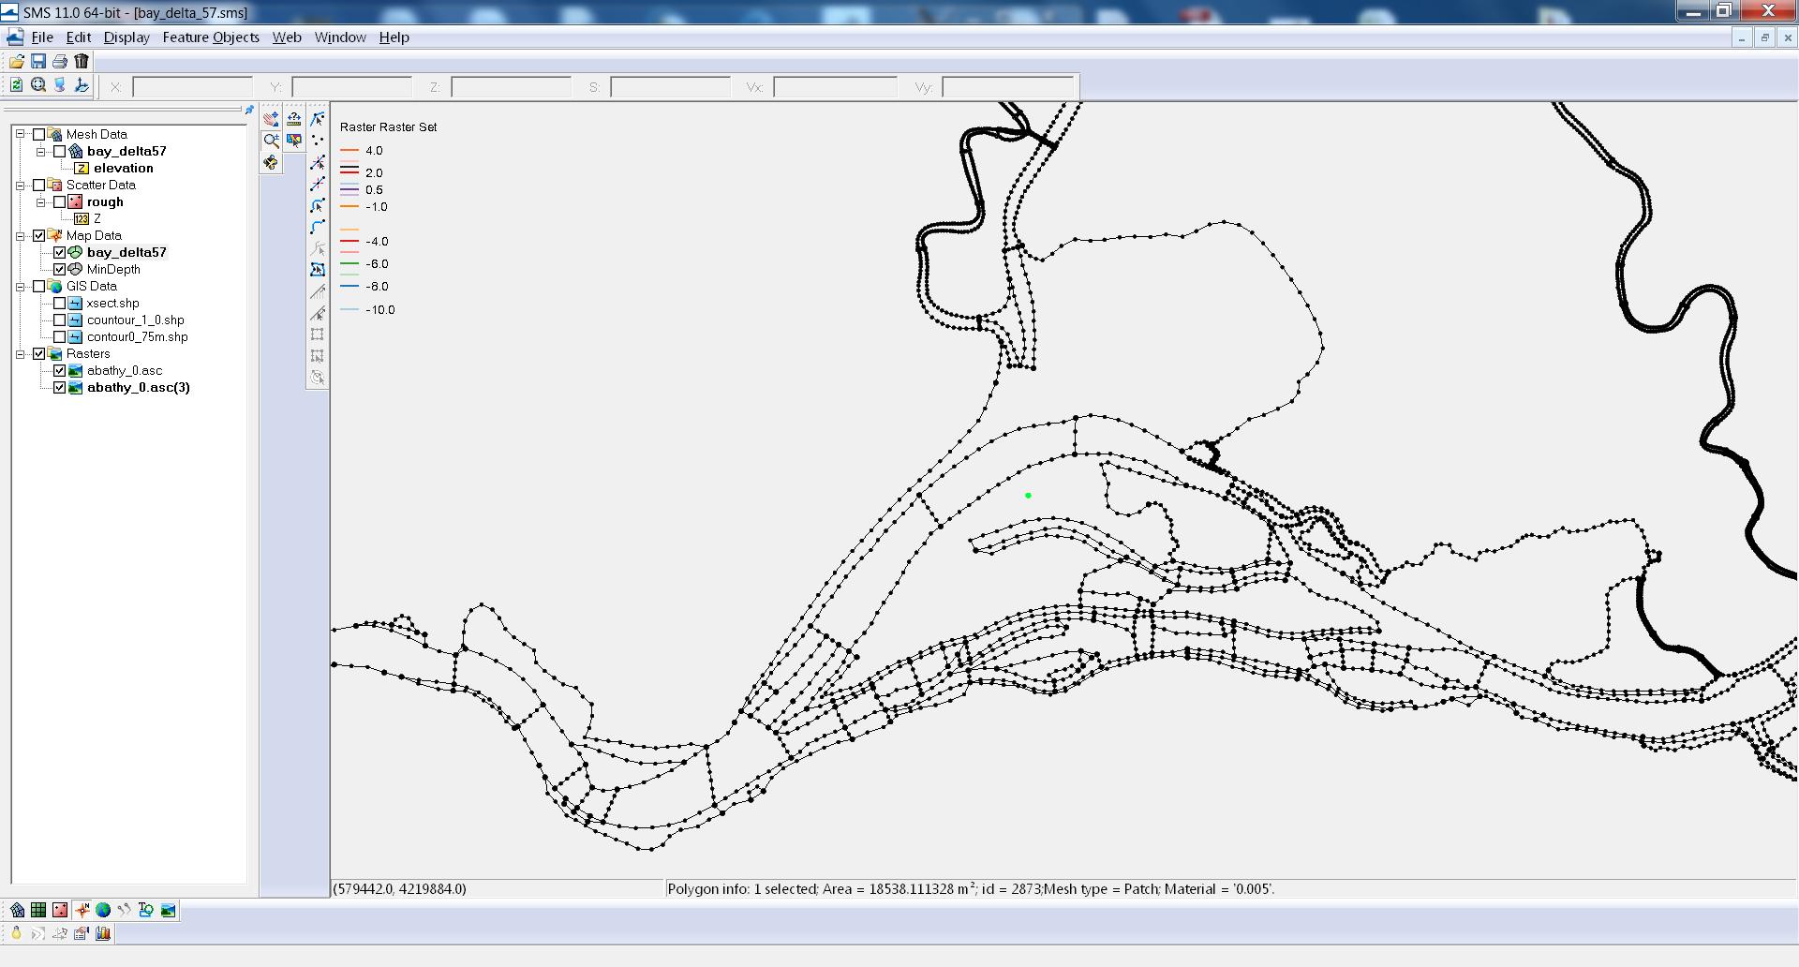
SMS Conceptual Model

Slide 13
DEM preparation: pre-filtering bathymetry
Unresolved features may be eliminated
eliminates lunar landscape undulations on mudflats
level set or active contour methods (e.g. Malladi and Sethian): contours conservatively straighten
California DWR has python code smooth_contour.py for small regions
This is mainly to assist in the arc creation, less for actual interpolation of depths

Slide 14
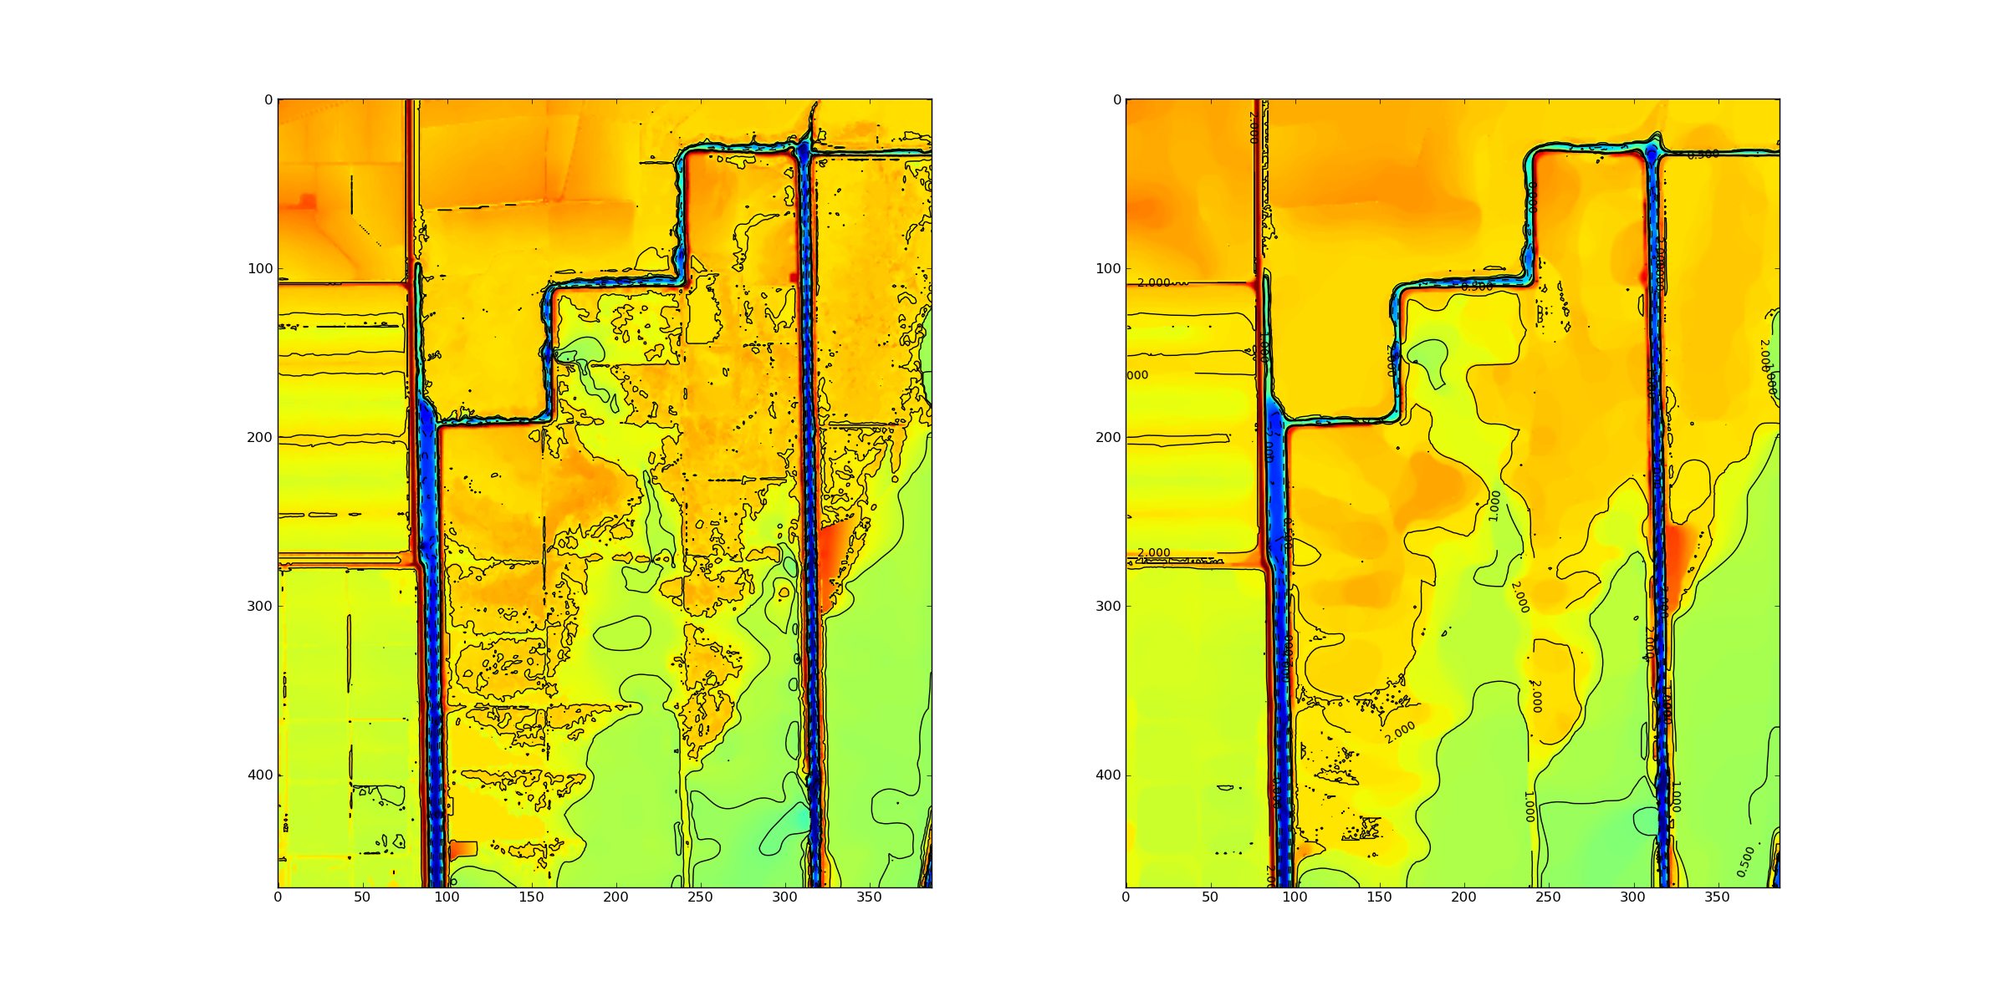
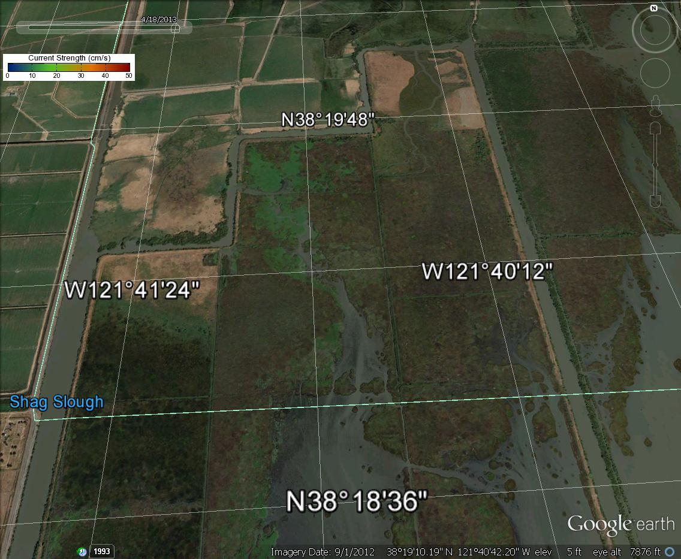
Liberty Island Smoothing:
Malladi and Sethian
Min-max curvature flow

Slide 15
Wetting and Drying in the Frontal Direction is Costly (side shores are fine)
Undulating channel

Slide 16
Generating Contour Shapefiles
ArcGIS allows graphical cleaning
GDAL (gdal_contour) is free and good for quick manipulation on-the-fly
SMS sister product WMS has some contour tools
All use bilinear interpolation
Note that SMS < 11.1 has a georeferencing mistake for contours (cell- vs vertex-centered)
Python shapefile library very useful for exporting arcs based on calculations in (x,y)

Slide 17
Visualizing Contours
SMS has very limited memory
You can use a coarse tin or DEM for conceptual visualization or on small domains
clip_dem.py allows tailored geographical information

Slide 18
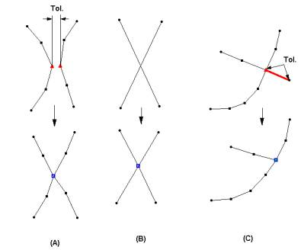
Cleaning
Snapping vertices
Intersecting arcs
Dangling arcs
Mixed feelings about them all

Slide 19
Magic Contours
Foot/top of slope, thalweg
Shoreline and probable “real” water levels
Flooding and mudflats
Key features (jetty, breakwater…)
TVD (h_tvd) and other algorithm switches
Depths used in friction and other user threshold choices

Slide 20
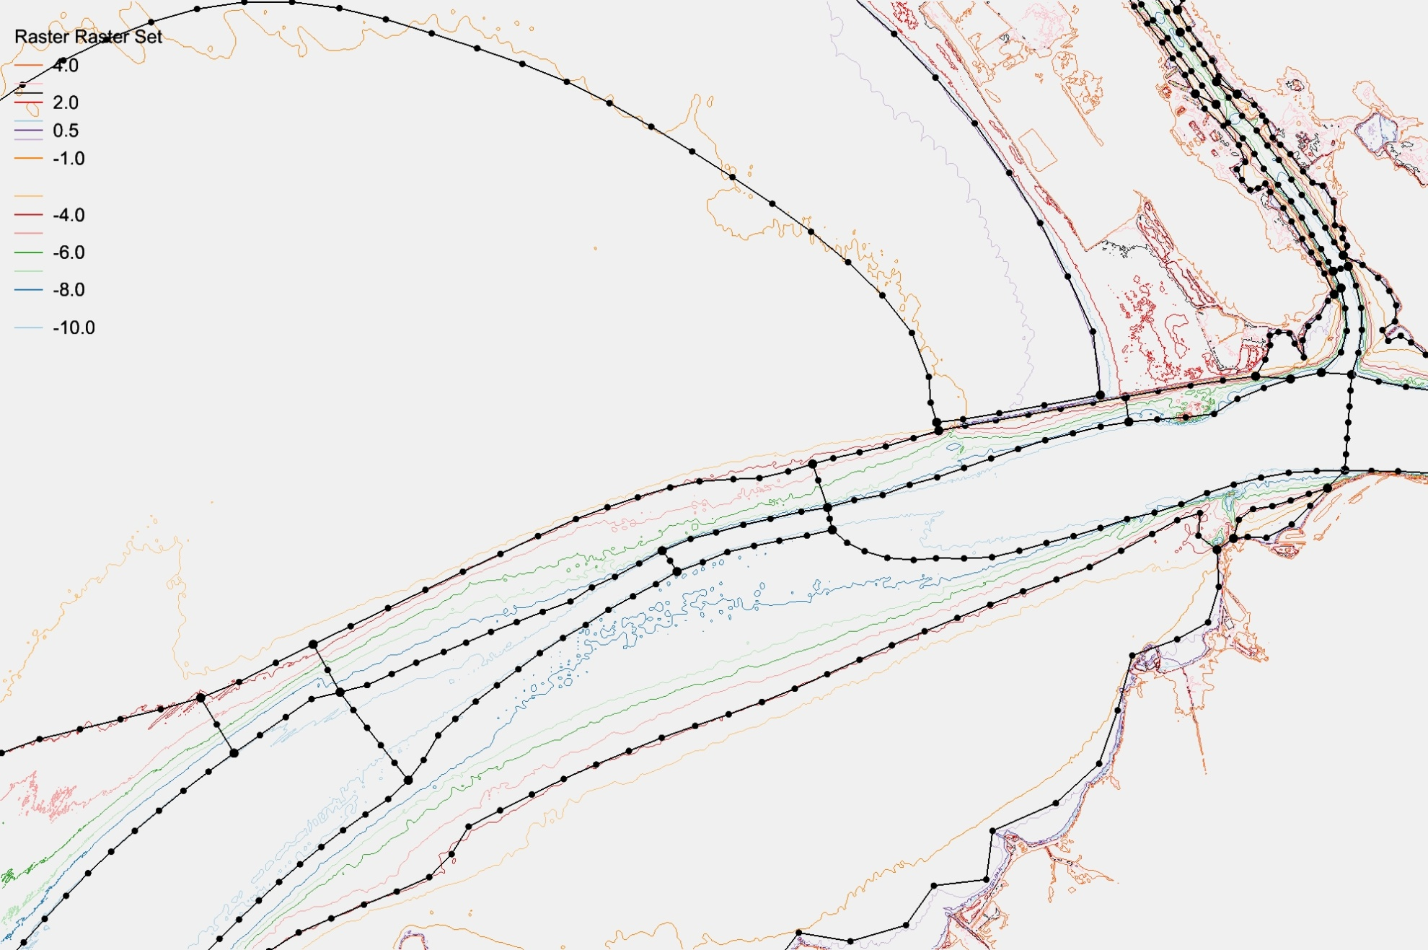
Tidal range
Shoal
Channel
Ship channel
Skew elements
h_tvd = 5m,
Water elev ~ 0.5m
so -4.0 NAVD contour mostly non-TVD

Slide 21
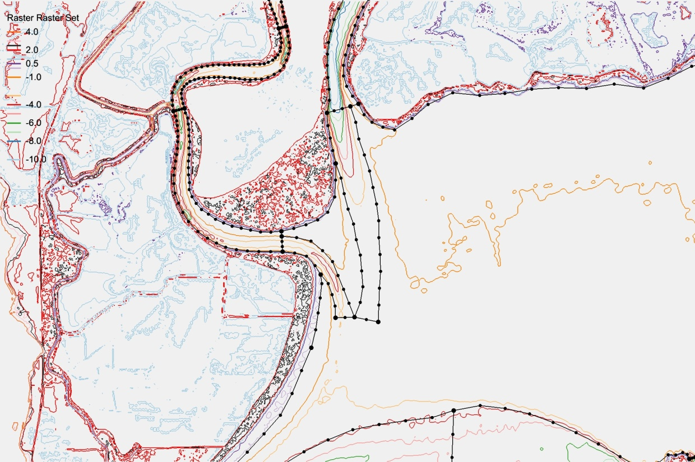
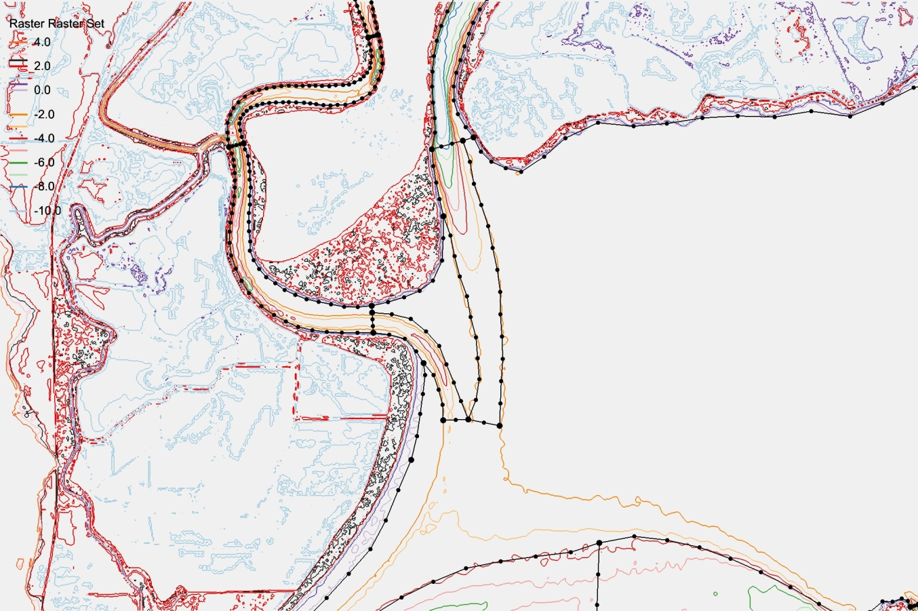
Choose Connected Contours
Well resolved without help
Changing from -2 to -3m increases connectivity
No need to be religious about following contours exactly

Slide 22
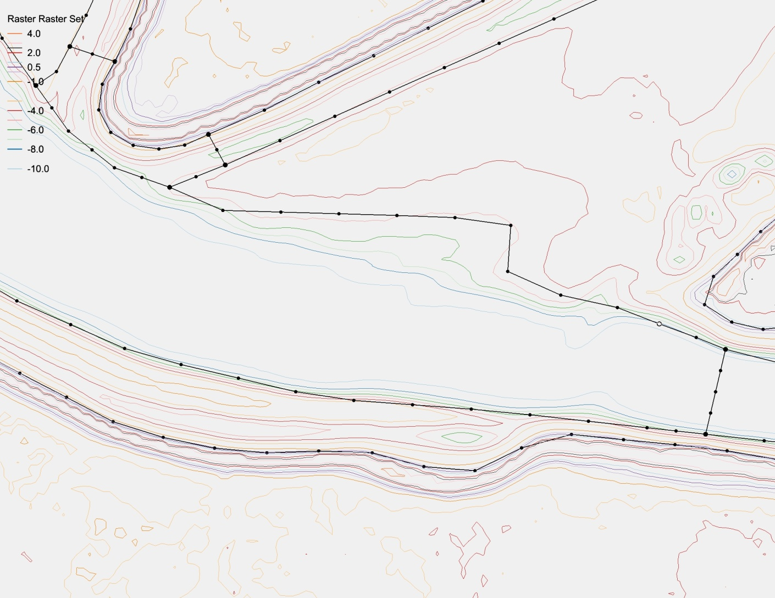
Choose Smoother Deep Contours

Slide 23
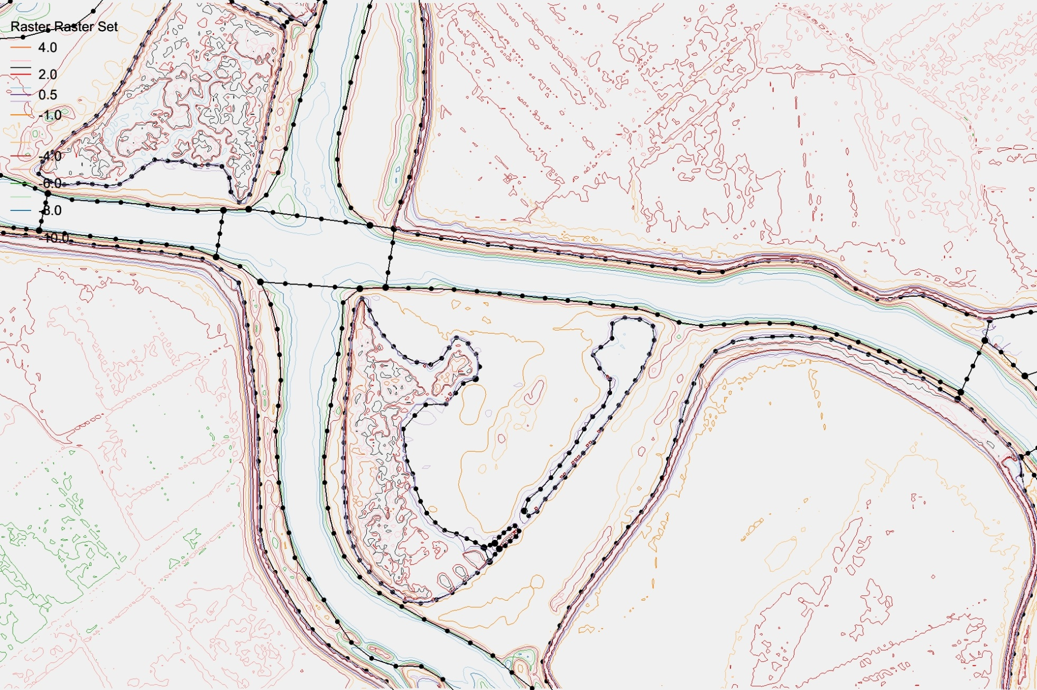
Stick with the center
Inner channel delineated
Follows inner channel without help
Ignores inner channel

Slide 24
Grid Density
Need guidance from inverse CFL>0.4
Start from a lowest expected Δt
Use CFL>0.4 to back calculate the coarsest Δx at a given depth
Deeper regions generally coarser than shallows but not always (compare this with explicit models which are constrained by CFL)
Often channel needs to be resolved for tracer transport
Curvature should be resolved:
2D: bend in shorelines
3D: changes in slope (vertical grid plays a role)
Width of features (sills, beaches, channels)
Skeletonization algorithms (see Per-Olof Persson dissertation)

Slide 25
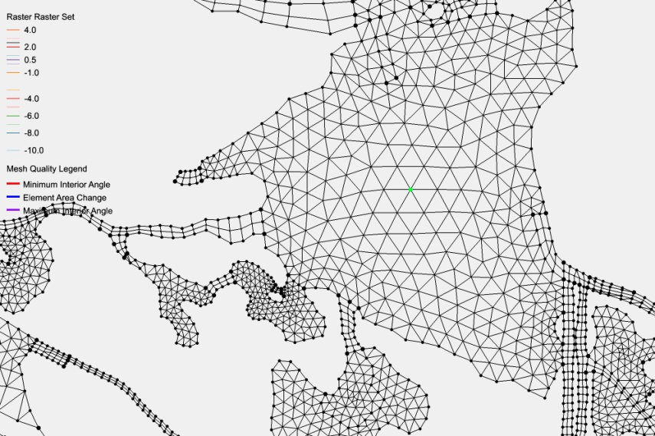
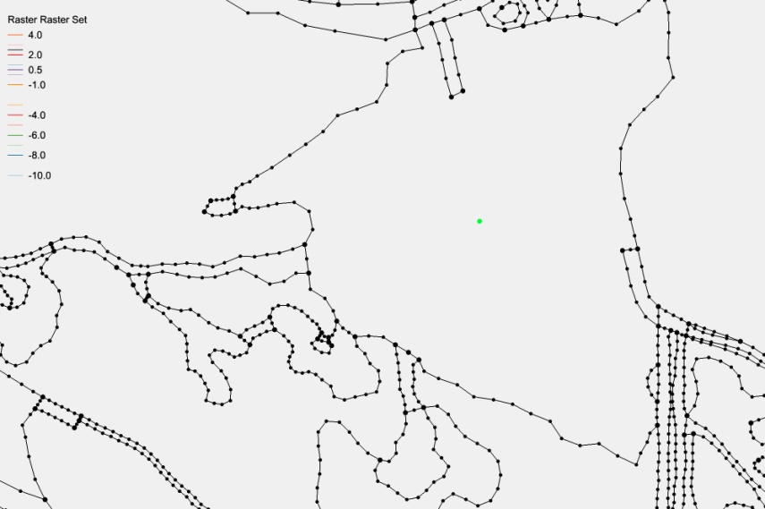

Control Grid Density In SMS
Density-based paving
Shore resolution propagates in
Refinement nodes (node in map tool) can enforce local resolution (but may produce skew elements)

Slide 26
Wetting and Drying
Element-based designation
Based on node elevations
All 3 wet => wet element
No partial wet/dry
Velocities calculated on edges of wet elements

Slide 27
Always wet
Clogged
Clogged or narrow
Robust!!
Mildly inaccurate: wrong contour?
With SCHISM you can faithfully represent channels (and other features), thru good choices of horizontal and vertical grids
In estuarine and near-shore applications, faithful representation of bathymetry and features is the right approach, as opposed to artificial manipulation of bathymetry

Slide 28
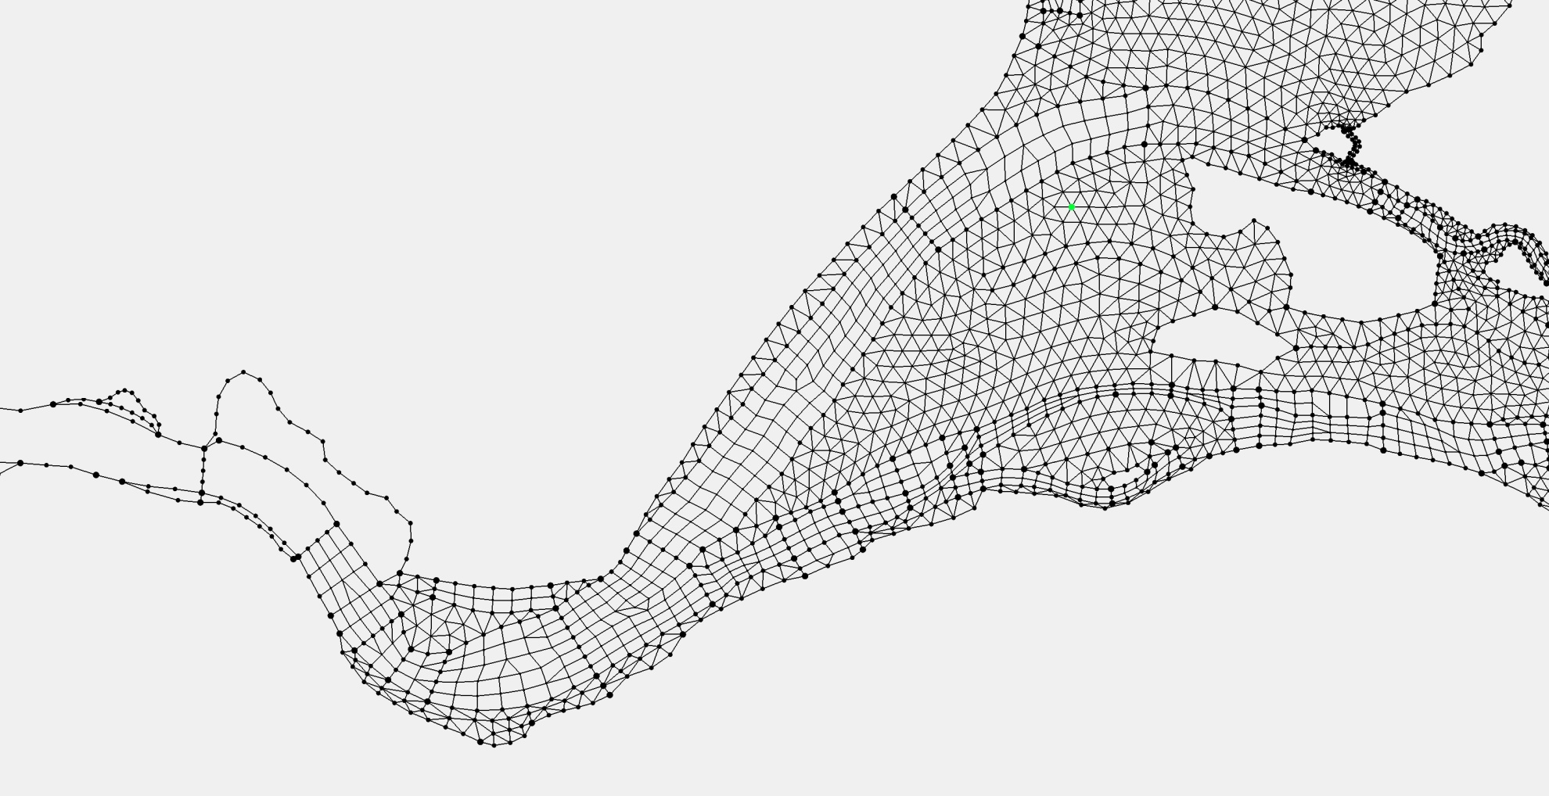
Patching and Paving
Pave
Patch

Slide 29
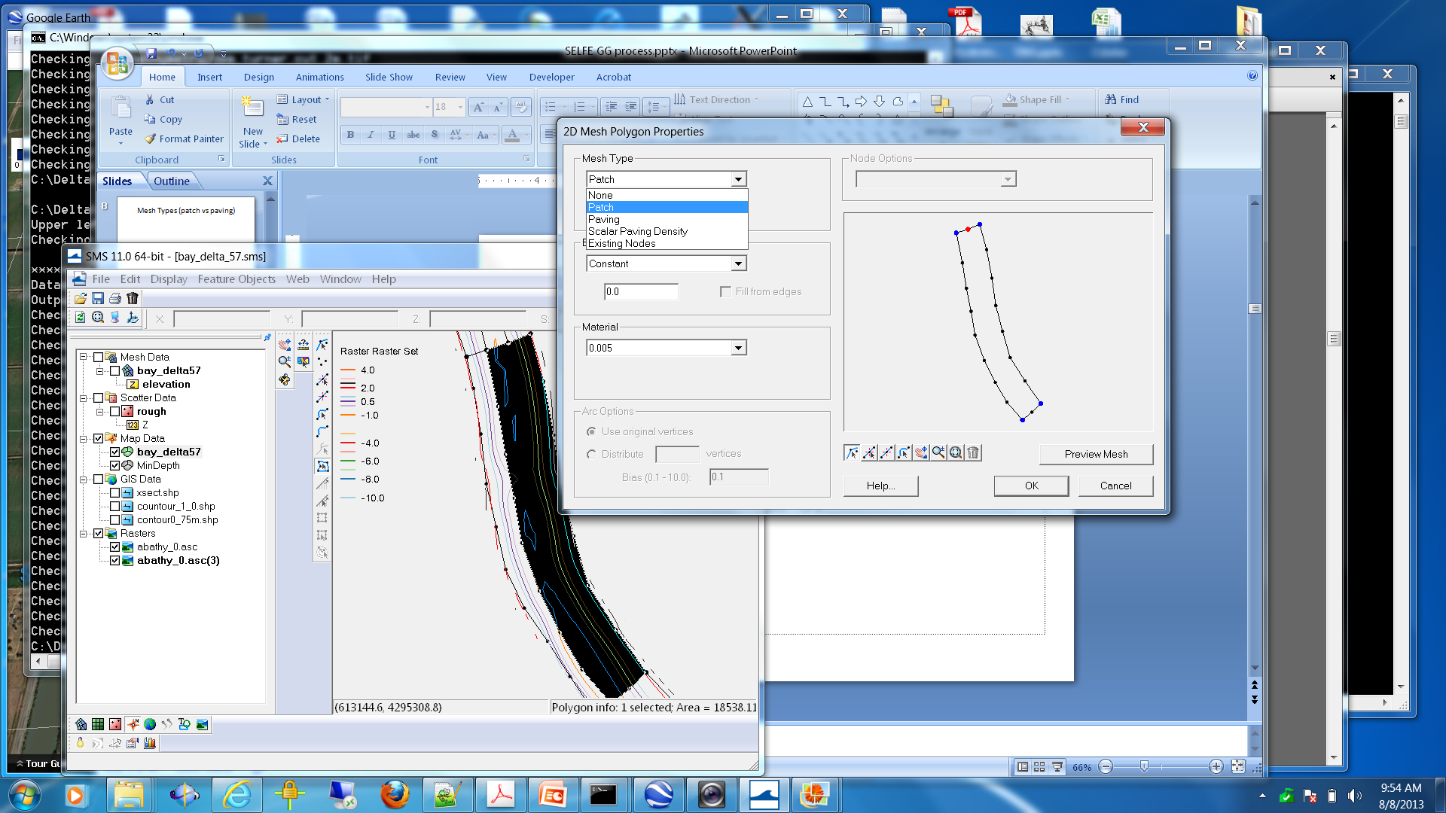
Mesh Types (Patch vs Paving)

Slide 30
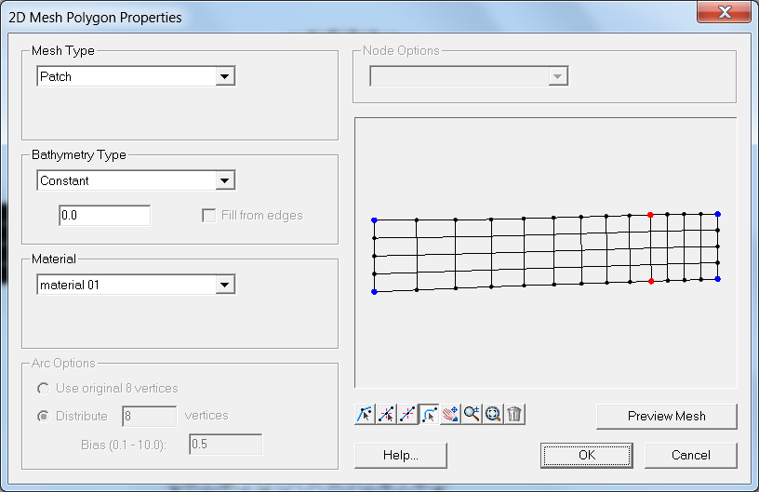
Bias easier to “undo” here

Slide 31
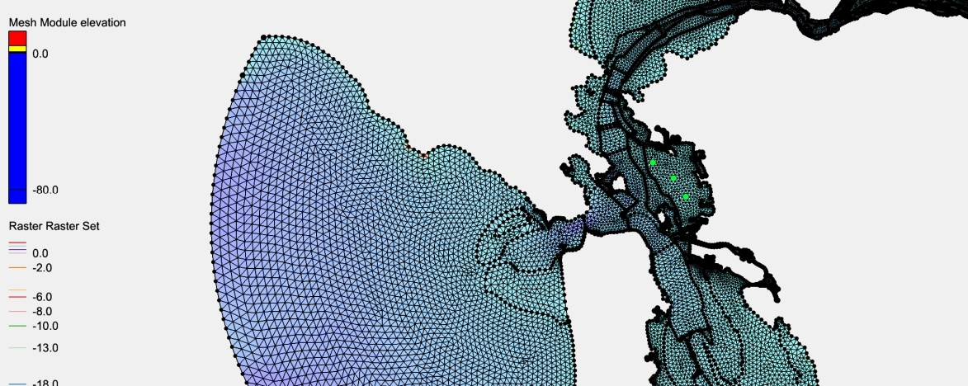
Patch vs Pave
Pave:
Recommended for quality grids on large, well-resolved water bodies
Works well when polygon is big and wide compared to arc nodes
Most robust of all methods

Slide 32
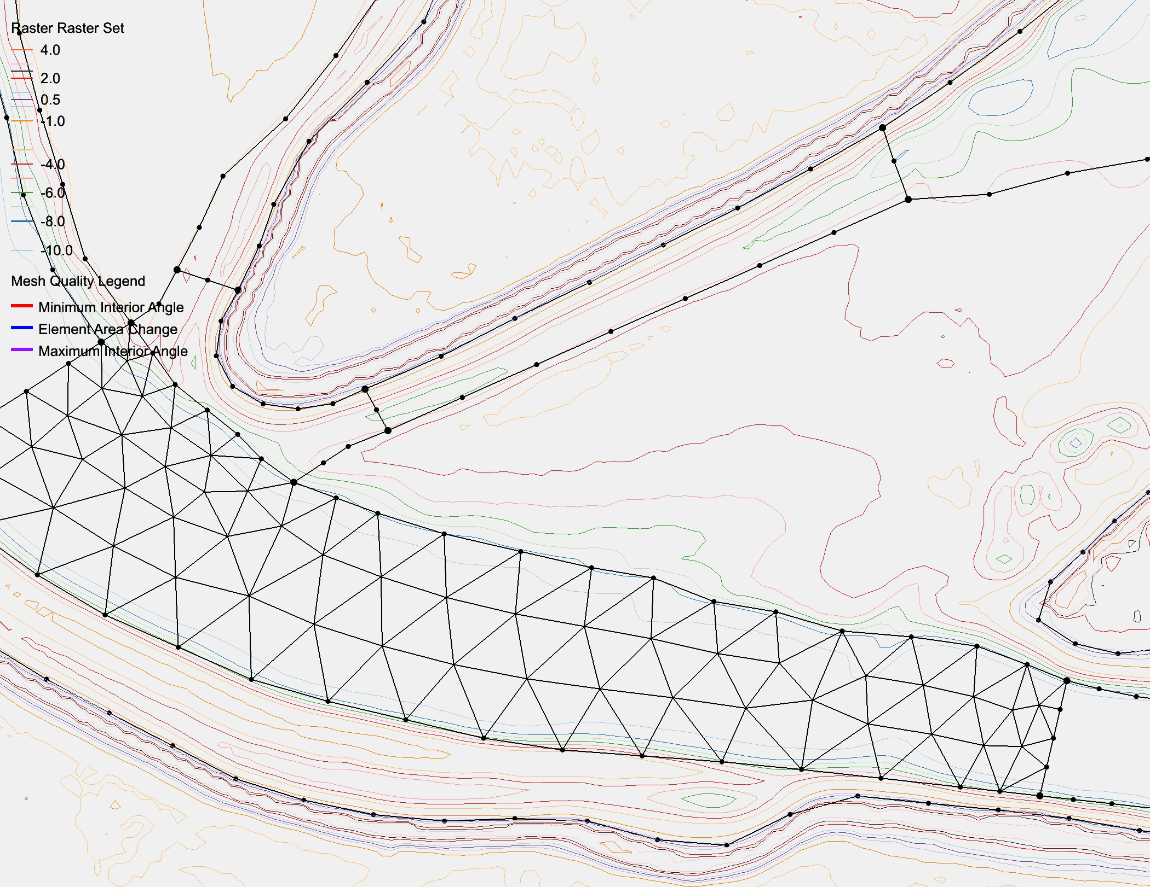

Slide 33
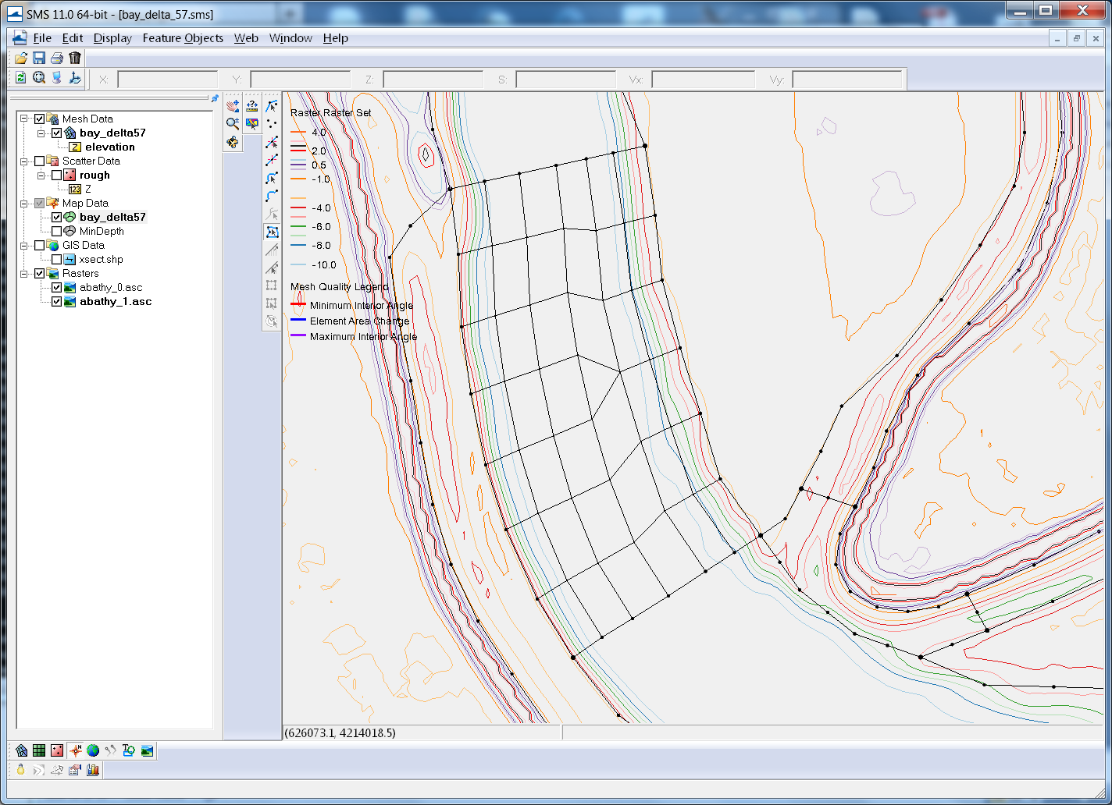
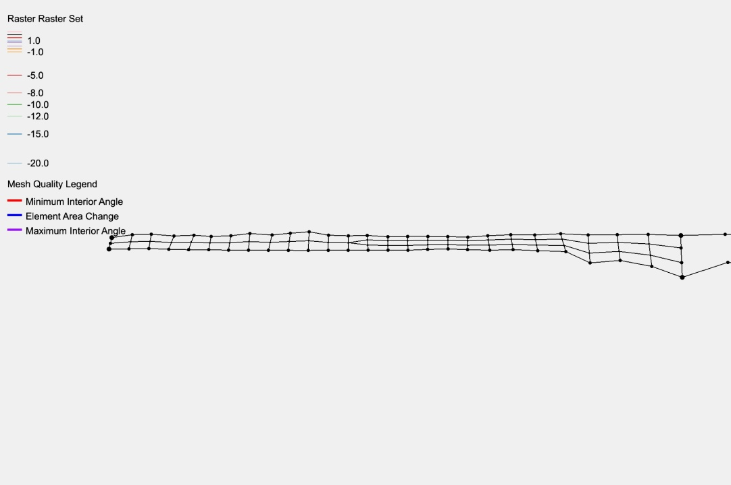
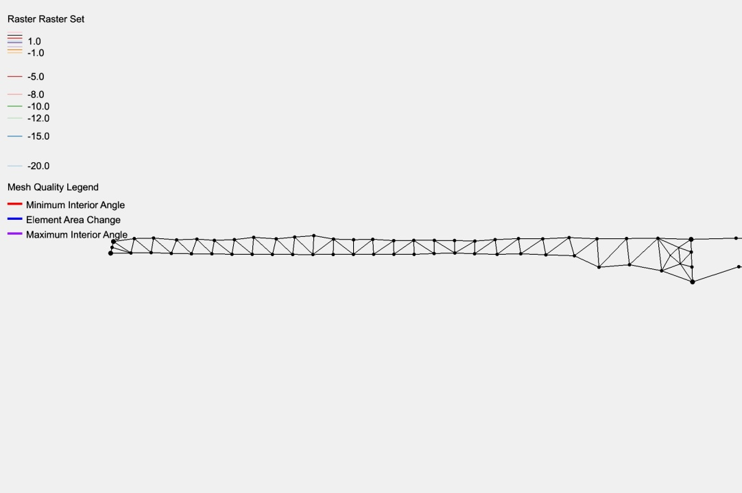
(Adaptive) Coon’s Patch
Quasi-structured grid block
Force mesh to be n-elements wide
Arbitrary anisotropy (3:1 or 4:1 common)
Follow the channel!!! Don’t round corners
Patch (Adaptive Coon’s Patch)
Pave (advancing front)

Slide 34
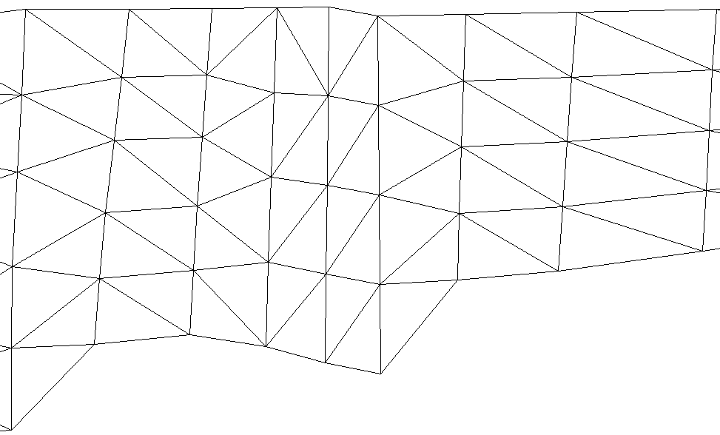
Hydraulic Structures
Q
Faces
1
2
1
1’
2
2’
3
3’
4
4’
5
1-1’ etc are node pairs
5’
“Block”

Slide 35
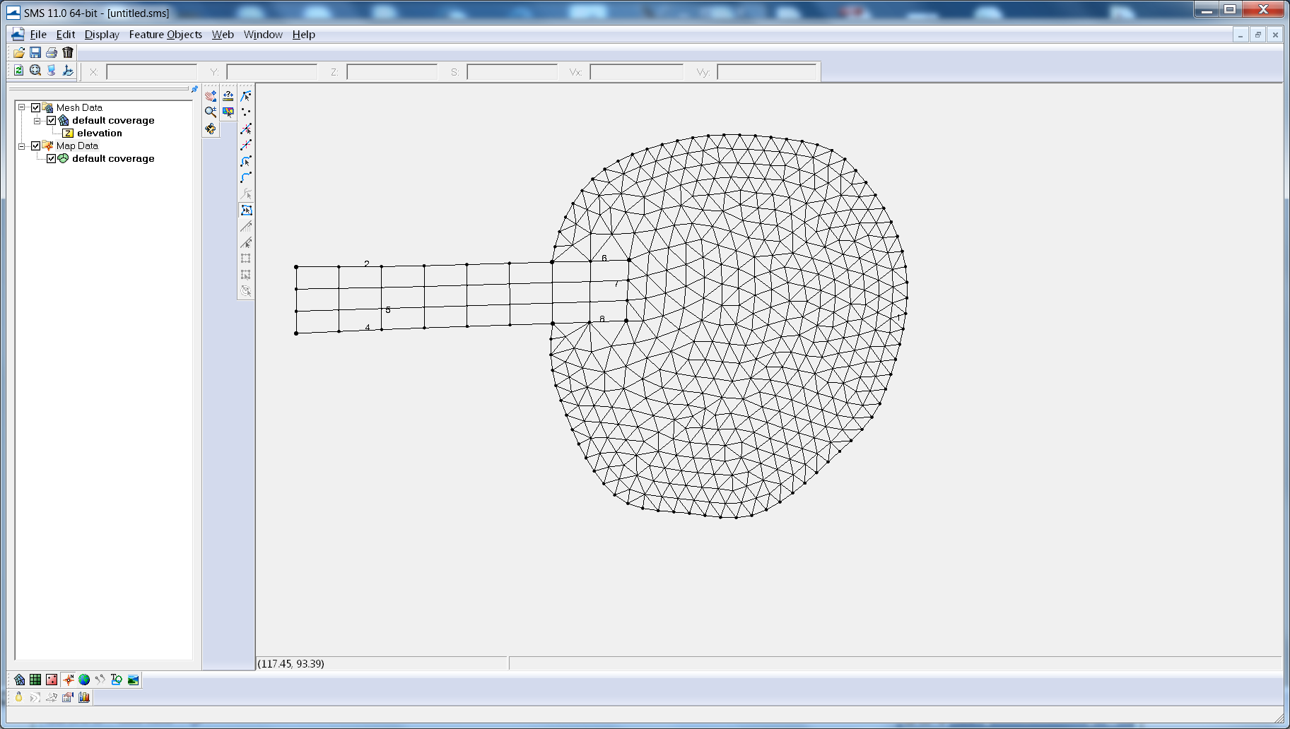
Dovetailing Patch and Pave*
*These ideas not unique to patch/pave

Slide 36
Populating Elevations
Big problem again … SMS doesn’t hold the data gracefully
Have heard of people doing it in stages
Can use stacked_dem_fill.py, which:
Populates with correct georeference
Matches contours
Uses prioritized DEMs
Gives some warnings

Slide 37
Metrics
Volumetric error (actually, average height)
Patterns can be systematic
Face/edge aperture or area
Storage area
Skew: SCHISM very tolerant, but good to look (if you use xmgredit5, try skewness of 14)
Need to use quality quads (xmgredit5: angle ratio >0.5)
Area change: SCHISM very tolerant, but good to look
Slope: PGE issue usually not a problem (vgrid plays a role also)
Local error: Richardson extrapolation
Painful without tools
TVD² and sub-cycling measures
Eddying regime requires more uniform and higher-quality grid to avoid distortion of eddy dynamics
CFL (>0.4) and subcycling issues
Xmgredit5 can easily check CFL for you
Dimensionless wave number may also need to be looked at

Slide 38
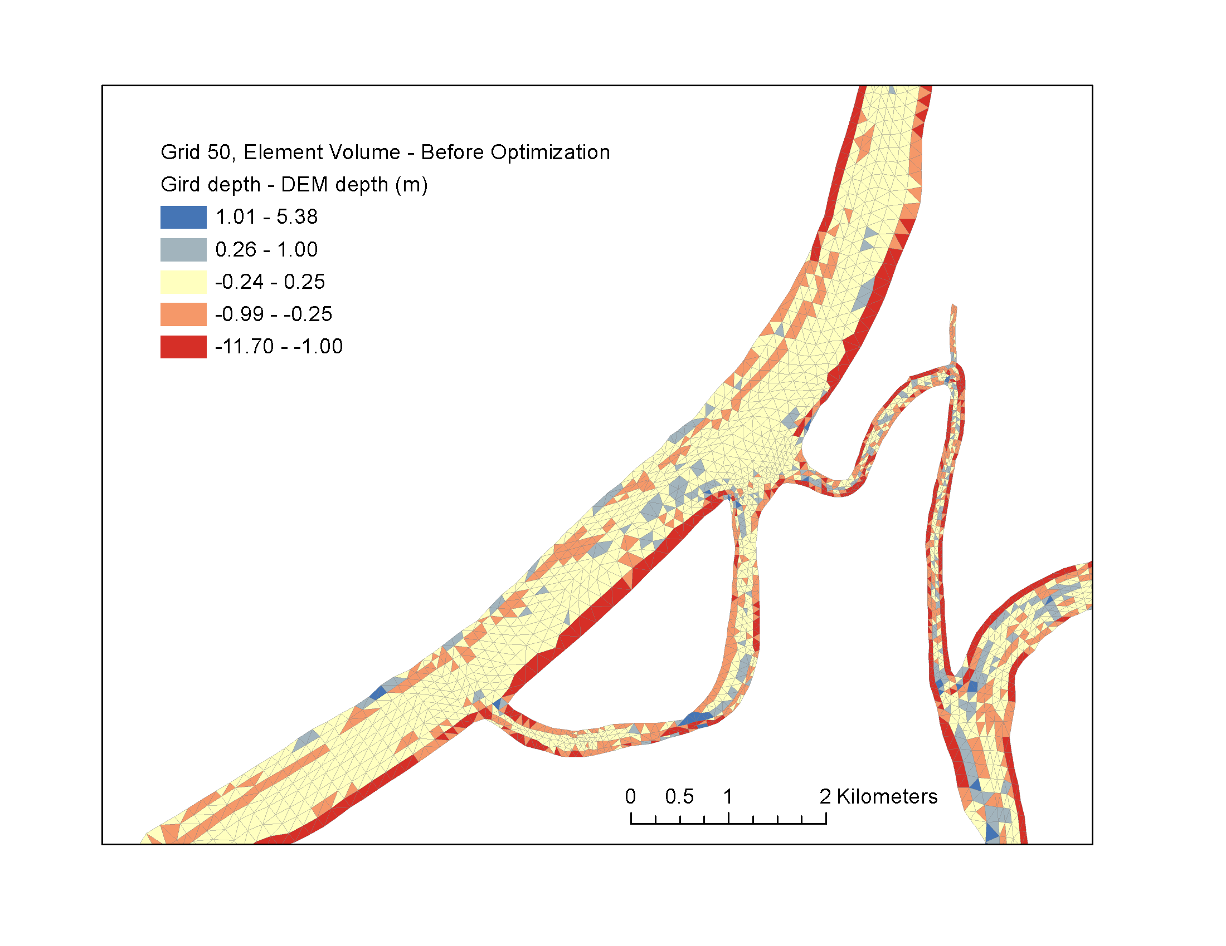
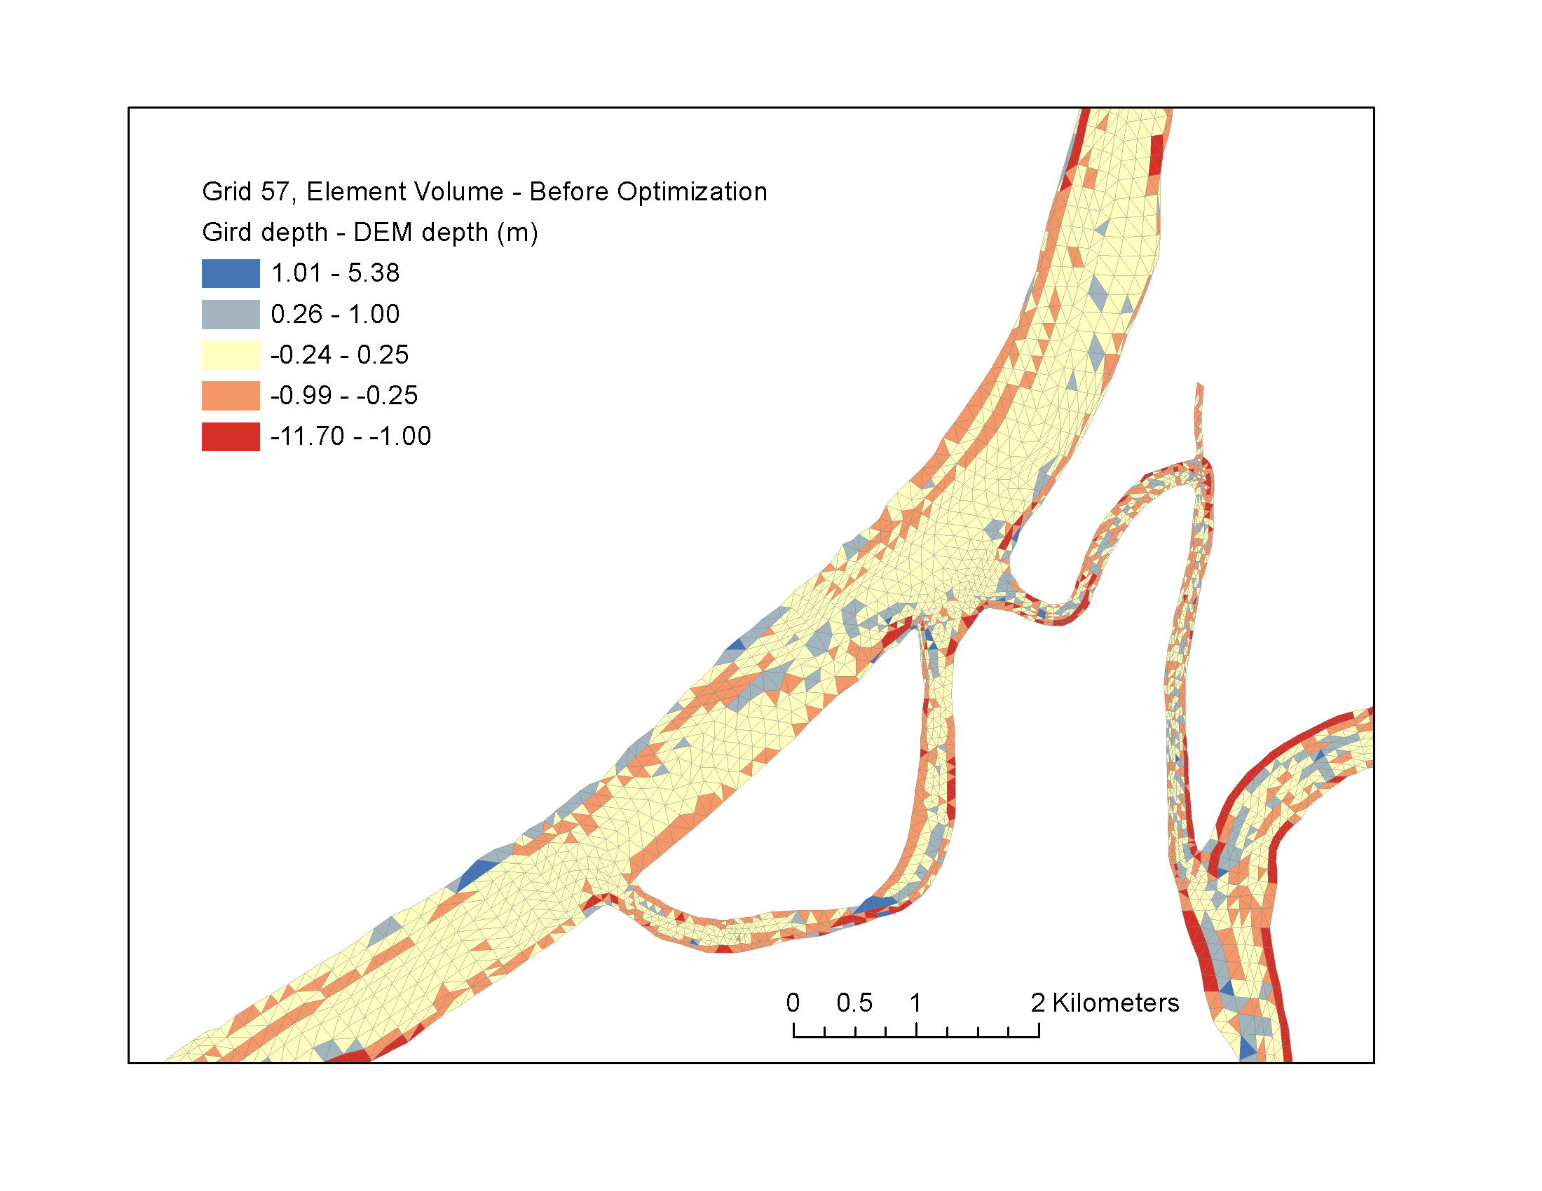
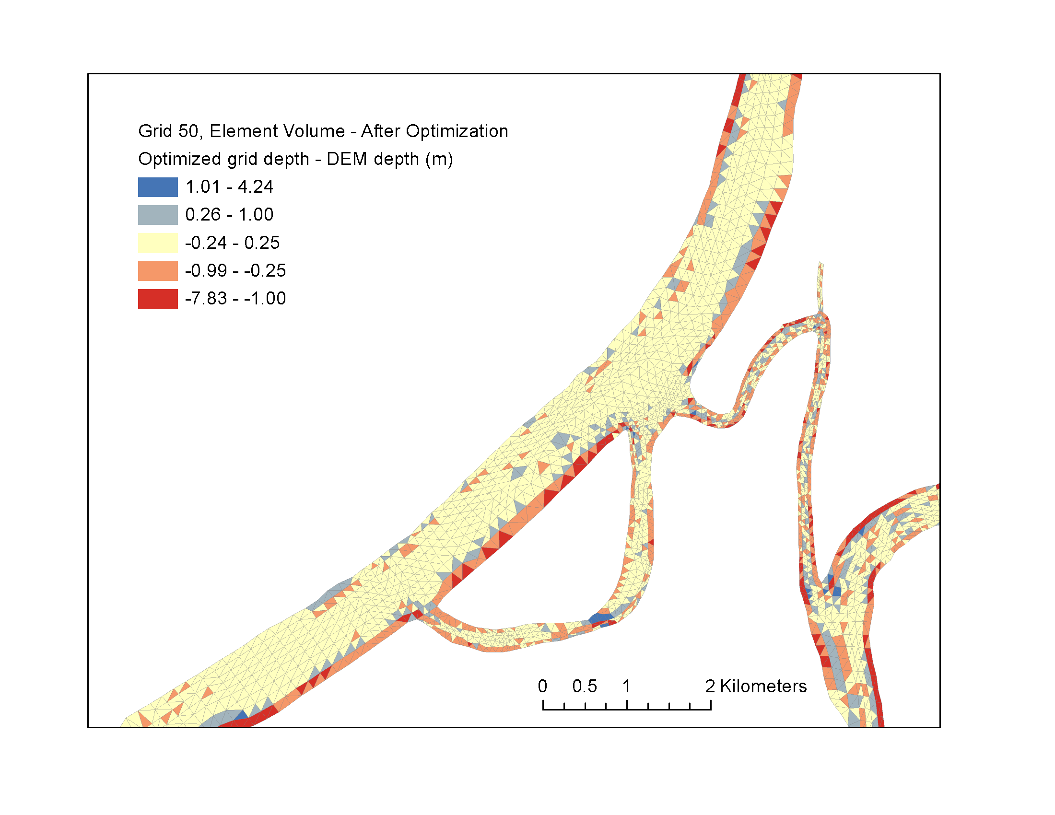
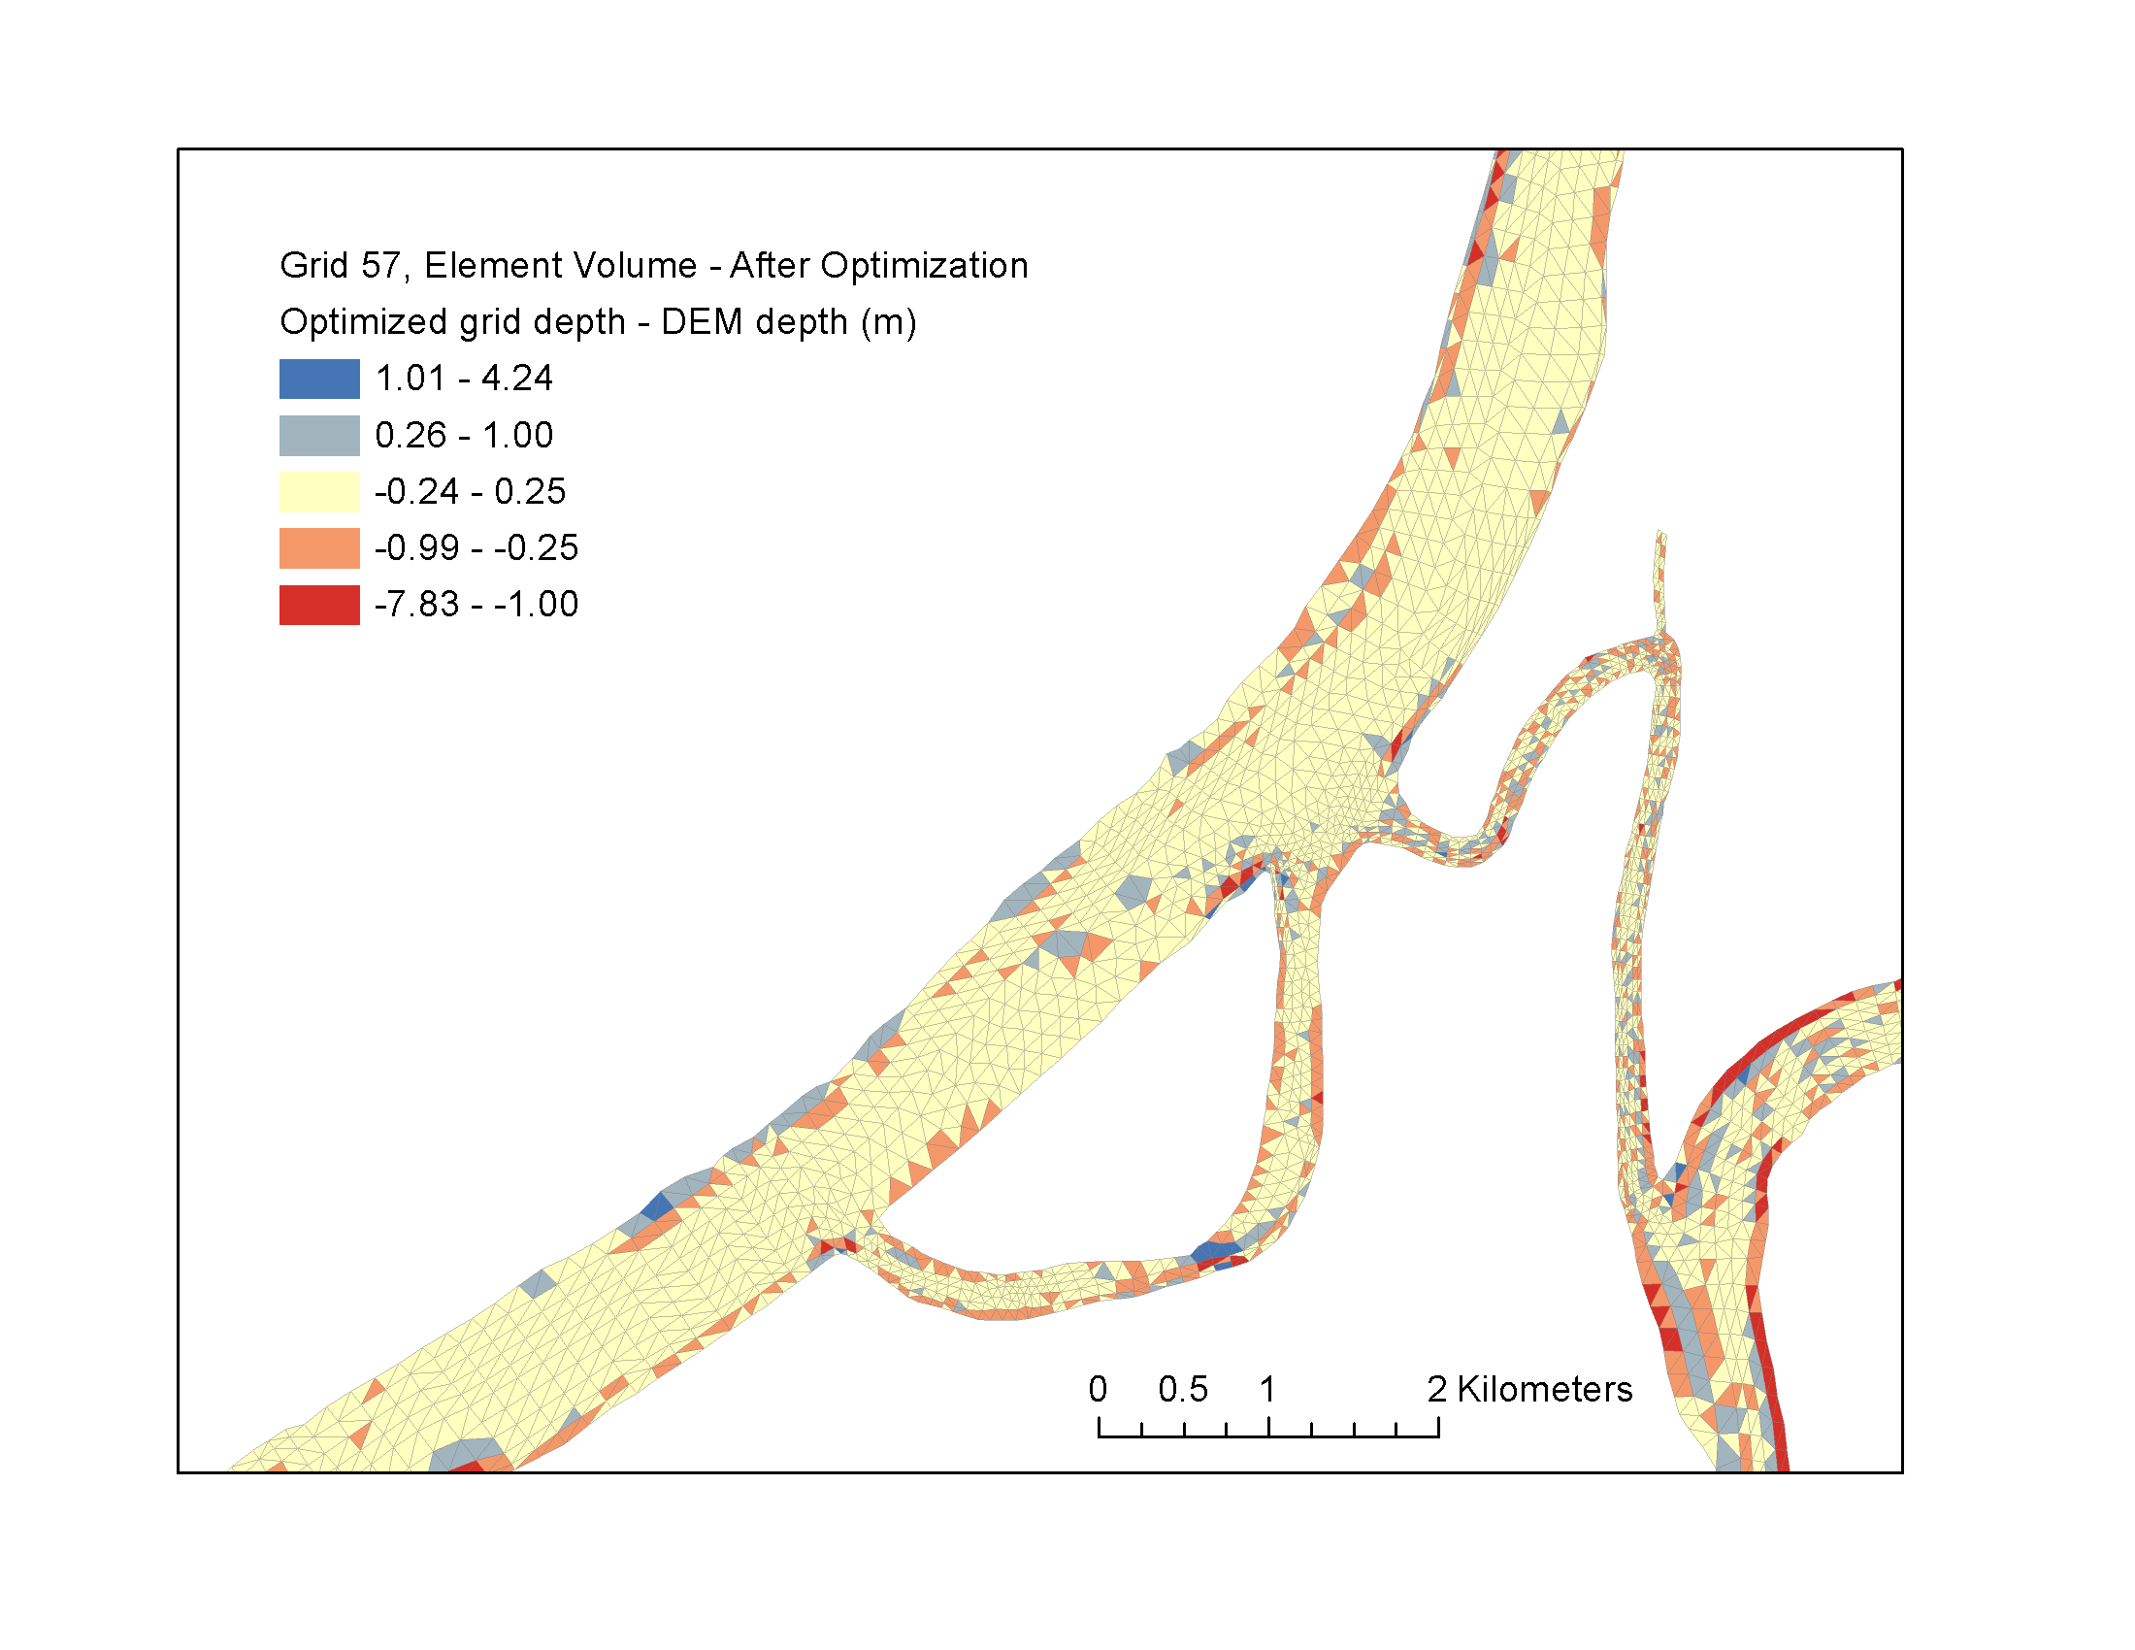
Bathymetry/Volume Matching

Slide 39
TVD tuning
(Vertically) implicit TVD² alleviated much of the pain
Use tvd_analyze.pl (we modify it to accumulate offenders over time)
Create a prop file and visualize
There is also a “hidden” dtbe visualization option

Slide 40
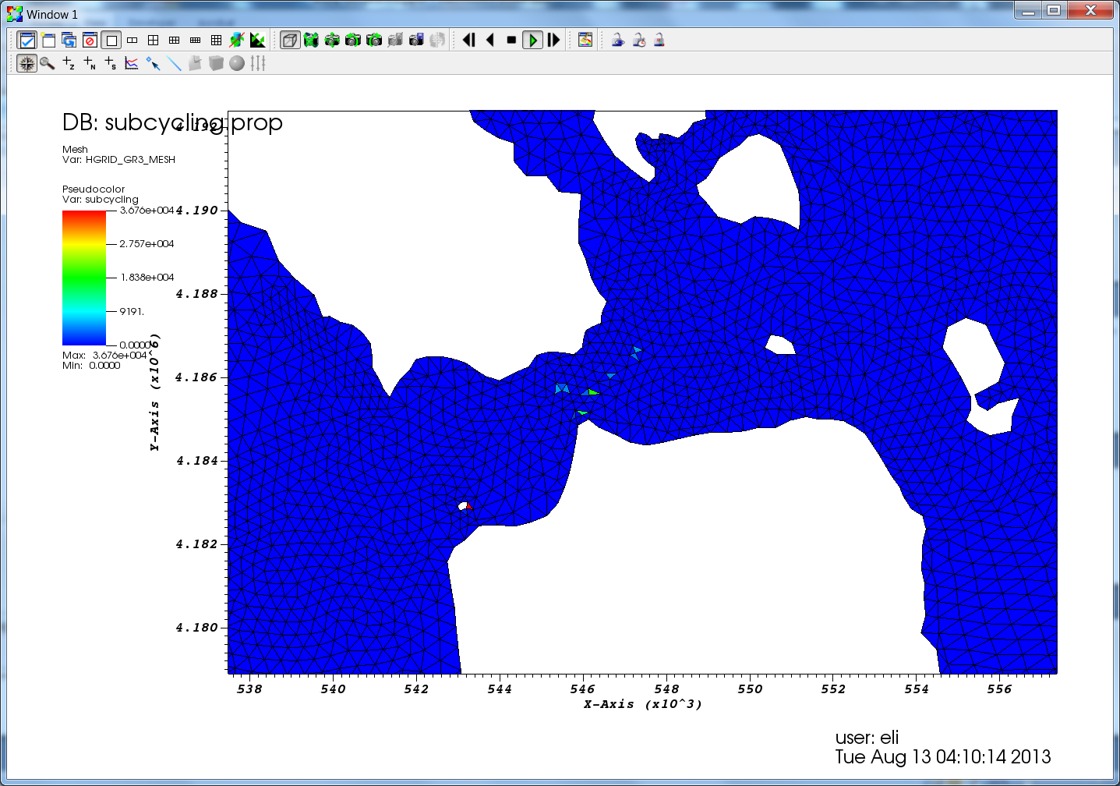

Slide 41
Automatic regrid/subgrid
…it’s generally easier (and quicker) to regrid the whole grid

Slide 42
Common Ad Hoc Fixup Steps
Deepening of boundary depths to prevent open boundary drying
There is a fancier approach to preserve the original depth…
In gredit, create a region and depth=max(depth,3)

Slide 43
Conclusions
SMS is an adequate tool for non-ortho grids
Good grid generation resolves flow/bathy features faithfully
Some finer scales ignored if not resolved
Implicit model provides you with more freedom for resolution
Shape functions and wet-dry rules; understand the physics and numerics!
You can’t work on this stuff unless you can fix-test-fix-test
So front-end on node-based inputs (see BayDeltaSCHISM)
IMPORTANT: always start from an estimate of smallest Δt you anticipate for the application and use CFL>0.4 to back-calculate the coarsest resolution at each depth
If you somehow decide to reduce Δt later, you may have to refine the grid
As a rough guide, Δt=100-450s for b-tropic, 100-200s for b-clinic applications (however, smaller Δt may be needed for some extreme cases)

