Slide 1
SCHISM physical formulation Joseph Zhang

Slide 2
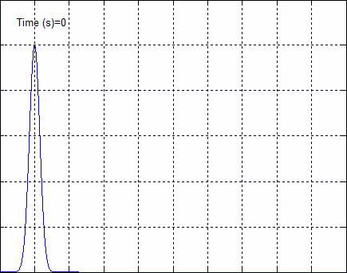
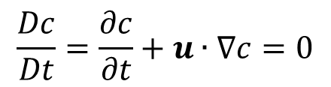
Advection
$$\frac{Dc}{Dt}=\frac{∂c}{∂t}+u∙∇c=0$$
u : advective velocity (usually known)

Slide 3
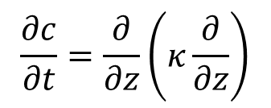
Diffusion
$$\frac{∂c}{∂t}=\frac{∂}{∂z}\left(κ\frac{∂}{∂z}\right)$$
κ : diffusivity [m²/s]

Slide 4
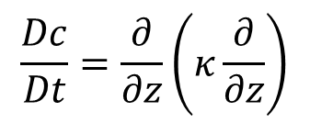
Advection-Diffusion
$$\frac{Dc}{Dt}=\frac{∂}{∂z}\left(κ\frac{∂}{∂z}\right)$$

Slide 5
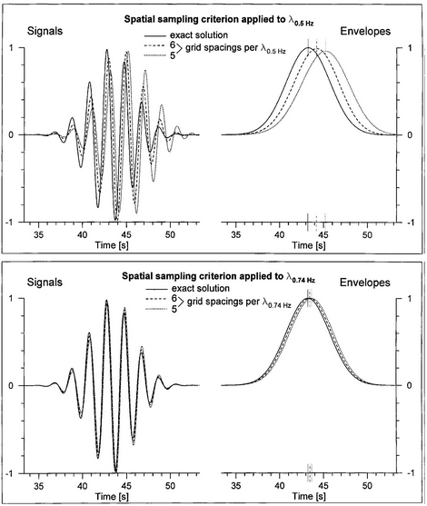
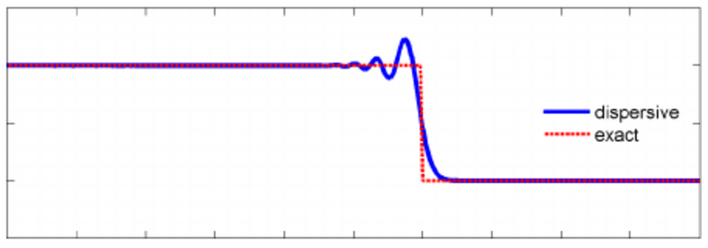

Dispersion
Waves of different frequencies travel at different phase speeds
Usually related to derivatives of odd order (either physical or numerical)
$$φ_{t}+φ_{xxx}−6φφ_{x}=0$$
No dispersion
With dispersion
Notes:
https://www.youtube.com/watch?v=jqJSwSmyB5E
https://www.youtube.com/watch?v=scBvd3FQ73U

Slide 6
Governing equations: Reynolds-averged Navier-Stokes
Continuity equation
Momentum equations
Vertical b.c.:
Equation of state
Transport of salt and temperature
Turbulence closure: Umlauf and Burchard 2003
z
MSL
x
East
shear
stratification

Slide 7

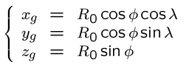

On spherical coordinates
z_{g}
φ⁰ (y)
z
λ
λ⁰ (x)
P
φ
O
y_{g}
x_{g}
We transform the coordinates instead of eqs
There are 2 frames used:
Global
Lon/lat (local @ node/element/side)
Changes to the code is mainly related to re-project vectors and to calculate distances

Slide 8

Continuity equation
Vertical boundary conditions: kinematic
z
surface
bottom
Integrated continuity equation
Notes:
Closure error

Slide 9
Hydrostatic model
Hydrostatic assumption
Separation of horizontal and vertical scales
Boussinesq assumption (=>incompressibility)

Slide 10



Momentum: Coriolis
>
f
Coriolis: “virtual force”
Newton’s 2nd law is only valid in an inertial frame
For large scale GFD flows, the earth is not an inertial frame
Small as it is, it is responsible for a number of unique phenomena in GFD
Accelerations in a rotating frame (Ω const.):
J
u
j
i
Ωxr
Coriolis
Centrifugal
acceleration
I
Ω

Slide 11
Momentum equation: vertical boundary condition (b.c.)
Surface
Bottom
Logarithmic law:
Reynolds stress:
Turbulence closure:
Reynolds stress (const.)
Drag coefficient:
u_{b}
δ_{b}
z=−h
Notes:
Assumption: bottom cell is inside BBL

Slide 12
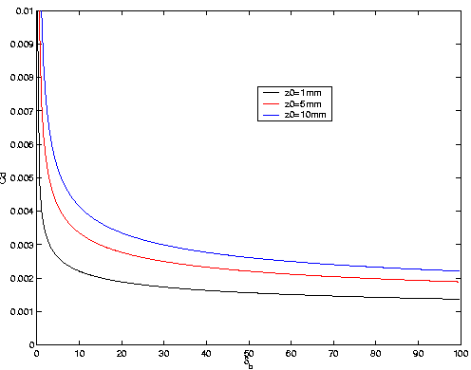
Bottom drag
meters
Use of z₀ seems most natural option, but tends to over-estimate C_{D} in shallow area
Strictly speaking C_{D} should vary with bottom layer thickness (i.e. vertical grid)
Different from 2D, 3D results of elevation depend on vertical grid (with constant C_{D})

Slide 13
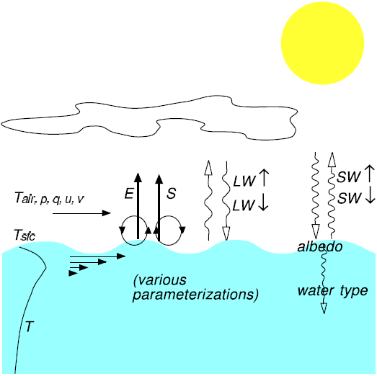
Transport equation: source terms
Precipitation and evaporation model
E: evaporation rate (kg/m²/s) (calculated from heat exchange model)
P: Precipitation rate (kg/m2/s) (measured)
Heat exchange model
IR’s are down/upwelling infrared (LW) radiation at surface
S is the turbulent flux of sensible heat (upwelling)
E is the turbulent flux of latent heat (upwelling)
SW is net downward solar radiation
The solar radiation is penetrative (body force) with attenuation (which depends upon turbidity) acts as a heat source within the water.

Slide 14
Air-water exchange
free surface height: variations in atmospheric pressure over the domain have a direct impact upon free surface height; set up due to wind stresses
momentum: near-surface winds apply wind-stress on surface (influences advection, location of density fronts)
heat: various components of heat fluxes (dependent upon many variables) determine surface heat budget
shortwave radiation (solar) - penetrative
longwave radiation (infrared)
sensible heat flux (direct transfer of heat)
latent heat flux (heating/cooling associated with condensation/evaporation)
water: evaporation, condensation, precipitation act as sources/sinks of fresh water
2-4 are accomplished thru the heat/salt exchange model

Slide 15
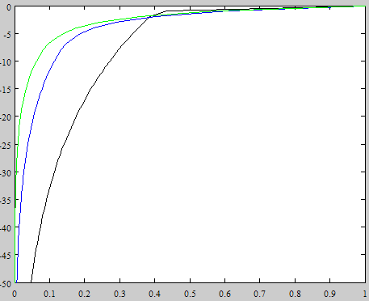
Solar radiation
Downwelling SW at the surface is forecast in NWP models - a function of time of year, time of day, weather conditions, latitude, etc [sflux_rad*.nc]
Upwelling SW is a simple function of downwelling SW
α is the albedo - typically depends on solar zenith angle and sea state
Attenuation of SW radiation in the water column is a function of turbidity and depth D (Jerlov, 1968, 1976; Paulson and Clayson, 1977):
R, d₁ and d₂ depend on water type; D is the distance from F.S.
Type | R | d₁ (m) | d₂ (m)
Jerlov I | 0.58 | 0.35 | 23
Jerlov IA | 0.62 | 0.60 | 20
Jerlov IB | 0.67 | 1.00 | 17
Jerlov II | 0.77 | 1.50 | 14
Jerlov III | 0.78 | 1.40 | 7.9
Paulson and Simpson | 0.62 | 1.50 | 20
Estuary | 0.80 | 0.90 | 2.1
III
Depth (m)
II
I
‘6’
‘7’
SW

Slide 16
Infrared radiation
Downwelling IR at the surface is forecast in NWP models - a function of air temperature, cloud cover, humidity, etc [sflux_rad*.nc]
Upwelling IR is can be approximated as either a broadband measurement solely within the IR wavelengths (i.e., 4-50 μm), or more commonly the blackbody radiative flux
ε is the emissivity, ~1
σ is the Stefan-Boltzmann constant
T_{sfc} is the surface temperature

Slide 17
Turbulent Fluxes of Sensible and Latent Heat
In general, turbulent fluxes are a function of:
• T_{sfc},, T_{air}
• near-surface wind speed
• surface atmospheric pressure
• near-surface humidity
Scales of motion responsible for these heat fluxes are much smaller than can
be resolved by any operational model - they must be parameterized (i.e., bulk aerodynamic formulation)
where:
u* is the friction scaling velocity
T* is the temperature scaling parameter
q* is the specific humidity scaling parameter
ρ_{a} is the surface air density
C_{pa} is the specific heat of air
L_{e} is the latent heat of vaporization
The scaling parameters are defined using Monin-Obukhov similarity theory,
and must be solved for iteratively (i.e., Zeng et al., 1998).

Slide 18
Wind Shear Stress: Turbulent Flux of Momentum
Calculation of shear stress follows naturally from calculation of turbulent heat fluxes
Total shear stress of atmosphere upon surface:
Alternatively, Pond and Picard’s formulation can be used as a simpler option

Slide 19
Inputs to heat/momentum exchange model
Forecasts of u_{w} v_{w} @ 10m, P_{A} @ MSL,T_{air} and q_{air} @2m
used by the bulk aerodynamic model to calculate the scaling parameters
Forecasts of downward IR and SW
Atmospheric properties (“air”)
data source | supplying agency | time period | spatial resolution | temporal resolution | area of coverage | data type
MRF | NCEP | 04/01/2001-02/29/2004 | 1° x 1° | 12-hour snapshots | 129W-120W, 35N-51N | forecast
GFS | NCEP | 07/03/2003-present | 1° x 1° | 3-hour snapshots | 180W-70W, 90S-90N | forecast
OSU-ARPS | OSU | 05/04/2001-02/25/2004 | 12 km | 1-hour snapshots | 128W-119W, 41N-47N (approx) | forecast
ETA/NAM | NCEP | 07/03/2003-present | 12 km | 3-hour snapshots | Eta Grid 218, west of 100W | forecast
NCAR/NCEP Reanalysis (NARR) | NCAR | 01/01/1979-12/31/2006 | 12km | 6-hour snapshots | North America | reanalysis
Heat fluxes (“rad”)
data source | supplying agency | time period | spatial resolution | temporal resolution | area of coverage | data type
AVN (lo-res) | NCEP | 04/01/2001-10/28/2002 | 0.7° x 0.7° (approx) | 3-hour averages | 129W-120W, 35N-51N | forecase
AVN (hi-res) | NCEP | 10/29/2002-02/29/2004 | 0.5° x 0.5° (approx) | 3-hour averages | 129W-120W, 35N-51N | forecast
GFS | NCEP | 07/03/2003-present | 0.5° x 0.5° (approx) | 3-hour averages | 180W-70W, 90S-90N | forecast
ETA/NAM | NCEP | 07/03/2003-present | 12 km | 3-hour snapshots | Eta Grid 218, west of 100W | forecast
NCAR/NCEP Reanalysis (NARR) | NCAR | 01/01/1979-12/31/2006 | 12km | 6-hour averages | North America | reanalysis

Slide 20
Turbulence closure: Umlauf and Burchard (2003)
Use a generic length-scale variable to represent various closure schemes
Mellor-Yamada-Galperin (with modification to wall-proximity function → k-kl)
k-ε (Rodi)
k-ω (Wilcox)
KPP (Large et al.; Durski et al)
Wall function
Diffusivity
Stability: Kantha and Clayson (smoothes Galperin’s stability function as it approaches max)

Slide 21
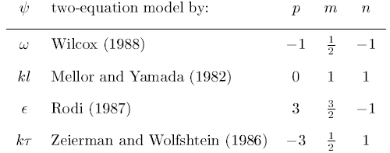
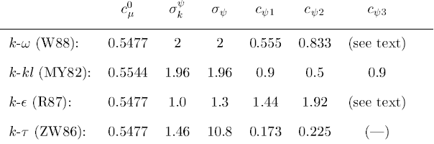
Turbulence closure: Umlauf and Burchard (2003)
Constants
Wall proximity function
depends on choice of scheme and stability function
Implementation of b.c. in GOTM

Slide 22
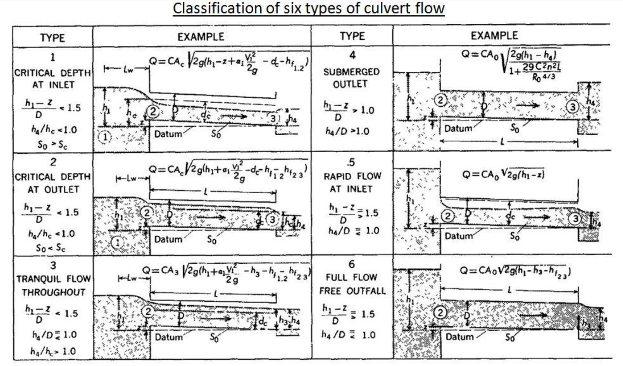
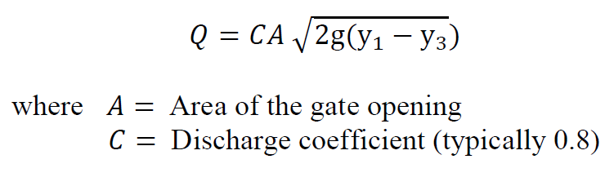
Hydraulics
Orifice equation for CCFB

Slide 23
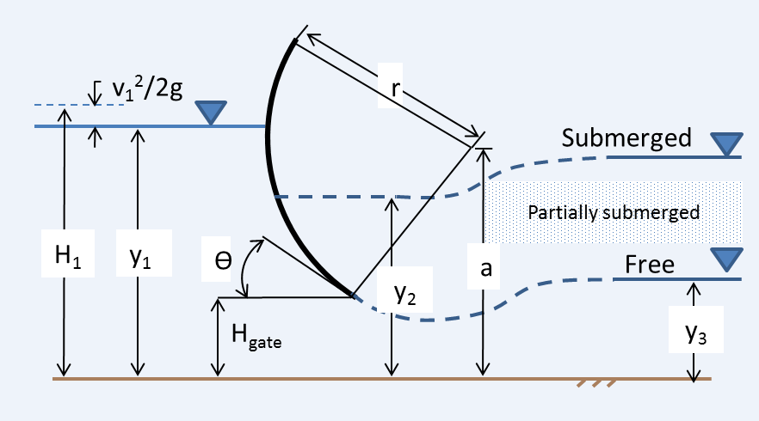
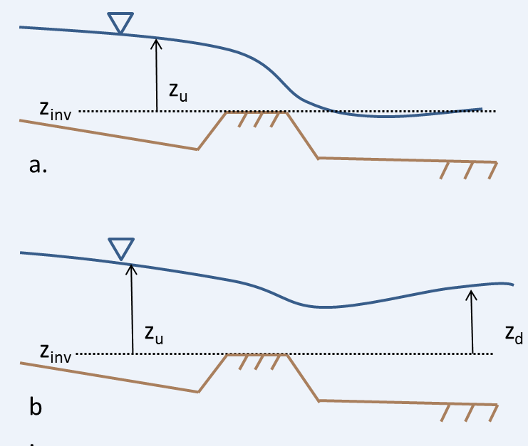
Hydraulics
Radial gate
weir

