Slide 1
SCHISM numerical formulation
Joseph Zhang

Slide 2
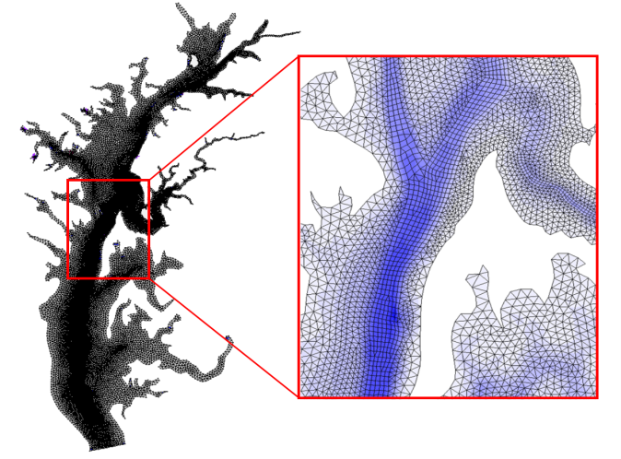
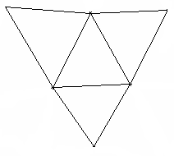

Horizontal grid: hybrid
3
4
Side 2
3
Side 2
Side 1
Side 3
Side 1
1
Side 4
2
1
Side 3
2
3
2
1
1
2
3
3
2
y_{s}
i
2
2
N_{i}
1
N_{i}
1
1
x_{s}
i
2
N_{i}
1
N_{i}
i
1

Slide 3
Vertical grid: SZ
Terrain-following zone
SZ zone
z
σ zone
S zone
N_{z}
σ=0
h_{c}
h_{s}
h_{s}
S-levels
k^{z}
σ=-1
k^{z}−1
Z-levels
2
1
Notes:
The F.S. cannot fall below hc<=hs

Slide 4
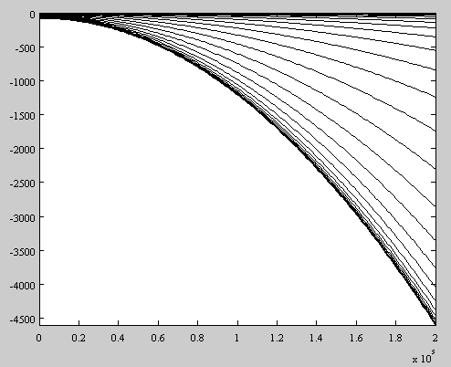
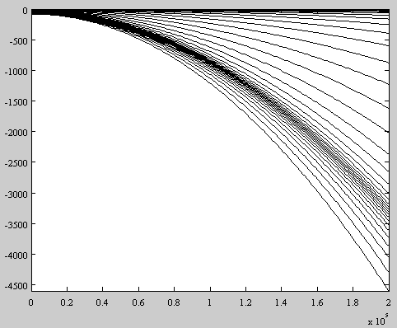
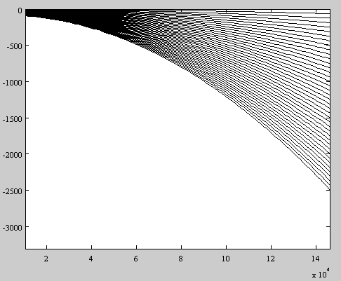
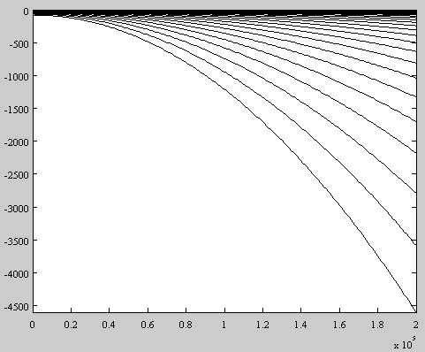
S-coordinates
θ_{f}=10⁻³, any θ_{b}
θ_{f}=10, θ_{b}=1
h_{c}
θ_{f}=10, θ_{b}=0
θ_{f}=10, θ_{b}=0.7

Slide 5
Vertical grid: SZ
z=−h_{s}

Slide 6
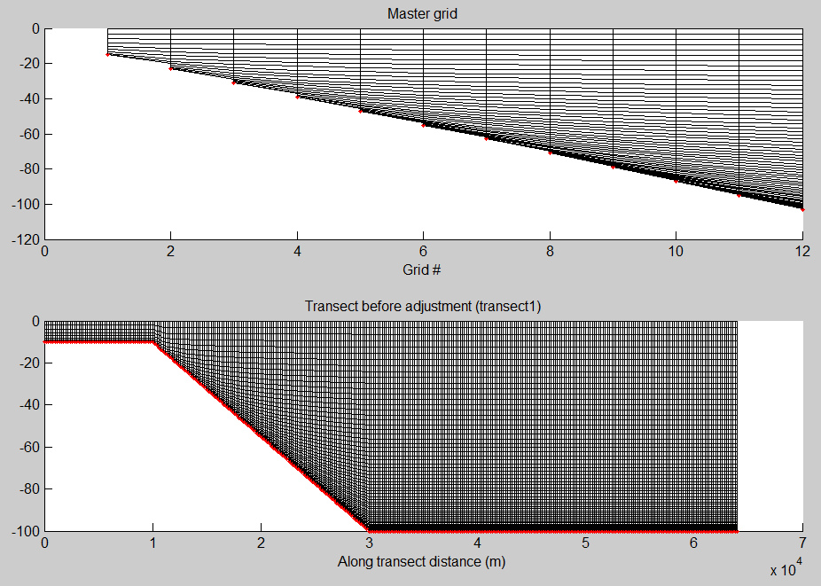
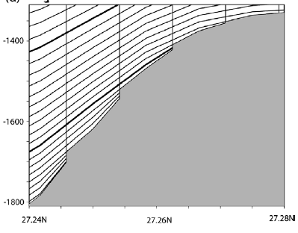
LSC² via VQS
Dukhovskoy et al. (2009)
Notes:
Masking process unnecessary

Slide 7

What to do with the staircases?
A
u
u
P
1
B
2
R
Q
1
2
LSC²= Localized Sigma Coordinates with Shaved Cells
(ivcor =1 in vgrid.in)

Slide 8
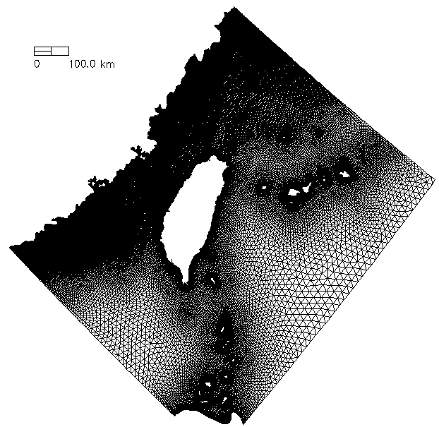
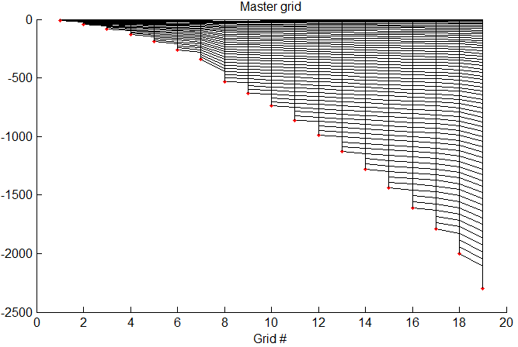
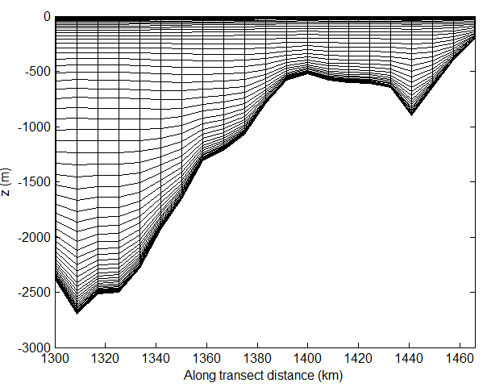
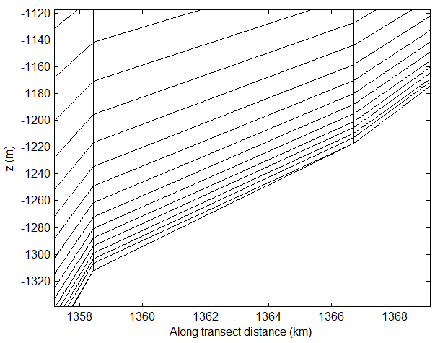
Vertical grid: LSC²
z (m)
Degenerate prism

Slide 9
Vertical grid (3)
3D computational unit: uneven prisms
Equations are not transformed into S- or σ-coordinates, but solved in the original Z-space
PGE
  Z-method with cubic spline (extrapolation on surface/bottom)
n_{k}
n_{k}
k (whole level)
k
N_{z}
η
N_{z}-1
u_{j,k+1} v_{j,k+1}
η
…….
u_{j,k+1} v_{j,k+1}
C_{i,k}
k
k-1
C_{i,k}
…….
k-1
k-1
w_{i,k-1}
w_{i,k-1}
k_{b}+1
k_{b}

Slide 10
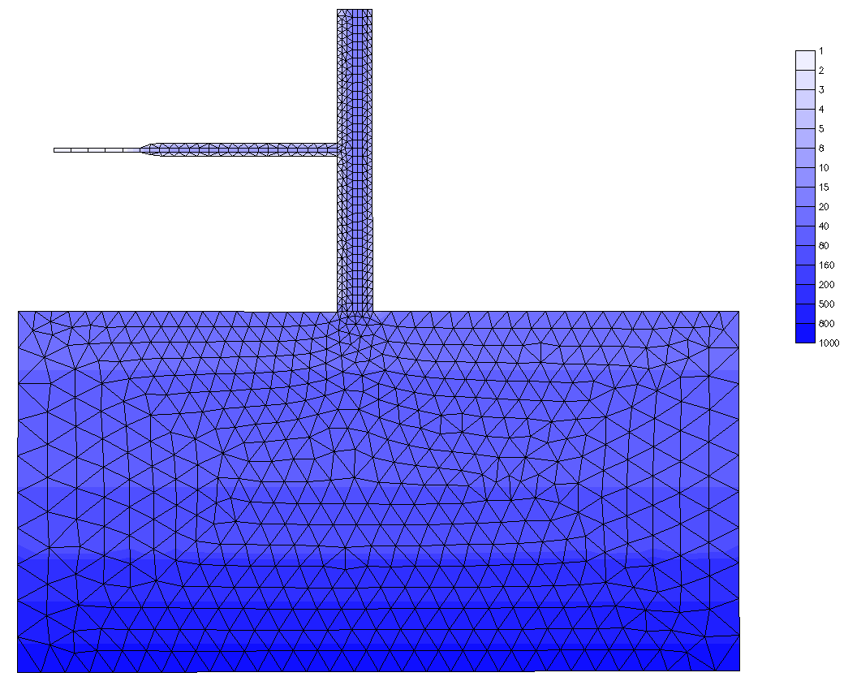
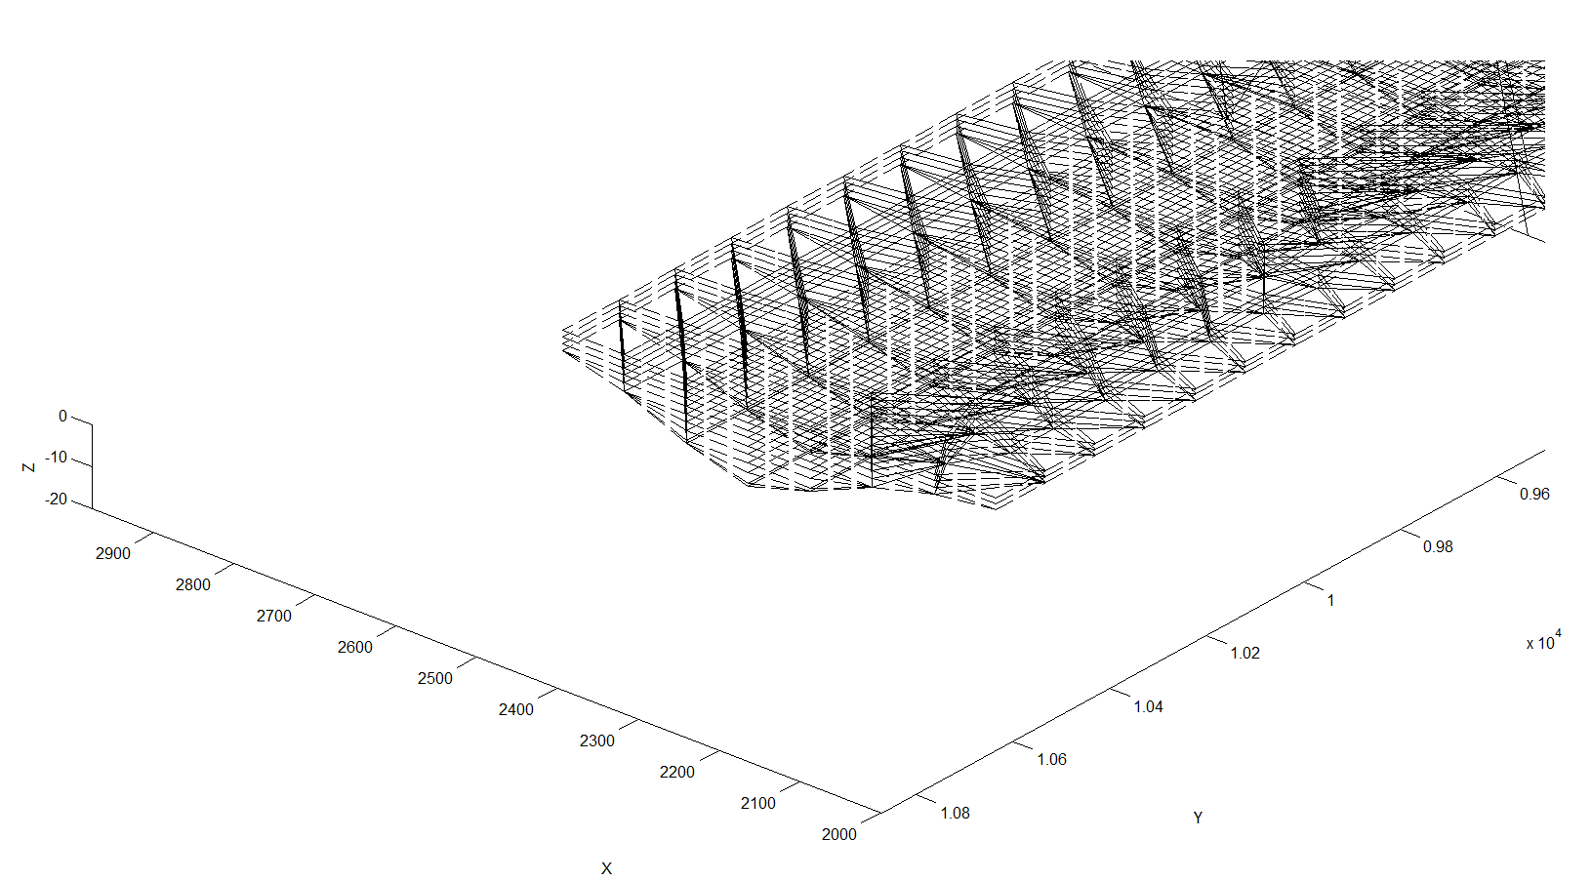
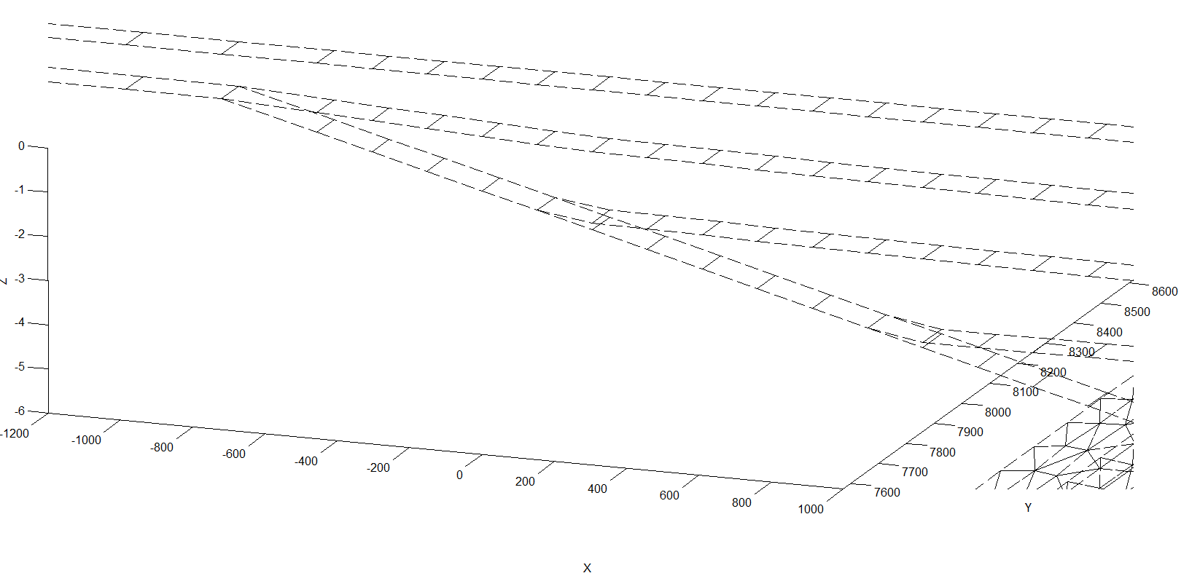
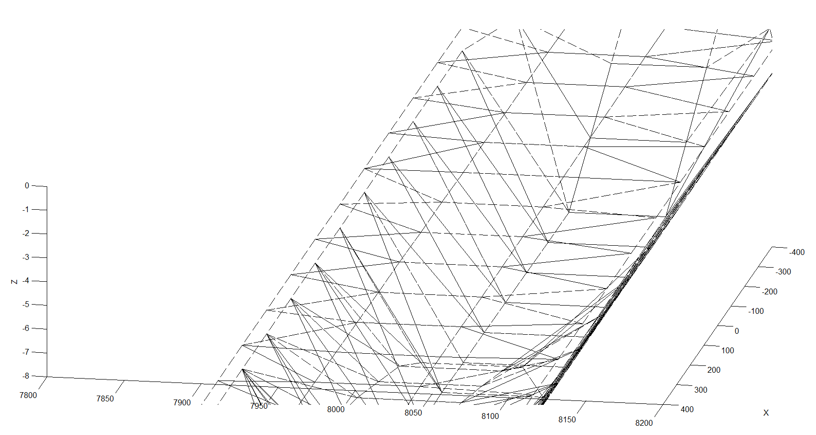
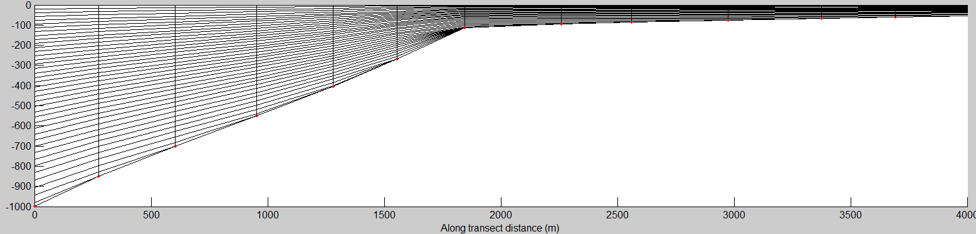
Polymorphism
Bathymetry (m)
Notes:
Flexibility is not just in the horizontal

Slide 11
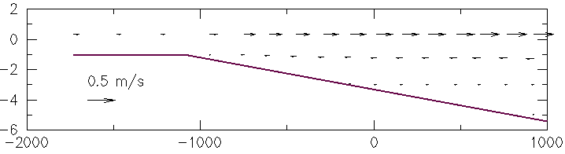

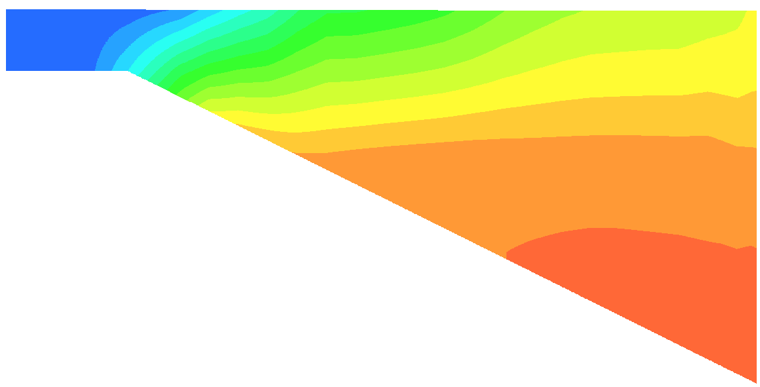
Polymorphism
flood
z (m)
x (m)
S (PSU)

Slide 12

Semi-implicit scheme
Continuity
Momentum
b.c.
Advection:
$$≈$$
Implicit treatment of divergence and pressure gradient (and SAV) terms by-passes most severe stability constraints: 0.5 ≤θ≤1
Explicit treatment: Coriolis, baroclinicity, horizontal viscosity, radiation stress…

Slide 13
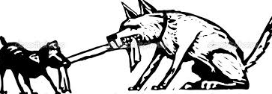

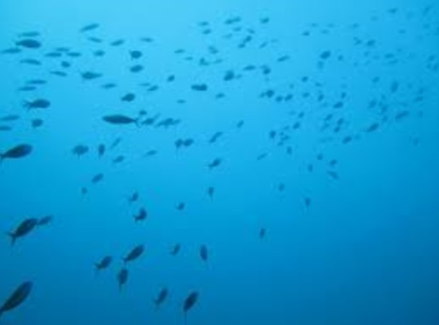
Eulerian-Lagrangian Method
ELM: takes advantage of both Lagrangian and Eulerian methods
  Grid is fixed in time, and time step is not limited by Courant number condition
  Advections are evaluated by following a particle that starts at certain point at time t and ends right at a pre-given point at time t+Δt.
  The process of finding the starting point of the path (foot of characteristic line) is called backtracking, which is done by integrating dx/dt=u₃ backward in 3D space and time.
  To better capture the particle movement, the backward integration is often carried out in small sub-time steps
    Simple backward Euler method
    2nd-order R-K method
    Interpolation-ELM does not conserve; integration ELM does
  Interpolation: numerical diffusion vs. dispersion
Diffusion
Dispersion
CFL>0.4
t+Δt
Characteristic line
t
advection
dispersion
diffusion

Slide 14
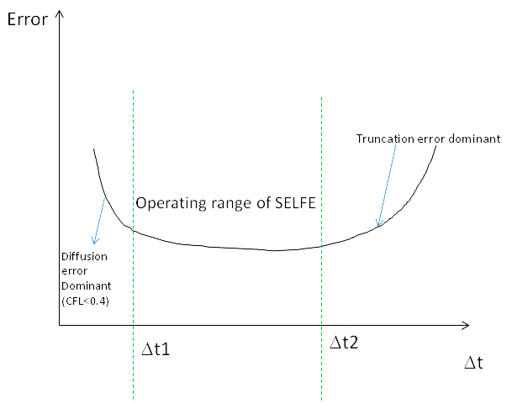
Operating range of SCHISM
…. for a fixed grid
Convergence: CFL=const, Δt→0

Slide 15
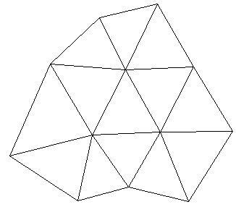
ELM with high-order Kriging
Best linear unbiased estimator for a random function f(x)
“Exact” interpolator
Works well on unstructured grid (efficient)
Needs filter (ELAD) to reduce dispersion
Drift function
Cubic spline
Fluctuation
K is called generalized covariance function
Minimizing the variance of the fluctuation we get
2-tier Kriging cloud
x
The numerical dispersion generated by kriging is reduced by a diffusion ELAD filter (Zhang et al. 2016)

Slide 16
Semi-implicit scheme
Continuity
Momentum
b.c.
$$≈$$
Implicit treatment of divergence and pressure gradient terms by-passes most severe CFL condition : 0.5 ≤θ≤1
Explicit treatment: Coriolis, baroclinicity, horizontal viscosity, radiation stress…

Slide 17

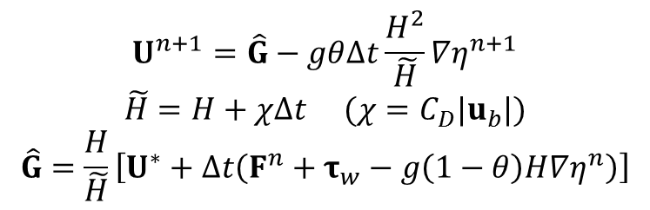
Galerkin finite-element formulation
A Galerkin weighted residual statement for the continuity equation:
Vertical integration of the momentum equation
(1) 2D case:
Shape function
$$U^{n+1}=\hat{G}−gθ∆t\frac{H^{2}}{\tilde{H}}∇η^{n+1}$$
$$\tilde{H}=H+χΔt (χ=C_{D}|u_{b}|)$$
$$\hat{G}=\frac{H}{\tilde{H}}\left[U^{∗}+Δt\left(F^{n}+τ_{w}^{}−g\left(1−θ\right)H∇η^{n}\right)\right]$$

Slide 18
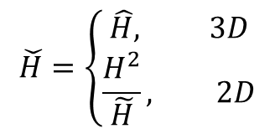


Galerkin finite-element formulation
Vertical integration of the momentum equation
(2) 3D case:
u_{b}
δ_{b}
z=−h
Momentum equation applied to the bottom boundary layer
via
Vertically integrated velocity becomes
(friction-modified depth)
Write in a unified compact form
$$\check{H}=\left\{\begin{matrix}\hat{H}, 3D \\ \frac{H^{2}}{\tilde{H}}, 2D\end{matrix}\right.$$
$$U^{n+1}=\hat{G}−gθ∆t\check{H}∇η^{n+1}$$
Note the difference in $\check{H}$between 2D/3D!

Slide 19
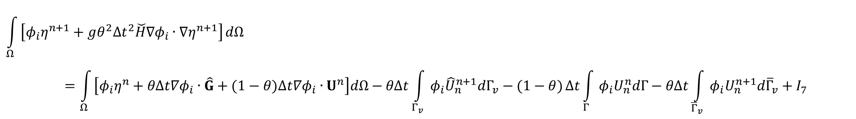
Finite-element formulation (cont’d)
Finally, substituting this eq. back to continuity eq. we get one equation for elevations alone:
I₁
$$\int_{Ω}{\left[φ_{i}η^{n+1}+gθ^{2}{Δt}^{2}\check{H}∇φ_{i}∙∇η^{n+1}\right]}dΩ=\int_{Ω}{\left[φ_{i}η^{n}+θΔt∇φ_{i}∙\hat{G}+(1−θ)Δt∇φ_{i}∙U^{n}\right]dΩ−θΔt\int_{Γ_{v}}{φ_{i}{\hat{U}}_{n}^{n+1}dΓ_{v}−(1−θ)}Δt\int_{Γ}{φ_{i}U_{n}^{n}dΓ−θΔt\int_{{\overline{Γ}}_{v}}{φ_{i}U_{n}^{n+1}d{\overline{Γ}}_{v}+I_{7}}}}$$
I₃
I₄
I₅
I₆
source
(i=1,…,N_{p})
Notes:
When node i is on boundaries where essential b.c. is imposed, η is known and so no equations are needed, and so I₂ and I₆ need not be evaluated there
When node i is on boundaries where natural b.c. is imposed, the velocity is known and so the last term on LHS is known → only the first term is truly unknown!

Slide 20
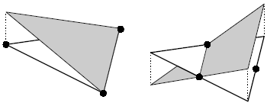
Shape function
Used to approximate the unknown function
Although usually used within each individual elements, shape function is global not local!
Must be sufficiently smooth to allow integration by part in weak formulation
Mapping between local and global coordinates
Assembly of global matrix
x
1
j-1
j
j+1
N
x
Conformal
Non-conformal
1
j-1
j
j+1
N
(Elevation)
(optional velocity)

Slide 21
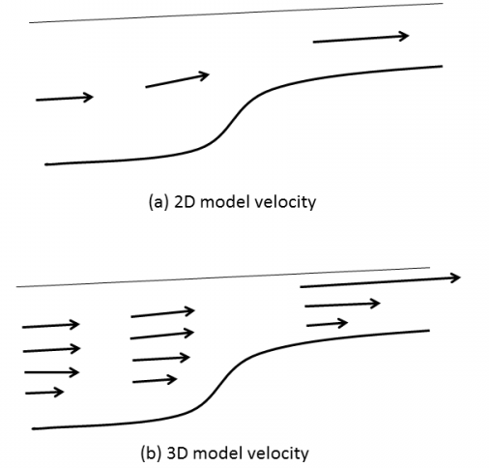


Matrices: I₁
$$\check{H}$$
i34(j)
$$\check{H}$$
Ω_{j}
i
i’ is local index of node i in Ω_{j}.
reaches its max when i’=l, and so does I₁.
i’
so diagonal is dominant if the averaged friction-reduced depth ≥0 (can be relaxed)
Mass matrix is positive definite and symmetric! JCG solver
(i’,1)
>
(i’,2)
Notes:
The conditioning of the matrix is related to depth and wet/dry – complex issue. Physically….

Slide 22
Matrices: I₃ and I₅
n
j
Γ_{ij}
i
Flather b.c. (overbar denotes mean)
j
Similarly

Slide 23

Matrices: I₇
Related to source/sink
B_{i}: ball of node i
UΩ_{m}: elements that have source/sink
S_{j}: volume discharge rate [m³/s]

Slide 24
Matrices: I₄
Has most complex form
i34(j)
We have decomposed vector f into two parts: one for averaging and the other for integration
Most complex part is the baroclinicity
at elements/sides

Slide 25
Baroclinicity: z-method
Interpolate density along horizontal planes
  Advantage: alleviate pressure gradient errors (Fortunato and Baptista 1996)
  Disadvantage: near surface or bottom
Density is defined at prism centers (half levels)
Re-construction method: compute directional derivatives along two direction at node i and then convert them back to x,y
Density gradient calculated at prism centers first (for continuity eq.); the values at face centers are averaged from those at prism centers (for momentum eq.)
  constant extrapolation (shallow) is used near bottom (under resolution)
  Cubic spline is used in all interpolations of ρ
  Mean density profile can be optionally removed
3/4 eqs for the density gradient vs. 2 unknowns – averaging needed for 3 pairs; e.g.
  Degenerate cases: when the two vectors are co-linear (discard)
  Vertical integration using trapzoidal rule
B
3
1
0
Element j
A
2

Slide 26
Momentum equation
(u,v) solved at side centers and whole levels
  Ease of imposing b.c.
Galerkin FE in the vertical
g
The matrix is tri-diagonal (Neumann b.c. can be imposed easily)
N_{z}
……..
Solution at bottom from the b.c. there (u=0 for χ≠0); otherwise free slip
k_{b}+2
k_{b}+1
δ_{b}
z=-h
k_{b}

Slide 27
Velocity at nodes
Needed for ELM (interpolation)
Method 1: inverse-distance averaging around ball (indvel=1) – more dissipation
Method 2: use linear shape function (conformal); averaging for conformal (indvel=0)
  Discontinuous across elements
  Filtering of modes: viscosity or Shapiro filter
  Needs velocity b.c.
  indvel=0 generally gives less dissipation but needs viscosity or filter for stabilization (important for eddying regime)
i
3
II
I
1
III
2
Diffusion vs dispersion

Slide 28
Shaprio filter
A simple filter to reduce sub-grid scale (unphysical) oscillations while leaving the physical signals intact (α=0.5 optimal)
1
4
0
No filtering for boundary sides – need b.c. there especially for incoming flow
3
2

Slide 29
Horizontal viscosity
Important for eddying regime for adding proper dissipation
P
1
4
1
x,η
6
y,ξ
Assuming uniformity
Q
I
0
x
II
S
2
x
0
5
2
3
I
II
(like Shapiro filter)
R
3
4
Bi-harmonic viscosity (ideal in eddying regime)
1a
4b
1b
1
4
4a
0
x
2a
2
3
3b
2b
3a
(Zhang et al. 2016)

Slide 30
Vertical velocity
Vertical velocity using Finite Volume
i34(j)
n_{k+1}
Bottom b.c.
k+1
Surface b.c. not enforced
k

Slide 31

Inundation algorithms
Algorithm 1 (inunfl=0)
  Update wet and dry elements, sides, and nodes at the end of each time step based on the newly computed elevations. Newly wetted vel., S,T etc calculated using average
Algorithm 2 (inunfl=1; accurate inundation for wetting and drying with sufficient grid resolution)
  Wet → add elements & extrapolate velocity
  Dry → remove elements
  Iterate until the new interface is found at step n+1
  Extrapolate elevation at final interface (smoothing effects)
dry
A
Γ^{n}
B
wet
Extrapolation of surface

Slide 32
Transport: upwind (1)
j
S
k
S
T_{i,k}
k-1
(sources: bdy_frc, flx_sf and flx_bt)
T_{i*}
Finite volume discretization in a prism (i,k): mass conservation
i34(j)+2
^
m≠n, Δt’ ≠ Δt;
T_{i}=T_{i,k;}
u_{j} is outward normal velocity
i34(j)
Focus on the advection first
From continuity equation
S⁺: outflow faces; S ⁻: inflow faces
Upwinding

Slide 33
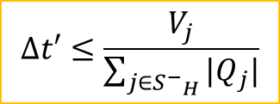

Transport: upwind (2)
S
k
j
Drop “m” for brevity (and keep only advection terms)
S
T_{i,k}
k-1
S
Max. principle is guaranteed if
$1−\frac{{∆t}^{′}}{V_{i}}\sum_{j∈S^{−}}{|Q_{j}|≥0\underset{⇒}{}}$ $∆t′≤\frac{V_{j}}{\sum_{j∈S^{−}}{|Q_{j}|}}$
Courant number condition (3D case)
Global time step for all prisms
Implicit treatment of vertical advective fluxes to bypass vertical Courant number restriction in shallow depths
$$∆t′≤\frac{V_{j}}{\sum_{j∈{S^{−}}_{H}}{|Q_{j}|}}$$
(Modified Courant number condition)
Mass conservation
Budget – vertical and horizontal sums
movement of free surface: small conservation error
Includes source/sink

Slide 34
Solar radiation
total solar radiation
Budget
The source term in the upwind scheme (F.D.)
Assume the heat is completely absorbed by the bed (black body) to prevent overheating in shallow depths

Slide 35
Transport: TVD²
Solve the transport eq in 3 sub-steps:
Horizontal advection (TVD method)
Vertical advection (TVD²)
Remaining (implicit diffusion)
Taylor expansion in space and time
Duraisamy and Baeder (2007)
Space limiter
Time limiter

Slide 36
TVD²
Upwind ratio
Downwind ratio
Iterative solver converges very fast
2nd-order accurate in space and time
Monotone
Alleviate the sub-cycling/small dt for transport that plagued explicit TVD
Can be used at any depths!
TVD condition:
(iterative solver)

Slide 37
Turbulence closure (itur=3)
Essential b.c.
Natural b.c.
FE formulation
k, ψ and diffusivities are defined at nodes and whole levels
Use natural b.c. first and essential b.c. is used to overwrite the solution at boundary
Neglect advection
The production and buoyancy terms are treated explicitly or implicitly depending on the sum to enhance stability

Slide 38
Turbulence closure (itur=3)

Slide 39
Turbulence closure

Slide 40
GOTM turbulence library
General Ocean Turbulence Model
One-dimensional water column model for marine and limnological applications
Coupled to a choice of traditional as well as state-of-the-art parameterizations for vertical turbulent mixing (including KPP)
Some perplexing problems on some platforms – robustness?
  Bugs page
  Division by 0?
www.gotm.net

Slide 41
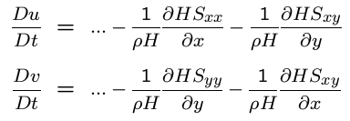
Radiation stress
S_{xx} etc are functions of wave energy, which is integrated over all freq. and direction

Slide 42
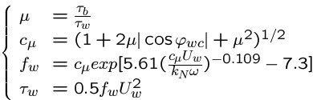
WBBL (Grant-Madsen)
Wave-current friction factor
Ratio of shear stresses
angle between bottom current and dominant wave direction
τ_{b}: current induced bottom stress
U_{w}: orbital vel. amplitude
ω: representative angular freq.
The nonlinear eq. system is solved with a simple iterative scheme starting from μ=0 (pure wave), c_{μ}=1. Strong convergence is observed for practical applications

Slide 43
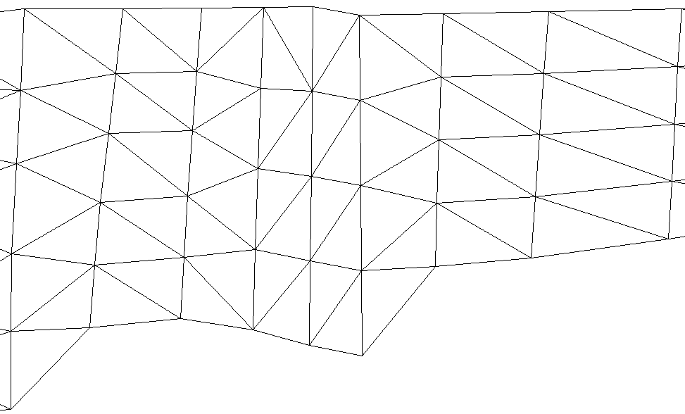
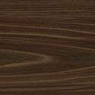
Hydraulics
Q
Faces (Γ^{b})
1
2
1
1’
2
2’
3
3’
4
4’
5
5’
1-1’ etc are node pairs
Block (Ω^{b})
The 2 ‘upstream’ and ‘downstream’ reference nodes on each side of the structure are used to calculate the thru flow Q

Slide 44
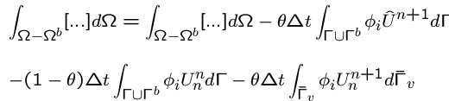
Hydraulics
The differential-integral eq. for continuity eq. is modified as
And for the momentum eq.
Add Γ^{b} as a horizontal boundary in backtracking
At Γ^{b} and also for all internal sides in Ω^{b}, the side vel. is imposed from Q – like an open bnd (add to I₃ and I₅)

Slide 45
SCHISM flow chart
Initialization
or hot start
end
yes
forcings
no
backtracking
Completed?
output
Turbulence
closure
Update levels
& eqstate
Transport
Preparation
(wave cont.)
Momentum
eq.
w
solver
Notes:
Numbers depend on specific set up also

Slide 46
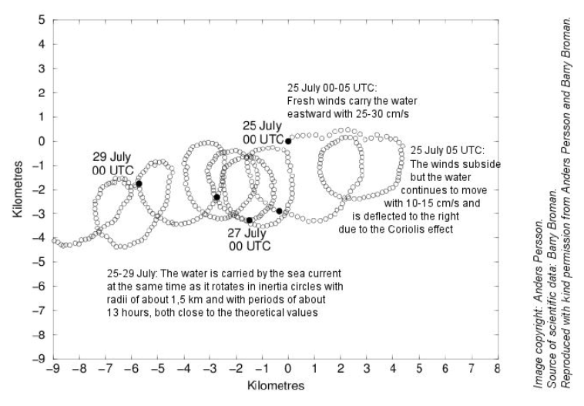
Numerical stability
Semi-implicitness circumvents CFL (most severe) (Casulli and Cattani 1994)
ELM bypasses Courant number condition for advection (actually CFL>0.4)
Implicit TVD² transport scheme along the vertical bypasses Courant number condition in the vertical
Explicit terms
  Baroclinicity → internal Courant number restriction (usually not a problem)
  Horizontal viscosity/diffusivity → diffusion number condition (mild)
  Upwind and TVD² transport: horizontal Courant number condition → sub-cycling
  Coriolis – “inertial modes” (Danilov 2013); needs to be controlled by viscosity/filter for large-scale (deep ocean) applications

Slide 47

Lateral b.c. and nudging
bctides.in
param.in
Variable | Type 1 (*.th) | Type 2: | Type 3 | Type 4 (*[23]D.th) | Type 5 | Type -1 | Type -4, -5 (uv3D.th); nudging | Nudging/sponge layer near bnd
η | elev.th: Time history; uniform along bnd | constant | Tidal amp/phases | elev2D.th: time- and space-varying along bnd | elev2D.th: combination of 3&4 | Must =0
S&T, tracers | [MOD].th: relax to time history (uniform along bnd) for inflow | Relax to constant for inflow | Relax to i.c. for inflow | [MOD]_3D.th: relax to time- and space-varying values along bnd during inflow
u,v | flux.th: via discharge (<0 normally!) | Via discharge (<0 normally!) | Tides (uniform amp/phase along bnd) | uv3D.th: time- and space-varying along bnd (in lon/lat for ics=2) | uv3D.th: combination of 3&4 (but tidal amp/phases vary along bnd) | Flather (‘0’ for η) | Relax to uv3D.th (2 separate relaxations for in & outflow)

Slide 48
4H of SCHISM
Hybrid FE-FV formulation
Hybrid horizontal grid
Hybrid vertical grid
Hybrid code (openMP-MPI)

