Slide 1
Using SCHISM
Online manual and wiki resource: www.schism.wiki
It helps if you know a few programming/scripting languages: python, matlab, FORTRAN/C…
Bare minimum
  Generate a hgrid.gr3 with simplest possible b.c.
  Run SCHISM in 2D config: manning.gr3, param.in, bctides.in, vgrid.in
  Pre-processing with ipre=1 first (with 1 CPU) to catch grid issues
  Then proceed to more complex set-ups

Slide 2
Post-processing and visualization
Combining binary outputs (MPI): FORTRAN & perl script in Utility/Combining_Scripts/)
Visualization (online demo)
  xmgredit
  xmvis6
  python (will replace ACE eventually)
  VisIT: up to date and can viz shaved cells; not very easy to install on linux
  matlab (needs update)
  GIS and google earth based
Extracting time series: vertical profiles, horizontal slabs, transects
  station outputs (easiest)
  FORTRAN scripts: must wait until outputs are combined; more flexible
  Linear interpolation in 3D (vs nearest neighbor in some other models)
  calculation of z-coordinates consistent with SCHISM code
  beware wet/dry interpolation
Residuals, harmonics analysis
ACE

Slide 3
SCHISM input types: glossary
*.gr3: grid-like files (node centered)
hgrid.ll: lon/lat form of horizontal grid
*.th: time history (b.c.)
*.ic: initial condition for elev, tracers
*.prop: element centered (property)
sflux/: atmos. forcings
*.in: vgrid; hotstart; parameters; b.c.; nudging files
Modules: gotmturb.inp, .nml ….
Bare minimum (mandatory) for pre-processing (ipre=1)
  hgrid.gr3 (and hgrid.ll if you are using some modules): no need for correct bathymetry & boundaries yet
  vgrid.in (1 layer for 2D)
  param.in
  bctides.in (may be fake)
  drag.gr3/rough.gr3/manning.gr3
Pre-processing
  Prepare the mandatory input files, and set ipre=1 in param.in
  Run SCHISM with 1 CPU only
  Check fort.11 for fatal errors (e.g. grids)
  Rectify grid/inputs errors and repeat until pre-processing is successful

Slide 4
.gr3 and .ll files
Your comments
44343 24025
1 -90.4293 30.1689 0.30
2 -90.4313 30.1625 0.30
3 -90.4327 30.1559 0.20
4 -90.4320 30.1498 0.20
………………………………………
1 3 1 2 3
2 3 2 4 5
3 3 15943 16197 15942
………………………………………
Except in hgrid.gr3 and hgrid.ll, only depth info is used
nodes
elements
2 = Number of open boundaries
69 = Total number of open boundary nodes
4 = Number of nodes for open boundary 1
1
2
3
4
………………………………………
12 = number of land boundaries
1756 = Total number of land boundary nodes
737 0 = Number of nodes for land boundary 1
29368
29421
29420
29467
………………………………………
Boundary info
(hgrid.gr3 only)

Slide 5
.bp format
Your comments
24025
1 -90.4293 30.1689 0.30
2 -90.4313 30.1625 0.30
3 -90.4327 30.1559 0.20
4 -90.4320 30.1498 0.20
………………………………………
24025 -89.01 35.71 10.5
points
Alternative: .sta

Slide 6
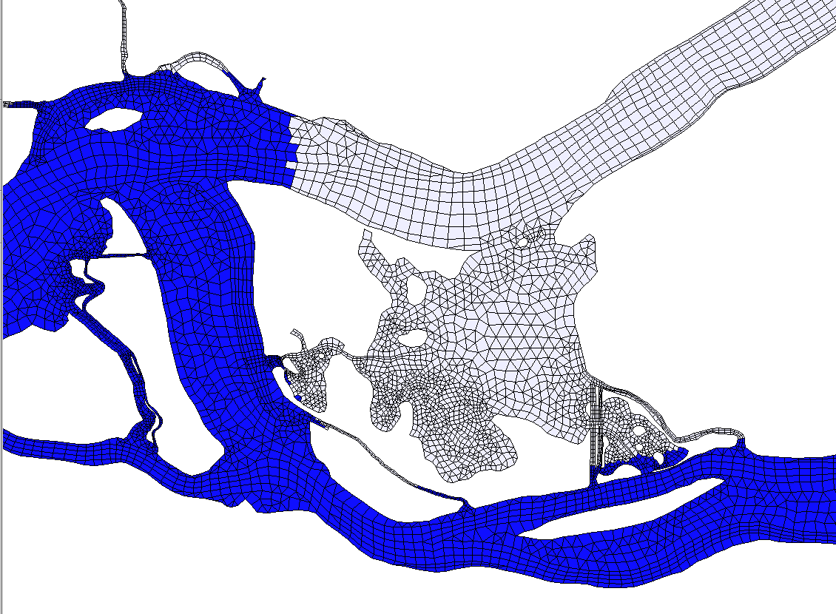
.prop format
1 0.0000000E+00
2 0.0000000E+00
3 0.0000000E+00
4 0.0000000E+00
5 0.0000000E+00
6 0.0000000E+00
7 0.0000000E+00
8 0.0000000E+00
9 1.0000000E+00
10 1.0000000E+00
11 0.0000000E+00
12 0.0000000E+00
13 0.0000000E+00
14 0.0000000E+00
15 0.0000000E+00
16 0.0000000E+00
17 0.0000000E+00
18 0.0000000E+00
19 1.0000000E+00
20 0.0000000E+00
21 0.0000000E+00
22 1.0000000E+00
23 0.0000000E+00
…………………..
‘Color’ each element

Slide 7
vgrid.in: SZ
2 ! ivcor
28 18 100. !h_{s}
Z levels
-5000.
……..
-100.00
S levels
30. 0.9 3. !h_{c} , θ_{b} , θ_{f}
18 -1
19 -0.9
……..
28 0.
Bottom z
Last z
1st σ
Pure S zone
Surface σ
z
σ zone
S zone
SZ zone
N_{z}
σ=0
h_{c}
h_{s}
h_{s}
S-levels
k^{z}
σ=-1
k^{z}−1
Z-levels
2
1

Slide 8
vgrid.in: LSC²
Needs script to generate (gen_vqs.f90 in Utility)
Make sure you visualize a few transects using plot_vqs.m
1 !ivcor
42 !nvrt
1 37 -1.000000 -0.703456 -0.665960 -0.369236 -0.167103 0.000000
2 37 -1.000000 -0.703456 -0.665960 -0.369236 -0.167103 0.000000
………………………….
233 37 -1.000000 -0.703456 -0.665960 -0.369236 -0.167103 0.000000
234 37 -1.000000 -0.703456 -0.665960 -0.369236 -0.167103 0.000000
235 37 -1.000000 -0.703456 -0.665960 -0.369236 -0.167103 0.000000
236 34 -1.000000 -0.749747 -0.562022 -0.419538 -0.309461 -0.222147 -0.136640 -0.065220 0.000000
237 34 -1.000000 -0.754543 -0.570416 -0.430663 -0.322695 -0.237054 -0.144453 -0.068642 0.000000
………………………….
Node #
Bottom
index
Bottom σ
Surface σ

Slide 9
bctides.in
04/15/2004 00:00:00 PST
0 40. ntip
2 nbfr
Z0
0. 1. 0.
O1
6.759775e-05 1.15343 118.92151
4 nope
3 3 0 4 0 !Georgia
Z0
0.1299680 0.000000E+00
0.1299680 0.000000E+00
0.1299680 0.000000E+00
O1
0.361010246 281.862898
0.36065857 281.918305
0.360767938 281.968364
1.e-3 T relaxation
88 3 0 0 0 !ocean
Z0
8.892417E-02 0.000000E+00
8.631096E-02 0.000000E+00
........................
O1
.........................
A simple example
12/01/2013 00:00:00 GMT
0 50. ntip
0 nbfr
2 !nope
1190 4 4 4 4 3 !Pacific
5.e-1
5.e-1
1.
139 4 4 4 4 3 !South China Sea
5.e-1
5.e-1
1.
Extra b.c. flags for tracer models if invoked
Phases don’t matter for Z0
b.c. flag for enabled tracer module (SED in this case)
There is a way to cheat if you really cannot find the issue….
B.C. flags drives additional inputs .th

Slide 10
param.in
Free format rules:
  Lines beginning with "!" are comments; blank lines are ignored;
  one line for each parameter in the format: keywords= value;
keywords are case sensitive; spaces allowed between keywords and "=" and
value; comments starting with "!" allowed after value;
  value is an integer, double, or 2-char string; for double, any of the format is acceptable: 40 40. 4.e1; use of decimal point in integers is OK but discouraged;
  Order of parameters not important
!+++++++++++++++++++++++++++++++++++++++++++++++++++++++++++++++++++++++
! Model configuration parameters
!+++++++++++++++++++++++++++++++++++++++++++++++++++++++++++++++++++++++
!-----------------------------------------------------------------------
! Pre-processing option. Useful for checking grid violations and get sample z coordinates (sample_z.out)
!-----------------------------------------------------------------------
ipre = 0 !Pre-processor flag (1: on; 0: off)
!-----------------------------------------------------------------------
! Bed deformation option (1: on; 0: off). If imm=1, bdef.gr3 is needed.
!-----------------------------------------------------------------------
imm = 0
! ibdef = 10 !needed if imm=1; # of steps used in deformation

Slide 11
param.in
!-----------------------------------------------------------------------
! Coordinate option: 1: Cartesian; 2: lon/lat (hgrid.gr3=hgrid.ll in this case,
! and orientation of triangles is outward of earth)
!-----------------------------------------------------------------------
ics = 1 !Coordinate option
cpp_lon = -124 !CPP projection centers: lon; not used if ics=2
cpp_lat = 46.25 !CPP projection centers: lat
!-----------------------------------------------------------------------
! Baroclinic/barotropic option. If ibcc=0 (baroclinic model), itransport is not used.
!-----------------------------------------------------------------------
ibcc = 0 !Baroclinic option
itransport = 1
nrampbc = 1 !ramp-up flag for baroclinic force
drampbc = 1. !not used if nrampbc=0
!-----------------------------------------------------------------------
! Hotstart option. 0: cold start; 1: hotstart with time reset to 0; 2:
! continue from the step in hotstart.in
!-----------------------------------------------------------------------
ihot = 1
!-----------------------------------------------------------------------
! Hydraulic model option. If ihydraulics/=0, hydraulics.in
! is required. This option cannot be used with non-hydrostatic model.
!-----------------------------------------------------------------------
ihydraulics = 0
!-----------------------------------------------------------------------
! Point sources/sinks option (0: no; 1: on). If =1, needs source_sink.in,
! vsource,th, vsink.th, and msource.th
!-----------------------------------------------------------------------
if_source = 0
SCHISM can use lon/lat even for high-resolution inundation study
ihot=2
t=0
t₁
ihot=1

Slide 12
param.in
!-----------------------------------------------------------------------
! If WWM is used, set coupling/decoupling flag. Not used if USE_WWM is distabled in Makefile
! 0: decoupled so 2 models will run independently;
! 1: full coupled (elevation, vel, and wind are all passed to WWM);
! 2: elevation and currents in wwm, no wave force in SCHISM;
! 3: no elevation and no currents in wwm, wave force in SCHISM;
! 4: elevation but no currents in wwm, wave force in SCHISM;
! 5: elevation but no currents in wwm, no wave force in SCHISM;
! 6: no elevation but currents in wwm, wave force in SCHISM;
! 7: no elevation but currents in wwm, no wave force in SCHISM;
! Note that all these parameters must be present in this file (even though not used).
!-----------------------------------------------------------------------
icou_elfe_wwm = 1
nstep_wwm = 1 !call WWM every this many time steps. If /=1, consider using quasi-steady mode in WWM
iwbl = 1 !1: modified Grant-Madsen formulation for wave boundary layer; used only if icou_elfe_wwm/=0; if icou_elfe_wwm=0, set iwbl=0
msc2 = 24 !same as MSC in .nml ... for consitency check between SCHISM and WWM-II
mdc2 = 30 !same as MDC in .nml

Slide 13
param.in
!-----------------------------------------------------------------------
! Define # of tracers in each module (if enabled)
!-----------------------------------------------------------------------
ntracer_gen = 2 !user defined module
ntracer_age = 4 !age calculation. Must be =2*N where N is # of age tracers
sed_class = 3 !SED3D (USE_SED on)
eco_class = 27 !EcoSim: must be between [25,60]
!-----------------------------------------------------------------------
! Initial condition for T,S. This value only matters for ihot=0 (cold start).
! If ic_*=1, the initial T,S field is read in from temp.ic and salt.ic (horizontally varying).
! If ic_*=2, the initial T,S field is read in from ts.ic (vertical varying).
! If ihot=0 && ic_*=2 || ibcc_mean=1, ts.ic is used for removing mean density profile.
!-----------------------------------------------------------------------
ic_TEM = 1
ic_SAL = 1 !must be same as ic_TEM
! initial conditions for other tracers.
! 1: needs inputs [MOD]_hvar_[1,2,...].ic ('1...' is tracer id); format of each file is similar to salt.ic;
! i.e. horizontally varying i.c. is used for each tracer.
! 2: needs [MOD]_vvar_[1,2,...].ic. Format of each file (for each tracer in tis MOD) is similar to ts.ic
! (i.e. level #, z-coord., tracer value). Verically varying i.c. is used for each tracer.
! 0: model sets own i.c. (EcoSim; TIMOR)
ic_GEN = 1 !user defined module
ic_AGE = 1 !Age
ic_SED = 1 !SED3D
ic_ECO = 1 !EcoSim
ic_ICM = 1 !ICM
ic_COS = 1 !CoSINE
ic_FIB = 1 !FIB

Slide 14
Control of dissipation in momentum
!-----------------------------------------------------------------------
! Methods for computing velocity at nodes.
! If indvel=0, conformal linear shape function is used; if indvel=1, averaging method is used.
! For indvel=0, some stabilization method is needed (see below).
!-----------------------------------------------------------------------
indvel = 0
!-----------------------------------------------------------------------
! 2 stabilization methods, mostly for indvel=0.
! (1) Horizontal viscosity option. ihorcon=0: no viscosity is used; =1: Lapacian;
! =2: bi-harmonic. If ihorcon=1, horizontal viscosity _coefficient_ (<=1/8, related
! to diffusion number) is given in hvis_coef0, and the diffusion #
! is problem dependent; [0.001-1/8] seems to work well.
! If ihorcon=2, diffusion number is given by hvis_coef0 (<=0.025).
! If indvel=1, no hvis is needed.
! (2) Shapiro filter (see below)
!-----------------------------------------------------------------------
ihorcon = 0
hvis_coef0 = 0.025 !const. diffusion # if ihorcon/=0; <=0.025 for ihorcon=2, <=0.125 for ihorcon=1
! cdh = 0.01 !needed only if ihorcon/=0; land friction coefficient - not active yet
!-----------------------------------------------------------------------
! 2nd stabilization method via Shapiro filter. This should normally be used
! if indvel=ihorcon=0. To transition between eddying/non-eddying regimes, use
! indvel=0, ihorcon/=0, and ishapiro=-1 (shapiro.gr3).
!-----------------------------------------------------------------------
ishapiro = 1 !on/off flag
shapiro = 0.5 !Shapiro filter strength, needed only if ishapiro=1; max is 0.5
!-----------------------------------------------------------------------
! Horizontal diffusivity option. if ihdif=1, horizontal diffusivity is given in hdif.gr3
!-----------------------------------------------------------------------
ihdif = 0
Important for eddying regime

Slide 15
param.in
!-----------------------------------------------------------------------
! Bottom friction.
! 2D model: bfric=-1, and needs manning.gr3 (Manning's n) and hmin_man below;
! 3D model: bfric=0: drag coefficients specified in drag.gr3; bfric=1:
! bottom roughness (in meters) specified in rough.gr3 (and in this case, negative
! or 0 depths in rough.gr3 indicate time-independent Cd, not roughness!)
! If iwbl=1, bfric must =1.
!-----------------------------------------------------------------------
bfric = 1 !nchi in code; must be -1 for 2D model
dzb_min = 0.5 !needed if bfric=1; min. bottom boundary layer thickness [m]. (analogous to Z)
dzb_decay = -3.4539 !needed if bfric=1; a decay const. [-]
!hmin_man = 1 !needed if bfric=-1; min. depth used in Manning's formulation (suggest: 1m)
!-----------------------------------------------------------------------
! Coriolis. If ncor=-1, specify "lattitude" (in degrees); if ncor=0,
! specify Coriolis parameter in "coriolis"; if ncor=1, model uses
! lat/lon in hgrid.ll for beta-plane approximation if ics=1, and in this case,
! the lattitude specified in CPP projection ('cpp_lat') is used. If ncor=1 and ics=2,
! cpp_lat is not used.
!-----------------------------------------------------------------------
ncor = 1 !must be 1 if ics=2
!latitude = 46 !if ncor=-1
!coriolis = 1.e-4 !if ncor=0
If bfric=1
Cd=Cdmax*exp[dzb_decay*(1-max(dzb,dtb_min)/dzb_min)]

Slide 16
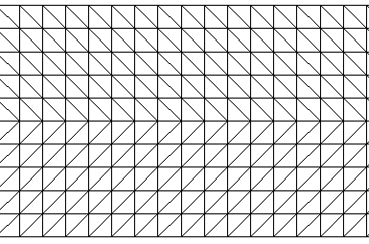
Developer’s own…
!-----------------------------------------------------------------------
! Mean T,S profile option. If ibcc_mean=1 (or ihot=0 and icst=2), mean profile
! is read in from ts.ic, and will be removed when calculating baroclinic force.
! No ts.ic is needed if ibcc_mean=0.
!-----------------------------------------------------------------------
ibcc_mean = 0
!-----------------------------------------------------------------------
! Max. horizontal velocity magnitude, used mainly to prevent problem in
! bulk aerodynamic module
!-----------------------------------------------------------------------
rmaxvel = 10.
!-----------------------------------------------------------------------
! Following 2 parameters control backtracking
!-----------------------------------------------------------------------
!-----------------------------------------------------------------------
! min. vel for invoking btrack and for abnormal exit in quicksearch
!-----------------------------------------------------------------------
velmin_btrack = 1.e-4
!-----------------------------------------------------------------------
! Nudging factors for starting side/node - add noise to avoid underflow
! The starting location is nudged to: old*(1-btrack_nudge)+btrack_nudge*centroid
! Suggested value: btrack_nudge=9.013e-3
!-----------------------------------------------------------------------
btrack_nudge= 9.013e-3

Slide 17
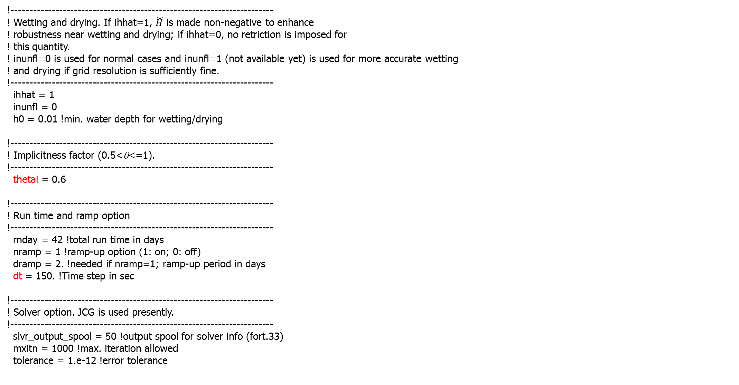
param.in
!-----------------------------------------------------------------------
! Wetting and drying. If ihhat=1, $\check{H}$ is made non-negative to enhance
! robustness near wetting and drying; if ihhat=0, no retriction is imposed for
! this quantity.
! inunfl=0 is used for normal cases and inunfl=1 (not available yet) is used for more accurate wetting
! and drying if grid resolution is sufficiently fine.
!-----------------------------------------------------------------------
ihhat = 1
inunfl = 0
h0 = 0.01 !min. water depth for wetting/drying
!-----------------------------------------------------------------------
! Implicitness factor (0.5<θ<=1).
!-----------------------------------------------------------------------
thetai = 0.6
!-----------------------------------------------------------------------
! Run time and ramp option
!-----------------------------------------------------------------------
rnday = 42 !total run time in days
nramp = 1 !ramp-up option (1: on; 0: off)
dramp = 2. !needed if nramp=1; ramp-up period in days
dt = 150. !Time step in sec
!-----------------------------------------------------------------------
! Solver option. JCG is used presently.
!-----------------------------------------------------------------------
slvr_output_spool = 50 !output spool for solver info (fort.33)
mxitn = 1000 !max. iteration allowed
tolerance = 1.e-12 !error tolerance

Slide 18
param.in
!-----------------------------------------------------------------------
! Advection (ELM) option. If nadv=1, backtracking is done using Euler method;
! nadv=2, using 2nd order Runge-Kutta; if nadv=0, advection in momentum
! is turned off/on in adv.gr3 (the depths=0,1, or 2 also control methods
! in backtracking as above). dtb_max/min are the max/min steps allowed -
! actual step is calculated adaptively based on local flow gradient.
!-----------------------------------------------------------------------
nadv = 1
dtb_max = 50. !in sec
dtb_min = 15.
!-----------------------------------------------------------------------
! If inter_mom=0, linear interpolation is used for velocity at foot of char. line.
! If inter_mom=1 or -1, Kriging is used, and the choice of covariance function is
! specified in 'kr_co'. If inter_mom=1, Kriging is applied to whole domain;
! if inter_mom=-1, the regions where Kriging is used is specified in krvel.gr3
! (depth=0: no kriging; depth=1: with kriging).
!-----------------------------------------------------------------------
inter_mom = 0
kr_co = 1 !not used if inter_mom=0 (-h, h²log(h), h³, -h⁵)
Also dependent on indvel

Slide 19
param.in
!-----------------------------------------------------------------------
! Transport method.
! If itr_met=1, upwind method is used. If itr_met>=2, TVD or WENO method is used
! on an element/prism if the total depth (at all nodes of the elem.)>=h_tvd and the flag in
! tvd.prop = 1 for the elem. (tvd.prop is required in this case);
! otherwise upwind is used for efficiency.
! itr_met=3 (horizontal TVD) or 4 (horizontal WENO -incomplete): implicit TVD in the vertical dimension.
! Also if itr_met>=3 and h_tvd>=1.e5, some parts of the code are bypassed for efficiency
!-----------------------------------------------------------------------
itr_met = 3
h_tvd = 5. !used only if itr_met>=2; cut-off depth (m)
!If itr_met=3 or 4, need the following 2 tolerances of convergence. The convergence
!is achieved when sqrt[\sum_i(T_i^s+1-T_i^s)^2]<=eps1_tvd_imp*sqrt[\sum_i(T_i^s)^2]+eps2_tvd_imp
eps1_tvd_imp = 1.e-4 !suggested value is 1.e-4, but for large suspended load, need to use a smaller value (e.g. 1.e-9)
eps2_tvd_imp = 1.e-14
!-----------------------------------------------------------------------
! Atmos. option. If nws=0, no atmos. forcing is applied. If nws=1, atmos.
! variables are read in from wind.th. If nws=2, atmos. variables are
! read in from sflux_ files.
! If nws=4, ascii format is used for wind and atmos. pressure at each node (see source code).
! If nws>0, 'iwindoff' can be used to scale wind speed (with windfactor.gr3).
!
! Stress calculation:
! If nws=1 or 4, or nws=2 and ihconsv=0, or nws=2 and iwind_form=-1,
! the stress is calculated from Pond & Pichard formulation
! If nws=2, ihconsv=1 and iwind_form=0, the stress is calculated from heat exchange
! routine;
! If WWM is enabled and icou_elfe_wwm>0 and iwind_form=-2, stress is calculated by WWM;
! otherwise the formulations above are used.
!-----------------------------------------------------------------------
nws = 2 !must /=3 for 2D model. If =2, needs windrot_geo2proj.gr3
wtiminc = 150. !time step for atmos. Forcing; must ≥dt
nrampwind = 1 !ramp-up option for atmos. forcing
drampwind = 2. !needed if nrampwind/=0; ramp-up period in days
iwindoff = 0 !needed only if nws/=0; '1': needs windfactor.gr3
iwind_form = -1

Slide 20
param.in
!-----------------------------------------------------------------------
! Turbulence closure.
!-----------------------------------------------------------------------
itur = 3
! dfv0 = 0
! dfh0 = 0
turb_met = KL
turb_stab = KC
xlsc0 = 0.1
!-----------------------------------------------------------------------
! Heat and salt exchange. isconsv=1 needs ihconsv=1; ihconsv=1 needs nws=2.
! If isconsv=1, need to compile with precip/evap module turned on.
!-----------------------------------------------------------------------
ihconsv = 1 !heat exchange option. If on, needs: albedo.gr3, watertype.gr3
isconsv = 0 !evaporation/precipitation model
3 or 4: needs diffmax.gr3,diffmin.gr3

Slide 21
param.in
!-----------------------------------------------------------------------
! Sponge layer for elevation and vel.
! If inu_elev=0, no relaxation is applied to elev.
! If inu_elev=1, relax. constants are specified in elev_nudge.gr3
! and applied to eta=0 (thus a depth=0 means no relaxation).
! Similarly for inu_uv (with input uv_nudge.gr3)
!-----------------------------------------------------------------------
inu_elev = 0
inu_uv = 0
!-----------------------------------------------------------------------
! Nudging options for tracers. If inu_[MOD]=0, no nudging is used. If inu_[MOD]=1,
! nudge to initial condition according to relaxation constants specified
! in [MOD]_nudge.gr3. If inu_[MOD]=2, nudge to values in [MOD]_nu,in
! (with step 'step_nu_tr') according to [MOD]_nudge.gr3.
! The final relaxation = horizontal relax (specified in [MOD]_nudge.gr3) times dt.
! [MOD] are tracer model names.
!-----------------------------------------------------------------------
inu_TEM = 2
inu_SAL = 2
inu_GEN = 0 !user defined
inu_AGE = 0 !Age
inu_SED = 0 !SED3D
inu_ECO = 0 !EcoSim
inu_ICM = 0 !ICM
inu_COS = 0 !CoSINE
inu_FIB = 0 !FIB
step_nu_tr = 86400. !time step [sec] in all [MOD]_nu.in (for inu_[MOD]=2)
For each tracer module; needs [MOD]_nu.in for ‘2’

Slide 22
param.in
!-----------------------------------------------------------------------
! Cut-off depth for cubic spline interpolation near bottom when computing horizontal gradients
! using hgrad_nodes() (radiation stress).
! If depth > depth_zsigma ('deep'),
! a min. (e.g. max bottom z-cor for the element) is imposed in the spline and so a more
! conservative method is used without extrapolation beyond bottom;
! otherwise constant extrapolation below bottom is used.
!-----------------------------------------------------------------------
depth_zsigma = 100. !h_bcc1
!-----------------------------------------------------------------------
! Dimensioning parameters for inter-subdomain btrack.
!-----------------------------------------------------------------------
s1_mxnbt = 0.5
s2_mxnbt = 3.0

Slide 23
param.in
!-----------------------------------------------------------------------
! Option for hotstart outputs (use combine_hotstart*.f90 to combine)
!-----------------------------------------------------------------------
hotout = 1 !1: output *_hotstart every 'hotout_write' steps
hotout_write = 4032 !divisible by ihfskip
!-----------------------------------------------------------------------
! Global output options.
!-----------------------------------------------------------------------
nspool = 6 !output step spool
ihfskip = 576 !stack spool; every ihfskip steps will be put into 1_*, 2_*, etc...
elev.61 = 1 !0: off; 1: on
pres.61 = 1
airt.61 = 1
shum.61 = 1
srad.61 = 1
flsu.61 = 1
fllu.61 = 1
radu.61 = 1
radd.61 = 1
flux.61 = 1
evap.61 = 0
prcp.61 = 0
wind.62 = 1
wist.62 = 0
dahv.62 = 0
vert.63 = 1
temp.63 = 1
salt.63 = 1
conc.63 = 0
tdff.63 = 1
vdff.63 = 0
kine.63 = 0
mixl.63 = 0
zcor.63 = 1
hvel.64 = 1
!-----------------------------------------------------------------------
! Outputs for (age)
!-----------------------------------------------------------------------
AGE_1.63 = 0 !indices from "1" to "ntr/2"; [days]
AGE_2.63 = 0
!-----------------------------------------------------------------------
! Specific outputs in SED3D (USE_SED must be on in Makefile;
! otherwise these are not needed)
!-----------------------------------------------------------------------
SED_1.63 = 0 !conc. of 1st class (one output need by each class) [g/L]
SED_2.63 = 0
SED_bfrac_1.61 = 0 ! Bed fraction 1st tracer (one output need by each class) [-]
SED_bfrac_2.61 = 0
SED_qbdl_1.62 = 0 ! Bedload transport rate (kg.m-1.s-1) for 1st tracer (one output need by tracer)
SED_qbdl_2.62 = 0
……
!-----------------------------------------------------------------------
! Non-standard outputs section. Some of these need corresponding cpp flags
! to be on in order to be active (will become default after we migrate to nc outputs)
!-----------------------------------------------------------------------
hvel.67 = 0 !horizontal vel. defined at side [m/s]
vert.69 = 0 !vertical vel. at centroids [m/s]
temp.70 = 0 !T at prism centers [C]
salt.70 = 0 !S at prism centers [PSU]
z0st.66 = 0 ! Sediment transport roughness length (m) {module: SED}
……

Slide 24
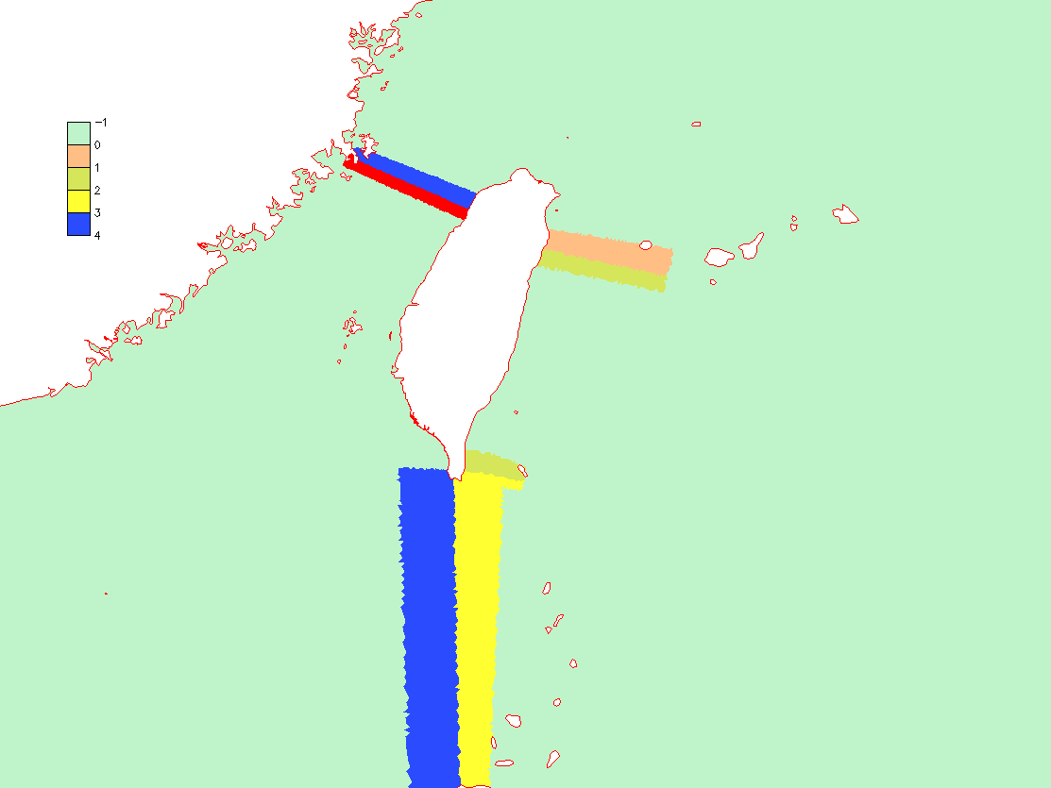
param.in
!-----------------------------------------------------------------------
! Outputs from other modules (WWM, Sediment, ICM etc)
!-----------------------------------------------------------------------
………….
!-----------------------------------------------------------------------
! Station output option. If iout_sta/=0, need output skip (nspool_sta) and
! a station.in. If ics=2, the cordinates in station.in must be in lon., lat,
! and z (measured from MSL; not used for 2D variables).
!-----------------------------------------------------------------------
iout_sta = 0
nspool_sta = 10 !needed if iout_sta/=0
!-----------------------------------------------------------------------
! Flag for harmonic analysis for elevation. If used , need to turn on cpp flags
! in Makefile first. Otherwise set it to 0.
!-----------------------------------------------------------------------
iharind = 0
!-----------------------------------------------------------------------
! Conservation check option. If consv_check=1, some fluxes are computed
! in regions specified in fluxflag.prop (regional number from -1 to an arbitrary integer).
!-----------------------------------------------------------------------
consv_check = 0
fluxflag.prop

Slide 25
Most important parameters are…
Momentum dissipation: indvel, ihorcon, ishapiro, inter_mom
  Appropriate combination of these must be used for different applications (dispersion vs diffusion)
  May start with: indvel= ihorcon=inter_mom=0, ishapiro=1 (‘MB-LI’ scheme)
  If diffusion is still too high, use indvel= inter_mom=ishapiro=0, ihorcon=2, hvis_coef0=0.025 (or smaller) – the ‘eddying’ option. If oscillation is found in non-eddying part, use ishapiro=-1 and set the filter strength in shapiro.gr3
  indvel=1 (ihorcon=ishapiro=inter_mom=0) is the most diffusive option (‘MA-LI’ scheme), but can be useful for 2D runs e.g.
dt: appropriate time step (another way to control dispersion/diffusion)
nws: use ‘2’ as much as possible (and there are scripts for generating sflux*.nc)
itr_met: use 3 and ‘h_tvd’ and tvd.prop to control efficiency

Slide 26
Hotstart.in (unformatted binary)
read(36) double1,iths,ifile
! Element data
do i=1,ne_global
read(36) iegb, idry_e, (we(j,i), trel(1:ntracers,j,i), j=1,nvrt)
enddo !i=1,ne_global
! Side data (side info can be generated by schism_geometry.f90)
do i=1,ns_global
read(36) isgb, idry_s, (su2(j,i), sv2(j,i), tsd(j,i), ssd(j,i), j=1,nvrt)
enddo
! Node data
do i=1,np_global
read(36) ipgb, eta2, idry, (tr_nd(1:ntracers,j,i), tr_nd0 (1:ntracers,j,i),q2(i,j), xl(i,j), dfv(i,j), dfh(i,j), dfq1(i,j), dfq2(i,j), qnon(i,j), j=1,nvrt)
enddo
!Optional modules data (ICM, SED2D, HA)
Nudging (TEM_nu.in and SAL_nu.in) (unformatted binary)
do it=1,n_nudging_steps
read(35) time_stamp !from t=0
do i=1,np_global
read(35)temp_nu(1:nvrt,i)
enddo !i
enddo !it

Slide 27
*.th: ASCII
flux.th (negative for inflow), TEM_1.th, SAL_1.th, elev.th, wind.th
Corresponds to b.c. flag=1
Easy to plot with xmgr5
Time (sec)
value 1 (1st bnd)
value 2 (2nd bnd)
…………..
value N (Nth bnd)
0. -0.084950529 0. -0.283168435 -0.226534754 -3.19980335 -16.367136
86400 -0.084950529 0. -0.283168435 -0.226534754 -3.19980335 -16.367136
172800 -0.084950529 0. -0.283168435 -0.226534754 -0.906139016 -22.2853565
259200 -0.084950529 0. -0.25485158 -0.226534754 -0.764554799 -16.367136
345600 -0.084950529 0. -0.25485158 -0.226534754 -0.764554799 -16.367136
432000 -0.084950529 0. -0.25485158 -0.226534754 -0.877822161 -16.367136
518400 -0.084950529 0. -0.25485158 -0.226534754 -3.17148638 -16.367136
604800 -0.084950529 0. -0.25485158 -0.226534754 -0.906139016 -16.367136
………………………………………………………………………………………………………….
Time steps ≥ main time step in param.in; record must start from 0
Time step in wind.th specified in param.in (wtiminc)

Slide 28
*3D.th: direct-access binary
elev2D.th, TEM_3D.th, SAL_3D.th, [tracer]_3D.th, uv3D.th (not discharge!)
Corresponds to b.c. flag=±4 or 5
Make sure you check values after creation
η
do it=1,nsteps
write(18,rec=irec_out+1)time,((th(i,j),j=1,nond(i)),i=1,nope)
enddo
S,T
do it=1,nsteps
write(18,rec=irec_out+1)time,(((th(i,j,l),l=1,nvrt),j=1,nond(i)),i=1,nope)
enddo
Tracers
do it=1,nsteps
write(18,rec=irec_out+1)time,((((th(i,j,l,itr),itr=1,ntracers),l=1,nvrt),j=1,nond(i)),i=1,nope)
enddo
u,v
do it=1,nsteps
write(18,rec=irec_out+1)time,(((u(i,j,l), v(i,j,l),l=1,nvrt),j=1,nond(i)),i=1,nope)
enddo
Time steps may be different from each other and ≥ param.in; record must start from t=0

Slide 29
*.ic: initial condition for T,S, tracers
ic_TEM(=ic_SAL)=1 in param.in: need temp.ic and salt.ic (.gr3 format)
ic_TEM=2 or ibcc_mean=1 in param.in: needs ts.ic (mean density removed)
For more generic i.c., use hotstart.in
For tracer modules, the files names are [tr]_hvar_[tn].ic (if ic_[tr]=1), or [tr]_vvar_[tn].ic (if ic_[tr]=2), where ‘tr’ is the tracer module name (e.g. ‘SED’), and ‘tn’ is the tracer index inside each module (e.g., class 1,2,…). The format is similar to temp.ic or ts.ic above
43 !total # of vertical levels;
1 -2000. 4. 34. !level #, z-coordinates, temperature, salinity
2 -1000. 5. 34.
3 -500. 6. 33.
4 -200. 7. 32.
5 -100. 8. 31.
...........
Sample ts.ic

Slide 30
Hydraulics.in
14 !# of structures
0.1 !Nudging factor
1 delta_cross_channel
3 48402 48977 ! # of node-pairs, 2 ref.nodes (global indices) for 2 faces
48403 48589 !node pair
48591 48782
48783 48978
radial ! struct type
2 ! n_duplicates
-3.420000 18.290000 10.000000 ! elevation, width, height or radius
1.000000 1.000000 1.000000 ! coef, op_downstream, op_upstream
1 ! time series enabled
2 ccfb_gate
3 163413 163248 ! # of node-pairs, 2 ref.nodes (global indices) for 2 faces
Consult manual for more details
time (sec)
op_up
elevation, width, height
-315420.0 1 2 1 1 -3.42 18.29 0
17748180.0 1 2 1 1 -3.42 18.29 10
28290600.0 1 2 1 1 -3.42 18.29 0
28297800.0 1 2 1 1 -3.42 18.29 10
delta_cross_channel.th
install
op_down
nduplicates

Slide 31
sflux/ (nws=2)
Requires hgrid.ll for interpolation
netcdf files (CF-1.0) reformatted from CFSR, NARR, NAM, WRF, MM5… (structured grid)
Three types
  sflux_air_[12]_*.nc: wind speed (u,v) (10m above MSL), air pressure (MSL), surface air T (2m above MSL), and specific humidity (2m above MSL)
  sflux_rad_[12]_*.nc: downward long (infrared) and short (solar) wave radiation fluxes – used in heat exchange only
  sflux_prc_[12]_*.nc: surface precipitation rate (kg/m²/s) – used in salt exchange only
Sample files: NARR (we have 1979-present on Sciclone)
Download NARR files for your application period. Each NARR file covers ~ 1 day (e.g., narr_air.1981_01_28.nc is for Jan. 28, 1981).
In your run directory, mkdir sflux and inside it, create symbolic links to the NARR files. e.g., if you run starts from June 10, 2004 and ends June 20, 2004, then
ln –s narr_air.2004_06_10.nc sflux_air_1.001.nc (OR: earlier date)
ln –s narr_air.2004_06_11.nc sflux_air_1.002.nc
...
ln –s narr_air.2004_06_21.nc sflux_air_1.012.nc (extra day to account for time zone difference)
Similarly for sflux_rad_*.nc and sflux_prc_*.nc. The number "1“ or “2” after "air_" denotes data set used
In sflux, copy the file sflux_inputs.txt and edit it to reflect the start time (time origin). The field "utc_start" is hours behind UTC (for application in eastern hemisphere, you may need to add an extra stack to cover t=0)
The time records in *.nc can be in irregular time steps. The code will first dovetail all time records (giving preference to later deck e.g. hindcast)
The time interval at which the main routine interpolates the atmos. info from *.nc is specified as wtiminc in param.in

Slide 32
! netcdf sflux_air_1.001 {
! dimensions:
! nx_grid = 349 ;
! ny_grid = 277 ;
! time = UNLIMITED ; // (8 currently)
! variables:
! float time(time) ;
! time:long_name = "Time" ;
! time:standard_name = "time" ;
! time:units = "days since 2001-01-01" ;
! time:base_date = 2001, 1, 1, 0 ;
! float lon(ny_grid, nx_grid) ;
! lon:long_name = "Longitude" ;
! lon:standard_name = "longitude" ;
! lon:units = "degrees_east" ;
! float lat(ny_grid, nx_grid) ;
! lat:long_name = "Latitude" ;
! lat:standard_name = "latitude" ;
! lat:units = "degrees_north" ;
! float uwind(time, ny_grid, nx_grid) ;
! uwind:long_name = "Surface Eastward Air Velocity (10m AGL)" ;
! uwind:standard_name = "eastward_wind" ;
! uwind:units = "m/s" ;
! float vwind(time, ny_grid, nx_grid) ;
! vwind:long_name = "Surface Northward Air Velocity (10m AGL)" ;
! vwind:standard_name = "northward_wind" ;
! vwind:units = "m/s" ;
! float prmsl(time, ny_grid, nx_grid) ;
! prmsl:long_name = "Pressure reduced to MSL" ;
! prmsl:standard_name = "air_pressure_at_sea_level" ;
! prmsl:units = "Pa" ;
! float stmp(time, ny_grid, nx_grid) ;
! stmp:long_name = "Surface Air Temperature (2m AGL)" ;
! stmp:standard_name = "air_temperature" ;
! stmp:units = "K" ;
! float spfh(time, ny_grid, nx_grid) ;
! spfh:long_name = "Surface Specific Humidity (2m AGL)" ;
! spfh:standard_name = "specific_humidity" ;
! spfh:units = "1" ;
!
! // global attributes:
! :Conventions = "CF-1.0" ;
! }

Slide 33
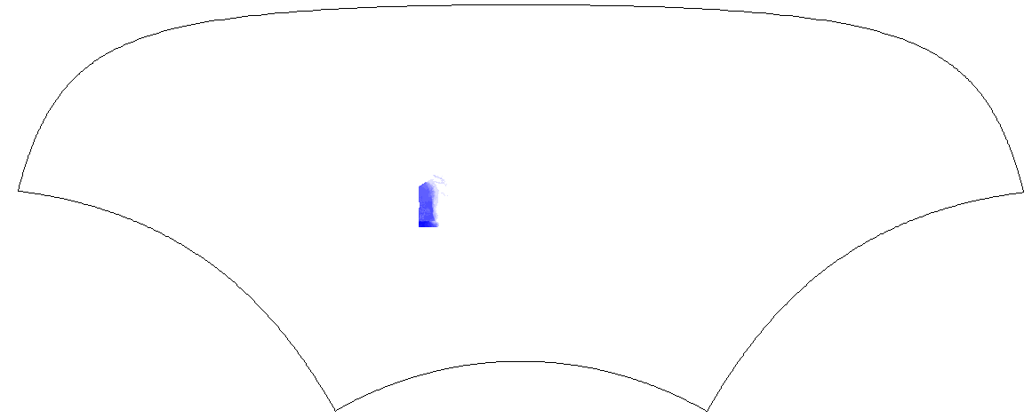
Details: interpolation
Sflux_air_2
sflux_air_1
In the overlapping area, the blending ratio is specified by relative_weight in netcdf_io of sflux_9c.F90 (default 1:99) to smooth the transition
In case of 2 sources/grids for a variable, use "1" as larger grid (i.e. encompassing hgrid.ll) and "2" as smaller grid. The code will calculate weights associated with the 2 grids, and if some nodes in hgrid.ll fall outside grid "2" the interpolation will be done on grid "1" only (see combine_sflux_data, in particular, bad_node_2 based on area coordinates outside [0,1]). Both grids must start from stack 1 and have same # of stacks for each variable. However, within each nc file # of time steps can vary

Slide 34
Creating your own sflux/
Sample m-lab scripts: readnc*.m
The grids used in atmospheric forcings (always structured) are different from hgrid.ll, but “1” must encompass hgrid.ll for successful interpolation, which is done in SCHISM at run time (both in space and in time)
  The collective time window from all .nc files MUST cover the simulation period!
Of all attributes in nc file, only 'base_date' is required (hour is not used)
Grids for air, rad and prc can be different (but must be the same within each type and each source). Additional requirements for the structured grid in .nc: [lon,lat](nx,ny) give x,y coord., nx is # of pts in lon. Suppose a node in the grid is given by (i,j) (1<=i<=nx), then the quad (i,j), (i+1,j), (i+1,j+1,i,j+1) must be along counter-clockwise direction
  Beware the m-lab function meshgrid when you transform the 1D lon/lat arrays to 2D! Always check the area
Some constants are hard-wired in sflux_9c.F90
  The maximum numbers of input files and time records are set in the module netcdf_io as max_files and max_times. If your application requires larger values simply increase them in the module
  *_[12]_max_window_hours are set in netcdf_io to define the max. time stamp (offset from start time in each file) within each nc file. Also, max_file_times (max. # of time records in each nc file) in routine get_times_etc () may be adjusted as well
Be careful if you use a huge wtiminc

Slide 35
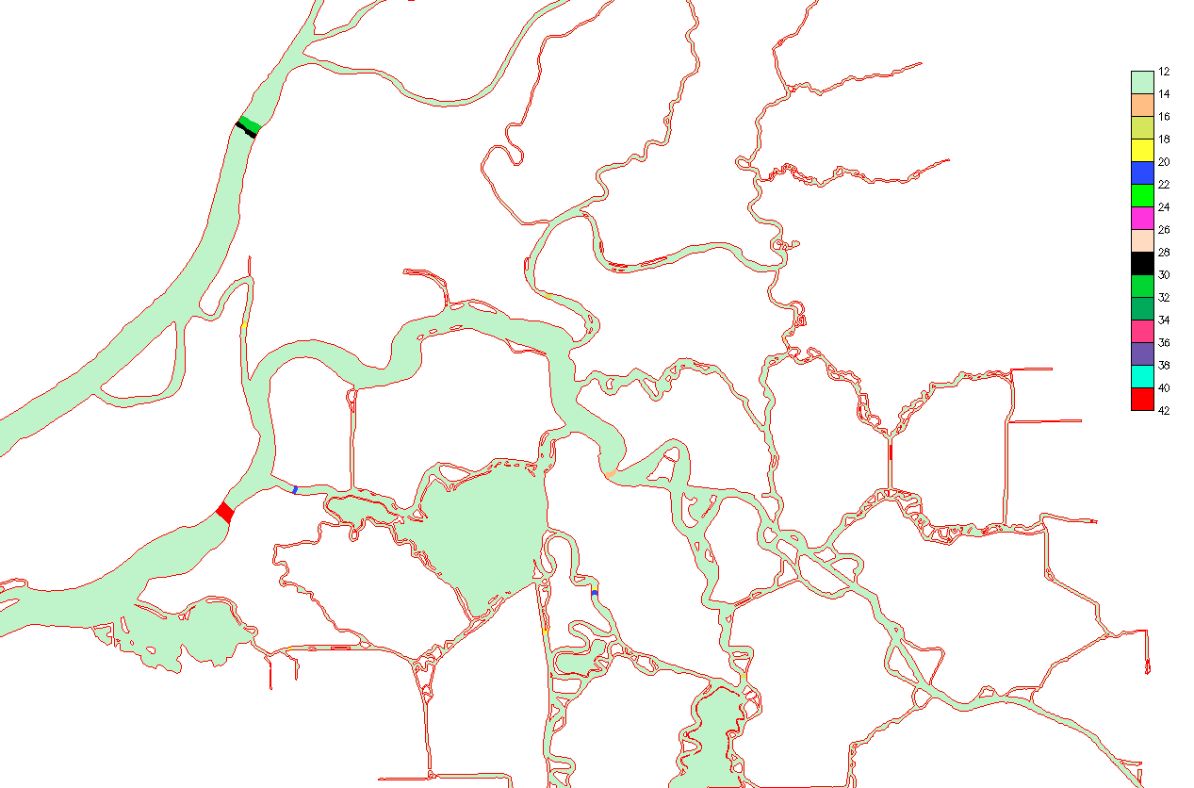
Fluxflag.prop
Compute various fluxes (from ‘hi’ to ‘lo’), total volume and mass
-1

Slide 36
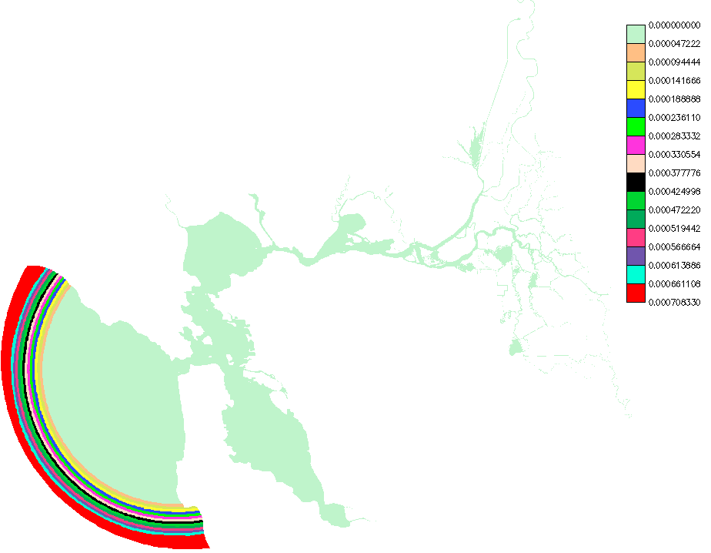
[TEM,SAL]_nudge.gr3
Horizontal nudging parameters for T,S (also elev, uv and tracers)
  Suggestion: max. relax=-log(0.1)/T90/86400, where T90 is the 90% decay time in days
  Final relax= [local value] * Δt
  Have simple scripts to generate these based on elliptic zone

Slide 37
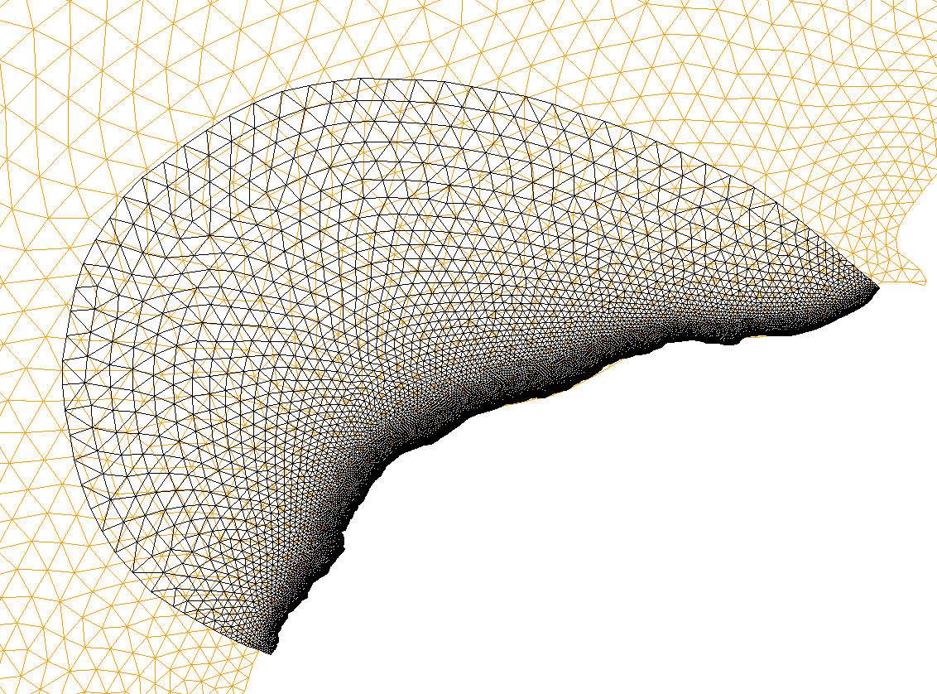
One-way nesting
Useful as a way to generate uv3D.th etc (when no other sources are available)
Use interpolate_variables_selfe6.f90 to generate *3D.th for the small-domain run (make sure the larger grid covers the smaller grid)
use the new *[23]D.th for the small-domain run
Since SCHISM does not allow drying at any open boundary nodes, make sure these nodes never become dry in the large-domain results – move them if necessary

Slide 38
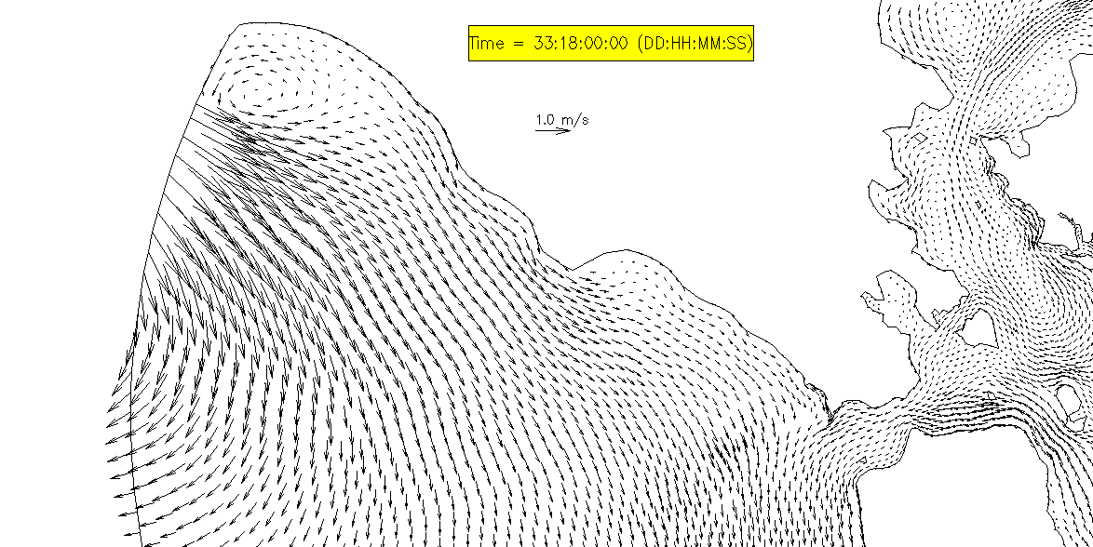
Horizontal b.c. for velocity: uv3D.th
What’s wrong with my open boundary
?
Incoming velocity is required but often unavailable
Use 1-way nesting to generate uv3D.th
Use 2D model for the ‘larger-domain’, with most dissipative settings
  θ=1
  Large Manning’s n near bnd
  indvel=1; inunfl=0

Slide 39
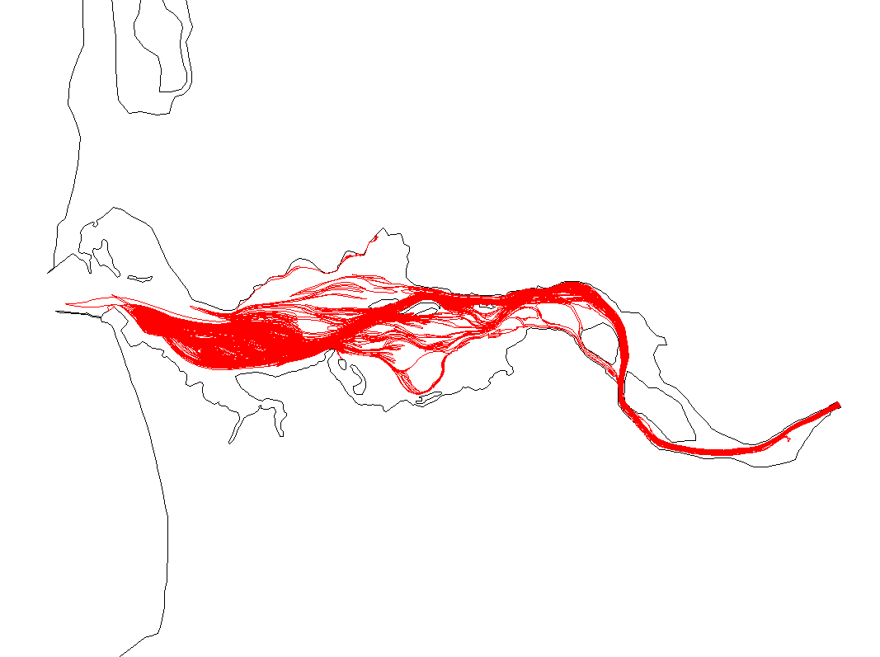
Particle tracking
3D tracking on unstructured grid
Adapted from backtracking portion of SCHISM (currently only Euler)
Has oil spill option (forward tracking only)
Base option can do forward or backward tracking
Inputs: hgrid.gr3, vgrid.in, particle.bp, *hvel.64, *vert.63, *elev.61 (*wind.62 and *tdff.63 for oil spill)
Output: particle.pth (drogue format that can be viz’ed with xmvis6)
particle.bp
Input for ELCIRC/SCHISM
1 nscreen
0 mod_part (0: passive; 1: oil spill)
1 ibf (forward (=1) or backward (=-1) tracking)
1 istiff (1: from F.S.)
1 -124 46.25 ics slam0 sfea0 (ics=2 still uses CPP)
0.1 8. 90. 10 960 9 !h0,rnday,dtm,nspool,ihfskip,ndeltp (same as param.in except for the last one, which is # of divisions)
16 nparticle
1 84600. 385000 510000 -5. !particle id, start time (s), starting x,y, and z relative to the instant f.s. (<=0)
2 84600. 300000 450000 -5.
3 84600. 200000 450000 -5.
4 84600. 120000 450000 -5.
5 84600. 380000 292500 -5.
6 84600. 360000 290000 -5.
7 84600. 320000 290000 -5.
…….
[Oil spill parameters]

Slide 40
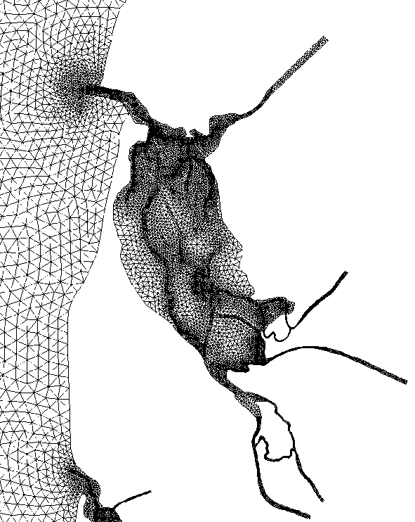
Boundary issues
Min h=1m
Drying near open boundary: impose a min depth in ~2 rows of elements
  Alternatively, use elev.ic or hotstart.in
Datum issue in upstream rivers is severe
  Initially “dry” river: elev.ic; pseudo channels; wet channels
  Use bed deformation module if you care about upstream
  Implicitness factor: stabilizes for channel flooding
  Damping of tides near river end: depth, friction
  elev+flow b.c.: over-specification to get stages right; must be compatible; not usually recommended (flow b.c. alone should suffice)
river extended

Slide 41
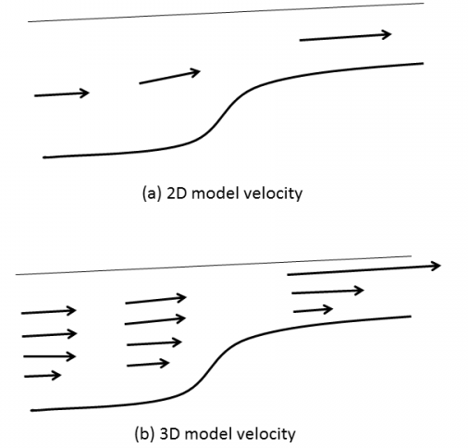
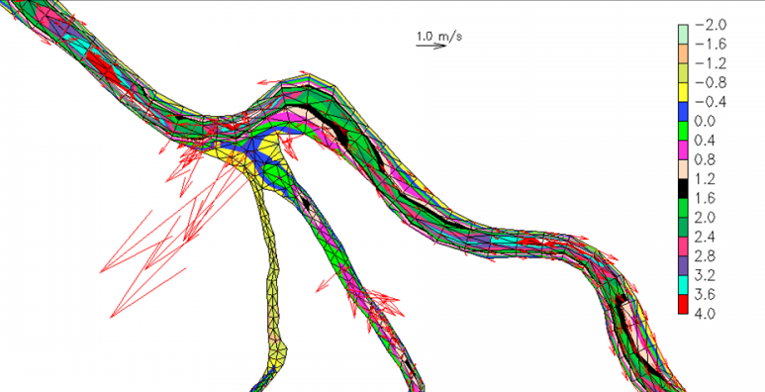
Wet/dry in shallow region (3D model)
In 3D, the roughness formulation leads to large Cd in shallow area
Limiting Cd in the shallow helps
Make sure that channels are not 'blocked', i.e., with at least 1 row of always-wet elements

Slide 42
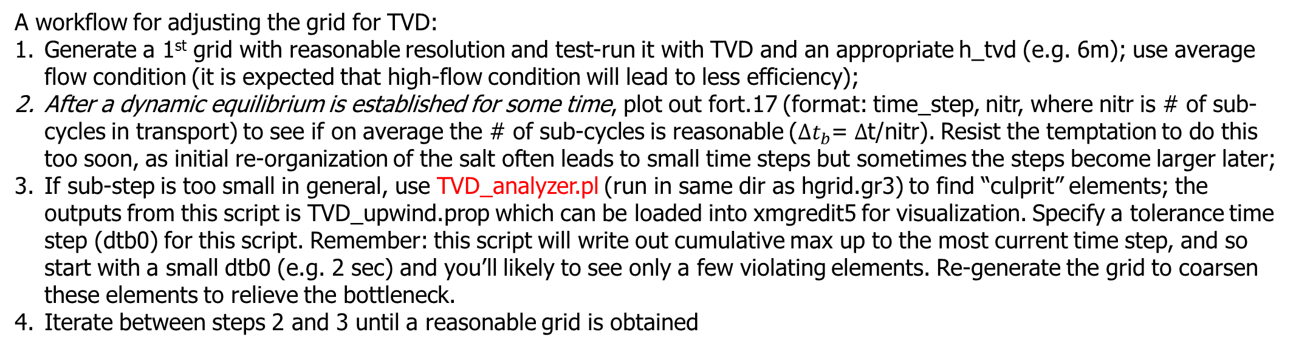
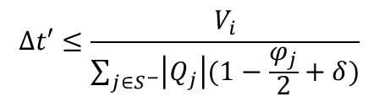
Tuning TVD transport
$$∆t′≤\frac{V_{i}}{\sum_{j∈S^{−}}{\left|Q_{j}\right|(1−\frac{φ_{j}}{2}+δ)}}$$
A workflow for adjusting the grid for TVD:
Generate a 1st grid with reasonable resolution and test-run it with TVD and an appropriate h_tvd (e.g. 6m); use average flow condition (it is expected that high-flow condition will lead to less efficiency);
After a dynamic equilibrium is established for some time, plot out fort.17 (format: time_step, nitr, where nitr is # of sub-cycles in transport) to see if on average the # of sub-cycles is reasonable (${∆t}_{b}$= $∆$t/nitr). Resist the temptation to do this too soon, as initial re-organization of the salt often leads to small time steps but sometimes the steps become larger later;
If sub-step is too small in general, use TVD_analyzer.pl (run in same dir as hgrid.gr3) to find “culprit” elements; the outputs from this script is TVD_upwind.prop which can be loaded into xmgredit5 for visualization. Specify a tolerance time step (dtb0) for this script. Remember: this script will write out cumulative max up to the most current time step, and so start with a small dtb0 (e.g. 2 sec) and you’ll likely to see only a few violating elements. Re-generate the grid to coarsen these elements to relieve the bottleneck.
Iterate between steps 2 and 3 until a reasonable grid is obtained
Additional control in TVD
h_tvd: threshold depth where TVD is invoked; should be min depth of stratification
tvd.prop: turn on/off TVD/upwind
Other considerations:
Vgrid: LSC² helps alleviate sub-cycling in shallows

Slide 43
LSC² script: gen_vqs.f90
!m_vqs: # of master grids
m_vqs=18
dz_bot_min=0.3 !min. bottom layer thickness [m]
allocate(hsm(m_vqs),nv_vqs(m_vqs),a_vqs(m_vqs))
hsm(1:7)=(/(7.+3*(i-1),i=1,7)/)
hsm(8:18)=(/28.,32.,37.,43.,50.,58.,67.,77.,88.,100.,120./)
nv_vqs(1:m_vqs)=(/(14+2*(i-1),i=1,m_vqs)/) !# of levels for each master grid (increasing with depth)
…
! Other consts.
! Stretching const. for the 1st master grid and also for depth <= hsm(1)
! |a_vqs0|<=1 (1: skew toward bottom; -1: toward surface; 0: no bias)
a_vqs0=-0.5
….
do m=1,m_vqs
do k=1,nv_vqs(m)
sigma=(k-1.0)/(1.0-nv_vqs(m))
! Alternative transformations below
! Option 1: quadratic
! a_vqs(m)=max(-1.d0,a_vqs0-(m-1)*0.03)
! tmp=a_vqs(m)*sigma*sigma+(1+a_vqs(m))*sigma !transformed sigma
! z_mas(k,m)=tmp*(etal+hsm(m))+etal
! Option 2: S
theta_b=0 !1
theta_f=1.5+0.03*(m-1)
cs=(1-theta_b)*sinh(theta_f*sigma)/sinh(theta_f)+ &
&theta_b*(tanh(theta_f*(sigma+0.5))-tanh(theta_f*0.5))/2/tanh(theta_f*0.5)
z_mas(k,m)=etal*(1+sigma)+hsm(1)*sigma+(hsm(m)-hsm(1))*cs
enddo !k
enddo !m
Controls near bottom resolution (used to consolidation of near-bottom levels)
z=Hs+η
s=aσ²+(1+a) σ (−1 ≤ σ≤0)
S transformation
Notes:
Use CA_DWR/RUN84b

Slide 44
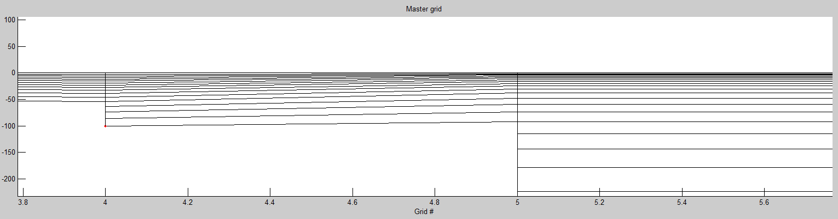
LSC²: tuning
Generally, the master grid and the final transect grid should be ‘pleasing to the eye’, with appropriate resolution where you wanted
  Use many transects to catch potential issues
  Prefer to resolve surface instead of bottom but…
Symptom #1: going against terrain
  Solution: adjust # of levels, stretching constants…
Symptom #2: too many degenerate (shaved) cells near bottom
  Solution: adjust a_vqs0, # of levels in some master grids…
Master grid
Notes:
Use CA_DWR/RUN84b

Slide 45
LSC²: performance consideration
Can use constant z after certain depths to save cost (esp. in deep ocean)
Use multiple sets of master grids in different parts of domain (take care of transition)
May want to optimize on a regional basis
!Last 3 master grids
z_mas(1:nv_vqs(5),6)=z_mas(1:nv_vqs(5),5)
z_mas(1:nv_vqs(6),7)=z_mas(1:nv_vqs(5),5)
z_mas(1:nv_vqs(6),8)=z_mas(1:nv_vqs(5),5)
z_mas(1+nv_vqs(5):nv_vqs(6),6)=(/-400,-460,-520,-590,-660,-740,-830,-930,-1050/)
z_mas(1+nv_vqs(5):nv_vqs(7),7)=(/-400,-460,-520,-590,-660,-740,-830,-930,-1050,-1200,-1400,-1600,-1800,-2000/)
z_mas(1+nv_vqs(5):nv_vqs(8),8)=(/-400,-460,-520,-590,-660,-740,-830,-930,-1050,-1200,-1400,-1600,-1800,-2000,-2400,-2900,-3500,-4200,-5000.,-7000,-1.e4/)
Notes:
Use CA_DWR/RUN84b

