Slide 1
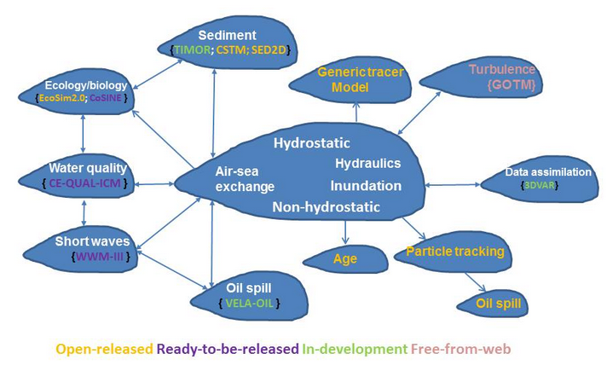
SCHISM Cross-scale Modeling System
Open-source community supported system
http://www.schism.wiki

Slide 2
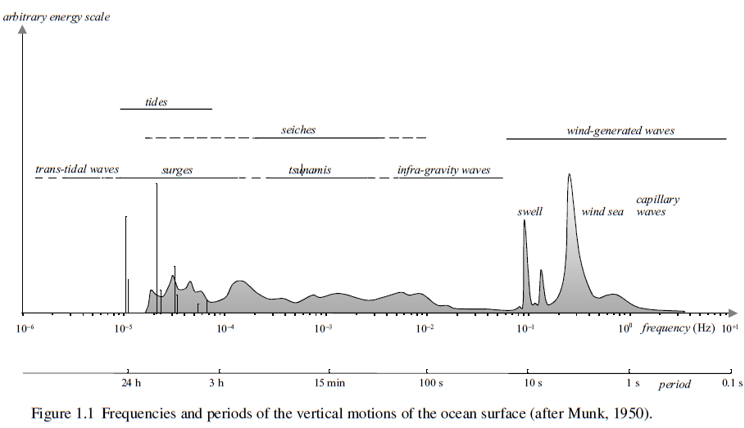
Waves: matter of scales…
Waves: vertical motions of sea surface (but internal waves are also of interest)

Slide 3
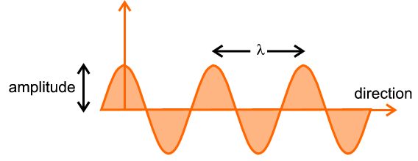
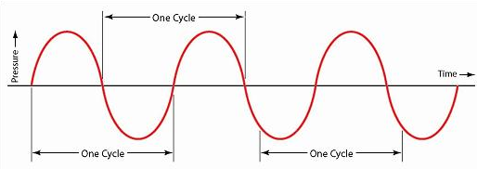
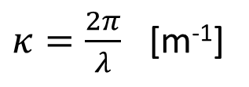
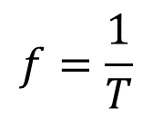
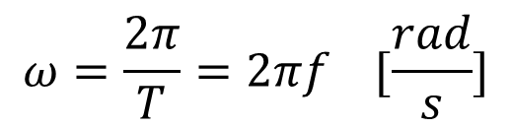
Monochromatic wave: a primer
crest
Spatial view:
Trough
T
Temporal view:
Frequency:
$$f=\frac{1}{T}$$
$$ω=\frac{2π}{T}=2πf [\frac{rad}{s}]$$
Wavenumber:
$κ=\frac{2π}{λ}$ [m⁻¹]

Slide 4

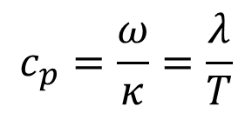
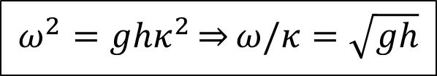

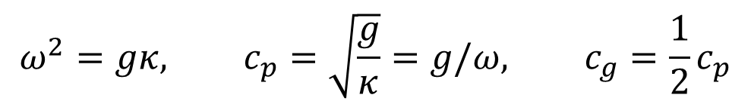
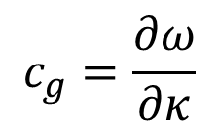
Dispersion relationship
Dispersion analysis for linearized Navier-Stokes equation
$$ω^{2}=gκtanh⁡(κh)$$
Shallow-water limit ($κh→0$)
$$ω^{2}=g{hκ}^{2}\overset{⇒}{}ω/κ=\sqrt{gh}$$
$$c_{p}=\frac{ω}{κ}=\frac{λ}{T}$$
$$c_{g}=\frac{∂ω}{∂κ}$$
Phase velocity:
Group velocity:
So in shallow-water limit, the wave is non-dispersive (i.e. all frequencies travel at same speed without dispersion)
$$c_{p}=c_{g}=\sqrt{gh}$$
Deep-water limit ($κh→∞$)
$$ω^{2}=gκ, c_{p}=\sqrt{\frac{g}{κ}}=g/ω, c_{g}=\frac{1}{2}c_{p}$$
(dispersion is important)

Slide 5
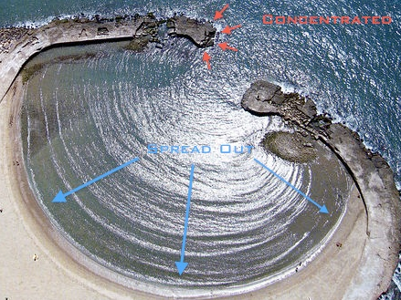
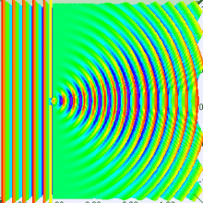

Wind waves
Period of 0.25–30 s and corresponding wave length of 0.1–1500m (in deep water)
Generated by the local wind, they are irregular and short-crested, and called wind sea
Random short waves consisting of multiple frequencies, and can be approximated as sum of individual freq’s (Fourier series)
Refraction and diffraction
Can be modeled with complete Navier-Stokes equation (without hydrostatic approx) but in practice this is expensive
Two types of models
Phase resolving: non-hydrostatic model
Phase averaging (spectral): thru statistic description of the sea state

Slide 6
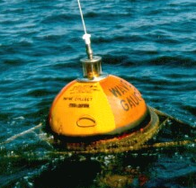
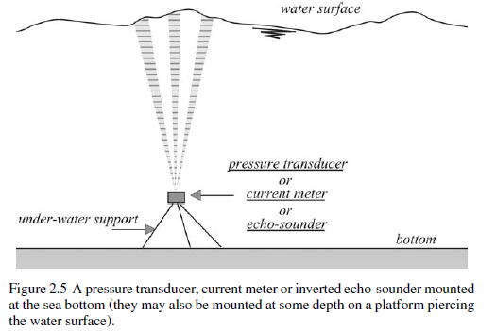
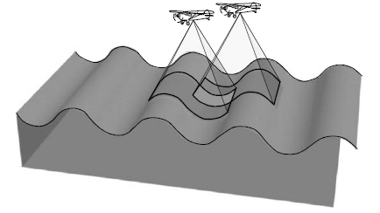
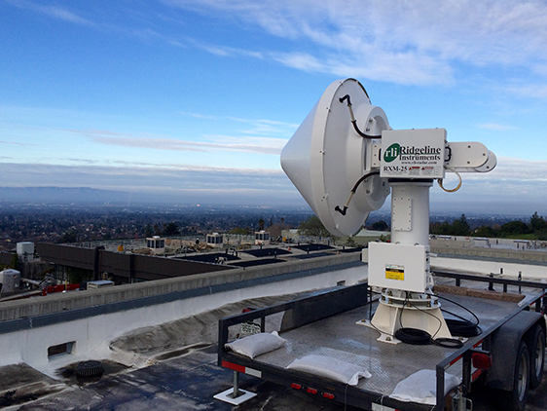
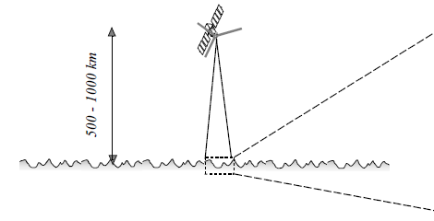
Observation
Wave rider buoy
Pressure transducer (bottom mounted)
Stereo-photography
X-band radar
Satellite altimetry

Slide 7
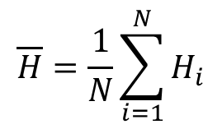
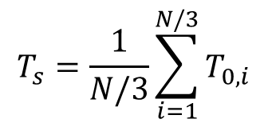
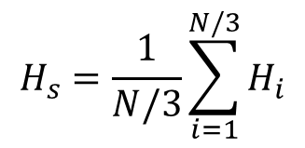
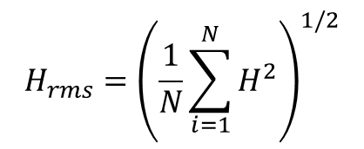
Description of wind waves
$$\overline{H}=\frac{1}{N}\sum_{i=1}^{N}{H_{i}}$$
Mean wave height
$$H_{rms}={\left(\frac{1}{N}\sum_{i=1}^{N}{H_{}^{2}}\right)}^{1/2}$$
RMS wave height
i
$$H_{s}=\frac{1}{N/3}\sum_{i=1}^{N/3}{H_{i}}$$
Significant wave height
(highest 1/3 of wave record)
H_{s} best approximates the visually estimated height
$$T_{s}=\frac{1}{N/3}\sum_{i=1}^{N/3}{T_{0,i}}$$
Significant wave period
(T₀ is the zero-crossing period)

Slide 8
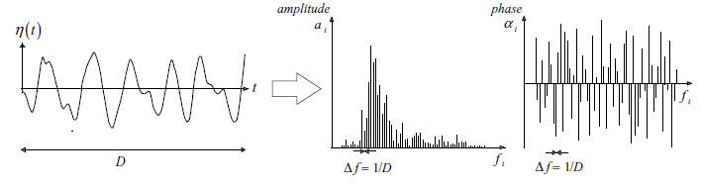
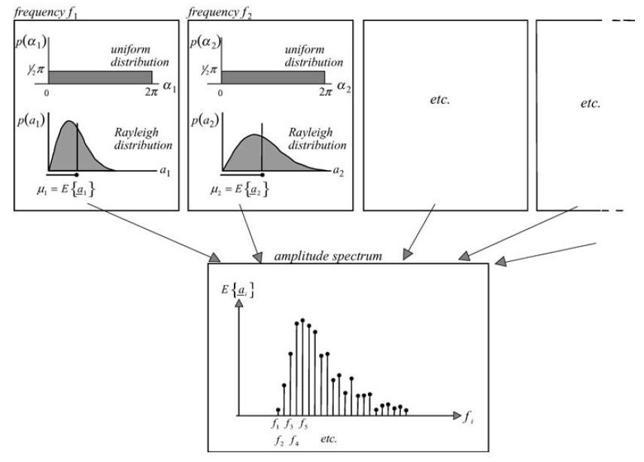
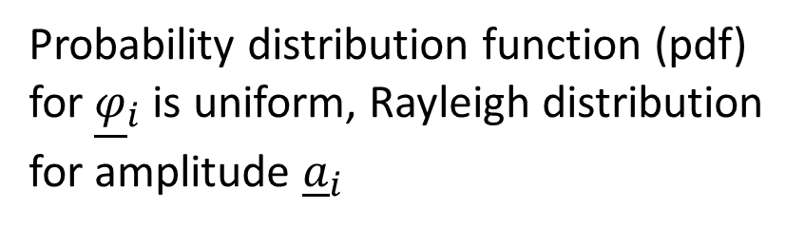
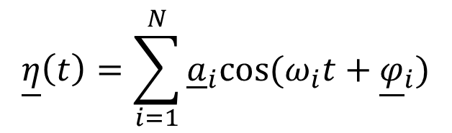
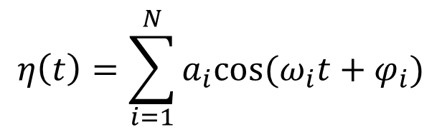
Amplitude spectrum
Random wave as Fourier series (at a fixed location)
$$η\left(t\right)=\sum_{i=1}^{N}{a_{i}cos⁡(ω_{i}t+φ_{i})}$$
Randomization of phase and amplitude
$$\underline{η}\left(t\right)=\sum_{i=1}^{N}{{\underline{a}}_{i}cos⁡(ω_{i}t+{\underline{φ}}_{i})}$$
Probability distribution function (pdf) for ${\underline{φ}}_{i}$ is uniform, Rayleigh distribution for amplitude ${\underline{a}}_{i}$
Amplitude spectrum

Slide 9
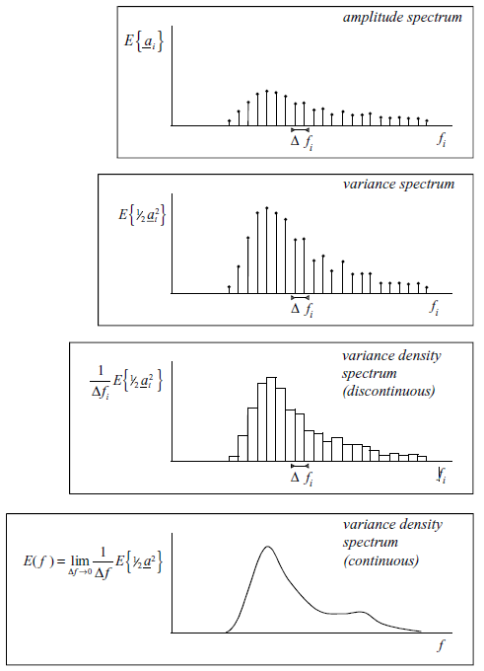
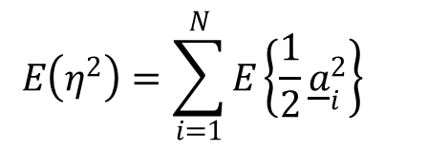
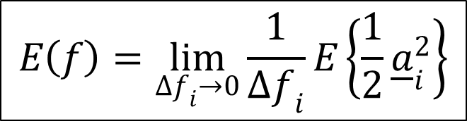
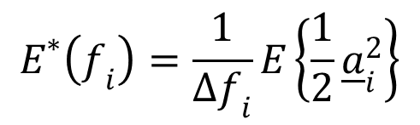
Variance density spectrum
$$E^{∗}\left(f_{i}\right)=\frac{1}{∆f_{i}}E\left\{\frac{1}{2}{\underline{a}}_{i}^{2}\right\}$$
Discrete variance density:
$$E\left(η^{2}\right)=\sum_{i=1}^{N}{E\left\{\frac{1}{2}{\underline{a}}_{i}^{2}\right\}}{}$$
Elevation variance:
Variance density spectrum
(note E() is not expectation!)
$$E\left(f\right)=\lim_{∆f_{i}→0}{\frac{1}{∆f_{i}}E\left\{\frac{1}{2}{\underline{a}}_{i}^{2}\right\}}$$
(in m²/Hz)
…under the assumption of stationary, Gaussian process (in practice 15-30min observation period is used for wave records)
Variance density spectrum gives a complete description of the random surface elevation and is one of the most important concepts

Slide 10
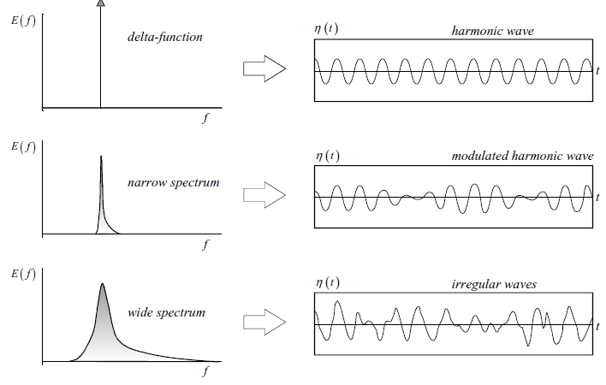
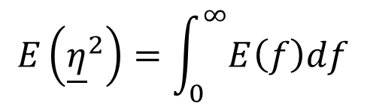
Interpretation of variance density spectrum
Total variance of elevation
$$E\left({\underline{η}}^{2}\right)=\int_{0}^{∞}{E\left(f\right)df}$$
Related to wave energy (× ρg)
So VDS can be seen as energy distribution over frequencies

Slide 11
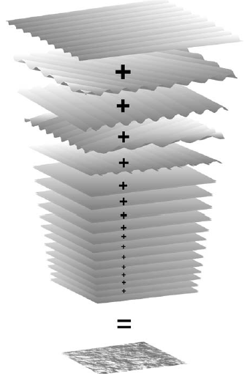
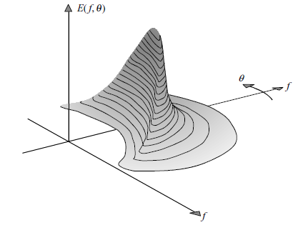
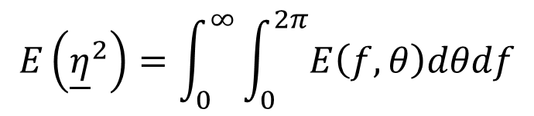
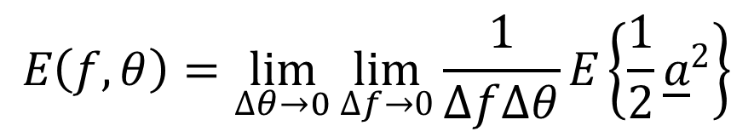
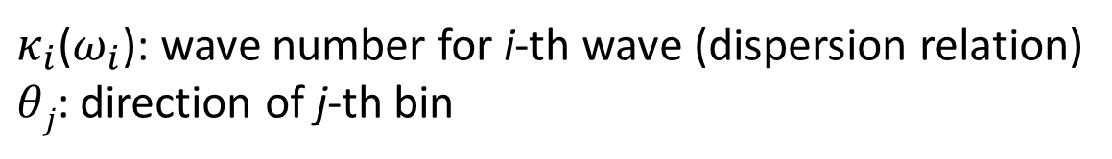
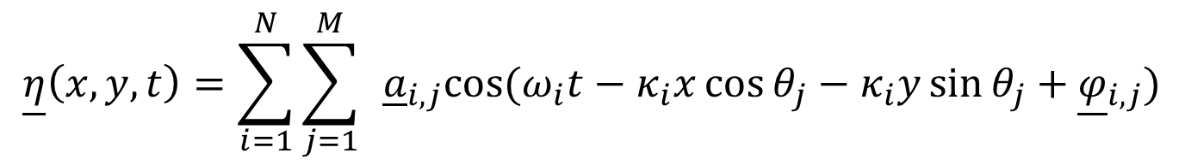
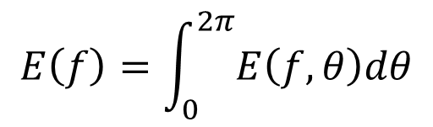
Generalization to 2D space
With different freq, directions, amplitude and phases
$$\underline{η}\left(x,y,t\right)=\sum_{i=1}^{N}{\sum_{j=1}^{M}{ }{\underline{a}}_{i,j}cos⁡(ω_{i}t−κ_{i}x\cos{θ_{j}−κ_{i}y\sin{θ_{j}}}+{\underline{φ}}_{i,j})}$$
$κ_{i}$($ω_{i}$): wave number for i-th wave (dispersion relation)
$θ﷮j$: direction of j-th bin
$$E\left(f,θ\right)=\lim_{∆θ→0}\lim_{∆f→0}{\frac{1}{∆f∆θ}E\left\{\frac{1}{2}{\underline{a}}_{}^{2}\right\}}$$
2D spectrum:
$$E\left({\underline{η}}^{2}\right)=\int_{0}^{∞}{\int_{0}^{2π}{E\left(f,θ\right)dθdf}}$$
$$E\left(f\right)=\int_{0}^{2π}{E\left(f,θ\right)dθ}$$
(reduction to 1D spectrum)

Slide 12
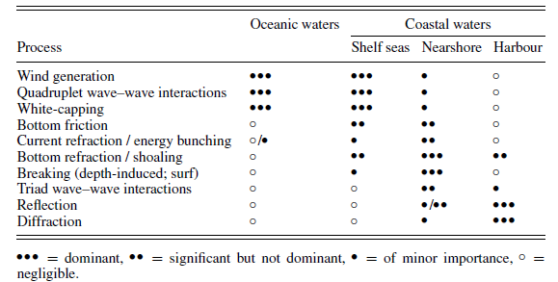
Wave processes in ocean and coastal waters

Slide 13
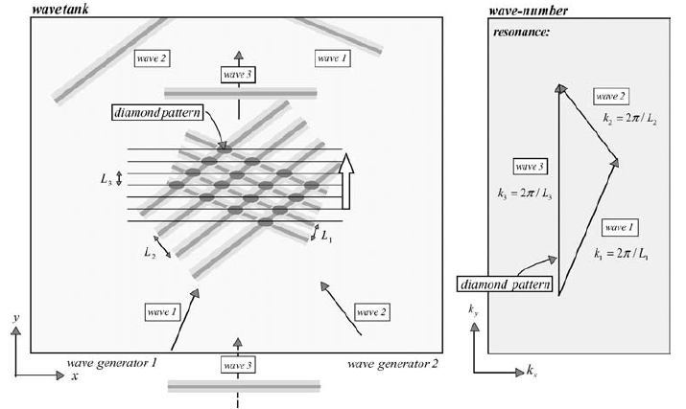
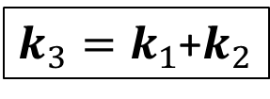
Triads (shallow water)
Interaction between 2 waves of different freq’s create a diamond pattern
The ‘diamond’ wave interacts with a 3rd progressive wave that meets the resonance condition
$k_{3}=k_{1}$+$k_{2}$

Slide 14

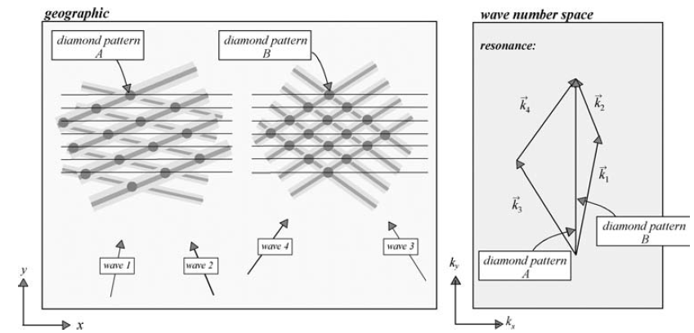
Quadruplet resonance (deep water)
Interaction between 2 waves of different freq’s create a diamond pattern
Pairs of diamond waves (4 waves) create resonant condition when

Slide 15
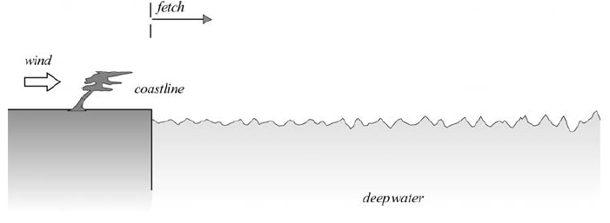
Wave processes in oceanic waters
Oceanic waters are deep waters (such that the waves are unaffected by the seabed) with straight or gently curving coastlines, without currents or obstacles such as islands, headlands and breakwaters.
Waves are generated by air-pressure fluctuations at the sea surface (not by wind friction), which are almost entirely due to wave-induced variations in the airflow (wind) just above the waves.
Under idealized conditions (constant wind blowing perpendicularly off a long and straight coastline over deep water), the significant wave height is determined by the wind, the distance to the upwind coastline (fetch) and the time since the wind started to blow (duration). So are the significant wave period and the energy density spectrum.

Slide 16
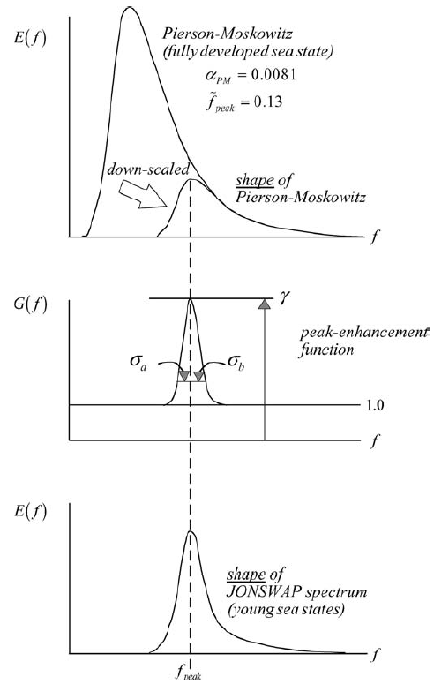
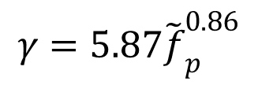
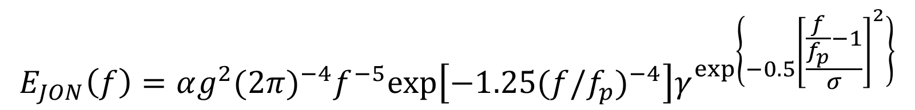
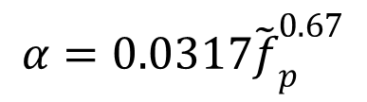
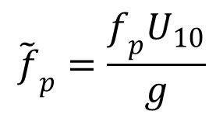



JONSWAP spectrum
Under these idealized conditions, the one-dimensional frequency spectrum has a universal shape: the JONSWAP (1D) spectrum for young sea states or the Pierson–Moskowitz spectrum for fully developed sea states
$$E_{JON}\left(f\right)=αg^{2}{(2π)}^{−4}f^{−5}exp⁡\left[−1.25{(f/f_{p})}^{−4}\right]γ^{\exp\left\{−0.5{\left[\frac{\frac{f}{f_{p}}−1}{σ}\right]}^{2}\right\}}$$
Pierson–Moskowitz (fully developed sea state)
JONSWAP (young sea)
$α$: energy scale
f_{p}: peak freq
γ: peak-enhancement const
σ: peak-width const (=σ_{a} when f< f_{p} and = σ_{b} when f> f_{p})
$${\tilde{f}}_{p}^{}=\frac{f_{p}U_{10}}{g}$$
Commonly use values ($f_{p}$ is dependent on U₁₀ and fetch):
$$α=0.0317{\tilde{f}}_{p}^{0.67}$$
$$γ=5.87{\tilde{f}}_{p}^{0.86}$$
$$σ_{a}=0.0547{\tilde{f}}_{p}^{0.32}$$
$$σ_{b}=0.0783{\tilde{f}}_{p}^{0.16}$$

Slide 17


Wave processes in oceanic waters
To model waves under more realistic, arbitrary oceanic water conditions, the concepts of fetch and duration cannot be used
The spectral energy balance of the waves is used. It represents the time evolution of the wave spectrum, based on the propagation, generation, wave–wave interactions and dissipation of all individual wave components at the ocean surface
$$\frac{∂E(f,θ;x,y,t)}{∂t}+\frac{∂c_{g,x}E(f,θ;x,y,t)}{∂x}+\frac{∂c_{g,y}E(f,θ;x,y,t)}{∂y}=S(f,θ;x,y,t)$$
(Eulerian form)
In deep water, C_{g} is not a function of x,y, so:
$$\frac{DE(f,θ;x,y,t)}{Dt}=S(f,θ;x,y,t)$$
(Lagrangian form; following wave rays)
S()
Owing to the interaction amongst the various wave components, the Eulerian approach is better suited for computations than the Lagrangian approach.

Slide 18



Source terms
$$S=S_{in}+S_{nl4}+S_{wc}$$
$S_{in}$: wave generation by wind
$S_{nl4}$: quadruplet wave–wave interaction
$S_{wc}$: dissipation by white-capping (breaking)
Hasselmann’s formula:
Some of these are poorly understood and empirically determined
In deep water, wave energy is dissipated only by breaking (white-capping)
In deep water, quadruplets of wave components interact by resonance
– These quadruplet wave–wave interactions redistribute the wave energy over the spectrum. They do not add or remove energy from the spectrum as a whole (the redistribution is said to be conservative)
– For sufficiently steep waves (waves being generated by wind, i.e., wind sea), the quadruplet wave–wave interactions cause a downshifting of the peak frequency of the spectrum and stabilize the spectral shape (the JONSWAP spectrum).
– The shape-stabilizing capacity of the quadruplet wave–wave interactions is the reason why the JONSWAP spectrum is characteristic for wind sea in oceanic waters. This spectrum is therefore widely accepted as the design spectrum in the engineering community.

Slide 19

Swells
Outside their generation area, the waves degenerate into swell, due to frequency- and direction dispersion
Ocean waves transforms irregular, short-crested wind-sea waves in a storm into regular, long-crested swell outside the storm (disaggregation in directions)
Swell is not steep enough for the quadruplet wave–wave interactions to be effective. The shape of a swell spectrum is therefore not a JONSWAP spectrum. A swell spectrum is narrow in both frequency and direction, but it depends otherwise entirely on the characteristics of the generating storm and the distance to that storm.

Slide 20



Waves in coastal waters
Coastal waters are waters that are shallow enough to affect the waves, adjacent to a coast, possibly with (small) islands, headlands, tidal flats, reefs, estuaries, harbors or other features, with time-varying water levels and ambient currents (induced by tides, or river discharge).
Horizontal variations in water depth cause shoaling and refraction. Horizontal variations in amplitude cause diffraction.
Shoaling is the variation of waves in their direction of propagation due to depth-induced changes of the group velocity in that direction. These changes in group velocity generally increase the wave amplitude as the waves propagate into shallower water (the propagation of wave energy slows down, resulting in ‘energy bunching’); Green’s law
Refraction is the turning of waves towards shallower water due to depth- or current-induced changes of the phase speed in the lateral direction (i.e., along the wave crest). For harmonic, long-crested waves in situations with parallel depth contours, Snell’s law can be used to compute the wave direction. If the depth contours are not parallel, the wave direction should be computed with wave rays
$$\frac{\sin{θ}}{c_{p}}=const$$
$θ$: angle btw direction of propagation and gradient of isobaths

Slide 21


Waves in coastal waters
Diffraction is the turning of waves towards areas with lower amplitudes due to amplitude changes along the wave crest
Particularly strong along the geometric shadow line of obstacles such as islands, headlands and breakwaters
For long-crested, harmonic waves, propagating over a horizontal bottom, Huygens’ principle, or a generalization thereof, can be used to compute the diffraction pattern
From potential theory, the diffraction is governed by a Helmholtz eq
Diffraction is challenging in spectral wave models: phases are important
Combined diffraction-refraction for long-crested, harmonic waves is modeled by the mild-slope eq
$$A=\operatorname{asin}{α,B=a\cos{α}}$$
(a: amplitude, α: phase)

Slide 22





Wave-current interaction
In the nearshore wave-current interaction is significant
Current shifts wave freq (Doppler effect)
Waves add extra momentum to current. This momentum transport acts as a horizontal stress in the water (radiation stress). Gradients in these stresses act as forces that may generate a slope of the mean water surface (set-up or set-down )
Relative freq and absolute freq differ by the current speed:
$$ω=σ+kU_{n}$$
absolute freq
$$U_{n}=U∙k$$
The dispersion relation is for the relative freq
$$σ=\sqrt{gκ\tanh{(κh)}}$$
So the group velocity
(has a component normal to wave propagation i.e. parallel to wave crest)
$$c_{g,a}=c_{g,r}+U$$

Slide 23


Reflection
A long-crested, harmonic wave that reflects off an obstacle, with or without energy dissipation, creates a (partially) standing wave.
Pure standing wave
Partial standing wave

Slide 24






Wave-induced momentum correction: radiation stress
Waves add extra momentum to current
This momentum transport acts as a horizontal stress in the water (radiation stress)
Gradients in these stresses act as forces that may generate a slope of the mean water surface (set-up or set-down )
$$S_{xx}=\left(2n−0.5\right)E$$
for waves travelling in x-direction
$$n=c_{g}/c_{p}$$
as extra momentum source
$$\frac{Du}{Dt}=…+R$$
$$R_{x}=−\frac{1}{ρ_{0}H}\left[\frac{∂S_{xx}}{∂x}+\frac{∂S_{xy}}{∂y}\right]$$
$$R_{y}=−\frac{1}{ρ_{0}H}\left[\frac{∂S_{xy}}{∂x}+\frac{∂S_{yy}}{∂y}\right]$$

Slide 25

Wave-current interaction
In the surf zone, the combination of wave-induced set-up and wave groupiness generates low frequency waves that radiate out to sea as infra-gravity waves (surf beat)
Depth-induced breaking: dissipation of wave energy
When waves enter water that is so shallow that the linear wave theory no longer holds, the nonlinear Boussinesq equations are available. These equations implicitly include shoaling, refraction, diffraction and reflections and also nonlinear wave–wave interactions. Even depth-induced breaking can be included.
Dispersion relation can be accurately represented in Boussinesq type models
4 types of wave breaking

Slide 26

Wave spectrum in shallow water
Under certain idealized conditions (constant wind blowing perpendicularly off a long and straight coastline, over shallow water with a constant depth), the significant wave height is determined by the wind speed, the distance to the upwind coastline (fetch), the time elapsed since the wind started to blow (duration) and the depth. So are the significant wave period and the energy density spectrum
Under these idealized conditions, the spectrum has a universal shape: the TMA spectrum, which is a generalized version of the JONSWAP spectrum. The directional width of this spectrum seems to be the same as in deep water
From JONSWAP to TMA

Slide 27






Wave action equation
Under more realistic, arbitrary coastal-water conditions, the spectral energy balance of the waves is used to compute the wave conditions. This shallow-water version of the energy balance is conceptually a straightforward extension of the energy balance in oceanic waters . It represents the time evolution of the wave spectrum, based on the propagation, generation, wave–wave interactions and dissipation of all spectral wave components individually.
As in oceanic waters, an Eulerian representation (based on a computational grid projected onto the coastal region) should be used for computations with the spectral energy balance. Ambient currents must be accounted for by replacing the energy density with the action density (i.e., the energy density divided by the relative frequency) in the energy-balance equation and taking some other relatively simple (conceptually) measures.
m
s
WAE (for 5-D space: $σ,θ;x,y,t$)
$$N=E/σ$$
$$\frac{∂N(σ,θ;x,y,t)}{∂t}+\frac{∂c_{g,x}N(σ,θ;x,y,t)}{∂x}+\frac{∂c_{g,y}N(σ,θ;x,y,t)}{∂y}+\frac{∂c_{θ}N(σ,θ;x,y,t)}{∂θ}+\frac{∂c_{σ}N(σ,θ;x,y,t)}{∂σ}=\frac{S(σ,θ;x,y,t)}{σ}$$
Advective velocities:
Source terms:
$$c_{g}=c_{g,a}+U$$
Bottom friction
$$c_{θ}=\dot{θ}=\frac{1}{κ}\frac{∂σ}{∂h}\frac{∂h}{∂m}+κ∙\frac{∂U}{∂s}$$
(s,m) are wave
oriented directions
$\frac{S}{σ}=S_{in}+S_{nl4}$+$S_{nl3}$+$S_{wc}+S_{bf}$
$$c_{σ}=\dot{σ}=\frac{∂σ}{∂h}\left(\frac{∂h}{∂t}+U∙∇h\right)−c_{g}κ∙\frac{∂U}{∂s}$$
triads

Slide 28

Source terms
Refraction is readily accounted for in the energy or action balance equation with an extra transport term. The presentation of diffraction is only experimentally formulated in the energy balance equation.
As the water depth decreases, the processes of wave generation by wind, quadruplet wave–wave interactions and dissipation by white-capping intensify and are joined by the process of bottom dissipation. In very shallow water (just outside and in the surf zone), triad wave–wave interactions and depth-induced breaking are added. These two processes dominate the wave evolution in the surf zone.
In general, the combination of triad wave–wave interactions and depth-induced wave breaking seems to stabilize the shape of the spectrum in the universal shape of the TMA spectrum. However, the triad wave–wave interactions may create an additional (secondary) high-frequency peak in the spectrum under fully developed, shallow-water conditions and near the outer edge of the surf zone.
Energy flow
From the wind, through triad and quadruplet wave–wave interactions to absorption at the lower frequencies (shifting the peak frequency and generating infra-gravity waves) and higher frequencies (possibly creating a secondary peak)
Dissipation by white-capping and surf-breaking at all frequencies and bottom friction at the low and mid-range frequencies

Slide 29

Wind Wave Model (WWM)
Developed in cooperation between the National Cheng Kung University, Taiwan and the Technical University of Darmstadt, Germany
One of the first 3rd-generation spectral wave models that solves the Eulerian form of the WAE on unstructured meshes
The Motivation was to have a flexible model for complicated domains
Unstructured-grid model of Wave Watch III V4.0
Numerical scheme
Geographical space
Residual distribution schemes (monotone, conservative, higher order, implicit & explicit)
Spectral space
Ultimate Quickest (explicit, 3rd order in space and time)
Source term integration
Dynamical (WWIII)

Slide 30
Wind Wave Model (WWM)
Physical formulation
Unified physics from deep to shallow water
The latest version of Fabrice Ardhuin’s of deep water physics
Extended WAE for strongly varying depths and wave-currents interactions; wave diffraction (Toledo et al. 2015, WISE 2010)
WWM fully coupled to SCHISM
Callable as a routine
Use same grid – efficiency
Both models are robust
Radiation stress formulations
Longuet-Higgins and Stewart (2D)
Ardhuin’s vortex formalism

Slide 31


Operator splitting
(geographic advection)
(source)

Slide 32









Residual distribution method
Used to approximate the geographic advection
$$\frac{∂N}{∂t}+c_{g}∙∇N=0$$
$$\int_{Ω}{\frac{∂N}{∂t}dΩ}=−{\int_{Ω}{c_{g}∙∇N dΩ} }_{}$$
T
Assume element-by-element balance:
Quasi-B grid for RD
Fluctuation of a cell
$$\int_{T}{\frac{∂N}{∂t}dT}=−\int_{T}{c_{g}∙∇N dT}=Φ_{T}$$
$$N=\sum_{i=1}^{3}{{w_{i}N}_{i}}$$
Shape function:
$$Φ_{T}=\sum_{i=1}^{3}{k_{i}N_{i}}$$
$$k_{i}=\frac{1}{2}n_{i}{∙c}_{g}\underset{⇒}{}\sum_{i}{k_{i}}=0$$
$$Φ_{T}$$
(fluctuation splitting)
(conservation of fluctuation)

Slide 33
Residual distribution method
Conservation: sum of fluctuations in a cell is conserved
Positivity (monotone): guaranteed with a stability constraint (CFL)
Linear preserving: depends on order of convergence
Godunov's order barrier theorem: linear monotone schemes cannot be of second order without producing oscillatory solutions
To gain higher-order accuracy with monotonicity, a nonlinear scheme has to be used.
In WWM, a few 2nd-order schemes are supported

Slide 34
Usage
Compile with USE_WWM on
Needs inputs
wwminput.nml: name list for all parameters (sample inside src/)
wwmbnd.gr3: b.c. types
Optional (if WW3 is used for i.c. and b.c.): bndfile.dat, .nc
Outputs
Directly from WWM: stations, global wave fields (nc format)
From SCHISM (param.in): ~25 wave variables (H_{s} etc); can be viz’ed with vis6
Make sure rm fort.* before each new start
!-----------------------------------------------------------------------
! Outputs from WWM (USE_WWM must be on in Makefile)
!-----------------------------------------------------------------------
wwm_1.61 = 0 !sig. height Hs (m)
wwm_2.61 = 0 !Mean average period (sec) - TM01
wwm_3.61 = 0 !Zero down crossing period for comparison with buoy (s) - TM02
wwm_4.61 = 0 !Average period of wave runup/overtopping - TM10
wwm_5.61 = 0 !Mean wave number (1/m)
wwm_6.61 = 0 !Mean wave length (m)
wwm_7.61 = 0 !Mean average energy transport direction (Average direction; deg)
wwm_8.61 = 0 !Mean directional spreading (deg)
wwm_9.61 = 0 !Discrete peak period Tpd (sec)
wwm_10.61 = 0 !Continuous peak period (Tp) based on higher order moments (sec)
wwm_11.61 = 0 !Peak phase vel. (m/s)
wwm_12.61 = 0 !Peak n-factor [-]
wwm_13.61 = 0 !Peak group vel. (m/s)
wwm_14.61 = 0 !Peak wave number (1/m)
wwm_15.61 = 0 !Peak wave length (m)
wwm_16.61 = 0 !Peak (dominant) wave direction Dp (degr) ... some buoys record this
wwm_17.61 = 0 !Peak directional spreading (deg) ... some buoys record this
wwm_18.61 = 0 !Discrete peak direction Dpd (deg) ... some buoys record this
wwm_19.61 = 0 !Orbital vel. (m/s)
wwm_20.61 = 0 !RMS orbital vel. (m/s)
wwm_21.61 = 0 !Bottom excursion period (sec)
wwm_22.61 = 0 !bottom wave period (sec)
wwm_23.61 = 0 !Ursell number based on peak period
wwm_24.61 = 0 !none
wwm_25.62 = 0 !Etot energy vector (m^2)
wwm_26.62 = 0 !none

Slide 35
wwminput.nml
&PROC
PROCNAME = 'roms_wwm_2003_test'! Project Name
DIMMODE = 2 ! Mode of run (ex: 1 = 1D, 2 = 2D) always 2D when coupled to SCHISM
LSTEA = F ! steady mode; under development
LQSTEA = F ! Quasi-Steady Mode; In this case WWM-II is doing subiterations defined as DELTC/NQSITER unless QSCONVI is not reached
LSPHE = F ! Spherical coordinates (T if using WW3 forcing)
LNAUTIN = T ! Nautical convention for all inputs given in degrees
LNAUTOUT = T ! Output in Nautical convention
! If T, 0 is _from_ north, 90 is from east etc;
! If F, maths. convention - 0: to east; 90: going to north
LMONO_IN = F ! For prescribing monochromatic wave height Hmono as a boundary conditions; incident wave is defined as monochromatic wave height, which is Hmono = sqrt(2) * Hs
LMONO_OUT = F ! Output wave heights in terms of Lmono
BEGTC = '19980901.000000' ! Time for start the simulation, ex:yyyymmdd. hhmmss
DELTC = 360 ! Time step (MUST match dt*nstep_wwm in SCHISM!)
UNITC = 'SEC' ! Unity of time step
ENDTC = '19980902.000000' ! Time for stop the simulation, ex:yyyymmdd. hhmmss
DMIN = 0.01 ! Minimum water depth. This must be same as h0 in selfe
/
&COUPL
LCPL = T ! Couple with current model ... main switch - keep it on for SCHISM-WWM
LROMS = F ! ROMS (set as F)
LTIMOR = F ! TIMOR (set as F)
LSHYFEM = F ! SHYFEM (set as F)
RADFLAG = 'LON'
LETOT = F ! Option to compute the wave induced radiation stress. If .T. the radiation stress is based on the integrated wave spectrum
! e.g. Etot = Int,0,inf;Int,0,2*pi[N(sigma,theta)]dsigma,dtheta. If .F. the radiation stress is estimated as given in Roland et al. (2008) based
! on the directional spectra itself. It is always desirable to use .F., since otherwise the spectral informations are truncated and therefore
! LETOT = .T., is only for testing and developers!
NLVT = 10 ! Number of vertical Layers; not used with SCHISM
DTCOUP = 600. ! Couple time step - not used when coupled to SCHISM
/
Better make sure all start/end dates are correct

Slide 36
wwminput.nml
&GRID
LCIRD = T ! Full circle in directional space
LSTAG = F ! Stagger directional bins with a half Dtheta; may use T only for regular grid to avoid char. line aligning with grid line
MINDIR = 340. ! Minimum direction for simulation (unit: degrees; nautical convention; 0: from N; 90: from E); not used if LCIRD = .T.
MAXDIR = 7.5 ! Maximum direction for simulation (unit: degrees); may be < MINDIR; not used if LCIRD = .T.
MDC = 36 ! Number of directional bins (must match MDC2 in param.in)
FRLOW = 0.03 ! Low frequency limit of the discrete wave period (Hz; 1/period)
FRHIGH = 1. ! High frequency limit of the discrete wave period.
MSC = 36 ! Number of frequency bins (must match MSC2 in param.in)
IGRIDTYPE = 3 ! Gridtype used.
! 1 ~ XFN system.dat
! 2 ~ WWM-PERIODIC
! 3 ~ SCHISM
! 4 ~ old WWM type
FILEGRID = 'hgrid.gr3' ! Name of the grid file. hgrid.gr3 if IGRIDTYPE = 3 (SCHISM)
LSLOP = F ! Bottom Slope limiter (default=F)
SLMAX = 0.2 ! Max Slope;
LVAR1D = F ! For 1d-mode if variable dx is used; not used with SCHISM
LOPTSIG = F ! Use optimal distributions of freq. in spectral space ... fi+1 = fi * 1.1. Take care what you high freq. limit is!
/
&INIT
LHOTR = F ! Use hotstart file (see &HOTFILE section)
LINID = F ! Initial condition; F for default; use T if using WW3 as i.c. etc
INITSTYLE = 1 ! 1 - Parametric Jonswap, 2 - Read from Global NETCDF files, work only if IBOUNDFORMAT=3
/

Slide 37
wwminput.nml
&BOUC
LBCSE = F ! The wave boundary data is time dependent
LBINTER = F ! Do interpolation in time if LBCSE=T (not available for quasi-steady mode within the sub time steps)
LBCWA = T ! Parametric Wave Spectra
LINHOM = F ! Non-uniform wave b.c. in space
LBCSP = F ! Specify (non-parametric) wave spectra, specified in 'FILEWAVE' below
LINDSPRDEG = F ! If 1-d wave spectra are read this flag defines whether the input for the directional spreading is in degrees (true) or exponent (false)
LPARMDIR = F ! If LPARMDIR is true then directional spreading is read from WBDS and must be in exponential format at this time, only valid for 1d Spectra
FILEWAVE = 'wave.bcd' ! Boundary file including discrete wave spectra
LBSP1D = F ! 1D (freq. space only) format for FILEWAVE if LBCSP=T and LINHOM=F
LBSP2D = F ! use T if IBOUNDFORMAT = 3
BEGTC = '19980901.000000' ! Begin time of the wave boundary file (FILEWAVE)
DELTC = 1 ! Time step in FILEWAVE
UNITC = 'HR' ! Unit
ENDTC = '19980902.000000' ! End time
FILEBOUND = 'wwmbnd.gr3' ! Boundary file defining boundary and Neumann nodes.
! Flag 0: not on bnd; 3: Neumann (0 gradient);
! 2: active bnd (Direchlet). Bnd flags imported from SCHISM:
! 1: exterior bnd; -1: interior (islands)
IBOUNDFORMAT = 1 ! 1 ~ WWM, 2 ~ FVCOM: 3 ~ WW3. FVCOM and WW3 works only with LBCWA=T.
! For WW3 boundary input also set LINHOM=T, LBCSE=T and this works only for spherical coordinates
! LMONO_IN = F ! incident wave is defined as monochromatic wave height, which is Hmono = sqrt(2) * Hs
! The following are needed only if LBCWA=T and LINHOM=F
WBHS = 2. ! Hs at the boundary for parametric spectra
WBSS = 2 ! 1 or -1: Pierson-Moskowitz, 2 or -2: JONSWAP, 3 or -3: all in one BIN,
! 4: Gauss. The sign decides whether WBTP below is
! peak (+) or mean period (-)
WBPKEN = 3.3 ! Peak enhancement factor for Jonswap Spectra if WBSS=2
WBTP = 8. ! Tp at the boundary (sec); mean or peak depending on the sign of WBSS
WBDM = 90.0 ! Avg. Wave Direction at the boundary
WBDSMS = 1 ! Directional spreading value in degrees (1) or as exponent (2)
WBDS = 10. ! Directional spreading at the boundary (degrees/exponent)
WBGAUSS = 0.1 ! factor for gaussian distribution if WBSS=1
! End section for LBCWA=T and LINHOM=F

Slide 38
wwminput.nml
&BOUC
….
NCDF_HS_NAME = 'hs' ! NETCDF var. name for the significant wave height (normally it is just 'hs')
NCDF_DIR_NAME = 'dir' ! NETCDF var. name for the mean wave direction (normally it is just 'dir')
NCDF_SPR_NAME = 'spr' ! NETCDF var. name for the mean directional spreading (normally it is just 'spr')
NCDF_FP_NAME = 'fp' ! NETCDF var. name for the peak freq. (normally it is just 'fp')
NCDF_F02_NAME = 't02' ! NETCDF var. name for the zero down crossing freq. (normally it is just 't02')
/
&WIND ! THIS IS NOW USED IN SCHISM
….
&CURR !NOT USED WITH SCHISM
…
&WALV !NOT USED WITH SCHISM
…
&ENGS !SOURCE TERMS
MESNL = 1 ! SNL4; MESNL = 0 , MESNL = 1, (Discrete Interaction approx. of Hasselmann)
MESIN = 2 ! Wind input: Ardhuin etal (1) (use LSOURCESWAM = .TRUE.); for ECMWF physics (2); Makin & Stam (3); Babanin et al. (4); Cycle 3 (5); no wind (0). Try MESIN=1, or !MESIN=2 and LSOURCESWAM=T
IFRIC = 1 ! Formulation for atmospheric boundary layer, (IFRIC = 1 for MESIN = 1, IFRIC = 4 for MESIN=5); only used if cycle 3 is switched on
MESBF = 1 ! Bottom friction: JONSWAP(1) (Default at 1); 2 - Madsen
FRICC = 0.067 ! Cjon - Bottom friction coefficient (always positive)
MESBR = 1 ! Shallow water wave breaking; 0: no; 1: BJ78 (Default at 1)
ICRIT = 1 ! Wave breaking criterion: set as 1 - SWAN, 2 - Dingemans - default = 2
ALPBJ = 0.5 ! Dissipation proportionality coefficient (0.5 is default)
BRHD = 0.78 ! Wave breaking coefficient for Const. type wave breaking criterion; range: 0.6-0.83 (suggested 0.78)
LMAXETOT = T ! Limit shallow water wave height by wave breaking limiter (default=T)
MESDS = 2 ! Formulation for the whitecapping source function; same value as MESIN
MESTR = 1 ! Formulation for the triad 3 wave interactions (MESTR = 0 (off), MESTR = 1 (Lumped Triad Approx. (LTA) like SWAN) (Default at 1)
TRICO = 0.1 ! proportionality const. (\alpha_EB); default is 0.1
TRIRA = 5. ! ratio of max. freq. considered in triads over mean freq.; 2.5 is suggested
TRIURS = 0.1 ! critical Ursell number; if Ursell # < TRIURS; triads are not computed
!LPRECOMPST4 = T ! Precompute the indices and weightings for the Ardhuin et al. formulation and save to disk, if it is .F. then the saved
! values are read from disk ! The fiels will be auto-detected, still make sure they correspond to your MSC,MDC,FRLOW,FRHIGH stuff, I add more checks soon and delete the !fort.5002 file if u are not sure!
/

Slide 39
wwminput.nml
&NUMS
ICOMP = 3 !implicit w/o splitting
AMETHOD = 7 !Jacobian matrix solver
SMETHOD = 1 !This switch controls the way the source terms are integrated. 0: no source terms;
! 1: splitting using RK-3 and SI for fast and slow modes 2: semi-implicit;
! 3: R-K3 (if ICOMP=0 or 1) - slow; 4: Dynamic Splitting (experimental)
DMETHOD = 2 ! Ultimate Quickest as in WW3 (usually best)
RTHETA = 0.5 ! Weighing factor for DMETHOD = 1, not really useful
LITERSPLIT = F ! T: double Strang split; F: simple split (more efficienct). Default: F
LFILTERTH = F
! LFILTERTH: use a CFL filter to limit the advection vel. In directional space. This is similar to WW3.
! Mostly not used. WWMII is always stable.
MAXCFLTH = 1.0 ! Max Cfl in Theta space; used only if LFILTERTH=T
FMETHOD = 1 ! Ultimate Quickest as in WW3 (best)
LFILTERSIG = F ! Limit the advection velocitiy in freq. space (usually F)
MAXCFLSIG = 1.0 ! Max Cfl in freq. space; used only if LFILTERSIG=T
LLIMT = T ! Switch on/off Action limiter, Action limiter must mostly be turned on.

Slide 40
wwminput.nml
&NUMS
…
MELIM = 3
! Formulation for the action limiter
! MELIM = 1 (default)
! Limiter according to the WAM group (1988)
! MELIM = 2
! Limiter according to Hersbach Janssen (1999)
! For MESIN = 1 and MESDS = 1, which represents Cycle 3 formulation or Ardhuin, or other formulations !except Cycle4, use MELIM = 1 and LIMFAK = 0.1
! For MESIN = 2 and MESDS = 2, which represents Cycle 4 formulation, use MELIM = 3 and LIMFAK = 0.6
LIMFAK = 0.6 ! Proportionality coefficient for the action limiter MAX_DAC_DT = Limfak * Limiter; see notes above for value
LDIFR = F ! Use phase decoupled diffraction approximation according to Holthuijsen et al. (2003) (usually T; if crash, use F)
IDIFFR = 1 ! Extended WAE account for higher order effects WAE becomes nonlinear; 1: Holthuijsen et al. ; 2: Liau et al. ; 3: Toledo et al. (in preparation)
LCONV = T ! Estimate convergence criterion and write disk (quasi-steady - qstea.out)
LCFL = F ! Write out CFL numbers; use F to save time
NQSITER = 1 ! # of quasi-steady (Q-S) sub-divisions within each WWM time step (trial and errors)
QSCONV1 = 0.98 ! Number of grid points [%/100] that have to fulfill abs. wave height criteria EPSH1
(other tolerance parameters…)

Slide 41
wwminput.nml
&NUMS
WAE_SOLVERTHR = 1.e-9, ! Threshold for the Block-Jacobi or Block-Gauss-Seider solver
MAXITER = 100, ! Max. number of iterations
PMIN = 1., ! Max. percentage of non-converged grid points
LNANINFCHK = T, ! Check for NaN and INF
LZETA_SETUP = F, ! Compute wave setup (simple momentum eq.)
ZETA_METH = 0, ! Method for wave setup, Mathieu please explain!
LSOURCESWAM = T, ! Use ECMWF WAM formualtion for deep water physics (MESIN=2)
LSOURCESWWIII = F, ! WW3 Ardhuin et al. sources, not working yet in this code- use MESIN=1
BLOCK_GAUSS_SEIDEL = T, ! Use the Gauss Seidel on each
! computer block. The result seems
! to be faster and use less memory
! But the # of iterations depends on the
! number of processors

Slide 42
Global outputs
! output of statistical variables over the whole domain at specified times.
&HISTORY
BEGTC = '19980901.000000' ! Start output time, yyyymmdd. hhmmss;
! must fit the simulation time otherwise no output.
! Default is same as PROC%BEGTC
DELTC = 1 ! Time step for output; if smaller than simulation time step, the latter is used (output every step for better 1D 2D spectra analysis)
UNITC = 'SEC' ! Unit
ENDTC = '19980902.000000' ! Stop time output, yyyymmdd. hhmmss
! Default is same as PROC%ENDC
DEFINETC = 86400 ! Time scoop (sec) for history files
! If unset or set to a negative value
! then only one file is generated
! otherwise, for example for 86400
! daily output files are created.
OUTSTYLE = 'NO' ! output option - use 'NO' for no output
…

Slide 43
Global outputs
&STATION
BEGTC = '19980901.000000' ! Start simulation time, yyyymmdd. hhmmss; must fit the simulation time otherwise no output
DELTC = 600 ! Time step for output; if smaller than simulation time step, the latter is used (output every step for better 1D 2D spectra analysis)
UNITC = 'SEC' ! Unit
ENDTC = '19980902.000000' ! Stop time simulation, yyyymmdd. hhmmss
DEFINETC = 86400 ! Time for definition of station files
OUTSTYLE = 'NO' ! output option
! 'NO' no output
! 'STE' classic station output (default)
! 'NC' for netcdf output
MULTIPLEOUT = 0 ! 0: output in a single netcdf file
! MPI_reduce is used (default)
! 1: output in separate netcdf files
! each associated with one process
USE_SINGLE_OUT = T ! T: Use single precision in the
! output of model variables (default)
PARAMWRITE = T ! T: Write the physical parametrization
! and chosen numerical method
! in the netcdf file (default T)
FILEOUT = 'wwm_sta.dat' !not used
LOUTITER = F
IOUTS = 8 ! Number of output stations
NOUTS = 'P-1', 'P-2', 'P-3', 'P-4', 'P-5', 'P-6', 'P-7', 'P-8'! Name of output files
XOUTS = 7280., 7257., 7324., 7319., 7302., 7270., 7958., 8663.! X-Coordinate of output locations
YOUTS = 19574., 18549., 17129., 15549., 14096., 12615., 8669., 5598.! Y-Coordinate of output locations
CUTOFF = 8*0.44 ! cutoff freq (Hz) for each station - consistent with buoys
LSP1D = T ! 1D spectral station output
LSP2D = F ! 2D spectral station output
LSIGMAX = T ! Adjust the cut-freq. for the output (e.g. consistent with buoy cut-off freq.)
! Below is selection for station specific variables. Default is F for all variables.
AC = F ! spectrum
WK = F ! variable WK
ACOUT_1D = F ! variable ACOUT_1D
ACOUT_2D = F ! variable ACOUT_2D
! Below is selection for all variables. Default is F for all variables.
HS = F ! significant wave height
…

Slide 44
Hotstart
&HOTFILE
LHOTF = F ! Write hotfile
FILEHOT_OUT = 'wwm_hot_out' !'.nc' suffix will be added
BEGTC = '19980901.000000' !Starting time of hotfile writing. With ihot!=0 in SCHISM,
!this will be whatever the new hotstarted time is (even with ihot=2)
DELTC = 86400. ! time between hotfile writes
UNITC = 'SEC' ! unit used above
ENDTC = '19980902.000000' ! Ending time of hotfile writing (adjust with BEGTC)
LCYCLEHOT = T ! Applies only to netcdf
! If T then hotfile contains 2 last records.
! If F then hotfile contains N record if N outputs
! have been done
! For binary only one record.
HOTSTYLE_OUT = 2 ! 1: binary hotfile of data as output
! 2: netcdf hotfile of data as output (default)
MULTIPLEOUT = 0 ! 0: hotfile in a single file (binary or netcdf)
! MPI_REDUCE is then used and thus you'd avoid too freq. output
! 1: hotfiles in separate files, each associated
! with one process
FILEHOT_IN = 'wwm_hot_in.nc' ! (Full) hot file name for input
HOTSTYLE_IN = 2 ! 1: binary hotfile of data as input
! 2: netcdf hotfile of data as input (default)
IHOTPOS_IN = 1 ! Position in hotfile (only for netcdf)
! for reading
MULTIPLEIN = 0 ! 0: read hotfile from one single file
! 1: read hotfile from multiple files (must use same # of CPUS???)
/
&NESTING
&PETScOptions (! only used with AMETHOD 4 or 5)

Slide 45

Other inputs
netcdf ww3.200309_hs {
dimensions:
level = 1 ;
longitude = 720 ;
latitude = 317 ;
time = UNLIMITED ; // (240 currently)
variables:
float longitude(longitude) ;
longitude:units = "degree_east" ;
longitude:long_name = "longitude" ;
longitude:standard_name = "longitude" ;
longitude:valid_min = -180.f ;
longitude:valid_max = 180.f ;
longitude:axis = "X" ;
float latitude(latitude) ;
latitude:units = "degree_north" ;
latitude:long_name = "latitude" ;
latitude:standard_name = "latitude" ;
latitude:valid_min = -90.f ;
latitude:valid_max = 90.f ;
latitude:axis = "Y" ;
double time(time) ;
time:long_name = "julian day (UT)" ;
time:standard_name = "time" ;
time:units = "days since 1990-01-01T00:00:00Z" ;
time:conventions = "relative julian days with decimal part (as parts of the day )" ;
time:axis = "T" ;
short MAPSTA(latitude, longitude) ;
MAPSTA:long_name = "status map" ;
MAPSTA:standard_name = "status map" ;
MAPSTA:units = "1" ;
MAPSTA:valid_min = -32 ;
MAPSTA:valid_max = 32 ;
short hs(time, latitude, longitude) ;
hs:long_name = "significant_wave_height" ;
hs:standard_name = "significant_height_of_wind_and_swell_waves" ;
hs:units = "m" ;
hs:_FillValue = -32767s ;
hs:scale_factor = 0.002f ;
hs:add_offset = 0.f ;
hs:valid_min = 0s ;
hs:valid_max = 32000s ;
ww3.200309_hs.nc
wwmbnd.gr3
bndfiles.dat
ww3.200309_dir.nc
ww3.200309_fp.nc
ww3.200309_hs.nc
ww3.200309_spr.nc
ww3.200309_t02.nc
2
Remember to rm fort.* before each trial! (otherwise the code would try to read from fort.5011 which takes a long time)

Slide 46

Hurricane Isabel
Notes:
Play animation
A relatively slow moving storm
Landfall at North Carolina on Sept. 18, 2003 as Category 2 storm, caused $3.6 billion damage

Slide 47


Hurricane Isabel: NDBC buoys
(b)
(a)
44017
44025
44008
44009
44004
Baltimore
Tolchester
44014
Annapolis
Cambridge
41025
41001
41004
41002
Lewisetta
41008
Windmill
Gloucester
Sewell
Kiptopeke
CBBT
CHLV2
Grid: 26,263 nodes; 34 SZ layers
Δt=50 sec (no split between SCHISM and WWM*)
Boundary condition from WWIII (IFREMER reanalysis)
20-day run: 20 hours wall-clock on 48 CPUs
Notes:
Numbers are NDBC buoys used for comparison in subsequent slides
Most other models use split between current and wave models; we found this leads to significant splitting errors

Slide 48

Hurricane Isabel: WRF wind

Slide 49

Hurricane Isabel: wave height
DATA Model
41001
41002
41008
41025
44004
b.c. error
44008
44009
44017
44025
CHLV2
Hs (m)
Days in Sept. 2003
Roland et al. (2012)
Notes:
Error in 44008 due to b.c.

Slide 50

Hurricane Isabel: peak period
DATA Model
41001
41002
41008
41025
44004
44008
44009
44017
44025
CHLV2
Tp (s)
Days in Sept. 2003
Notes:
Transition from swell to short waves during hurricane

Slide 51

Surface elevation
DATA
Model: without waves
Model: with waves
Baltimore
Tolchester
Annapolis
Cambridge
Lewisetta
Windmill
Gloucester
Sewell
Kiptopeke
CBBT
CHLV2
Notes:
No WBL!!!

Slide 52

Hurricane Isabel: max. difference
Elev (m)
| Wave − Nowave |
Notes:
Between with/out waves

Slide 53





Limon test
A simple yet comprehensive test
Bathymetry (m)
B.C.
2
3
Wave-induced current
H_{s}
Notes:
Between with/out waves

Slide 54
Wave-sediment exercises
Training_Course_Cases/
SCHISM-WWM-SED3D: Ches Bay with wave and sediment transport – need to upgrade to latest version
meander_RUN02h: sediment transport only; migration of channel due to morphodynamics
Notes:
Between with/out waves

