Slide 1
Sediment transport model (SED3D)
Sediment
{TIMOR; SED3D; SED2D}
Generic tracer Model
Turbulence {GOTM}
Ecology/biology
{EcoSim2.0; CoSINE }
Hydrostatic
Water quality
{ CE-QUAL-ICM }
Air-sea
exchange
Hydraulics
Data assimilation
{3DVAR}
Inundation
Non-hydrostatic
Short waves {WWM-III }
Particle tracking
Age
Oil spill
{ VELA-OIL }
Oil spill
Open-released Ready-to-be-released In-development Free-from-web

Slide 2

Sediment-water mixture studies
Approach 1: as a continuum with sediment acting as a tracer (although it may affect water density)
Approach 2: multi-phase flow
Different models governing each phase
Sediment as Lagrangian particles
Hybrid: parameterization schemes (on turbulence, Reynolds stress etc)

Slide 3
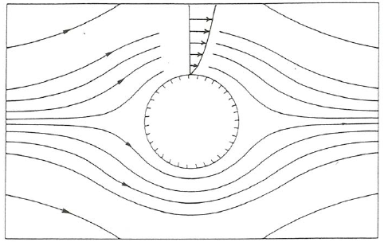
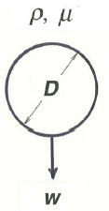
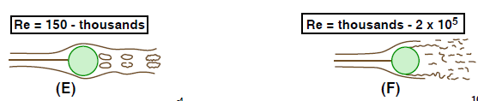
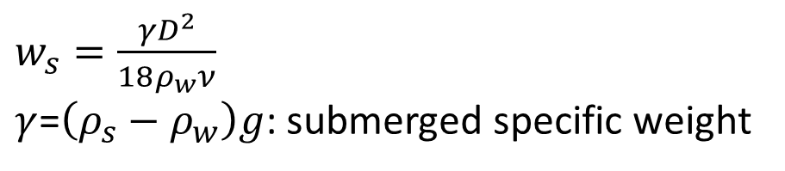
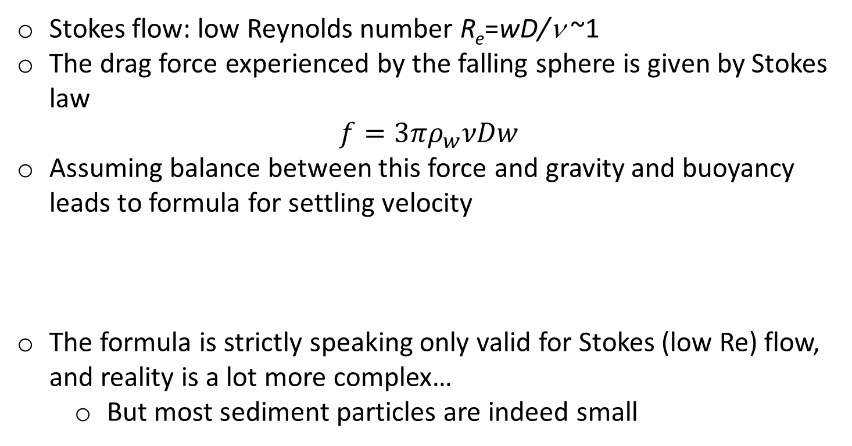
Stokes flow past a sphere: settling velocity
Stokes flow: low Reynolds number R_{e}=wD/ν ~1
The drag force experienced by the falling sphere is given by Stokes law
$$f=3{πρ}_{w}νDw$$
Assuming balance between this force and gravity and buoyancy leads to formula for settling velocity
The formula is strictly speaking only valid for Stokes (low Re) flow, and reality is a lot more complex…
But most sediment particles are indeed small
$w_{s}=\frac{{γD}^{2}}{18ρ_{w}ν}$
$γ$=$\left(ρ_{s}−ρ_{w}\right)g$: submerged specific weight

Slide 4
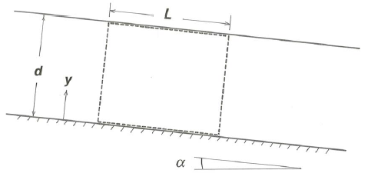
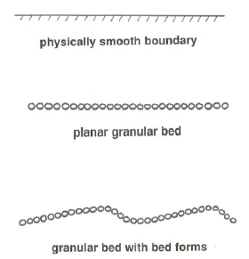
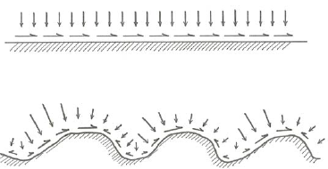
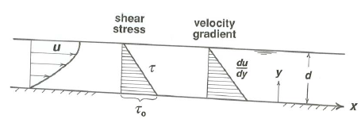
Open channel flow
Chezy flow (down a slope): commonly used in lab and in numerical models to represent turbulent open channel flow
Uniform flow is generated due to the balance between gravity and friction
Bottom drag
Viscous shear stress (tangential to bottom)
Pressure (normal to bottom): also known as form drag
Details depend on Re, bottom type etc. At higher Re, the form drag dominates
Laminar flow

Slide 5
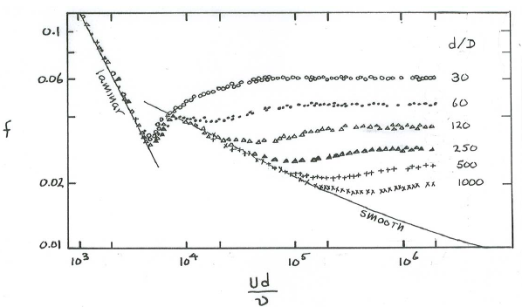

Bottom roughness
Full turbulence is assumed in the BBL: complex relationship with Re
The roughness consists of a few components: grain roughness (Nikuradse), bedload transport, and bedform roughness length (wave ripples and sand wave) from Soulsby (1997)
$$z_{0}=\max\left(z_{0N} ,\max\left(z_{0cr},z_{0wr}+z_{0bld}\right)+z_{0sw}\right))$$
$$z_{0N}=D_{50}/12$$
(Nikuradse)
Moody’s diagram
C_{D}

Slide 6
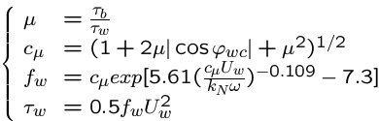
Wave bottom boundary layer
Bottom shear stress calculation with waves (Grant & Madsen formulation)
Ratio of shear stresses
angle between bottom current and dominant wave direction
τ_{b}: current induced bottom stress
U_{w}: orbital vel. amplitude
ω: representative angular freq.
The nonlinear eq. system is solved with a simple iterative scheme starting from μ=0 (pure wave), c_{μ}=1. Strong convergence is observed for practical applications

Slide 7
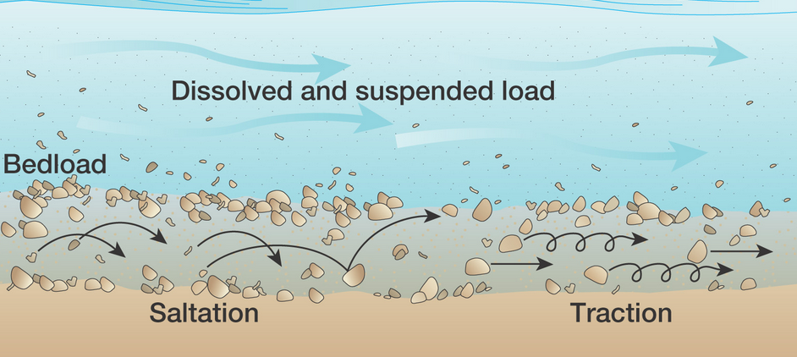
Sediment transport: terminology
Turbulent sediment-transporting flows represent one of the most difficult problems in all of fluid mechanics
• Relative inertia: ρ_{s}/ρ_{w}>>1 → little affected by fluid turbulence
• Particle size relative to eddy size: eddies may distort the particle path
• Turbulent velocity fluctuations relative to particle velocity: affects settling path
• The effect of acceleration on the drag force: Stokes law may no longer be applicable
Erosion: flow exerts sufficient force on a bed particle to set it into motion.
Suspension: The flow lifts particles away from the bed after entrainment
Saltation: particle undergo near-bed ballistic movement, largely unaffected by turbulence
Traction: particles are moved in contact with or close to the bed by fluid forces
Settling: Particles settle toward the bed through the surrounding fluid.
Hindered settling: The proximity of other settling particles hinders the settling of each particle.
Collisions: Differing velocities plus inertia leads to collisions (or close encounters) between particles.
Diffusion: Suspended sediment undergoes upward turbulent diffusion against the concentration gradient.
Deposition: Particles come to rest on the bed
Liquefaction: Rearrangement of packing in the bed leads to reduction in particle contact, partial or total support of particles by pore fluid, then refreezing of the texture by dewatering.

Slide 8
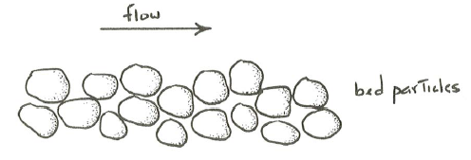
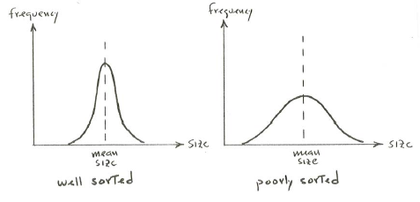
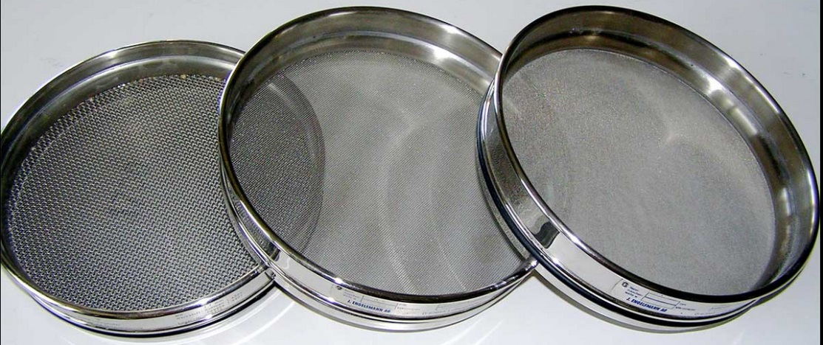
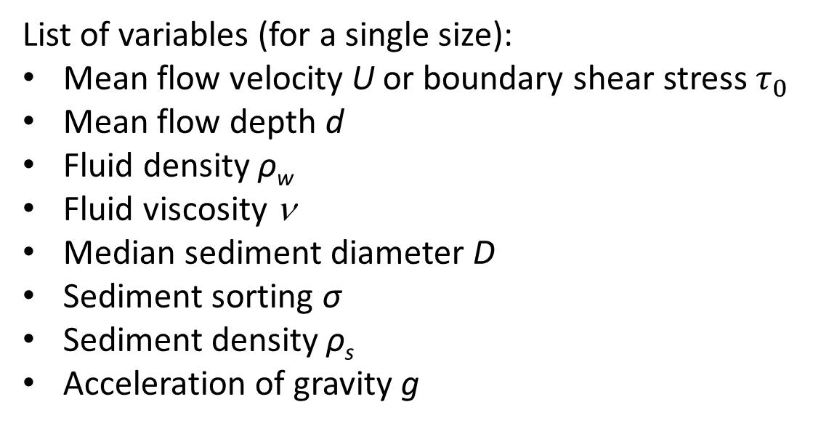
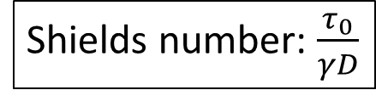
Sediment definitions
Size: nominal diameter (compared to a sphere); measured by a sieve
Mean/medium grain size
Sorting: often not uni-modal (e.g. bi-modal for natural sediments)
Dry bulk density
Active layer (bed surface)
substrate
Armored layer
List of variables (for a single size):
Mean flow velocity U or boundary shear stress $τ_{0}$
Mean flow depth d
Fluid density ρ_{w}
Fluid viscosity ν
Median sediment diameter D
Sediment sorting σ
Sediment density ρ_{s}
Acceleration of gravity g
size
Shields number: $\frac{τ_{0}}{γD}$
(initiation of sediment by flow)

Slide 9
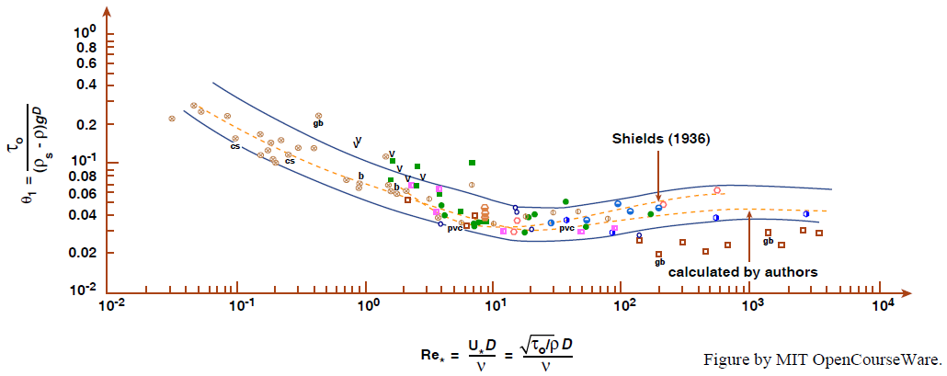


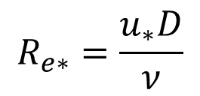
Initiation of motion: critical shear stress
Assuming non-cohesive sediment
Simple kinematic argument leads to a critical (turbulent) shear stress for initiation of sediment motion from the bed
$$\frac{τ_{c}}{γD}=f(R_{e∗})$$
Critical Shields #:
$$R_{e∗}=\frac{u_{∗}D}{ν}$$
Boundary Reynolds #:
$${(u}_{∗}=\sqrt{τ_{b}/ρ_{w}})$$
Shields diagram (Miller 1977)

Slide 10


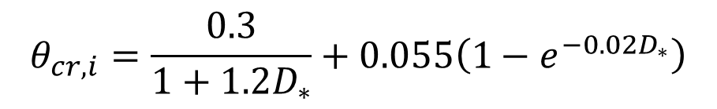
Critical shear stress: multi class
Selective entrainment: after the flow reaches steady state, the size distribution of the sediment on the bed surface is coarser than the substrate, as the flow selectively entrains the finer fractions in preference to the coarser fractions
Equal mobility (Parker et al. 1982)
Ratio of the fractional transport rate of a given size fraction to the proportion of the given size fraction in the bed sediment is the same for all of the size fractions
Hiding-sheltering and rollability effects balance the particle weight effect
$$τ_{ci}=γ_{i}D_{50,i}θ_{cr,i}$$
(ith class)
$$θ_{cr,i}=\frac{0.3}{1+1.2D_{∗}}+0.055\left(1−e^{−0.02D_{∗}}\right)$$
Critical Shields #
$$D_{∗}=D_{50,i}{\left[γ_{i}ρ_{w}/ν^{2}\right]}^{1/3}$$

Slide 11
Sediment transport model (SED3D)
Based on the SCHISM transport formulation
sediment advection and diffusion
Sediment vertical settling incorporated implicitly into TVD²
Erosion/deposition
based on the Regional Oceanographic Modeling System (ROMS) sediment transport module (Warner et al., 2008)
Bed load sediment transport
Van Rijn formula modified to include the influence of bed-slope
Bed elevation change (morphology)
adapted from the SAND2D bottom update model (Fortunato and Oliveira, 2004)

Slide 12
Flow chart
MORSELFE
SED
SCHISM-WWM-SED
-
SELFE
SCHISM
SELFE
hydrodynamic
hydrodynamic
•
•
water levels
water levels
•
•
velocity
velocity
ROMS sediment
Radiation
sediment
Radiation
•
•
bed load transport
stresses
bed load transport
stresses
•
•
suspended load transport
suspended load transport
•
•
Vertical settling
Vertical settling
•
•
Erosion/deposition
Erosion/deposition
Wave model
Wave model
SCHISM
SELFE
transport
transport
•
•
sediment advection and diffusion
sediment advection/diffusion/settling
updates bathymetry
updates bathymetry

Slide 13
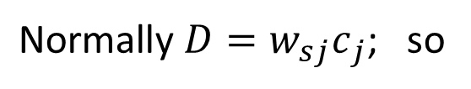
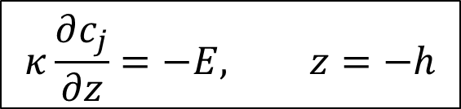
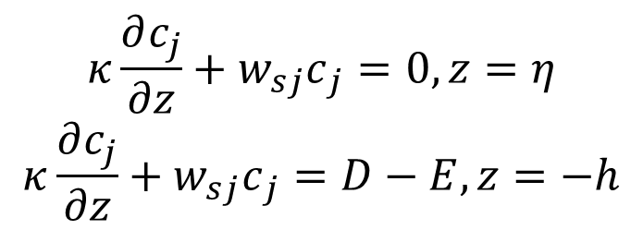
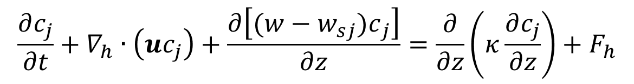
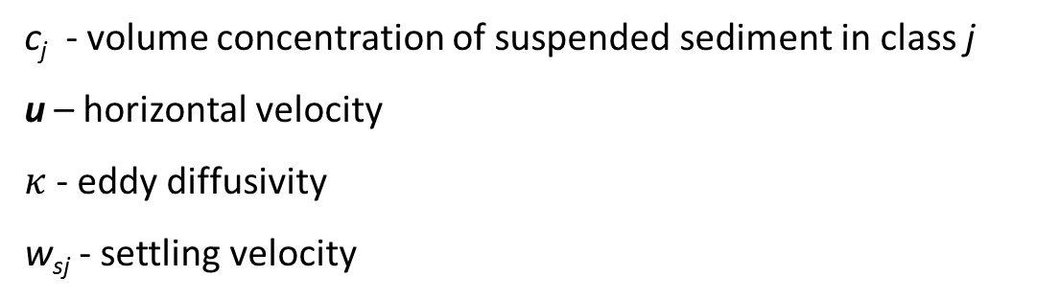
Suspended sediment transport
Advection-diffusion equation for each sediment size-class j with settling vel $w_{sj}$
$$\frac{∂c_{j}}{∂t}+∇_{h}∙\left(uc_{j}\right)+\frac{∂\left[{(w−w_{sj})c}_{j}\right]}{∂z}=\frac{∂}{∂z}\left(κ\frac{∂c_{j}}{∂z}\right)+F_{h}$$
(horizontal mixing)
c_{j} - volume concentration of suspended sediment in class j
u – horizontal velocity
$κ$- eddy diffusivity
w_{sj} - settling velocity
B.C.
$$κ\frac{∂c_{j}}{∂z}+{w_{sj}c}_{j}=0, z=η$$
$$κ\frac{∂c_{j}}{∂z}+{w_{sj}c}_{j}=D−E, z=−h$$
$$κ\frac{∂c_{j}}{∂z}=−E, z=−h$$
$\text{Normally} {D=w_{sj}c}_{j}$; so
In addition, D-E changes depth if morphology is turned on.

Slide 14
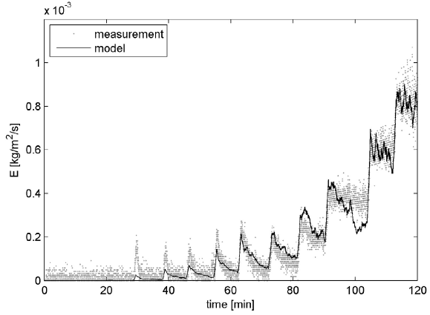
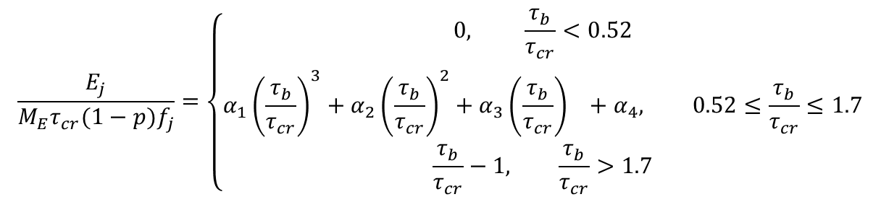

Erosion & Deposition
For each sediment class (j), the net flux into the water column is the sum of deposition flux (D) and erosion flux (E).
Deposition flux (evaluated using ELM for large Δt)
Erosion flux
Ariathurai and Arulanamdam, 1978)
$${D=w_{sj}c}_{j∗}$$
E_{0,j} - empirical entrainment rate
p - sediment porosity
f_{j} - volumetric fraction of sediment class j
τ_{cr,j} - critical shear stress for class j
τ_{b} – bed shear stress
Winterwerp (2012): to account for some cohesive behavior (without flocs)
$$\frac{E_{j}}{M_{E}τ_{cr}(1−p)f_{j}}=\left\{\begin{matrix}0, \frac{τ_{b}}{τ_{cr}}<0.52 \\ α_{1}{\left(\frac{τ_{b}}{τ_{cr}}\right)}^{3}+α_{2}{\left(\frac{τ_{b}}{τ_{cr}}\right)}^{2}+α_{3}{\left(\frac{τ_{b}}{τ_{cr}}\right)}^{}+α_{4}, 0.52≤\frac{τ_{b}}{τ_{cr}}≤1.7 \\ \frac{τ_{b}}{τ_{cr}}−1, \frac{τ_{b}}{τ_{cr}}>1.7\end{matrix}\right.$$
M_{E}: empirical const
*TVD² is modified to account for settling velocity

Slide 15
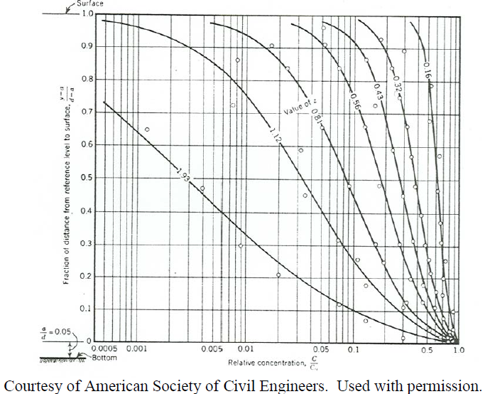
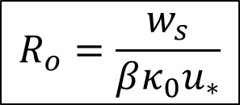
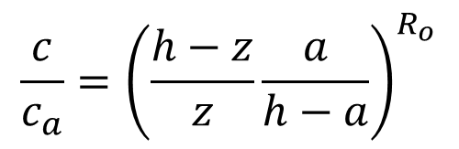

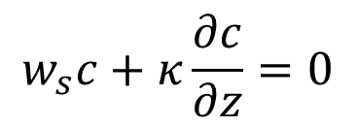
Rouse profile
Equilibrium suspended sediment profile under homogeneous and isotropic turbulence
Balance between settling and turbulent diffusion
$$w_{s}c+κ\frac{∂c}{∂z}=0$$
Profile of diffusivity for turbulent open-channel flow (z is measured from bed):
$$κ=βκ_{0}u_{∗}z(1−z/h)$$
So the solution is (z=a is a reference height):
$$\frac{c}{c_{a}}={\left(\frac{h−z}{z}\frac{a}{h−a}\right)}^{R_{o}}$$
Rouse number:
$$R_{o}=\frac{w_{s}}{βκ_{0}u_{∗}}$$
Larger Rouse number →sharper concentration gradient near bed

Slide 16
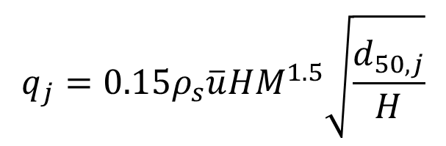
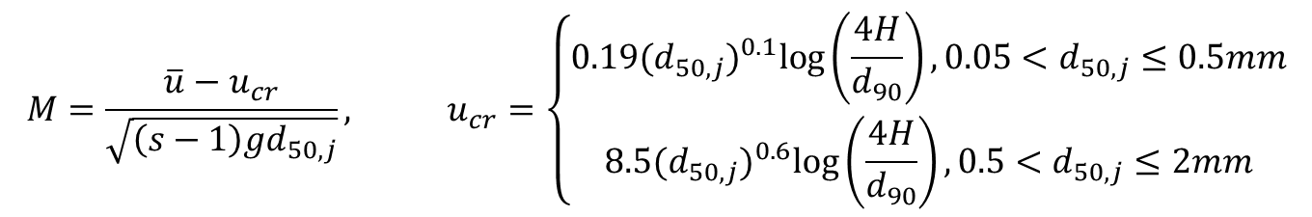
Bed-load transport and bed update
Bed-load is important for larger particles
Van Rijn (2007)
Modified to include the influence of bed-slope
Antunes do Carmo (1995); Soulsby (1997); Lesser et al. (2004); Damgaard et al. (1997) – magnitude & direction
$$q_{j}=0.15ρ_{s}\overline{u}HM^{1.5}\sqrt{\frac{d_{50,j}}{H}}$$
$$M=\frac{\overline{u}−u_{cr}}{\sqrt{\left(s−1\right)gd_{50,j}}}, u_{cr}=\left\{\begin{matrix}0.19{(d_{50,j})}^{0.1}\log\left(\frac{4H}{d_{90}}\right), 0.05<d_{50,j}≤0.5mm \\ 8.5{(d_{50,j})}^{0.6}\log\left(\frac{4H}{d_{90}}\right), 0.5<d_{50,j}≤2mm\end{matrix}\right.$$

Slide 17
Bed-load transport and bed update
Bed elevation change: Solves Exner equation with a node centered finite volume technique based on an unstructured grid:
h – depth
p – porosity
Q – residual sand flux from bedload transport
q – instantaneous sand flux

Slide 18
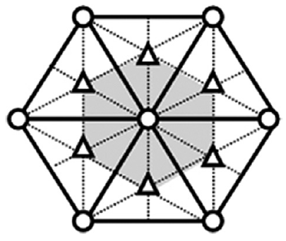
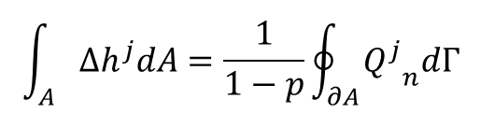
Bed update
Finite volume approximation on a medium-dual grid (SAND2D)
$$\int_{A}{∆h^{j}dA=\frac{1}{1−p}\oint_{∂A}{{Q_{}^{j}}_{n}dΓ}}$$
Matrix equation for Δh^{j} (@nodes) is solved with JCG (positive definite and symmetric).

Slide 19
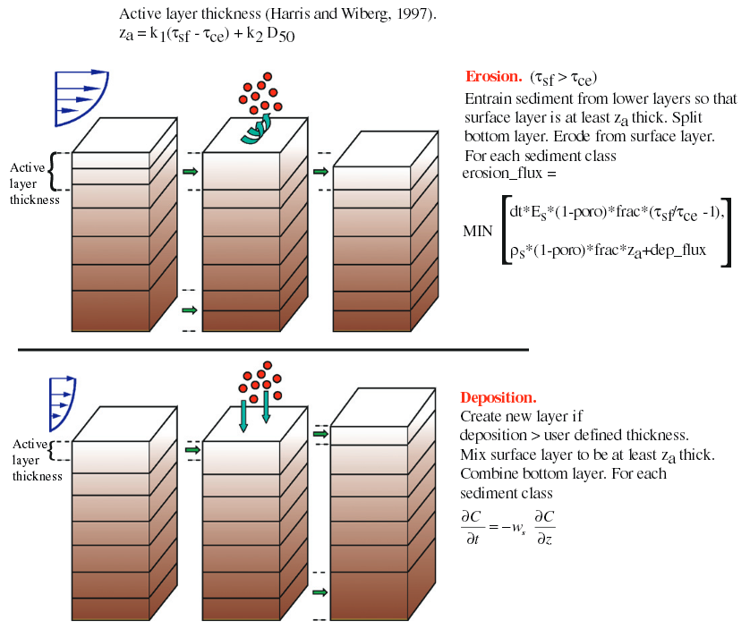
Bed model
Bed fraction update
Warner et al. (2008)

Slide 20
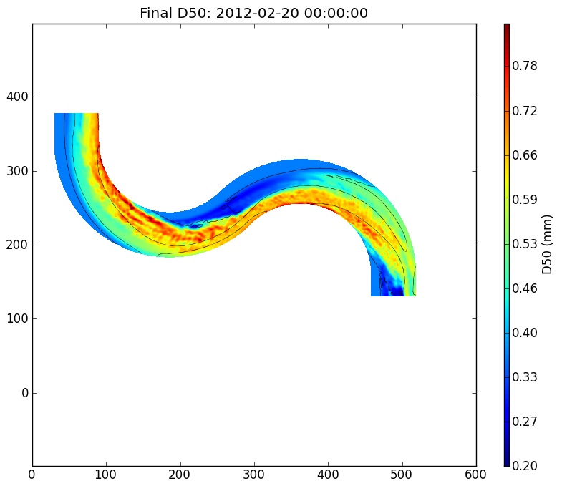
Sorting
Pavement: erosion of finer particles, leaving coarser ones on the bed surface layer →higher/lower concentration of coarse/fine sediments near bed
Armoring: after all finer particles eroded, the coarser particles in the bed can no longer be eroded under normal flow condition

Slide 21
Sediment code
sed_mod.F90
sediment.F90 (suspended load; link with WWM)
sed_init.F90
read_sed_input.F90
sed_avalanching.F90
sed_bedload.F90: Exner eq
sed_friction.F90: bottom shear stress, roughness etc (link with WWM)
sed_misc_subs.F90: settling vel, critical shear stress etc

Slide 22
Inputs/outputs
sediment.in: parameters
also set some in param.in: sed_class, ic_SED, inu_SED, outputs
*.ic: i.c. including bedthick.ic (initial thickness of the bed)
hotstart.in now includes sediment concentration part
(optional) *.th: similar to other modules
(optional) nudging: SED_nudge.gr3, SED_nu.in (similar to other modules)
When active morphology is turned on (sed_morph=1), it’s better to
Use a bare-rock region near inflow bnd via bedthick.ic
Use source/sink approach near river inflow bnd’s, as errors in sediment inflow, erosion/deposition may result in closure of bnd!
Outputs: *.61-3

Slide 23
sediment.in
!- BEDLOAD --------------------------------------------------------------------
!- 0 = Disabled
!- 1 = van rijn (2007)
!- 2 = Meyer-Peter and Mueller (1948) - not active
!------------------------------------------------------------------------------
bedload == 1
!- SUSPENDED LOAD -------------------------------------------------------------
!- 0 = Disabled
!- 1 = Enabled
!------------------------------------------------------------------------------
suspended_load == 1
!- Erosional formulations
!- 0 = Ariathurai & Arulanandan (1978)
!- 1 = Winterwerp et al. (2012)
! The dimension of the erosion constant SAND_ERATE varies with different formulations
!------------------------------------------------------------------------------
ierosion == 0
!- Dumping/dredging option
!- 0: no; 1: needs input sed_dump.in
------------------------------------------------------------------------------
ised_dump == 0
!- BOTTOM BOUNDARY CONDITION OPTION
!- 1 = Warner (2008)
!- 2 = Tsinghua Univ group (under dev)
!------------------------------------------------------------------------------
ised_bc_bot == 1
Note the ‘==‘ sign!

Slide 24
sediment.in
!------------------------------------------------------------------------------
!- MORPHOLOGY -----------------------------------------------------------------
!- 0 = Disabled
!- 1 = Fully Enabled (Bed characteristics + bathymetry are updated)
!- 2 = Partially Enabled (Only bed characteristics are updated for BCG purpose)
! If sed_morph=1, sed_morph_time (in days) is the time after which active morphology is turned on.
!------------------------------------------------------------------------------
sed_morph == 1
sed_morph_time == 5.d0
!- SEDIMENT DENSITY IN STATE EQUATION -----------------------------------------
!- 0 = Disabled
!- 1 = Enabled
!------------------------------------------------------------------------------
ddensed == 0

Slide 25
sediment.in
!- COMPUTATION OF SEDIMENT SETTLING VELOCITY ---------------
!- (Soulsby, 1997)
!- 0 = Disabled (user-defined settling velocity)
!- 1 = Enabled (Computed from SAND_SD50 and SAND_SRHO)
!------------------------------------------------------------------------------
comp_ws == 0
!- COMPUTATION OF SEDIMENT CRITICAL SHEAR STRESS ---------
!- (Soulsby, 1997), from critical Shields parameter
!- 0 = Disabled (user defined)
!- 1 = Enabled
!------------------------------------------------------------------------------
comp_tauce == 0
!- ROUGHNESS LENGTH PREDICTION FROM BEDFORMS ----------------------------------
!- bedforms_rough:
!- 0 = Disabled (rough.gr3 for hydrodynamic and sediment)
!- 1 = Z0 bedforms for hydrodynamics (if bfric=1) / Nikurasde for sediment (Van Rijn, 2007)
!- 2 = Z0 bedforms for both hydrodynamics (if bfric=1) and sediment
! (so '1' and '2' will send total roughness back to hydro, but total roughness
! is limited to dzb_min*0.1 - see sed_friction.F90)
!- iwave_ripple:
!- 0 = wave ripples computes following Grant and Madsen (1982)
!- 1 = wave ripples computes following Nielsen (1992)
!- irough_bdld:
!- 0 = no roughness induced by sediment transport
!- 1 = roughness induced by sediment transport (method following iwave_ripple)
! Note: iwave_ripple and irough_bdld are only used when WWM is invoked
!------------------------------------------------------------------------------
bedforms_rough == 2
iwave_ripple == 0
irough_bdld == 0
!- SLUMPING OF SEDIMENTS (AVALANCHING) ---
!- slope_avalanching:
!- 0 = Disabled
!- 1 = Enabled
!- dry_slope_cr: Critical slope for dry element
!- wet_slope_cr: Critical slope for wet element
!---------------------------------------------------------------
slope_avalanching == 1
dry_slope_cr == 1.0
wet_slope_cr == 0.3

Slide 26
sediment.in
!- BEDLOAD DIFFUSION COEFFICIENT (-) (>=0.0) ----------------------------------
!------------------------------------------------------------------------------
bdldiffu == 5.d0
!- BEDLOAD TRANSPORT RATE COEFFICIENT (-) -------------------------------------
! [0,1]; original flux is applied with 1
!------------------------------------------------------------------------------
BEDLOAD_COEFF == 1.0d0
!- MINIMUM AND MAXIMUM THRESHOLD FOR bottom drag coefficient [-]
!------------------------------------------------------------------------------
Cdb_min == 0.000001
Cdb_max == 0.01

Slide 27
sediment.in
!- SEDIMENT TYPE - [1:Ntracers] -----------------------------------------------
SED_TYPE == 1 1 1 1 1 !5 classes
!- D50 MEDIAN SEDIMENT GRAIN DIAMETER (mm) - [1:Ntracers] ---------------------
!------------------------------------------------------------------------------
SAND_SD50 == 0.12d0 0.18d0 0.39d0 0.60d0 1.2d0
!- SEDIMENT GRAIN DENSITY (kg/m3) - [1:Ntracers] ------------------------------
!------------------------------------------------------------------------------
SAND_SRHO == 2650.0d0 2650.0d0 2650.0d0 2650.0d0 2650.0d0
!- PATICLES SETTLING VELOCITY (mm/s) - [1:Ntracers] ---------------------------
! These will be overwritten if comp_ws=1 & Sedtype(i)=1 (so in that case you can
! comment this line out)
!------------------------------------------------------------------------------
SAND_WSED == 8.06d0 16.92d0 51.43d0 78.19d0 128.65d0
!- SURFACE EROSION RATE, E0 - [1:Ntracers] --------------------------
! If ierosion=0, dimension is kg/m/m/s
! If ierosion=1, dimension is s/m (see M_E of Table 1 of Winterwerp et al. 2012, JGR, vol 117)
!------------------------------------------------------------------------------
SAND_ERATE == 1.6d-3 1.6d-3 1.6d-3 1.6d-3 1.6d-3 !ierosion=0

Slide 28
sediment.in
!- CRITICAL SHEAR STRESS FOR EROSION (Pa) - [1:Ntracers] -----
! These will be overwritten if comp_tauce=1 and Sedtype(i)=1 (so in that case you can
! comment this line out)
!------------------------------------------------------------------------------
SAND_TAU_CE == 0.15d0 0.17d0 0.23d0 0.3d0 0.6d0
!- MORPHOLOGICAL TIME-SCALE FACTOR (>= 1.) - [1:Ntracers] ---------------------
!- A value of 1.0 lead to no scale effect.
!------------------------------------------------------------------------------
SAND_MORPH_FAC == 1.0d0 1.0d0 1.0d0 1.0d0 1.0d0

Slide 29
sediment.in
!==============================================================================
!- BED SEDIMENT PARAMETERS -
!==============================================================================
!- NUMBER OF BED LAYERS (-) ---------------------------------------------------
!------------------------------------------------------------------------------
Nbed == 1
!- BED LAYER THICKNESS THRESHOLD (m) ------------------------------------------
!- If deposition exceed this value, a new layer is created
! but the active layer thickness is given in bottom(:,:,iactv)
! Using a large value to bypass this, which enhances sorting stability
!------------------------------------------------------------------------------
!NEWLAYER_THICK == 0.001d0 → Smaller value speeds up sorting
NEWLAYER_THICK == 100.d0

Slide 30
Tuning sediment transport
A few important considerations for sediment simulation
Turbulence closure scheme
dzb_min: make sure not to truncate large C_{D} too soon in shallow water; dzb_decay=0
Vgrid (sed profile)
Δt: may need to be reduced in the case of very active morph
Active morphology (as in marsh)
May use a bare-rock region near bnd where vel is imposed, because the bottom shear stress at the bnd is not accurate
Impose inflow suspended sed conc using mass sources instead of b.c. to prevent large changes of depths at bnd
If bedload is important, adjust bdldiffu (to avoid too steep front) and BEDLOAD_COEFF (to adjust migration distance etc)
Morphological acceleration to save time
Only works if the forcing is periodic
Erosional and depositional masses at a time step are scaled up
Some bed properties are adjusted accordingly (e.g. mass, fraction)

Slide 31
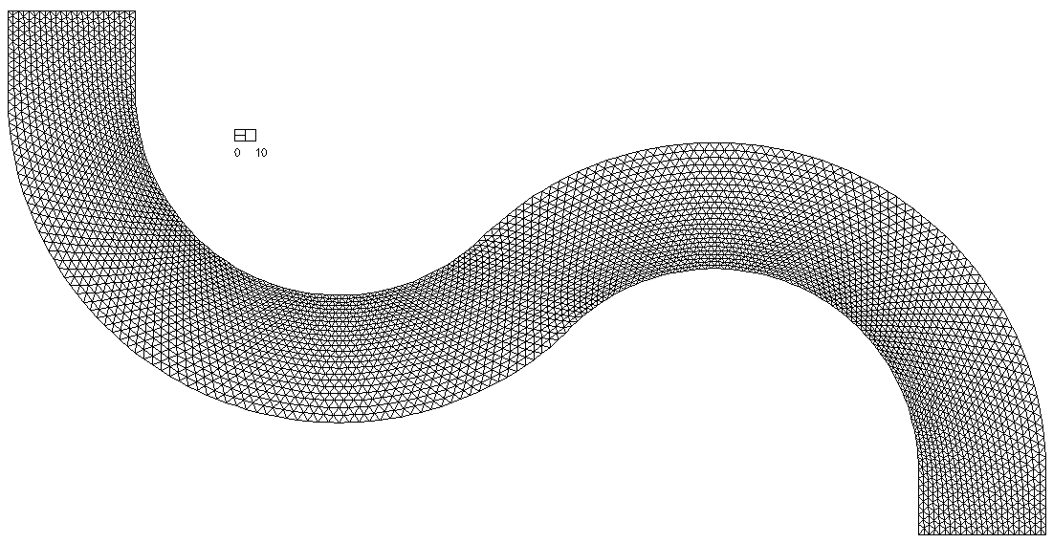
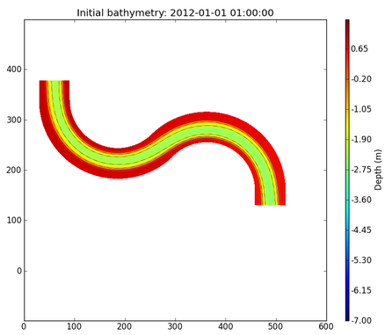
Channel meandering
η=0.4m
10m
η=0 m

Slide 32
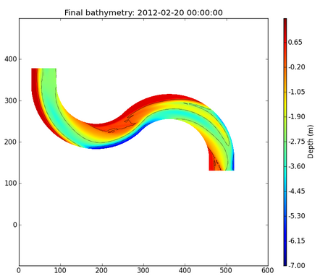
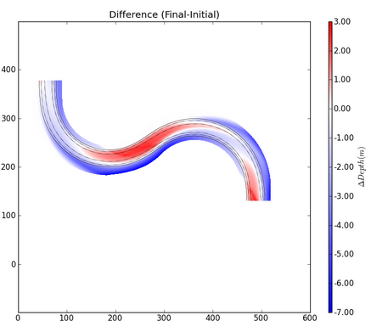
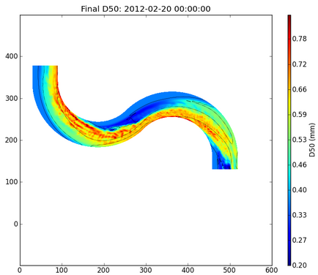
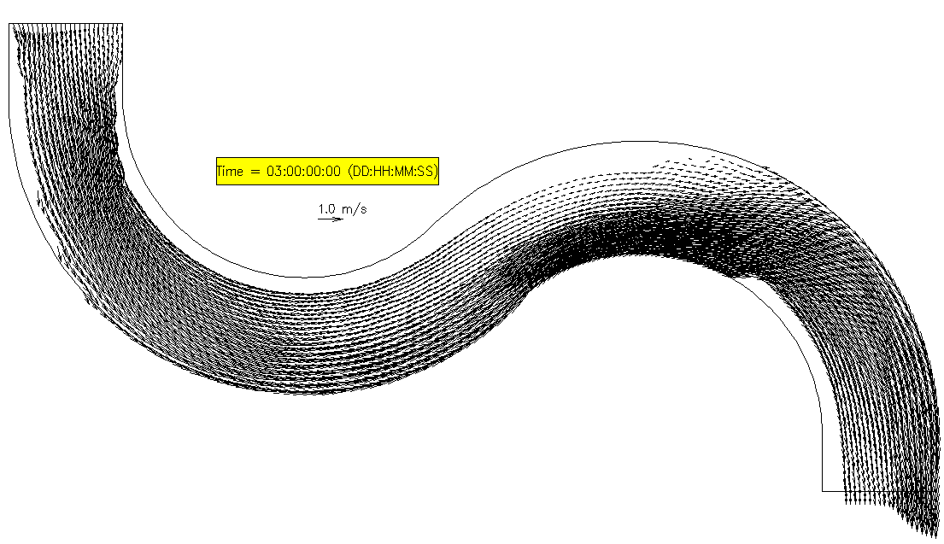
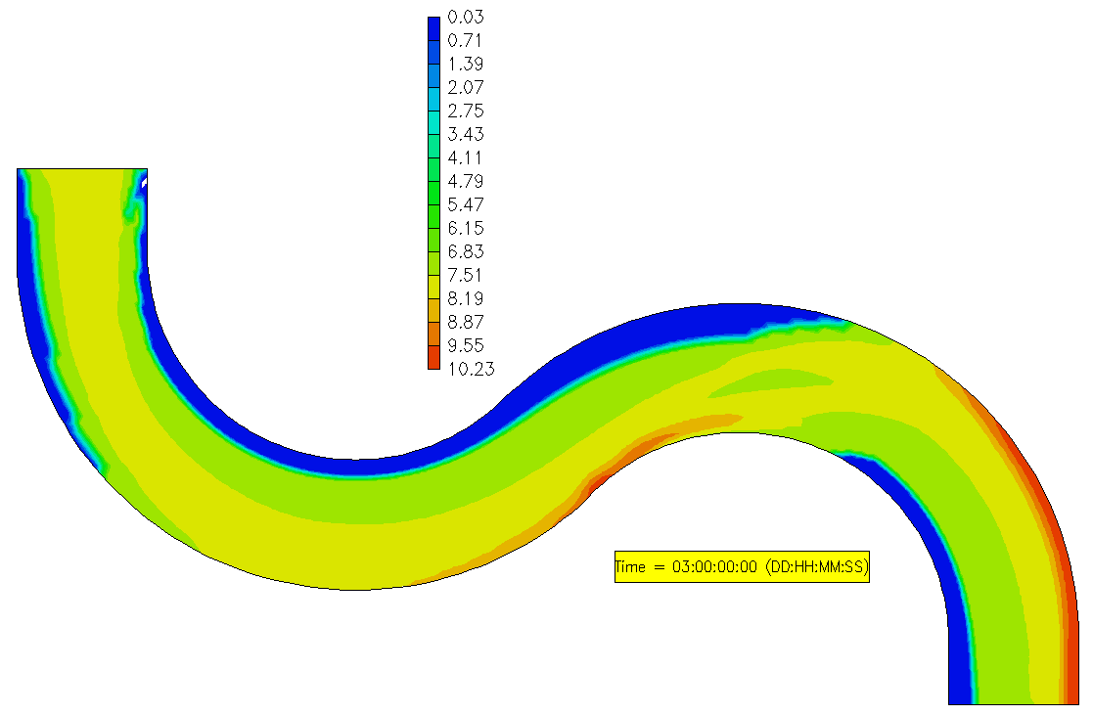
Channel meandering
With MF=10
Bottom roughness (mm)

Slide 33
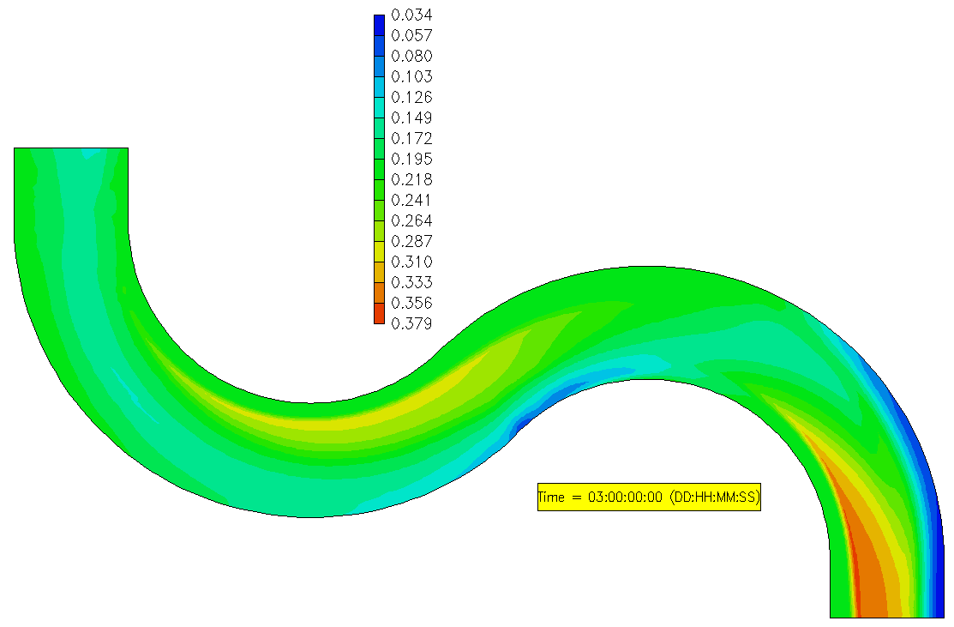
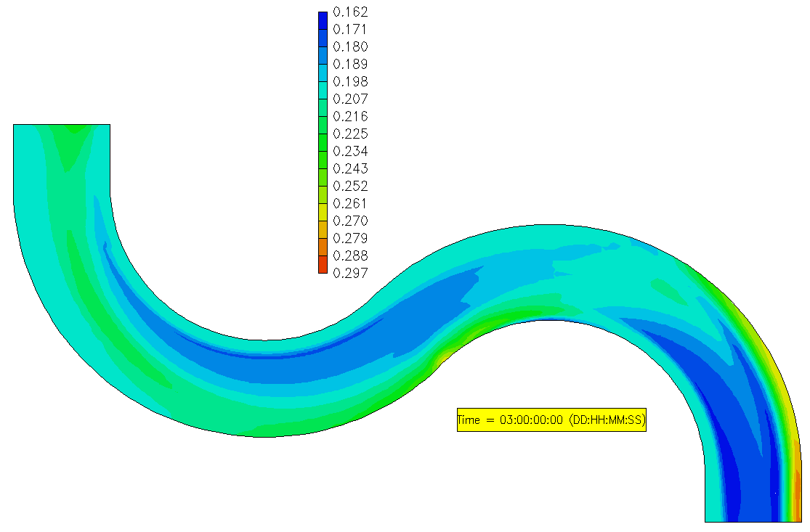
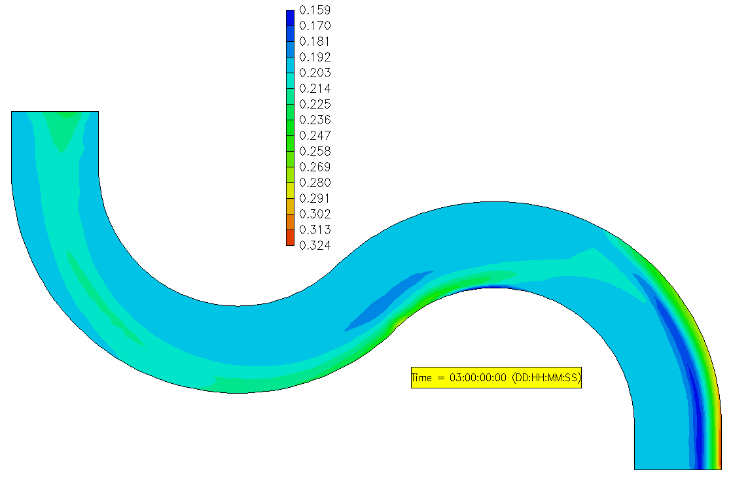
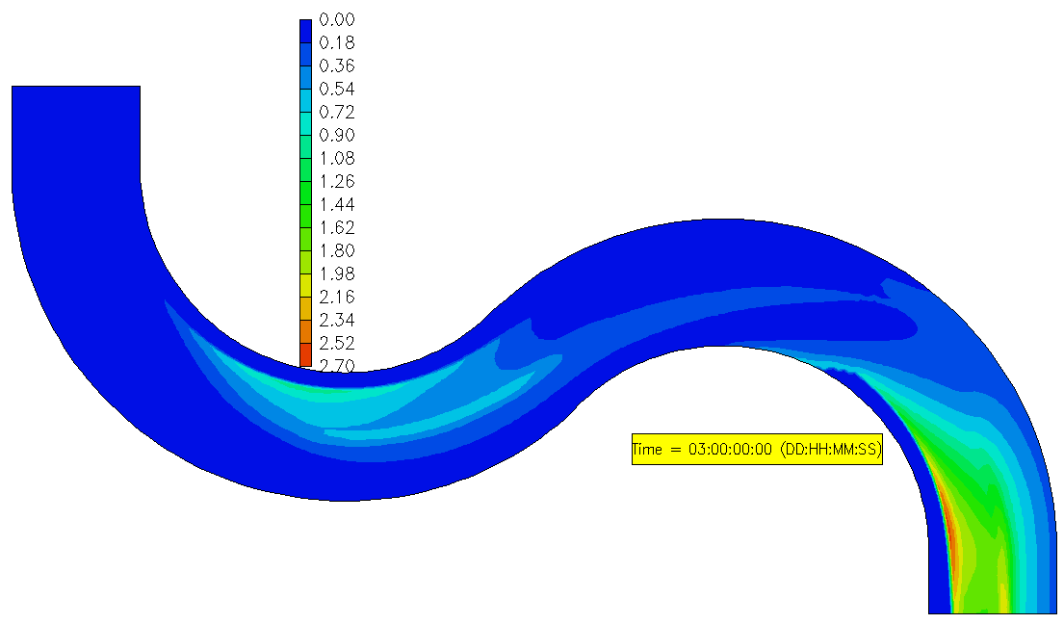
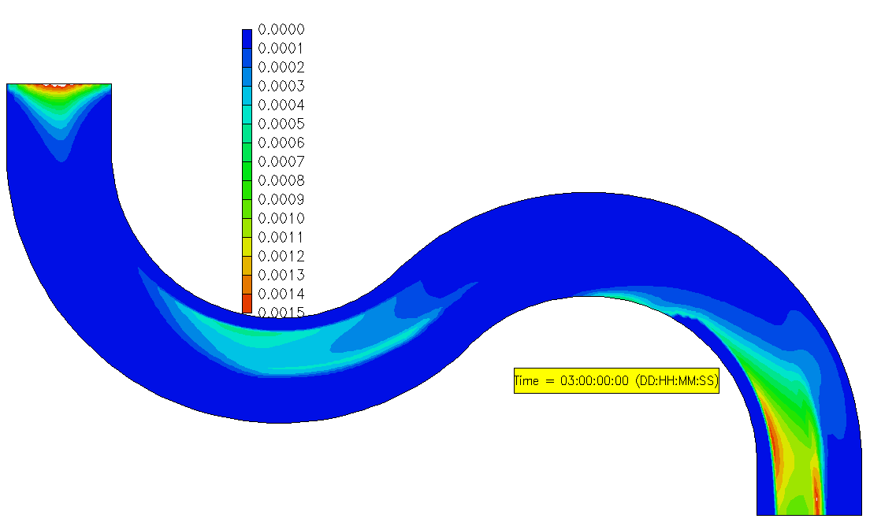
Sorting
Fraction
Class #1
Class #3
Class #5
Surface conc [g/L]
Class #3
Class #1

Slide 34


Idealized beach

Slide 35
Marsh migration module

Slide 36

Basic algorithm
Physics only at the moment
Initially all elements are marked as either marsh or non-marsh or barrier
Barrier elements will never become marsh and they’ll stop marsh migration from neighboring elements
At a given time step, find the max/min depths in an elem: S_{max}=h_{max}+h_{SLR}, and S_{min}=h_{min}+h_{SLR} (adjusted by SLR)
If the elem was marsh last step, and S_{max}>0.5m, it’s drowned and converted to non-marsh
If the elem was non-marsh last step, and -1 ≤ S_{min}≤0.25m, and none of its neighbors are barrier, then it becomes marsh
Barrier
Marsh

Slide 37


Inputs/outputs
Compiling: USE_MARSH, USE_SED, USE_WWM
param.in: slr_rate, mrsh.66
i.c.
marsh_init.prop: 0/1; right now roughness will be increased for marsh elements to 1cm (Cd=0.05)
marsh_barrier.prop: 0/1
Upland sources: via volume/mass sources
source_sink.in, vsource.th, msource.th
Script utilizes the one for interpolation between 2 UG’s
Inputs for SED3D (D50, fractions etc)
Inputs for WWM
Outputs: mrsh.66 (needs centers.gr3 for combining)
Latest marsh run: /sciclone/home10/yinglong/vims20/ChesapeakeBay/RUN201g

Slide 38

Marsh model setup: hydro
Vgrid: currently 2D
B.C.
Flow at Matt. And Pamunky R.
Elev at ocean and upper Bay bnd (with SLR): see Elev/
Clear water inflow (C=0)
Bottom roughness (rough.gr3): 1cm in marsh elements, 0.1mm elsewhere (see Cd/)
Volume/mass sources
Related to upland sources
Volume source is derived from annual precipitation rate (44 inch/yr)
Mass sources include: bogus T,S; sediment conc of 2kg/L (un-diluted dry mud)
elev.th
+ elev2D.th
SLR

Slide 39

Marsh model setup: WWM
No B.C.
Waves internally generated
Hs (m)

Slide 40

Marsh model setup: SED
3 classes: silt, clay and sand (D50 = 0.05, 0.10, 0.20 mm)
I.C.
Bed thickness: bare rock near bnd’s (can be relaxed); 0 in barrier elements (generated by ../Scripts/find_elements.f90)
Bed fraction: loosely based on survey data (25%, 25%, 50%) – probably need to sort them initially (sed_morph=2); large supply (5m bed)
No suspended sediment initially
Initial marsh and barrier locations (marsh_barrier.prop & marsh_init.prop): generated by ../Scripts/find_elements.f90 using info from Karinna et al.; see Barrier/
B.C.: no suspended sediment inflow
Bedload off: important for slopy marshes?
Upland sediment supply: from Julie
source_sink.in, [m,v]source.th
Generated by ../Scripts/find_elements.f90 by searching for nearest wet element
Morph factor of 30 (i.e. 1yr →30 yrs)
bedthick.ic (m)

Slide 41



Marsh model setup: SED
marsh_init.prop
marsh_barrier.prop
bedthick.ic (m)

Slide 42

Upland sources
Probably the largest source of uncertainty
Right now just applied a constant rate of volume source (44 inch /yr) and a constant density (dry mud) →constant soil erosion rate over time
Did not incorporate all of Julie’s info – this is left for future development
Other fine tunings: maybe just add to bottom elevation?

Slide 43
Issues and TODOs
Code
Tweak migration algorithm
Slumping of edge due to wave attack
Time series of M.A.
Parameters
Bathymetry error
hgrid: needs to incorporate all features a prior; add upper Bay & Jame R. back
param.in: dzb_min, dt, itur
Bottom roughness: use vegetationform drag?
sediment.in: erosion const, grain size/class, bedforms_rough, bedload (and coefficients)?; avalanching
Sediment supply (bedthick.ic): 5m enough?
Add Isabel
vgrid (b-clinic?): LSC2
B.C.: suspended load from inflow?
Forcings
Upland: how to translate sources into suspended load?

