Slide 1
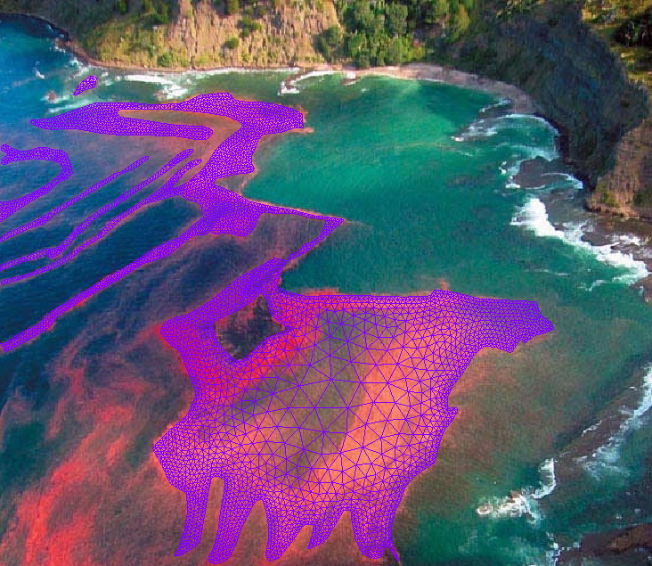

Introduction: Seamless Cross-scale Modeling with
Joseph Zhang
Virginia Institute of Marine Science
Center for Coastal Resource Management

Slide 2
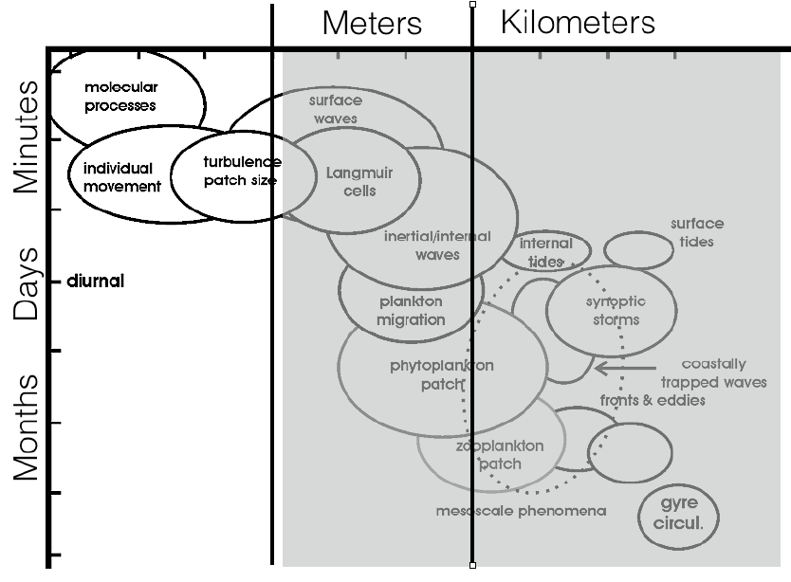
Matter of scales…

Slide 3
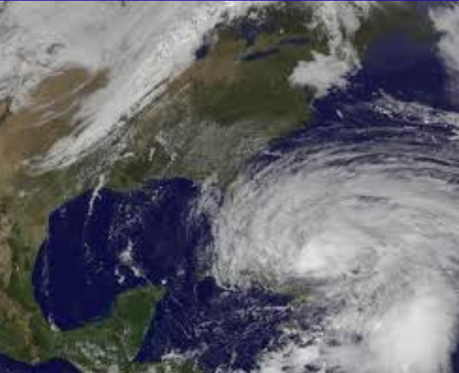
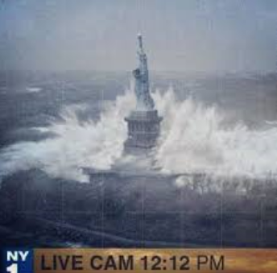
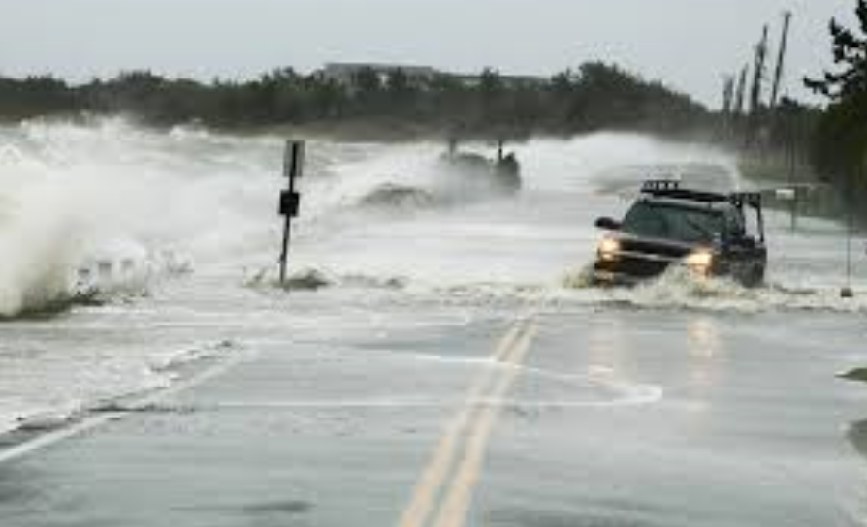
Notes:
Hurricane Sandy

Slide 4
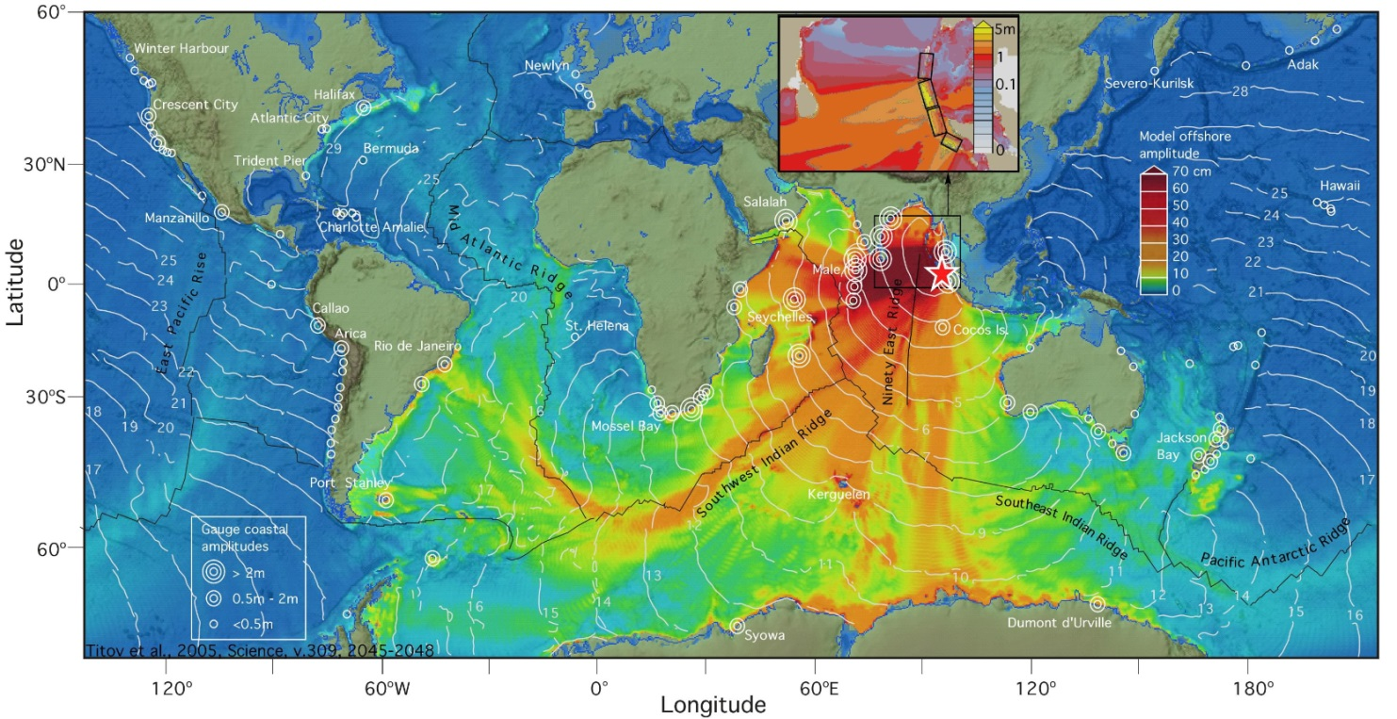
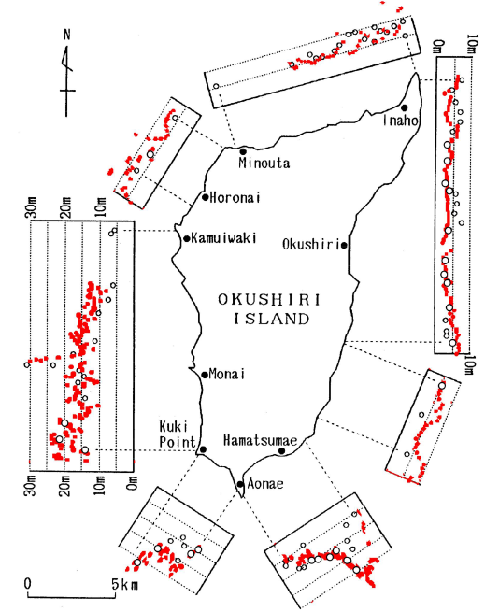
Tsunamis

Slide 5
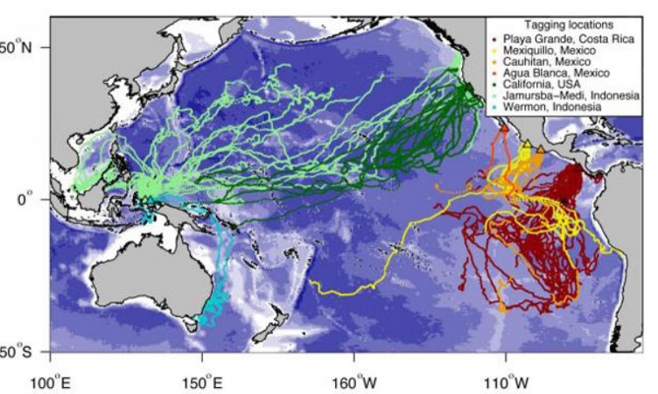
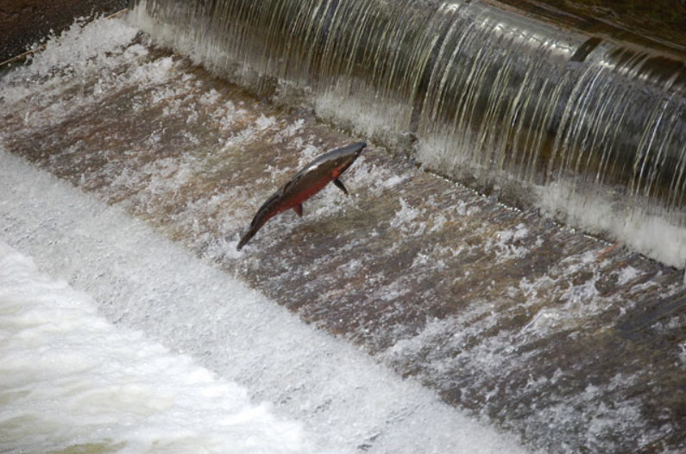
The messy reality…
Dam(n)!

Slide 6
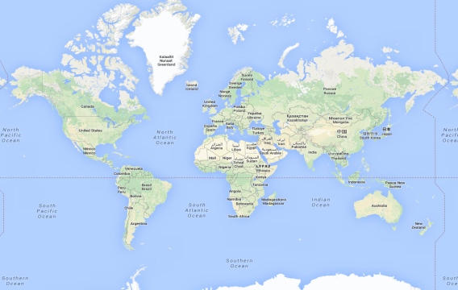


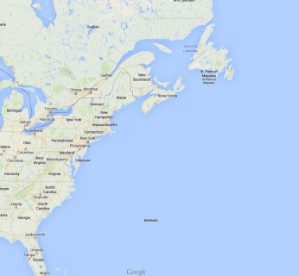
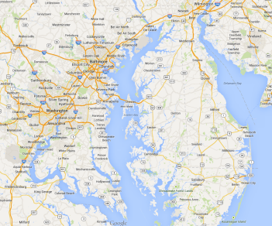
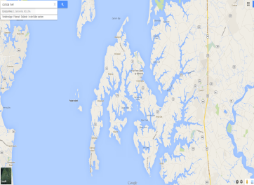
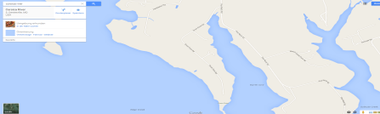
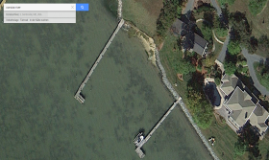
Resolution is king
Notes:
Issue of cross-scale modeling (both up- and down-scaling)
Upscaling: ghost ships from 2011 Tohoku tsunami were found at US west coast 1 year after

Slide 7
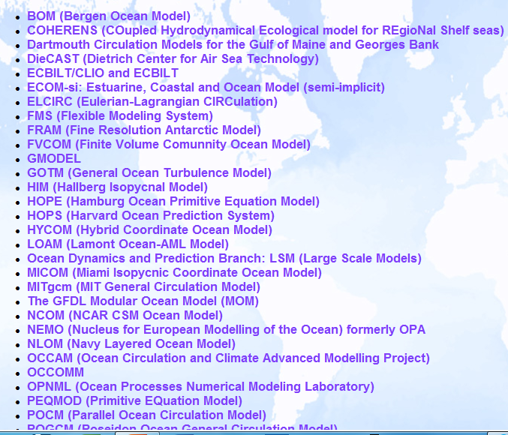
Existing hydrodynamic models
Explicit ‘mode-splitting’ models
  Solves the hydrostatic equations in external and internal mode separately (splitting errors)
  Easy to implement (with possible exception of filters), and well understood
  99% of the existing models
  Subject to CFL constraints (severe in shallow water)
  Structured and unstructured grids
  Excellent parallel scaling
Implicit models: the cross-scale models
  Solve the HS equations in one time step (no mode splitting errors)
  Difficult to implement (and parallelize)
  No CFL constraints
  Mostly on unstructured grids
  Parallel scaling not as good
UnTRIM
SUNTANS
ELCIRC
SHYFEM
ECOM-si
SELFE/SCHISM
Notes:
Implicit DG models under dev.

Slide 8
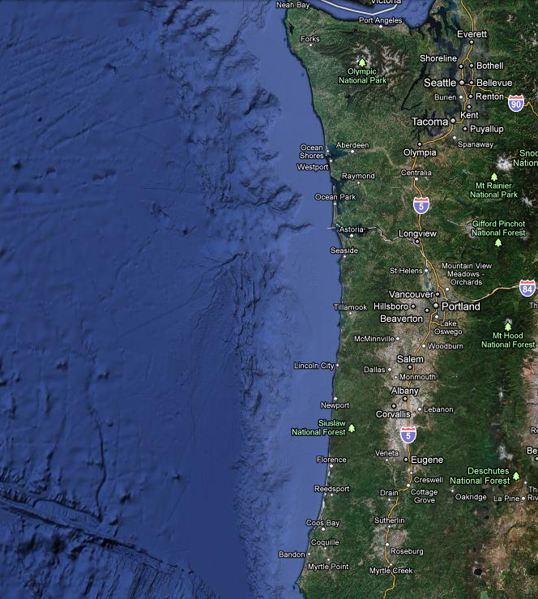
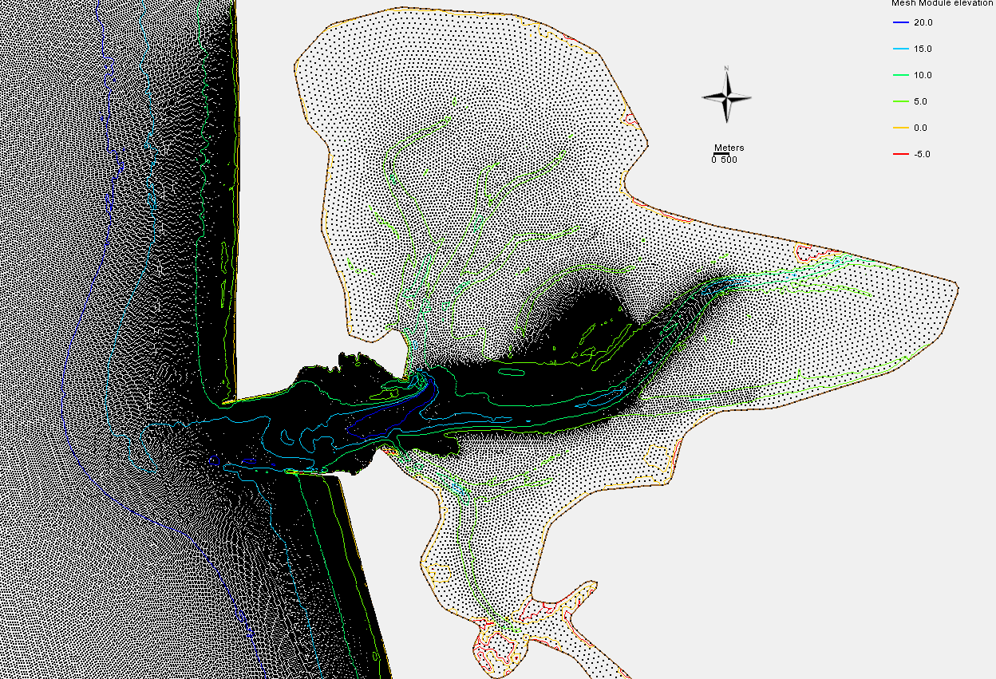
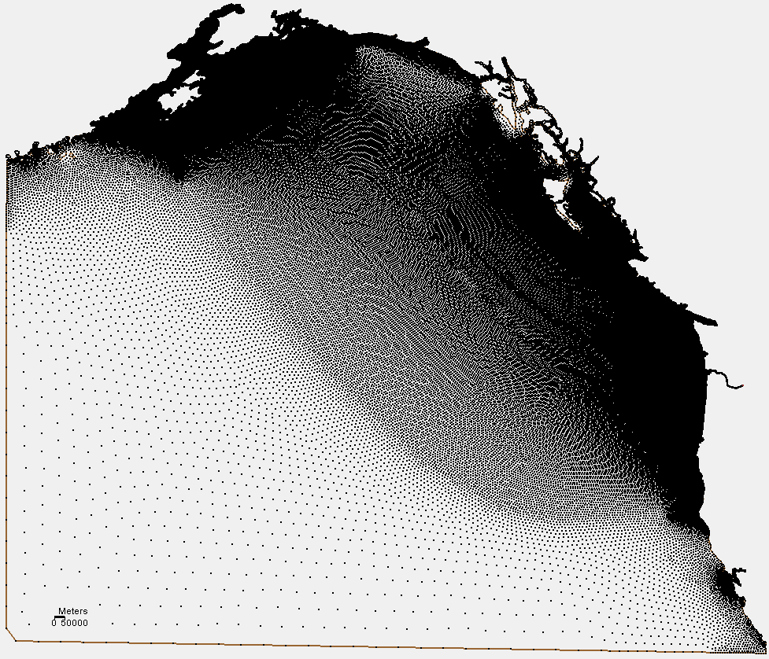
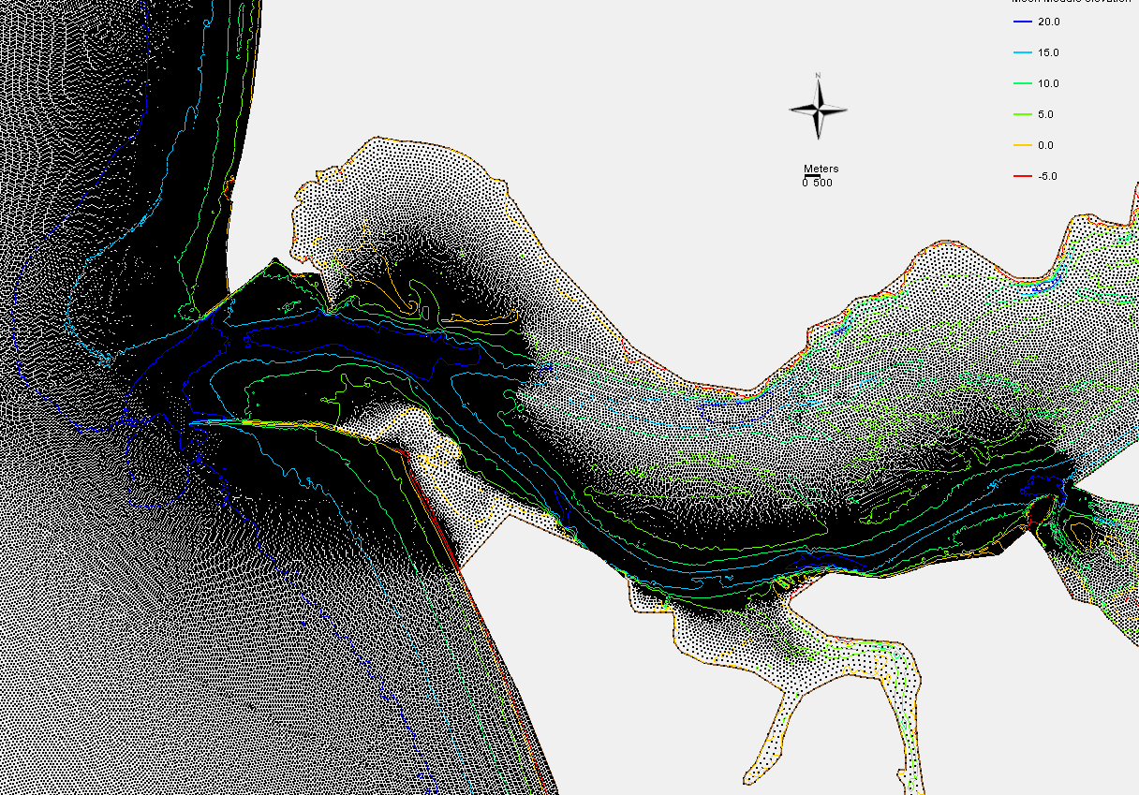
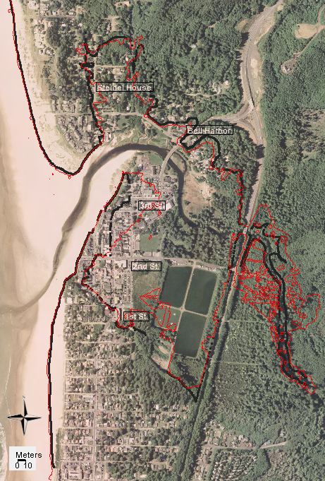
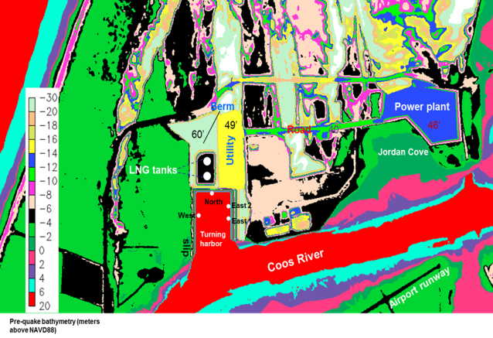
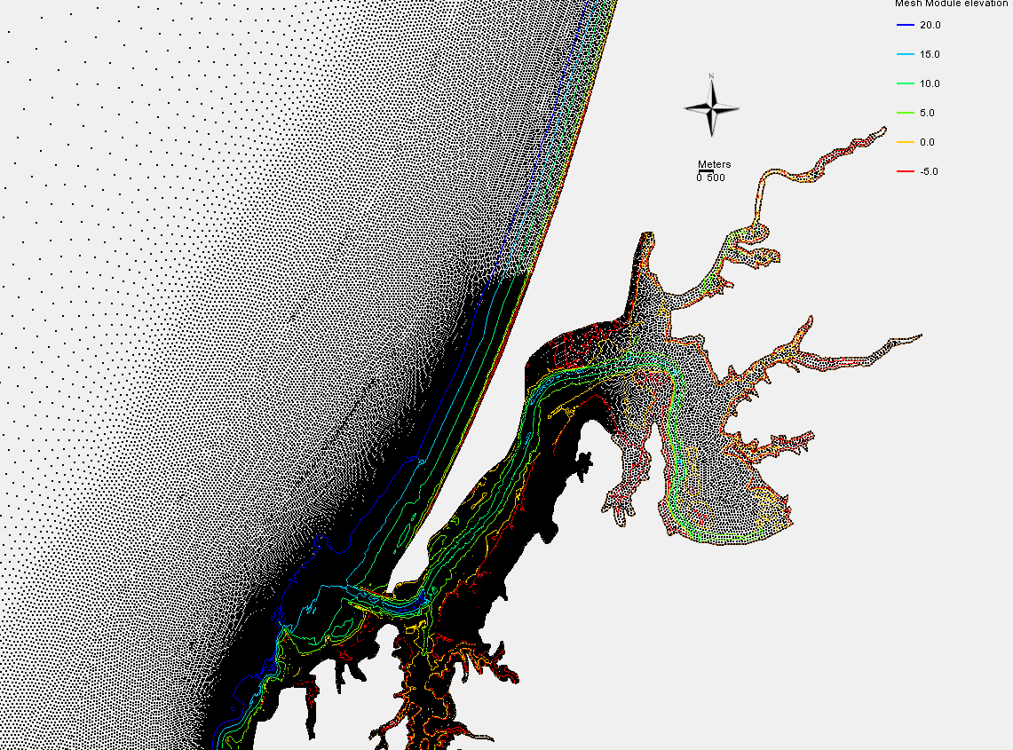
Cross-scale modeling with UG
500m
Grays Harbor
Columbia River
500m
Pacific
50km
500m
Coos Bay

Slide 9
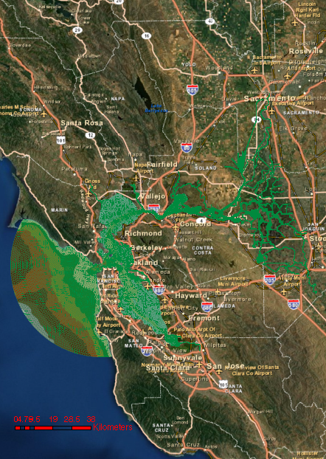
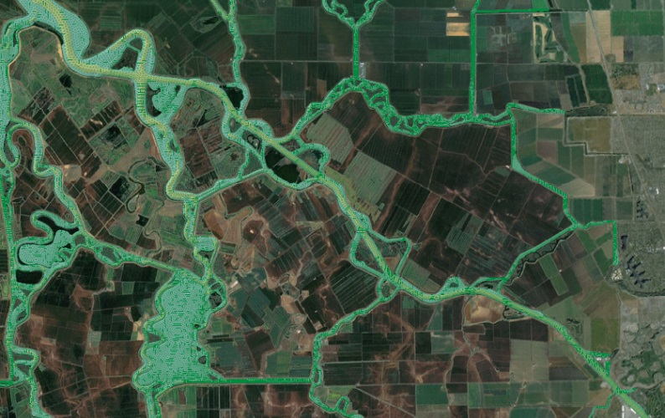
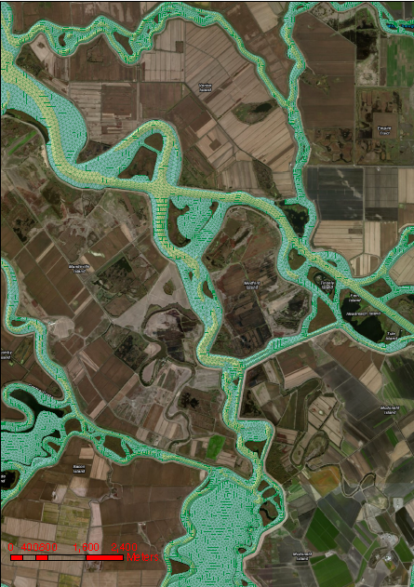
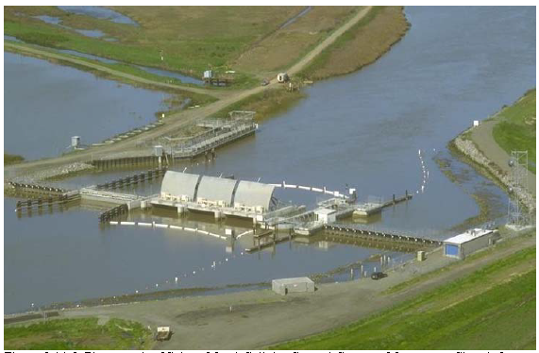
Cross-scale modeling with UG
Notes:
e.g. of cross scale: butterfly effects

Slide 10
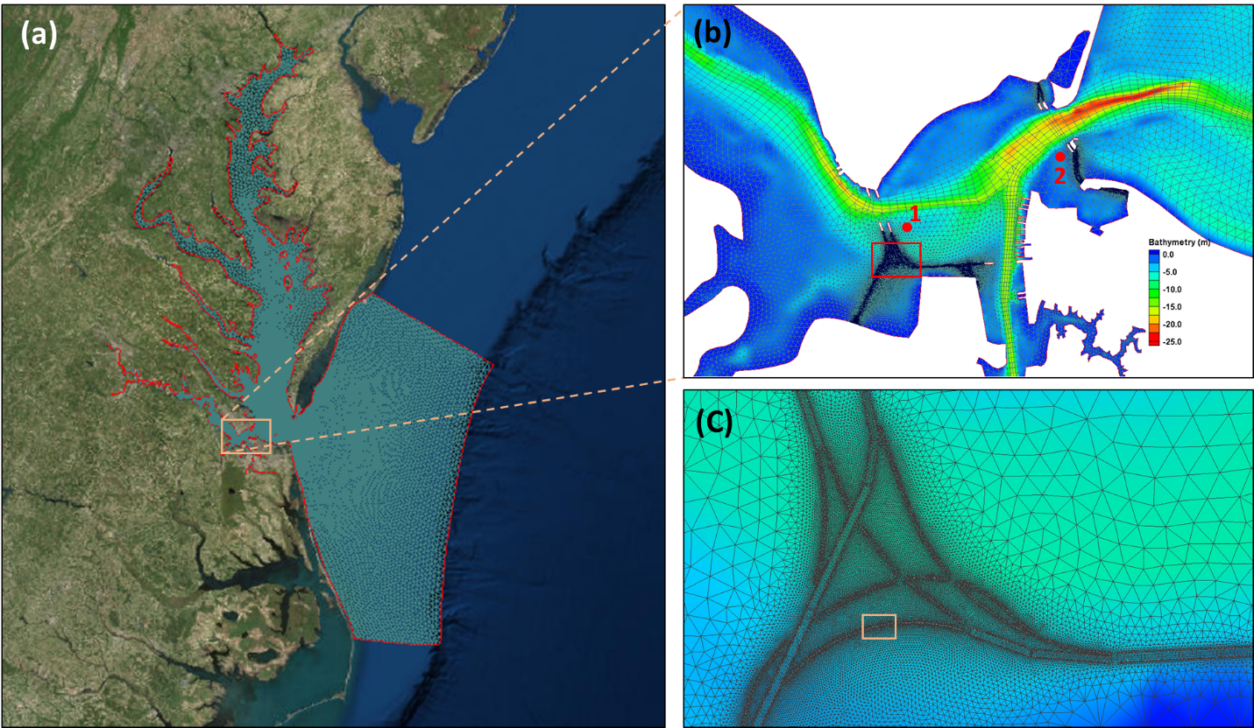
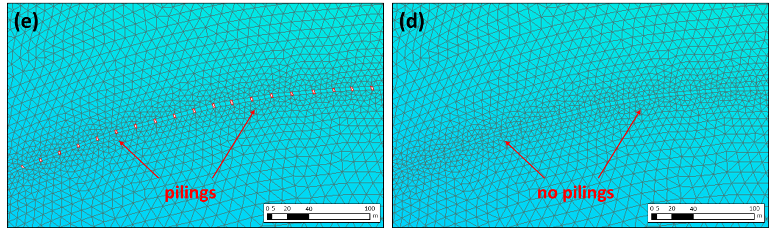
Cross-scale modeling with UG
Notes:
e.g. of cross scale: butterfly effects

Slide 11
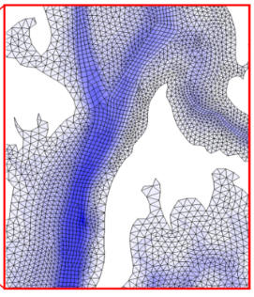



SCHISM: Semi-implicit Cross-scale Hydroscience Integrated System Model
A derivative product of SELFE v3.1, distributed with open-source Apache v2 license
  Substantial differences now exist between the two models
  Free svn access to release branch for general public
Galerkin finite-element and finite-volume approach: generic unstructured triangular grids
  ELCIRC (Zhang et al. 2005), UnTRIM (Casulli 1990; 2010), SUNTANS (Fringer 2006): finite-difference/volume approach →orthogonal grid
  Hydrostatic or non-hydrostatic options
Semi-implicit time stepping: no mode splitting → large time step and no splitting errors
Eulerian-Lagrangian method (ELM) for momentum advection → more efficiency & robustness
Major differences from SELFE v3.1
  Apache license
  Mixed grids (tri-quads)
  LSC² vertical grid (Zhang et al. 2015)
  Implicit TVD transport (TVD²)
  Higher-order ELM with ELAD
  Bi-harmonic viscosity
SELFE
SCHISM
Eddying regime (Zhang et al. 2016)
visit schism.wiki

Slide 12
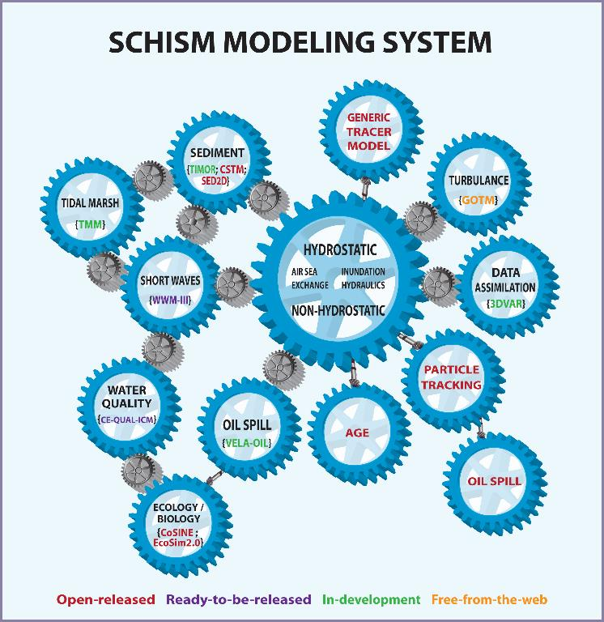
SCHISM modeling system
c/o Karinna Nunez
Notes:
Marsh model

Slide 13
Why SCHISM?
Major differentiators from peers
  Implicit FE solvers → superior stability → very tolerant of bad-quality meshes
  No bathymetry smoothing or manipulation necessary: faithful representation of bathymetry is key in nearshore regime
  Accurate yet efficient: implicit + low inherent numerical dissipation; flexible gridding system
Well-benchmarked; certified inundation scheme for wetting and drying (NTHMP)
Fully parallelized with domain decomposition (MPI+openMP) with strong scaling (PetSc solver)
Operationally tested and proven (DWR, NOAA, CWB, HZG…)
Open source, with wider community support (190+ registered user groups)

Slide 14
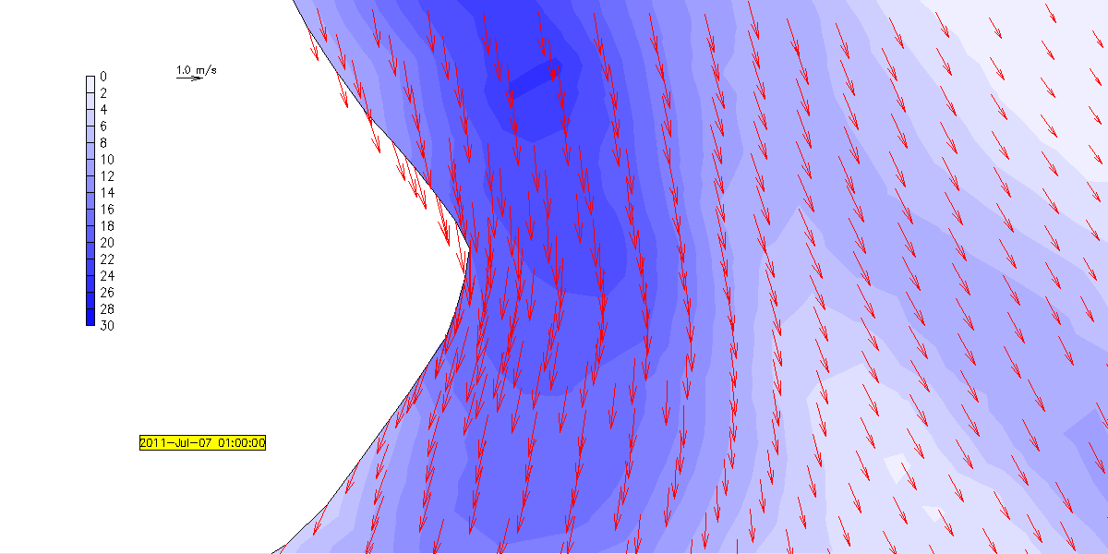

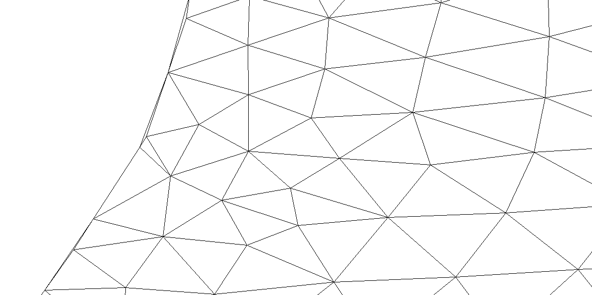
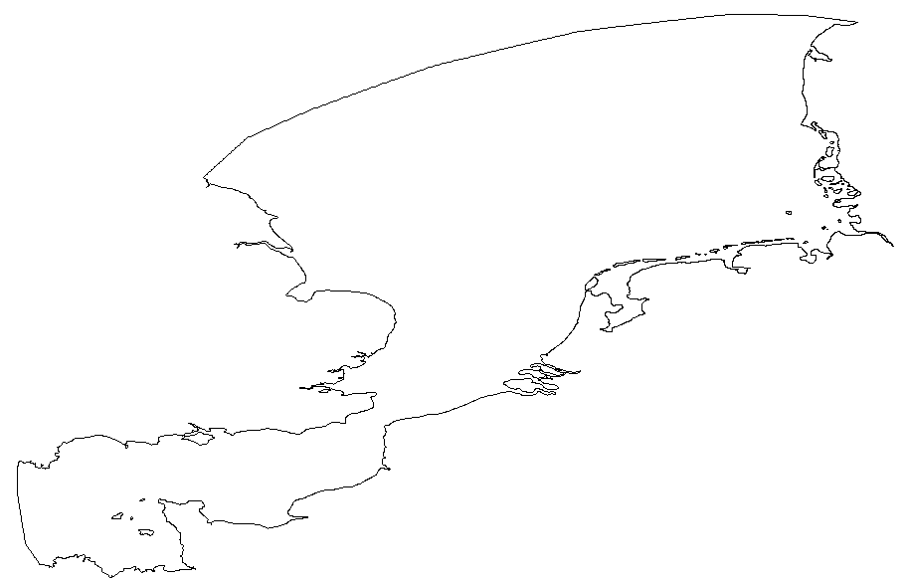
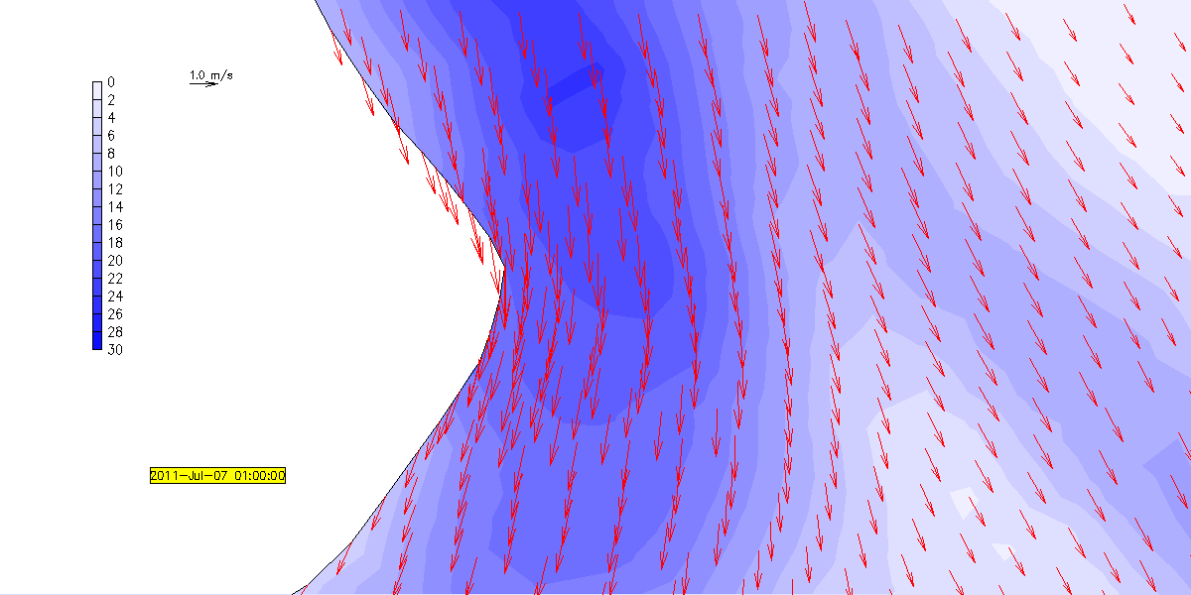
How skew can you go??
Notes:
RUN06c

Slide 15
Benchmarks
Conservation
Inundation (stipulated by NTHMP)
  Basic hydrodynamic considerations
    Mass conservation
    Convergence
  Analytical benchmarking
    Single wave on a simple beach
    N-wave on a beach
  Laboratory benchmarking
    Solitary wave on a simple beach
    Solitary wave on a composite beach
    Solitary wave on a conical island
    Tsunami runup onto a complex three-dimensional beach; Monai Valley
    Vortex shedding behind an island
  Field tests
    1964 Prince William Sound tsunami (on OR coast)
    1993 Nansei-Oki-Hokkaido tsunami
    2010 Chilean
Hydraulics
Hydrostatic: geostrophy, global…
Non-hydrostatic
  Standing waves
  Internal waves
Salt intrusion: Columbia River, San Francisco Bay, Chesapeake Bay, European estuaries (Burla 2009…)
SCHISM-WWM: Roland et al. (2012 JGR)
SCHISM-EcoSim: (Rodrigues et al. 2009)
SCHISM-SED (Pinto et al. 2012)
SCHISM-related publications: http://ccrm.vims.edu/schism/schism_pubs.html
Notes:
50+ journal papers
Field applications are benchmarks also!

Slide 16
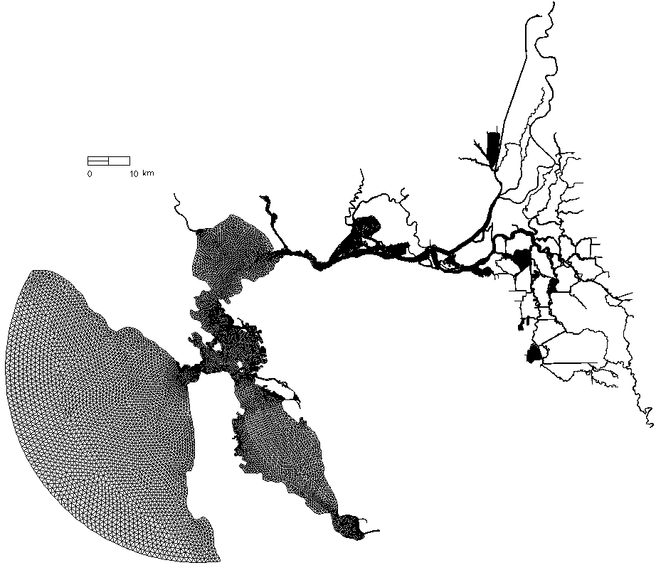
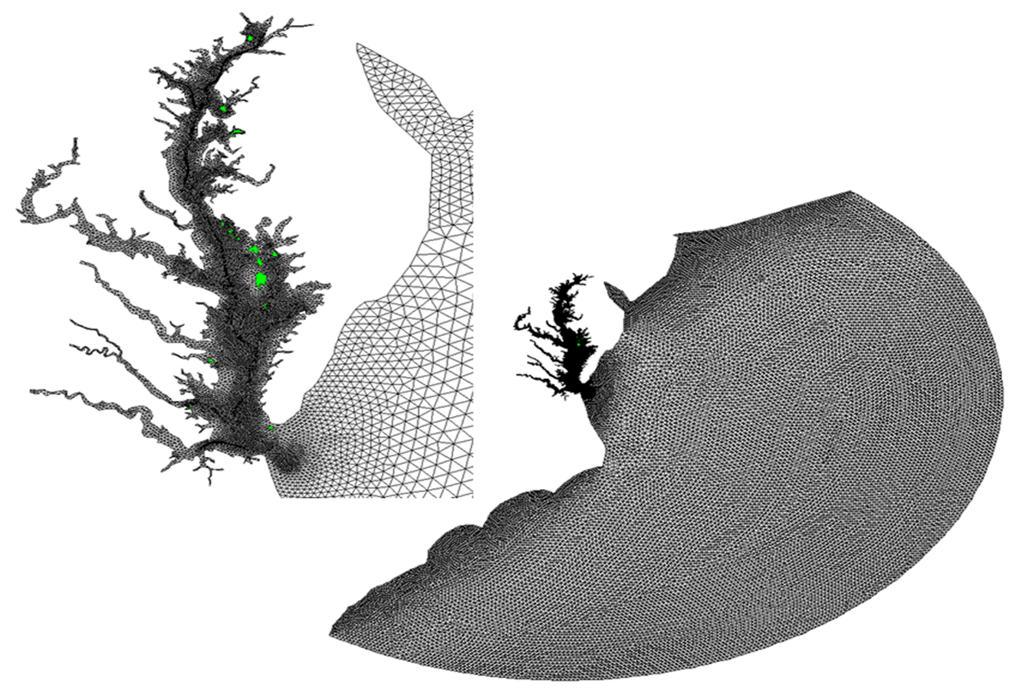
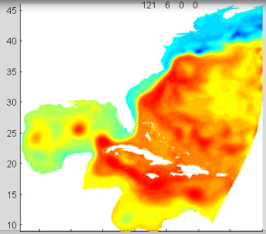
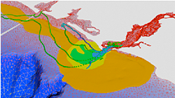
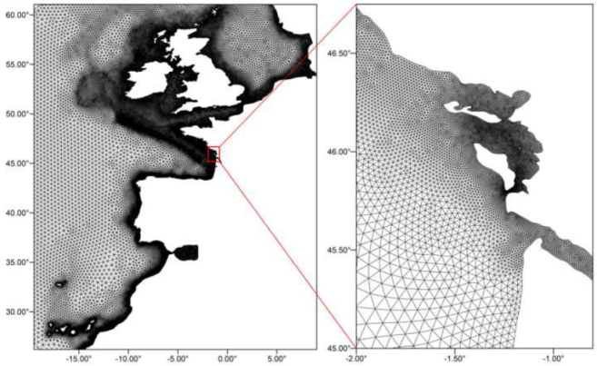
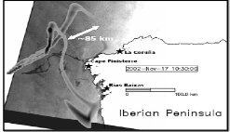
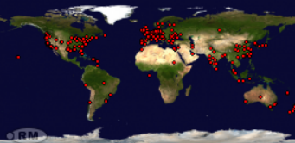
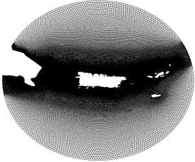
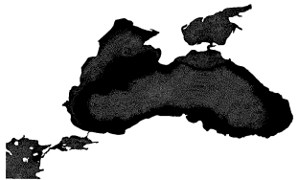
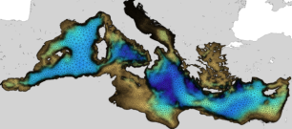
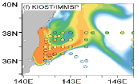
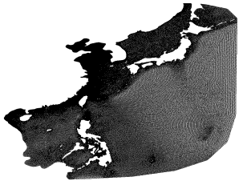
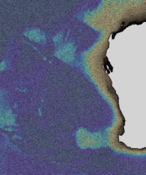
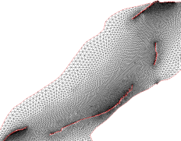
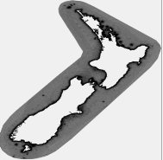

Applications
c/o: SCHISM users
1
16
2
3
4
10
1
2
16
12
11
12
13
4
13
9
8
5
15
7
5
3
14
6
11
8
15
9
14
6
7
10
Notes:
Aljezur : fecal contamination model
Fukushima incident: transport of radioactive materials (137C) near the nuclear plant

Slide 17
Sample applications
Notes:
We did not want to develop new models – time consuming….

Slide 18



Columbia River Forecast
NOAA COOPS
http://tidesandcurrents.noaa.gov/ofs/creofs/creofs.html

Slide 19




San Francisco Bay & Delta

Slide 20


Grid
Non-orthogonal grid helps!

Slide 21



North and Baltic Seas
Unstructured grid covering North & Baltic Seas
  310K nodes, 620K triangles
  Resolution: 200m in German Bight and Danish Strait (min=60m)
  LSC² (29 layers on average)
3D baroclinic simulation
  Initial & boundary conditions from MyOcean
  Monthly mean river flow
  Atmos. forcing from DWD
  Time step 150s
  TVD² transport
  On 160CPUs (Whirlwind), it runs 252x faster than real time
A key challenge is the convoluted Danish Strait (Belts, Sound…)
BalticSea
North Sea
(a)
Latitude
(b)
Latitude
Zhang et al. (2016)
Longitutde

Slide 22


Darβ to Gotland Basin transect T,S
Transect from Darβ to North Gotland

Slide 23




Black-Marama-Aegean Sea: cascading basins
Stanev et al. (2017)

Slide 24

Black Sea: eddying activity
SSH
SST
Relative vorticity/f
08-Oct-2008
12-Nov-2008
22-Jan-2009

Slide 25


Black Sea: overflow
‘Negative plume’
West
East
South
North
(c,d) Bosphorous
Strait into Black Sea
South
North
South
North
Distance along transect (km)
Salinity
Notes:
Fig. 5. Penetration of Marmara Sea water into the Black Sea. (a) shows zonal
salinity and temperature cross-sections on January 9, 2009; (b) is the same but for a meridional section on January 4, 2009; (c and d) are plotted along the thalweg ‘BS‘ near the exit of the Strait on November 8, 2008 and November 26, 2008, respectively. The lcoations of cross-sections are sown in Fig. 1.

Slide 26

Bosphorous Strait exchange flow
south
2008-10-26
north
2008-11-02
T
One of the strongest exchange flow in the ocean
Hydraulic jumps are common over sills due to supercritical flow regime
S
TKE
Vel
southern sill

Slide 27





Northwestern Pacific around Taiwan
Model set-up
    Horizontal grid: 480K nodes, 960K elements. Quasi-uniform resolution in open seas (5-9km), 100-200m around Taiwan, 50m nearshore, 5m min resolution (in ports/harbors)
    Vertical grid: LSC², max 41 layers (@10km depth), average 29 layers
    No bathymetry smoothing/clipping (c/o LSC²)
    Δt=120s, bi-harmonic viscosity
    I.C. and B.C. from HYCOM
Model performance: 100x RT on 480 Intel cores (8 OMP threads per node)
Zheng et al. (2006)
Bathymetry
Notes:
Essential to vary res smoothly in eddying regime
Steep slopes r everywhere in the domain

Slide 28

Kuroshio: SSH

Slide 29


Kuroshio
SST
SSS

Slide 30








Lake stratification
Lake Mendota: ~10km across
Heat fluxes from NARR; albedo=0.1, water type of Jerlov III
Temperature i.c. from the profile at Buoy 101
Δt=60s; turbulence closure of k-ω
2nd-order TVD transport
Density stratification is weak!
101
T (ºC)
103
102
CTD
SCHISM
Zhang et al. (Ocean Modelling 2015)

Slide 31




Tidal Marsh Model
York River
Chesapeake Bay
Marsh migration in 30 years, with 4mm/yr sea-level rise
In the non-eddying regime, skew elements can save a lot of computational cost!
Fringing marshes need fine resolution (1m cross, 10m along)
Fully coupled SCHISM-SED-WWM-Marsh model
Include upland sediment inputs, land use and observed SLR for the past 30 years
180K nodes, 360K elements
Morphological factor=30
Notes:
Community scale!

Slide 32

SCHISM web
Notes:
140 registered groups (given the short history of the model) (each dot is one visit)

Slide 33


SCHISM WIKI

Slide 34

Online training

Slide 35
Summary
We have made tremendous progress on seamless cross-scale modelling during the past decade
Cross-scale modeling can be effectively done with unstructured grids and implicit time stepping
  Accuracy, efficiency, flexibility and robustness are all important factors in this endeavor
  New model capabilities are and will continue to be developed to address the challenges in a range of scales (e.g., higher-order schemes)
We have built a comprehensive modeling system based on SCHISM
  Synergy between users and developers is key
  SCHISM community is very open and forwarding thinking
  We welcome user contributions
Unstructured grids + Implicit time stepping + ELM + Higher-order
Flexibility Accuracy Robustness Efficiency (F.A.R.E.)
Cross-scale applications
Notes:
Flexibility: model options

Slide 36
Numerical methods

Slide 37

Notes:
We try to do better than other models in terms of sharing know-how.
Ctrl-X, Ctrl-V

Slide 38

Grand vision: Cross-scale Seamless Modeling
…at least for hydrostatic regime
Climate
El Nino
Tide
Upwelling /
Downwelling
1000 km
Tsunamis
Plume processes
ETM
km
Estuary
processes
Surface
waves
LATERAL DISTANCE
Internal
waves
Sharp fronts
plume /estuary
m
Turbulent
processes
cm
sec
min
hr
day
year
cent
TIME
O(1m-1000km)
O(min – decade)
Notes:
Bio processes similarly

