Slide 1
MSCI602: Unstructured-grid modeling for oceans and estuaries
Instructor: Joseph Zhang

Slide 2
Logistics
Recording of classes
Syllabus
Learning goals
HPC setup
Learning expectation
Homework
Mid-term and final projects

Slide 3

Syllabus online
  Dynamic & adaptable to your learning experience!
  Get up-to-date info about the course
  Lecture/lab recordings
  Slides & references
  Instructions on tools installation
  Final grade: 75% to pass
Three modules
  Mesh generation
  2D model
  3D model

Slide 4
SCHISM3D modeling workflow
BLUF
Forcing
Atmos
B.C. & I.C.
DEM
Mesh generation
Pre-processing
Nudging
…
Visual
Post-processing
Skill assessment
Simulation
Analysis
Observation

Slide 5
Learning goals
The main goal of this course is for students to:
Develop understanding of important aspects of SCHISM modeling system, including mesh generation methods, underlying assumptions in physics, numerical algorithm to solve the partial differential equations
Learn how to use the High-Performance Computing (HPC) environment required to conduct model simulations
  Not a programming course
Learn to build their own models to simulate realistic 2D and 3D processes (including the assessment of the impact of relative sea level processes on compound flooding etc)

Slide 6
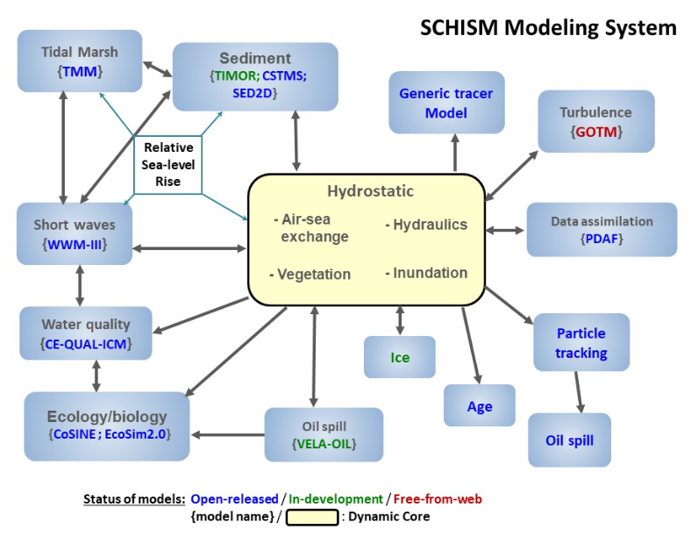
SCHISM modeling system
We’ll only cover the ‘hydro’ module in this course

Slide 7
Versatility of SCHISM
‘hydro’ module is highly reconfigurable to accomplish a diversity of goals
3D baroclinic cross-scale lake-river-estuary-plume-shelf-ocean circulations
Compound surge (Summit-to-Sea)
Tsunami-tide interaction
Vegetation (submerged or emergent)
Offshore wind farm; tidal turbine
Climate change

Slide 8
HPC: Sciclone
Most tools are already loaded on Sciclone
  All students: need to install two python packages (pylibs & pySCHISM)
Access to Sciclone
  For external students, you can also try to install all tools on your own systems (listed in syllabus)
Most tools already installed/immediately usable if you copy over my environment: ACE, FORTRAN scripts…
  Remember to remove 2 lines in my .cshrc (conflicts of python env)

Slide 9
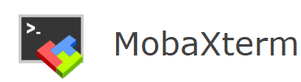


Windows tools
UNIX shell
  Mobaxterm or any other packages (e.g. putty)
  Used to connect from Windows to Sciclone, with X included (for visual)
SMS
  Mesh generation software
  Download & install 3.13
  License code in the syllabus
VisIT (2.13.3)
  3D visualization software
  We’ll use client-server mode: Windows version will communicate with the linux version (installed on Sciclone/viz)

Slide 10
A complete list of tools
For external students who do not have access to Sciclone
A UNIX shell with X (for Windows users); e.g. mobaxterm
HPC compilers and modules for building SCHISM (see online manual)
  ACE tool, xmgredit5 (source code in SCHISM src/Utility/ACE/)
  pylibs (for schismview): see instructions below
  PySCHISM: see instructions below
VisIT 2.13.3
SMS version 13.3

Slide 11
Learning expectation
Pre-class readings
  See syllabus: read before the class
  Some may be challenging
  Come to classes with questions
  Send your comments & questions to me – I will address common issues during classes (or other means)
During classes
  A lot of hands-on opportunities for you
  Raise your hand for short clarification questions
Post-class reading: review slides, recording

Slide 12
Homework
Honor code
Give your best effort
Collaboration is allowed if you are really stuck
Or come to me for help

Slide 13
Projects
Mid-term project: Delaware Bay 2D model (with hydrologic inputs)
Final project
  Theme: 3D cross-scale application
  NW Pacific Ocean: Kuroshio, coastal currents, rivers/estuaries
  Or your own choice: you’ll need to prepare forcing info but I may help

Slide 14
Poll everywhere?
Feedback welcome anytime!

Slide 15
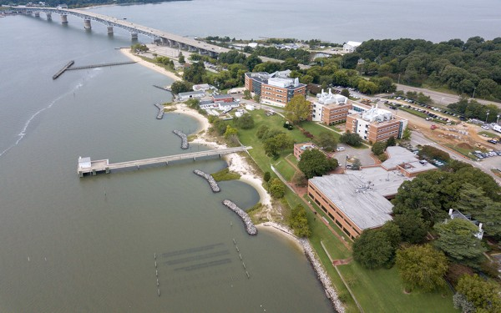




Students self-introduction (Name/Status/Interest/Fun/& QA)

Slide 16
Python setup
Check bora HPC env
Pylibs
  https://schism-dev.github.io/schism/master/getting-started/pre-processing-with-pylib/installation.html (Method 1)
PySCHISM
  https://schism-dev.github.io/schism/master/getting-started/pre-processing-with-pyschism/installation.html (Github method with developer)

