Slide 1
Lab: Meshing a toy problem

Slide 2
Sciclone setup
.cshrc*
Test gredit
Work on either /sciclone/data10 or schism10
To prepare for future classes:
Copy all files in my MSCI602 dir to your desktop and to your Sciclone dir
On Sciclone: rsync -aLz /sciclone/home/yinglong/DISKS/vims20/MSCI602 <your dir>
To desktop: rsync -aLz <your UID>@boara.sciclone.wm.edu:/sciclone/home/yinglong/DISKS/vims20/MSCI602 <your dir>
ctrl-z to push to background followed by bg
Install pylibs and pySCHISM

Slide 3
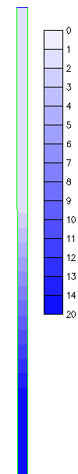
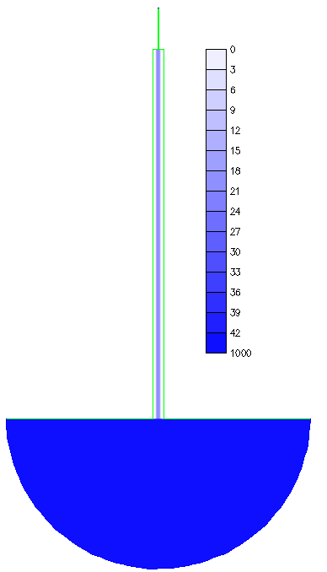
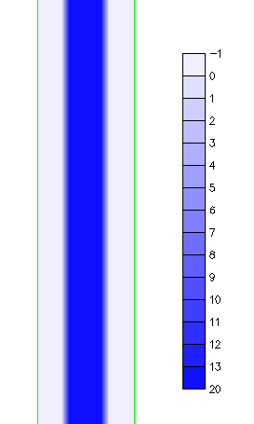
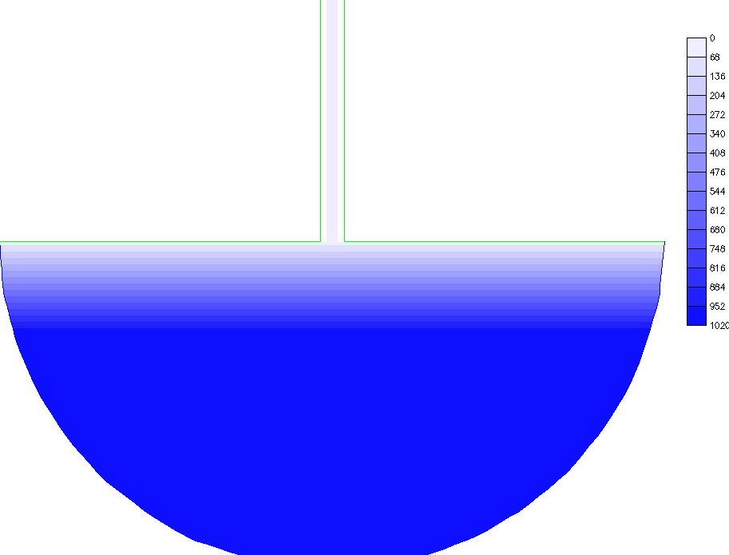
A toy case for estuary-shelf model
Try to follow the dimensions shown here but it's OK to use your own
Linear slopes used here
River depth at boundary = 1m
Estuary depths from –1m to 20m (channel)
Shelf depths from 20m to 1km
Create two open segments: ocean and river
3km
River: 40km x 1km
z=0
20m
12km
Estuary: 400km x 12 km
Depth (m)
45km
R=150km
Ocean bnd

Slide 4
Compile SCHISM package
Clone SCHISM github to your own dir (cf. Online manual)
git clone ...
cd into dir
git checkout tags/v5.11.0
cd cmake; mkdir build; cd build

Slide 5
Lab: Meshing Delaware Bay

Slide 6
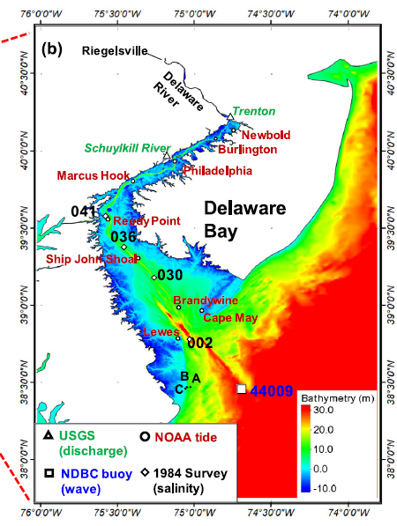
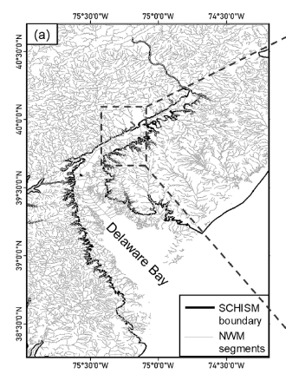
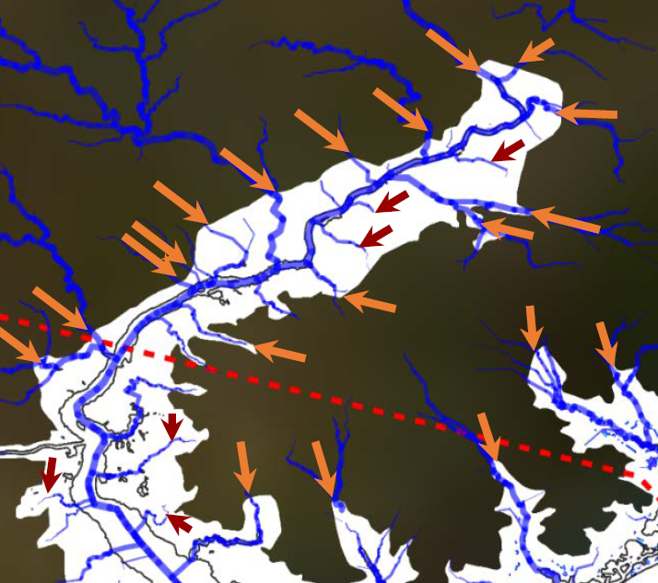
Background
DE Bay is a typical estuary in Mid Atlantic Bay (read Whitney & Garvine 2006)
Main tributary is Delaware River: flow of ~100 to ~1000 m³/s
Meso-tidal estuary with a maintained/dredged shipping channel
Numerous smaller tributaries – typical of most estuarine systems: e.g., Schuylkill
Economically significant system: Philadelphia

Slide 7
Your tasks
Based your understanding of the estuarine systems, generate a mesh for DE Bay
DEMs are in: /sciclone/home/yinglong/DISKS/vims20/MSCI602/RUN01b
Set projection to WGS84 (geographic) - this is set automatically after you load geotifs below
Use geotif for SMS; contours_-20to0m/ has shapefile for isobaths from –20 to 0 in interval of 2m
Cut land boundary at ~10m above sea level to include some watershed
Ocean boundary at the entrance
After a mesh is generated
Create and cd into your working dir on Sciclone
rsync -aLz /sciclone/home/yinglong/DISKS/vims20/MSCI602/RUN01b .
Transfer your .2dm (Windows) to this dir (RUN01b)
Convert .2dm to .gr3: ~yinglong/Scripts/2dm2gr3_m2m.pl 1 new.2dm new.gr3
Visualize it with gredit
Check negative/small/skew elements
Fix bad quads: ~yinglong/bin/fix_bad_quads (tolerance of 0.5). The output is hgrid.gr3.new
Rename hgrid.gr3.new as hgrid.old (mv hgrid.gr3.new hgrid.old). Make sure it's in lon/lat
Load depths using load_dem.pl
Check bathymetry against DEM! Especially channel connection
Check CFL>0.4
[xmgredit5] Generate open boundary: ocean, DE River as a minimum
Fix flow open boundary (DE River) if necessary (set a min depth of 3m) to allow flow into the domain
Append b.c. part to hgrid.gr3

Slide 8
Homework #1
Finish DEB mesh
Submit SMS map and final hgrid.gr3 (with depths loaded and b.c. Part included)
You can upload your files onto Sciclone for me to review (remember to set read permission), or upload them to 1Drive or G-drive
Due in 2 weeks

