Slide 1
Introduction to SCHISM2D Joseph Zhang

Slide 2
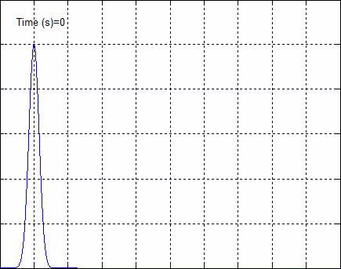
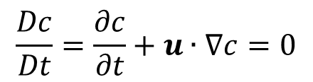
Advection
$$\frac{Dc}{Dt}=\frac{∂c}{∂t}+u∙∇c=0$$
u : advective velocity (usually known)

Slide 3
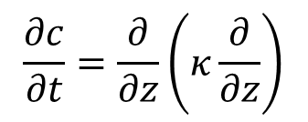
Diffusion
$$\frac{∂c}{∂t}=\frac{∂}{∂z}\left(κ\frac{∂}{∂z}\right)$$
κ : diffusivity [m²/s]

Slide 4
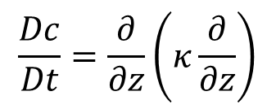
Advection-Diffusion
$$\frac{Dc}{Dt}=\frac{∂}{∂z}\left(κ\frac{∂}{∂z}\right)$$

Slide 5
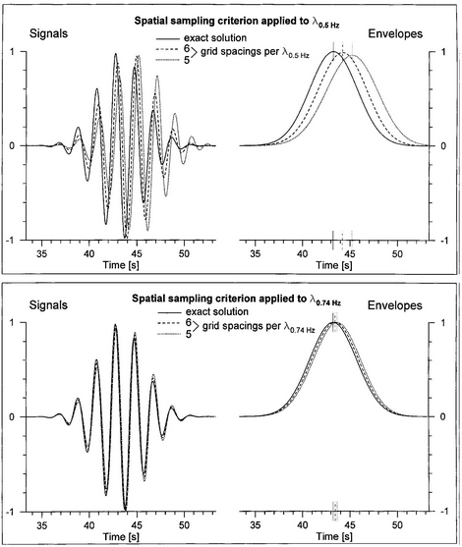
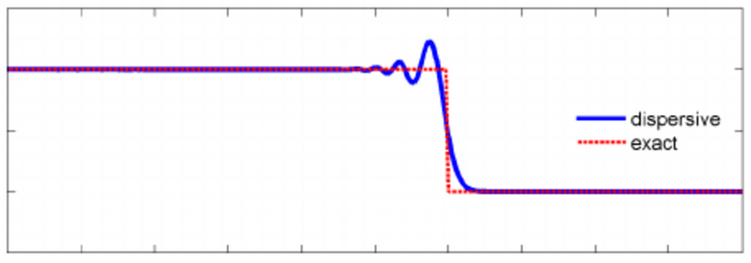

Dispersion
Waves of different frequencies travel at different phase speeds
Usually related to derivatives of odd order (of either physical or numerical origin)
$$φ_{t}+φ_{xxx}−6φφ_{x}=0$$
With dispersion
No dispersion
Notes:
https://www.youtube.com/watch?v=jqJSwSmyB5E
https://www.youtube.com/watch?v=scBvd3FQ73U

Slide 6
Why 2D model?
Simple physics, yet powerful for many applications
Segue to 3D model
Combination of 2D-3D is very powerful in calibration
Use 2D to quickly calibrate elevation

Slide 7
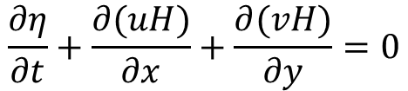
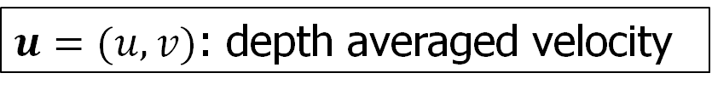

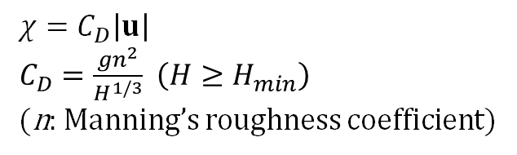
Governing equations: 2D (depth averaged)
Continuity equation:
$$\frac{∂η}{∂t}+\frac{∂(uH)}{∂x}+\frac{∂(vH)}{∂y}=0$$
Momentum equations:
Explicit terms
Air pressure
$\frac{Du}{dt}=f−g∇η+\frac{τ_{w}−χu}{H} (f=−fk×u+g∇\left(αφ+φ_{SAL}\right)−\frac{∇p_{A}}{ρ_{0}})$
Implicit terms
Tidal potential & SAL
$τ_{w}$: wind stress (via air-sea exchange)
z
North
East
y
$$χ=C_{D}\left|u\right|$$
$C_{D}=\frac{gn^{2}}{H^{1/3}}$ $\left(H≥H_{min}\right)$
(n: Manning’s roughness coefficient)
datum
x
η
H=h+η
h
v
u
$u=(u,v)$: depth averaged velocity

Slide 8

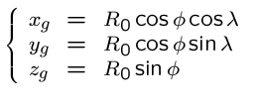

Spherical coordinates (lon/lat)
z_{g}
φ⁰ (y)
z
λ
λ⁰ (x)
SCHISM uses original lon/lat: we transform the coordinates instead of eqs
Avoids polar singularity
Preserves all good numerical properties
P
φ
O
y_{g}
x_{g}
We use 2 frames:
Global (origin @ earth center)
Lon/lat (local @ node/element/side)
Changes to the code are limited to re-project vectors and to calculate distances

Slide 9
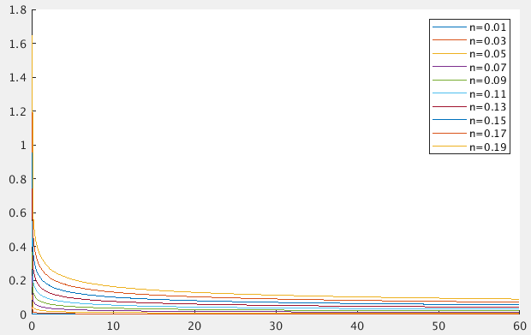
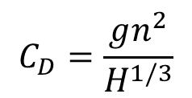
Bottom drag: Manning’s formula
$$C_{D}=\frac{gn^{2}}{H^{1/3}}$$
H (m)
The larger n is, the larger C_{D} is
Singularity at small H (e.g., watershed); usually a min depth (~1m) is used

Slide 10
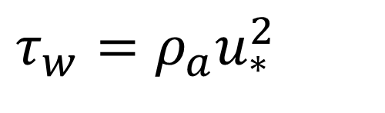
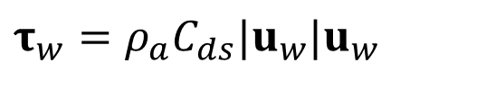
Wind Shear Stress: Turbulent Flux of Momentum
Calculation of shear stress follows naturally from calculation of turbulent heat fluxes (in 3D)
Total shear stress of atmosphere upon surface:
$$τ_{w}=ρ_{a}u_{∗}^{2}$$
Frictional velocity (from air-sea exchange model)
Example: Pond and Picard’s formulation can be used as a simple option
$$τ_{w}=ρ_{a}C_{ds}|u_{w}|u_{w}$$
There are newer/more accurate stress formulations (Hwang) inside SCHISM (iwind_form)

Slide 11
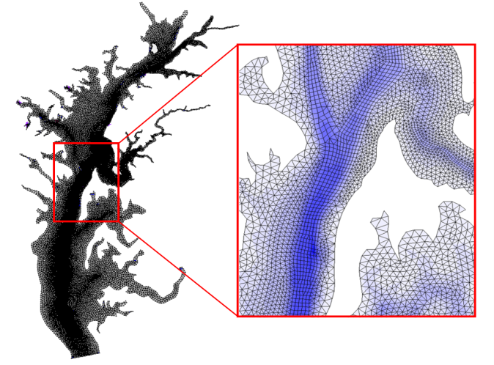
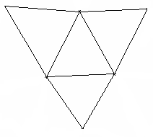

Horizontal grid: hybrid
3
4
Side 2
3
Side 2
Side 1
Side 3
Side 1
1
Side 4
2
1
Side 3
2
3
2
1
1
2
Counter-clockwise convention
/ right-hand rule
3
3
y_{s}
2
2
x_{s}
i
2
1
i
N_{i}
1
N_{i}
1
2
N_{i}
1
N_{i}
i
1
Counter-clockwise convention

Slide 12
Staggering of variables
In SCHISM, we do not strictly distinguish 2D, 3D and allows locally 2D/3D or even quasi-1D
Stencil: uneven prisms
vgrid.in for 2D: 1 vertical layer
n_{k}
n_{k}
k (surface)
k
N_{z}
η
N_{z}-1
u_{j,k} v_{j,k}
η
…….
u_{j,k} v_{j,k}
C_{i,k}
k
k-1
C_{i,k}
…….
k-1
k-1 (bottom)
w_{i,k-1}
w_{i,k-1}
k_{b}+1
k_{b}

Slide 13



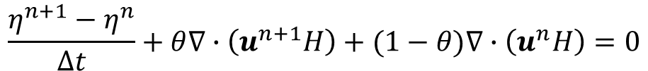
Semi-implicit scheme
Continuity
$$\frac{η^{n+1}−η^{n}}{Δt}+θ∇∙\left(u^{n+1}H\right)+(1−θ)∇∙\left(u^{n}H\right)=0$$
$$\frac{u^{n+1}−u^{∗}}{Δt}=f−gθ∇η^{n+1}−g(1−θ)∇η^{n}+{\left(\frac{τ_{w}−χu}{H}\right)}_{}^{n+1}$$
$$(0.5≤θ≤1)$$
Momentum
$u$: depth averaged velocity
Advection (ELM):
$$≈$$
where $u^{∗}$ is evaluated along the characteristic line defined by: Dx/Dt=u
Implicit treatment of divergence, pressure gradient (and vegetation form drag) terms by-passes most severe stability constraints: 0.5 ≤θ≤1
Explicit treatment: Coriolis, horizontal viscosity, radiation stress…

Slide 14
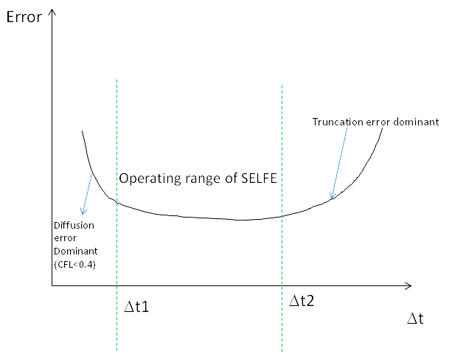
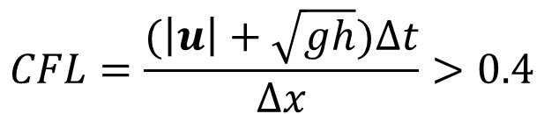
Operating range of SCHISM
…. for a fixed mesh, you cannot reduce Δt indefinitely!
This constraint is one of the most common mistakes made by users
$$CFL=\frac{(\left|u\right|+\sqrt{gh})∆t}{∆x}>0.4$$
ELM prefers larger Δt (truncation error ~1/Δt)
As a result, SCHISM requires CFL>0.4
Convergence: CFL=const, Δx, Δt→0 at the same rate
For barotropic field applications: [100,450] sec
Start with 150sec
For a fixed mesh

Slide 15
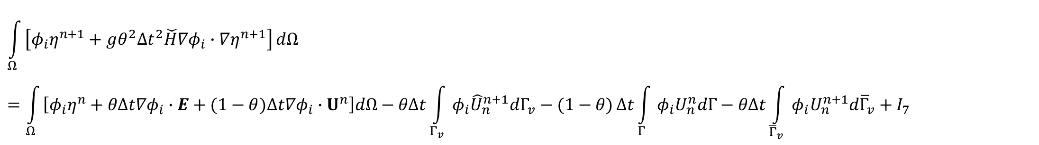
Finite-element formulation
Finally, substituting this eq. back to continuity eq. we get one equation for elevations alone:
I₁
$$\int_{Ω}{\left[φ_{i}η^{n+1}+gθ^{2}{Δt}^{2}\check{H}∇φ_{i}∙∇η^{n+1}\right]}dΩ=\int_{Ω}{\left[φ_{i}η^{n}+θΔt∇φ_{i}∙E+(1−θ)Δt∇φ_{i}∙U^{n}\right]dΩ−θΔt\int_{Γ_{v}}{φ_{i}{\hat{U}}_{n}^{n+1}dΓ_{v}−(1−θ)}Δt\int_{Γ}{φ_{i}U_{n}^{n}dΓ−θΔt\int_{{\overline{Γ}}_{v}}{φ_{i}U_{n}^{n+1}d{\overline{Γ}}_{v}+I_{7}}}}$$
I₃
I₄
I₅
I₆
sources
(i=1,…,N_{p})
Notes:
When node i is on boundaries where essential b.c. is imposed, η is known and so no equations are needed, and so I₆ needs not be evaluated
Boundary condition (b.c.) is free lunch in FE model (cf. staggering in FV)
The inherent numerical dispersion in FE nicely balances out the numerical diffusion inherent in the implicit time stepping scheme!
This integral equation underpins the robustness and accuracy of SCHISM!

Slide 16
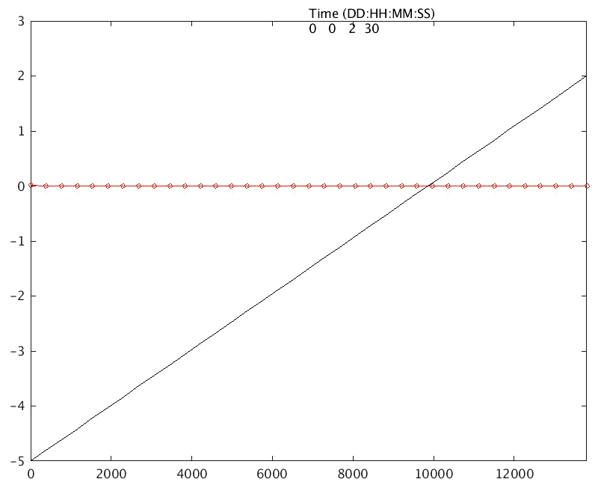
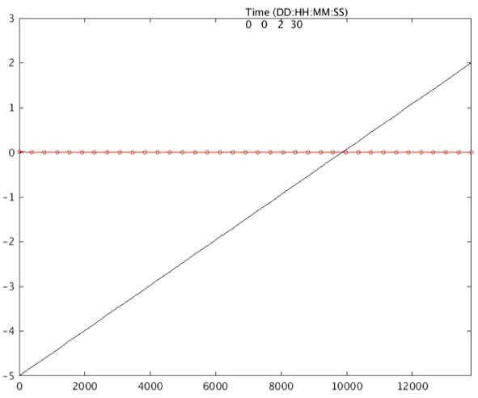
Inundation scheme
SCHISM solves for the surface elevations at all nodes at each time step, including dry nodes
Elevations at dry nodes are part of the volume budget, and they may vary over time just as those at wet nodes
They can be viewed as groundwater
Note the ‘pumping’ of groundwater initially, in preparation for wetting/drying (this may take a while)
As a result, it’s desirable to prepare (‘pump’) the groundwater at cold start to speed up the ramp-up process (via elev.ic; ~1cm below bottom)
elev.ic for compound studies
Important: filter out dry elevations in post-proc

Slide 17
Numerical stability
Semi-implicitness circumvents CFL (most severe) (Casulli and Cattani 1994)
ELM bypasses Courant number condition for advection (actually CFL>0.4)
Explicit terms
Horizontal viscosity → diffusion number condition (mild; enforced by Shapiro filters)
Coriolis – “inertial modes” in eddying regime (Le Roux 2009; Danilov 2013); needs to be stabilized by viscosity/filter

Slide 18
Summary
SCHISM discretizes the domain using triangular-quad elements
Solves the hydrostatic equations using a semi-implicit scheme to bypass the most severe stability constraints
CFL>0.4
Start with dt=150s for most field cases
Stability is guaranteed, even for extremely bad meshes!
Finite-element formulation uses linear shape function: implication for extraction
Inundation is part of the algorithm (cannot be turned off); it treats dry points as ‘ground water’
For compound flood studies, it’s best to set the initial surface elevation just below the bottom to prepare the system

