Slide 1
SCHISM3D physics and numerics
Joseph Zhang

Slide 2



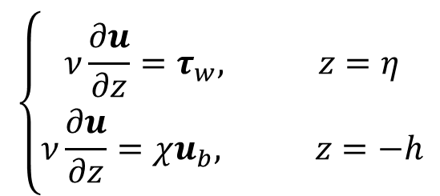
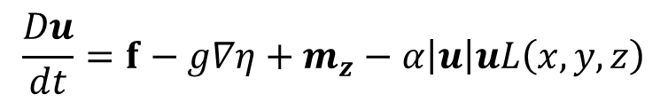
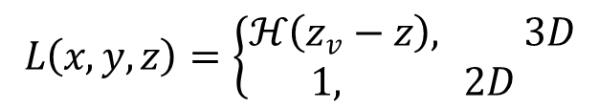
Governing equations: Reynolds-averged Navier-Stokes (with vegetation)
Continuity equation
Momentum equations
vegetation (implicit)
$$\frac{Du}{dt}=f−g∇η+m_{z}−α\left|u\right|uL\left(x,y,z\right)$$
(
$$\left\{\begin{matrix}ν\frac{∂u}{∂z}=τ_{w}, z=η \\ ν\frac{∂u}{∂z}=χu_{b}, z=−h\end{matrix}\right.$$
baroclinicity
  Vertical b.c. (3D):
(upward)
z
(north)
y
$$m_{z}=\left\{\begin{matrix}\frac{∂}{∂z}\left(ν\frac{∂u}{∂z}\right), 3D \\ \frac{τ_{w}−χu}{H}, 2D\end{matrix}\right.$$
x
(east)
h
z=z_{v}
$$L\left(x,y,z\right)=\left\{\begin{matrix}ℋ\left(z_{v}−z\right), 3D \\ 1, 2D\end{matrix}\right.$$
H^{α}
$$α(x,y)=D_{v}N_{v}C_{Dv}/2$$
(vegetation)

Slide 3
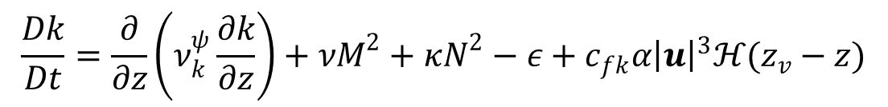
Governing equations: Reynolds-averged Navier-Stokes
Equation of state
Transport of salt and temperature
Turbulence closure: Umlauf and Burchard 2003
shear
stratification
$$\frac{Dk}{Dt}=\frac{∂}{∂z}\left(ν_{k}^{ψ}\frac{∂k}{∂z}\right)+νM^{2}+κN^{2}−ε+c_{fk}α{\left|u\right|}^{3}ℋ(z_{v}−z)$$
vegetation
$$\frac{Dψ}{Dt}=\frac{∂}{∂z}\left(ν_{ψ}^{}\frac{∂ψ}{∂z}\right)+\frac{ψ}{k}\left[c_{ψ1}νM^{2}+c_{ψ3}κN^{2}−c_{ψ2}εF_{wall}+c_{fψ}α{\left|u\right|}^{3}ℋ(z_{v}−z)\right]$$

Slide 4
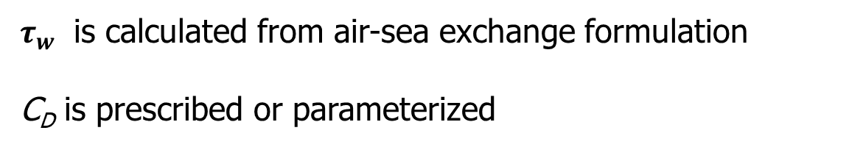
Momentum equation: vertical boundary condition (b.c.)
Surface
Bottom
u_{b}
δ_{b}
z=−h
$τ_{w}$ is calculated from air-sea exchange formulation
C_{D} is prescribed or parameterized
Notes:
Assumption: bottom cell is inside BBL

Slide 5
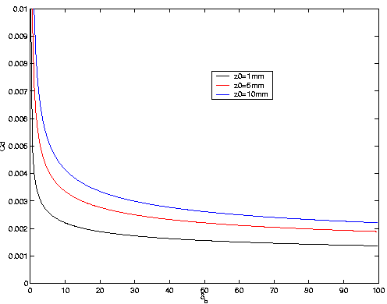
Bottom drag
Bottom drag coefficient via roughness:
Use of z₀ seems most natural option, but tends to over-estimate C_{D} in shallow area
  Needs to be limited (dzb_min)
C_{D} also varies with bottom layer thickness (i.e. vertical grid)
3D results depend on vertical grid
Bottom boundary layer thickness (m)

Slide 6
SCHISM3D numerical formulation

Slide 7
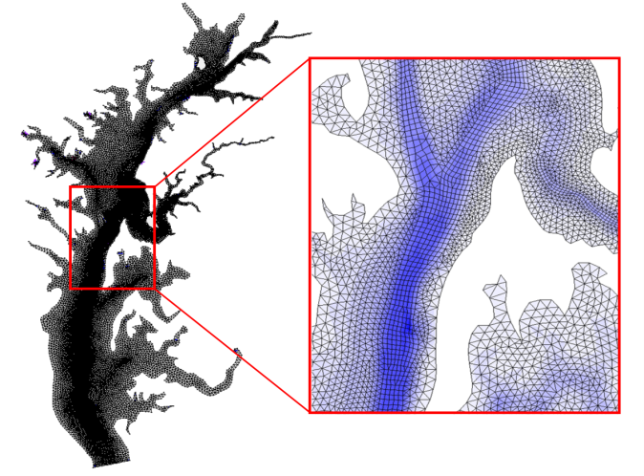
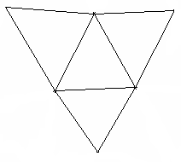

Horizontal grid: hybrid
3
4
Side 2
3
Side 2
Side 1
Side 3
Side 1
1
Side 4
2
1
Side 3
2
3
2
1
1
2
Counter-clockwise convention
3
3
y_{s}
2
2
x_{s}
i
2
1
i
N_{i}
1
N_{i}
1
2
N_{i}
1
N_{i}
i
1
Internal ball
Boundary ball

Slide 8
Vertical grid: SZ option
z
h_{s}
k^{z}
σ-levels
k^{z}−1
Z-levels
2
1
* z layers are optional
Notes:
The F.S. cannot fall below hc<=hs

Slide 9
Vertical grid: SZ option
z
h_{s}
k^{z}
k^{z}−1
Z-levels
2
1
Notes:
The F.S. cannot fall below hc<=hs

Slide 10
Vertical grid: SZ option
z
σ zone
S zone
N_{z}
σ=0
h_{c}
h_{s}
S-levels
k^{z}
σ=-1
Z-levels
* Question: how to get pure S (i.e. no Z)?
Notes:
The F.S. cannot fall below hc<=hs

Slide 11
Vertical grid: SZ option
SZ zone
z
σ zone
S zone
N_{z}
σ=0
h_{c}
h_{s}
S-levels
k^{z}
σ=-1
k^{z}−1
Z-levels
2
1
Transformation for terrain-following coordinates can take several forms
A popular choice is ROMS’s S transformation ($θ_{f} and θ_{b}$ are tunable parameters):
Notes:
The F.S. cannot fall below hc<=hs

Slide 12
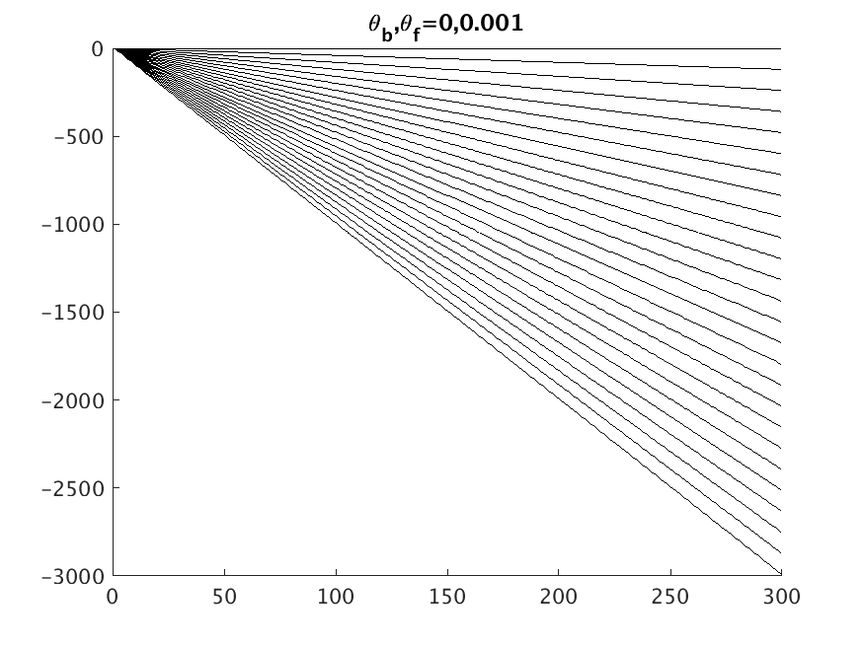
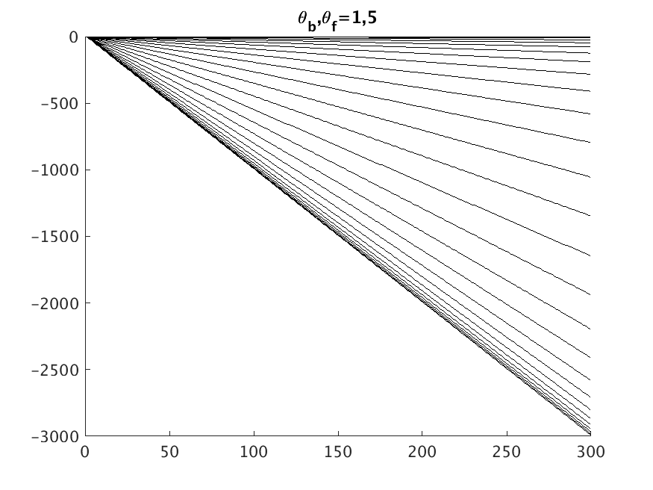
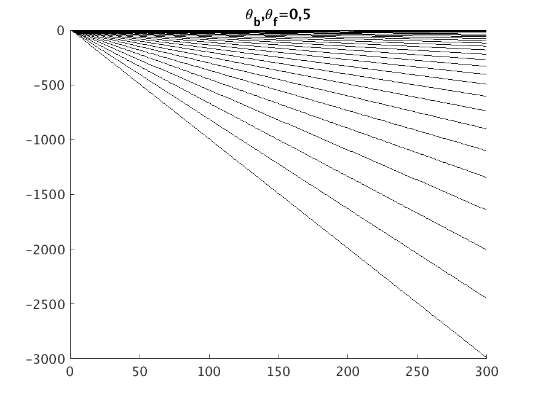
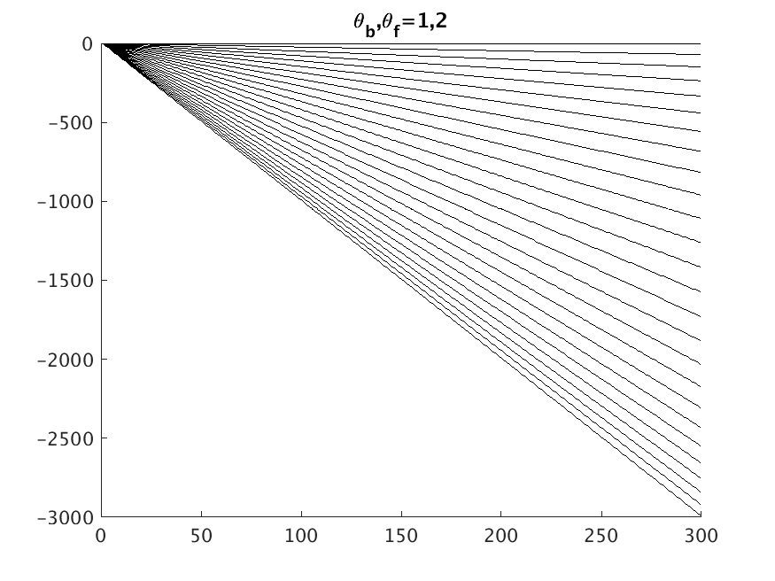
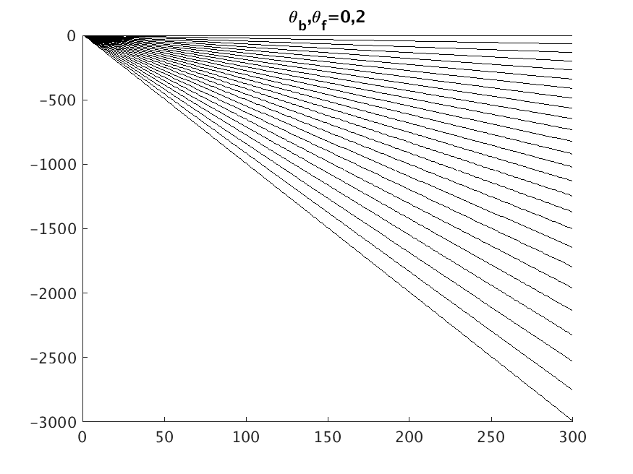

S-coordinates
θ_{b}=0: resolve surface only
θ_{b}=1: resolve surface & bottom
* Note that S-transformation degenerates to σ-transformation when h<h_{c}

Slide 13
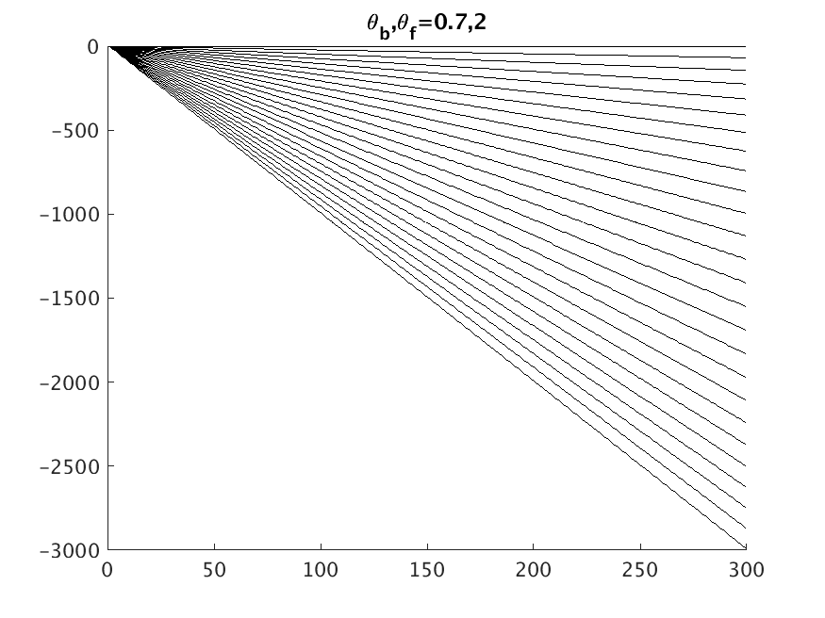
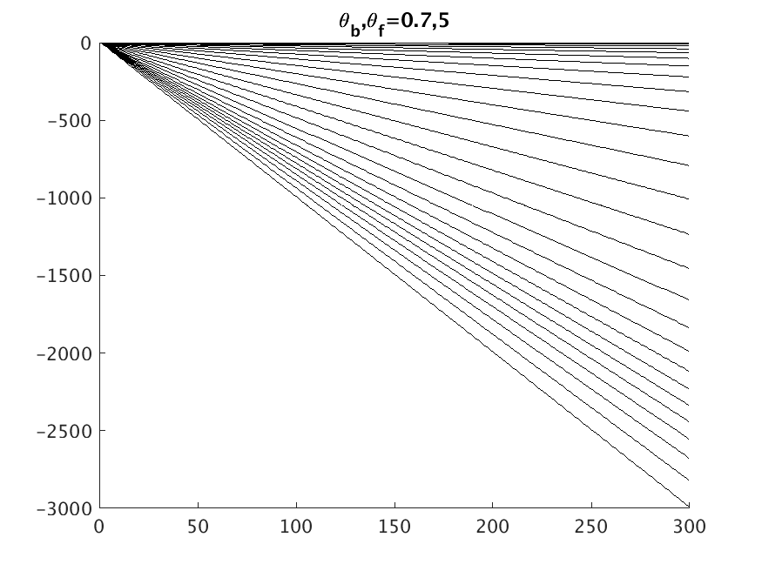
S-coordinates
θ_{b}=0.7: resolve surface and a zone above bottom

Slide 14
Vertical grid: SZ option
h_{c}
z=−h_{s}
Note that the bottom cells are shaved – no staircases!
The model will crash of the surface falls below h_{c}

Slide 15
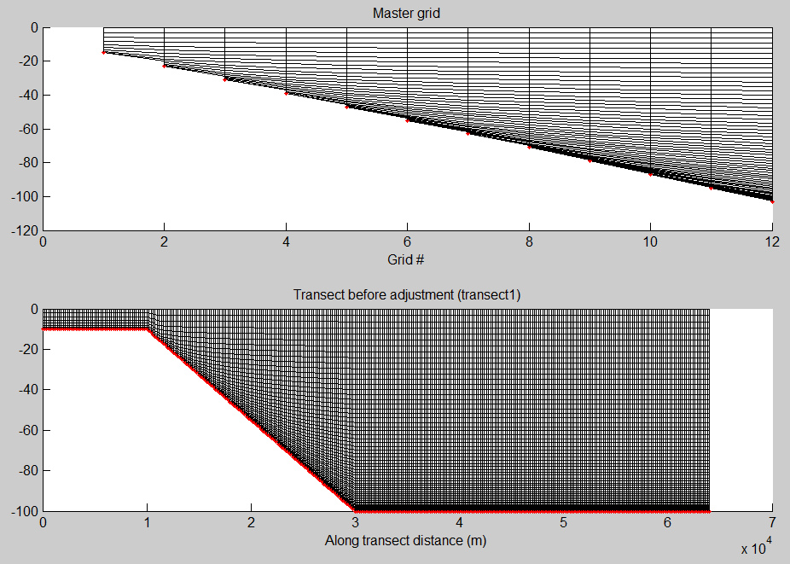
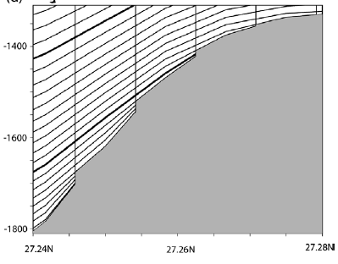
Vertical grid (2): LSC² (via Vanishing Quasi Sigma)
Dukhovskoy et al. (2009)
Procedure for VQS
Different # of levels are used at different depths
At a given depth, the # of levels is linearly interpolated from the 2 adjacent master grids
Thin layers near the bottom are masked
Staircases appear near the bottom (like Z), but otherwise terrain following
Notes:
Masking process unnecessary

Slide 16
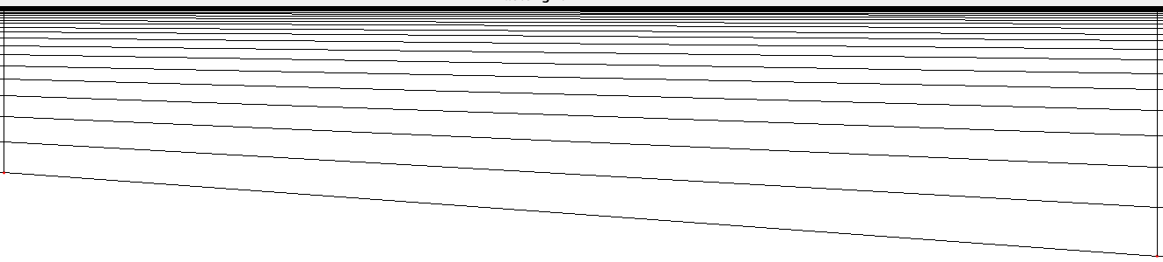
Procedure
A node
Master grid 1
Master grid 2
≥dz_bot_min
Local bottom
*Thin bottom layers will be combined with another neighboring layer
Notes:
Masking process unnecessary

Slide 17

LSC²
*No masking of thin layers (c/o implicit scheme)
*Shuts down artificial exchanges between shallow and deep prisms
*Generated using FORTRAN scripts (gen_vqs*.f90)
A
u
u
P
1
B
2
R
Q
1
2
LSC²= Localized Sigma Coordinates with Shaved Cells

Slide 18
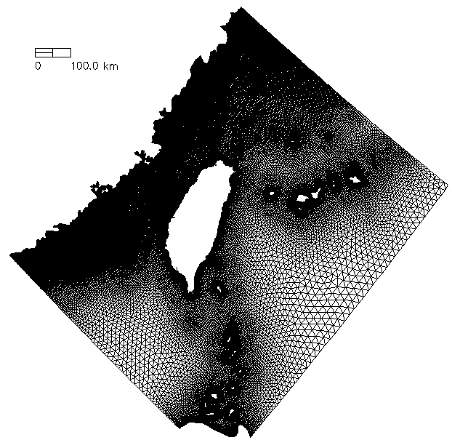
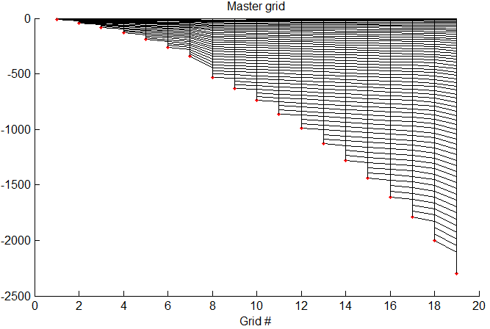
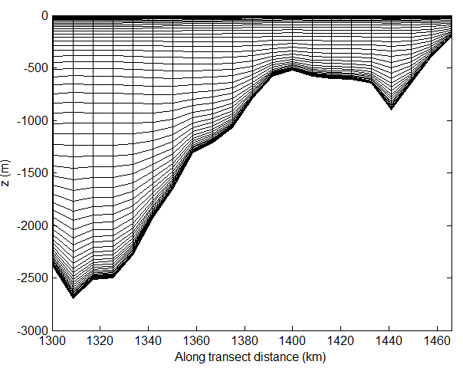
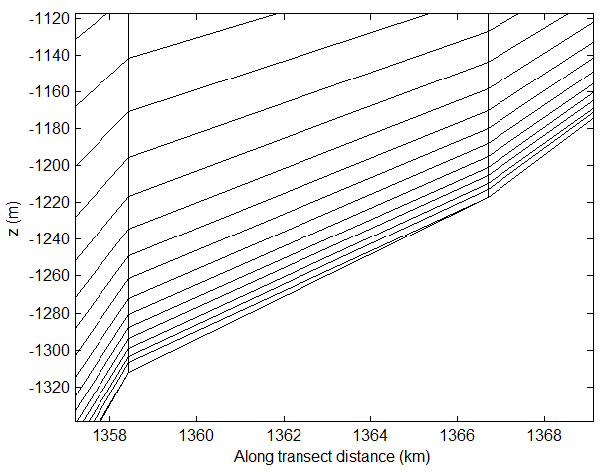
Vertical grid: LSC²
z (m)
Degenerate prism

Slide 19
Staggering of variables
3D computational unit: uneven prisms
Equations are not transformed into S- or σ-coordinates, but solved in the original Z-space (good for pressure gradient error)
n_{k}
n_{k}
k (whole level)
k
N_{z}
η
N_{z}-1
u_{j,k} v_{j,k}
η
…….
u_{j,k} v_{j,k}
C_{i,k}
k
k-1
C_{i,k}
…….
k-1
k-1
w_{i,k-1}
w_{i,k-1}
k_{b}+1
k_{b}

Slide 20
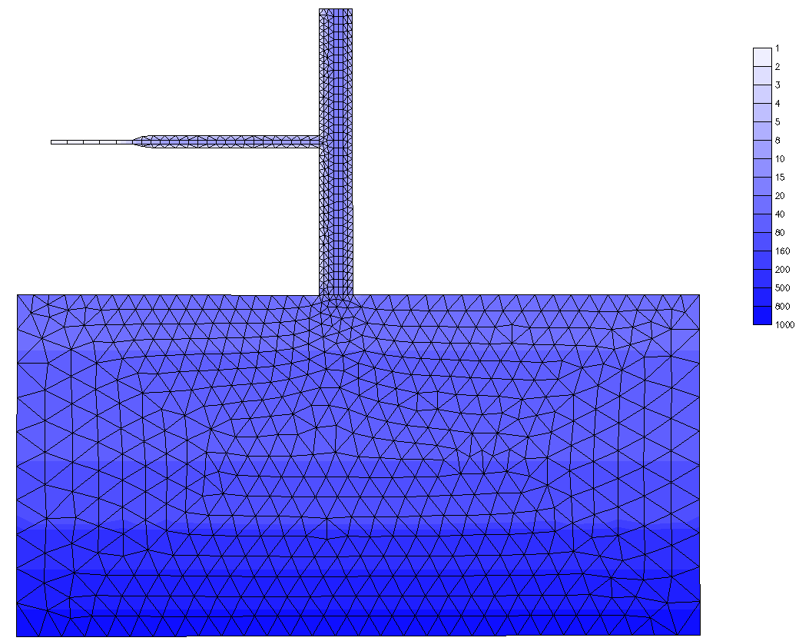
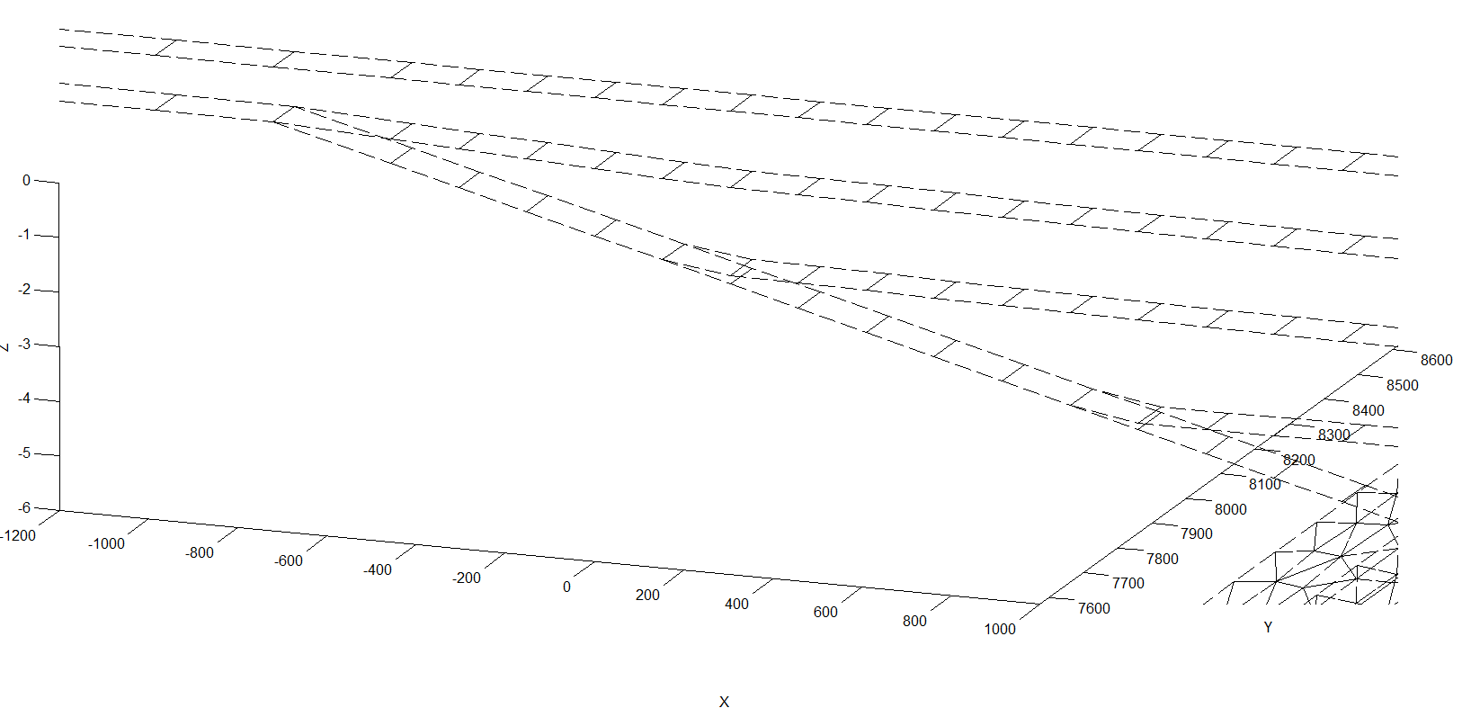
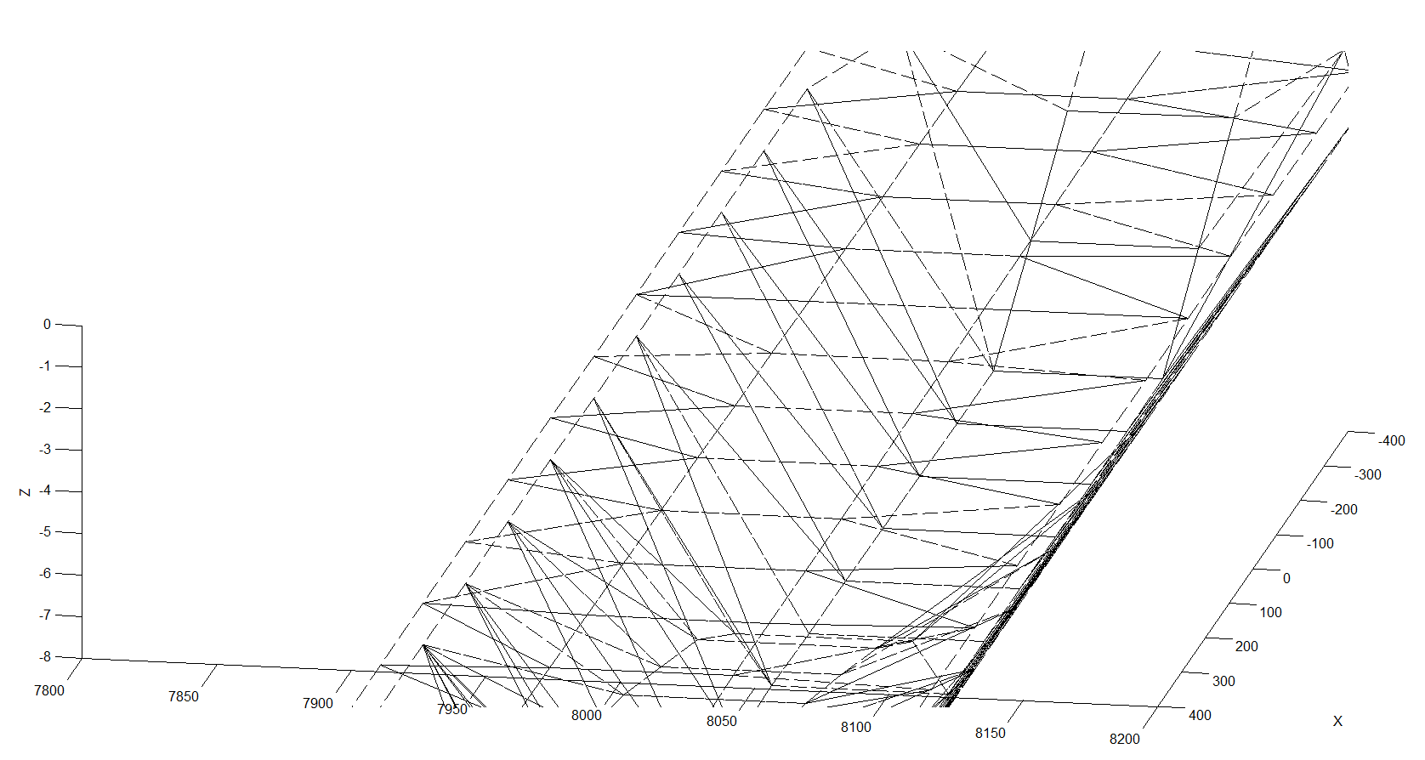
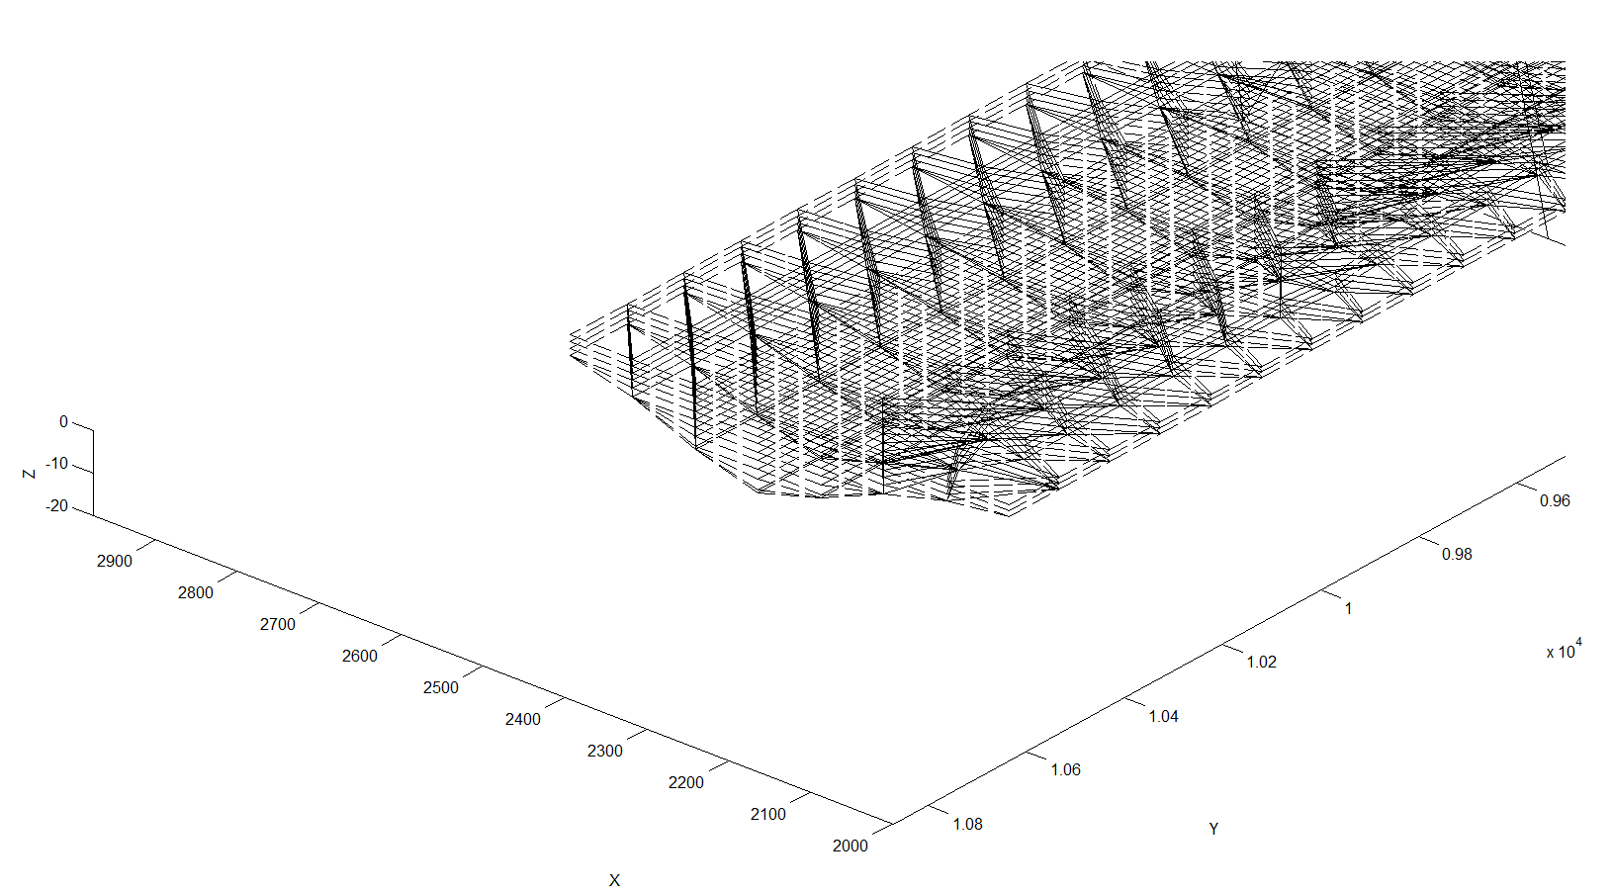
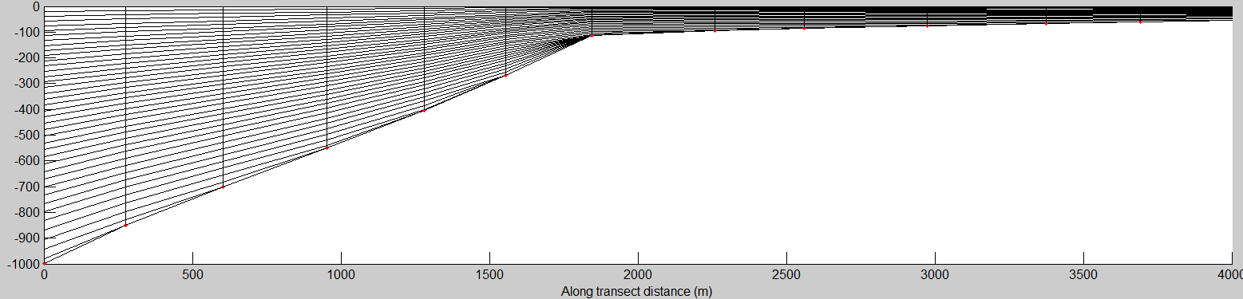
Polymorphism
Zhang et al. (2016)
Bathymetry (m)
Quasi-1D
2DV
Notes:
Flexibility is not just in the horizontal

Slide 21
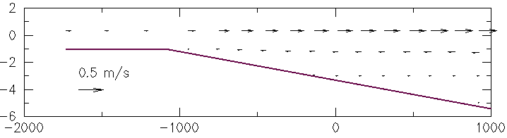

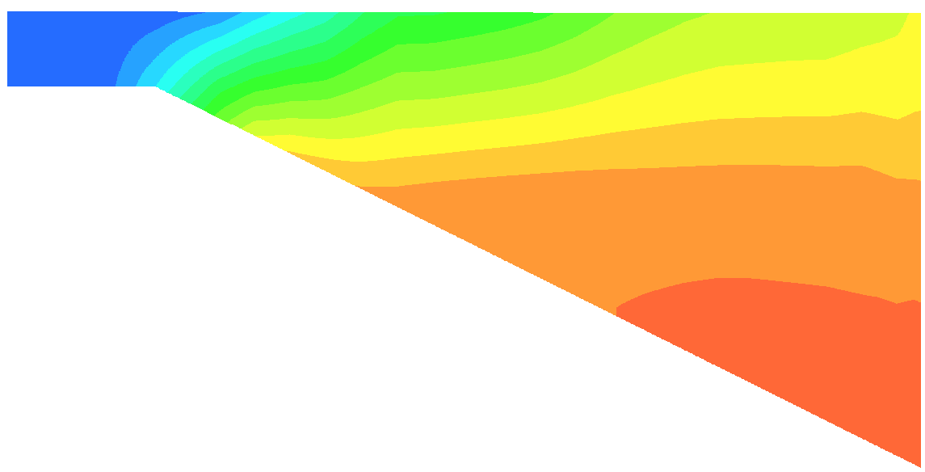
Polymorphism
*A single SCHISM grid can smoothly transition between full 3D, 2DH, 2DV and quasi-1D modes
  Make sure there are large no jumps in friction etc
*This results in great flexibility and efficiency (and robustness)!
flood
z (m)
x (m)
S (PSU)

Slide 22

Semi-implicit scheme
Continuity
$$\frac{u^{n+1}−u^{∗}}{Δt}=f−gθ∇η^{n+1}−g(1−θ)∇η^{n}+m_{z}^{n+1}−α\left|u\right|u^{n+1}L\left(x,y,z\right)$$
Momentum
Barotropic solver ('dycore')
b.c. (3D)
Advection (ELM):
$$≈$$
Implicit treatment of divergence, pressure gradient and vegetation form drag terms by-passes most severe stability constraints: 0.5 ≤θ≤1
Explicit treatment of remaining terms (Coriolis, baroclinicity, horizontal viscosity, radiation stress…) leads to mild stability constraints

Slide 23
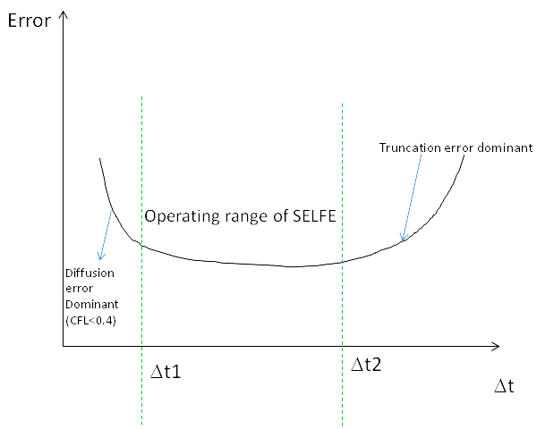
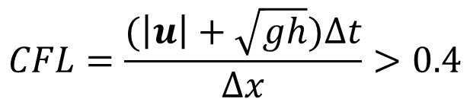
Operating range of SCHISM
…. for a fixed grid, you cannot reduce Δt indefinitely!
$$CFL=\frac{(\left|u\right|+\sqrt{gh})∆t}{∆x}>0.4$$
ELM prefers larger Δt (truncation error ~1/Δt)
  As a result, SCHISM requires CFL>0.4
Convergence: CFL=const, Δx, Δt→0 at the same rate
For baroclinic field applications: [100,200] sec
Start with 150 sec
This constraint is one of the most common mistakes made by users

Slide 24
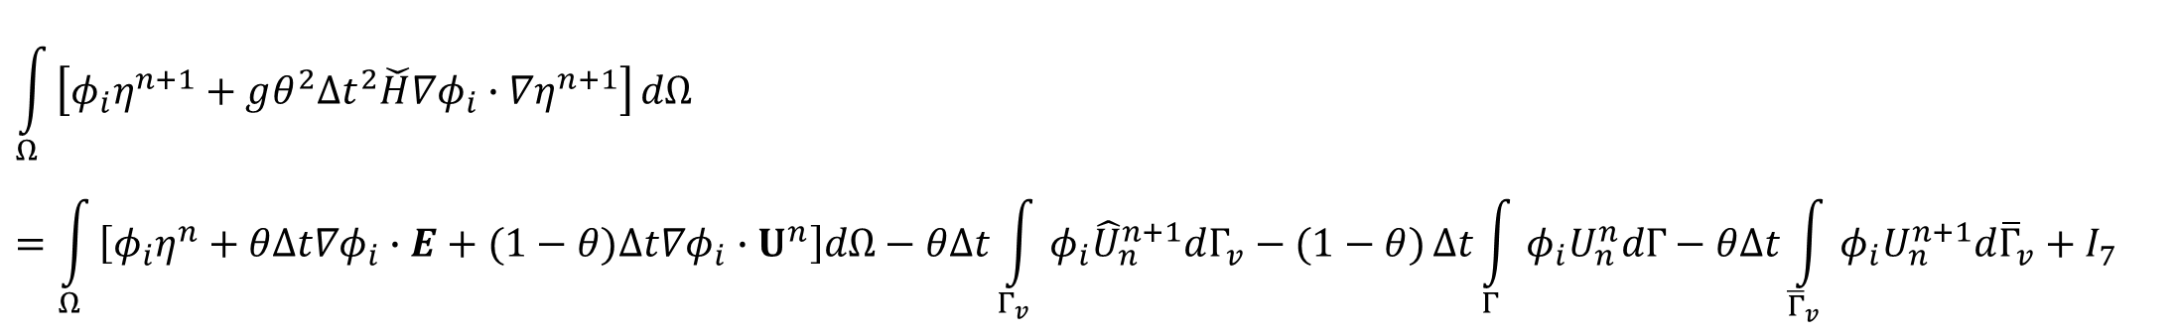
Finite-element formulation
Finally, substituting this eq. back to continuity eq. we get one equation for elevations alone:
I₁
$$\int_{Ω}{\left[φ_{i}η^{n+1}+gθ^{2}{Δt}^{2}\check{H}∇φ_{i}∙∇η^{n+1}\right]}dΩ=\int_{Ω}{\left[φ_{i}η^{n}+θΔt∇φ_{i}∙E+(1−θ)Δt∇φ_{i}∙U^{n}\right]dΩ−θΔt\int_{Γ_{v}}{φ_{i}{\hat{U}}_{n}^{n+1}dΓ_{v}−(1−θ)}Δt\int_{Γ}{φ_{i}U_{n}^{n}dΓ−θΔt\int_{{\overline{Γ}}_{v}}{φ_{i}U_{n}^{n+1}d{\overline{Γ}}_{v}+I_{7}}}}$$
I₃
I₄
I₅
I₆
(i=1,…,N_{p})
sources
Notes:
When node i is on boundaries where essential b.c. is imposed, η is known and so no equations are needed, and so I₆ needs not be evaluated
b.c. is free lunch in FE model (cf. staggering in FV)
The inherent numerical dispersion in FE nicely balances out the numerical diffusion inherent in the implicit time stepping scheme!
Dimension of I_{i} is m³ (volume)

Slide 25

Shape function
Used to approximate the unknown function
Although usually used within each individual elements, shape function is global not local!
Must be sufficiently smooth to allow integration by part in weak formulation
SCHISM uses linear shape function (pyramid) in both horizontal and vertical dimensions in FE formulation (compare with FV)
  Therefore, pre- and post-processing scripts also use linear interpolation
  DEM interpolation: make sure to resolve around stations for wet/dry!
  Extraction of time series
Shape function

Slide 26
Shaprio filter
A simple filter to reduce sub-grid scale (unphysical) oscillations while leaving the physical signals largely intact (α=0.5 optimal)
Equivalent to the horizontal viscosity (but can be applied to very skew elements)
1
4
0
2
3
No filtering for boundary sides – so need b.c. there especially for incoming flow

Slide 27
Hyper viscosity
Important for eddying regime for adding proper dissipation
P
1
4
1
x,η
6
y,ξ
Assuming uniformity
Q
I
0
x
II
S
2
x
0
5
2
3
I
II
(like Shapiro filter)
R
3
4
Bi-harmonic viscosity (ideal in eddying regime)
1a
4b
1b
1
4
4a
In cross-scale cases, biharmonic and Shapiro filters are applied together to ensure adequate dissipation everywhere
In eddying regime (balanced, weakly forced), biharmonic filter is mostly sufficient. Bathymetry does not play a major role
In non-eddying regime (strongly forced), need to crank up dissipation via Shapiro. Bathymetry plays a major role
Delineation of regimes: 500 – 1000 m depth
0
x
2a
2
3
3b
2b
3a
Stencil for bi-harmonic
(Zhang et al. 2016)

Slide 28
Transport solvers
All based on FV methods for mass conservation
Operator splitting into horizontal and vertical advection parts
  Last fractional step: diffusion, source
Vertical advection: implicit FV
  TVD²: implicit, 2-limiter TVD scheme (Ye et al. 2018)
Horizontal advection: explicit FV
  Upwind: 1st order, diffusive
  TVD: 2nd order, with flux limiter, monotone
  WENO: 3rd order, almost monotone
  ELM: 1st order, monotone, unconditionally stable but non-conservative. Used mostly in nearshore regime to bypass stability condition
The explicit horizontal advection is the main bottleneck of SCHISM
  There are a few ways to alleviate the bottleneck (upwind, ELM)
  For coastal/estuarine applications: TVD+upwind+ELM
  For cross-scale applications: WENO+upwind+ELM, but need to adjust WENO zone to avoid dipersion
j
S
k
S
T_{i,k}
k-1

Slide 29
SCHISM flow chart
Initialization
or hot start
end
yes
forcings
no
backtracking
Completed?
output
Turbulence
closure
Update levels
& eqstate
Transport
Preparation
(Mom+cont.)
Momentum
eq.
w
Most expensive part as the horizontal advection is explicit
solver
Notes:
Numbers depend on specific set up also

Slide 30
Summary
SCHISM solves complete set of Navier Stokes equations (in hydrostatic form) plus transport equations & turbulence closure
Uses semi-implicit FE formulation for barotropic core solver (thus bypasses CFL restriction)
Uses FV solver for transport equations: explicit horizontal advection is the bottleneck; ELM can alleviate this
Balance between numerical dispersion (FE) and diffusion (implicit scheme)
Vertical grid allows flexible LSC² – shaved cells are key
  Triangular or quadrangular prisms as the basic stencil
Momentum is stabilized with filter-like viscosity and hyper viscosity (tunable)
These building blocks maximize flexibility, efficiency and robustness, and underpin its seamless cross-scale capability

