Slide 1
LSC² vertical grid system
Joseph Zhang

Slide 2
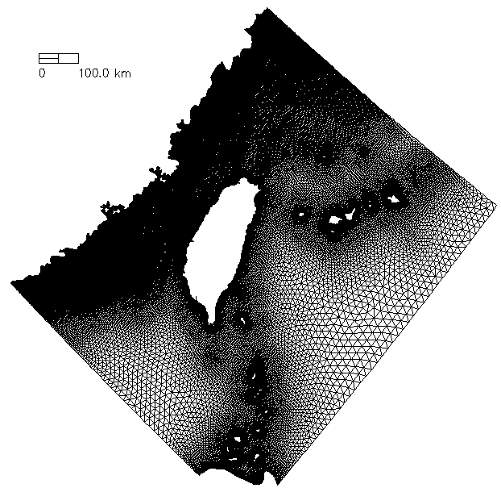
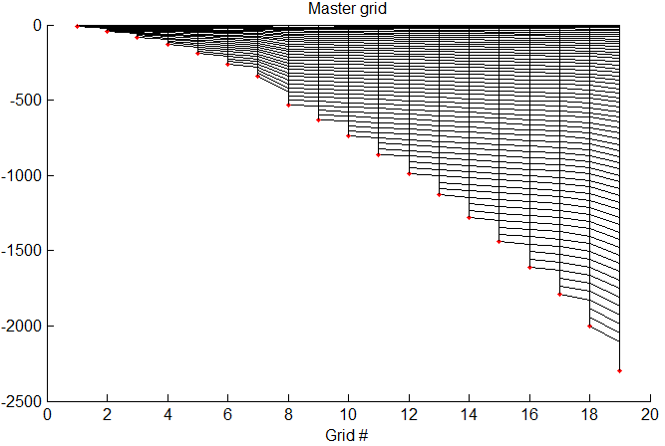
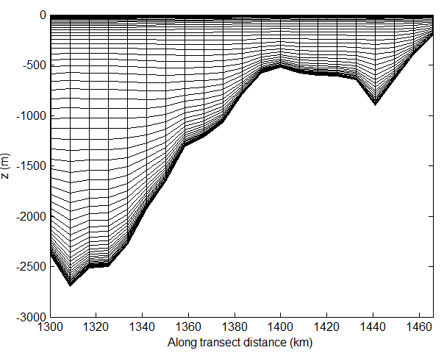
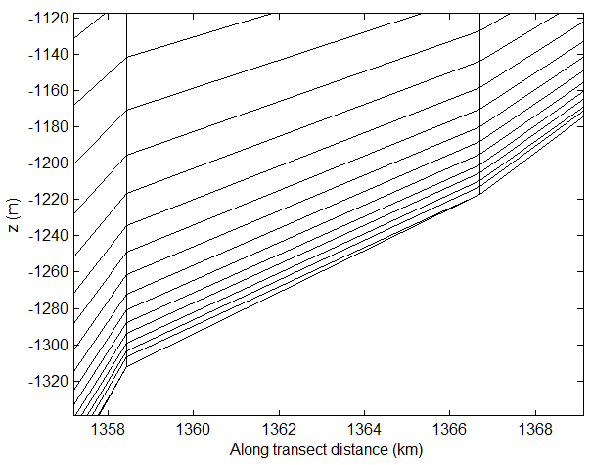
Vertical grid: LSC²
z (m)
Degenerate prism

Slide 3
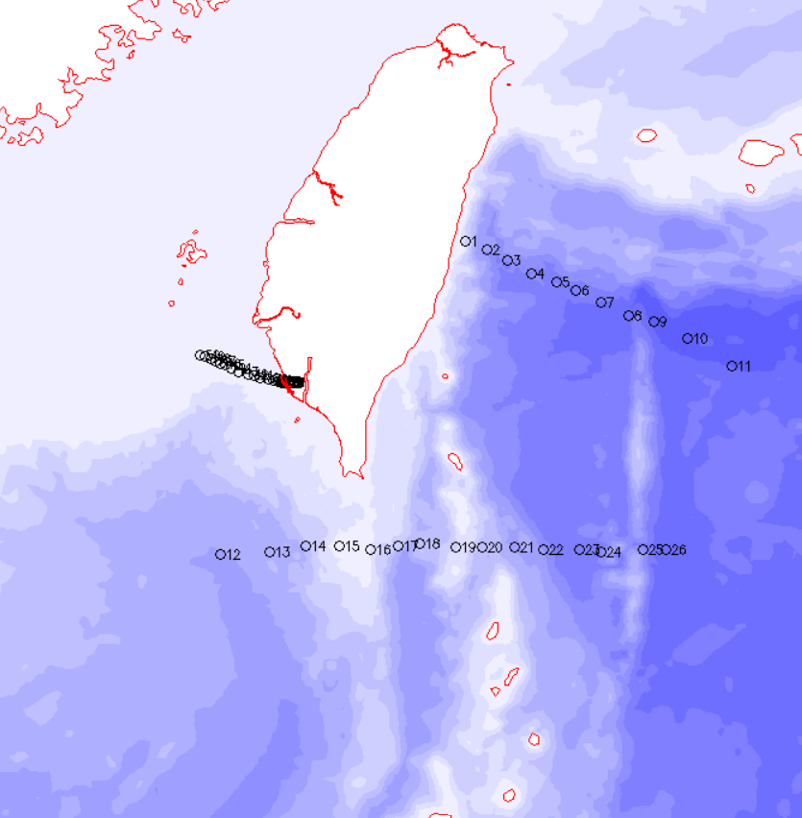
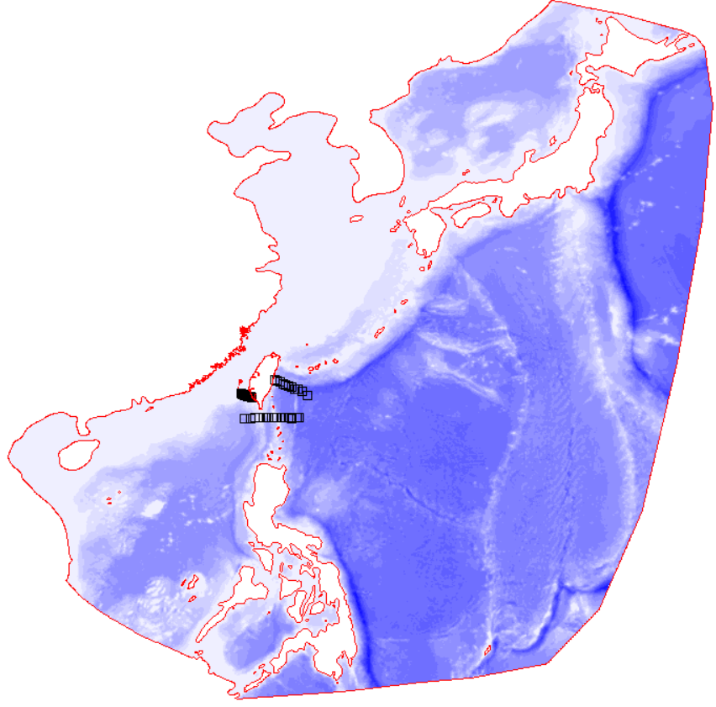
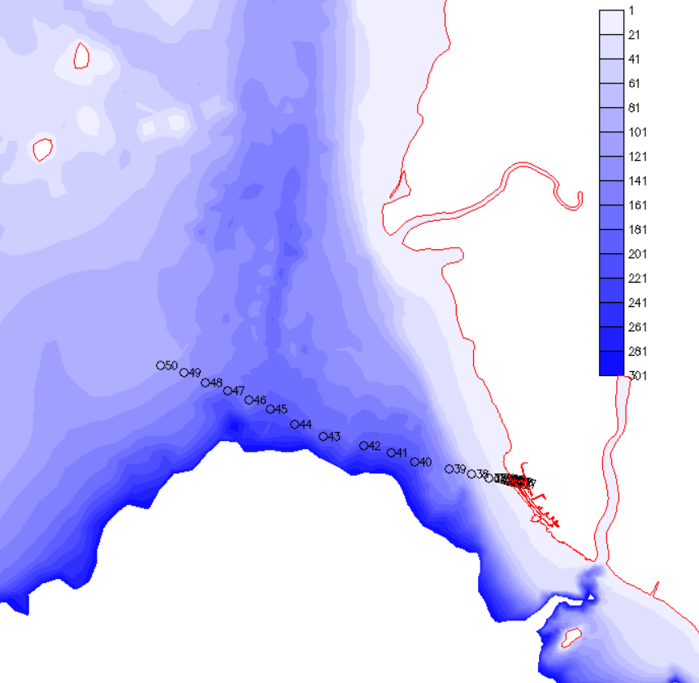

LSC² script: define transect(s)
Step 1: prepare transect(s) using gredit
You can combine as many transects as you want to get a comprehensive view of the vgrid
Depth (m)
Notes:
Used CA_DWR/RUN84b

Slide 4
LSC² script: gen_vqs.f90
FORTRAN and mlab Scripts in /sciclone/home/yinglong/DISKS/vims20/MSCI602/RUN02a
# of master grids (depths)
!m_vqs: # of master grids
m_vqs=9
dz_bot_min=0.1 !min. bottom layer thickness [m]
allocate(hsm(m_vqs),nv_vqs(m_vqs),a_vqs(m_vqs))
hsm=(/0.4,10.,50.,100.,2.e3,4.e3,6.e3,8.e3,1.1e4/) !.,2000.,1.1e4/)
nv_vqs=(/2,24,30,33,33,33,33,33,33/)
! nv_vqs(6)=nv_vqs(5)+4
! nv_vqs(7)=nv_vqs(6)+4
! nv_vqs(8)=nv_vqs(7)+5
if(m_vqs<2) then
write(*,*)'Check vgrid.in:',m_vqs
stop
endif
if(hsm(1)<0) stop 'hsm(1)<0'
do m=2,m_vqs
if(hsm(m)<=hsm(m-1)) then
write(*,*)'Check hsm:',m,hsm(m),hsm(m-1)
stop
endif
enddo !m
! Other consts.
! Stretching const. for the 1st master grid and also for depth <= hsm(1)
! |a_vqs0|<=1 (1: skew toward bottom; -1: toward surface; 0: no bias)
a_vqs0=0
Controls near bottom resolution (used to consolidation of near-bottom levels)
Step 2: Define master depths and # of levels
Depths (ascending order; covers max depth)
# of levels for each master depth (same order)
Stretching constant for shallowest depth
Notes:
Used CA_DWR/RUN84b

Slide 5
LSC² script: gen_vqs.f90
! Generate a master vgrid (z_mas)
etal=0 !used in master grid only; elev.
if(etal<=-hsm(1)) then
write(*,*)'elev<hsm:',etal
stop
endif
nvrt_m=nv_vqs(m_vqs)
print*, 'nvrt in master vgrid=',nvrt_m
allocate(z_mas(nvrt_m,m_vqs))
z_mas=-1.e5
! Define master grids
do m=1,m_vqs
do k=1,nv_vqs(m)
sigma=(k-1.0)/(1.0-nv_vqs(m))
! Option 2: S
theta_b=0
if(m<=2) then
theta_f=1
else if(m==3) then
theta_f=2
else if(m==4) then
theta_f=3
else if(m==5) then
theta_f=6.2
else if(m==6) then
theta_f=6.6
else if(m==7) then
theta_f=7.0
else if(m==8) then
theta_f=7.3
else
theta_f=7.5
endif
cs=(1-theta_b)*sinh(theta_f*sigma)/sinh(theta_f)+ &
&theta_b*(tanh(theta_f*(sigma+0.5))-tanh(theta_f*0.5))/2/tanh(theta_f*0.5)
z_mas(k,m)=etal*(1+sigma)+hsm(1)*sigma+(hsm(m)-hsm(1))*cs
enddo !k
enddo !m
Adjust θ_{b} and θ_{f} here
Step 2: Define z-coordinates for each master grid/depth
Notes:
Used CA_DWR/RUN84b

Slide 6
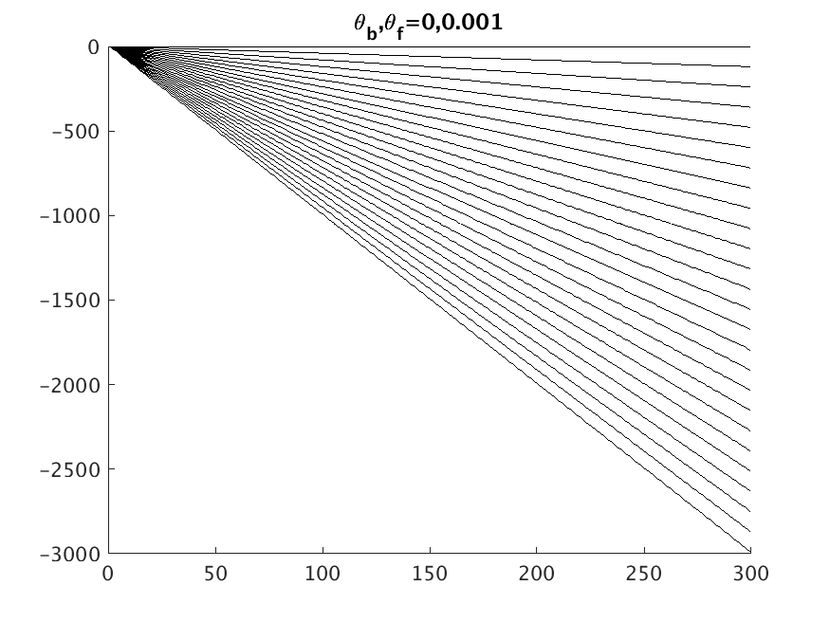
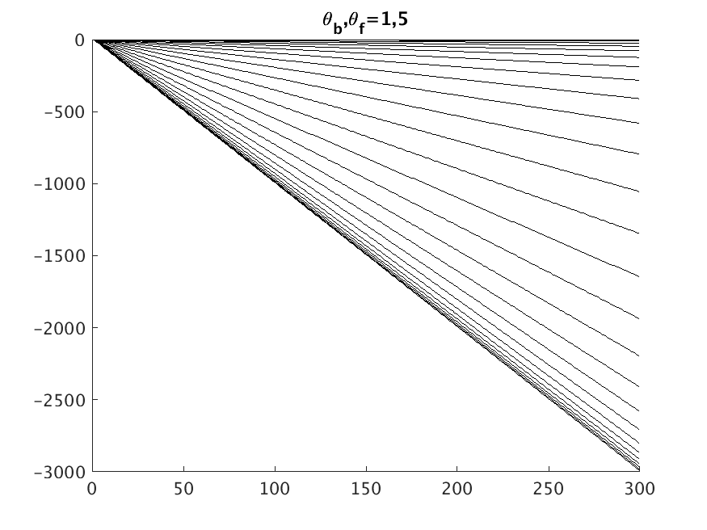
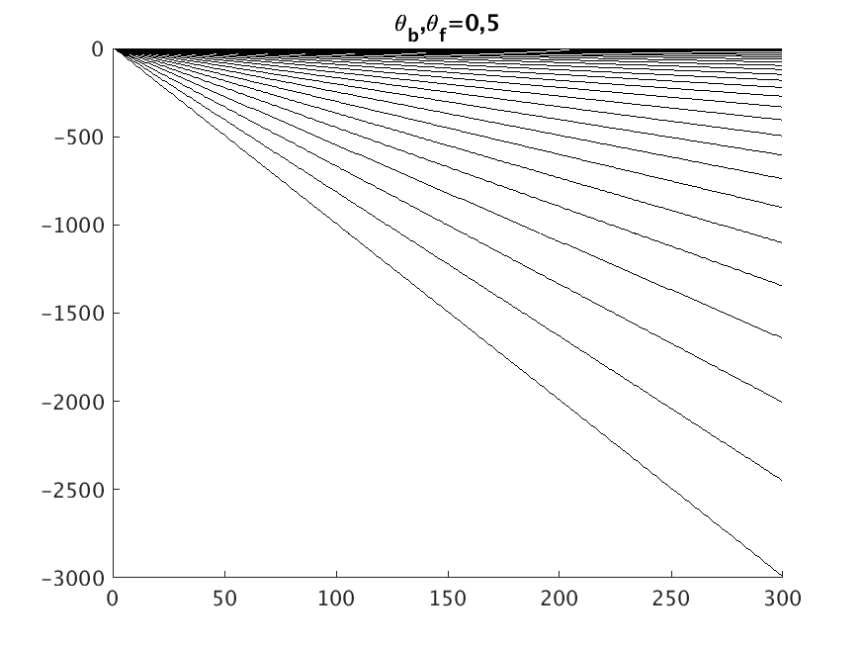
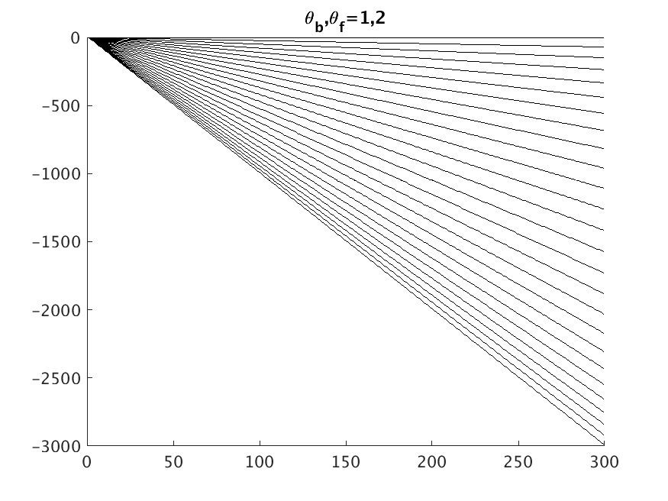
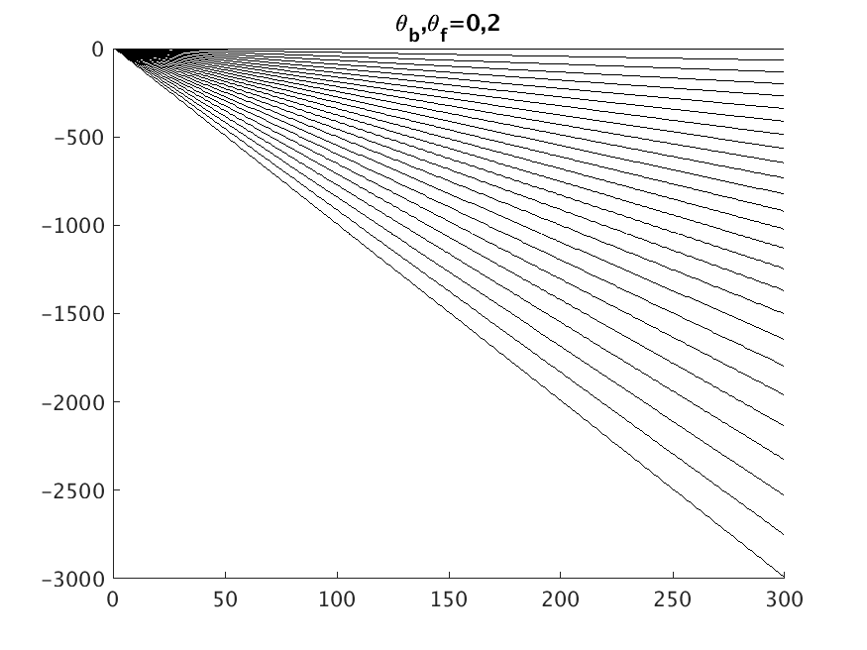

S-coordinates
θ_{b}=0: resolve surface only
θ_{b}=1: resolve surface & bottom
* Note that S-transformation degenerates to σ-transformation when h<h_{c}

Slide 7
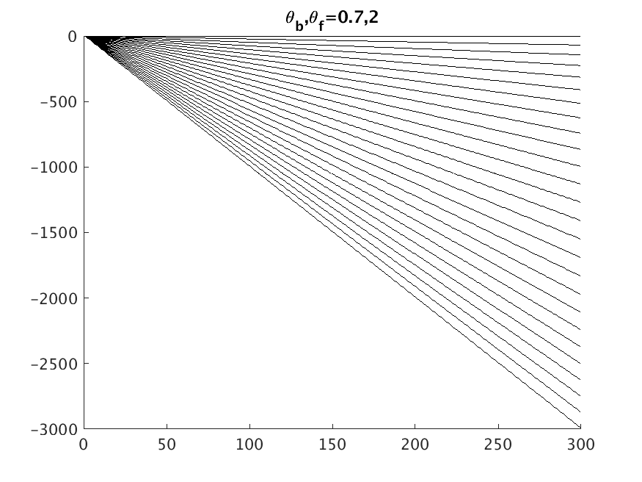
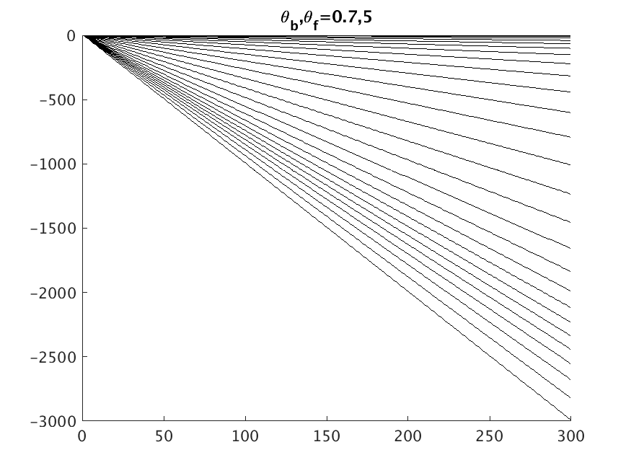
S-coordinates
θ_{b}=0.7: resolve surface and a zone above bottom

Slide 8
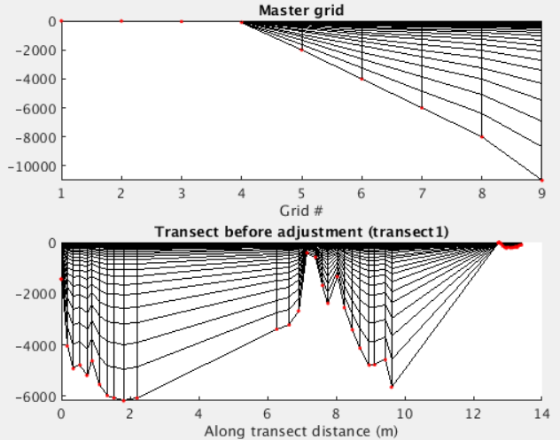
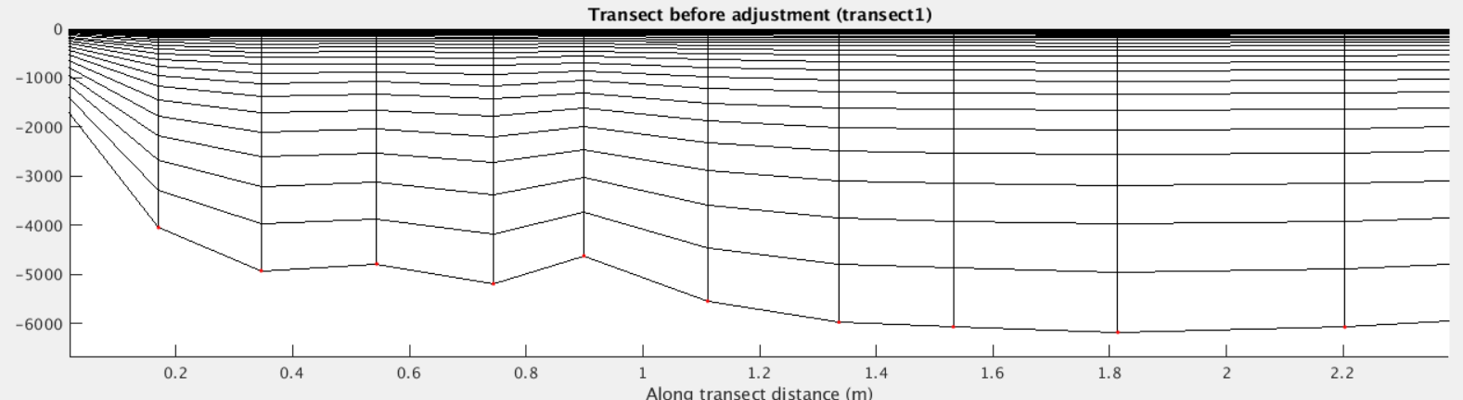
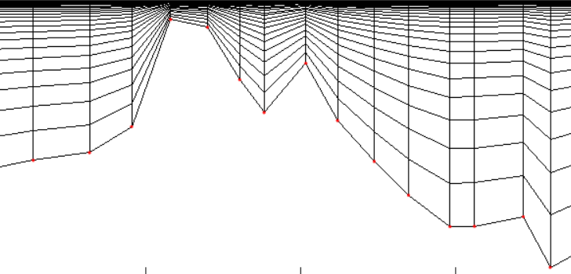
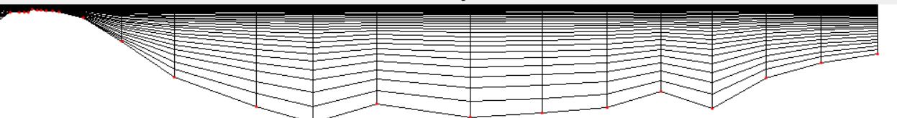
LSC² script: inspection & adjustment
Step 3: compile and run the script; viz the transect(s) with plot_VQS.m
Step 4: repeat Steps 2-3 if needed to achieve a desirable vgrid
Gaps between different segments
Meters or degrees (from hgrid.gr3)
Notes:
Used CA_DWR/RUN84b

Slide 9
LSC²: demo
Set theta_b=1 (resolve the bottom) and adjust theta_f’s
Use fewer master grids (degeneracy)
Change dz_bot_min (degeneracy)
To launch matlab:
qlogin -q matlab -t 100 1:x5672:ppn=1
(request here max 100 minutes)
module load matlab
Matlab –nosplash
On James:
qsub -X -I -l walltime=1:00:00 -l nodes=1:potomac:ppn=1 -q matlab
Notes:
Used CA_DWR/RUN84b

Slide 10
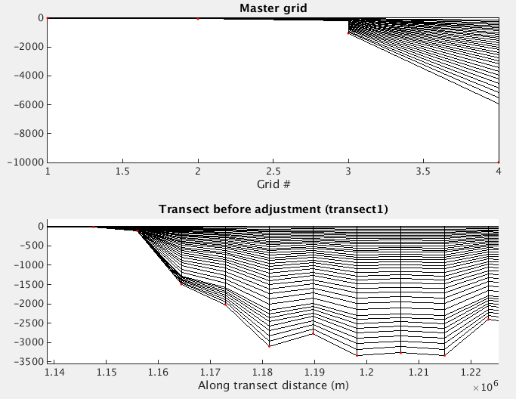
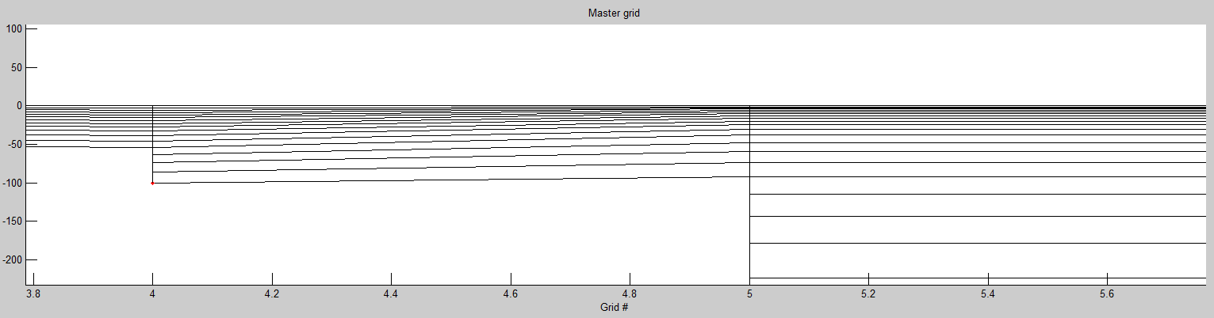
LSC²: tuning
Generally, the master grid and the final transect grid should be ‘pleasing to the eye’, with resolution applied where you wanted
  Use many transects to catch potential issues
  Usually resolve surface at the expense of bottom but…
Symptom #1: going against terrain
  Solution: adjust # of levels, stretching constants in master grids
Symptom #2: too many degenerate (shaved) cells near bottom
  Potential causes: too few # of master grids and large differences between adjacent master grids; dz_bot_min;
Master grid
Too few # of master grids
Against terrain
Too many
degenerate prisms?
Notes:
Demo on using transect.bp (/sciclone/home10/yinglong/vims20/CA_DWR/RUN84d/Vgrid)

Slide 11
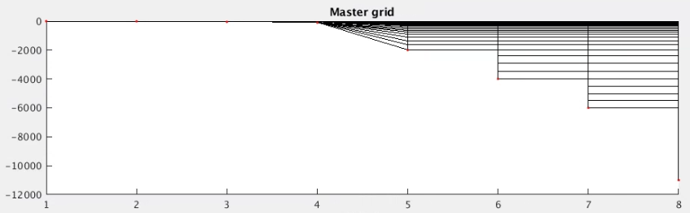
Flexibility in LSC²: add Z layers near the bottom
See RUN02a/gen_vqs_addZ.f90
LSC² is highly customizable (like UG in the horiznotal)
One possibility is to specify z layers after certain depths to save cost (esp. in deep ocean)
!Last 3 master grids
z_mas(1:nv_vqs(5),6)=z_mas(1:nv_vqs(5),5)
z_mas(1:nv_vqs(5),7)=z_mas(1:nv_vqs(5),5)
z_mas(1:nv_vqs(5),8)=z_mas(1:nv_vqs(5),5)
z_mas(1+nv_vqs(5):nv_vqs(6),6)=(/-2400.,-2900.,-3500.,-4000./)
z_mas(1+nv_vqs(5):nv_vqs(7),7)=(/-2400.,-2900.,-3500.,-4000.,-4500.,-5000.,-5500.,-6.e3/)
z_mas(1+nv_vqs(5):nv_vqs(8),8)=(/-2400.,-2900.,-3500.,-4000.,-4500.,-5000.,-5500.,-6.e3,-7.e3,-8.e3,-9.e3,-1.e4,-1.1e4/)
Copy 5th master to 6th, 7th and 8th
Specify z coorindates directly

Slide 12
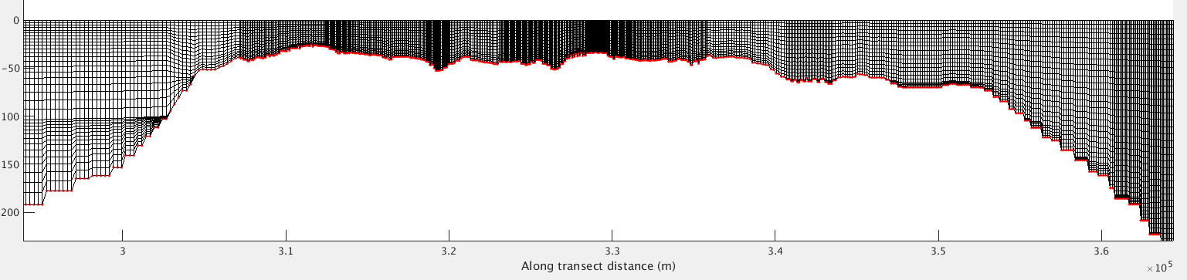
Flexibility in LSC²: region-based masters
Use multiple sets of master grids in different parts of domain
  Different sets are stitched together at ‘choke’ points
  Ensure smooth transition: different sets of master grids must match at the borders
The 2 master grids share same coordinates for h<=100m
Bosphorous Strait
Master grid #1
Master grid #2
Black Sea
Marmara Sea

