Slide 1
Setting up SCHISM3D
Joseph Zhang

Slide 2
Pre-processor
Bare minimum
Generate a hgrid.gr3 with b.c.
Run SCHISM in 2D barotropic config: manning.gr3, param.nml, bctides.in, vgrid.in (2 levels)
Pre-processing with ipre=1 (with 1 CPU) to catch mesh and other issues
Then proceed to more complex set-ups
Establish a good workflow and be willing to revise the mesh

Slide 3
SCHISM input types: glossary
*.gr3: grid-like files (node centered); only hgrid.gr3 has b.c. info at the end
hgrid.ll: lon/lat form of horizontal grid (.gr3 format)
*.th*: time history (b.c.); ASCII or nc
*.ic: initial condition for elev, tracers (ASCII; most of them of .gr3 format)
sflux/: atmos. forcings (netCDF CF 1.0)
param.nml: parameters
*.in: vgrid (vertical grid); bctides.in (b.c.) (ASCII)
*.prop: element centered property (ASCII)
*.nc: hotstart, tracer nudging inputs; or b.c. time history inputs (type 4 or 5)

Slide 4
Details of inputs

Slide 5
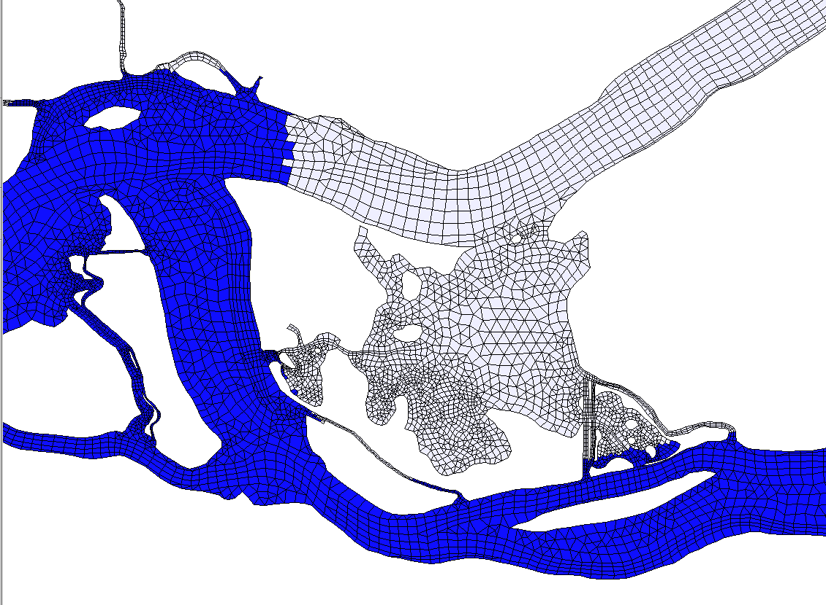
.prop
Set ‘property’ values at each element (in contrast, *.gr3 sets property (e.g. depth) at each node)
Element #
Elem property
1 0.0000000E+00
2 0.0000000E+00
3 0.0000000E+00
4 0.0000000E+00
5 0.0000000E+00
6 0.0000000E+00
7 0.0000000E+00
8 0.0000000E+00
9 1.0000000E+00
10 1.0000000E+00
…………………..

Slide 6
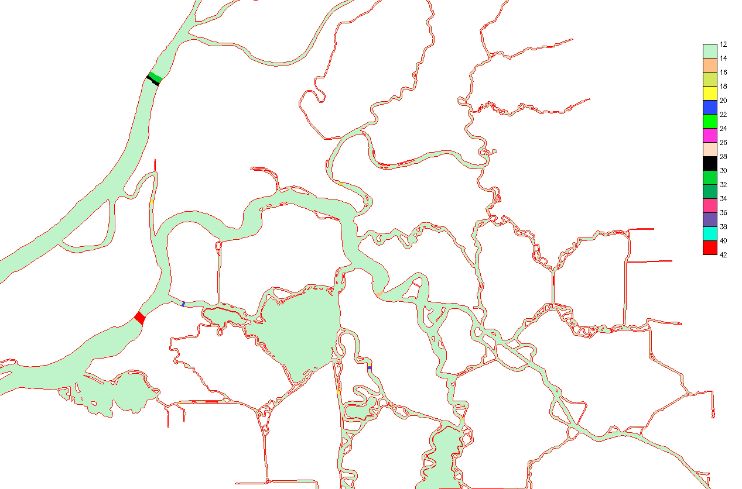
fluxflag.prop
Compute various fluxes (from ‘high’ to ‘low’), if the difference of flags=1 and neither are -1
Otherwise ignored
Output is flux.out (time, flow from 1->0, 2->1, …)
28
-1
-1
-1
27

Slide 7
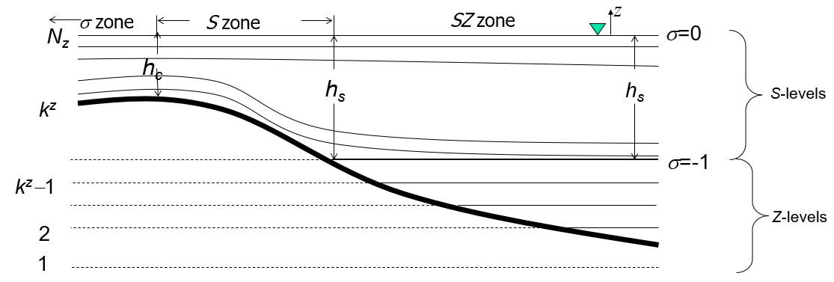
vgrid.in (1): SZ option
ivcor (1: LSC²; 2: SZ)
2
28 18 100.
Z levels
-5000.
……..
-100.00
S levels
10. 0.9 3.
18 -1
19 -0.9
……..
28 0.
h_{s}
Bottom
* Question: how to get pure S (i.e. no Z)?
Bottom z
Last z = -h_{s}
h_{c} , θ_{b} , θ_{f}
1st σ
surface
Surface σ
Code won’t check the indices (FYI only)

Slide 8
vgrid.in (1): pure S (no Z)
2
28 1 1.e6
Z levels
-1.e6
S levels
10. 0.9 3.
1 -1
2 -0.9
……..
28 0.
h_{s}
Bottom
Bottom z
σ zone
S zone
z
N_{z}
σ=0
surface
h_{c}
h_{s}
S-levels
k^{z}
σ=-1

Slide 9
vgrid.in (2): LSC²
Need pre-proc script to generate (e.g. gen_vqs*.f90 in Utility)
May take a few iterations to get desirable vgrid
Visualize the vertical grid along transects using plot_vqs.m
1 !ivocr
46
2 2 11 1 15 1 14 1 ...
1 -9. -9. -1. -9. -1. -9. -1. ...
2 -1 -9. -0.888763 -9. -0.884930 -9. -0.884930 .....
Maximum # of levels
Bottom level indices at all nodes
Level # followed by σ coordinates at this level at each nodes. The σ coordinates should normally be in [-1,0]; '-9' means level 1 is below the bottom at this node
Level #

Slide 10
Lateral b.c. and nudging
bctides.in
param.nml
Variable | Type 1 (*.th) | Type 2: | Type 3 | Type 4 (*[23]D.th) | Type 5 | Type -1 | Type -4, -5 (uv3D.th); nudging | Nudging/sponge layer near boundary
η | elev.th: Time history; uniform along bnd | Constant elev | Tidal amp/phases | elev2D.th.nc: time- and space-varying along bnd | elev2D.th.nc: combination of 3&4 | Must =0 | N/A | inu_elev
S&T, tracers | [MOD]_?.th: relax to time history (uniform along bnd) for inflow | Relax to constant for inflow | Relax to i.c. for inflow | [MOD]_3D.th.nc: relax to time- and space-varying values along bnd during inflow | N/A | N/A | N/A | inu_[MOD]
u,v | flux.th: via discharge (<0 for inflow!) | Constant discharge (<0 for inflow!) | Tides | uv3D.th.nc: time- and space-varying along bnd (in lon/lat for ics=2) | uv3D.th.nc: combination of 3&4 | Flather (‘0’ for η) | Relax to uv3D.th.nc (2 separate relaxations for in & outflow) | inu_uv

Slide 11
bctides.in: tracer b.c.
12/01/2013 00:00:00 GMT
0 50. ntip
0 nbfr
2 nope
1190 2 0 0 0 Pacific
1. !elev B.C.
139 0 2 0 0 River
-10000. !river discharge in m³/s
12/01/2013 00:00:00 GMT
0 50. ntip
0 nbfr
2 nope
1190 2 0 3 0 Pacific
!elev B.C.
139 0 2 0 0 River
-10000. !river discharge in m³/s
12/01/2013 00:00:00 GMT
0 50. ntip
0 nbfr
2 nope
1190 2 0 3 2 Pacific
!elev B.C.
139 0 2 0 0 River
-10000. !river discharge in m³/s
0.01 !T relaxation
0.01 !T relaxation scale
33. !S b.c.
0.02 !S relaxation
Any non-zero tracer b.c. flags require relaxation coefficient
Use bi-section method to narrow down the error if you are stuck

Slide 12
param.nml
Three major sections
CORE: mandatory parameters. If not specified, the code will crash
OPT: optional parameters with code defaults (often a good starting point but…)
SCHOUT: optional parameters that control outputs

Slide 13
CORE
&CORE
!+++++++++++++++++++++++++++++++++++++++++++++++++++++++++++++++++++++++
! Core (mandatory) parameters; no defaults
!+++++++++++++++++++++++++++++++++++++++++++++++++++++++++++++++++++++++
! Pre-processing option. Useful for checking grid errors etc. Can only use 1 CPU if ipre=1
ipre = 0 !Pre-processor flag (1: on; 0: off)
! Baroclinic/barotropic option. If ibc=0 (baroclinic model), ibtp is not used.
ibc = 0 !Baroclinic option
ibtp = 1 !transport solver
rnday = 30 !total run time in days
dt = 100. !Time step in sec
! Grid for WWM (USE_WWM)
msc2 = 24 !same as msc in .nml ... for consitency check between SCHISM and WWM
mdc2 = 30 !same as mdc in .nml
! Define # of tracers in tracer modules (if enabled)
ntracer_gen = 2 !user defined module (USE_GEN)
ntracer_age = 4 !age calculation (USE_AGE). Must be =2*N where N is # of age tracers
sed_class = 5 !SED3D (USE_SED)
eco_class = 27 !EcoSim (USE_ECO): must be between [25,60]
! Global output controls
nspool = 36 !output step spool
ihfskip = 864 !stack spool; every ihfskip steps will be put into 1_*, 2_*, etc...
/

Slide 14
OPT: Initial condition flags
!-----------------------------------------------------------------------
! Elevation initial condition flag for cold start only. If ic_elev=1, elev.ic
! (in *.gr3 format) is needed
! to specify the initial elevations; otherwise elevation is
! initialized to 0 everywhere
!-----------------------------------------------------------------------
ic_elev = 1
!-----------------------------------------------------------------------
! Elevation boundary condition ramp-up flag. =0: ramp up from 0;
! =1: ramp up from
! elev. values read in from elev.ic or hotstart.nc - if neither is
! present, from 0.
! This flag is mainly used to start the simulation from non-zero elev.
! The ramp-up period is same as 'dramp' below.
!-----------------------------------------------------------------------
nramp_elev = 0
* Question: how to impose 3D i.c.?
Tracer i.c.
!-----------------------------------------------------------------------
! Initial condition for T,S. This value only matters for ihot=0 (cold start).
! If ic_*=1, the initial T,S field is read in from temp.ic and salt.ic (horizontally varying).
! If ic_*=2, the initial T,S field is read in from ts.ic (vertical varying).
! If ihot=0 && ic_*=2 || ibcc_mean=1, ts.ic is used for removing mean density profile.
!-----------------------------------------------------------------------
ic_TEM = 1
ic_SAL = 1 !must be same as ic_TEM
! initial conditions for other tracers.
! 1: needs inputs [MOD]_hvar_[1,2,...].ic ('1...' is tracer id); format of each file is similar to salt.ic;
! i.e. horizontally varying i.c. is used for each tracer.
! 2: needs [MOD]_vvar_[1,2,...].ic. Format of each file (for each tracer in tis MOD) is similar to ts.ic
! (i.e. level #, z-coord., tracer value). Verically varying i.c. is used for each tracer.
! 0: model sets own i.c. (EcoSim; TIMOR)
ic_GEN = 1 !user defined module
ic_AGE = 1 !Age
ic_SED = 1 !SED3D
ic_ECO = 1 !EcoSim
ic_ICM = 1 !ICM
ic_COS = 1 !CoSINE
ic_FIB = 1 !FIB
Elevation i.c.

Slide 15

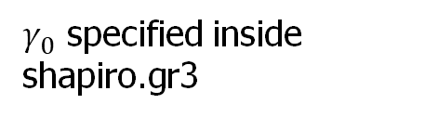

OPT: control of dissipation in momentum
!-----------------------------------------------------------------------
! Methods for computing velocity at nodes.
! If indvel=0, conformal linear shape function is used; if indvel=1, averaging method is used.
! For indvel=0, a stabilization method is needed (see below).
!-----------------------------------------------------------------------
indvel = 0
!-----------------------------------------------------------------------
! 2 stabilization methods, mostly for indvel=0.
! (1) Horizontal viscosity option. ihorcon=0: no viscosity is used; =1: Lapacian;
! =2: bi-harmonic. If ihorcon=1, horizontal viscosity _coefficient_ (<=1/8, related
! to diffusion number) is given in hvis_coef0, and the diffusion #
! is problem dependent; [0.001-1/8] seems to work well.
! If ihorcon=2, diffusion number is given by hvis_coef0 (<=0.025).
! If indvel=1, no horizontal viscosity is needed.
! (2) Shapiro filter (see below)
!
! For non-eddying regime applications (nearshore, estuary, river), easiest option is:
! indvel=0, ishapiro=1 (shapiro=0.5), ihorcon=inter_mom=0.
! For applications that include eddying regime, refer to the manual.
!-----------------------------------------------------------------------
ihorcon = 2
hvis_coef0 = 0.025 !const. diffusion # if ihorcon/=0; <=0.025 for ihorcon=2, <=0.125 for ihorcon=1
! cdh = 0.01 !needed only if ihorcon/=0; land friction coefficient - not active yet
!-----------------------------------------------------------------------
! 2nd stabilization method via Shapiro filter. This should normally be used
! if indvel=ihorcon=0. To transition between eddying/non-eddying regimes, use
! indvel=0, ihorcon/=0, and ishapiro=-1 (shapiro.gr3).
!-----------------------------------------------------------------------
ishapiro = 2 !on/off flag
shapiro0 = 1.e3 !Shapiro filter strength
Eddying or regime or cross scale: indvel=0, ihorcon=2, hvis_coef0 = 0.025, ishapiro=2, with a proper shapiro.gr3 (starting with 100)
$γ_{0}$ specified inside shapiro.gr3
Smagorinsky-like filter
$$γ=0.5\tanh\left(γ_{0}∆t\hat{μ}\right)$$
$$\hat{μ}=\sqrt{u_{x}^{2}+v_{y}^{2}+{(u_{y}+v_{x})}^{2}/2}$$
(deformation)

Slide 16
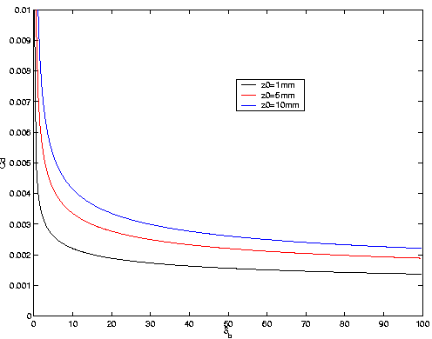
OPT: bottom friction
!-----------------------------------------------------------------------
! Bottom friction.
! nchi=0: drag coefficients specified in drag.gr3; nchi=-1: Manning's
! formulation (even for 3D prisms) with n specified in manning.gr3.
! nchi=1: bottom roughness (in meters) specified in rough.gr3.
! Cd is calculated using the log law, when dzb>=dzb_min; when
! dzb<dzb_min,
! Cd=Cdmax, where Cdmax=Cd(dzb=dzb_min).
!
! If iwbl/=0, nchi must =1.
!-----------------------------------------------------------------------
nchi = 1
dzb_min = 0.5 !needed if nchi=1; min. bottom boundary layer thickness [m].
hmin_man = 1. !needed if nchi=-1: min. depth in Manning's formulation [m]
When imposing bottom roughness, remember to limit the boundary layer thickness with dzb_min to avoid large friction in shallows
This is similar to limiting Manning’s formula with hmin_man
Bottom boundary layer thickness (m)

Slide 17
OPT: Transport solver
Use itr_met=3 (TVD) or 4 (WENO) for most b-clinic applications
Fine tuning (of efficiency, dispersion) handles
h_tvd: shallower depths use efficient upwind
tvd.prop: use upwind where property=0
ielm_transport: beware combination of this and WENO
!-----------------------------------------------------------------------
! Transport method.
! If itr_met=1, upwind method is used. If itr_met>=2, TVD or WENO method is used
! on an element/prism if the total depth (at all nodes of the elem.)>=h_tvd and the flag in
! tvd.prop = 1 for the elem. (tvd.prop is required in this case);
! otherwise upwind is used for efficiency.
! itr_met=3 (horizontal TVD) or 4 (horizontal WENO): implicit TVD in the vertical dimension.
! Also if itr_met==3 and h_tvd>=1.e5, some parts of the code are bypassed for efficiency
!-----------------------------------------------------------------------
itr_met = 3
h_tvd = 5. !used only if itr_met>=2; cut-off depth (m)
!If itr_met=3 or 4, need the following 2 tolerances of convergence. The convergence
!is achieved when sqrt[\sum_i(T_i^s+1-T_i^s)^2]<=eps1_tvd_imp*sqrt[\sum_i(T_i^s)^2]+eps2_tvd_imp
eps1_tvd_imp = 1.e-4 !suggested value is 1.e-4, but for large suspended load, need to use a smaller value (e.g. 1.e-9)
eps2_tvd_imp = 1.e-14
!Optional hybridized ELM transport for efficiency
ielm_transport = 0 !1: turn on
max_subcyc = 10 !used only if ielm_transport/=0. Max # of subcycling per time step in transport allowed
!if itr_met = 4, the following parameters are needed
!if itr_met=4 and ipre=1, diagnostic outputs are generated for weno accuracy and stencil quality,
! see subroutine weno_diag in src/Hydro/misc_subs.F90 for details
ip_weno = 2 !order of accuracy: 0- upwind; 1- linear polynomial, 2nd order; 2- quadratic polynomial, 3rd order
courant_weno=0.5 !Courant number for weno transport
epsilon1 = 1.e-15 !coefficient for 2nd order weno smoother
epsilon2 = 1.e-10 !1st coefficient for 3rd order weno smoother
At a given element:
ELM is used if local subcycling # exceeds max_subcyc (if ielm_transport=1)
Upwind is used if h<h_tvd or tvd.prop=0 at an elem
Otherwise, higher-order methods (TVD or WENO) are used at this elem

Slide 18
OPT: Transport solver
!-----------------------------------------------------------------------
! Transport method.
! If itr_met=1, upwind method is used. If itr_met>=2, TVD or WENO method is used
! on an element/prism if the total depth (at all nodes of the elem.)>=h_tvd and the flag in
! tvd.prop = 1 for the elem. (tvd.prop is required in this case);
! otherwise upwind is used for efficiency.
! itr_met=3 (horizontal TVD) or 4 (horizontal WENO): implicit TVD in the vertical dimension.
! Also if itr_met==3 and h_tvd>=1.e5, some parts of the code are bypassed for efficiency
!-----------------------------------------------------------------------
itr_met = 3
h_tvd = 5. !used only if itr_met>=2; cut-off depth (m)
!If itr_met=3 or 4, need the following 2 tolerances of convergence. The convergence
!is achieved when sqrt[\sum_i(T_i^s+1-T_i^s)^2]<=eps1_tvd_imp*sqrt[\sum_i(T_i^s)^2]+eps2_tvd_imp
eps1_tvd_imp = 1.e-4 !suggested value is 1.e-4, but for large suspended load, need to use a smaller value (e.g. 1.e-9)
eps2_tvd_imp = 1.e-14
!Optional hybridized ELM transport for efficiency
ielm_transport = 0 !1: turn on
max_subcyc = 10 !used only if ielm_transport/=0. Max # of subcycling per time step in transport allowed
!if itr_met = 4, the following parameters are needed
!if itr_met=4 and ipre=1, diagnostic outputs are generated for weno accuracy and stencil quality,
! see subroutine weno_diag in src/Hydro/misc_subs.F90 for details
ip_weno = 2 !order of accuracy: 0- upwind; 1- linear polynomial, 2nd order; 2- quadratic polynomial, 3rd order
courant_weno=0.5 !Courant number for weno transport
epsilon1 = 1.e-15 !coefficient for 2nd order weno smoother
epsilon2 = 1.e-10 !1st coefficient for 3rd order weno smoother
For coastal/estuarine applications
TVD+upwind+ELM​ works robustly, so you can set tvd.prop=1 uniformly
For cross-scale applications
WENO+upwind works fine
WENO+upwind+ELM generally works, but may need to adjust WENO zone to avoid dispersion​
In all cases, do not abuse ELM as it does have side effects (not conservative)
As a guideline, transport time step should be ~5-10 sec, so adjust max_subcyc accordingly

Slide 19
OPT: Atmospheric forcing
!-----------------------------------------------------------------------
! Atmos. option. If nws=0, no atmos. forcing is applied. If nws=1, atmos.
! variables are read in from wind.th. If nws=2, atmos. variables are
! read in from sflux_ files.
! If nws=4, ascii format is used for wind and atmos. pressure at each node (see source code).
! If nws>0, 'iwindoff' can be used to scale wind speed (with windfactor.gr3).
!
! Stress calculation:
! If nws=1 or >=4, or nws=2 and ihconsv=0, or nws=2 and iwind_form=-1,
! the stress is calculated from Pond & Pichard formulation
! If nws=2, ihconsv=1 and iwind_form=0, the stress is calculated from heat exchange
! routine;
! If WWM is enabled and icou_elfe_wwm>0 and iwind_form=-2, stress is calculated by WWM;
! otherwise the formulations above are used.
!-----------------------------------------------------------------------
nws = 2
wtiminc = 150. !time step for atmos. forcing
drampwind = 2. !ramp-up option for atmos. forcing
iwindoff = 0 !needed only if nws/=0; '1': needs windfactor.gr3
iwind_form = -1
!-----------------------------------------------------------------------
! Heat and salt exchange. isconsv=1 needs ihconsv=1; ihconsv=1 needs nws=2.
! If isconsv=1, need to compile with precip/evap module turned on.
!-----------------------------------------------------------------------
ihconsv = 0 !heat exchange option
isconsv = 0 !evaporation/precipitation model
nws=2 is recommended. pySCHISM can help you
Heat & salt exchange options rely on nws=2
Atmos variables used are in sflux_rad* and sflux_prc*
Salt exchange must have heat exchange on
To use salt exchange, need to recompile code with PREC_EVAP on
wtiminc: usually equal to dt, but larger values may save time (especially for large sflux inputs)

Slide 20
OPT: Turbulence closure
!-----------------------------------------------------------------------
! Turbulence closure.
!-----------------------------------------------------------------------
itur = 3
! dfv0 = 1.e-6 !needed if itur=0
! dfh0 = 1.e-6 !needed if itur=0
turb_met = KL !needed if itur=3,5. Use KE if itur=5
turb_stab = KC !needed if itur=3 or 5. Use 'GA' if turb_met='MY'; otherwise use 'KC'.
xlsc0 = 0.1 !needed if itur=3 or 5. Scale for surface & bottom mixing length (>0)
itur=3 (or 4) for baroclinic cases
itur=3 (or 4): needs diffmax.gr3,diffmin.gr3 (max/min diffusivity; e.g. 1 and 1.e-6)
turb_met: KE (k-ε) or KL (k-kl) usually works well

Slide 21
OPT: backtracking
!-----------------------------------------------------------------------
! Dimensioning parameters for inter-subdomain btrack.
! If error occurs like 'bktrk_subs: overflow' or 'MAIN: nbtrk > mxnbt'
! gradually increasing these will solve the problem
!-----------------------------------------------------------------------
s1_mxnbt = 0.5
s2_mxnbt = 3.5
These two parameters have no effects on accuracy; only affect memory consumption during inter-subdomain backtracking (ELM)
Defaults are fine for most cases
In extreme cases (rapid change in resolution), you may get a fatal error “nbtrk…”
When this occurs, may gradually increase these two parameters
Sometimes, the error is due to very noisy velocity, so you need to fix other issues: ALWAYS viz velocity!

Slide 22
OPT: flux check
!-----------------------------------------------------------------------
! Conservation check option. If iflux=1, some fluxes are computed
! in regions specified in fluxflag.prop (regional number from -1 to an arbitrary !integer).
!-----------------------------------------------------------------------
iflux = 1
fluxflag.prop

Slide 23
SCHOUT
!-----------------------------------------------------------------------
!Station output option. If iout_sta/=0, need output skip (nspool_sta) and
!a station.in. If ics=2, the cordinates in station.in must be in lon., lat,
!and z (measured from datum; not used for 2D variables).
!-----------------------------------------------------------------------
iout_sta = 1
nspool_sta = 10 !needed if iout_sta/=0
!-----------------------------------------------------------------------
! Flag for harmonic analysis for elevation. If used , need to turn on USE_HA
! in Makefile, and input harm.in. Otherwise set it to 0. Hotstart ihot=2 is not working with HA
! Outputs are harme_* and use combine_outHA to combine.
!-----------------------------------------------------------------------
iharind = 0

Slide 24
Station.in
1 1 1 1 1 1 1 1 1 !on (1)|off(0) flags for elev, air pressure, windx, windy, T, S, u, v, w
4 !# of stations
1 6.5833 54.0000 0 !Format: station #,x,y,z; z is z-coordinate
2 7.1583 55.195 -1.
3 6.35 54.1667 -5.
4 8.4514 54.7942 0
z is z-coordinates, not distance from surface! So z<0 is below the datum
No effect on 2D variables
If you want to extract a 3D variable at multiple depths, use multiple stations with different z
For 3D variables, code will extrapolate above surface/below bottom as needed
Online vs offline extraction: pros and cons

Slide 25
Most important parameters are…
Momentum dissipation: indvel, ihorcon, ishapiro
Appropriate combination of these should be used for different applications (dispersion vs diffusion)
Non-eddying cases: indvel=0, ishapiro=1 (shapiro=0.5), ihorcon=inter_mom=0
Eddying or regime or cross scale: indvel=0, ihorcon=2, hvis_coef0 = 0.025, ishapiro=2, with a proper shapiro.gr3 (starting with 100)
dt: appropriate time step
Another way to control dispersion/diffusion
Reducing dt will increase diffusion and decrease dispersion
Starts with dt=150 s
nws: use ‘2’ as much as possible (use pySCHISM to generate sflux*.nc)
itr_met: use 3 or 4
Performance tuning required especially for WENO as the transport solver is the bottleneck
If you use ELM to alleviate the bottleneck (ielm_transport=1), set max_subcyc so that transport time step is ~ 5 sec

Slide 26
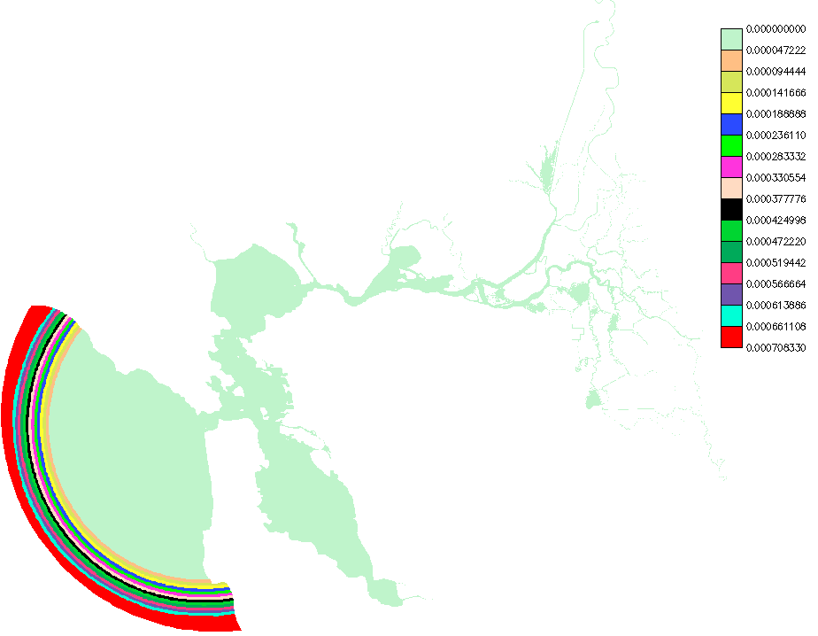
Tracer nudging
Tracers are usually ‘relaxed’ near the ocean bnd to another model (e.g. HYCOM) that also provides the b.c., to prevent gradients being developed there
Tracer nudging inputs consist of two components
*_nudge.gr3 that specify the horizontal relaxation strength over the domain (0 outside the nudging zone)
*_nu.nc that specify the tracer values being nudged to over time, at points specified in *_nudge.gr3
Horizontal nudging for T,S (also other tracers)
Suggestion: max relaxation scale of a few days
Have simple scripts (or pySCHISM) to generate these based on a fixed distance from the open bnd
Vertical nudging scales in param.nml
=0
>0

Slide 27
Tracer nudging value inputs
netcdf SAL_nu {
dimensions:
time = 93 ;
node = 2883 ;
nLevels = 50 ;
one = 1 ;
variables:
double time(time) ;
time:dimname = "time" ;
int64 map_to_global_node(node) ;
map_to_global_node:dimname = "node" ;
float tracer_concentration(time, node, nLevels, one) ;
string tracer_concentration:dimname = "time", "node", "nLevels", "one" ;
data:
time = 0, 1, 2, 3, 4, 5, 6, 7, 8, 9, 10, 11, 12, 13, 14, 15, 16, 17, 18, 19,
20, 21, 22, 23, 24, 25, 26, 27, 28 ;
map_to_global_node = 94178, 94182, 97671, 120851, 120852, 120853, 120854,
120855, 120856, 120857, 120858, 120859, 123609, 123610, 123611, 123612,
….
tracer_concentration =
34.63076,
34.62345,
34.57667,
34.50737,
34.4041,
34.30476,
….
Can be generated using pySCHISM or FORTRAN scripts
Since nudging only occurs near the ocean bnd only, ‘map_to_global_node’ specifies the list of nodes in that area

Slide 28
B.C.: *[23]D.th.nc
elev2D.th.nc, TEM_3D.th.nc, SAL_3D.th.nc, [tracer]_3D.th.nc, uv3D.th.nc
Corresponds to b.c. flag=4 or 5
Can be generated using pySCHISM or FORTRAN scripts
netcdf uv3D.th {
dimensions:
nOpenBndNodes = 1329 ;
nLevels = 48 ;
nComponents = 2 ;
one = 1 ;
time = UNLIMITED ; // (2881 currently)
variables:
float time_step(one) ;
time_step:long_name = "time step in seconds" ;
double time(time) ;
time:long_name = "simulation time in seconds" ;
float time_series(time, nOpenBndNodes, nLevels, nComponents) ;
// global attributes:
:_NCProperties = "version=1|netcdflibversion=4.4.1.1|hdf5libversion=1.8.18" ;
data:
time_step = 3600 ;
time = 0, 3600, 7200, 10800, 14400, 18000, 21600, 25200, 28800, 32400,
36000, 39600, 43200, 46800, 50400, 54000, 57600, 61200, 64800, 68400,
72000, 75600, 79200, 82800, 86400, 90000, 93600, 97200, 100800, 104400,
108000, 111600, 115200, 118800, 122400, 126000, 129600, 133200, 136800,
140400, 144000, 147600, 151200, 154800, 158400, 162000, 165600, 169200,
Records must start from t=0
Time step specified inside and ≥ dt

Slide 29
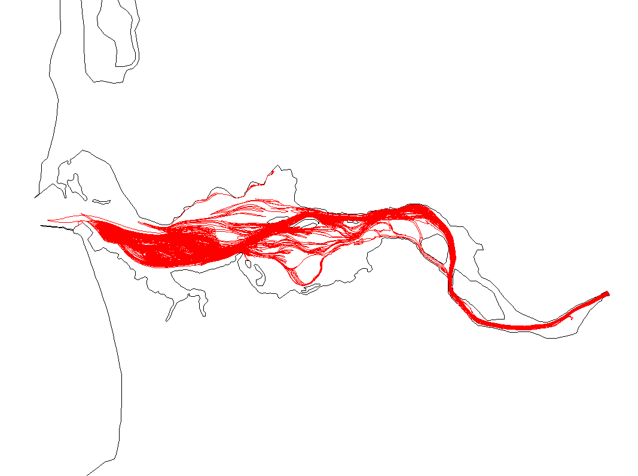
Particle tracking
Offline 3D tracking on unstructured grid
Currently only Euler option
Can do both forward and backward tracking
Oil spill option supports only forward tracking
Inputs:
hgrid.gr3, vgrid.in
Output *.nc: need to have elev, horizontal vel, vertical velocity; also wind and diffusivity for oil spill
particle.bp: main parameter input
Output: particle.pth (drogue format that can be viz’ed with xmvis6)

Slide 30
particle.bp
Input for ptrack
1 nscreen
0
1
1
1 -124 46.25
0.1 8. 90. 10 960 9
16
1 84600. 385000 510000 -5.
2 84600. 300000 450000 -5.
3 84600. 200000 450000 -5.
4 84600. 120000 450000 -5.
5 84600. 380000 292500 -5.
6 84600. 360000 290000 -5.
7 84600. 320000 290000 -5.
…….
[Oil spill parameters]
mod_part (0: passive; 1: oil spill)
ibf (forward (=1) or backward (=-1) tracking)
istiff (1: from F.S.)
Ics, slam0, sfea0 (ics=2 still uses CPP)
h0 , rnday, dtout (=dt*nspool; time step in *.nc), nspool, ihfskip, ndeltp (# of divisions for tracking – aim for ~10s for tracking step)
# of particles
E.g.: dtout/ndelp=10 sec
particle id, start time (s), starting x,y, and z relative to the instant f.s. (<=0)

