Slide 1
Set up toy case in 3D
Joseph Zhang

Slide 2
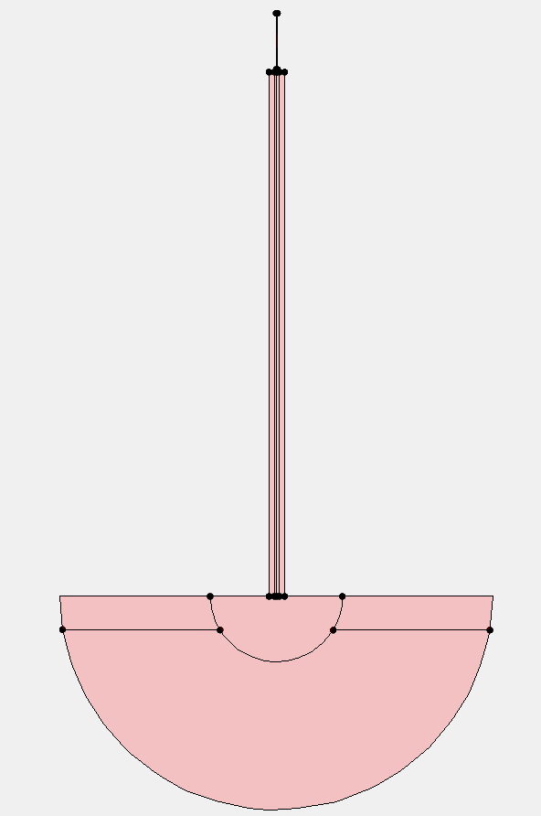
A toy model for estuary-shelf
Simple estuary-shelf model
Apply the lessons you’ve learnt so far to set up a simple 3D case
Your tasks
  Revise the mesh for 3D if you wish
  Load bathymetry by creating a sloping shelf outside, a shipping channel inside with side shoals (gredit)
  Generate the remaining inputs (*.ic for T,S; river flow; simple M2 tides with 0.5m amplitude; 1000 m³/s river flow)
    Compare LSC² and SZ
  Run the model for 60 days and use visIT or schismview to qualitatively assess the results

Slide 3
Homework #2
Finish the idealized case, using SZ and LSC²
Visualize and compare the mean surface and bottom salinity (≥60days)
  You can use /sciclone/home/yinglong/bin_hima/compute_average5.exe to compute average field (run inside outputs/; output is average.out (.gr3 format))
Submit your two runs (SZ and LSC²) with outputs

Slide 4
Set up Delaware Bay in 3D
Joseph Zhang

Slide 5
A realistic 3D model
Set up the DEB case in 3D
Your tasks
  Mesh based on the 2D case with bathymetry loaded from CUDEM
  Generate other inputs
    Try LSC² and SZ
    Same river flow at Trenton as 2D
    sflux using pySCHISM
    *.nc (b.c. and nudging) from pySCHISM (HYCOM)
      pyschism/examples/HYCOM/
    Note that pySCHISM can also generate a hotstart.nc, but S i.c. is from ocean
      Use T,S i.c. (gredit)
    Run the model for 60 days

Slide 6
Homework #3
Finish 3D DEB case with precipitation (as in 2D compound case) enabled (≥60 days)
Viz and analyze results for 3D processes (mean SSS etc)
Assess your results qualitatively against Whitney & Garvine (2006)
Submit your run dir using LSC² with outputs
HRRR can be found: /sciclone/home/yinglong/DISKS/vims20/MSCI602/RUN01b/HRRR/sflux

