Slide 1
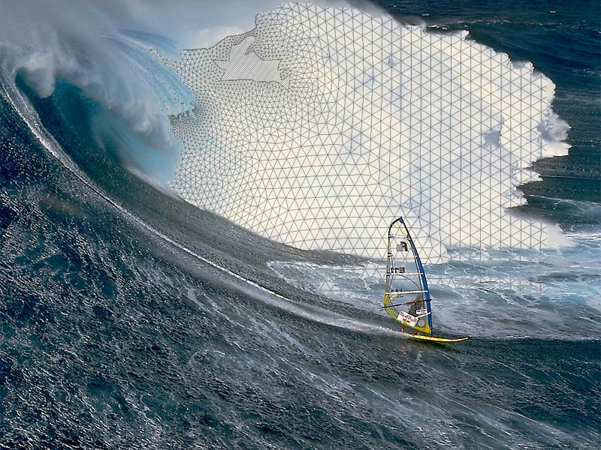
Mesh generation for Eddying and Transitional Regime
Joseph Zhang

Slide 2
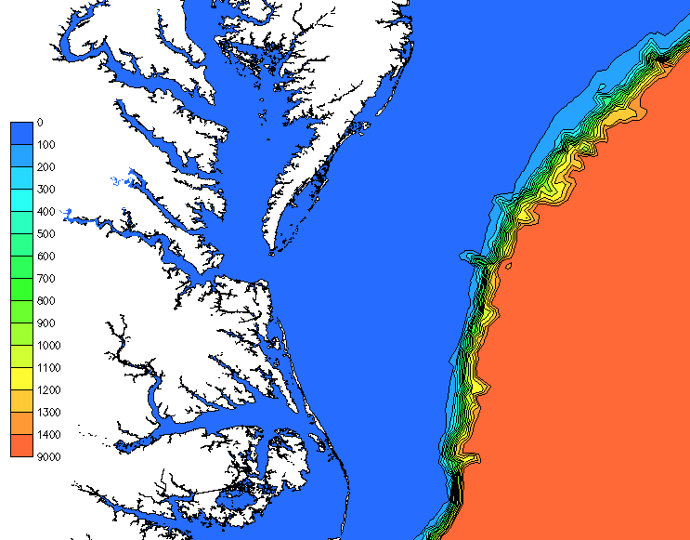
Definitions
Bathymetry (m)
Non-eddying
Major challenge: steep slopes in deep ocean
Meshing is an important step in tackling this challenge
Transitional
Eddying

Slide 3
Typical workflow in setting up SCHISM3D
Mesh generation
Code compilation
2D model, ipre=1
check errors in meshing and parameters
2D model, ipre=0
*A highly skillful 3D model requires iterative workflow!
3D model

Slide 4
Mesh generation
Always keep the map file and DEM sources and be willing to edit the mesh, as often the model results (and sometimes efficiency) depend on the mesh
  Tuning parameters on a fixed mesh is not be sufficient
Tools like SMS make the meshgen process easy, so it’s important to make sure the entire workflow is repeatable and reproducible
Focus should be to resolve key features; also pay attention to efficiency (horizontal transport)
Good news: meshgen is very similar between 3D and 2D in the non-eddying regime
The main differences exist in eddying and transitional regimes
For 3D model, the mesh transition should be gradual and smoother in eddying and transition regimes
Most challenging situation is where the transitional regime is very tight (e.g., steep slopes)

Slide 5
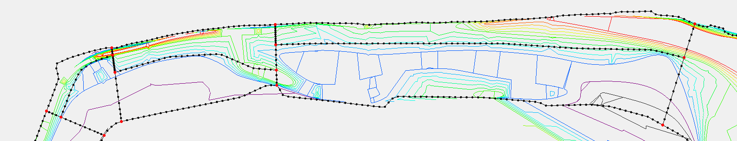
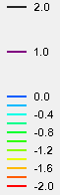
Mesh generation: channels
Make sure major channels are resolved with at least 1 row of ‘always wet’ elements – no blockage of channel flow
Bathymetry (m)
Example for Qiangtang River
Lower river: channel can be delineated
patches
patches
paving
paving
Don’t be timid in resolving the narrow channel!
(actually the model may misbehave without this)
Resolving features is much easier with SCHISM – be game! Bathymetry smoothing is not recommended
Skew elements are fine in non-eddying regime (rivers, estuaries)

Slide 6
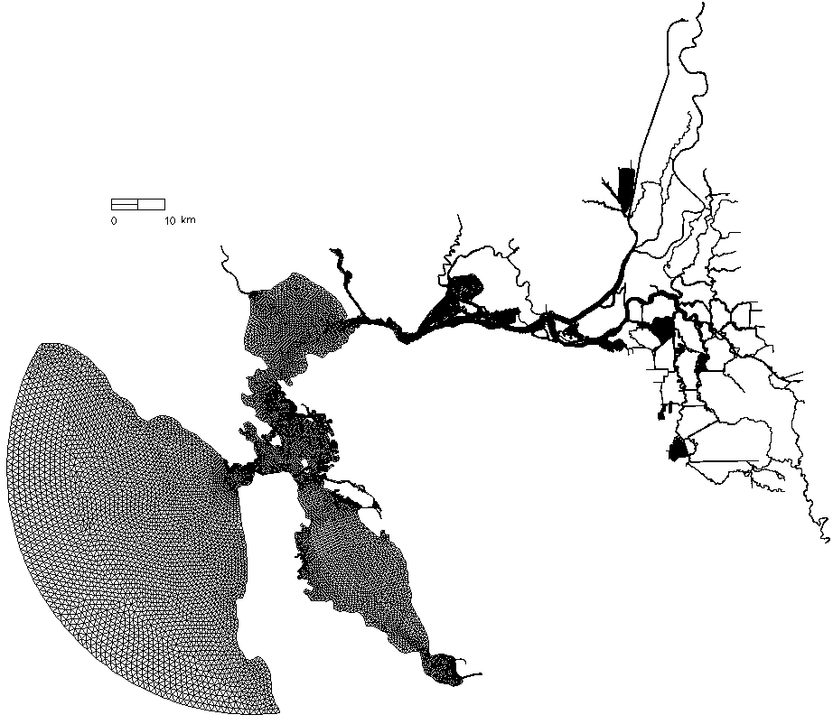
Mesh generation: efficiency
Implicit TVD² transport (in vertical) is very efficient, but horizontal transport is still explicit (and is SCHISM’s main bottleneck)
Therefore, beware mesh resolution in high-flow regions to avoid excessive sub-cycling under TVD or WENO
There are two options to avoid this bottleneck
  Use more efficient upwind in areas of little stratification
  Use Eulerian-Lagrangian method (ielm_transport=1) and set a max sub-cycling # (max_subcyc): beware ELM/WENO combination that can lead to dispersion
Delta
Bay
e.g.: the Delta portion in San Francisco Bay & Delta is mostly shallow and consists of many narrow canals so can be simulated using upwind as mesh resolution there is already high

Slide 7
Mesh generation for eddying/transitional regime
Eddying and non-eddying regimes are governed by different balances
  Non-eddying regime: mostly forced/dissipated, ageostrophic
  Eddying regime: weakly forced, mostly balanced (geostrophic)
  Examples of eddying regime: deep ocean, open deep basins of Great Lakes
Mesh generation for eddying regime therefore should strive to preserve this balance by using gradually varying resolution
  This is also because the bathymetric variation in the deep ocean is negligible
    Beware size function-based mesh generator
  Sharp transition would distort or create spurious eddying processes (Wang and Danilov 2013), but not model stability
  Simplicity in mesh design here is a virtue: do not over-constrain the mesh unnecessarily in eddying regime
  Use auxiliary arcs to avoid excessive resolution in deep water (hydrostatic assumption)
  Important to delineate the regimes (and use different strategies)

Slide 8
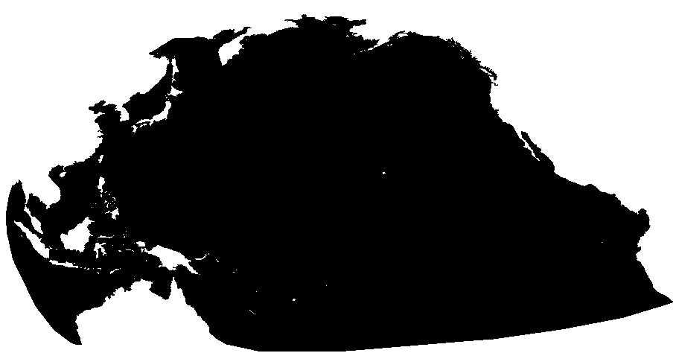
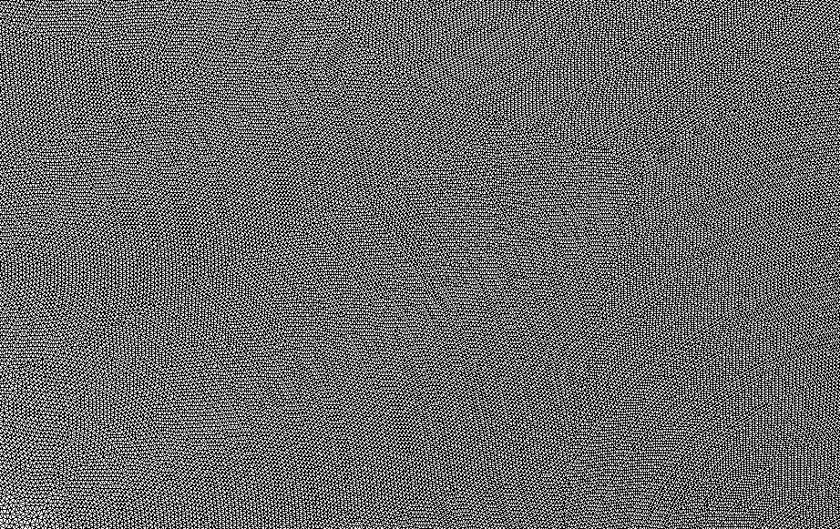
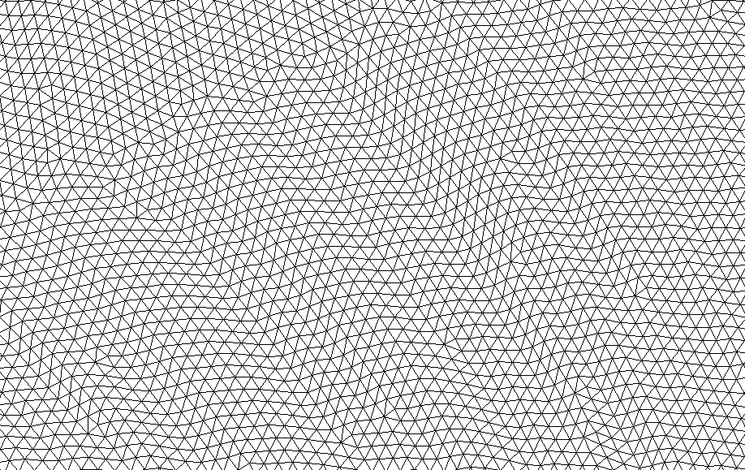
Example of mesh in eddying regime
‘Featureless’ mesh in open ocean

Slide 9
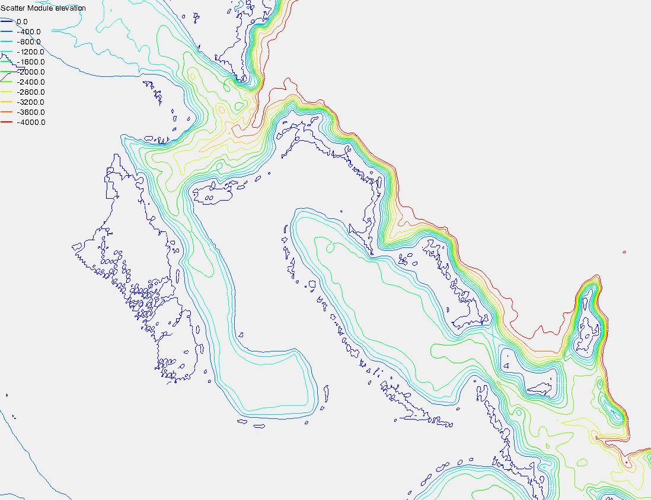
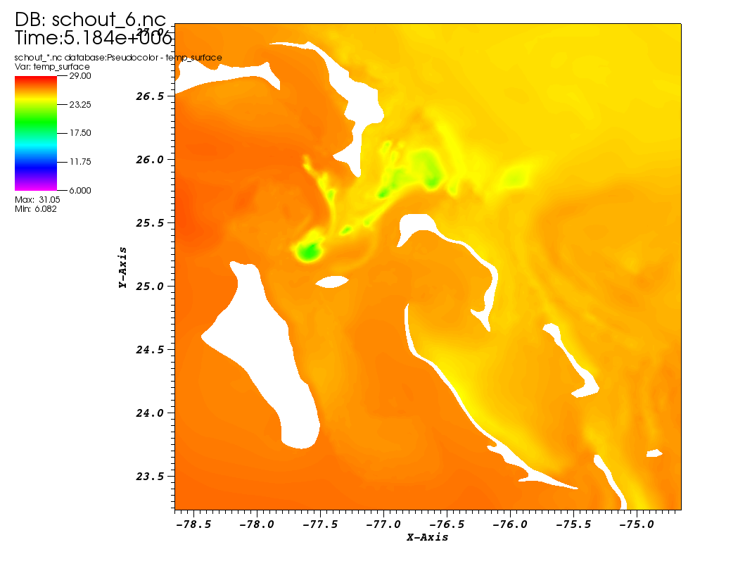
Mesh generation near slopes
Particularly challenging is narrow transitional regime between eddying and non-eddying regimes, e.g. near those tiny islands sitting on very steep bottom slope
  Stick to the ‘simplicity’ rule, and only add auxiliary arcs to enforce proper resolution in deep water
  You’ll know if you are successful by looking for spurious ‘upwelling’ (very cold water) near islands
  Rule of thumb
    ~3 km resolution at islands: OK
    1-3 km at islands: probably OK
    <1 km resolution: you may have a problem if slope is steep, and may need to add auxiliary arcs to enforce coarser resolution in adjacent deep ocean
Vertical grid (LSC²) can help to some extent, but not a panacea

Slide 10
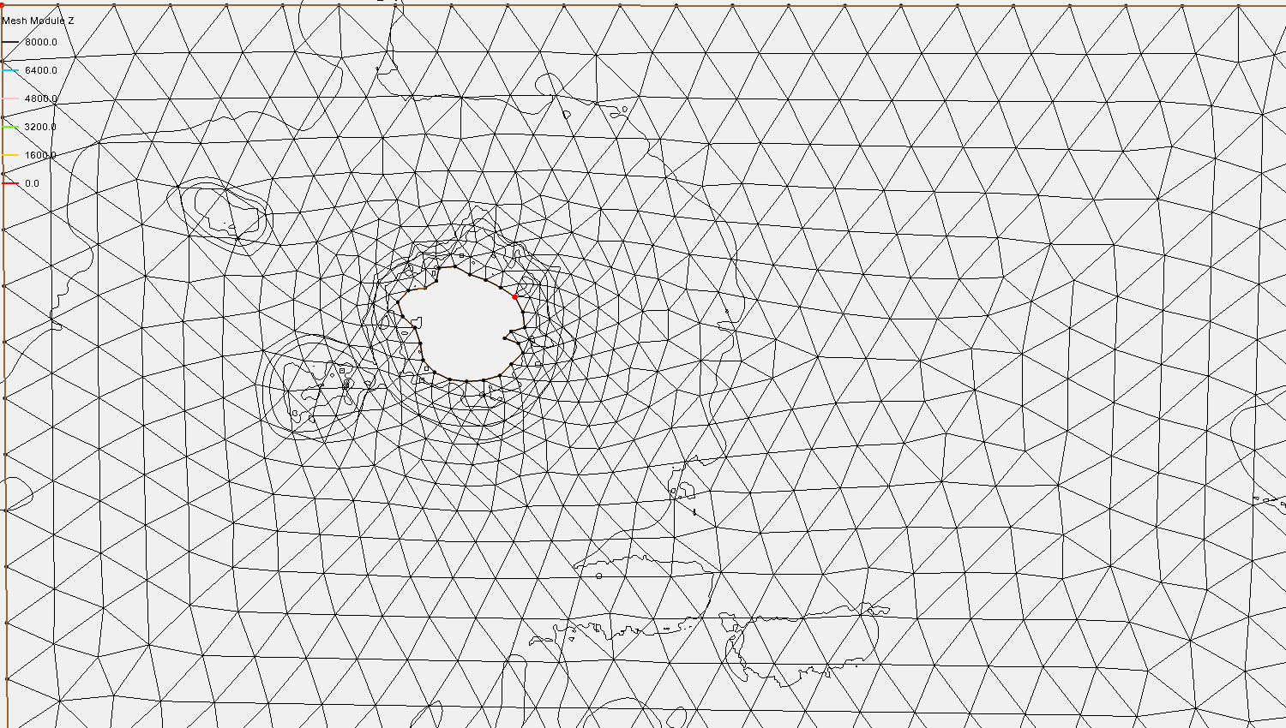
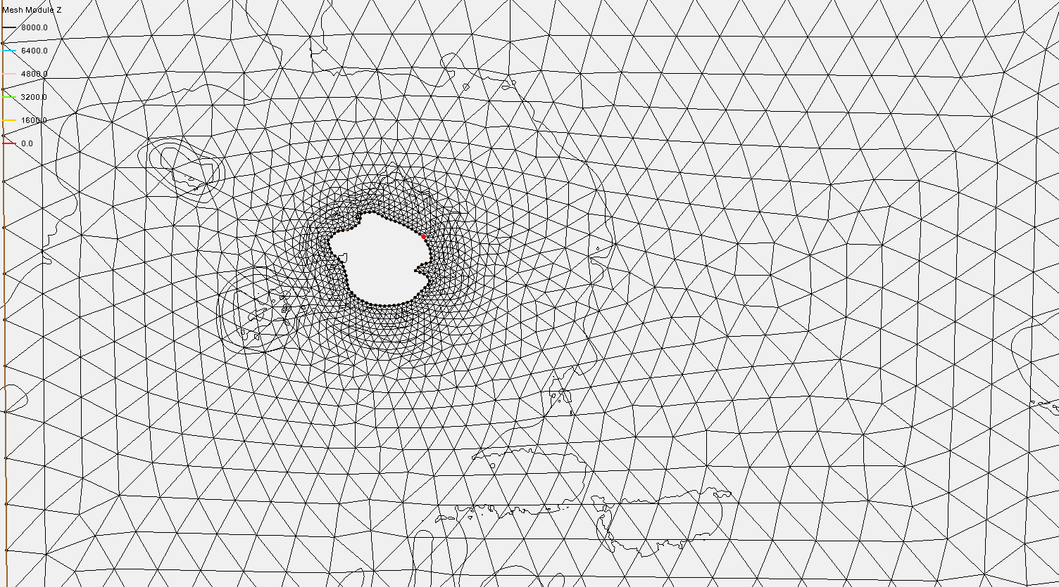
3km resolution @ island
1km resolution @ island
Need an auxiliary arc @ 500m to enforce a coarser resolution!
The resolution @ 500m is now comparable or smaller than the water depth (sub-mesoscale)
There is a solution for sub-mesoscale by reducing time step
500m isobath (where resolution is still reasonable)

Slide 11
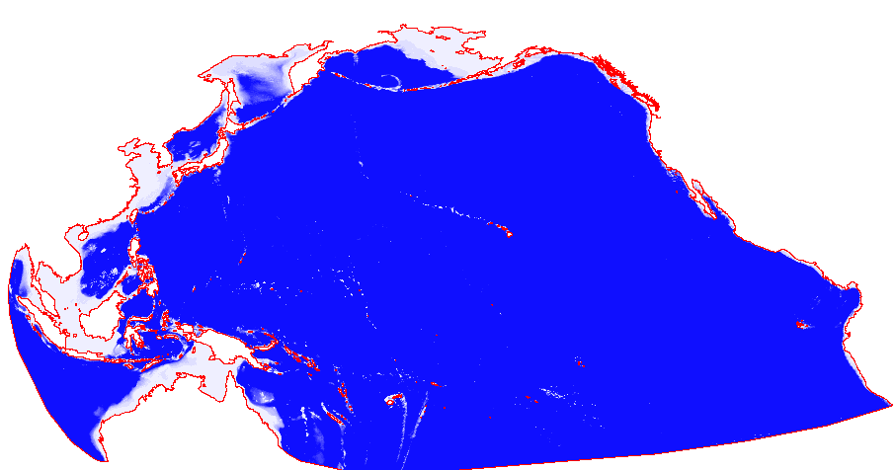
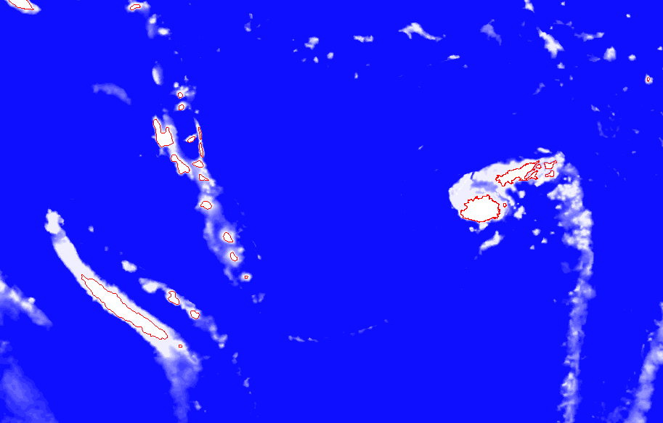
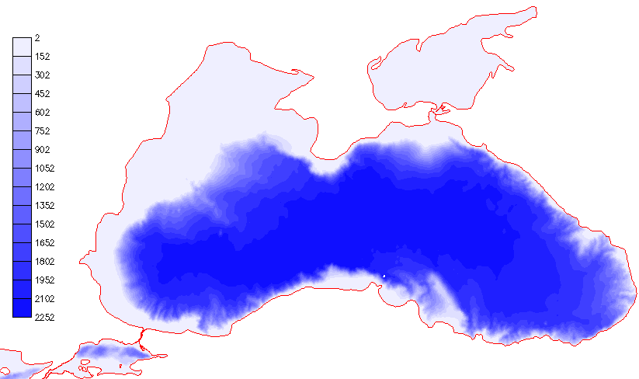
Steep slopes are everywhere…
Black Sea
Bathymetry (m)
*Smoothing the slopes has consequences of altering physics

Slide 12
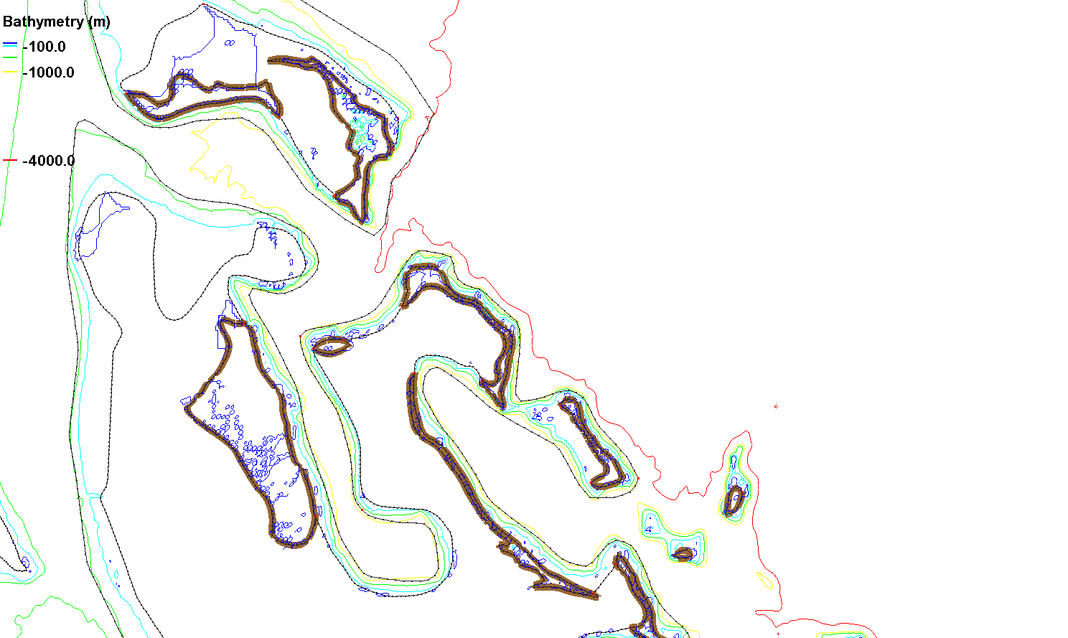
Non-eddying regime (shallow)
Near steep slopes, need to first delineate eddying and non-eddying regimes
Eddying regime (deep)
Non-eddying regime (shallow)

Slide 13
Near steep slopes, use auxiliary arcs to separate the non-eddying regime and the eddying regime:
Make sure the elements inside the eddying regime are mostly uniform or gradually varying, and not super fine;
Keep sharp transitions in element size inside the non-eddying regime
Auxiliary arcs

Slide 14
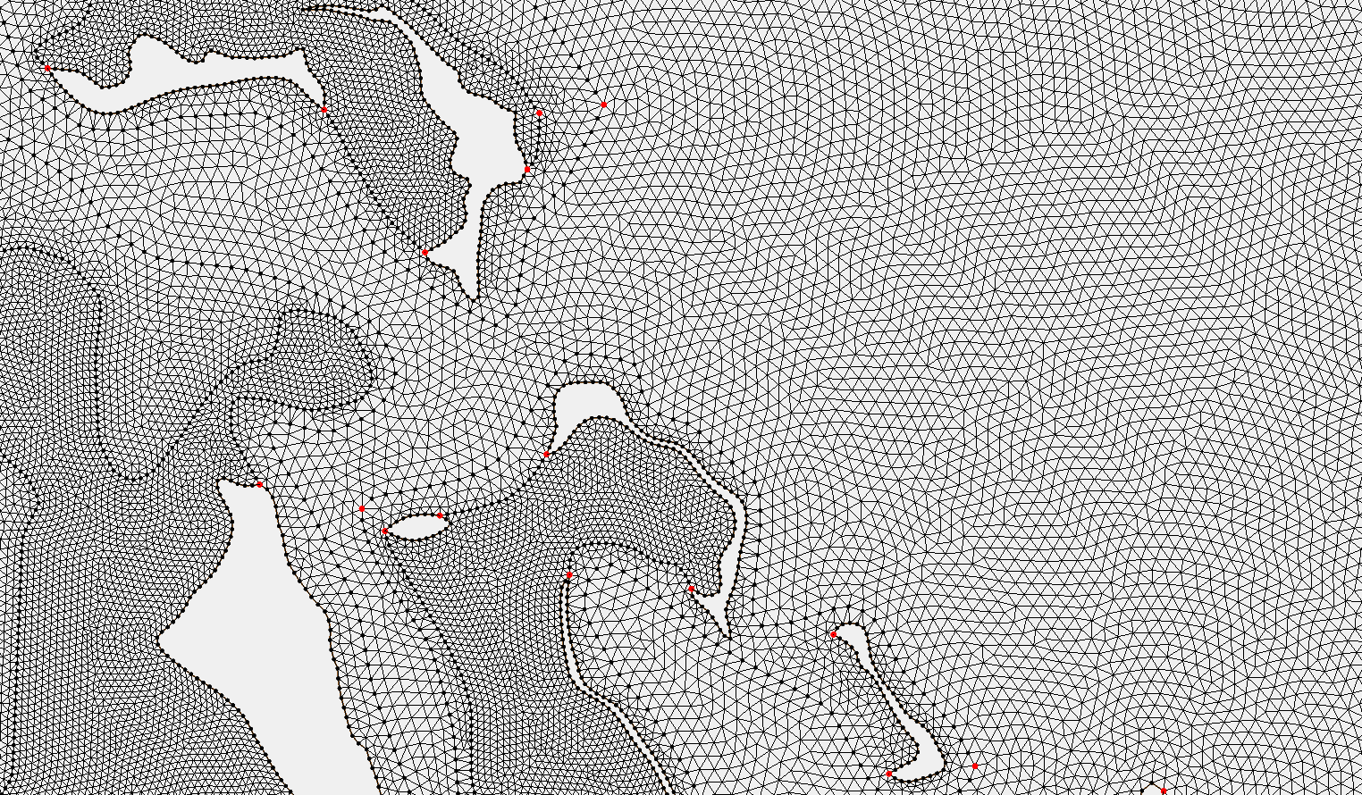
Good mesh
Eddying regime (deep): smooth
Sharp transitions in element size only in the non-eddying regime

Slide 15
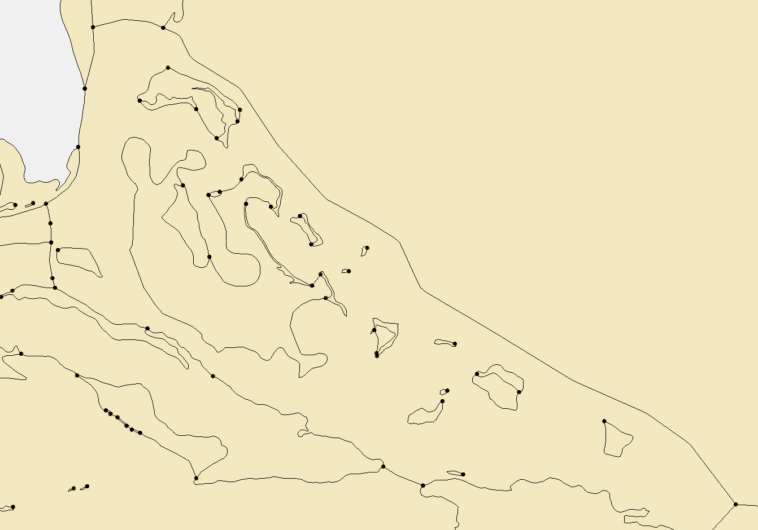
Bad mesh/map
Unnecessary constraint

Slide 16
Consequences of non-smooth transition in eddying regime
Spurious upwelling on a bad mesh
This is usually very easy to spot
Always check this in your SST results
General rules:
‘Simplicity’ often is a good starting point
Avoid over-constraining the mesh in eddying or transitional regimes
Add auxiliary arcs only if necessary to delineate the regimes
In non-eddying regime, do as before – liberal use of arcs is fine

Slide 17
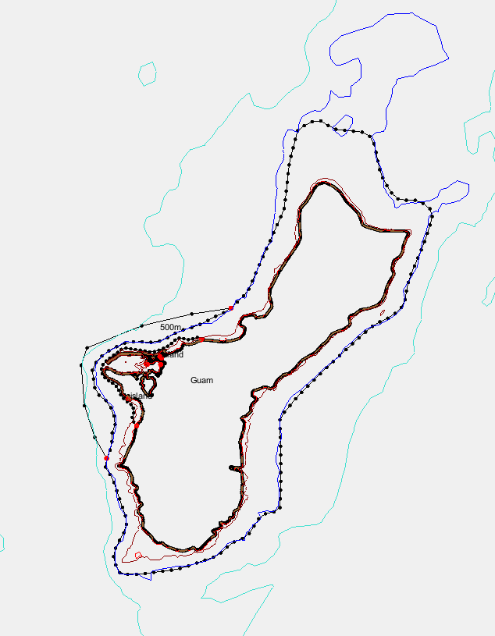
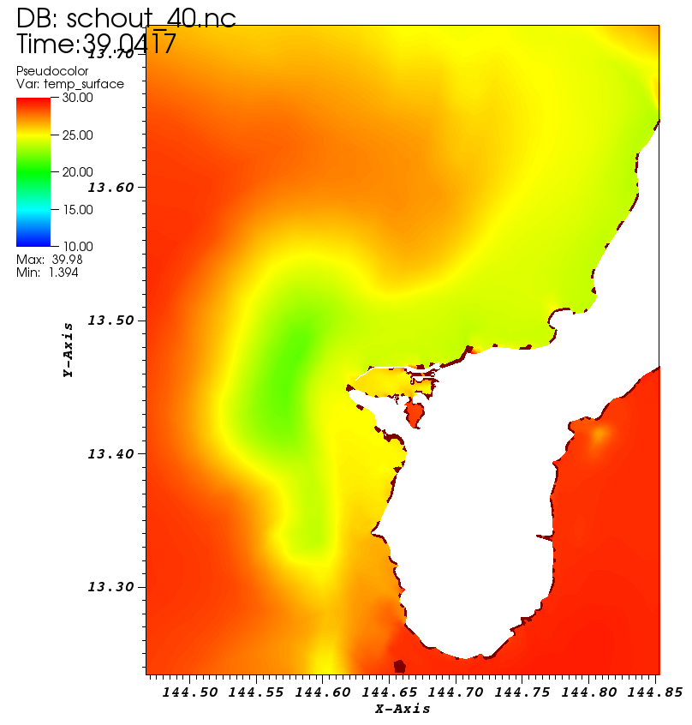
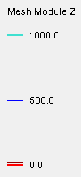
Meshing around Guam
Bathymetry
Over-constraining between 500m and 1km isobaths
Bad transition there led to spread of upwelled water

Slide 18
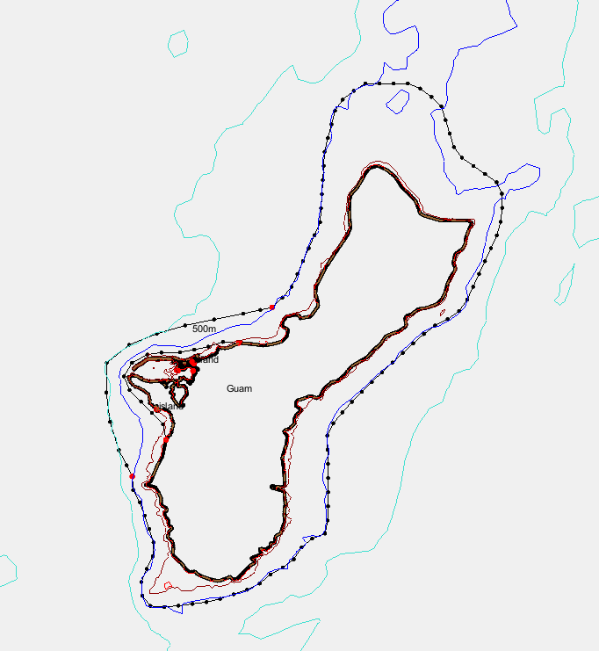
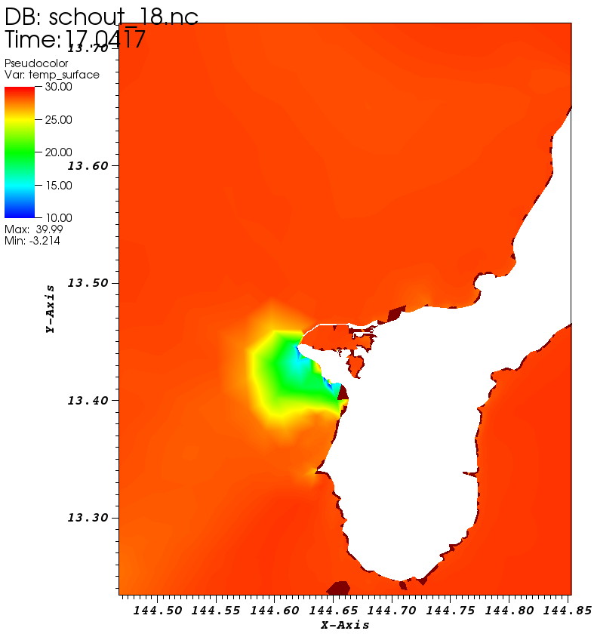
Meshing around Guam
Bathymetry
Resolution at 500m isobath is too fine (due to steep slope)

Slide 19
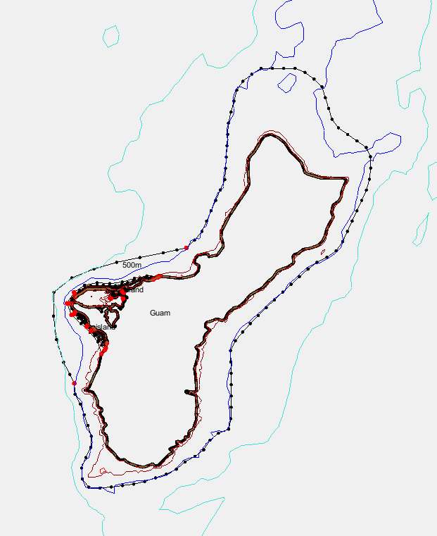
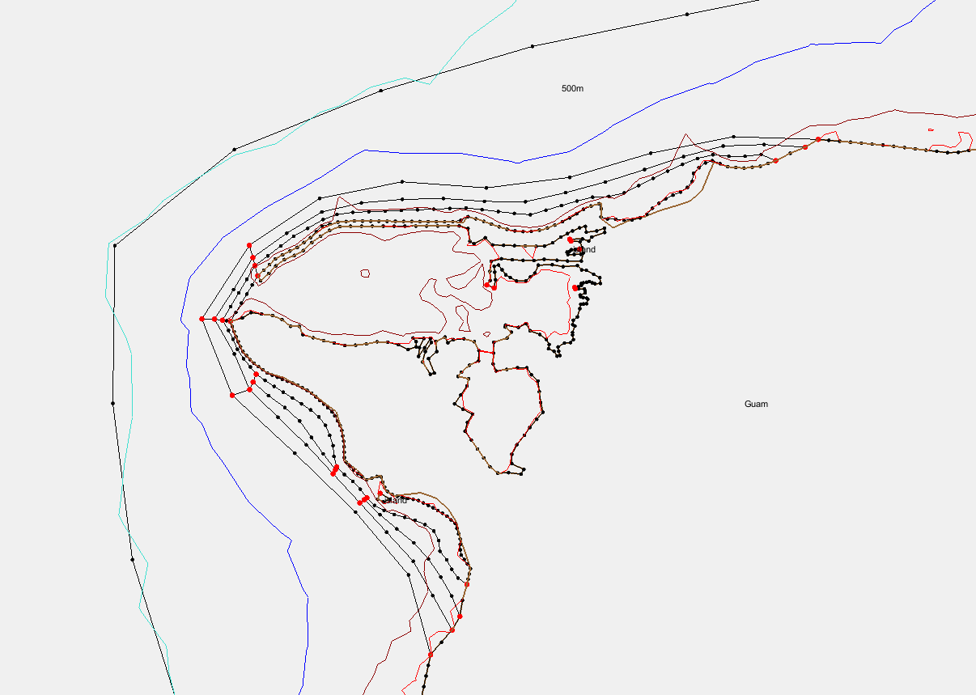
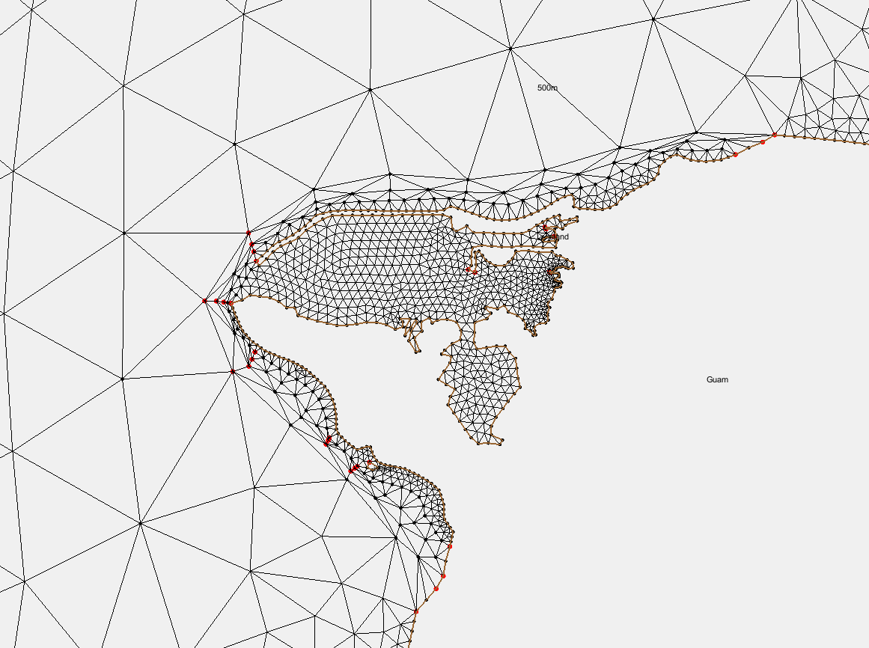
Meshing around Guam: forced transition nearshore
Bathymetry
Force rapid transition of resolution nearshore to ensure a proper resolution at 500m depth
Skew elements are fine nearshore

Slide 20
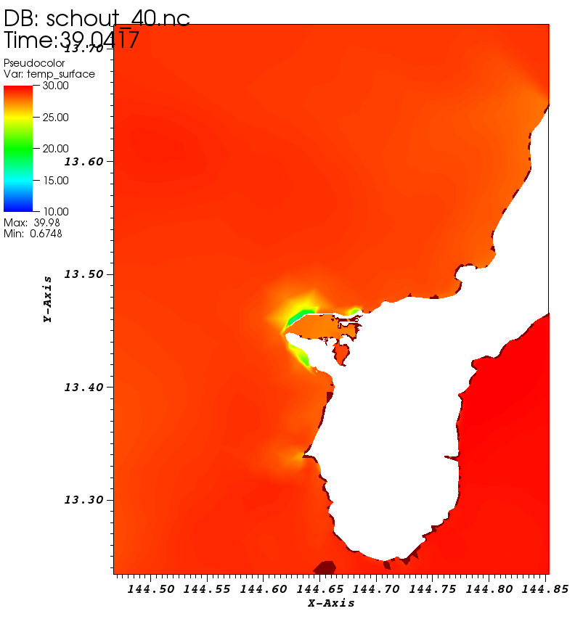
Meshing around Guam
Bathymetry
* ‘Upwelling’ near the harbor is now more reasonable (probably real)

Slide 21
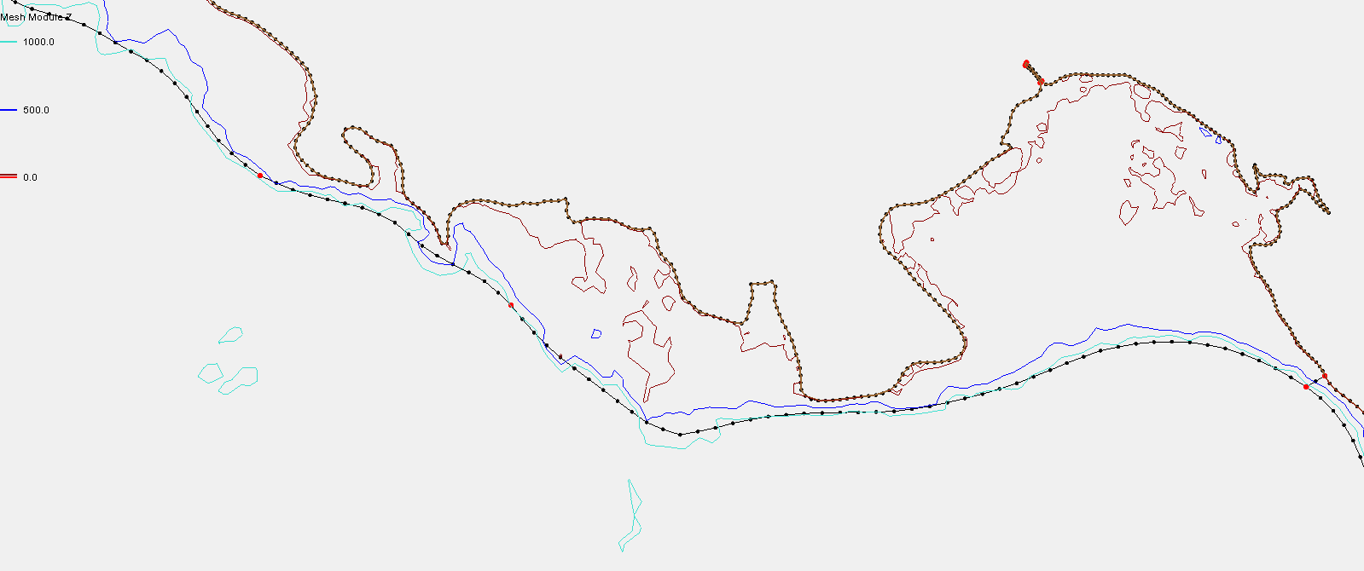
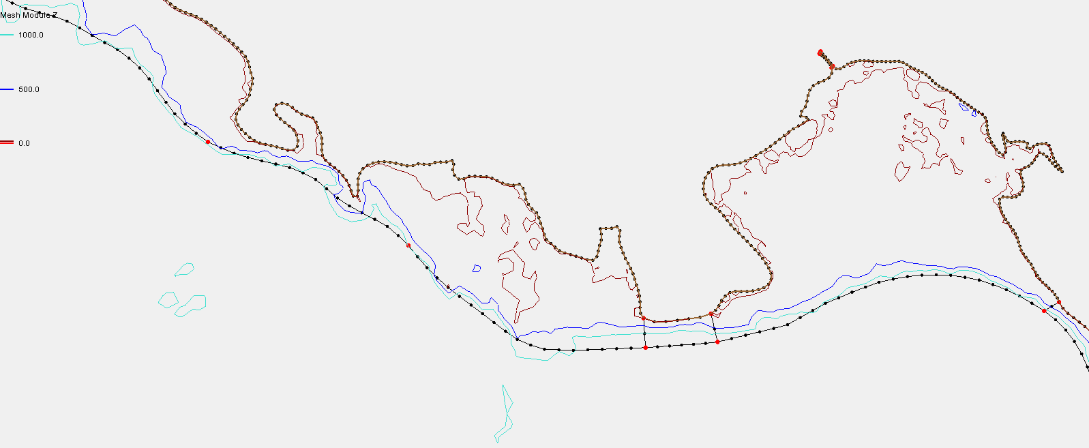
Another example with steep slope
*No room for transition btw eddying and non-eddying regimes
Need to make some room for transition between regimes
Sometimes this requires arcs ‘going off the isobath’ (you can still enforce isobaths with vertices)
Use vertices to enforce isobath

Slide 22
Summary
Meshing for 3D model is more complex than 2D especially in eddying and transitional regimes
Principles closely follow 2D, with extra care in the transitional regime
  Start simple: not over-constraining mesh there, which can lead to skew elements or unnecessary mesh transition
  Start with modest resolution especially at island boundaries (~3km)
  If you have to refine islands, you might need to add auxiliary arcs but keep them at a minimum (only if necessary)
  If spurious upwelling occurs, adjusting the mesh is often the best strategy; make sure horizontal resolution is greater than depth
Design vertical grid (LSC²) to take full advantage of polymorphism

Slide 23
Recap: steep slope challenge
Auxiliary arc (coarse)
3km rule for island to avoid excess fine resolution in deep water
Island
(hires;
<1km)
X

Slide 24
Recap: 3D setup for cross-scale cases
param.nml:
indvel=0, ihorcon=2, hvis_coef0 = 0.025, ishapiro=2, with a proper shapiro.gr3 (starting with 100)
WENO+upwind (itr_met=4, h_tvd=5m)

