Slide 1
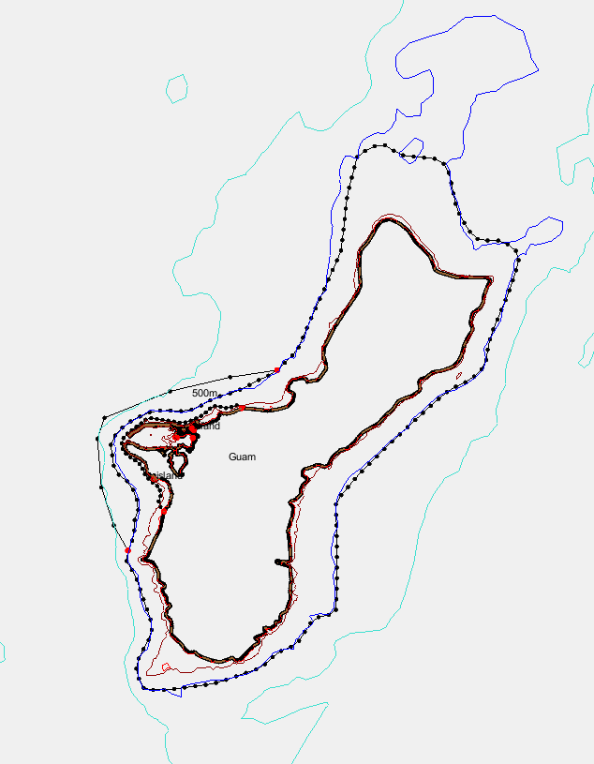
Set up Guam in 3D
Joseph Zhang

Slide 2
Files you'll need
DEMs in /sciclone/home/yinglong/DISKS/vims20/MSCI602/RUN03a/DEM
  Main DEM is guam_13_mhw_2008.asc
  Complemented by Gebco away from Guam
Generate a mesh for this cross-regime case
Set up LSC² grid
Start simulation at 2023/1/1 GMT and run for 60 days
Use pySCHISM to generate b.c., nudging inputs: …pyschism/examples/HYCOM/
i.c. (hotstart.nc) from HYCOM
  Download HYCOM first with …pyschism/examples/HYCOM/download_hycom.py
  Then use FORT script to generate hotstart.nc: gen_hot_from_hycom.f90
Use pySCHISM to generate sflux (from GFS): pyschism/examples/Sflux/gen_sflux_gfs2.py
  You can also try ERA5
Play with different options
  For momentum dissipation: ihorcon; ishapiro etc
  Transport solver options: WENO+upwind

Slide 3
Homework #4
Finish the Guam case
Run ≥60 days
Assess 3D results qualitatively (SST etc)
Submit your run dir with outputs
ERA5 as sflux can be found:
/sciclone/home/yinglong/DISKS/vims20/MSCI602/RUN03a/ERA5

