Slide 1
SCHISM calibration: some typical issues
Joseph Zhang

Slide 2
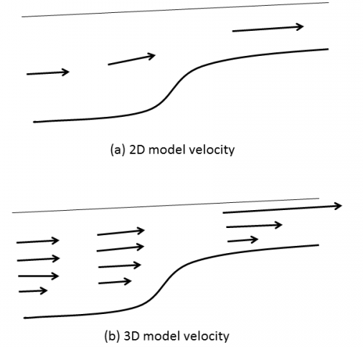
Wet/dry in shallow region: 2D vs 3D
2D and 3D models react to the bottom friction very differently
2D model does not allow vertical shear, so large friction will slow down the flow
3D model allows large vertical shear ➔large friction will create large shear & numerical noise!
3D model will work well with small friction
Best strategy: use LSC² and 2DH in shallows

Slide 3

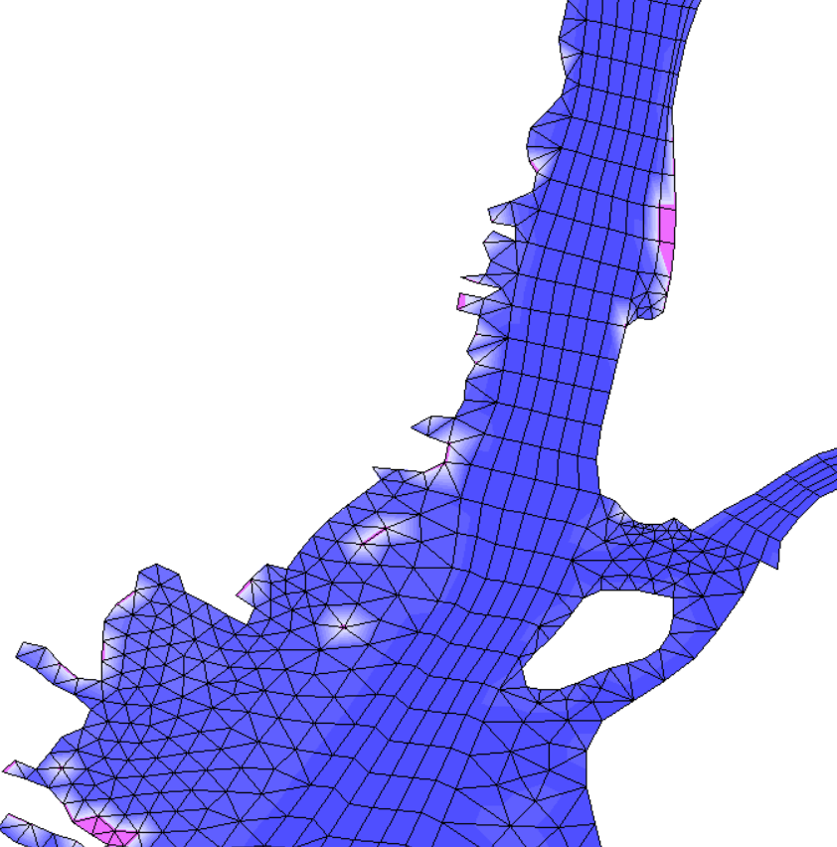
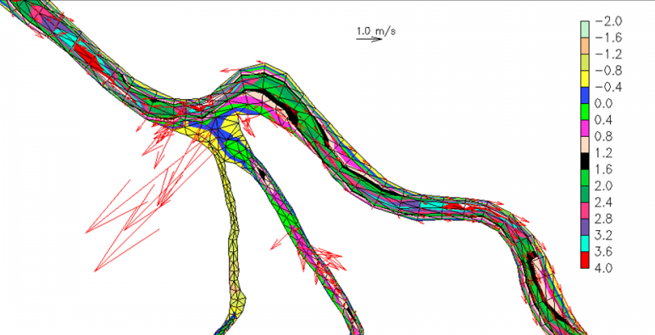
Wet/dry in shallow region
In 3D, the roughness formulation leads to large C_{D} in shallow area − a recipe for disaster (and an artifact)
Limiting C_{D} in the shallow helps: 3D model prefers smaller C_{D} in shallows
2D model can handle small or large C_{D}
2D or 3D: make sure that channels are not 'blocked‘ by using at least 1 row of always-wet elements
Locally 2D configuration helps: use LSC²!
Pay attention to 2D/3D transition: using a small friction there always works
# of levels
2D/3D transition

Slide 4
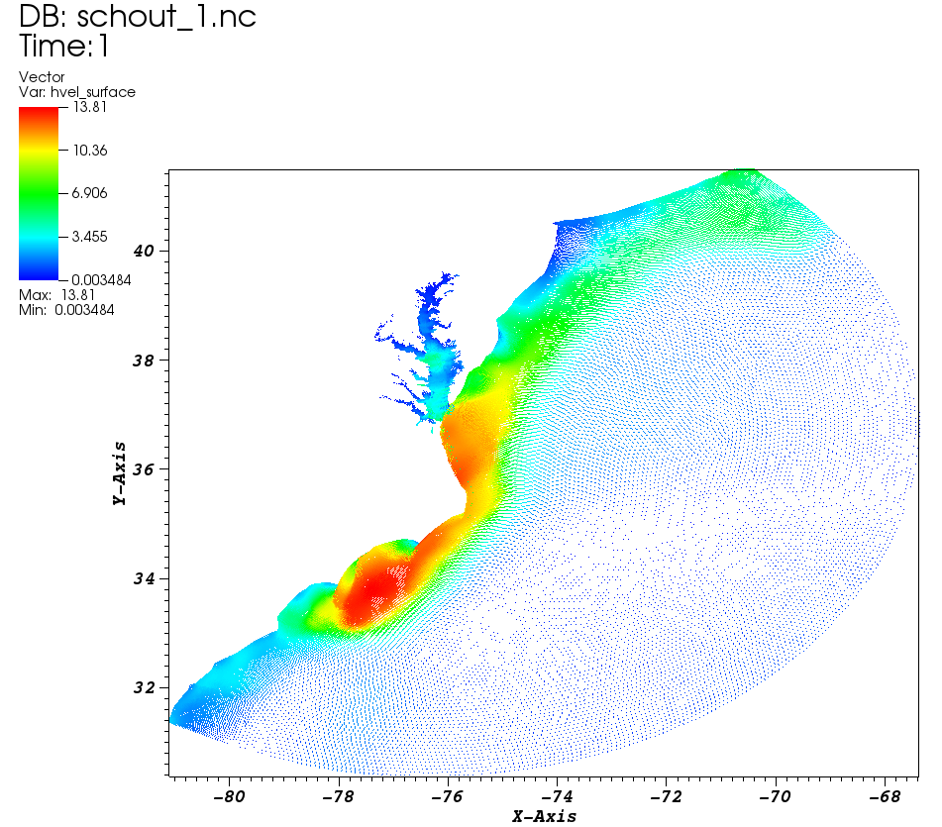
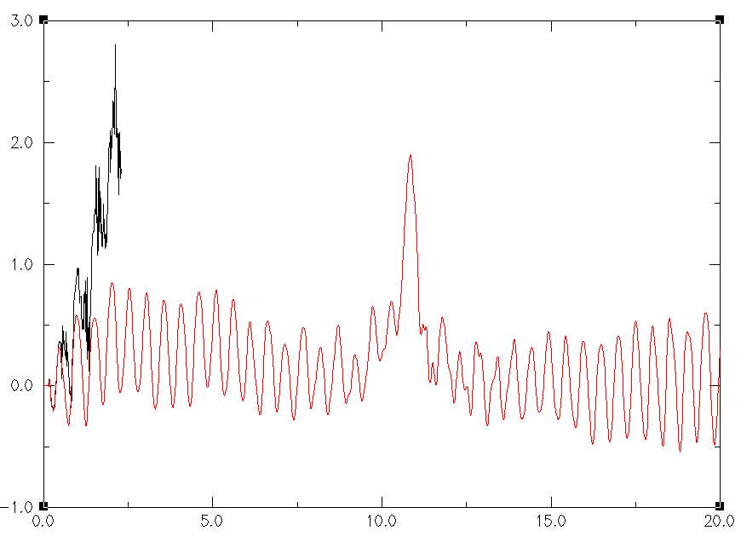
Blow up or strong instability
Tide+storm surge (Hurricane Isabel) simulation for Chesapeake Bay
2D is successful
3D has large velocity and noisy/large elevation
Changes from 2D to 3D: reasonable bottom roughness and vgrid.in
What went wrong?
In param.nml:
itur=0
dfv0=1.e-6 !viscosity
dfh0=1.e-6 !diffusivity
2D
3D
You cannot master numerics without understanding physics!
η
Days
Notes:
Hint: dt, itur=0 with small viscosity, …

Slide 5
Transport efficiency bottleneck; WENO dispersion
To alleviate bottleneck of the explicit horizontal advection solver
Use tvd.prop and h_tvd, and/or
Use ELM to limit max # of subcycling (max_subcyc)
Beware the combination of ELM and WENO as the latter has numerical dispersion
Symptoms are usually easy to notice: high and persistent tracer gradients
Caused by the high gradients brought in by ELM that exacerbate the numerical dispersion
Not an issue between ELM and TVD/upwind
Solution
Use a sufficiently large max_subcyc (to limit the use of ELM)
Make sure ‘WENO’ zone in tvd.prop has sufficient mesh quality
Start with upwind in most nearshore areas, and gradually add WENO in tvd.prop (upwind/ELM combination does not pose any issue)
Notes:
Used CA_DWR/RUN84b

Slide 6
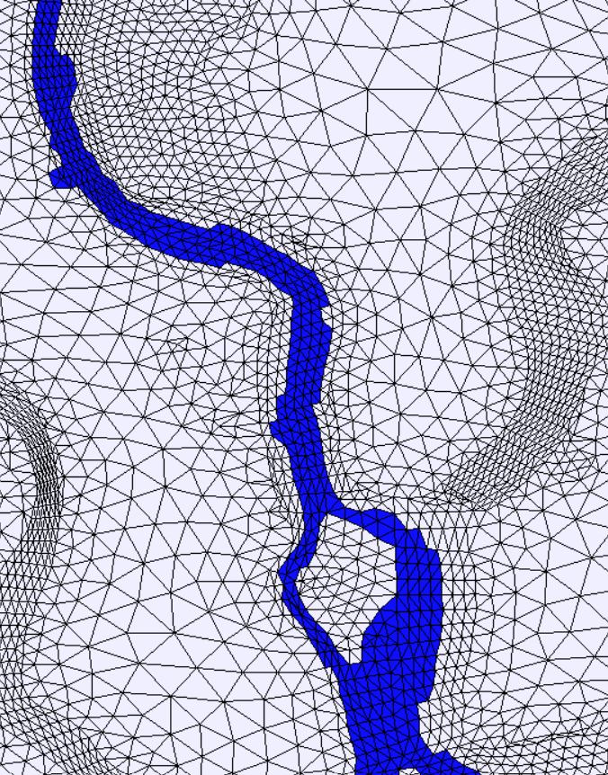
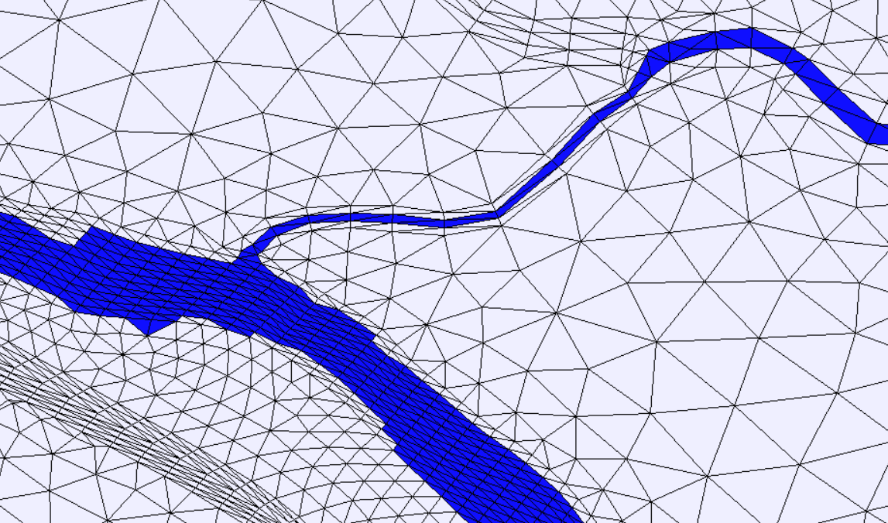
Transport efficiency bottleneck: WENO dispersion
Poorly resolved channel (this leaves WENO zone in close contact with potential ELM zone)
Poorly resolved but also bad quality
Notes:
Used CA_DWR/RUN84b

Slide 7
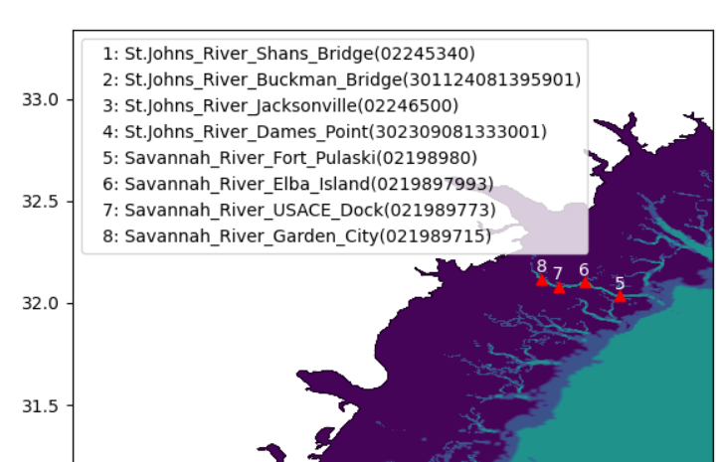
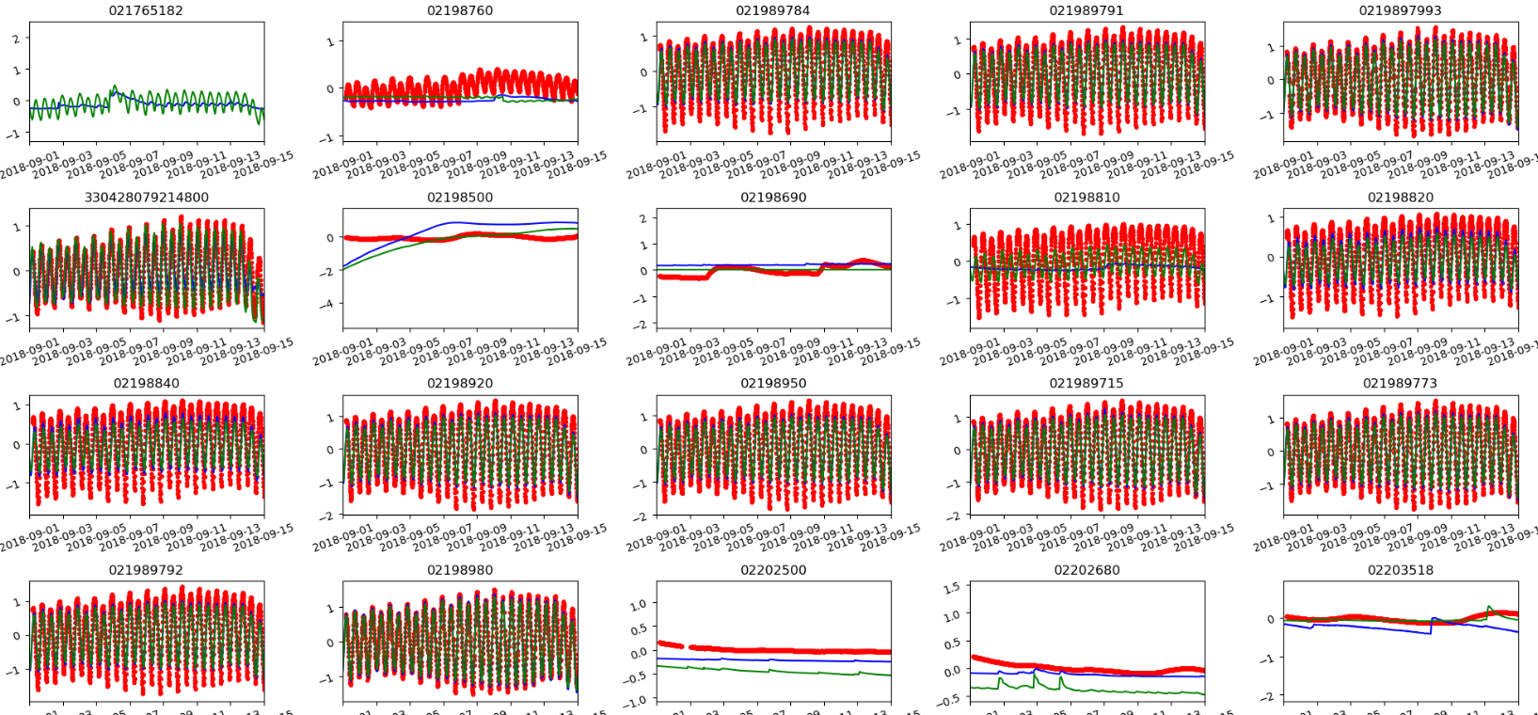
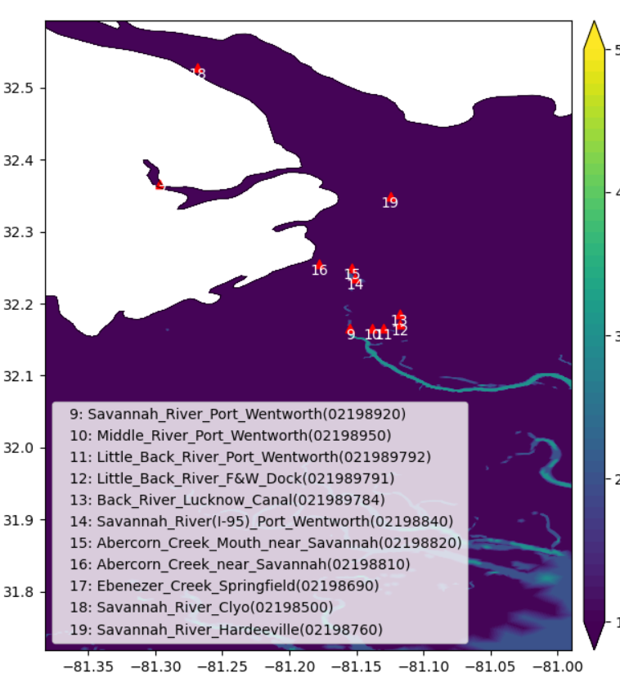
Savannah River tides
Tides are damped in Savannah River system
Notes:
RUN06a_JZ

Slide 8

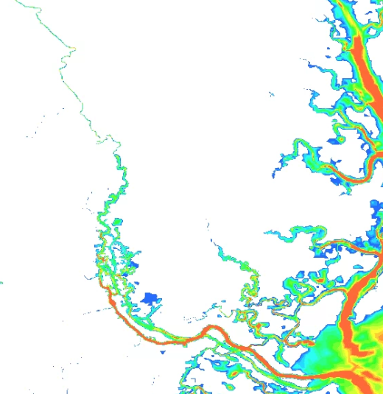
Savannah River: bathymetry
Bathymetry (m)
Used BlueTopo as DEM, which has a disrupted channel upstream
Imposed min depth of 4m upstream to get continuous channel
However, it turned out the tidal reflected by the shallow upstream channel is crucial for the tidal amplitude!
Be careful when you manipulate the depths!
Imposed a min depth of 1m instead
Notes:
RUN06a_JZ

Slide 9
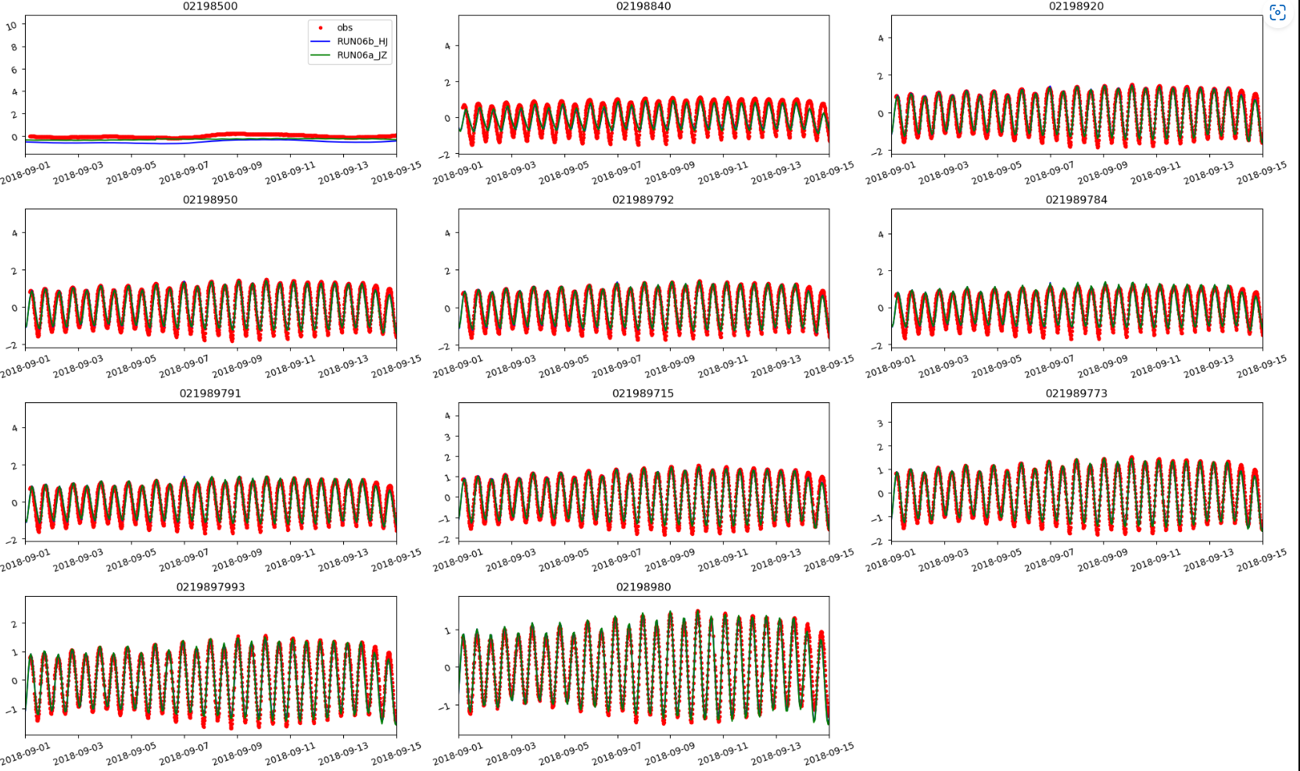
Savannah River tides: original BlueTopo
Tides are improved!
DEM, DEM, DEM…
Ask for this info when working with other models before looking at their results!
Notes:
RUN06a_JZ

Slide 10
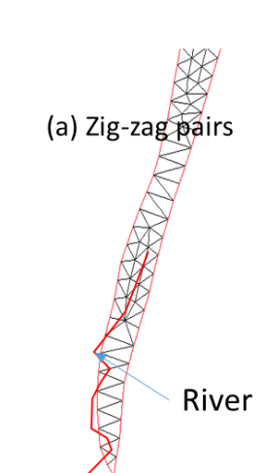
Hydrologic flow
Hydrologic flow is very complex
Sensitive to topography
River in/out of domain creates source/sink pairs in close proximity
This pathological configuration can lead to large positive/negative elevations
Notes:
Hint: dt, itur=0 with small viscosity, …

Slide 11
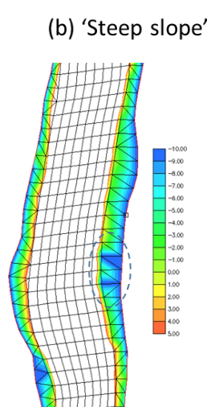
Hydrologic flow
Steep slopes on coarse resolution can lead to poorly resolved watershed
This can generate ‘pulses’ of high-speed flow and strange tracer patterns
Notes:
Hint: dt, itur=0 with small viscosity, …

Slide 12
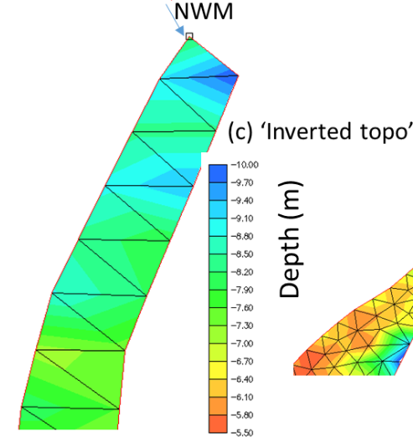
Hydrologic flow
Inflow is stuck on low ground (‘bowl’) as it’s blocked by ‘mountains’
Refining mesh helps
Notes:
Hint: dt, itur=0 with small viscosity, …

Slide 13
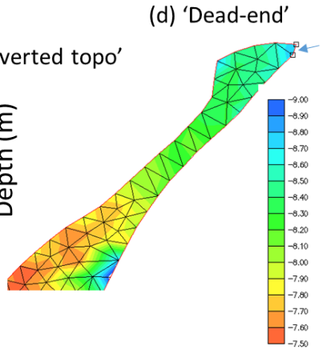
Hydrologic flow
Poorly resolved channel leads to ventilation issue
Water will have trouble coming out smoothly
Consider refining here
Notes:
Hint: dt, itur=0 with small viscosity, …

Slide 14
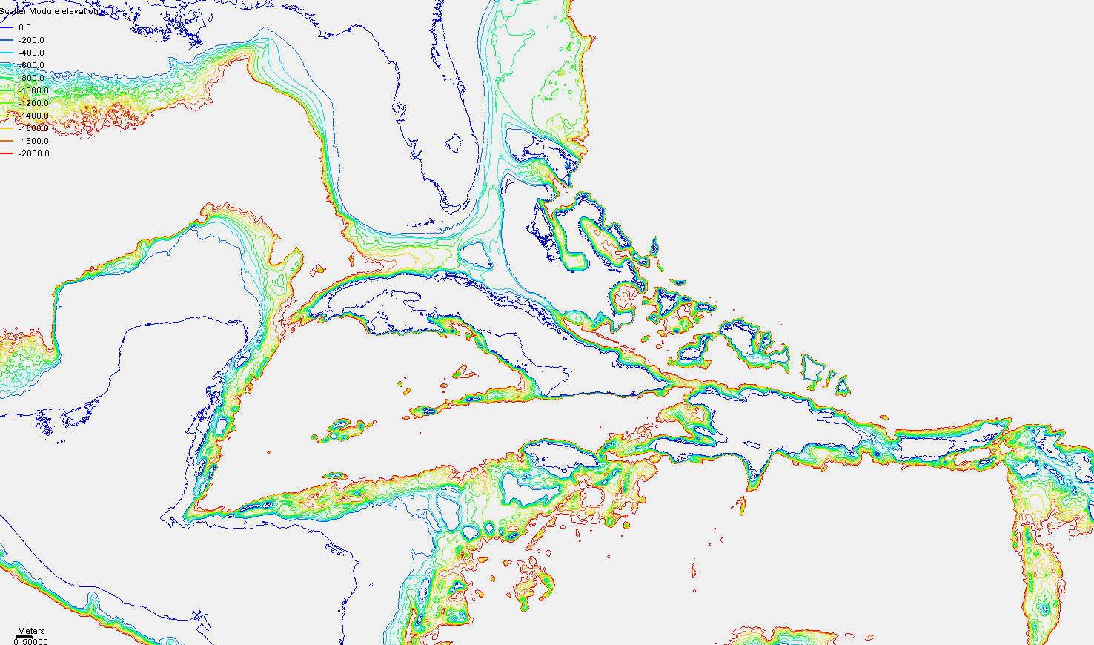



The case of under-resolution in eddying regime
Under-resolution occurs frequently in areas of steep slopes, mostly to save cost in areas of no significant interest
In general, under-resolution in the horizontal dimension should be matched with an under-resolution in the vertical, often taking advantage of many degenerate prisms near the bottom. This reduces PGE
Time step may be reduced to stabilize the momentum over the steep slopes (useful for submesoscale processes)
Remember to recheck CFL>0.4 if you reduce time step!
Florida
u
u
1
2

Slide 15
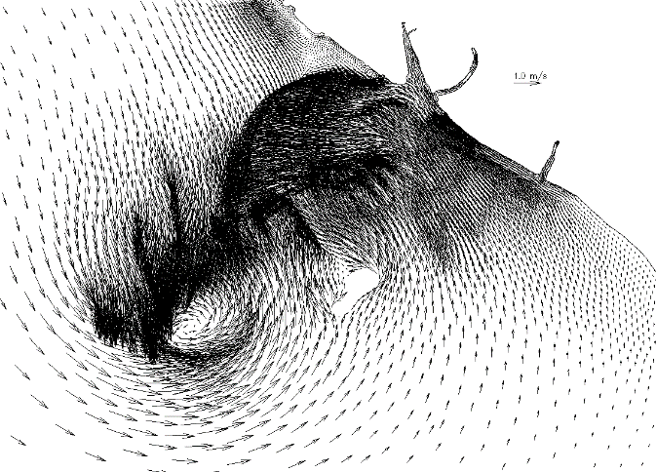
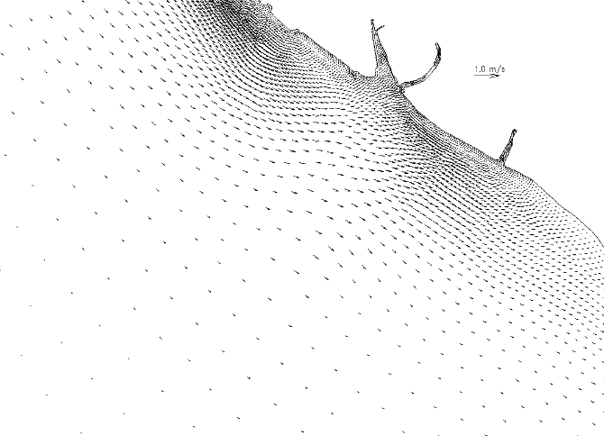
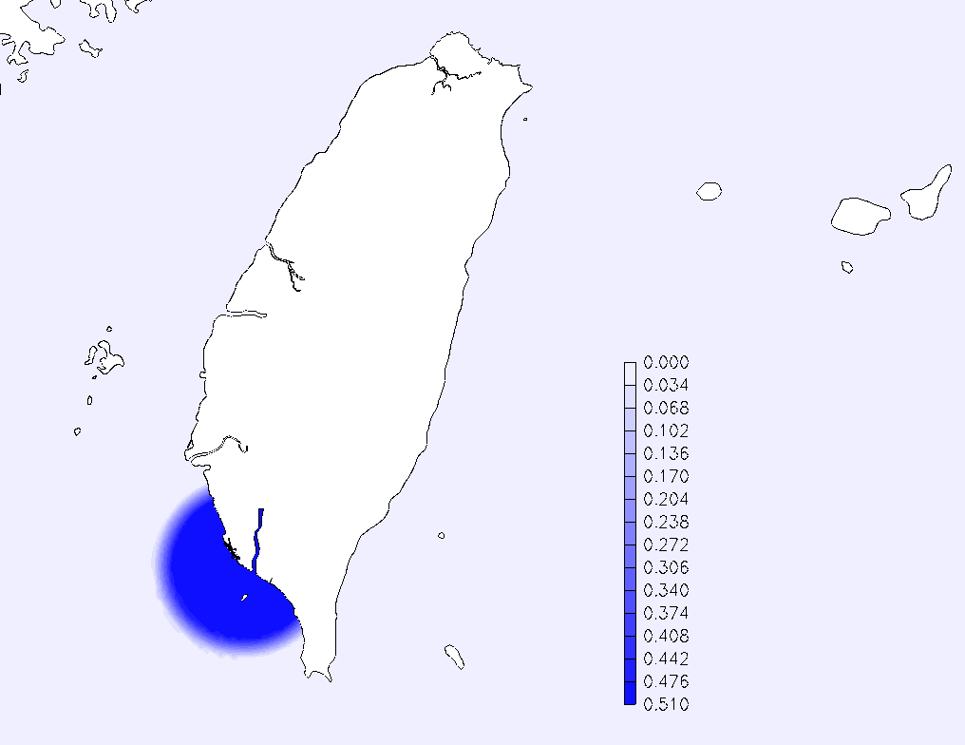
Transition between eddying and non-eddying regime
Sharp mesh transition, with insufficient dissipation
Smooth transition (no additional dissipation)
Filter strength
Sharp resolution change in transitional regime triggered artificial accumulation of energy
Two solutions
Make sure the mesh transition is smooth
If non-smooth transition must be used, add extra numerical dissipation in shapiro.gr3 or use niter_shap

Slide 16
A few ways to blow up the model
Violation of inverse CFL criterion in open water areas
Blocked main channel
Completely dry open boundary segment with imposed flow b.c.
Bad quality quads: always use the pre-proc script
Large C_{D} in shallow regions with 3D cells
Improper parameter setting:
indvel=ishapiro=ihorcon=0 (no dissipation)
Inter subdomain back-tracking dimensions (s1_mxnbt, s2_mxnbt); increase these gradually for sharply transitioned meshes
Always visualize surface velocity in animation mode to find potential issues

Slide 17
Summary

Slide 18
SCHISM model …
Is an implicit model without mode splitting
Uses Galerkin FE formulation
Uses Eulerian-Lagrangian Method for advection
Numerical diffusion and dispersion are balanced and can be adjusted in different regimes
Therefore….
Large Δt is required for accuracy and convergence (CFL>0.4)
No mesh orthogonality is necessary – skew elements and sharp transition of resolution are tolerated, at least in non-eddying regime

Slide 19
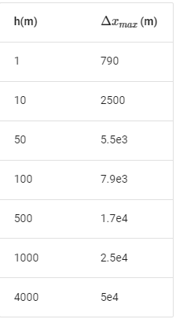
When generating a mesh for SCHISM…
Make sure major channels are resolved with at least 1 row of ‘always wet’ elements – no blockage of channel flow
Always keep the SMS map file and DEM sources and be willing to edit the mesh, as often the model results (and sometimes performance) depend on it
First estimate the smallest Δt you’d use, and then estimate the coarsest Δx at sample depths to ensure CFL>0.4
Resolving features is much easier with SCHISM – be game! Bathymetry smoothing is not necessary
Implicit TVD² transport is very efficient, but horizontal transport is still explicit (and is the main bottleneck)
Beware of mesh resolution in critical regions to avoid excessive sub-cycling
Use upwind in areas of no stratification
Δt=100s

Slide 20
When setting up SCHISM…
Always check the mesh first with a 2D model with ipre=1
Start from simple and then build up complexity
Examine surface velocity in animation mode to find potential issues
Start with time step of 150s
Avoid large C_{D} in shallow areas in 3D regions (suggestion: start with 0.0025): polymorphism helps
Make sure open boundaries stay wet during simulation (or use source approach)
Negative river flow for inflow with open boundary approach; positive for inflow with source approach
Notes:
B-tropic model; with const. forcing ….

Slide 21
When calibrating SCHISM…
Remember the mesh is the single most important factor for accuracy – here lies the greatest strength and challenge of unstructured grids
Control the balance between numerical diffusion and dispersion (indvel, ihorcon…)
LSC² grid is a very powerful tool (resembling unstructured grid in the vertical)
Transport solver performance may require some experience
Notes:
B-tropic model; with const. forcing ….

Slide 22
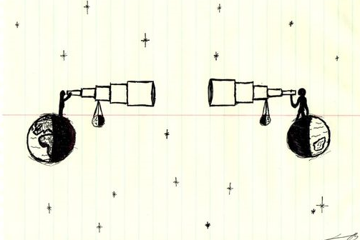
Get help
Remember you are not alone… ask question via mailing list
Help (and truth) is out there…
Happy UG modeling…

