Slide 1
Final project: preview
Joseph Zhang

Slide 2
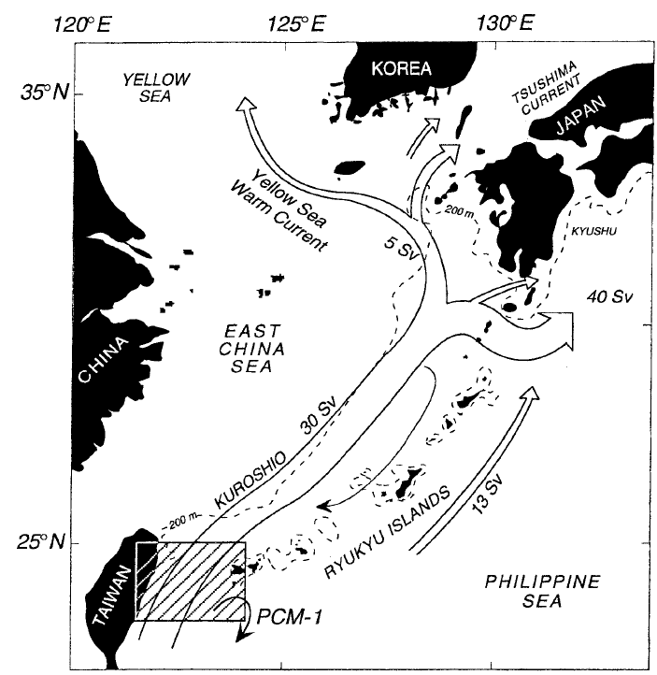
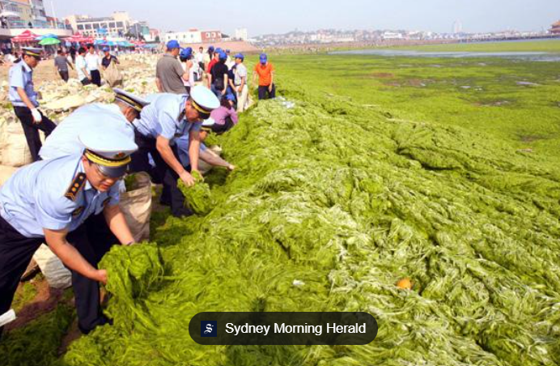
^{Major processes in NW Pacific}
A typical cross-scale application
Very complex current system
Major western boundary current: Kuroshio
Kuroshio extensions: Yellow Sea Warm Current, Tsushima Current etc
Large rivers with plumes: Yangtze, Pearl, Yellow, Amur, …
Steep shelf break (e.g., eastern Taiwan)
Numerous small islands
Economically significant
Major population centers in Asia Pacific
Productive fishery (at least used to be)
Eutrophication issues
Johns et al. (2001)

Slide 3
^{Your tasks}
DEMs in /sciclone/home/yinglong/DISKS/vims20/MSCI602/RUN04a/DEM
High-resolution DEMs around Taiwan
Supplemented by Gebco (500m)
load_dem.pl
Generate hgrid and vgrid (LSC²)
Example of domain (account: selfeguest passwd: Londonbridge)
Starts April 1, 2013 (GMT) and run for at least 50 days
Forced by HYCOM, ERA5 or GFS
Include at least 1 river (e.g., Yangtze) for cross-scale application
flow_Yangtze.th: reverse sign if you use open boundary approach
Minimum expectation
Kuroshio is qualitatively captured
Estuarine and plume processes in the resolved rivers are qualitatively captured
If you wish to select your own domain, you'll need to prepare the files yourself (I may help)

Slide 4
^{Rubics}
Share your run dir with me by May 4
Final presentation: May 6
20 min for each student including Q&A
Rubrics for final project assessment
Please send your slides to me for record keeping after final presentation

