Slide 1
Grid generation for SCHISM using SMS with application to compound flooding
Wei Huang, Karinna Nunez, Dan Yu, Fei Ye, and Joseph Zhang
Virginia Institute of Marine Science

Slide 2
Steps in preparing ‘maps’ for SMS grid generation
Generating coastlines and land boundary
Resolving major river channels
Resolving levees (and other important features)
Adding NWM segments into map

Slide 3
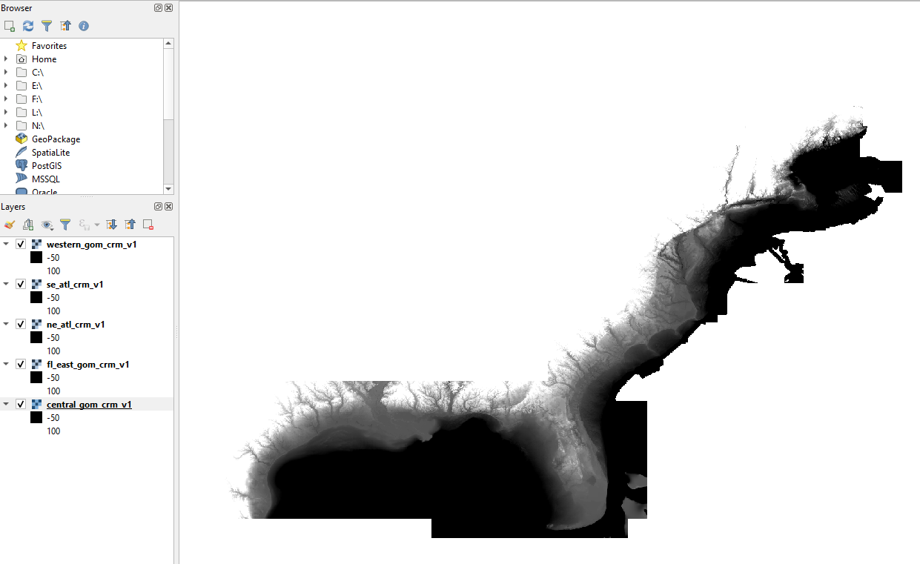
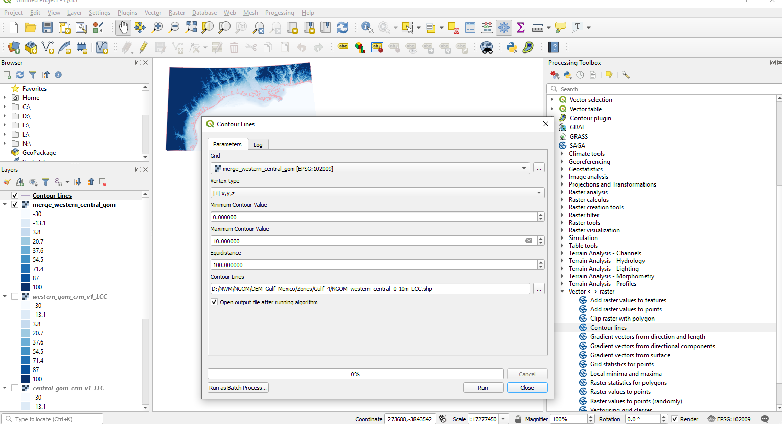
1. Generating coastlines and land boundaries
Loading DEMs from NOAA CRM, ~90m resolution. There are 5 pieces of CRM files available covering east coast and GOMx regions: (https://maps.ngdc.noaa.gov/viewers/bathymetry/?layers=dem)
Extracting 0m contour as coastline (which will be revised later) and 10m contour as land boundary
NOAA_CRM (3 arc-s, 90m)
https://maps.ngdc.noaa.gov/viewers/bathymetry/?layers=dem

Slide 4
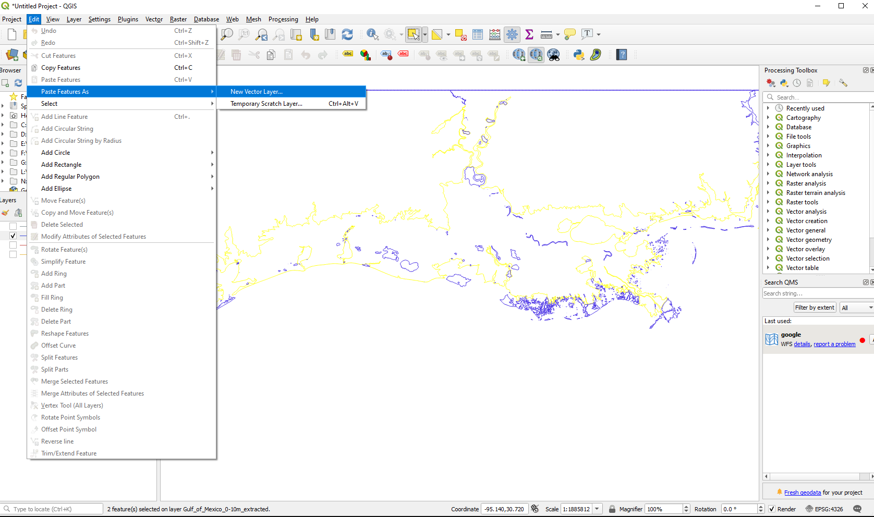
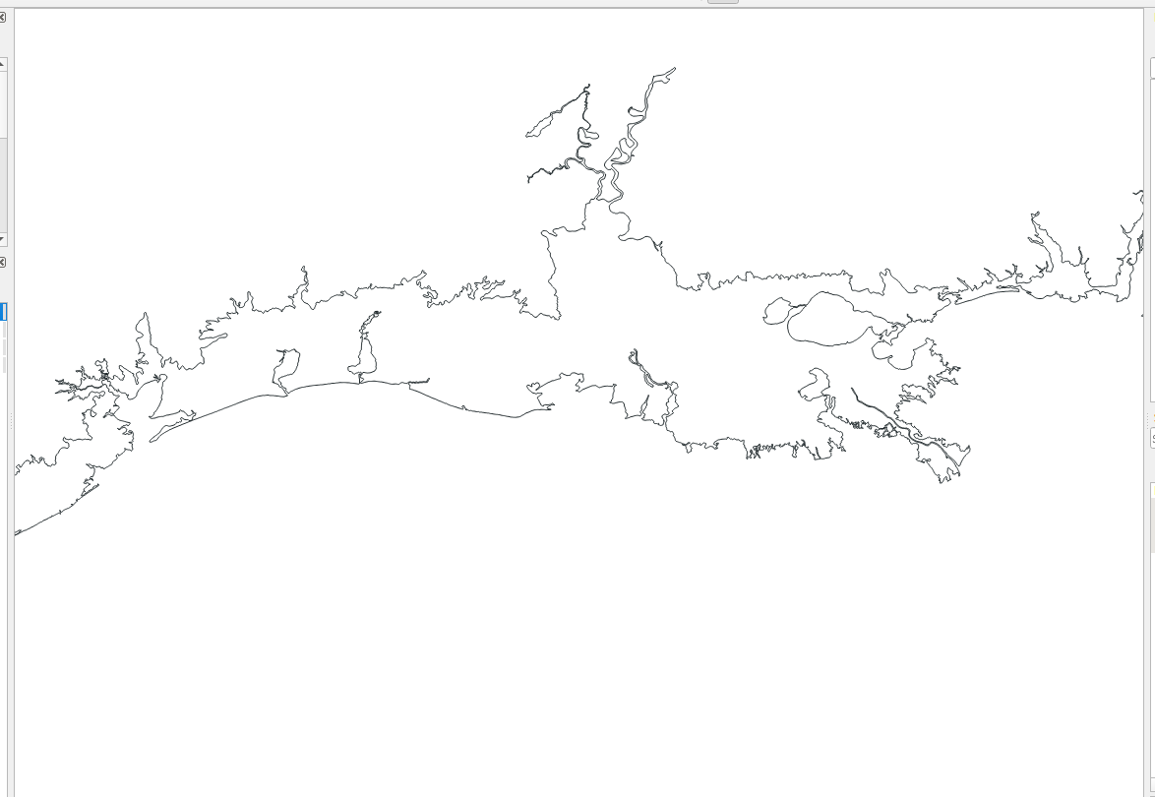
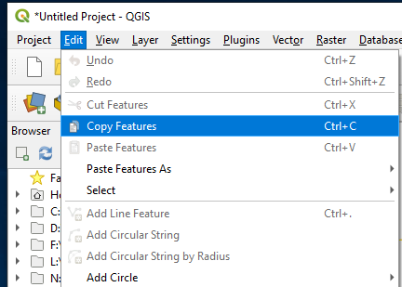
1. Generating coastlines and land boundaries
Use GIS tools to simplify or clean the contours to remove unresolved small features
Copy some cleaned lines from the existing shape files and work on them as a new layer
Use "Select Feature" button in QGIS to select the feature arc, and then copy and paste it in a new layer.

Slide 5
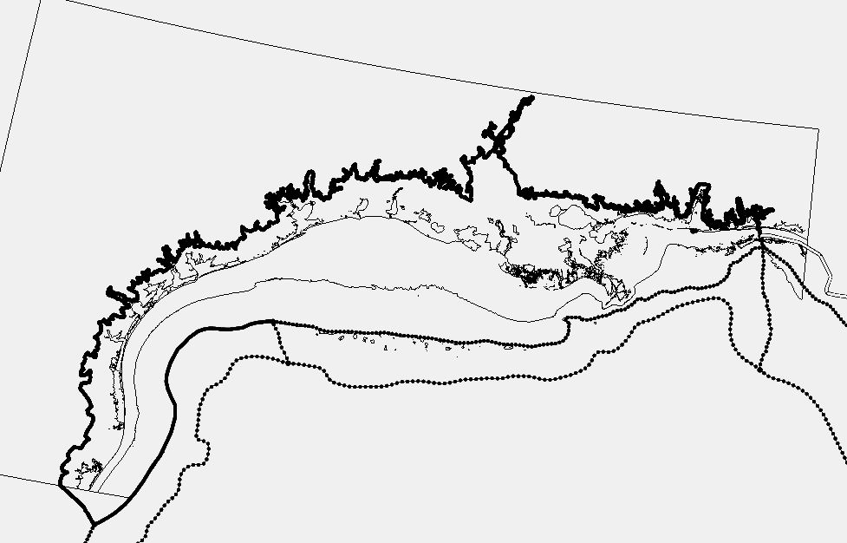
1. Generating coastlines and land boundaries
Load the coastline and land boundary into SMS
In open ocean, go easy on grid resolution transition (which is important for 3D applications): please refer to Chapter 5.7.1 in the user manual
Convert the shape file into “feature arcs” and reset the resolution to desired value using “redistribute arcs” option
Land boundary: ~400m
Shoreline: 500m-1km outside estuaries; variable inside estuaries

Slide 6
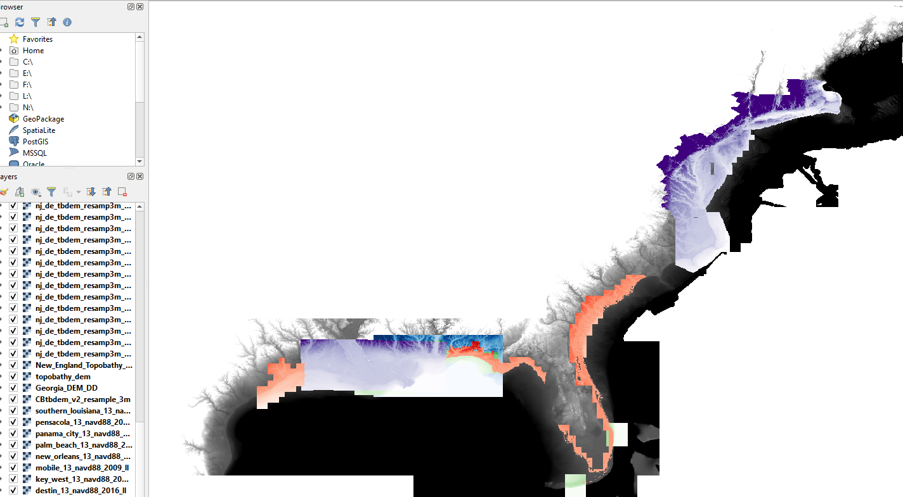
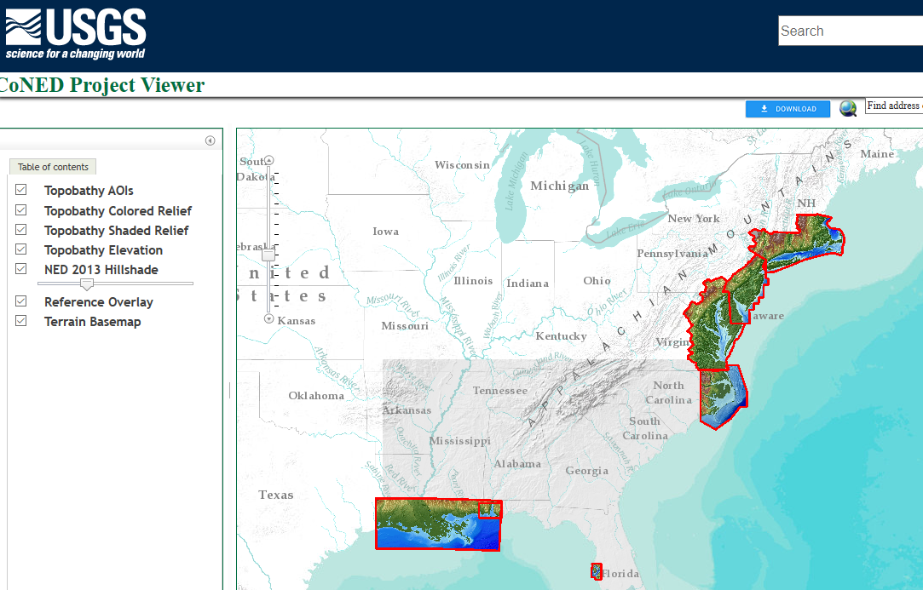
2. Resolving river channels and major creeks
Download relevant higher resolution DEMs to extract contour lines in a region
USGS_CoNED (1m, nav1983, navd 88)
https://topotools.cr.usgs.gov/topobathy_viewer/

Slide 7
2. Resolving river channels and major creeks
Contour values extracted should be dictated by the specific river channel depths and side slopes
For estuaries in coastal zones, contours from 5-30m below water are usually used to detect the highest bathymetric gradients
For river channels and creeks in watershed, contours from 1-5 m below water or sometimes 0m-10m above water may be extracted to help detect the thalwegs
Imageries are helpful also

Slide 8
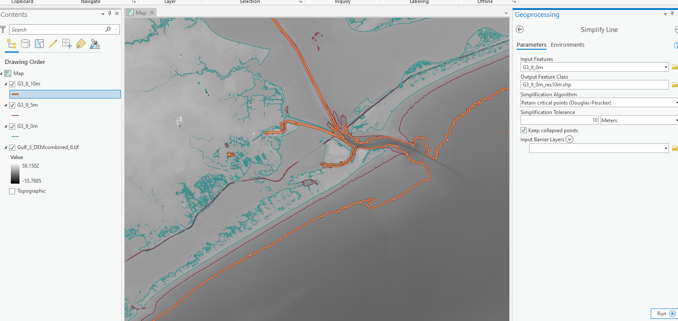
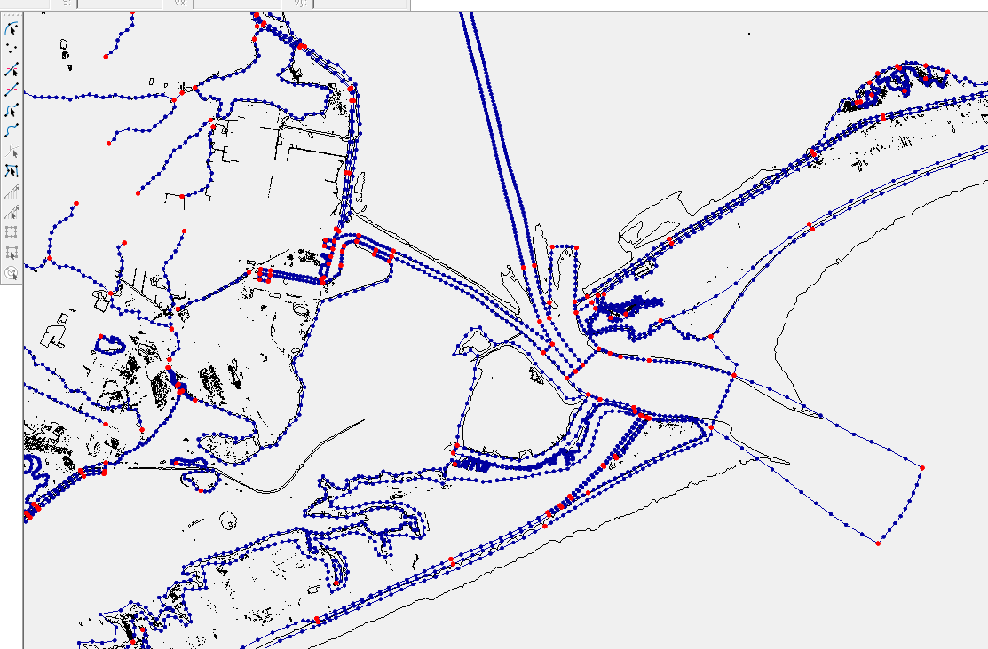
2. Resolving river channels and major creeks
For coastal estuaries, extract contours of 5m-30m depths below water (-30m ~ -5m from DEMs) to help identify river channels
Resample using “Simplify Line” to reset the resolution of contour to 10m, to reduce the size of the shape files in GIS
Use these contours as guidance to resolve river channels in SMS

Slide 9
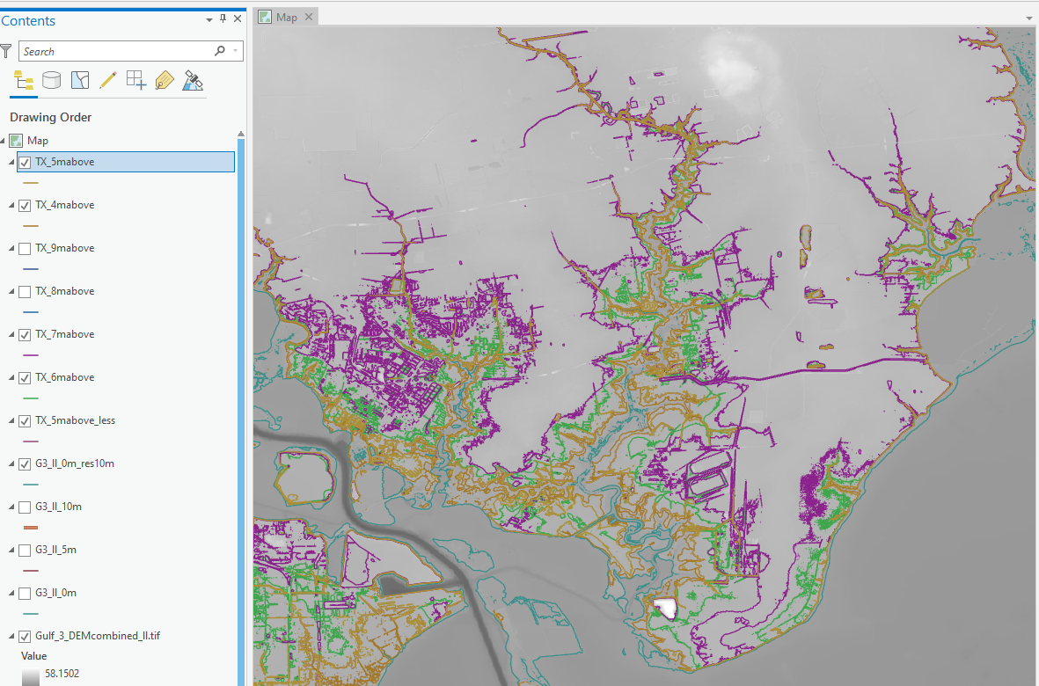
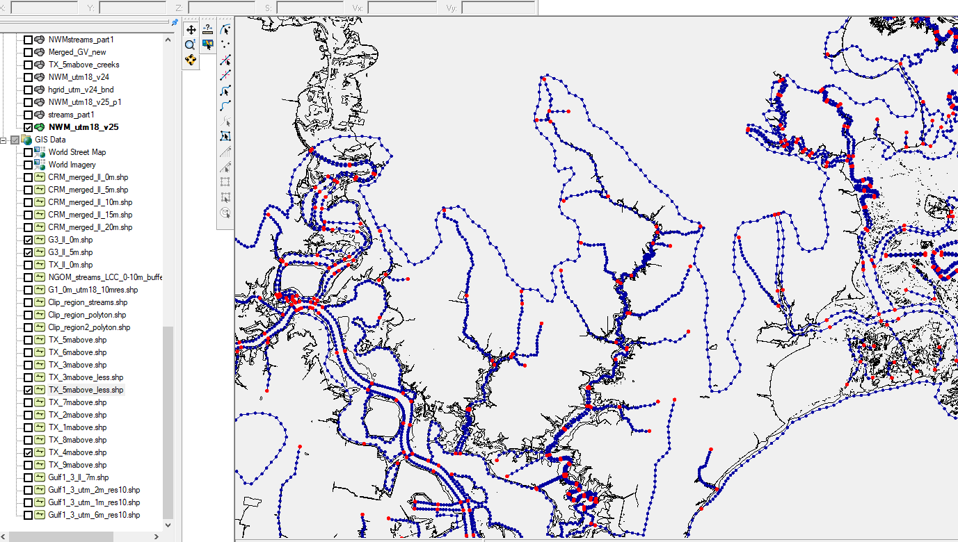
2. Resolving river channels and major creeks
If desired, for watershed rivers/creeks, extract 1m to 10m above MSL to help identify thalwegs of creeks
Set along-channel resolution to be 50-300m
Cross-channel resolution varies from upstream to downstream and also depends on 2D/3D config
Generally, use at least 5 cross-channel segments in regions with important 3D processes (e.g. stratification)
Otherwise, 1-2 rows of elements are sufficient

Slide 10
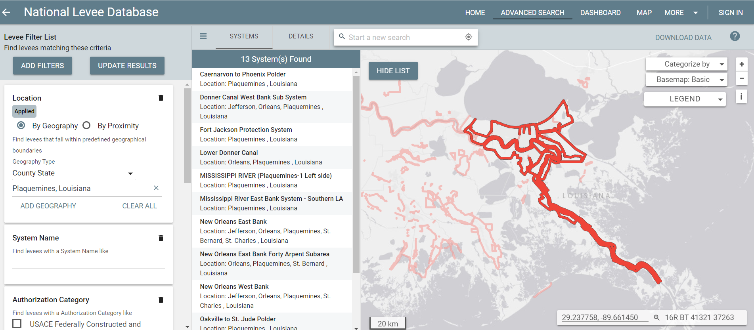
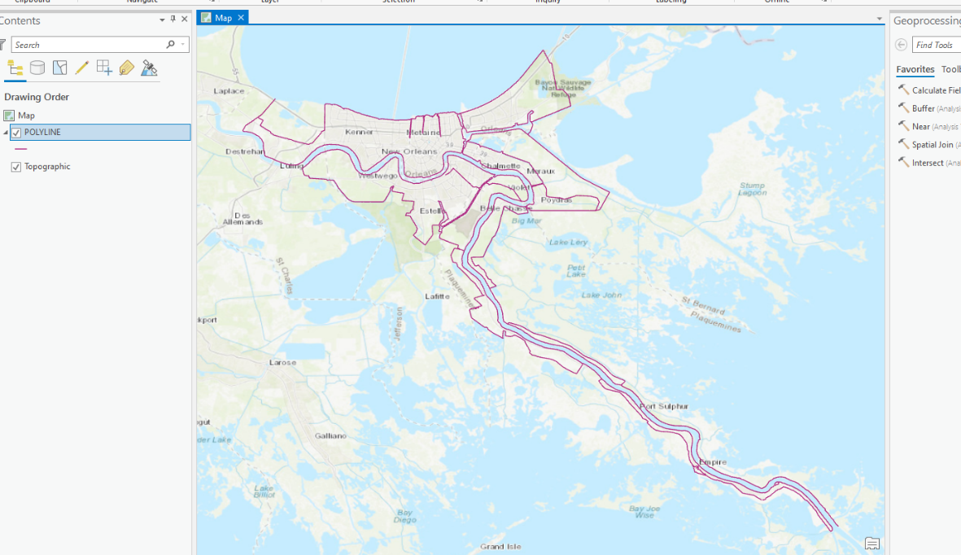
3. Resolving levees and other features
Levee shape files can be found by following website:
https://levees.sec.usace.army.mil/#/

Slide 11
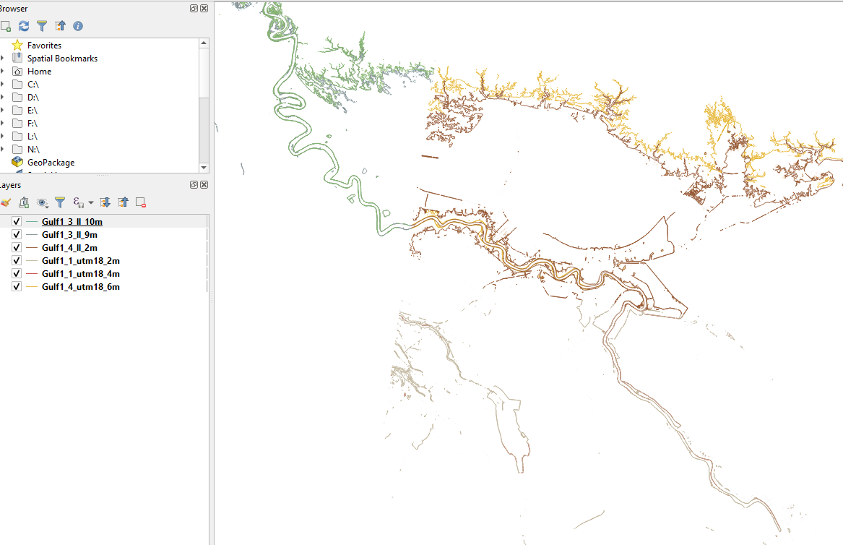
3. Resolving levees and other features
Extract 1-8m above MSL contour lines to help identify bottom and top of levee
Select the most relevant contour lines and save as new shape file in QGIS

Slide 12
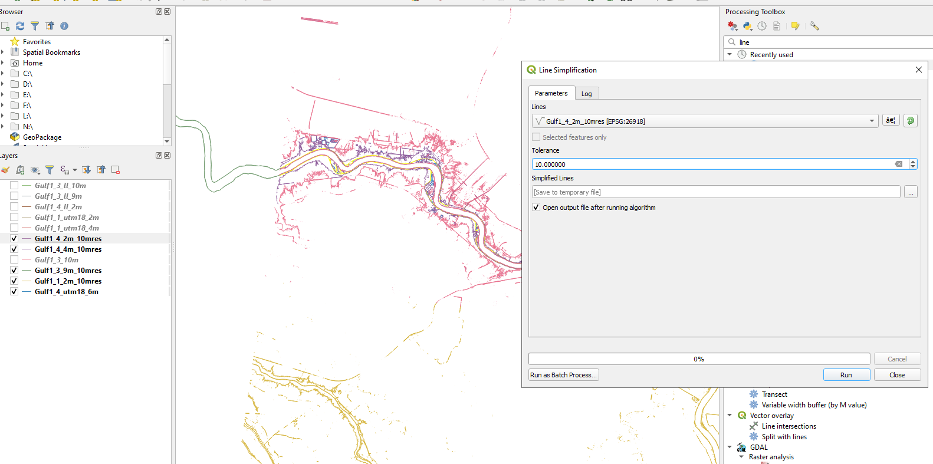
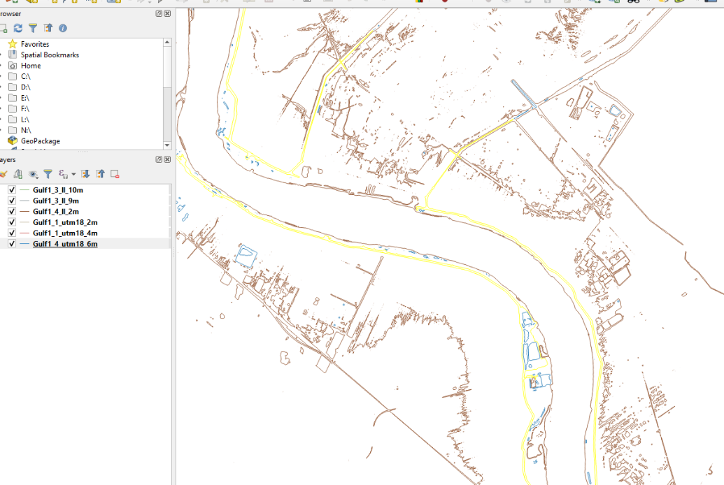
3. Resolving levees and other features
Take levees in lower Mississippi River as an example, use 4-5m isotopo to trace the top of levees, and use 2m isotopo as the bottom of levees.
For lower Mississippi, levees in some southern parts of river are lower than 2m, not all connected, and hard to tell from the imagery. So this part is not included at the moment
For northern parts, elevation is higher, use 9m or 8m contour as the bottom of levees, and use 10m contour to trace the top of levees.
Before loading the contours into SMS, simplify contours by selecting clean contours in GIS tools, reset the line resolution (~10m) to reduce size, and save them as new shape files

Slide 13
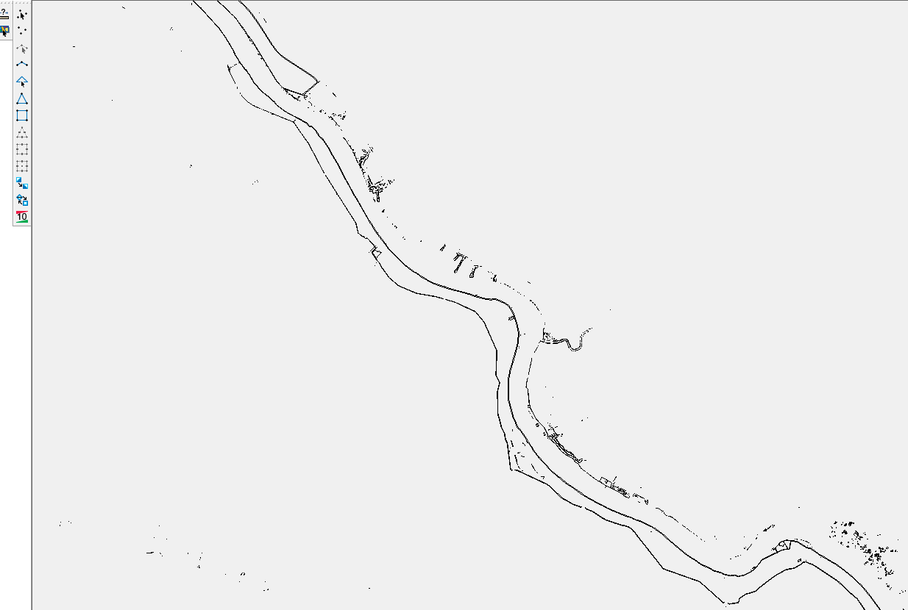
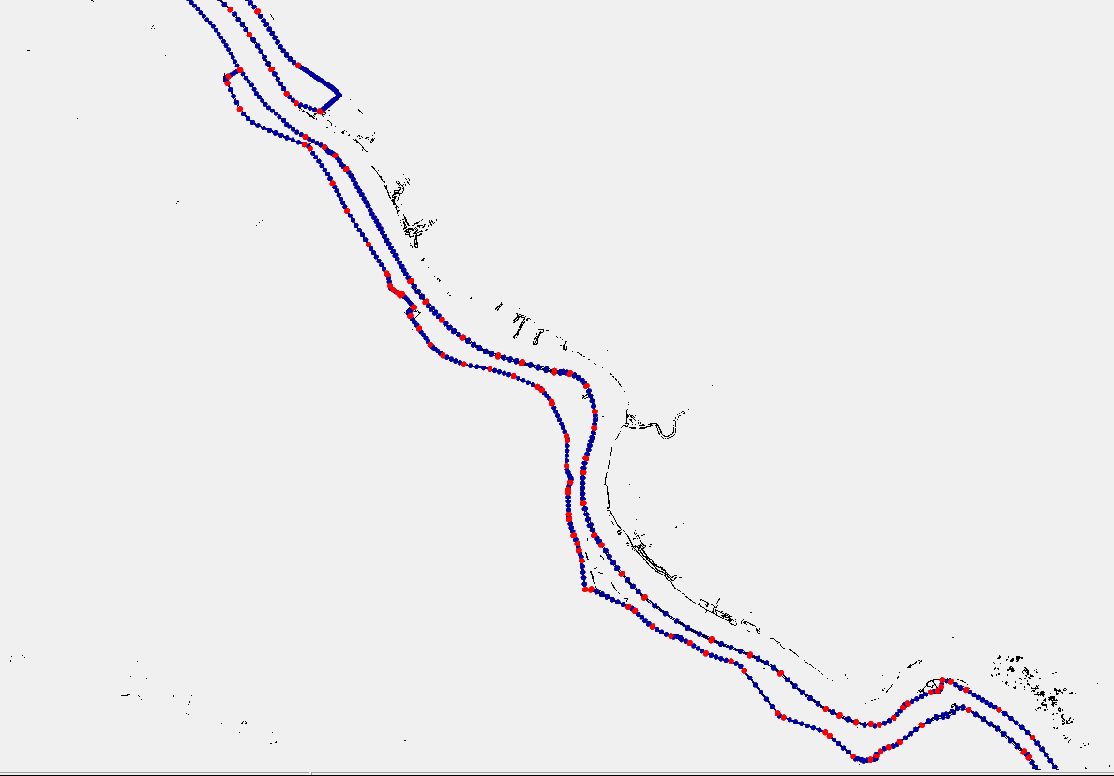
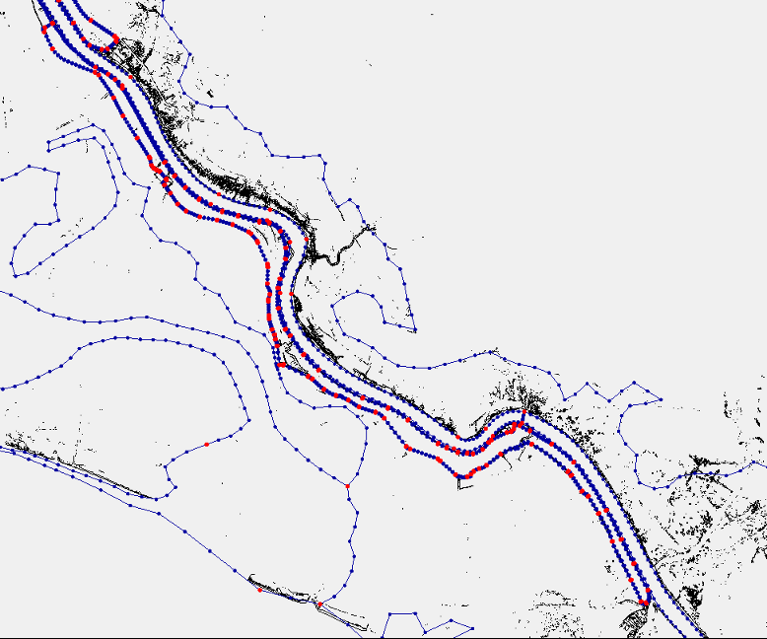
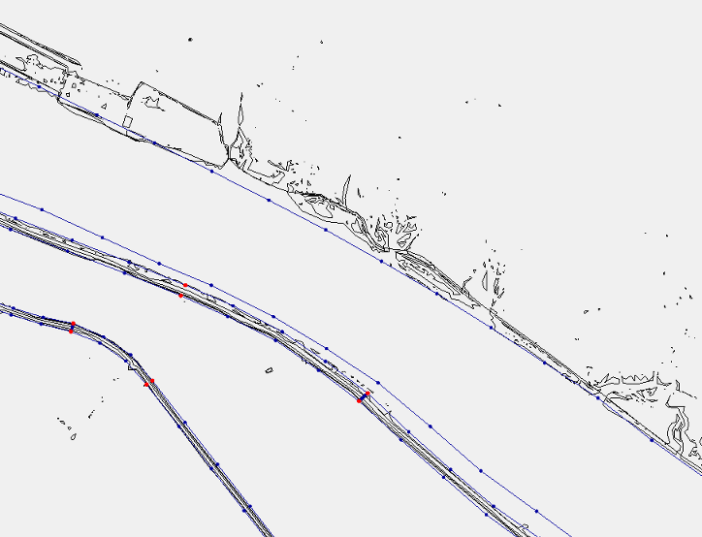
3. Resolving levees and other features
Load contours into SMS, convert them into feature arcs, reset the resolution to 150m (along levee), adjust locations to make sure they do not across other feature arcs
This way the bottom and crest of levee are accurately captured regardless of the final along-levee resolution
River boundary
Levee boundary

Slide 14
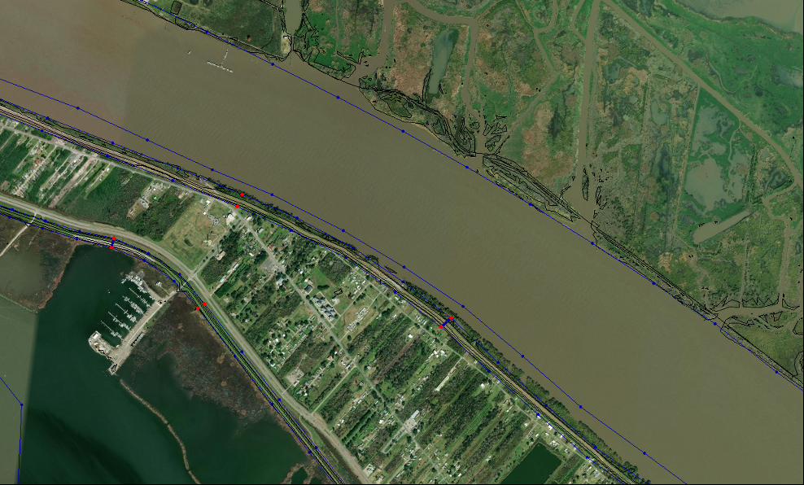
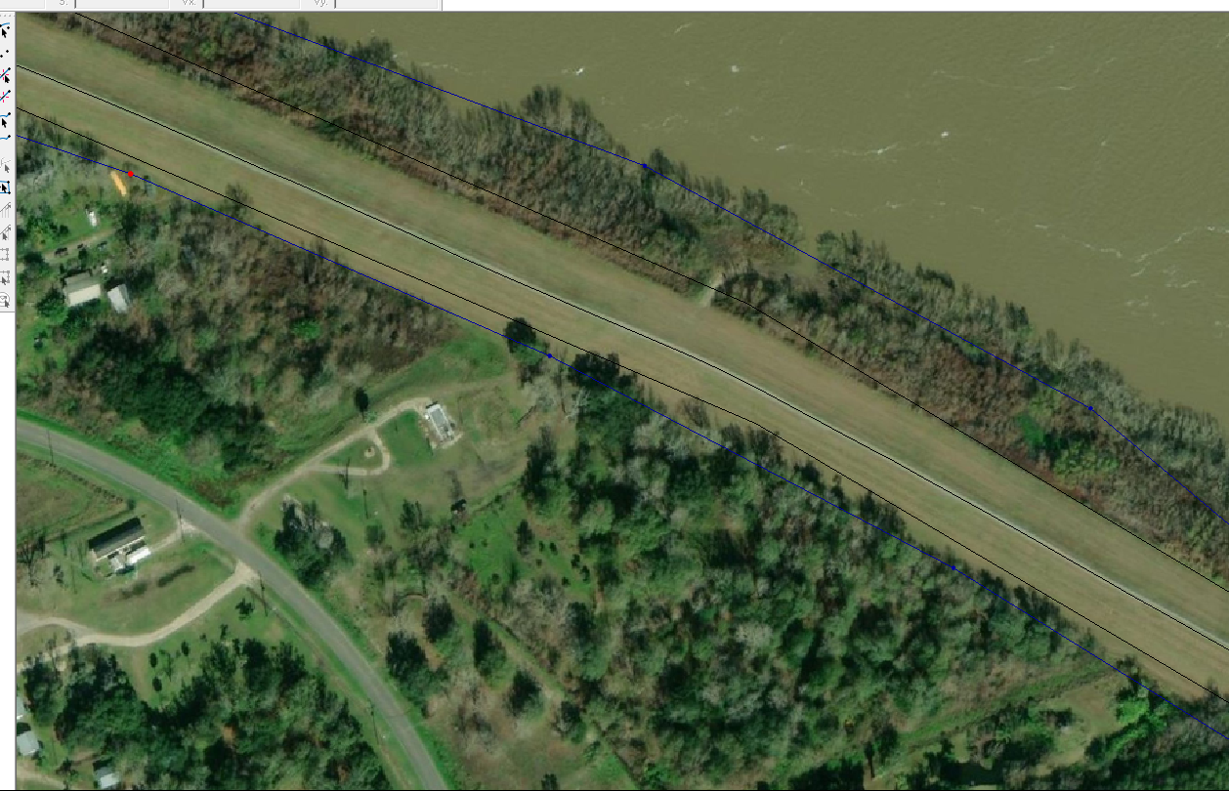
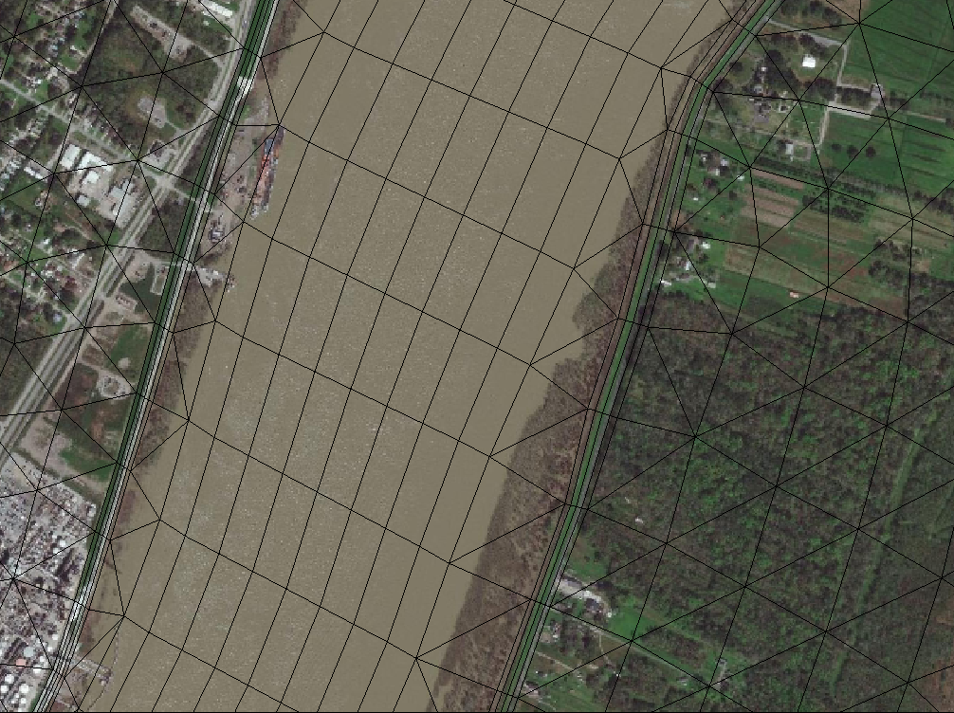
3. Resolving levees and other features
Use satellite imagery to edit levee arcs when there is mismatch between DEMs and imagery
Levees

Slide 15
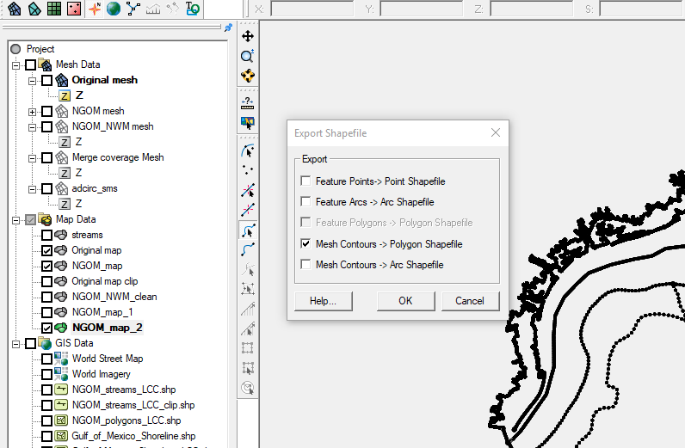
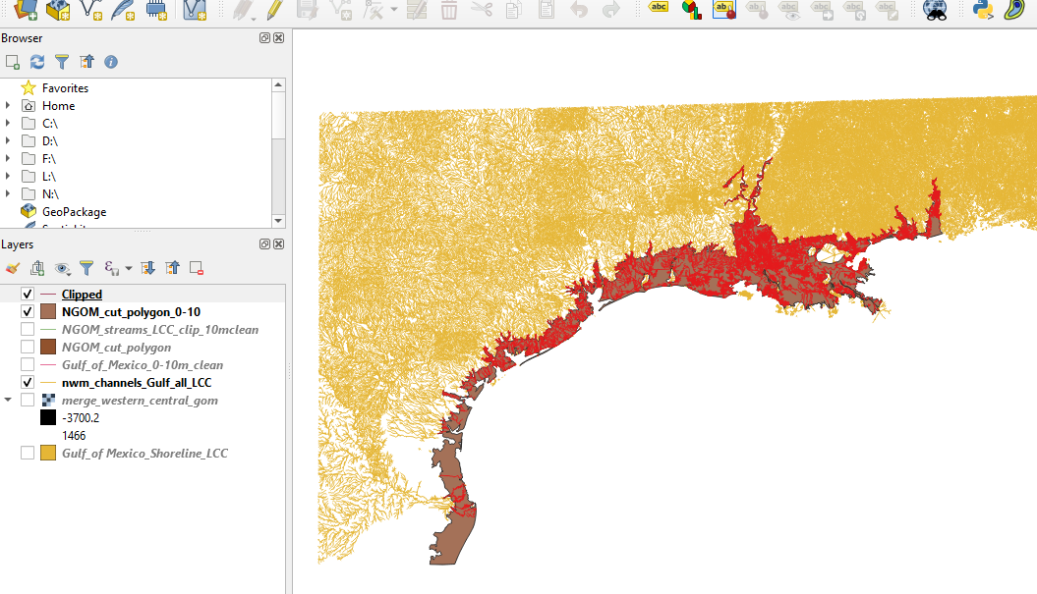
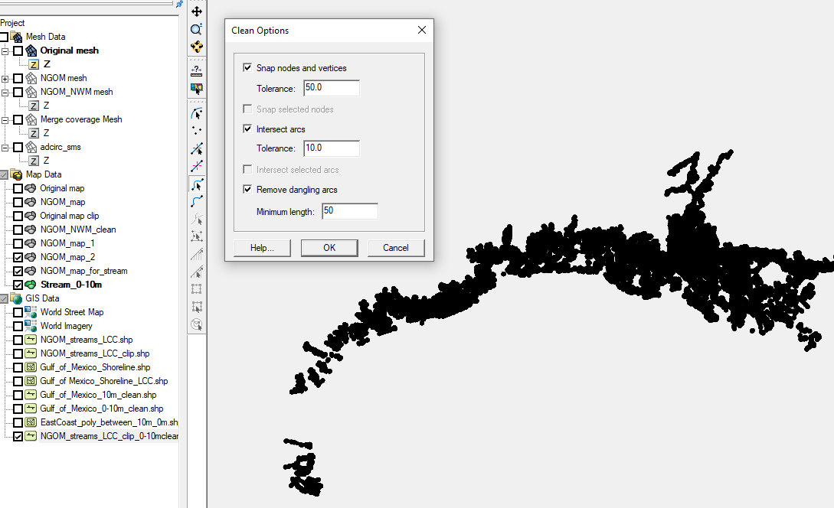
4. Adding NWM segments
First, convert SMS polygons (shoreline, land boundary and river channels) to shapefile to help clip NWM segments
In GIS, clip the NWM stream arcs using the polygons (between 0-10m) as masks, and then save as shapefile
Import shapefiles for NWM to SMS; convert the clipped stream segments to feature objects
Clean the arcs using the following tolerance: 50m
Redistribute NWM arcs to desired resolution (~300m)
Merge the NWM segments into the previous map
May need to repeat this procedure for specific rivers

Slide 16
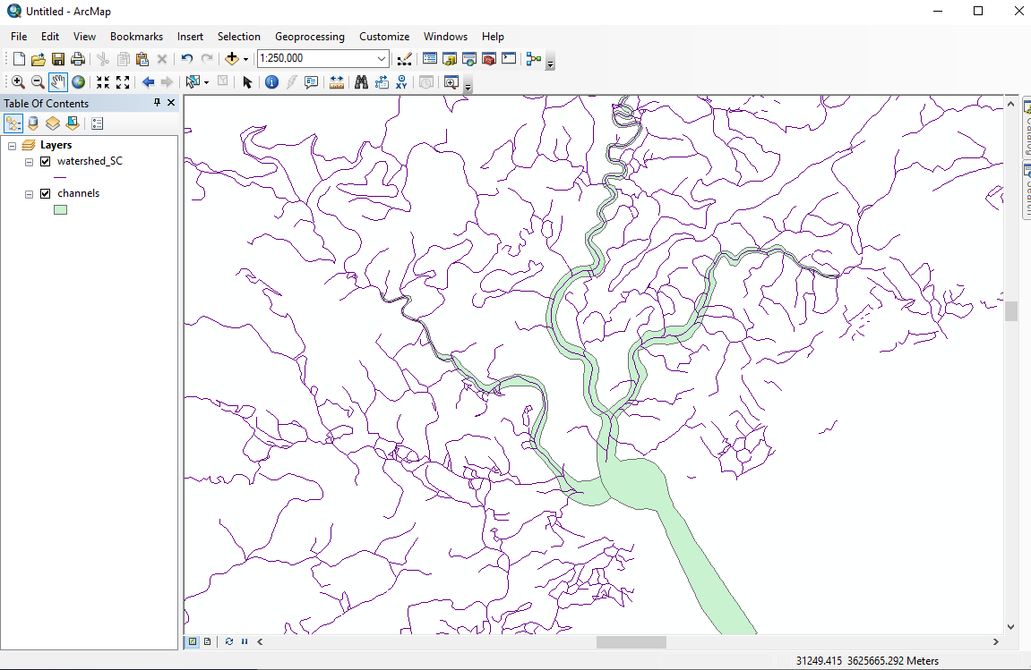
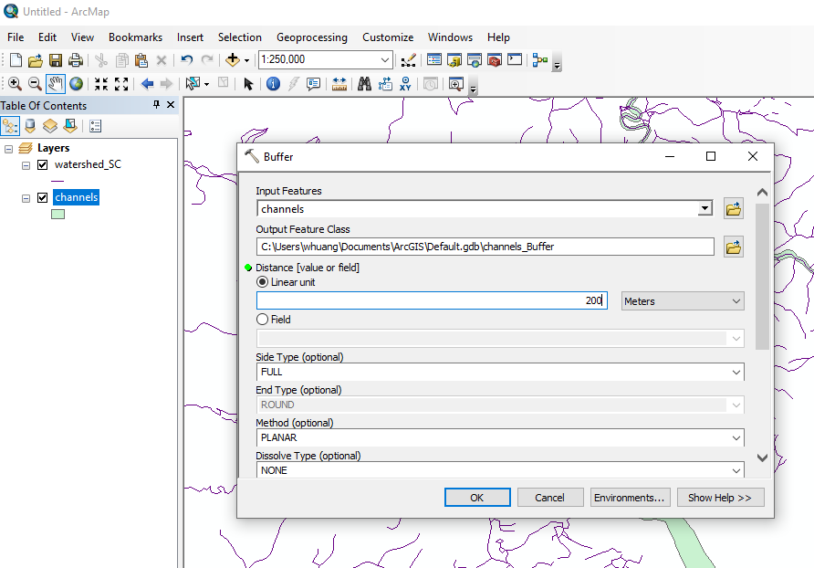
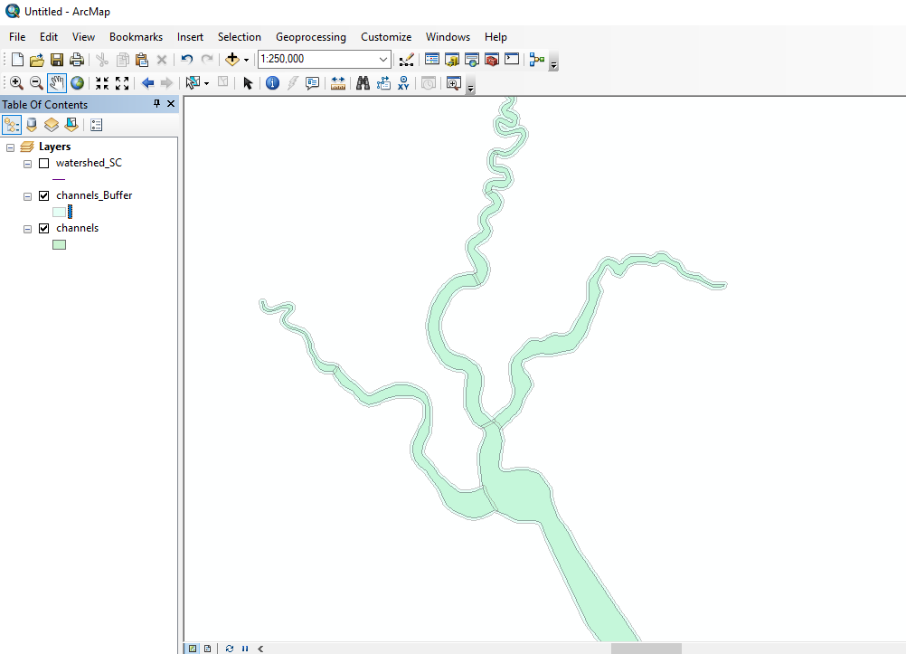
4. Some tips on merging NWM arcs
Open the two shape files: channels.shp and watershed_SC.shp in ArcMap software.
Use the “buffer” tool to define a zone so that the interest area and the channel area are not overlapped.

Slide 17
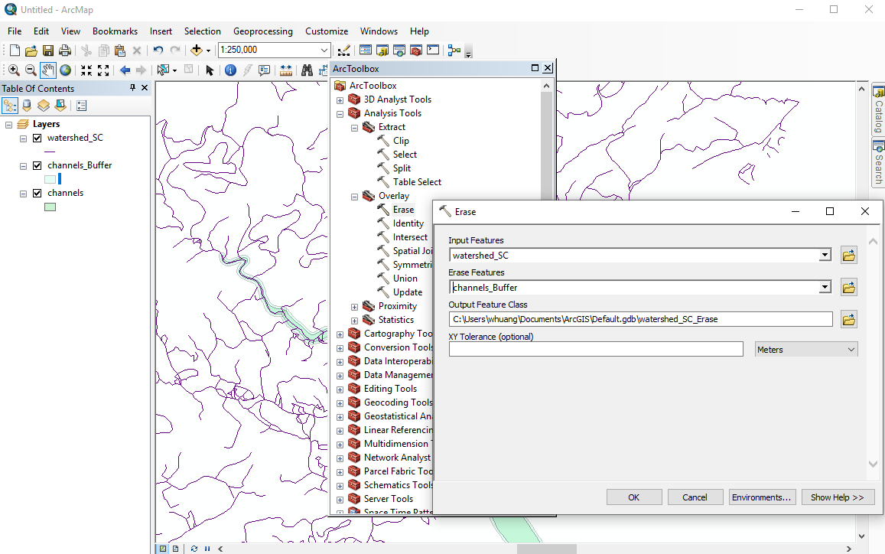
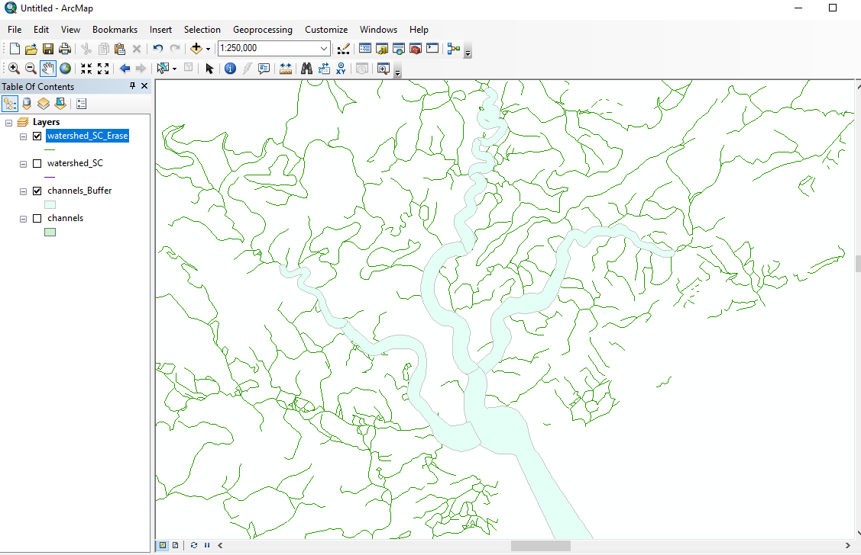
4. Some tips on merging NWM arcs
Use “erase” tool to erase the NWM arcs inside our river polygons.
Then you will get the watershed_SC_Erase which the arcs in the channels_Buffer have been excluded.

Slide 18
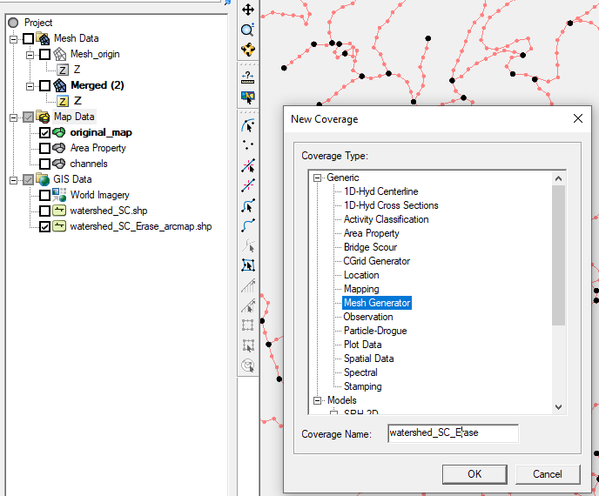
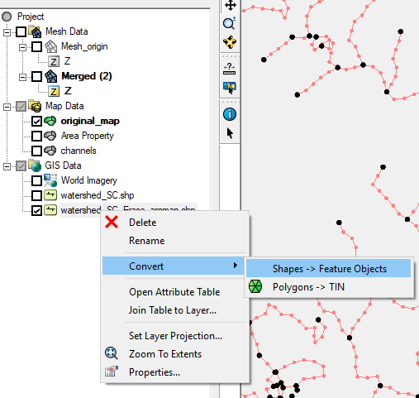
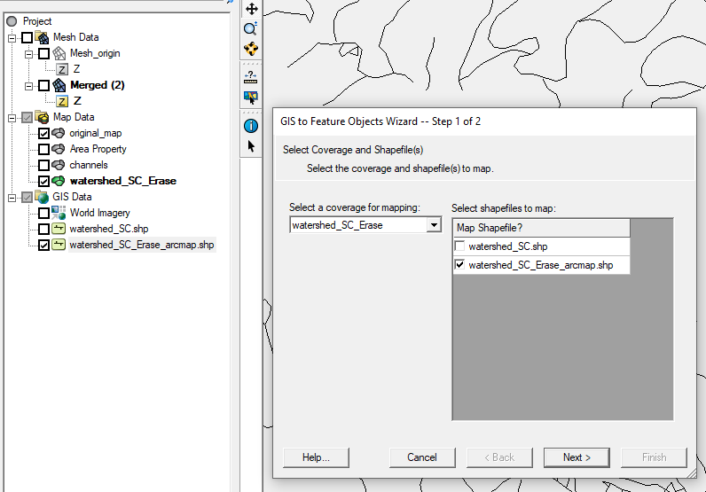
4. Some tips on merging NWM arcs
Load the watershed_SC_arcmap.shp into SMS
Convert it to a feature object by creating a separate new map coverage called watershed_SC_Erase

Slide 19
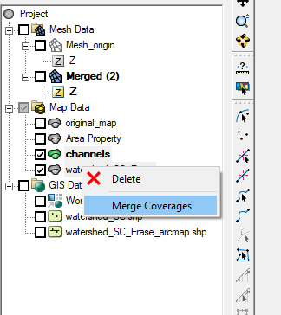
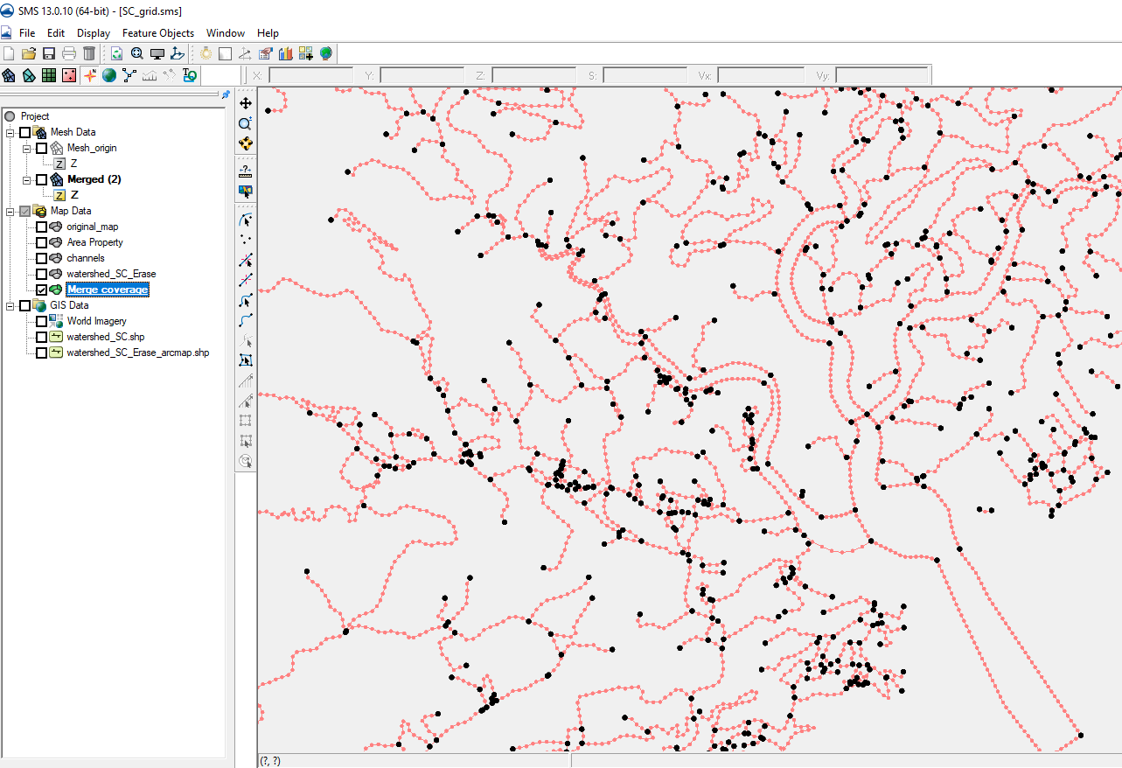
4. Some tips on merging NWM arcs
Merge the channels and the watershed_SC_Erase into one map file.
Then you will have a newly merged map as shown below, which is the semi-final map that has everything in it

Slide 20
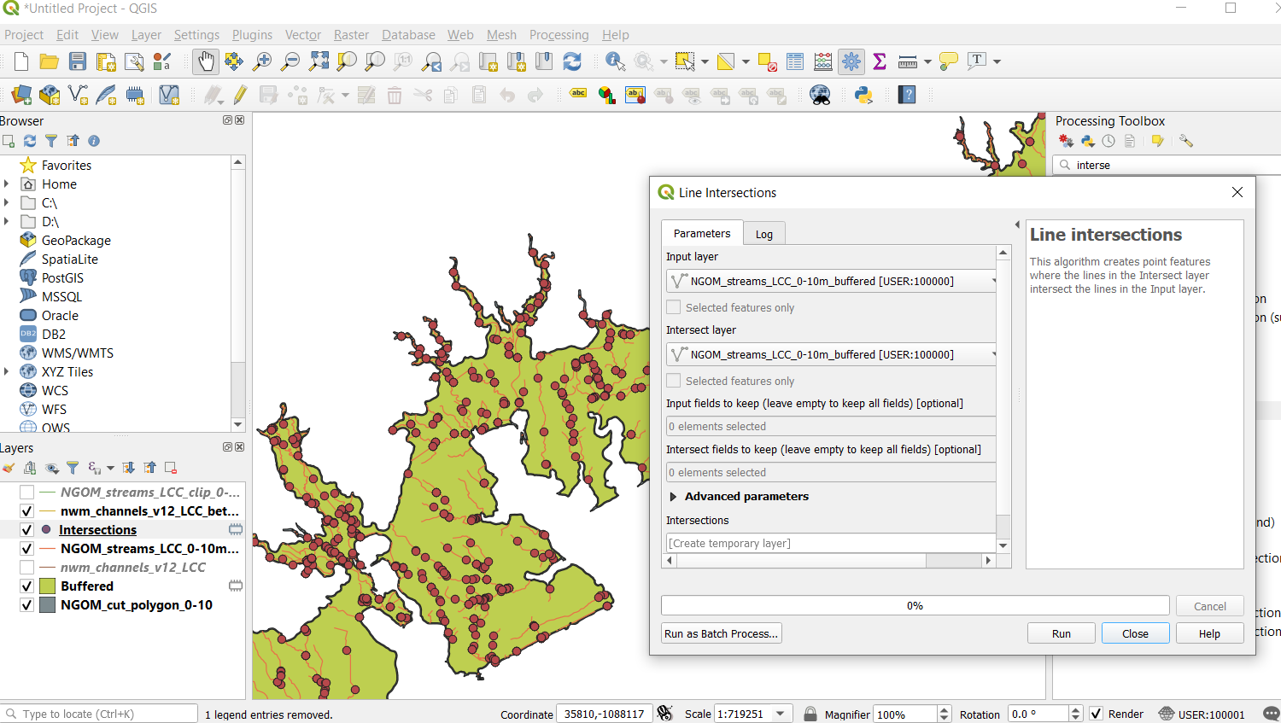
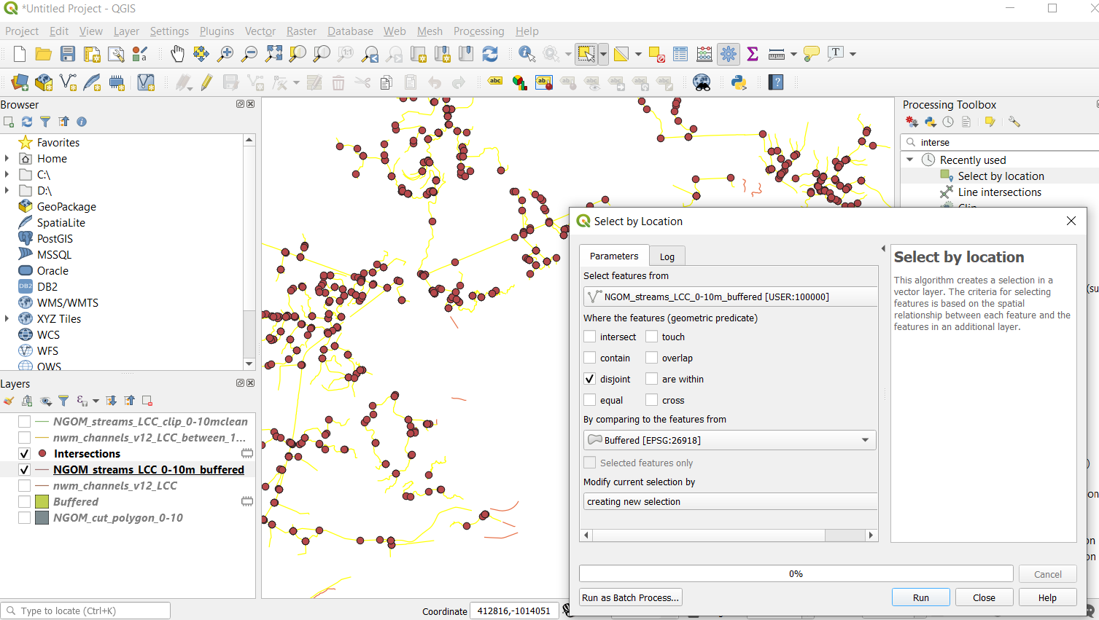
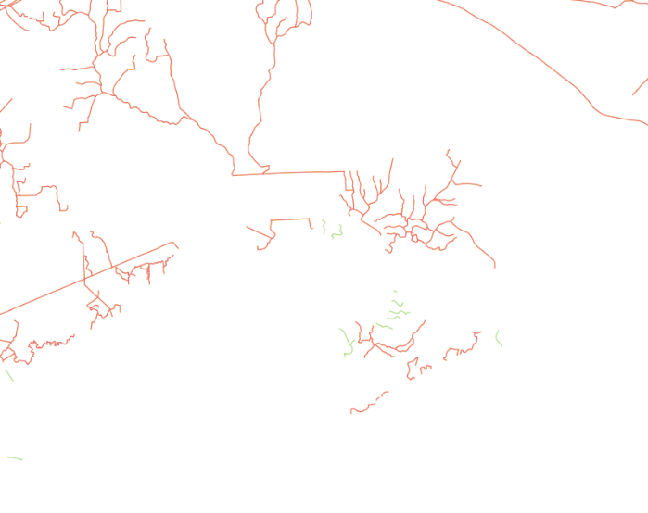
4. Some tips on merging NWM arcs
In GIS, clean the small hanging arcs (i.e. not attached to major streams) if desired
Extract the intersections using "Line intersections" tool
Select the arcs using "Select by locations" so that hanging arcs will be excluded.
Then invert the selection, copy the selection, and paste it to a new layer: Green color (hanging arcs) will be excluded.

Slide 21
Next step
Generate grid in SMS
Need to specify meshing types (patch, paving) in polygons
Generate grid
Remember to ‘Select disjoint’ (under Nodes menu) and remove disjoint nodes
‘Renumber’ (under Nodes) as an added safety measure
Optionally re-project to lon/lat
Proceed to other model setup as outlined in Fei’s doc

