Slide 1





National Water Model

Slide 2
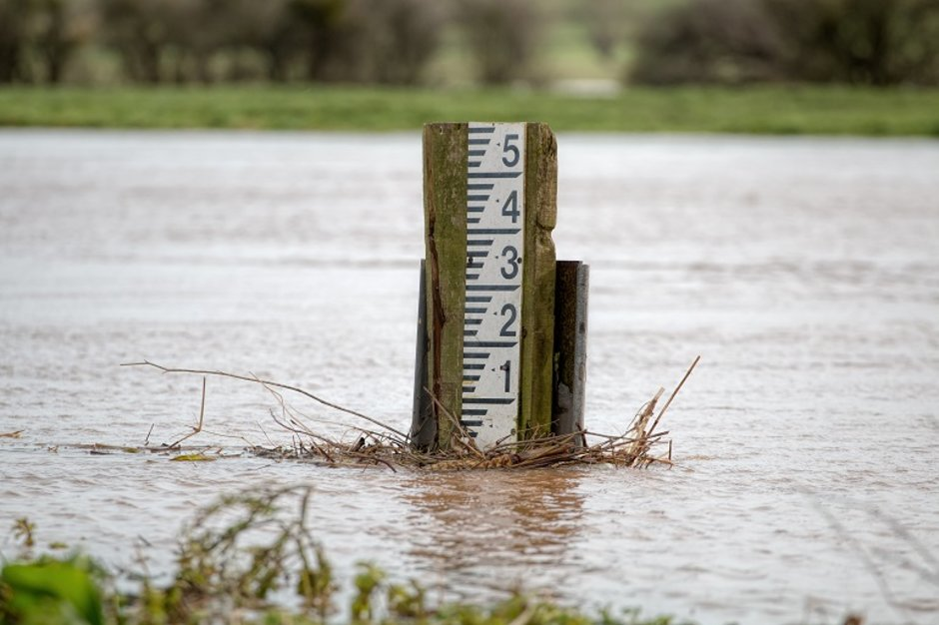
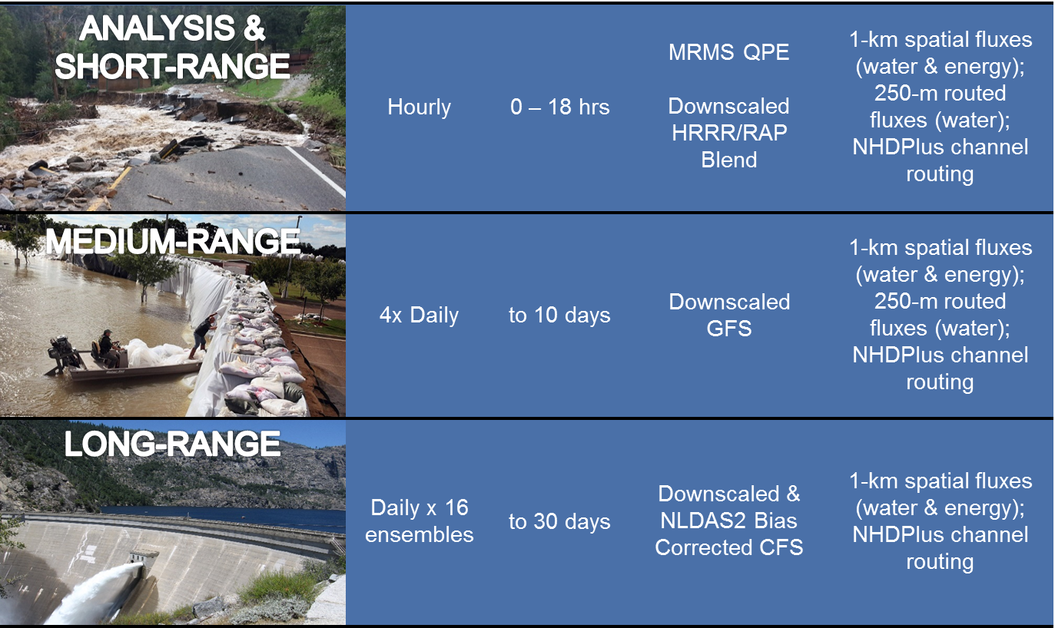
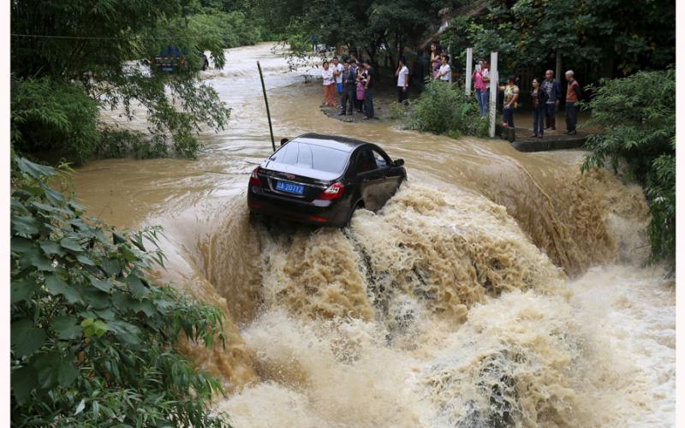
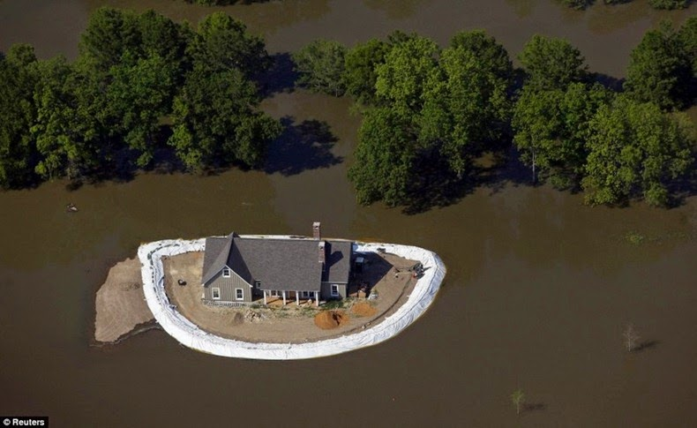
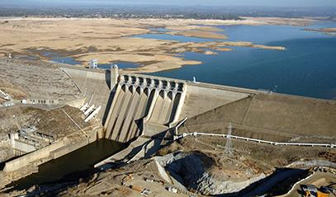
National Water Model V1.1/V1.2
Operational Analysis and Forecast Cycling Configurations
Analysis
Cycling
Forecast
Forcing
Outputs
MRMS QPE
Downscaled
HRRR/RAP
Blend
1km Land States,
250m Sfc Routed Water,
NHDPlus
Streamflow
Hourly
-3 Hours
Short-Range
Downscaled
HRRR/RAP
Blend
1km Land States,
250m Sfc Routed Water,
NHDPlus
Streamflow
Hourly
18 hours
Medium-Range
1km Land States,
250m Sfc Routed Water,
NHDPlus
Streamflow
4 x Day
10 days
Downscaled GFS
Long-Range
Daily Ensemble
(16 members)
Downscaled and Bias-Corrected CFS
1km Land States,
NHDPlus
Streamflow
30 days

Slide 3
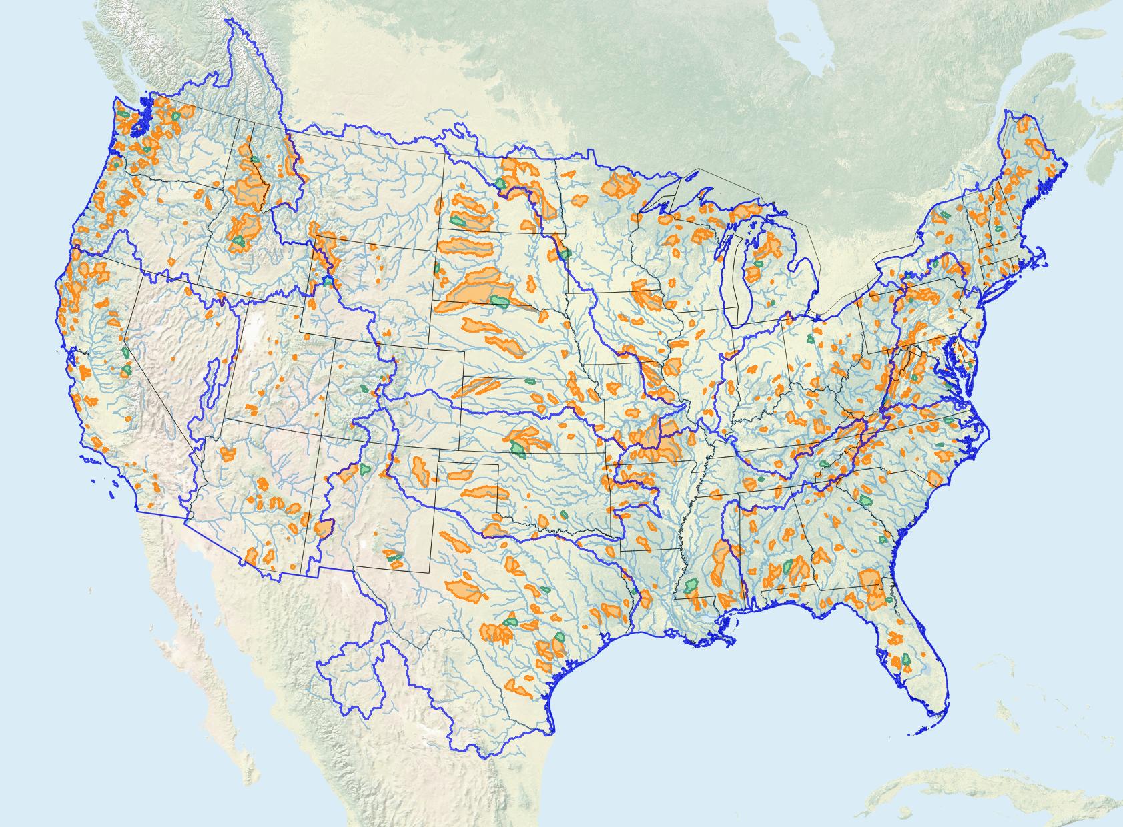
Future Plans: Upgrading to NWM V2.0 and Beyond
v1.0
v1.1
v1.2
Foundation Established August 2016
Water Resource Model for 2.7 Million Stream Reaches
First Upgrade
May 2017
Increased cycling freq. and forecast length, initial calibration, improved soil/snow physics
Second Upgrade
March 2018
Extensive calibration, improved hydrofabric (terrain and stream connections), improved data assimilation
NWM V1.2 Calibration Regions (Shaded)
v2.0
Third Upgrade
Winter 2018-19
Expansion to Hawaii, medium range ensemble configuration, increased modularity, improved calibration, longer Analysis look-back period
10% of domain now directly calibrated
Calibrated basins:
NWMv1.1: 48
(from USGS GAGES-II)
NWMv1.2: 1,164
(from USGS GAGESII + CADWR)
‹#›

Slide 4
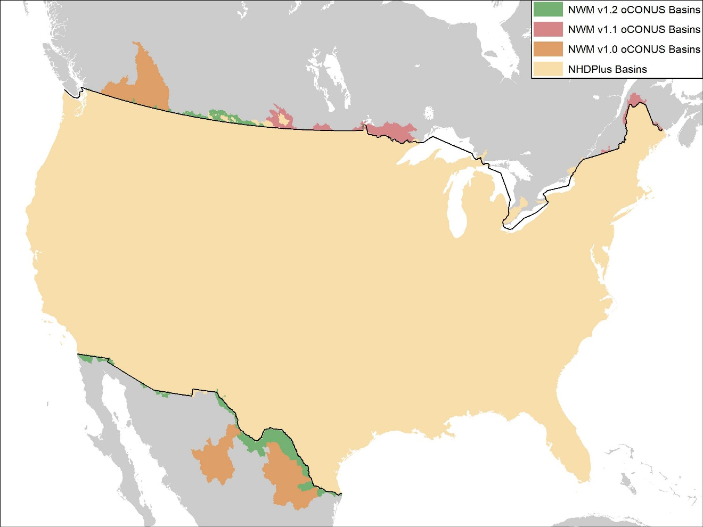
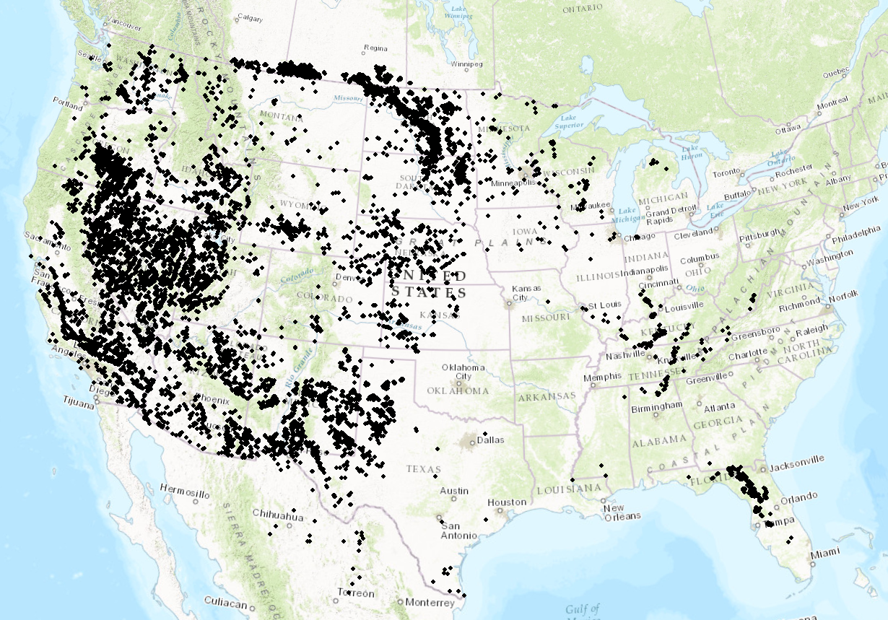
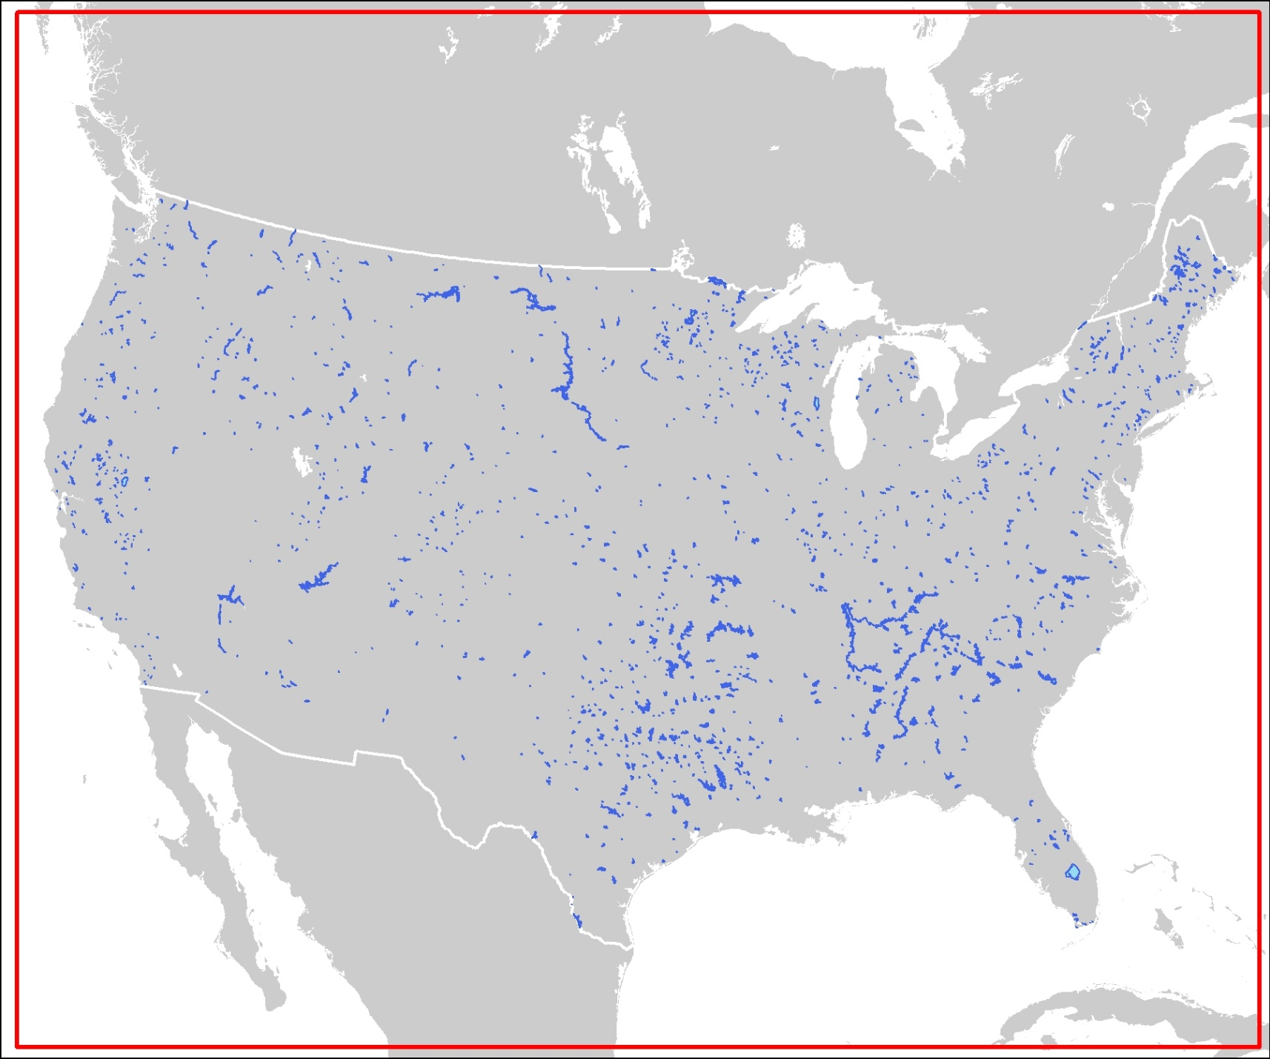
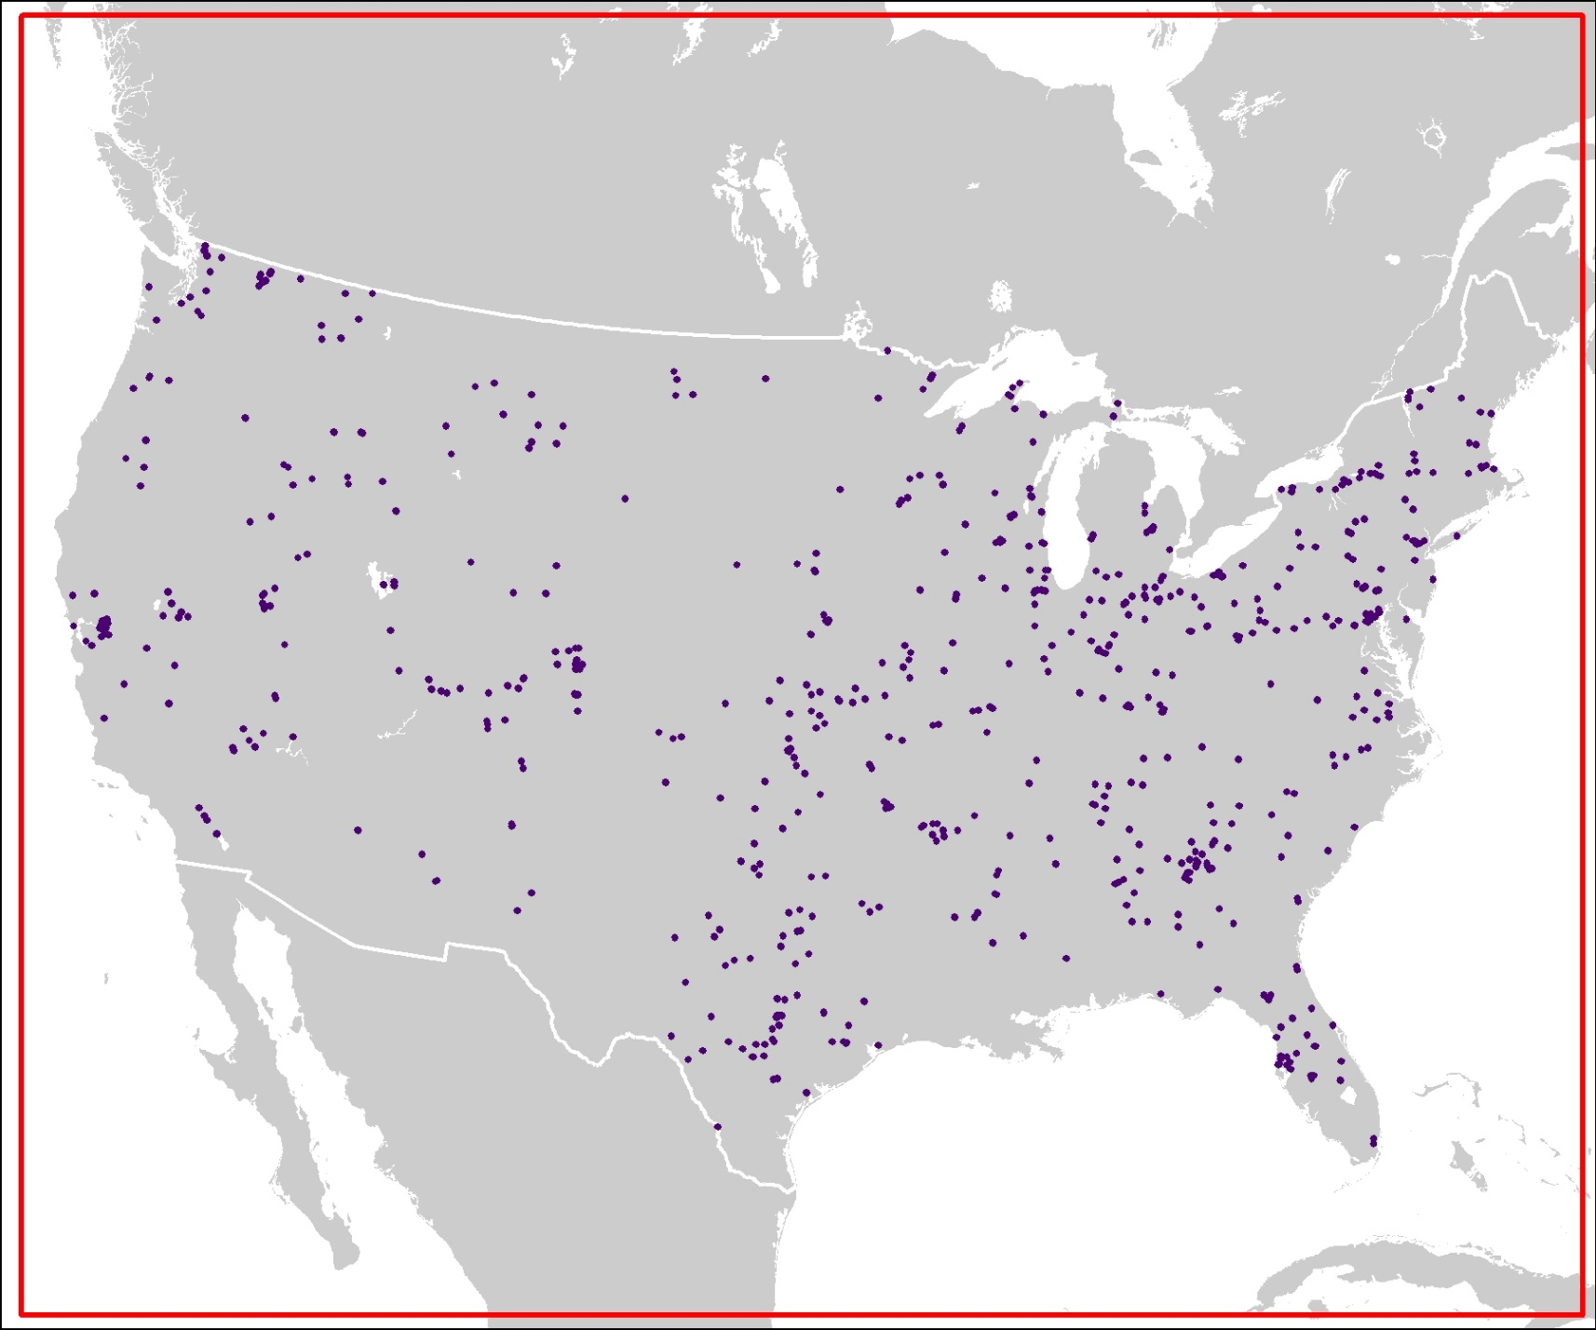
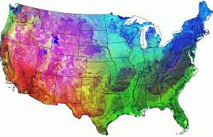

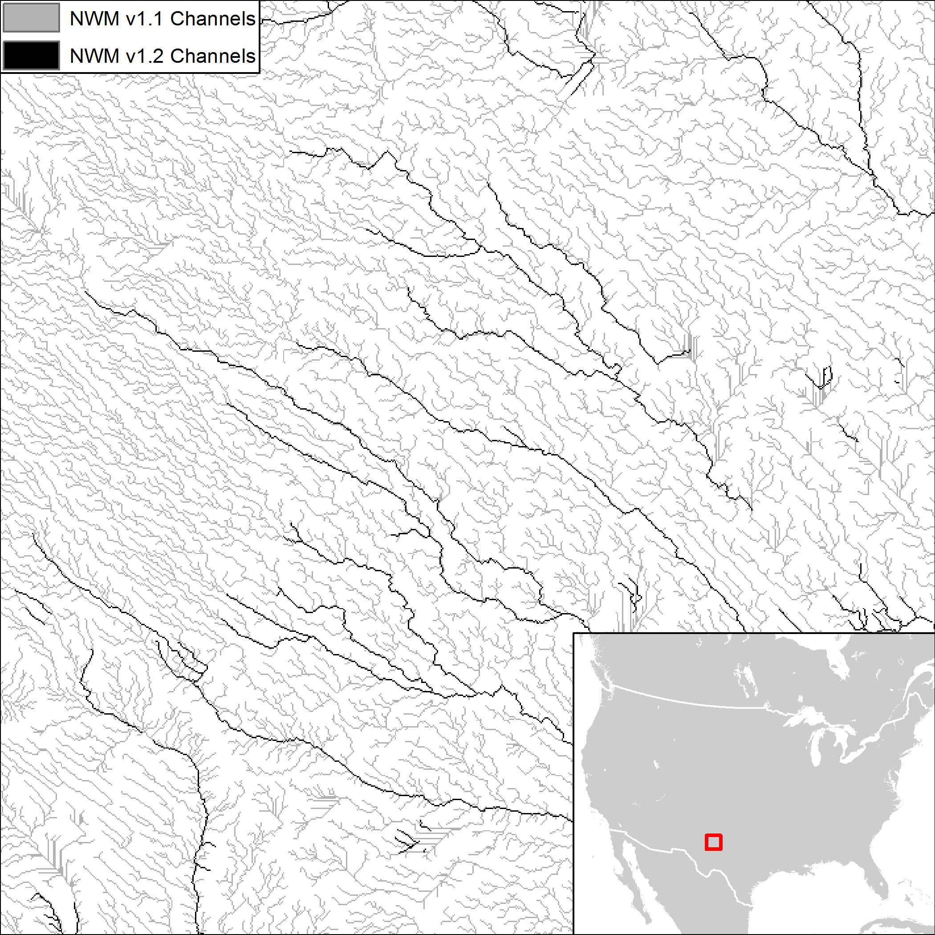
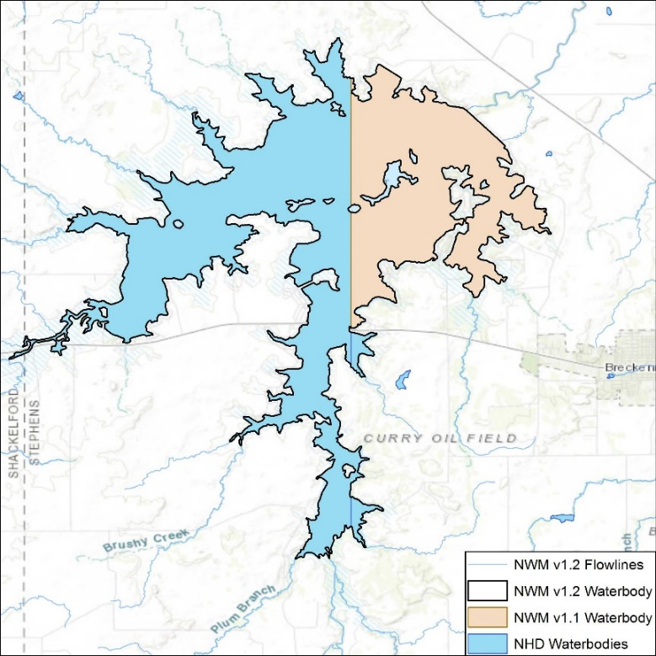
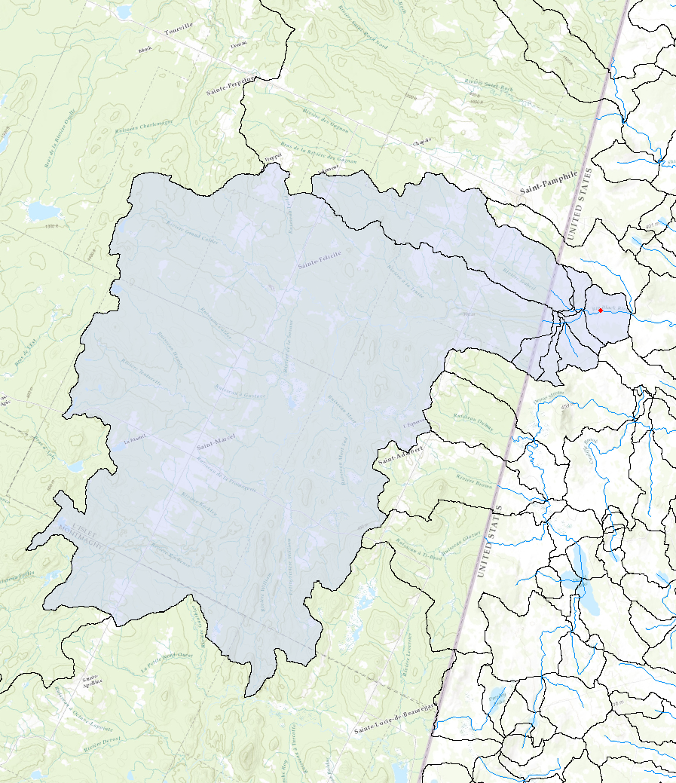
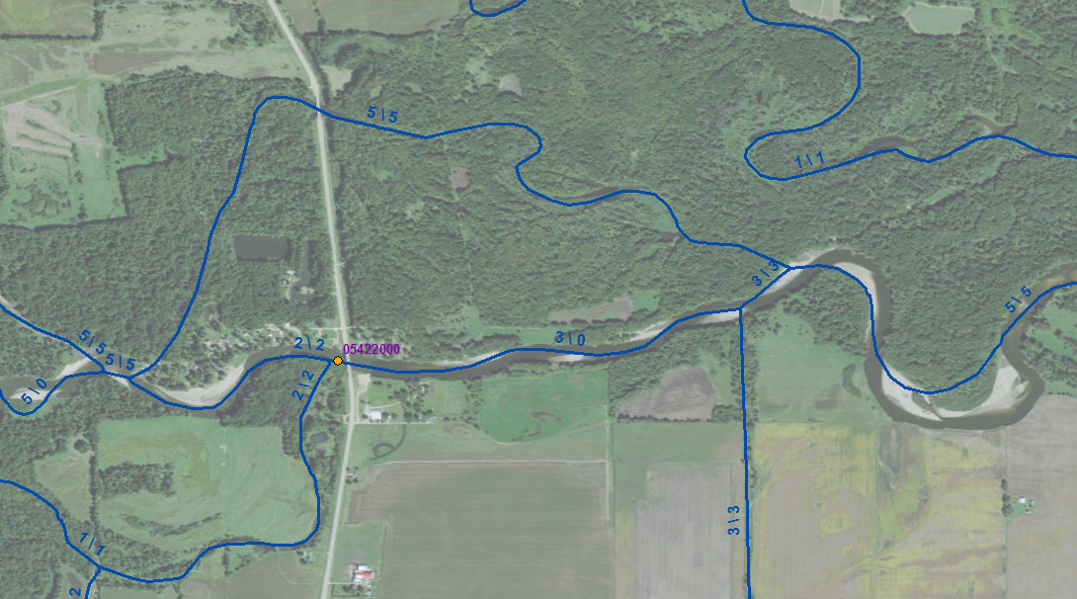
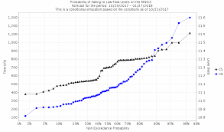
NWM V1.2 Parameter and Data Improvements
oCONUS Coverage Improvements
DEM & Channel Harmonization
Reservoir Improvements
Gauge Additions and Network Improvements
Dynamic Parameter Updates
Added or altered 328 reservoirs, improved reservoir parameters
Added 680 new USGS gages, corrected gauge locations, removed tidally-influenced gages, fixed stream breaks
Added hooks to enable on-demand automated updates of improved hydrologic and land surface parameters
Improved oCONUS coverage in Canada & Mexico
Used higher resolution DEM source data to improve underlying network parameters
These improvements often have large local impacts that are not represented in regionally-computed statistics
‹#›

Slide 5
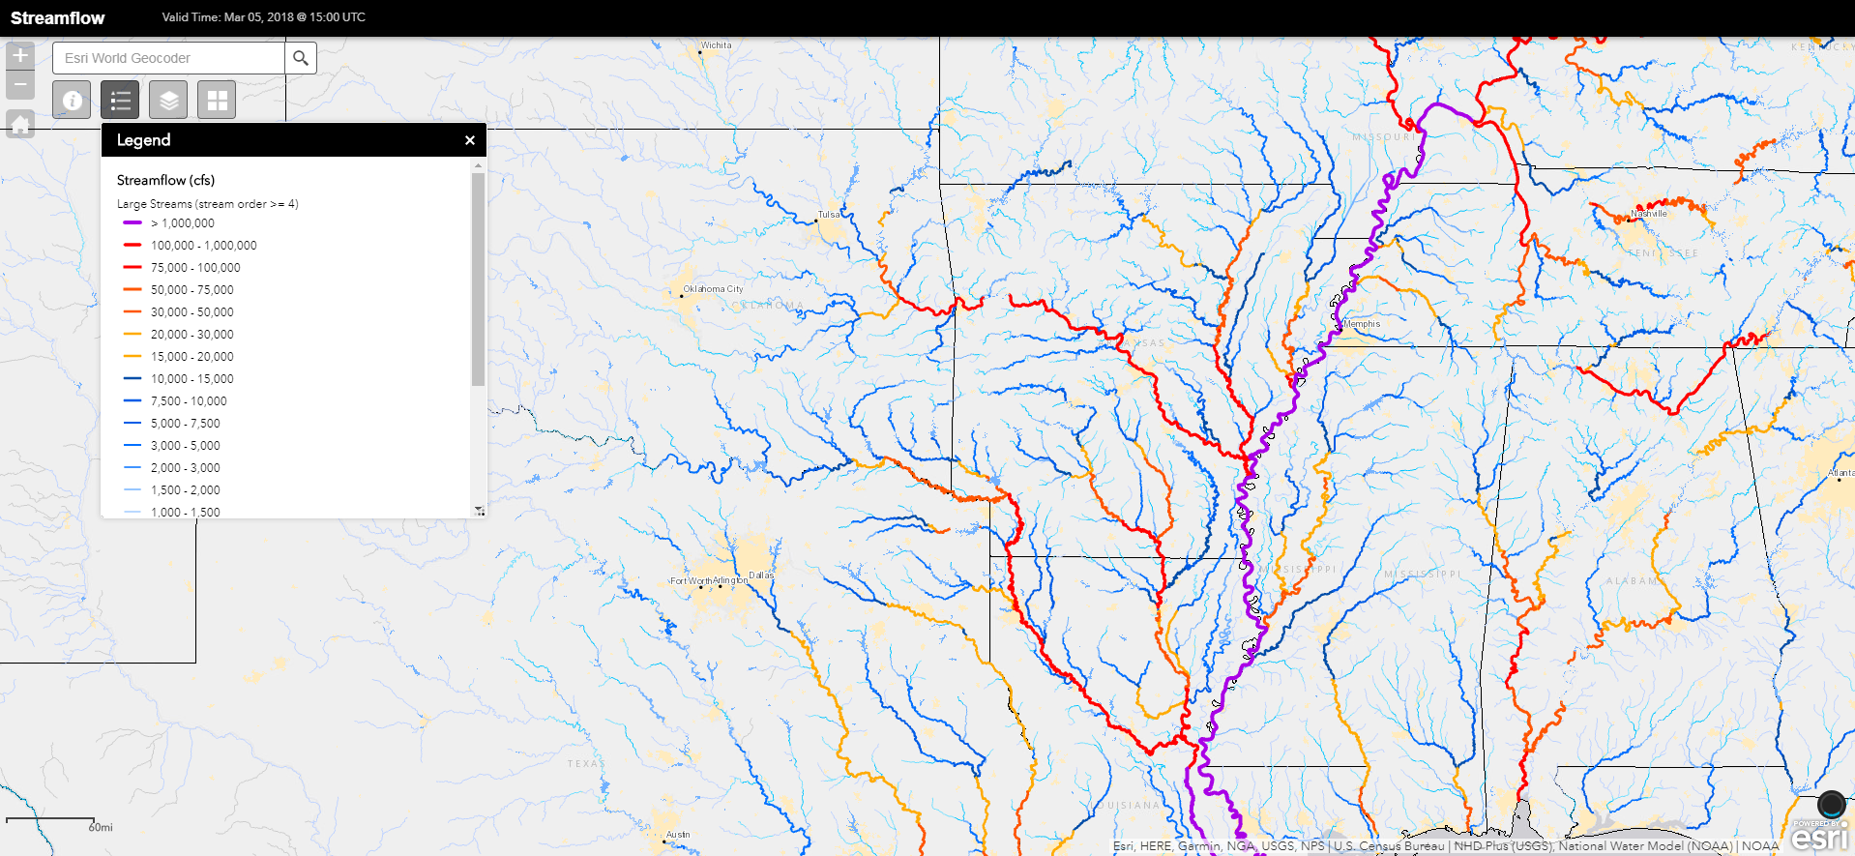
NWM Streamflow Output
‹#›

Slide 6
NWM Channel Structure
NWM streamflow output indexed by feature_id. Does not contain river geometry.
1
1
3
2
2
3
Runoff Input
Streamflow Output
‹#›

Slide 7
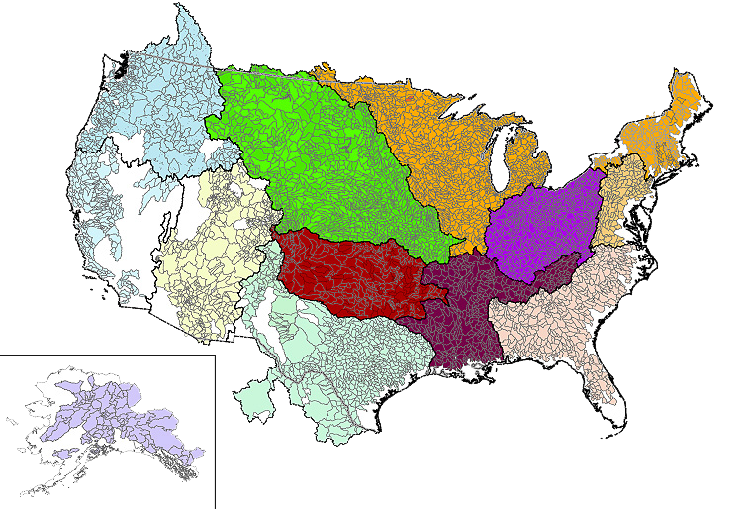
NWM Development: Coastal Coupling
Vision
Couple NOAA's freshwater models with coastal models to provide an integrated flood forecast to approximately 100 million people in the coastal zone.
Scope
The initial phase of this project will demonstrate coupling between the National Water Model, an inland water resources model, and appropriate ocean models at a local scale.
Couple the National Ocean Service Extratropical Surge and Tide Operational Forecast System (ESTOFS) / Advanced Circulation Model (ADCIRC) to the National Water Model (NWM) in the coastal zone.
Scaling this local-scale solution to regional and national domains will be the focus of subsequent iterations of this project.
Over 100 million people live in the white space near the coast
who don’t get an integrated flood forecast today
‹#›

Slide 8
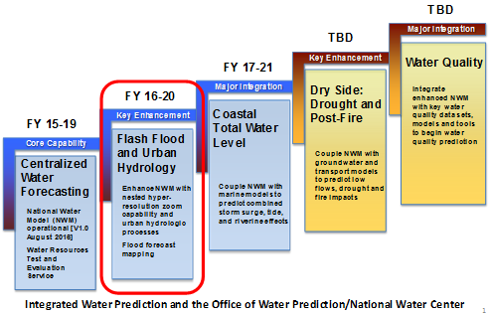
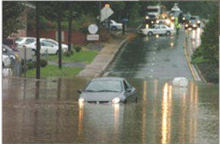
NWM Development: Hyper Resolution Modeling
Goal: demonstrate pre-operational hyper resolution window modeling capability to provide street-level inundation information
Mandated by Congress and due by Q4 of 2020
Needed for areas of complex terrain and built environment
Triggered by conditions seen in the CONUS NWM
Will be demonstrated on three urban areas
Status
Developed overall strategy white paper
Identifying candidate models and basins
‹#›
Flash flooding in Charlotte, NC

Slide 9






NWM Development: Anthropogenic Process Representation
Problem Definition
Dams have an enormous impact, yet are represented in only a basic way in the NWM
1,506 Reservoirs currently represented in the NWM V1.2, with expansion to > 5,000
Dams are operated in different ways, each reservoir has a unique set of operating rules
Rule curve availability makes direct use in 1000’s of NWM reservoirs impractical
Objective is to design, construct, integrate and test new modules necessary to accurately simulate reservoir releases within the NWM
Methodology/Expected Outcome(s)
By utilizing machine learning (ML) techniques, the relationships between inputs and outputs (i.e., reservoir releases) are captured and utilized as a part of the NWM.
Phase #1
Phase #2
Selection of target reservoirs from a basin (6-digit HUC)
Collection of reservoir data and preprocessing
Training the ML model for use in the operational NWM
Matrices of connecting weights for basin #1
Reservoir data for basin #1
ML model
A simple Neural Network representation
Reservoir data for basin #2
Matrices of connecting weights for basin #2
.
.
.
.
.
.
.
.
Corrector steps to revise the simulated releases based on physical limitations on reservoir storage and releases
Reservoir data for basin # n
Matrices of connecting weights for basin #n
‹#›
Notes:
To simulate the reservoir releases at the current time step, R(t), for example, the input combination follows as:
Relase(t)=f{Release(t-1), Inflow(t), Storage(t-1), Elev (t)}
where Inflow(t), and Elev (t) denote inflow and the pool elevation at the current time step; Release(t-1) and Storage(t-1) are reservoir releases and storage at the previous time step, respectively.

Slide 10
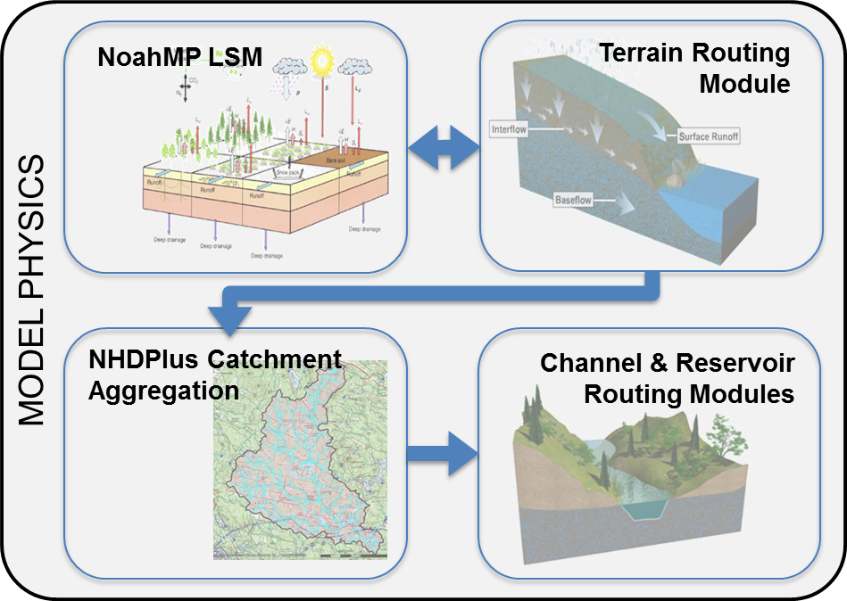
NWM Development: Modularity and Community Collaboration
Community development and collaboration is central to the NWM enterprise effort
OWP is embarking upon a major, multi-year effort, building on and expanding community
Improve on existing modularity of NWM processes using a step-wise, version-over-version approach
Spin-up a community code management system
Implement a development sandbox with uniform NWM code base and supporting data
Formulation of this sandbox is ongoing, input will be gathered from the NOS, USGS, DOE, CUAHSI, NCEP, NASA, ACE and others
End Goal: A system which supports community development and funnels innovation into a common platform that can be leveraged for both research and operations across a wide range of scales and applications.
Example of existing modular components within the National Water Model
‹#›

Slide 11

Summary
The NWM is running operationally 24x7, producing nationwide water resource analyses and forecast guidance
Complements information where already available and provides first-ever guidance at underserved locations
What exists now is a foundation that will be rapidly upgraded
V1.2 upgrade scheduled for March 2018
Calibration of 1000+ USGS Gauges II reference basins
Improved streamflow data assimilation, hydro-fabric, dynamic parameter ingest
Longer-term efforts—coastal coupling, ensemble forecast configuration, flood inundation mapping, inclusion of Great Lakes basin and expansion to Hawaii and Alaska, modularization and groundwater, drought, water quality, hyper-resolution and water management modeling.
Collaborative partnerships key and efforts are underway now
Code modularity increasing, accessible version control being formulated
Community sandbox being developed (CUAHSI, USGS, DOE, NOS, others)
Community Advisory Committee on Water Prediction (CAC-WP)
‹#›

