Slide 1
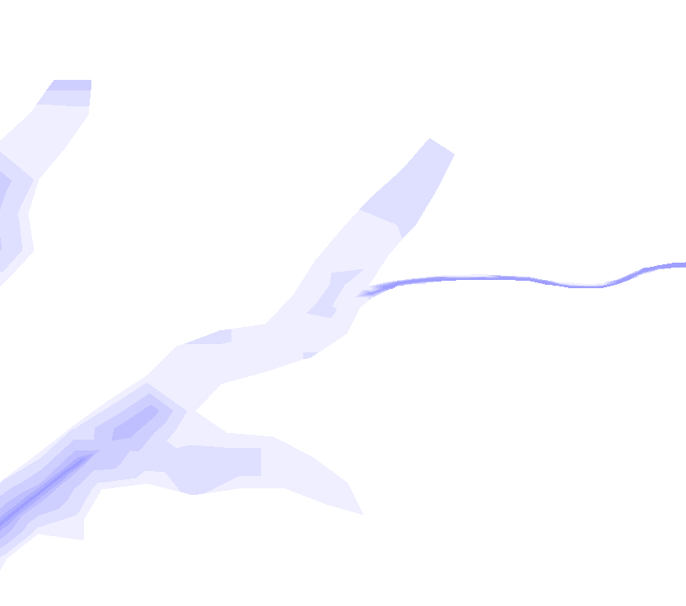
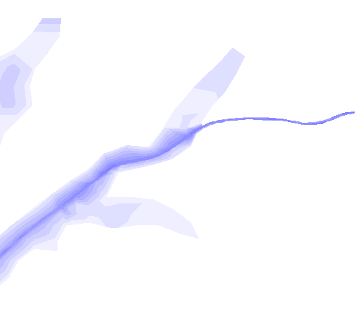
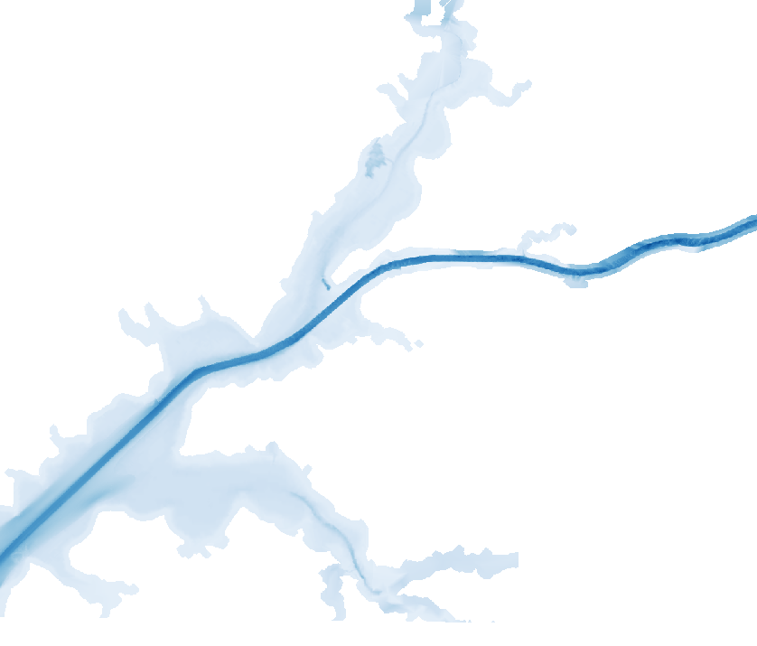
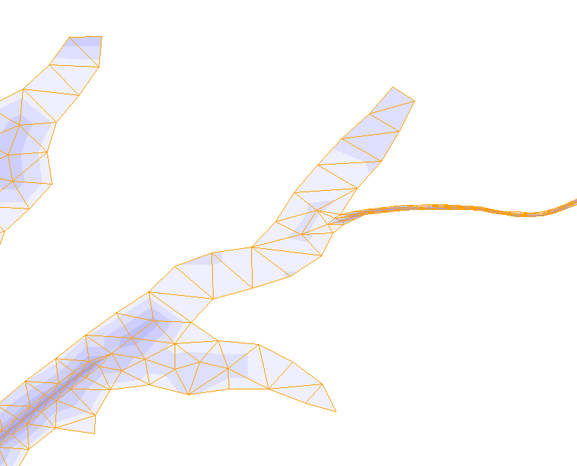
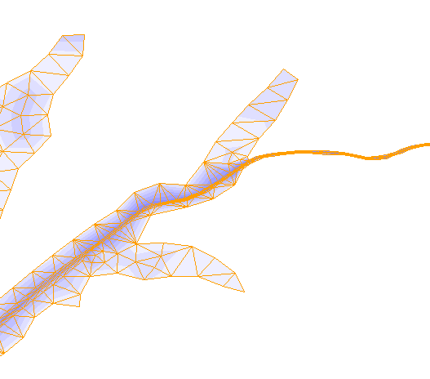
Site-specific enhancement : Chesapeake City (8573927)
Previous mesh
Revised mesh
Refined mesh around the station
Used the latest Bluetopo DEM
Applied 0 friction
Chesapeake City
(8573927)
Chesapeake City
(8573927)

Slide 2
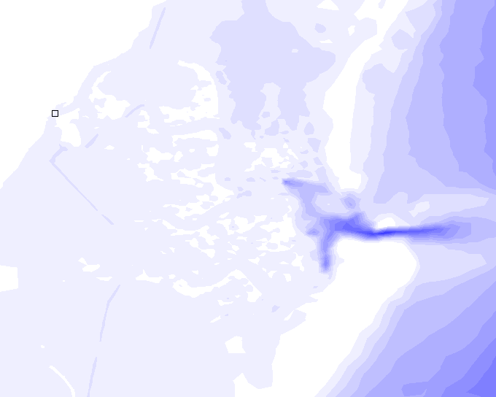
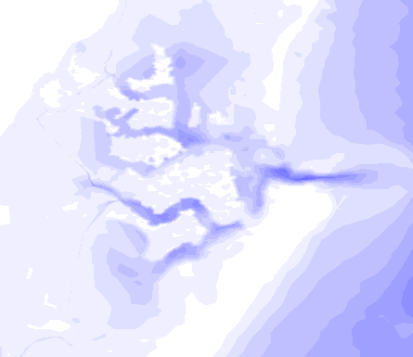
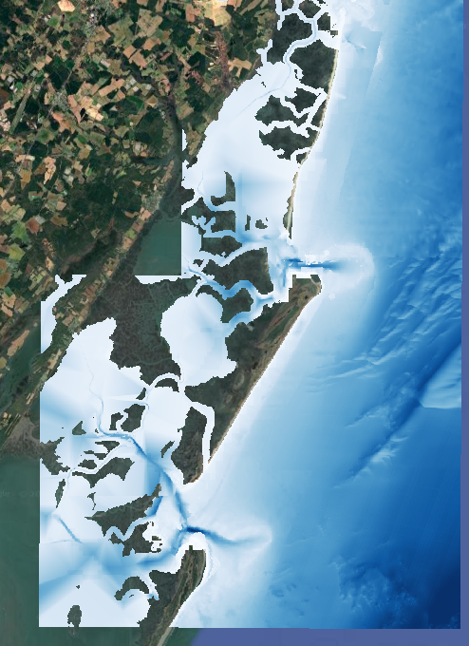
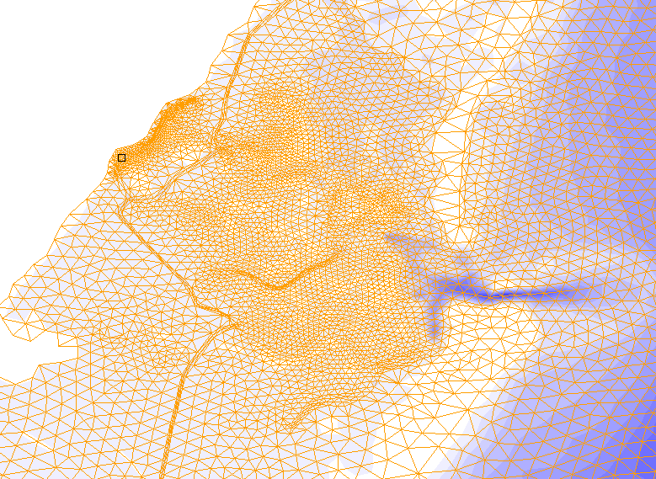
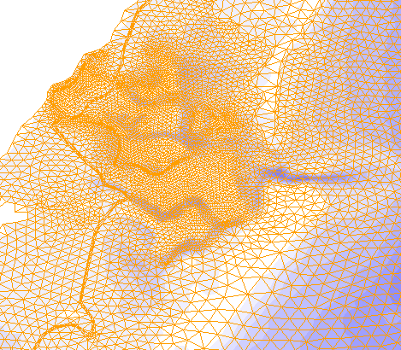
Site-specific enhancement : Wachapreague (8631044)
Previous mesh
Revised mesh
Wachapreague
(8631044)
Wachapreague
(8631044)
Refined mesh around the station
Used the latest Bluetopo DEM
Applied 0 friction

Slide 3
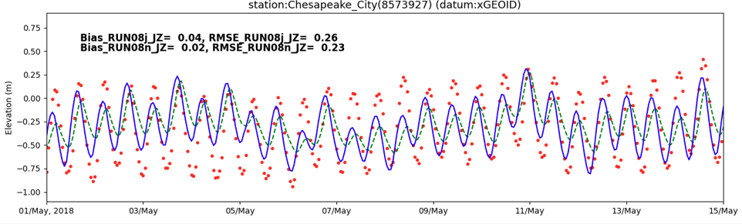
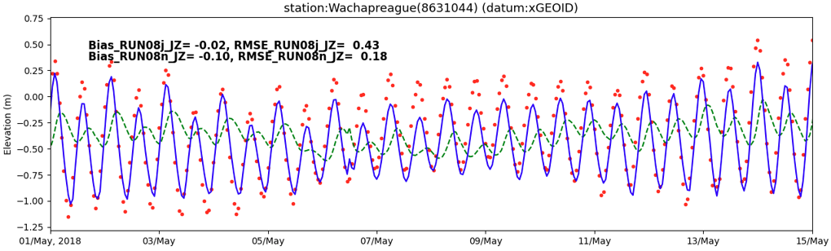
Site-specific enhancement : Chesapeake City & Wachapreague
Revised mesh
Previous mesh

Slide 4
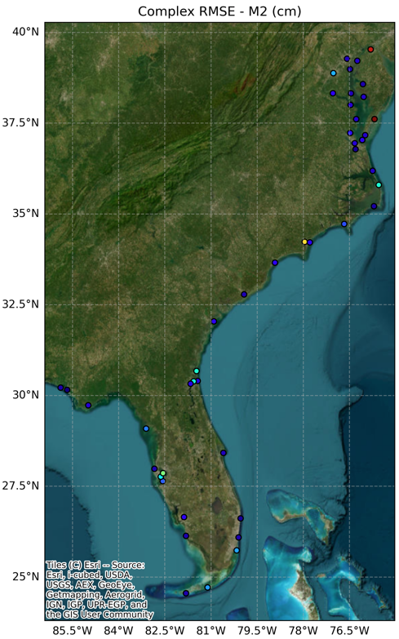
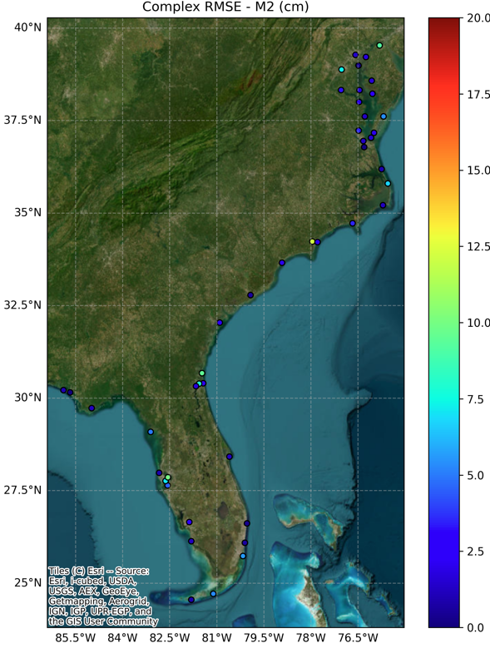
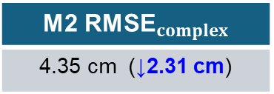
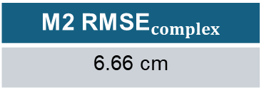
Comparison of Tidal Complex RMSE : Revised vs. Previous Mesh
a) Previous Mesh
b) Revised Mesh
Previous mesh
M2 ${\text{RMSE}}_{complex}$
6.66 cm
Revised mesh
M2 ${\text{RMSE}}_{complex}$
4.35 cm (↓2.31 cm)

Slide 5
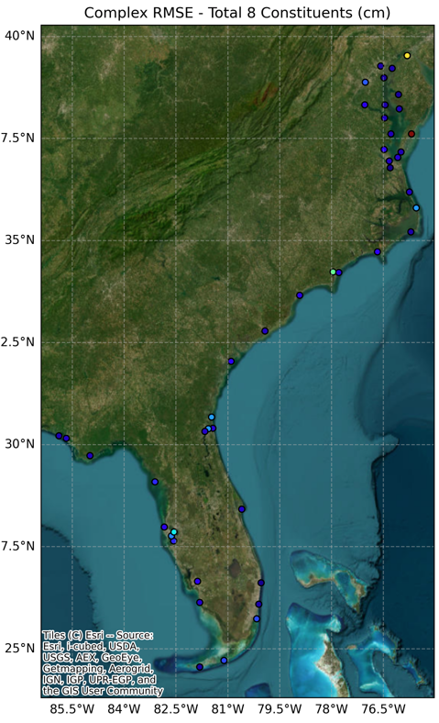
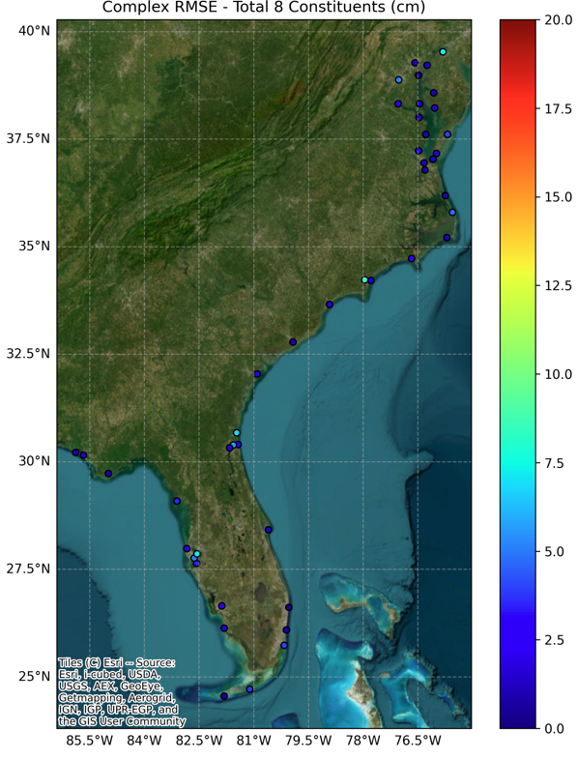
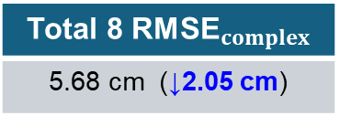
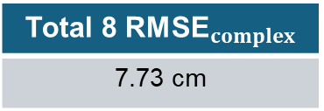
Comparison of Tidal Complex RMSE : Revised vs. Previous Mesh
a) Previous Mesh
b) Revised Mesh
Previous mesh
Total 8 ${\text{RMSE}}_{complex}$
7.73 cm
Revised mesh
Total 8 ${\text{RMSE}}_{complex}$
5.68 cm (↓2.05 cm)

Slide 6
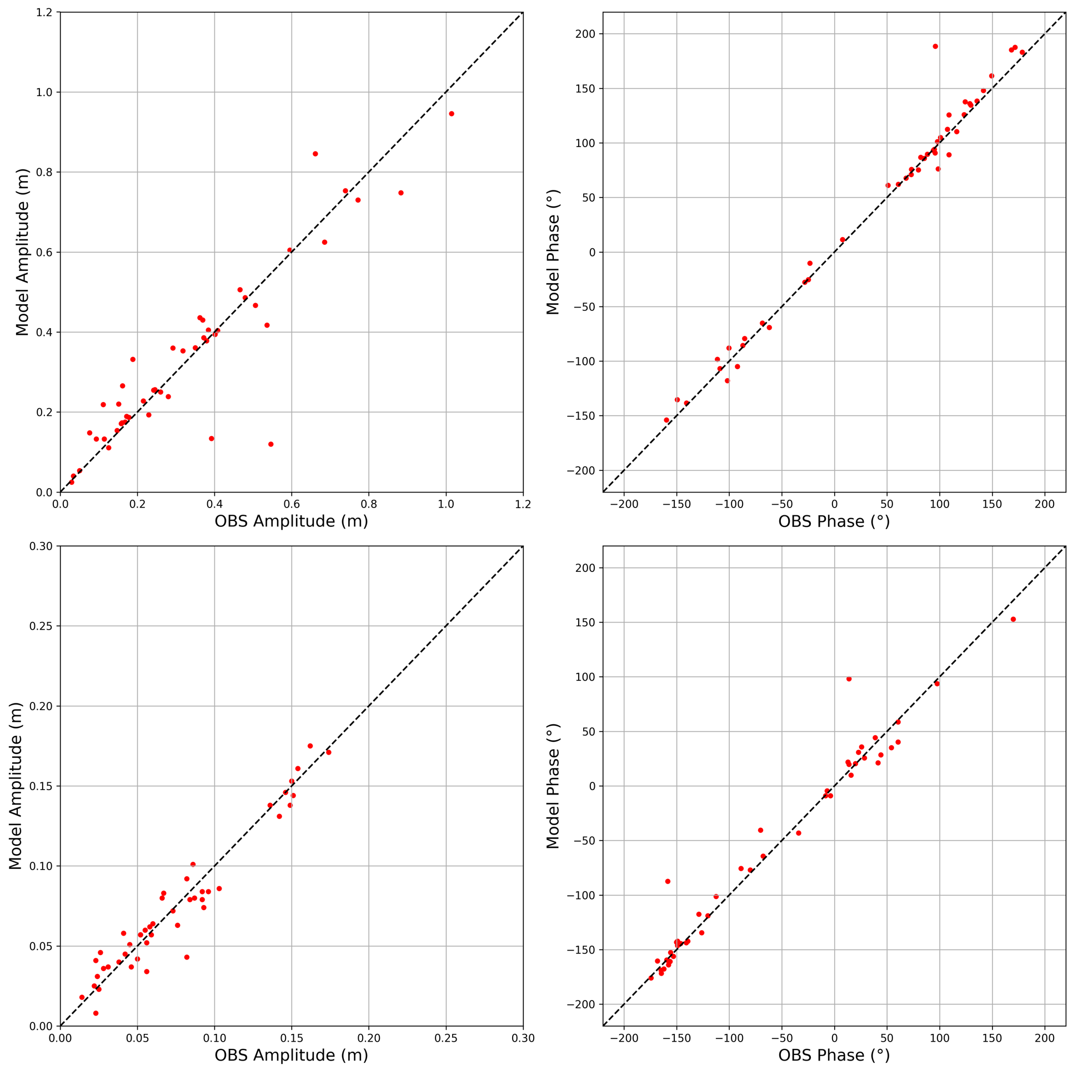
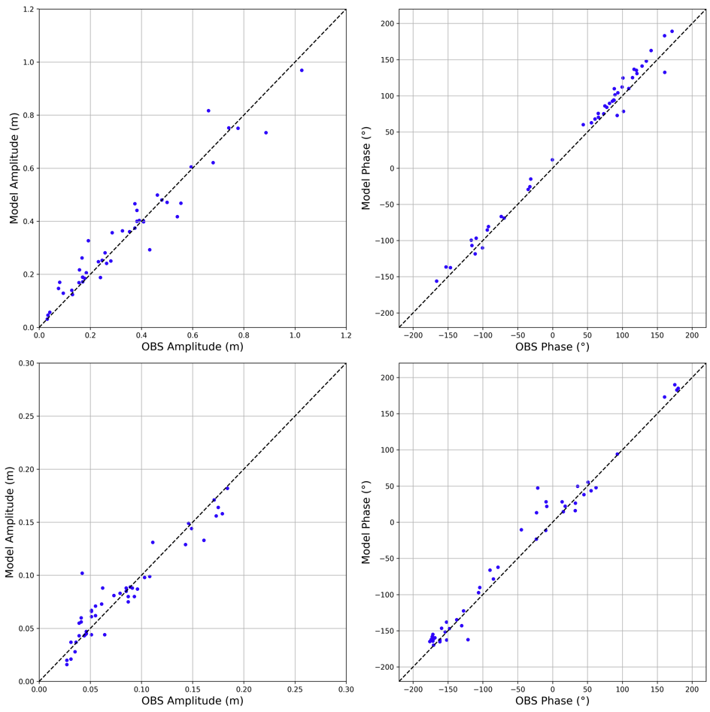
Scatter Plot: Revised vs. Previous Mesh
Previous mesh
Revised mesh
(a) M2 amp
(b) M2 phase
(a) M2 amp
(b) M2 phase
2 problematic stations
(c) K1 amp
(d) K1 phase
(c) K1 amp
(d) K1 phase

Slide 7
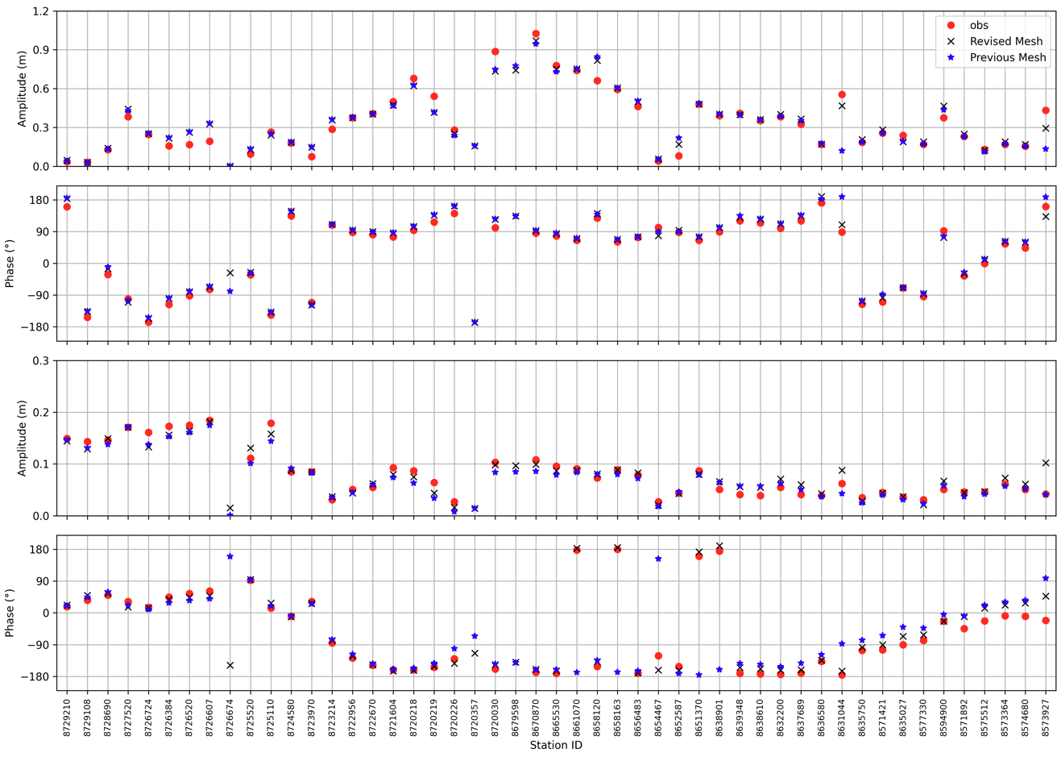
Comparison HA: Revised vs. Previous Mesh
(a) M2 amp
Wachapreague
(8631044)
Chesapeake City
(8573927)
(b) M2 phase
(c) K1 amp
Worse?
(d) K1 phase

Slide 8
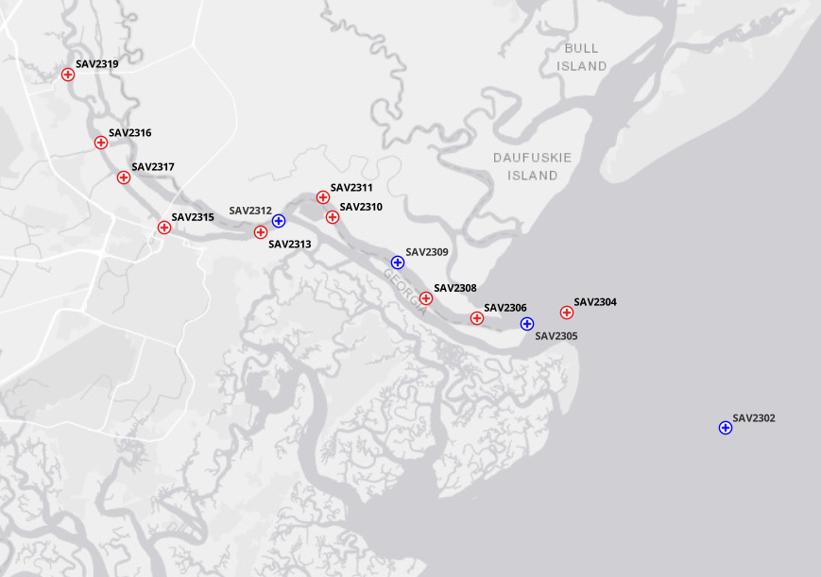
ADCP Deployment and Station Overview in Savannah
No | Station ID | Orientation | Period* | 1st Bin Range (Bin size)
1 | SAV2302 | Downward | Group 1 | 1.50 (1.00)
2 | SAV2304 | Upward | Group 2 | 2.12 (1.00)
3 | SAV2305 | Downward | Group 3 | 1.40 (1.00)
4 | SAV2306 | Upward | Group 1 | 2.11 (1.00)
5 | SAV2308 | Upward | Group 1 | 1.40 (1.00)
6 | SAV2309 | Downward | Group 1 | 1.40 (1.00)
7 | SAV2310 | Upward | Group 2 | 1.20 (1.00)
8 | SAV2311 | Upward | Group 1 | 1.55 (1.00)
9 | SAV2312 | Downward | Group 2 | 1.50 (1.00)
10 | SAV2313 | Upward | Group 2 | 2.00 (1.00)
11 | SAV2315 | Upward | Group 1 | 1.55 (1.00)
12 | SAV2316 | Upward | Group 2 | 1.05 (0.50)
13 | SAV2317 | Upward | Group 2 | 1.05 (0.50)
14 | SAV2319 | Upward | Group 2 | 1.05 (0.50)
ADCP station (Upward-looking)
ADCP station (Downward-looking)
Savannah River
Group 1 : 2023.05.23 ~ 2023.07.20
Group 2 : 2023.07.14 ~ 2023.09.15
Group 3 : 2023.09.07 ~ 2023.10.19 (Don’t cover this time)

Slide 9
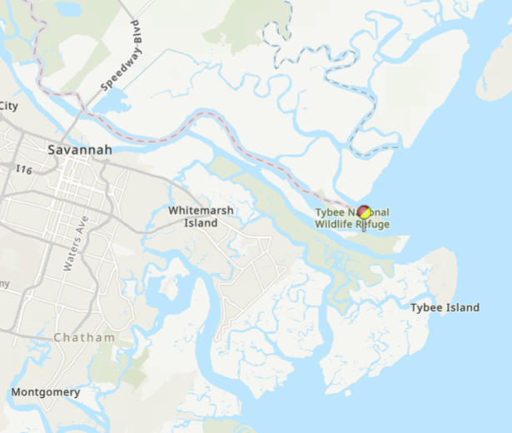
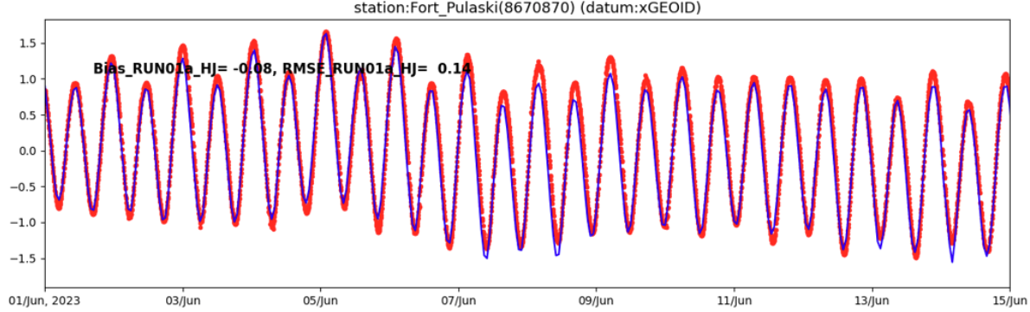
SCHISM setup and validation with 2023 SECOFS run : elev
Based with the latest SECOFS run
Same process (set up) with SECOFS 2018 run (RUN08n_JZ)
Using USGS flow @ Savannah (Clyo) as internal open boundary
Total 150 days run considering the ADCP data availability (Starts from May 1st , 2023).
Elevation results are well matched with observation
The elevation scores (rmse, bias) show mostly consistent with previous 2018 run
(e.g for Fort Pulaski station, 2023 run has 0.14 m RMSE and 2018 run has 0.10 m RMSE)
Fort Pulaski (8670870)

Slide 10
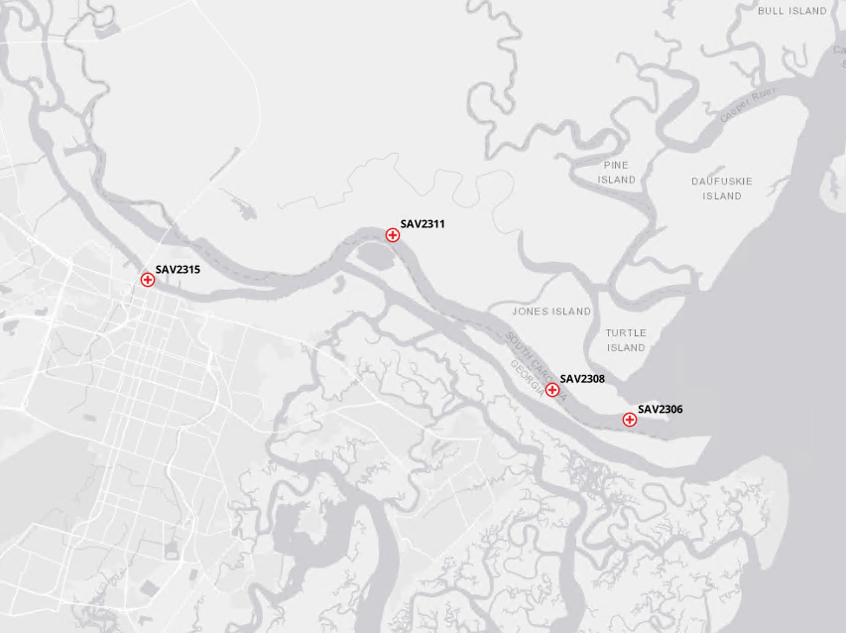
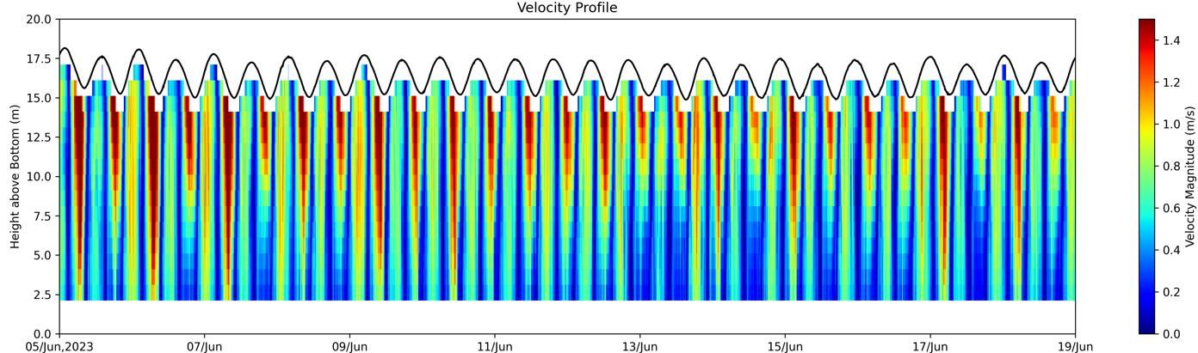
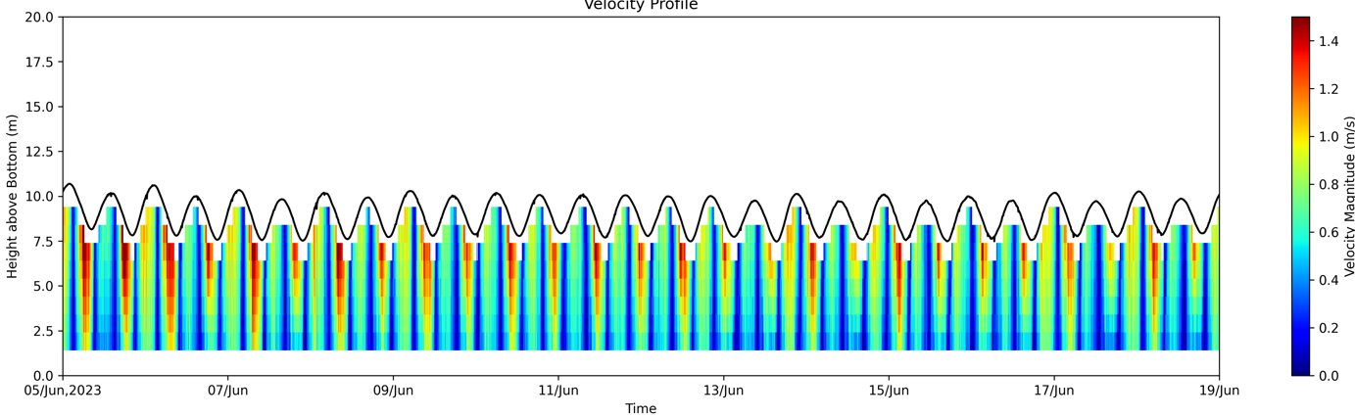
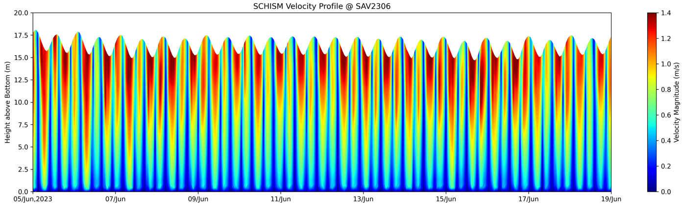
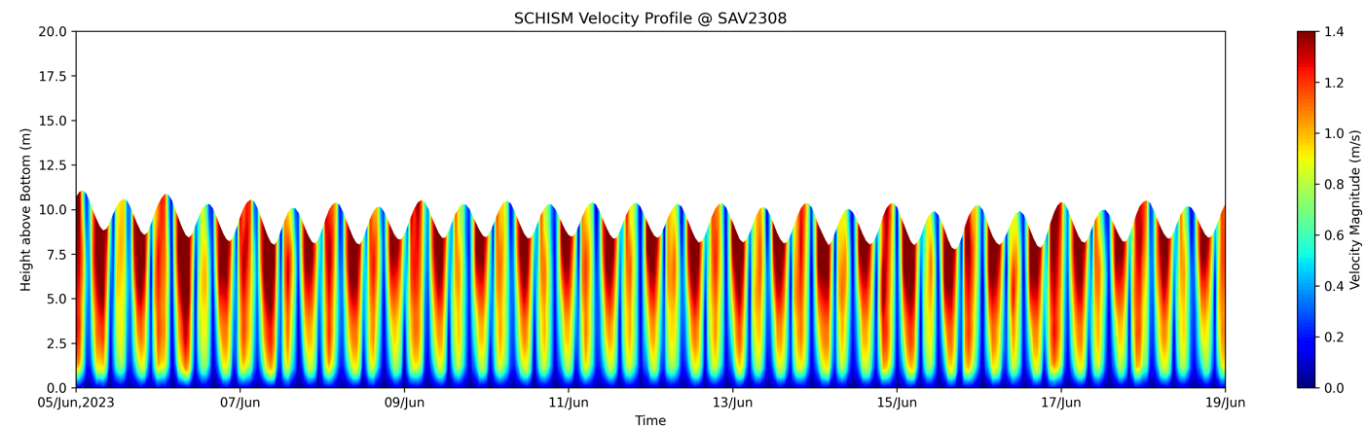
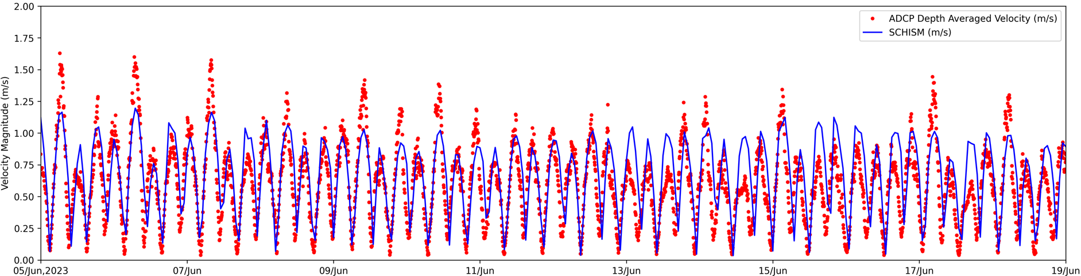
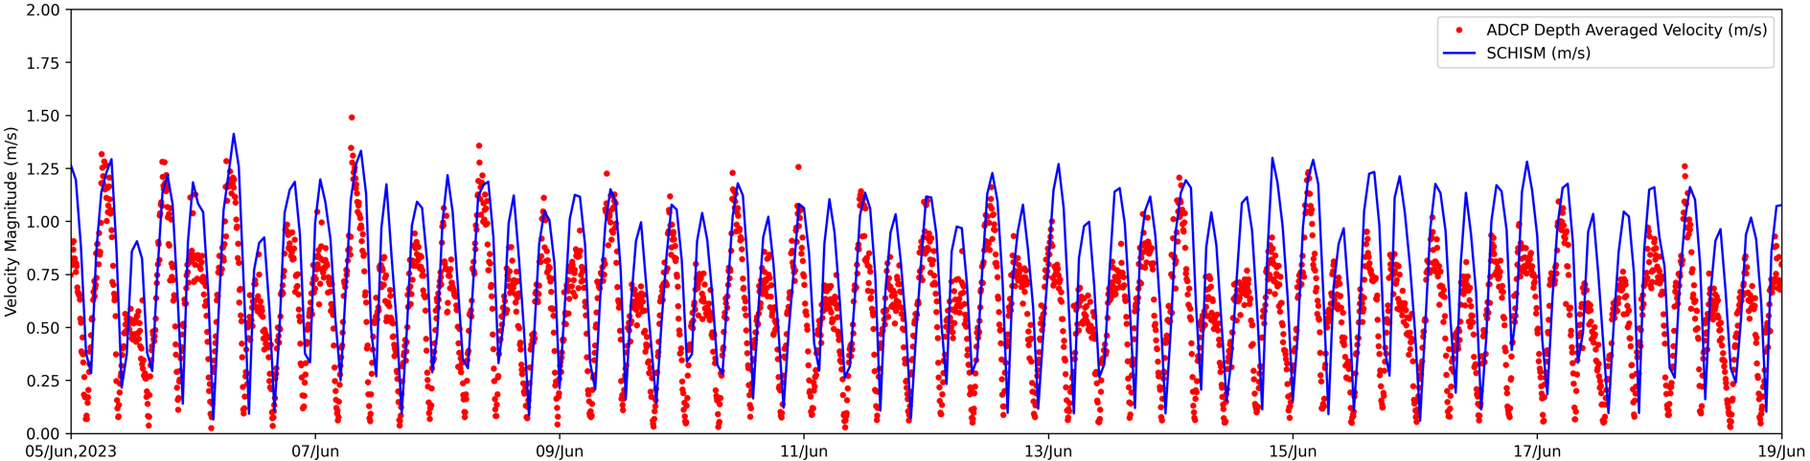
Velocity Profile Comp with ADCP (Group 1)
Station ID
SAV2306; SAV2308; SAV2311; SAV2315 (Upward)
SAV2302; SAV2309 (Downward)
SAV2306
ADCP
SAV2308
ADCP
SCHISM
SCHISM
RMSE : 0.23 m/s; CC : 0.72
RMSE : 0.32 m/s; CC : 0.66

Slide 11
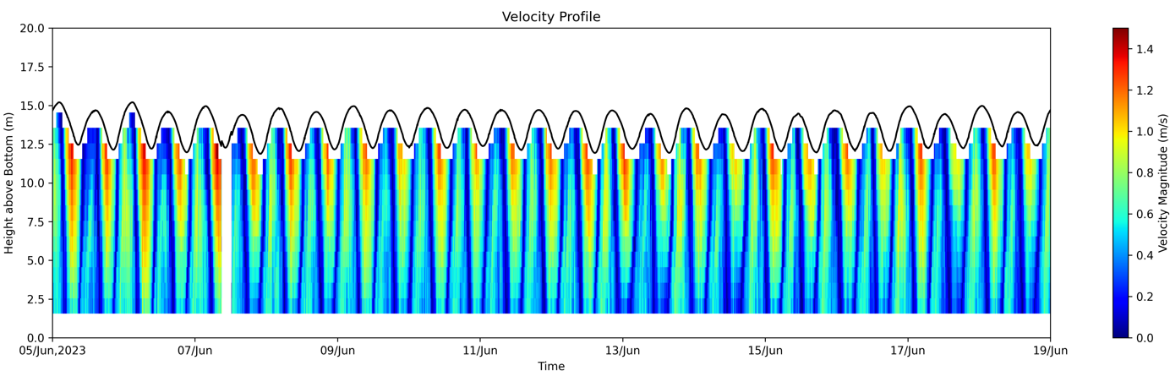
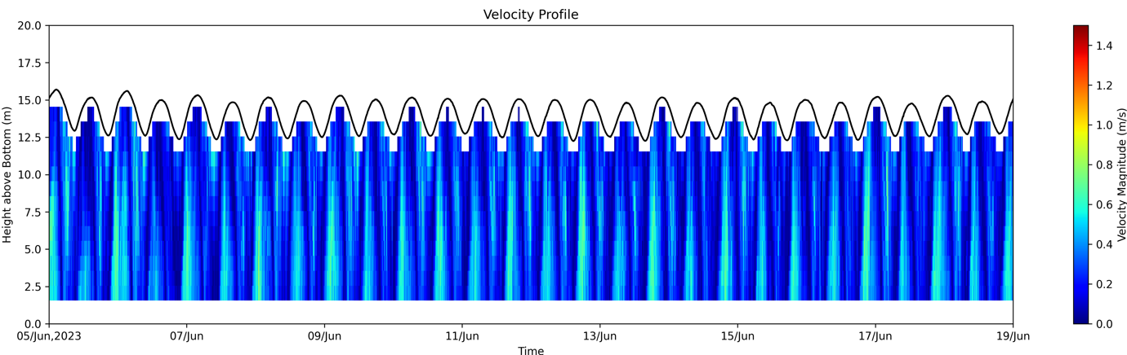
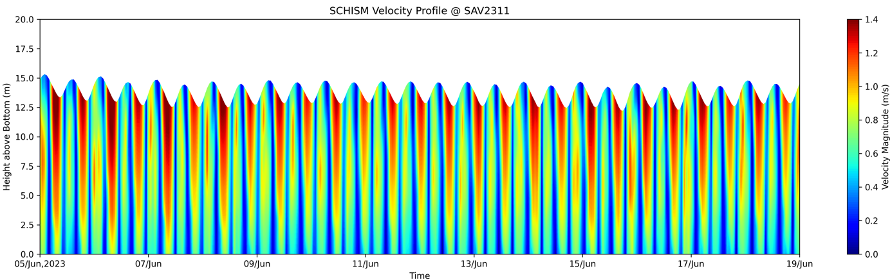
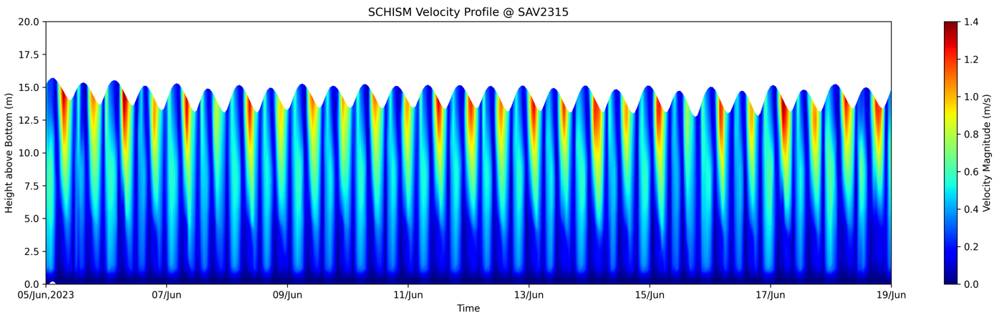
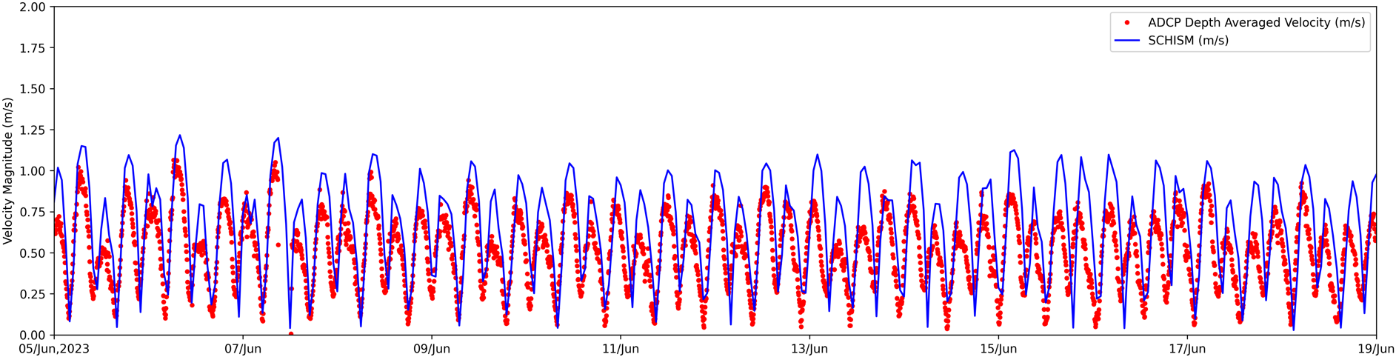
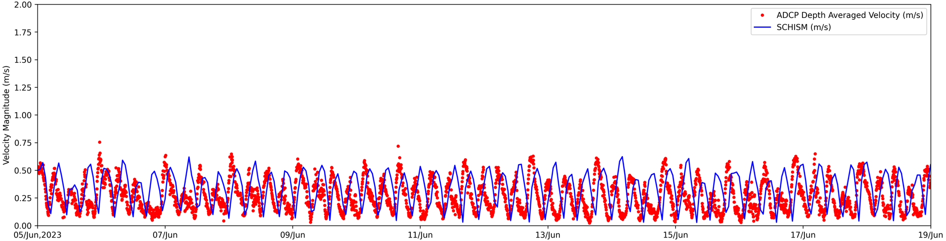
Velocity Profile Comp with ADCP (Group 1)
Station ID
SAV2306; SAV2308; SAV2311; SAV2315 (Upward)
SAV2302; SAV2309 (Downward)
SAV2311
ADCP
SAV2315
ADCP
SCHISM
SCHISM
RMSE : 0.25 m/s; CC : 0.73
RMSE : 0.24 m/s; CC : -0.18 (Phase)

Slide 12
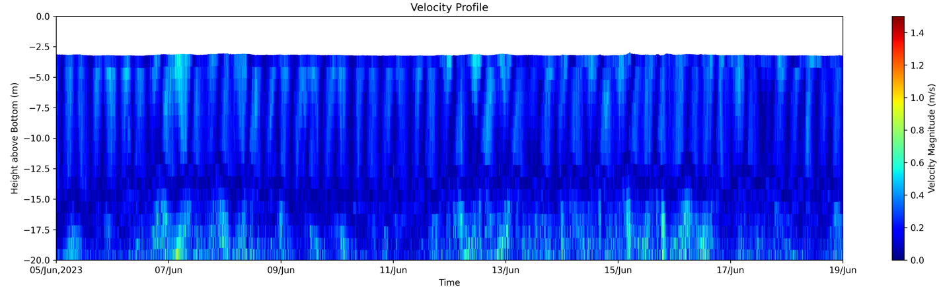
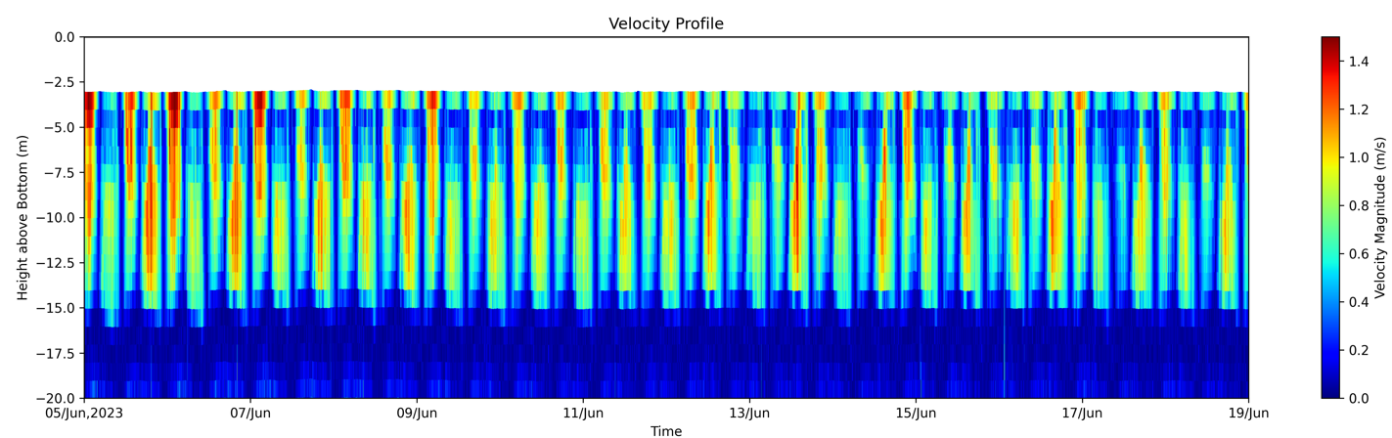
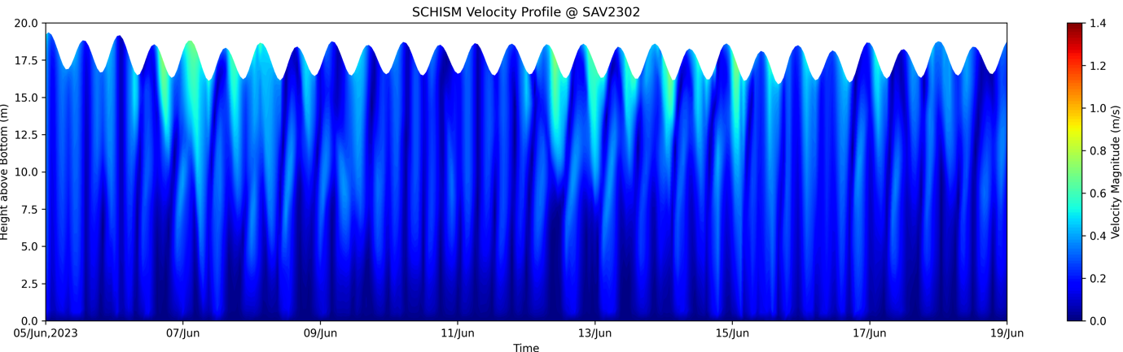
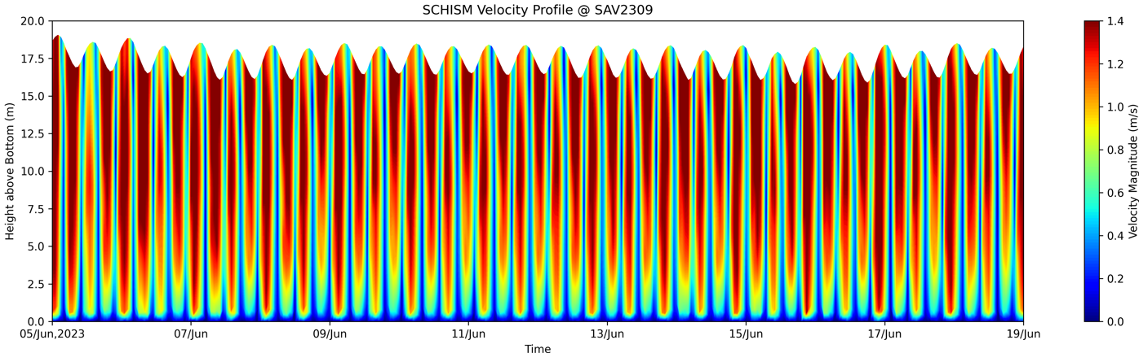
Velocity Profile Comp with ADCP (Group 1)
Station ID
SAV2306; SAV2308; SAV2311; SAV2315 (Upward)
SAV2302; SAV2309 (Downward)
SAV2302
ADCP
SAV2309
ADCP
Out-of-range data
Out-of-range data
SCHISM
SCHISM
Hard to compare the depth-averaged velocity because of absence of ADCP data (elevation and depth)
- The pressure data exist but that value is from water surface elevation

Slide 13
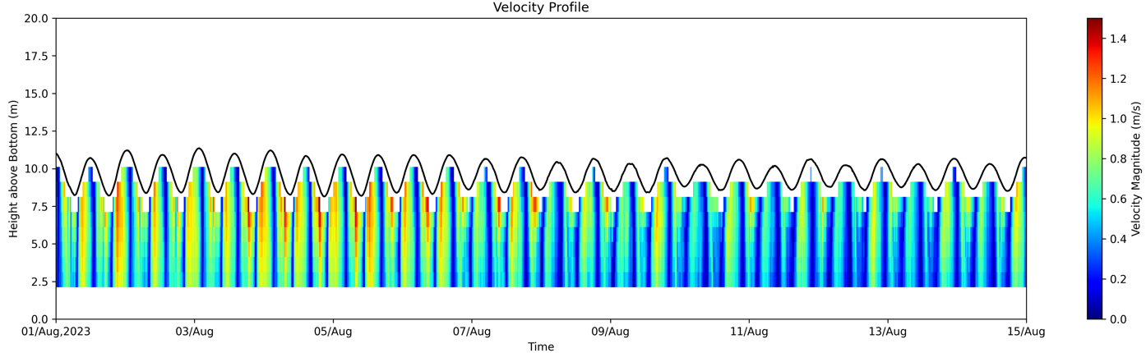
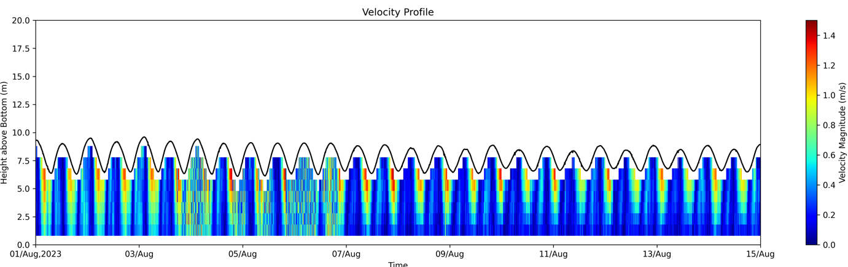
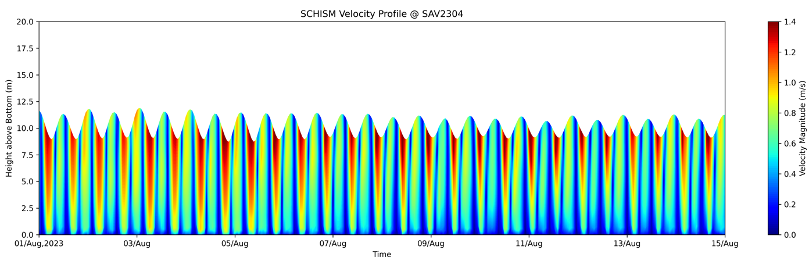
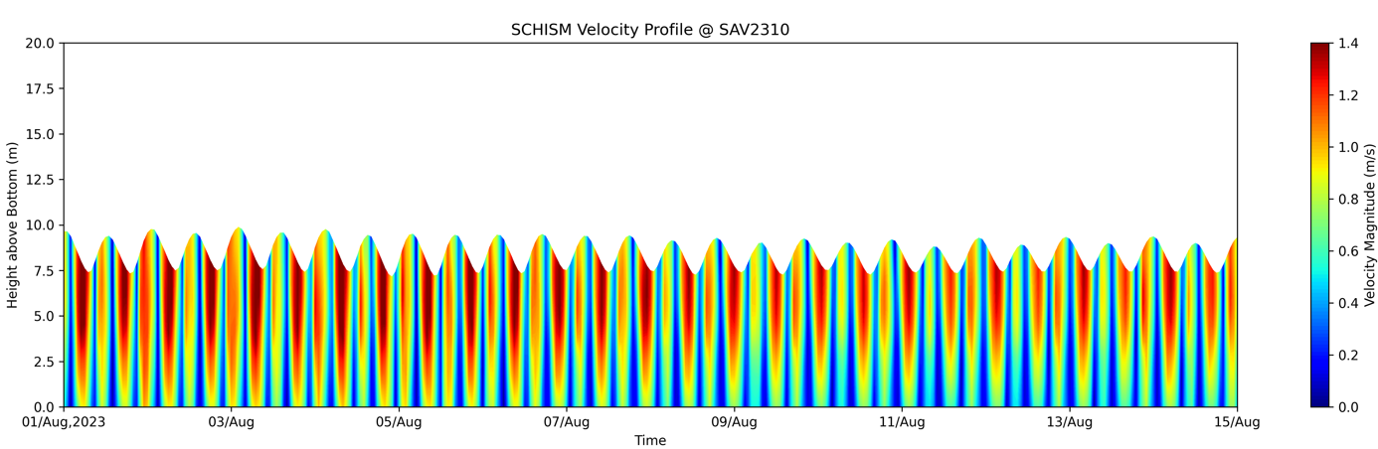
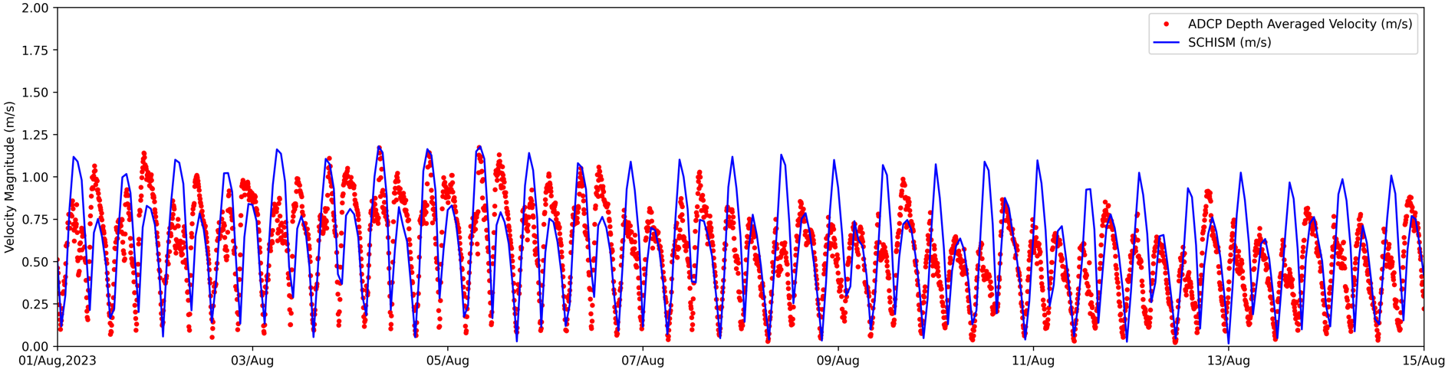
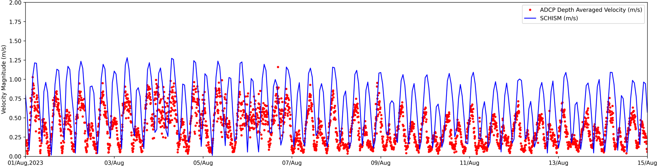
Velocity Profile Comp with ADCP (Group 2)
Station ID
SAV2304; SAV2310; SAV2313; SAV2316; SAV2317; SAV2319 (Upward)
SAV2312 (Downward)
SAV2304
ADCP
SAV2310
ADCP
Weird Period
SCHISM
SCHISM
RMSE : 0.26 m/s; CC : 0.57
RMSE : 0.42 m/s; CC : 0.45

Slide 14
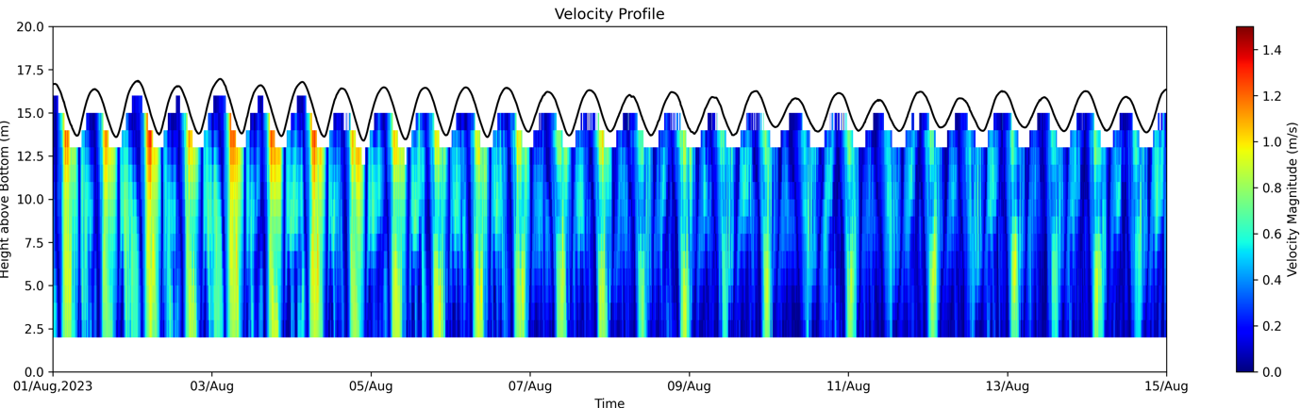





Velocity Profile Comp with ADCP (Group 2)
Station ID
SAV2304; SAV2310; SAV2313; SAV2316; SAV2317; SAV2319 (Upward)
SAV2312 (Downward)
SAV2313
ADCP
SAV2316
ADCP
SCHISM
SCHISM
RMSE : 0.47 m/s; CC : 0.45
RMSE : 0.28 m/s; CC : 0.29

Slide 15






Velocity Profile Comp with ADCP (Group 2)
Station ID
SAV2304; SAV2310; SAV2313; SAV2316; SAV2317; SAV2319 (Upward)
SAV2312 (Downward)
SAV2317
ADCP
SAV2319
ADCP
SCHISM
SCHISM
RMSE : 0.23 m/s; CC : 0.20
RMSE : 0.38 m/s; CC : 0.37

Slide 16


Velocity Profile Comp with ADCP (Group 2)
Station ID
SAV2304; SAV2310; SAV2313; SAV2316; SAV2317; SAV2319 (Upward)
SAV2312 (Downward)
SAV2312
ADCP
Out-of-range data
SCHISM
Hard to compare the depth-averaged velocity because of absence of ADCP data (elevation and depth)
- The pressure data exist but that value is from water surface elevation

Slide 17
NOAA station list check (Base run : RUN08n_JZ)
Southeast Coast Station
Total 49 stations
The station locations (from Yi) are the same as those used by VIMS (station.bp)
Some station locations were revised by VIMS to improve model performance
VIMS will update the station.bp file.
Use existing location | Restore the station locations
Existing Location Better (2) | Original Location Better (5) | Same Performance (42)
South Port Everglades (8722956), Windmill Point (8636580) | Key West (8724580), Cedar Key (8727520), Oregon Inlet Marina (8652587), Yorktown (8637689), Wachapreague(8631044) | All stations except 7 stations
Puerto Rico Station
Total 9 stations (1 station is iterative : Culebra, PR (9752235))
The station locations (from Yi) are slightly different from those used by VIMS (station.bp)
3 stations are missed (9757809, 9754228, 9759938) – No data now
Model performance is same (VIMS station location and Yi station location)

