Slide 1
Steps in preparing ‘maps’ for SMS mesh generation
Generate coastlines and land boundary
Resolve major river channels
Resolve levees (and other important features)
Add NWM segments into map

Slide 2
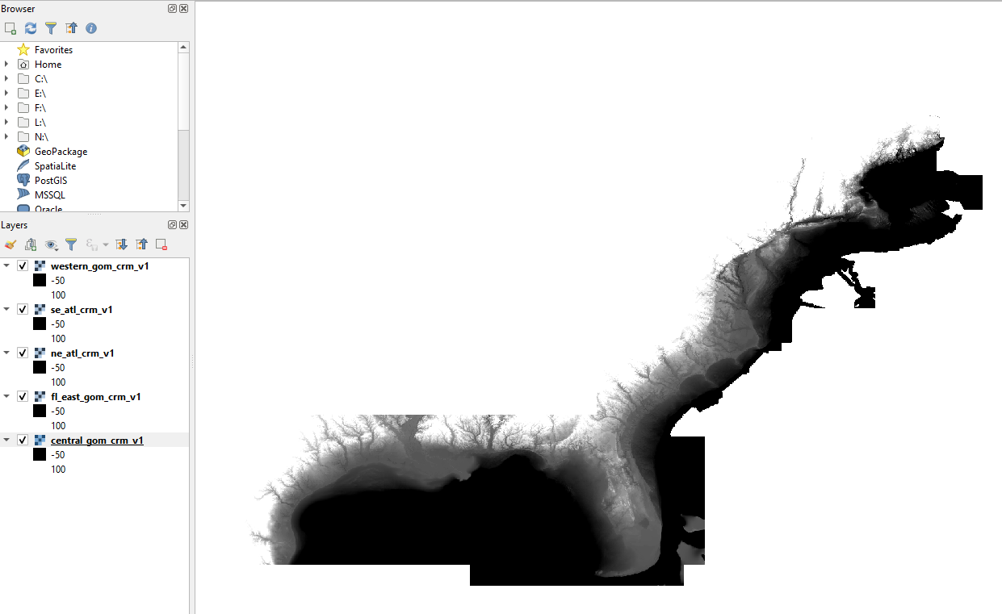
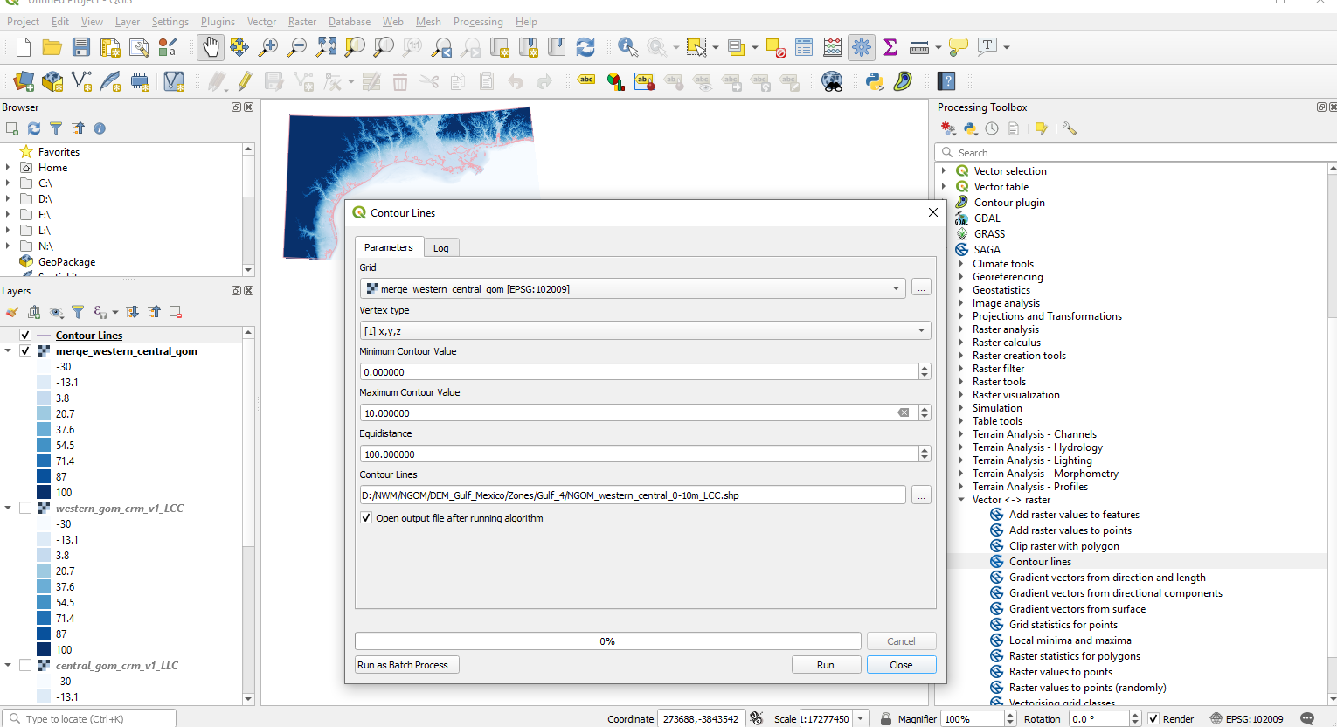
1. Generate coastlines and land boundaries
Load DEMs from NOAA CRM, ~90m resolution. There are 5 pieces of CRM files available covering east coast and GOMx regions: (https://maps.ngdc.noaa.gov/viewers/bathymetry/?layers=dem)
Extract 0m contour as coastline (which will be revised later) and 10m contour as land boundary
NOAA_CRM (3 arc-s, 90m)
https://maps.ngdc.noaa.gov/viewers/bathymetry/?layers=dem

Slide 3
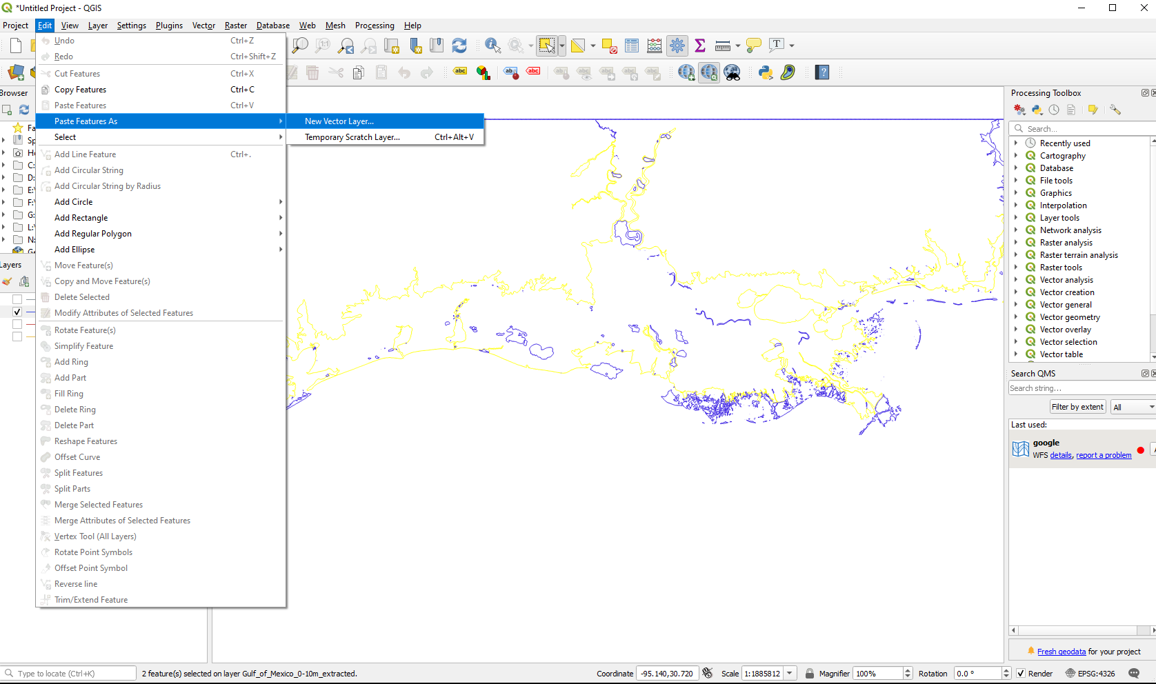
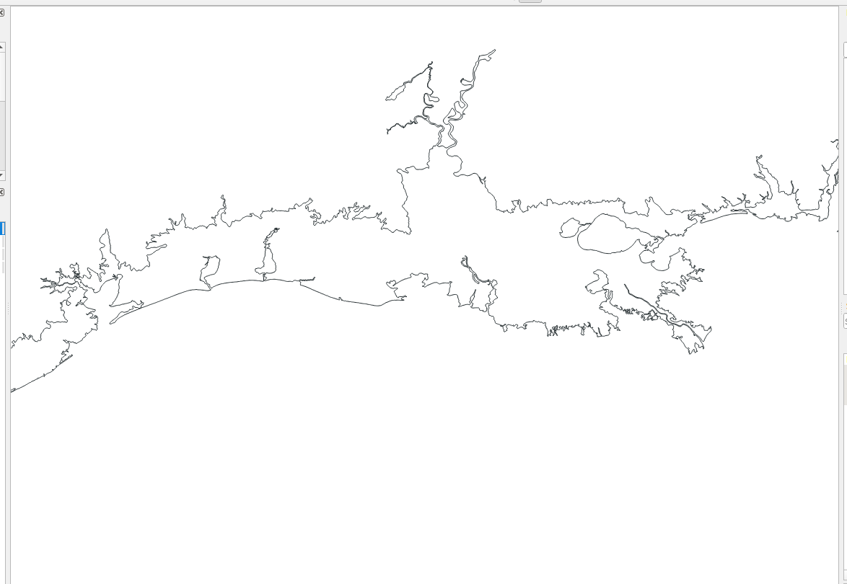
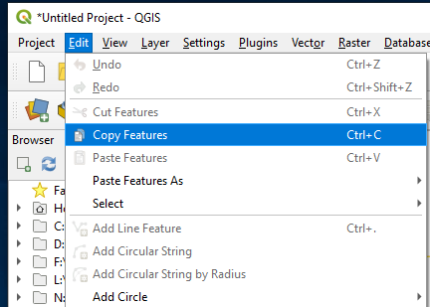
1. Generate coastlines and land boundaries
Use GIS tools to simplify or clean the contours to remove unresolved small features
Copy some cleaned lines from the existing shape files and work on them as a new layer
  Use "Select Feature" button in QGIS to select the feature arc, and then copy and paste it in a new layer.

Slide 4
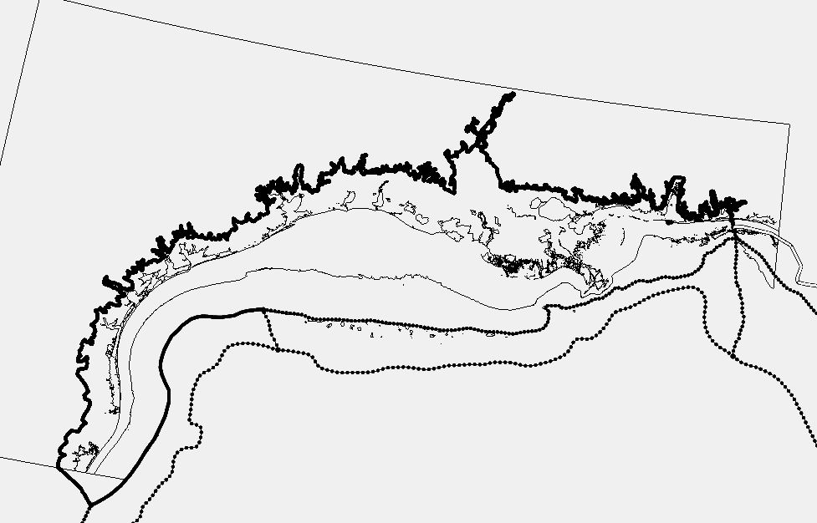
1. Generate coastlines and land boundaries
Load the coastline and land boundary into SMS
In open ocean, go easy on grid resolution transition (which is important for 3D applications): please refer to Chapter 5.7.1 in the user manual
Convert the shape file into “feature arcs” and reset the resolution to desired value using “redistribute arcs” option
  Land boundary: ~300m
  Shoreline: 200m-1km without estuaries; variable inside estuaries (finer upstream)

Slide 5
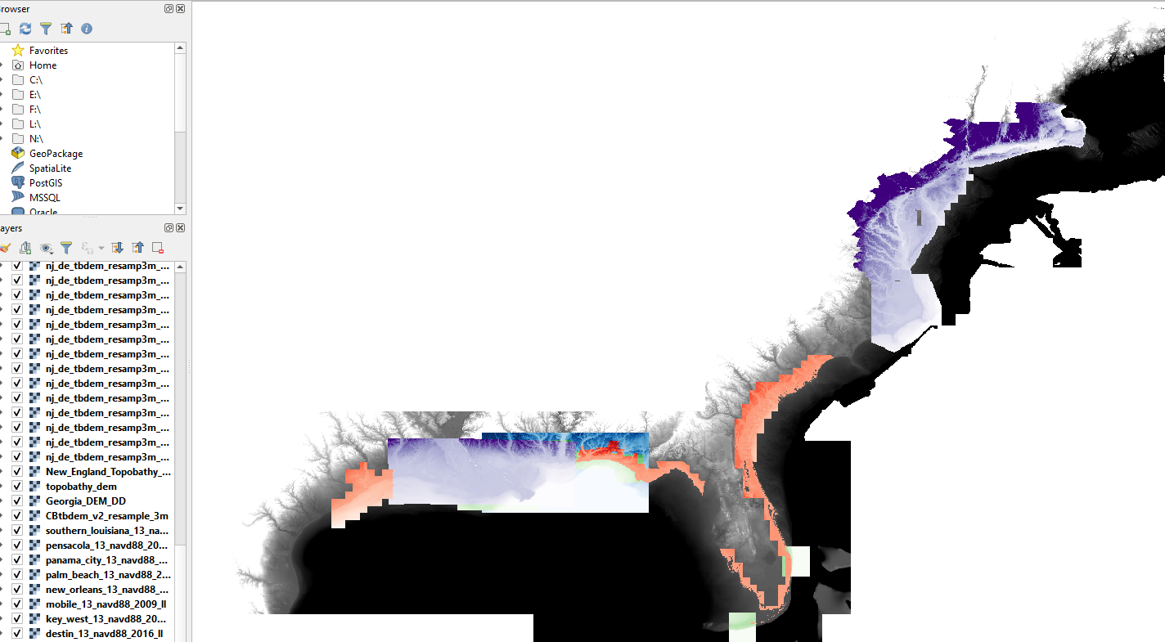
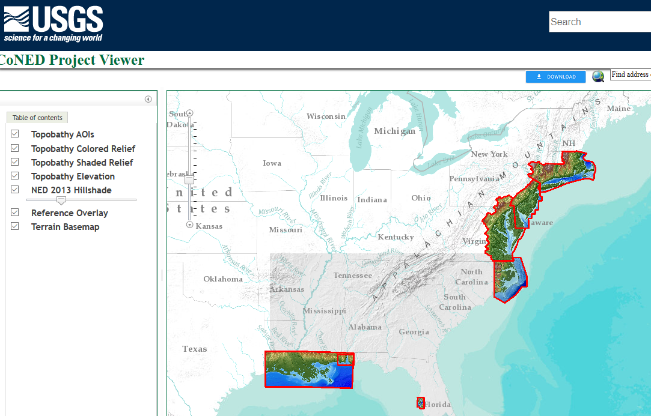
2. Resolve river channels and major creeks
Download relevant higher resolution DEMs to extract contour lines in a region
USGS_CoNED (1m, nav1983, navd 88)
https://topotools.cr.usgs.gov/topobathy_viewer/

Slide 6
2. Resolve river channels and major creeks
Contour values extracted should be dictated by the specific river channel depths and side slopes
For estuaries in coastal zones, contours from 5-30m below water are usually used to detect the highest bathymetric gradients
For river channels and creeks in watershed, contours from 1-5 m below water or sometimes 0m-10m above water may be extracted to help detect the thalwegs
  Imageries are helpful also
Quads (patches) are useful to ensure adequate cross-channel resolution
  This entails some manual work

Slide 7
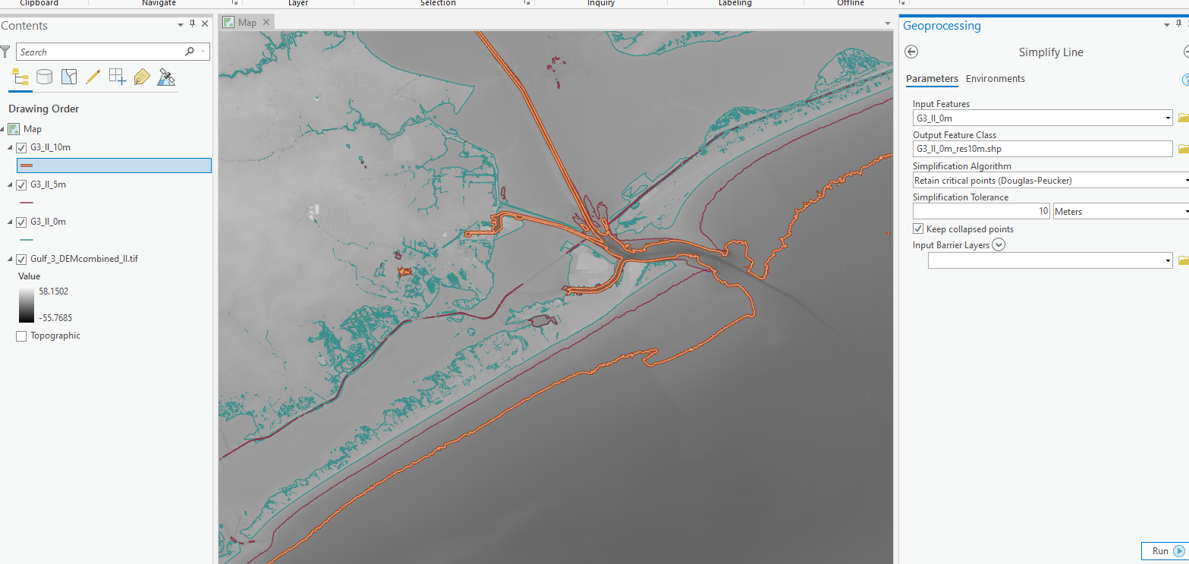
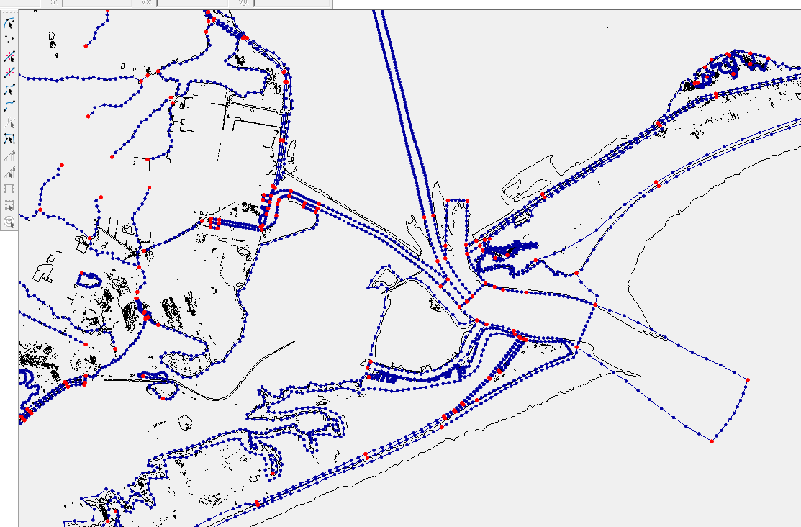
2. Resolve river channels and major creeks
For coastal estuaries, extract contours of 5m-30m depths below water (-30m ~ -5m from DEMs) to help identify river channels
Resample using “Simplify Line” to reset the resolution of contour to 10m, to reduce the size of the shape files in GIS
Use these contours as guidance to resolve river channels in SMS

Slide 8
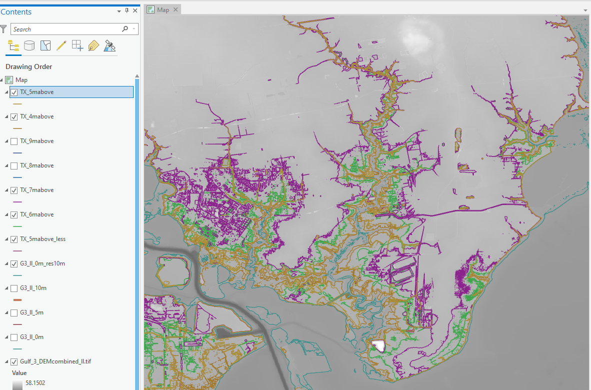
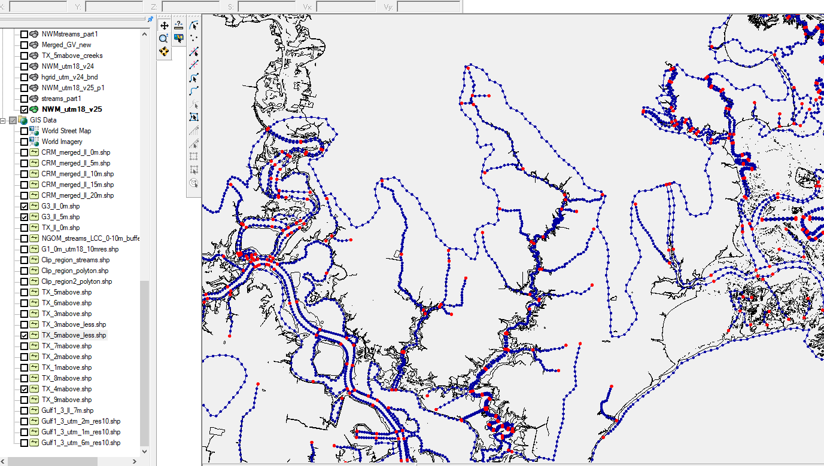
2. Resolve river channels and major creeks
If desired, for watershed rivers/creeks, extract 1m to 10m above MSL to help identify thalwegs of creeks
Set along-channel resolution to be 50-300m (finer upstream)
Cross-channel resolution varies from upstream to downstream and also depends on 2D/3D config
  Generally, use at least 5 cross-channel segments in regions with important 3D processes (e.g. stratification)
  Otherwise, 1-2 rows of elements are sufficient

Slide 9
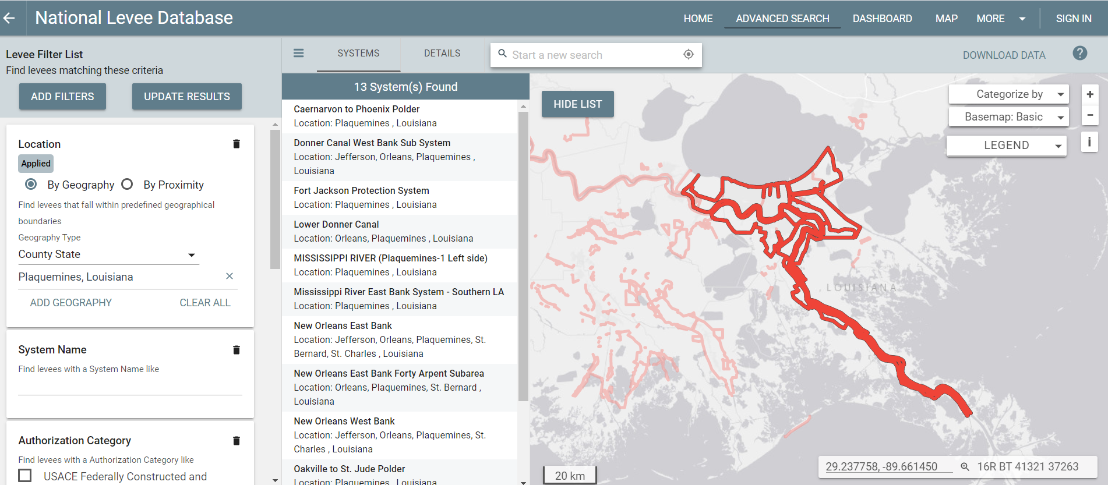
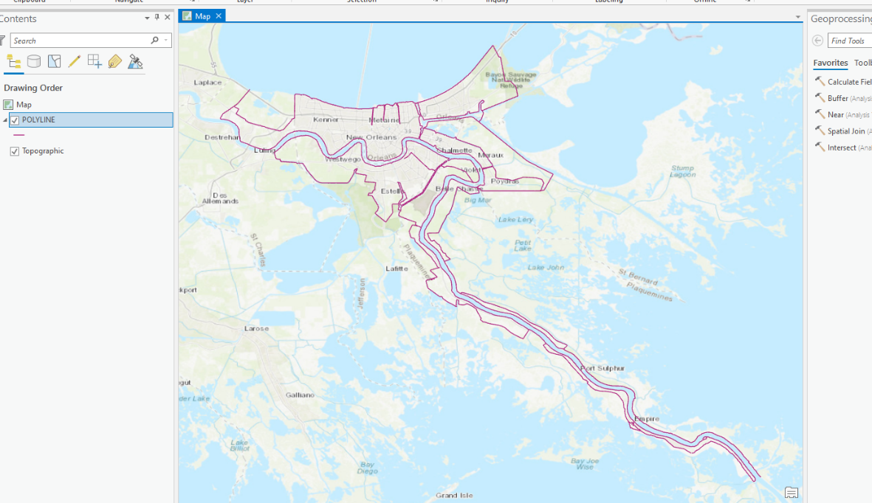
3. Resolve levees and other features
Levee shape files can be found by following website:
  https://levees.sec.usace.army.mil/#/

Slide 10
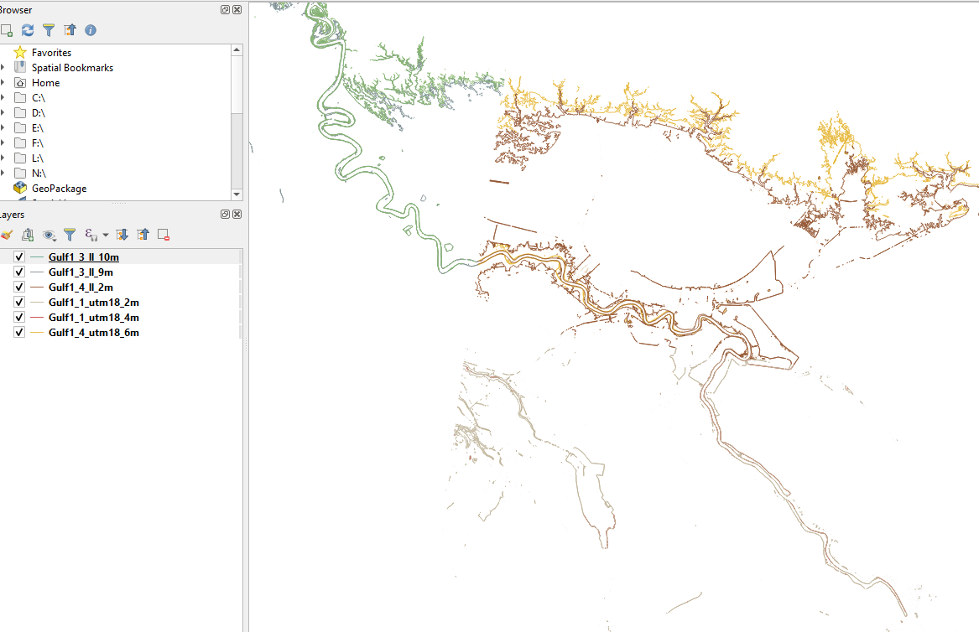
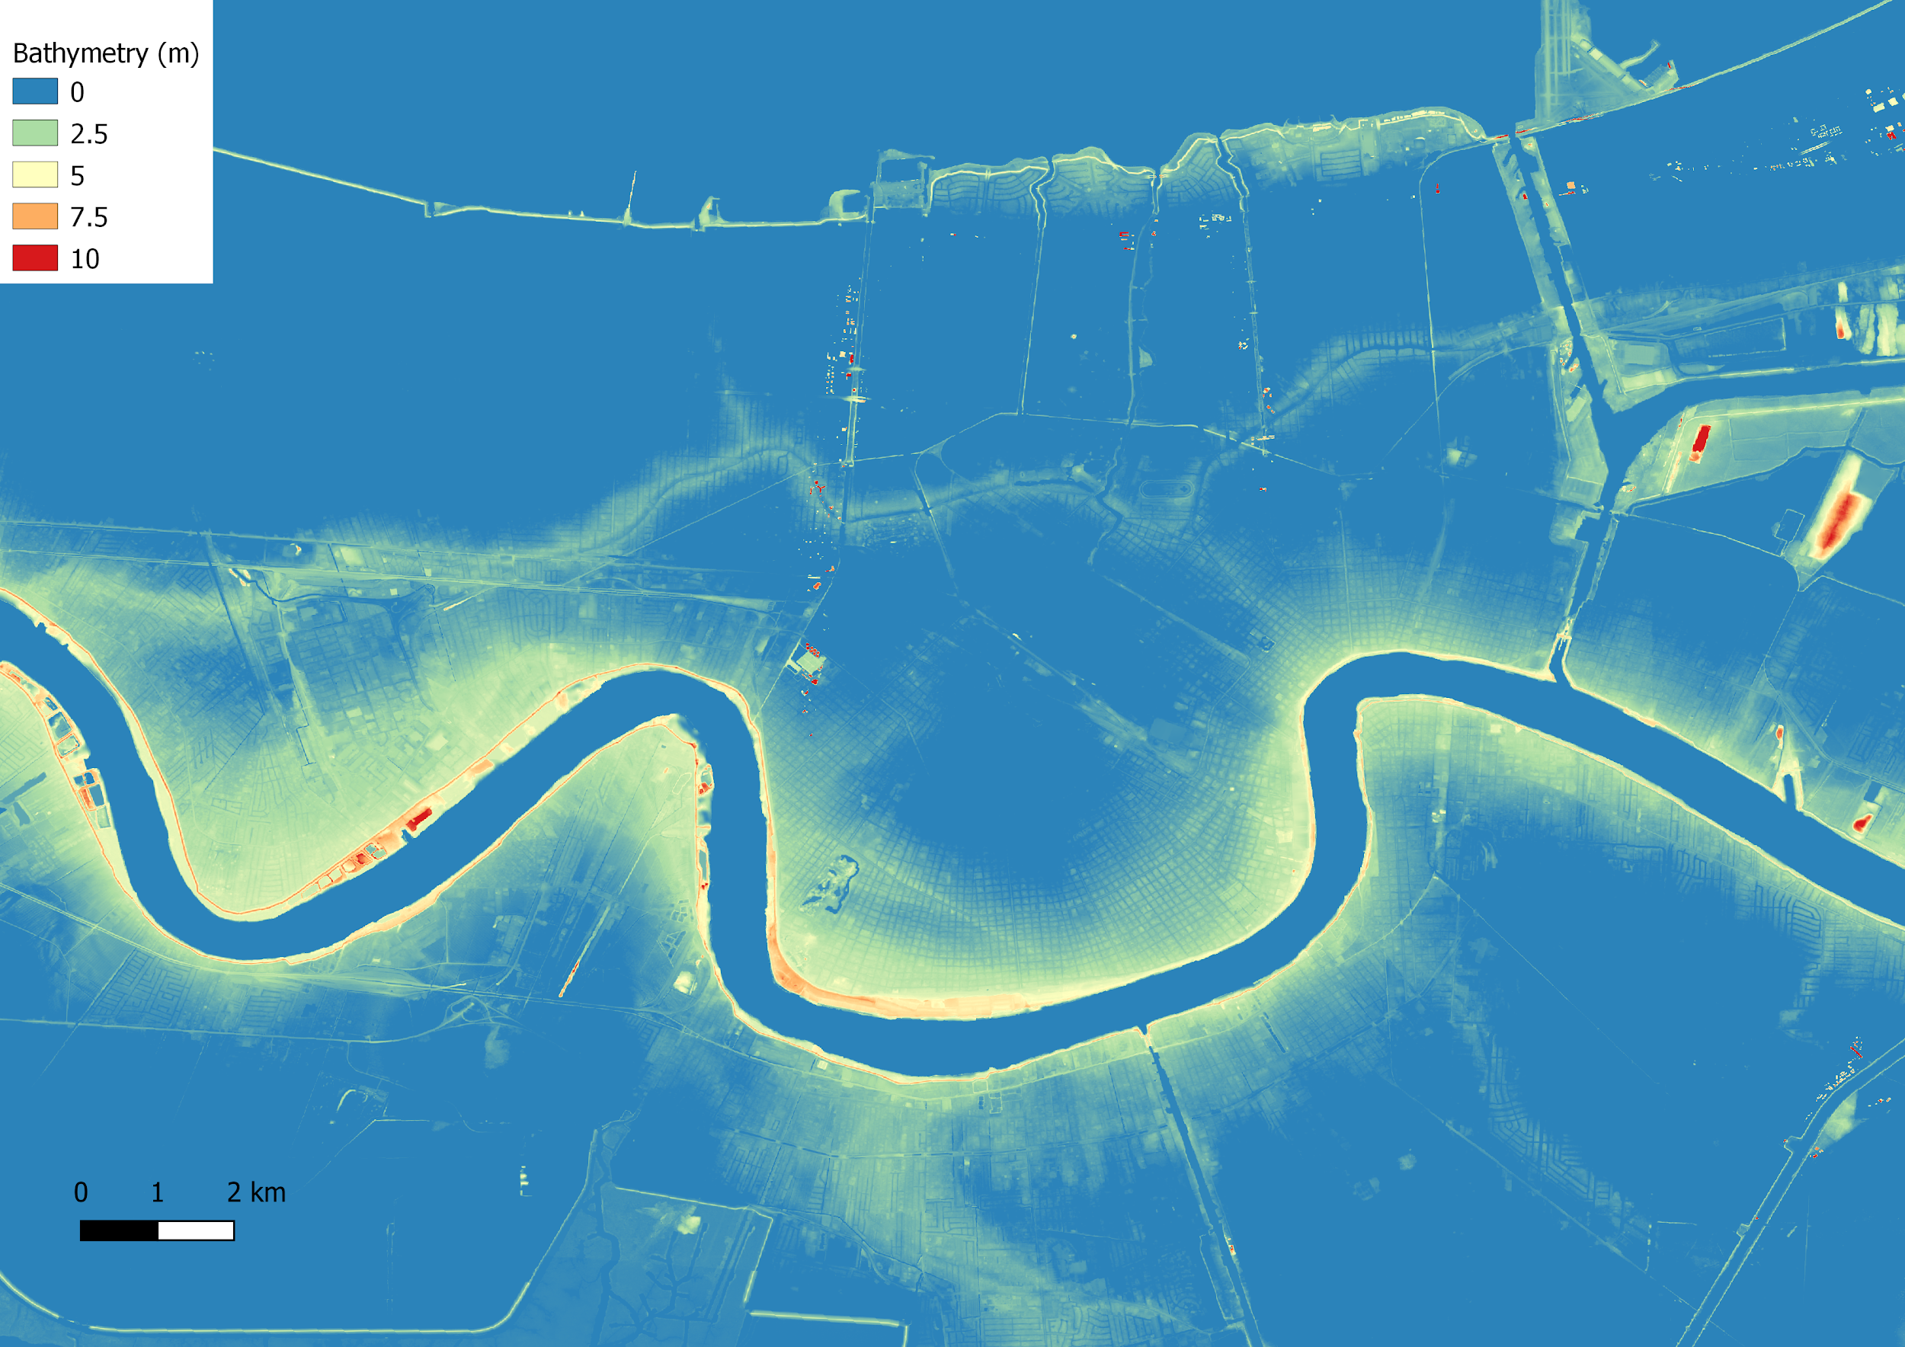
3. Resolve levees and other features
Extract 1-8m above MSL contour lines from DEMs to help identify bottom and top of levee
Select the most relevant contour lines and save as new shape file in QGIS

Slide 11
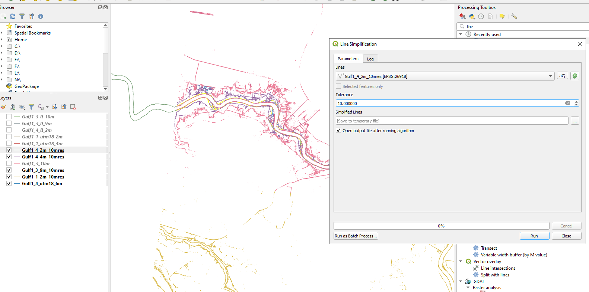
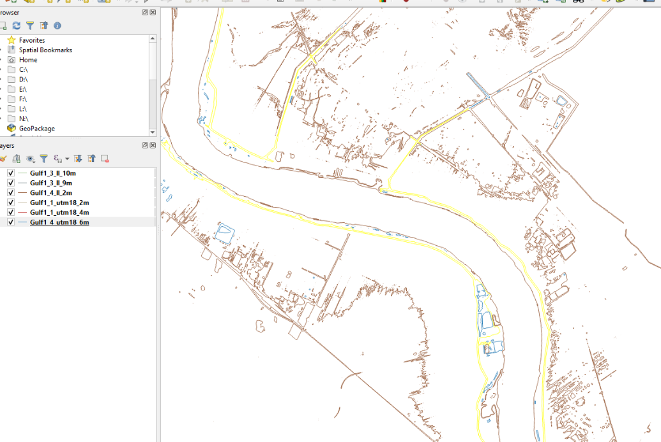
3. Resolving levees and other features
Take levees in lower Mississippi River as an example, use 4-5m isotopo to trace the top of levees, and use 2m isotopo as the bottom of levees.
For lower Mississippi, levees in some southern parts of river are lower than 2m, not all connected, and hard to tell from the imagery. So this part is not included at the moment
For northern parts, elevation is higher, use 9m or 8m contour as the bottom of levees, and use 10m contour to trace the top of levees.
Before loading the contours into SMS, simplify contours by selecting clean contours in GIS tools, reset the line resolution (~10m) to reduce size, and save them as new shape files

Slide 12
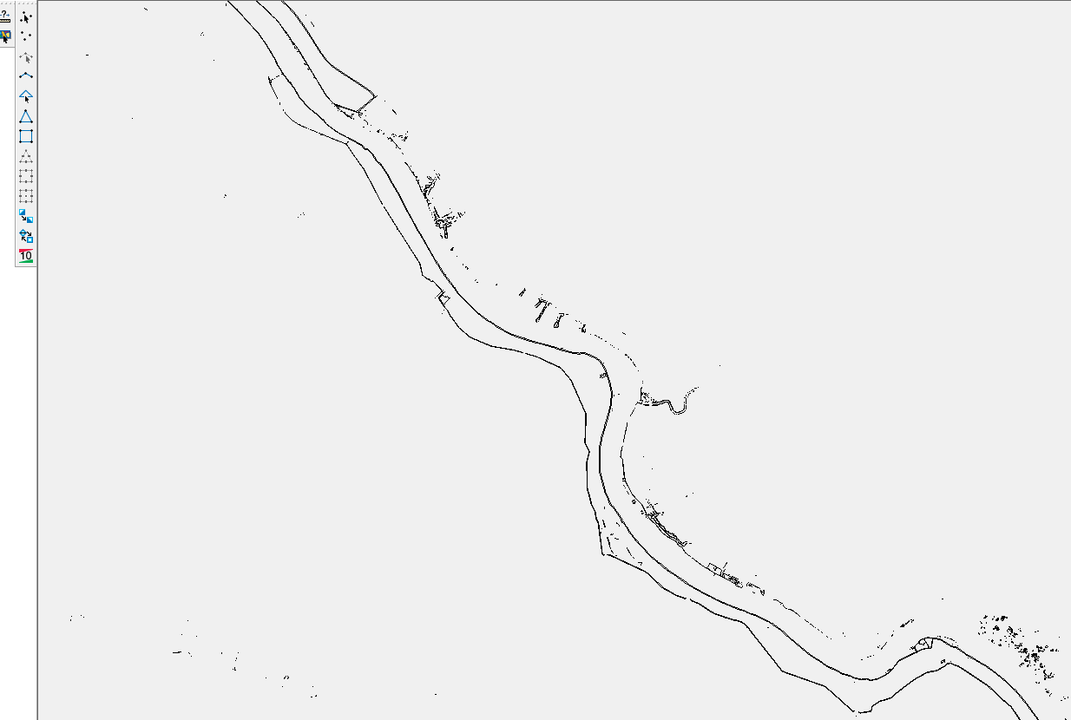
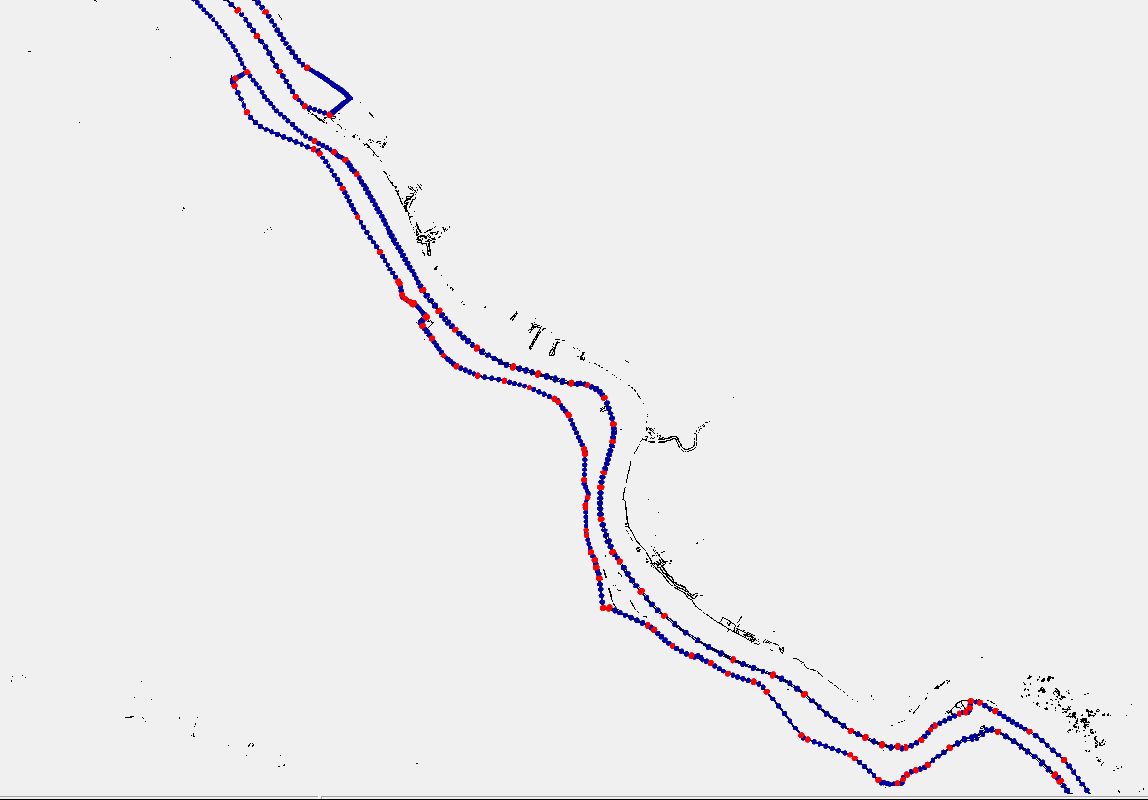
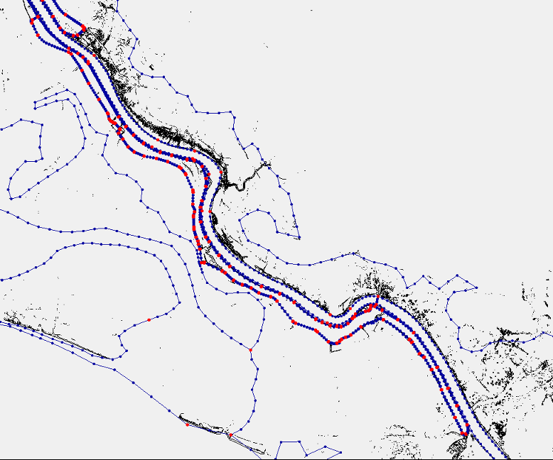
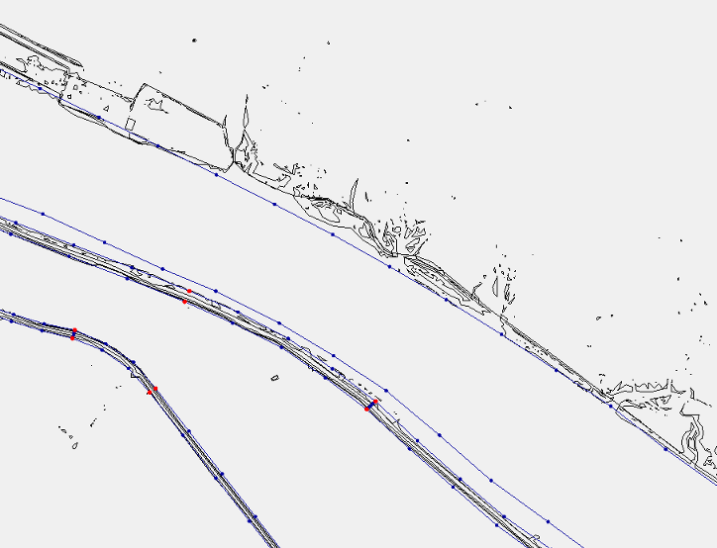
3. Resolve levees and other features
Load contours into SMS, convert them into feature arcs, reset the resolution to 150m (along levee), adjust locations to make sure they do not across other feature arcs
This way the bottom and crest of levee are accurately captured regardless of the final along-levee resolution
River boundary
Levee boundary

Slide 13
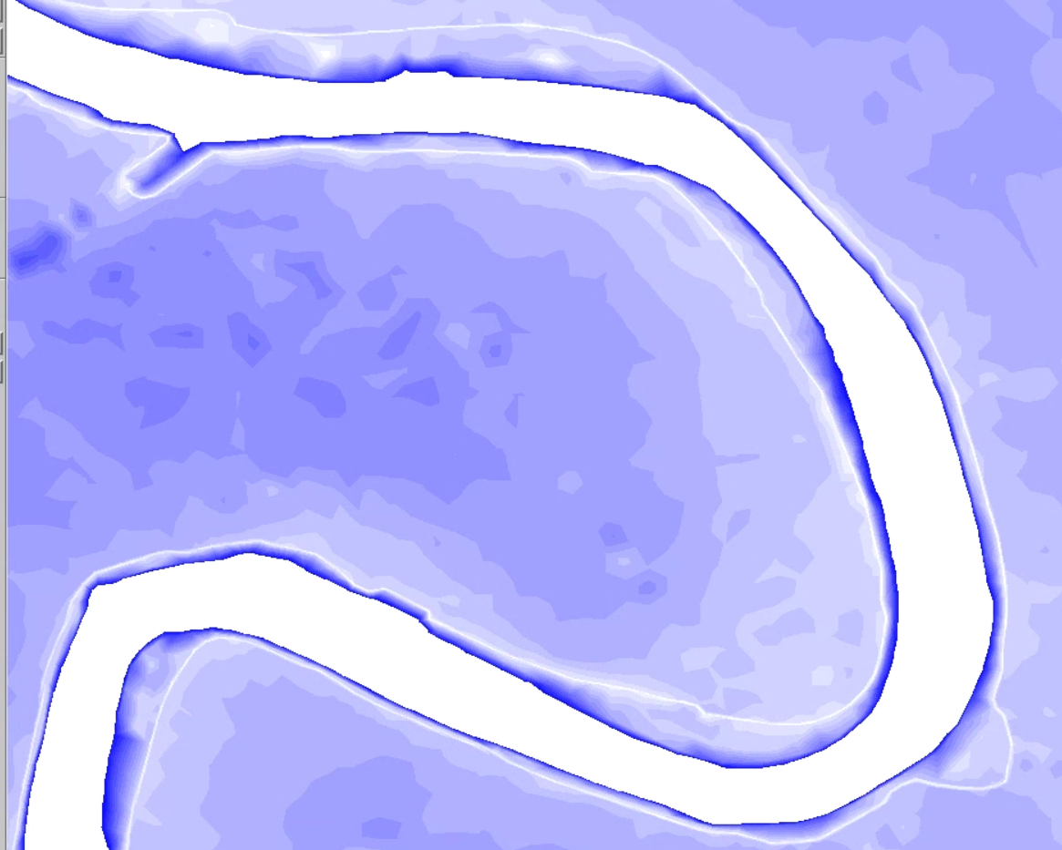
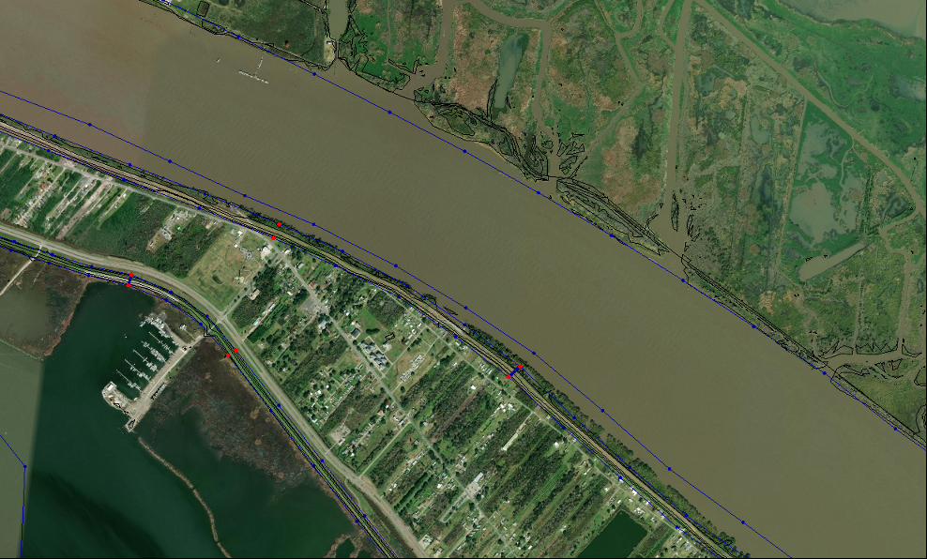
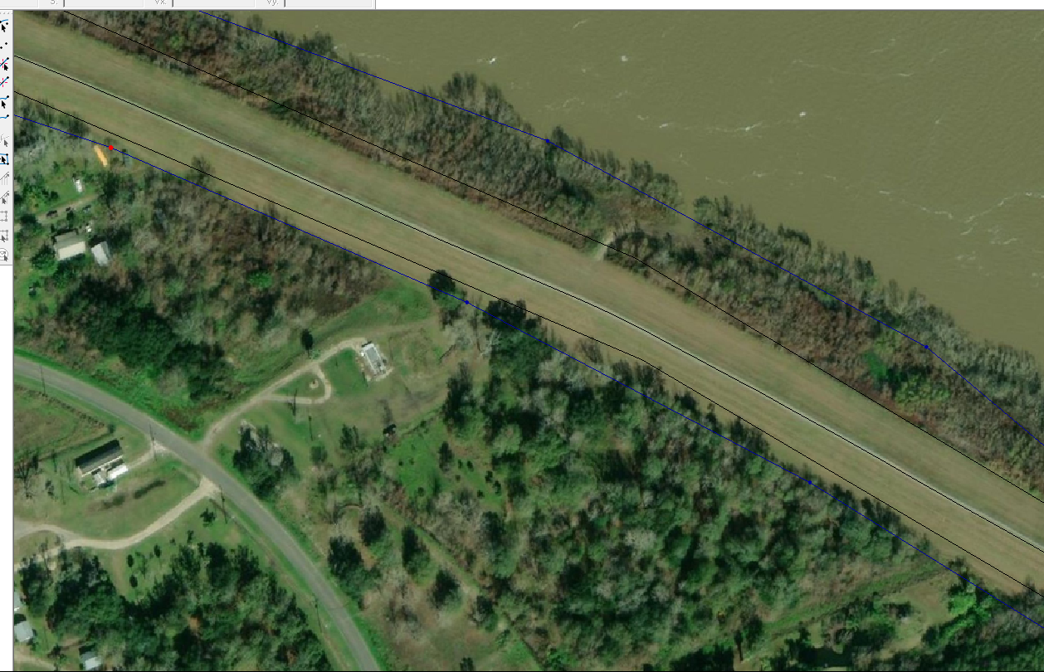
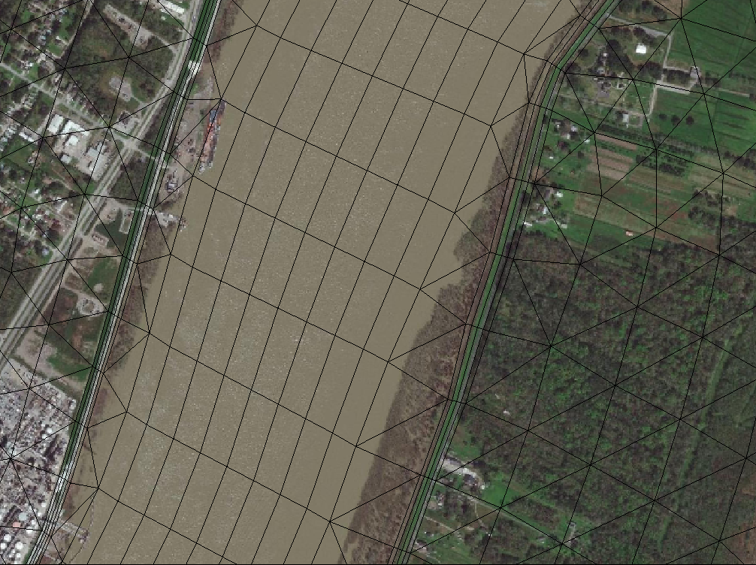
3. Resolve levees and other features
Use satellite imagery to edit levee arcs when there is mismatch between DEMs and imagery
Levees

Slide 14
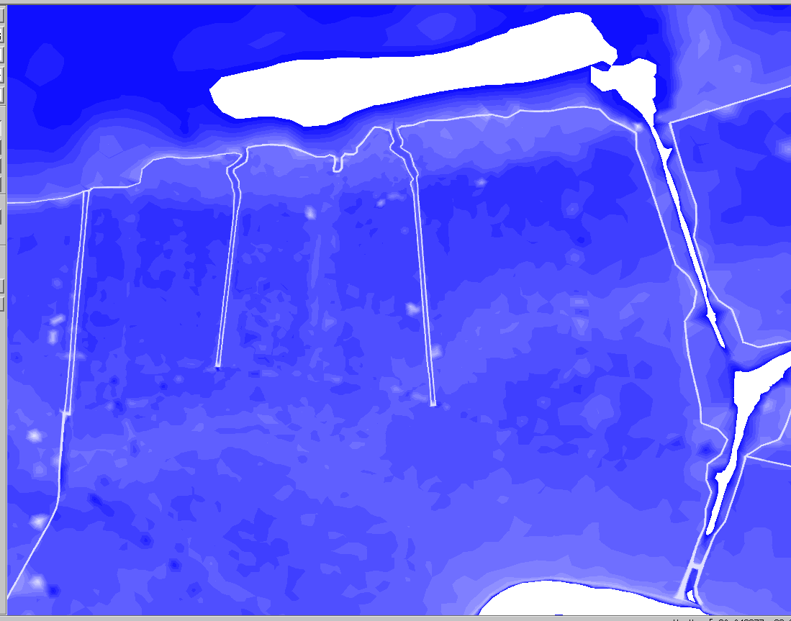
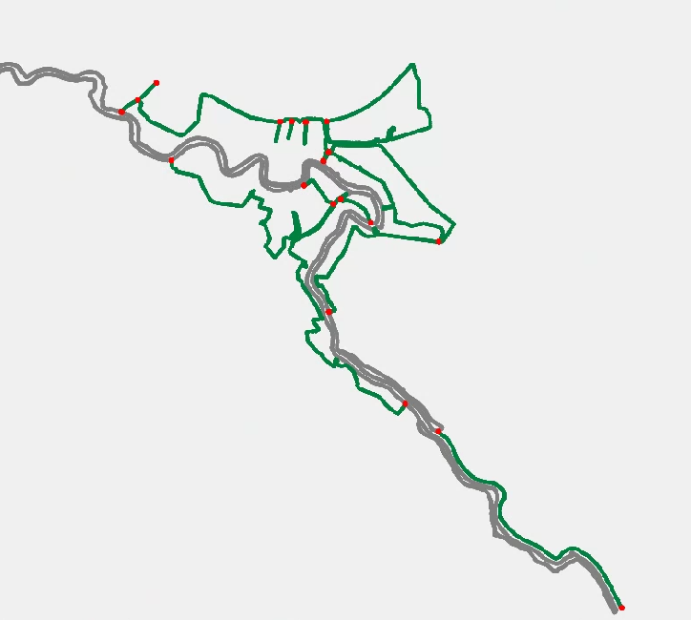
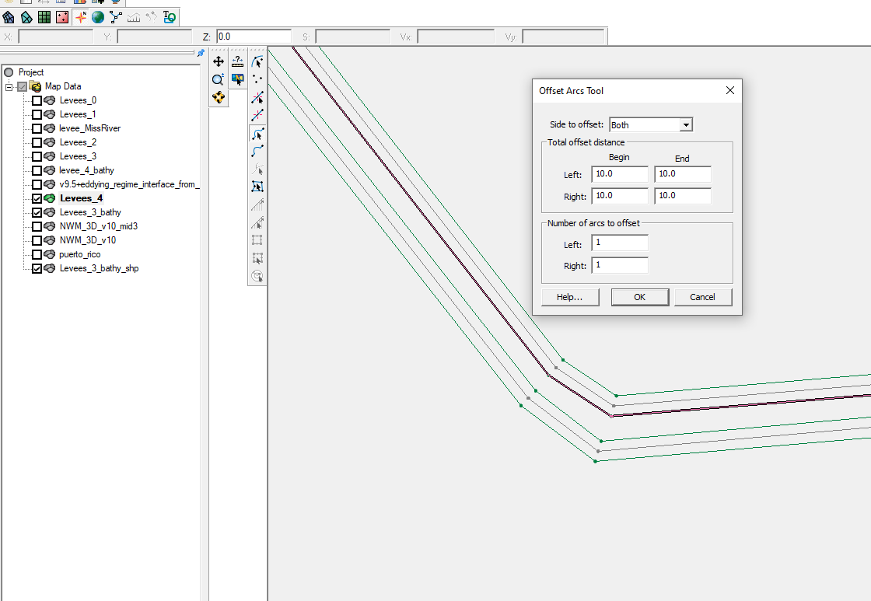
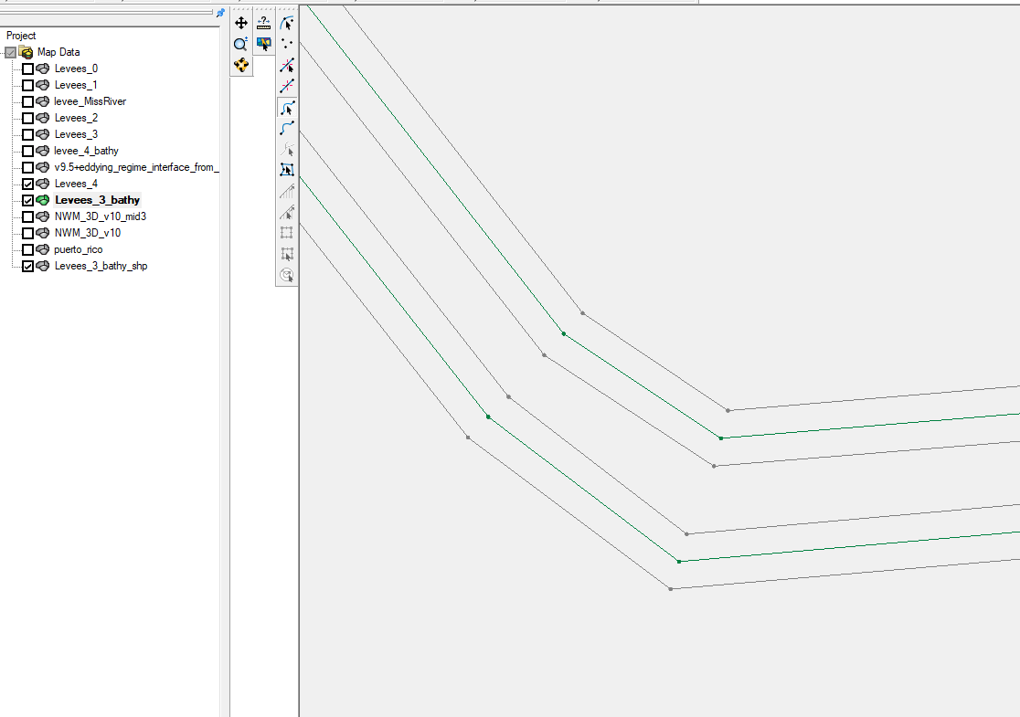
3. Resolve levees and other features
Some levees and flood walls can not be resolved by using high-res DEMs, National Levee Database will be used as guidance.
Download levee’s shp file:
https://levees.sec.usace.army.mil/#/levees/system/4405000525/summary
Convert shp file to feature arcs in SMS
Reset resolution, use four cross channel segments to resolve levees’ top and bottom.
Generating a separate map for levees which has 5 m broader than the top of the real levees. Save as separate mesh for loading levee height

Slide 15
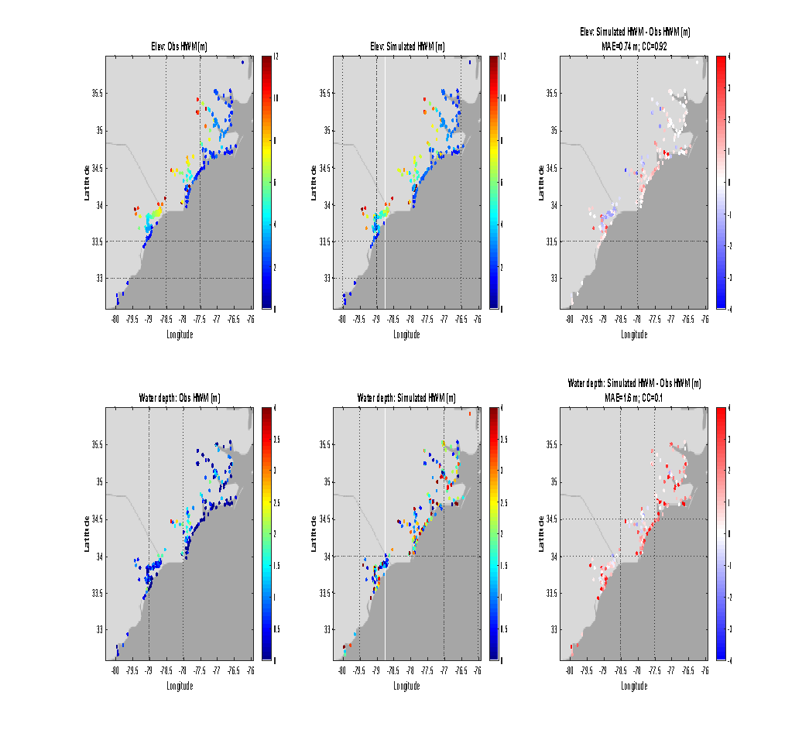
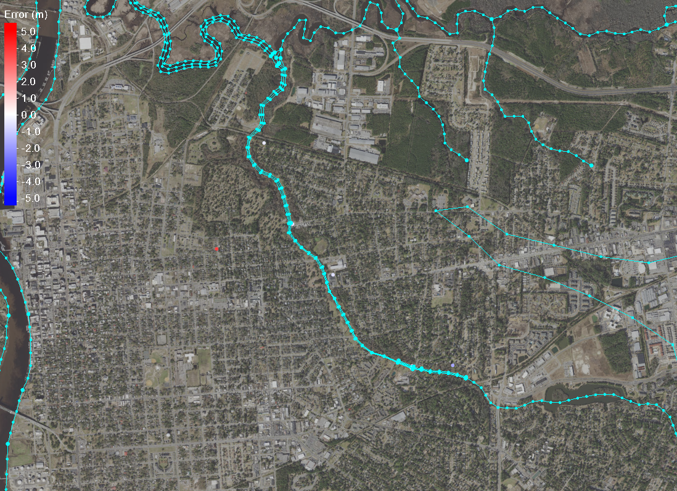
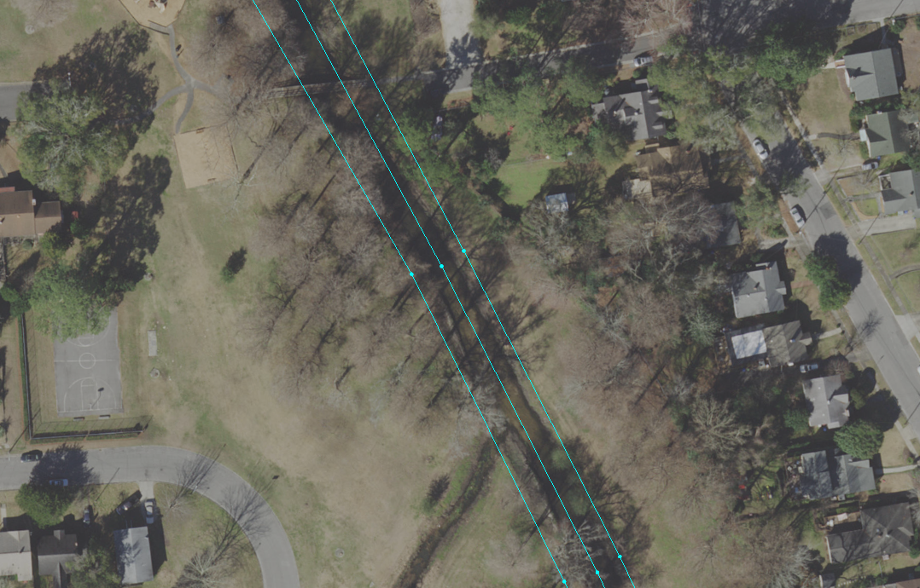
3. Resolve levees and other features
A tributary creek of North Cape Fear River
Simulated high water marks for Hurricane Florence are greatly improved by resolving small features!
HWM
(b)
Model-data comparison on high water marks
Model error (m)
Model error (m)
Glider deployment:
model-data comparison on hurricane mixing
Ye et al. (in review)

Slide 16
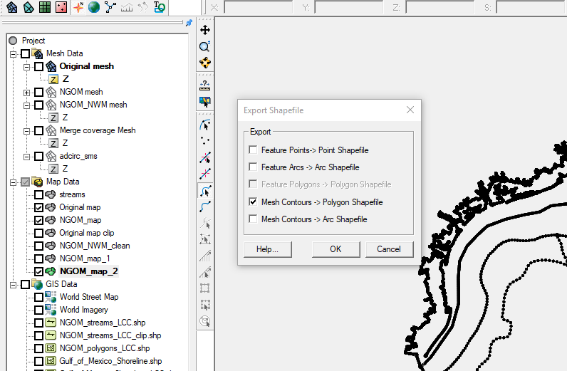
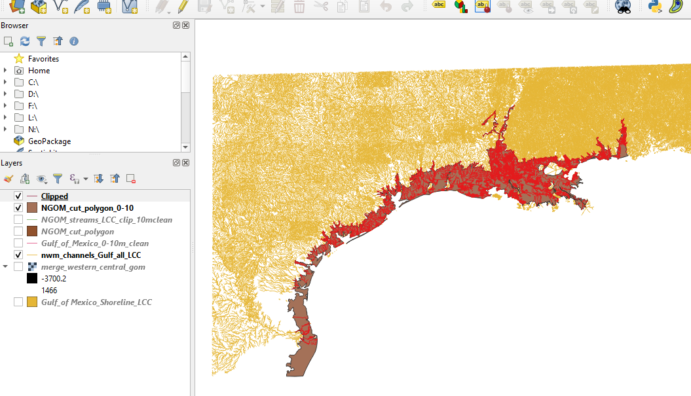
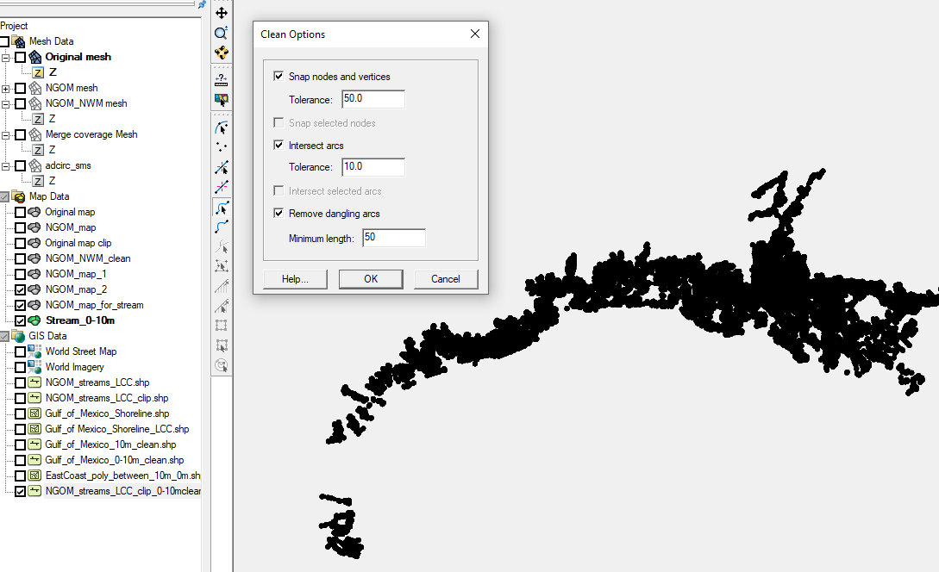
4. Add NWM segments
First, convert SMS polygons (shoreline, land boundary and river channels) to shapefile to help clip NWM segments
In GIS, clip the NWM stream arcs using the polygons (between 0-10m) as masks, and then save as shapefile
Import shapefiles for NWM to SMS; convert the clipped stream segments to feature objects
Clean the arcs using the following tolerance: 50m
Redistribute NWM arcs to desired resolution (e.g. 200m)
Merge the NWM segments into the previous map
May need to repeat this procedure for specific rivers

Slide 17
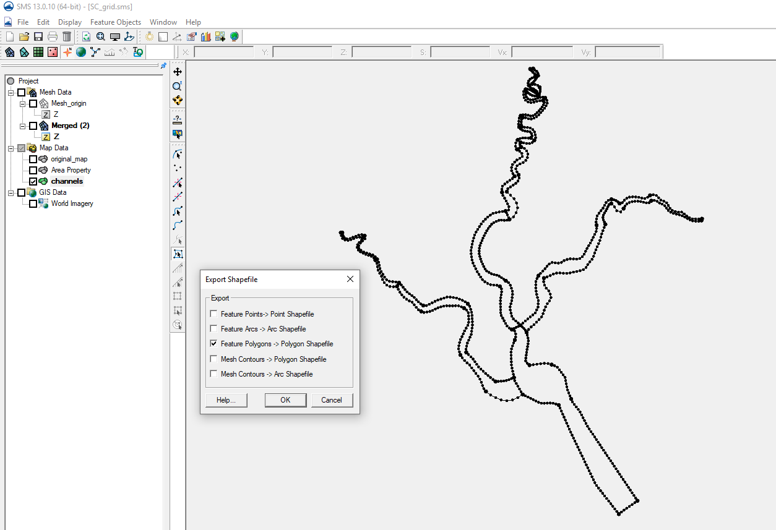
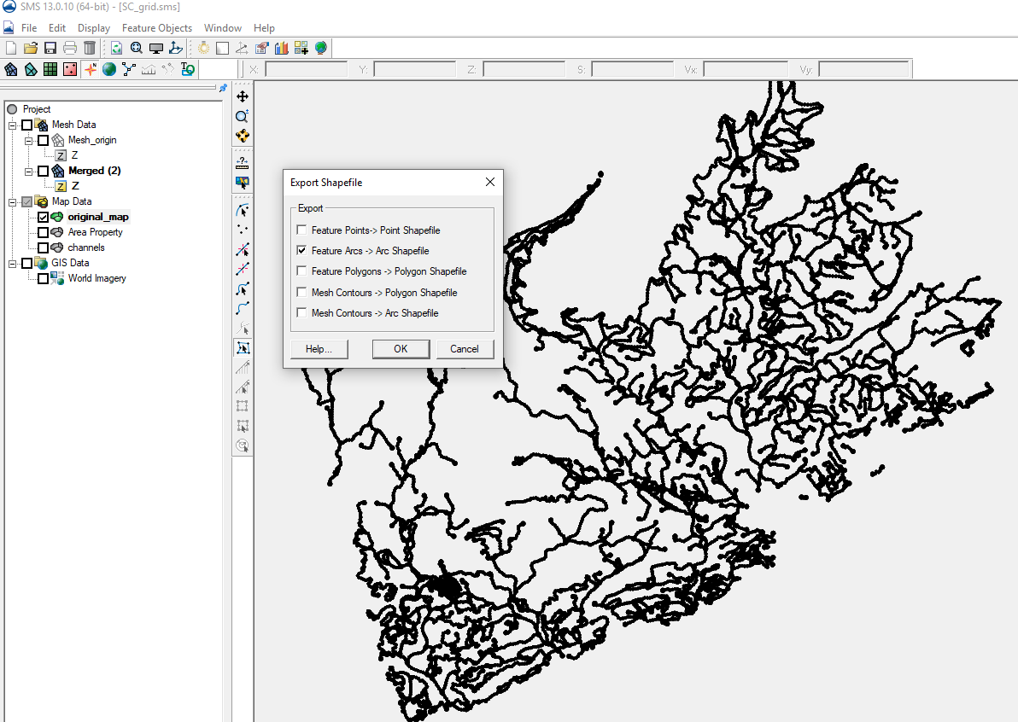
4. Add NWM segments
Save the channel map to shape file (channels.shp), select “Feature Polygons -> Polygon Shapefile” in the “Export Shapefile” options.
Save the watershed to shape file (watershed_SC.shp), select “Feature Arcs -> Arcs Shapefile” in the “Export Shapefile” options.

Slide 18
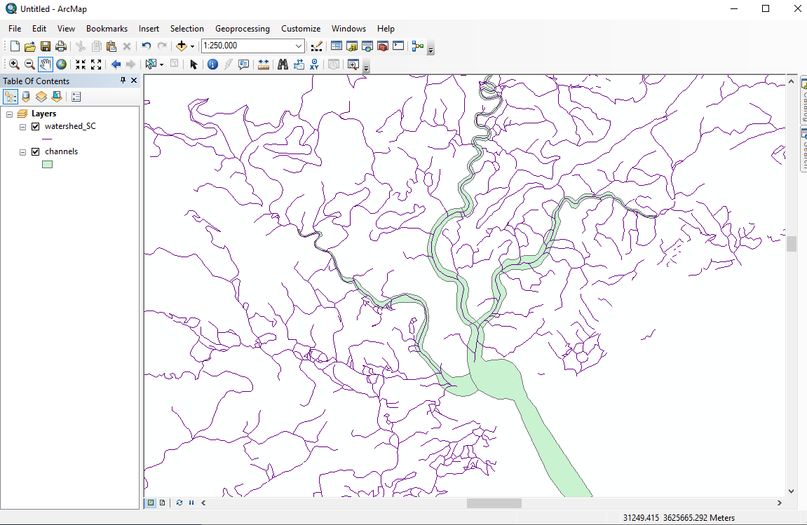
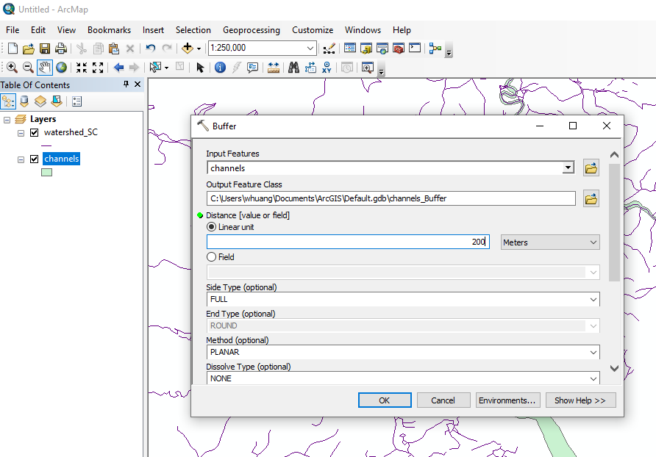
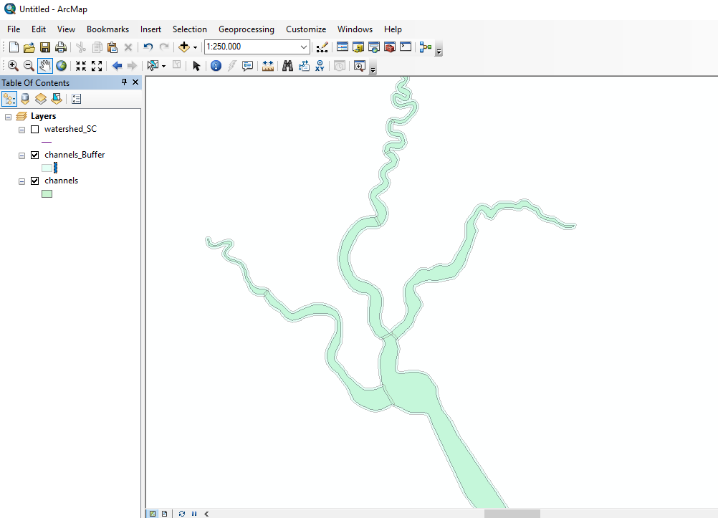
4. Add NWM segments
Open the two shape files: channels.shp and watershed_SC.shp in ArcMap software
Use the “buffer” tool to define a zone so that the interested area and the channels do not overlap

Slide 19
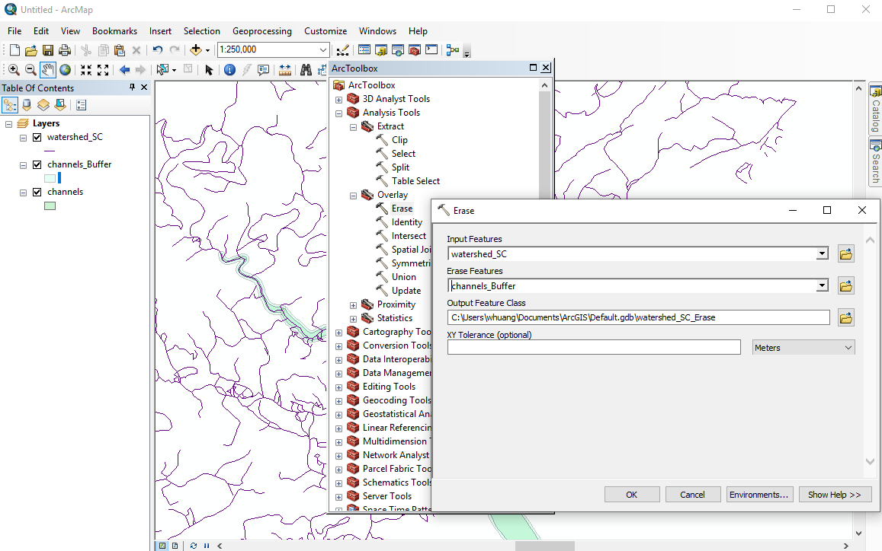
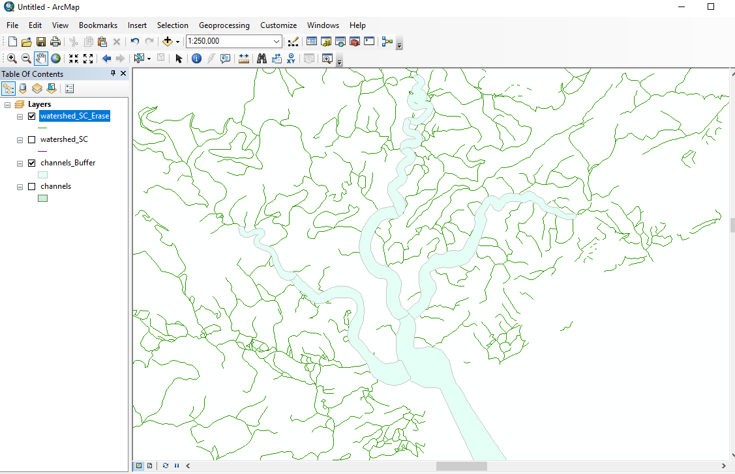
4. Add NWM segments
Use “erase” tool to erase the NWM arcs inside our river polygons (where we have manually aligned channels)
Obtain the watershed_SC_Erase in which the NWM arcs in the channels_Buffer have been excluded

Slide 20
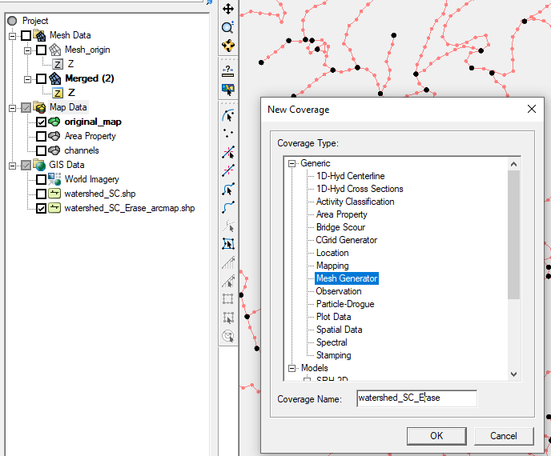
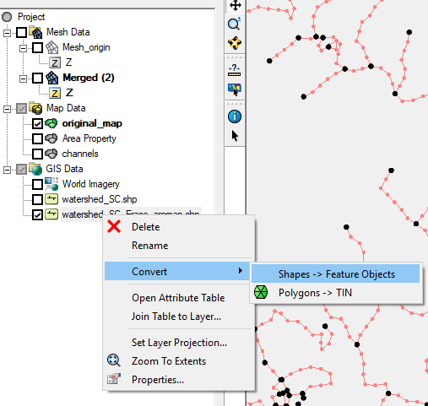
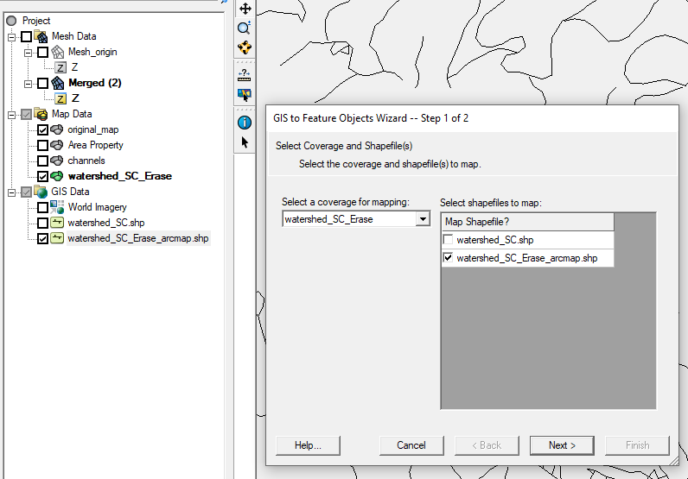
4. Add NWM segments
Load the watershed_SC_arcmap.shp into SMS
Convert it to a feature object by creating a separate new map coverage called watershed_SC_Erase

Slide 21
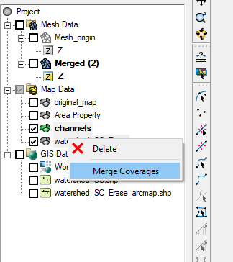
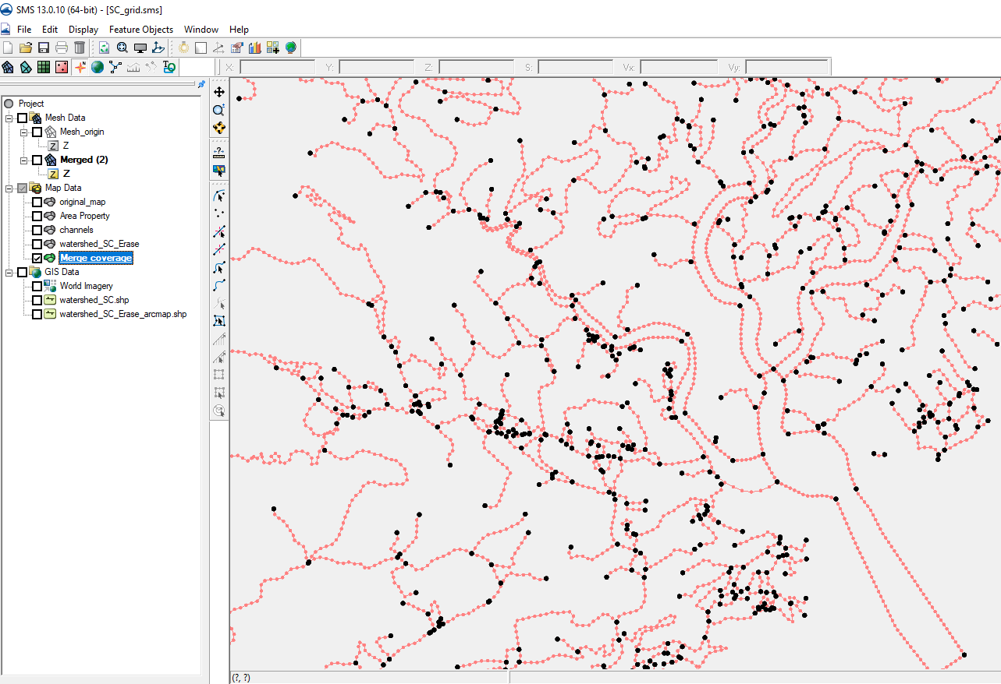
4. Some tips on merging NWM arcs
Merge the channels and the watershed_SC_Erase into one map file
Then you will have a newly merged map as shown below, which is the semi-final map that has everything in it

Slide 22
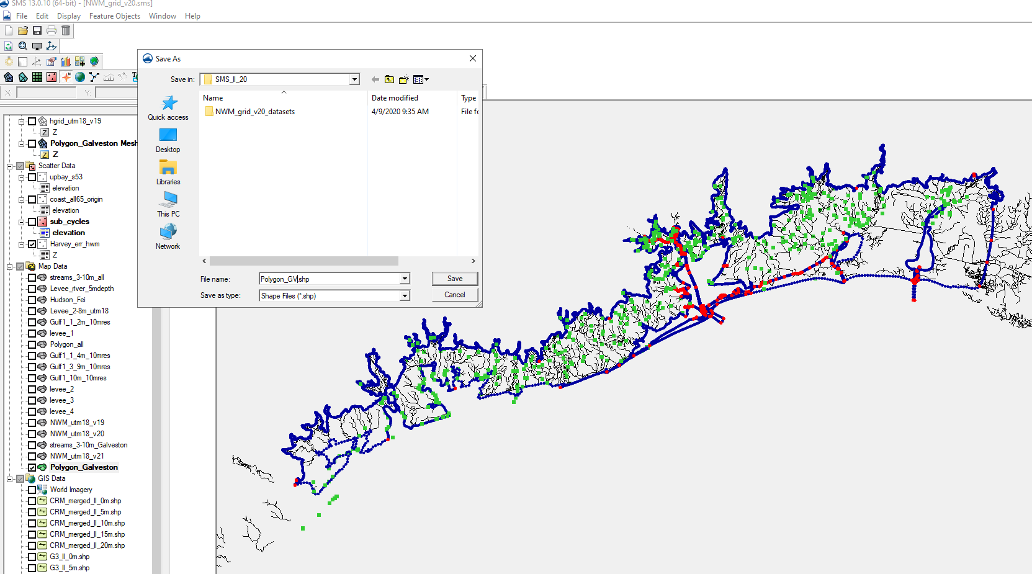
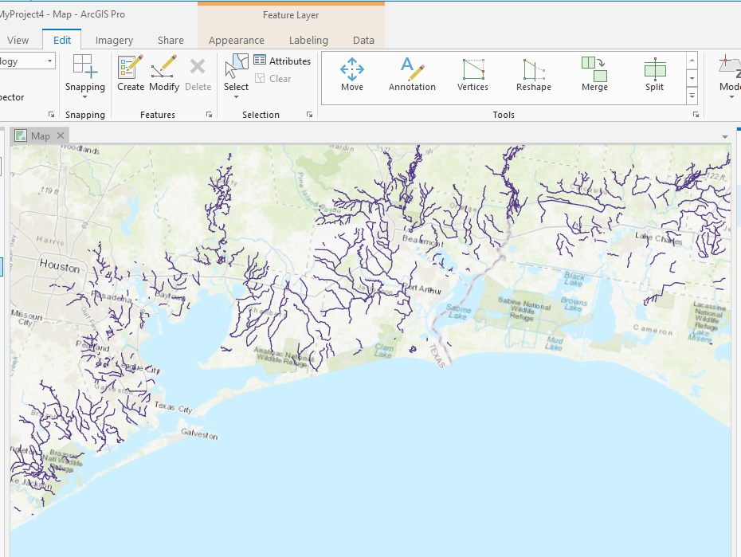
5. Procedures for cleaning up NWM segments
Take the NWM segments around Galveston Bay as example
In SMS, save "feature polygon to polygon shape file" as Polygon_GV.shp file.
In GIS tool, use this polygon to clip NWM segments with a buffer zone (10m buffered polygon)

Slide 23



5. Procedures for cleaning up NWM segments
Convert the NWM segments from shp file to feature arcs
select all “feature points” and convert them to “feature vertices”; some points cannot/won’t be converted, which is what we want.
select all feature arcs and redistribute vertices with a proper resolution (300 m)
clean up all arcs using a smaller distance than the watershed resolution (150 in this example; you can try a larger number, but not larger than the watershed resolution).
Moreover, setting the tolerance for intersect arcs to a larger value (75 m) should improve the cleaning. This has not been tested, and you may have to deal with dangling arcs.

Slide 24


5. Procedures for cleaning up NWM segments
One potential backward using clean options is that lots of dangling arcs may be resulted, therefore, crashing the mesh generation.

