Slide 1
Progress on 3D project
Wei Huang, Fei Ye, Joseph Zhang , Dan Yu and Karinna Nunez
Virginia Institute of Marine Science
03/10/2020

Slide 2
Overview of progress
Assess NWM v2.0 products
Improve NWM coupling script: add an option to merge the source/sink pairs within a specified distance to avoid 'disappearing' flow
For 3D baroclinic runs, improve the efficiency of interpolating HYCOM outputs for I.C., B.C. and nudging files: 5 times faster, can be finished within 10 minutes
Revised grid in several regions to capture features in high-resolution DEMs to improve model skill
Preliminary results of two 3D baroclinic simulations of Hurricane Katrina
Worked on the subcycling issue in the transport solver to enhance the efficiency of 3D simulation
3 manuscripts drafted from current results
Preparing 3D baroclinic run for Hurricanes Harvey and Florence

Slide 3
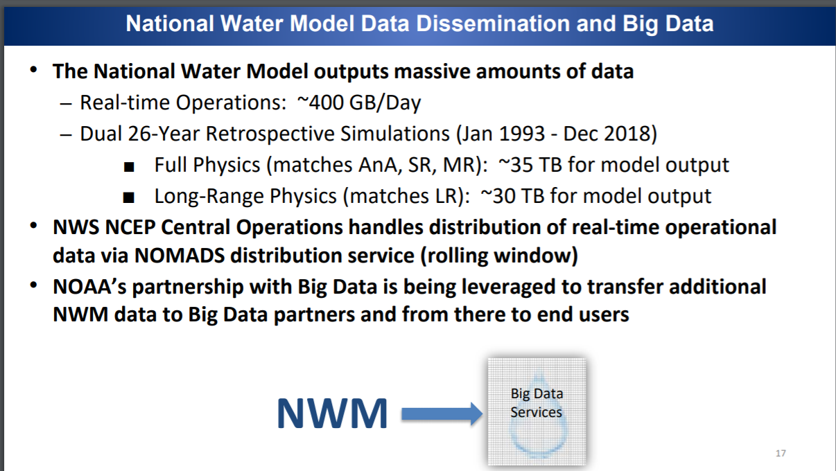
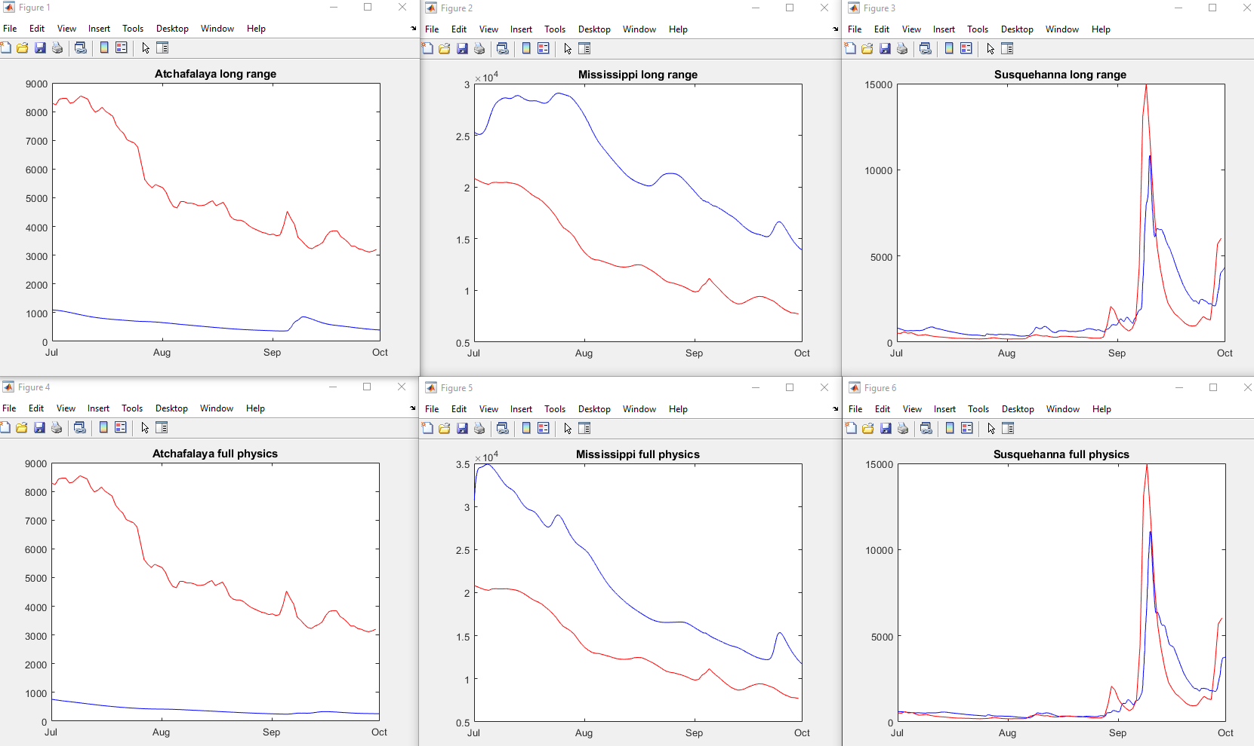
Assess NWM v2.0
NWM v2.0 has comparable results at most rivers
Seems to give less accurate flows for Atchafalaya and Mississippi River?

Slide 4
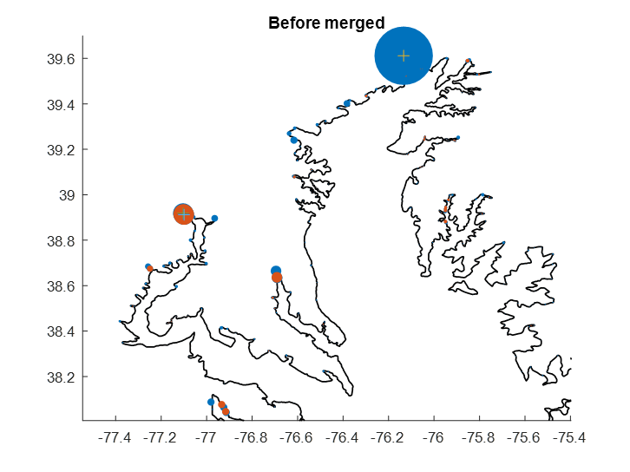
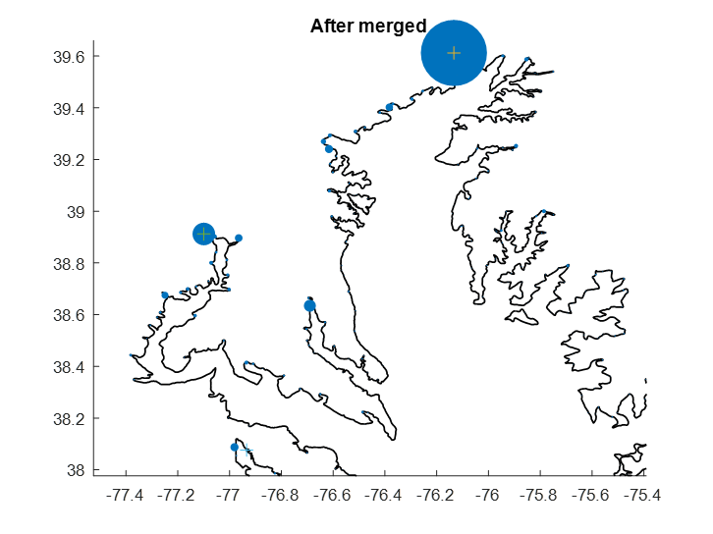
Improving NWM coupling script
Added extra option to merge source/sink fluxes within a given distance
In this way, meandering rivers going into/out of elements within this given distance will be merged.
In the latest setup, sinks are merged with the nearby (< 4 km) sources

Slide 5
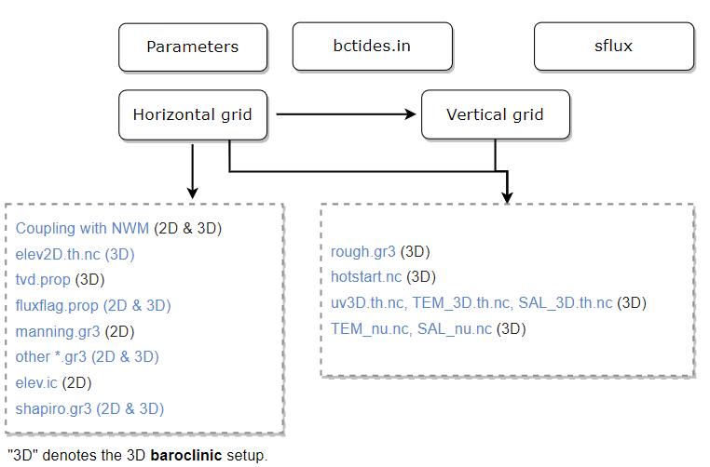
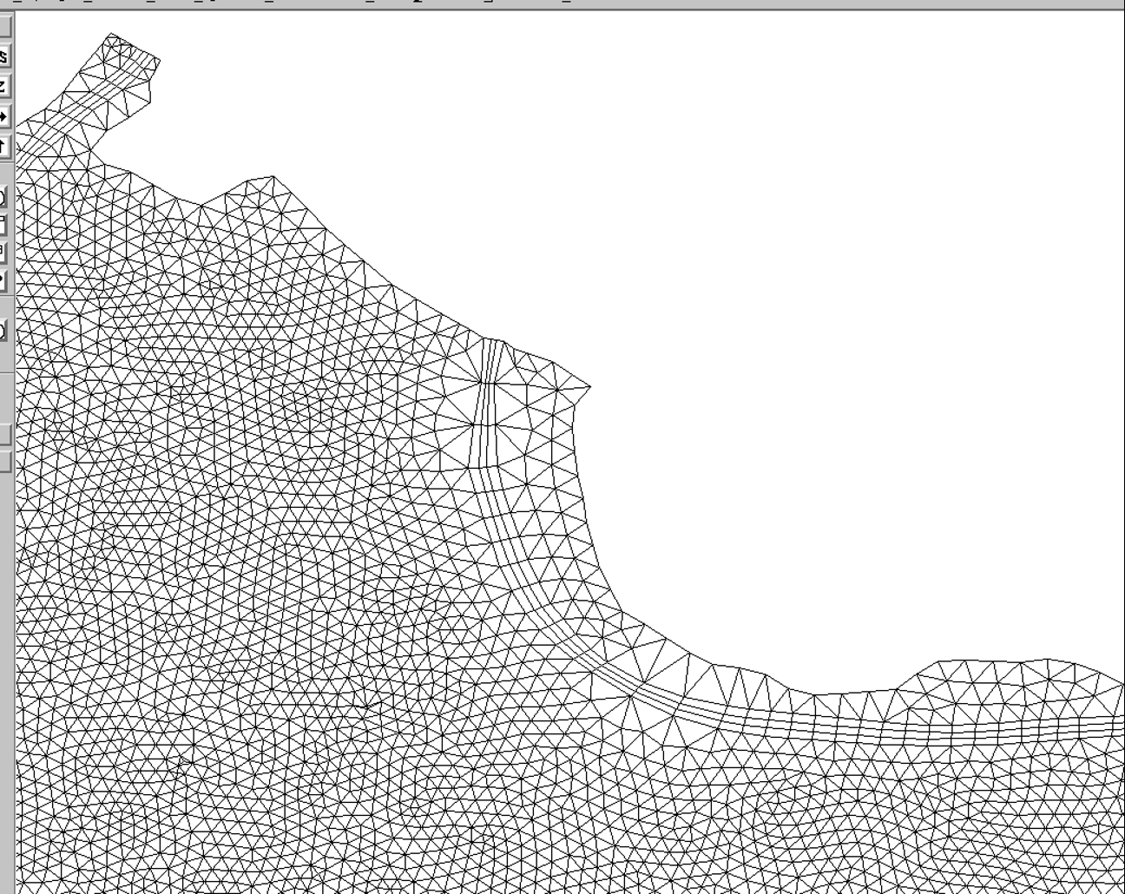
Prepare input files for 3D baroclinic simulation
Revise rivers with large discharge and stations with large errors (Mississippi River, Rivers in Mobile Bay, Delaware distributes, and station near Wachapreague)
Fixed a few small elements to alleviate subcycling in the transport solver, and enhance the model’s efficiency.
For example: Mississippi River, use larger along channel resolution for elements along Mississippi River
Relieve a bottleneck in pre-proc: interpolation from HYCOM
Revised scripts for interpolating HYCOM outputs onto I.C. and B.C. are more efficient: can be generated within 10 min, which is 5 times faster

Slide 6
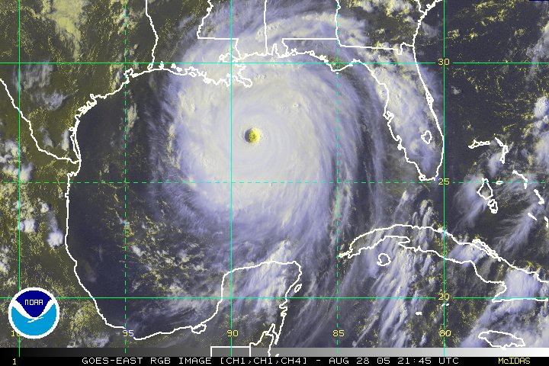
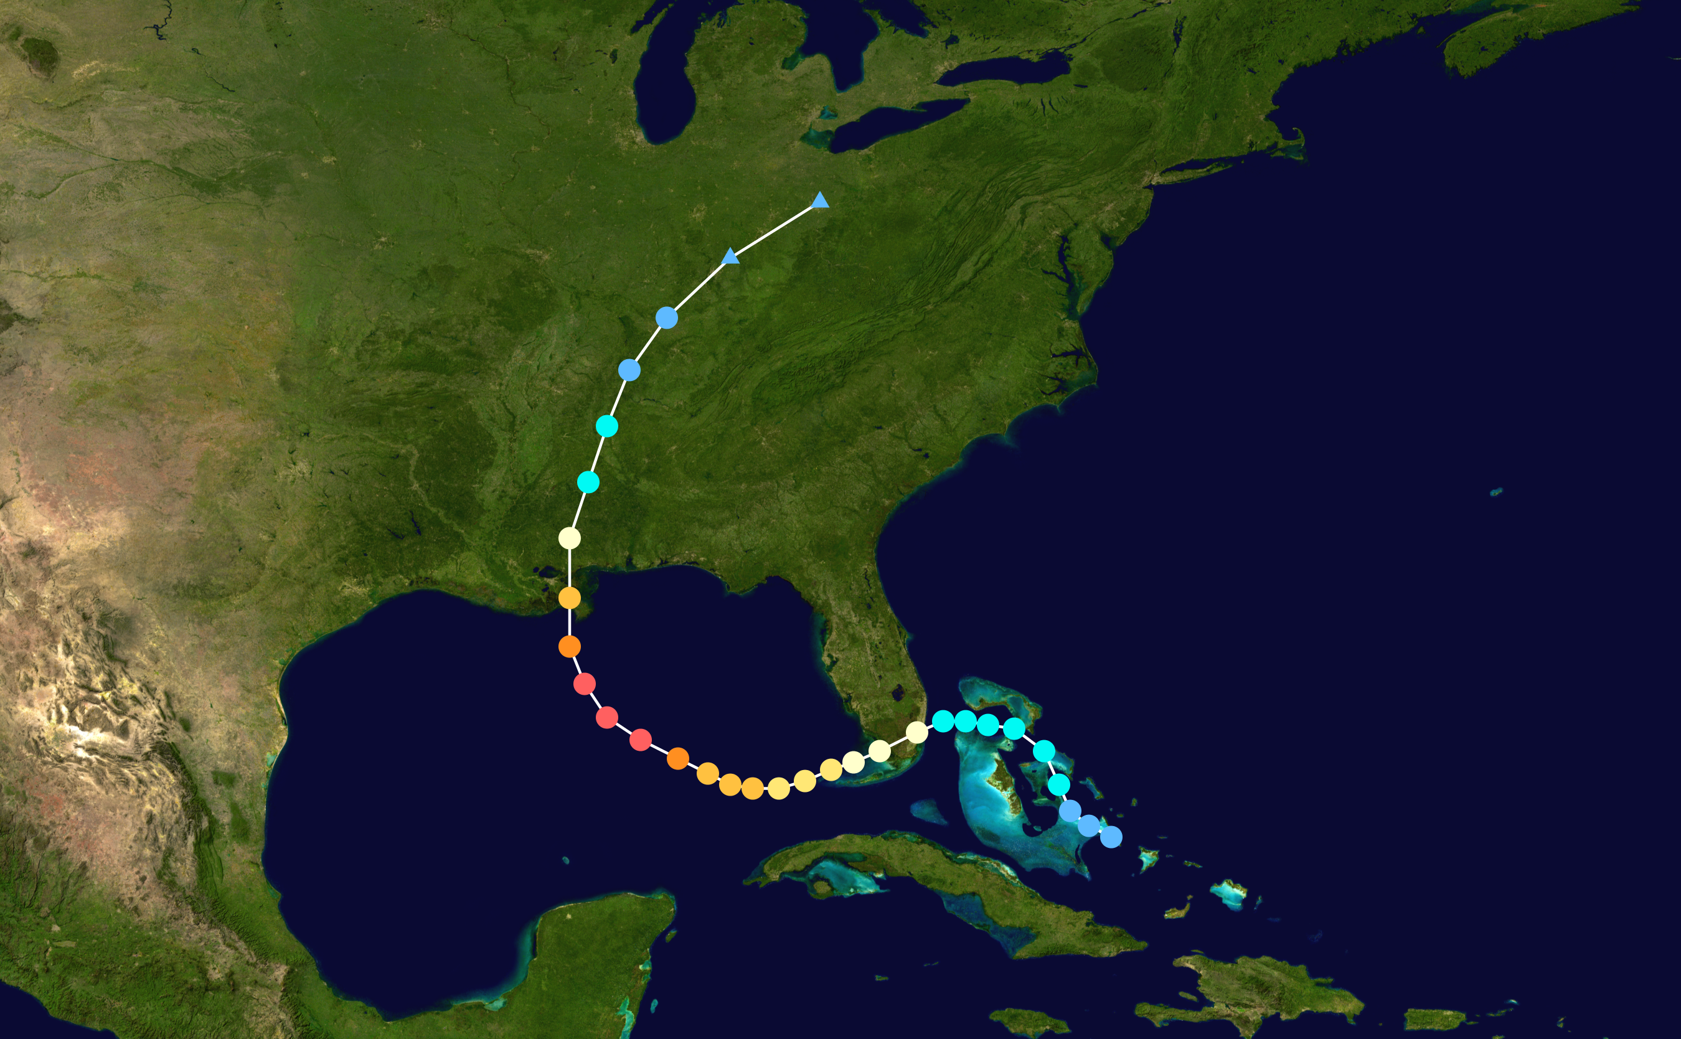
Preliminary results for Hurricane Katrina (Uncalibrated 3D baroclinic simulation)

Slide 7
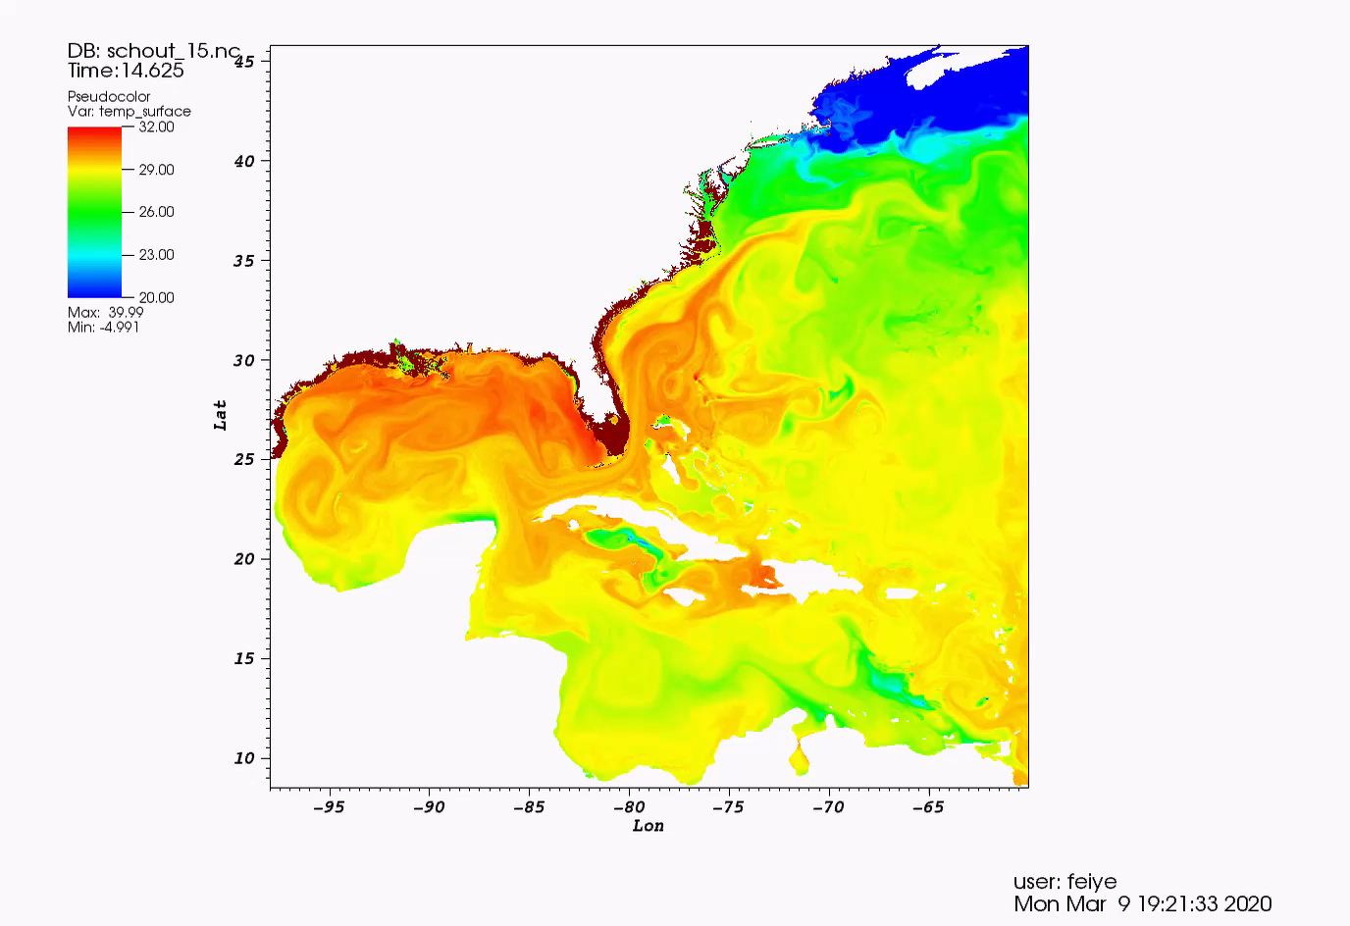
Simulated surface temperature - signal of Katrina
Simulated
Sea Surface Temperature (ºC)
Hurricane Katrina’s path

Slide 8
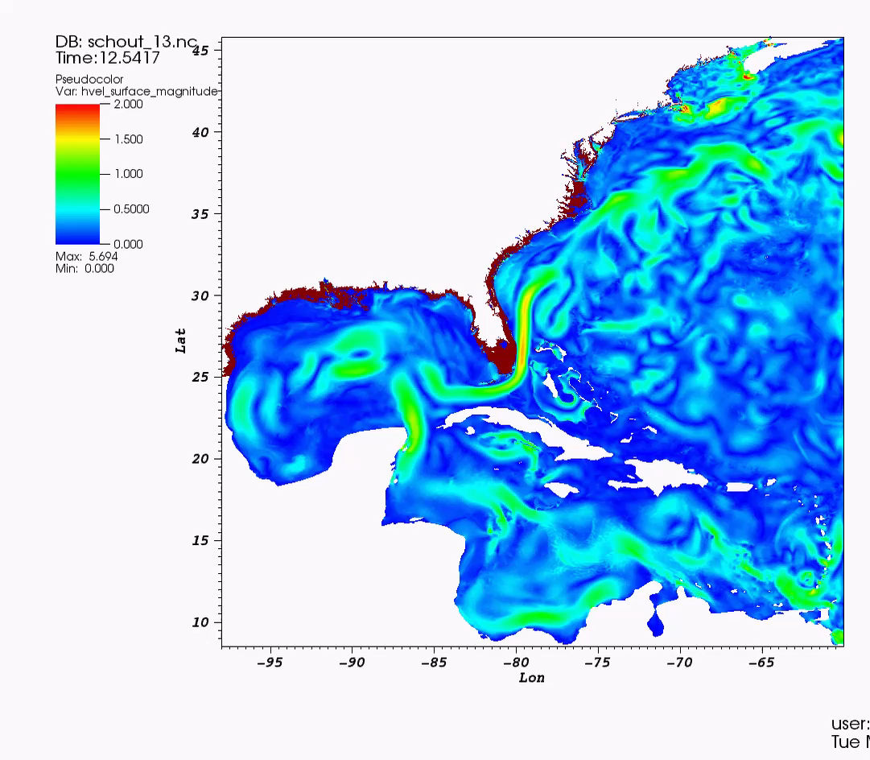
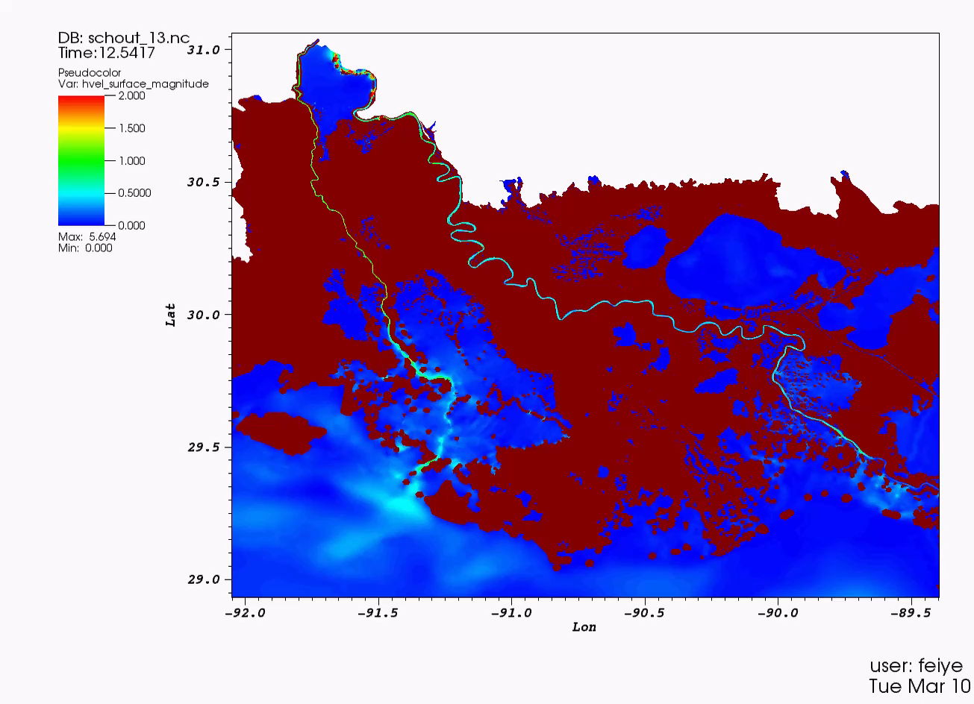
Simulated surface velocity - signal of Katrina
Simulated surface velocity (m/s)
Zoomed-in view on the Mississippi River

Slide 9
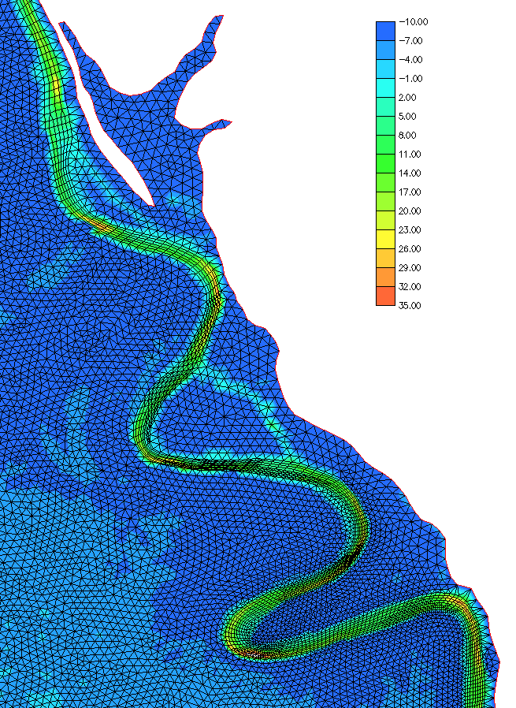
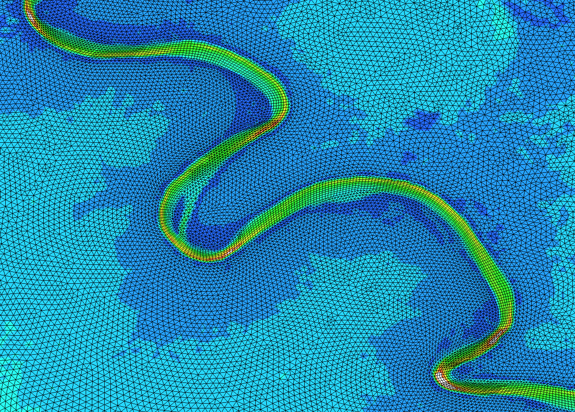
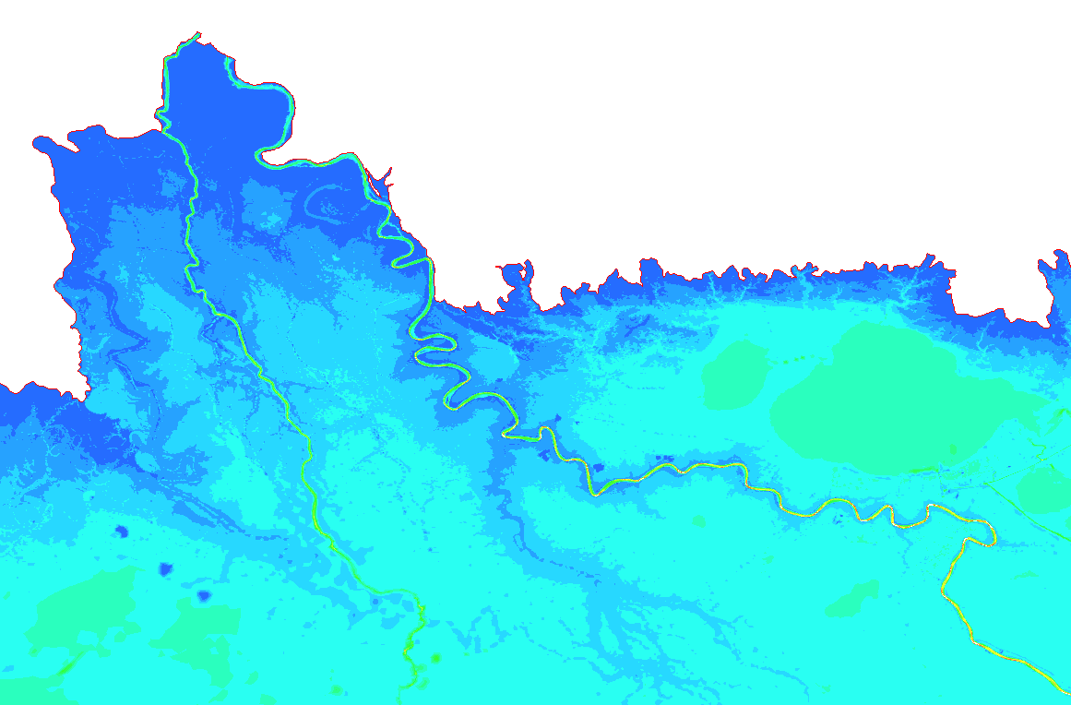
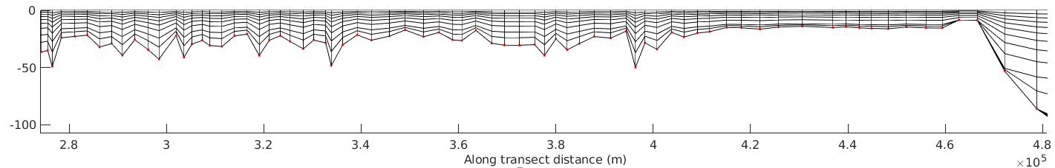
Grids in the Mississippi River
Bathymetry (m)
Mississippi River
z (m)
Vertical grid

Slide 10
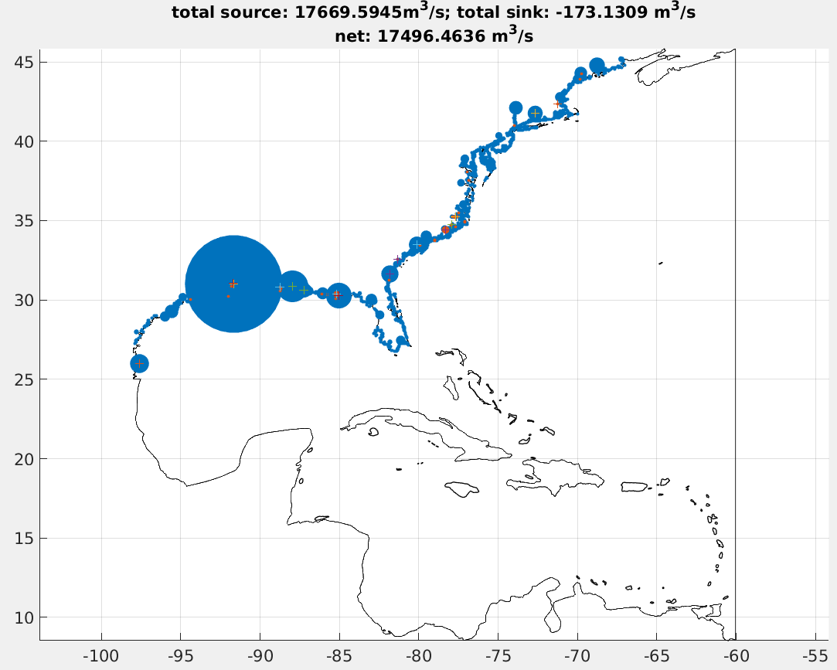
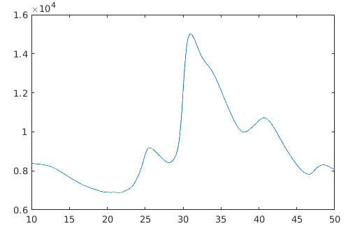
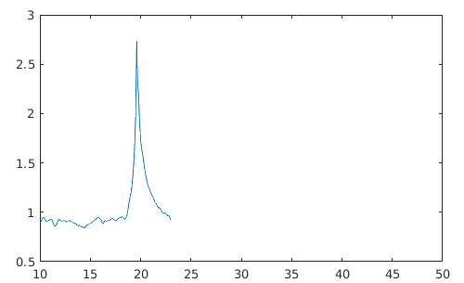
Discharge and elevation in the Mississippi River
Fresh water inputs from NWM (time-averaged around the Katrina period)
River flood
NWM Source locations, scaled by discharge
Discharge (m3/s)
Hurricane Katrina
Mississippi River
9188 m³/s
Elevation (m)
There should probably be a second peak during the river flooding period
Simulation
ends
Days from 2005-08-10

Slide 11
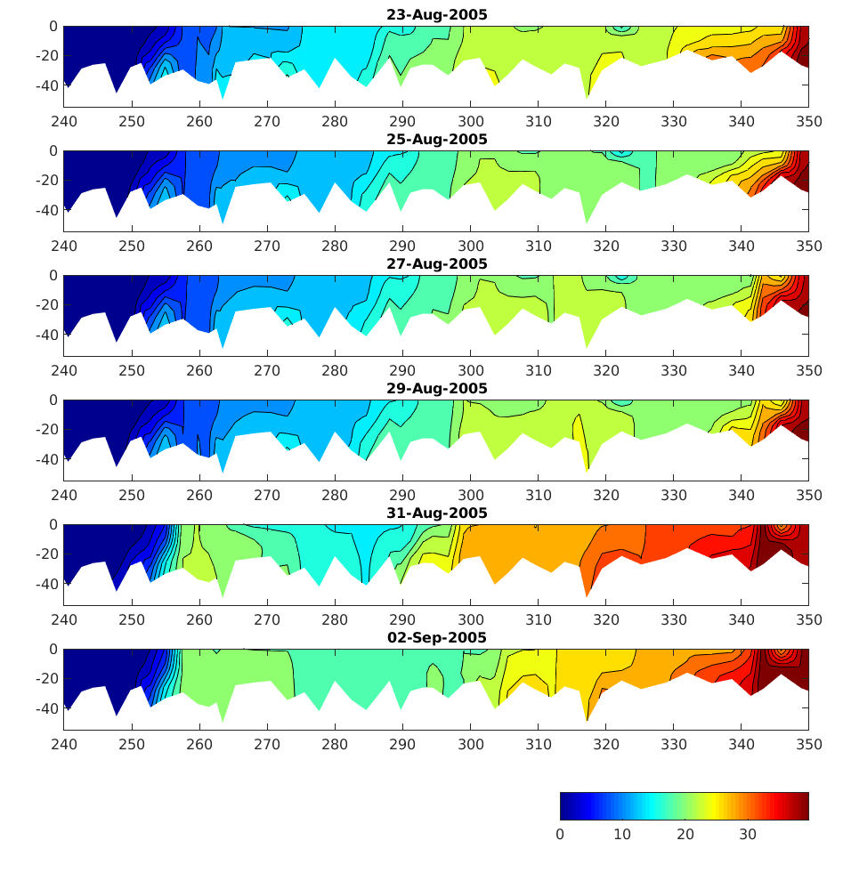
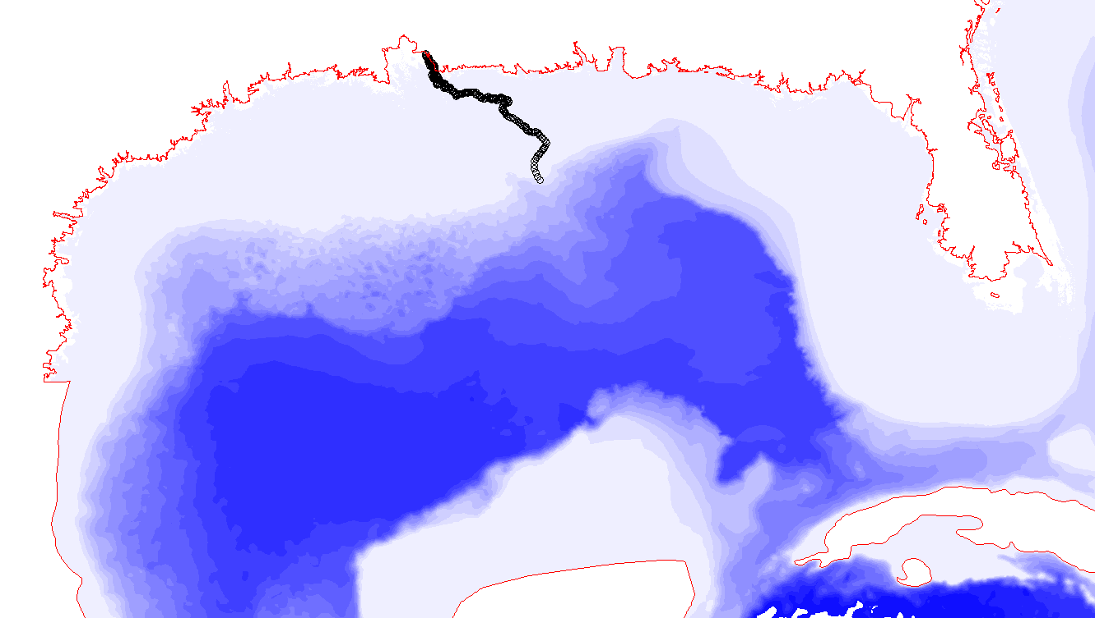
Along-channel salinity distribution in the Mississippi River
Stratification before the storm
Mississippi River
Landfall of Katrina
Salinity intrusion after the storm
z (m)
Simulation ends before the river flooding period
If the simulation extends to the river flooding period, salinity should be pushed seaward again.
upstream
Along-channel distance (km)
downstream
Salinity (PSU)

Slide 12
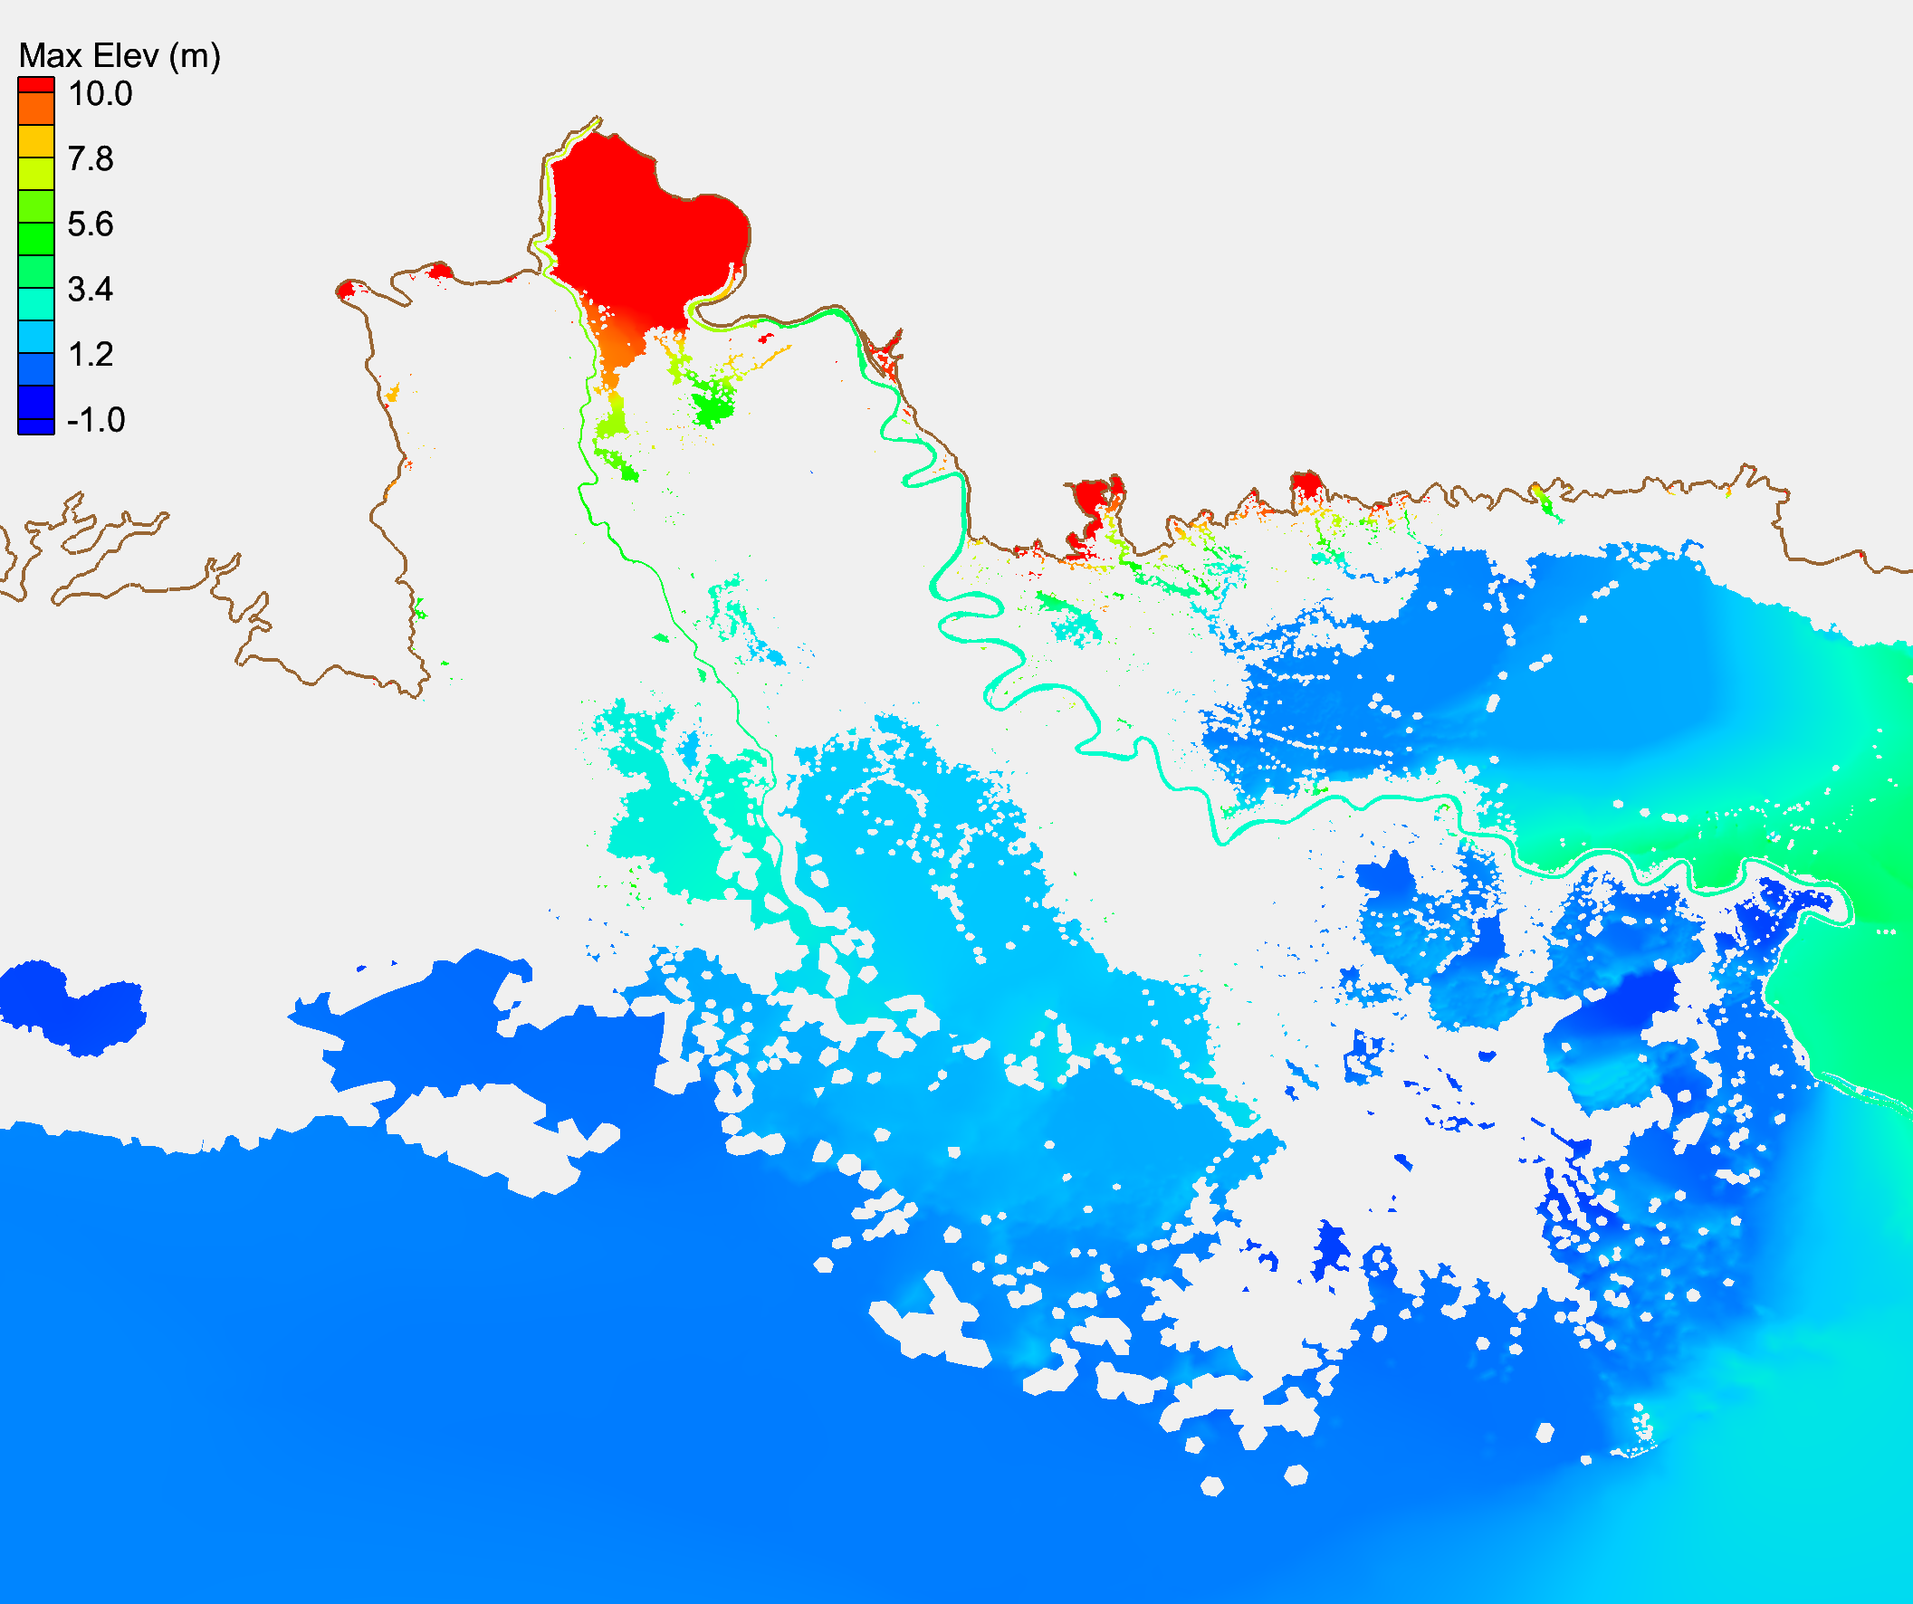
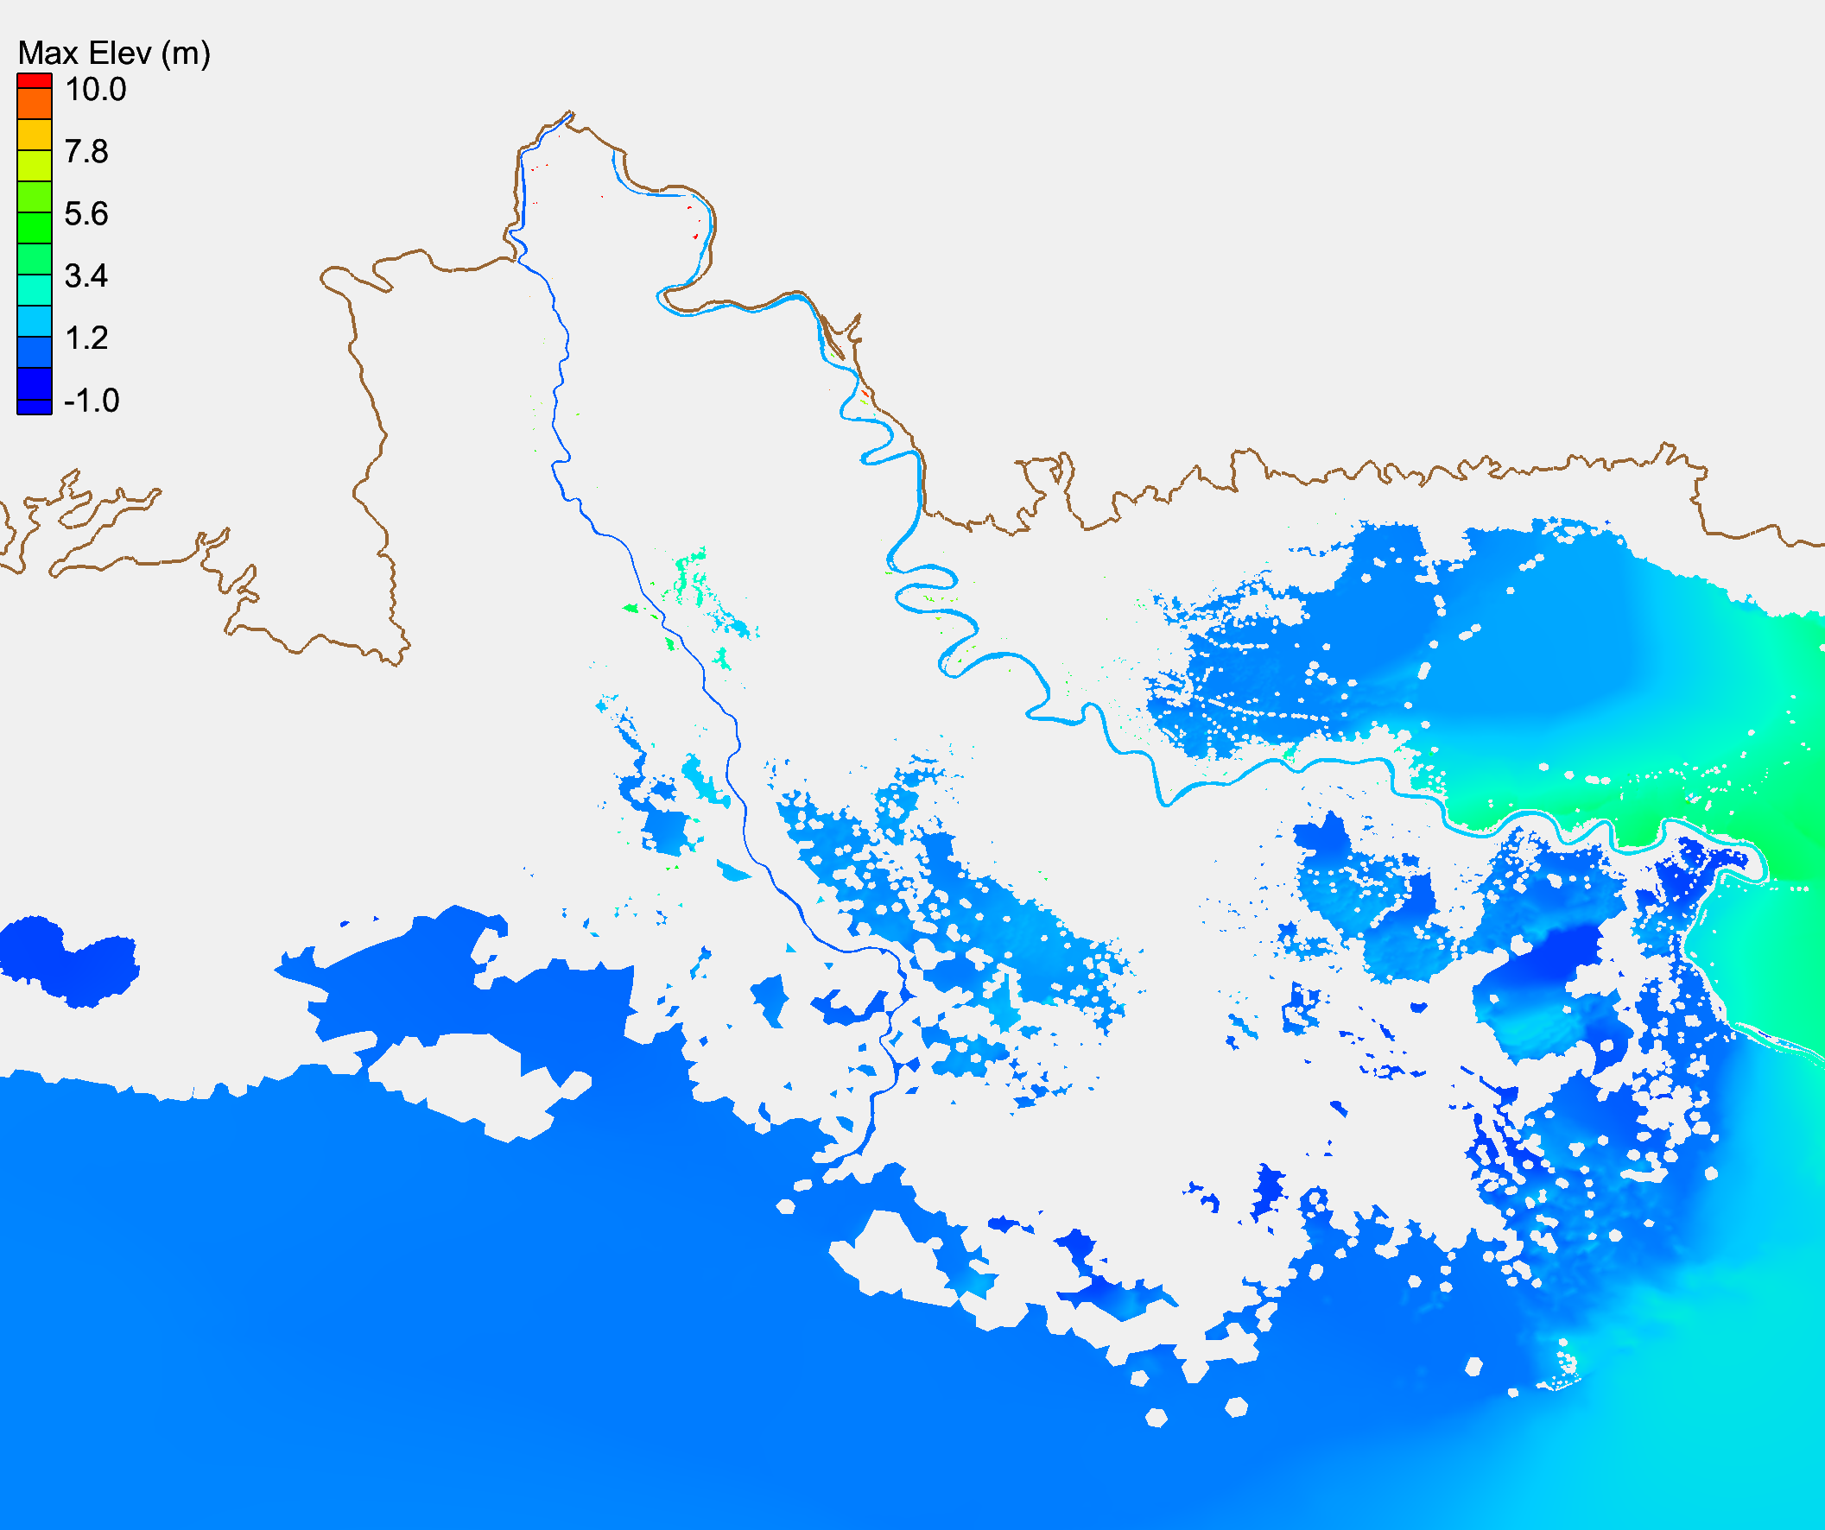
Simulated maximum elevation with/without NWM
With NWM
Without NWM

Slide 13
Manuscript 1: Tidal Simulation Revisited
¹Wei Huang, ¹Y. Joseph Zhang, ¹Fei Ye, ¹Karinna Nunez ²Saeed Moghimi, and ²Edward Myers, ¹Haocheng Yu,
¹ Virginia Institute of Marine Science, College of William and Mary
² NOAA National Ocean Service
Abstract: Accurate simulation of tides nearshore is necessary for any hydrodynamic model and a pre-requisite for other more complex processes. This study highlights the most important factor of simulating tides: the bathymetry. Main controls of tidal simulation are assessed: bottom friction, horizontal resolution/quality of model grid, quality of DEMs, high-order numerics and time step. The results show that the model can only perform well if high-quality DEMs are available and bathymetry is properly represented with locally high grid resolution, thus demonstrating the central role played by bathymetry in tidal simulation.

Slide 14
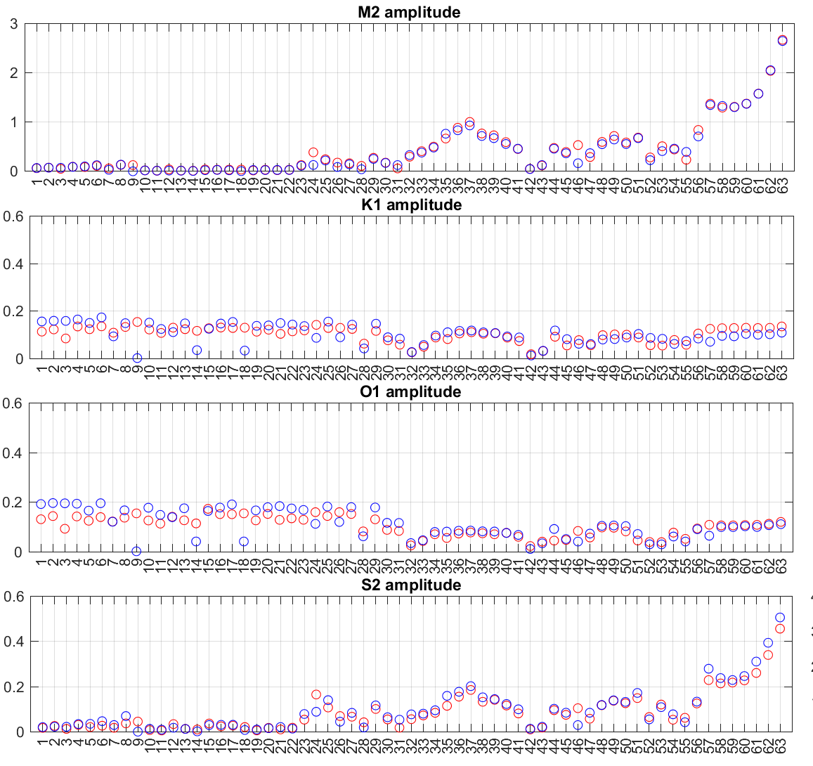
Validation of major tidal constituents
Cedar Key, FL
stations that are highly uncertain due to low-quality DEMs
Tidal amplitude (m)
Wachapreague No high quality DEMs
SCHISM
OBS
stations

Slide 15
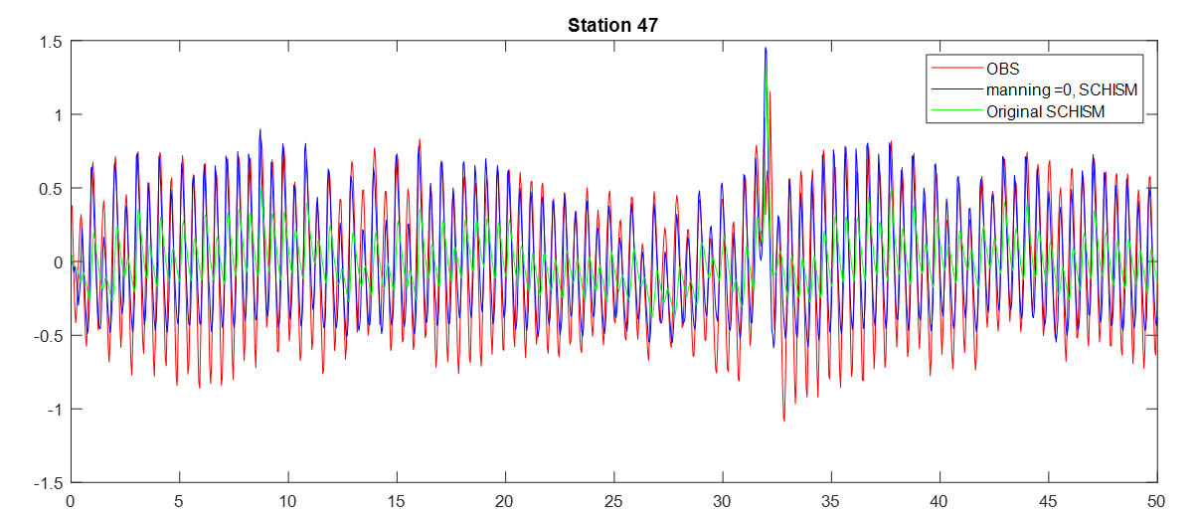
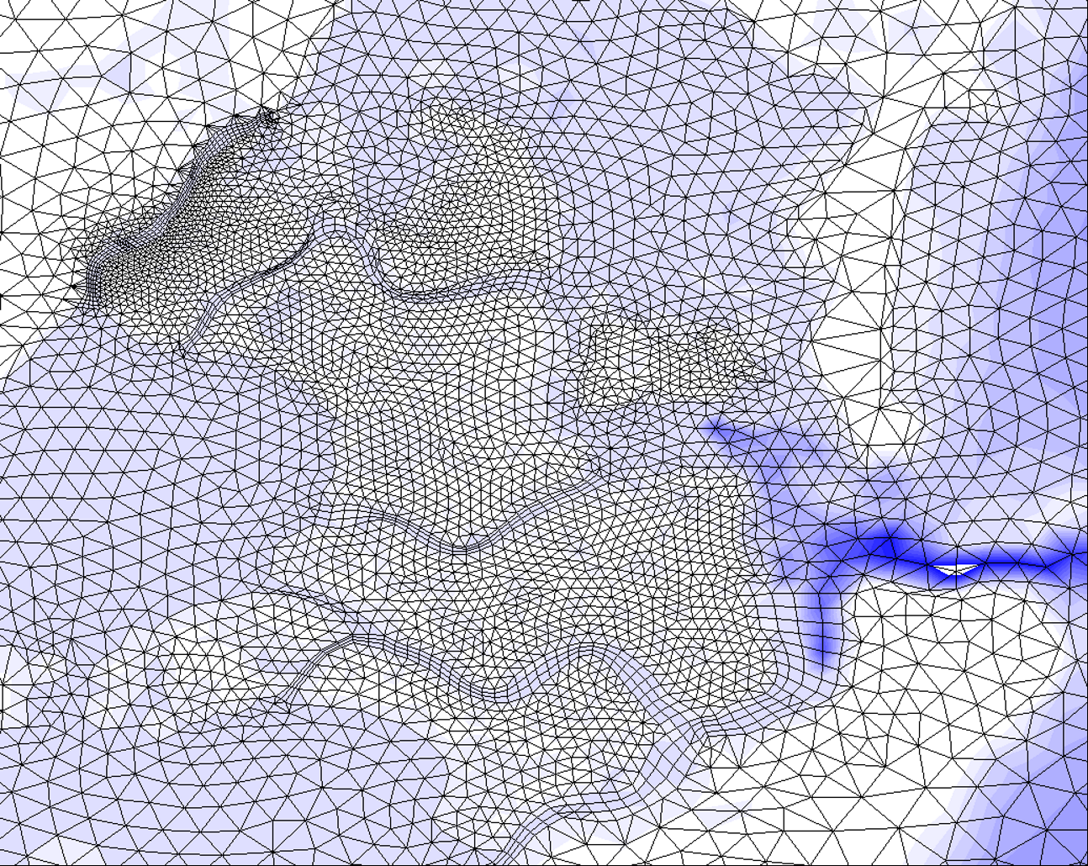
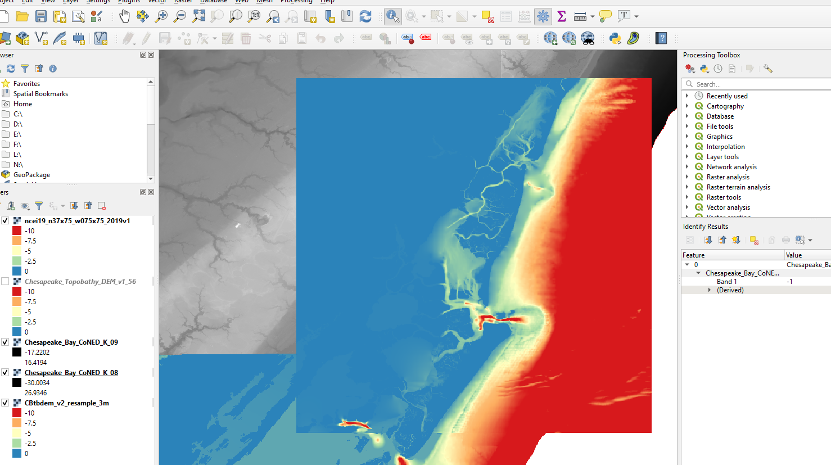
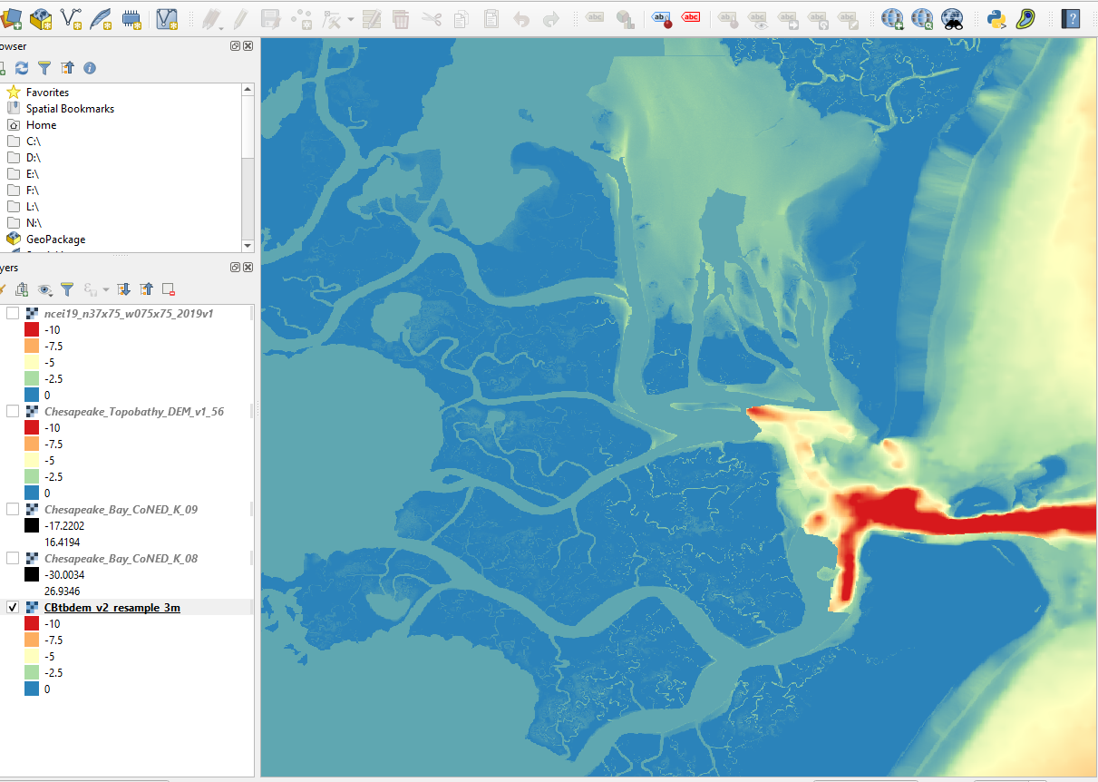
Unable to fix Wachapreague station due to bad quality DEM
Simulated tides are severely under-estimated at this station
Setting bottom friction for the nearby region to be 0 improves the results but this choice is not defensible (prevalence of vegetations locally)
Resolving grid with higher resolution did not help
Real culprit: fake values in the high-resolution DEM

Slide 16
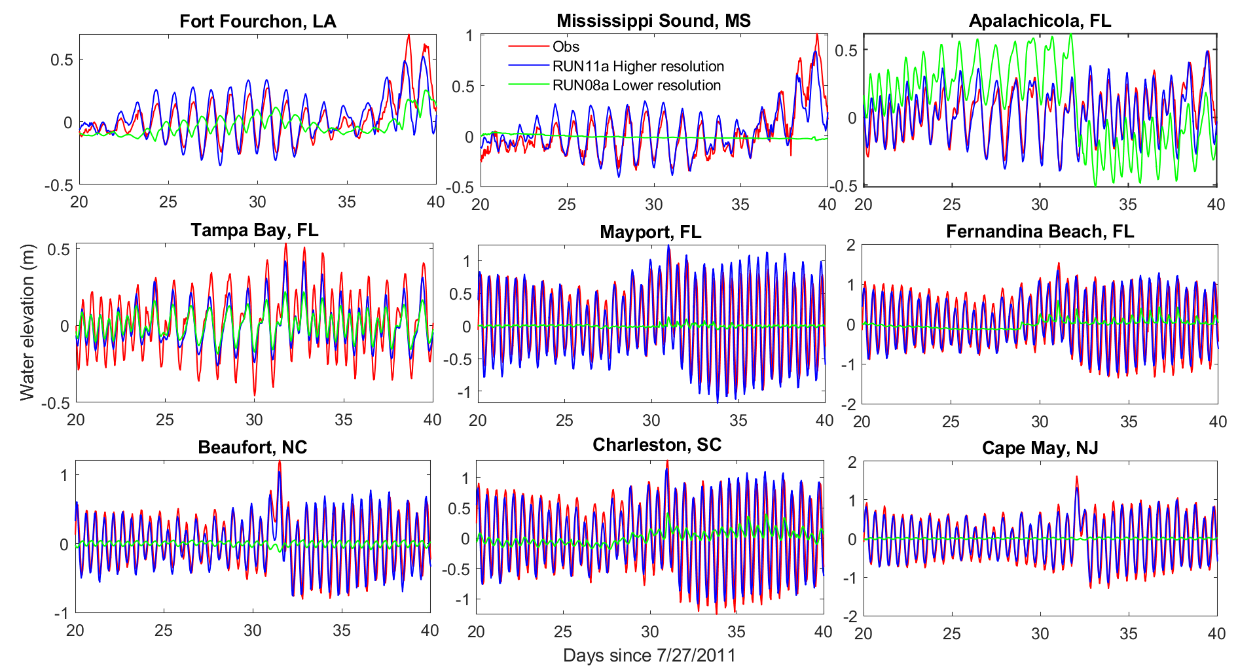
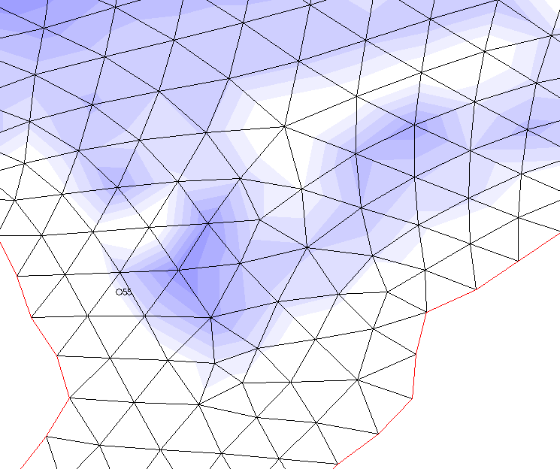
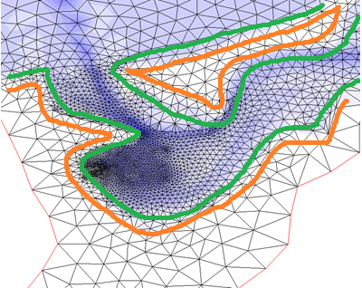
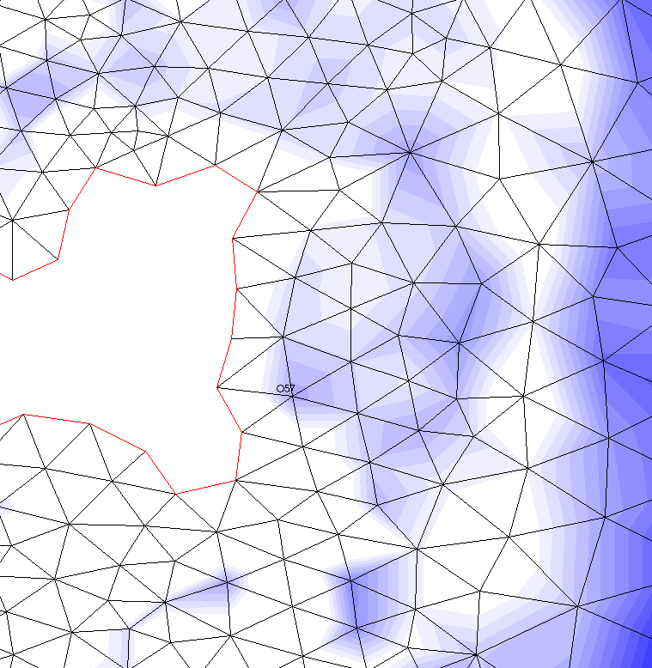
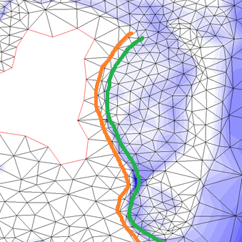
Importance of resolving bathymetry based on high quality DEMs
Given that high resolution/quality DEMs are available in most areas, resolving grid to well represent bathymetry is found to be the most importance factor in improving model skill
Resolved
Not resolved
Nantucket Island, MA
Chatham, Lydia Cove, MA

Slide 17
Conclusions for paper
Without good quality DEMs, adjusting friction may not always be able to compensate fully
Without good quality DEMs, high-order numerics or baroclinicity cannot make up for the deficiency*
Good quality DEMs yield accurate results only if the grid well resolves the bathymetry/geometry
Mesh quality plays a relatively minor role in SCHISM’s performance*
* more evidence is being gathered to support some of these conclusions

Slide 18
Manuscript 2: Wind induced quasi-steady state balance for 12 coastal water bodies along east and south coast
¹Wei Huang, ¹Joseph Zhang, ¹Fei Ye, ²Chunyan Li, ¹Haocheng Yu, ¹Karinna Nunez, ³Saeed Moghimi, and ³Edward Myers
¹ Virginia Institute of Marine Science, College of William of Mary
² Department of Oceanography and Coastal Science, School of Coast and Environment, Louisiana State University
³ NOAA National Ocean Service
Abstract: Quasi-steady state balance is an equilibrium state controlled by a simple first order linear equation between wind and pressure gradient. It was found in multiple water bodies along Louisiana coast including Lake Pontchartrain, Barataria Bay, Calcasieu Lake, and an Arctic lagoon: Elson lagoon. This paper checks 12 coastal water bodies along east and south coast of the continent of United States using SCHISM. The results indicate that quasi-steady state is fulfilled for all the 12 coastal water bodies. The accuracy of the quasi-steady equation depends greatly on the geometry/shape/opening of each system.

Slide 19
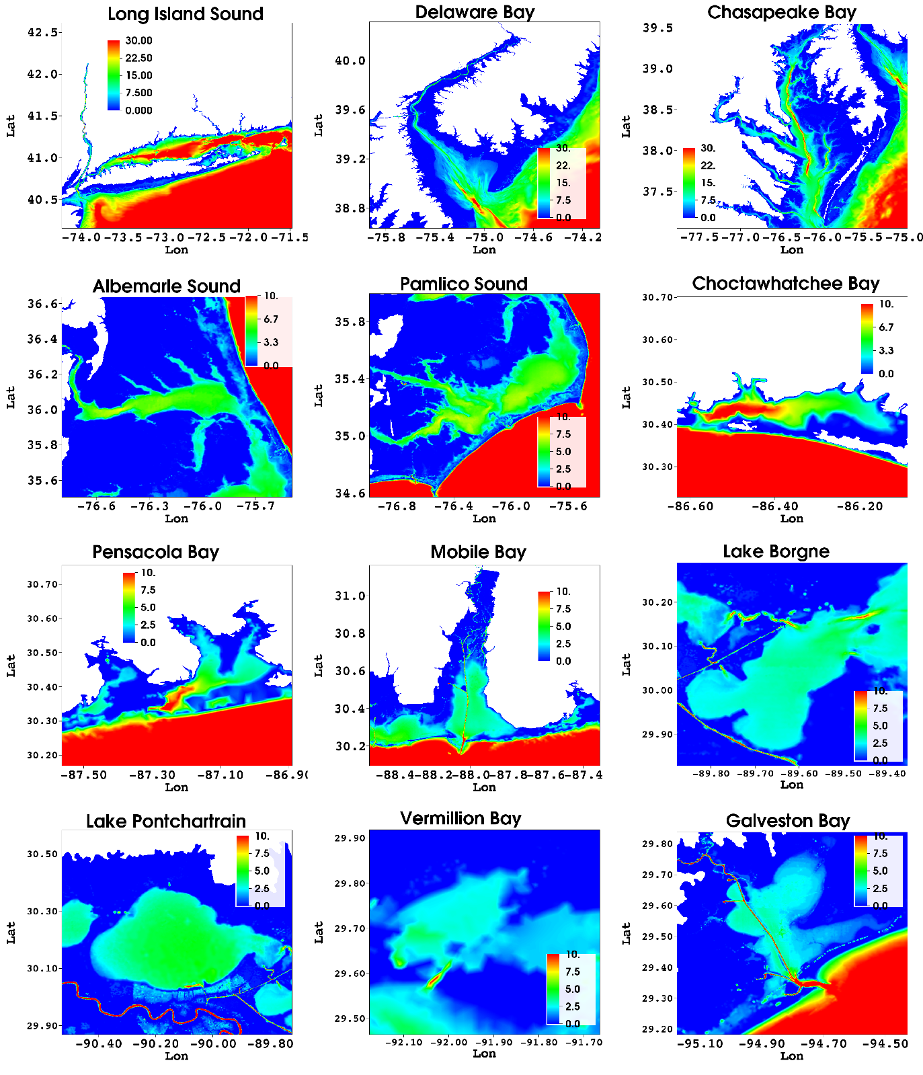
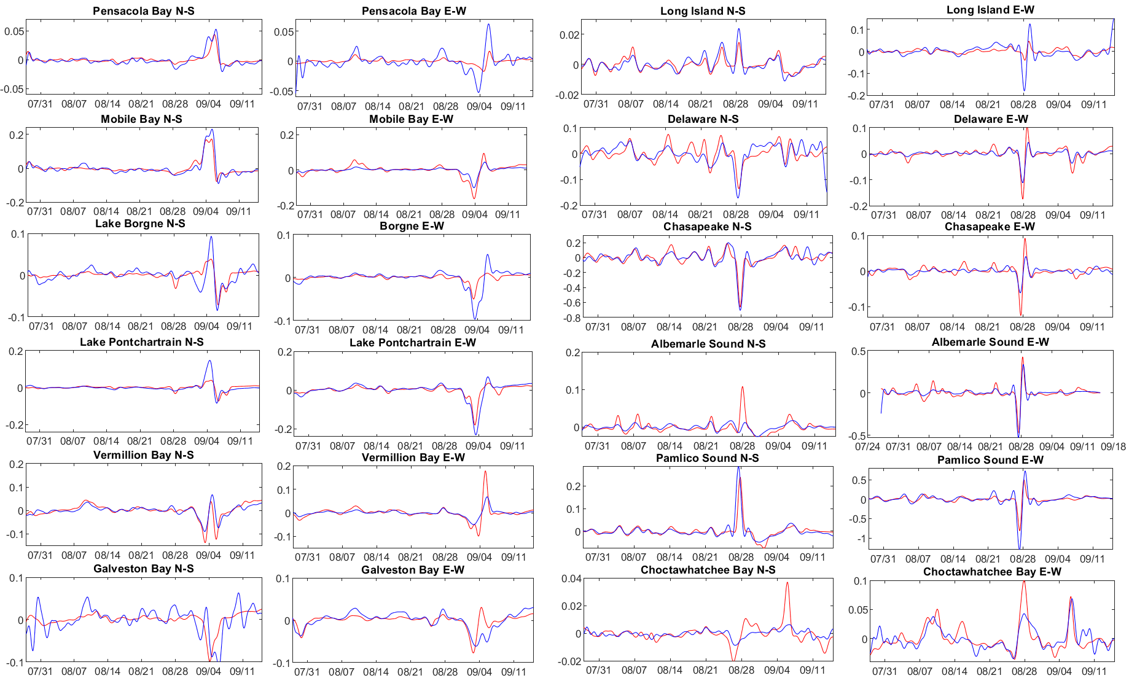
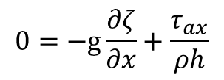
Take advantage of SCHISM’s creek-to-ocean, summit-to-sea capability
Apply quasi-steady state equation to 12 coastal water bodies
Quasi-steady state balance is an equilibrium between pressure gradient and wind stress by the following equation
$$0=−g\frac{∂ζ}{∂x}+\frac{τ_{ax}}{ρh}$$

Slide 20
Manuscript 3: Comparison of storm surge induced by multi-scale atmospheric systems
¹Wei Huang, ¹Y. Joseph Zhang, ¹Fei Ye, ¹Karinna Nunez ²Saeed Moghimi, and ²Edward Myers, ¹Haocheng Yu,
¹ Virginia Institute of Marine Science, College of William and Mary
² NOAA National Ocean Service
Abstract: In Sep, 2011, Tropical storm Lee has great impact on Louisiana coast, which follows a few days after Hurricane Irene. Tropical storm Lee is unique in a sense that it combined with a strong cold front event, thus has significant impact on the coastal area. This manuscript aims to study the effect of different scale of atmospheric systems including cold front, tropical storm, and hurricane in 2011 on the hydrodynamics by 3D SCHISM model.

Slide 21
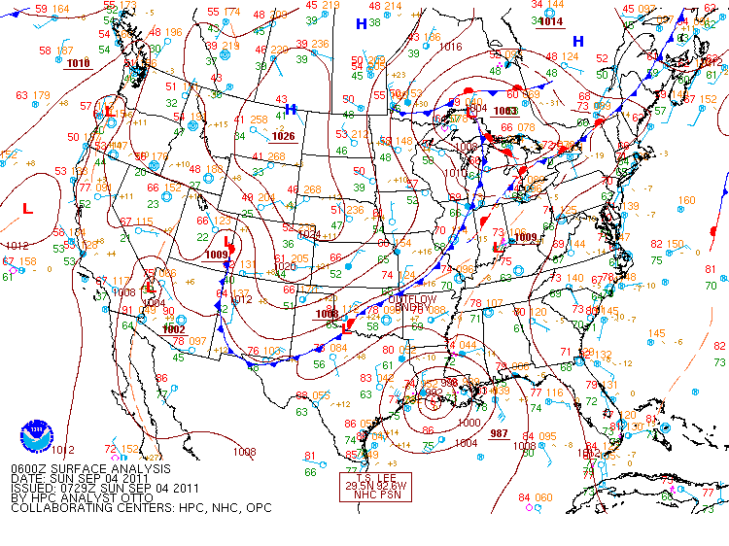
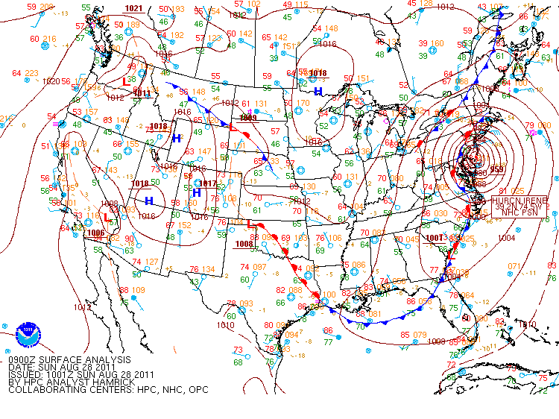
Objectives: study the responses of hydrodynamic responses to different types of weather systems.

Slide 22
Ongoing work
Add all remaining levees in lower Mississippi (Wei)
3D simulations and calibration of 4-5 hurricane events (Wei & Fei)
Efficient auto detection algorithm for thalwegs in watershed using ArcGIS Pro (Karinna)
Thanks!

