Slide 1
Progress on 3D project
Wei Huang, Fei Ye, Joseph Zhang, Dan Yu
Aug 2020

Slide 2
Major progresses
Sensitivity tests of parameters controlling heat exchange:
RUN30a: hmin_airsea_ex=1mm,
RUN30b: albedo=0, watertype=7 in GoMx region
RUN30c: hmin_airsea_ex= 0.1mm
Finally determine hmin_airsea_ex=1mm to be base run
Sensitivity tests to separate forcing
RUN30d: ocean effect only (hurricane + tides)
RUN30e: NWM flow only
RUN30f: precipitation only
Analyzing results and drafting manuscript

Slide 3
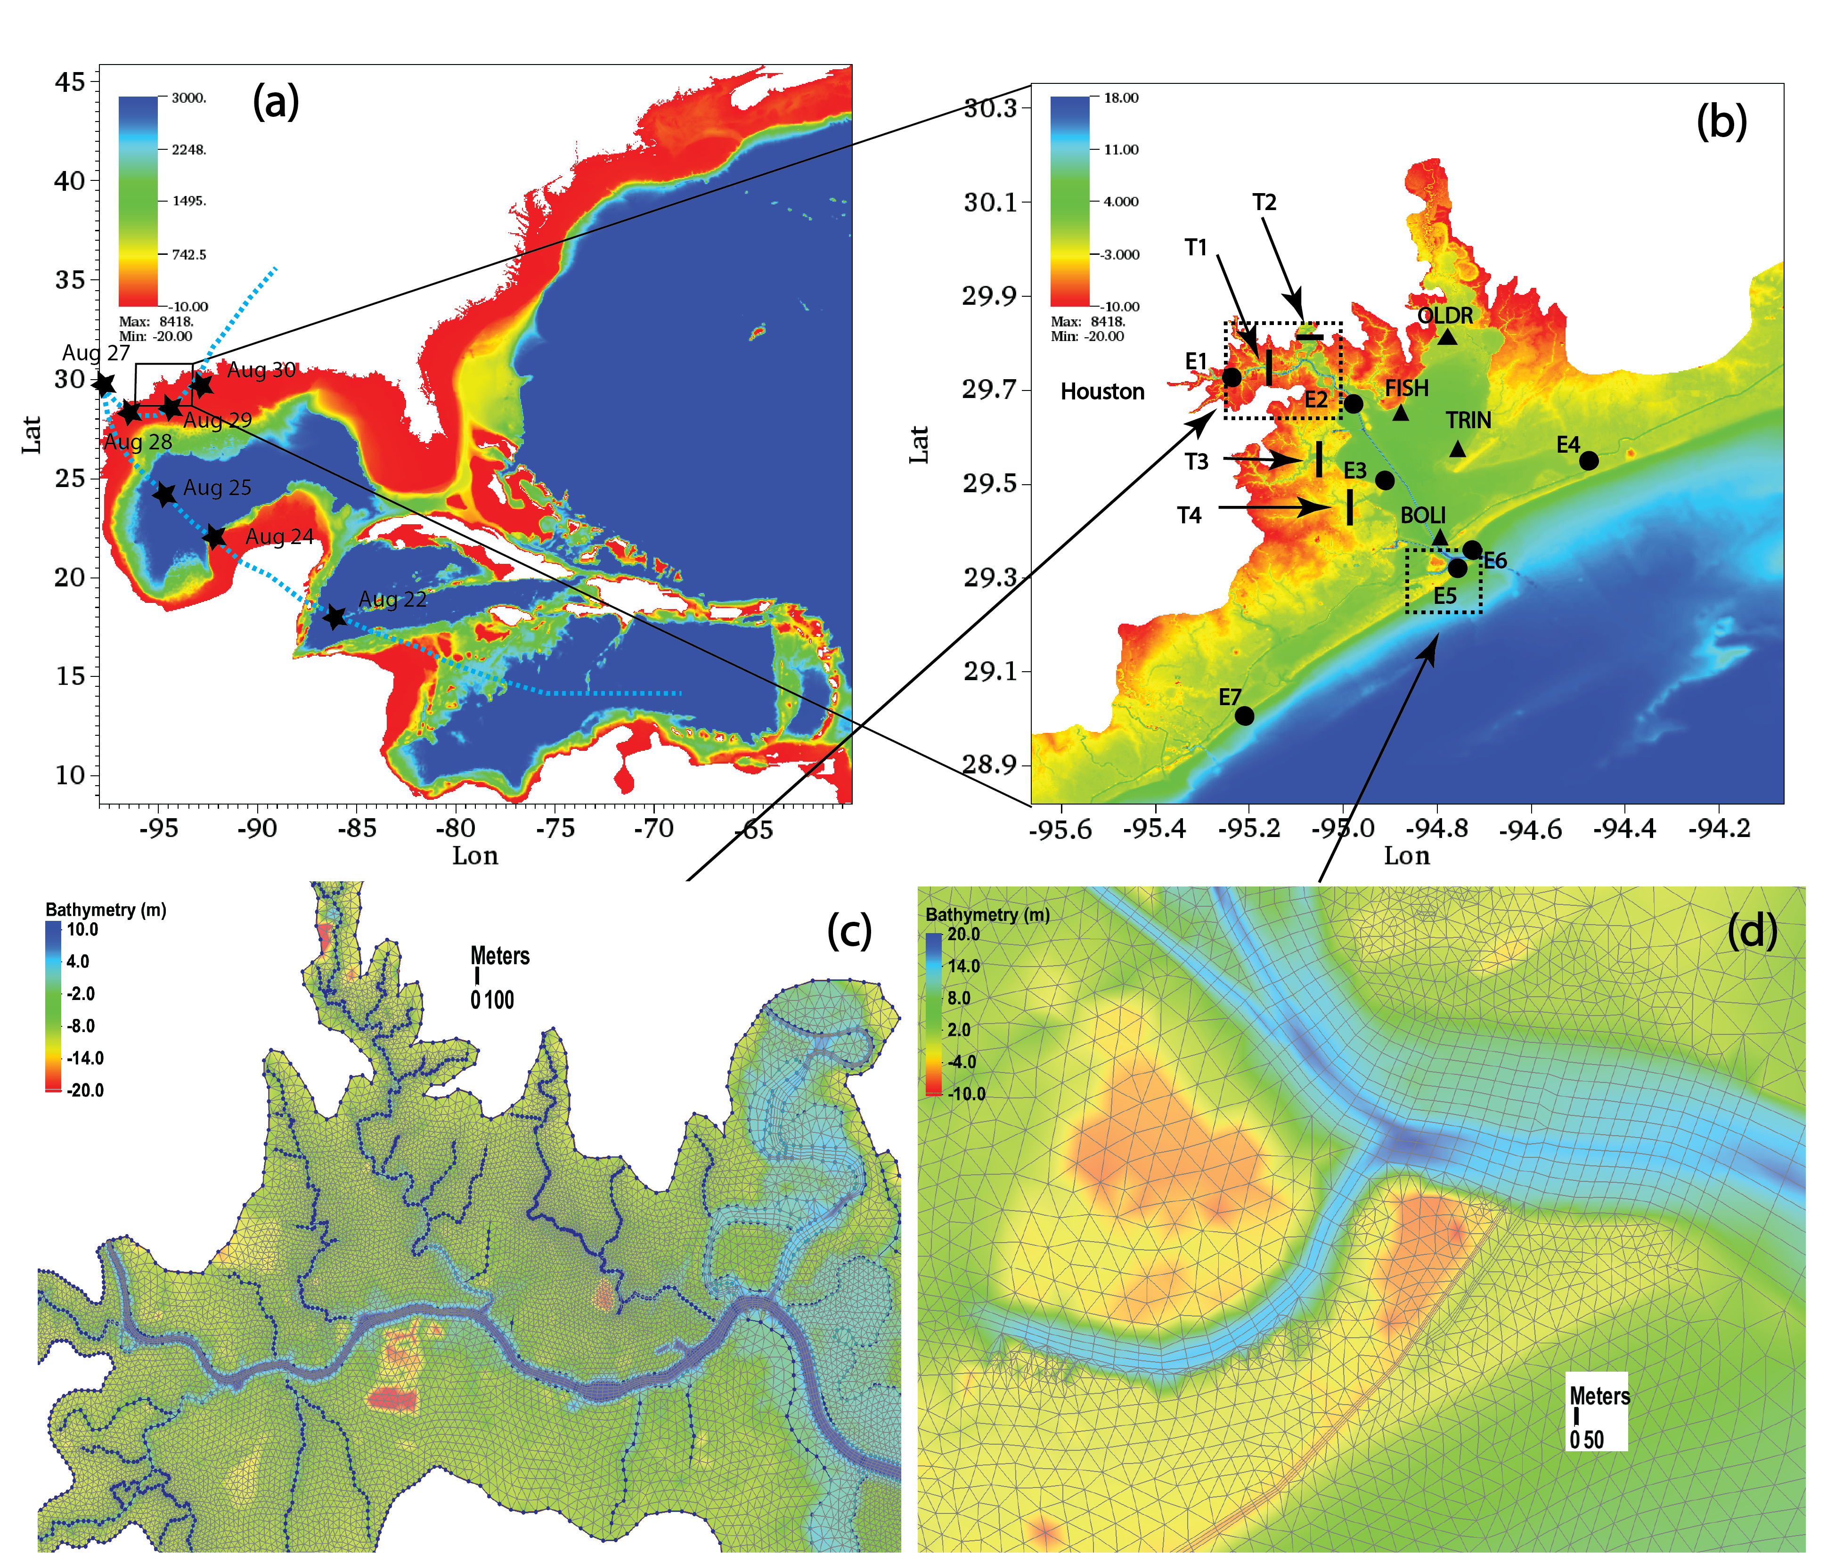
Horizontal grid
Mesh domain and bathymetry used for simulation.
Fig. a shows the whole domain of hgrid
Fig. b shows the study region of Galveston bay with observation stations
Fig. c and d reveals channels, seawalls, and levees by quads in hgrid

Slide 4
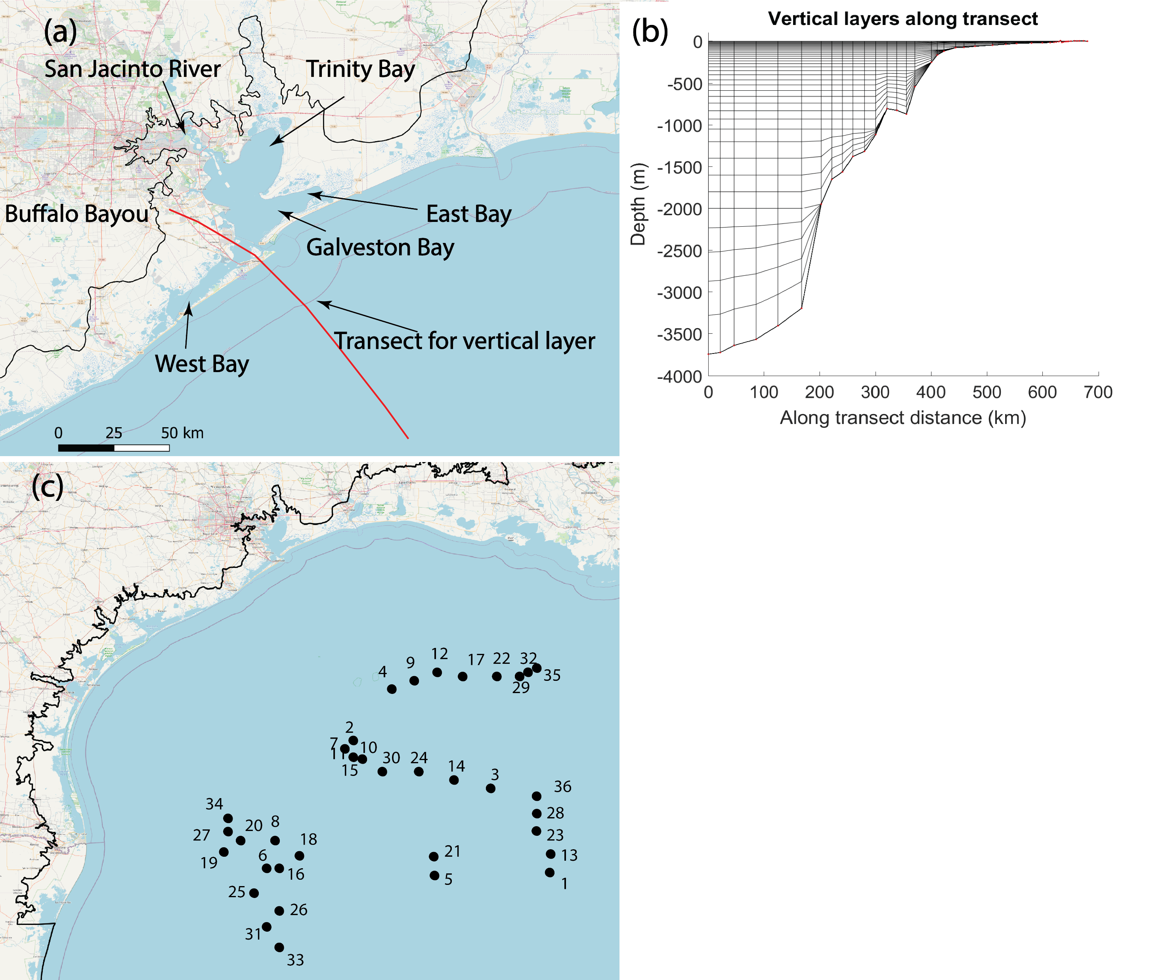
Vertical grid
shows the geographical info of study area,
shows the vertical grid ,
shows locations of Argo profiles.

Slide 5
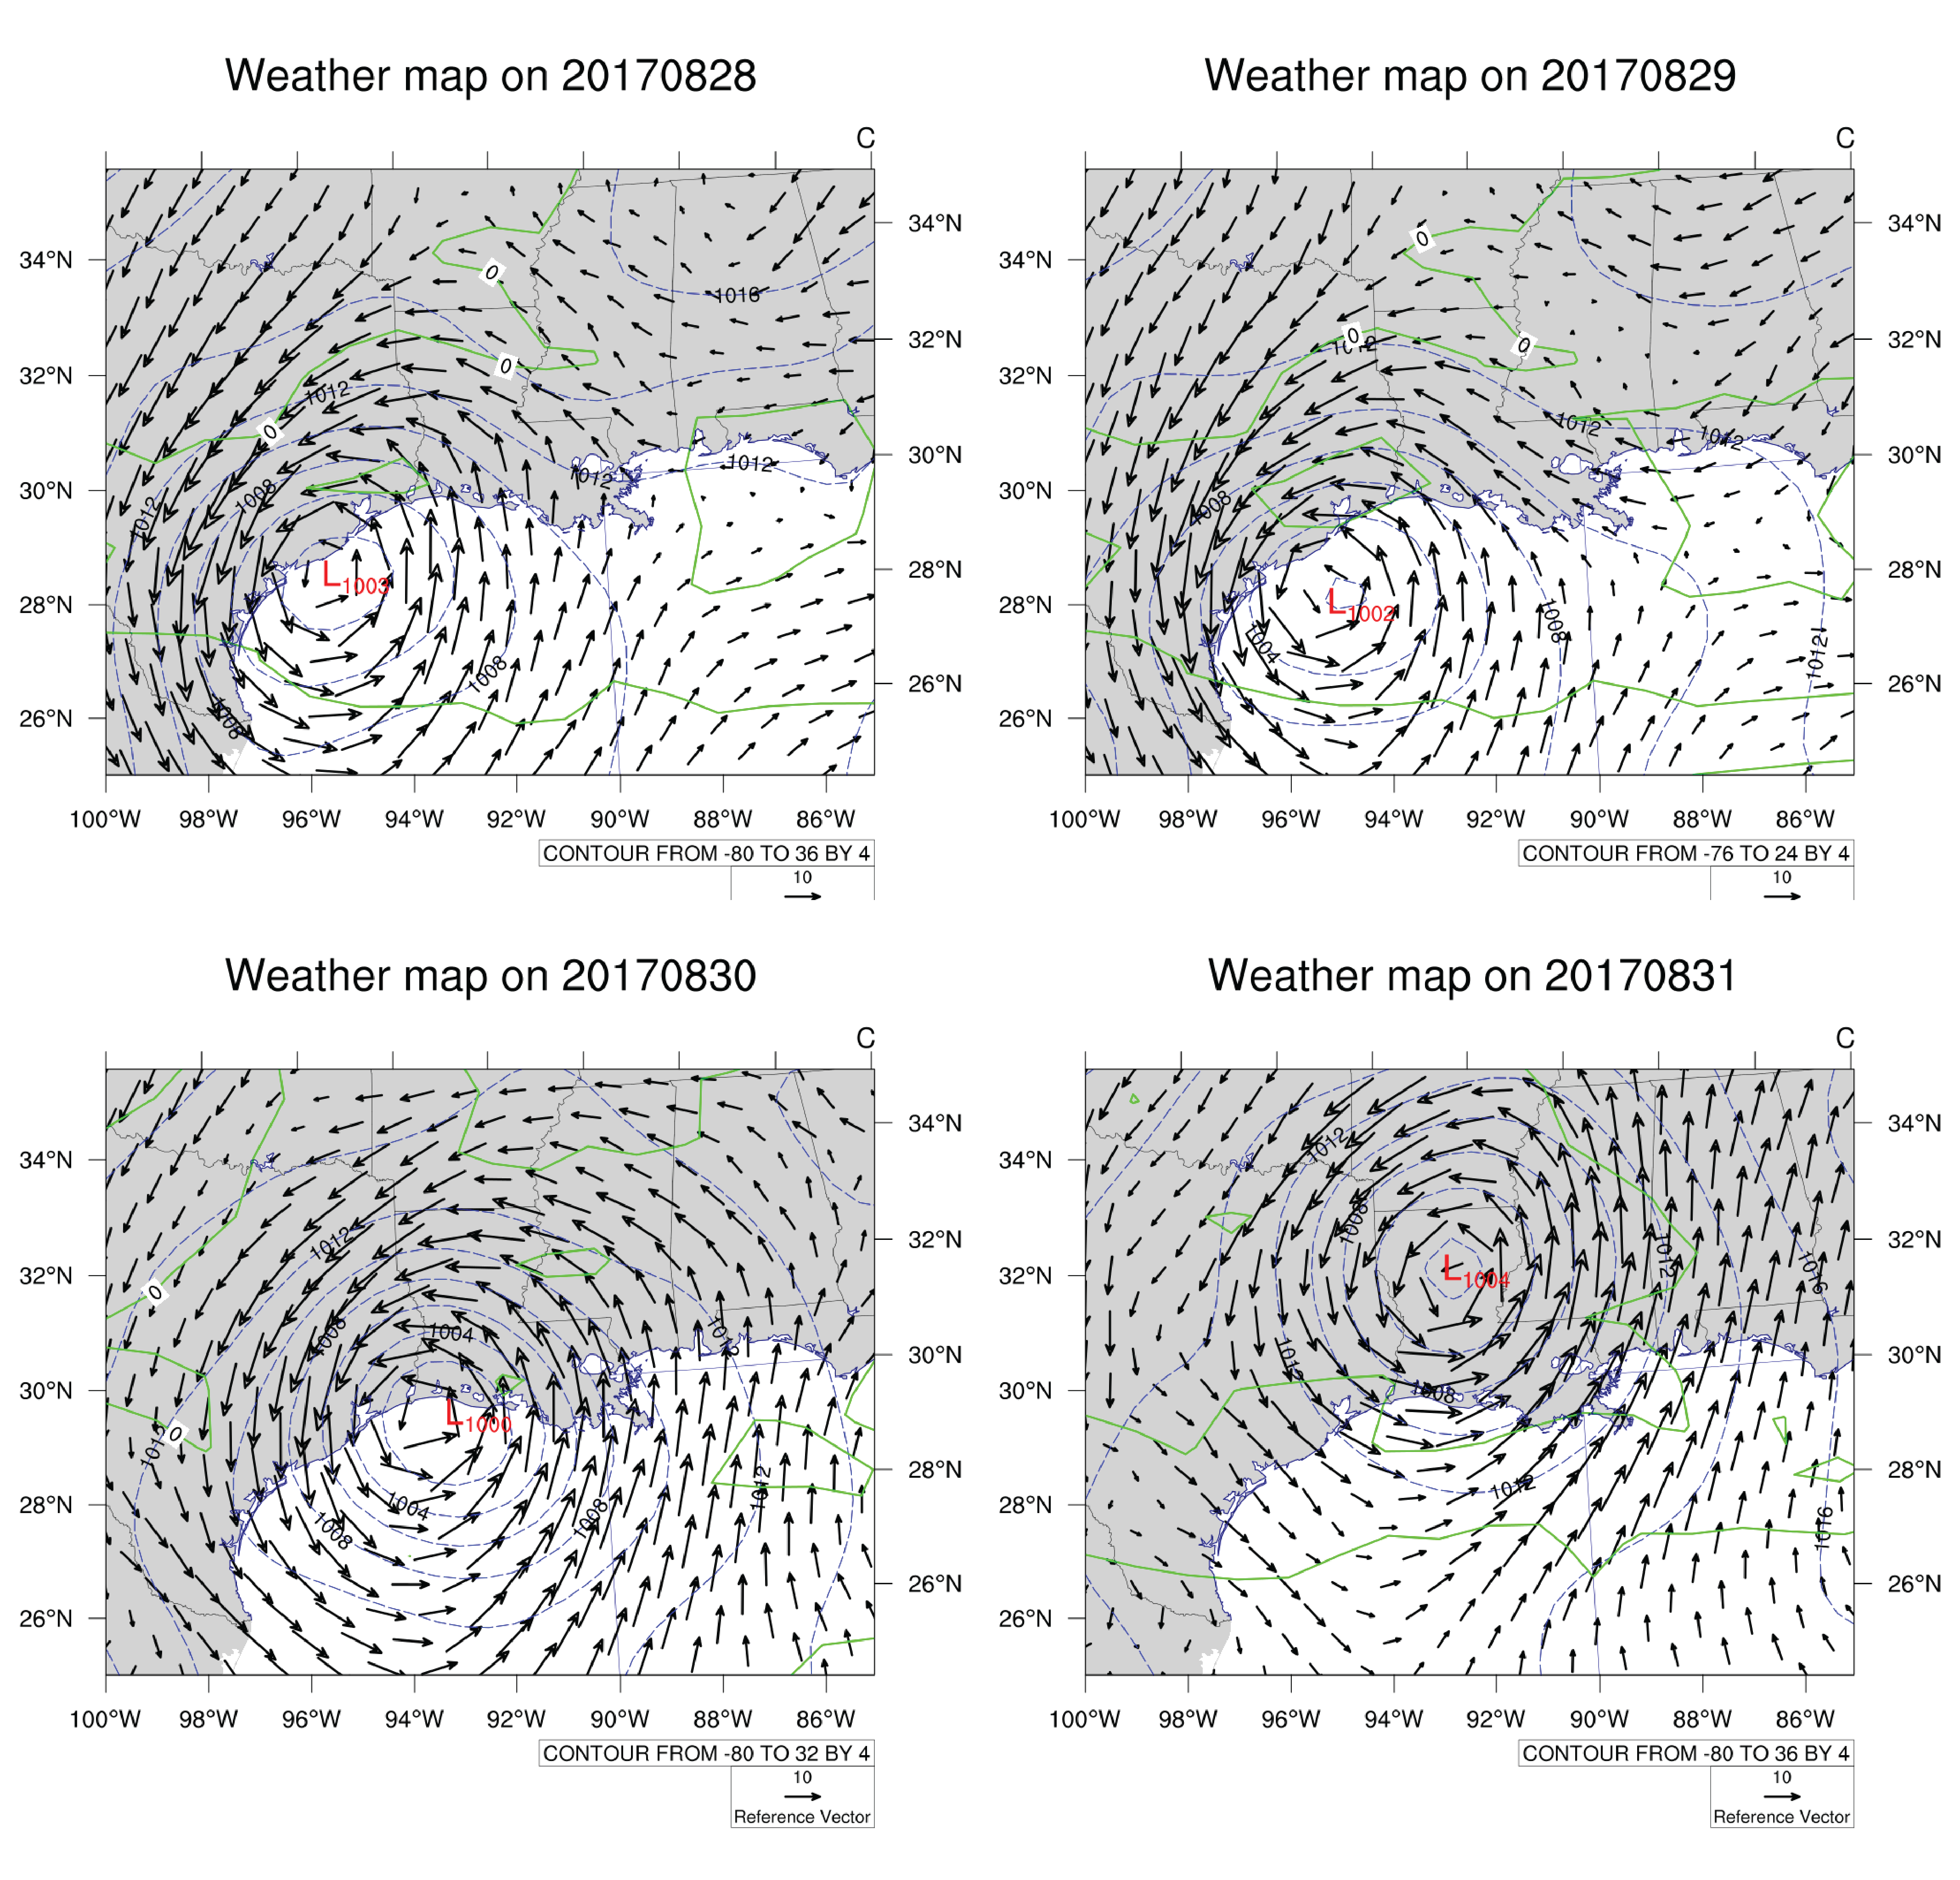
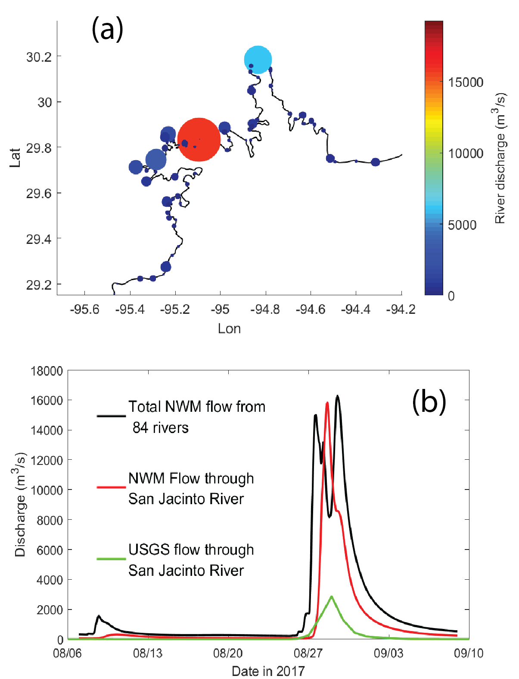
Input flows and weather background
(a) Flows from NWM coupled into SCHISM, and (b) summation of all 84 flows inside Galveston Bay (excluding SJ) compared with flows through San Jacinto River only.
Weather maps for Hurricane Harvey. Arrows show wind vectors at 2m above, blue lines are air pressures (hPa), green lines are dew point temperature (Td).

Slide 6
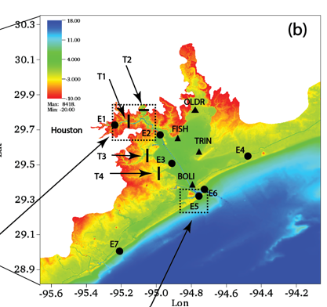
Validation of water level and along channel velocity
Calibration of along channel surface velocities of E2 and E5 stations (positive seaward). MAE are 0.25 m/s for E2 and 0.32 m/s for E3, CC are 0.90 for E2 and 0.85 for E3.
Validation of water level of E1-E7 stations. Vertical datum is NAVD88. Blue lines are model results, red dots are observations. Averaged MAE for RUN30a: 0.13 m

Slide 7
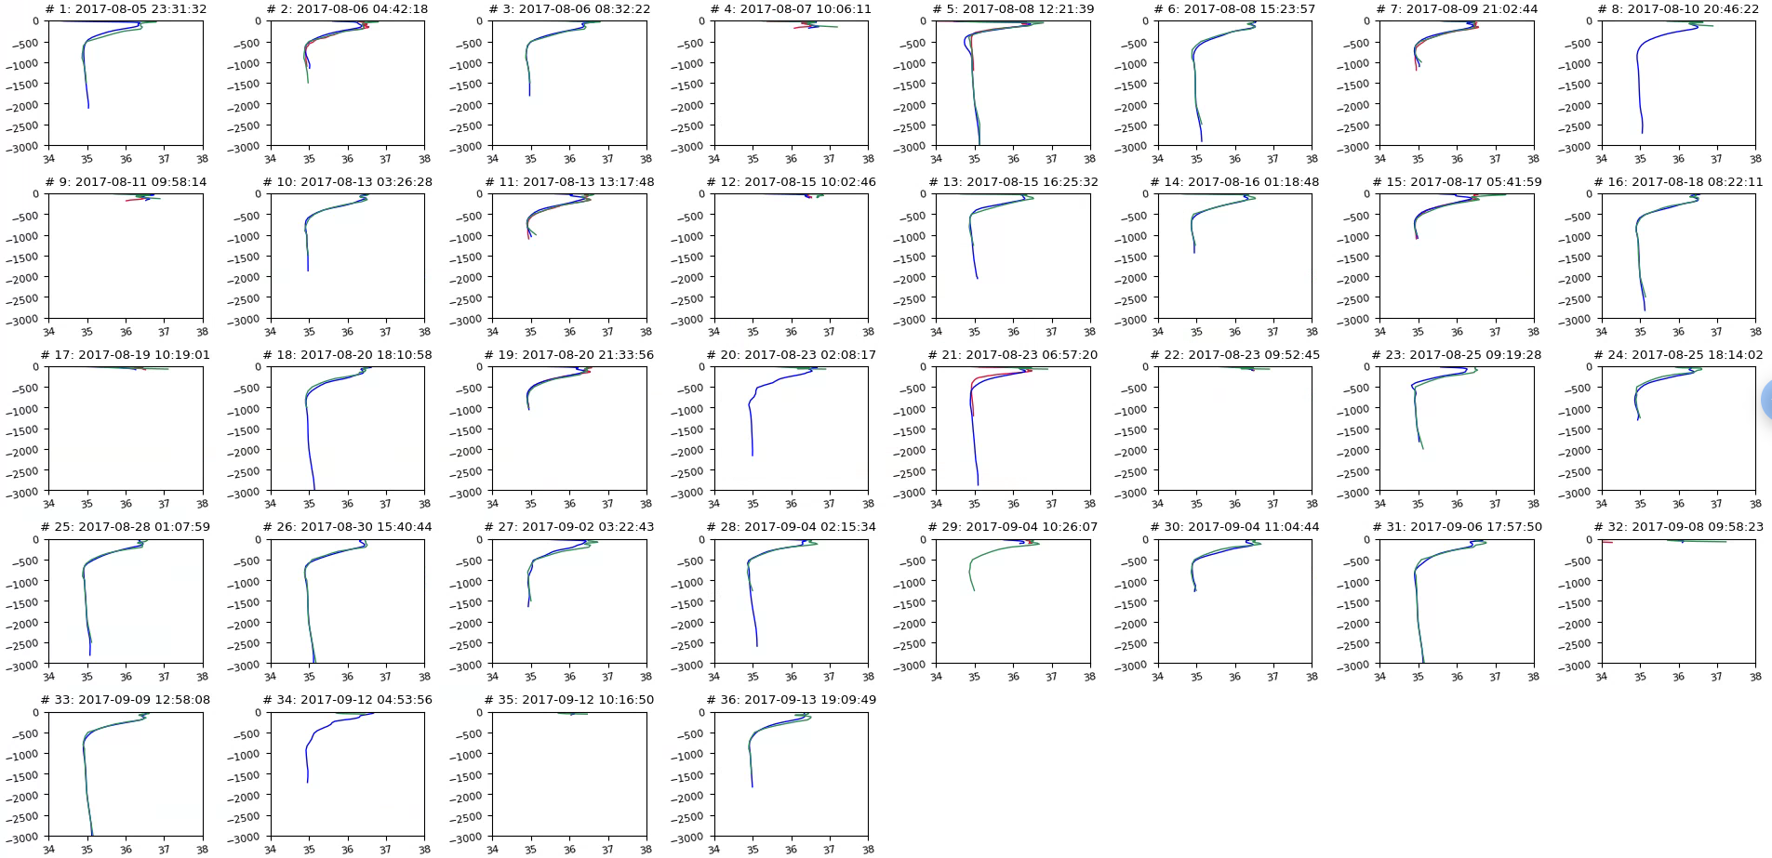
ARGO Salinity ( : no data)
SCHISM HYCOM (data assimilated)
Comparison of salinity with Argo profiles
z (m)
Sal (PSU)

Slide 8
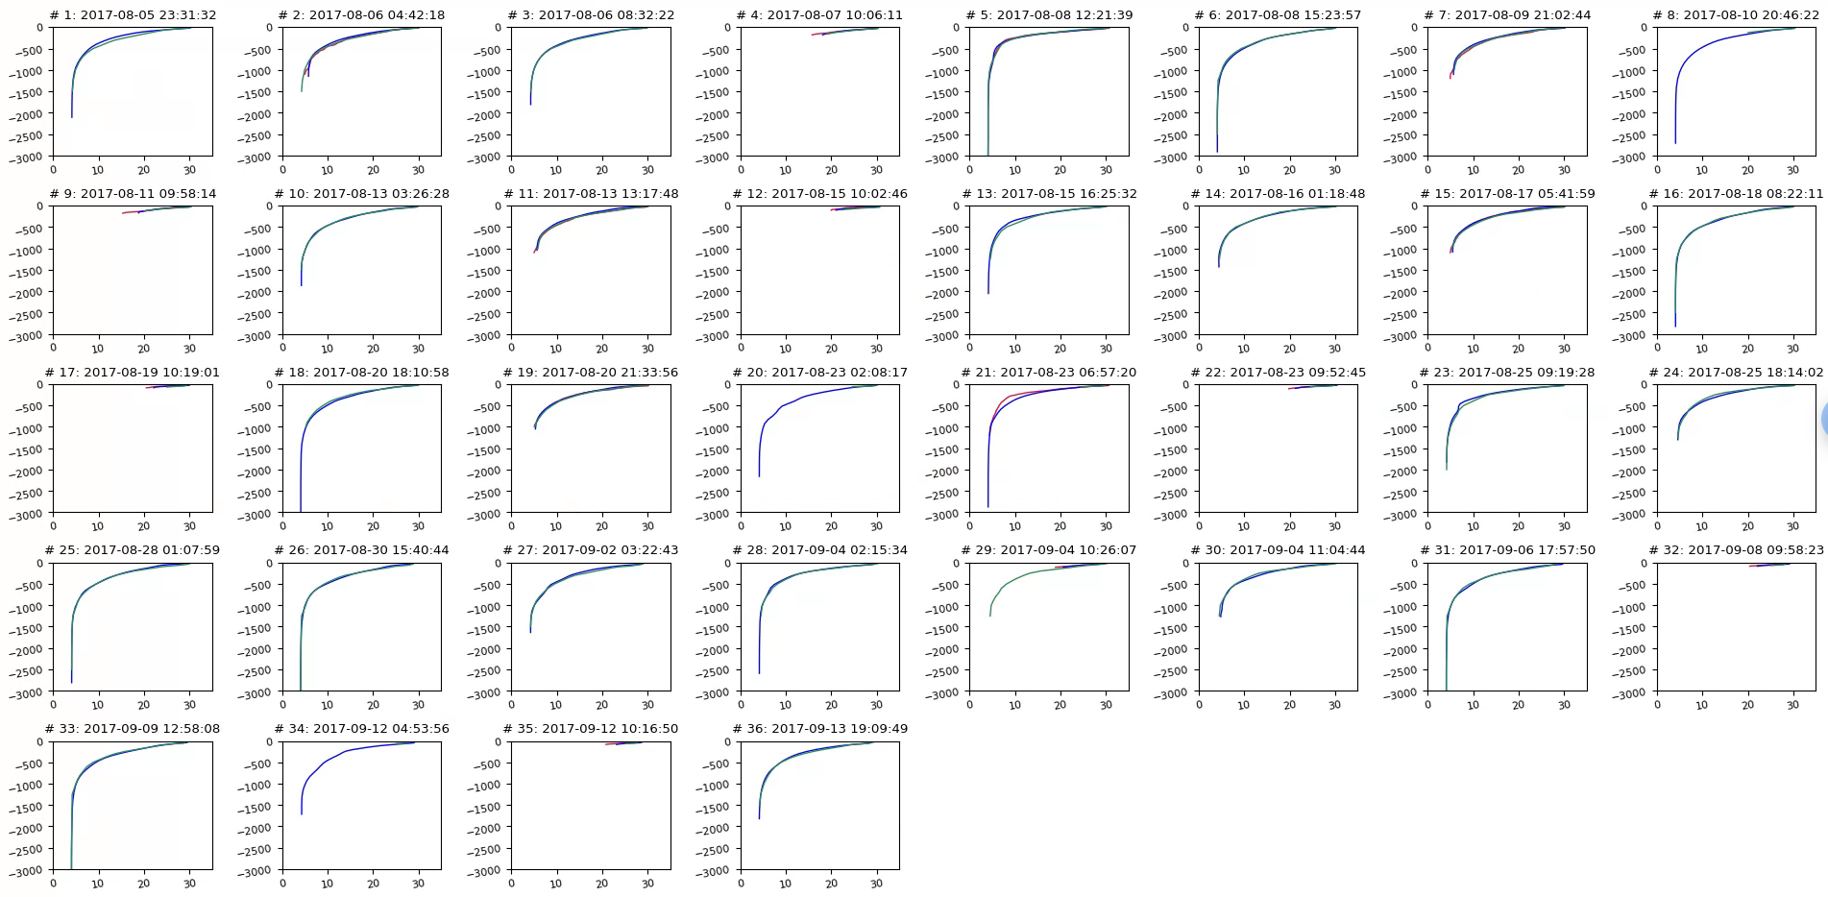
Comparison of temperature with Argo profiles
ARGO Salinity ( : no data)
SCHISM HYCOM (data assimilated)
z (m)
T (ºC)

Slide 9
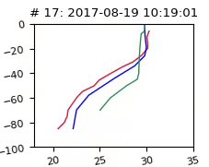
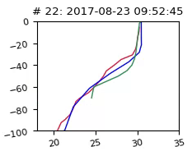
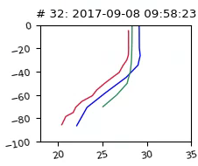
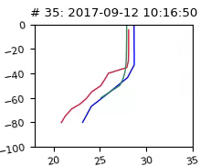
Hurricane signals from surface temperature
Mixing layer becomes deeper as Hurricane Harvey approaches
Wind speed: 3.2 m/s
Wind speed: 4.5 m/s
Wind speed: 8.3 m/s
Wind speed: 4.1 m/s
z (m)
T (ºC)

Slide 10
Comparison of salinity/temp with observed time series
The model successfully captured the dramatic drop in S (and some drop in T as well) during the storm, especially near the entrance, and also the rebounding of S at BOLI after the storm due to seawater re-intrusion.
Negative biases in T may have originated from watershed as seen at OLDR. averaged MAE for salinity and temperature are 1.97 ppt and 1.88 oC, respectively.

Slide 11
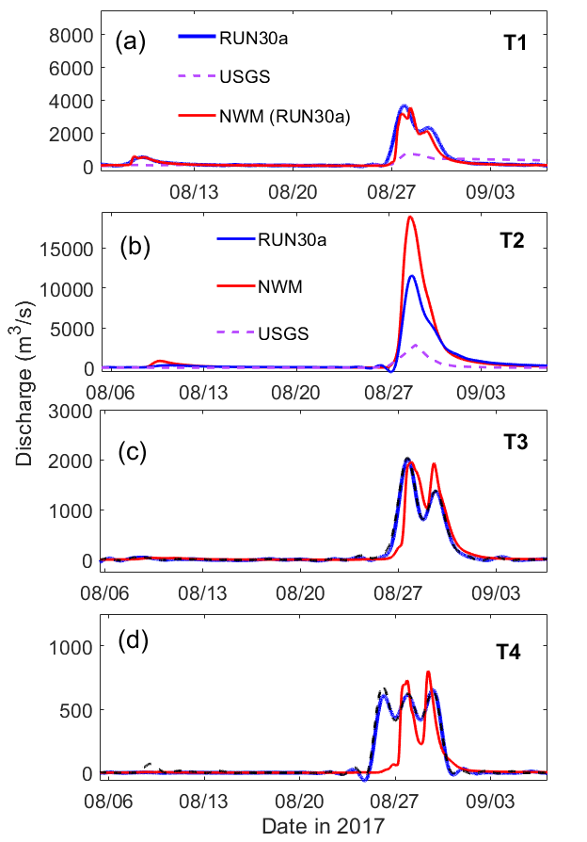
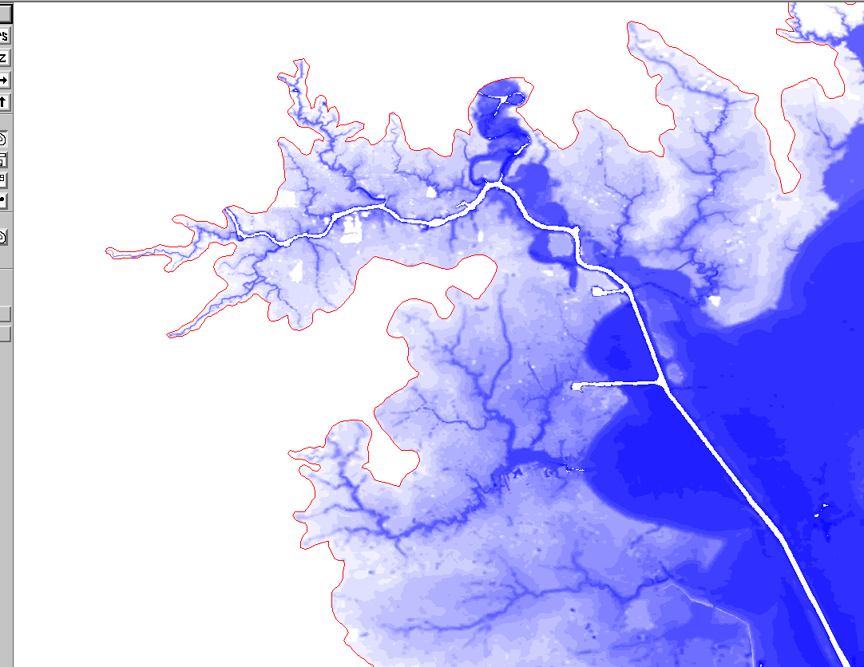
Comparisons of river flows through 4 transects between that from NWM, USGS, and modeled results.
T2
T1
T3
T4
At the first 2 transects, SCHISM results lie between NWM (which tends to over-predict flow) and USGS (which may also have errors, as the peak @ SJ seems to be close to Buffalo B.);
There is generally agreement between NWM and SCHISM flows at the other 2 transects;
the differences are due to different routing algorithms used in the 2 models;
In addition the pluvial effects dominate transect 4

Slide 12
High water mark (HWM) comparisons
(a)
(b)
(c)
The overall MAE=0.69m. Larger errors are found in Calcasieu Lake/Lake Charles region where the DEMs have large uncertainties; excluding this region the MAE is reduced to 0.63m.
(d)
(e)
High water mark (HWM) comparisons between USGS observation and SCHISM outputs. Fig a and b show the HWM from USGS and SCHISM, respectively, Fig. c shows the difference or errors of the HWM simulation. Fig. d shows the linear regression between the observed and modeled HWM, Fig. e shows the histogram of errors.

Slide 13
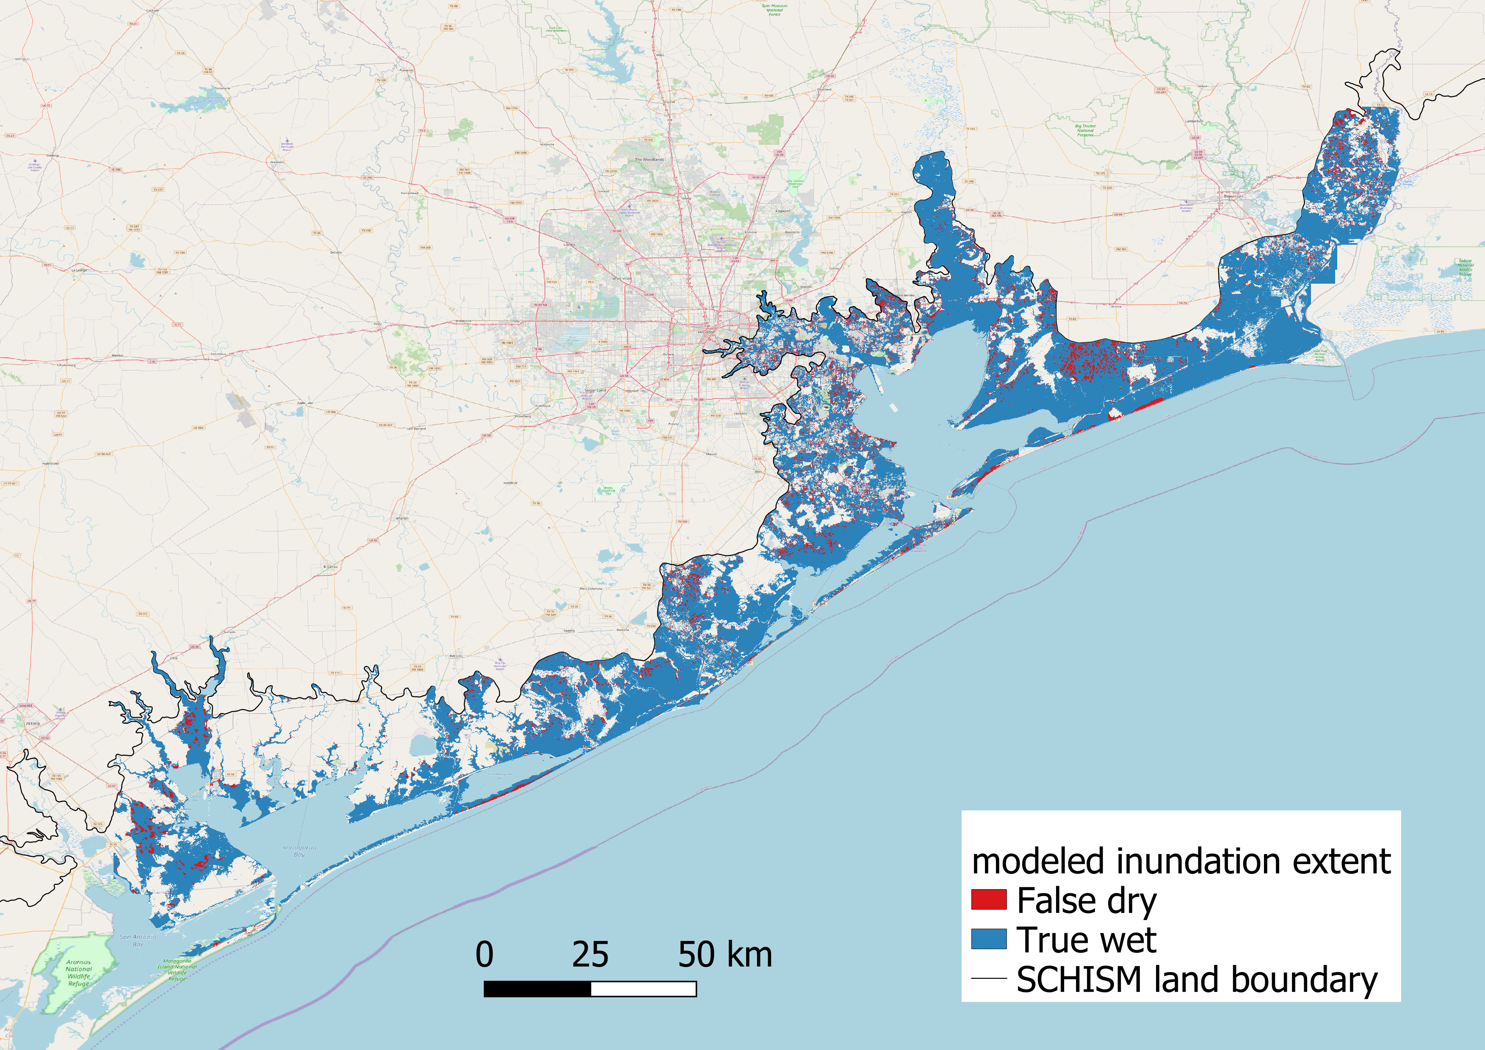
Inundation extent comparison with FEMA data
Inundation extent predicted by SCHISM (FEMA). 10cm cut-off; hit rate=0.92, MAE=1.12m.

Slide 14
Results from sensitivity tests separating different forcing
E1-4 are heavily dominated by river flow (NWM), without which the peak surges would not be sustained long enough.
Pluvial effects also contribute to some minor surges of ~20cm.
Even at E5-6, the contribution from NWM is still visible at the tail end of surge
Observation​
Baseline​
Ocean force only (Hurricane Harvey + tides)​
NWM flow only​
Precipitation only​

Slide 15
Results from sensitivity tests separating different forcing
It’s clear that the compound effects (up to 0.5m) are highly nonlinear at all locations (as signified by departure from 0 line) and are mostly positive at most stations. Negative compound effects are also observed at some inland stations (E1,2,4) during certain times
_
+
+
_
Time series of water elevation from base case and that from the summation of three sensitivity test.
Difference of water elevation from base case and that from the summation of three sensitivity test.

Slide 16
Results from sensitivity tests separating different forcing
Ocean effects are minor at both locations.
Both NWM river (imposed as B.C.) and rainfall effects are significant at Transect 3;
At Transect 4, the river B.C. effects are minor and most of the flow there came from rainfall;
At both locations, the total sum of flows from all 3 sources is close to the baseline results but with some under-estimation, which suggests compound effects for flow;
It’s reassuring that the baseline generally agrees with NWM output at this location, even though different routing algorithms are used in the 2 models;
Therefore imposing flow B.C. alone in a hydrodynamic model will severely underestimate the flow!

Slide 17
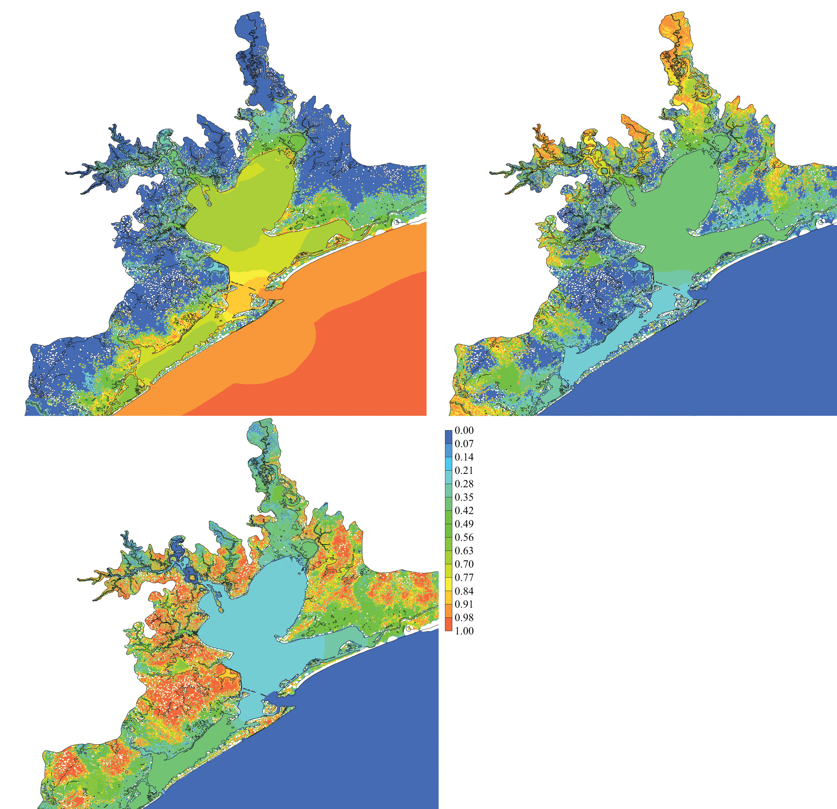
(a)
(b)
Proportions of deviations as explained by each of the 3 factors (neglecting compound effects) in the total deviation. (a) Ocean force; (b) NWM flow (as B.C.); (c) Precipitation.
10cm is used as min cut-off to exclude regions with low inundation (the white space in the plots). The blacklines are 0m isobath. Sum of proportions from all 3 factors =1. Any non-zero values indicate locations with potential compound effects.
(c)
The ocean factor dominates in coastal ocean (over 98%), but only accounts for less than 80% of the total in the lower Bay, less than 60% in the upper Bay and low-lying rivers.
The river factor dominates in the watershed regions with river network, but also accounts for 30% and 10% in upper/lower Bay respectively.
The direct precipitation factor is significant mostly on high ground in the watershed, but still accounts for ~10% in the Bay and also near river network.

Slide 18
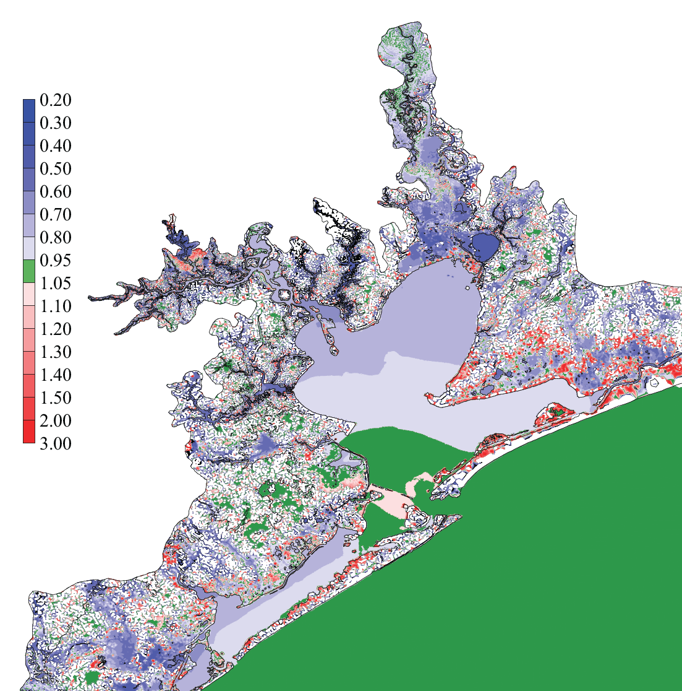
Compound factors as defined by max(baseline)/ max(deviations from 3 runs)
The denominator is a conservative estimate of the total max deviation because the maximums from each factor may occur at different times ; therefore the compound factor calculated this way is generally <=1 with some exceptions.
10cm is used as the cut-off to exclude regions with low inundation (the white space in the plots).
Compound factors close to 1 indicate negligible compound effects.
The compound effects are generally weak in the coastal ocean and portions of lower Bay, where the ocean factor dominates, and the high ground in the watershed (where the precipitation is the sole source), but significant in the East & West Bays, upper Bay and watershed areas with river network.
Near the maximum inundation extent in the barrier islands and in the wildlife refuge north of East Bay, the baseline maximum exceeds the sum of 3 factors, suggesting localized amplifications.
It is clear that using the results from individual factors would overestimate in most regions by at least 20%.

Slide 19
Conclusions
Coastal watersheds are considerably more complex than other types of watersheds with a myriad of competing factors from ocean, rivers, atmosphere (wind and precipitation) and groundwater (not accounted for in this paper).
Compound effects are highly nonlinear and so simulating each source (ocean, river and rainfall) separately and summing up and contributions from all would not work
Treating watershed flow as B.C. and neglecting rainfall in the coastal watershed regions will result in large errors in river flows and elevations.

Slide 20
Thanks!

