Slide 1
Grid Generation with NWM
Wei Huang, Karinna Nunez, Dan Yu, Fei Ye, and Joseph Zhang
11/19/2019

Slide 2
Summary of progress
Started 2 months ago at VIMS
Learning the SCHISM model
Started grid generation for the large domain including GOM and East Coast
Just finished the 1st version of the grid
Preliminary test run with 2-D barotropic mode

Slide 3
Grid generation work flow with SMS
Extract coastlines and land boundaries (10m) from high resolution DEMs of NOAA (crm, CUDEM) and USGS (CoNED).
Clip streams from NWM based on the coastline and 10m land boundary with 200m buffer zone.
Clean the streams using QGIS to remove small dangling arcs and polygons.
Merge the streams into SMS.
Build polygons and generate mesh.
Use Gredit to find the collapsed elements and use spring script to remove some collapsed elements.
Go back to SMS to fix the remaining problematic arcs.
Interpolate the bathymetry using NOAA_crm dems.
Test run the 2-D barotropic.

Slide 4
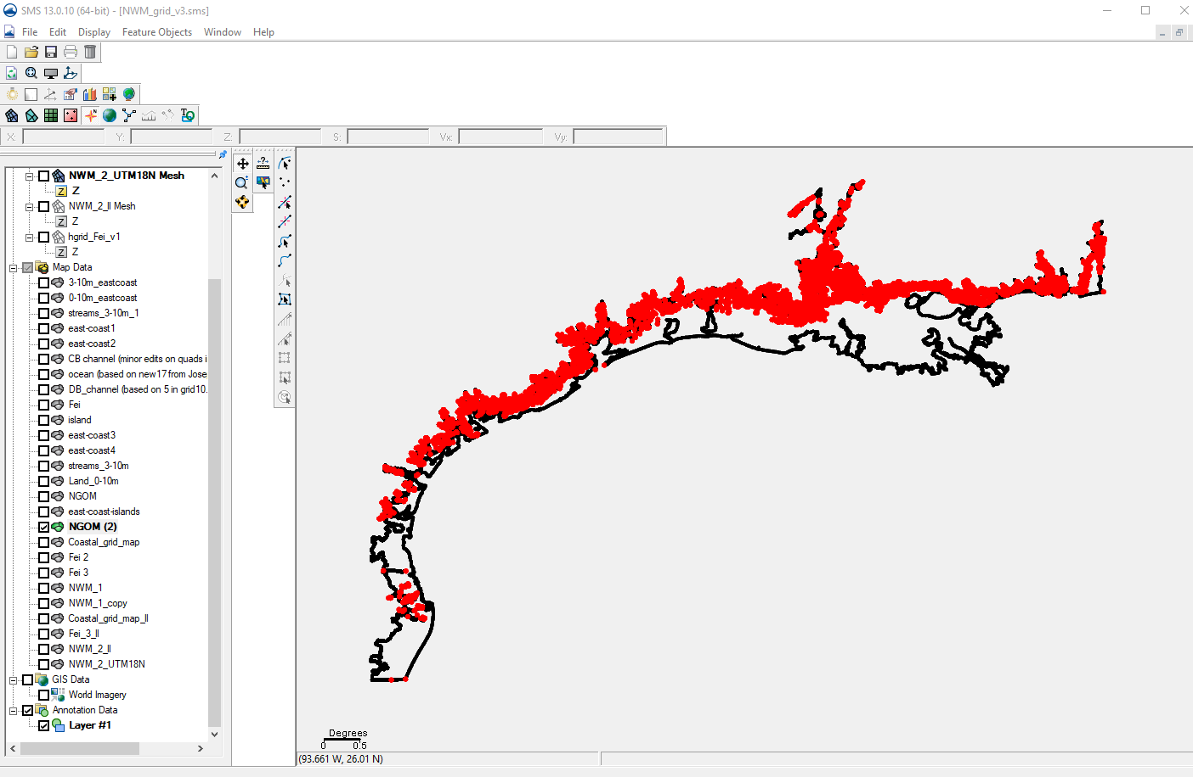
Add map file for Northern Gulf of Mexico:

Slide 5
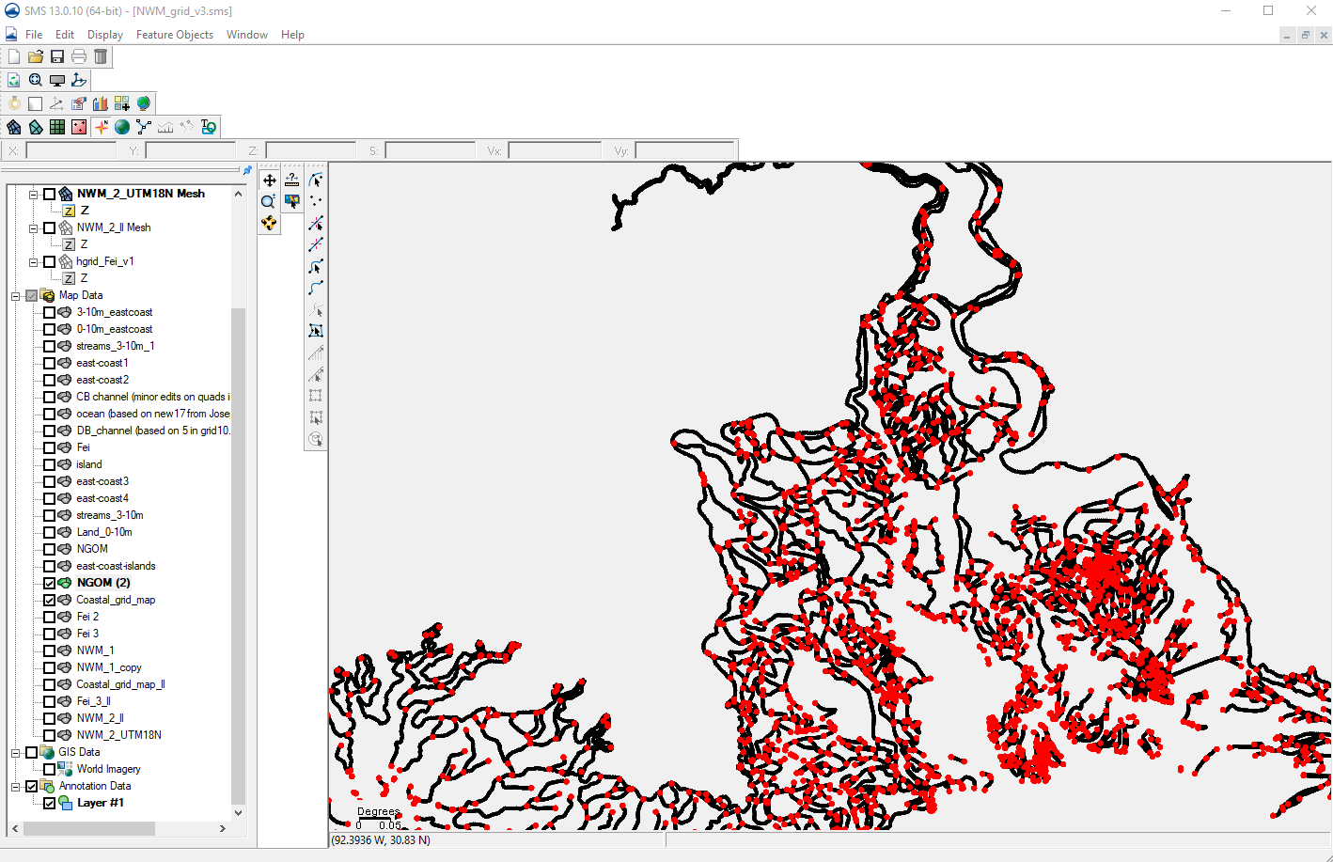
Add Streams from NWM

Slide 6
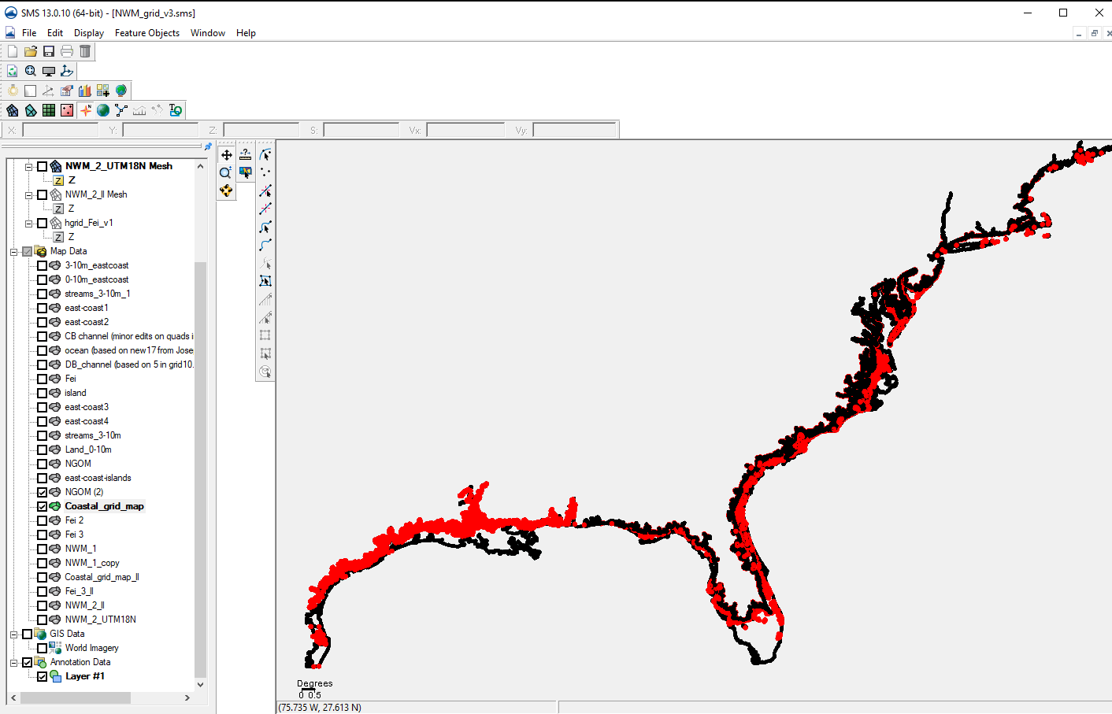
Merge Map file with East Coast

Slide 7
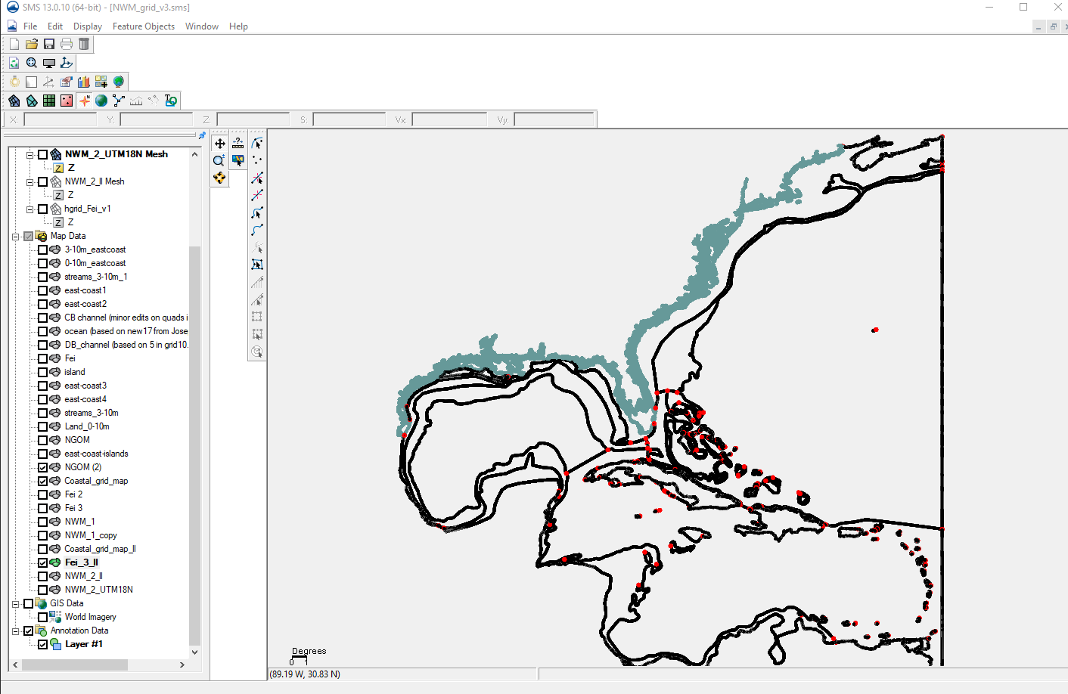
Merge with previous work

Slide 8
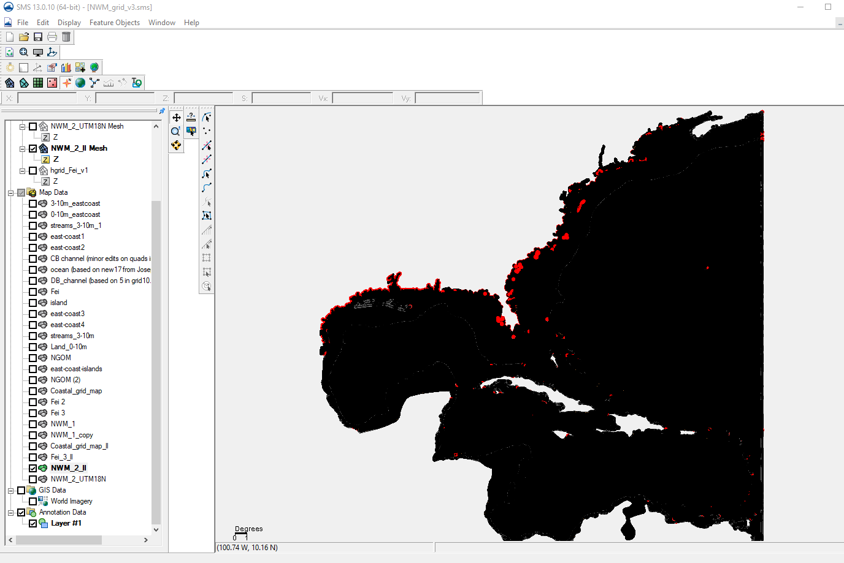
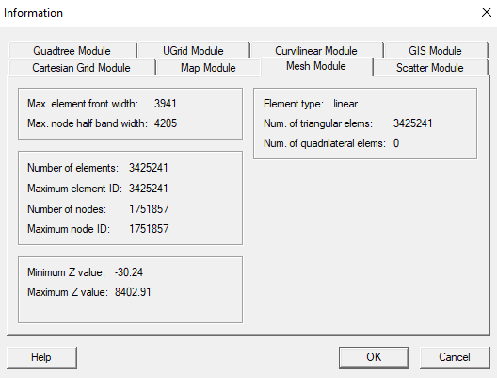
Generate mesh
Mesh nodes:

Slide 9
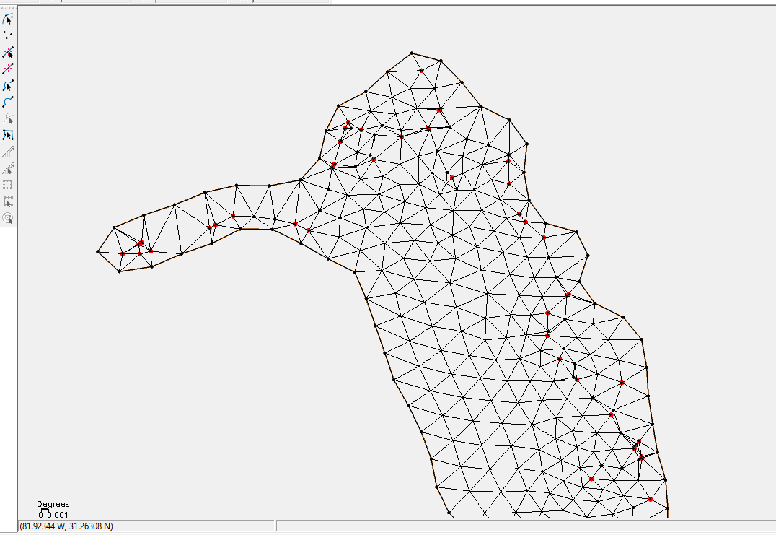
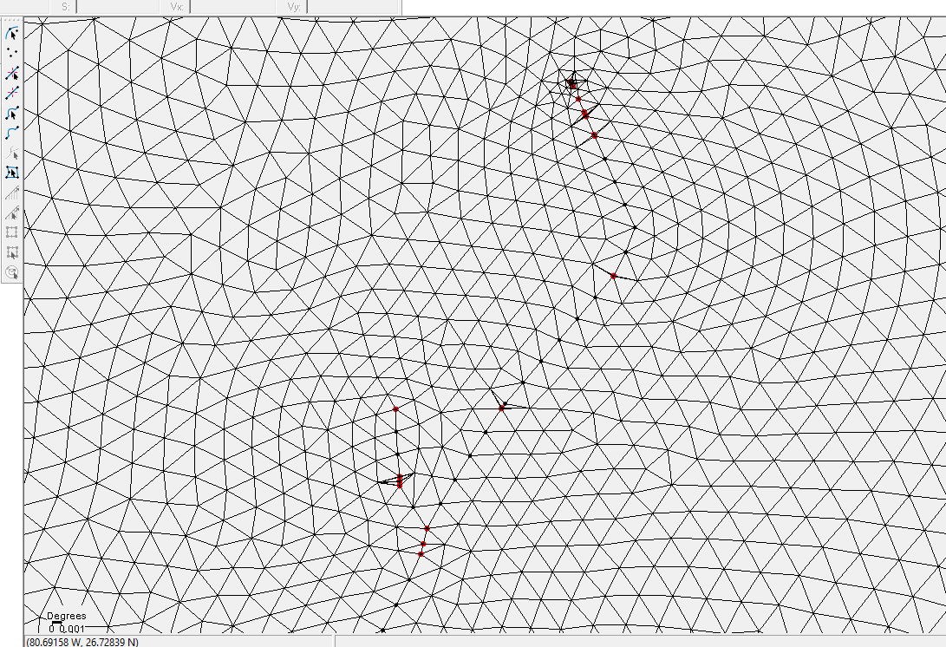

Slide 10
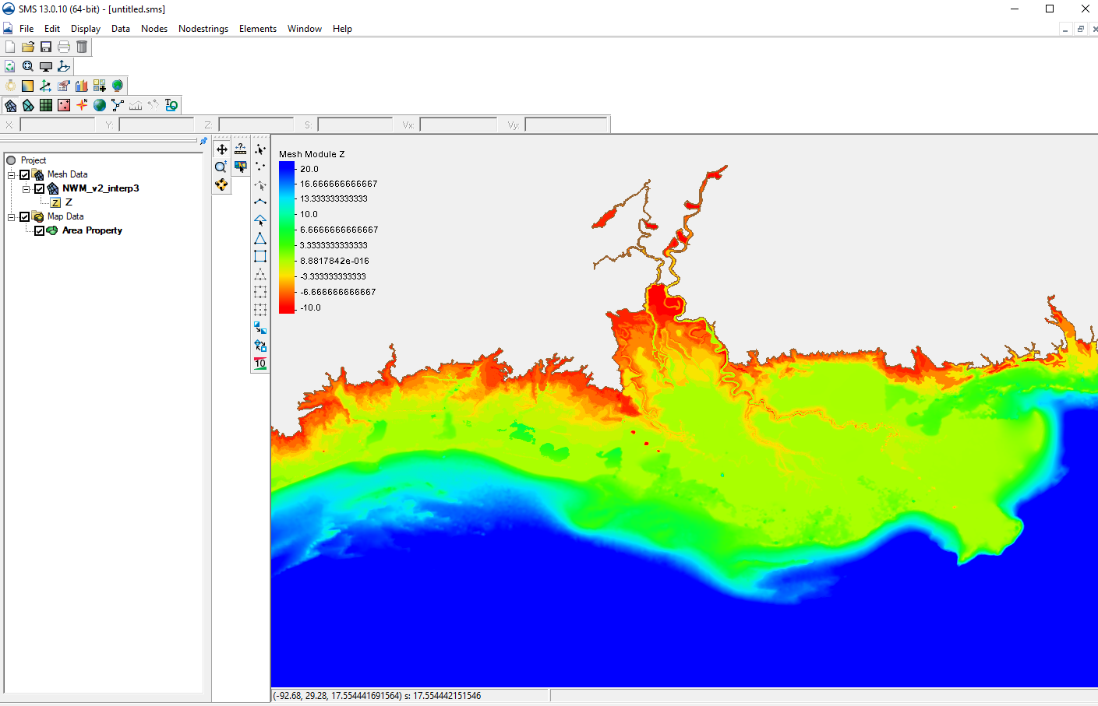
Interpolate bathymetry from CRM
Still cleaning up other DEM files

Slide 11
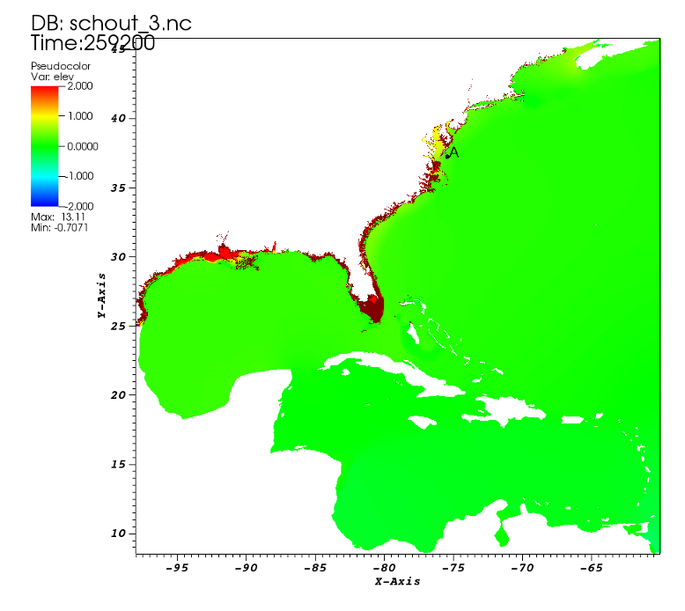
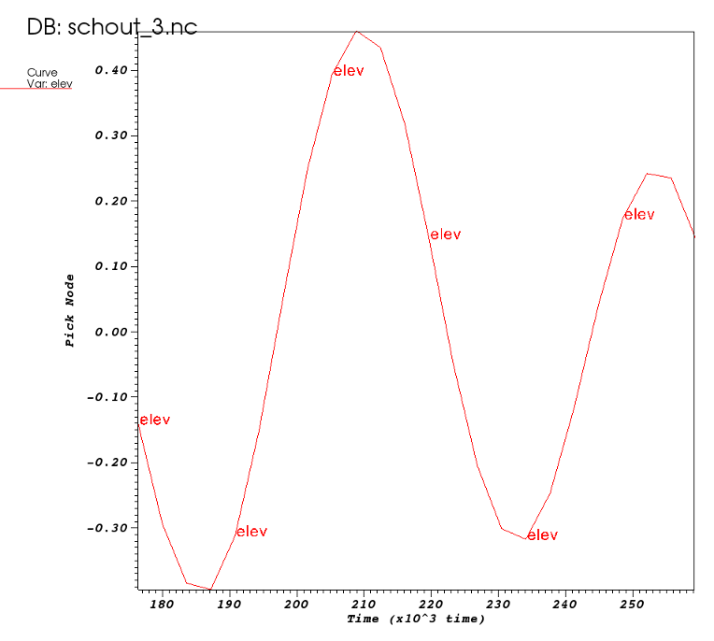
2-D barotropic run: first results

Slide 12
Next steps
Interpolate higher resolution DEMs.
Add major shipping channels.
Calibrate 2-D model with NWM flows under Hurricane Irene; compare results with NOAA’s coastal gauges.
Prepare vertical grid.
Run 3-D barotropic condition
Add atmospheric forcing
Calibration
Run 3-D baroclinic condition
Calibration

