Slide 1
DEMs and New SCHISM Grid for East Coast and Gulf of Mexico
Wei Huang, Karinna Nunez, Dan Yu, Fei Ye, and Joseph Zhang
12/10/2019

Slide 2
Summary of progress
Preparation of multiple DEMs from coarser to finer resolution
Size issue is severe for SMS
Used GIS to resample, split rasters, convert format (from .tif to .asc) and extract isobaths.
All in NAVD88
Revised SCHISM grid for east coast + GoMX
Resolved some barrier islands
Added channels for major rivers (Missi.; Hudson; Ches Bay; DE Bay) and shipping channels in LA and TX Bays
Coupler to NWM streams using Fortran script

Slide 3
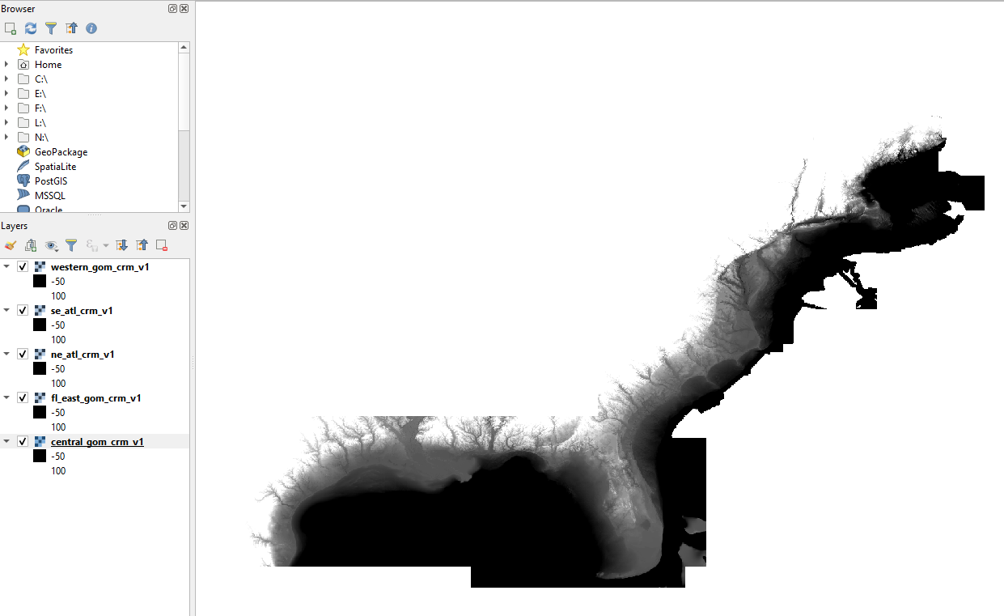
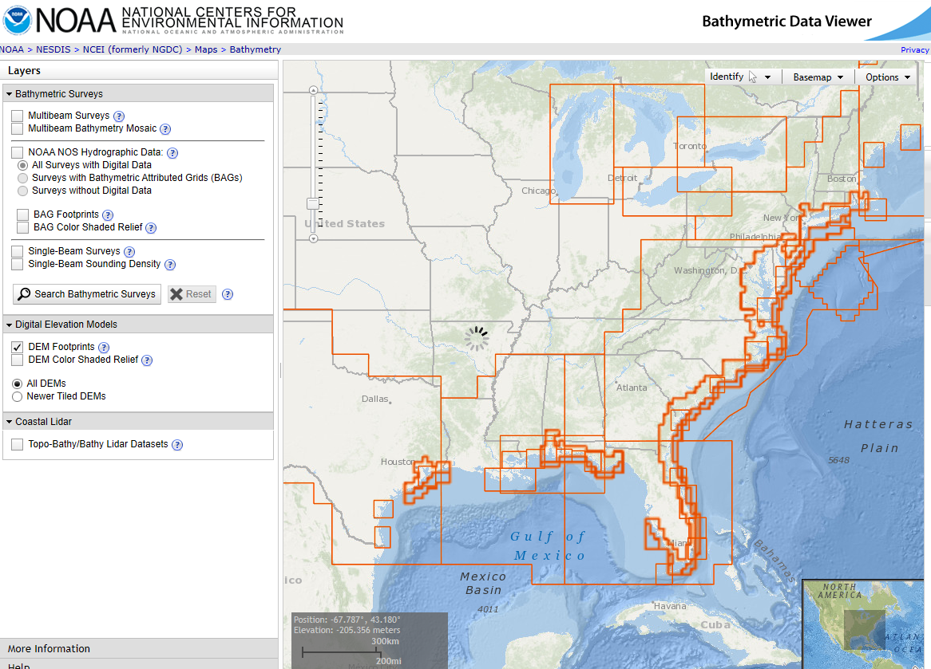
DEMs from coarser to finer resolution
Loading DEMs from NOAA CRM, ~90m resolution.
NOAA_CRM (3 arc-s, 90m)
https://maps.ngdc.noaa.gov/viewers/bathymetry/?layers=dem

Slide 4
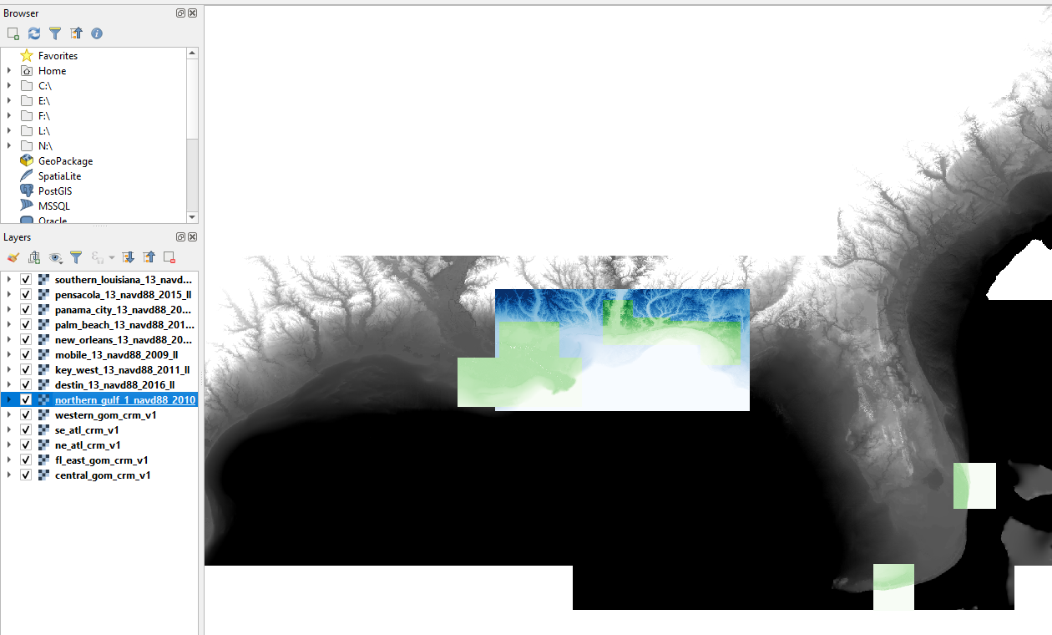
DEMs: Coastal Digital Elevation Model (NOAA)
1 arc resolution
1/3 arc resolution

Slide 5
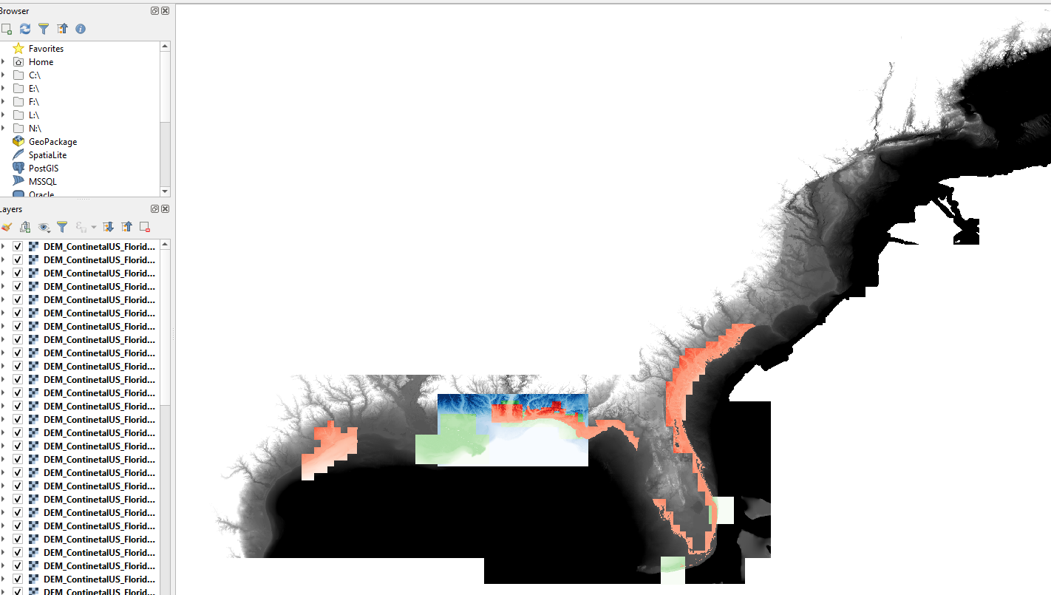
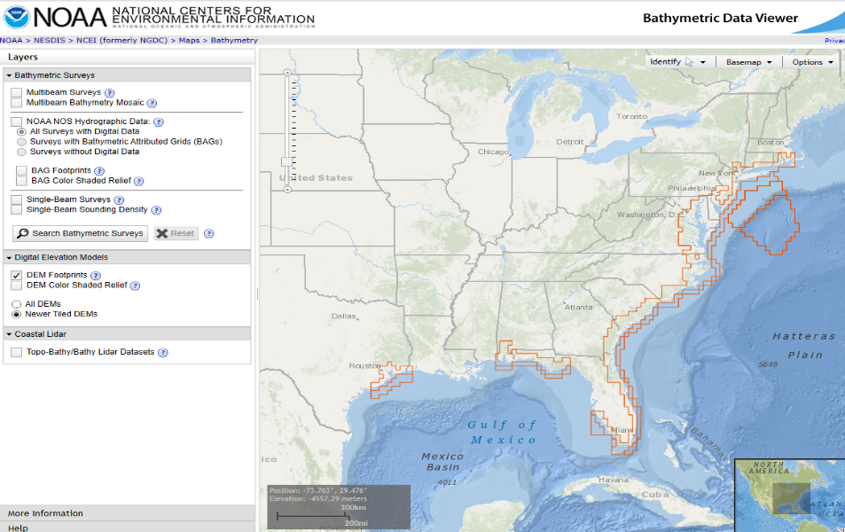
DEMs: CUDEM (NOAA)
1/9 arc-s resolution
NOAA_CUDEM (1/9 arc-s, 3m, nav1983, navd 88)
https://maps.ngdc.noaa.gov/viewers/bathymetry/?layers=dem

Slide 6
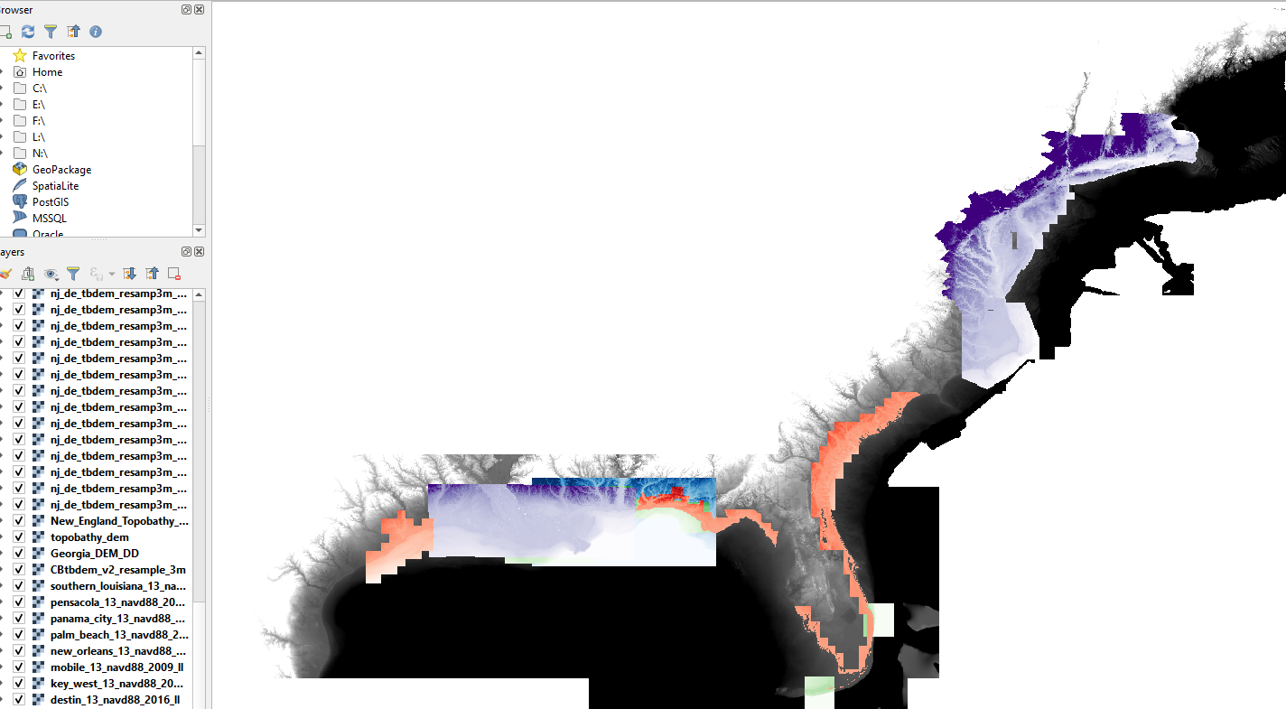
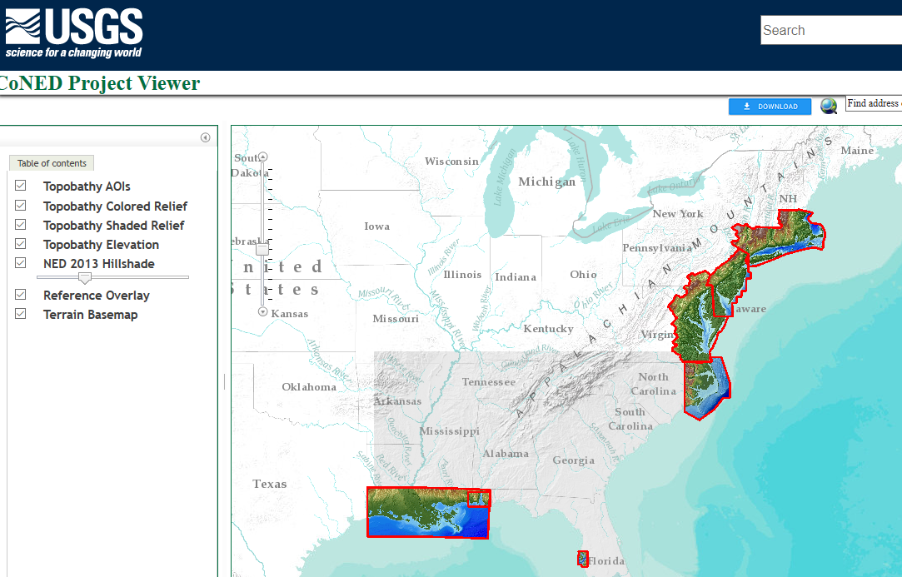
DEMs: USGS CONED
1-3 m resolution
USGS_CoNED (1m, nav1983, navd 88)
https://topotools.cr.usgs.gov/topobathy_viewer/

Slide 7
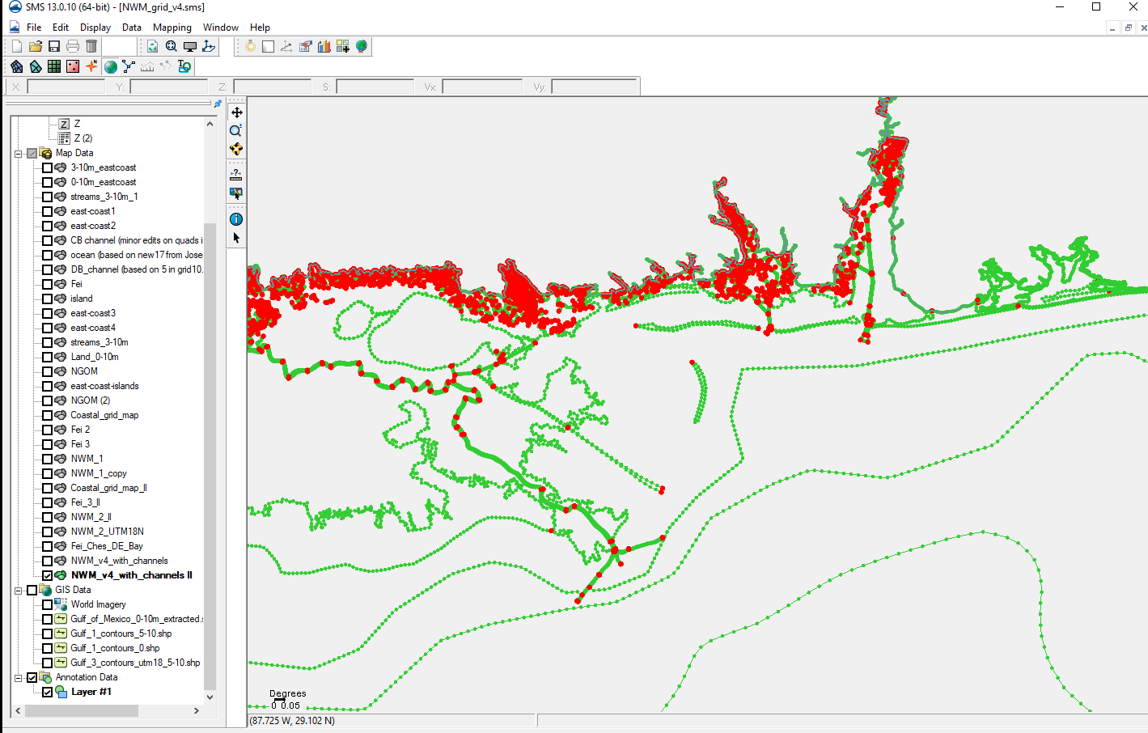
Revised SCHISM grid
Adding arcs along barrier islands with resolution of 1500 m

Slide 8
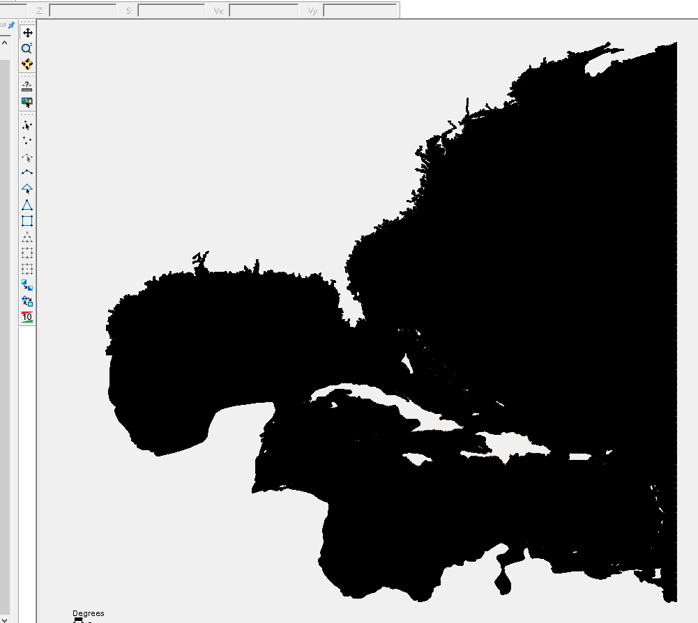
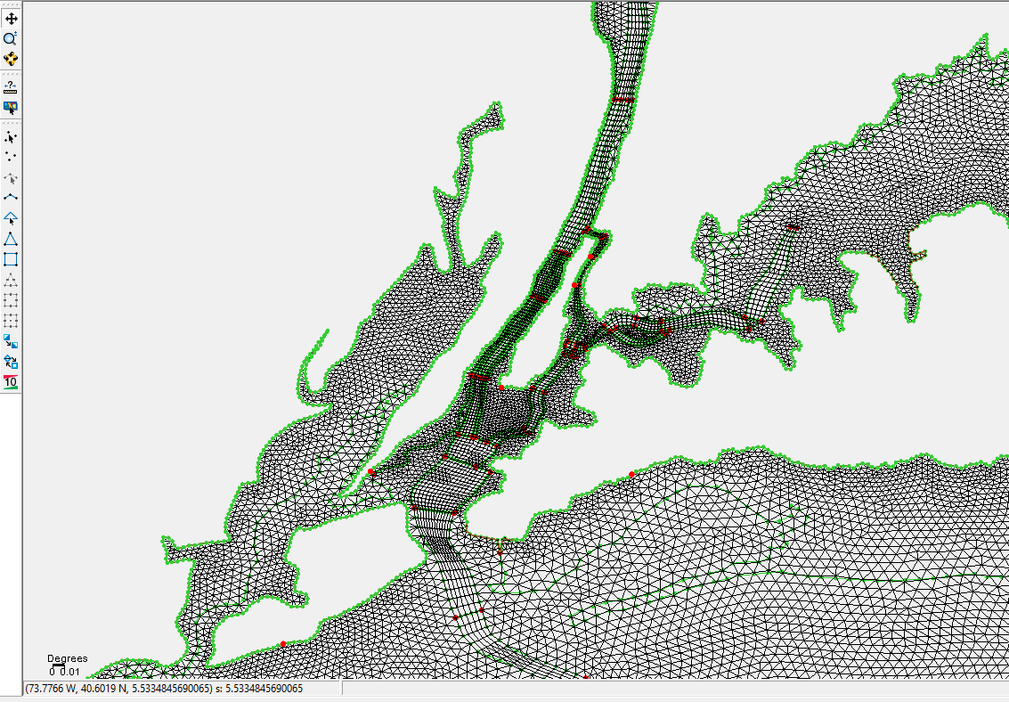
Revised SCHISM grid
Adding channels for major rivers using quads: Hudson River, Mobile Bay, Mississippi River, Atchafalaya River, Calcasieu Lake, Galveston Bay
New grid has 1.8 M nodes, 3.6 M elements

Slide 9
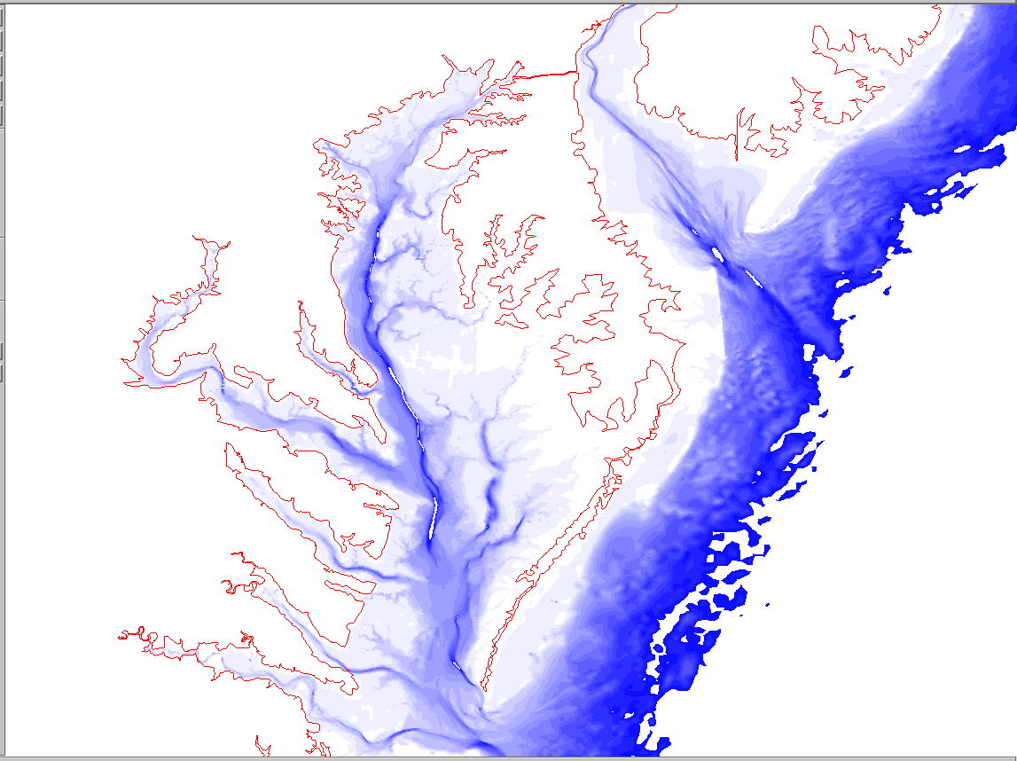
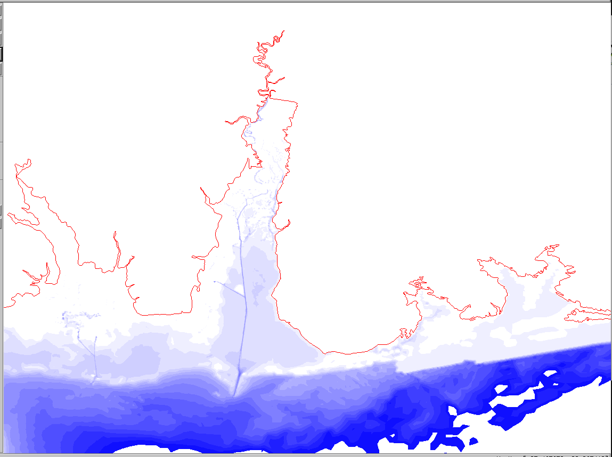
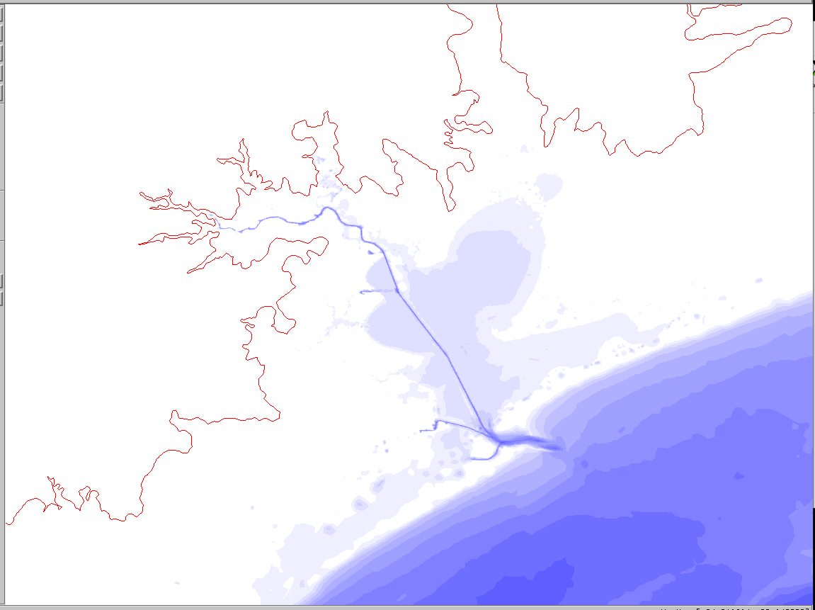
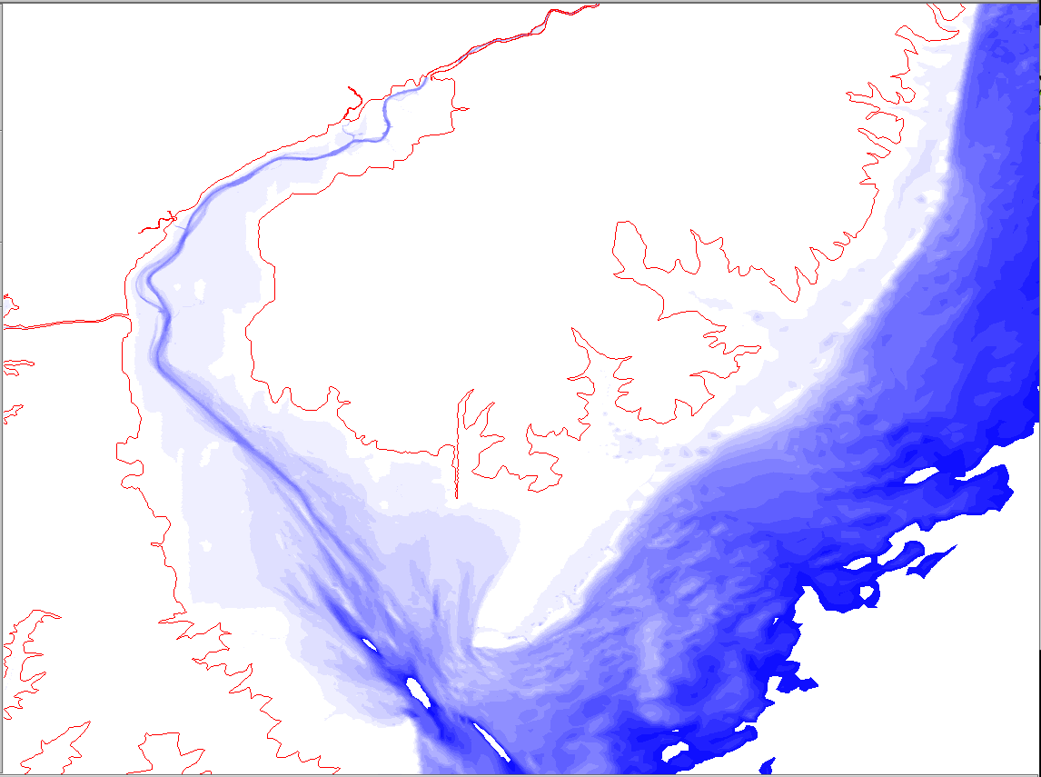
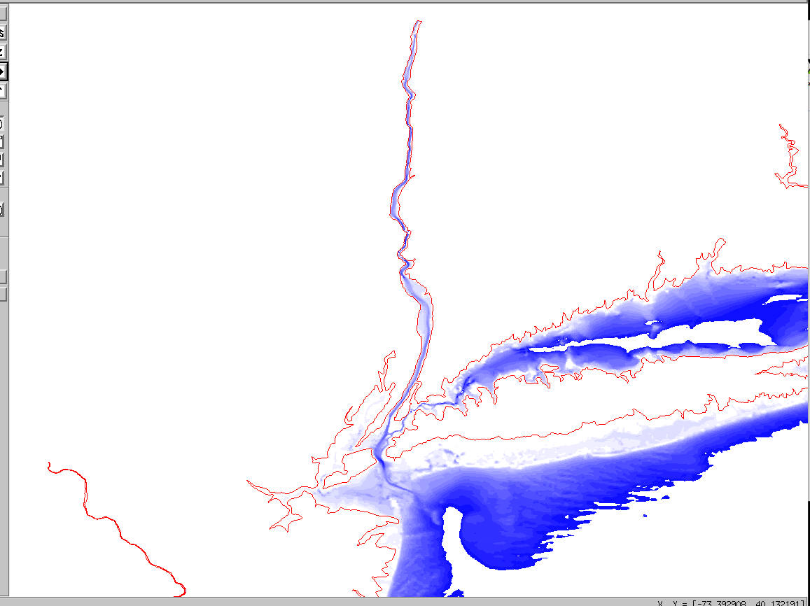
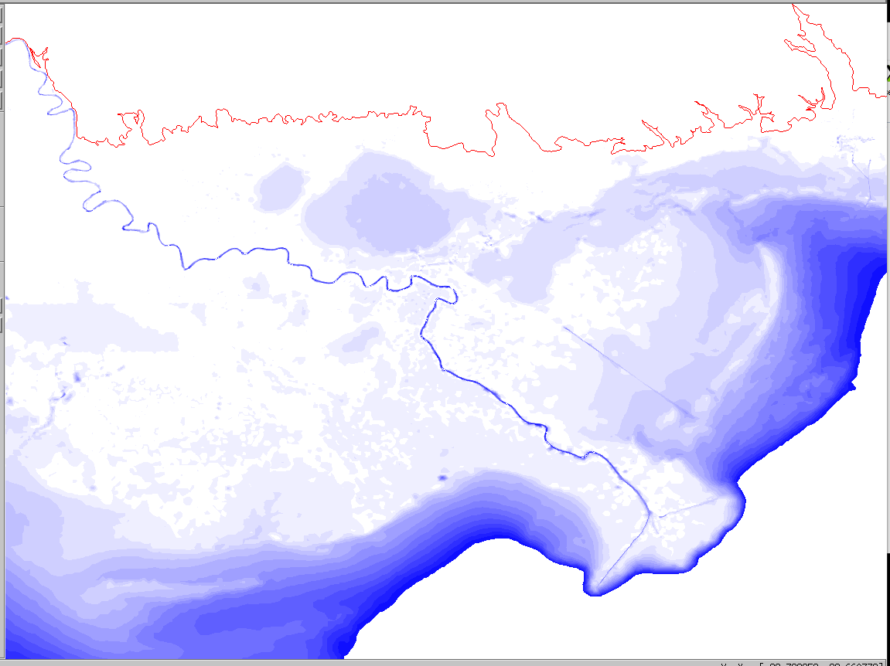
Loading DEMs from coarser to finer resolution

Slide 10
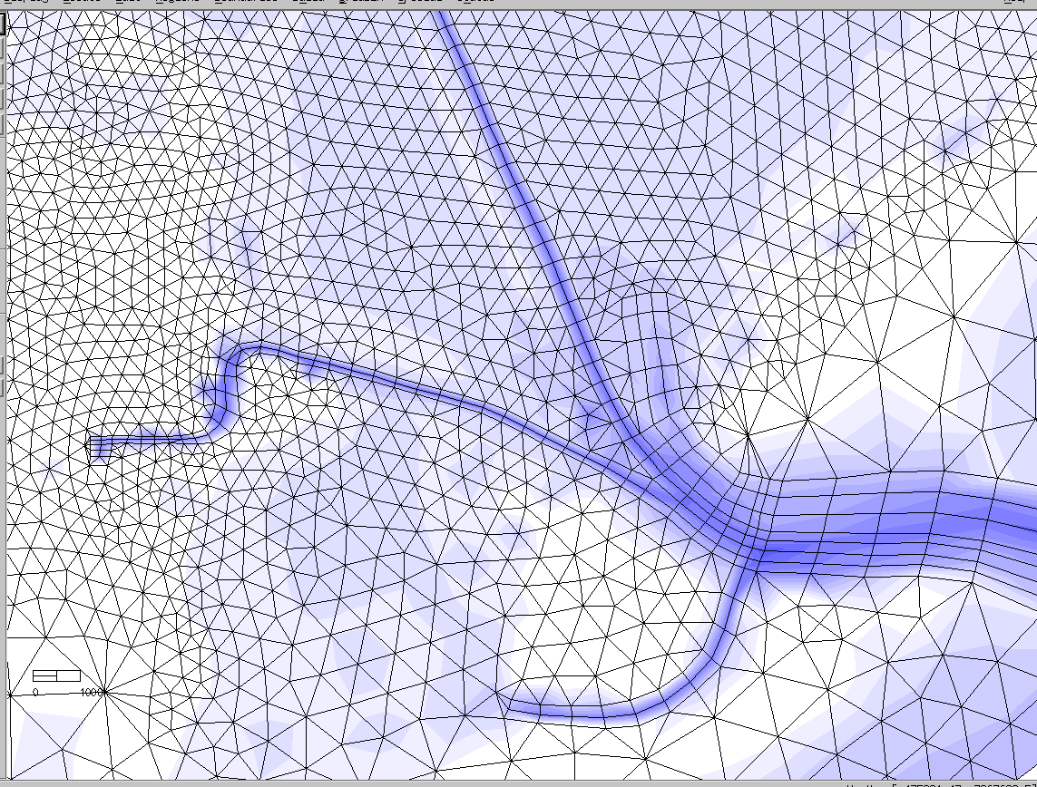
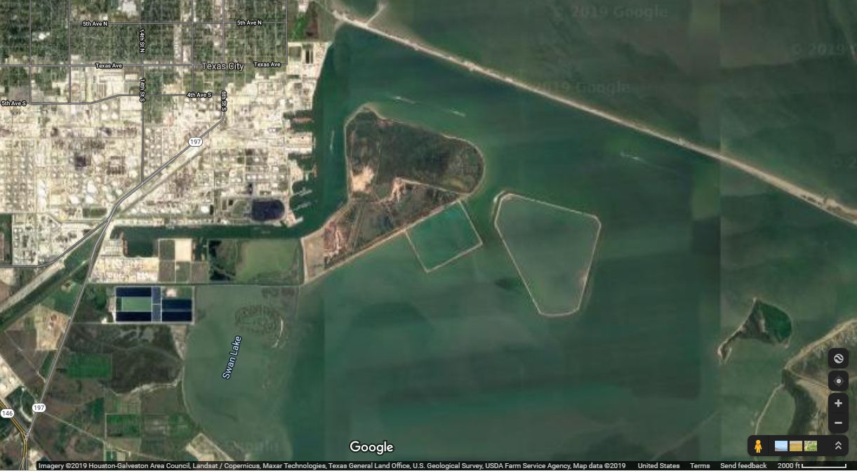

Slide 11
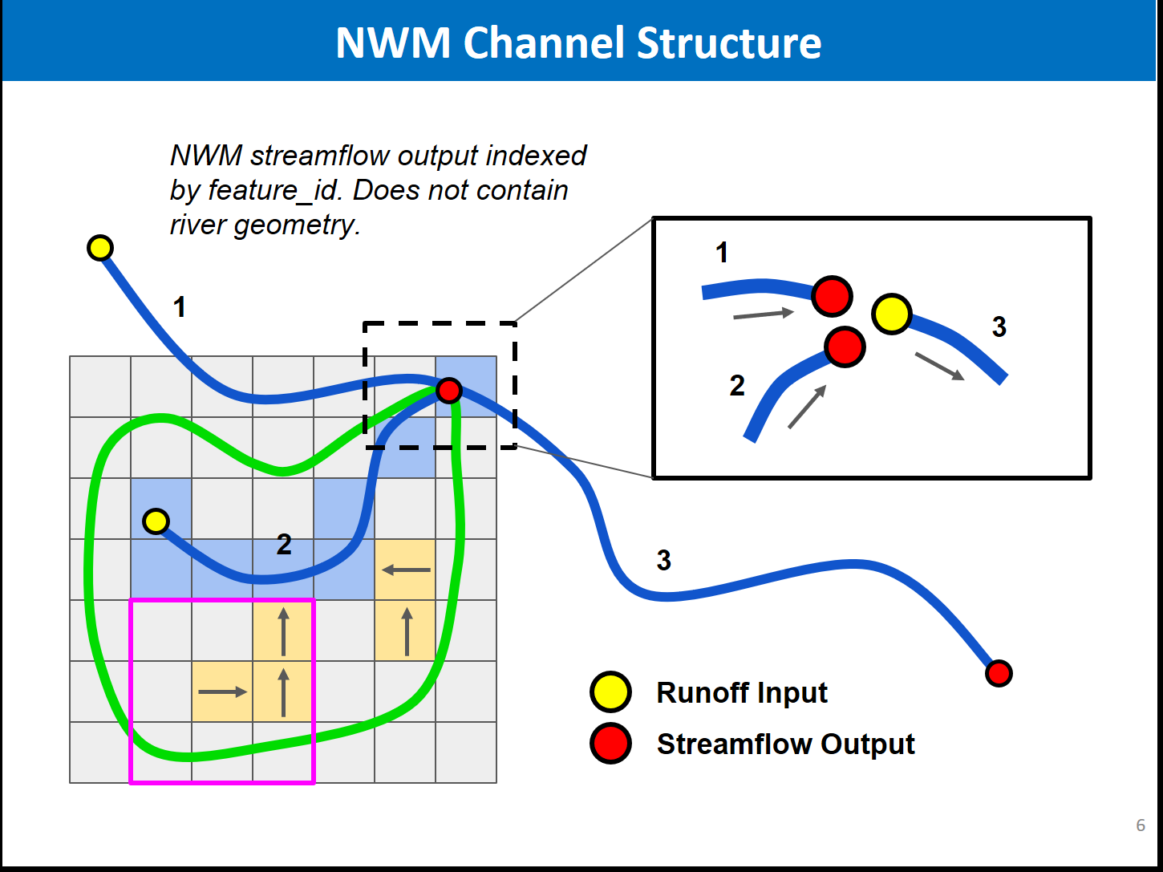
Coupling of NWM streams using Fortran script
How are the points along a NWM stream segment arranged? What is the direction of the flow or how to determine the direction of the flow?
We assume the points are arranged from upstream to downstream.

Slide 12
TODO
Finalize the revised grid
Finalize the FORTRAN coupling script
2D calibration for Hurricane Irene
2D calibration for Hurricane Harvey

