Slide 1
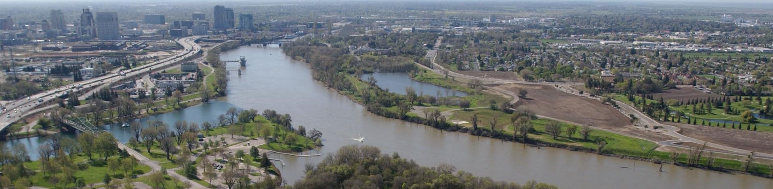
Hydraulic Structures
CALIFORNIA DEPARTMENT OF WATER RESOURCES
Concepts and configuration
Eli Ateljevich, Bay Delta Office

Slide 2
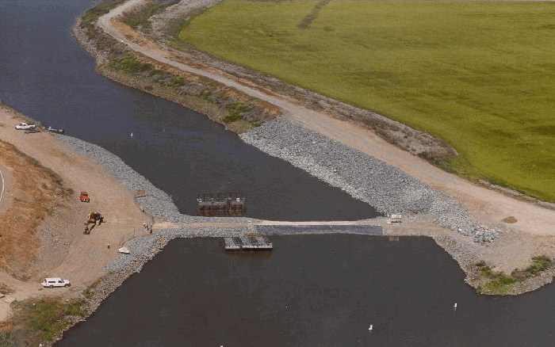
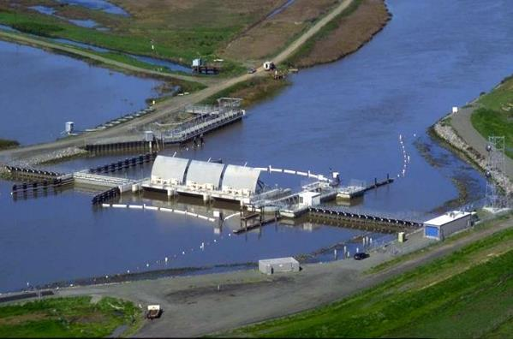
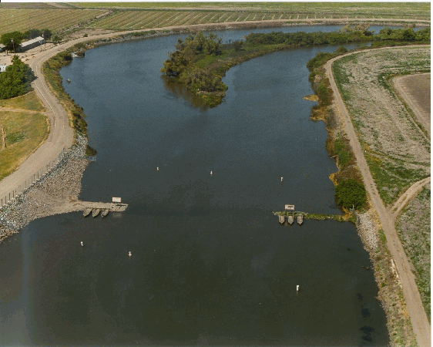
Types of structures
Transfers of (pumped) water
Weir
Culvert
Generic orifice equation
Radial Gate
2 parameterizations
Weir/culvert combo

Slide 3
Implementation
Common hydraulic/orifice equations
Head difference assessed at reference nodes
Prescribed flow (transfer) also possible
Similar implementation and restrictions as flux boundary
Flows distributed uniformly over cross-section (1D)
Required to not go dry locally
Nudging factor is applied 0 < nu < 1
Structures can be “uninstalled” in time series
Revert to normal hydrodynamics
Time series (th) multivariate, irregular

Slide 4
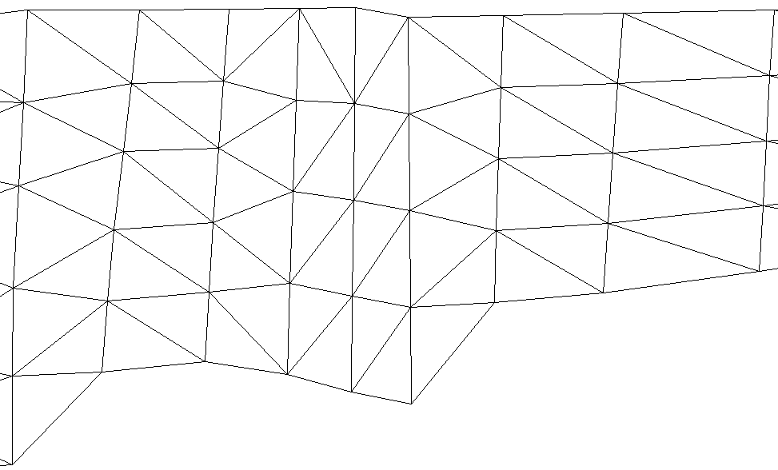
Defining Structures
Upstream
Downstream
Reference nodes
“hydraulic head”
Paired nodes
Defined land-to-land
1
1’
2
2’
3
3’
4
4’
5
5’
Structure location
Structure
Reference node

Slide 5
Steps Configuring the Structure
Prep mesh: node pairs, straight
Enable in param.in: ihydraulics=1
Geometry and parameters: hydraulics.in
Time series control: my_gate.th
See doc: Hydraulic Structures in SCHISM
******************************************
Preprocessor (BayDeltaSCHISM yaml-based system)
Locations are physical (line segment)
See preprocessor document or BayDeltaSCHISM examples

Slide 6
Structure Time Series
#datetime install ndup op_down op_up elev width height
1999-11-26T08:24 1 2 1.0 1.0 -3.42 18.29 0
1999-12-14T09:24 1 2 1.0 1.0 -3.42 18.29 10
1999-12-14T14:25 1 2 1.0 1.0 -3.42 18.29 0
1999-12-15T09:22 1 2 1.0 1.0 -3.42 18.29 10
-4263060.0 1 2 1.0 1.0 -3.42 18.29 0
8762400.0 1 2 1.0 1.0 -3.42 18.29 10
9113400.0 1 2 1.0 1.0 -3.42 18.29 0
9368640.0 1 2 1.0 1.0 -3.42 18.29 10
install = 0 reverts to normal hydrodynamics
Series are multivariate
Columns needed vary
Documented in manual
Series are irregular
Entry at 0. or negative required
BayDeltaSCHISM model_time.py to_elapsed utility used for translation

Slide 7
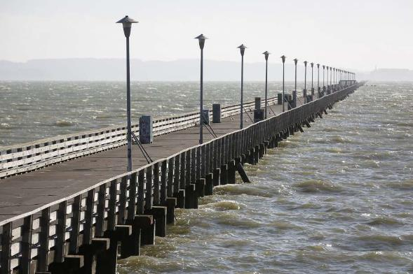
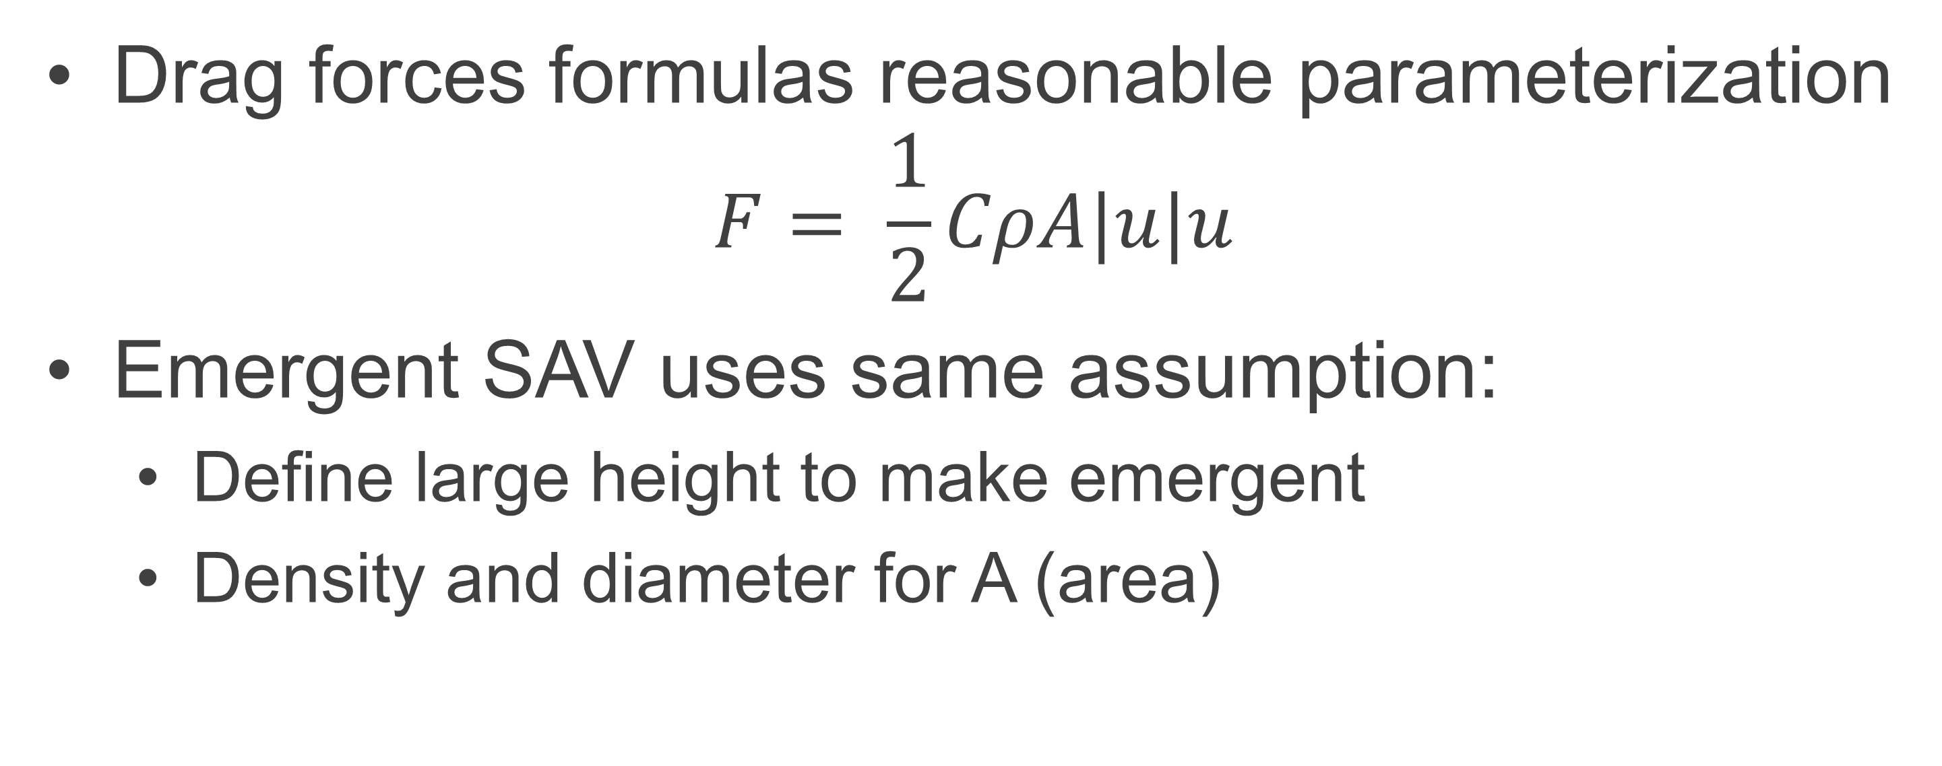
Piers and Drag-inducing Structures
Drag forces formulas reasonable parameterization
$$F= \frac{1}{2}CρA|u|u$$
Emergent SAV uses same assumption:
Define large height to make emergent
Density and diameter for A (area)

Slide 8
Questions?
Eli.Ateljevich@water.ca.gov

Slide 9




Follow us on social media
CADWR
CA_DWR
calwater
cadepartmentofwaterresources
Notes:
NEGATIVE SPACE
GOOD

