Slide 2

Mesh Density
Approach
Reference surface
no stretch
z
hybrid
more stretch
related sigma
$$z=\int_{η_{0}}^{z}{φ\left(x, t\right)dt}$$
prototype
stretched

Slide 3
Curvature Flow Grid Gen
Small scale: Wiggles in bed smoothed, evolve according to curvature + size function
Large scale: Basin scale also has curvature, consistent with PGE goals
Hybridized with size function: good mesh except for shallow + transitions
Concept taken from Level Set methods proposed by Sethian
but applied using simpler graph smoothing.

Slide 4
Reducing transitions
Do this by allowing rounding up/down using greedy (tabu) algorithm
Reduces transitions by half
Still current weak link
  connected component based tabu?

Slide 5
Pre-smoothing Bathymetry

Slide 6
Where can I get the DWR tools?
BayDeltaSCHISM is on GitHub

Slide 7
Interesting results
Size functions make easier to evaluate
Z-inspired mesh become more terrain conforming when water levels go down
  And less when they go up
  Use high water as reference (preliminary)
Pure sigma grids are the limiting case
All this is pretty mediocre on shallow moonscape

Slide 8
dzb_min issues
Some LSC² mesh styles causes more variation in bottom lower layer widths
More/different crisscrossing of dzb_min in param.in (transition from roughness to drag)
Extra dampening easy to misdiagnosed:
  Particularly for salinity (attributed to v. resolution or even differences in diapycnal mixing)

Slide 9
Steps Configuring the Structure
Prep mesh: node pairs, straight
Enable in param.in: ihydraulics=1
Geometry and parameters: hydraulics.in
Time series control: my_gate.th
See doc: Hydraulic Structures in SCHISM
******************************************
Preprocessor (BayDeltaSCHISM yaml-based system)
  Locations are physical (line segment)
  See preprocessor document or BayDeltaSCHISM examples

Slide 10
Structure Time Series
#datetime install ndup op_down op_up elev width height
1999-11-26T08:24 1 2 1.0 1.0 -3.42 18.29 0
1999-12-14T09:24 1 2 1.0 1.0 -3.42 18.29 10
1999-12-14T14:25 1 2 1.0 1.0 -3.42 18.29 0
1999-12-15T09:22 1 2 1.0 1.0 -3.42 18.29 10
-4263060.0 1 2 1.0 1.0 -3.42 18.29 0
8762400.0 1 2 1.0 1.0 -3.42 18.29 10
9113400.0 1 2 1.0 1.0 -3.42 18.29 0
9368640.0 1 2 1.0 1.0 -3.42 18.29 10
install = 0 reverts to normal hydrodynamics
Series are multivariate
  Columns needed vary
  Documented in manual
Series are irregular
  Entry at 0. or negative required
BayDeltaSCHISM model_time.py to_elapsed utility used for translation

Slide 11
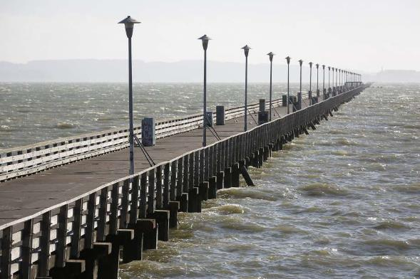
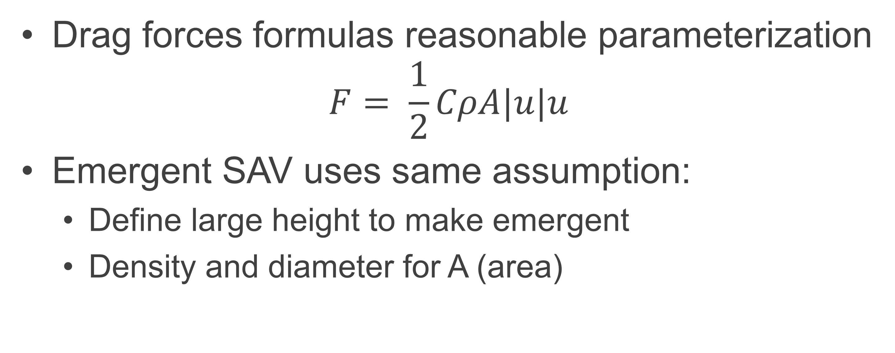
Piers and Drag-inducing Structures
Drag forces formulas reasonable parameterization
$$F= \frac{1}{2}CρA|u|u$$
Emergent SAV uses same assumption:
  Define large height to make emergent
  Density and diameter for A (area)

Slide 12
Questions?
Eli.Ateljevich@water.ca.gov

Slide 13




Follow us on social media
CADWR
CA_DWR
calwater
cadepartmentofwaterresources
Notes:
NEGATIVE SPACE
GOOD

