Slide 1
Version Control for SCHISM
Best practices and Workflow with SVN
Eli Ateljevich, PhD
Delta Modeling Section
California Department of Water Resources
Notes:
ALIGNMENT
GOOD
RIGHT JUSTIFIED TO A GRID LINE

Slide 2
Main Subjects
Problems version control can (not) solve
Branching strategy standards for SCHISM
Patterns of use
Basic checkout-update-commit
Feature branch
Releases branches and tags
Factors that determine success
Culture
User Practices
Tool stuff

Slide 3
Version Control (VC) Goals
Concurrent editing and basic text merging
Space for experiments
Checkpoints, rollback and undo
Log fixes and enhancements
Tag official versions
Distribution
Alternate versions (ie per institution)

Slide 4
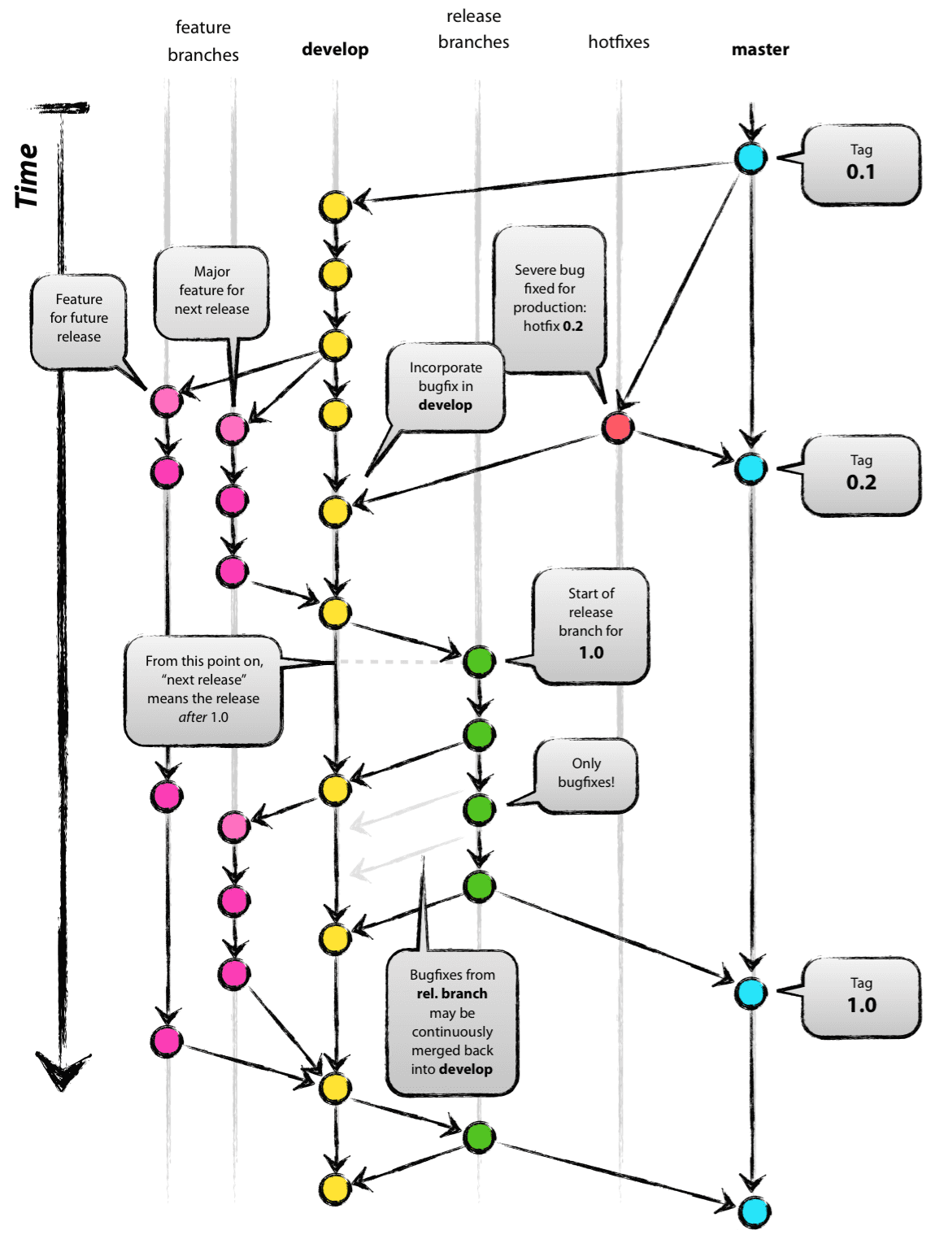
Branching patterns
/schism
| -- trunk
| -- branches
| -- crazy_idea
| -- v5.6
| -- dwr_only
| -- tags
| -- v5.6.0
| -- v5.6.1
| -- v5.6.2
Goal to separate:
Stable development
Unstable features
Release cleanup
Official versions
Institution departures
Many branching patterns exist:
Culture/size based
Trunk Based Development:
good for SCHISM community
For comparisons see trunkbaseddevelopment.com
The “successful branch model” … not very successful

Slide 5
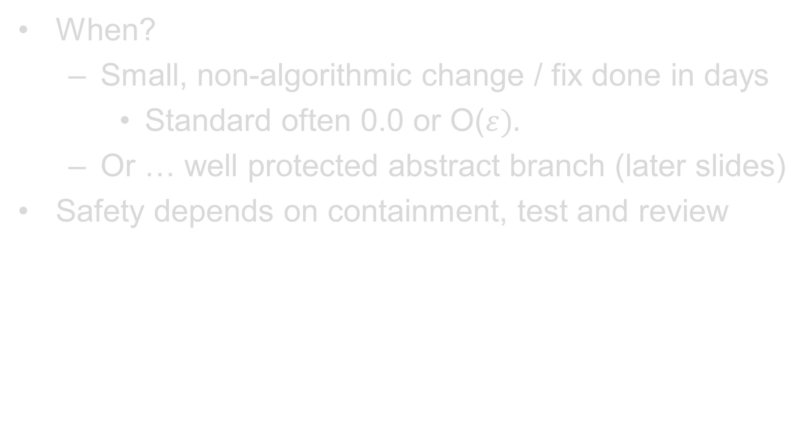
Case 1: Work on Trunk
When?
Small, non-algorithmic change / fix done in days
Standard often 0.0 or O($ε).$
Or … well protected abstract branch (later slides)
Safety depends on containment, test and review
Main Trunk
Here is
Some Code
Check out
Here is
New Code
Update
Repository
Here is
Some New Code
Commit
Working Copy

Slide 6
Case 1: Implementation
home% svn co http:/repos-url/schism/trunk schism_trunk
[ cd to /src directory, work on code]
schism_trunk/src% svn update
[ other changes … your job to reconcile]
schism_trunk/src% svn commit –m “Directed err.out to /output dir”
Notes:
“co” is shorthand for “checkout” which is also fine to write
This example uses –m for the message, but using editor is generally better and gives you a second chance
Commit often

Slide 7
Case 2: Feature Branch
trunk
Isolate destabilizing change
Very few active developers (1 – 2 ideal)
Short life, single project
Finish before structure changes (SVN >= 1.11 helps)
Long feature projects very bad, particularly multiple
Merge trunk to branch frequently (daily)
Final reintegration trivial because trunk changes already there
Test well before/after final merge and create a good message
Consider the alternative: abstract branching
merge
reintegration
feature
test carefully here

Slide 8
Case 2: Implementation Example
Create the branch:
% svn copy http:/repos-url/schism/trunk \
http:/repos-url/schism/branch/schism_wwm
Get a copy of the branch. Fresh checkout to working copy schism_wwm is the safest way. Note you can use “co” instead of checkout
% svn checkout http:/repos-url/schism/schism_wwm schism_wwm
[ cd to /src/HWWM directory, work on code. Now do an intermediate point commit you might do this often, especially before merging trunk]
schism_wwm/src/WWM% svn commit –m “Did X to wind wave model. Compiles and runs.”
[Frequently merge the latest from the trunk into your branch working copy, resolve any conflicts and commit. Note that you are doing the merge inside the recipient (branch) working copy]
schism_wwm% svn merge http:/repos-url/schism/trunk
[work on code, account for new stuff in trunk]
schism_wwm% svn commit –m”Made wwm feature X compatible with new feature Y in trunk”
[Close out feature branch , merging into trunk. Note that you do the merge from the recipient (trunk) working copy. Note –reintegrate which I recommended previously is deprecated in svn >= 1.8 and it is done “automatically” by detecting reintegration:
https://stackoverflow.com/questions/18444634/tortoisesvn-subversion-1-8-merge-no-more-reintegrate-a-branch-option Ask someone experienced]
schism_wwm% svn commit –m”Finished new wwm feature X, about to close out feature branch”
schism_wmm% cd ..
% svn checkout http:/repos-url/schism/trunk schism_trunk
% cd schism_trunk
schism_trunk% svn merge –-reintegrate http:/repos-url/schism/branch/schism_wwm
schism_trunk% commit –m “Reintegrated feature X to trunk, verified trunk works. Ready for review.”
[Delete it – don’t worry, “deleted” things can be recovered. You can do this from anywhere since it is a command that acts entirely on the server side.]
schism_trunk/src% svn delete http:/repos-url/schism/schism_wwm

Slide 9
Case 3: Release Branch
trunk
v5.8
(branch)
release branch
v5.8.0
(tag,freeze features)
v5.8.1
(tag)
Our usual reality for trunk-based development*
trunk
bug fix
release branch
Eventual direction for well-resourced trunk-based development
*Trunk based development (TBD) is name for a common branching pattern in SVN and Git. If interested you can find many resources online

Slide 10
Case 3: Release Branch
Isolates a prospective release for bug fixes.
A project lead will create them with consensus
Associated w/major and minor revision numbers: v5.
Tags with a third digit will be added as sets of bug fixes roll in: v5_6_0
A tag is official version. Never develop a tag.
Bug fixes should not introduce capability or change interface
Big fixes should be regularly merged to/from trunk.
Kind of flexible during buildup to first tag
TBD doctrine favors cherry-picked trunk to release merges.
SVN workflow same as feature branch except:
Never closed out or reintegrated
No new features. Model interface should not change after first tag

Slide 11
Case 4: Alternate Version
trunk
Maintenance challenging: merge from trunk must be regular
Leads to “branching a branch”
Better to handle with abstraction where possible
schism_my_institute (branch)

Slide 12
Case 4: Synchronized Private Branch
Branch off with svn copy and update
Hard to maintain, incessant merges from trunk
For unsynchronized, use svn export to get a clean copy with no svn metadata tags.

Slide 13
Branching by Abstraction
Build a software fence around changed item
Best: interface that wraps the old/new way
A param.in switch also works, hindered by lack of default
Old stuff is the first implementation
The new one can be empty
Commit the fence immediately on trunk
You can often pass a test of 0.d0
Maintain the fence until feature is ready
Then add tests of your new switch
Phase out the old method as desired
Notes:
Branching

Slide 14
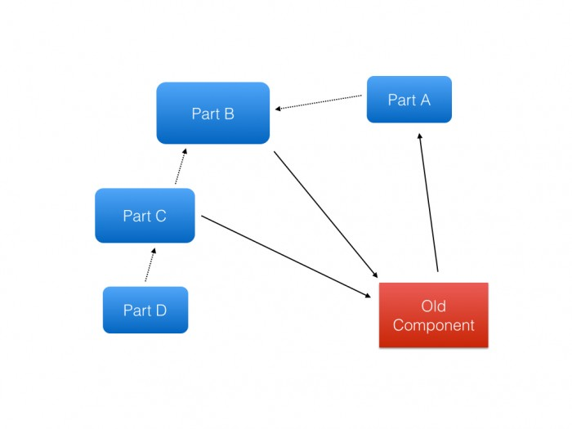
Mock Example: Adding POTM* to SCHISM
Hydro
Actually two existing implementations:
1. native closure as embedded
2. GOTM through its own API
*Pretend Ocean Turbulence Model

Slide 15
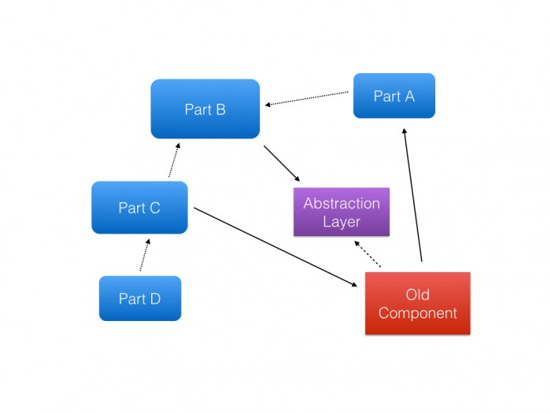
Hydro
evaluate_turbulence
- evaluate_turbulence API considers needs of potm, gotm and native
- only native and gotm are wrapped at early stage

Slide 16
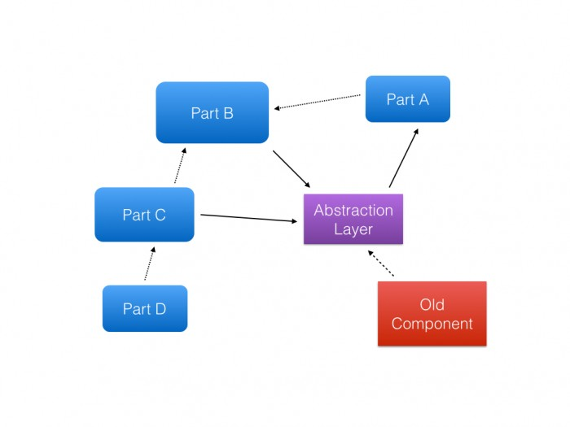
Hydro
evaluate_turbulence
Versioning: Stage is tested and committed criterion is epsilon or no change
No actual coding of POTM turbulence has happened

Slide 17
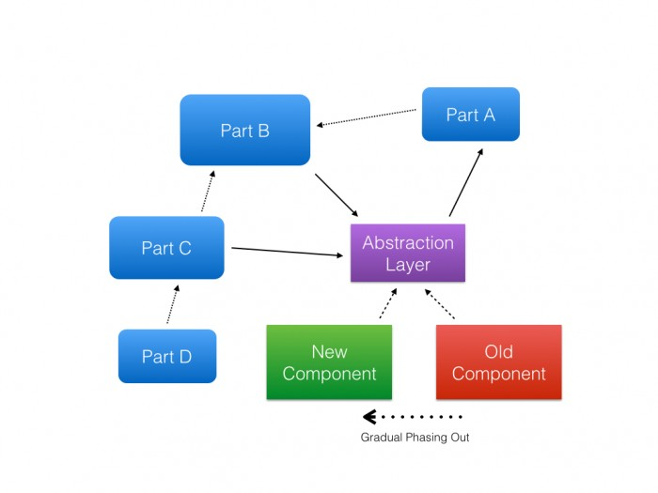
Hydro
potm
native/gotm
input option or phase out
Now you can code potm
Compiles, but tests emphasize native and gotm until potm ready

Slide 18
Shelves and Checkpoints
These are new in SVN
Stash work while you do something else
Switch branches without losing work
(shelve, switch, commit, switch back, unshelve)
Belated branch
(shelve, make branch, switch, unshelve)
Daily local checkpoints you can roll back

Slide 19
Getting out of a jam
“Undo” commit is a reverse merge (-r 1981:1980)
Local rollback: use checkpoints
Tree conflict: changes to directories structure and file contents concurrently
SVN > 1.11 for working copies helps with easy cases
Feel free to contact me or list

Slide 20
Culture Factors for VC
Enthusiasm for version control technology participation
Developer experience with tool, project-scale branching
Size of group
De facto centrality of product
Code review
Test coverage and automation
Distrust/need for public hosting

Slide 21
Questions
Eli Ateljevich (Eli.Ateljevich@water.ca.gov)

