Slide 1

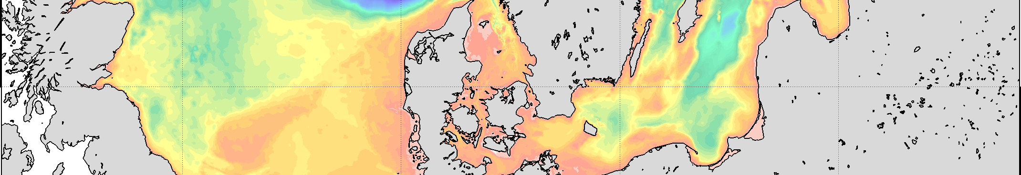
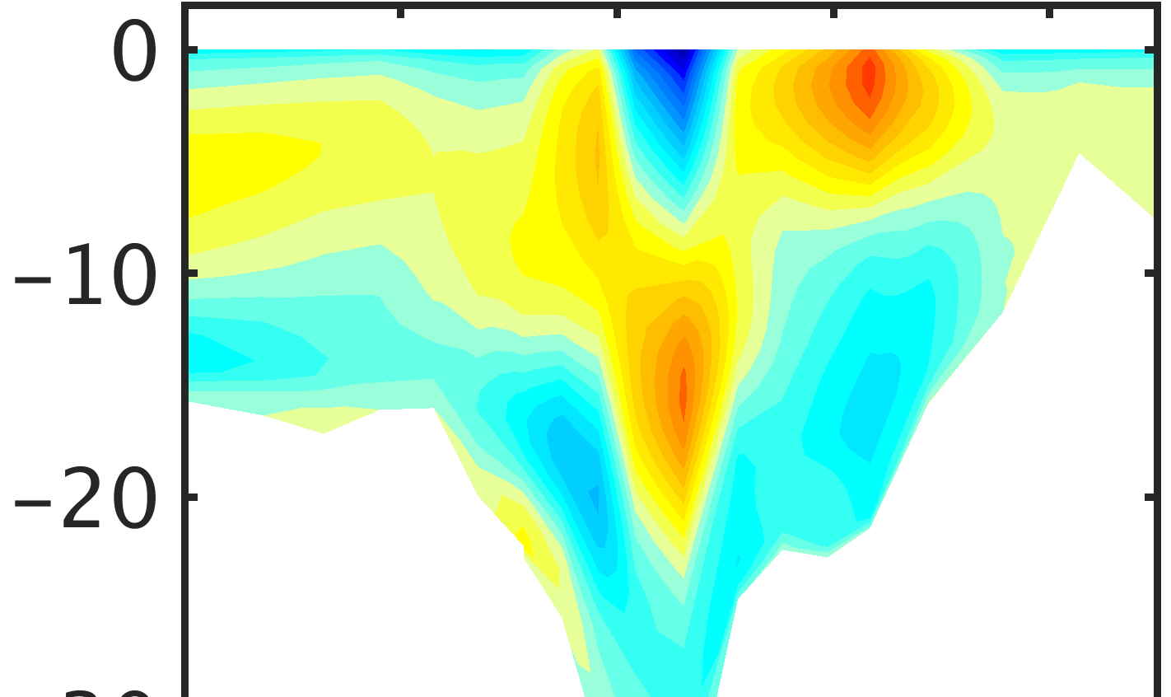
Secondary Circulation in the Danish straits
Verena Haid,
Emil Stanev, Johannes Pein, Joanna Staneva, Wei Chen
SCHISM-Workshop, April 15-18, 2019
Department of Water Resources, Sacramento, CA

Slide 2

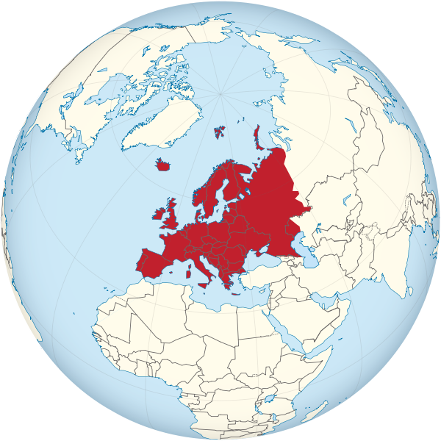
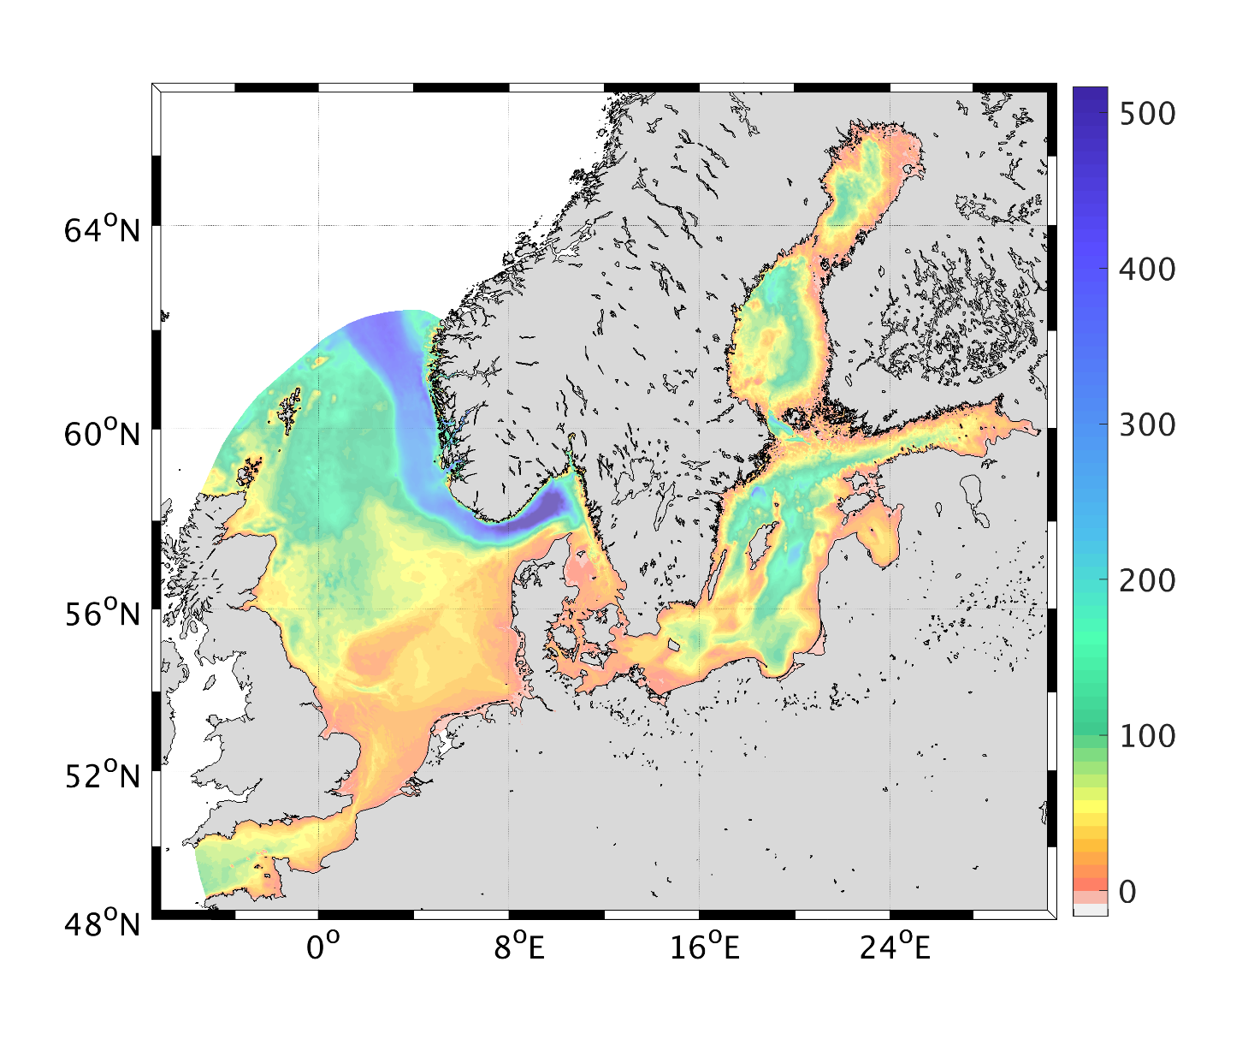
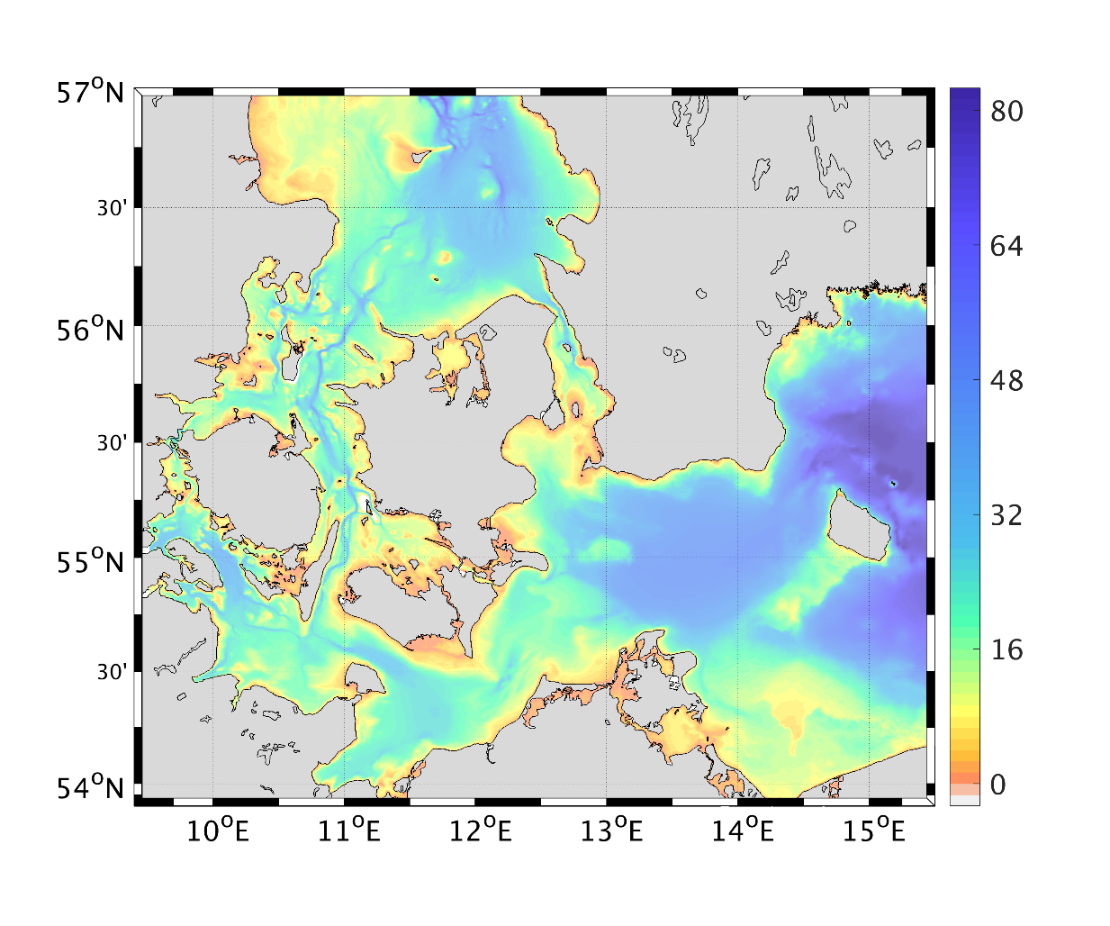
Introduction
The Danish straits
Source: Wikimedia Commons
Located in the North Sea –
Baltic Sea Transition Zone
Three connecting, narrow
and shallow straits:
Little Belt, Great Belt, Sound
Baltic Sea receives ~16000 m³ s⁻¹
freshwater input (Meier and Kauker, 2003)
→ strong salinity gradient between Baltic Sea and North Sea
→ strait dynamics comparable to estuaries
Strong atmospheric influence:
- inflow/outflow controlled by air pressure/winds
- events on scales of several days
m
m
2

Slide 3
METHODS
Model, grid, data sets etc.
SCHISM (Semi-implicit Cross-Scale Hydroscience Integrated System Model; Zhang et al. 2016)
Regional North Sea - Baltic Sea grid (Stanev et al. 2018)
- horizontal resolution 3 km to 100 m
- variable # (max. 59) sigma layers with shaved cell technique (LSC²; Zhang et al. 2015)
Initialisation:
monthly climatological temperature and
salinity data (Janssen et al. 1999)
Surface forcing:
- hourly 7-km COSMO EU data from DWD
- river runoff from EHYPE (SMHI)
Open boundary forcing:
hourly Copernicus product
m
3

Slide 4
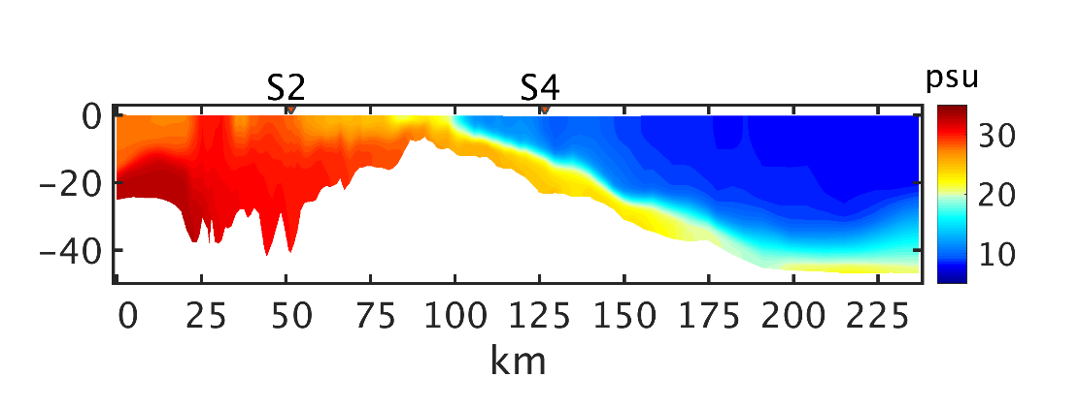
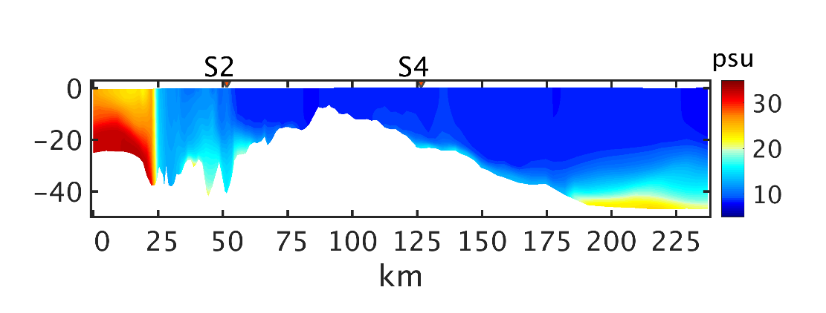
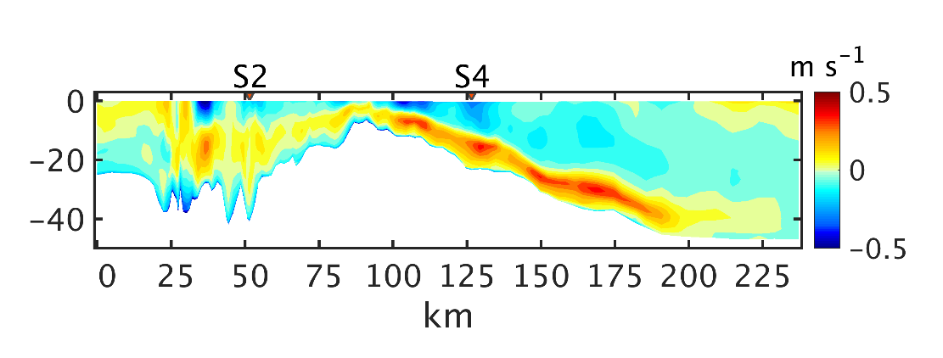
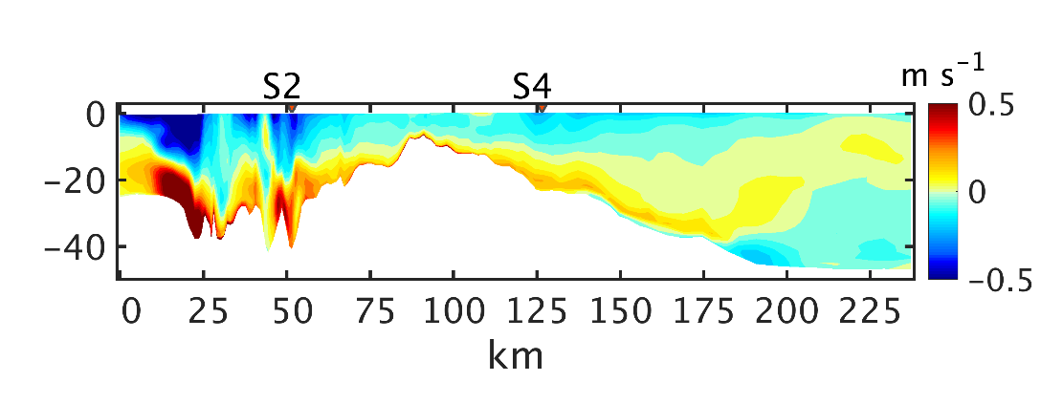
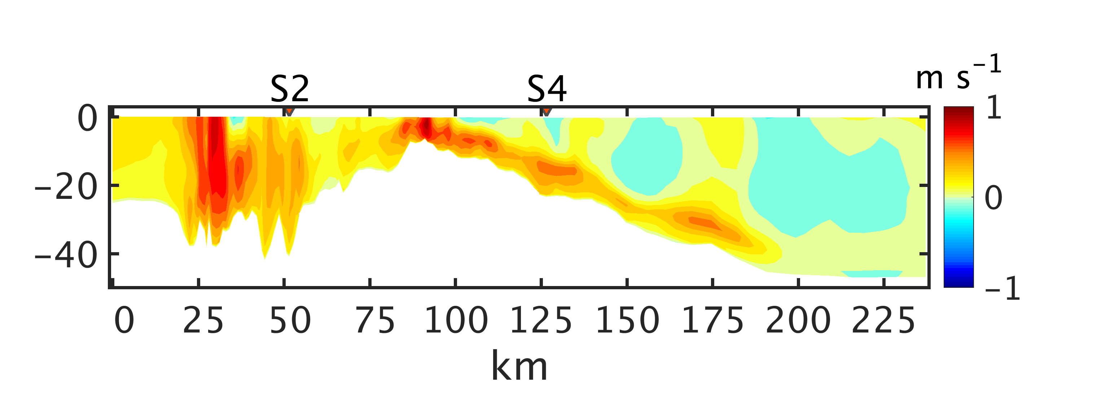
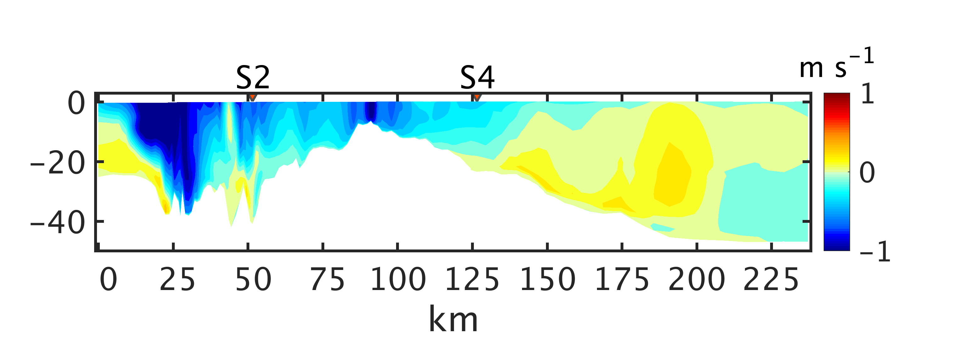
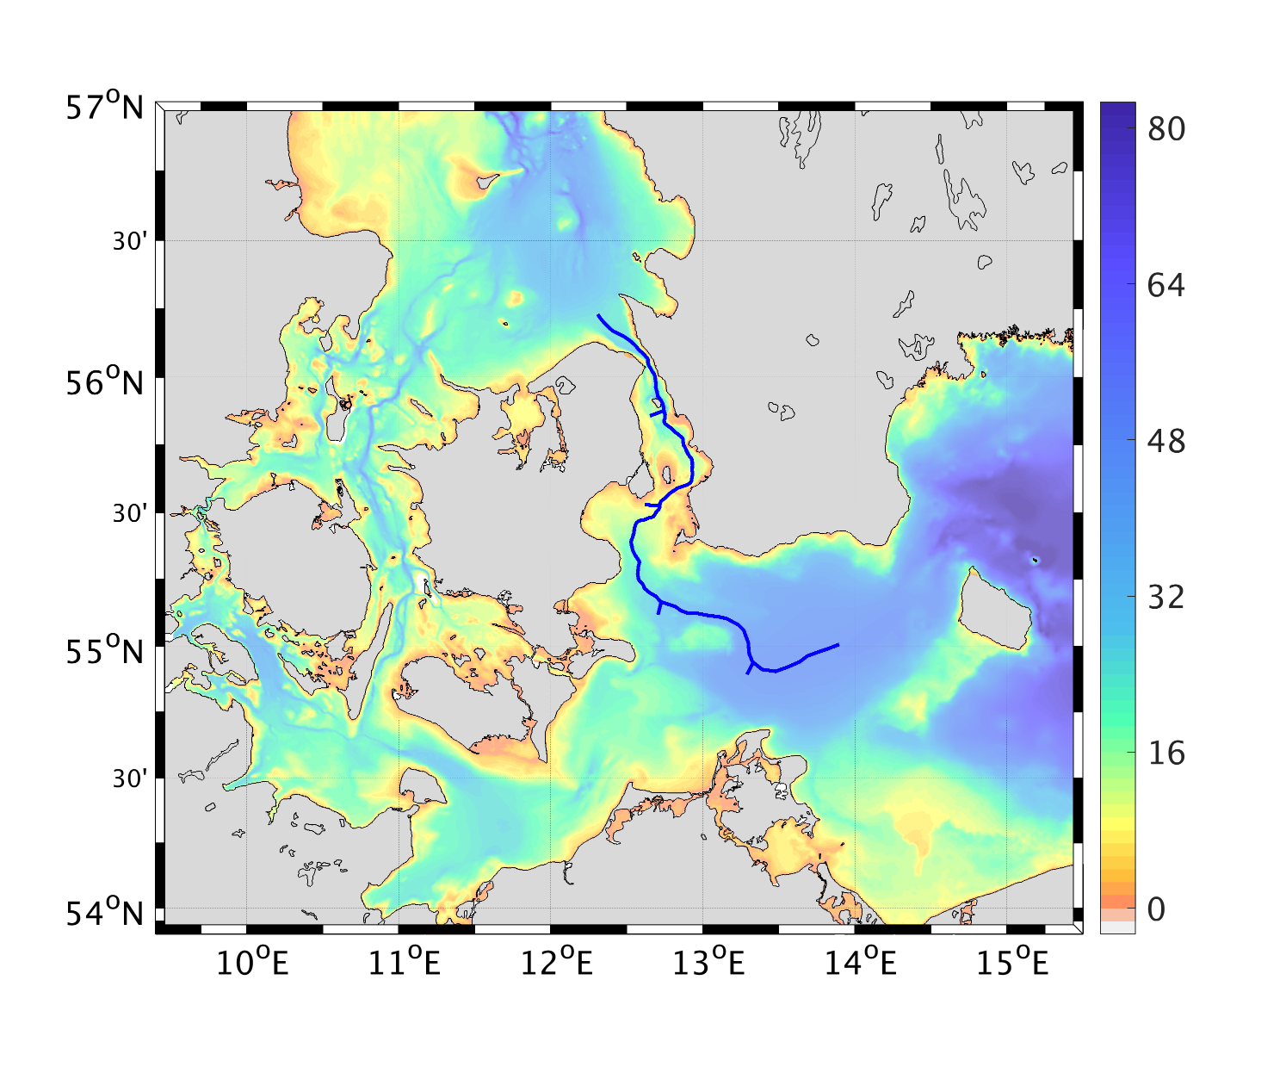
Along-channel characteristics
Transect along the Sound (T-SA)
Inflow phase
25-30 October 2014
Outflow phase
12-17 November 2014
Salinity
Salinity
Along-channel velocity
Along-channel velocity
Kattegat
T-SA
T-S1
50
T-S2
Great Belt
100
T-S3
Bornholm Basin
T-S4
O-V
150
Arkona Basin
200
4
Fehmarn Belt

Slide 5
Introduction
Secondary circulation
Main drivers (based on idealized studies of estuaries):
Differential advection of buoyancy
‘flood’
‘ebb’
Channel curvature (and morphology)
Coriolis force
Northern Hemisphere
outer bend
inner bend
Advection of lateral momentum, friction
Of course, in reality all these effects are superimposed on each other …
5

Slide 6
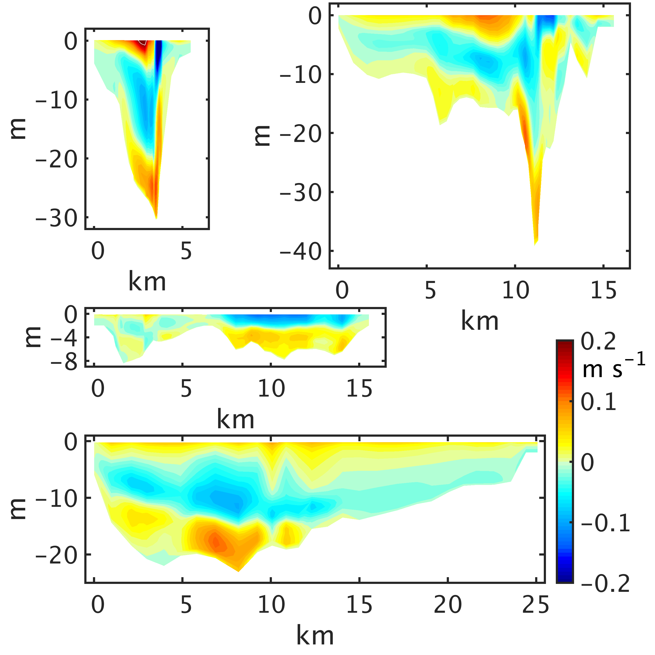
Lateral velocity
Transect Sound 1 (T-S1)
Inflow phase
25-30 October 2014
T-SA
T-SA
T-S1
T-S1
50
T-S2
50
T-S2
O-D
O-D
100
T-S3
100
T-S3
T-S4
T-S4
O-V
O-V
150
150
0
0
m
m
-10
-10
-20
-20
-30
T-S1
-30
0
5
km
-40
T-S2
0
5
10
15
km
6

Slide 7
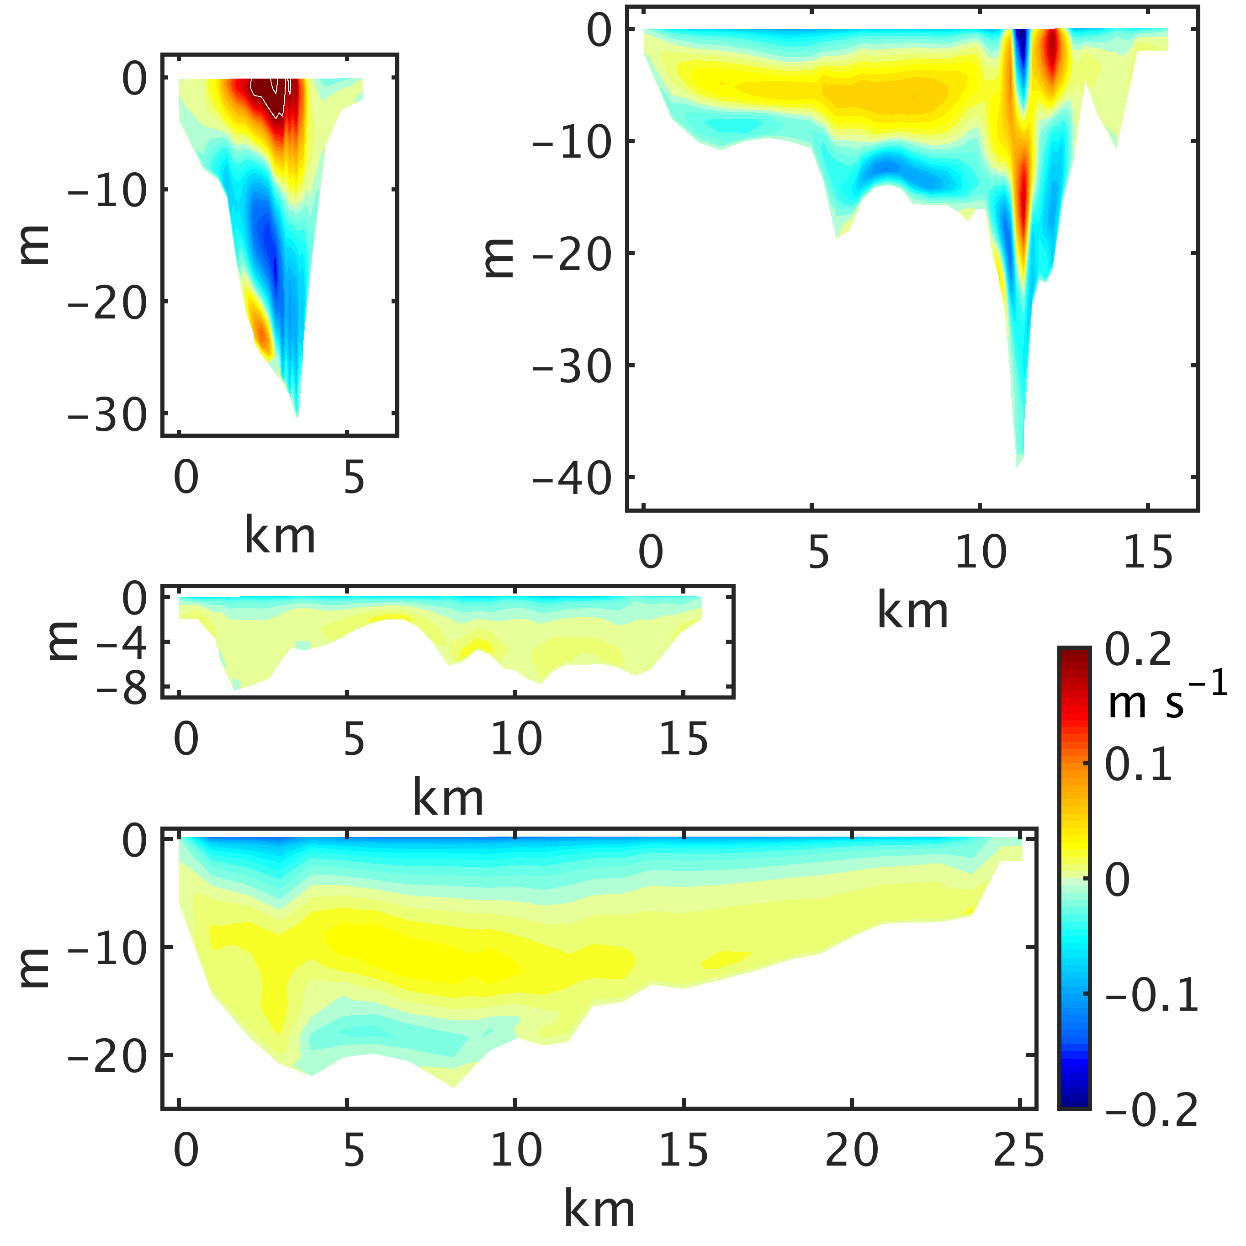
Lateral velocity
on four cross sections through the Sound
T-S1
50
T-S2
O-D
100
T-S3
Inflow phase
25-30 October 2014
Outflow phase
12-17 November 2014
T-S4
T-S1
T-S1
T-S2
T-S2
T-S3
T-S3
T-S4
T-S4
7

Slide 8
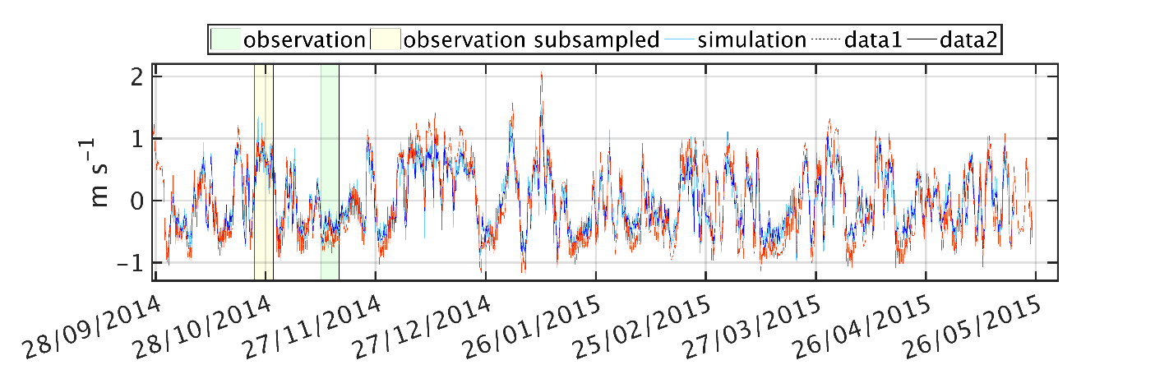
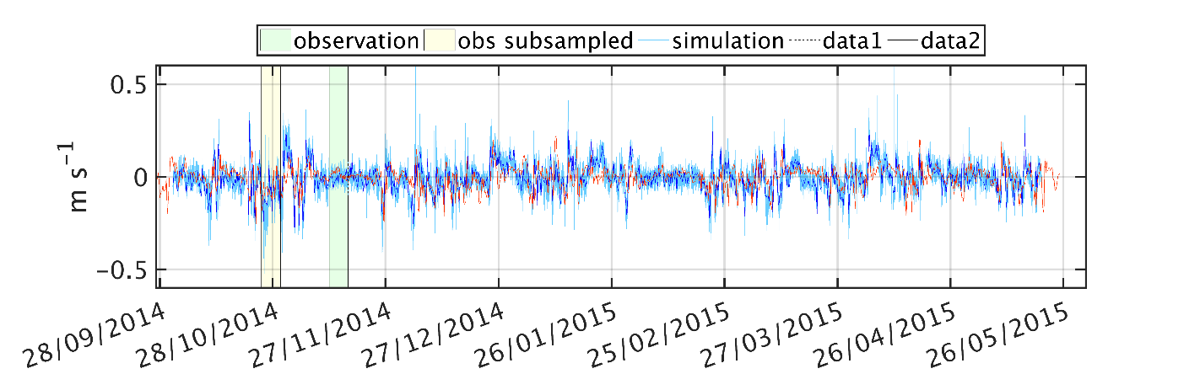
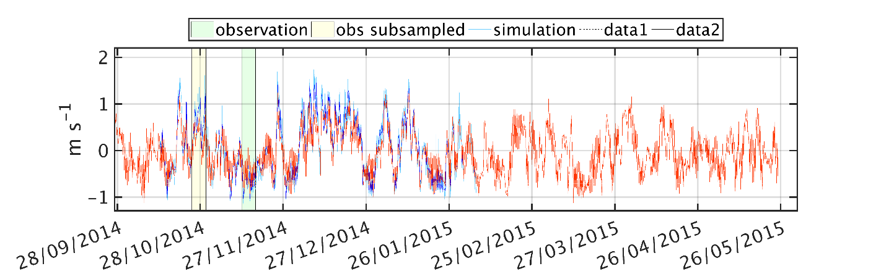
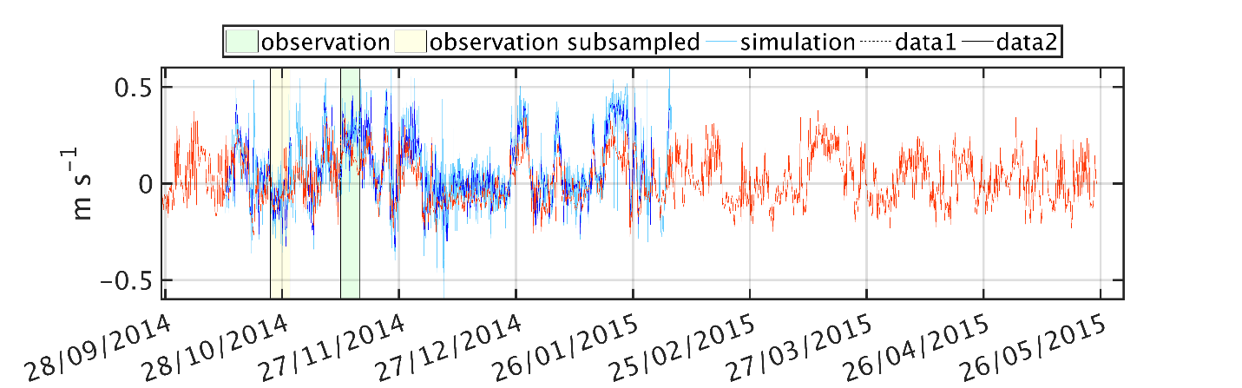
Validation
Comparison with current meter data
Drogden Fyr, 5m
Velocities
Correlation coefficient
T-SA
axial
0.91
T-S1
50
T-S2
O-D
lateral
100
T-S3
T-S4
O-V
0.35
150
Vengeancegrund, 5m
Velocities
Observations Model
T-SA
0.89
axial
T-S1
50
T-S2
O-D
T-S3
lateral
100
T-S4
O-V
0.68
150
8

Slide 9
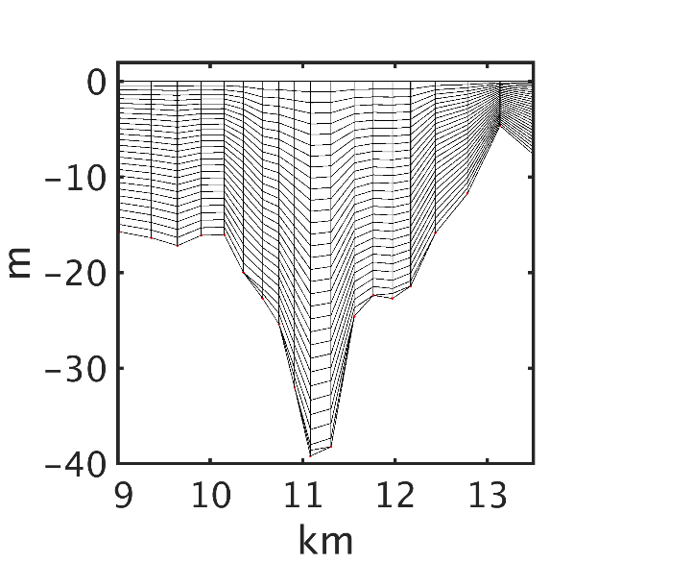
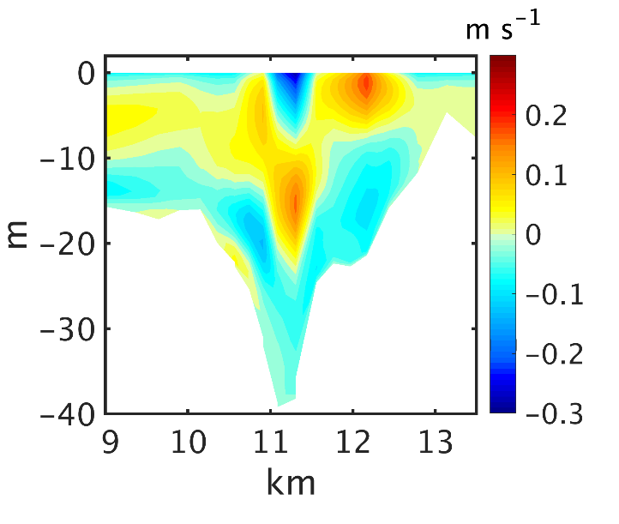
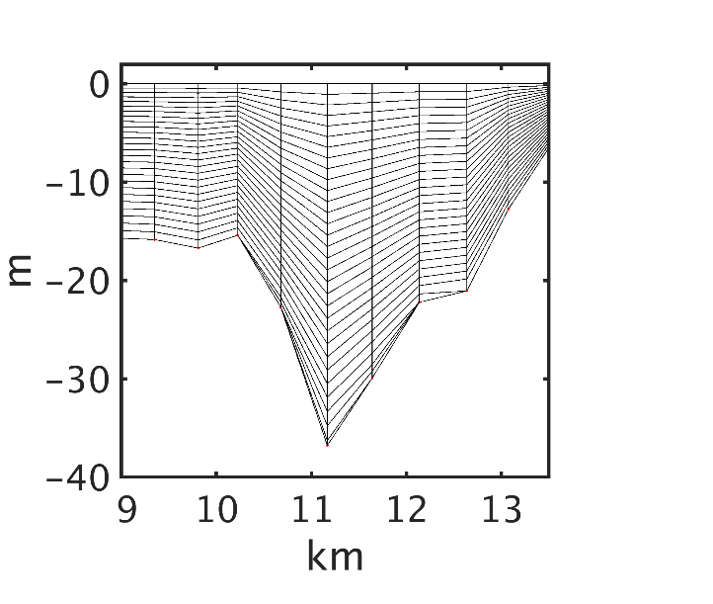
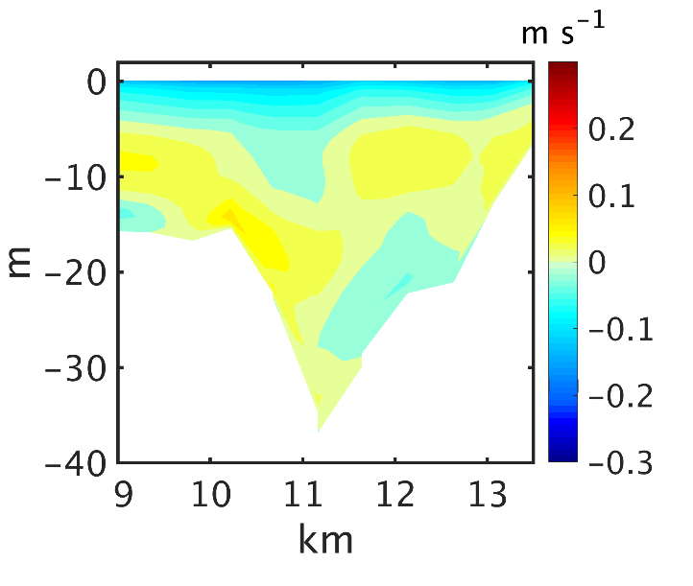
Influence of model resolution
Transect Sound 2 (T-S2), outflow phase
Grid resolution
Lateral velocity
Up to 100 m
T-S1
50
T-S2
O-D
fine grid
fine grid
100
T-S3
T-S4
Up to 500 m
coarse grid
coarse grid
9

Slide 10
Influence of model resolution
Transect Sound 2 (T-S2), outflow phase
Grid resolution
Lateral velocity
Up to 100 m
T-S1
50
T-S2
O-D
fine grid
fine grid
100
T-S3
T-S4
Up to 500 m
coarse grid
coarse grid
10

Slide 11

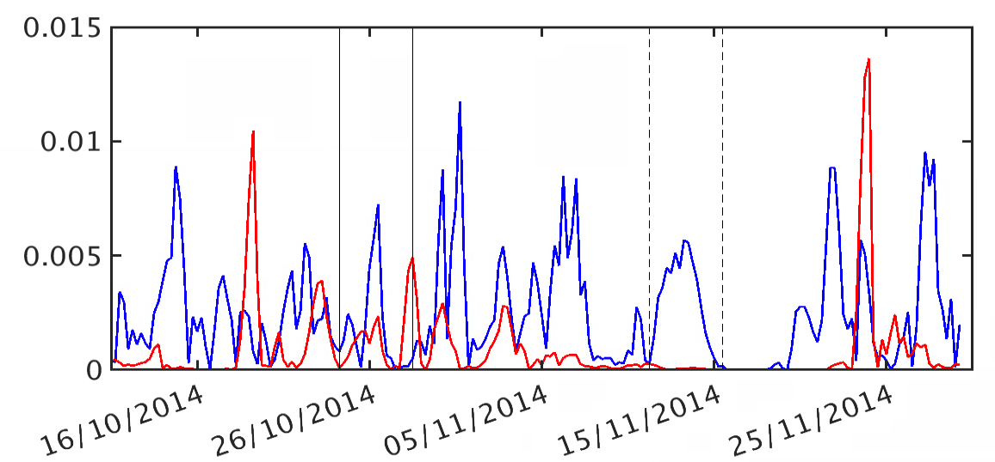
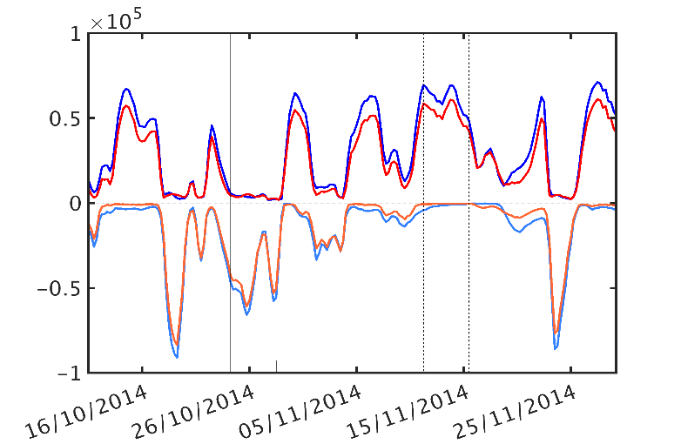
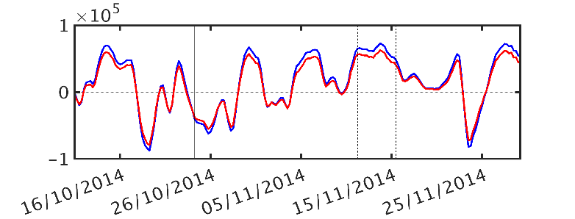
Influence of model resolution
Sound 2, dispersion and two-directional transport
dispersion [m² s⁻¹]
T-SA
T-S1
50
T-S2
fine grid coarse grid
O-D
100
T-S3
T-S4
O-V
150
Two-directional transport [m³ s⁻¹]
Out: Coarse Fine
In: Coarse Fine
net transport [m³ s⁻¹]
fine grid coarse grid
11

Slide 12
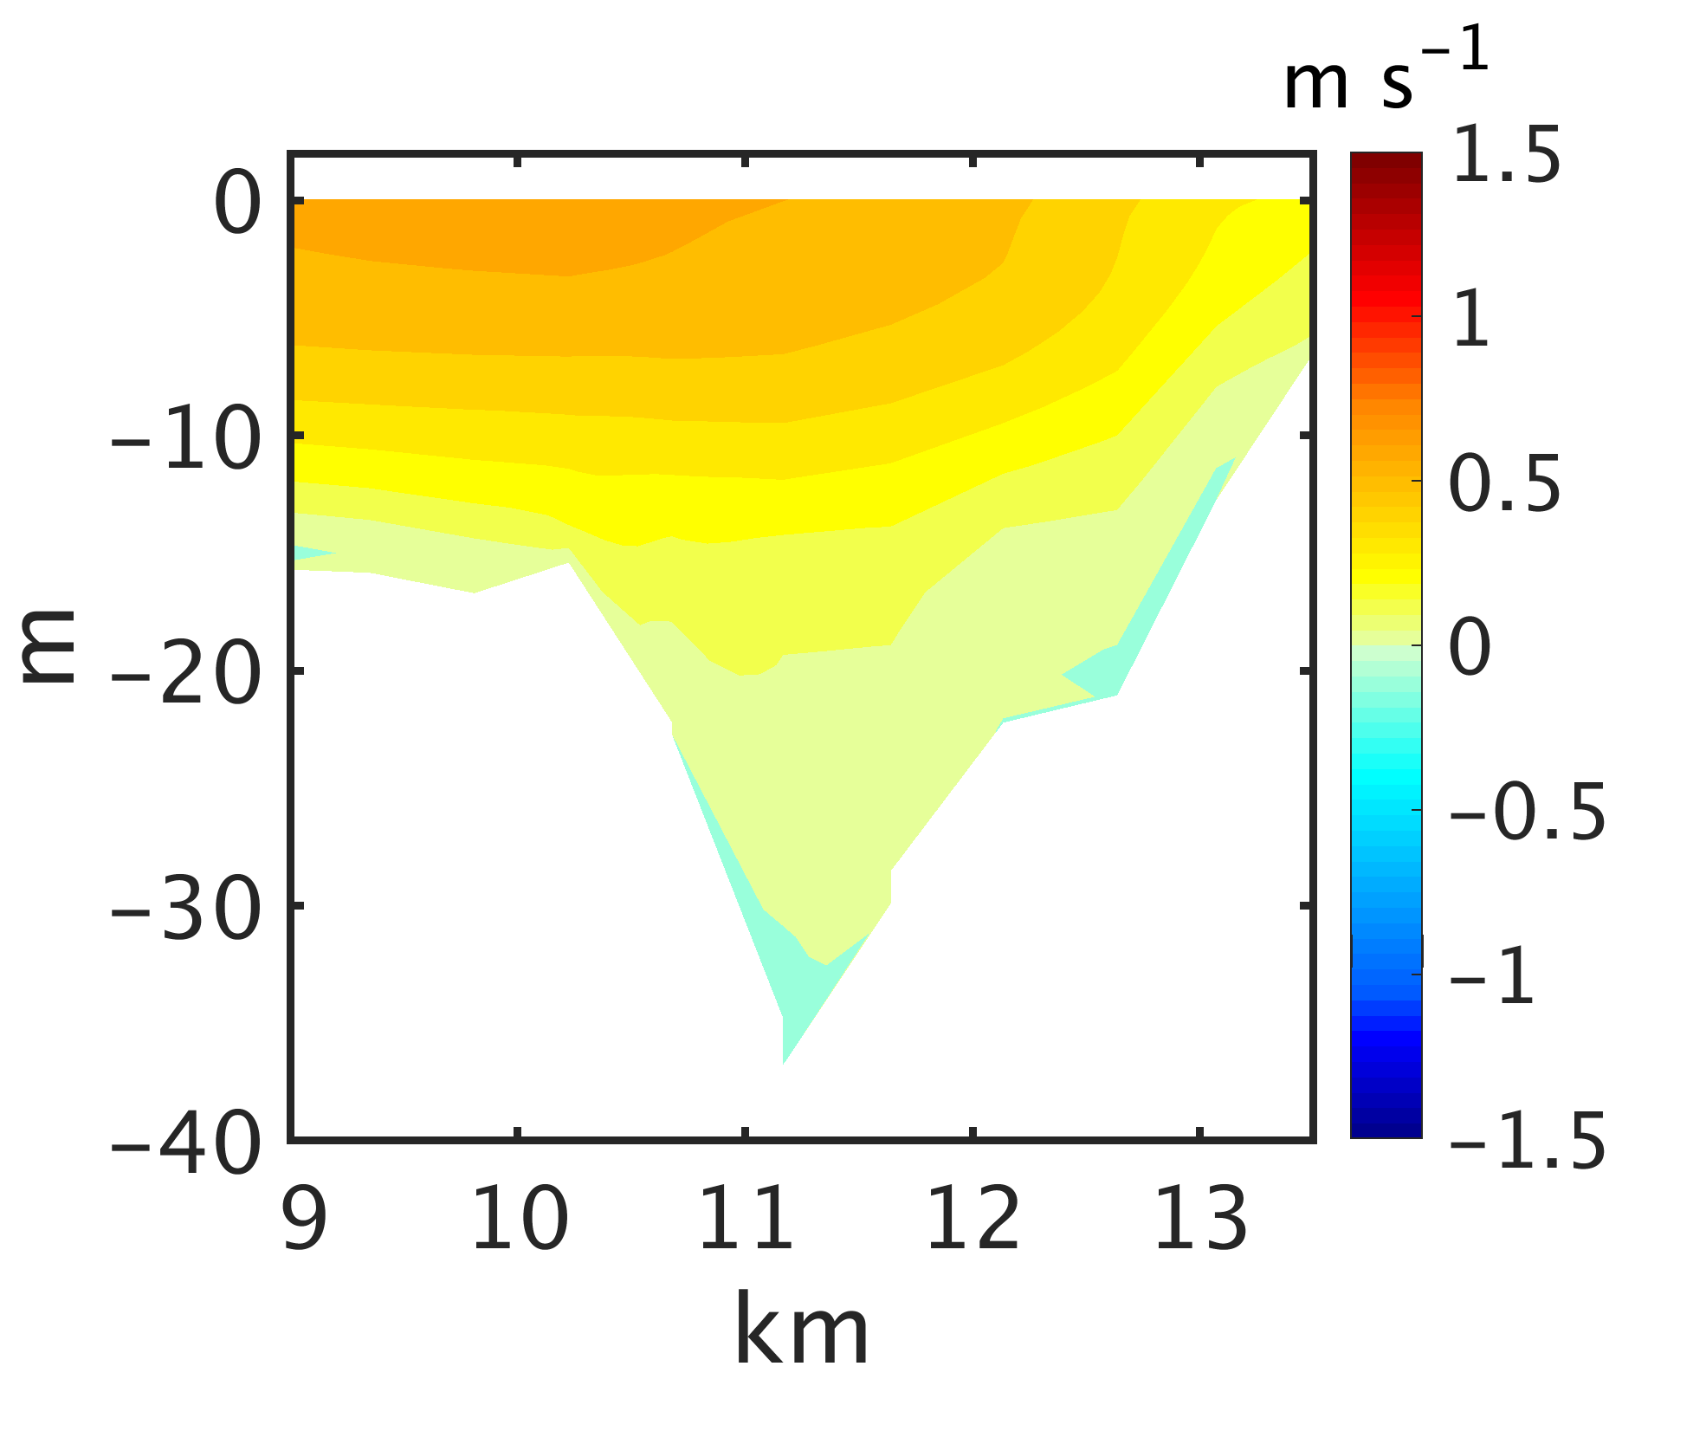
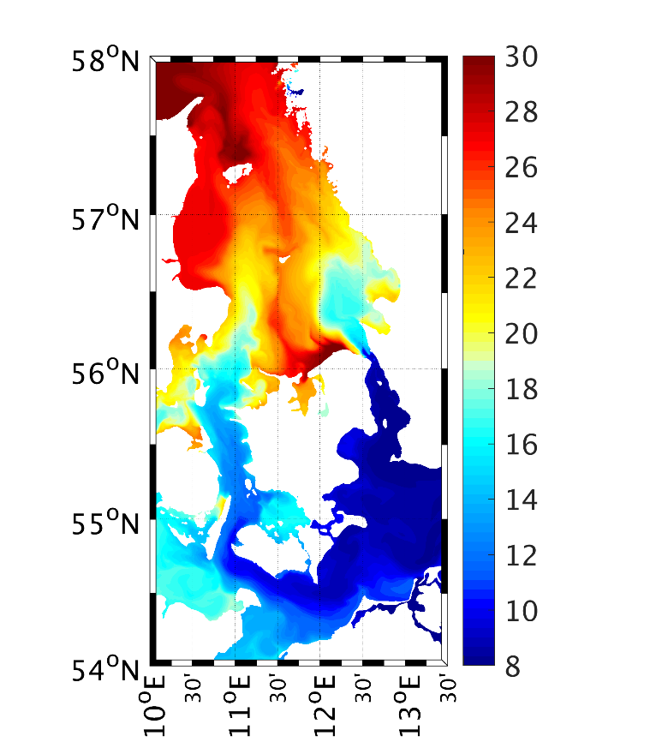
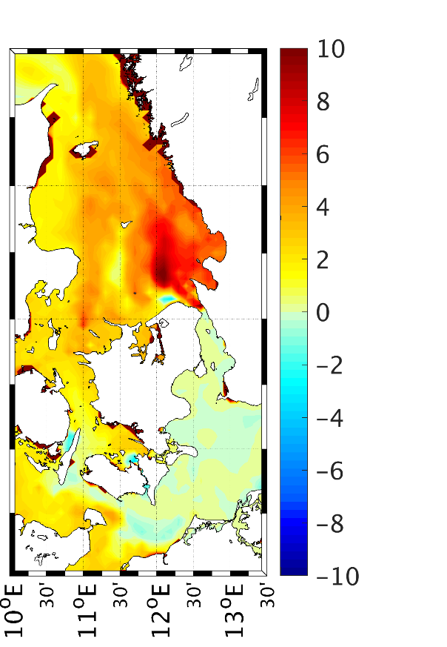
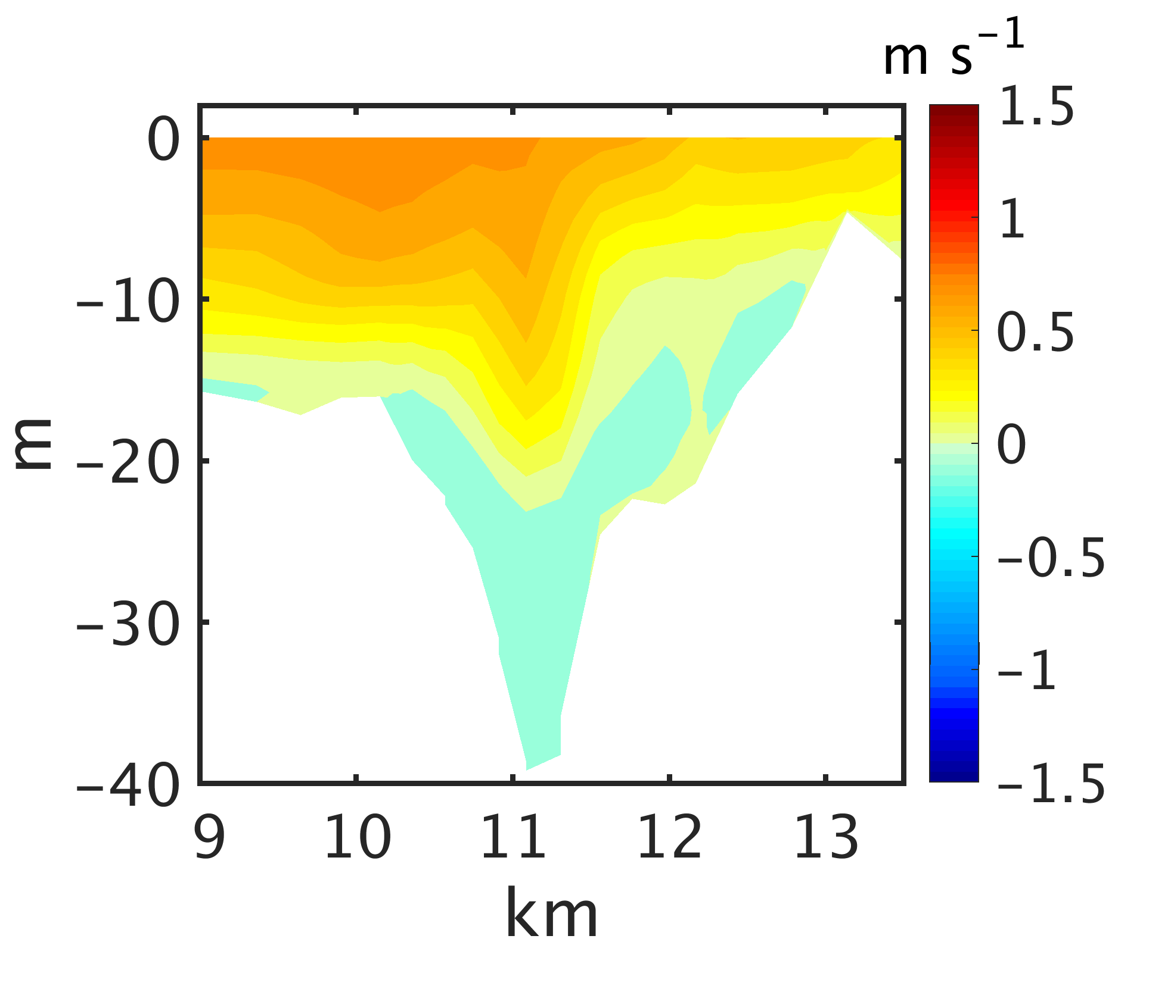
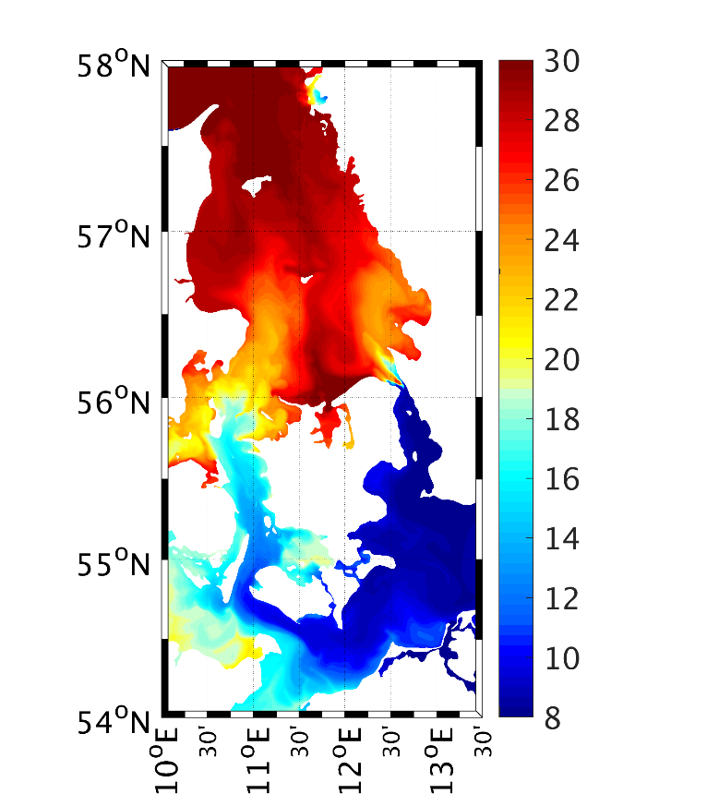
Influence of model resolution
Sound 2, outflow phase
Lateral velocity
Axial velocity
Surface salinity at end of outflow
phase
psu
difference
psu
psu
12

Slide 13
Summary and Conclusions
Secondary circulation in the Danish straits
with adequate resolution SCHISM successfully recreates the lateral circulation
With the strong morphological variability in the Sound, the appearance of the secondary circulation differs strongly with location
Lateral circulation intensifies over steep slopes (especially during the outflow phase)
Inadequate resolution leads to
-> misrepresentation of secondary circulation cells
-> underestimation of vertical and horizontal mixing
-> biased axial flow and transports
-> biased water characteristics
13

Slide 14
Summary and Conclusions
Secondary circulation in the Danish straits
with adequate resolution SCHISM successfully recreates the lateral circulation
With the strong morphological variability in the Sound, the appearance of the secondary circulation differs strongly with location
Lateral circulation intensifies over steep slopes (especially during the outflow phase)
Inadequate resolution leads to
-> misrepresentation of secondary circulation cells
-> underestimation of vertical and horizontal mixing
-> biased axial flow and transports
-> biased water characteristics
Thank you for your attention!
14

Slide 15
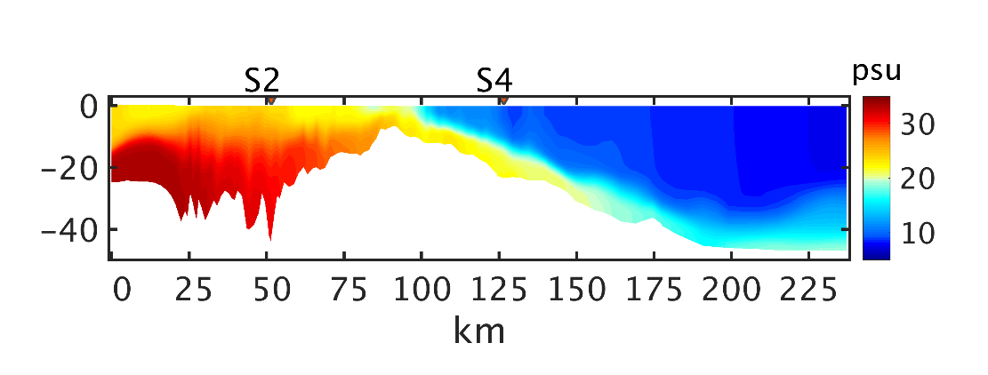

Along-channel SAlinity
Transect along the Sound
Inflow phase
Outflow phase
High resolution
Low resolution

Slide 16
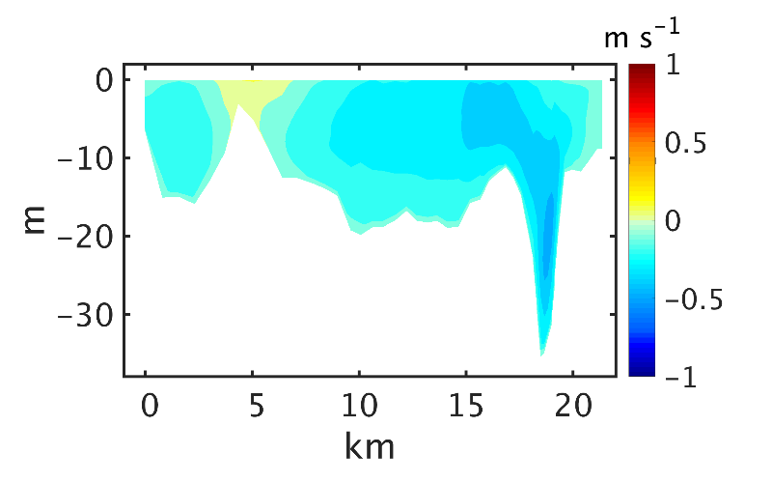
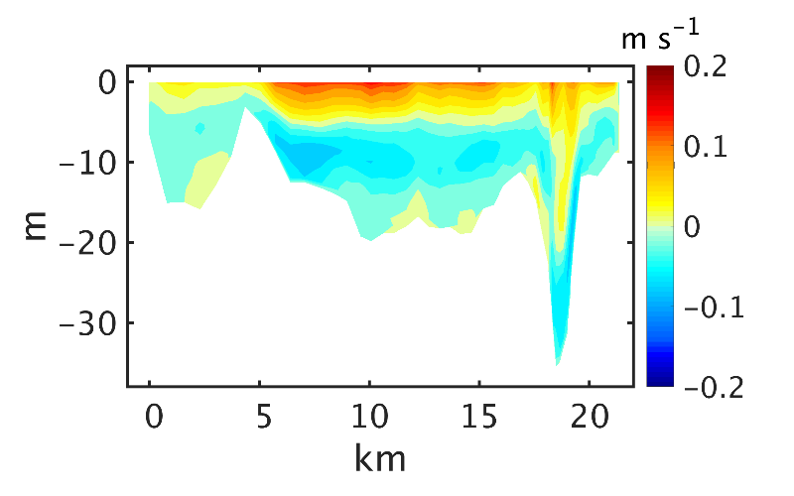
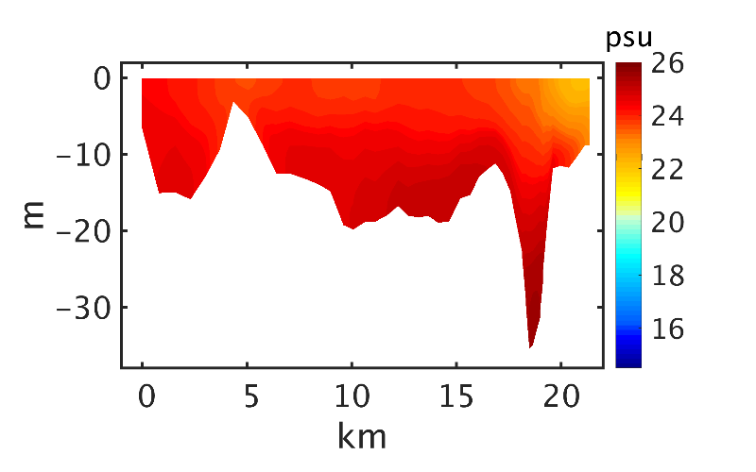
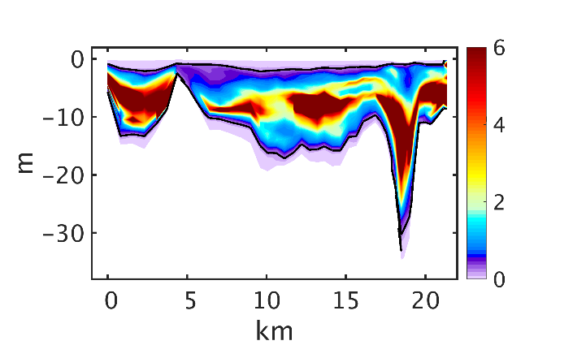
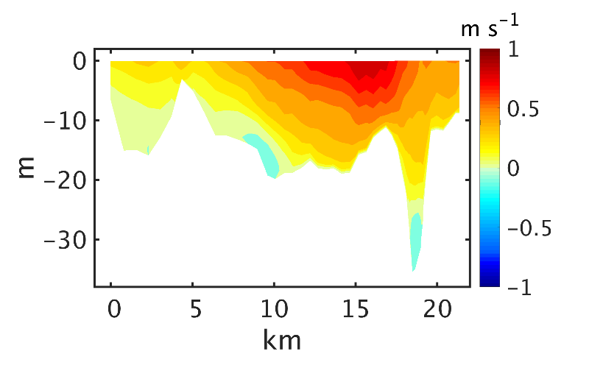
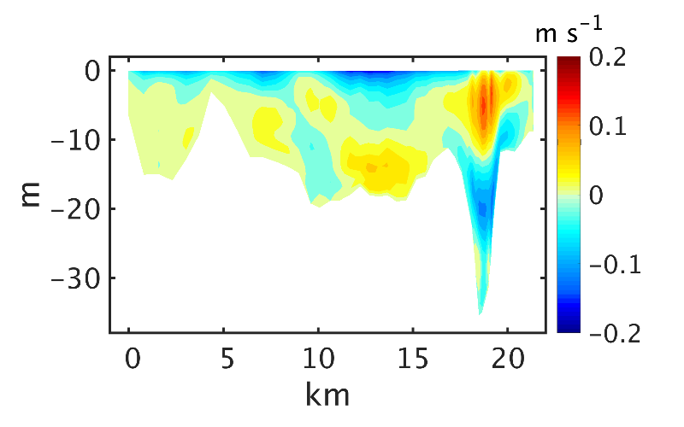
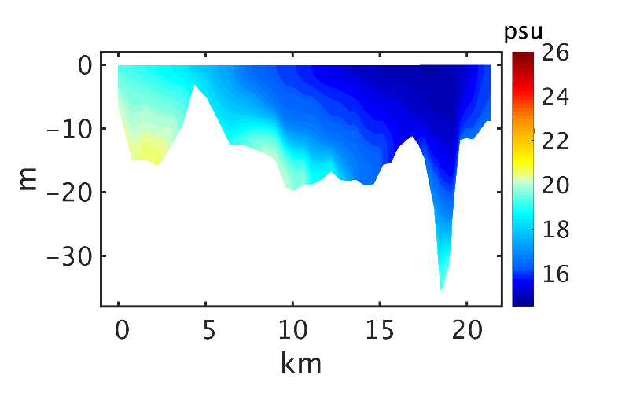
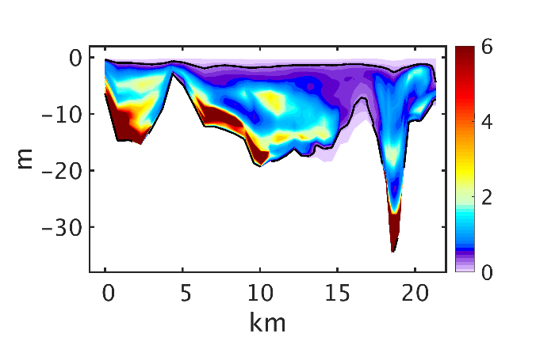
sound1 sound2 sound3 sound4
Inflow0 transport: -42068 -41721 -38733 -40018
Outflow0 1025-1042 transport: 62611 59987 57959 55468
Vengeancegrund section
Inflow (Transport: -57568 m^3/s)
Outflow (transport: 86540 m^3/s)
a)
b)
c)
d)
e)
f)
Fig. 8. Mean over inflow (25-30/10/2014, a-d) and outflow (12-17/11/2014, e-h) periods axial velocity (a,e), lateral velocity (b, f), salinity (c, g) and Ri (d, h) along the section line through Vengeancegrund in the Great Belt.
g)
h)

Slide 17
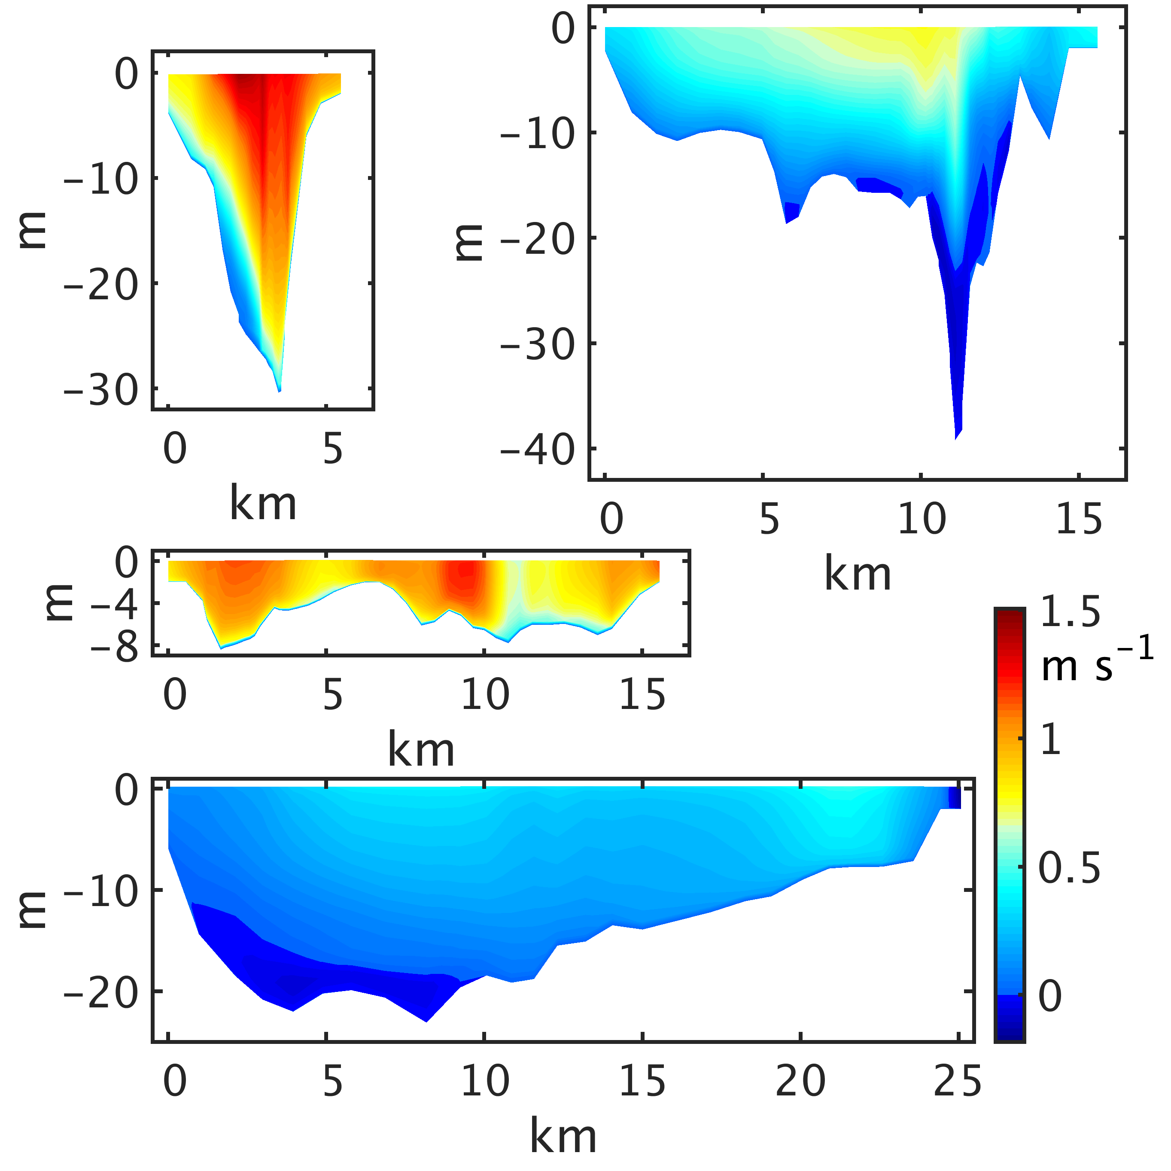
Lateral velocity
on four cross sections through the Sound
Outflow phase
12-17 November 2014
Sound 1
Axial velocity
Sound 2
Sound 3
Sound 4
17

Slide 18
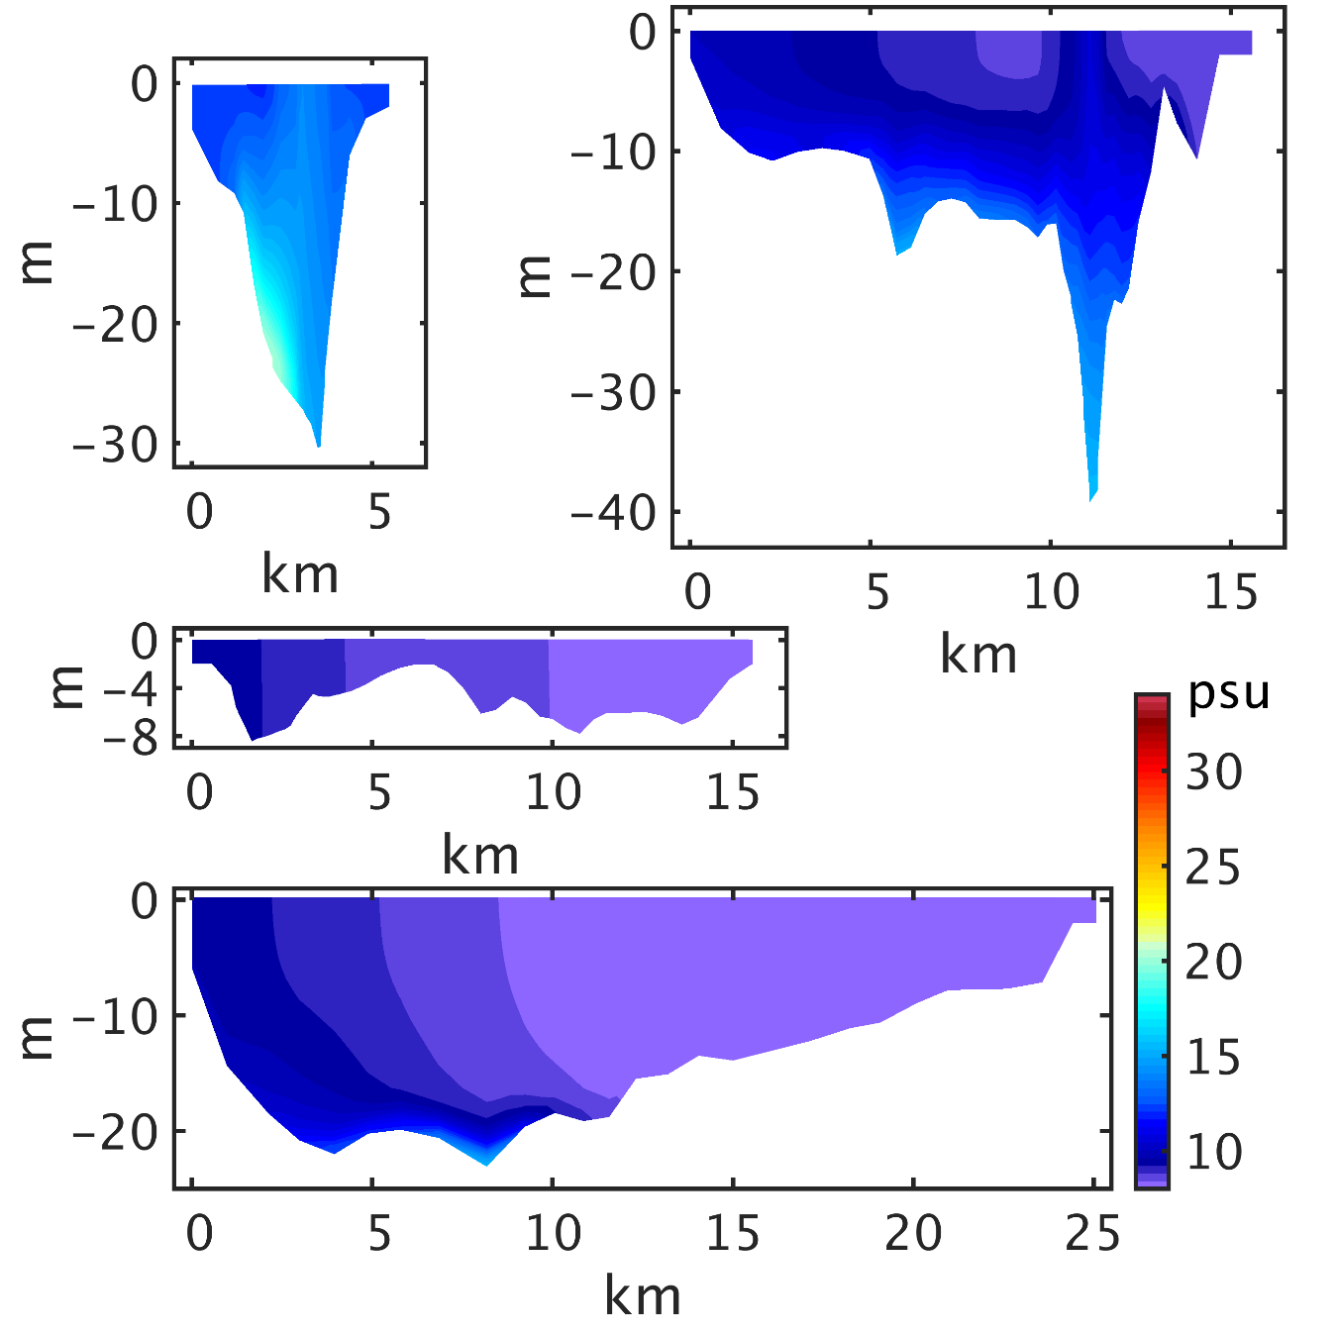
Lateral velocity
on four cross sections through the Sound
Outflow phase
12-17 November 2014
Sound 1
Salinity
Sound 2
Sound 3
Sound 4
18

Slide 19
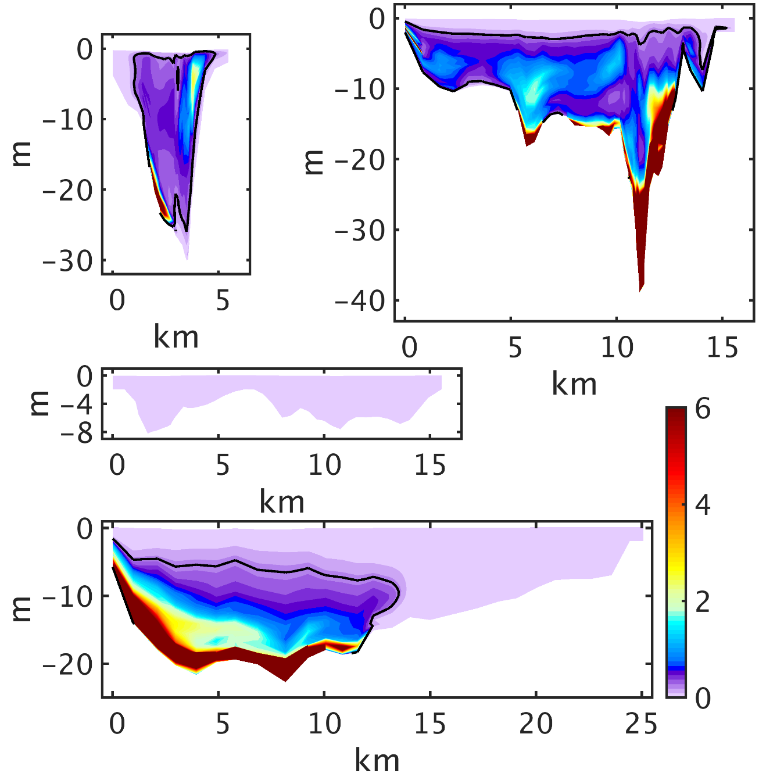
Lateral velocity
on four cross sections through the Sound
Outflow phase
12-17 November 2014
Sound 1
Richardson number
Sound 2
Sound 3
Sound 4
19

Slide 20
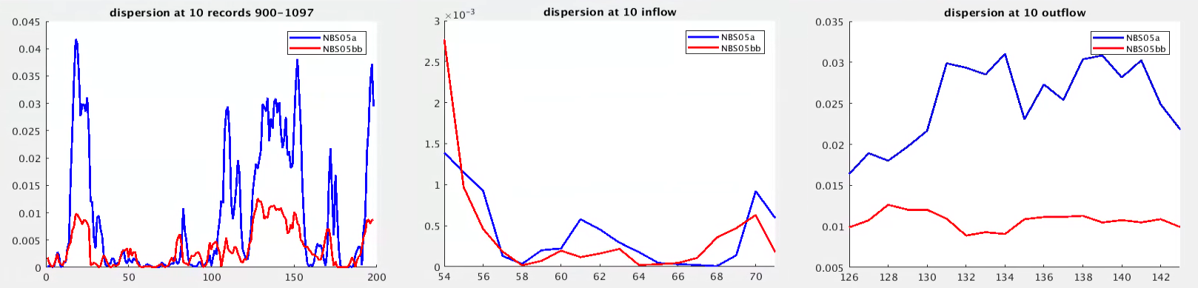
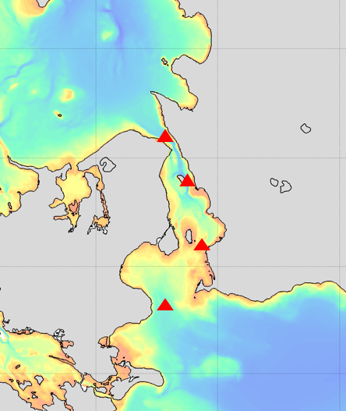
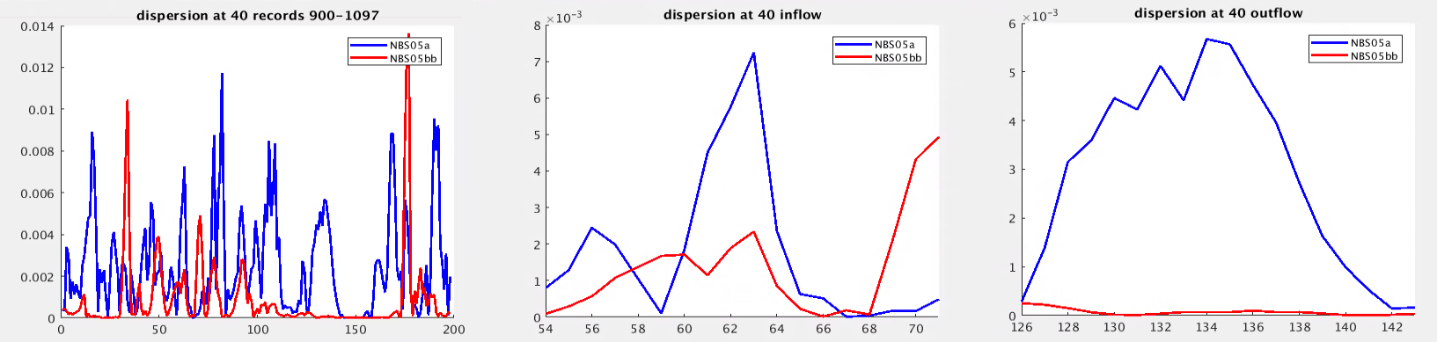
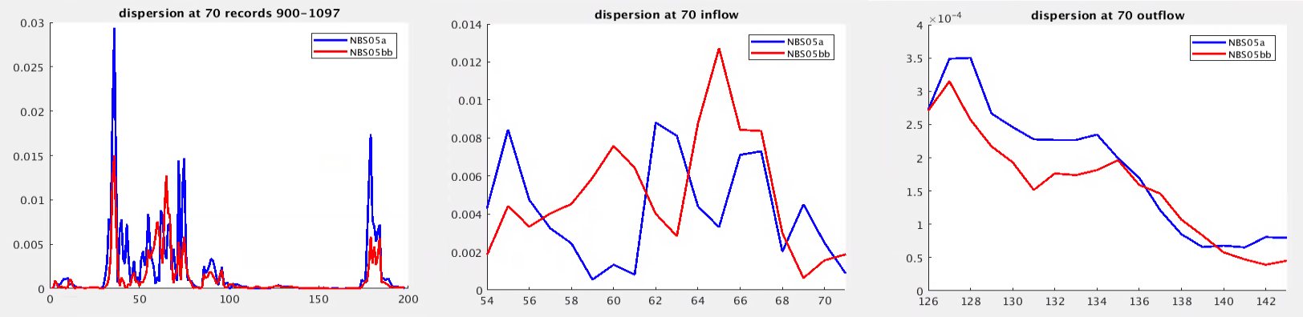
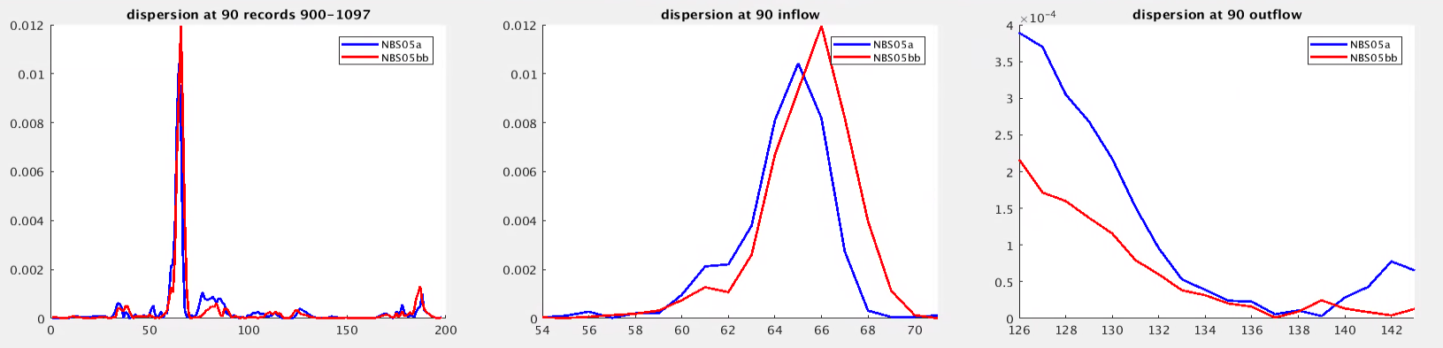
10
40
70
90

Slide 21
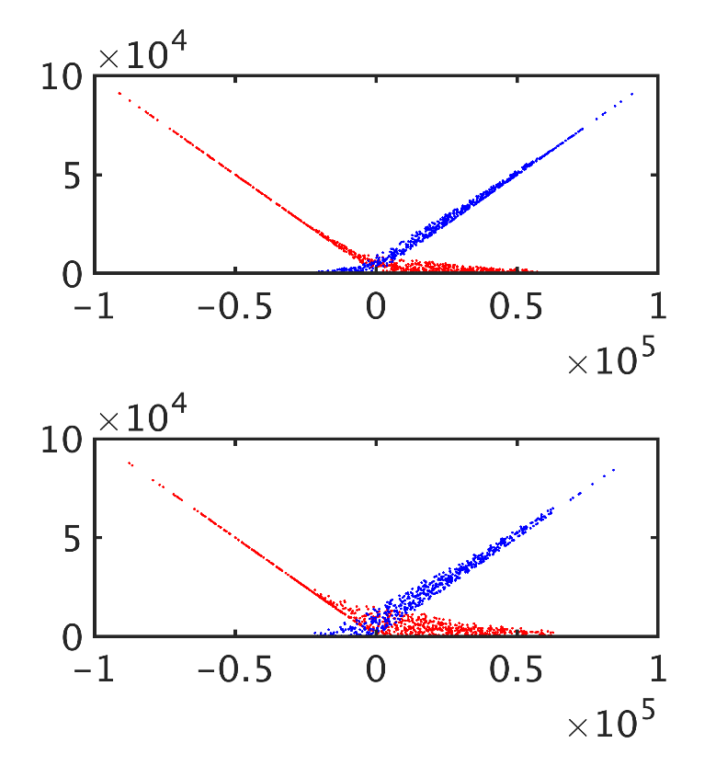
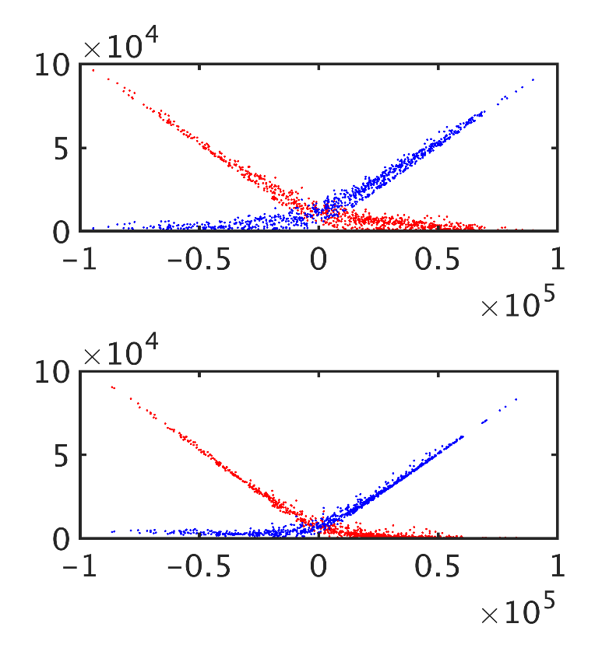
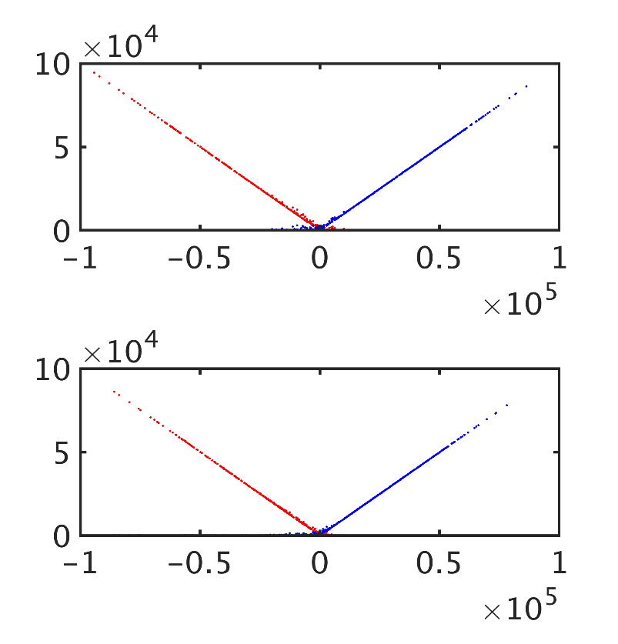

Sound 1
Sound 2
fine
fine
Inflow outflow
coarse
coarse
Sound 3
Sound 4
fine
fine
coarse
coarse

Slide 22






Sound 1
Sound 2
Coarse
Fine
Coarse
fine
Sound 3
Sound 4

