Slide 1
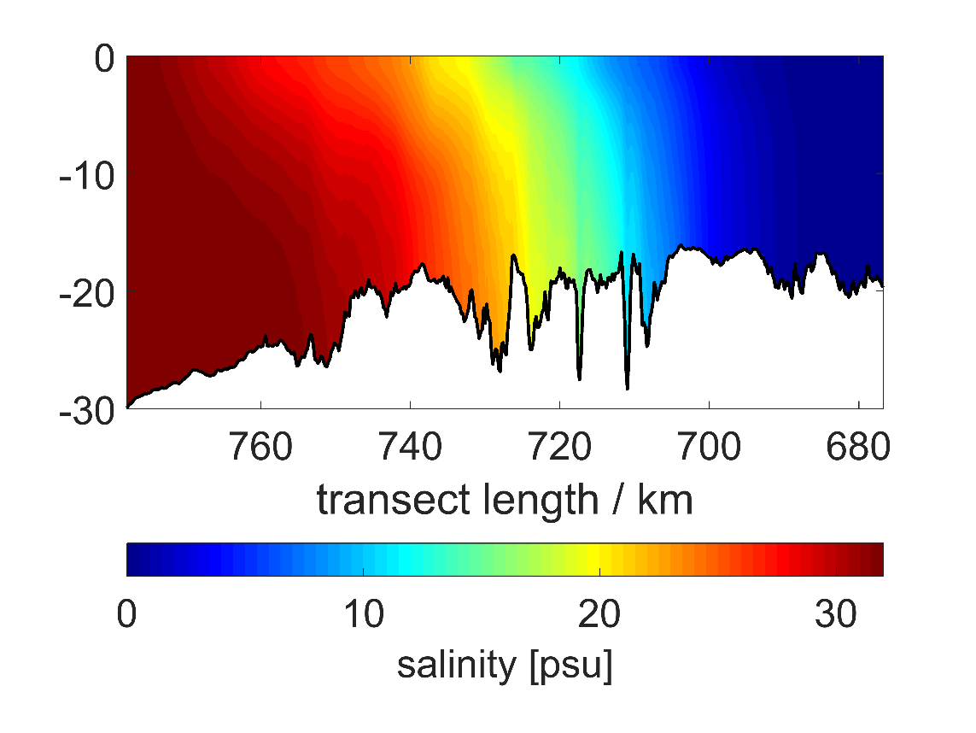
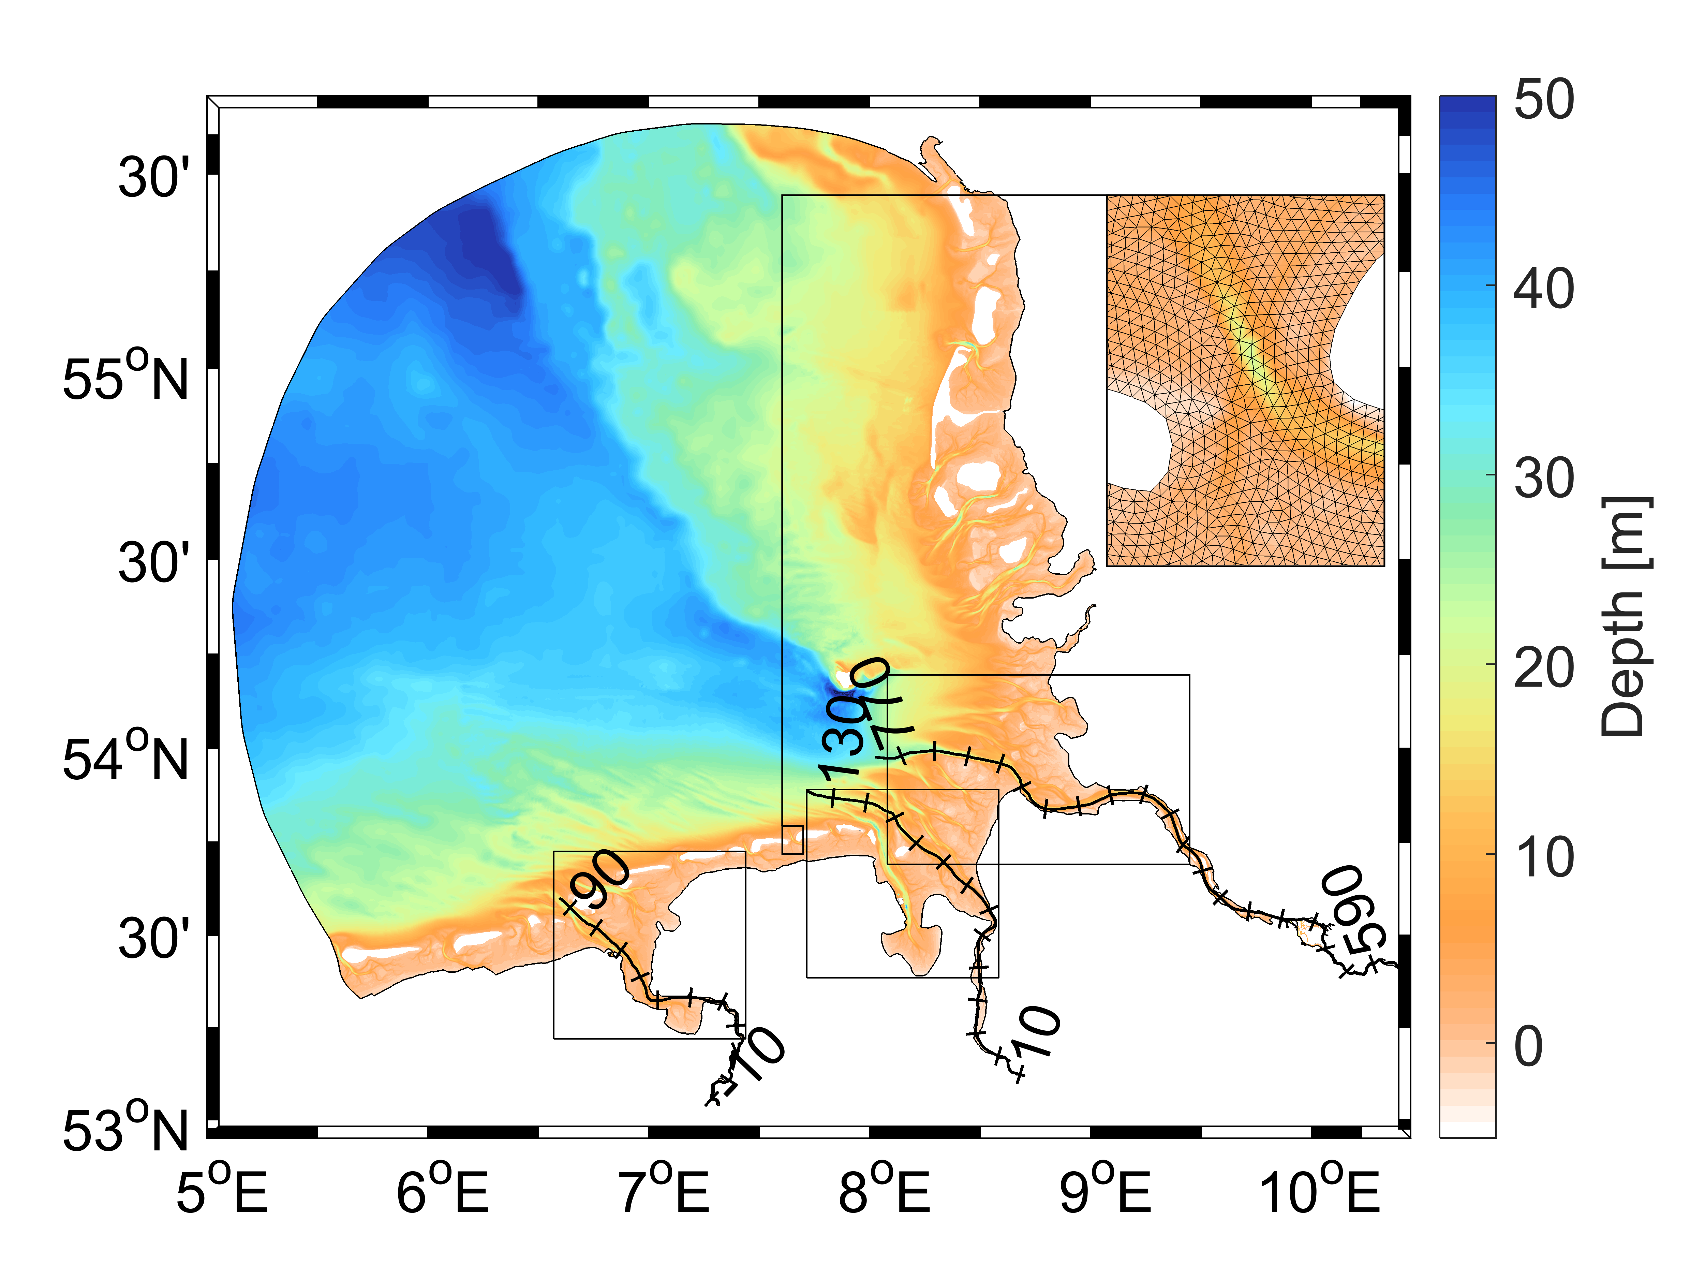
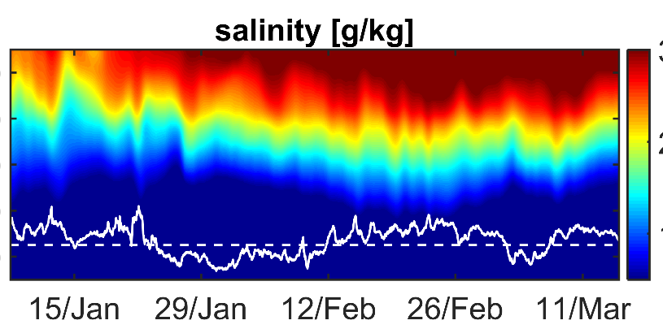
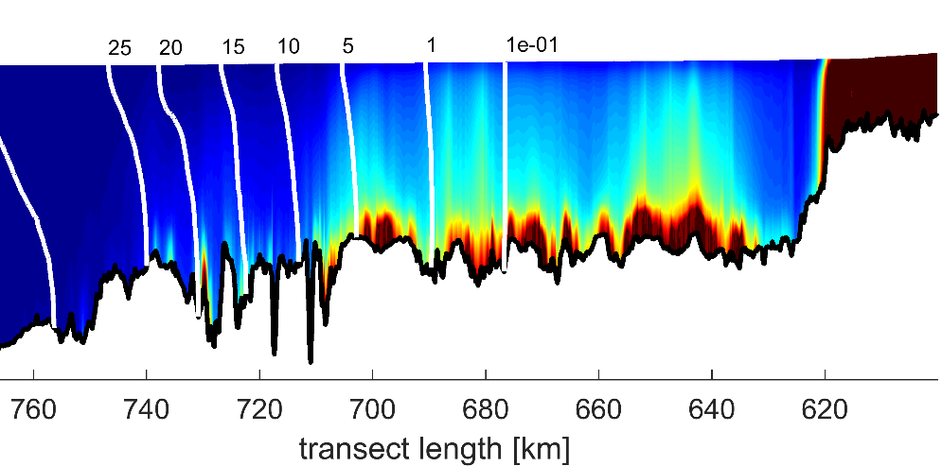
German Bight Estuaries: AN INTER-COMPARISON STUDY FROM THE PERSPECTIVE OF NUMERICAL MODELING
Emil V. Stanev, Johannes Pein, Benjamin Jacob
Institute of Coastal Research
ISCHISM SPECIAL TTRAINING
April 15, 2019

Slide 2
Outline
Introduction of the model setup
Validation
Comparison of the three estuaries
Simulated SPM dynamics in the Elbe
Conclusions

Slide 3

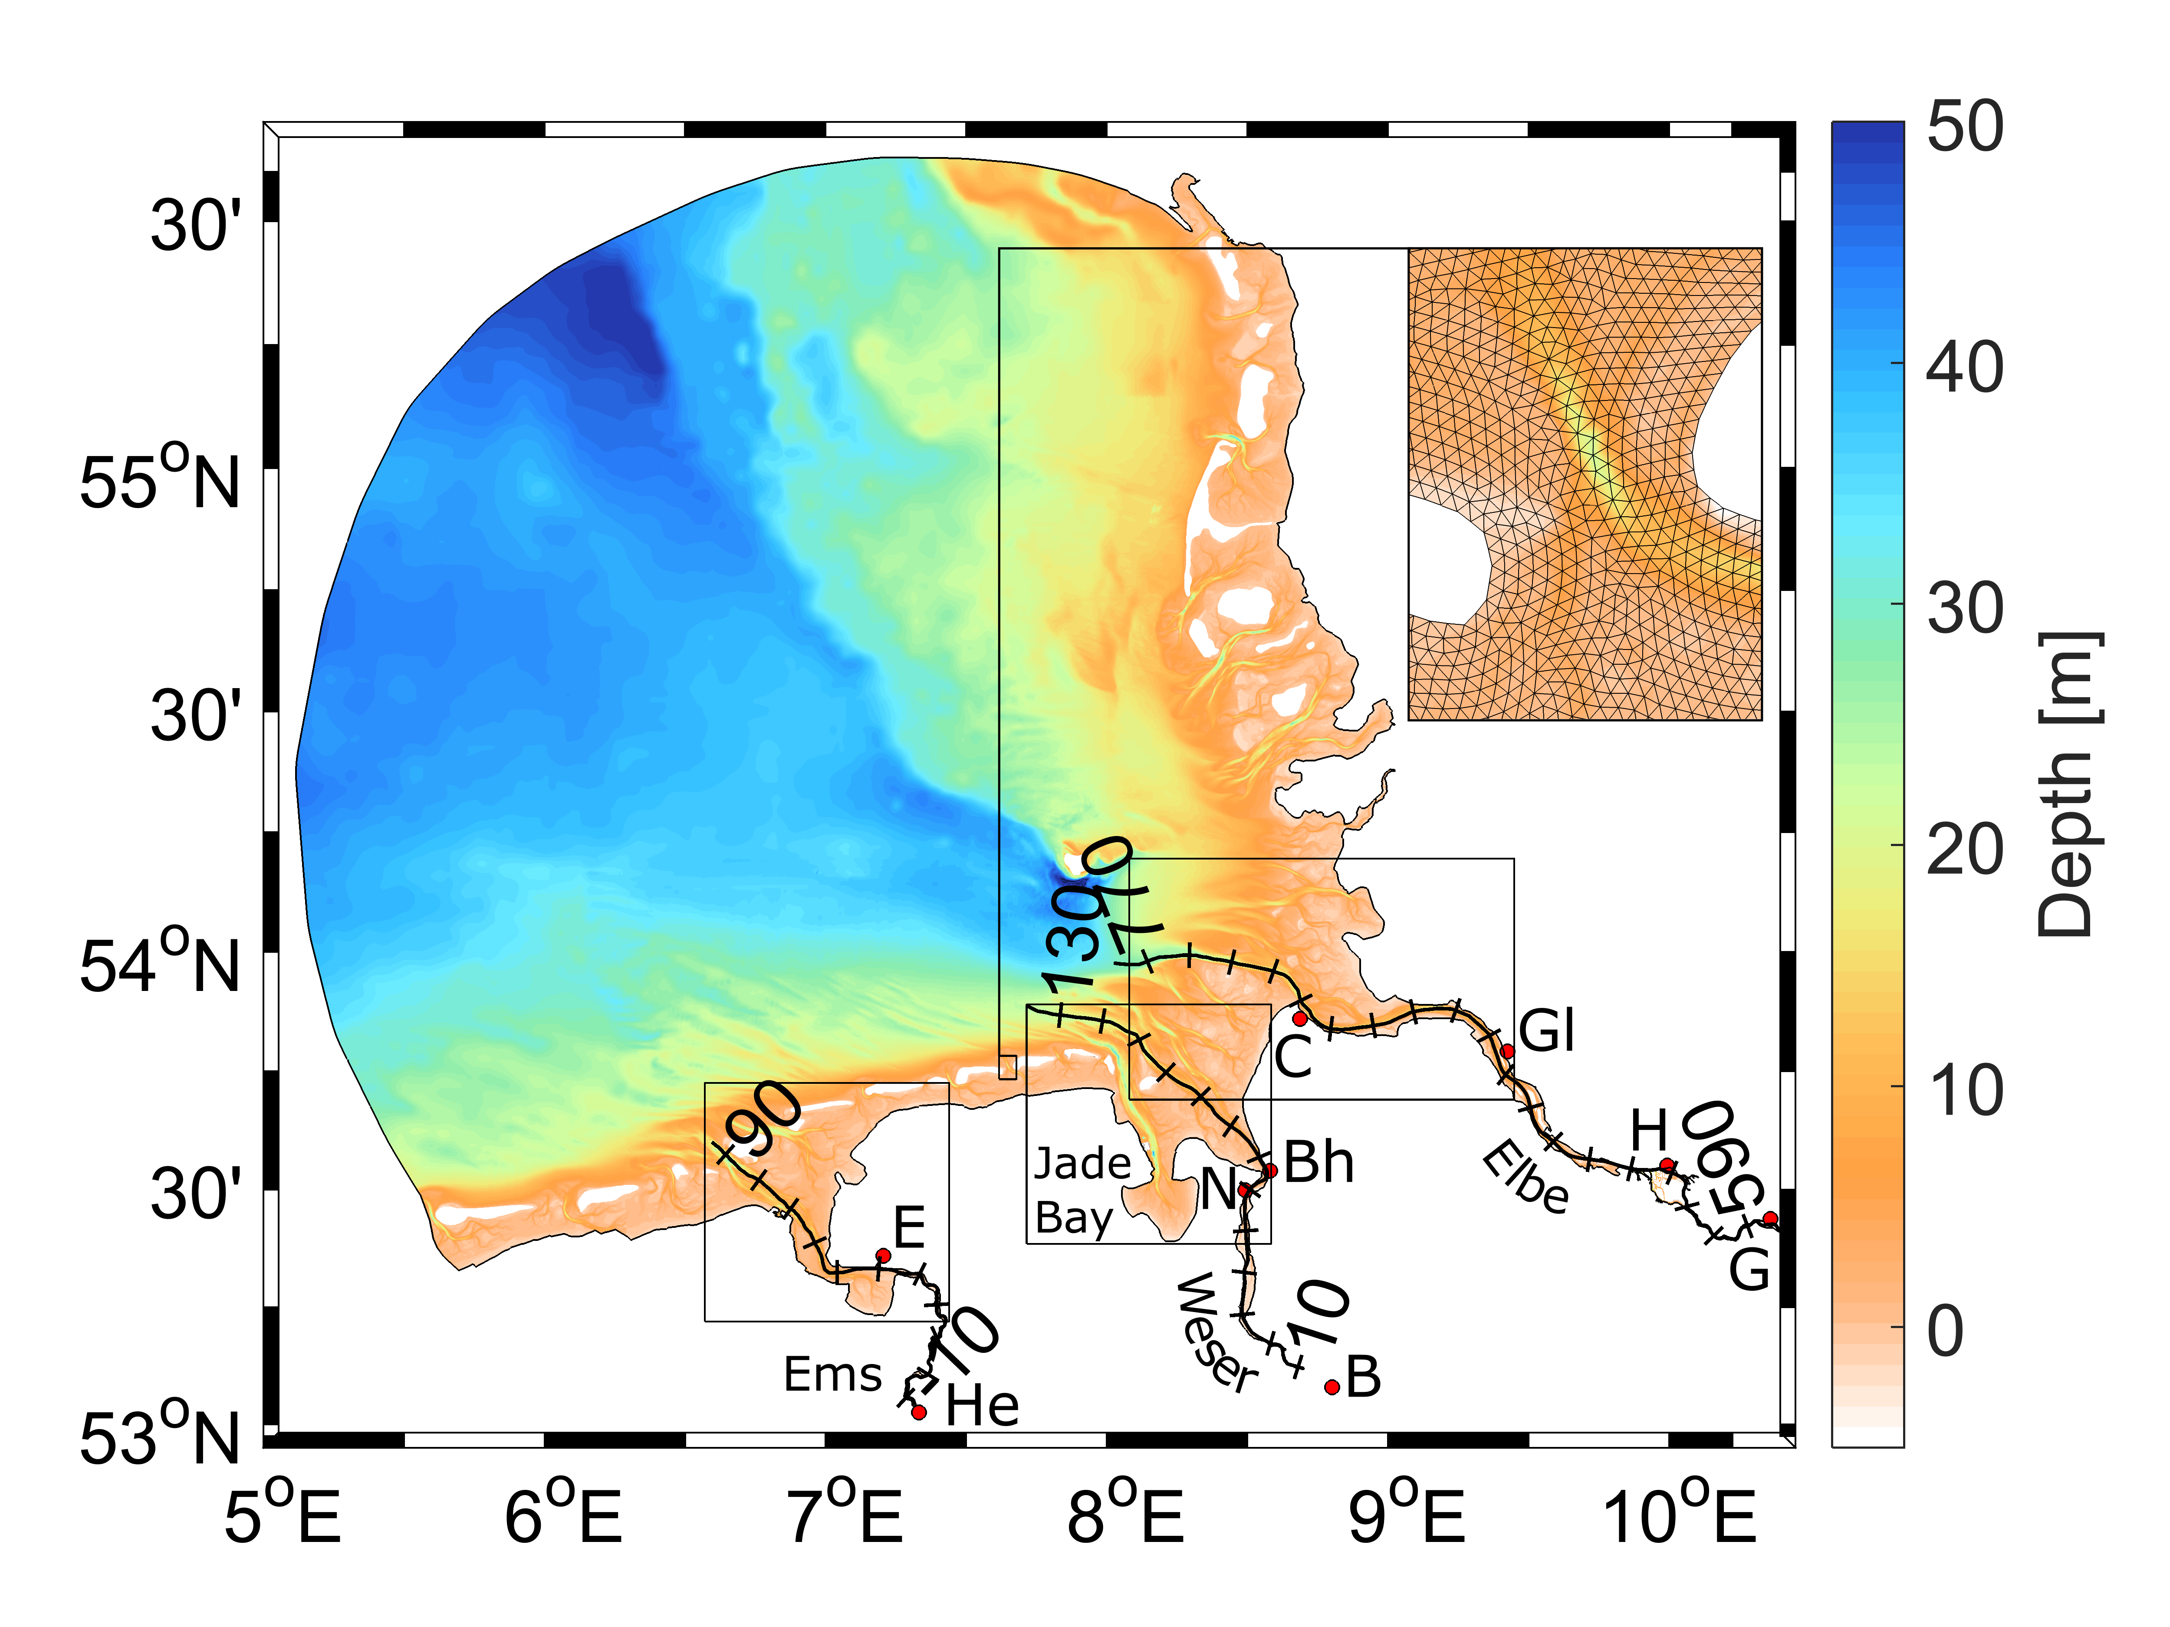
Model system and Area
Semi-implicit Cross-scale Hydroscience Integrated System Model; www.schism.wiki
3D, Reynolds averaged Navier-Stokes-Equations, unstructured grids
Derivative product of SELFE (A Semi-implicit Eulerian-Lagrangian Finite Element model).
Eulerian-Lagrangian Method (ELM) for momentum advection
SED3D
Notes:
Setup with increasing resolution into tidal rivers to seamlessly resolve transformation of tidal wave up the tidal rivers.
Simulate tidal wave down to weir Geesthacht, Bremen-Hemelin
Similar
Fine resolution simulate transformation of tidal wave
gen, Herbrum
21 Vertical Layers
475k nodes
940k elements
120 s timestep
Channels quadliteral elements 50 m wide narrowest
Open sea around 400 m res
Period: 1 Jan 2012 to 31 August 2012
Sediment Model SED 3D

Slide 4
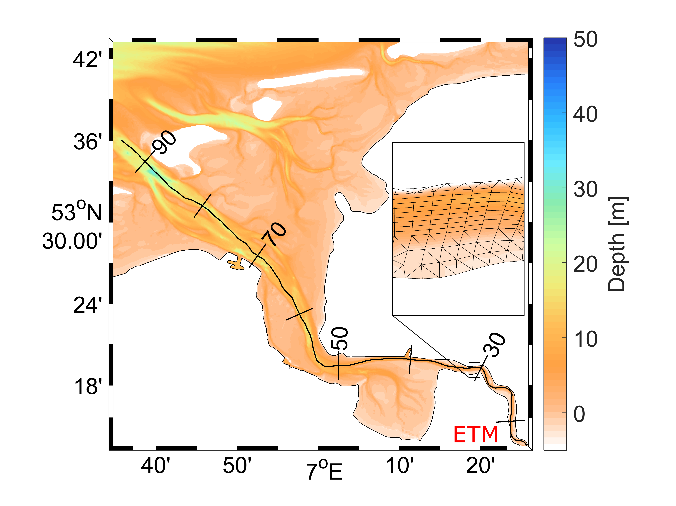
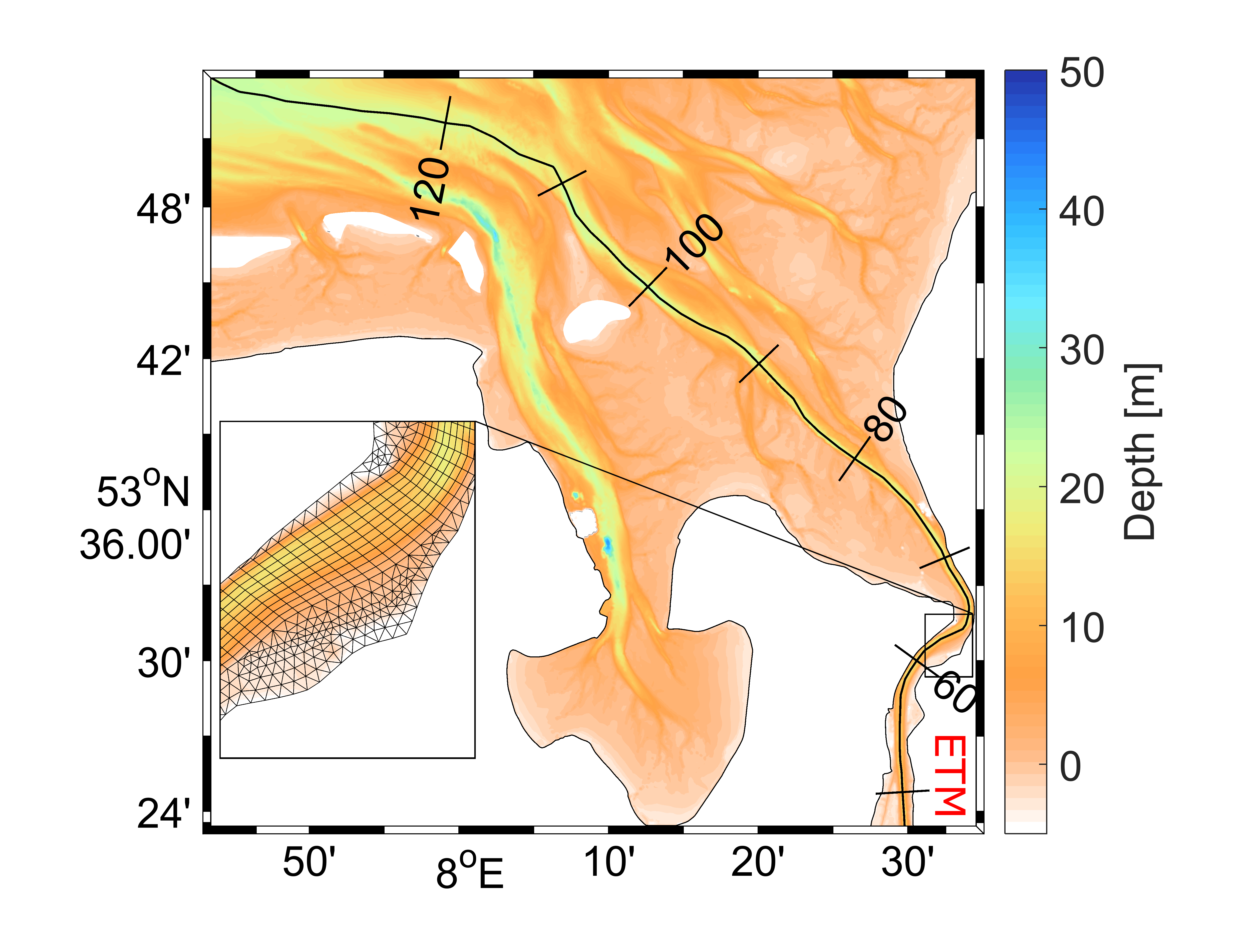
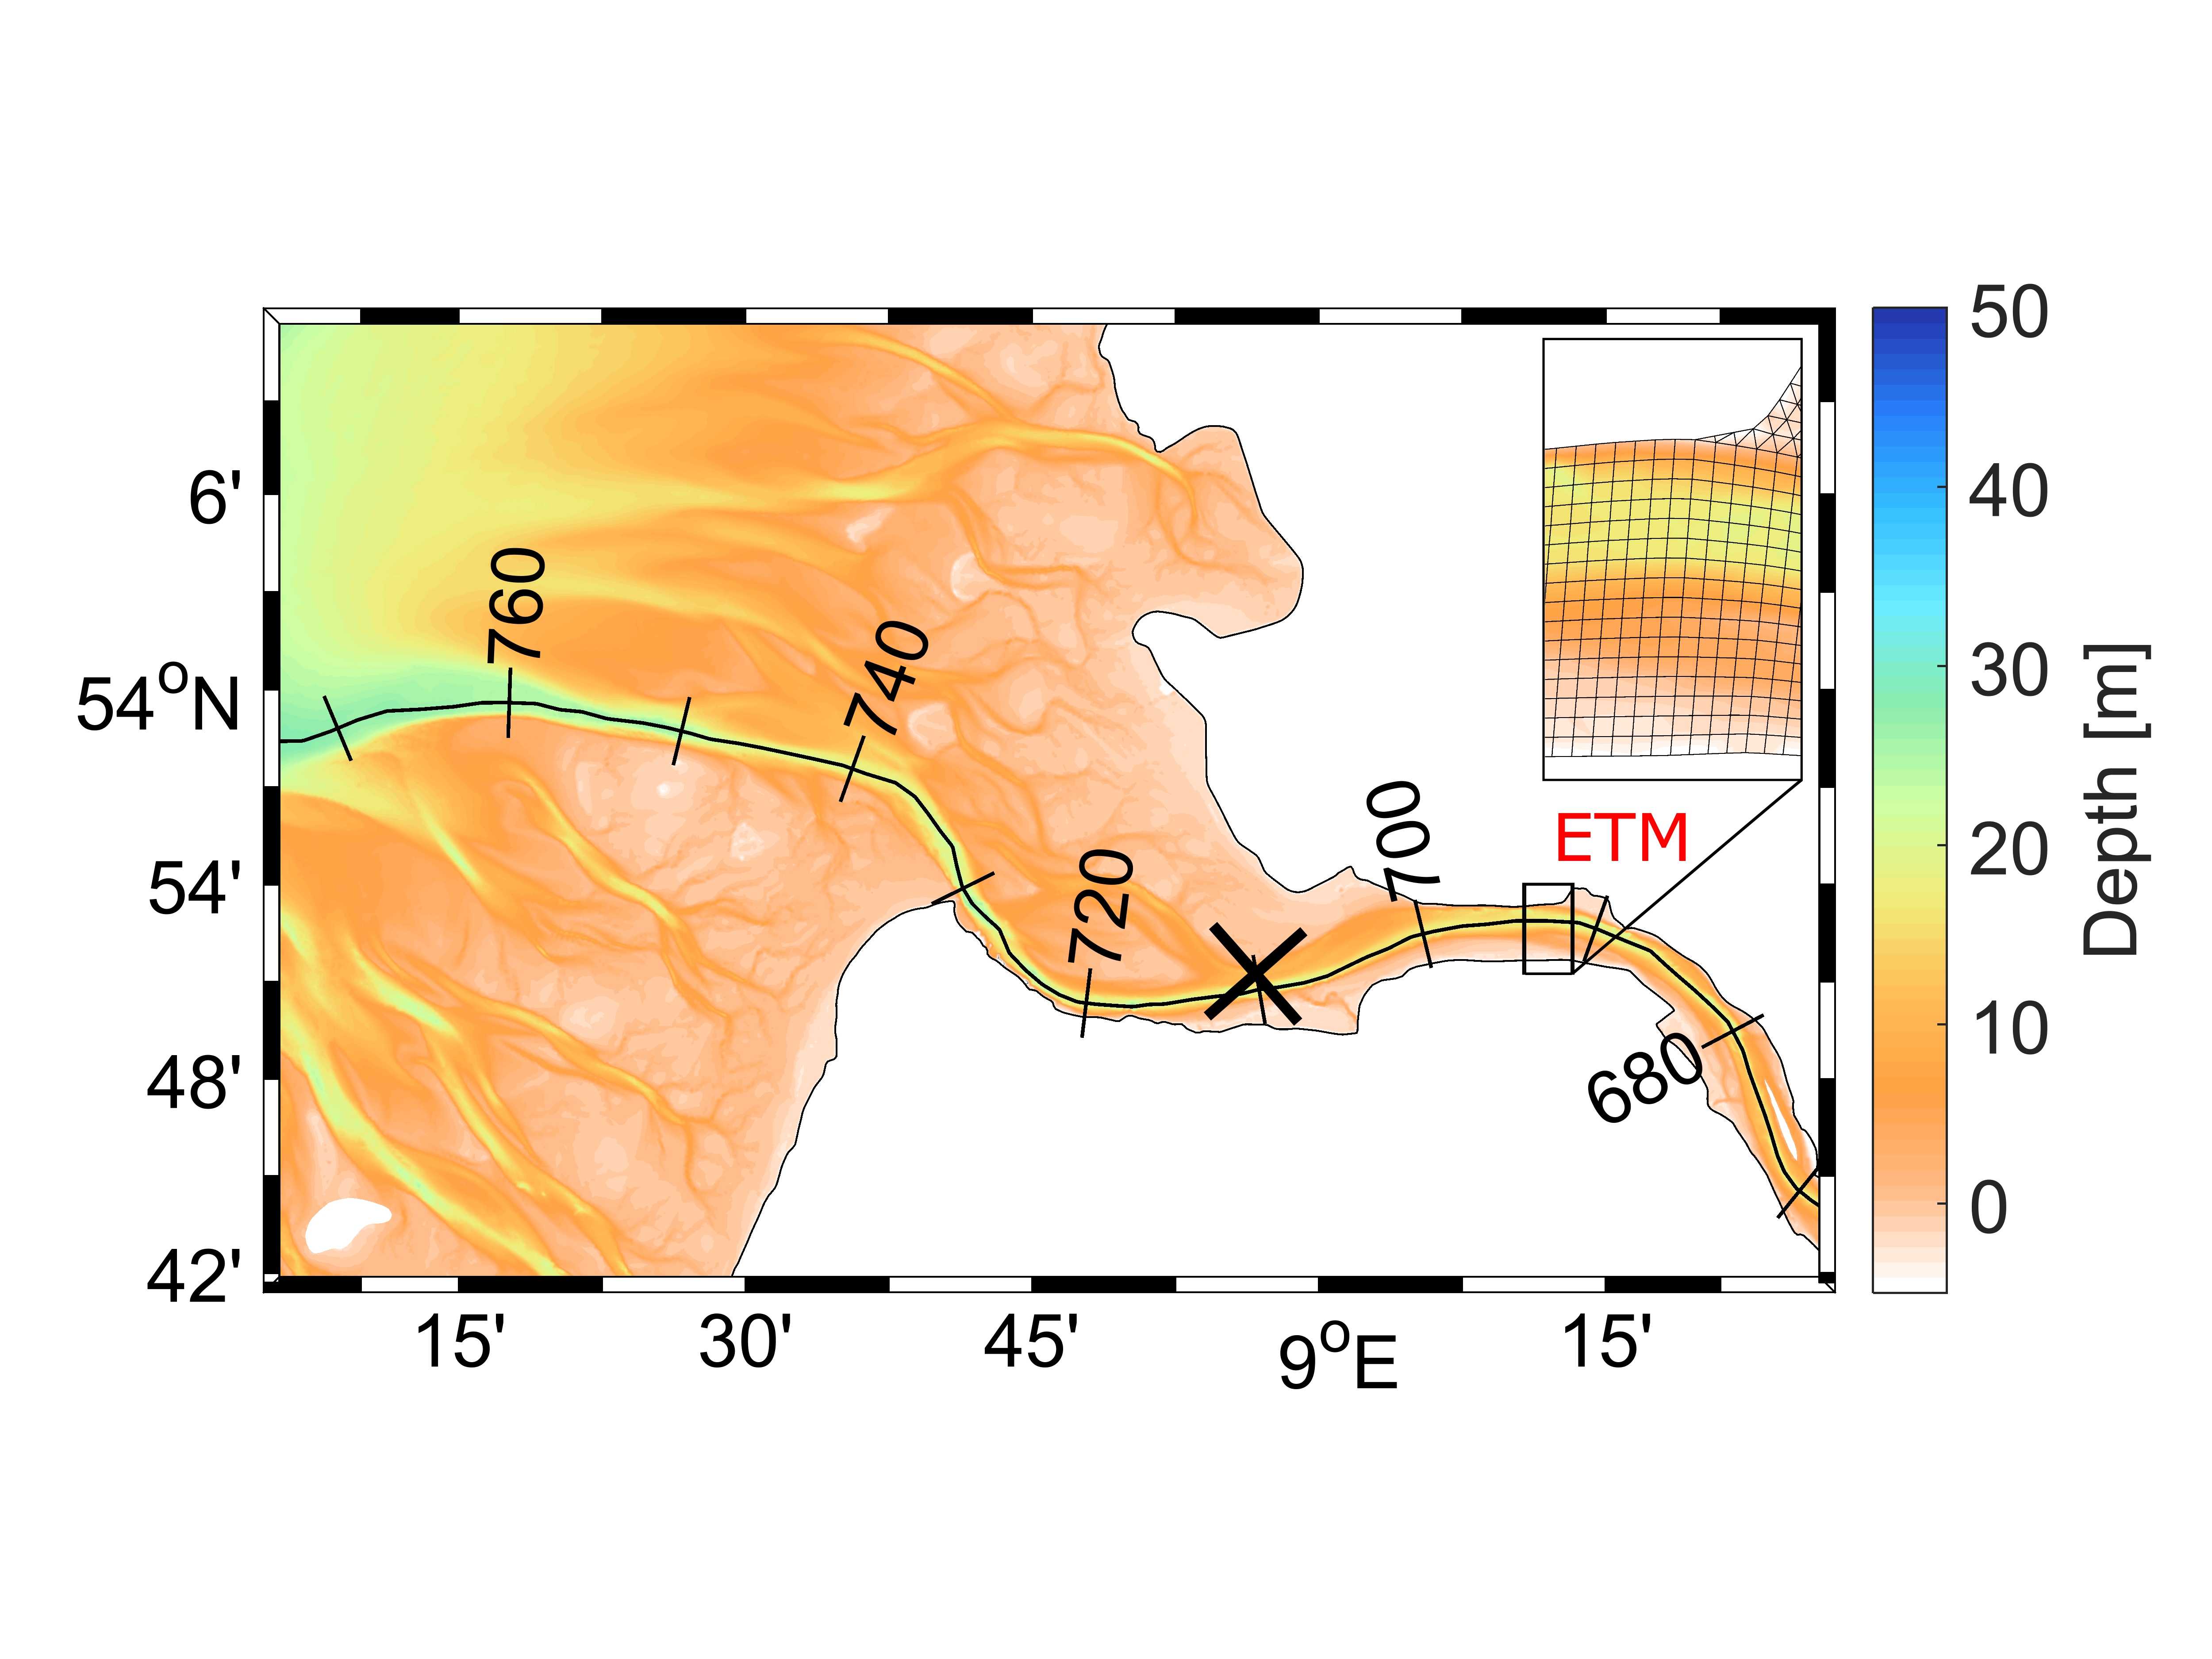
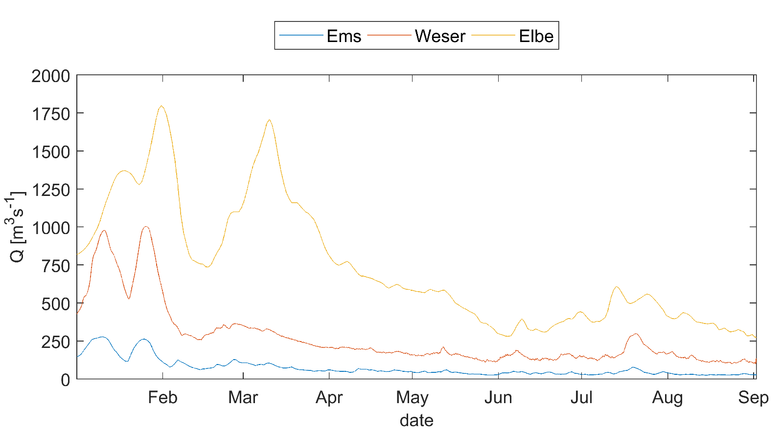
Model Setup
Estuaries
Similar
Tides + atmosphere
Distance mouth - limnic part
Different
Bathymetry, shapes
River runoff
Notes:
ETM at landwards ENDs of mixing zones of salt and fresh water
Common:
also propagation of thalweg into North Sea
Different Also:
Ems behind tidal inlet
Ems:
Weser:
Hyper-synchronus
Elbe:
Tidal wave decrease until bruns büttel landward increases until hamburg
Weser:
Hyper synchronus -> convergence dominates over friction increasing tidal range
Advantages of models:
Seamlessly address the cross-scale dynamics dominating coaastal and estuarine environments

Slide 5
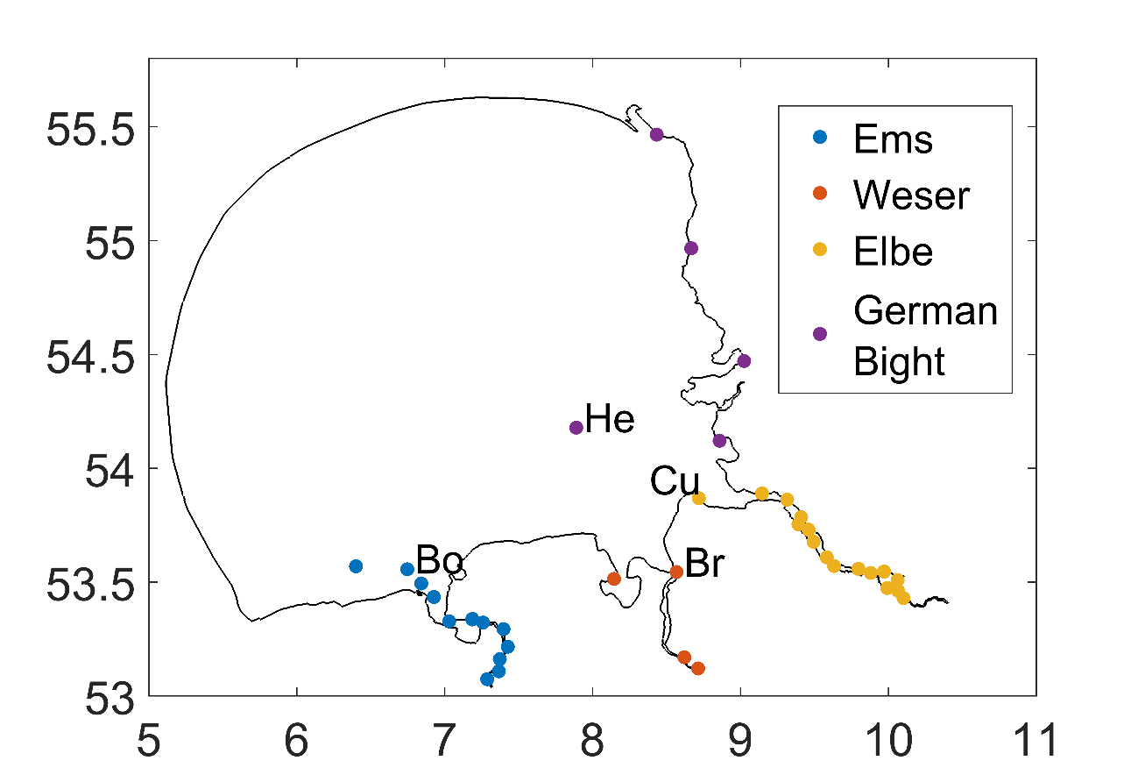
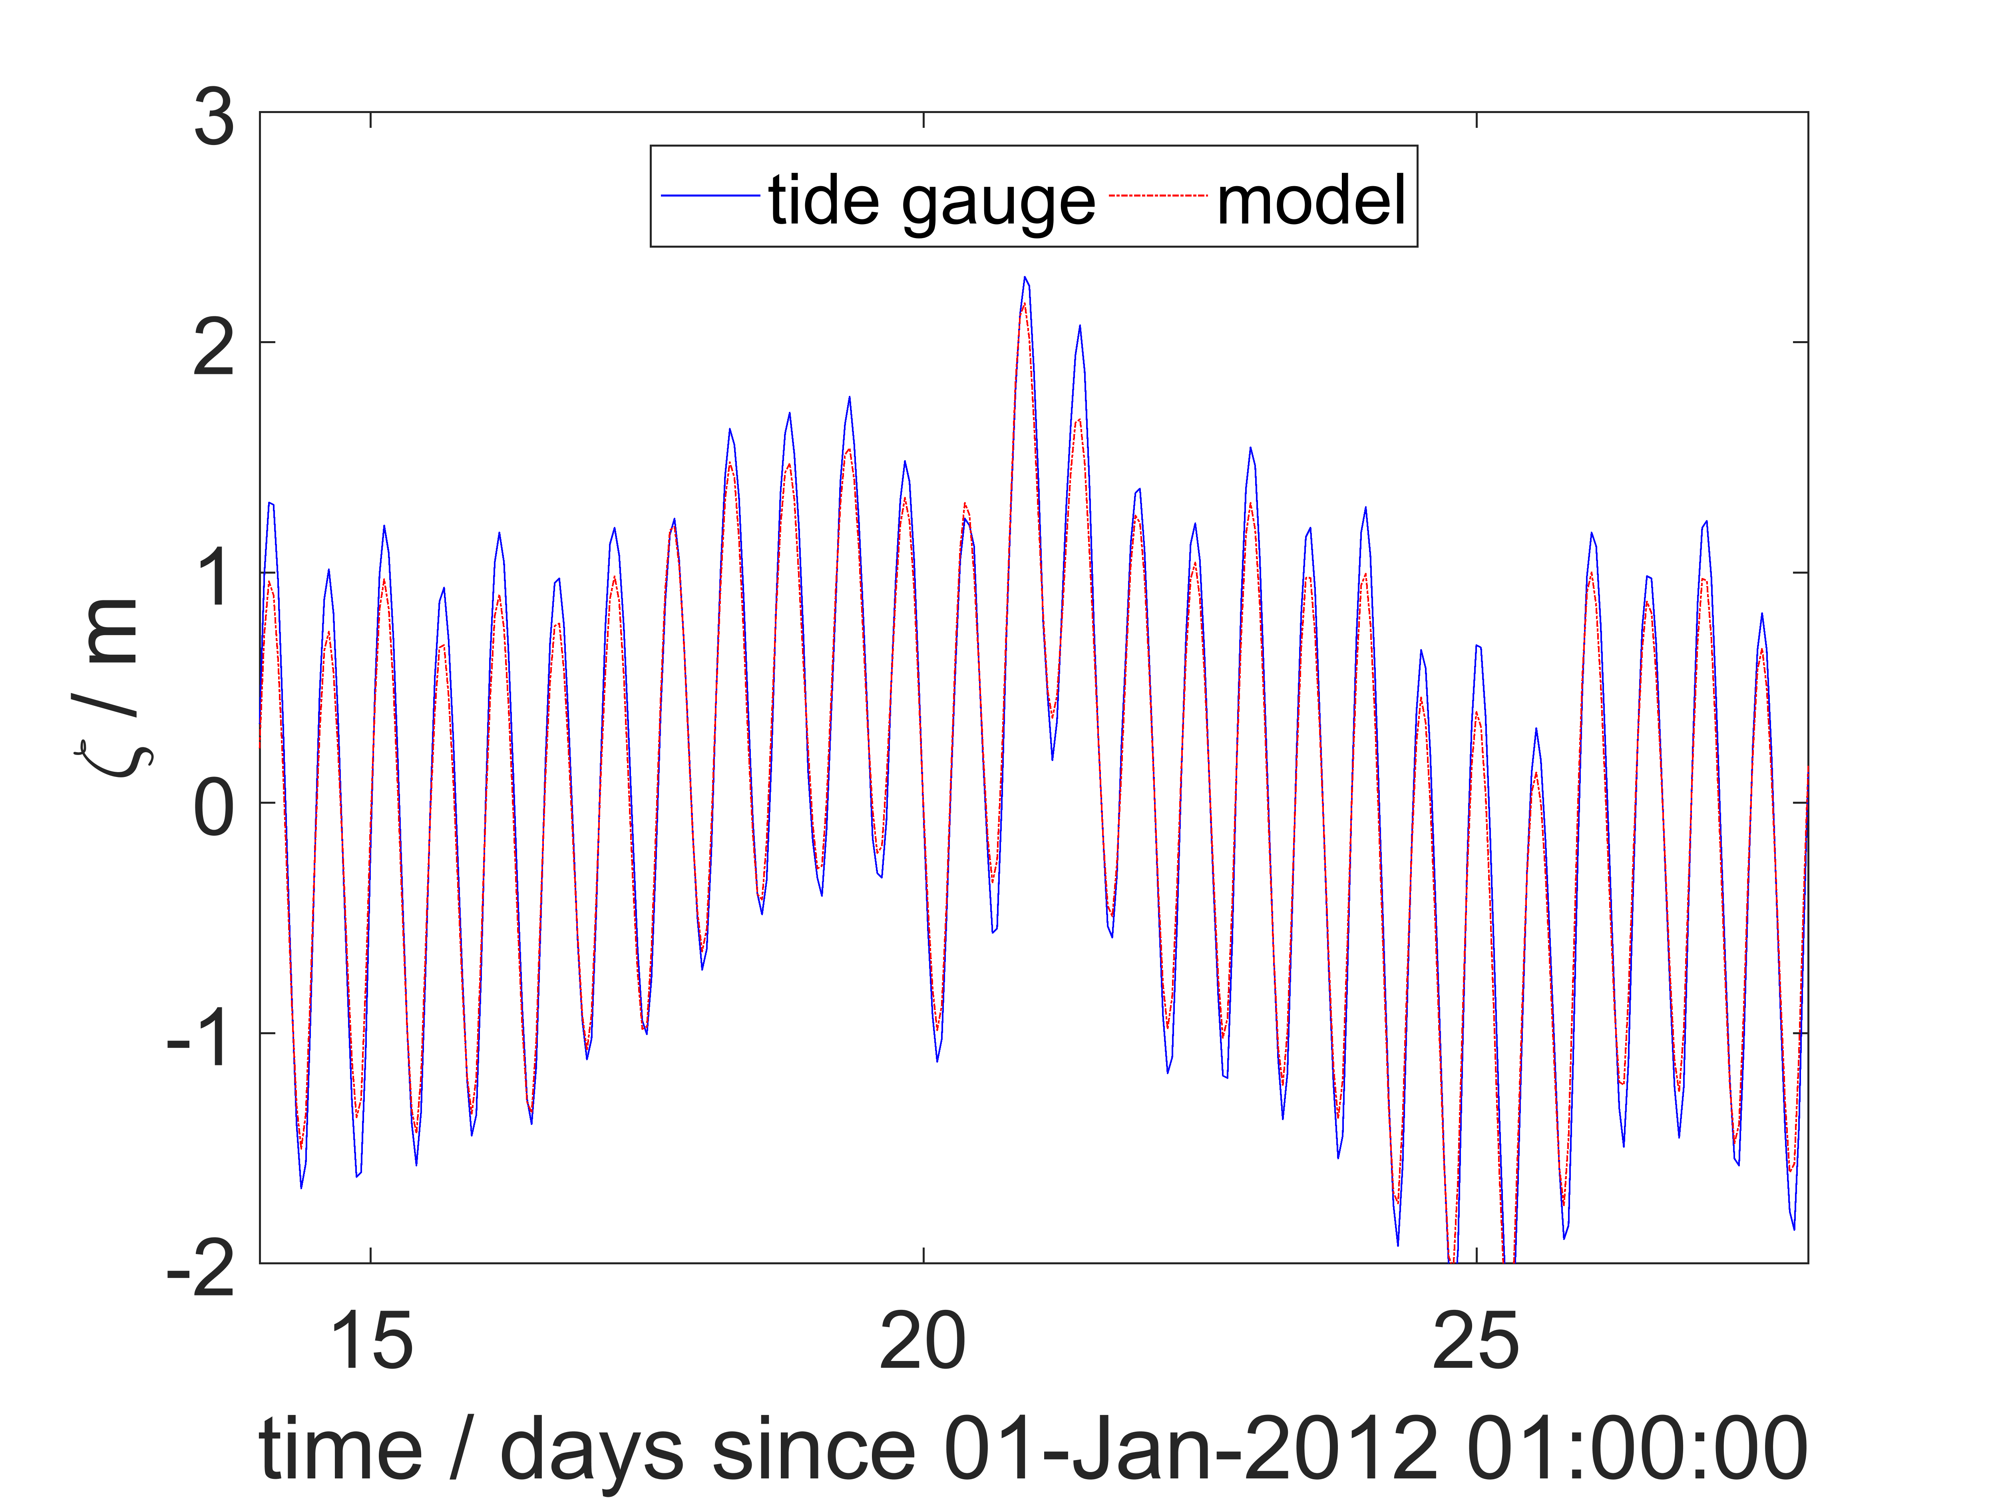
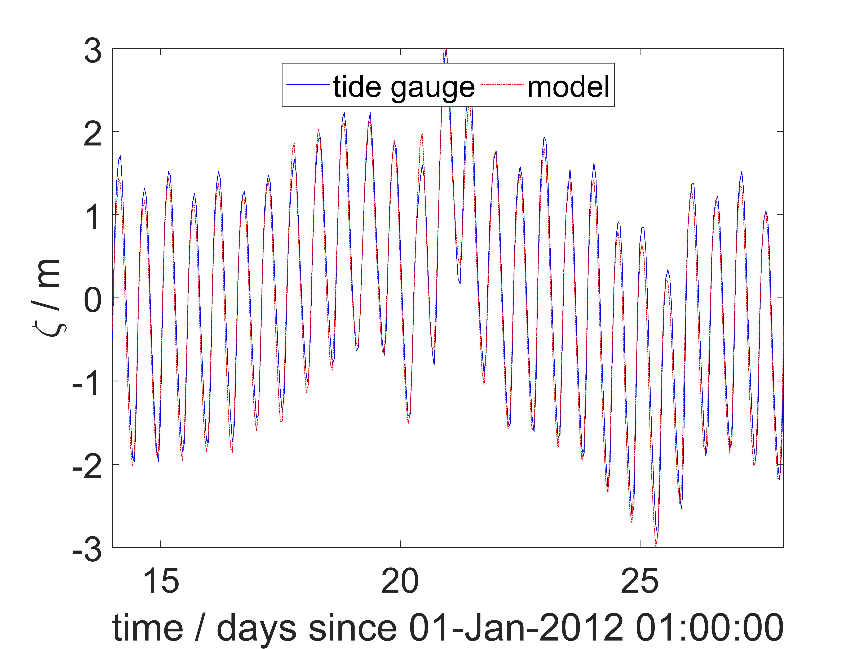
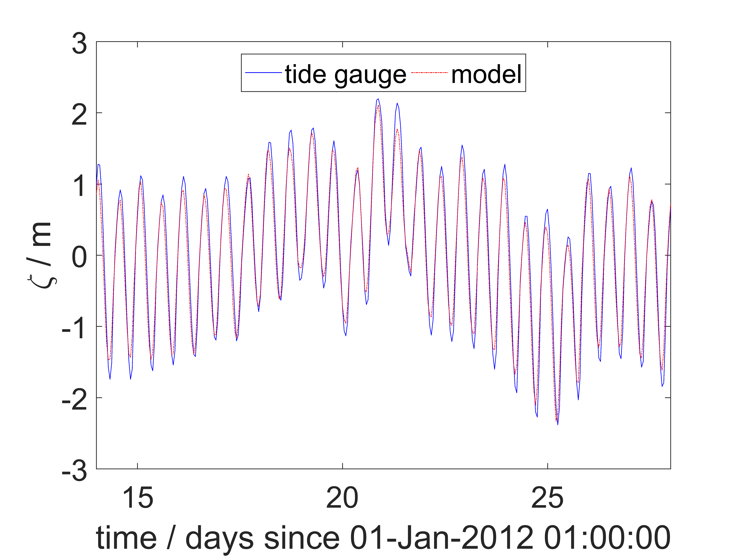
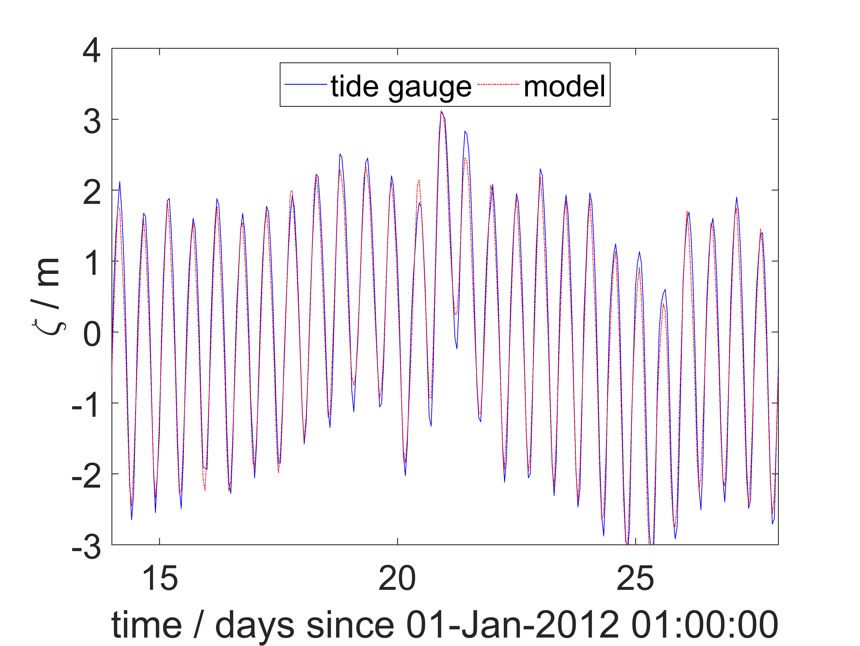
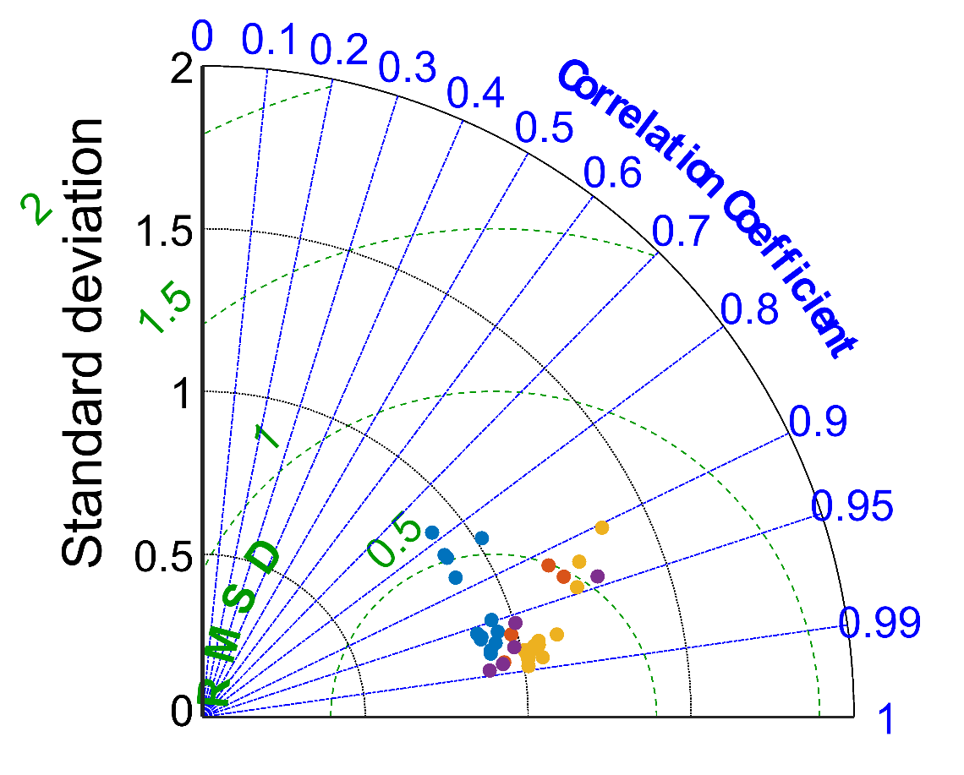
Validation - Sea Surface Height
Tide Gauge Comparison
He
Cu
Bo
Br
Notes:
10% error

Slide 6
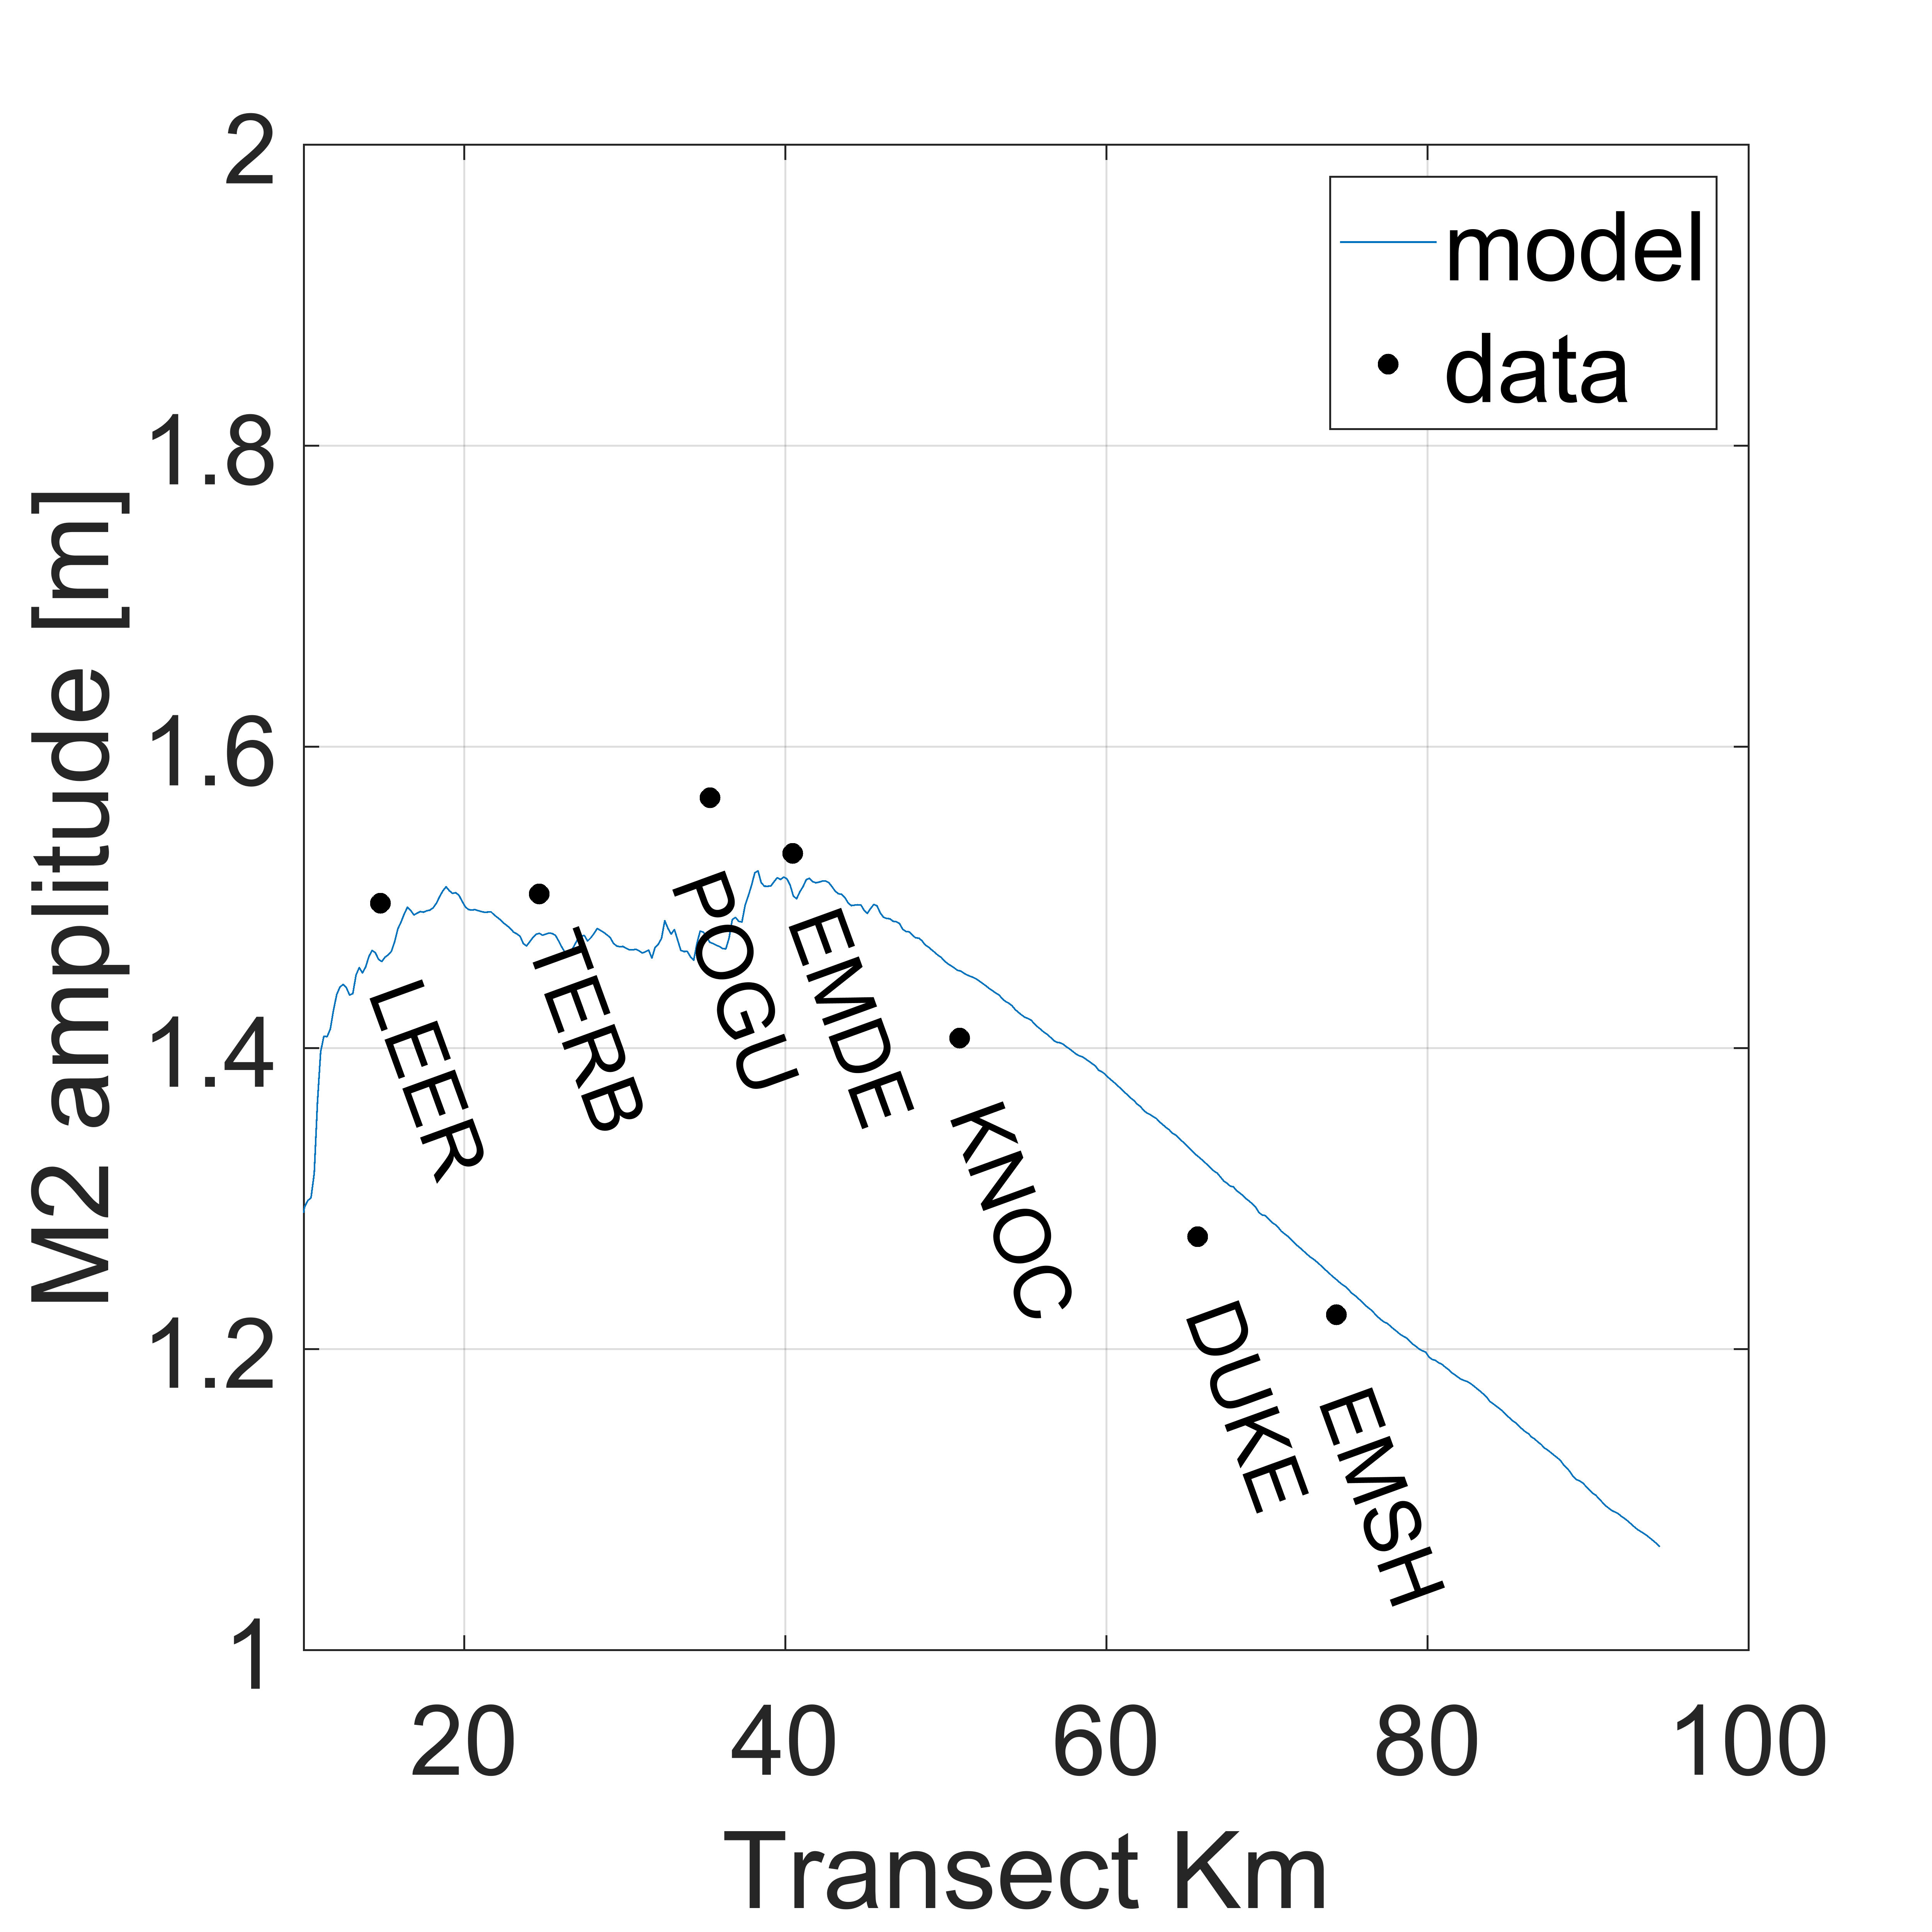
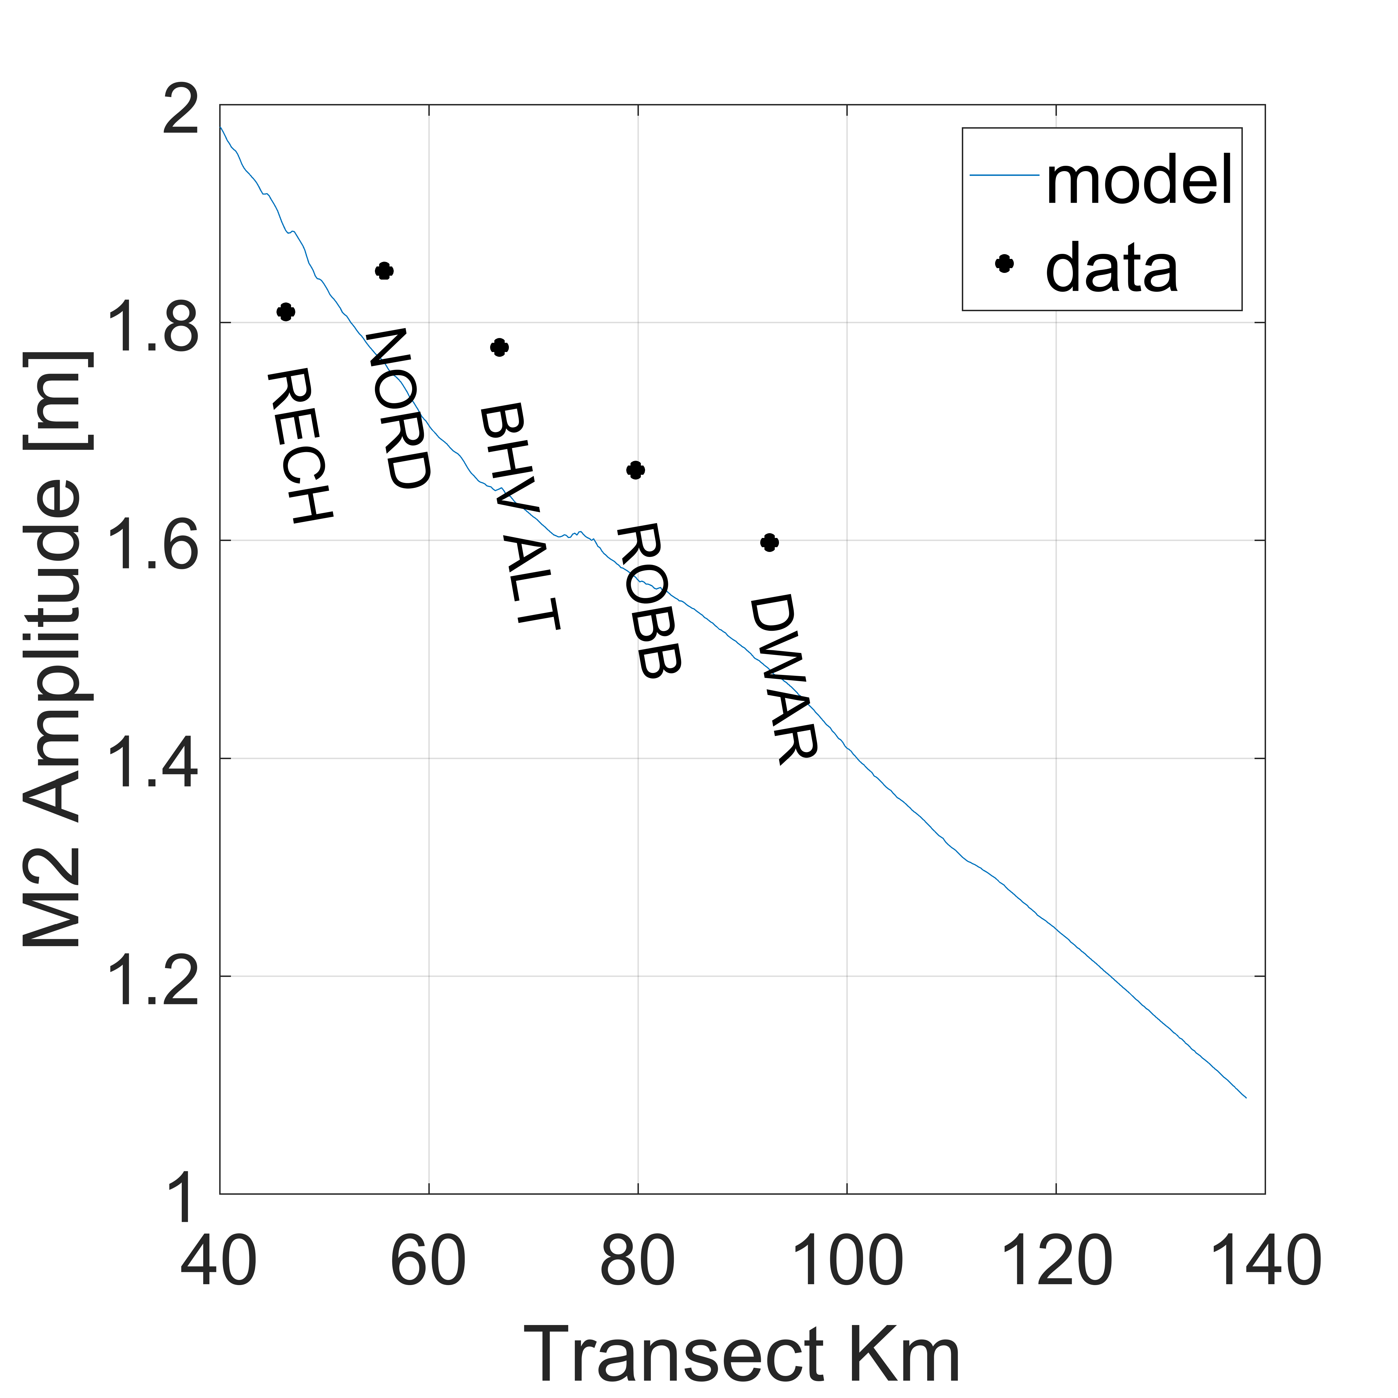
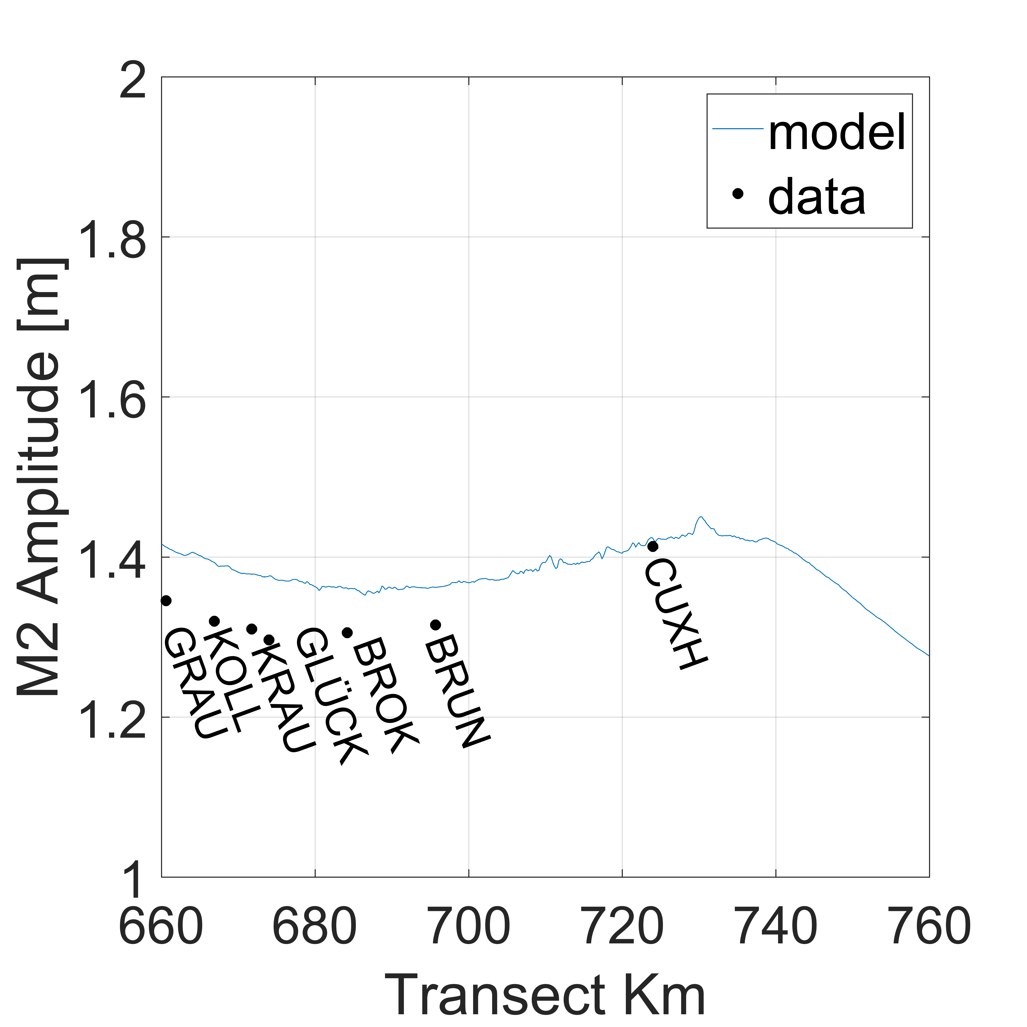
Validation - Sea Surface Height
Along Estuary Tidal Amplitude
Ems
Ems
Weser
Elbe
Model tends to underestimate the amplitude by 5-10cm
Tidal propagation sensitive to individual bathymetry and shape
Notes:
Different curves -> propagation sensitive to bathymetry and shape

Slide 7
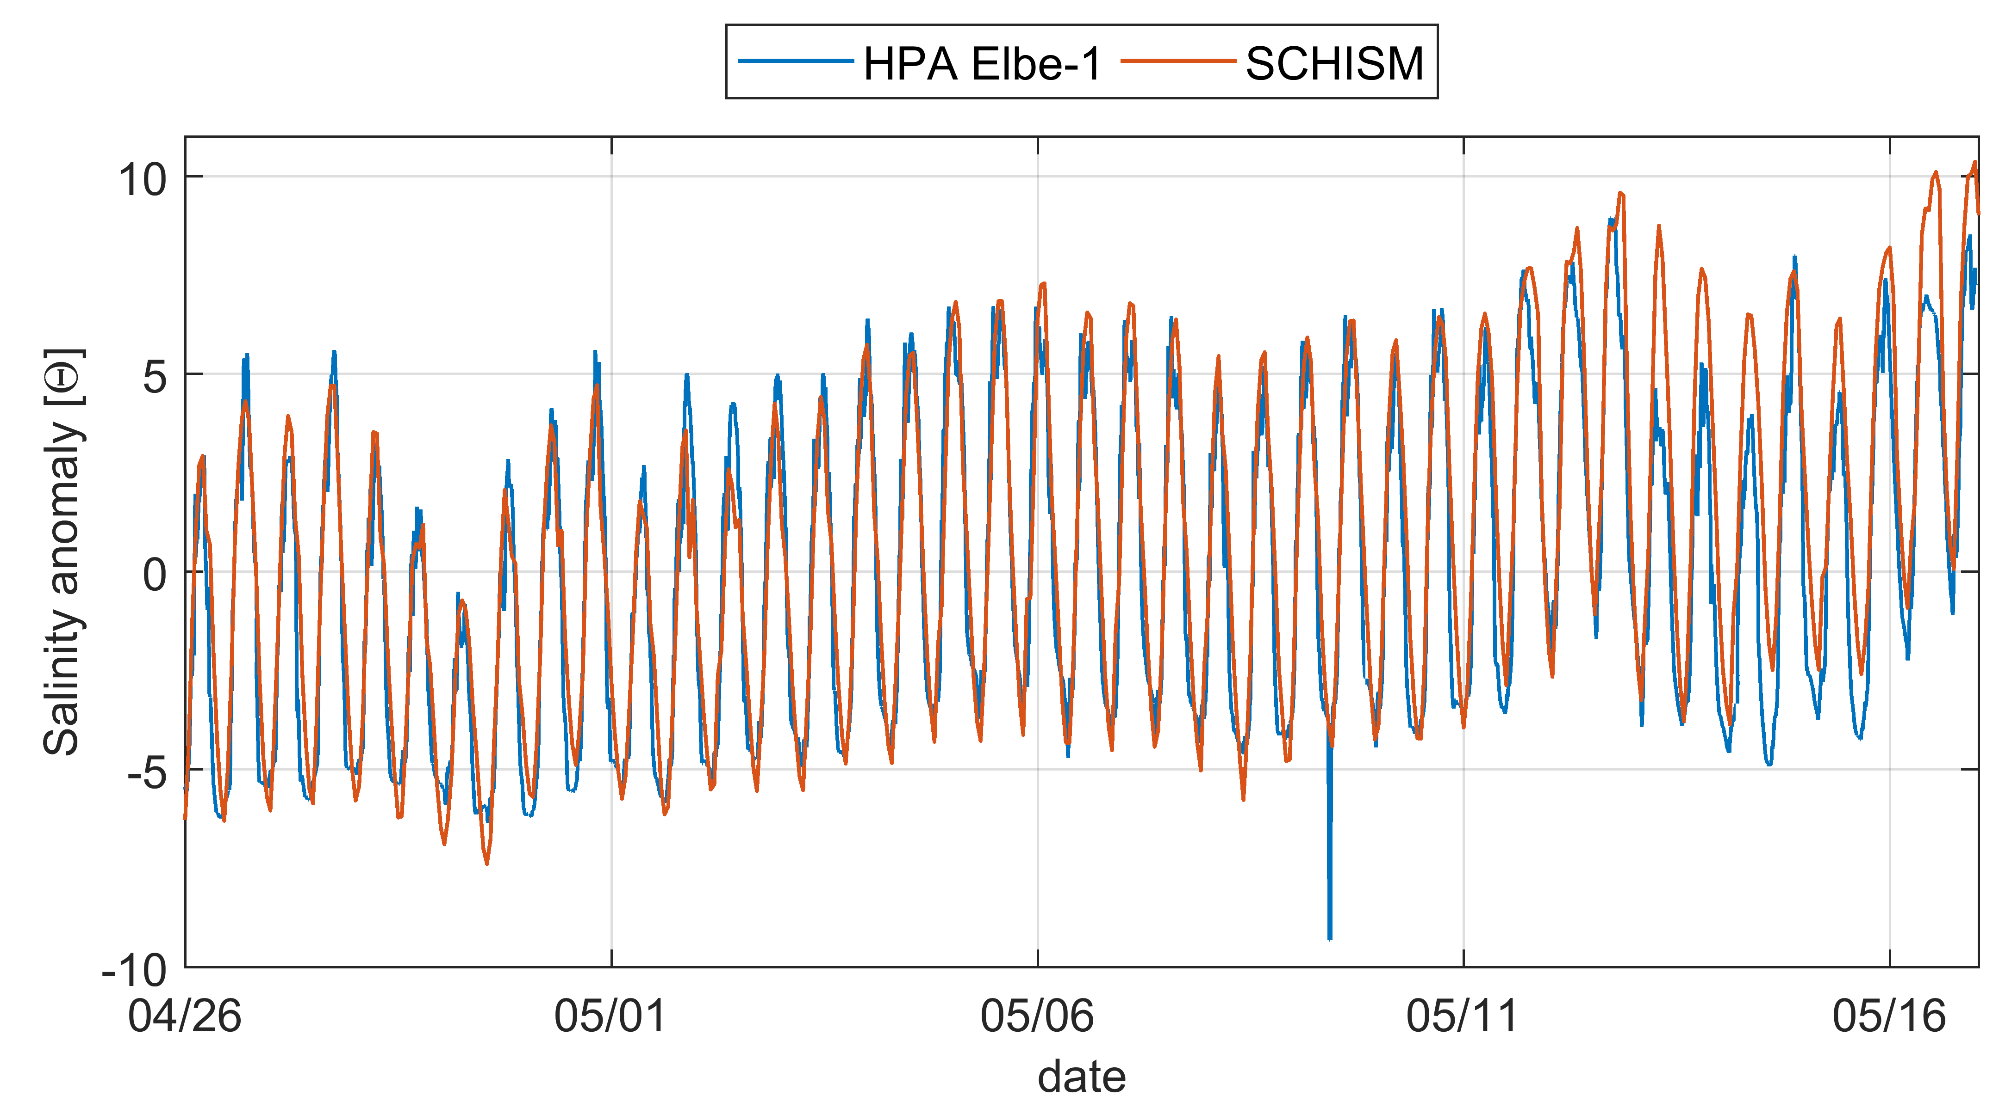
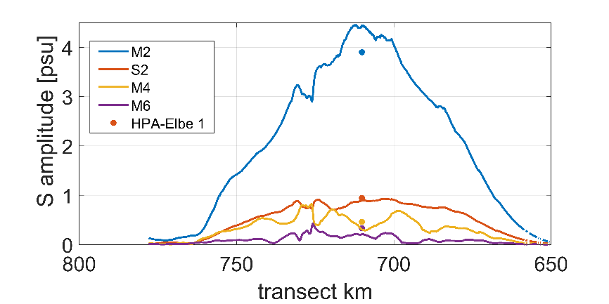
Validation - Salinity
Comparison with Elbe Station
The model reproduced tidal and longer time scale variability, but slightly higher semi-diurnal amplitudes.
Notes:
Decrease in river runoff april

Slide 8
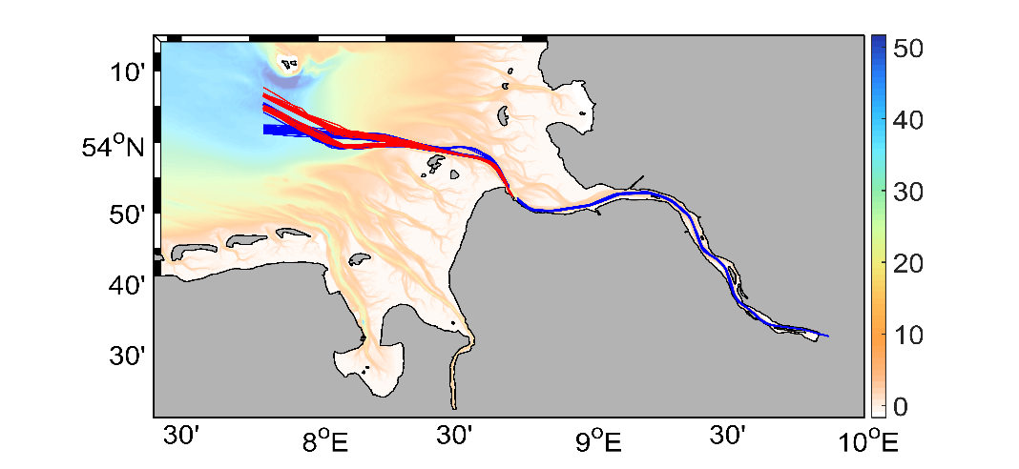
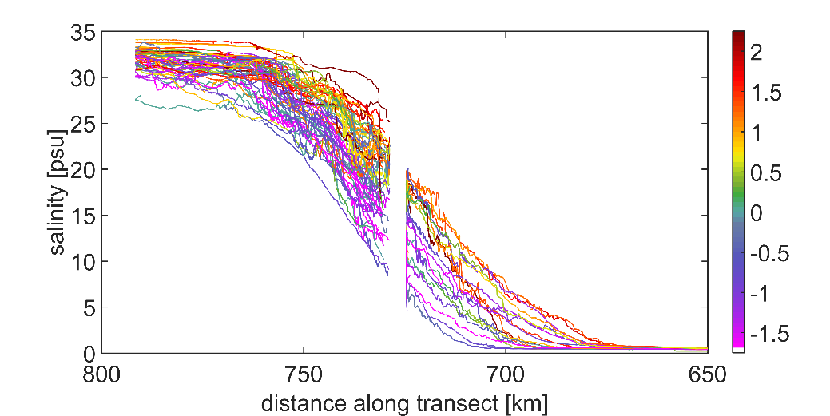
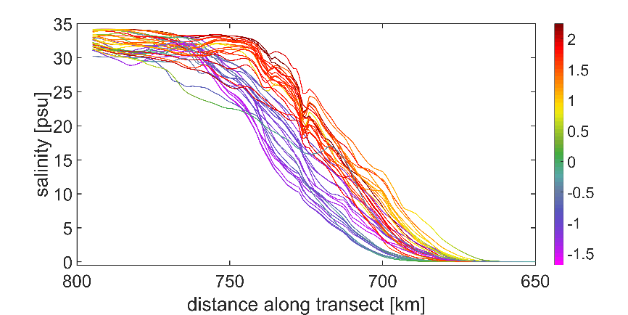
Validation - Salinity
Comparison with FerryBox Data
Estuarine salinity gradient important for: along estuary advection+diffusion, lateral exchange, vertical stratification (mixing); O2; biota
Observations via FerryBoxes ideal possibility to validate the model near Thalweg
Model reproduces salinity dynamics on different spatial and temporal scales
Cux-Imm
Ger-Eng-Nor
Depth [m]
Sea level at Cuxhaven [m]
[m]
FerryBox
Model
Notes:
Lücke?

Slide 9
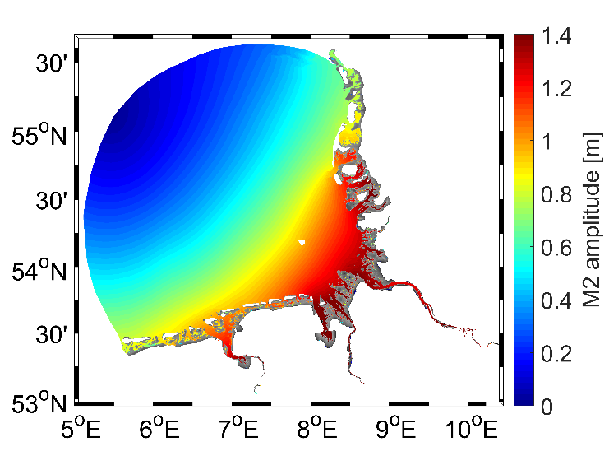
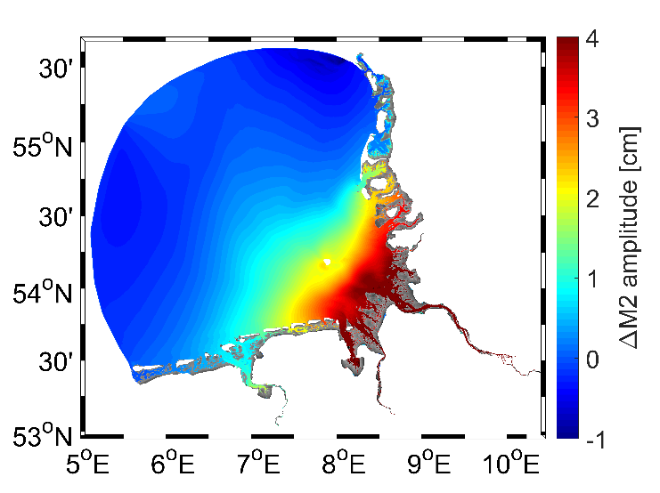
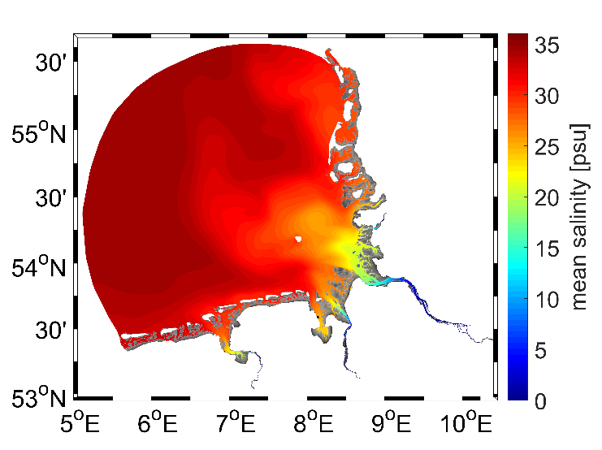
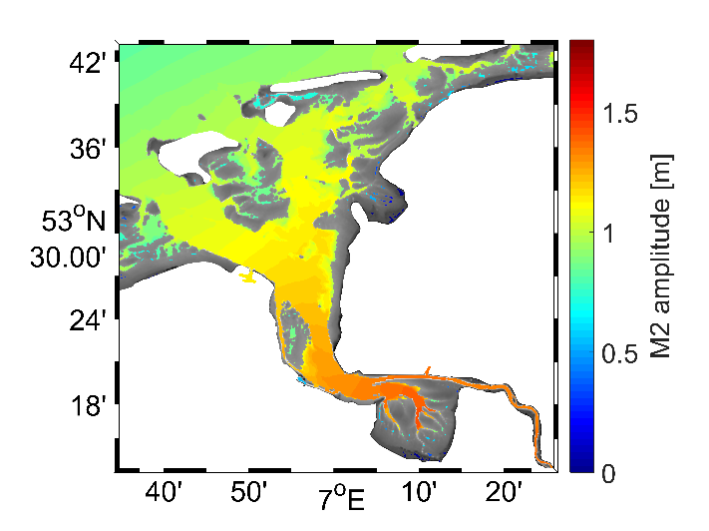
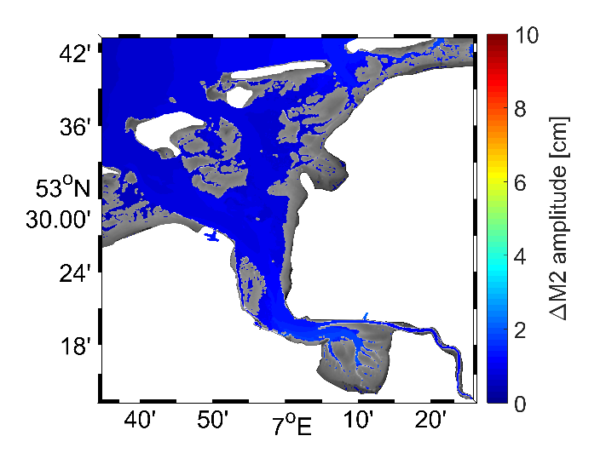
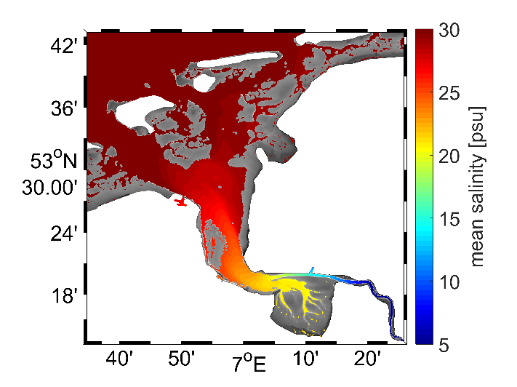
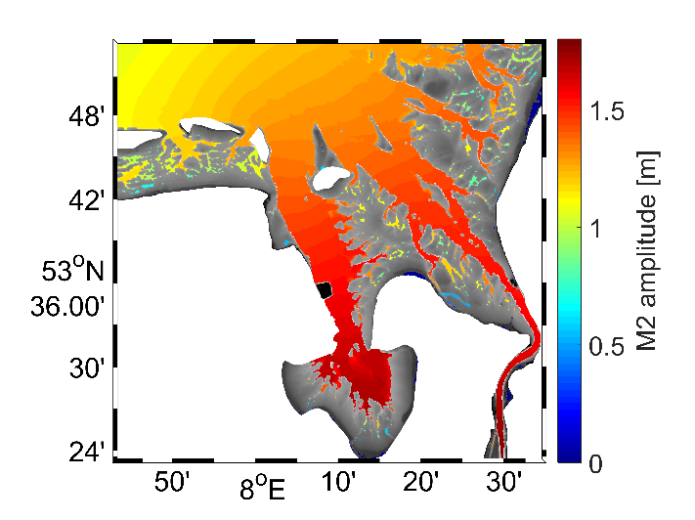
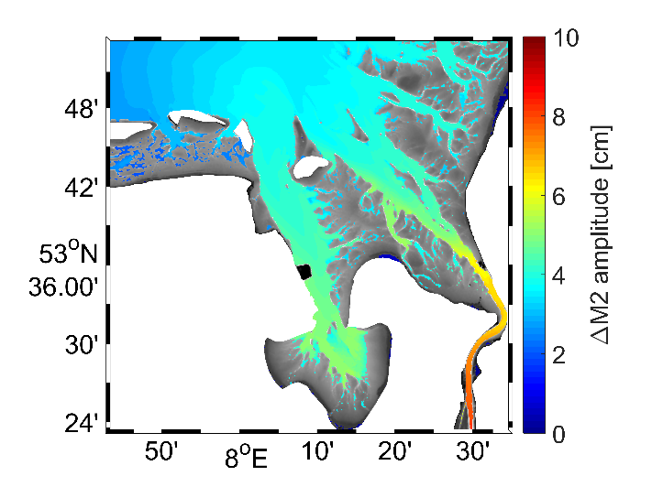
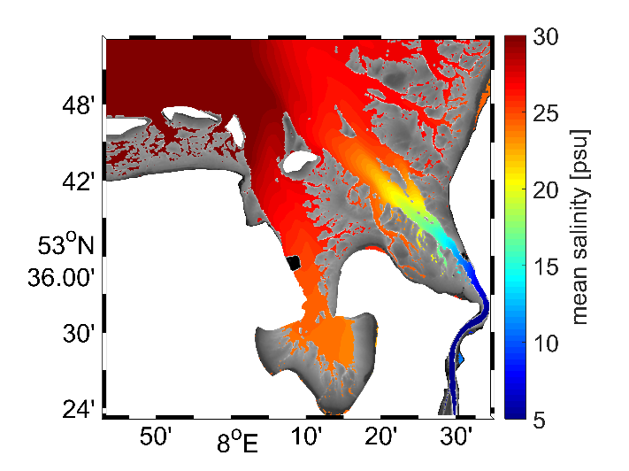
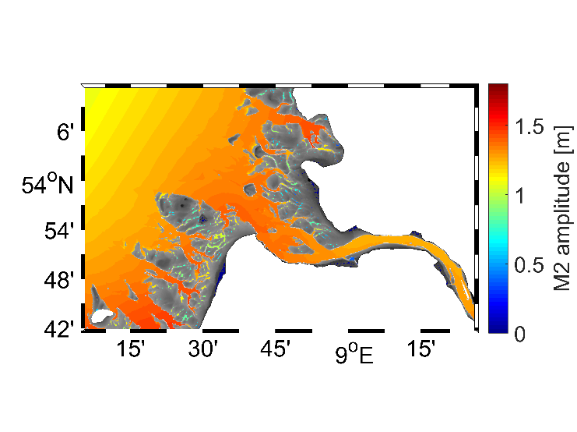
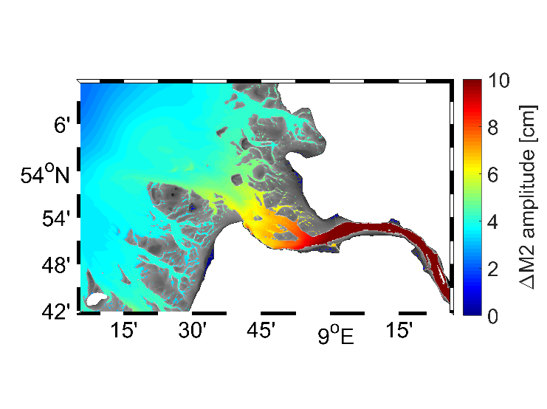
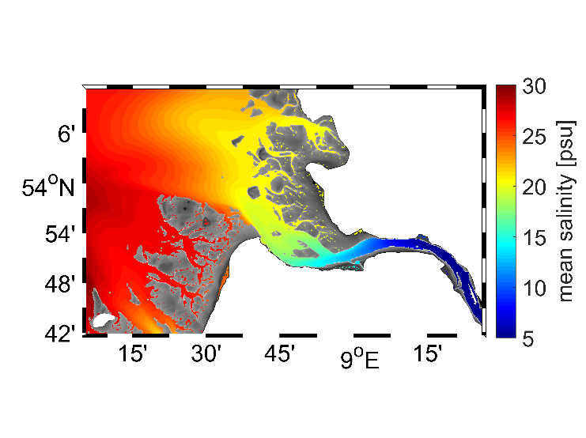
Tides in the wadden Sea and Estuaries
Contribution of salinity to tidal response
M2 - Tide
M2 – Tide (baroclinic – barotropic)
M2 Difference Baroclinic – Barotropic
Small in ocean area
Large in limnic part
Traces salinity front rather than tidal amplitude
Density largely impacts tidal dynamics
Differences in front comparable to m4 tide
Density shapes tidal asymmetry in fontal area
Notes:
Tidal range largest Wesert Estuary / Jade Bay
To identify contribution of salinity
Differences around 5% M2 amp
Low values in Ems due to low river run off
Large differences in limnic part smaller in ocean part
Density

Slide 10
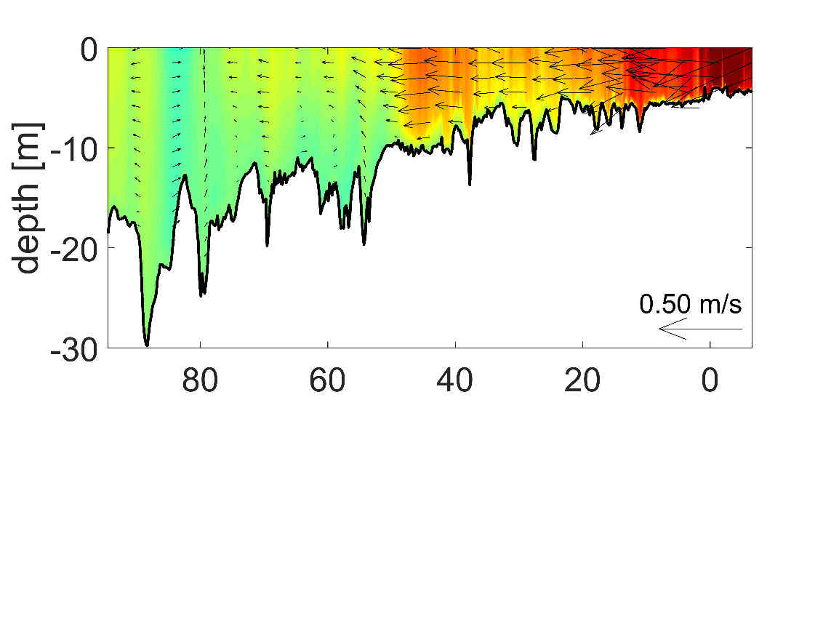
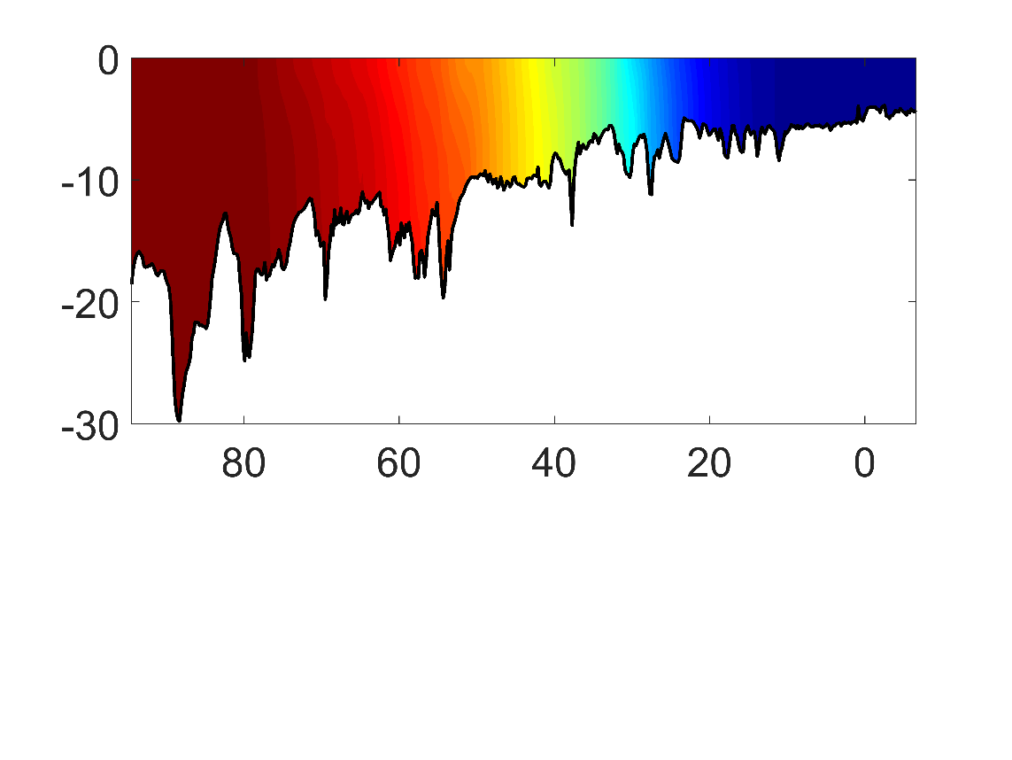
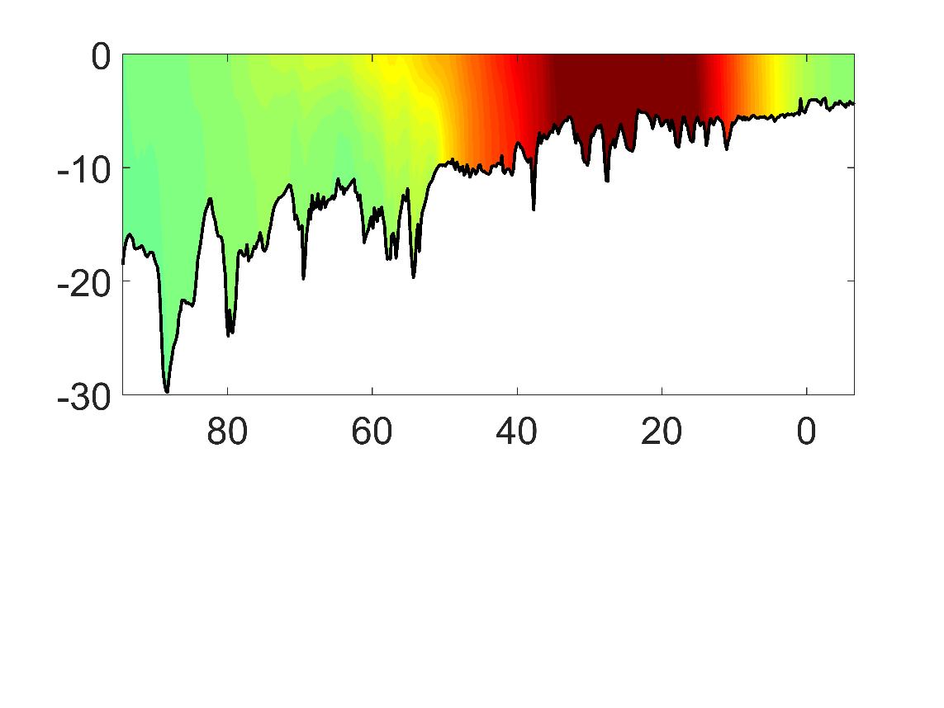
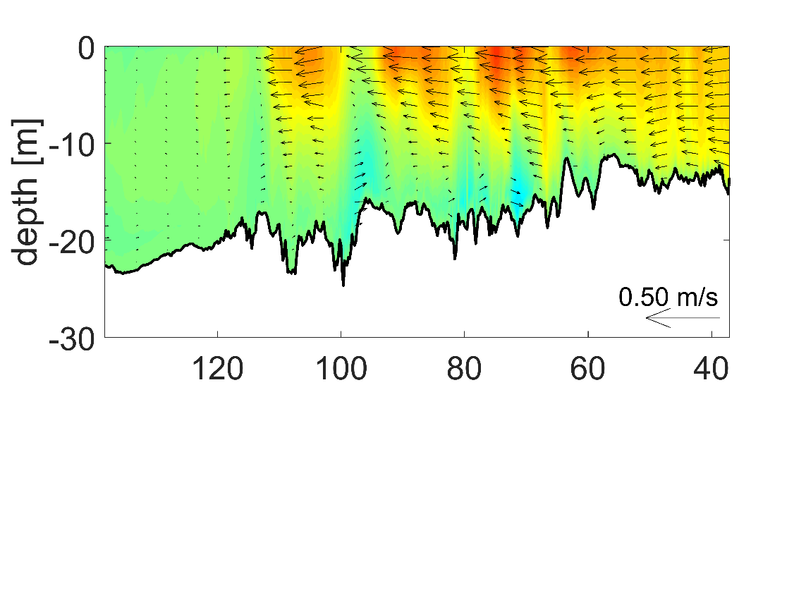
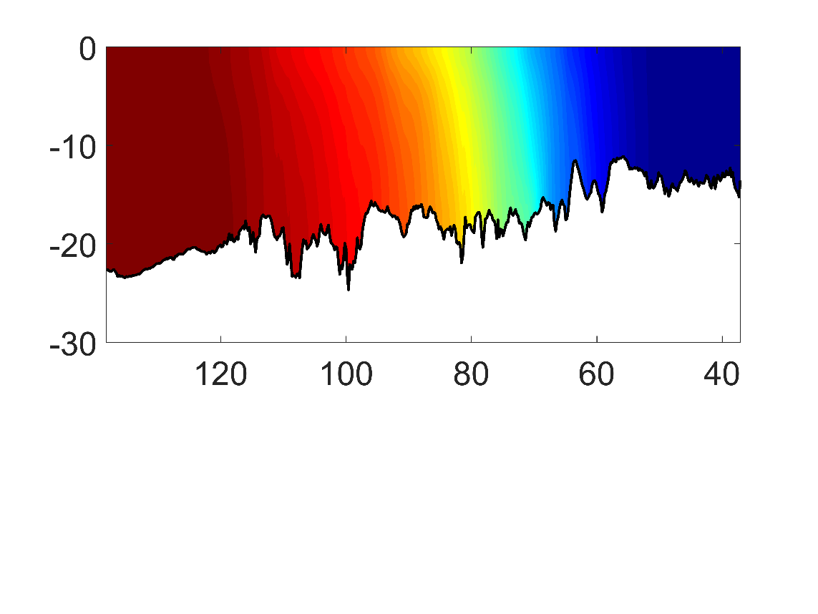
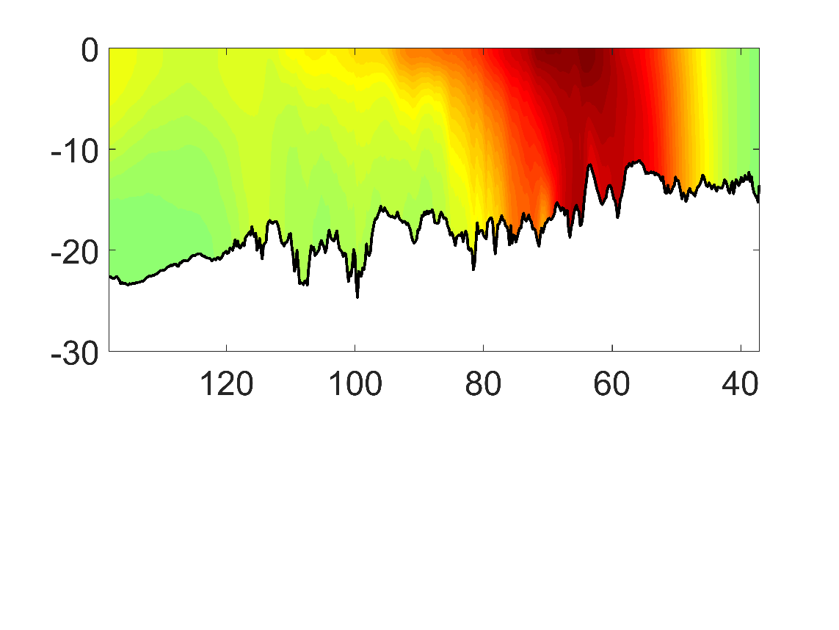
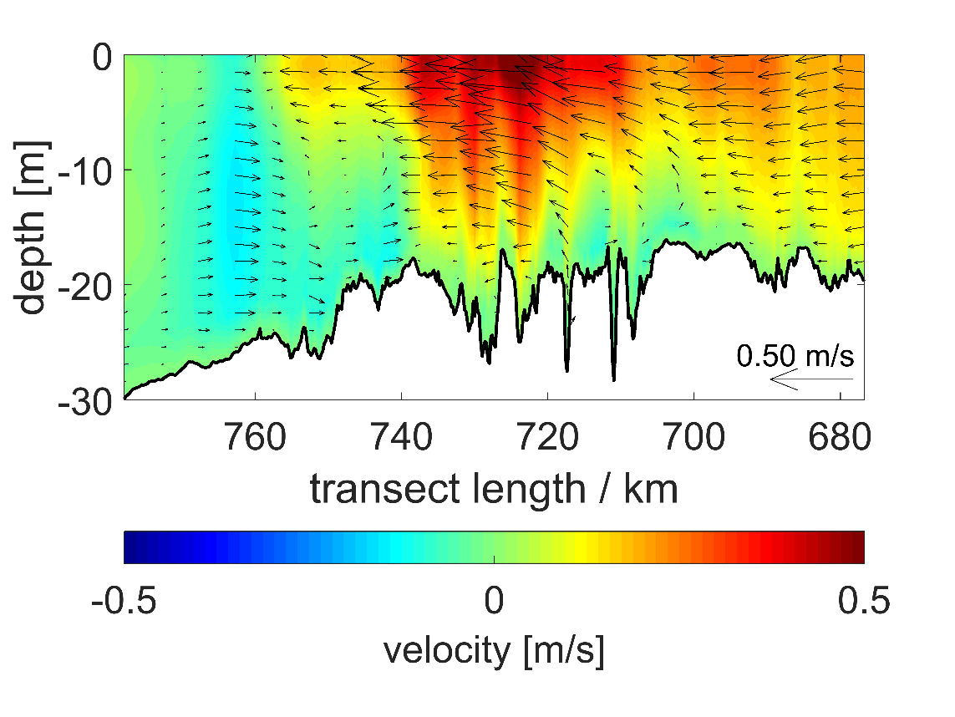
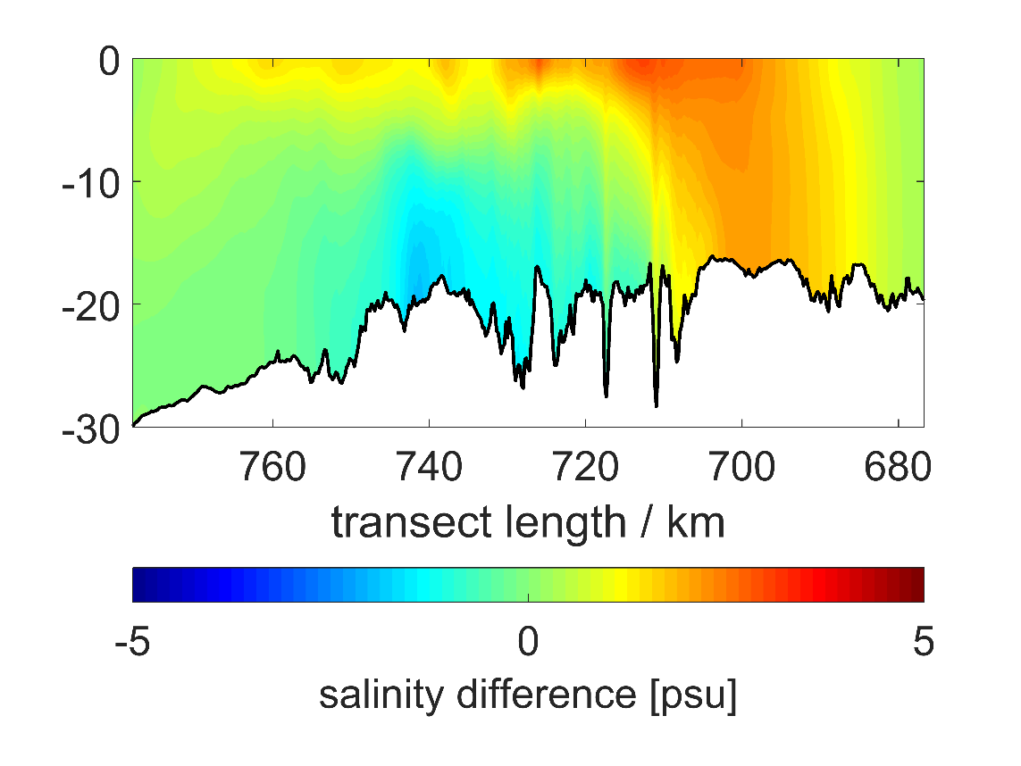
Salinity Front and Estuarine Circulation
Comparison along Thalweg
Average velocity
01.0.1 -15.03
Neap phase
average salinity
Spring -neap
salinity difference
Notes:
Velocity average
-Typical estuarine circulation
Decreases in mouth atrea
Ems / Weser thicker bottom layer / further propgation of ocean water
>> aprrox until low salt range of front (5-10 psu)
increasing extend of tidal fronts Ems to Elbr
Vertical stratifiation (Plume Elbe)
Differences could be attributed to river run off bathymetry
-------
Spring neap difference
Maximum end of riverine part approaching front
Lower Spring neap difference from Ems over Weser to Elbe:
River run off oposes landwarc propagation of
Maybe relevent in control of sediment dynamics

Slide 11

Salinity Front and Estuarine Circulation
Comparison along Thalweg
Ems
Weser
Elbe
Notes:
Velocity average
-Typical estuarine circulation
Decreases in mouth atrea
Ems / Weser thicker bottom layer / further propgation of ocean water
>> aprrox until low salt range of front (5-10 psu)
increasing extend of tidal fronts Ems to Elbr
Vertical stratifiation (Plume Elbe)
Differences could be attributed to river run off bathymetry
-------
Spring neap difference
Maximum end of riverine part approaching front
Lower Spring neap difference from Ems over Weser to Elbe:
River run off oposes landwarc propagation of
Maybe relevent in control of sediment dynamics

Slide 12
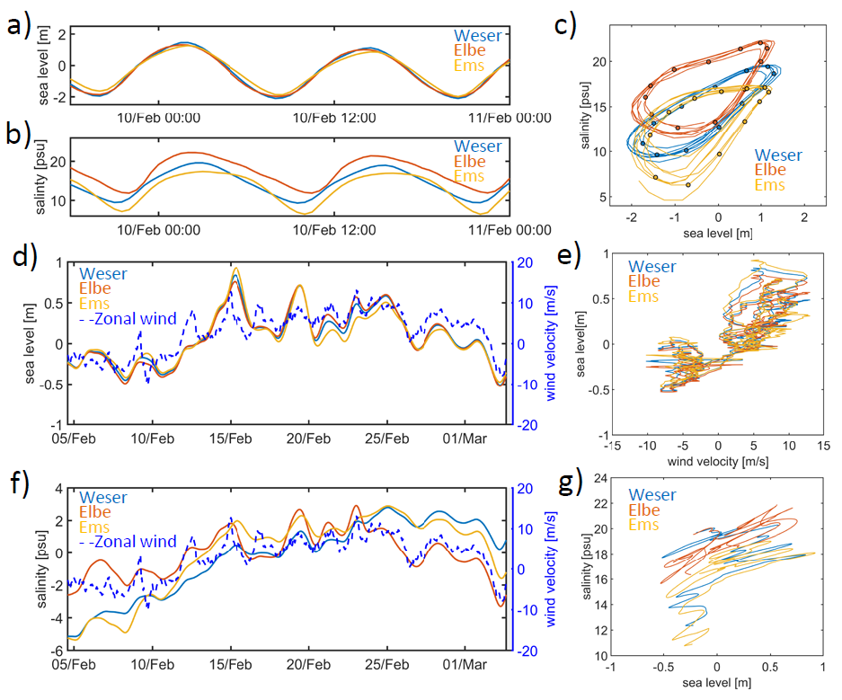
Synchronous dynamics of the three estuaries
Notes:
Relation: wind sea level sss in frontal center (snchronyzed to same phase)
a)
Similar TR sinusodial sea level couarse
b)
Salinity: flood asymetry faster increase (different sampling location could reduce SSS shift)
Largest Flood asymetry in Elbe
Salinity Increase/decrease Elbe: 2 Weser 1.3 Ems 1.2
C intra tidal variability:
Phase difference 90° -> circle
Anti clockwise
Different trajecterories -> different response of salinity to tidal forcing
d) f)
Zonal Wind drifr of longterm variability
14 d/f detided Clear response to west winds
For salinity very different courses.
Different change of freshwater in three esrurase
Intra tidal periods Weser strongest corelation SSH/SSS

Slide 13
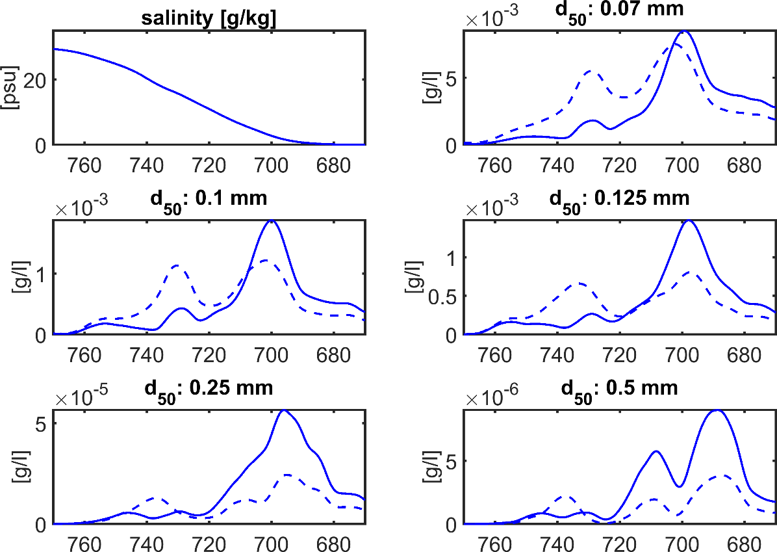
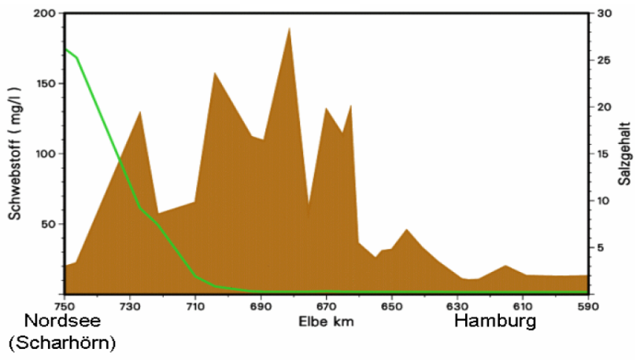
Simulation of Estuarine Turbidity zone
Initialization of coupled model hydrodynamic + non-cohesive sedimentes with grain-size distribution taken from AufMOD (BAW,BSH) with 8 sediment classes
higher concentration for finer grain sizes
Specific Distribution of sediment classes along estuary
Simulations with homogenous salinity and temperature pronounces the Importance of the estuarine salinity gradient
Image: Kappenberg, J., & Fanger, H. U. (2007). Sedimenttransportgeschehen in der tidebeeinflussten Elbe, der Deutschen Bucht und in der Nordsee. GKSS FORSCHUNGSZENTRUM GEESTHACHT GMBH-PUBLICATIONS-E, 1(20),
Notes:
Concentration decrease with grain size

Slide 14
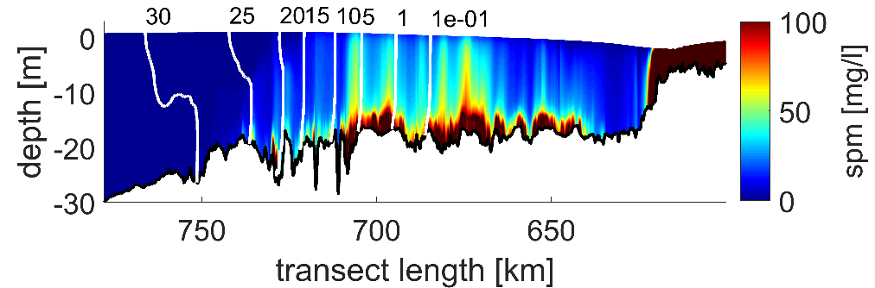
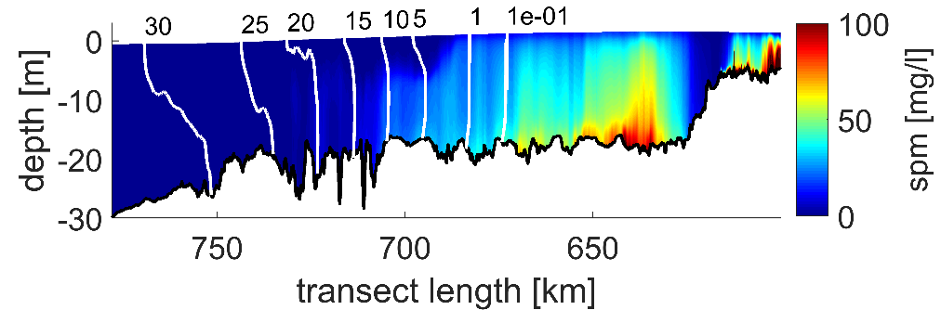
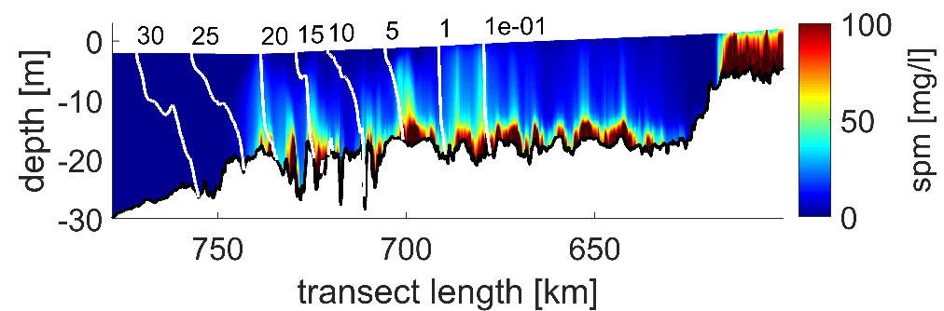
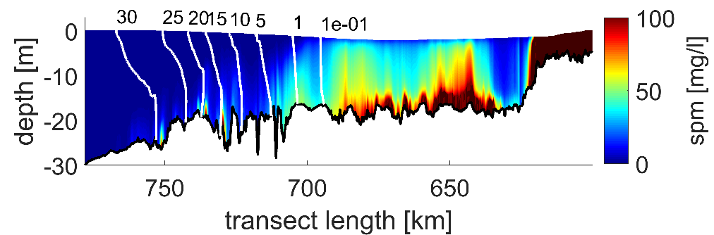
ETM dynamics over the tidal cycle
SPM concentration of grain diameter (d₅₀) = 0.07 mm
Flood
High water slack
Ebb
Low water slack
-> Pronounced flood-ebb asymmetry
-> Tidal-mixing asymmetry with enhanced SIPS during ebb
Notes:
SPM trapiing at limit of salt intrusion

Slide 15
cONCLUSIONS
The model compares well to observational data.
Density effects on SSH variations are comparable to the M4 amplitude and largely affect the tidal asymmetry.
Density strongly affects the hydro- and sediment dynamics in the Weser and Elbe. Due to low river discharge, the Ems is rather barotropic.
Sediment sorting is dependent on grain size and baroclinicty.
Different exposure to wind and very different ratios of run off to tidal mixing in the individual estuaries result in the locally different role of density.

Slide 16
ConcLUSIONS
Benjamin Jacob
Institute of Coastal Research
Max-Planck-Straße 1
E-Mail: Benjamin.jacob@hzg.de
21502 Geesthacht
+49 (0)4152 87-1505

