Slide 1
Eddying regime
Joseph Zhang

Slide 2

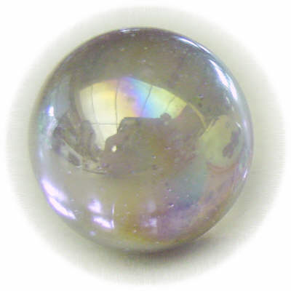
Challenges in eddying regime
Part of these challenges are due to poorly understood physics (e.g., scale differences =>different parameterizations)
Scale-aware parameterization is an active research area, and is badly needed for UG models: don’t double count; don’t half count; don’t blow up; respect energetics and “enstro-getics”
Different regimes prefer different numerics
Estuarine regime is strongly forced/dissipated: larger numerical dissipation might be acceptable?
Large-scale eddying regime is weakly forced/mostly balanced: requires low numerical dissipation and dispersion (to control spurious modes etc)
May be best to accommodate the eddying regime and keep the inherent numerical dissipation and dispersion low, and add dissipation when needed (via numerical scheme or explicit mixing)
Eddying and transitional regimes require smoothly transitioned grid in order to not distort eddying processes
Estuarine regime generally allows more liberal use of skew elements and sharp grid transition as there is sufficient amount of (physical) dissipation
The key is to strike a balance between numerical diffusion and dispersion
Most challenging in eddying regime is near steep shelf breaks
Diffusion
Dispersion
Eternal struggle between diffusion and dispersion
Notes:
Mention the theoretical challenges

Slide 3
Control of dissipation in momentum
!-----------------------------------------------------------------------
! Methods for computing velocity at nodes.
! If indvel=0, conformal linear shape function is used; if indvel=1, averaging method is used.
! For indvel=0, a stabilization method is needed (see below).
!-----------------------------------------------------------------------
indvel = 0
!-----------------------------------------------------------------------
! 2 stabilization methods, mostly for indvel=0.
! (1) Horizontal viscosity option. ihorcon=0: no viscosity is used; =1: Lapacian;
! =2: bi-harmonic. If ihorcon=1, horizontal viscosity _coefficient_ (<=1/8, related
! to diffusion number) is given in hvis_coef0, and the diffusion #
! is problem dependent; [0.001-1/8] seems to work well.
! If ihorcon=2, diffusion number is given by hvis_coef0 (<=0.025).
! If indvel=1, no horizontal viscosity is needed.
! (2) Shapiro filter (see below)
!
! For non-eddying regime applications (nearshore, estuary, river), two easiest options are:
! (1) indvel=1, ishapiro=ihorcon=0, and any choices of inter_mom;
! (2) indvel=0, ishapiro=1 (shapiro=0.5), ihorcon=inter_mom=0.
! For applications that include eddying regime, refer to the manual.
!-----------------------------------------------------------------------
ihorcon = 0
hvis_coef0 = 0.025 !const. diffusion # if ihorcon/=0; <=0.025 for ihorcon=2, <=0.125 for ihorcon=1
! cdh = 0.01 !needed only if ihorcon/=0; land friction coefficient - not active yet
!-----------------------------------------------------------------------
! 2nd stabilization method via Shapiro filter. This should normally be used
! if indvel=ihorcon=0. To transition between eddying/non-eddying regimes, use
! indvel=0, ihorcon/=0, and ishapiro=-1 (shapiro.gr3).
!-----------------------------------------------------------------------
ishapiro = 1 !on/off flag
shapiro = 0.5 !Shapiro filter strength, needed only if ishapiro=1; max is 0.5
!-----------------------------------------------------------------------
! Kriging ELM
!-----------------------------------------------------------------------
inter_mom = 0
kr_co = 1 !not used if inter_mom=0
indvel=1, ishapiro=ihorcon=0: occasionally useful for b-tropic applications, but should be avoided in general because of larger numerical dissipation
By defalt, use indvel=0
Make sure you impose vel b.c. at all open boundaries
Eddying regime or cross scale: indvel=0, ihorcon=2, hvis_coef0 = 0.025 ishapiro=0 or -1
Non-eddying regime: indvel=ihorcon=0, ishapiro=1
There are 2 additional handles to control dissipation: inter_mom & kr_co
Kriging ELM: inter_mom=1
Use kr_co for order of interpolation
Not effective handle: implicitness factor

Slide 4
Transport solver
!-----------------------------------------------------------------------
! Transport method.
! If itr_met=1, upwind method is used. If itr_met>=2, TVD or WENO method is used
! on an element/prism if the total depth (at all nodes of the elem.)>=h_tvd and the flag in
! tvd.prop = 1 for the elem. (tvd.prop is required in this case);
! otherwise upwind is used for efficiency.
! itr_met=3 (horizontal TVD) or 4 (horizontal WENO): implicit TVD in the vertical dimension.
! Also if itr_met==3 and h_tvd>=1.e5, some parts of the code are bypassed for efficiency
! Controls for WENO are not yet in place
!-----------------------------------------------------------------------
itr_met = 4
h_tvd = 5. !used only if itr_met>=2; cut-off depth (m)
!If itr_met=3 or 4, need the following 2 tolerances of convergence. The convergence
!is achieved when sqrt[\sum_i(T_i^s+1-T_i^s)^2]<=eps1_tvd_imp*sqrt[\sum_i(T_i^s)^2]+eps2_tvd_imp
eps1_tvd_imp = 1.e-4 !suggested value is 1.e-4, but for large suspended load, need to use a smaller value (e.g. 1.e-9)
eps2_tvd_imp = 1.e-14
!if itr_met = 4, the following parameters are needed
!if itr_met=4 and ipre=1, diagnostic outputs are generated for weno accuracy and stencil quality,
! see subroutine weno_diag in src/Hydro/misc_subs.F90 for details
ip_weno = 2 !order of accuracy: 0- upwind; 1- linear polynomial, 2nd order; 2- quadratic polynomial, 3rd order
courant_weno=0.5 !Courant number for weno transport
epsilon1 = 1.e-8 !coefficient for 2nd order weno smoother
epsilon2 = 1.e-10 !1st coefficient for 3rd order weno smoother
epsilon3 = 1.e-25 !2nd coefficient for 3rd order weno smoother (not used)
!Elad filter has not been implemented yet; preliminary tests showed it might not be necessary
ielad_weno = 0 !ielad, if ielad=1, use ELAD method to suppress dispersion
small_elad = 1.e-4 !small
Use itr_met=3 or 4 for most b-clinic applications
Additional handles: h_tvd, tvd.prop
Set tvd.prop to be 0 inside regions of no stratification or interest for better performance
Two tolerances for TVD² nonlinear iterative solver may occasionally need to be adjusted
Adjust WENO parameters to control numerical dispersion

Slide 5
Most important parameters are…
Momentum dissipation: indvel, ihorcon, ishapiro, inter_mom
Appropriate combinations of these can be used for different applications (dispersion vs diffusion)
May start with: indvel= ihorcon=inter_mom=0, ishapiro=1 (‘MB-LI’ scheme)
If dissipation is still too high, use indvel= inter_mom=ishapiro=0, ihorcon=2, hvis_coef0=0.025 (or smaller) – the ‘eddying’ option. If oscillation is found in non-eddying areas, use ishapiro=-1 and set the filter strength in shapiro.gr3 (equivalent to Laplacian viscosities)
Adjust shapiro.gr3 to get appropriate amount of dissipation as needed (max of 0.2 seems adequate)
indvel=1, ihorcon=ishapiro=inter_mom=0 is the most diffusive option (‘MA-LI’ scheme), but can be useful for 2D runs etc
dt: appropriate time step
Another way to control dispersion/diffusion
Reducing dt will increase diffusion and decrease dispersion, and vice versa
nws: use ‘2’ as much as possible (and there are scripts for generating sflux*.nc); important for temperature
itr_met: use 3 or 4
Use ‘h_tvd’ and tvd.prop to control efficiency: upwind scheme is used if h<h_tvd and the elem is marked as ‘0’ in tvd.prop for better efficiency
‘Upwind’ zone: upstream river where there is no stratification or regions of no interest
WENO (‘4’) is the best option, but requires some tuning to control dispersion

Slide 6
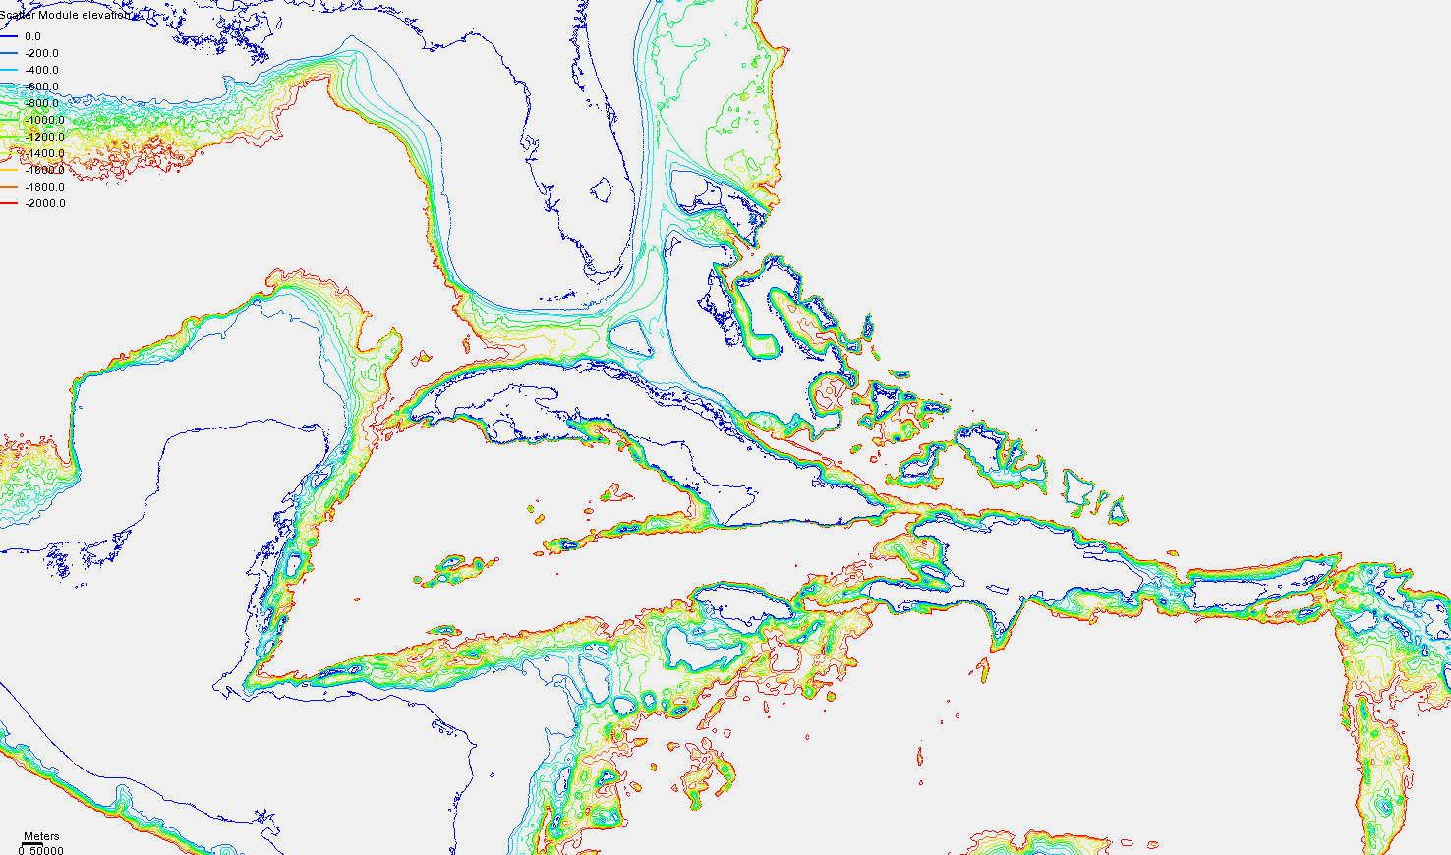



The case of under resolution in eddying regime
Under resolution occurs frequently in areas of steep slopes, mostly to save cost in areas of no significant interest
In general, under resolution in the horizontal dimension should be matched with an under resolution in the vertical, often taking advantage of many degenerate prism near the bottom and a non-smooth LSC² there. This reduces PGE
The combined Laplacian and bi-harmonic viscosity can be used to stabilize the momentum over the steep slopes (ishapiro=-1)
Florida
u
u
1
2

Slide 7
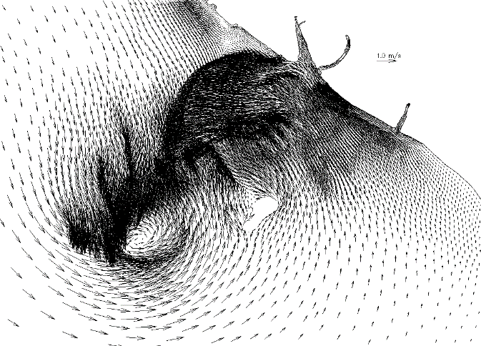
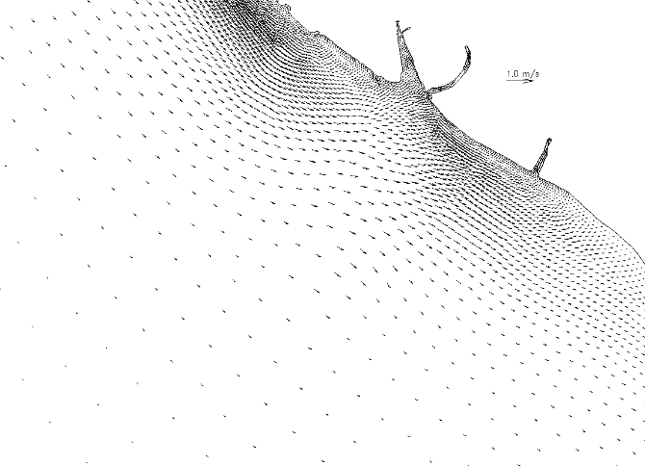
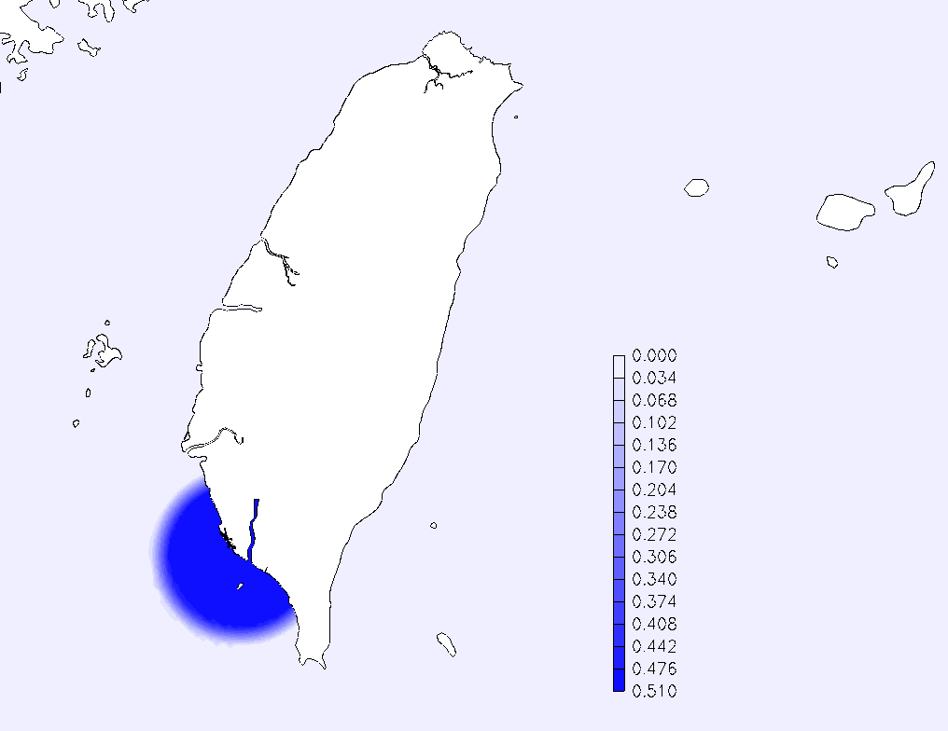
Transition between eddying and non-eddying regime
Sharp grid transition, with insufficient dissipation
Smooth transition (no additional dissipation)
Shapiro.gr3
Filter strength
Sharp transition in this critical regime, enabled by UGs, may trigger artificial accumulation of energy, without adequate dissipation mechanism
Resolution gradient-aware viscosity may be the ultimate solution (e.g., combination of Laplacian & bi-harmonic viscosity)
Two pragmatic solutions
Make sure the grid transition is smooth (in fact smooth grid is required in eddying regime as well)
If non-smooth transition has to be used, add numerical dissipation in the form of filter or combined viscosities

Slide 8
Model setup in eddying regime: workflow
Gridgen: use quasi-uniform grid as much as possible
Select proper parameters
Sub-tides from HYCOM (scripts in svn directory)
i.c. (elev, u,v,T,S)
b.c. (elev, u,v,T,S)
T,S: can be interpolated from (daily) HYCOM and used as [TEM,SAL]_3D.th.nc
SSH, u, v from HYCOM: as elev2D.th.nc and uv3D.th.nc (no tides yet; need to combine with tides)
Nudging for tracers (T,S)
[TEM,SAL]_nudge.gr3: relaxation factors (0 - 1/T_{r}). May adjust T_{r} to get a smooth transition (usually ~1 day)
[TEM,SAL]_nu.nc: HYCOM values (can be junks outside the nudging zone or reduced to just cover the nudging zone, with some ‘allowance’)
Add tides: FES2014 for elev, u,v

Slide 9
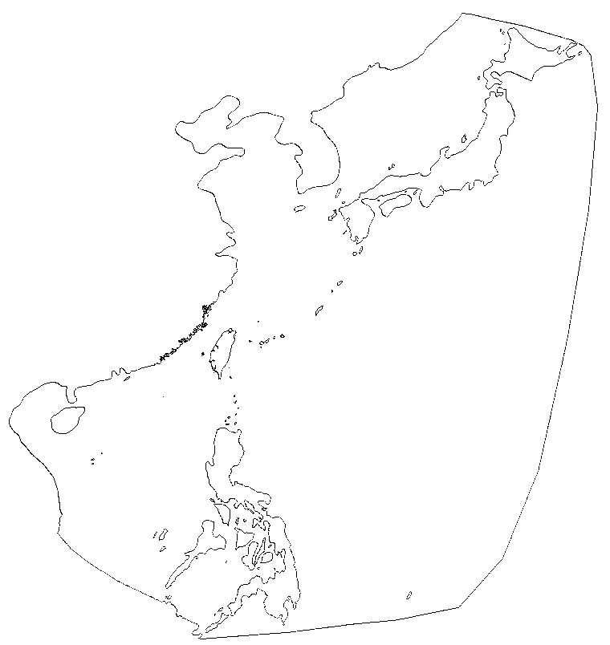
Initial and boundary condition inputs from HYCOM
gen_hot_3Dth_from_hycom.f90 is the main script
HYCOM nc files required: [SSH,TS,UV]_[1,2,..nfiles].nc
Note that HYCOM formats may change so you may have to change some read statements inside
Essentially a 3D interpolation script to interpolate from HYCOM grid to SCHISM grid
! First statement
open(10,file='gen_hot_3Dth_from_nc.in',status='old')
read(10,*) iuv !1: include vel and elev. in hotstart.in; 0: only T,S
read(10,*) tem_es,sal_es !T,S values for estuary points defined in estuary.gr3
read(10,*) tem_outside,sal_outside !T,S values for pts outside bg grid in nc
read(10,*) dtout !time step in .nc [sec]
read(10,*) nob,iob(1:nob) !# of open bnds that need *3D.th; list of IDs
read(10,*) nndays !# of days needed in output
read(10,*) nfiles !# of stacks of HYCOM files
close(10)
if(tem_es<0.or.sal_es<0.or.tem_outside<0.or.sal_outside<0) &
&stop 'Invalid T,S constants'
! Read in hgrid and vgrid
open(17,file='estuary.gr3',status='old')
open(16,file='hgrid.ll',status='old')
open(14,file='hgrid.gr3',status='old') !only need depth info and connectivity
open(19,file='vgrid.in',status='old')
open(11,file='fort.11',status='replace')
read(14,*)
read(14,*)ne,np
…. (compute SCHISM geometry)
Seg #2
(South China Sea)
Seg #1 (pacific)

Slide 10
Initial and boundary condition inputs from HYCOM
Reading from HYCOM
do ifile=1,nfiles
!--------------------------------------------------------------------
write(char3,'(i20)')ifile
char3=adjustl(char3); len_char3=len_trim(char3)
! Open nc file
status = nf90_open('TS_'//char3(1:len_char3)//'.nc', nf90_nowrite, sid)
call check(status)
status = nf90_open('SSH_'//char3(1:len_char3)//'.nc', nf90_nowrite, ncids(1))
status = nf90_open('UV_'//char3(1:len_char3)//'.nc', nf90_nowrite, ncids(2))
if(ifile==1) then
! Get dimnesions from S
status = nf90_inq_varid(sid, "salinity", svid)
print*, 'Done reading variable ID'
print*, sid,svid,ncids(1:2),'TS_'//char3(1:len_char3)//'.nc'
! Get dimensions from the 1st file
! Assumed same as for all variables
! WARNING: indices reversed from ncdump!
…
! processing static info
do i=1,ixlen
lon(i,:)=xind(i)
enddo !i
do j=1,iylen
lat(:,j)=yind(j)
enddo !j
! lon=lon-360 !convert to our long.
Code will check the validity of read-in values and may crash if rjunk is not set properly
!Scaling etc
salt=salt*1.e-3+20
temp=temp*1.e-3+20
uvel=uvel*1.e-3
vvel=vvel*1.e-3
ssh=ssh*1.e-3
!Define junk value for sid; the test is salt<rjunk+0.1
rjunk=-3.e4*1.e-3+20
Then the code will try to find parent cells for hgrid nodes; const T,S (from gen*.in) will be used for nodes outside HYCOM grid
If the parent cells have junk values, the code will search for nearest cells that have valid values
Const extrapolation is used to fill values above surface/below bottom
Output hotstart.nc at the 1st step only
Output *th.nc for all steps

Slide 11
*[23]D.th.nc
elev2D.th.nc, TEM_3D.th.nc, SAL_3D.th.nc, [tracer]_3D.th.nc, uv3D.th.nc (not discharge)
Corresponds to b.c. flag=±4 or 5
Make sure you check values after creation
netcdf uv3D.th {
dimensions:
nOpenBndNodes = 1329 ;
nLevels = 48 ;
nComponents = 2 ;
one = 1 ;
time = UNLIMITED ; // (2881 currently)
variables:
float time_step(one) ;
time_step:long_name = "time step in seconds" ;
double time(time) ;
time:long_name = "simulation time in seconds" ;
float time_series(time, nOpenBndNodes, nLevels, nComponents) ;
// global attributes:
:_NCProperties = "version=1|netcdflibversion=4.4.1.1|hdf5libversion=1.8.18" ;
data:
time_step = 3600 ;
time = 0, 3600, 7200, 10800, 14400, 18000, 21600, 25200, 28800, 32400,
36000, 39600, 43200, 46800, 50400, 54000, 57600, 61200, 64800, 68400,
72000, 75600, 79200, 82800, 86400, 90000, 93600, 97200, 100800, 104400,
108000, 111600, 115200, 118800, 122400, 126000, 129600, 133200, 136800,
140400, 144000, 147600, 151200, 154800, 158400, 162000, 165600, 169200,
Time steps may be different from each other and ≥ dt in param.in; record must start from t=0

Slide 12
Nudging inputs from HYCOM
gen_nudge_from_hycom.f90
Shares a lot of common code with gen_hot_3Dth_from_hycom.f90
! First statement
ndays_mon=(/31,28,31,30,31,30,31,31,30,31,30,31/) !# of days in each month for non-leap yr
! hr_char=(/'03','09','15','21'/) !each day has 4 starting hours in ROMS
open(10,file='gen_nudge_from_nc.in',status='old')
read(10,*) tem_outside,sal_outside !T,S values for pts outside bg grid in nc or include.gr3
read(10,*) dtout,nt_out !time step in .nc [sec], output stride
read(10,*) nndays !# of nc files
close(10)
! Read in hgrid and vgrid
open(16,file='hgrid.ll',status='old')
open(15,file='include.gr3',status='old')
open(14,file='hgrid.gr3',status='old') !only need depth info and connectivity
open(19,file='vgrid.in',status='old')

Slide 13
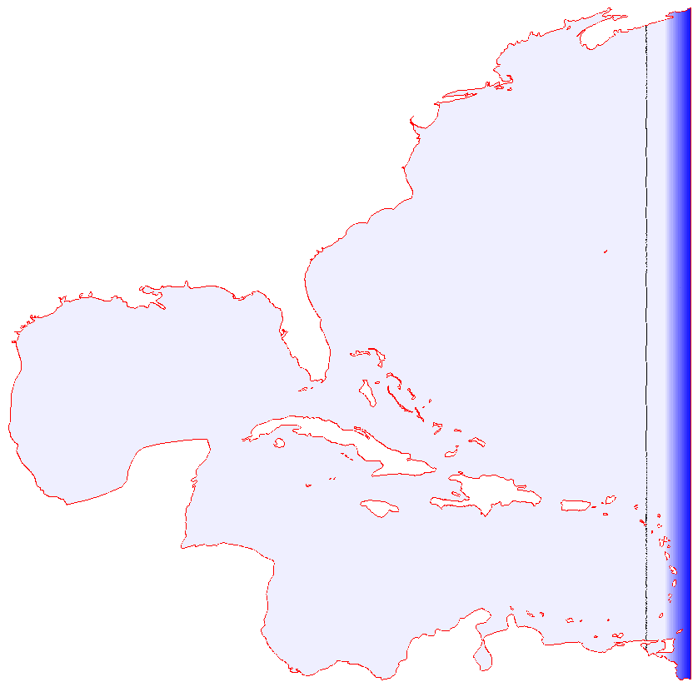
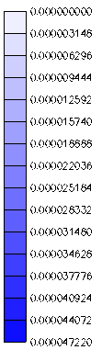
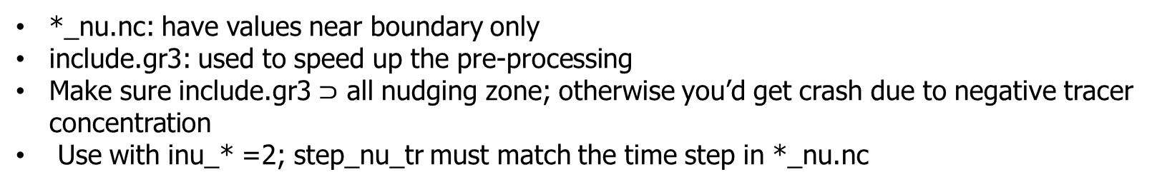
Nudging inputs from HYCOM
*_nu.nc: have values near boundary only
include.gr3: used to speed up the pre-processing
Make sure include.gr3 $⊃$ all nudging zone; otherwise you’d get crash due to negative tracer concentration
Use with inu_* =2; step_nu_tr must match the time step in *_nu.nc
include.gr3
netcdf TEM_nu {
dimensions:
node = 42746 ;
nLevels = 43 ;
one = 1 ;
time = UNLIMITED ; // (183 currently)
variables:
double time(time) ;
int map_to_global_node(node) ;
float tracer_concentration(time, node, nLevels, one) ;
data:
time = 0, 1, 2, 3, 4, 5, 6, 7, 8, 9, 10, 11, 12, 13, 14, 15, 16, 17, 18, 19,
20, 21, 22, 23, 24, 25, 26, 27, 28, 29, 30, 31, 32, 33, 34, 35, 36, 37,
38, 39, 40, 41, 42, 43, 44, 45, 46, 47, 48, 49, 50, 51, 52, 53, 54, 55,
56, 57, 58, 59, 60, 61, 62, 63, 64, 65, 66, 67, 68, 69, 70, 71, 72, 73,
74, 75, 76, 77, 78, 79, 80, 81, 82, 83, 84, 85, 86, 87, 88, 89, 90, 91,
92, 93, 94, 95, 96, 97, 98, 99, 100, 101, 102, 103, 104, 105, 106, 107,
108, 109, 110, 111, 112, 113, 114, 115, 116, 117, 118, 119, 120, 121,
122, 123, 124, 125, 126, 127, 128, 129, 130, 131, 132, 133, 134, 135,
136, 137, 138, 139, 140, 141, 142, 143, 144, 145, 146, 147, 148, 149,
150, 151, 152, 153, 154, 155, 156, 157, 158, 159, 160, 161, 162, 163,
164, 165, 166, 167, 168, 169, 170, 171, 172, 173, 174, 175, 176, 177,
178, 179, 180, 181, 182 ;
map_to_global_node = 1563, 1564, 1565, 1566, 1567, 1568, 1570, 1571, 1572,
1573, 1574, 1646, 1647, 1648, 1649, 1650, 1651, 1652, 1653, 1654, 1655,
1656, 1657, 1658, 1659, 1660, 1661, 1662, 1663, 1664, 1665, 1666, 1667,
Relaxation (1/s)
Junks

Slide 14
Add tides
HYCOM does not have tides (actually it may be better to explicitly filter out any high-frequency signals in it)
Tidal signals are added into HYCOM SSH and u,v at the boundary
Tidal potential should be added in the interior of the domain
Add tidal elevation
Can use iettype=5: tidal amplitudes/phases are specified in bctides.in, whereas non-tidal HYCOM is in elev2D.th.nc
Add tidal velocity
Easiest way is to use FES2014 to generate harmonics for vel, and then use ifltype=5
Alternative approach of adding tidal velocity
Use a simple script to combine two uv3D.th.nc (e.g. from HYCOM and from OneWayNestScripts)
The script basically interpolates in time and adds up the 2 components
Since the velocity is never perfect at the boundary, the tracer concentration needs to be nudged in a zone near the ocean boundary
The incoming vel is more important, especially for indvel=0 which has lower dissipation and thus requires more stabilization

Slide 15
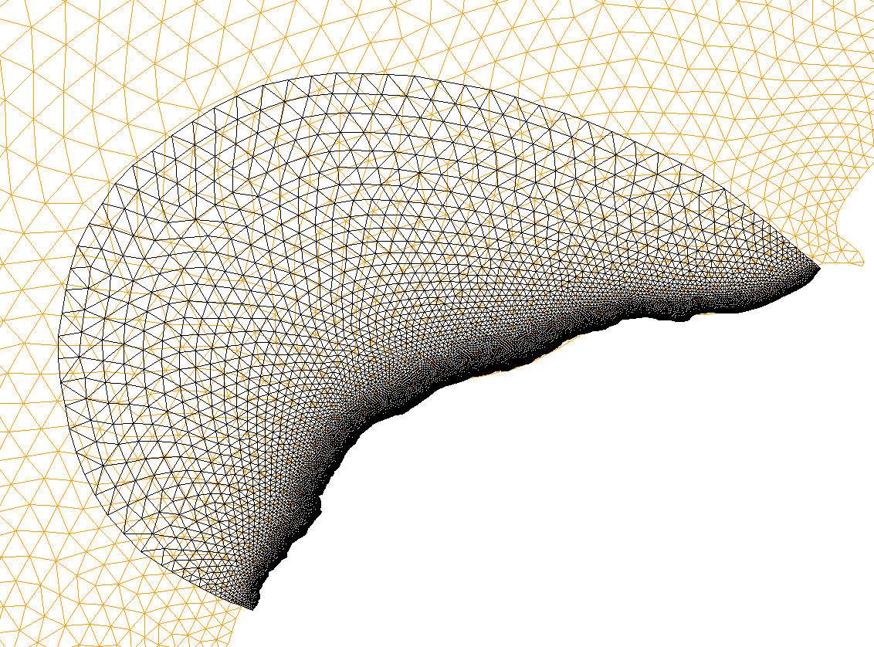
One-way nesting
Useful as a way to generate uv3D.th.nc etc (when no other sources are available)
Use interpolate_variables_selfe7.f90 to generate *[23]D.th.nc for the small-domain run
Make sure the larger grid covers the smaller grid)
Since SCHISM does not allow drying at any open boundary nodes and at any time, make sure these nodes never become dry in the large-domain results – move them or redo open boundary segments if necessary
Use the new *[23]D.th.nc for the small-domain run
Problematic open bnd nodes

Slide 16
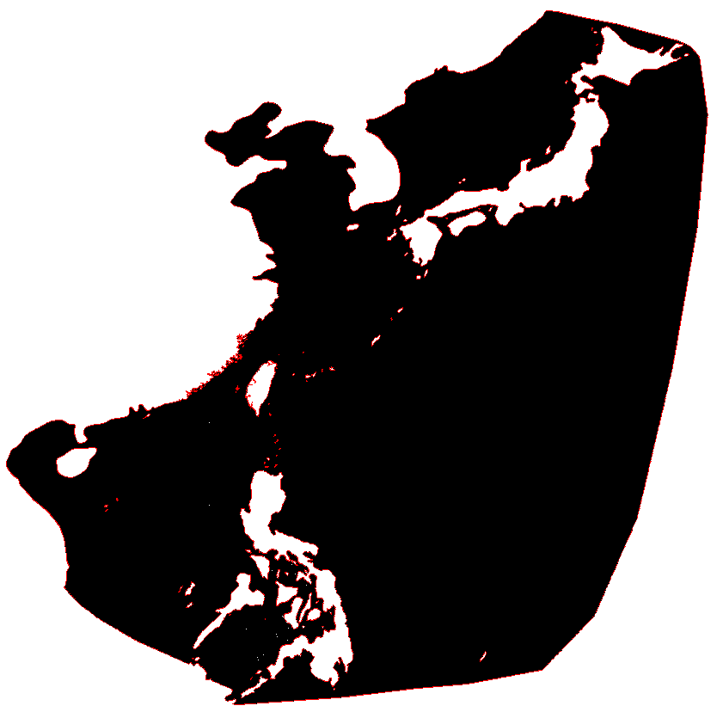
Case study: Kuroshio
Step 1: grid generation for both 2D b-tropic and 3D b-clinic models
Start from a moderate resolution in eddying regime and refine as needed
Smooth transition from deep ocean to shelf break
Add nearshore features (channels, rivers, jetties); non-smooth grids are fine
Step 2: do 2D b-tropic model
Get tidal amplitudes and phases from a global model (e.g. FES2014)
Calibrate tides
Pacific
SCS

Slide 17
Kuroshio: baroclinic model
Prepare a LSC² grid
Plot out many transects for review
Download and prepare HYCOM files
Download atmospheric forcing (CFSR; ERA5) and prepare sflux/: there are pre-proc scripts in Utility/Sflux_nc/
Prepare nudging grids ([TEM,SAL]_nudge.gr3): elliptic zone or fixed distance from ocean boundary
Prepare nudging inputs (TEM,SAL]_nu.nc) from HYCOM
Tip: exclude most parts of the domain outside the nudging zone in include.gr3 to speed up
Prepare hotstart.nc and *.th.nc from HYCOM
hotstart.nc and [TEM,SAL].th.nc are final
elev2D.th.nc and uv3D.th.nc will be combined with tidal components later
Get elev and vel harmonics from FES2014
Set iettype=ifltype=5 in bctides.in
indvel=ishapiro=0, ihorcon=2, hvis_coef0=0.025
If the grid is not smooth in the transitional regime, use ishapiro=-1 (with shapiro.gr3) to add dissipation locally
Notes:
/NSYSU/RUN35b_2014

Slide 18
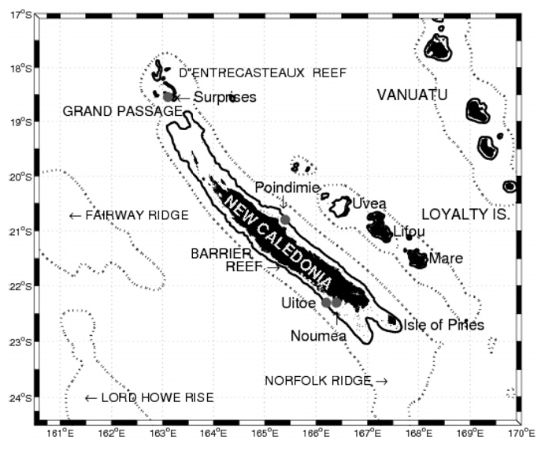
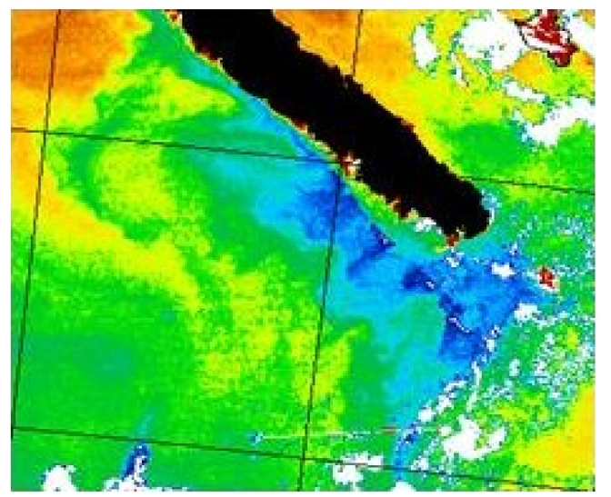
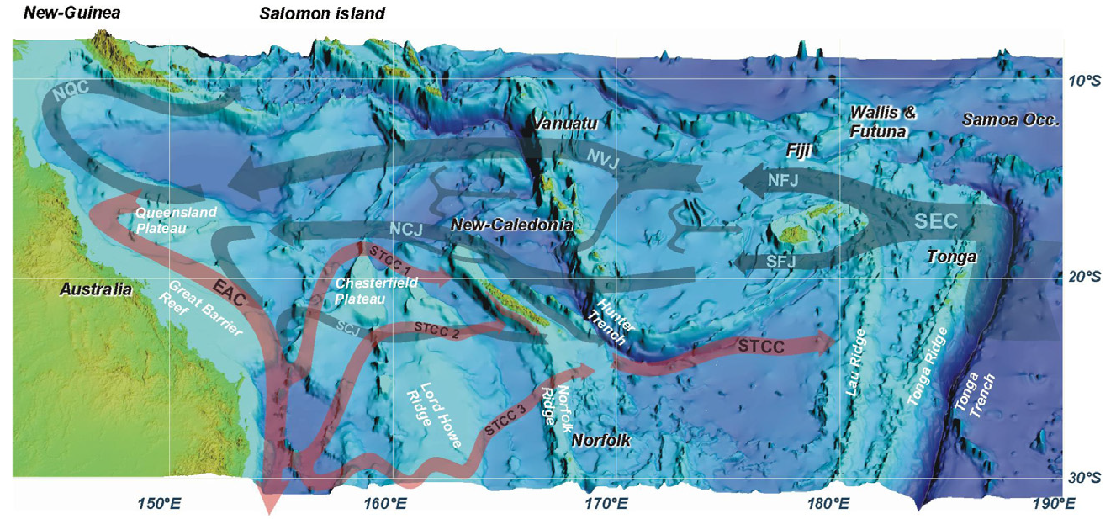
Case study: New Caledonia reefs
Marchesiello et al. (2010)
South Pacific island surrounded by reefs
Reefs are sentinel species for environmental changes
There is a need to understand the flow around the reefs
Persistent upwelling wind on 1 side of the island, but only southern part of the island shows upwelling pattern
c/o J. Ifevre

Slide 19
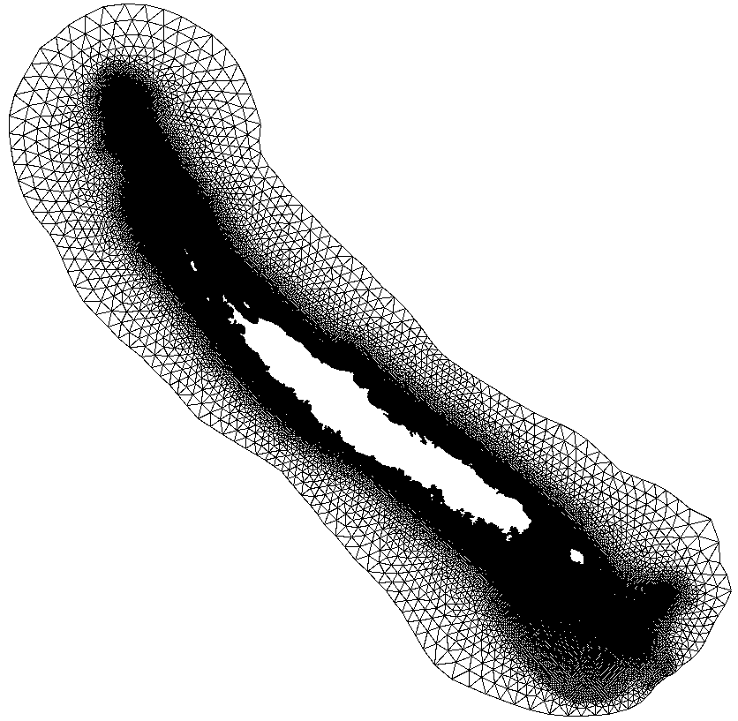
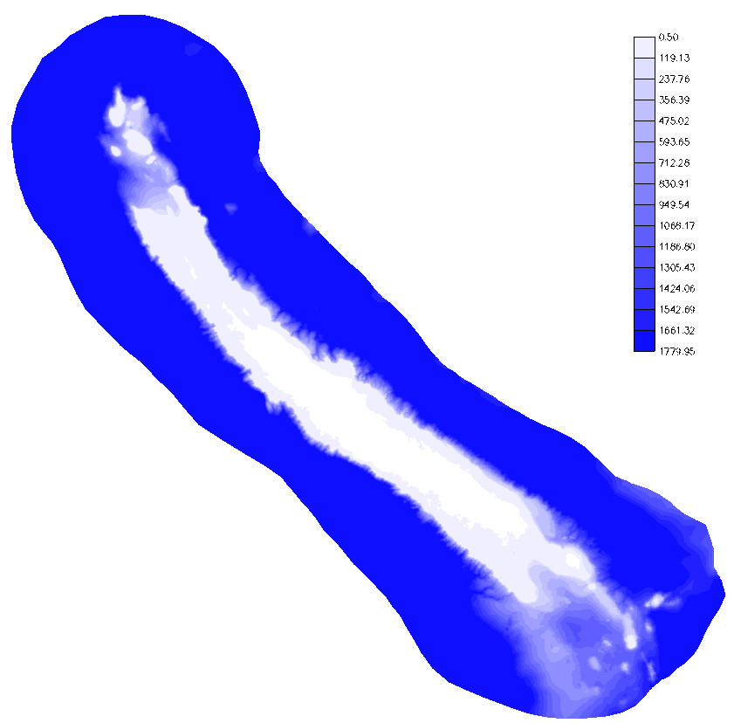
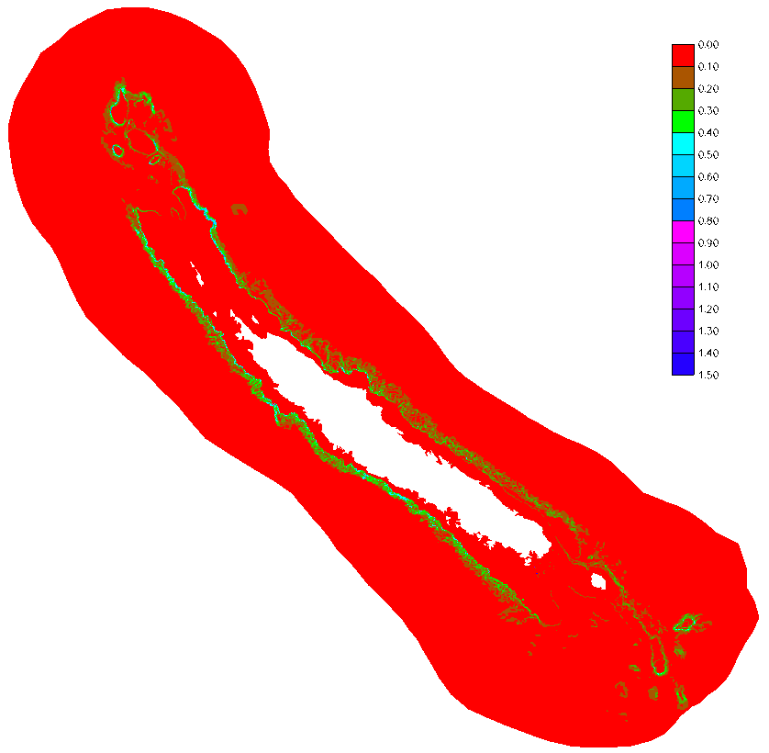
Bathymetry
Depth (m)
Slope
Steep slopes around reefs

Slide 20
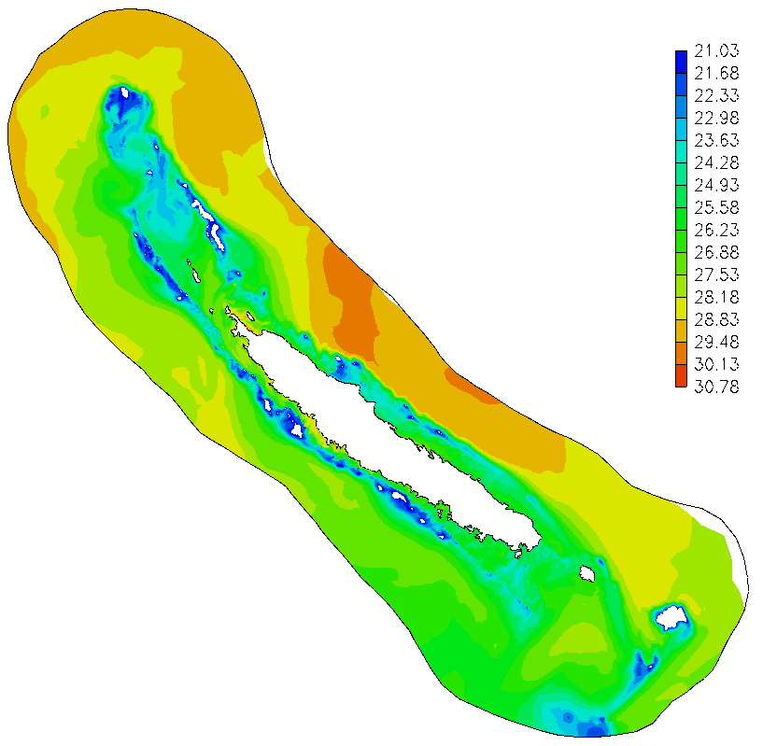
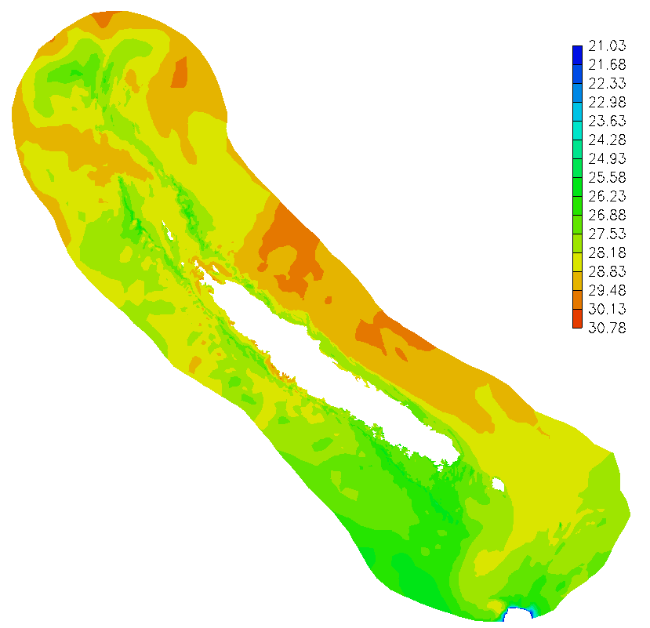
Model set-up
Modest horizontal grid resolution around the reefs (~500m)
LSC² grid
PGE leads to sub-grid noise in momentum, which needs to be stabilized properly
Non-eddying option (ishapiro=1, ihorcon=0) works better due to larger dissipation
Possible to combine this option with eddying option elsewhere with ishapiro=-1
SST (ºC)
SST (ºC)
ishapiro=1, ihorcon=0
ishapiro=0, ihorcon=2

Slide 21
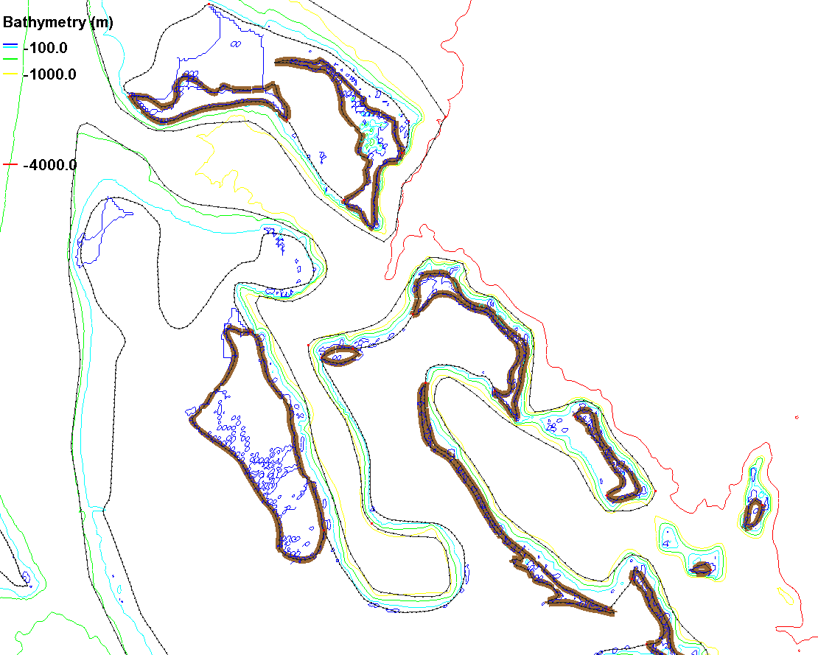
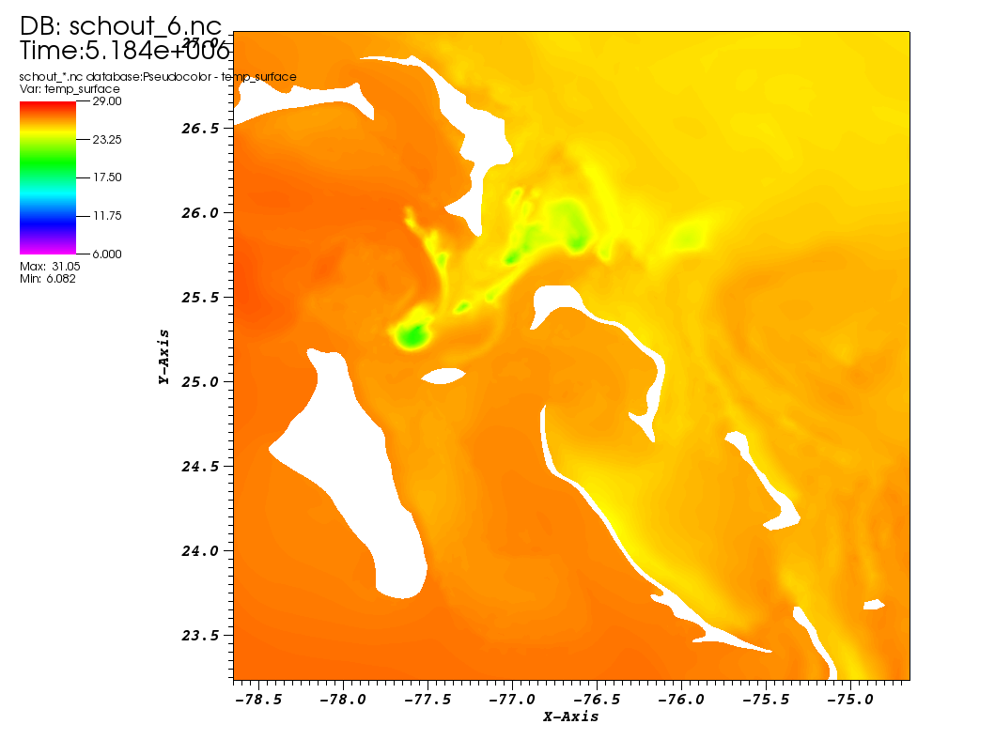
Gulf Stream: Caribbean islands
Non-eddying regime (shallow)
Prevalence of steep slopes in Caribbean seas presents severe challenges due to PGE
The issue is exacerbated by under resolution; results are often spurious upwelling
Grid this region by carefully delineating the 2 regimes
Also need additional momentum dissipation (Shapiro filter)
Eddying regime (deep)
Spurious upwelling
Non-eddying regime (shallow)

Slide 22
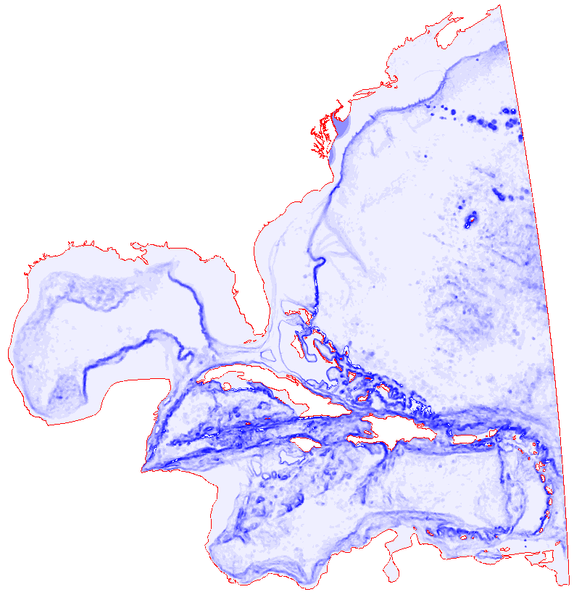

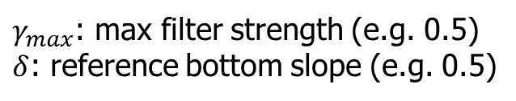

Gulf Stream: momentum dissipation
Additional viscosity is needed near steep slopes to stabilize momentum there
We can use Shapiro filter as a function of the slope (gen_slope_filter.f90)
$$γ=γ_{max}tanh⁡(2|∇h|/δ)$$
$γ_{max}$: max filter strength (e.g. 0.5)
$δ$: reference bottom slope (e.g. 0.5)
γ
We can even choose a filter based on gradient of grid size etc (scale selective parameterization)

Slide 23
Gulf Stream: PGE
There are 2 depth parameters that control PGE near steep slopes: h2_bcc > h1_bcc
The 'below-bottom' gradient is zeroed out if h≥h2_bcc (i.e. like Z as in most large-scale models); constant extrapolation is used (i.e. like terrain-following) if h≤h1_bcc. Linear transition is used if h1_bcc < h < h2_bcc
In the older versions, we have also tried a criterion based on Hannah-Wright ratio (surrogate of slope): hw_*

Slide 24
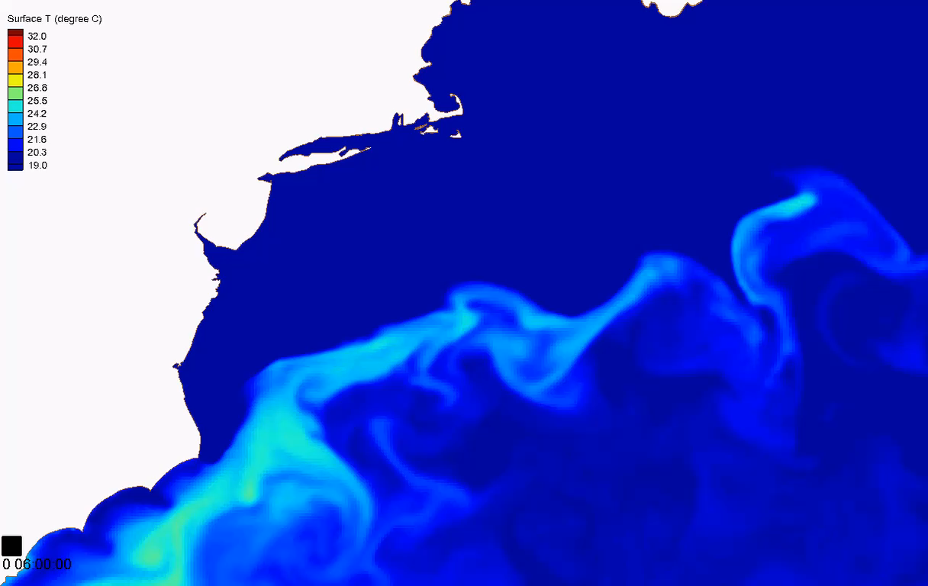

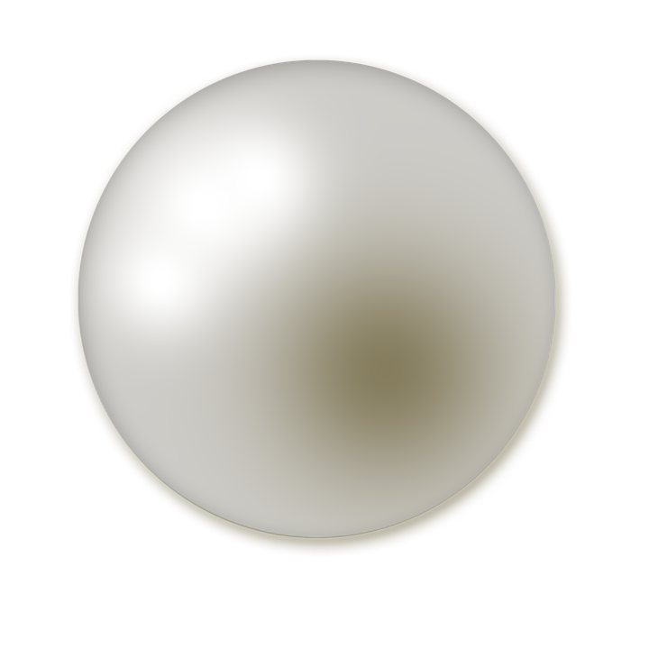
Higher-order scheme: Gulf Stream meandering
2nd order TVD
3rd order WENO
SST(ºC)
SST(ºC)
Grid resolution: 2~7 km; 388K nodes and 766K elements; 27 LSC² vertical levels on average
Time step=150 seconds
No bathymetry smoothing
Higher-order schemes help reduce numerical dissipation as required in large-scale processes

Slide 25
Periodic b.c.
Useful for benchmarks
The implicit framework in SCHISM makes the implementation of periodic b.c. a challenge
Take advantage of spherical coordinates for this type of b.c. (single periodic only; no double periodic)
Wrap hgrid around a sphere (either along equator or meridionally near two poles)
Pre-proc script: periodic_grid.f90
!Lengths in x,y (m) (box)
rlx=100e3; rly=10e3
!Resolution in x,y (m)
!# of divisions in x must >=360
dx=rlx/361; dy=1e3
!Min/max lat (degr) - use a small meridional band to minimize
!distortion
!The global (x,y,z) are calculated via:
!x=R_e*cos(\phi)*cos(\lambda)
!y=R_e*cos(\phi)*sin(\lambda)
!z=R_p*sin(\phi)
ymin=-0.5; ymax=0.5
!Radius @ pole to match rly
r_pole=rly/(ymax-ymin)/pi*180
nx=rlx/dx+0.01 !# of divisions in x
ny=rly/dy+0.01 !# of divisions in y
if(nx<360) stop 'Make sure # of divisions in x >=360!'
!Back calculate radius of 'earth' @ equator to match length in x
r_eq=rlx/2/pi
!Resolutions in lon/lat (degr)
dx_lon=360./(nx+1)
dy_lat=(ymax-ymin)/ny
!Min/max lon (degr)
xmin=-180
xmax=180-dx_lon !leave a gap
Make sure you have sufficient resolution along zonal direction (at least 360 divisions): otherwise you’d get an error from backtracking

Slide 26
Periodic b.c.: add wrap-around elements
1
1’
2
2’
Set ics=2 and optionally ncor=0
Viz may have some artifact – paraView can do spherical viz
3
3’
!Bnd seg
write(12,*)0,' = open' !# of open bnd
write(12,*)0 !total # of open bnd nodes
write(12,*)4 !# of land bnd
write(12,*)(nx+3)*2 !total # of land bnd nodes
write(12,*)nx+1,0 !1st land bnd
do i=1,nx+1
write(12,*)1+(i-1)*(ny+1)
enddo !i
write(12,*)2,0 !2nd land bnd, across dateline
write(12,*)nn-ny
write(12,*)1
write(12,*)2,0 !3rd land bnd
write(12,*)ny+1
write(12,*)nn
write(12,*)nx+1,0 !4th bnd
do i=1,nx+1
write(12,*)nn-(i-1)*(ny+1)
enddo !i
! Add wrap-around elements
do iy=1,ny
nt=nt+2
nd1=nn-ny+iy-1
nd2=iy
ic1(nt-1,1)=nd1
ic1(nt-1,2)=nd2
ic1(nt-1,3)=nd2+1
ic1(nt,1)=nd1
ic1(nt,2)=nd2+1
ic1(nt,3)=nd1+1
enddo !iy

Slide 27
Summary
Balance between numerical diffusion and dispersion is of paramount significance in eddying regime
Start from lowest numerical dissipation level, and add it back (in the form of viscosity) gradually
Often times the bi-harmonic viscosity is not sufficient near steep slopes, so additional Shapiro filter is required (ishapiro=-1)
Control dispersion by carefully choosing parameters in higher-order schemes (WENO, kriging ELM etc)
Smooth hgrid is required in eddying and transitional regimes; LSC² grid is usually sufficient

