Slide 1
Grid generation for SCHISM with SMS Joseph Zhang, VIMS Eli Ateljevich, DWR

Slide 2
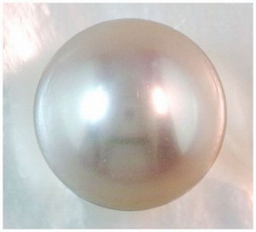
The good news and bad news
Bad news
UG grid generation is often a laborious and iterative process
Steepest part of the learning curve for UG models
This is especially true for very large grids: a common source of frustration with SMS – build confidence gradually and do it in stages
Good news
SCHISM is not picky about grid quality; it won’t blow up easily
Once you master the G.G., the rest of the model setup is more straightforward
A few ways to blow up the model
Bad quality quads (backtracking error): split them to get pair of triangles if you are not sure
Completely blocking the water flow, e.g., by under-resolving the main channel
Dry open boundary: a few ways around this (there is now a branch that handles this)
Momentum dissipation too low (parameter choice): dissipation is essential part of non-eddying regime

Slide 3
Overview of The GG process
Know your domain and target physics
Understand SCHISM numerics
Usually it’s easy to get ‘reasonable’ results without much effort
You cannot take full advantage of SCHISM features unless you understand inner working of its physics and numerics
Elevation and contour data preparation
Digitize or determine boundary (ideally as shape files from ArcGIS)
Import and refine conceptual model
Identify critical features/contours
Identify resolution/density
Create polygons and patch/pave locations
Generate the mesh
Populate mesh elevations (depths): no smoothing
Mesh quality and bathymetric metrics: important for eddying regime
Performance and accuracy metrics: transport solvers are often the main bottleneck
Clip mesh as necessary for subdomains of interest
Concatenate/splice meshes
More physics, less numerics

Slide 4
General rules
Unlike explicit models, you’ll find G.G. for SCHISM is more ‘intuitive’ and ‘freer’
Implicit model allows you to focus on physics instead of numerics (CFL…)
You are freer to resolve important features without worrying about cost/instability
SCHISM is not picky about grid quality (except for quads); however, grid quality pays off for accuracy especially in some critical regions
G.G. for baroclinic applications requires more effort (often an iterative process): establishing a good workflow is essential
Grid needs to be smooth in eddying and transitional regimes, in order to not distort eddy kinetics (Wang and Danilov 2016)

Slide 5
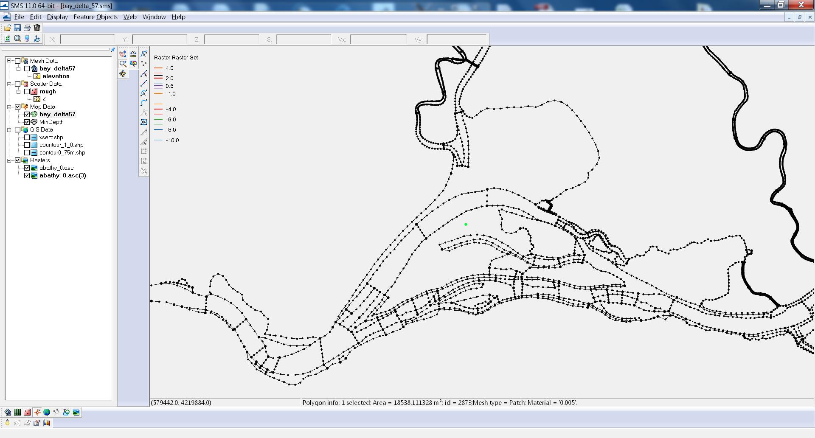
SMS Conceptual Model
Nodes, vertices, arcs and polygons
The basic meshing unit is (closed) polygon
Dangling arcs sometimes cause crash
Feature nodes may lead to skew elements

Slide 6
DEM preparation: pre-filtering bathymetry
Unresolved subgrid features may be eliminated
eliminates lunar landscape undulations on mudflats
level set or active contour methods (e.g. Malladi and Sethian): contours conservatively straighten
California DWR has python code smooth_contour.py for small regions
This is more for assisting in the arc creation than for actual interpolation of depths
ArcGIS has many tools for arc preparation
Output as shape files and import into SMS
Can also clip, clean, and manipulate arcs (e.g. min distance)

Slide 7
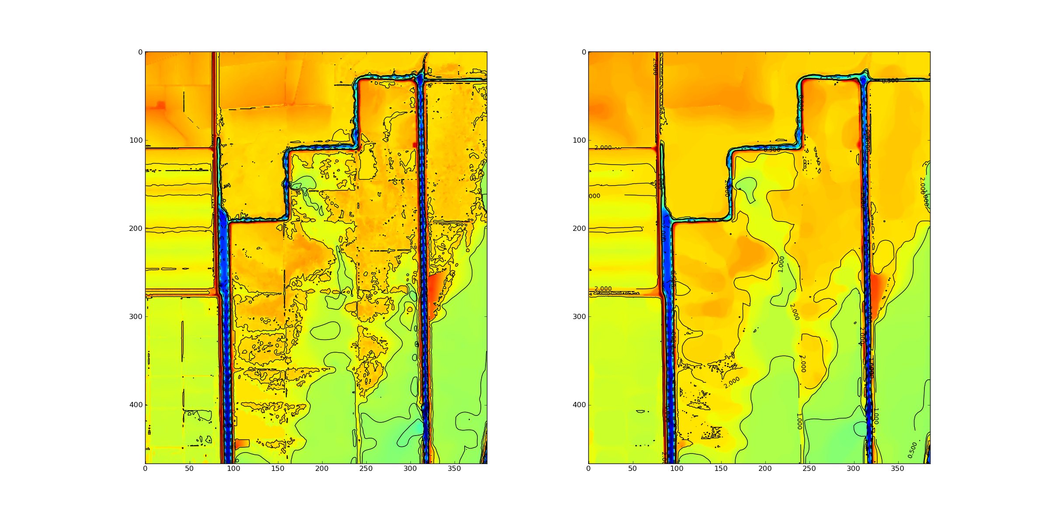
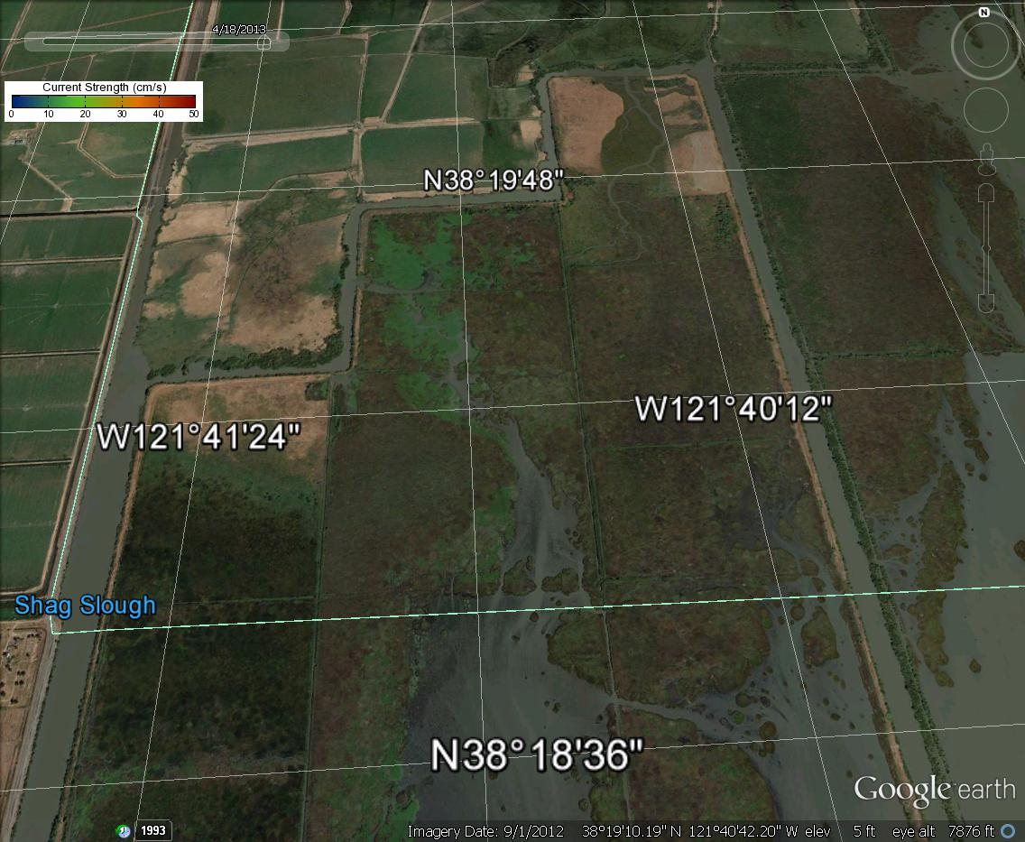
Liberty Island Smoothing:
Malladi and Sethian
Min-max curvature flow

Slide 8
Magic Contours
Foot/top of slope, thalweg
High-gradient zone in DEM for ‘features’
Shoreline and probable “real” water levels
Important for wet/dry; always grid ‘conservatively’ to account for interpolation ‘error’ (e.g., use 0.5m instead of 0m, or use ArcGIS to shift a distance away from the actual isobath)
Flooding and mudflats: may need an estimate of surface elevation, or just resolve well
Key features (jetty, breakwater…)
TVD (h_tvd) and other algorithm switches
Depths used in friction and other user threshold choices

Slide 9
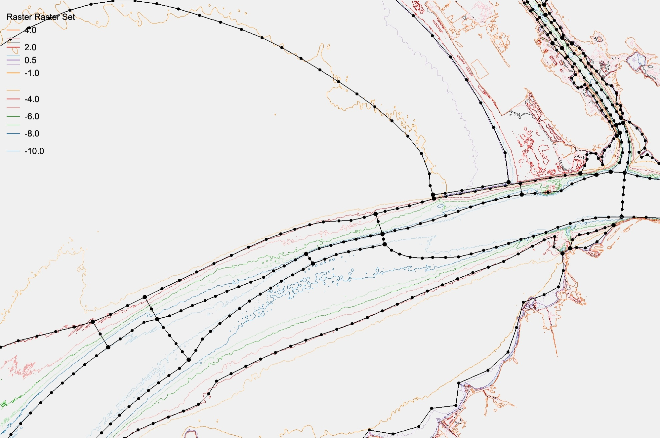
Tidal range
Shoal
Channel
Ship channel
Skew elements
h_tvd = 5m,
Water elev ~ 0.5m
so -4.0 NAVD contour mostly non-TVD

Slide 10
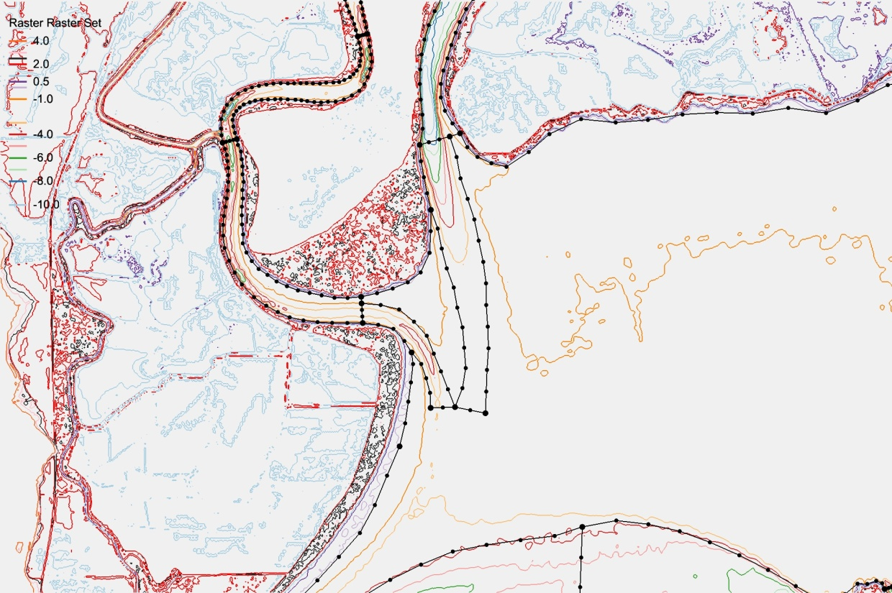
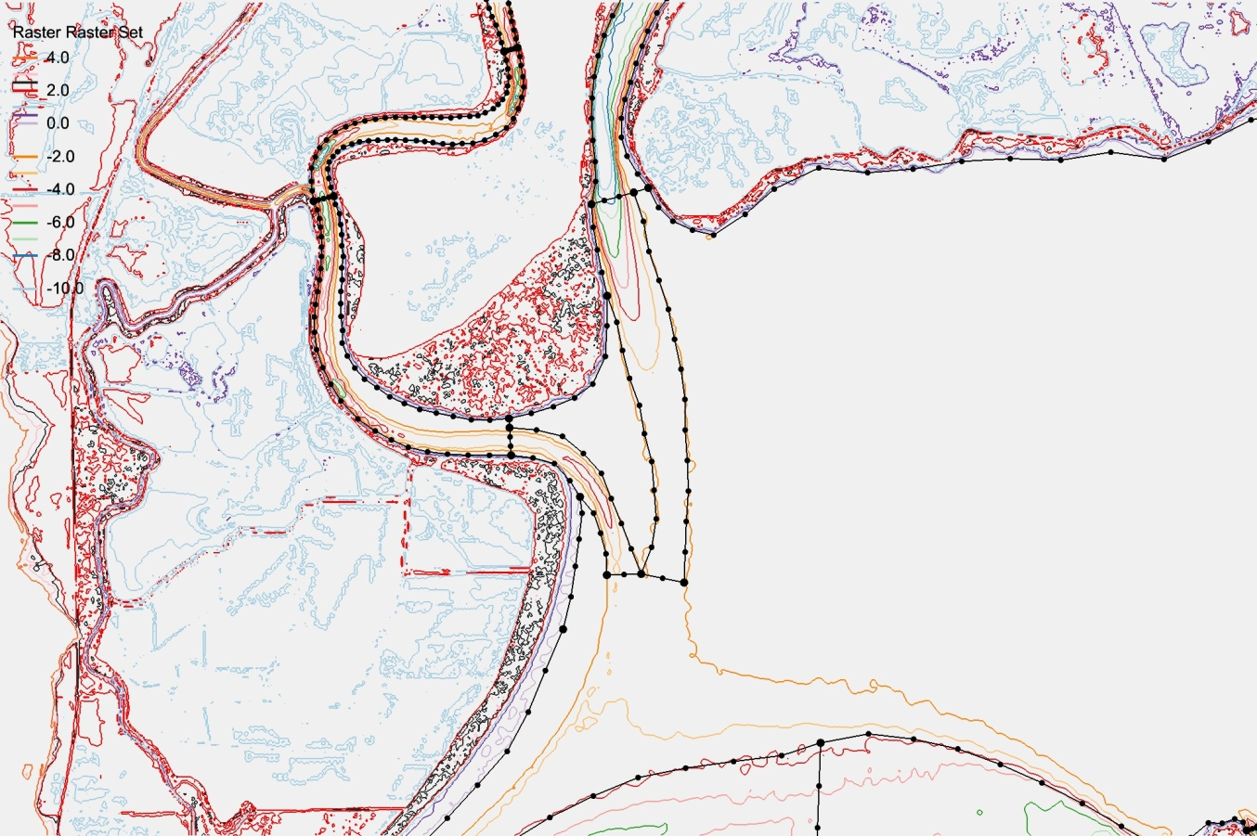
Choose Connected Contours
SMS works best with closed polygons
If you have to use ‘hanging arcs’, you may consider improving grid quality a little afterwards (e.g. xmgredit has spring)
Well resolved without help
Changing from -2 to -3m increases connectivity
No need to be religious about following contours exactly

Slide 11
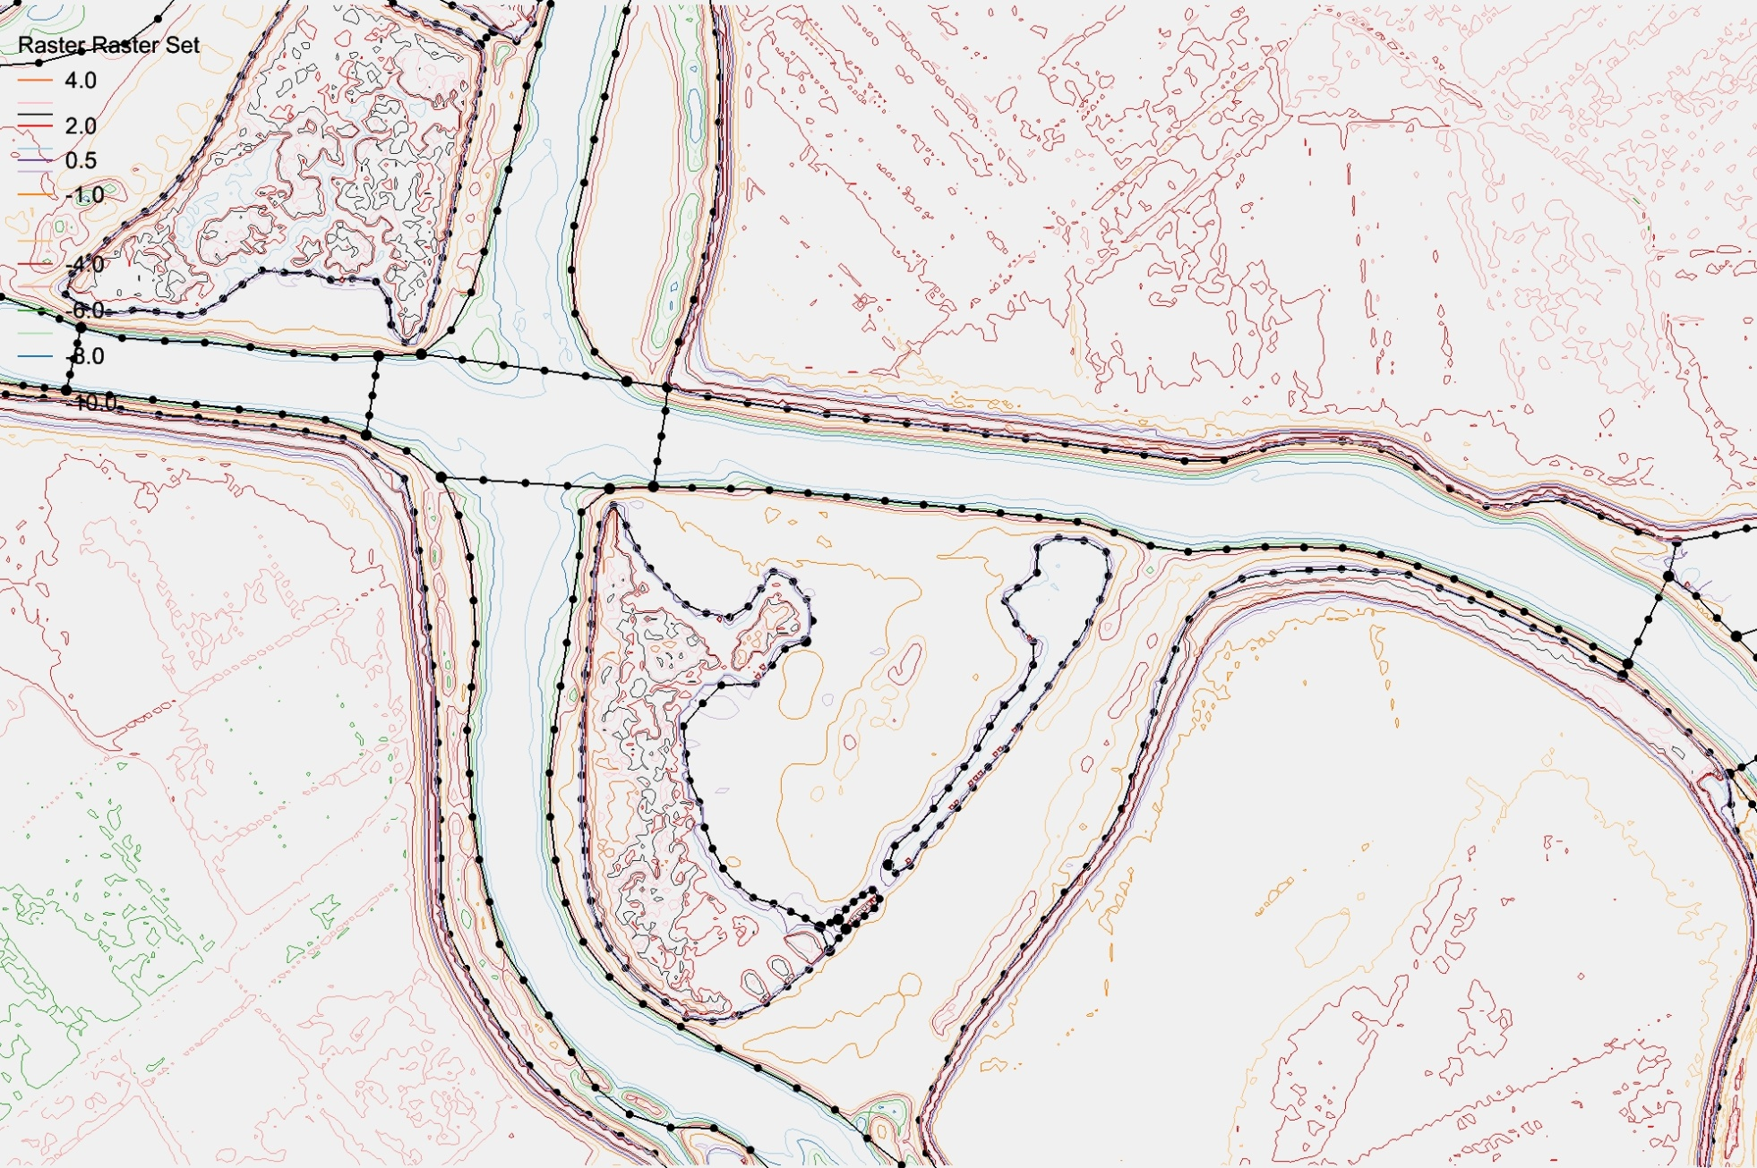
Stick with the center
Follows inner channel without help
Inner channel delineated
Ignores inner channel
Notes:
Right most arcs: have choice on whether to delineate both channel and boundary.

Slide 12
Grid Density
Need guidance from inverse CFL>0.4
Start from a smallest expected Δt (e.g., 100s)
Use CFL>0.4 to back calculate the coarsest Δx at a given depth
Deeper regions generally coarser than shallows but not always (compare this with explicit models that are constrained by CFL)
Often channel needs to be resolved for tracer transport
Curvature should be resolved:
2D: bend in shorelines
3D: changes in slope (vertical grid plays a role)
Width of features (sills, beaches, channels)
Skeletonization algorithms (see Per-Olof Persson dissertation)

Slide 13
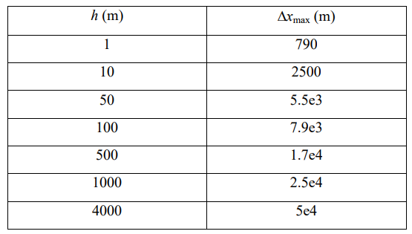

Grid resolution Guide
Δt=100s (expected minimum*)
$$≤$$
Remember to refine grid if for some reason you have to reduce Δt
Small patches of violation is fine especially near shoreline; avoid it in large open area

Slide 14
Wetting and Drying
Element-based designation
Based on node elevations
All 3|4 wet => wet element
No partial wet/dry
Velocities calculated on edges of wet elements

Slide 15
Always wet
Clogged
Clogged or narrow
Robust!!
Mildly inaccurate: wrong contour?
With SCHISM you can faithfully represent channels (and other features), thru good choices of horizontal and vertical grids
In estuarine and near-shore applications, faithful representation of bathymetry and features is the right approach, as opposed to artificial manipulation of bathymetry

Slide 16
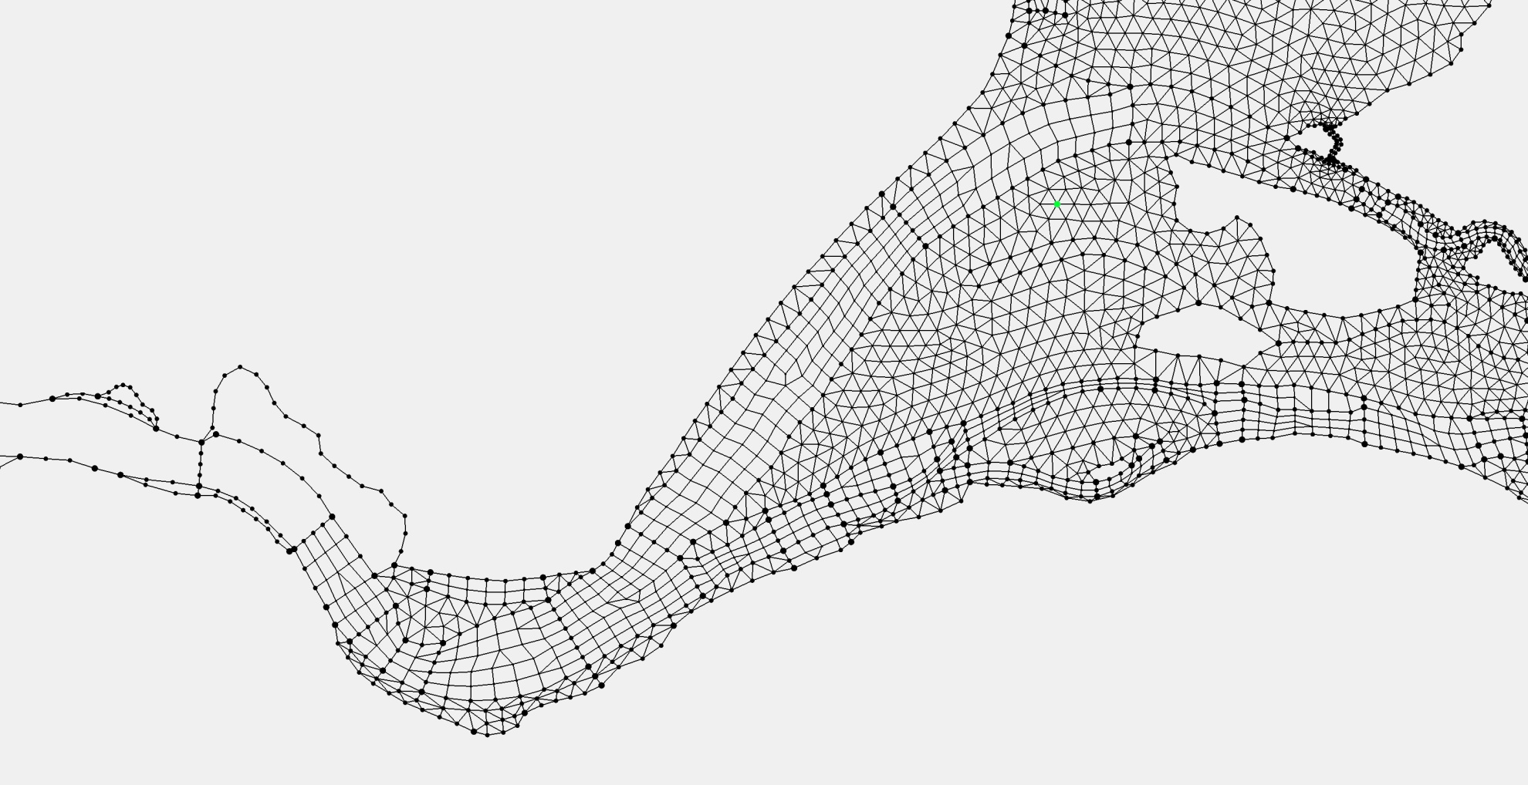
Patching and Paving
Newer versions of SMS are more forgiving with patches
Remember to check quality for quads in gredit5 (otherwise you may get an error from backtracking..)
Pave
Patch

Slide 17
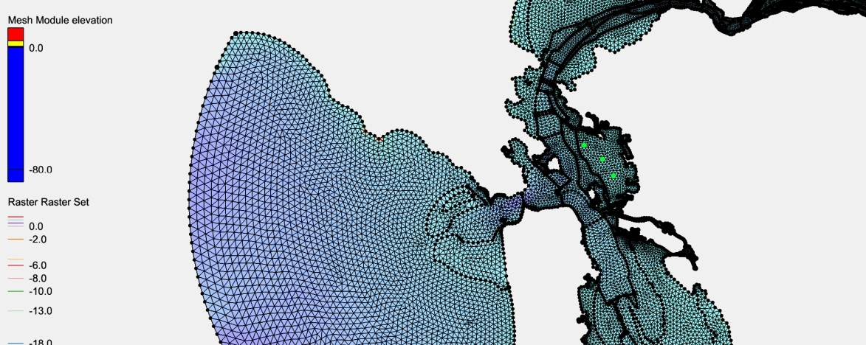
Patch vs Pave
Pave:
Recommended for quality grids on large, well-resolved water bodies
Works well when polygon is big and wide compared to arc nodes
Most robust of all methods
Resolution harder to control in the interior
Patch
Usually used for channels or other regularly shaped structures
Gives you better control on interior resolution

Slide 18
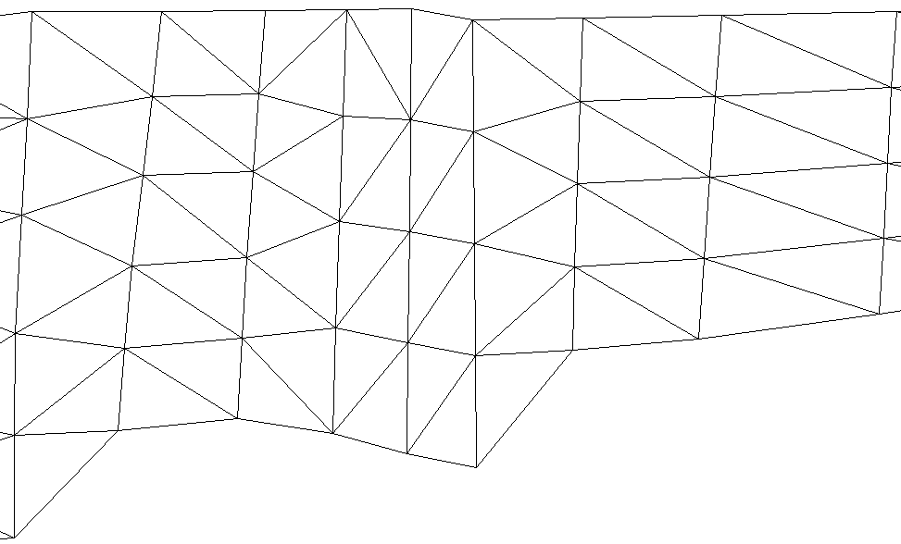
Hydraulic Structures
Q
Faces
1
2
1
1’
2
2’
3
3’
4
4’
5
1-1’ etc are node pairs
5’
“Block”
Patches are natural choices here…

Slide 19
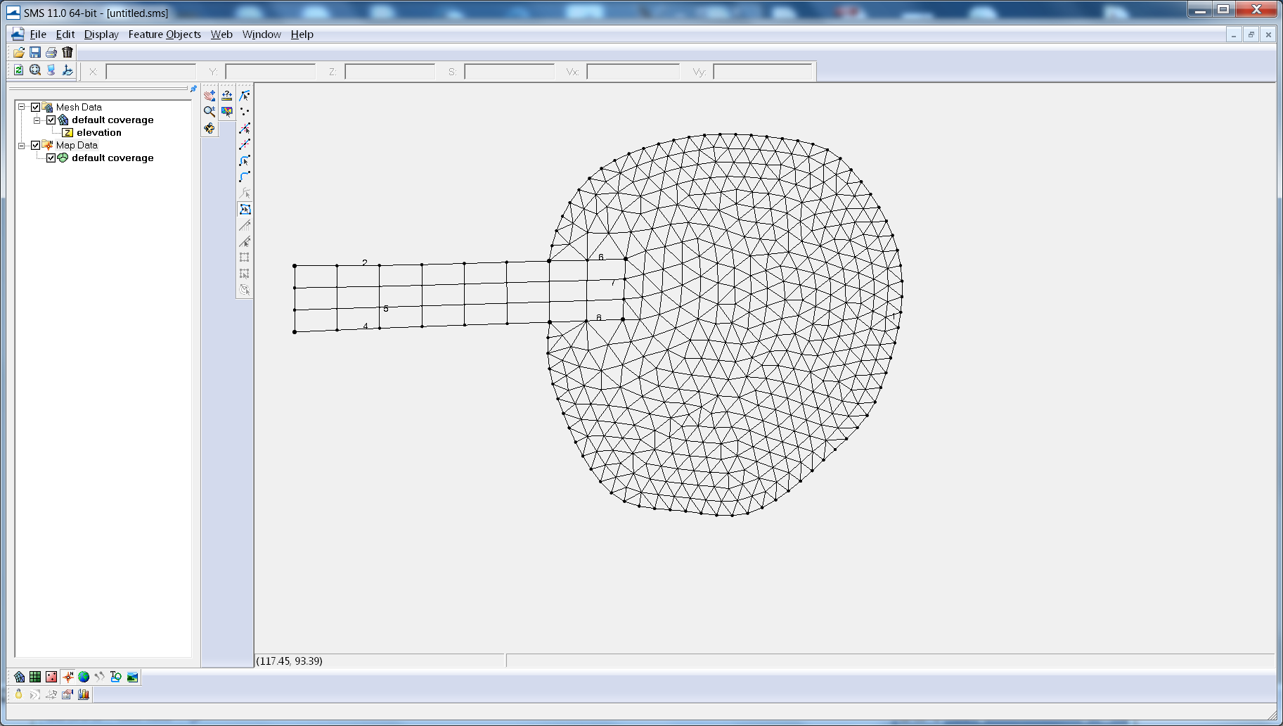
Dovetailing Patch and Pave*
*These ideas not unique to patch/pave
*Note the change in effective resolution…

Slide 20
Populating Elevations
Big problem again … SMS doesn’t hold the data gracefully
Have heard of people doing it in stages
Can use stacked_dem_fill.py, which:
Populates with correct georeference
Matches contours
Uses prioritized DEMs
Gives some warnings
We have FORTRAN scripts for loading very large TIN (UG) or raster DEMs
We always use linear interpolation (consistent with SCHISM’s shape function), without any smoothing
You should really visualize the bathymetry immediately after G.G.; correct mistakes (e.g. blocked channels) immediately

Slide 21
Metrics
Volumetric error (actually, average height)
Patterns can be systematic
This can be significant in minor channels: ‘greedy gridding’
Face/edge aperture or area
Storage area
Skew: SCHISM very tolerant, but good to look (if you use xmgredit5, try skewness of 14)
Need to use quality quads (xmgredit5: angle ratio >0.5)
Area change: SCHISM very tolerant, but good to look
Slope: PGE issue usually not a problem (vgrid and parameterization play a role also)
Local error: Richardson extrapolation
Painful without tools
TVD² and sub-cycling measures (fort.17; dtbe outputs): less of a problem with TVD²
Eddying regime requires more uniform and higher-quality grid to avoid distortion of eddy dynamics
CFL (>0.4)
Xmgredit5 can easily check CFL for you
Dimensionless wave number may also need to be looked at

Slide 22
TVD tuning
(Vertically) implicit TVD² alleviated much of the pain
There is also a “hidden” dtbe visualization option (USE_ANALYSIS) which you can use to find subcycling ‘hot spots’
As a rule of thumb, transport time step of 5-10s range is reasonable

Slide 23
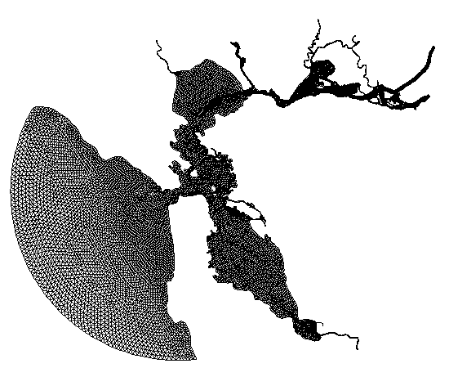
Common Ad Hoc Fixup Steps
Deepening of boundary depths to prevent open boundary from becoming dry
There is a fancier approach to preserve the original depth using bed deformation module or point sources
In gredit, create a region and depth=max(depth,3)

Slide 24
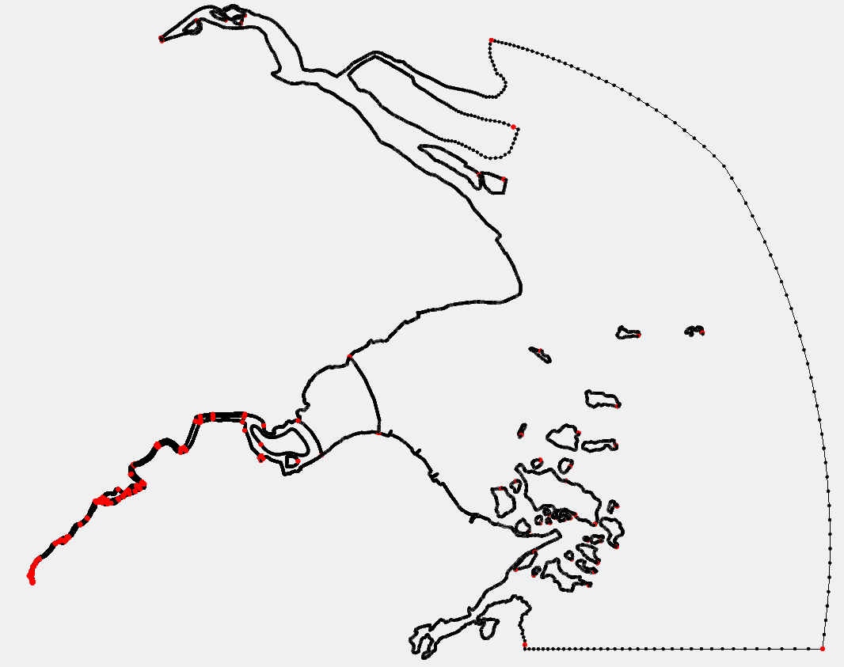
Gridding shallow systems
Hangzhou Bay
Qiantang River

Slide 25
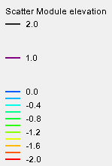
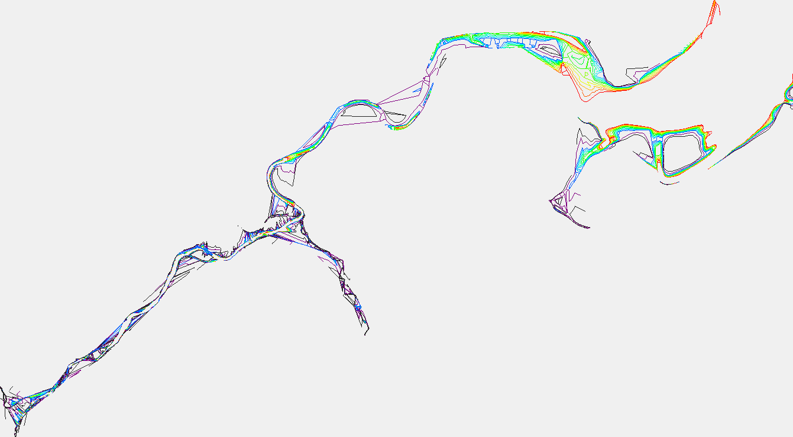
Qiantang River
Big portion of the river is above MSL!

Slide 26
Gridding strategy
From observation we know that the channel rarely dries up, as the surface elevation is 1-2m above the bottom
In the model setup, we can specify a non-zero i.c. for elev; e.g. we know from observation that the elevation in the upper most stretch of river is ~3m above MSL, so we can use η=3.2m everywhere as elev.ic (including the ocean part)
Then we gradually ramp down the elev toward η=0 at the ocean boundary
System response is barotopic and fast
Set nramp_elev=1 so the model will ramp down from elev.ic
During gridding, capture the ‘below MSL’ portion of the channel in the lower part of the river first
Be game in resolving narrow channel!
In the upper stretches where the bottom is mostly above MSL, it’s up to you whether to skip the details of bathymetry during gridding
At the river inflow boundary, you may dredge a small region to let water come in. The model will set up the surface slope automatically

Slide 27
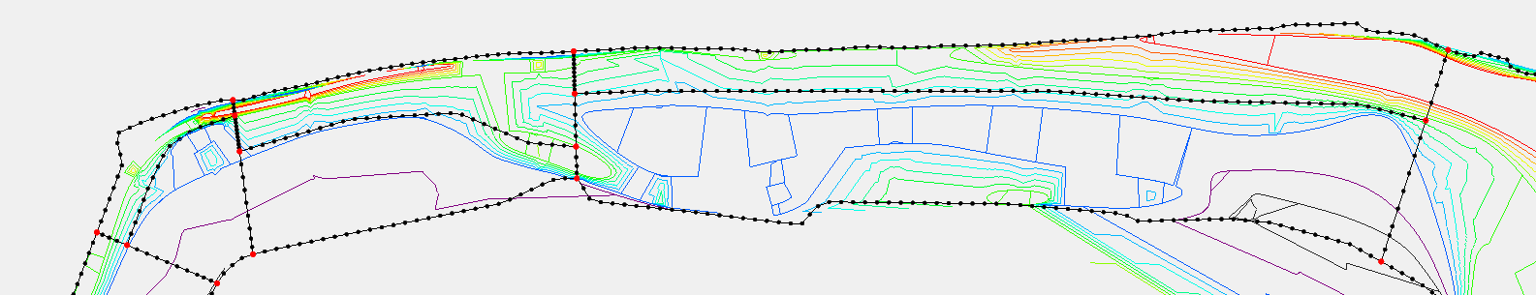
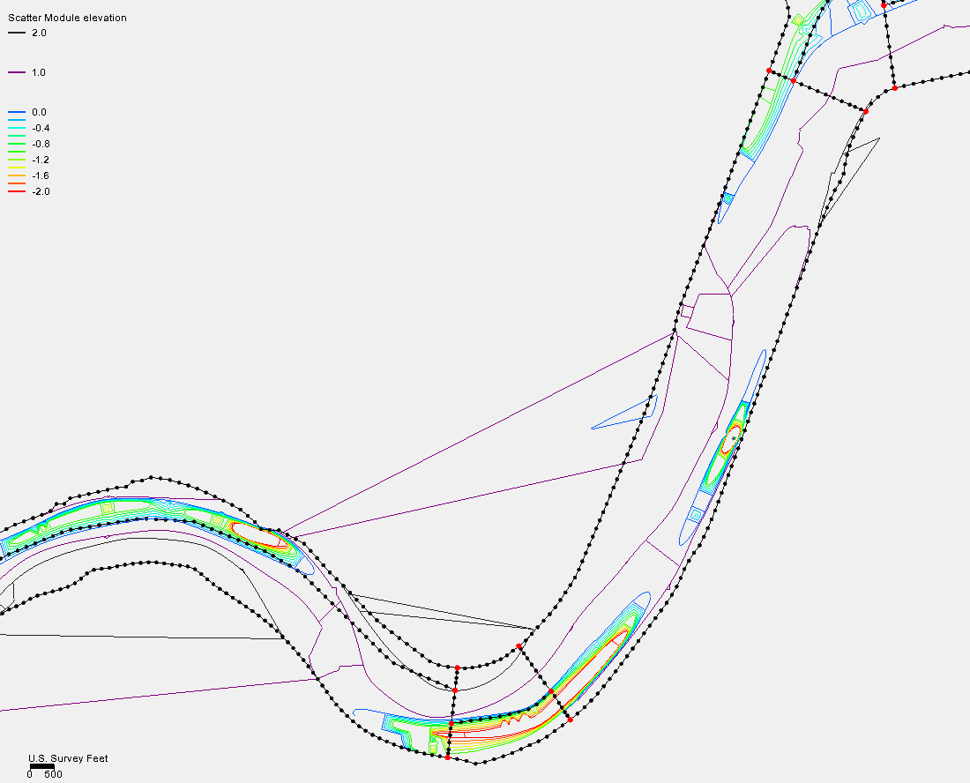
Gridding strategy
Lower river: channel can be delineated
patches
patches
paving
paving
Don’t be timid in resolving the narrow channel!
(Actually the model may misbehave without this)
Upper river: your choice (but try to resolve)

Slide 28
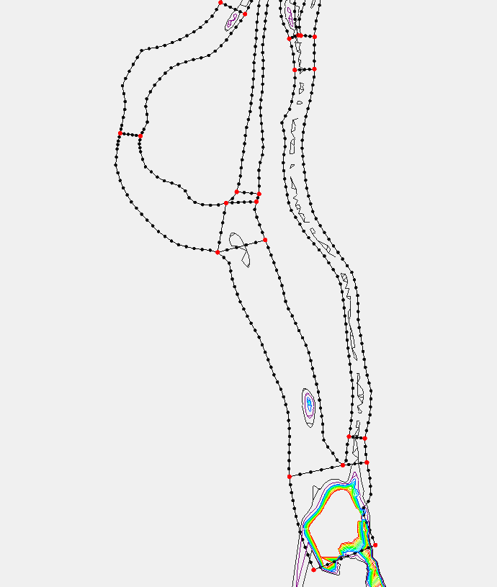
River inflow boundary
* Alternatively, use point sources
Dredged area

Slide 29
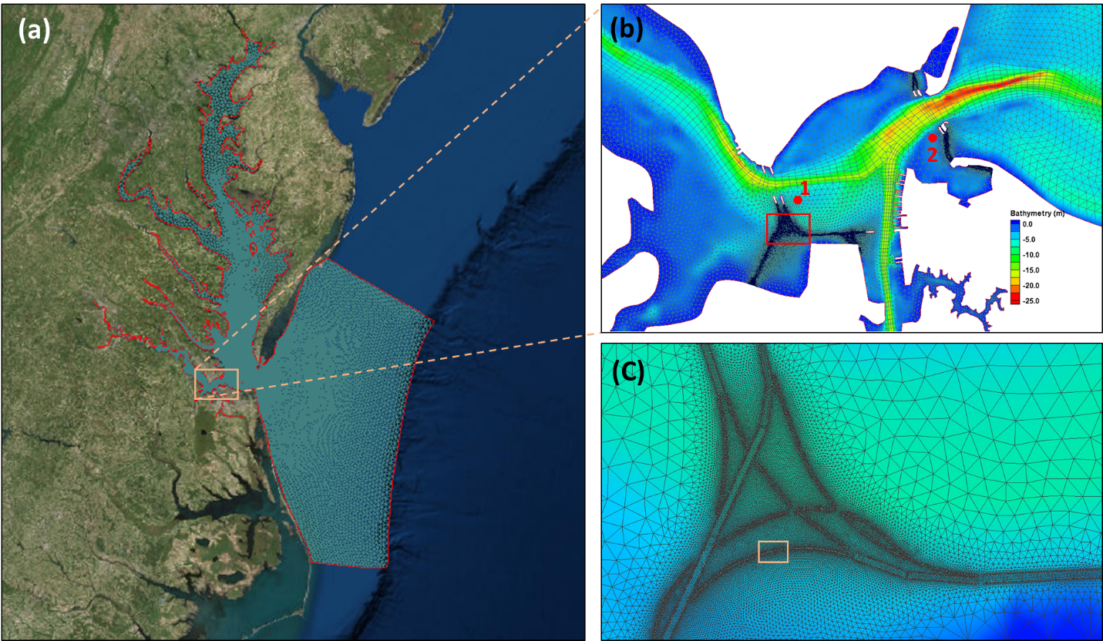
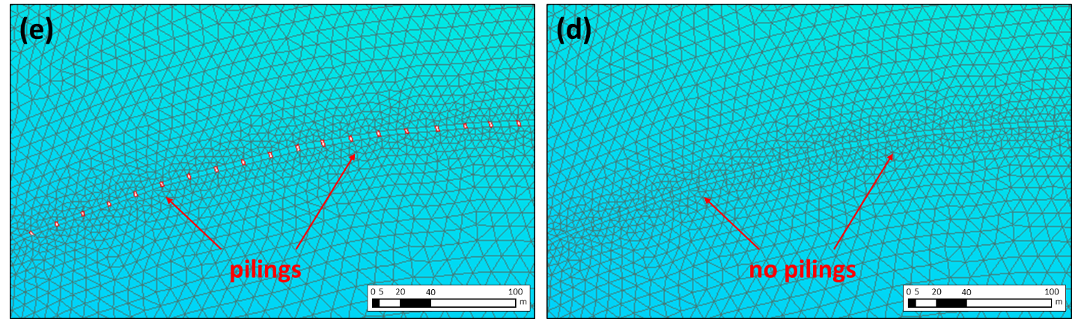
Bridge piling
~1800 bridge pilings in lower Chesapeake Bay, 1-2m in diameter
Used ArcGIS to export shape files for all pilings into SMS
Time step of 120s (efficiency)
Liu et al. (Ocean Dynamics 2018)

Slide 30
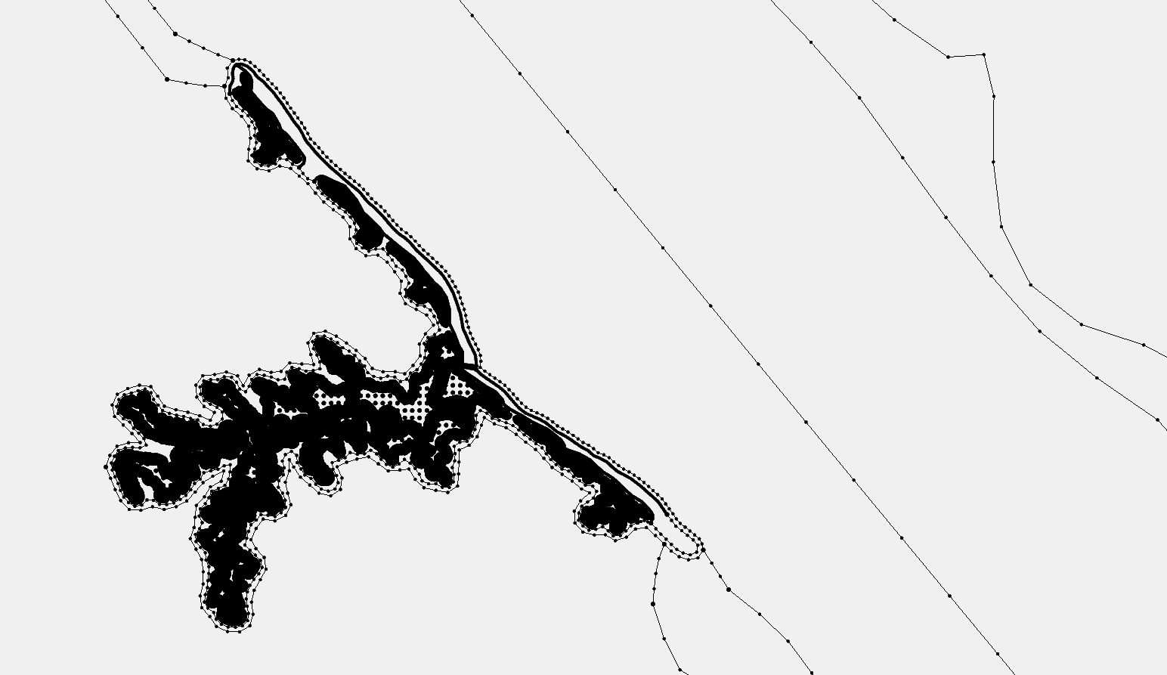
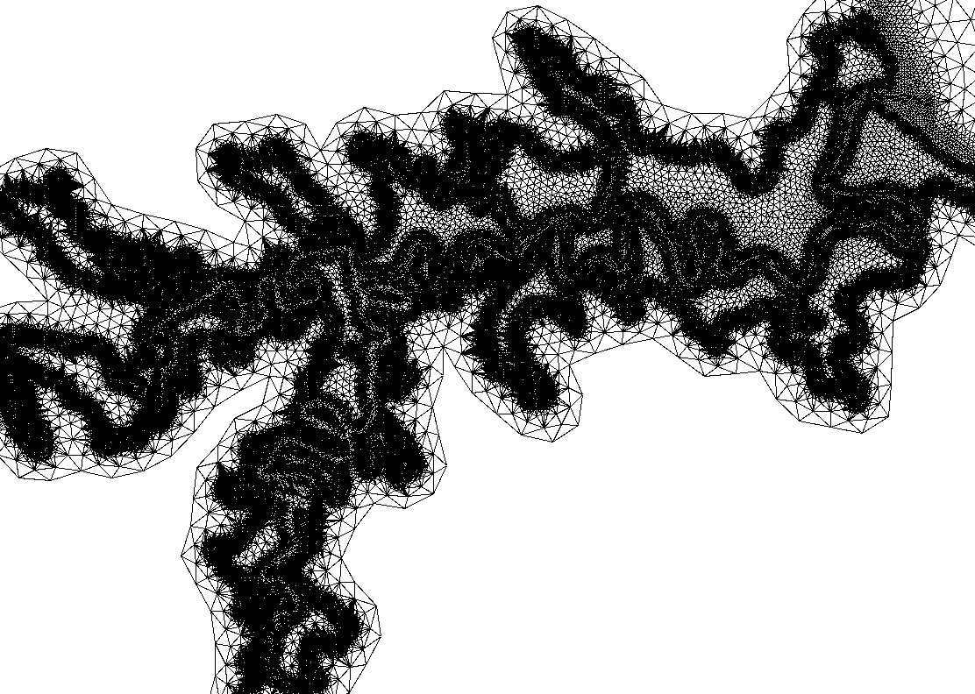
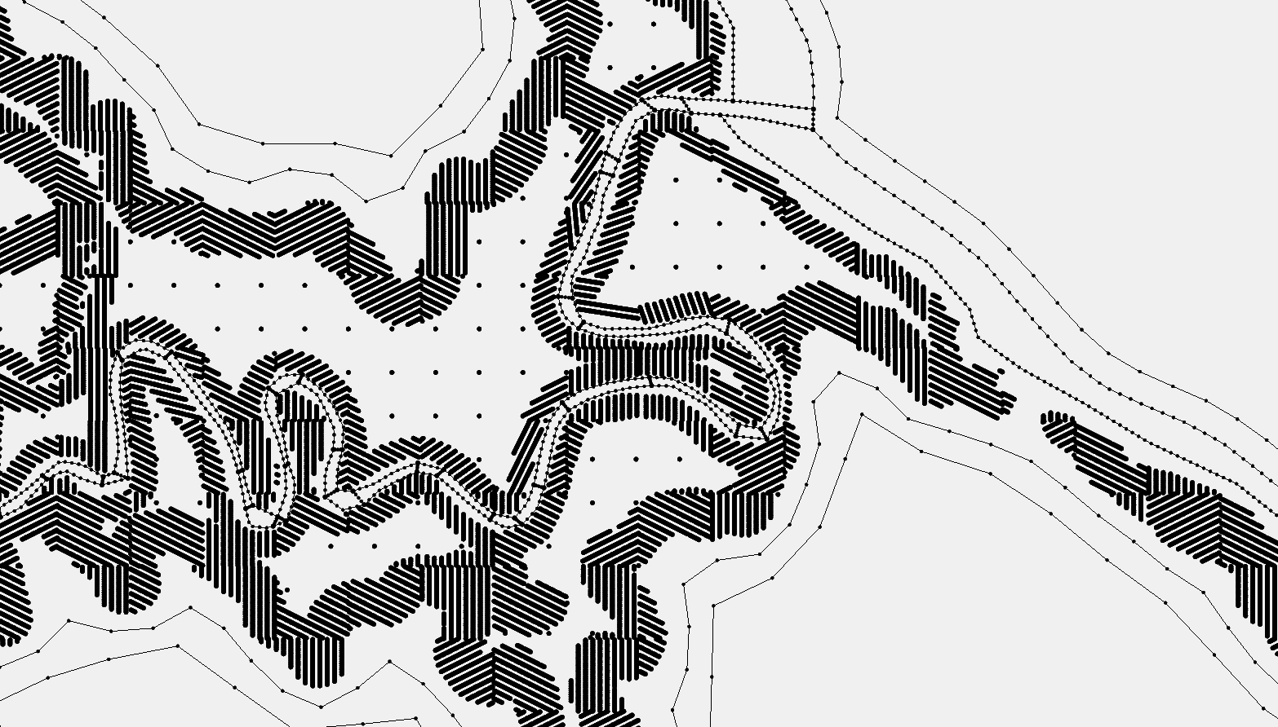
Marsh
Marshes need super high resolution (~1m)
Use ArcGIS to generate ‘marsh points’
Import into SMS as feature nodes
Set a very small tolerance (1.e-6m)
Skew elements are generated, which is fine with the model (including WWM, SED3D)

Slide 31
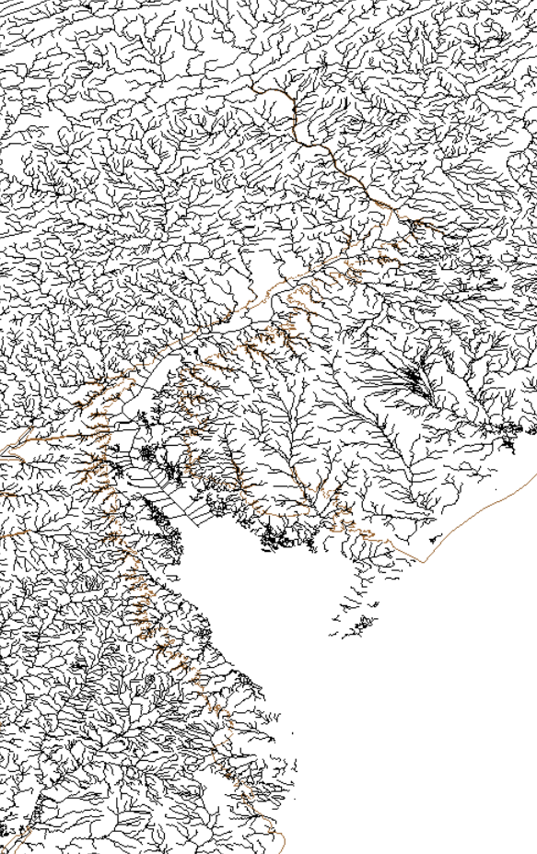
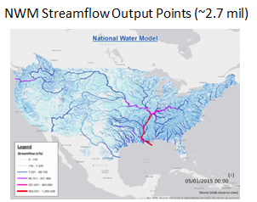
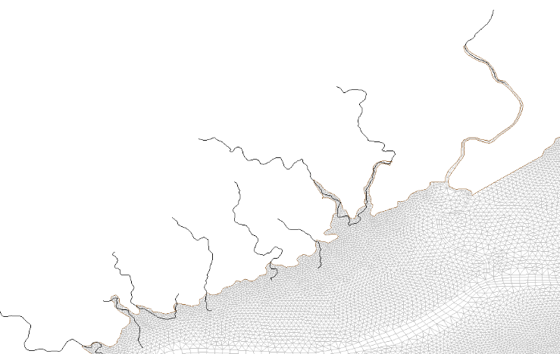
Coupling to watershed model: the Delaware Bay case
Coupling SCHISM to National Water Model (NWM) for compound flooding problems
Need to resolve small creeks to facilitate water delivery from NWM
Inject flow at all intersections between NWM segments and SCHISM’s boundary
Segments that intersect
the land boundary
NWM segments
SCHISM boundary

Slide 32
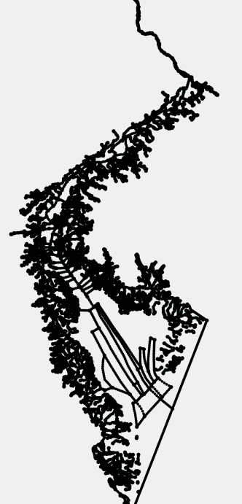
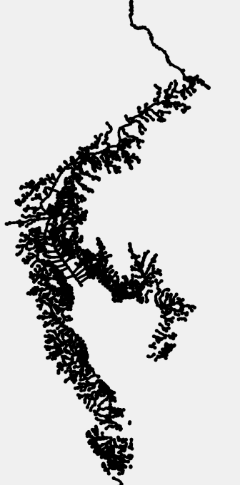
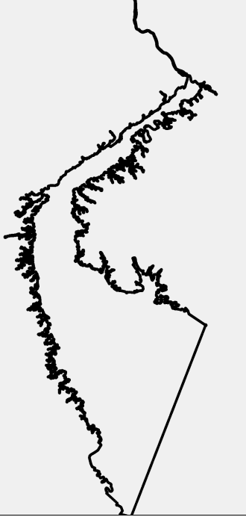
Grid Generation for DE Bay
Combine shapefiles and the grid boundary (@-10m) into a single map
Add main shipping channel that is missing from NWM
NWM shapefile
Exterior boundary
(10m above MSL)
+
=

Slide 33
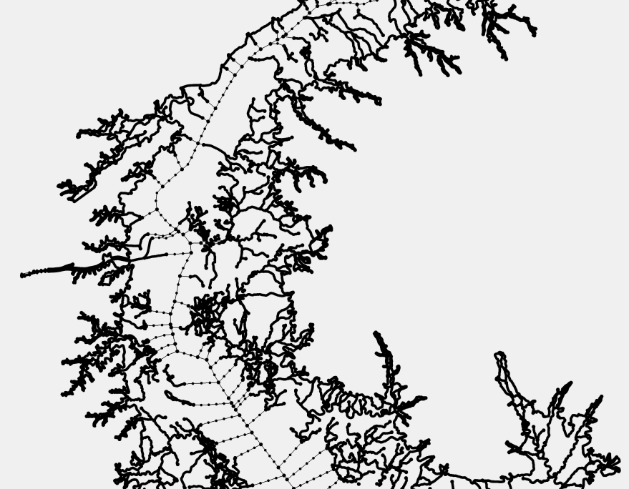
Final SMS map
Tolerances in SMS seem important
SMS picky at some arcs being close to each other

Slide 34
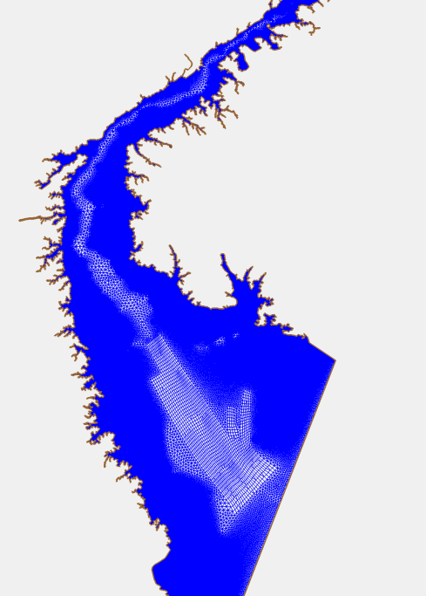
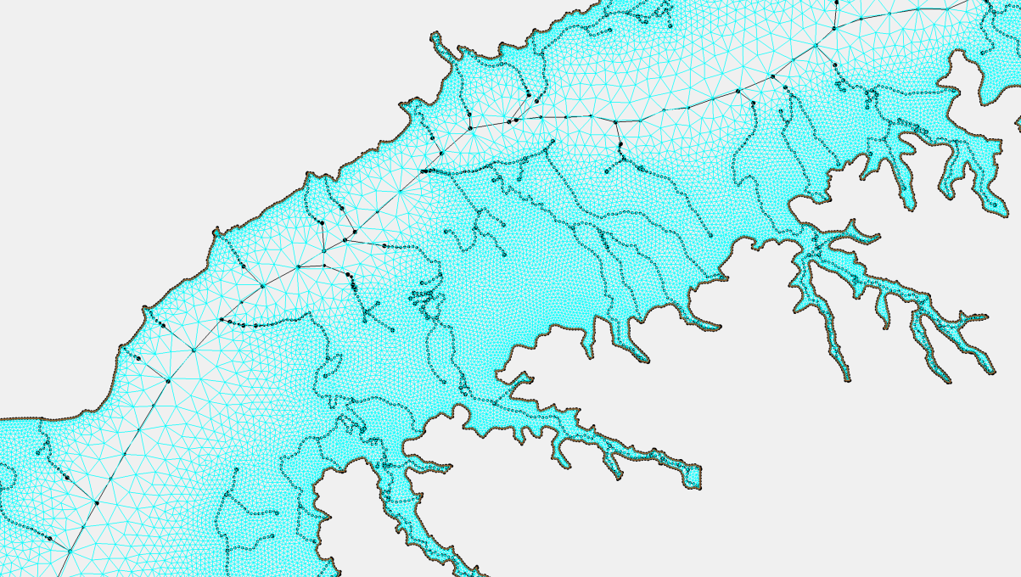
Final grid
Some skew elements are generated because some arcs are close to each other
We can leave them as they are (SCHISM can handle) or use our tools to smooth out the transition a little (without touching the main channel)
Aligning main channels manually – this took a few hours only
This ensures accuracy and proper propagation of tides into the estuaries

Slide 35
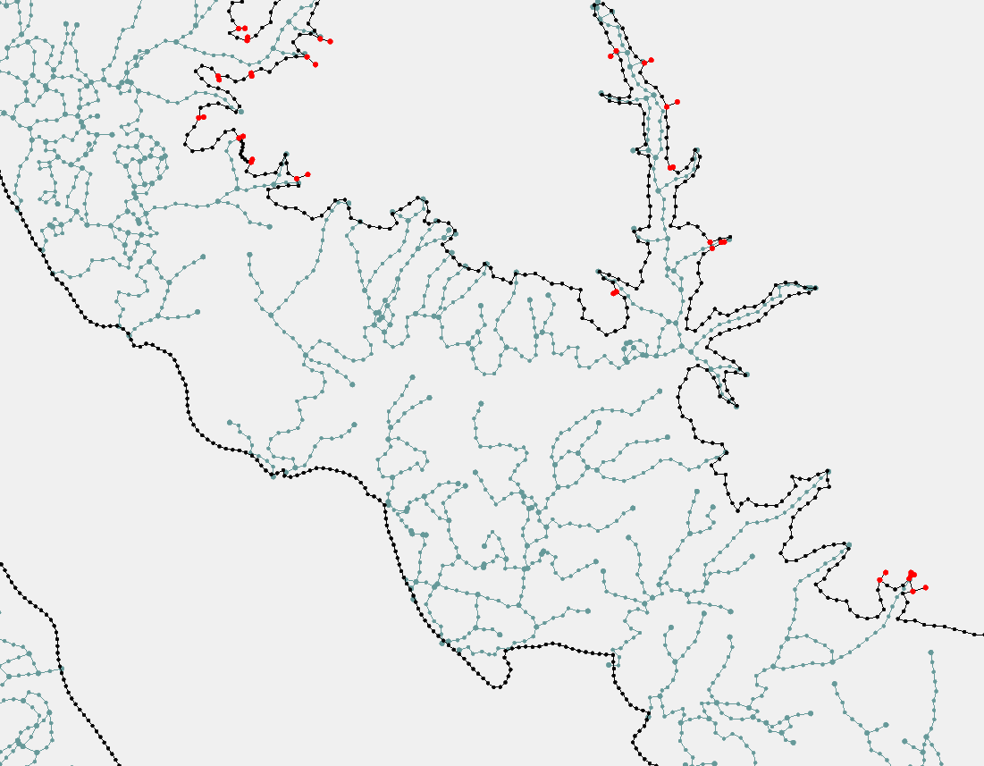
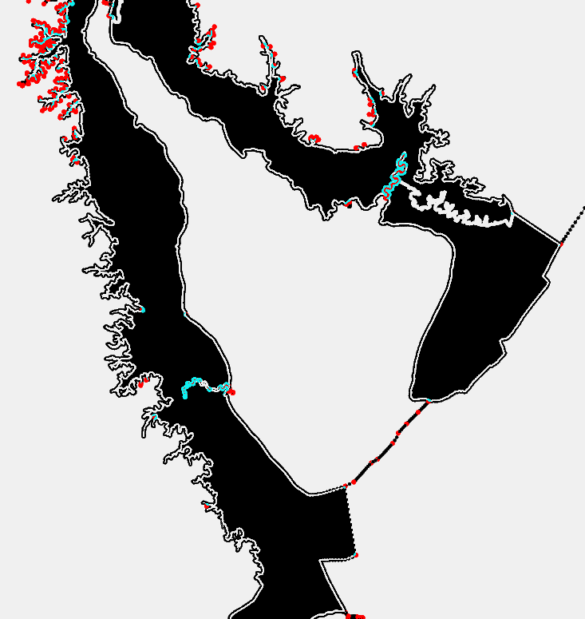
Extend to larger extent (US east coast)
Workflow
Extract domain exterior boundary (@-10m)
Extract shoreline
Form polygons between (1) and (2); optionally leave a buffer between polygons
In ArcGIS, clip NWM segments that are outside the polygon
Manually add major channels
Best to do in stages, one estuary at a time to make steady progress
boundary
shoreline

Slide 36
Eddying regime
Eddying regime prefers quasi-uniform grid (bathymetry variation in deep ocean is mostly negligible)
Most challenging part is near steep shelf breaks
Always start from quasi-uniform grid and then adjust as needed

Slide 37
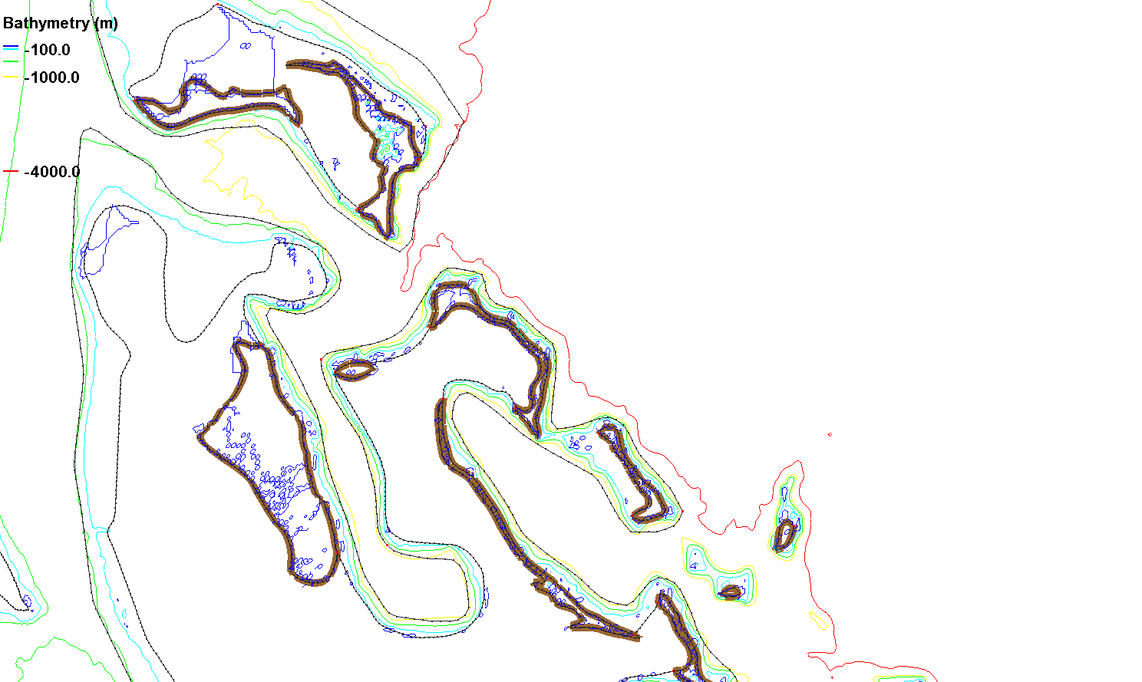
Non-eddying regime (shallow)
Caribbean islands
Use arcs to separate the non-eddying regime and the eddying regime:
Make sure the elements inside the eddying regime are nearly uniform;
Keep sharp transitions of element size inside the non-eddying regime
The very steep slopes require additional momentum dissipation
Eddying regime (deep)
Non-eddying regime (shallow)

Slide 38
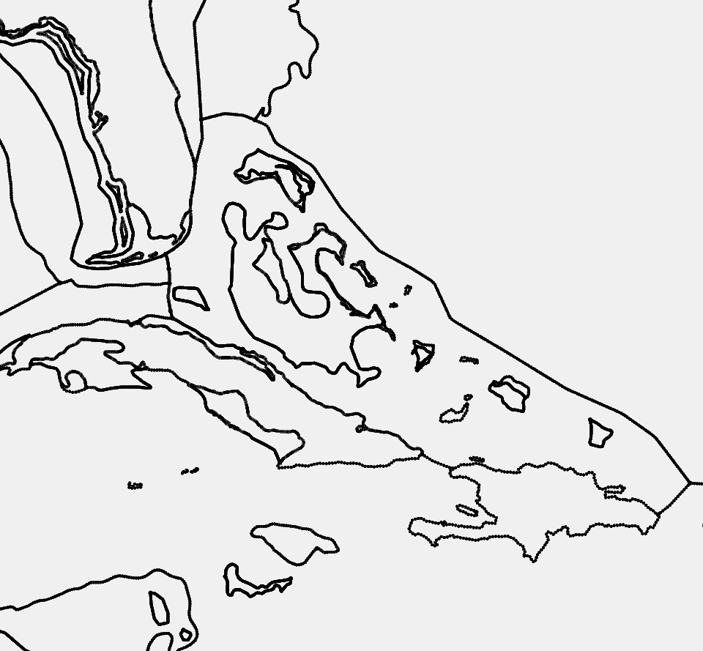
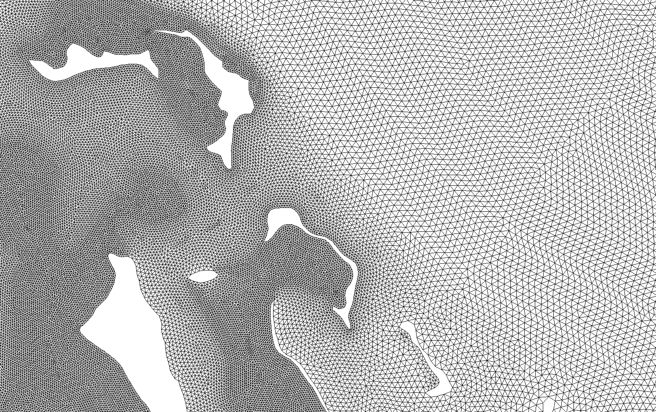
Bad grid
Size transition inside the eddying regime, which can distort meso-scale eddies and lead to unpredictable behaviors.
Unnecessary arc
* Need to delineate different regimes

Slide 39
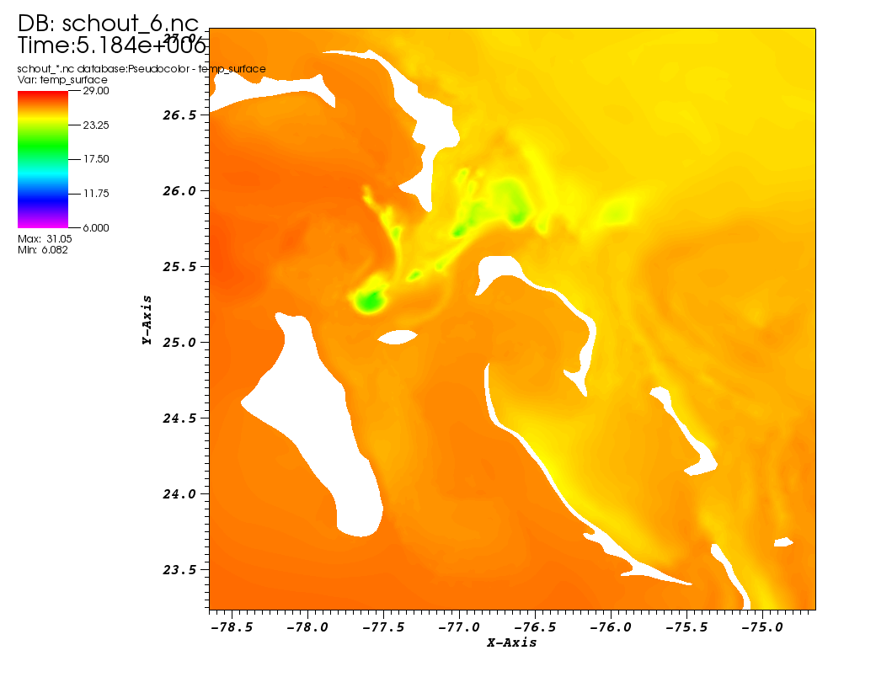
Spurious upwelling on a bad grid
(this type of spurious upwelling is persistent and easy to spot)

Slide 40
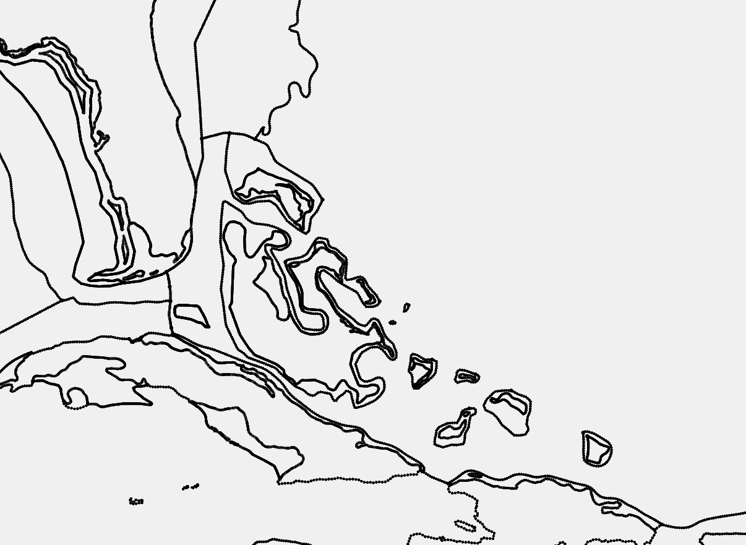
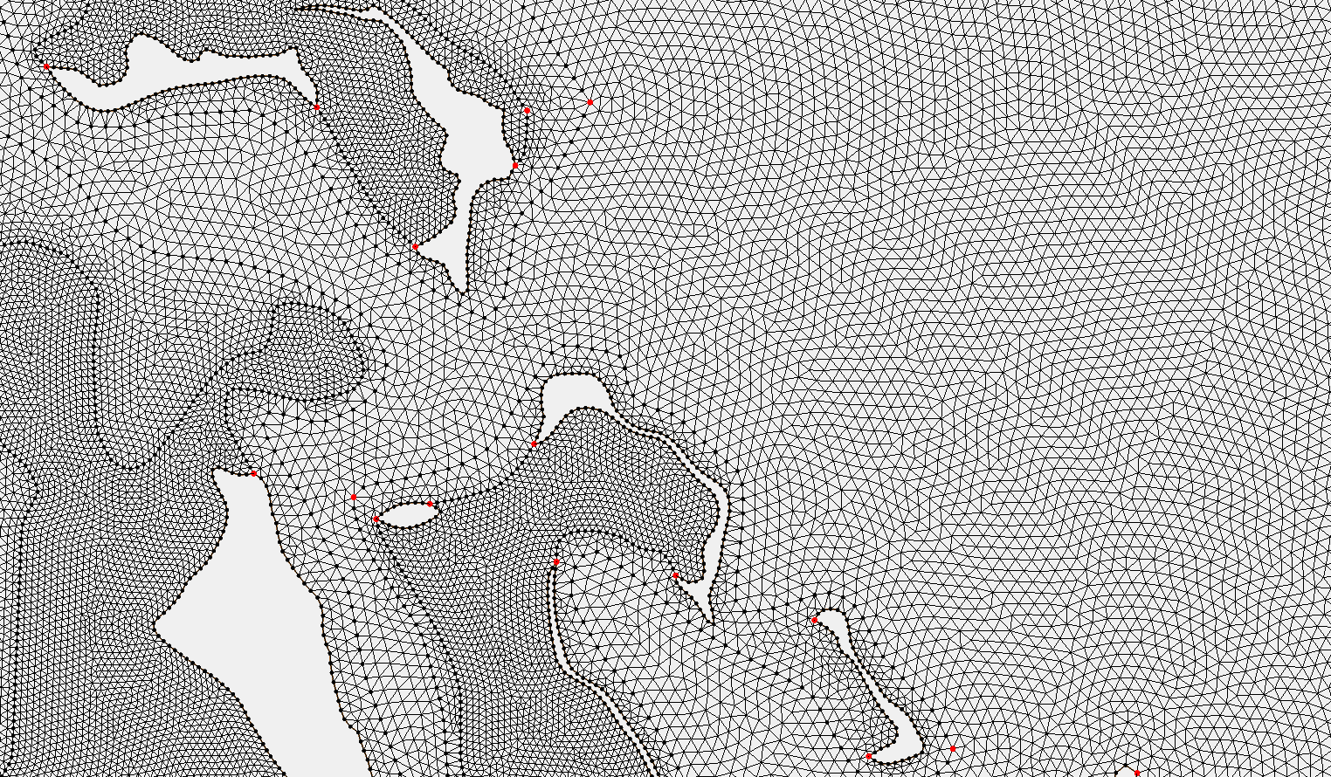
Good grid
Sharp transitions of element size only in the non-eddying regime
Mark the boundaries between 2 regimes (even though they are close)

Slide 41
Conclusions
SMS is an adequate tool for non-orthogonal grids used by SCHISM
Good grid generation resolves flow/bathy features faithfully
Some finer scales ignored if not resolved
Implicit FE model provides you with more freedom for resolution
Shape functions and wet-dry rules; understand the physics and numerics!
You can’t work on this stuff unless you can fix-test-fix-test
So front-end on node-based inputs (see BayDeltaSCHISM)
IMPORTANT: always start from an estimate of smallest Δt you anticipate for the application and use CFL>0.4 to back-calculate the coarsest resolution at each depth
If you somehow decide to reduce Δt later, you may have to refine the grid
As a rough guide, Δt=100-450s for b-tropic, 100-200s for b-clinic applications (however, smaller Δt might be needed for some extreme cases)

Slide 42
Conclusions (cont’d)
For shallow-water systems, resolve the channels (even if they are narrow)
Gridding upstream requires some understanding of how the model deals wet/dry (parameterization is important)
For eddying and transitional regimes, vary resolution gradually; delineate the boundaries with non-eddying regime
Skew elements are fine in non-eddying regime

