Slide 1
LSC²
Joseph Zhang

Slide 2
Start simple…
Start with simpler S or SZ vertical grid
  Often times you can get quite reasonable results with these
  Note that Z is always shaved
Move on to LSC²
  Like UG in the vertical, but with the benefit of a layered model
  Know your processes
  A good LSC² grid should
    Be ‘pleasing’ to the eye
    Have resolution where you wanted (vice versa)
    Minimize dissipation due to ‘degeneracy’: terrain-following has minimal dissipation
Improvise!
Notes:
Masking process unnecessary

Slide 3
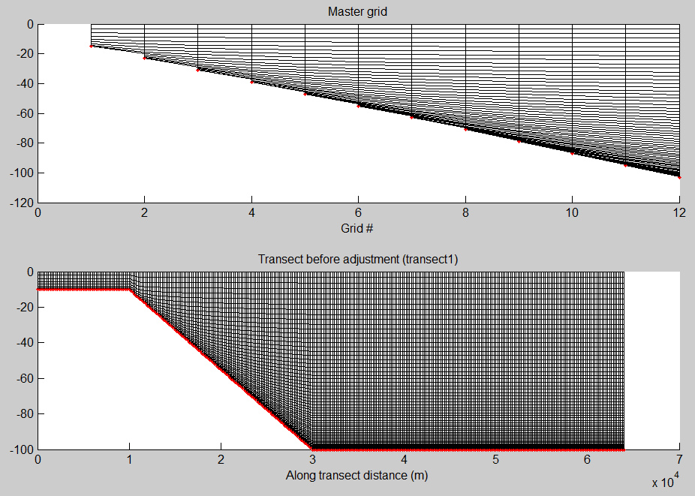
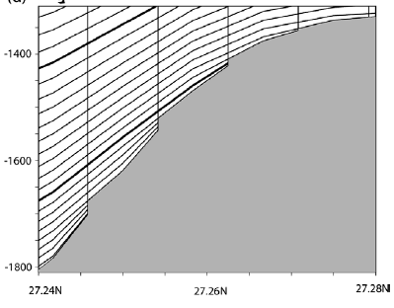
Vanishing quasi-sigma (VQS)
Dukhovskoy et al. (2009)
Procedure for VQS
Different # of levels are used at different depths
At a given depth, the # of levels is interpolated from the 2 adjacent master grids
Thin layers near the bottom are masked
Staircases appear near the bottom (like Z), but otherwise terrain following
Notes:
Masking process unnecessary

Slide 4
LSC²
Different # of levels are used at different depths
At a given depth, the # of levels is interpolated from the 2 adjacent master grids
Thin layers near the bottom are combined
Staircases appear near the bottom (like Z) are avoided by using shaved cells
Notes:
Masking process unnecessary

Slide 5
LSC²
At a given depth, find 2 adjacent masters
  If the depth is shallower than the 1st master, use terrain following with stretching
Z coordinates for the given depth are interpolated from the 2 adjacent master grids
Master
o
o
o
o
o
o
o
o
o
o
o
o
o
o
o
o
o
o
o
o
o
o
o
o
o
o
o
o
o
o
o
o
o
o
o
o
o

Slide 6
Thin layers
nodes
In LSC², thin layers are combined instead of masked
The parameter that controls the min layer thickness is dz_bot_min
Shaved cells are added whenever mismatches in # of levels between adjacent nodes occur
Shaved cells avoid staircases in Z, and are crucial for bottom controlled processes (salt intrusion, gravity overflow etc)
o
o
o
o
o
o
o
o
o
o
o
o
o
o
o
o
o
o
o
o
o
o
o
o
o
Combine
o
o
o
o
Shaved cells

Slide 7
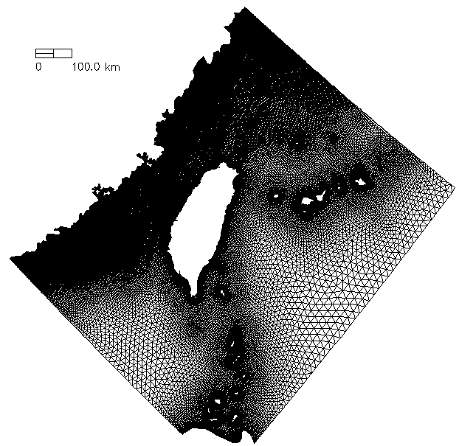
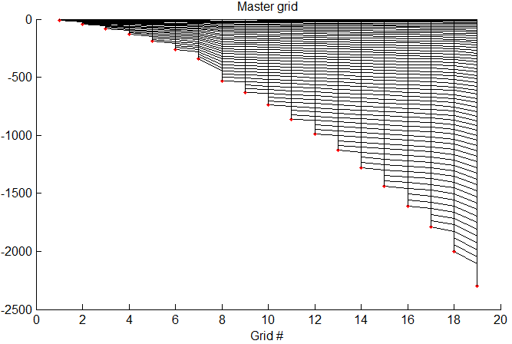
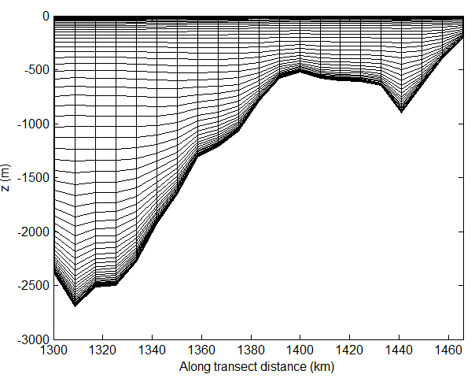
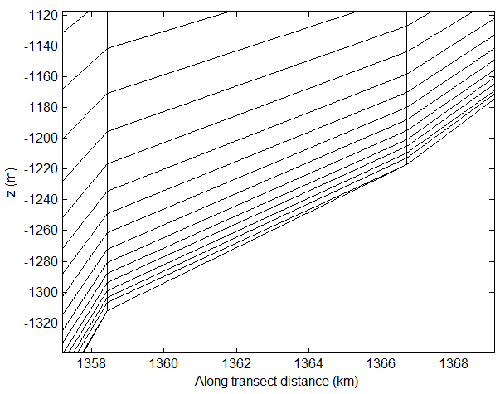
LSC²
Final LSC² grid, as seen from a transect
To get a comprehensive view of the 3D grid, combine as many transects as you wish – plot_VQS.m will plot out all (x-axis is along-transect distance)
Degenerate prism

Slide 8

What to do with the staircases?
A
u
u
P
1
B
2
R
Q
1
2
LSC²= Localized Sigma Coordinates with Shaved Cells
(ivcor =1 in vgrid.in)
*No masking of thin layers (c/o implicit scheme)

Slide 9
Staggering of variables
3D computational unit: uneven prisms
Equations are not transformed into S- or σ-coordinates, but solved in the original Z-space
Degeneracy is easily handled when viewed from a node/side/element
A
n_{k}
n_{k}
k (whole level)
k
N_{z}
P
η
N_{z}-1
u_{j,k+1} v_{j,k+1}
η
B
…….
u_{j,k+1} v_{j,k+1}
R
Q
C_{i,k}
k
k-1
C_{i,k}
1
…….
k-1
k-1
w_{i,k-1}
2
w_{i,k-1}
k_{b}+1
k_{b}

Slide 10
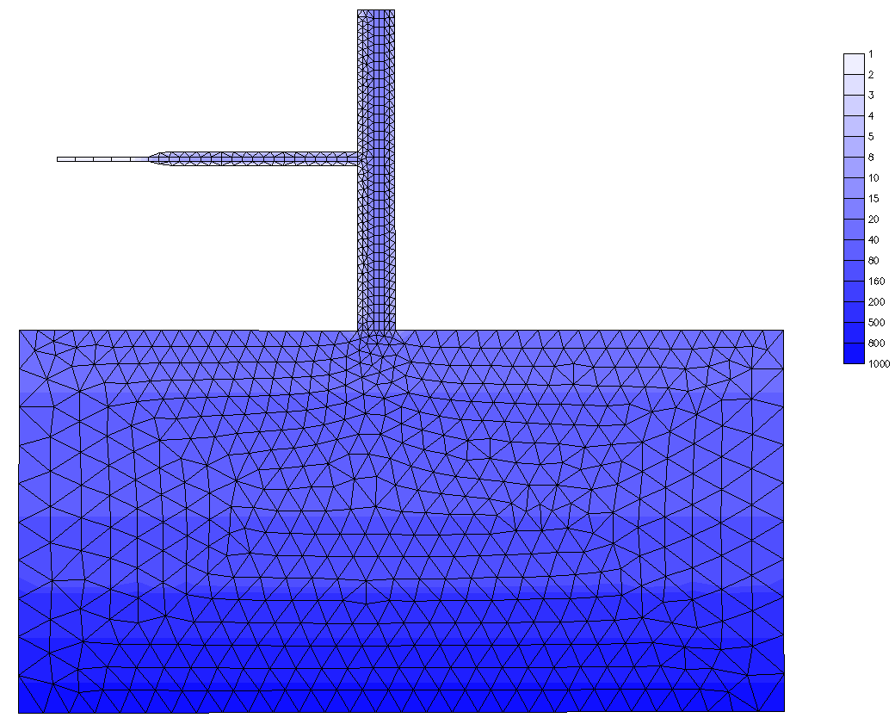
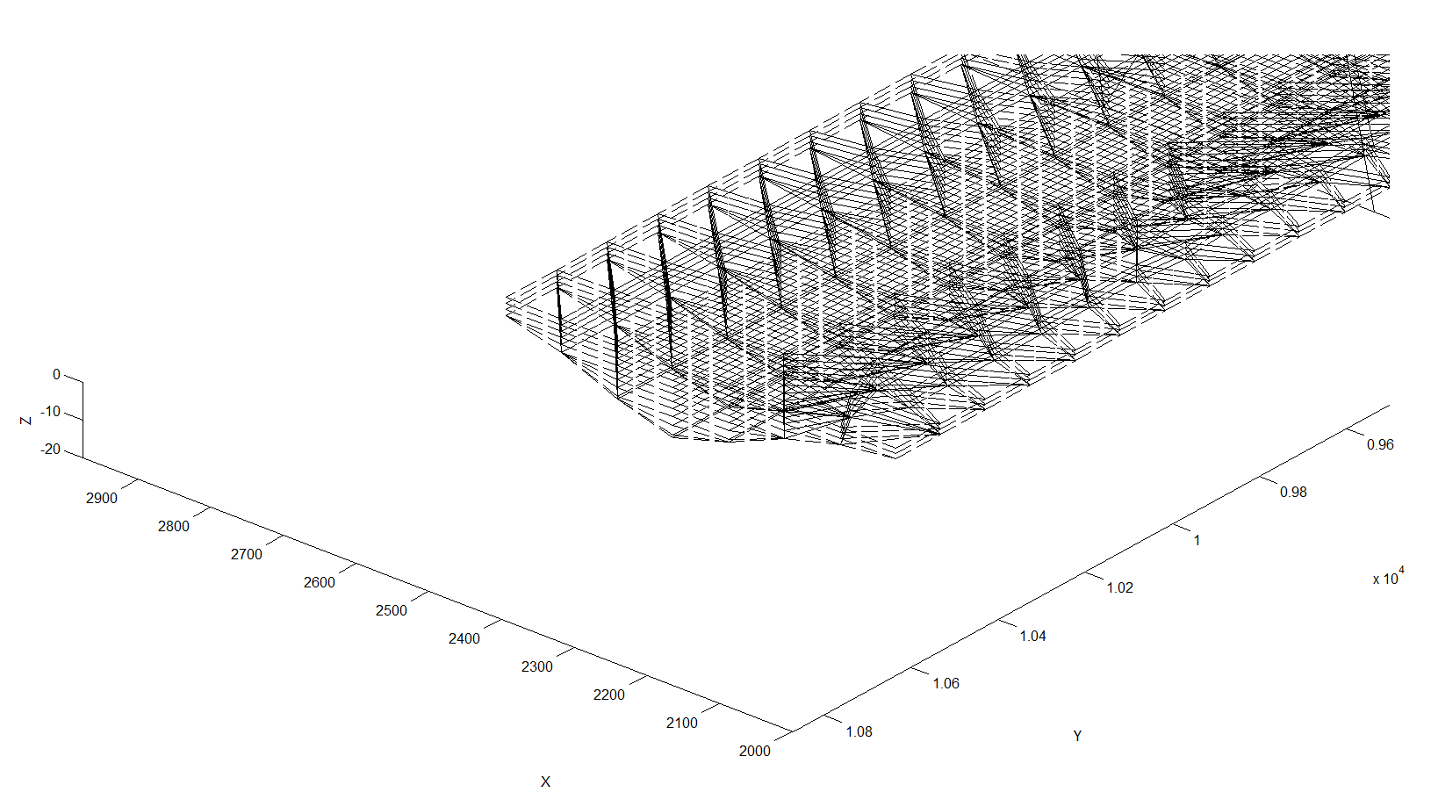
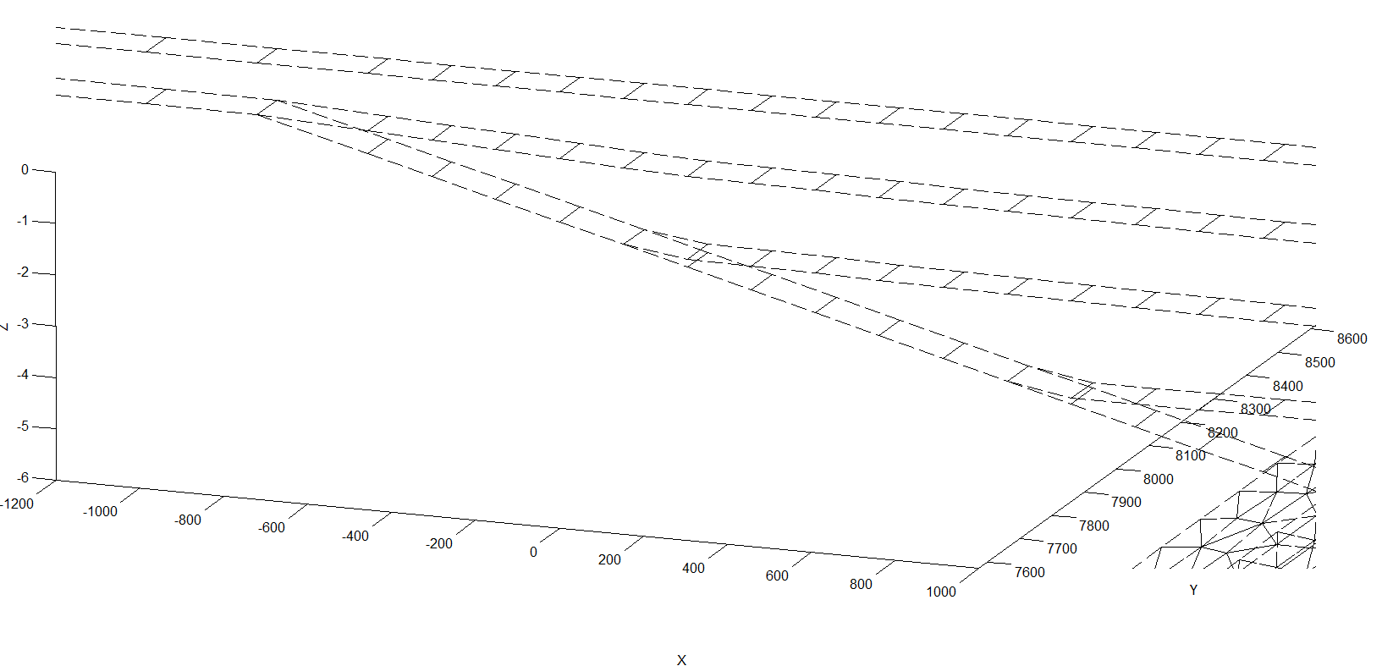
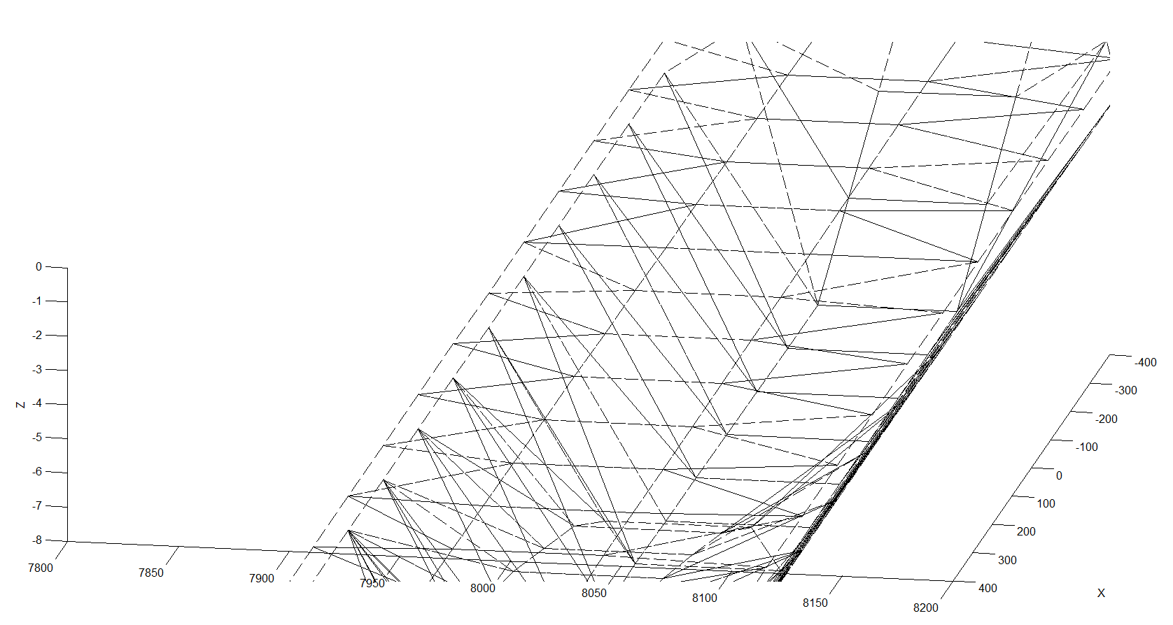
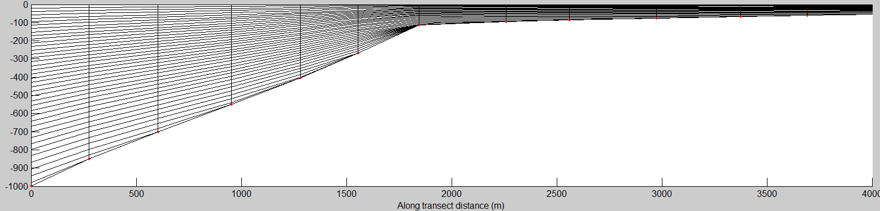
Polymorphism
Zhang et al. (2016)
Bathymetry (m)
Notes:
Flexibility is not just in the horizontal

Slide 11
LSC² script: gen_vqs.f90
!m_vqs: # of master grids
m_vqs=18
dz_bot_min=0.3 !min. bottom layer thickness [m]
allocate(hsm(m_vqs),nv_vqs(m_vqs),a_vqs(m_vqs))
hsm(1:7)=(/(7.+3*(i-1),i=1,7)/)
hsm(8:18)=(/28.,32.,37.,43.,50.,58.,67.,77.,88.,100.,120./)
nv_vqs(1:m_vqs)=(/(14+2*(i-1),i=1,m_vqs)/) !# of levels for each master grid (increasing with depth)
…
!Other consts.
!Stretching const. for the 1st master grid and also for depth <= hsm(1)
!|a_vqs0|<=1 (1: skew toward bottom; -1: toward surface; 0: no bias)
a_vqs0=-0.5
…
do m=1,m_vqs
do k=1,nv_vqs(m)
sigma=(k-1.0)/(1.0-nv_vqs(m))
!Alternative transformations below
!Option 1: quadratic
!a_vqs(m)=max(-1.d0,a_vqs0-(m-1)*0.03)
!tmp=a_vqs(m)*sigma*sigma+(1+a_vqs(m))*sigma !transformed sigma
!z_mas(k,m)=tmp*(etal+hsm(m))+etal
!Option 2: S
theta_b=0
theta_f=1.5+0.03*(m-1)
cs=(1-theta_b)*sinh(theta_f*sigma)/sinh(theta_f)+ &
&theta_b*(tanh(theta_f*(sigma+0.5))-tanh(theta_f*0.5))/2/tanh(theta_f*0.5)
z_mas(k,m)=etal*(1+sigma)+hsm(1)*sigma+(hsm(m)-hsm(1))*cs
enddo k
enddo m
Controls near bottom resolution (used to consolidate near-bottom levels). Handle for # of degenerate prisms.
z=Hs+η
s=aσ²+(1+a) σ (−1 ≤ σ≤0)
a_vqs0
S transformation (or you favorite coordinates here)
(There are more options also; see gen_vqs_Rutgers.f90)
Notes:
Used CA_DWR/RUN84b

Slide 12
LSC² script: gen_vqs.f90 (cont’d)
…….
! Compute final z-coordinates
znd=-1.e6
do i=1,np
if(dp(i)<=hsm(1)) then !shallow
kbp(i)=nv_vqs(1)
do k=1,nv_vqs(1)
sigma=(k-1.0)/(1.0-nv_vqs(1))
sigma_vqs(k,i)=a_vqs0*sigma*sigma+(1+a_vqs0)*sigma !transformed sigma
znd(k,i)=sigma_vqs(k,i)*(eta2(i)+dp(i))+eta2(i)
enddo !k
cycle
endif
!Deep
!Find a master vgrid
m0(i)=0
do m=2,m_vqs
if(dp(i)>hsm(m-1).and.dp(i)<=hsm(m)) then
m0(i)=m
zrat=(dp(i)-hsm(m-1))/(hsm(m)-hsm(m-1)) !(0,1]
exit
endif
enddo !m
if(m0(i)==0) then
print*, 'Failed to find a master vgrid:',i,dp(i)
stop
endif
* Usually you don’t need to change other parts of the script, but good to go thru all
kbp(i)=0
do k=1,nv_vqs(m0(i))
z1=z_mas(min(k,nv_vqs(m0(i)-1)),m0(i)-1)
z2=z_mas(k,m0(i))
z3=z1+(z2-z1)*zrat
if(z3>=-dp(i)+dz_bot_min) then !combine thin layers
znd(k,i)=z3
else
kbp(i)=k; exit
endif
enddo !k
if(kbp(i)==0) then
print*, 'Failed to find a bottom:',i,dp(i),z3,z_mas(1:nv_vqs(m0(i)),m0(i))
stop
endif
znd(kbp(i),i)=-dp(i)
…
enddo !i
Notes:
Used CA_DWR/RUN84b

Slide 13
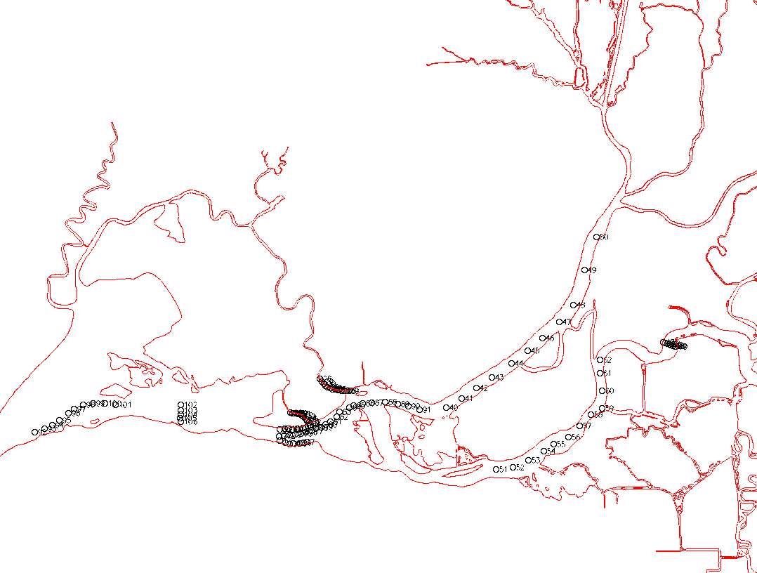
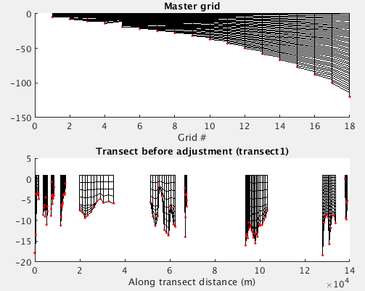
LSC²: viz 3D grid
Check master grids: generally, the master grid and the final transect grid should be ‘pleasing to the eye’, with resolution applied where you wanted
To viz 3D grid with plot_VQS.m, use many transects to catch potential issues
  Order build points in a way you can remember (the distance is measured continuously from previous point)
  Tip: assign different depths to each ‘segment’ (optional); this way the script will plot out different segments in isolation for better viz
  Keep in mind that usually the transect does not coincide with horizontal grid nodes (nearest neighbors interpolation)
transect.bp

Slide 14
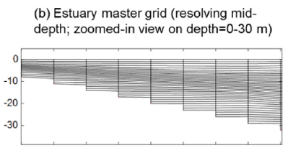
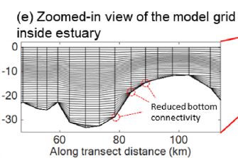
LSC²: resolution
Usually need to resolve surface instead of bottom but you can do whatever you wish!
For example, we additionally resolved pycnocline in Chesapeake Bay simulations by tweaking the master grids
Beware interaction between the near-bottom resolution and dzb_min (and thus friction) if you use roughness formulation

Slide 15
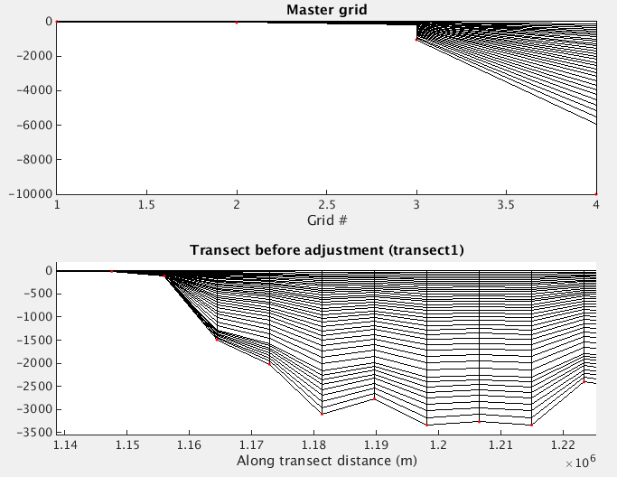
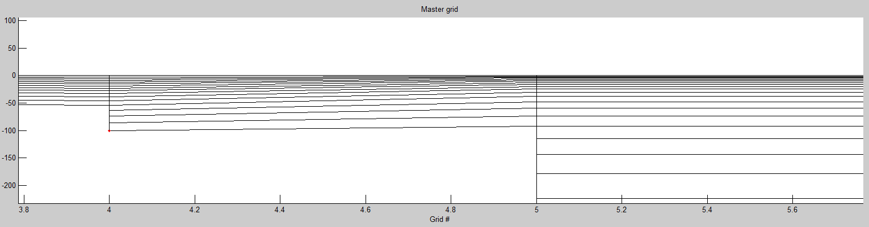
LSC²: common issues
Symptom #1: going against terrain
  Solution: adjust # of levels, stretching constants for master grids
  You can enforce it using min/max, but don’t overdo it (non-smooth)
Symptom #2: too many degenerate (shaved) cells near bottom
  Usually harmless except when the bottom processes are of concern (e.g. gravity overflow), as it may attenuate momentum
  Solution: adjust spacing in some master grids (dz_bot_min, too few # of master grids, stretching constants, large differences in # of levels between adjacent master grids, etc)
Master grid
Too few # of master grids
Against terrain
Too many
degenerate prisms?
Notes:
Demo on using transect.bp (/sciclone/home10/yinglong/vims20/CA_DWR/RUN84d/Vgrid)

Slide 16
Embedding Z: performance consideration
Can use constant z after certain depths to save cost (esp. in deep ocean)
May avoid griefs in tuning parameters in the script
But beware bottom controlled processes
Try to use 2D config in shallows to enhance stability and improve efficiency
  Set the 1st master grid as nv_vqs0(1)=2 (levels)
You can also ‘declare’ a region pure terrain-following by making the 1st master grid deep enough
Or even embed a pure terrain-following zone between 2 depths (later)
Last 3 master grids
z_mas(1:nv_vqs(5),6)=z_mas(1:nv_vqs(5),5)
z_mas(1:nv_vqs(6),7)=z_mas(1:nv_vqs(5),5)
z_mas(1:nv_vqs(6),8)=z_mas(1:nv_vqs(5),5)
z_mas(1+nv_vqs(5):nv_vqs(6),6)=(/-400,-460,-520,-590,-660,-740,-830,-930,-1050/)
z_mas(1+nv_vqs(5):nv_vqs(7),7)=(/-400,-460,-520,-590,-660,-740,-830,-930,-1050,-1200,-1400,-1600,-1800,-2000/)
z_mas(1+nv_vqs(5):nv_vqs(8),8)=(/-400,-460,-520,-590,-660,-740,-830,-930,-1050,-1200,-1400,-1600,-1800,-2000,-2400,-2900,-3500,-4200,-5000.,-7000,-1.e4/)

Slide 17
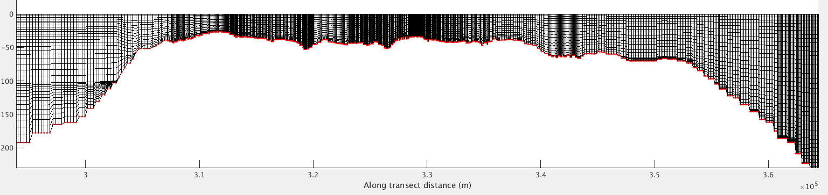
LSC²: multiple sets of masters
Use multiple sets of master grids in different parts of domain (and take care of transition)
Great way for optimization on a regional basis
The 2 master grids share same coordinates for h<=100m
Master grid #1
Master grid #2

Slide 18
Embedding pure S into LSC²
if(m0(i)==3) then !pure S
kbp(i)=nv_vqs(m0(i))
do k=1,kbp(i)-1
sigma=(k-1.0)/(1.0-kbp(i))
theta_b=0; theta_f=1
cs=(1-theta_b)*sinh(theta_f*sigma)/sinh(theta_f)+ &
&theta_b*(tanh(theta_f*(sigma+0.5))-tanh(theta_f*0.5))/2/tanh(theta_f*0.5)
znd(k,i)=etal*(1+sigma)+hsm(1)*sigma+(dp(i)-hsm(1))*cs
enddo !k
else !LSC2
kbp(i)=0
do k=1,nv_vqs(m0(i))
z1=z_mas(min(k,nv_vqs(m0(i)-1)),m0(i)-1)
z2=z_mas(k,m0(i))
z3=z1+(z2-z1)*zrat
if(z3>=-dp(i)+dz_bot_min) then
znd(k,i)=z3
else
kbp(i)=k; exit
endif
enddo !k
if(kbp(i)==0) then
print*, 'Failed to find a bottom:',i,dp(i),z3,z_mas(1:nv_vqs(m0(i)),m0(i))
stop
endif
endif !m0(i)
znd(kbp(i),i)=-dp(i)
Pure S tends to have less momentum dissipation and easier to tune
To embed pure S into different zones of LSC², make sure the 2 master grid levels match
Modify the code segment where the z-coordinates are generated
hsm=(/0.5, 4.,25.,33.,58.,100.,350.,1050.,2000.,5000.,8500./)
nv_vqs(1:n_sd)=(/2,14,14,17,25,33,45/)
……
!Deep
!Find a master vgrid
m0(i)=0
do m=2,m_vqs
if(dp(i)>hsm(m-1).and.dp(i)<=hsm(m)) then
m0(i)=m
zrat=(dp(i)-hsm(m-1))/(hsm(m)-hsm(m-1)) !(0,1]
exit
endif
enddo !m
if(m0(i)==0) then
print*, 'Failed to find a master vgrid:',i,dp(i)
stop
endif

Slide 19
LSC²: multiple sets of masters
!# of master sets used in different regions (share same m_vqs)
max_m=2
!m_vqs: max # of grids/depths in each master grid
m_vqs=10
dz_bot_min=3 !min. bottom layer thickness [m]
allocate(hsm(max_m,m_vqs),nv_vqs(max_m,m_vqs))
!2nd master set: Black Sea
hsm(2,:)=(/20.,60.,100.,140.,180.,220.,260.,2400.,3000.,4000./)
nv_vqs(2,1:7)=(/15,19,23,26,29,31,33/) !# of levels for each master grid
!grid #9, 10 are not used (exceed max depth of Black Sea)
nv_vqs(2,8:m_vqs)=nv_vqs(2,7)+15
!1st: rest
hsm(1,:)=(/20.,60.,100.,140.,300.,500.,1.e3,2.e3,3.e3,6.e3/)
nv_vqs(1,1:7)=(/15,19,23,26,31,33,39/)
nv_vqs(1,8)=nv_vqs(1,7)+6
nv_vqs(1,9)=nv_vqs(1,8)+5
nv_vqs(1,10)=nv_vqs(1,9)+8
!Define last few master grids
!1st set
z_mas(1,1:nv_vqs(1,7),8)=z_mas(1,1:nv_vqs(1,7),7)
z_mas(1,1+nv_vqs(1,7):nv_vqs(1,8),8)=(/-1100.,-1250.,-1400.,-1600.,-1800.,-2000./)
z_mas(1,1:nv_vqs(1,8),9)=z_mas(1,1:nv_vqs(1,8),8)
z_mas(1,1+nv_vqs(1,8):nv_vqs(1,9),9)=(/-2200.,-2400.,-2600.,-2800.,-3000./)
z_mas(1,1:nv_vqs(1,9),10)=z_mas(1,1:nv_vqs(1,9),9)
z_mas(1,1+nv_vqs(1,9):nv_vqs(1,10),10)=(/-3300.,-3600.,-4000.,-4400.,-4800.,-5200.,-5600.,-6000./)
!2nd set
z_mas(2,1:nv_vqs(2,7),8)=z_mas(2,1:nv_vqs(2,7),7)
z_mas(2,nv_vqs(2,7)+1:nv_vqs(2,8),8)=-(/280,300,320,350, &
&400,470,560,670,800,1000,1200,1400,1700,2000,2400/)
!last 2 master grids are not used (exceed max depth)
z_mas(2,1:nv_vqs(2,9)-1,9)=z_mas(2,1:nv_vqs(2,9)-1,8)
z_mas(2,nv_vqs(2,9),9)=-3.e3
z_mas(2,1:nv_vqs(2,10)-1,10)=z_mas(2,1:nv_vqs(2,10)-1,8)
z_mas(2,nv_vqs(2,10),10)=-4.e3
Pre-Processing/gen_vqs_2masters.f90
! Compute zcoor
znd=-1.e6
iflag=0
do i=1,np
!Find master set
if(ireg(i)==1) then !rest
indx=1 !master set index
else !Black Sea
indx=2
endif !ireg(i)

Slide 20
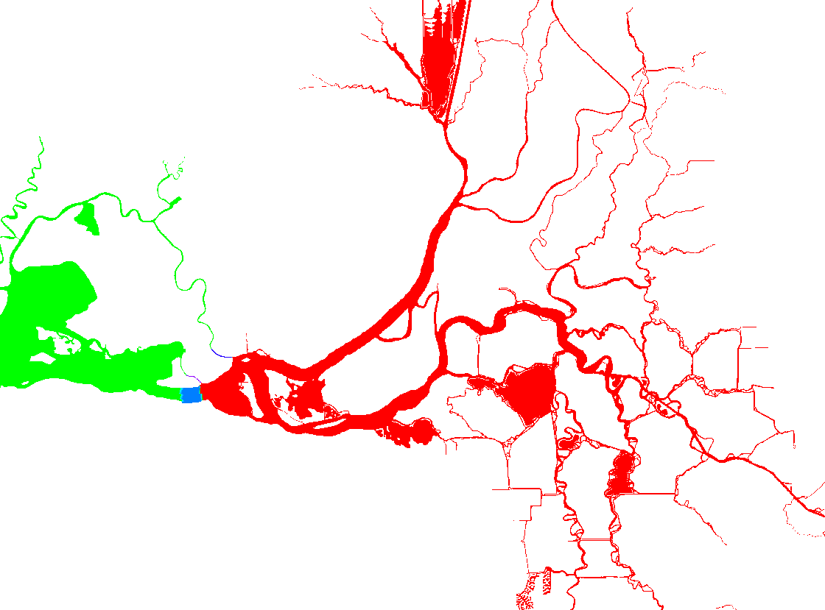
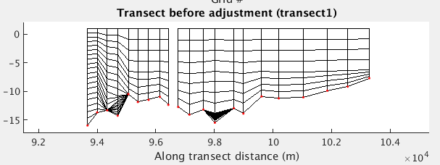
Regionally based LSC² grid: momentum dissipation
Transition the master grid from Bay into shallow Delta to save cost
Tip: use Cd=0 in the non-smooth transition (to effectively turn the 3D model into 2D) to reduce momentum attenuation
  However, the dissipation may be still too high
DWR now uses a new approach to generate LSC² grid
2D for entire Delta!
Non-smooth vgrid (set Cd=0)
Transition region
?

Slide 21
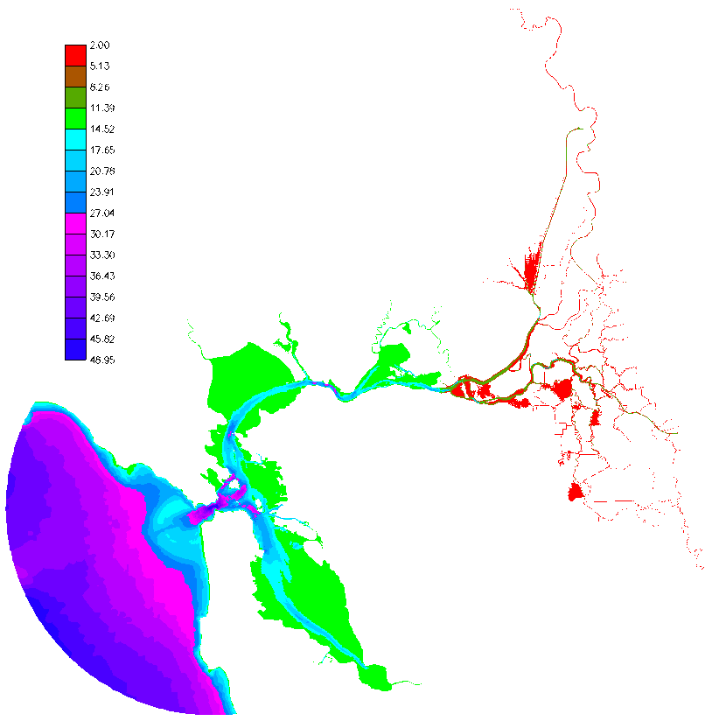
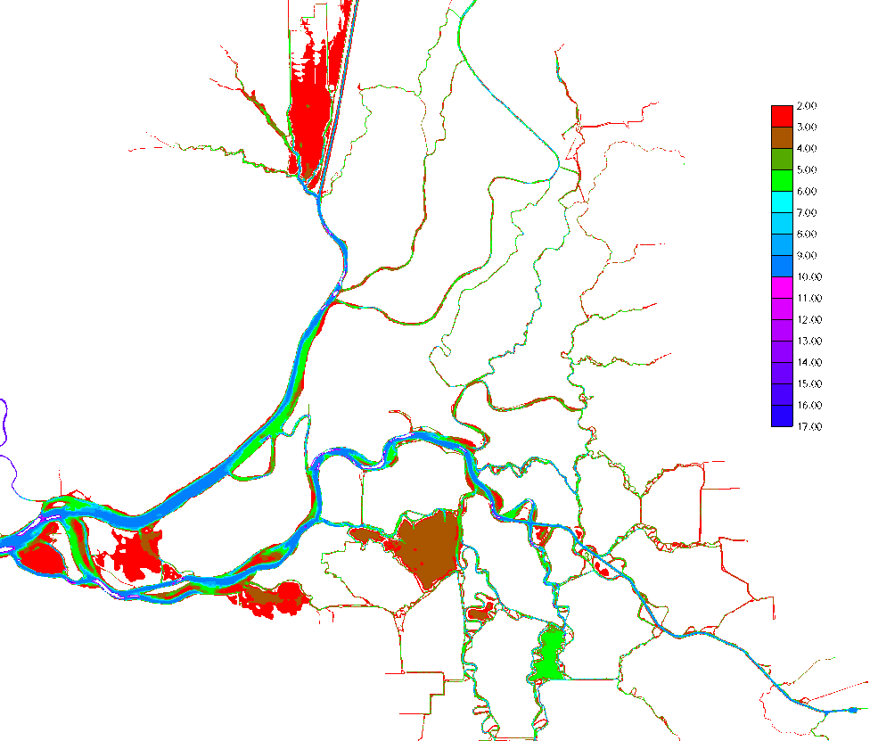
Editing LSC² grid
nlev.gr3
# of vertical levels
# of vertical levels
Notes:
RUN84k

Slide 22
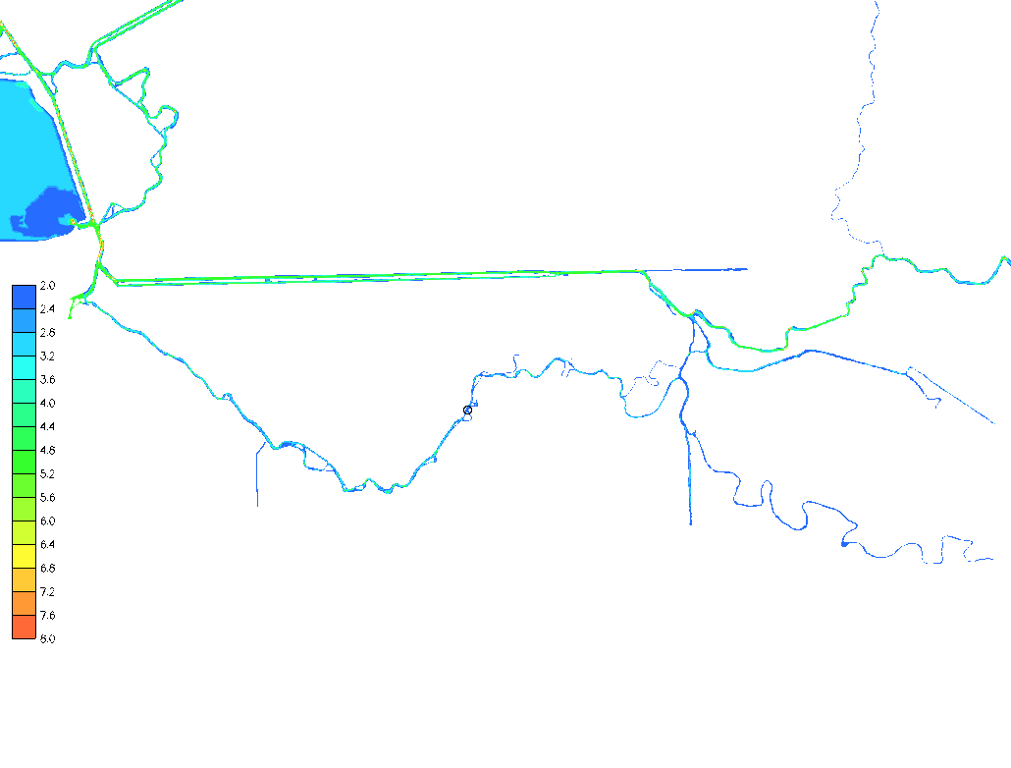
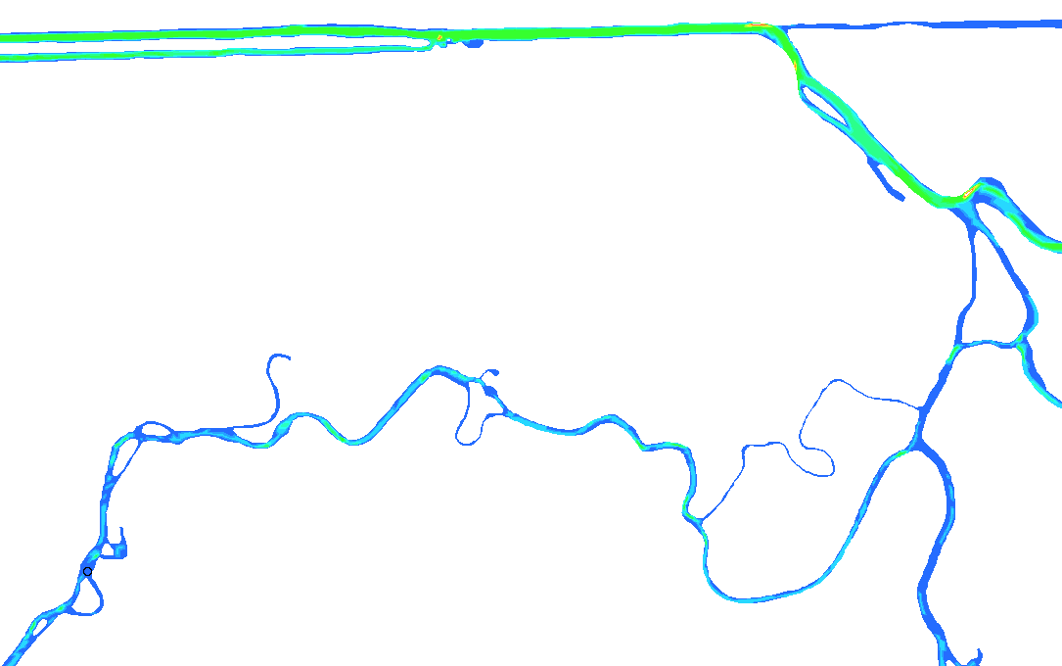
Editing LSC² grid
nlev.gr3
2D zone!
2D across channel
Edit nlev.gr3 and then use Pre-Processing/edit_vgrid.f90 to generate new vgrid.in
Key is to find ‘control’ points (e.g. sills, shallow)
Great way of making upstream rivers or even entire embayment 2D
Notes:
RUN84k

Slide 23
Eddying regime
Eddying regime prefers quasi-uniform hgrid (bathymetry variation in deep ocean is mostly negligible)
Most challenging part is near steep shelf breaks
LSC² grid can be used in conjunction with hgrid to ‘stabilize’ the instability as found near steep slopes
Also important is to adjust momentum dissipation locally (later) to avoid spurious ‘upwelling’
Realistic upwelling can be simulated with either LSC² or SZ

Slide 24
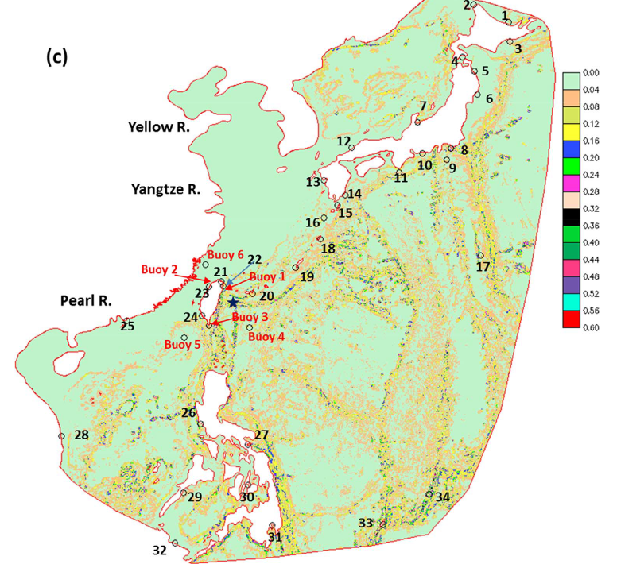
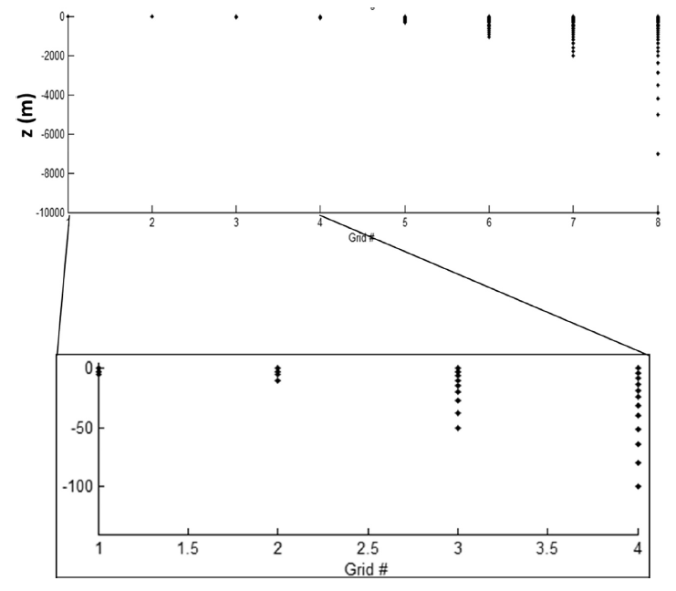
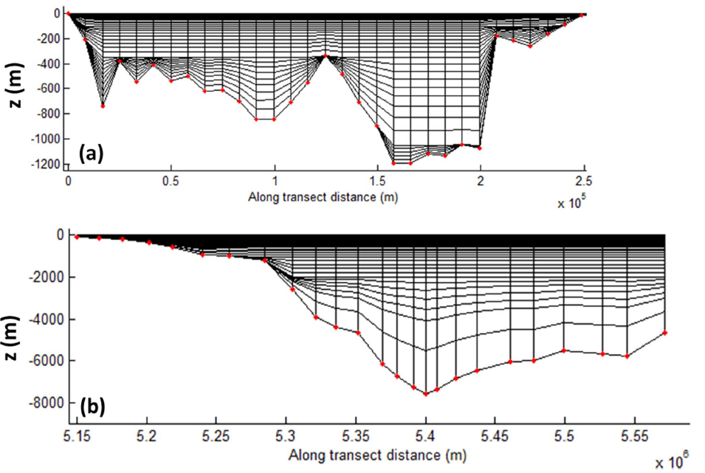
Eddying regime example: Kuroshio
Slope
Master grids
Yu et al. (2018)

Slide 25
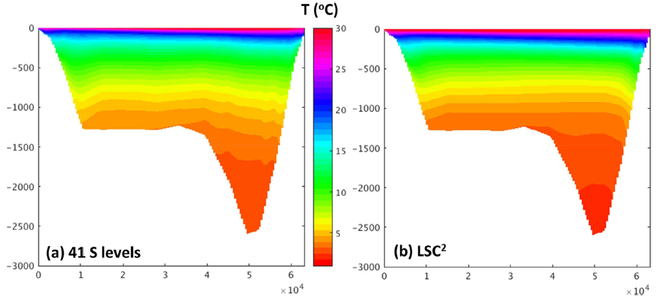
Eddying regime example: Kuroshio
* LSC2 effectively preserved the sharp thermocline over time

Slide 26
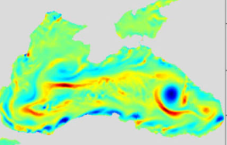
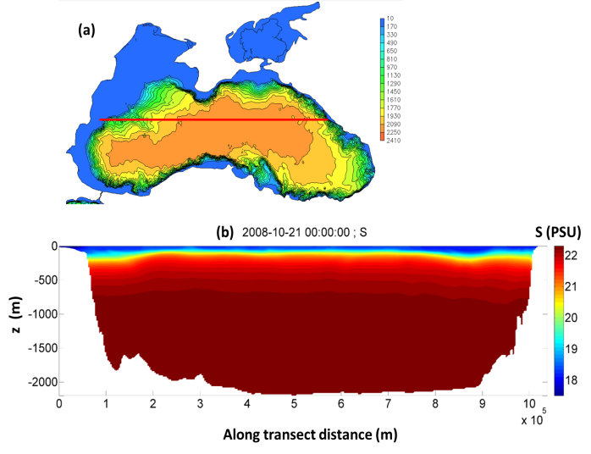

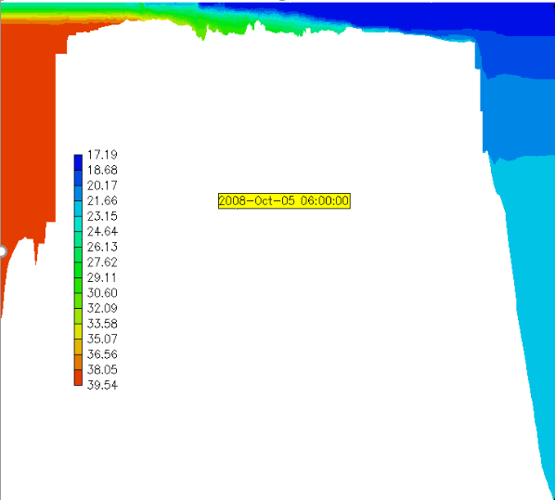
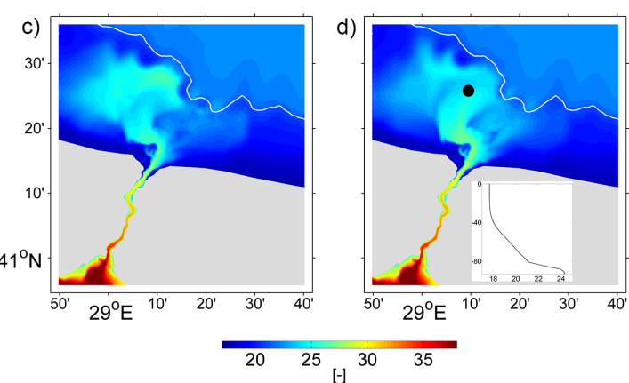
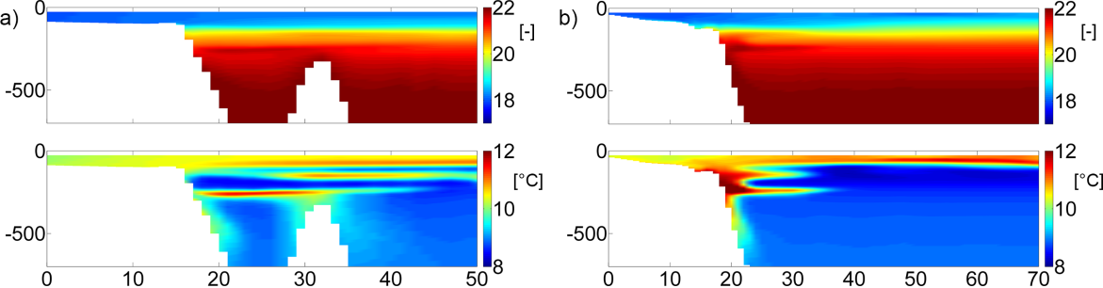
Flow over steep bathymetry
Marmara Sea
Bosphorus Strait
Black Sea
PSU
(Stanev et al. 2017, Ocean Dyn.)
Gravity flow into canyon
Bosphorus Strait
West
East
South
North
Steep slopes are actually common in oceans and estuaries
Either Z or terrain-following grid will have issues here
Can serve as revealing benchmarks

Slide 27
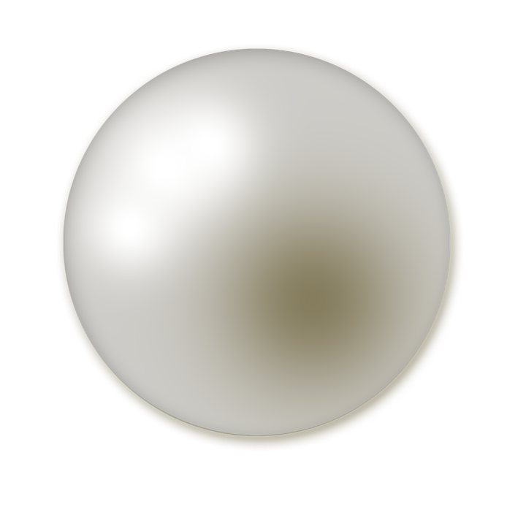
Summary
Hybrid LSC² gridding system provides maximum flexibility for the vertical grid
  Alleviate PGE (Z like in parts of water column)
  Better simulation of surface/bottom controlled processes (like terrain-following)
Shaved cells significantly improve model skills for bottom controlled processes
Design of LSC² is up to users, much like UG in the vertical
  Use it to add resolution wherever you want
  Pay attention to aesthetics
Combination of LSC² and UG in the horizontal results in polymorphism, which is indispensable for creek-to-ocean applications

