Slide 1
SCHISM code review Joseph Zhang

Slide 2
svn directory structure
Central repository (VIMS)
private
branches
public
public
trunk
tags
Release branch
cmake
mk
test
src
doc
Core,Driver,Hydro
EcoSim
GOTM
ICM
OillSpill-Jung
ParMetis-3.1-Sep2010
Sed2d
Sediment
CoSiNE
WWMIII
Utility
ICE
FABM
FIB
……………………….
Source codes are mostly inside src
/Utility are serial codes (may add openMP in the future)
Other dirs contain parallel FORTRAN codes (MPI/openMP)

Slide 3
Utility
UtilLib: shared routines
Pre-Processing: nudging, horizontal viscosity, LSC²….
Gen_Hotstart: example to show how to generate hotstart.in (e.g. from gridded data in nc format like HYCOM)
Sflux_nc: readnc*.m show various examples of how to generate your own sflux/ files; also scripts to download NARR and CFSR
SMS: conversion scripts between .2dm and .gr3
Tides: scripts for FES2014 etc to generate harmonics (for elev and velocity)
Grid_Scripts
Interpolating depths: interpolate_depth_structured2.f90; interpolate_unstructured.f90
Generate a grid with periodic b.c.: periodic_grid.f90
Particle_tracking (including oil spill)
ACE: build ACE tool (highly recommended, especially xmgredit5 )
Combining_Scripts
combine_output11: combine CPU-specific nc outputs into a single (global) nc output (schout_1.nc etc)
autocombine_MPI_elfe.pl: drives combine_output* to automatically combine available outputs as the run progresses
combine_hotstart7: combine CPU-specific hotstart outputs into a single hotstart.nc
combine_gr3: combine some CPU-specific ASCII outputs (e.g. maxelev) into a global .gr3
We are working toward eliminating the need for combining in the future

Slide 4
Utility
OneWayNestScripts
Can be used to do 1-way nesting between 2 SCHISM runs
The main use is to generate uv3D.th.nc (e.g. from a b-tropic tidal run)
A better and simpler alternative is to use the tidal harmonics from FES2014 and ifltype=5
Vis_Matlab
SCHISM_SLAB.m; SCHISM_TRANSECT.m: these are up to date with LSC²; shaved cells are plotted
Works on either combined or un combined nc outputs
ArcGIS: interface to ArcGIS viz
Post-Processing-Fortran
read_output9*: time series extraction (efficient)
Works on either combined or uncombined nc outputs
Compute average fields: compute_average3.f90
Works on either combined or uncombined nc outputs
Extract whole 3D grid: read_output8_allnodes.f90 (combined or uncombined nc outputs)
Interface to GNOME
Extract a sub-region

Slide 5
Hydro part
Core/
Driver/
schism_driver
schism_glbl
schism_msgp
schism_assert
petsc_schism
schism_version
misc_modules
Hydro/
schism_init
schism_step
schism_finalize
grid_subs
schism_io
bktrk_subs
sflux_9c
transport_TVD_imp
transport_TVD
hydraulic_structures
misc_subs
solver_subs
lap
harm

Slide 6
schism_driver
program schism_driver
use schism_msgp, only: parallel_init,parallel_finalize,parallel_abort
use schism_version
implicit none
character*8 cli
call get_command_argument(1,cli)
if (cli(1:2) == "-v")then
print*, ""
call print_version
stop
endif
call parallel_init → can also take a comm world from outside (e.g. coupler)
Deal with command args
call get_command_args
call schism_main
call parallel_finalize
end program schism_driver
subroutine schism_main
use schism_msgp, only: myrank debug only
implicit none
integer :: it,iths,ntime
call schism_init(iths,ntime)
do it=iths+1,ntime
call schism_step(it)
enddo it
call schism_finalize
end subroutine schism_main

Slide 7
SCHISM flow chart
grid_subs.F90
schism_init.F90
decomp; initialization
or hot start
end
schism_finalize.F90
sflux_9c.F90
yes
forcings
no
bktrk_subs.F90
4%
Completed?
backtracking
10%
schism_io.F90
output
1%
no
Turbulence
closure
6%
schism_step.F90
1%
Update levels
& eqstate
misc_subs.F90
60-80%
Transport
Preparation
(wave cont.)
10%
<1%
transport_TVD*.F90
1%
w
10%
Momentum eq.
solver
* For large grids, I/O cost may be significant
Notes:
Numbers depend on specific set up also

Slide 8
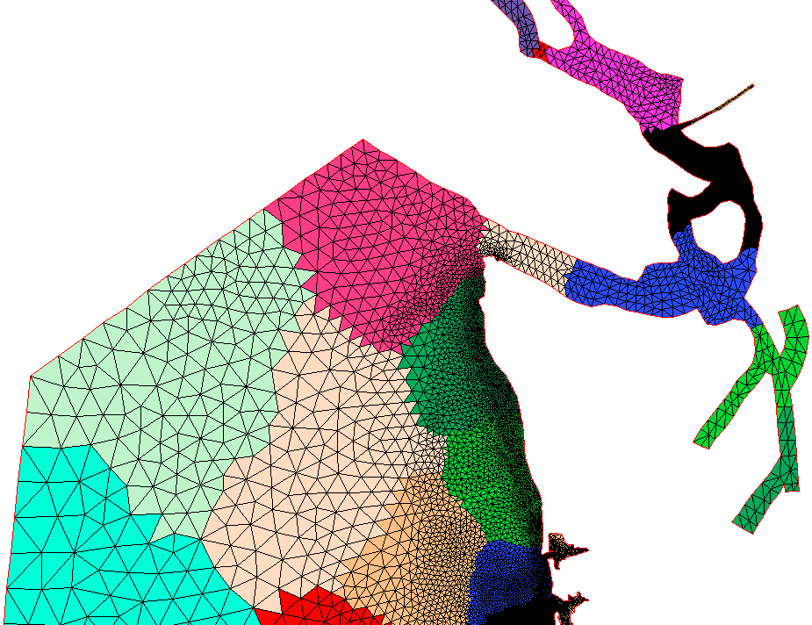
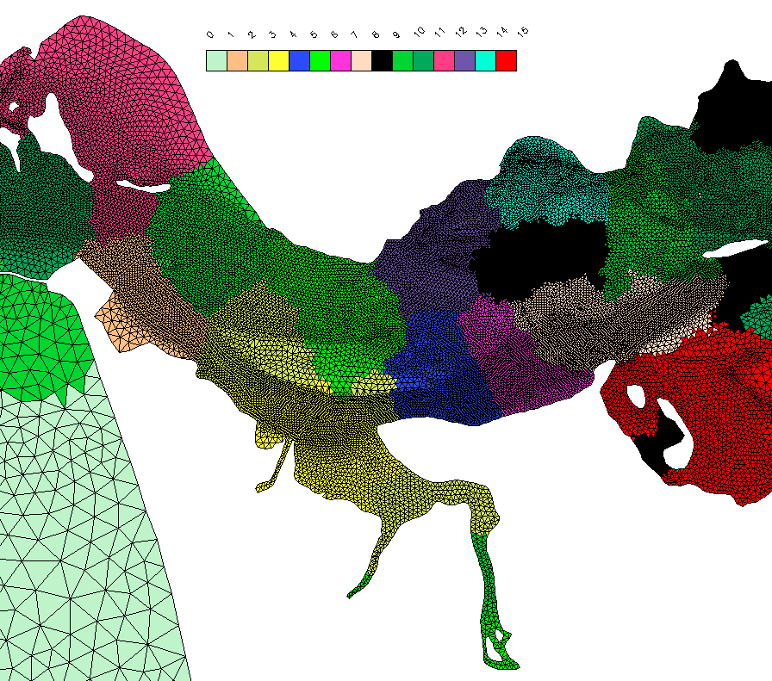

Domain decomposition (MPI)
The domain is first partitioned into non-overlapping sub-domains element-wise
Each MPI process (‘rank’) takes and works on a sub-domain
All ranks must see consistent info (in overlapping regions)
Sub-domain may not be contiguous
viz with xmgredit5 (global_to_local.prop)
Then each sub-domain is augmented with 1 (or 2 for WENO) layer of ghost elements where exchange of info occurs (why?)
Resident elements (of a particular sub-domain): non-overlapping and reside in 1 and only 1 sub-domain (iegrpv(1:ne_global))
Resident sides, nodes: all sides/nodes of resident elements
Question: can resident sides/nodes belong to more than 1 sub-domain? (hint: interface sides/nodes)
Ghost elements (aka halos): non-resident elements that have at least 1 resident node
Ghost sides/nodes: non-resident sides/nodes of ghost elements
Analogous definition for 2nd-tier ghost zone
Augmented elem/side/node: resident + ghost
“ghosts” of sub-domain #6
6
4
4
Elem $⊃$ side $⊃$ node

Slide 9
Domain decomposition code (_init → grid_subs)
Code segments for domain partitioning
aquire_hgrid(.false.) in partition_hgrid(): initial partition based on naïve ordering of elements
ParMetis lib
MPI-based parallel library that implements a variety of algorithms for partitioning and repartitioning unstructured graphs
based on the multilevel partitioning and fill-reducing ordering algorithms that are implemented in the serial package METIS
Optimal partitioning is obtained by minimizing the edge cuts
Adjustable parameters inside for optimal performance
aquire_hgrid(.true.): final partitioning
6
4
“ghosts”
4

Slide 10
schism_glbl: variables
 | Global | Local non-augmented | Ghost | Augmented | Augmented up to 2 tier
Elements | ne_global | ne | neg | nea | nea2
Nodes | np_global | np | npg | npa | npa2
Sides | ns_global | ns | nsg | nsa | nsa2
Mapping arrays are essential for understanding MPI code
99.9% of vars inside the code are local (in resident or aug
domains); I/O is usually done in global vars
Why not use global vars more?
I/O is expensive in parallel env!
Each process (sub-domain) has its own set of variables/memory
var names appear same but occupy different memory - polymorphism
global-to-local, local-to-global mappings
resident vs augmented (i.e., resident + ghost)
Linked lists: iegl()%next%next%next… for element
Each process has its own version of this list, with the local element number at the top (if inside aug. domain), and after that the rank numbers in ascending order
ipgl() and isgl():
Consistency among processes (e.g., elevations): follow the smallest rank
Interfacial nodes/sides may be resident in more than 1 domain
Implication for sum
Operations on neighborhood (e.g. local ball info): need exchange of info
Computation usually done inside resident domain
Communication done in ghost domain (with aid from global indices)
Communication
MPI standard
Bundle up before posting for efficiency
Boundary info: use global info for simplicity
if(associated(ipgl(iplg(ip))%next)) then !interface node
if(ipgl(iplg(ip))%next%rank<myrank) cycle !already in the sum so skip
endif
A linked list
NULL
head
tail
NULL

Slide 11
schism_glbl module: vars
module schicm_glbl
implicit none
public !Default scope is public
…….
Element geometry data
integer,save :: ne_global !Global number of elements
integer,save :: ne !Local number of resident elements
integer,save :: neg !Local number of ghost elements
integer,save :: nea !Local number of elements in augmented subdomain (ne+neg)
integer,save,allocatable :: ielg(:) !Local-to-global element index table (augmented)
type(llist_type),save,pointer :: iegl(:) !Global-to-local element index table (augmented)
Similarly
iplg(ip), islg(isd)
Important: do not confuse ‘global’ vars in _glbl with global quantities associated with global domain (pre-partitioned)!
Vars with global extent are usually named as _global, _glbl , _gb

Slide 12

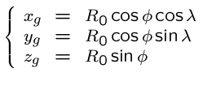

Spherical coordinates
z_{g}
φ⁰ (y)
z
λ
λ⁰ (x)
P
φ
Avoids polar singularity easily
Preserves all original matrix properties
O
y_{g}
x_{g}
We transform the coordinates instead of eqs
There are 2 frames used:
Global
Lon/lat (local @ node/element/side): zonal/meridional/vertical
Changes to the code are simple: mainly related to re-project vectors and to calculate geometric quantities like distances

Slide 13
schism_glbl: coordinates
Node Cartesian coordinates
They mean different things for ics=1 (plane projection) or ics=2 (sphere)
For ics=1, znd=0, and xnd,ynd are the Cartesian coord. in the projection plane;
For ics=2, the triplet is the coordinate in a global frame with origin at center of earth, x-axis points to prime meridian, z-axis to the north pole
real(rkind),save,allocatable :: xnd(:),ynd(:),znd(:) !Node cartesian coordinates
real(rkind),save,allocatable :: xlon(:),ylat(:) !Node lat/lon coordinates in radians
real(rkind),save,allocatable :: znl(:,:), zs (:,:), ze (:,:) !local frame (vertical up)
Transformation tensor for node frame: pframe(i,j,ip) for ics=2.
where j=1:3 is the axis id, i=1:3 is the component id, ip is the local node id (aug.)
For ics=1, this is not used
real(rkind),save,allocatable :: pframe(:,:,:)
If(ics==2) then
call project_pt('g2l',xnd(n2),ynd(n2),znd(n2), (/xctr(k),yctr(k),zctr(k)/),eframe(:,:,k),xn2,yn2,tmp)
rr=sqrt((xy_kr(1,i)-xn2)**2+(xy_kr(2,i)-yn2)**2)
endif
* Tip: try to use predefined geometric distance arrays as much as possible (e.g. distj()) instead of calculating these from coordinates

Slide 14
Connectivity info: elem-elem
int :: ic3(1:4,ie) – positive if the neighbor element is inside the aug. domain as well (and in this case it is the local index of the neighbor element); 0 if (global) boundary; negative if the neighbor element is outside the aug. domain and in this case, the absolute value is the global element index. The order follows the definition of side
ic3
ic3
ic3
(ic3=0)
ie
ie
ic3
ic3
3
4
Side 2
3
Side 2
Side 1
Side 3
Side 1
1
Side 4
2
1
Side 3
2

Slide 15

Connectivity info: node-elem (ball)
int :: nne(ip) – total # of neighbor elements around local node ip, including those outside the aug. domain
int :: indel(1:nne(ip),ip) – surrounding elements of node ip. If inside aug. domain, this is the local element index; if outside, this is the negative of the global element index.
int :: iself(1:nne(ip),ip) – the local node index for node ip in indel() (even if it is outside)
* The order of list follows counter-clockwise. For an internal node ip, the starting elem is arbitrary and the ‘ball’ is ‘closed’. For a boundary node, the starting elem is unique and the ball is ‘open’.
3
2
2
ip
2
N_{i}
1
N_{i}
1
N_{i}
1
N_{i}
ip
1

Slide 16
schism_glbl: node-node
int :: nnp(ip) – total # of surrounding nodes for node ip, including all nodes outside the aug. domain (but excluding ip itself)
int :: indnd(1:nnp(ip),ip) – list of surrounding nodes. If outside the aug. domain, negative global index is returned.
* The order follows indel (counter-clockwise); starting node is arbitrary for internal closed ball, unique for boundary open ball
3
ip
2
N_{i}
1

Slide 17
schism_glbl: side-elem & side-node
int :: isdel(1:2,isd) & isidenode(1:2,isd) – order of the two adjacent elements follows global indices, and so the vector from node 1 to 2 in isidenode(1:2,isd) forms local y-axis while the vector from element 1 to 2 in isel(1:2,isd) forms local x-axis. Therefore either of isdel(1:2,isd) can be negative. The element index is local (positive) if it is inside the aug. domain; otherwise the minus of global element index is returned. If isd is resident and not ghost, then is(isd,1)>0 (inside the aug. domain), and is(isd,2)>=0, and isd is on the boundary if and only if is(isd,2)=0.
y_{s}
y_{s}
2
2
x_{s}
1
x_{s}
1
i
i
2
1

Slide 18

MPI code: to exchange or not to exchange?
Elem $⊃$ side $⊃$ node
SCHISM partitions domain based on elements
Sides/nodes are derived from elements
This determines the ghost exchanges
Assuming the operations are consistent among all MPI processes (‘ranks’)
If you operate on aug elements (nea or nea2), you often do NOT need to exchange ghosts
If you work on all aug sides and only modify properties of sides/nodes, you do NOT need to exchange
If you work on all aug nodes and only modify properties of nodes, you do NOT need to exchange
Any other operations, you may need exchange!
Ghost exchanges are often associated with ‘operations in a neighborhood’, directly or indirectly – beware ‘implied’ cases
Exchanges are always ‘safe’
So why not do so always? Hint: cost
MPI: best practices
Consistency ensures all ranks see same values at same location
Communication vs computation cost: reduce exchanges especially global reductions (sum…)
Parallel scaling: strong vs weak
Scalable ≠ efficient
Avoid serial sections: Amdahl’s law
Parallel I/O is expensive, esp for large core count!
SCHISM uses rank-specific I/O for global outputs (no comm); if openMP is enabled, this is done by the master thread

Slide 19
An ‘implied’ case
sum_A(1:npa)=0 !total area in a ball
do i=1,nea
do j=1,i34(i)
nd=elnode(j,i)
sum_A(nd)=sum_A(nd)+area(i)
enddo !j
enddo !i
2
i
2
N_{i}
1
N_{i}
1
sum_A(1:npa)=0 !total area in a ball
do i=1,np !resident
do j=1,nne(i)
ie=indel(j,i)
sum_A(nd)=sum_A(nd)+area(ie)
enddo !j
enddo !i
call exchange_...(sum_A)
Rewrite in ‘direct’ form
“ghosts”
i
* Lesson: simple/direct algorithms are better in parallel codes!

Slide 20
schism_glbl: boundary info
Most bnd arrays take global indices as argument:
iettype(), ifltype(), itetype(), isatype(), and ittrtype() all take global bnd segment as argument; other b.c. arrays (eth etc) are also global.
Except that mapping arrays for node/side take local indices:
isbs(nsa) - positive if a local side is on the global open bnd (in this case, isbs() is the global segment #); -1 if it is on land bnd; 0 if internal side.

Slide 21


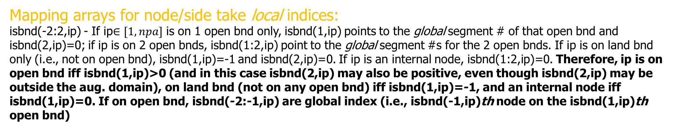
schism_glbl: boundary info for nodes
Mapping arrays for node/side take local indices:
isbnd(-2:2,ip) - If ip$∈[1,npa]$ is on 1 open bnd only, isbnd(1,ip) points to the global segment # of that open bnd and isbnd(2,ip)=0; if ip is on 2 open bnds, isbnd(1:2,ip) point to the global segment #s for the 2 open bnds. If ip is on land bnd only (i.e., not on open bnd), isbnd(1,ip)=-1 and isbnd(2,ip)=0. If ip is an internal node, isbnd(1:2,ip)=0. Therefore, ip is on open bnd iff isbnd(1,ip)>0 (and in this case isbnd(2,ip) may also be positive, even though isbnd(2,ip) may be outside the aug. domain), on land bnd (not on any open bnd) iff isbnd(1,ip)=-1, and an internal node iff isbnd(1,ip)=0. If on open bnd, isbnd(-2:-1,ip) are global index (i.e., isbnd(-1,ip)th node on the isbnd(1,ip)th open bnd)
open
open
land

Slide 22
schism_glbl: flow & other arrays
do i=1,nea
if(idry_e(i)==1) cycle
do k=kbe(i),nvrt
….
enddo k
enddo i
integer,save,allocatable :: idry(:) !wet/dry flag
integer,save,allocatable :: kbs(:) !Side bottom vertical indices (similar for ndoe/elem)
!tracer concentration @ prism center: tr_el(ntracers,nvrt,nea2)- but last index usually is valid up to nea only except for TVD
real(rkind),save,allocatable :: tr_el(:,:,:)
real(rkind),save,allocatable :: tr_nd(:,:,:) !tracer concentration @ node and whole levels
real(rkind),save,allocatable :: bdy_frc(:,:,:) !body force at prism center Q_{i,k}
real(rkind),save,allocatable :: flx_sf(:,:) !surface b.c. \kappa*dC/dz = flx_sf (at element center)
real(rkind),save,allocatable :: flx_bt(:,:) !bottom b.c.

Slide 23
schism_init
!Init. I/O
fdb='nonfatal_0000'
lfdb=len_trim(fdb)
write(fdb(lfdb-3:lfdb),'(i4.4)') myrank
open(12,file='outputs/'//fdb,status='replace') !non-fatal errors
* Tip: dump your own debug info into (12,*); do not create your own output files, as parallel I/O is not cheap!
!Read in param.in
call get_param('param.in','im2d',1,im2d,tmp,stringvalue)
Generic routine for everyone
!Aquire vertical grid
call aquire_vgrid
!Partition horizontal grid into subdomains
call partition_hgrid
!Aquire full horizontal grid based on final partition
call aquire_hgrid(.true.)
!Dump horizontal grid
call dump_hgrid
!Construct parallel message-passing tables
call msgp_tables
!Initialize parallel message-passing datatypes
call msgp_init
!Synchronize
call parallel_barrier
Calls aquire_hgrid(.false.) before ParMETIS

Slide 24
schism_init
Allocate and init. Arrays
Remaining geometric computation
Bctides.in
Hydraulic inputs
Source/sink inputs
Optional inputs (triggered by param.in)
Shaprio filter; end of pre-proc
init_inter_btrack
Kriging neighborhood and inverting matrix
Cold start
η,u,v,w,T,S (at prism center, node, side)
First few records of .th
Init GOTM,
Init tracer modules
Hotstart
Read hotstart.nc
Elem. Data: global → local (mpi_bcast)
Side data
Node data
Module data (if enabled)
Find position for .th*, nudging inputs, sflux/, and station outputs
Write header part of binary outputs (from each proc)
Init vertical grid (z-coordinates): levels0() or levels1() – including bed deformation
Vel. @ nodes: nodalvel
Init density and mean vertical profile (to reduce PGE): cubic spline
Init heat exchange model
Init optional modules (WWM, Sed, ICM…)
* Tip: remember to take care of hotstart when you add time series inputs or anything that is time sensitive

Slide 25
Message passing in SCHISM
Identify neighbor proc (send ⬄receive)
nhtrecv1=0 !# of recvs
do i=1,nhtblocks
ndgb1=structures(i)%upnode
if(ipgl(ndgb1)%rank==myrank) then; if(ipgl(ndgb1)%id<=np) then
ndgb2=structures(i)%downnode
irank=ipgl(ndgb2)%rank
if(irank/=myrank) then
itmp=nhtrecv1(irank)+1
nhtrecv1(irank)=itmp
ihtrecv1_ndgb(itmp,irank)=ndgb2 global node #
ihtrecv1(itmp,irank)=i-1 displacement into recv arrays like block_refnd2_*
endif ref. node 2 is outisde myrank
endif; endif ipgl; ref. node 1 is in myrank and not ghost
enddo i=1,nhtblocks
!Comm. send counts
call mpi_alltoall(nhtrecv1,1,itype,nhtsend1,1,itype,comm,ierr)
if(ierr/=MPI_SUCCESS) call parallel_abort('MAIN: all2all(2)')
!Get global node # for sends
do i=0,nproc-1
if(nhtrecv1(i)/=0) then
if(i==myrank) call parallel_abort('MAIN: illegal comm.(1)')
call mpi_isend(ihtrecv1_ndgb(1,i),nhtrecv1(i),itype,i,600,comm,srqst(i),ierr)
if(ierr/=MPI_SUCCESS) call parallel_abort('MAIN: send error (0)')
else
srqst(i)=MPI_REQUEST_NULL
endif nhtrecv1
enddo i
6
4
4
do i=0,nproc-1
if(nhtsend1(i)>nhtblocks) call parallel_abort('MAIN: nhtsend1(i)>nhtblocks')
if(nhtsend1(i)/=0) then
if(i==myrank) call parallel_abort('MAIN: illegal comm.(2)')
call mpi_irecv(ihtsend1_ndgb(1,i),nhtsend1(i),itype,i,600,comm,rrqst(i),ierr)
if(ierr/=MPI_SUCCESS) call parallel_abort('MAIN: recv error (0)')
else
rrqst(i)=MPI_REQUEST_NULL
endif nhtsend1
enddo i
call mpi_waitall(nproc,rrqst,rstat,ierr)
if(ierr/=MPI_SUCCESS) call parallel_abort('MAIN: mpi_waitall rrqst tag=600',ierr)
call mpi_waitall(nproc,srqst,sstat,ierr)
if(ierr/=MPI_SUCCESS) call parallel_abort('MAIN: mpi_waitall srqst tag=600',ierr)
!Build send list
do i=0,nproc-1
do j=1,nhtsend1(i) nhtsend1>0
ndgb=ihtsend1_ndgb(j,i)
if(ipgl(ndgb)%rank/=myrank) call parallel_abort('MAIN: send node not mine')
ihtsend1(j,i)=ipgl(ndgb)%id-1 displacement (into elev. array etc) (local index)
enddo j
enddo i
Build message passing tables using global indices

Slide 26
Message passing in SCHISM
Bundle up
6
4
!Create data type for exchange
!Send type
send_bsize=1; recv_bsize=1
do i=0,nproc-1
if(nhtsend1(i)/=0) then
#if MPIVERSION==1
call mpi_type_indexed(nhtsend1(i),send_bsize,ihtsend1(1,i),rtype, &
&htsend_type(i),ierr)
#elif MPIVERSION==2
call mpi_type_create_indexed_block(nhtsend1(i),1,ihtsend1(1,i),rtype, &
&htsend_type(i),ierr)
#endif
if(ierr/=MPI_SUCCESS) call parallel_abort('MAIN: create htsend_type',ierr)
call mpi_type_commit(htsend_type(i),ierr)
if(ierr/=MPI_SUCCESS) call parallel_abort('commit htsend_type',ierr)
Debug
write(12,*)'htsend list:',i,nhtsend1(i),ihtsend1(1:nhtsend1(i),i)
endif
enddo i
!Recv type
do i=0,nproc-1
if(nhtrecv1(i)/=0) then
#if MPIVERSION==1
call mpi_type_indexed(nhtrecv1(i),recv_bsize,ihtrecv1(1,i),rtype, &
&htrecv_type(i),ierr)
#elif MPIVERSION==2
call mpi_type_create_indexed_block(nhtrecv1(i),1,ihtrecv1(1,i),rtype, &
&htrecv_type(i),ierr)
#endif
if(ierr/=MPI_SUCCESS) call parallel_abort('MAIN: create htrecv_type',ierr)
call mpi_type_commit(htrecv_type(i),ierr)
if(ierr/=MPI_SUCCESS) call parallel_abort('commit htrecv_type',ierr)
Debug
write(12,*)'htrecv list:',i,nhtrecv1(i),ihtrecv1(1:nhtrecv1(i),i)
endif
enddo i
4
!Post send
do i=0,nproc-1
if(nhtsend1(i)/=0) then
if(i==myrank) call parallel_abort('MAIN: illegal comm.(2)')
call mpi_isend(eta2,1,htsend_type(i),i,601,comm,srqst(i),ierr)
if(ierr/=MPI_SUCCESS) call parallel_abort('MAIN: send error (2)')
else
srqst(i)=MPI_REQUEST_NULL
endif
enddo i
!Post recv
do i=0,nproc-1
if(nhtrecv1(i)/=0) then
if(i==myrank) call parallel_abort('MAIN: illegal comm.(2)')
call mpi_irecv(block_refnd2_eta,1,htrecv_type(i),i,601,comm,rrqst(i),ierr)
if(ierr/=MPI_SUCCESS) call parallel_abort('MAIN: recv error (2)')
else
rrqst(i)=MPI_REQUEST_NULL
endif
enddo i
call mpi_waitall(nproc,rrqst,rstat,ierr)
if(ierr/=MPI_SUCCESS) call parallel_abort('MAIN: mpi_waitall rrqst tag=601',ierr)
call mpi_waitall(nproc,srqst,sstat,ierr)
if(ierr/=MPI_SUCCESS) call parallel_abort('MAIN: mpi_waitall srqst tag=601',ierr)
Pass messages!

Slide 27
Example of ghost exchange
swild98=0
do i=1,ns residents
if(idry_s(i)==1) cycle
do k=1,nvrt
dudx=0; dudy=0; dvdx=0; dvdy=0
icount=0
do j=1,2
ie=is(i,j)
if(ie/=0) then
icount=icount+1
dudx=dudx+sdbt(1,k,ie)
dudy=dudy+sdbt(2,k,ie)
dvdx=dvdx+sdbt(3,k,ie)
dvdy=dvdy+sdbt(4,k,ie)
endif ie/=0
enddo j=1,2
if(icount==0) then
write(errmsg,*)'MAIN: Impossible 78'
call parallel_abort(errmsg)
endif
dudx=dudx/icount
dudy=dudy/icount
dvdx=dvdx/icount
dvdy=dvdy/icount
swild98(1,k,i)=dudx*sframe(1,1,i)+dudy*sframe(2,1,i) dudn; whole level
swild98(2,k,i)=dvdx*sframe(1,1,i)+dvdy*sframe(2,1,i) dvdn
if(isbs(i)==-1) swild98(:,k,i)=0 free slip land bnd
enddo k=1,nvrt
enddo i=1,ns
!Update ghost
call exchange_s3d_2(swild98)
Tip 1: if you operate around any horizontal neighborhood, you likely need the exchanges to ensure data consistency among all ranks
Tip 2: sometimes this operation is implied (and subtle); there is no harm in exchanging, except you pay the price of over-communication
Tip 3: if you can, try to rewrite your algorithm to avoid comm to improve parallel efficiency (strong scalability)
6
4
“ghosts”
9
4

Slide 28
Vertical grid: levels0()
Compute z-coordinates at elements, nodes, and sides
Set wet/dry flags for elements
an element is "dry" if one of nodes is dry
an element is wet if all nodes are wet (and all sides are wet as well)
weed out isolated wet nodes: a node is wet if and only if at least one surrounding element is wet
A side is wet if and only if at least one adjacent element is wet
In short: a wet element has 3/4 wet nodes and sides; a dry element may have wet or dry nodes/sides → consistency of indices is fundamental in MPI codes
Rewetted nodes: calculate u,v, S & T (averaging)
Rewetted sides: calculate u,v (averaging)

Slide 29
Vertical grid: levels1()
Suitable for fine grid resolution
Iteration for finding interfacial nodes
Go along shoreline and make surrounding elements wet or dry
Enforce consistency in wet/dry flags
Compute side vel. at newly wetted sides based on average of neighbors
Final extrapolation of elevation into dry zone
Weed out isolated wet nodes
Reset vel. at dry sides to 0
Reset elevations at dry nodes below MSL to add a thin wet layer
Carry on with the same stuff in levels0()
dry
A
Γ^{n}
B
wet
Extrapolation of surface

Slide 30
schism_step: the main work horse
bed deformation
bottom drag
horizontal viscosity
tidal potential
wind stress and atmos. Fluxes
WWM: vortex forces
S,T nudging values
Hydraulics
read in *.th*; compute vel. b.c. based on discharges (except for uv3D.th); source/sink inputs
Bottom drag (including optional wave effects)
turbulence closure: at nodes
backtracking (more later) → (u,v,w,S,T) @ nodes, sides, and elem.
Inter-subdomain btrack
density gradients using cubic spline and reconstruction method
continuity eq
evaluation of FE matrices (2D & 3D)
compute sparse matrix (I₁₋₇) and impose essential b.c. (including vegetation)
solver:
CG with Jacobian pre-conditioner
Or use PETSc sovlers for large core counts
if(myrank==0) write(16,*)'done solver; ', 'etatot=',etatot
momentum eq: sides
Impose b.c.
Hydraulics
Shapiro filter (indvel<=0)
do j=1,ns
if(idry_s(j)==1) then
do k=1,nvrt
su2(k,j)=0
sv2(k,j)=0
enddo k
cycle
endif
Wet sides
node1=isidenode(j,1)
node2=isidenode(j,2)
……………………
enddo j

Slide 31
schism_step
Sponge layer: elev., vel.
Vertical velocity: element centroid
Transport
upwind or TVD or WENO: prisms (no btrack)
prepare mass source/sink, surface & bottom b.c.: bdy_frc(); flx_sf(); flx_bt()
do_transport_tvd_imp(): including b.c.
conversion to nodes for output and for eqstate (turbulence closure)
tracer transport
nudging
new vgrid (levels*): wet/dry
new (u,v,w) at nodes: nodalvel()
Density & mean profile of density
calculation of fluxes and conservation check
global outputs (proc-specific nc files)
Write header of next stack
Station outputs
Output hotstart (proc-specific nc files)

Slide 32
Netcdf output (rank specific)
Can be used anywhere to output any 2D or 3D arrays (need to make sure this is called once per time step)
Need to pay attention to nc variable handles
After the run is done, autocombine_MPI_elfe.pl will pick up the array automatically
Visualize the results with VisIT – the plugin will automatically recognize the new arrays
Var name to appear in nc
array
if(iof(1)==1) call writeout_nc(id_out_var(1+4), 'elev', 1, 1, npa, eta2)
dimensions
Var ID (in/out)
Magic number
Procedures for adding new outputs
Array can be node/side/elem centered and staggered in vertical
Add output control flags in _init
Search for ‘outfile(‘; best add the new output at the end and remember to update noutput
The code will automatically add control flags (iof()) for you; remember to add these flags inside param.in
Add new outputs in _step, IN THE SAME ORDER as they appear in _init
Again remember to update noutput
That’s it

Slide 33
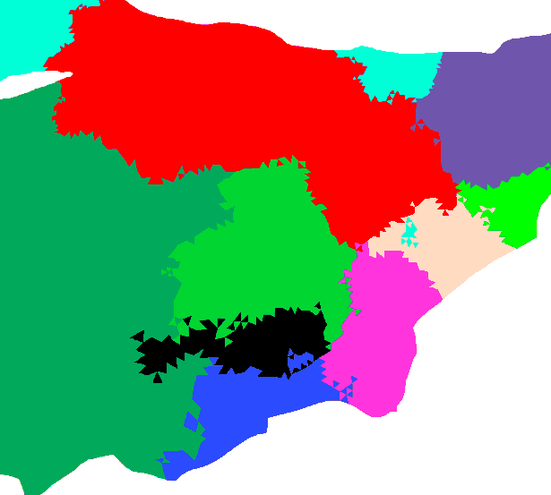

Inter-subdomain backtracking: inter_btrack()
Send and recv lists (structures)
quicksearch() − abnormal cases
nfl=2: exit aug. domain upon entry
nfl=3: exit aug. domain during iteration (save state)
Outer loop
Nbt, btlist%
btsendq%
btrecvq%
New btlist%
send%
recv%
mpi_waitsome
Several temp arrays are required for message passing, and the dimensions have 2 scales in them:
s1_mxnbt (<) s2_mxnbt
If you get an error from inter_btrack, try increasing these 2 gradually
All ranks commun.
btdone%rank
btrack()
yes
no
Aug. domain?
All done?
btdone
Exit domain
btsendq%
bttmp%
Inner loop

Slide 34
sflux_9c
surf_fluxes (called by SCHISM)
get_wind (called by SCHISM)
turb_fluxes: Calculate bulk aerodynamic surface fluxes over water using method of Zeng et al
esat_flat_r (function): Calculate saturation vapor pressure
psi_m (function):
rotate_winds:
check_allocation
netcdf_io (module):
get_rad
get_precip_flux
get_dataset_info
char_num (function): convert number to char
get_file_name (fucntion):
check_err
JD (function): Julian date
get_times_etc:
get_file_times:
check_times
get_dims
halt_error
read_coord
read_data
list_nodes
list_elems
get_weight: calculate parent elements and interpolation weights
fix_coords
get_sflux_inputs
get_bracket: in time
get_sflux_data
interp_time: interpolate in time
interp_grid: interpolate in space
combine_sflux_data: combine from 2 sources;

Slide 35
Tips
air,rad,prc
Stack # (up to 9999)
sflux_air_1.0001.nc
Data source/grid
Of all attributes in nc file, only 'base_date' is required
air, rad and prc each can have up to 2 sources;
In case of 2 sources/grids for a variable, use "1" as larger grid (i.e. encompassing hgrid.ll) and "2" as smaller grid. The code will calculate weights associated with the 2 grids, and if some nodes in hgrid.ll fall outside grid "2" the interpolation will be done on grid "1" only (see combine_sflux_data, in particular, bad_node_2 based on area coordinates outside [0,1]). Both grids must start from stack 1 and may have different # of stacks for each variable (and starting times of '1' and '2' may be different). However, within each nc file # of time steps can vary (actually the records can be in irregular times)
Grids for air, rad and prc can be different (but must be the same within each type and each source)
Additional requirements for the structured grid in .nc:
2D arrays [lon,lat](nx,ny) give x,y coord., nx is # of pts in x.
Suppose a node in the grid is given by (i,j) (1<=i<=nx), then the quad (i,j), (i+1,j), (i+1,j+1,i,j+1) must be along counter-clockwise direction;
air_1_relative_weight and other constants can be changed inside sflux_inputs.txt. These are relative weights of the 2 sources for air, rad and prc if needed. All weights must > 0
air_1_max_window_hours (etc) define the max. time stamp (offset from start time in each) within each nc file (the actual offset should not equal air_1_max_window_hours); these constants can be adjusted in sflux_inputs.txt.
More constants can be adjusted in netcdf_io and elsewhere; e.g. max_file_times (max. # of time records in each nc file) in routine get_times_etc(). Actual of time records>=2.

Slide 36
Transport: upwind/TVD/WENO (transport_TVD_imp.F90)
Unmodified fluxes at faces of prisms (horizontal)
Step 1: Sub-cycling with each time step (horizontal)
If(TVD)
Loop11: do
if(TVD) limit all fluxes
calculate dtb (1st iteration only for upwind)
Do advection with horizontal b.c. (with relaxation)
exchange
enddo loop11
Else if (WENO)
calculate dtb for 1st sub-step
calculate interfacial fluxes using WENO
Do advection, with horizontal b.c.
exchange
Endif
*Outputs some diagnostic messages (diffusion # etc)

Slide 37
TVD²
Upwind ratio
Downwind ratio
Iterative solver converges very fast
2nd-order accurate in space and time
Monotone
Alleviate the sub-cycling/small Δt for transport that plagued explicit TVD
Can be used at any depths!
TVD condition:
(iterative solver)

Slide 38
Transport: upwind/TVD/WENO (transport_TVD_imp.F90)
Step 2: TVD² (vertical dimension)
do m=1,ntr
do !iterations for implicit solver
Construct spatial limiter
Construct temporal limiter
Form tri-diag matrix (taking care of boundaries especially moving surface)
Solve implicit vertical advection (nonlinear)
Check if converged
enddo
enddo !m

Slide 39
Transport: upwind/TVD/WENO (transport_TVD_imp.F90)
Step 3: Other explicit terms (using original time step)
Calculate tri-diagonal matrix from implicit diffusion and vertical swimming/settling
Calculate RHS (explicit terms like horizontal diffusion, source/sink etc)
Solve matrix equation
Impose tracer bounds for certain modules
Exchange

Slide 40
Create your own tracer model
‘USE_GEN’: user-defined model
Set ntracer_gen and tracer-related parameters in param.in: ic_GEN…
Work on 2 files – search for ‘user-defined tracer part’
schism_init.F90: if you use standard way to init. the tracers (i.e. [hv]tr_*.ic), you do not need to do anything here
schism_step.F90:
#ifdef USE_GEN
itmp1=irange_tr(1,3)
itmp2=irange_tr(2,3)
! I'm showing an example of adding swimming velocity as body force below
! IMPORTANT: if you check conservation, make sure you take into account
! b.c. and body force. The example below sets velocity to 0 at surface and
! bottom in order to conserve mass (with no-flux b.c. there)
!$OMP do
do i=1,nea
if(idry_e(i)==1) cycle
!Element wet
flx_sf(itmp1:itmp2,i)=0
flx_bt(itmp1:itmp2,i)=0
bdy_frc(itmp1:itmp2,:,i)=0
!settling vel in internal prisms (positive downward)
wsett(itmp1:itmp2,:,i)=gen_wsett !*sin(2*pi*time/10/86400)
!$OMP end do
#endif
autocombine_MPI_elfe.pl knows the tracer module is invoked and so you can directly use it to combine results (GEN_[1,2,…])

Slide 41
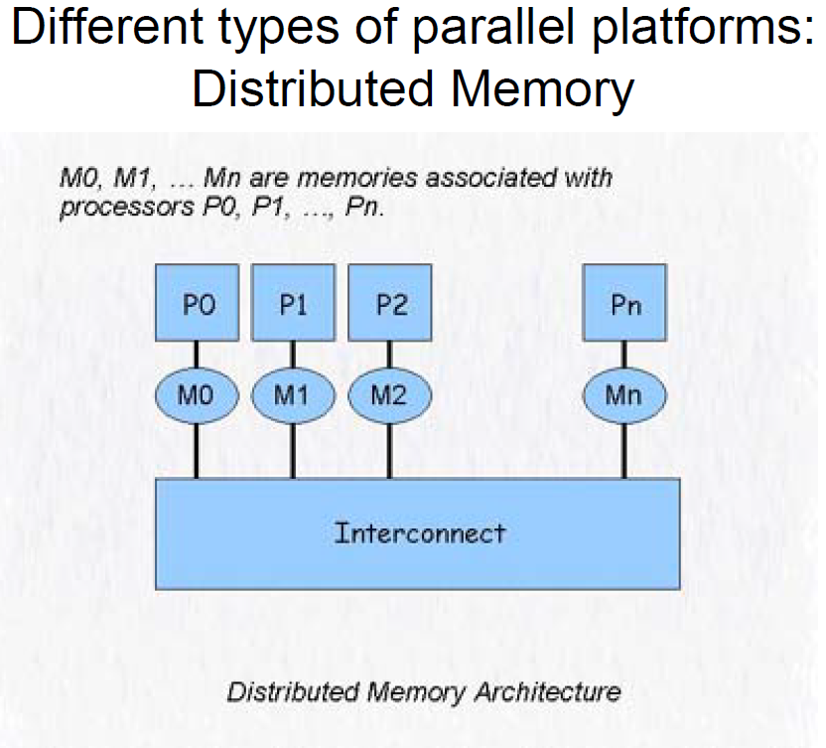
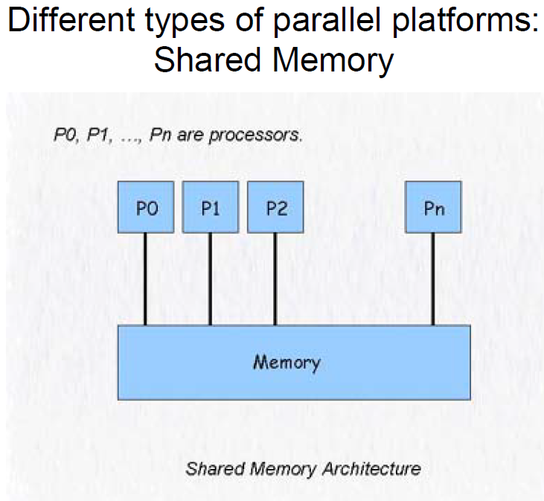
MPI vs OpenMP
MPI
openMP

Slide 42
OpenMP
OpenMP (www.openmp.org)
Protocol designed to provide automatic parallelization through compiler pragmas.
Mainly loop driven parallelism
Best suited to desktop and small SMP computers
OpenMP is a “quick and dirty” way of parallelizing a program.
OpenMP is usually used on existing serial programs to achieve moderate parallelism with relatively little effort
Caution: Race Conditions
When two threads are changing the same memory location at the same time
Conventional wisdom (at the moment)
Use MPI for smaller core count; use hybrid for large core count
OpenMP helps load imbalance, which becomes significant at large core count
Even if the load is evenly distributed across MPI processes, all processes are not created equal (e.g. intra vs inter cores)
Most MPI cmds are thread safe
OpenMP 5 supports GNU hybrid, which is the new trend
However, implementing OpenMP to avoid sync overhead is not a trivial task

Slide 43
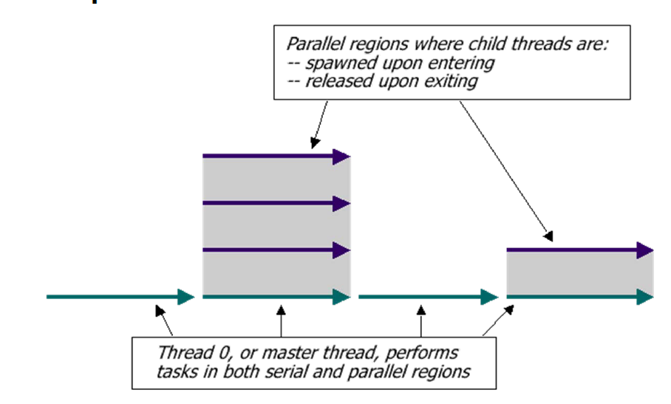
OpenMP execution model
In OpenMP, execution begins only on the master thread. Child threads are spawned and released as needed.
Threads are spawned when program enters a parallel region.
Threads are released when program exits a parallel region

Slide 44
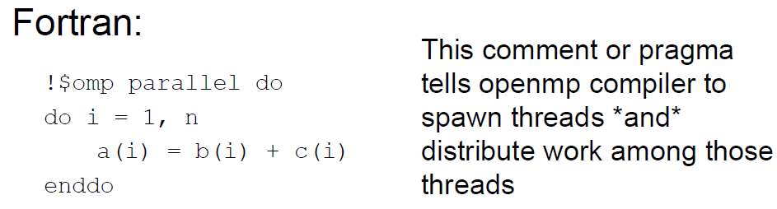
OpenMP example
$omp end parallel do
Important: user can NOT control the order of execution with OMP!

Slide 45
Running OpenMP
OMP_NUM_THREADS environment variable sets the number of processors the OpenMP program will have at its disposal.
#!/bin/tcsh
setenv OMP_NUM_THREADS 4
./mycode < my.in > my.out

Slide 46
Pitfall #1: Data dependencies
Consider the following code:
a(1) = 1;
do i=1,5
a(i) = i + a(i-1)
enddo
There are dependencies between loop iterations.
Sections of loops split between threads will not necessarily execute in order
Out of order loop execution will result in undefined behavior

Slide 47
Pitfall #2: race condition
$OMP parallel do
do i=1,10
temp=2*a(i)
a(i)=temp
b(i)=temp/c(i)
enddo !i
$OMP end parallel do
By default, all threads share a common address space. Therefore, all threads will be modifying temp simultaneously, resulting in race condition (which may corrupt memory in the worst scenario!)
Race condition is the most common bug in openMP and is also the trickiest to find, as program may actually work properly most of time and the errors are random (welcome to the parallel world)
Solution is to declare temp as a private var (i.e. each thread has different copy of it (in memory))
Note the iteration var is always private!! Arrays are usually shared
$OMP parallel do default(shared) private(i,temp)
do i=1,10
temp=2*a(i)
a(i)=temp
b(i)=temp/c(i)
enddo !i
$OMP end parallel do

Slide 48
Reduction operations
It’s a common task to find max/min, sum etc of arrays etc
Making intermediate var private only solves part of the problem, as we still need to find a global value from all private copies
openMP provides reduction operators that go with loops
Reduction vars are always shared
Sync overhead!
Outside parallel region
sum1=0
!$OMP parallel default(shared) private(i)
!$OMP do reduction(+: sum1)
do i=1,n
sum1=sum1+a(i)
enddo !i
$OMP end do
$OMP end parallel
Spawning threads
Destroying threads

Slide 49
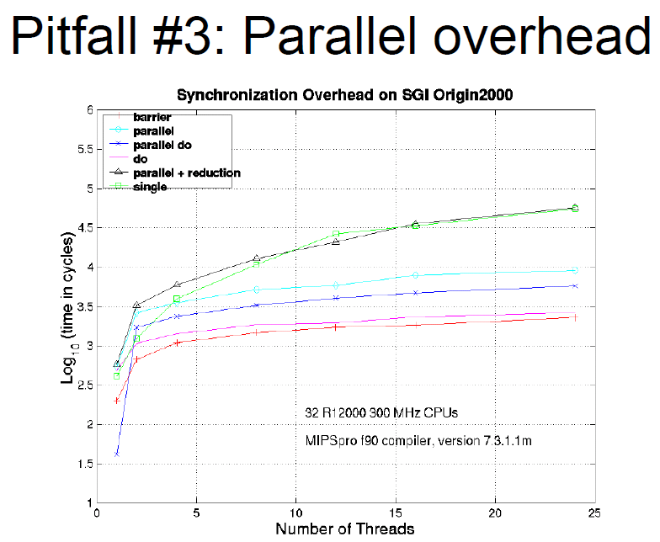

Slide 50
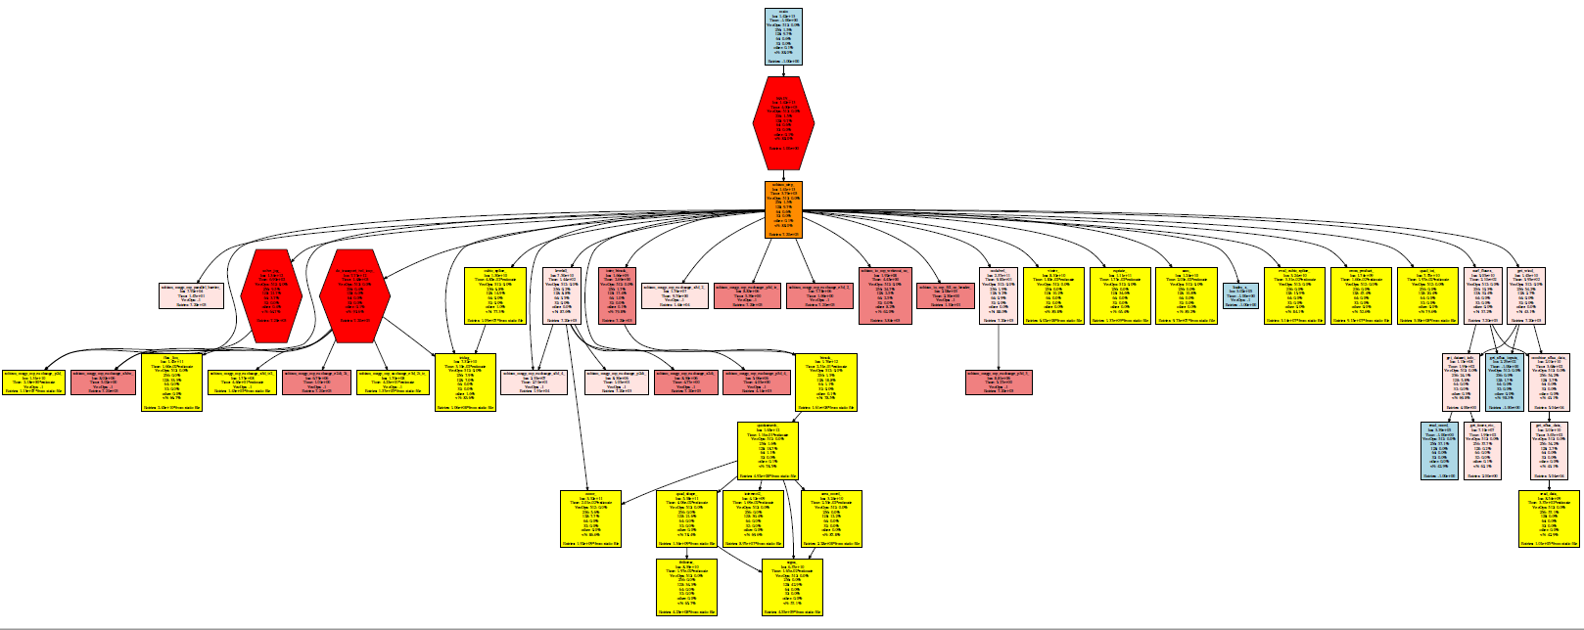
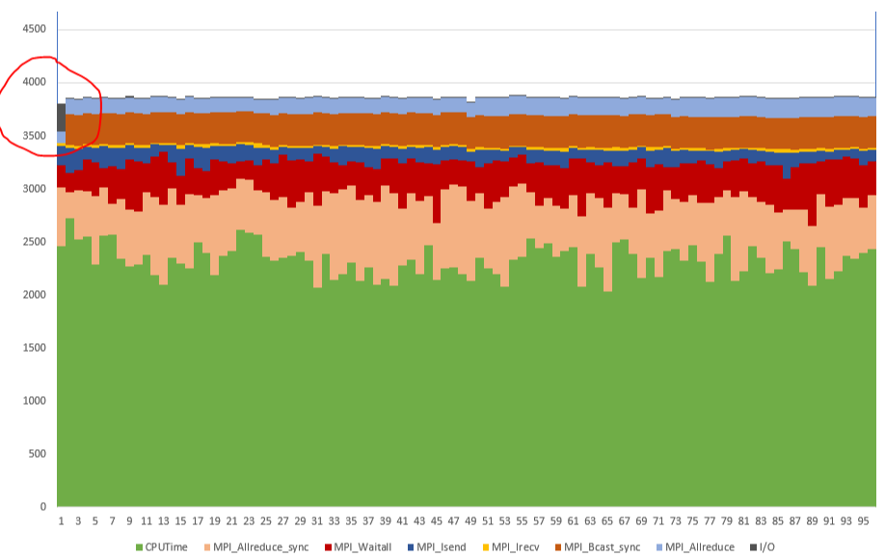
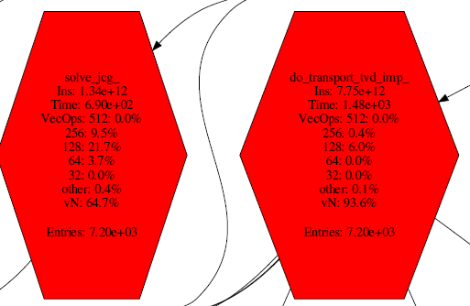
Performance tuning
Bay-Delta case on Stampede2 (SKX)
c/o: Laura Carrington, SDSC

Slide 51
Summary
Before you work on the code
Familiarize yourself with the important geometric and dynamic arrays
Mindful of ghost exchanges
Mindful of openMP
Plan out your new algorithm and discuss it with other developers
Pay attention to parallel efficiency (strong and weak scaling), as SCHISM is envisioned to scale to 10K cores
Always discuss with me and other developers before you embark on any substantive changes to the code (including modules)
Use svn effectively for incremental developments
Test/revise/test/revise…

