Slide 1
SCHISM: vegetation formulation
Joseph Zhang

Slide 2
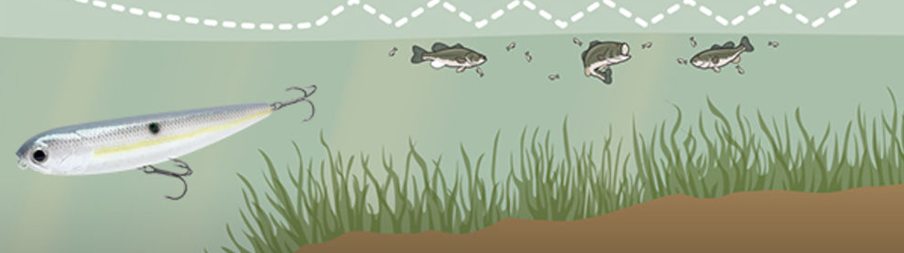



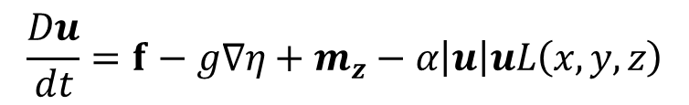

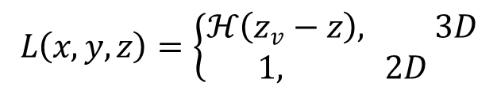
Governing equations: Reynolds-averged Navier-Stokes (with vegetation)
Continuity equation
Momentum equations
vegetation
$$\frac{Du}{dt}=f−g∇η+m_{z}−α\left|u\right|uL\left(x,y,z\right)$$
$$\left\{\begin{matrix}ν\frac{∂u}{∂z}=τ_{w}, z=η \\ ν\frac{∂u}{∂z}=χu_{b}, z=−h\end{matrix}\right.$$
  Vertical b.c. (3D):
$$(χ=C_{D}\left|u_{b}\right|)$$
$$m_{z}=\left\{\begin{matrix}\frac{∂}{∂z}\left(ν\frac{∂u}{∂z}\right), 3D \\ \frac{τ_{w}−χu}{H}, 2D\end{matrix}\right.$$
z
East
MSL
x
$$L\left(x,y,z\right)=\left\{\begin{matrix}ℋ\left(z_{v}−z\right), 3D \\ 1, 2D\end{matrix}\right.$$
z=z_{v}
$$α(x,y)=D_{v}N_{v}C_{Dv}/2$$
(vegetation)

Slide 3
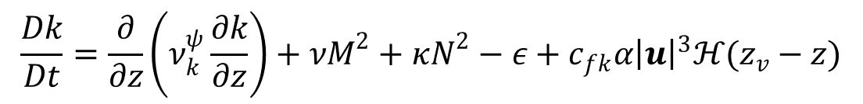
Governing equations: Reynolds-averged Navier-Stokes (with vegetation)
Equation of state
Transport of salt and temperature
Turbulence closure: Umlauf and Burchard 2003
Wave attenuation by vegetation: Mendez and Losada (2004) implemented inside WWM
shear
stratification
$$\frac{Dk}{Dt}=\frac{∂}{∂z}\left(ν_{k}^{ψ}\frac{∂k}{∂z}\right)+νM^{2}+κN^{2}−ε+c_{fk}α{\left|u\right|}^{3}ℋ(z_{v}−z)$$
vegetation
$$\frac{Dψ}{Dt}=\frac{∂}{∂z}\left(ν_{ψ}^{}\frac{∂ψ}{∂z}\right)+\frac{ψ}{k}\left[c_{ψ1}νM^{2}+c_{ψ3}κN^{2}−c_{ψ2}εF_{wall}+c_{fψ}α{\left|u\right|}^{3}ℋ(z_{v}−z)\right]$$

Slide 4
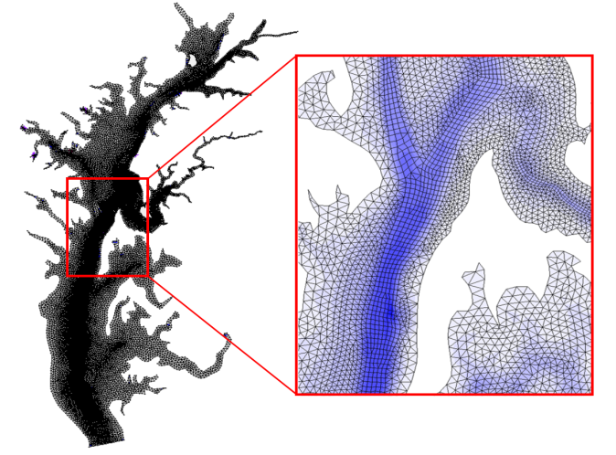
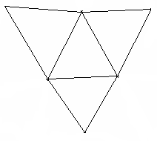

Horizontal grid: hybrid
3
4
Side 2
3
Side 2
Side 1
Side 3
Side 1
1
Side 4
2
1
Side 3
2
3
2
1
1
2
Counter-clockwise convention
3
3
y_{s}
2
2
x_{s}
i
2
1
i
N_{i}
1
N_{i}
1
2
N_{i}
1
N_{i}
i
1
Internal ‘ball’: starting elem is arbitrary
Boundary ball: starting elem is unique

Slide 5
Vertical grid (1): SZ
Terrain-following zone
SZ zone
z
σ zone
S zone
N_{z}
σ=0
h_{c}
h_{s}
h_{s}
S-levels
k^{z}
σ=-1
k^{z}−1
Z-levels
2
1
Notes:
The F.S. cannot fall below hc<=hs

Slide 6
Vertical grid: SZ
z=−h_{s}
The bottom cells are shaved – no staircases!

Slide 7
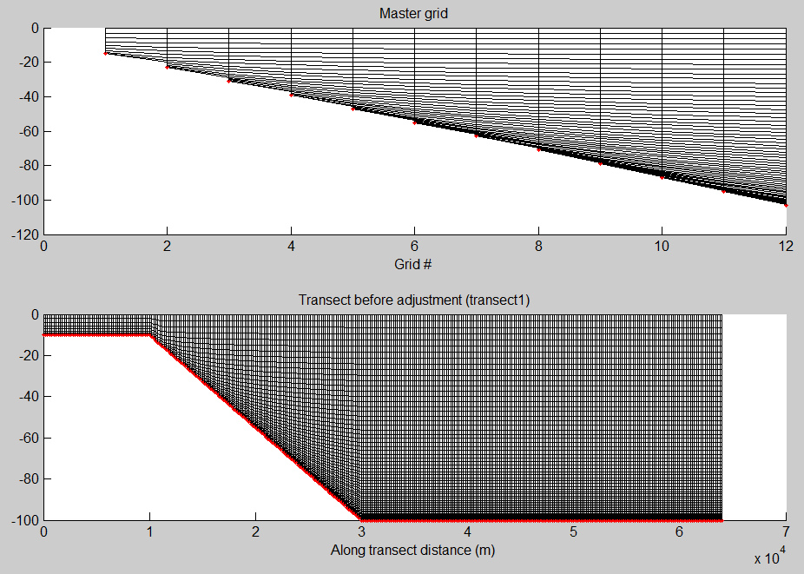
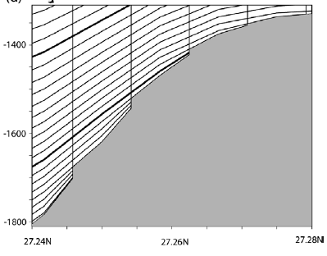
Vertical grid (2): LSC² via VQS
Dukhovskoy et al. (2009)
Procedure for VQS
Different # of levels are used at different depths
At a given depth, the # of levels is interpolated from the 2 adjacent master grids
Thin layers near the bottom are masked
Staircases appear near the bottom (like Z), but otherwise terrain following
Notes:
Masking process unnecessary

Slide 8

What to do with the staircases?
A
u
u
P
1
B
2
R
Q
1
2
LSC²= Localized Sigma Coordinates with Shaved Cells
(ivcor =1 in vgrid.in)
*No masking of thin layers (c/o implicit scheme)

Slide 9
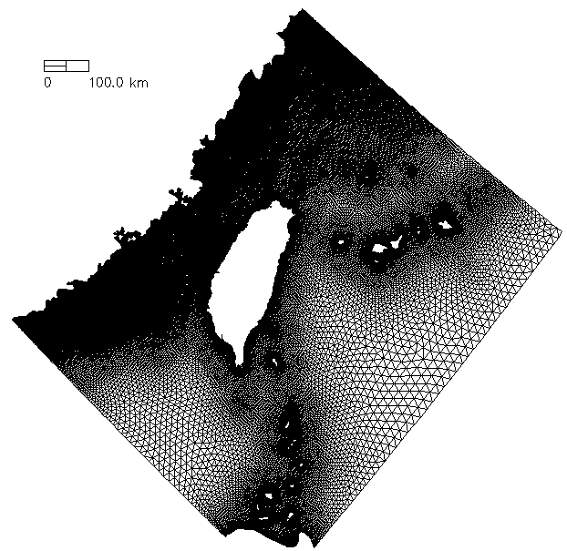
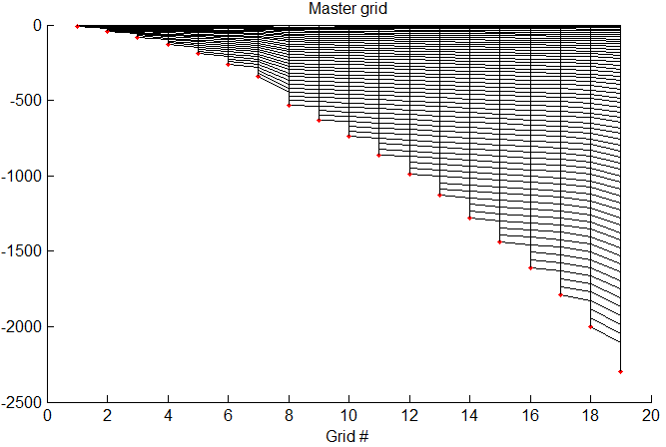
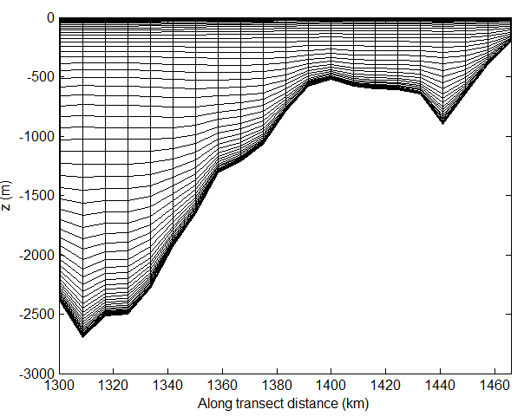
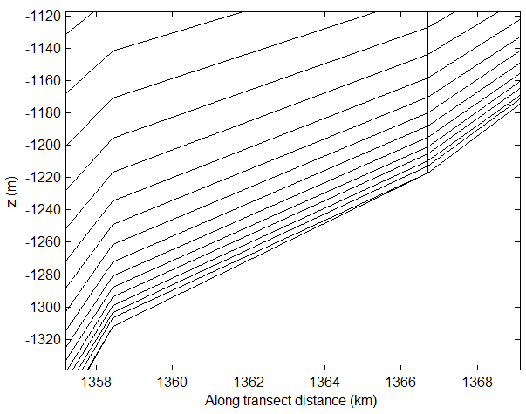
Vertical grid: LSC²
z (m)
Degenerate prism

Slide 10
Staggering of variables
3D computational unit: uneven prisms
Equations are not transformed into S- or σ-coordinates, but solved in the original Z-space
Pressure gradient
  Z-method with cubic spline (extrapolation on surface/bottom)
n_{k}
n_{k}
k (whole level)
k
N_{z}
η
N_{z}-1
u_{j,k+1} v_{j,k+1}
η
…….
u_{j,k+1} v_{j,k+1}
C_{i,k}
k
k-1
C_{i,k}
…….
k-1
k-1
w_{i,k-1}
w_{i,k-1}
k_{b}+1
k_{b}

Slide 11
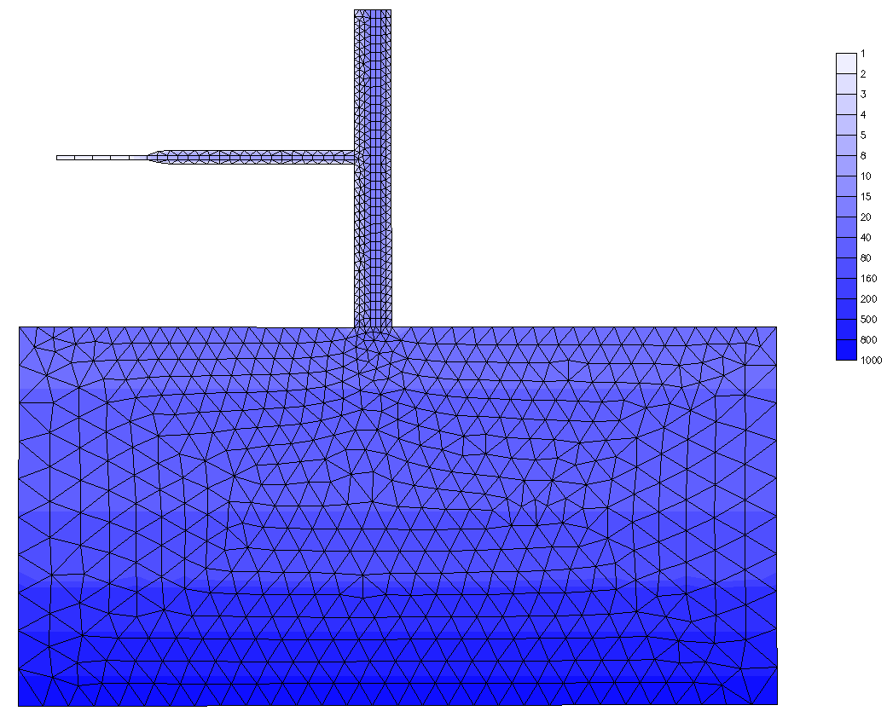
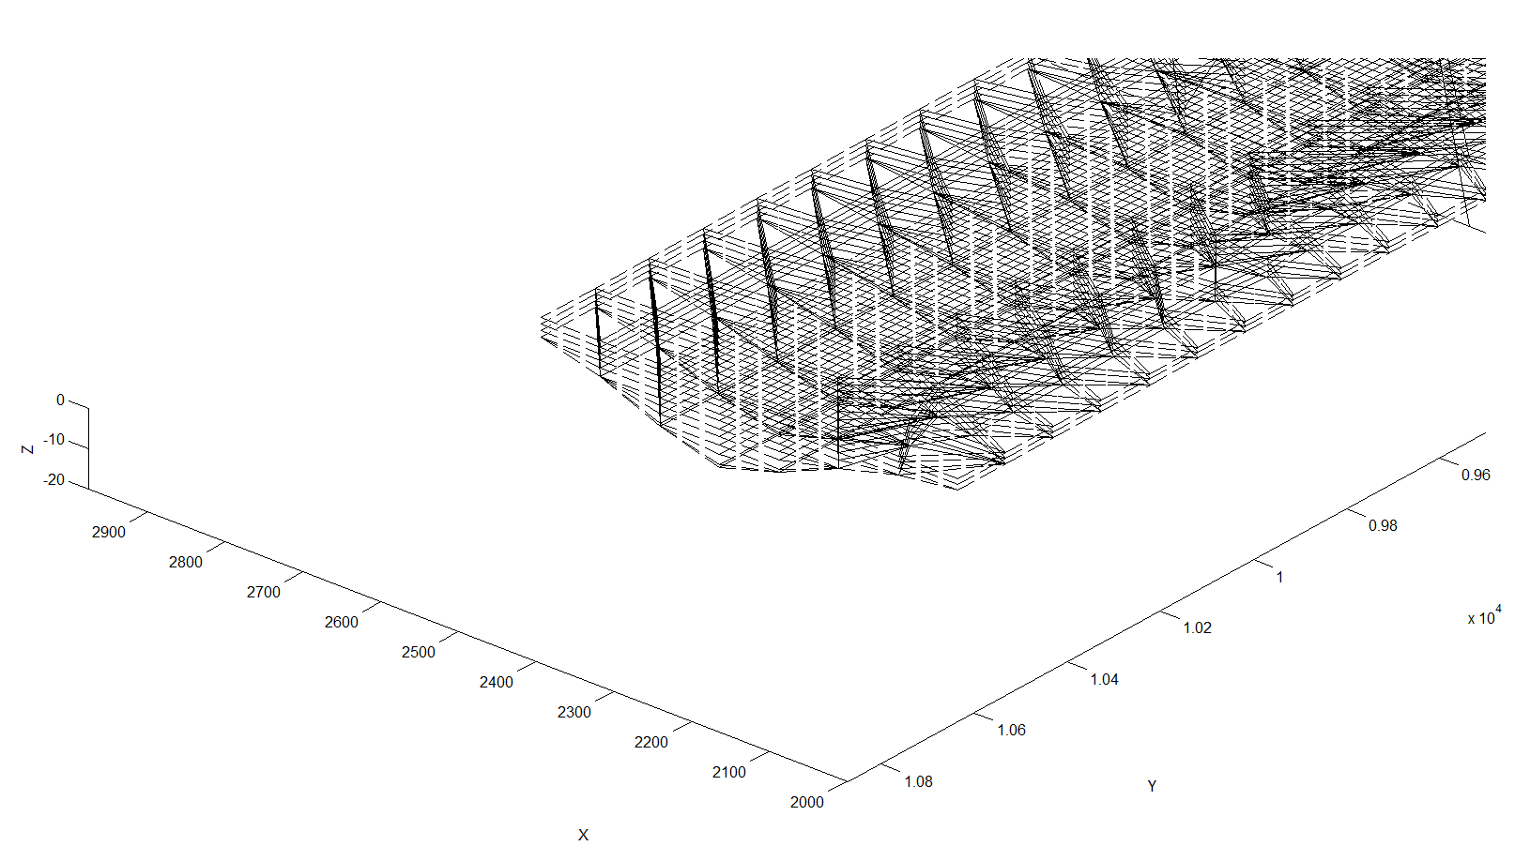
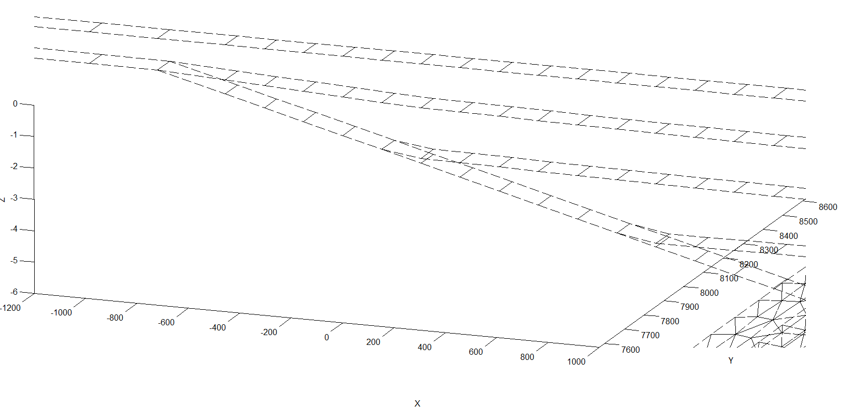
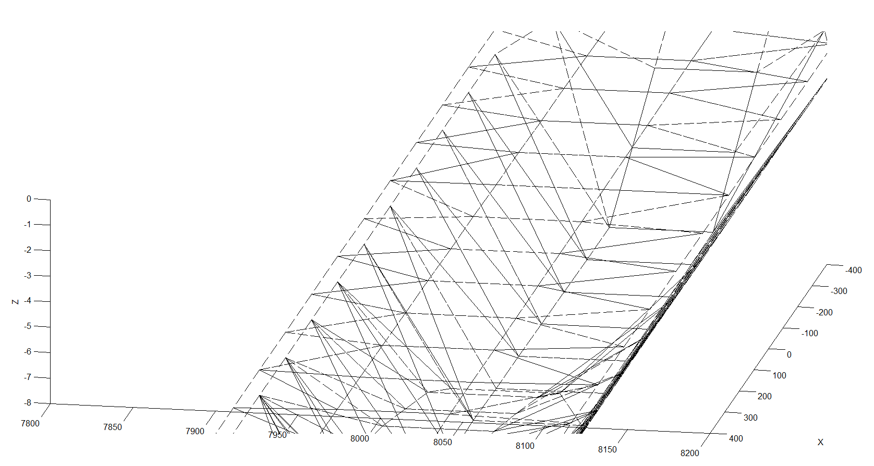
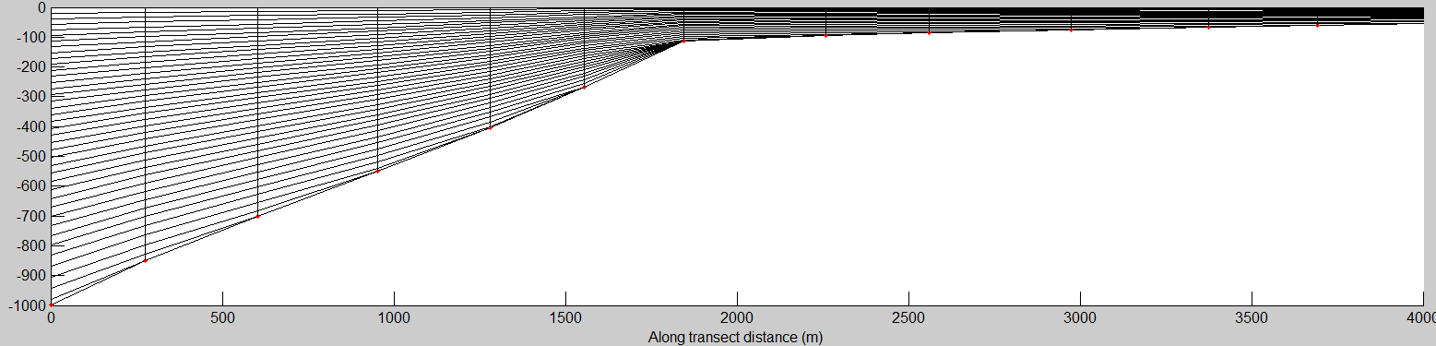
Polymorphism
Zhang et al. (2016)
Bathymetry (m)
Notes:
Flexibility is not just in the horizontal

Slide 12
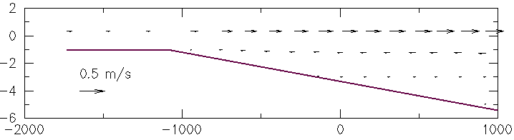

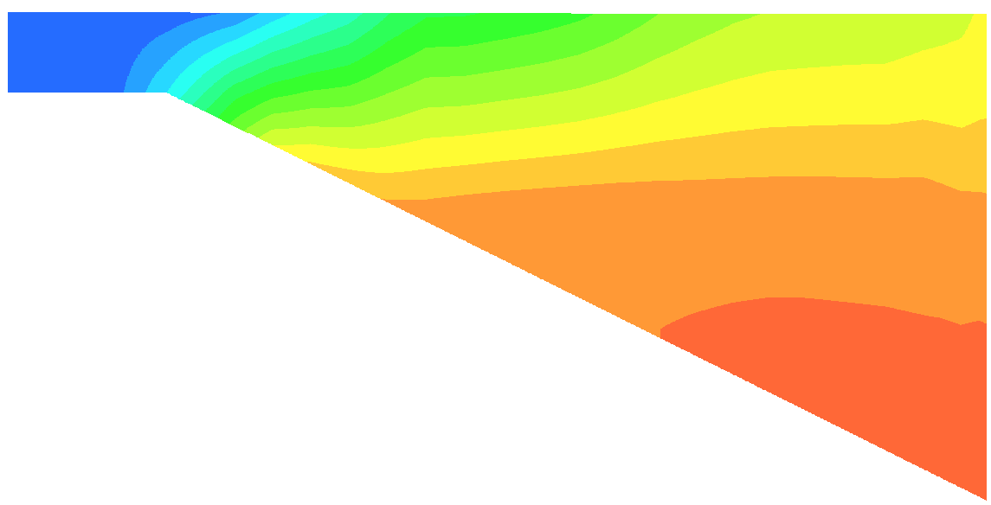
Polymorphism
flood
z (m)
x (m)
S (PSU)
*Make sure there is no jump in Cd between 2D/3D zones

Slide 13

Semi-implicit scheme
Continuity
Momentum
$$\frac{u^{n+1}−u^{∗}}{Δt}=f−gθ∇η^{n+1}−g(1−θ)∇η^{n}+m_{z}^{n+1}−α\left|u\right|u^{n+1}L\left(x,y,z\right)$$
b.c. (3D)
Advection:
$$≈$$
Implicit treatment of divergence, pressure gradient and SAV form drag terms by-passes most severe stability constraints: 0.5 ≤θ≤1
Explicit treatment: Coriolis, baroclinicity, horizontal viscosity, radiation stress…

Slide 14
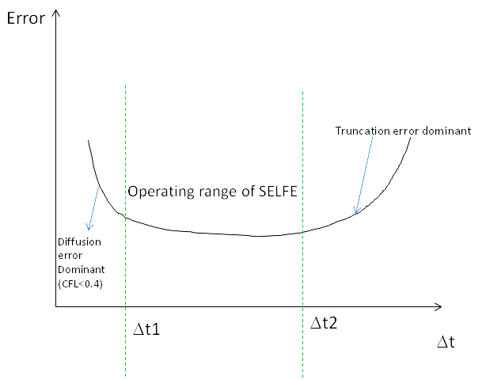
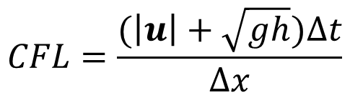
Operating range of SCHISM
…. for a fixed grid
$$CFL=\frac{(\left|u\right|+\sqrt{gh})∆t}{∆x}$$
ELM prefers larger Δt (truncation error ~1/Δt)
  As a result, SCHISM requires CFL>0.4
Convergence: CFL=const, Δt→0
For barotropic field applications: [100,450] sec
For baroclinic field applications: [100,200] sec (e.g., start with 150 sec)

Slide 15
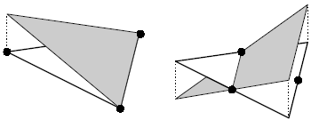
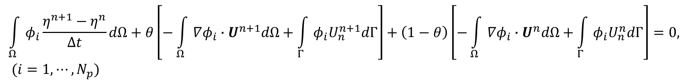
Galerkin finite-element formulation
A Galerkin weighted residual statement for the continuity equation:
$$\int_{Ω}{φ_{i}\frac{η^{n+1}−η^{n}}{Δt}dΩ}+θ\left[−\int_{Ω}{∇φ_{i}∙U^{n+1}dΩ+\int_{Γ}{φ_{i}U_{n}^{n+1}dΓ}}\right]+\left(1−θ\right)\left[−\int_{Ω}{∇φ_{i}∙U^{n}dΩ+\int_{Γ}{φ_{i}U_{n}^{n}dΓ}}\right]=0, (i=1,⋯,N_{p})$$
$φ_{i}$: shape/weighting function; U: depth-integrated velocity; θ:implicitness factor
Need to eliminate U^{n+1} to get an equation for η alone. We’ll do this with the aid from momentum equation:
$$\frac{u^{n+1}−u^{∗}}{Δt}=f−gθ∇η^{n+1}−g(1−θ)∇η^{n}+m_{z}^{n+1}−α\left|u\right|u^{n+1}L\left(x,y,z\right)$$
Shape function (global)
Conformal
Non-conformal

Slide 16

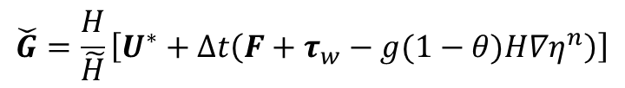
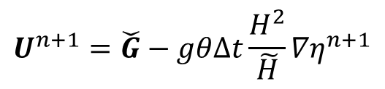
2D case
The unknown velocity can be easily found as:
$$U^{n+1}=\check{G}−gθΔt\frac{H^{2}}{\tilde{H}}{∇η}^{n+1}$$
$$\check{G}=\frac{H}{\tilde{H}}\left[U^{∗}+∆t\left(F+τ_{w}−g(1−θ)H∇η^{n}\right)\right]$$
(explicit terms)
$$\tilde{H}=H+(χ+α|u|H)Δt$$
* The effect of vegetation in 2D is equivalent to bottom friction, with C_{D} increased by αH

Slide 17
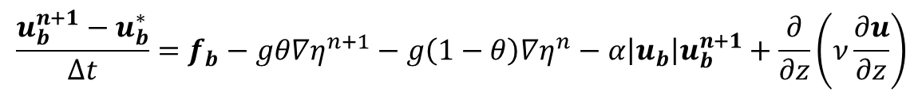
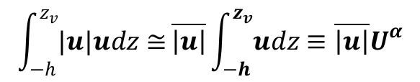
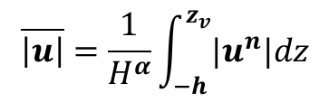
3D case
Vertical integration of the momentum equation from bottom to surface:
u_{b}
$$\frac{U^{n+1}−U^{∗}}{Δt}=F−gθ∇η^{n+1}−g\left(1−θ\right)∇η^{n}+τ_{w}−χu_{b}^{n+1}−α\overline{\left|u\right|}U^{α}$$
δ_{b}
$$\int_{−h}^{z_{v}}{|u|udz≅}\overline{\left|u\right|}\int_{−h}^{z_{v}}{udz}≡\overline{\left|u\right|}U^{α}$$
z=−h
Assuming:
$$\overline{\left|u\right|}=\frac{1}{H^{α}}\int_{−h}^{z_{v}}{|u^{n}|dz}$$
Momentum equation applied to the bottom boundary layer
$$\frac{u_{b}^{n+1}−u_{b}^{∗}}{Δt}=f_{b}−gθ∇η^{n+1}−g\left(1−θ\right)∇η^{n}−α\left|u_{b}\right|u_{b}^{n+1}+\frac{∂}{∂z}\left(ν\frac{∂u}{∂z}\right)$$
Therefore
$$u_{b}^{n+1}=\frac{1}{1+α|u_{b}|∆t}\left[u_{b}^{∗}+f_{b}∆t−g(1−θ)∆t∇η^{n}\right]−\frac{gθ∆t}{1+α|u_{b}|∆t}∇η^{n+1}$$
Now still need to find U^{α}

Slide 18
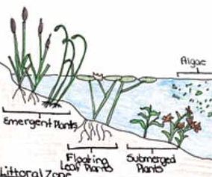
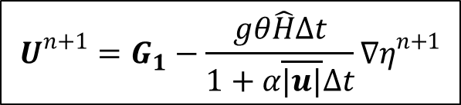

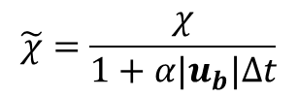
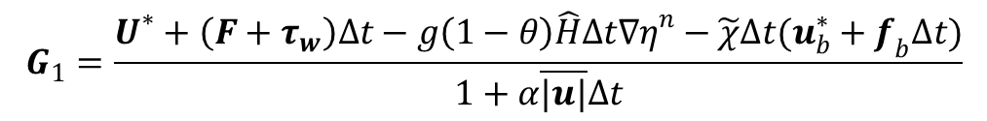

3D case: locally emergent vegetation
We have
$$U^{α}=U^{n+1}$$
So:
$$U^{n+1}=G_{1}−\frac{gθ\hat{H}Δt}{1+α\overline{|u|}∆t}{∇η}^{n+1}$$
$$G_{1}=\frac{U^{∗}+\left(F+τ_{w}\right)∆t−g\left(1−θ\right)\hat{H}∆t{∇η}^{n}−\tilde{χ}∆t(u_{b}^{∗}+f_{b}∆t)}{1+α\overline{|u|}∆t}$$
$$\hat{H}=H−\tilde{χ}∆t$$
$$\tilde{χ}=\frac{χ}{1+α|u_{b}|∆t}$$

Slide 19
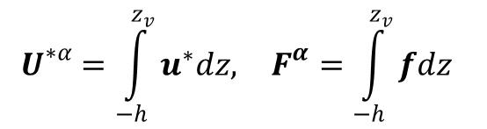
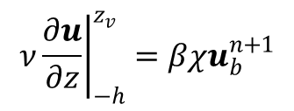

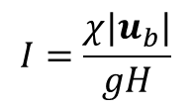


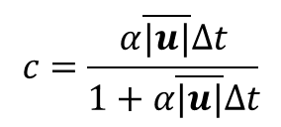
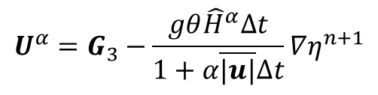
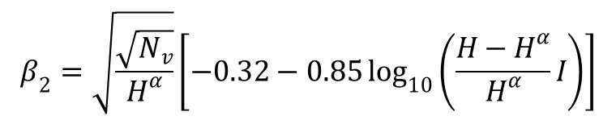

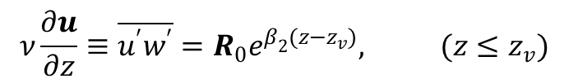

3D case: locally submerged vegetation
Integrating from bottom to top of canopy:
$$U^{α}=U^{∗α}+F^{α}∆t−gθH^{α}∆t∇η^{n+1}−g(1−θ)H^{α}∆t∇η^{n}−α∆t\overline{\left|u\right|}U^{α}+∆tν{\left.\frac{∂u}{∂z}\right|}_{−h}^{z_{v}}$$
$$U^{∗α}=\int_{−h}^{z_{v}}{u^{∗}dz, } F^{α}=\int_{−h}^{z_{v}}{fdz }$$
Inside vegetation layer, the stress obeys exponential law (Shimizu and Tsujimoto 1994)
$$ν\frac{∂u}{∂z}≡\overline{u^{′}w^{′}}=R_{0}e^{β_{2}(z−z_{v})}, (z≤z_{v})$$
$β_{2}$ is a constant found from empirical formula (calculated from previous time step):
$$β_{2}=\sqrt{\frac{\sqrt{N_{v}}}{H^{α}}}\left[−0.32−0.85\log_{10}\left(\frac{H−H^{α}}{H^{α}}I\right)\right]$$
$$I=\frac{χ|u_{b}|}{gH}$$
$$ν{\left.\frac{∂u}{∂z}\right|}_{−h}^{z_{v}}=βχu_{b}^{n+1}$$
Therefore
$$(β=e^{β_{2}\left(z_{v}−z_{b}\right)}−1)$$
$$U^{α}=G_{3}−\frac{gθ{\hat{H}}^{α}∆t}{1+α\overline{|u|}∆t}∇η^{n+1}$$
${(G}_{3}=\frac{U^{∗α}+F^{α}∆t+β\tilde{χ}∆t\left(u_{b}^{∗}+f_{b}∆t\right)−g(1−θ){\hat{H}}^{α}∆t∇η^{n}}{1+α\overline{|u|}∆t}$)
$${\hat{H}}^{α}=H^{α}+β\tilde{χ}∆t$$
Finally:
$$c=\frac{α\overline{|u|}∆t}{1+α\overline{|u|}∆t}$$
$$U^{n+1}=G_{2}−gθ\overset{̿}{H}Δt{∇η}^{n+1}$$
$$\overset{̿}{H}=H−\tilde{χ}Δt−c{\hat{H}}^{α}$$

Slide 20

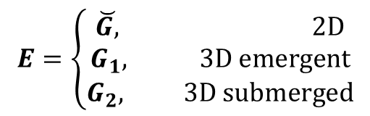
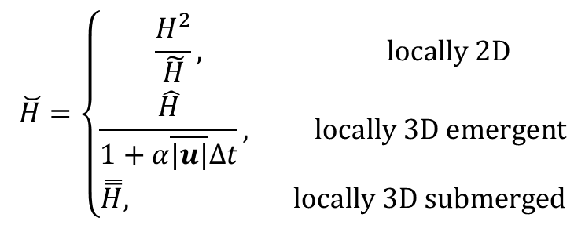

General case
In compact form:
$$U^{n+1}=E−gθ\breve{H}Δt{∇η}^{n+1}$$
$$\breve{H}=\left\{\begin{matrix}\frac{H^{2}}{\tilde{H}}, locally 2D \\ \frac{\hat{H}}{1+α\overline{|u|}∆t}, locally 3D emergent \\ \overset{̿}{H}, locally 3D submerged\end{matrix}\right.$$
(Note the difference in $\check{H}$between 2D/3D)
$$E=\left\{\begin{matrix}\breve{G, } 2D \\ G_{1}, 3D emergent \\ G_{2}, 3D submerged\end{matrix}\right.$$
The choices of 2D/3D emergent/submerged are made at each side

Slide 21
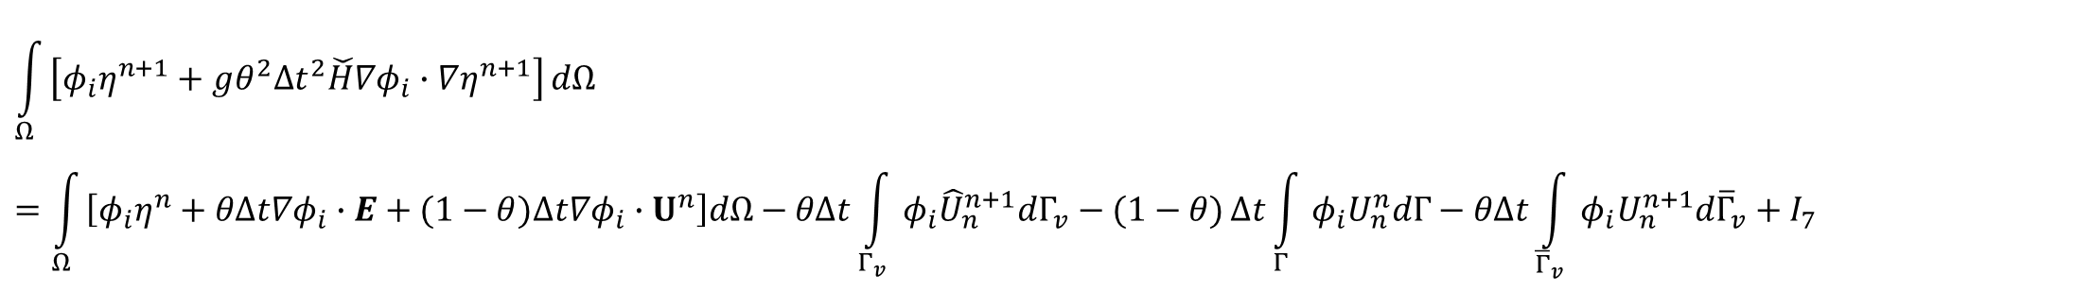
Finite-element formulation (cont’d)
Finally, substituting this eq. back to continuity eq. we get one equation for elevations alone:
I₁
$$\int_{Ω}{\left[φ_{i}η^{n+1}+gθ^{2}{Δt}^{2}\check{H}∇φ_{i}∙∇η^{n+1}\right]}dΩ=\int_{Ω}{\left[φ_{i}η^{n}+θΔt∇φ_{i}∙E+(1−θ)Δt∇φ_{i}∙U^{n}\right]dΩ−θΔt\int_{Γ_{v}}{φ_{i}{\hat{U}}_{n}^{n+1}dΓ_{v}−(1−θ)}Δt\int_{Γ}{φ_{i}U_{n}^{n}dΓ−θΔt\int_{{\overline{Γ}}_{v}}{φ_{i}U_{n}^{n+1}d{\overline{Γ}}_{v}+I_{7}}}}$$
I₃
I₄
I₅
I₆
sources
(i=1,…,N_{p})
Notes:
When node i is on boundaries where essential b.c. is imposed, η is known and so no equations are needed, and so I₂ and I₆ need not be evaluated there
When node i is on boundaries where natural b.c. is imposed, the velocity is known and so the last term on LHS is known → only the first term is truly unknown!
b.c. is free lunch in FE model (cf. staggering in FV)
The inherent numerical dispersion in FE nicely balances out the numerical diffusion inherent in the implicit time stepping scheme!

Slide 22
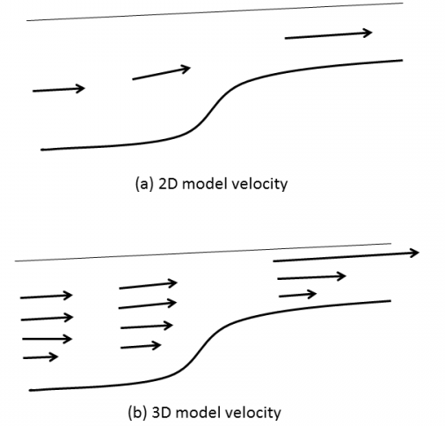


Matrices: I₁
$$\check{H}$$
i34(j)
Ω_{j}
$$\check{H}$$
i
i’ is local index of node i in Ω_{j}.
reaches its max when i’=l, and so does I₁.
i’
so diagonal is dominant if the averaged friction-reduced depth ≥0 (can be relaxed)
Mass matrix is positive definite and symmetric! JCG or PETSc solvers work fine
(i’,1)
>
(i’,2)
Notes:
The conditioning of the matrix is related to depth and wet/dry – complex issue. Physically….

Slide 23
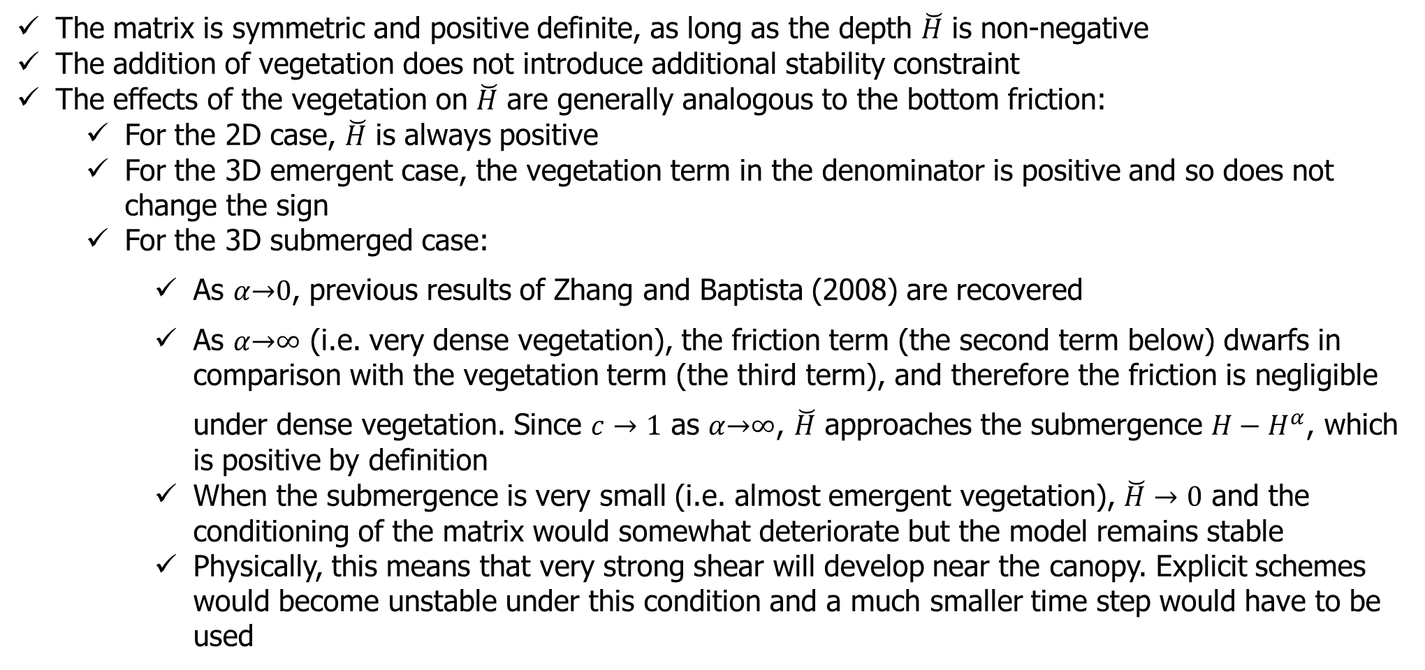

Matrix
The matrix is symmetric and positive definite, as long as the depth $\breve{H}$ is non-negative
The addition of vegetation does not introduce additional stability constraint
The effects of the vegetation on $\breve{H}$ are generally analogous to the bottom friction:
  For the 2D case, $\breve{H}$ is always positive
  For the 3D emergent case, the vegetation term in the denominator is positive and so does not change the sign
  For the 3D submerged case:
    As $α\underset{→}{}0$, previous results of Zhang and Baptista (2008) are recovered
    As $α\underset{→}{}∞$ (i.e. very dense vegetation), the friction term (the second term below) dwarfs in comparison with the vegetation term (the third term), and therefore the friction is negligible under dense vegetation. Since $c→1$ as $α\underset{→}{}∞$, $\breve{H}$ approaches the submergence ${H−H}^{α}$, which is positive by definition
    When the submergence is very small (i.e. almost emergent vegetation), $\breve{H}→0$ and the conditioning of the matrix would somewhat deteriorate but the model remains stable
    Physically, this means that very strong shear will develop near the canopy. Explicit schemes would become unstable under this condition and a much smaller time step would have to be used
$$\overset{̿}{H}=H−\tilde{χ}Δt−c{\hat{H}}^{α}$$
friction
vegetation

Slide 24

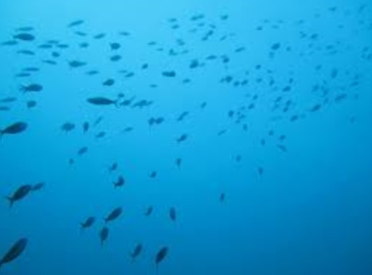
Eulerian-Lagrangian Method (ELM)
ELM: takes advantage of both Lagrangian and Eulerian methods
  Grid is fixed in time, and time step is not limited by Courant number condition
  Advections are evaluated by following a particle that starts at certain point at time t and ends right at a pre-given point at time t+Δt.
  The process of finding the starting point of the path (foot of characteristic line) is called backtracking, which is done by integrating dx/dt=u₃ backward in 3D space and time.
  To better capture the particle movement, the backward integration is often carried out in small sub-time steps
    Simple backward Euler method
    2nd-order R-K method
    Interpolation-ELM does not conserve; integration ELM does
  Interpolation: numerical diffusion vs. dispersion
t+Δt
Characteristic line (3D)
t
advection
Flow
dispersion
diffusion

Slide 25
Baroclinicity: projection method
Interpolate density along horizontal Z-planes
  Advantage: alleviate pressure gradient errors (Fortunato and Baptista 1996)
  Disadvantage: near surface or bottom
Density is defined at prism centers (half levels)
Re-construction method: compute directional derivatives along two direction at node i and then convert them back to x,y
Density gradient calculated at prism centers first (for continuity eq.); the values at face centers are averaged from those at prism centers (for momentum eq.)
  constant extrapolation (shallow) is used near bottom
  Cubic spline is used in all interpolations of ρ
  Mean density profile can be optionally removed
3 or 4 eqs for the density gradient vs. 2 unknowns – averaging needed for 3 pairs; e.g.
  Degenerate cases: when the two vectors are co-linear (discard)
  Vertical integration using trapzoidal rule
The 'below-bottom' case: gradient is zeroed out if element h>=h2_bcc (i.e. like Z) or uses constant extrapolation (i.e. like terrain-following) if h<=h1_bcc(<h2_bcc); linear transition in between
B
3
1
0
Element j
A
2

Slide 26
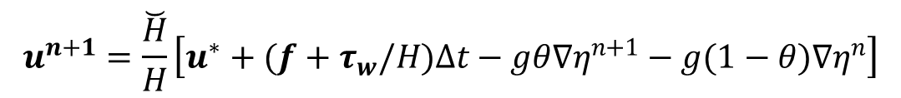
Momentum equation: 2D case
The depth-averaged velocity can be directly solved once unknown elevations are found:
$$u^{n+1}=\frac{\breve{H}}{H}\left[u^{∗}+(f+τ_{w}/H)∆t−gθ∇η^{n+1}−g(1−θ)∇η^{n}\right]$$
@side centers

Slide 27
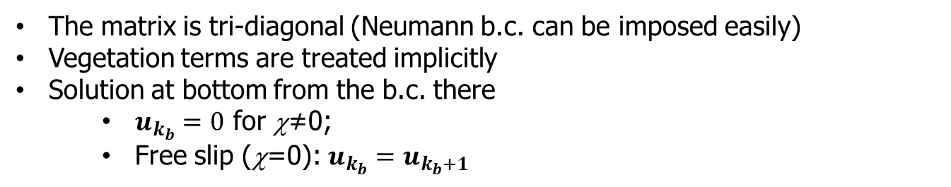


Momentum equation: 3D case
Galerkin FE in the vertical column of a side center:
$$\int_{z_{b}}^{η}{φ_{l}\left[bu^{n+1}−Δt\frac{∂}{∂z}\left(ν\frac{∂u^{n+1}}{∂z}\right)\right]dz}=\int_{z_{b}}^{η}{φ_{l}gdz}, (l=k_{b}+1,⋯,N_{z})$$
$$b=1+α|u^{n}|Δtℋ(z_{v}−z)$$
Vegetation
$φ_{l}$: vertical hat function; g: explicit terms
b
The matrix is tri-diagonal (Neumann b.c. can be imposed easily)
Vegetation terms are treated implicitly
Solution at bottom from the b.c. there
  $u_{k_{b}}=0$ for χ≠0;
  Free slip (χ=0): $u_{k_{b}}=u_{k_{b}+1}$
N_{z}
……..
k_{b}+2
k_{b}+1
δ_{b}
z=-h
k_{b}

Slide 28

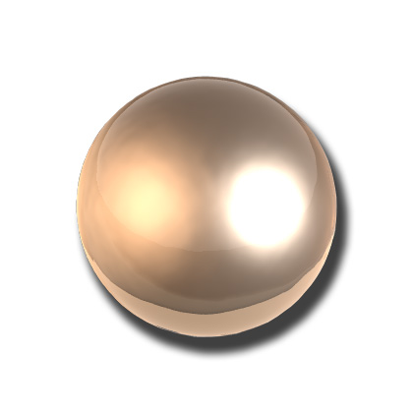
Velocity at nodes
Needed for ELM (interpolation), and can serve as a way to further stabilize the mom solver by adding some inherent numerical diffusion
Method 1: inverse-distance averaging around ball (indvel=1 or MA schemes) – larger dissipation; no further stabilization needed
Method 2: use linear shape function (conformal) (indvel=0 or MB schemes)
  Discontinuous across elements; averaging to get the final value at node
  Split quads into a pair of triangles to use this formula
  Generally requires velocity b.c. at open boundary (mostly for incoming info)
  indvel=0 generally gives less dissipation but needs further stabilization in the form of viscosity or Shapiro filter for stabilization (important for eddying regime)
An ideal numerical algorithm should strike a balance between dispersion and diffusion (dissipation). Neither dispersion nor dissipation is good!
i
3
II
I
1
III
2
Diffusion
Dispersion
Eternal struggle between diffusion and dispersion

Slide 29
Shaprio filter
A simple filter to reduce sub-grid scale (unphysical) oscillations while leaving the physical signals largely intact (α=0.5 optimal)
1
4
0
No filtering for boundary sides – so need b.c. there especially for incoming flow
Equivalent to Laplacian viscosity
3
2

Slide 30
Horizontal viscosity
Important for eddying regime for adding proper dissipation
P
1
4
1
x,η
6
y,ξ
Assuming uniformity
Q
I
0
x
II
S
2
x
0
5
2
3
I
II
(like Shapiro filter)
R
3
4
Bi-harmonic viscosity (ideal in eddying regime)
1a
4b
1b
1
4
4a
0
x
2a
2
3
3b
2b
3a
(Zhang et al. 2016)

Slide 31

Turbulence closure (itur=3)
$$\frac{Dk}{Dt}=\frac{∂}{∂z}\left(ν_{k}^{ψ}\frac{∂k}{∂z}\right)+νM^{2}+κN^{2}+c_{fk}α{\left|u\right|}^{3}ℋ\left(z_{v}−z\right)−ε$$
P
vegetation
$$\frac{Dψ}{Dt}=\frac{∂}{∂z}\left(ν_{ψ}^{}\frac{∂ψ}{∂z}\right)+\frac{ψ}{k}\left[c_{ψ1}νM^{2}+c_{ψ3}κN^{2}+c_{fψ}α{\left|u\right|}^{3}ℋ(z_{v}−z)−c_{ψ2}εF_{wall}\right]$$
Essential b.c.
Natural b.c.
FE formulation
k, ψ and diffusivities are defined at nodes and whole levels
Use natural b.c. first and essential b.c. is used to overwrite the solution at boundary
Neglect advection
The production and buoyancy terms are treated explicitly or implicitly depending on the sum to enhance stability

Slide 32
Turbulence closure (itur=3)
P
P
P
P

Slide 33






Lab test
Flow in a long flume with bottom vegetation
(a)
O: Lab data
−: SCHISM
−: SCHISM without SAV
Distance from bottom (cm)
Shimitsu & Tsujimoto (1994)
u (cm/s)
(b)
Distance from bottom (cm)
 | D (cm) | $H^{α}$ (cm) | N (cm⁻²) | H (cm) | Depth-averaged velocity from lab (cm/s) | Depth-averaged velocity from model (cm/s)
R32 | 0.1 | 4.1 | 1 | 7.47 | 13.87 | 13.6
A71 | 0.15 | 4.6 | 0.25 | 8.95 | 33.05 | 33.1
Lab setup
Reynolds stress (cm²/s²)

Slide 34





Wave attenuation by vegetation
$$h$$
$$αh$$
$$ε_{veg}=\overline{\int_{−h}^{s−h}{\frac{1}{2}C_{D}ρDu\left|u\right|∙udz}}$$
Vegetation:
Diameter: D
Plants/m²: N
Integrate orbital velocity over depth and average over wave period:
$$ε_{veg}=\frac{2}{3π}ρC_{D}DN{\left(\frac{kg}{2σ}\right)}^{3}\frac{\sinh^{3}\left(kαh\right)+sinh\left(kαh\right)}{{3kcosh}^{3}\left(kh\right)}H^{3}$$
Formulated by Dalrymple (1984), Mendez & Losada (2004)
Implemented inside WWM and validated against some lab data

Slide 35
Summary
We have incorporated the vegetation effects into SCHISM & WWM
The effects may be either 2D or 3D
  3D effects can be from emergent or submerged vegetation
The vegetation terms are implemented implicitly for robustness so strong shear flow near canopy can be simulated without sacrificing numerical stability or efficiency
At the moment the form drag coefficient is assumed constant, but vertically variable drag can be easily implemented (to account for swaying and self-shading effects)
Similar technique may be applied to other types of structures (e.g., floating)
The enhanced model serves as backbone for vegetation growth model, now implemented inside ICM (Nicole’s talk)

