Slide 1
High-order transport scheme based on WENO
for the eddying ocean
Fei Ye, Joseph Zhang, Zhengui Wang
SCHISM developers’ workshop
Sacramento, 2019-04-16
Notes:
Add slide numbers

Slide 2
Outline
  Motivation
  Tracer transport based on WENO
    3rd-order Scheme design
    Benchmarks and realistic applications
    Parameters and source codes
  Summary

Slide 3
Outline
  Motivation
  Tracer transport based on WENO
    3rd-order Scheme design
    Benchmarks and realistic applications
    Parameters and source codes
  Summary

Slide 4
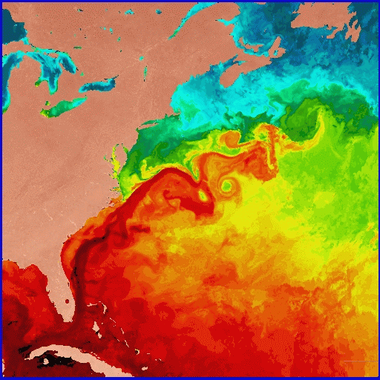
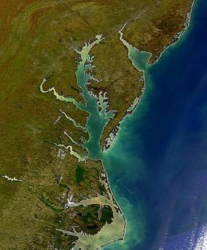
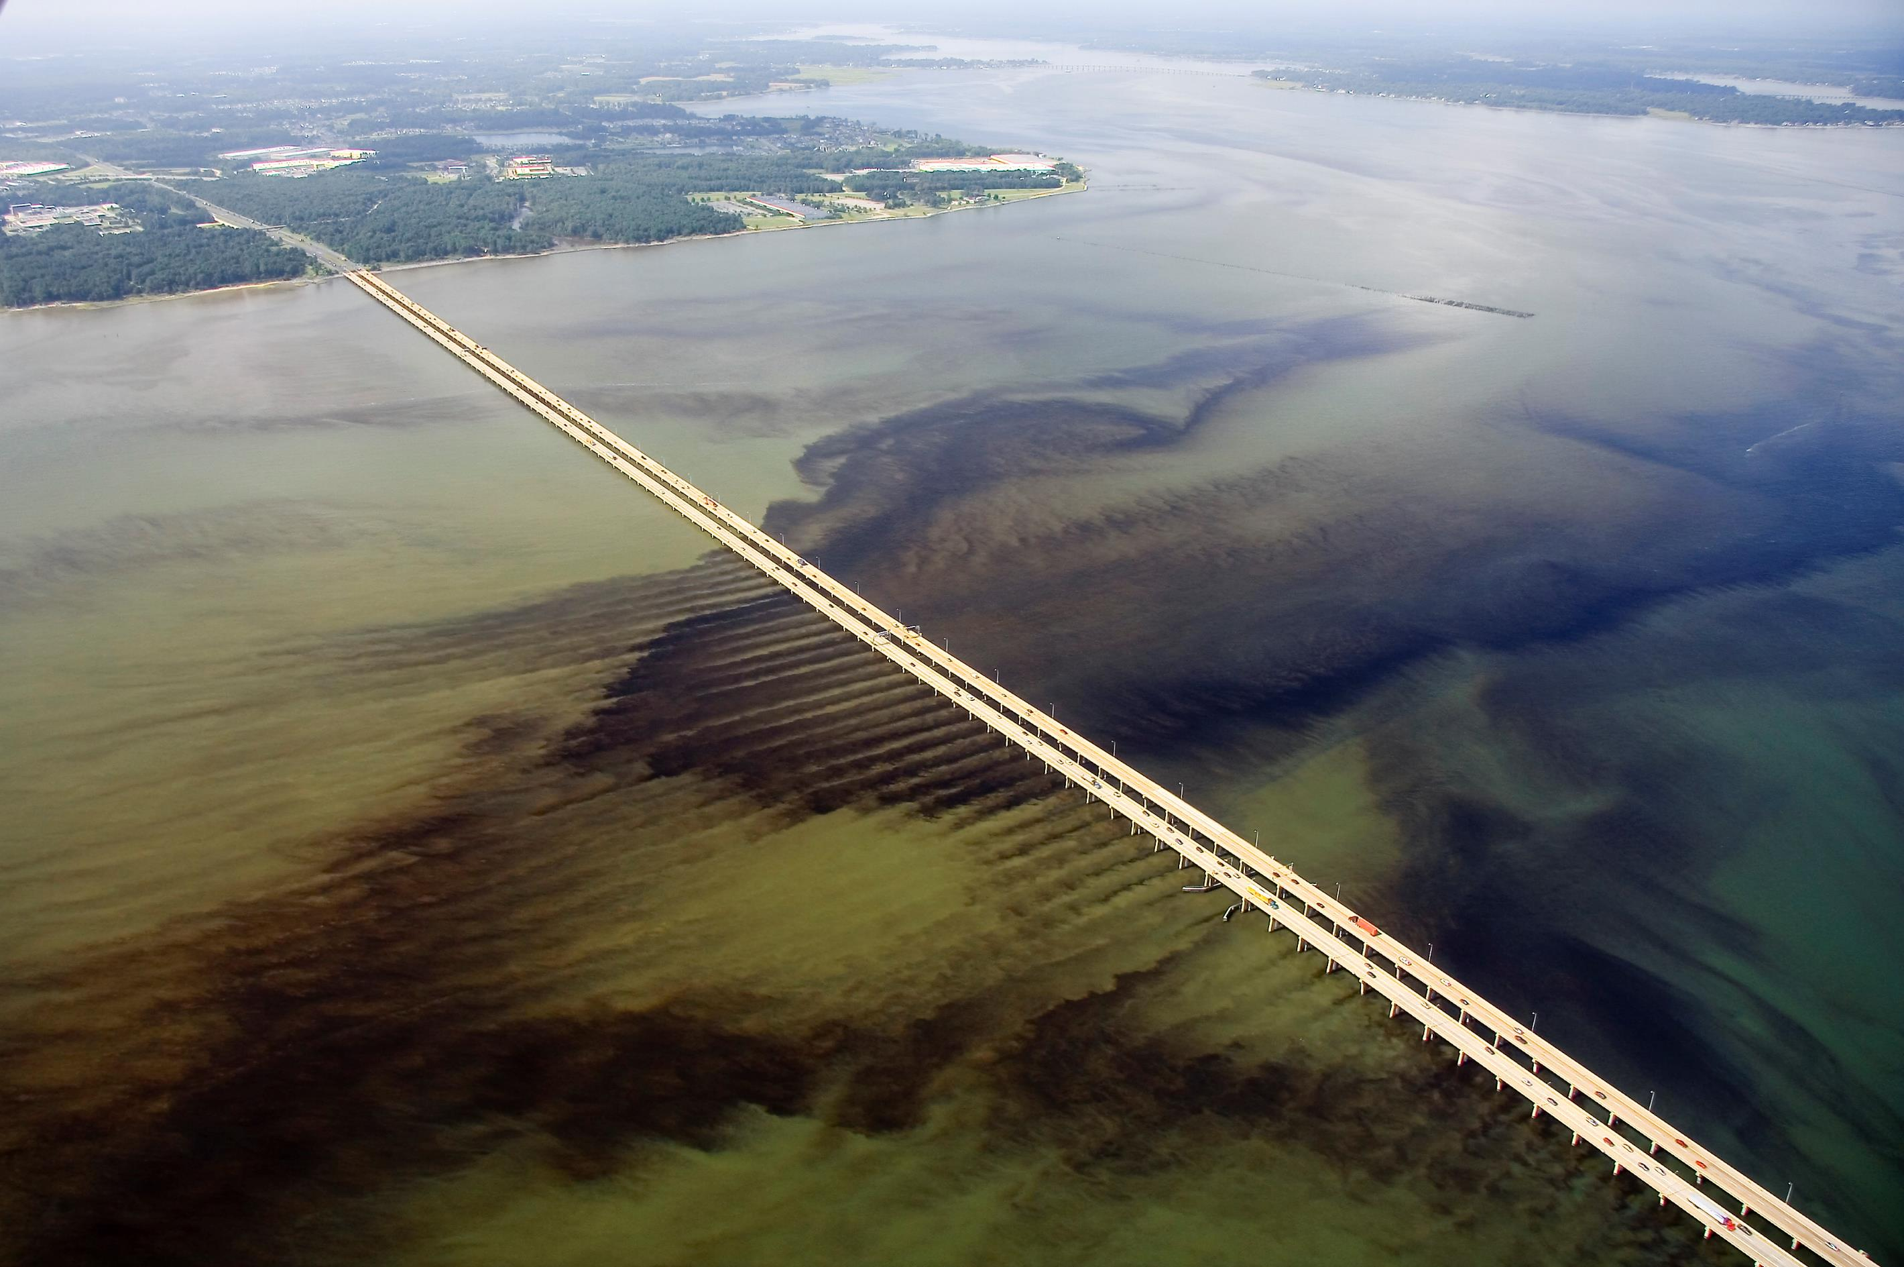
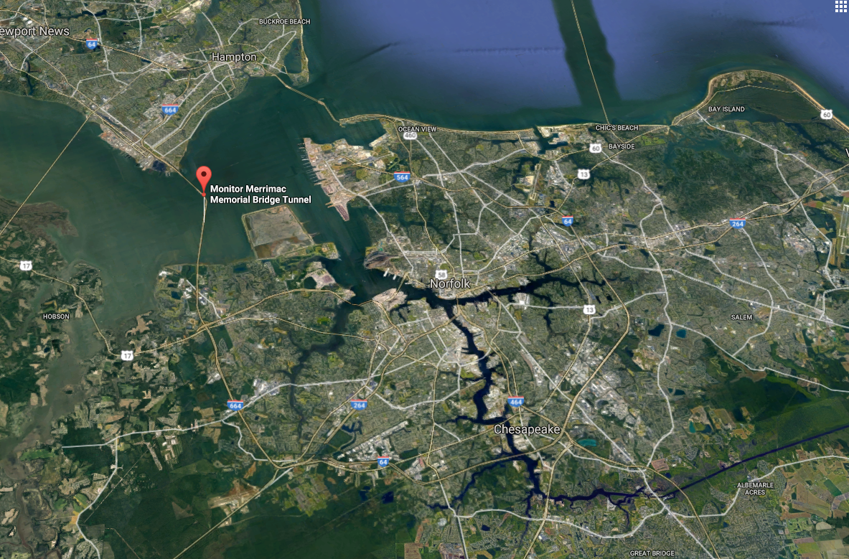
Motivation – a typical cross-scale system of our interest
Northwest Atlantic
Gulf Stream
Processes are interrelated,
for example:
Chesapeake Bay
Gulf Stream’s fluctuations contributing to coastal flooding (Ezer et al., 2013)
Warm-core rings affecting water mass and chlorophyll distributions along the coast (Ryan et al., 2001)
Larval transport (Epifanio and Garvine, 2000)
James River
Elizabeth River
Monitor-Merrimack Bridge
(Algal bloom; photo courtesy of Dr. Wolfgang Vogelbein; locally zoomed-in view of the original photo)
Notes:
Going into the large-scale eddying regime presents new challenges

Slide 5
Motivation - non-eddying regime (Chesapeake Bay)
The 2nd order transport scheme in SCHISM (itr_met=3) works well in:
resolving sharp salinity gradient;
capturing salt intrusion.

Slide 6
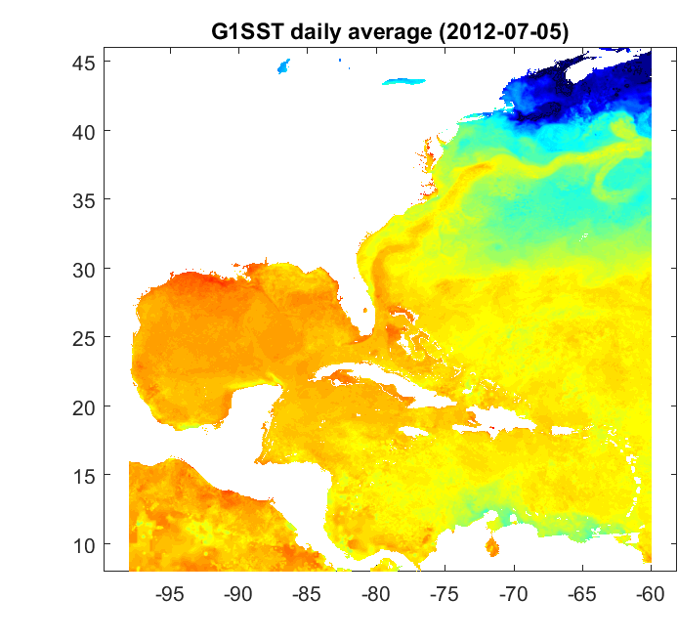
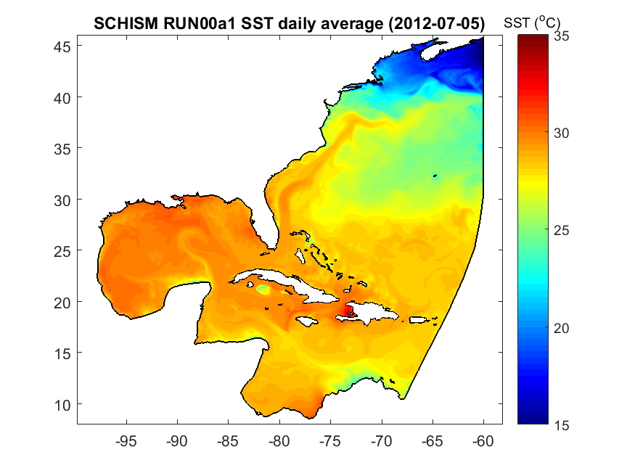
Motivation – eddying regime
The 2nd order transport scheme does NOT work very well in resolving the Gulf Stream
Notes:
In this final example, I’m showing the system near the CB
To study or model these processes, we need to adopt a multi-scale methodology.

Slide 7
Motivation
  Characteristics of the eddying regime:
    weakly forced
    less physical mixing than rivers and estuaries.
  Requires low numerical dissipation and dispersion; higher than 2nd-order transport schemes are needed.
Notes:
In this final example, I’m showing the system near the CB
To study or model these processes, we need to adopt a multi-scale methodology.

Slide 8
Outline
  Motivation
  Tracer transport based on WENO
    3rd-order scheme design
    Benchmarks and realistic applications
    Parameters and source codes
  Summary

Slide 9
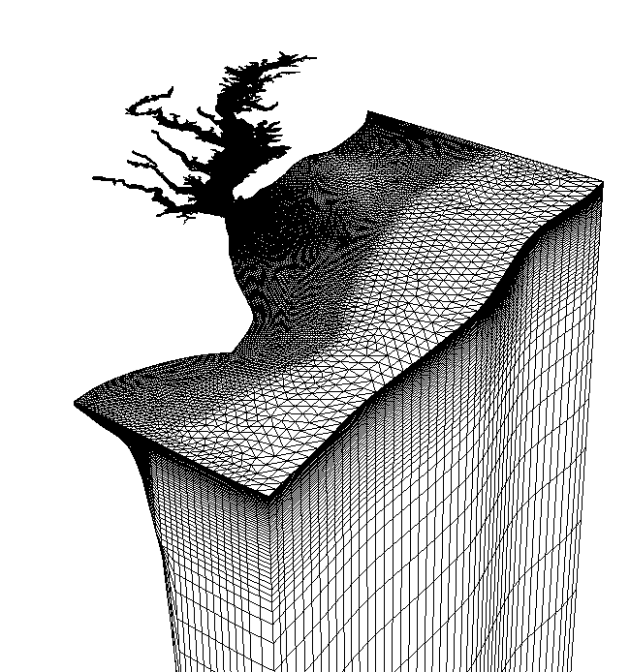
Transport equation: Finite volume with operator splitting
Horizontal advection: among the multiple ways to approximate the interfacial concentration, we choose WENO because:
  it’s truly multi-dimensional, rather than quasi-1D like TVD
  it’s relatively easy to extend to higher order.
  although the stencils are more complex than lower order schemes, most coefficients can be pre-computed
Vertical advection and other terms:
  2nd-order implicit TVD² solver (Ye et al., 2016); the length-scale in the vertical dimension/discretization is much smaller than that in the horizontal dimension
Notes:
Mention that we are using weno reconstruction, which is the main content of this presentation
interfacial flux, many ways in doing this,
add bullets, why choose weno (): truly multi-dimensional, not quasi-1D like TVD and FCT, only upwind/downwind not cross-wind; easy to go to higher order.

Slide 10

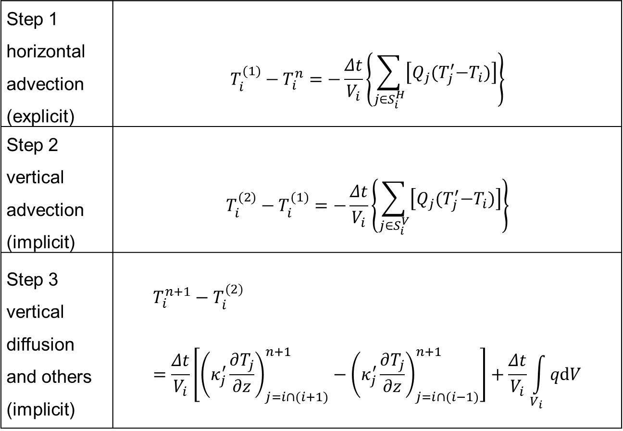
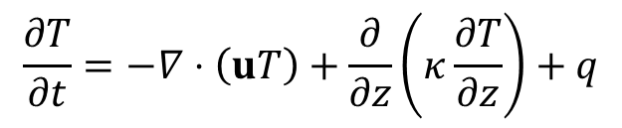
Formulation (operator splitting)
Step 1 horizontal advection (explicit) | $$T_{i}^{(1)}−T_{i}^{n}=−\frac{Δt}{V_{i}}\left\{\begin{aligned}\sum_{j∈S_{i}^{H}}{\left[Q_{j}{(T}_{j}^{′}−T_{i})\right]}\end{aligned}\right\}$$
Step 2 vertical advection (implicit) | $$T_{i}^{(2)}−T_{i}^{(1)}=−\frac{Δt}{V_{i}}\left\{\begin{aligned}\sum_{j∈S_{i}^{V}}{\left[Q_{j}{(T}_{j}^{′}−T_{i})\right]}\end{aligned}\right\}$$
Step 3 vertical diffusion and others (implicit) | $$T_{i}^{n+1}−T_{i}^{(2)}=\frac{Δt}{V_{i}}\left[{\left(κ_{j}^{′}\frac{∂T_{j}}{∂z}\right)}_{j=i∩(i+1)}^{n+1}−{\left(κ_{j}^{′}\frac{∂T_{j}}{∂z}\right)}_{j=i∩(i−1)}^{n+1}\right]+\frac{Δt}{V_{i}}\int_{V_{i}}{qdV}$$
$$\frac{∂T}{∂t}=−∇⋅\left(uT\right)+\frac{∂}{∂z}\left(κ\frac{∂T}{∂z}\right)+q$$
$$T_{i}$$
Notes:
Remind the audience we dealt with Step 2 previously

Slide 11
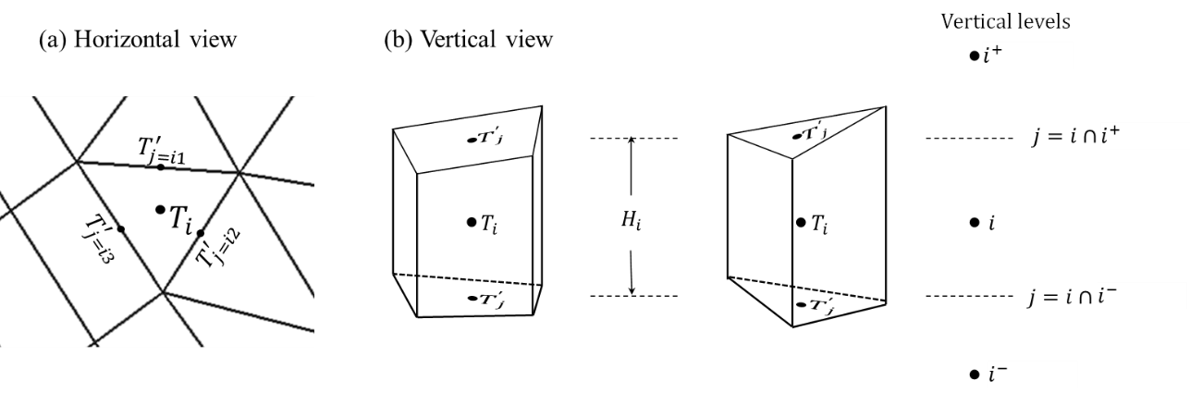
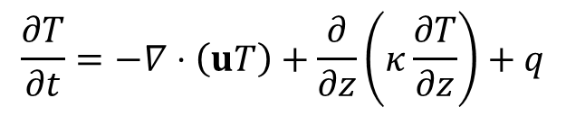
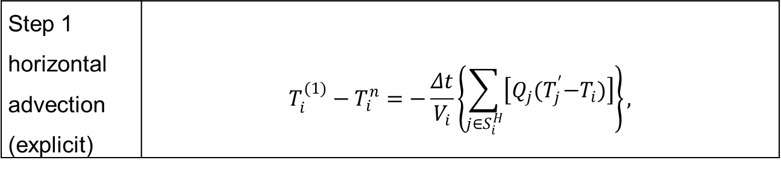
Formulation (operator splitting)
$$\frac{∂T}{∂t}=−∇⋅\left(uT\right)+\frac{∂}{∂z}\left(κ\frac{∂T}{∂z}\right)+q$$
Step 1 horizontal advection (explicit) | $$T_{i}^{(1)}−T_{i}^{n}=−\frac{Δt}{V_{i}}\left\{\begin{aligned}\sum_{j∈S_{i}^{H}}{\left[Q_{j}{(T}_{j}^{′}−T_{i})\right]}\end{aligned}\right\},$$
Finite volume framework:
$$T_{i}$$
Notes:
Remind the audience we dealt with Step 2 previously

Slide 12
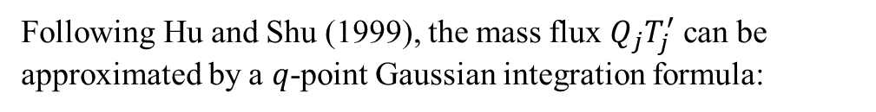
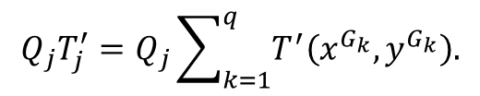
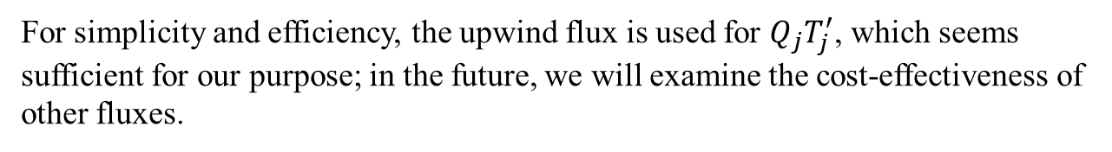
Formulation (operator splitting)
$$\frac{∂T}{∂t}=−∇⋅\left(uT\right)+\frac{∂}{∂z}\left(κ\frac{∂T}{∂z}\right)+q$$
Step 1 horizontal advection (explicit) | $$T_{i}^{(1)}−T_{i}^{n}=−\frac{Δt}{V_{i}}\left\{\begin{aligned}\sum_{j∈S_{i}^{H}}{\left[Q_{j}{(T}_{j}^{′}−T_{i})\right]}\end{aligned}\right\},$$
Following Hu and Shu (1999), the mass flux $Q_{j}T_{j}^{′}$ can be approximated by a $q$-point Gaussian integration formula:
$$T_{i}$$
$$Q_{j}T_{j}^{′}=Q_{j}\sum_{k=1}^{q}{T^{′}\left(x^{G_{k}},y^{G_{k}}\right).}$$
For simplicity and efficiency, the upwind flux is used for $Q_{j}T_{j}^{′}$, which seems sufficient for our purpose; in the future, we will examine the cost-effectiveness of other fluxes.
Notes:
Remind the audience we dealt with Step 2 previously

Slide 13
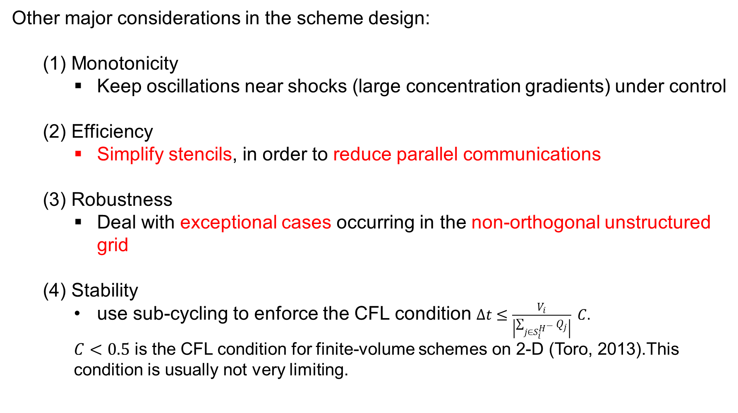
Design
Other major considerations in the scheme design:
  (1) Monotonicity
    Keep oscillations near shocks (large concentration gradients) under control
  (2) Efficiency
    Simplify stencils, in order to reduce parallel communications
  (3) Robustness
    Deal with exceptional cases occurring in the non-orthogonal unstructured grid
  (4) Stability
    use sub-cycling to enforce the CFL condition $Δt≤\frac{V_{i}}{\left|\sum_{j∈S_{i}^{H^{−}}}{Q_{j}}\right|} C.$
    $C<0.5$ is the CFL condition for finite-volume schemes on 2-D (Toro, 2013).This condition is usually not very limiting.
Notes:
These concerns lead to several constraints (up next) that we forced on ourselves in designing the scheme.
Mention that it’s still a preliminary work, still experimenting.

Slide 14
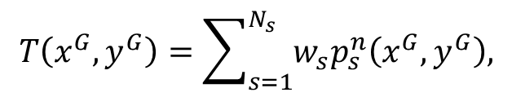




Design: neighborhood
$$y$$
Use the values on the center element and its neighbors to construct polynomials and approximate face values (Liu et al., 1994; Hu and Shu, 1999):
$$(x=0;y=1)$$
$$T\left(x^{G},y^{G}\right)=\sum_{s=1}^{N_{s}}{w_{s}p_{s}^{n}\left(x^{G},y^{G}\right),}$$
12
1
11
2
3
G
10
$$(x=1;y=0)$$
1st-tier neighborhood is chosen: the elements that share 1 or 2 nodes with the center element (red)
Why not 2nd-tier?
Enough information to get the accuracy we need
Efficiency (computation and communication)
Monotonicity (less numerical oscillation)
0
$$x$$
9
4
5
8
6
7
Notes:
Explain the Normalized local coordinates, to reduce truncation error

Slide 15
Design: neighborhood
$$y$$
Use the values on the center element and its neighbors to construct polynomials and approximate face values (Liu et al., 1994; Hu and Shu, 1999):
$$(x=0;y=1)$$
$$T\left(x^{G},y^{G}\right)=\sum_{s=1}^{N_{s}}{w_{s}p_{s}^{n}\left(x^{G},y^{G}\right),}$$
12
1
11
2
3
G
10
$$(x=1;y=0)$$
0
$$x$$
9
To reduce truncation error, normalized local coordinates are used on each big stencil (red and grey elements), such that :
the coordinate origin coincides with the centroid of the center element;
the x and y axes are scaled (without rotation) by the distance between the origin and the furthest neighbor’s centroid.
4
5
8
6
7
Notes:
Explain the Normalized local coordinates, to reduce truncation error

Slide 16
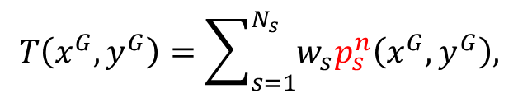
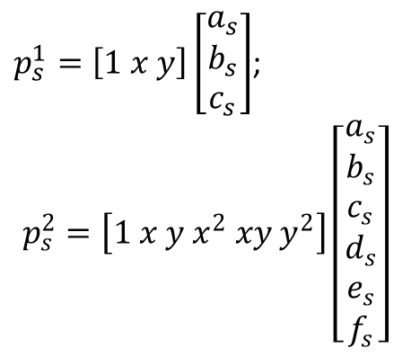
Design: Stencil
Use the values on the center element and its neighbors to construct polynomials and approximate face values (Liu et al., 1994; Hu and Shu, 1999):
A 3-element stencil that forms a linear polynomial (2rd-order reconstruction)
$$T\left(x^{G},y^{G}\right)=\sum_{s=1}^{N_{s}}{w_{s}p_{s}^{n}\left(x^{G},y^{G}\right),}$$
$p_{s}^{1}=\left[1 x y\right]\left[\begin{matrix}a_{s} \\ b_{s} \\ c_{s}\end{matrix}\right]$;
$$p_{s}^{2}=\left[1 x y x^{2} xy y^{2}\right]\left[\begin{matrix}a_{s} \\ b_{s} \\ c_{s} \\ d_{s} \\ e_{s} \\ f_{s}\end{matrix}\right]$$
A 6-element stencil that forms a quadratic polynomial (3rd-order reconstruction)
Notes:
Both computational cost and parallel communication cost; mention that benchmark tests suggest 2nd-tier is more prone to numerical dispersion
Add a linear polynomial/stencil

Slide 17
Design: Stencil
Use the values on the center element and its neighbors to construct polynomials and approximate face values (Liu et al., 1994; Hu and Shu, 1999):
A 3-element stencil that forms a linear polynomial (2rd-order reconstruction)
$$T\left(x^{G},y^{G}\right)=\sum_{s=1}^{N_{s}}{w_{s}p_{s}^{n}\left(x^{G},y^{G}\right),}$$
Multiple choices in forming the stencils
We chose to sequentially list all 1st-tier neighbors to cover all directions.
A 6-element stencil that forms a quadratic polynomial (3rd-order reconstruction)
Notes:
Both computational cost and parallel communication cost; mention that benchmark tests suggest 2nd-tier is more prone to numerical dispersion
I should note that bad stencils are not always bad. It all depends on the concentration field. That’s why ideally we need stencils from all directions to cover all bases.

Slide 18
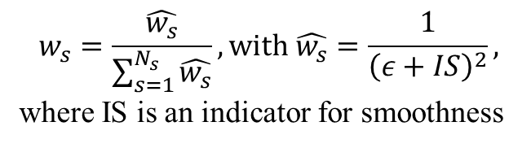
Design: Stencil
Use the values on the center element and its neighbors to construct polynomials and approximate face values (Liu et al., 1994; Hu and Shu, 1999):
A 3-element stencil that forms a linear polynomial (2rd-order reconstruction)
$$T\left(x^{G},y^{G}\right)=\sum_{s=1}^{N_{s}}{w_{s}p_{s}^{n}\left(x^{G},y^{G}\right),}$$
$$w_{s}=\frac{\hat{w_{s}}}{\sum_{s=1}^{N_{s}}{\hat{w_{s}}}}, with \hat{w_{s}}=\frac{1}{{\left(ε+IS\right)}^{2}},$$
where IS is an indicator for smoothness
A 6-element stencil that forms a quadratic polynomial (3rd-order reconstruction)
Larger gradient → larger IS → smaller weight
Notes:
Both computational cost and parallel communication cost; mention that benchmark tests suggest 2nd-tier is more prone to numerical dispersion
I should note that bad stencils are not always bad. It all depends on the concentration field. That’s why ideally we need stencils from all directions to cover all bases.

Slide 19
Design: Stencil
Use the values on the center element and its neighbors to construct polynomials and approximate face values (Liu et al., 1994; Hu and Shu, 1999):
A 3-element stencil that forms a linear polynomial (2rd-order reconstruction)
$$T\left(x^{G},y^{G}\right)=\sum_{s=1}^{N_{s}}{w_{s}p_{s}^{n}\left(x^{G},y^{G}\right),}$$
It is possible to get one-order-higher accuracy through optimal weighting
We chose not to use optimal weighting
Pros: doesn’t have to deal with negative weights (robustness on generic UG)
  Cons: potentially lose one order of accuracy with the same stencils
A 6-element stencil that forms a quadratic polynomial (3rd-order reconstruction)
Notes:
Both computational cost and parallel communication cost; mention that benchmark tests suggest 2nd-tier is more prone to numerical dispersion
I should note that bad stencils are not always bad. It all depends on the concentration field. That’s why ideally we need stencils from all directions to cover all bases.

Slide 20
Design: identifying and removing problematic stencils
An example of
an invalid linear stencil
Co-linear element centers
We apply an empirical threshold on the matrix determinant under the scaled coordinates, to identify and remove near-singular stencils.
Notes:
For example, in this abnormal case, the matrix determinant is nearly singular.

Slide 21
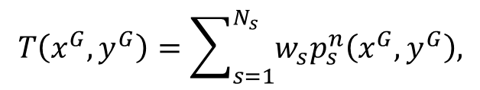
Design: straddling stencils
(a)
(b)
Straddling stencils may induce oscillations if there is a shock (large gradient) at the side (solid yellow line);
but as long as we have non-straddling stencils, things are under control:
12
12
1
11
1
11
2
10
2
10
$$T\left(x^{G},y^{G}\right)=\sum_{s=1}^{N_{s}}{w_{s}p_{s}^{n}\left(x^{G},y^{G}\right),}$$
3
0
9
3
0
9
4
5
4
5
6
8
6
8
What if all stencils are straddling this side?
7
7
Straddling
Not straddling
Notes:
What are the extreme cases

Slide 22
Design: straddling stencils
Caveat: uniform rectangular grid does not have a valid quadratic stencil under the current design.
A combination of abnormal cases
straddling:
singular:

Slide 23
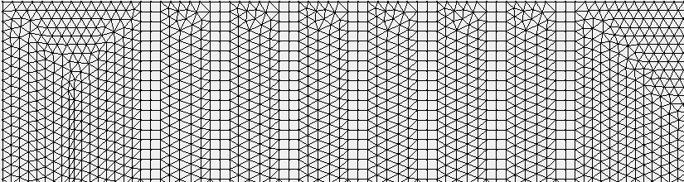
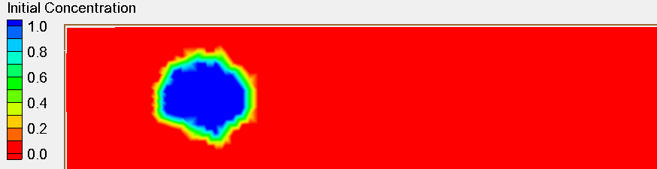


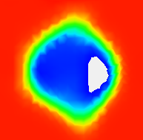

Quadrangles
Advection of an irregular staircase
uniform eastward velocity
Normally, we only use triangles in the eddying regime
The shape of the irregular staircase when it reaches the east boundary:
3rd-order WENO,
with invalid stencils removed and downgrading to 2nd-order at local regions
3rd-order WENO,
not removing invalid straddling stencils
Upwind
2nd-order WENO

Slide 24
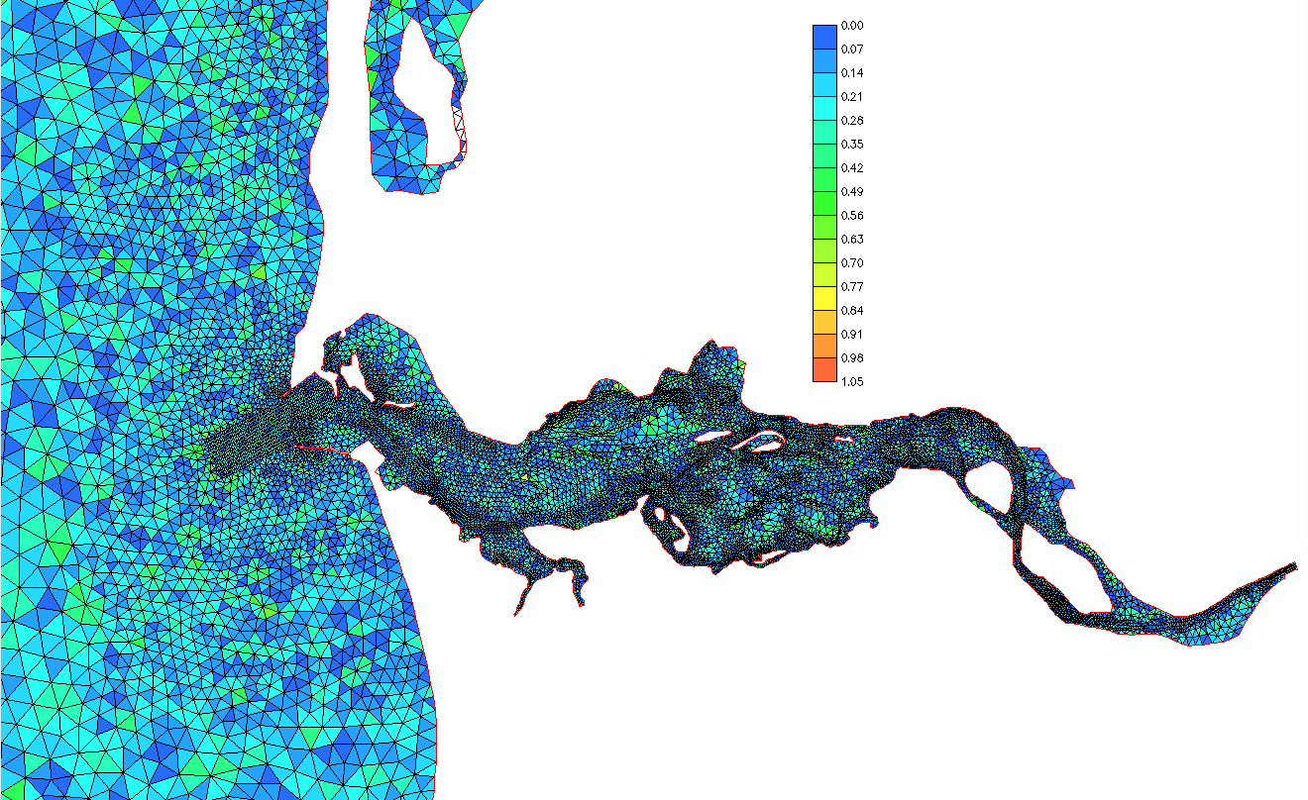
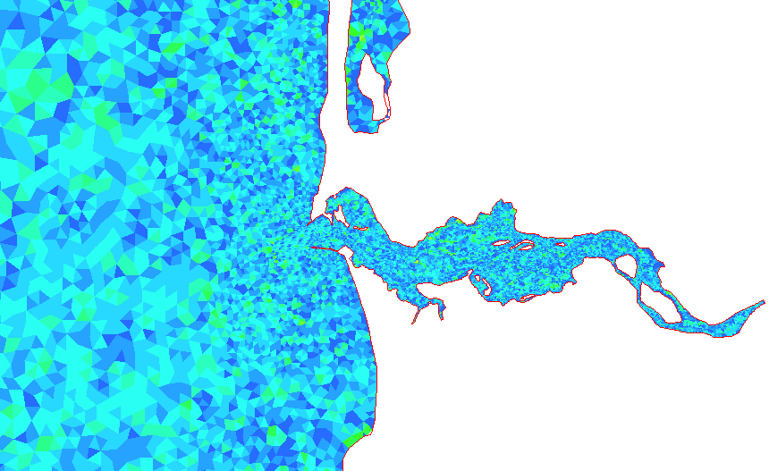
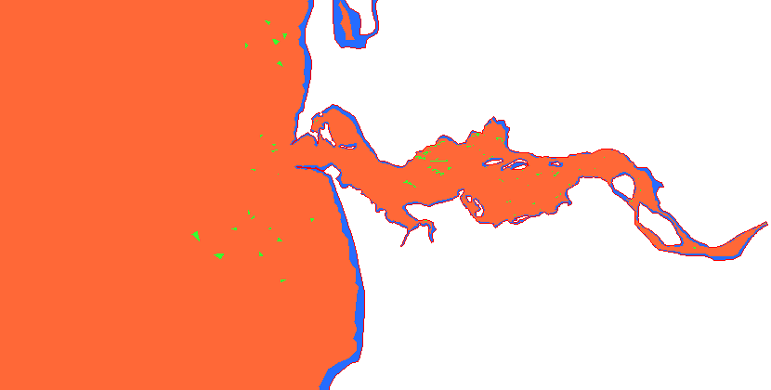
Design: identifying and removing problematic stencils
0%
50%
100%
Percentage of near-singular stencils at each element
(these stencils are excluded from reconstruction)
Actual accuracy
no flux boundary
  2nd order WENO
  3rd order WENO

Slide 25
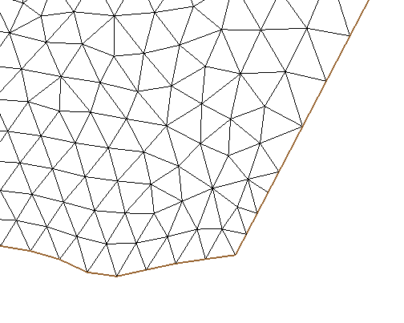
Design: boundary condition
Inflow side: relaxed to b.c.
Outflow side: upwind approximation
Open boundary
Sides with only one node on the boundary:
2nd order WENO approximation when possible
Land
boundary:
no flux

Slide 26
Outline
  Motivation
  Tracer transport based on WENO
    3rd-order Scheme design
    Benchmarks and realistic applications
    Parameters and source codes
  Summary

Slide 27
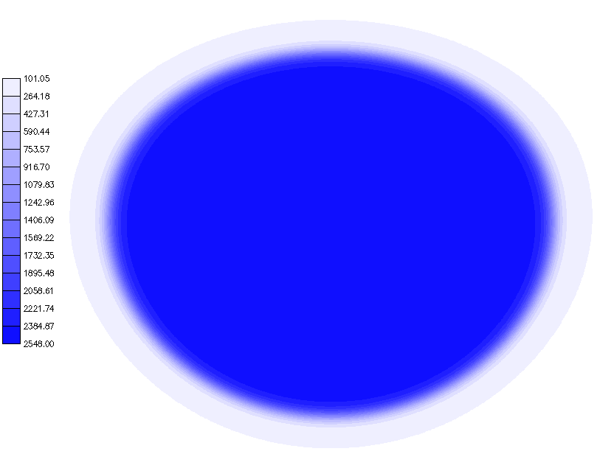
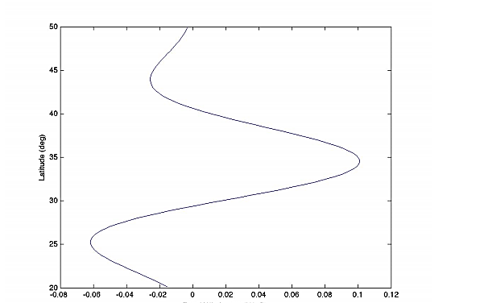
Benchmark: SOMA (Simulating Ocean Mesoscale Activity)
Initial T is a function of depth, resembling the real ocean condition
An ocean test case for the evaluation of mesoscale eddy simulation (Ringler et al., 2012)
Idealized basin (16ºW~16ºE; 20ºN~50ºN) defined on the surface of the sphere, with a 100 m deep shelf and a 2000 m deep ocean bottom.
z (m)
Bathymetry (m)
T(ºC)
Zonal wind forcing,
resembling the trade wind pattern
Latitude
Zonal wind stress
Notes:
*show 1 animation from WENO3 in previous slide

Slide 28
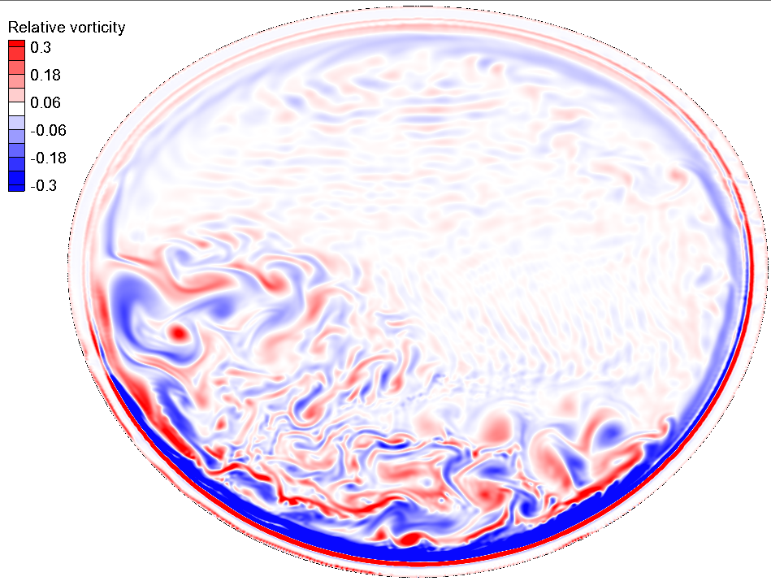
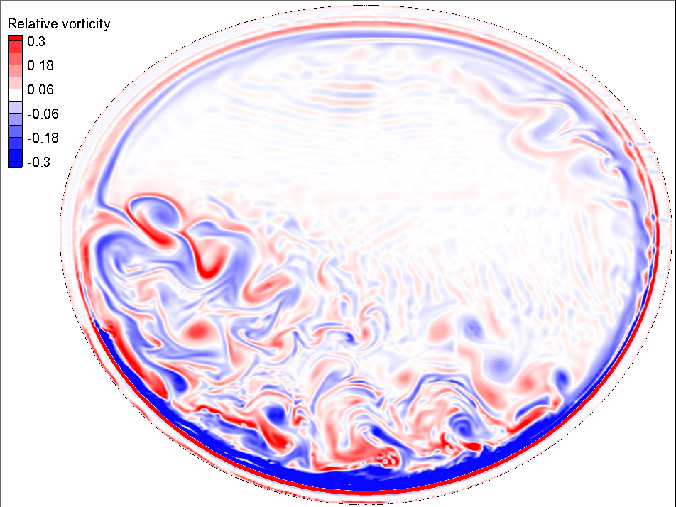
SOMA (Vorticity field after 3 years at 100 m depth)
SOMA test on a medium-resolution grid:
9-km horizontal resolution; 0.45 million nodes; 49 vertical levels
2nd order TVD
3rd order WENO
Notes:
processes, Danilov’s paper
*show 1 animation from WENO3 in previous slide
generating eddies both in the double-gyre region and the coastal region
colorbar

Slide 29
Gulf Stream application
Baroclinic
430 K nodes and 840 K elements
27.0 layers on average
Time step=150 s
~100 times faster than real time with 480 cores
large element size transition from estuaries (100 m) to the open ocean (7 km) in a single grid;
original non-smoothed bathymetry captured with local refinements at steep slopes (Fig. 9c);
depth-varying but terrain-following vertical layers; (Fig. 9d);
no data assimilation.
Notes:
Mention that we’re still looking at the qualitative picture here; we have not gone into quantitative model-data comparisons yet.

Slide 30
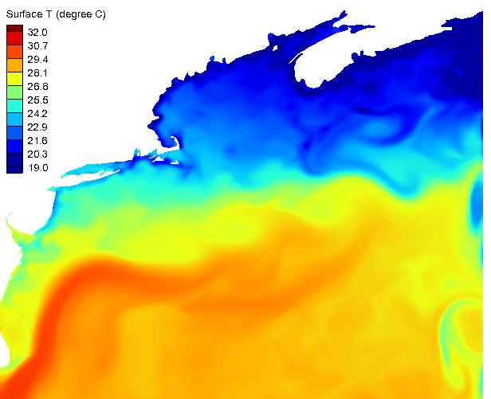
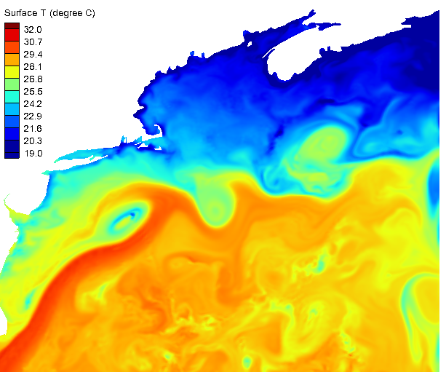
Preliminary application: Gulf Stream
SST(ºC)
2nd order TVD
SST(ºC)
3rd order WENO
Gulf of Maine
Atlantic Ocean
Notes:
Mention that we’re still looking at the qualitative picture here; we have not gone into quantitative model-data comparisons yet.

Slide 31
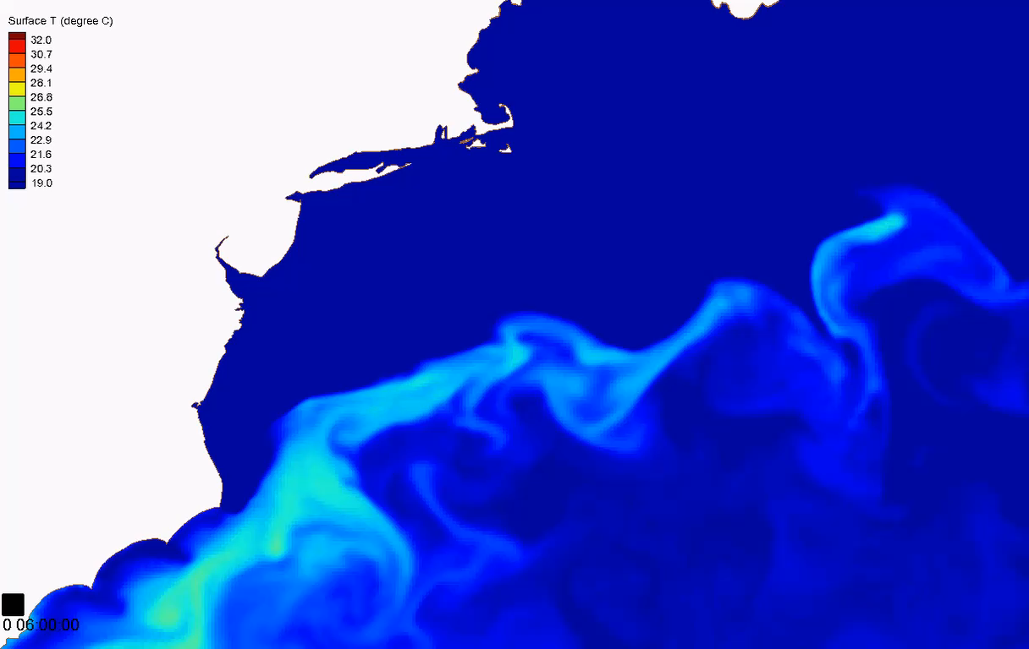

Application: Gulf Stream (animation)
2nd order TVD
3rd order WENO
SST(ºC)
SST(ºC)
Simulation time:
Day HH:MM:SS
Simulation time:
Day HH:MM:SS
Notes:
Mention that we’re still looking at the qualitative picture here; we have not gone into quantitative model-data comparisons yet.

Slide 32
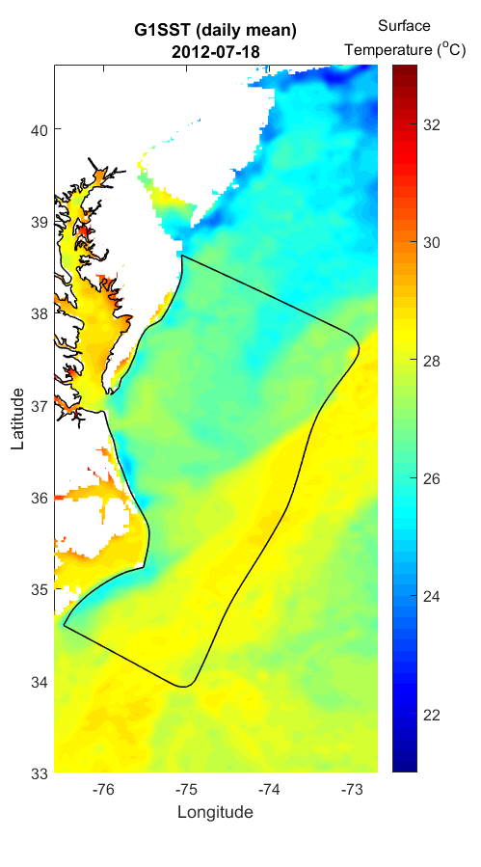
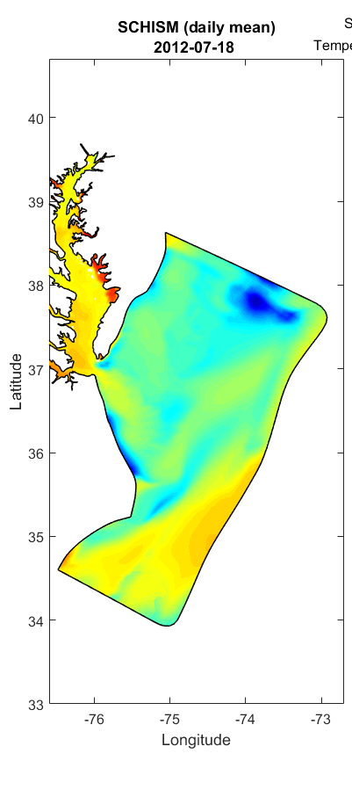
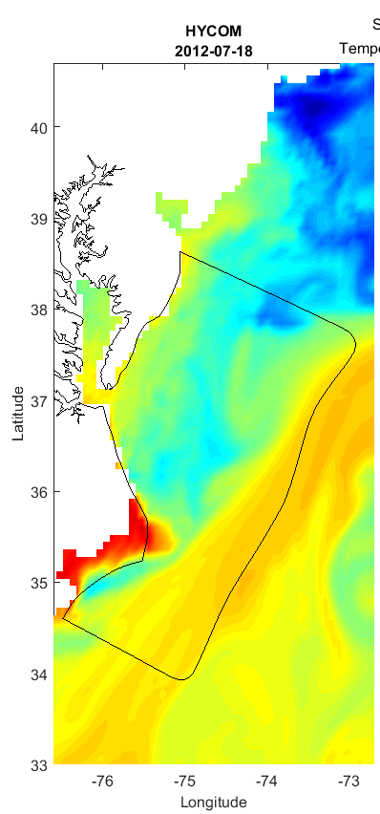
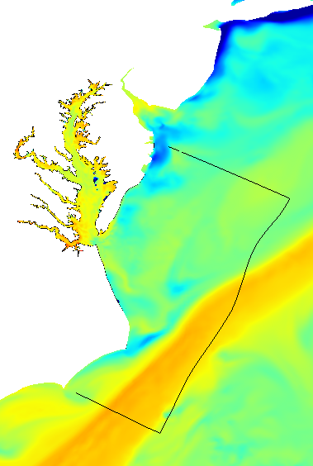

Application: Gulf Stream (animation)
(a) Observation
(b) SCHISM Bay model
(c) Global HYCOM
(d) SCHISM regional domain (zoomed-in view)
Delaware.
Bay
Ches.
Bay
Gulf Stream
Atlantic
Ocean
The spurious SST near the ocean boundary in the small-domain SCHISM ChesBay model is improved; the coastal upwelling is still captured

Slide 33
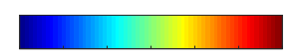
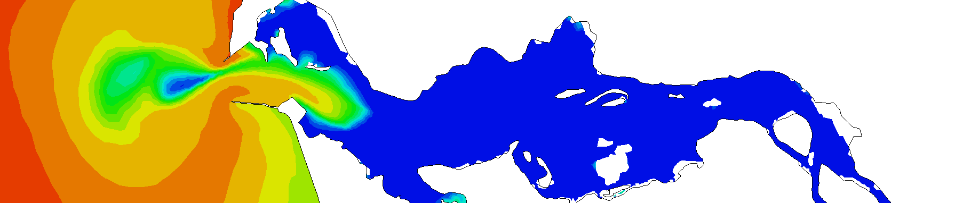
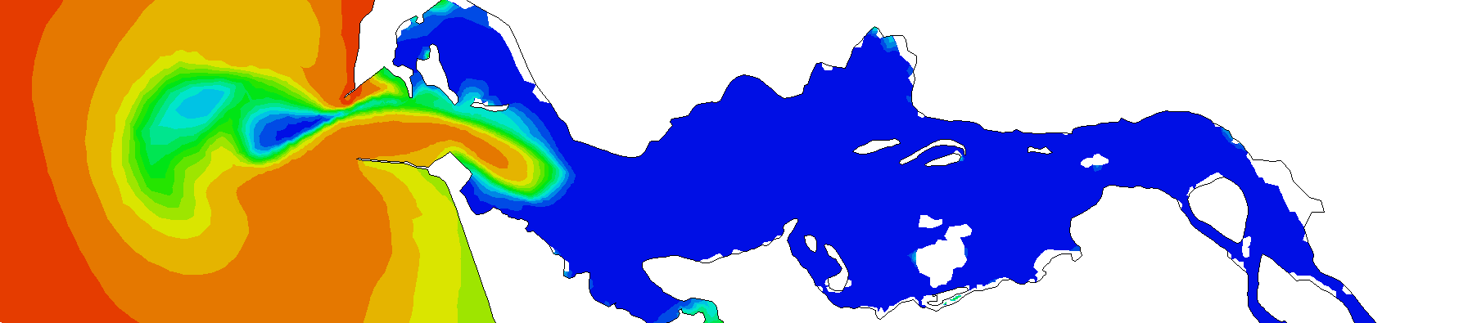
Columbia River
Compared to TVD, the new scheme brings more salt intrusion and stratification at the river downstream, which is closer to observation.
Snapshots (at the same time) of the typical bottom salinity is shown below.
Bottom Salinity (PSU)
0
>=30
2nd order TVD
Columbia River
Pacific Ocean
3rd order WENO

Slide 34
Outline
  Motivation
  Tracer transport based on WENO
    3rd-order Scheme design
    Benchmarks and realistic applications
    Parameters and source codes
  Summary

Slide 35
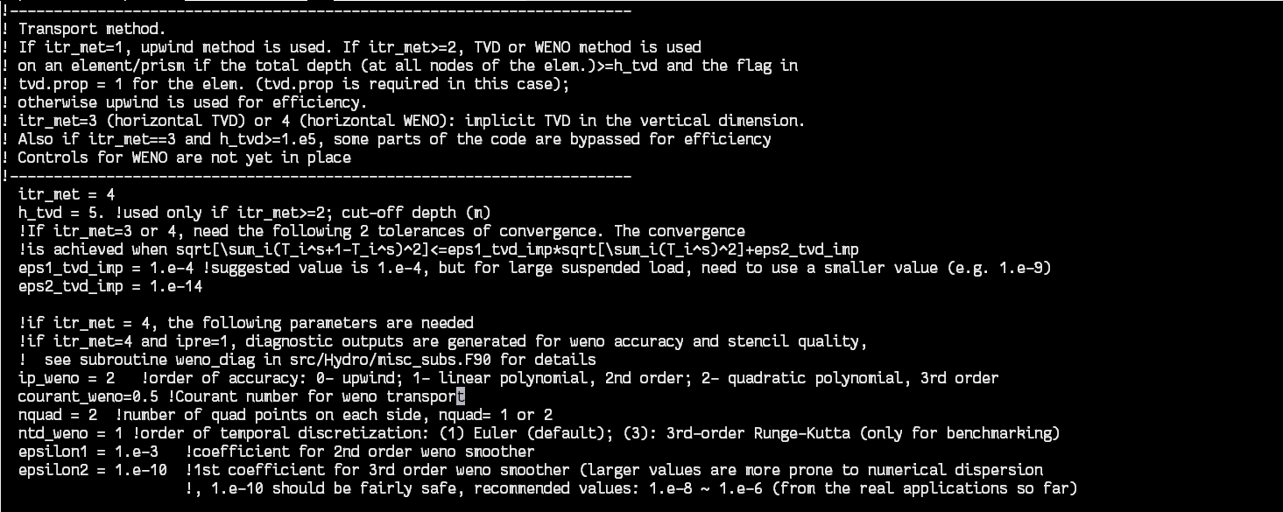
Parameters
Open “your_svn_trunk/src/param.in.sample”

Slide 36
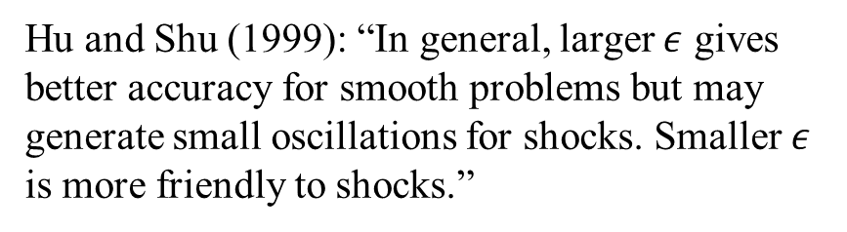
Design: Stencil
Use the values on the center element and its neighbors to construct polynomials and approximate face values (Liu et al., 1994; Hu and Shu, 1999):
A 3-element stencil that forms a linear polynomial (2rd-order reconstruction)
$$T\left(x^{G},y^{G}\right)=\sum_{s=1}^{N_{s}}{w_{s}p_{s}^{n}\left(x^{G},y^{G}\right),}$$
$$w_{s}=\frac{\hat{w_{s}}}{\sum_{s=1}^{N_{s}}{\hat{w_{s}}}}, with \hat{w_{s}}=\frac{1}{{\left(ε+IS\right)}^{2}},$$
where IS is an indicator for smoothness
A 6-element stencil that forms a quadratic polynomial (3rd-order reconstruction)
Hu and Shu (1999): “In general, larger $ε$ gives better accuracy for smooth problems but may generate small oscillations for shocks. Smaller $ε$ is more friendly to shocks.”
Notes:
Both computational cost and parallel communication cost; mention that benchmark tests suggest 2nd-tier is more prone to numerical dispersion
I should note that bad stencils are not always bad. It all depends on the concentration field. That’s why ideally we need stencils from all directions to cover all bases.

Slide 37
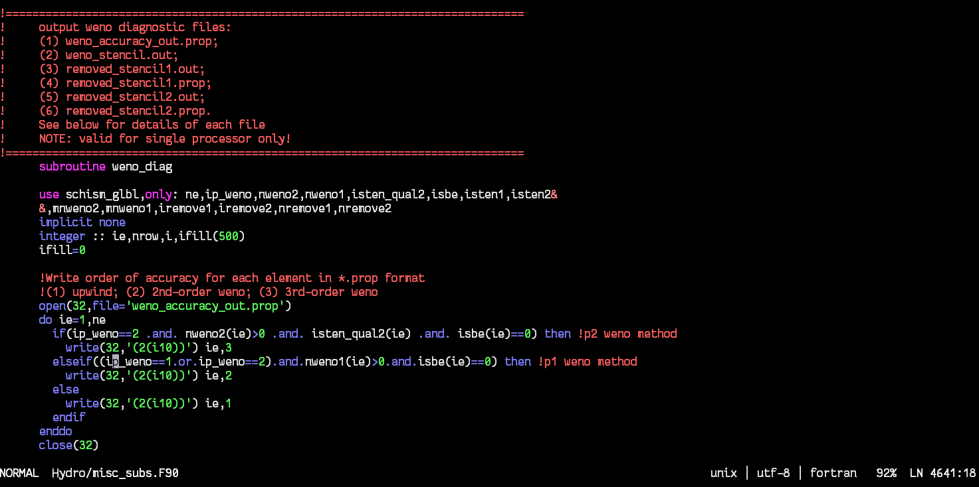
Parameters
Open “your_svn_trunk/src/Hydro/misc_sub.f90” for more details on weno diagnostic outputs when ipre=1
(a)
(b)
Northeast Pacific
Northwest Atlantic

Slide 38
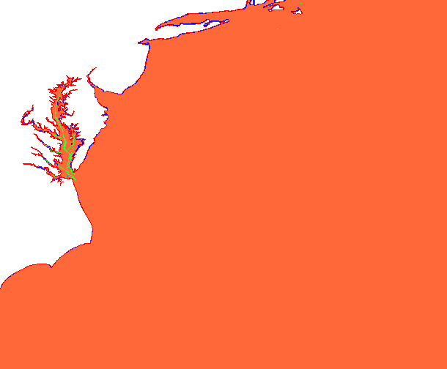
Parameters
Open “your_svn_trunk/src/Hydro/misc_sub.f90” for more details on
weno diagnostic outputs when ipre=1
(a)
Actual accuracy:
no flux boundary
  2nd order WENO
  3rd order WENO
(b)
Northeast Pacific
Chesapeake Bay
Columbia River
Northwest Atlantic

Slide 39
Source code
(1) | schism_glbl.F90 | Global arrays used by weno transport
(2) | schism_init.F90 | Pre-calculate geometry-related properties (not changing with time): set up stencils; check stencil quality; set boundary condition; calculate polynomial coefficients …
(3) | misc_subs.F90 | Contains subroutines/functions for (2)
(4) | transport_TVD_imp.F90 | Calculate properties that change with time: Smoothness indicator; weights; reconstructed face concentration; fluxes; updated prism concentration (for horizontal advection)
(5) | schism_msgp.F90 | Contains subroutines that exchange interface concentration between pairs of sub-domains
In each source file, search for code enclosed by “!weno>” and “!<weno”.

Slide 40
Source code
Note on message-passing for WENO:
Currently, upwind flux is used, meaning that the reconstruction is only conducted in the big stencil that centers on its upwind prism.
If an inflow side in the current rank is also an interface side between two ranks, it will keep the initial value (0) inside the current rank; while the same side will be an outflow side in the neighboring rank, where its concentration will be re-constructed and shared with the current rank.

Slide 41
Outline
  Motivation
  Tracer transport based on WENO
    3rd-order Scheme design
    Benchmarks and realistic applications
    Parameters and source codes
  Summary

Slide 42
Summary
The specific designs of the new method focus on striking a balance among accuracy, monotonicity, efficiency, and robustness
Eddies and filaments are better resolved using this new scheme with benchmark tests and a field application to the Gulf Stream
Also slightly improves the simulated salinity intrusion and stratification in an estuarine setting, thus ideal for cross-scale applications.
The 3rd-order scheme costs 20-30% more computational time than the 2nd-order TVD scheme; haven’t seen the need for 4th-order so far

Slide 43
Thanks for your attention!
Notes:
Add slide numbers

Slide 44
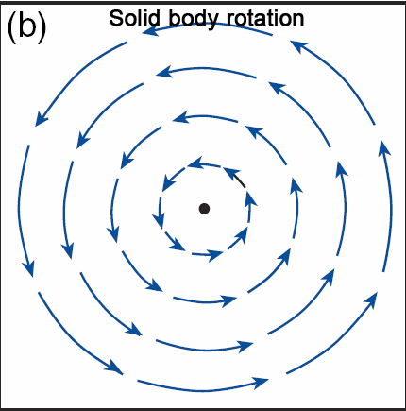
Numerical benchmark
2D Rotating Gauss hill test
Fine-resolution grid
(old schemes v.s. new scheme)
Less numerical diffusion
Preserves the shape better (not susceptible to grid orientation, because it is a truly multi-dimensional reconstruction)
 | Upwind | TVD | WENO
RMSE | 0.035 | 0.017 | 0.002
Over/under-shoots | 0/0 | 0/0 | 0/-2×10⁻⁵
CPU time relative to TVD | 0.8 | 1 | 1.3
Low-resolution grids (new scheme)
Notes:
Briefly explain model setup

Slide 45
Source codes

