Slide 1
Shallow Water regime & hydrology
Joseph Zhang

Slide 2
Importance of bathymetry in shallow-water regime
The importance of bathymetry is widely acknowledged
But most models pay lip service to this
Issue exacerbated by numeric considerations (PGE, stability)
Also as the grid resolution is finite, the ‘true’ bathymetry can never be 100% reproduced in the grid
Many important processes are driven by bathymetric features
Salt intrusion
Gravity overflow
Canyon processes; internal tides
Shoal-channel contrast; shear dispersion
Hypoxia
SCHISM’s resolution-on-demand capability makes feature capturing easy (bathymetry & geometry)

Slide 3
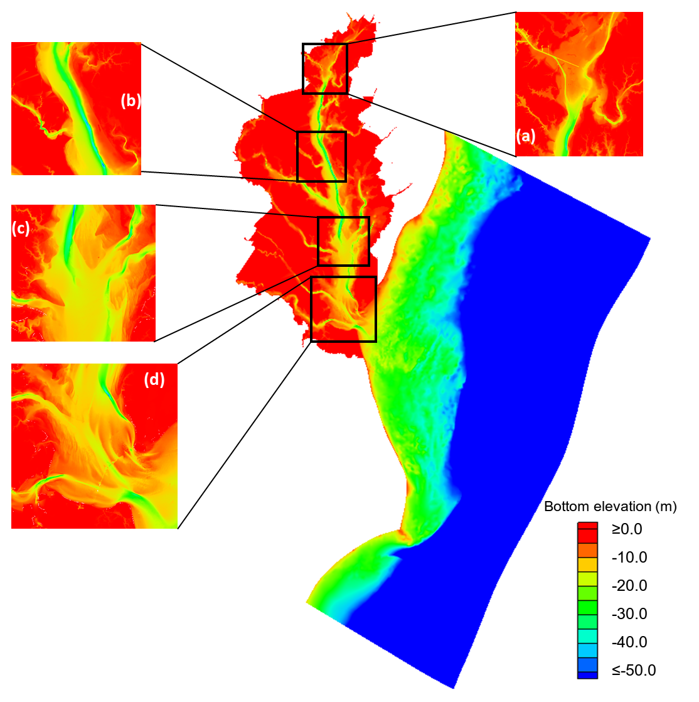
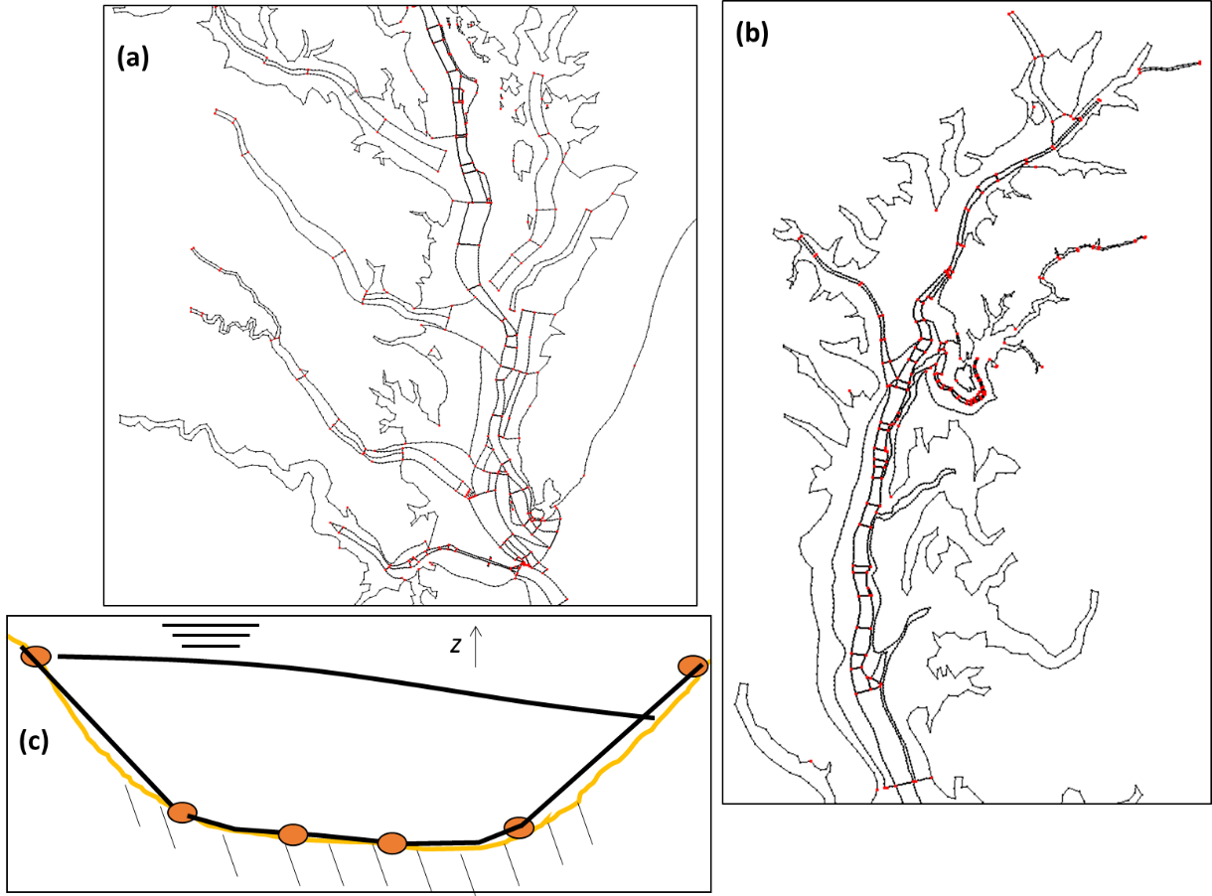
Horizontal grid design
Complex channel systems. How to accurately represent them in the model?
USGS DEM
Key ‘choke points’ need to be adequately resolved
Skew elements are almost unavoidable if we want to faithfully represent key features like channel
Although a smooth transitioned grid is theoretically preferred, it’s often impractical (e.g. at steep slopes)
On the other hand, mixing regimes should be different across those steep slopes (more later)

Slide 4
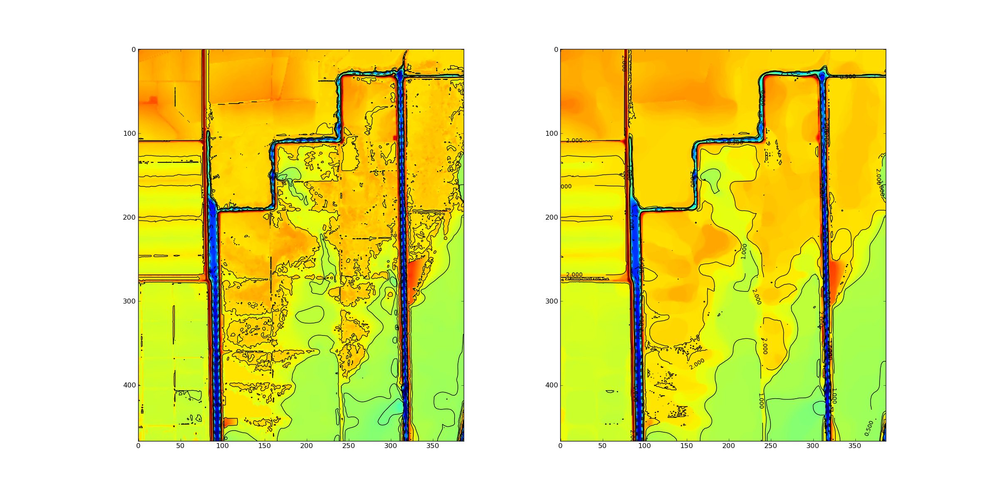
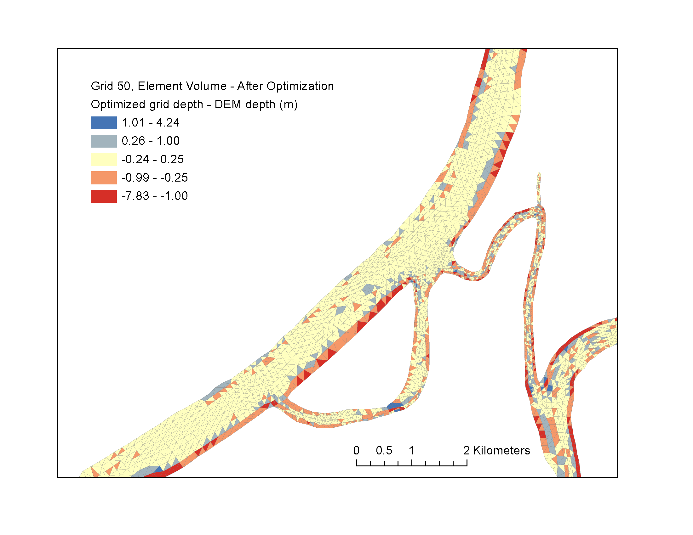
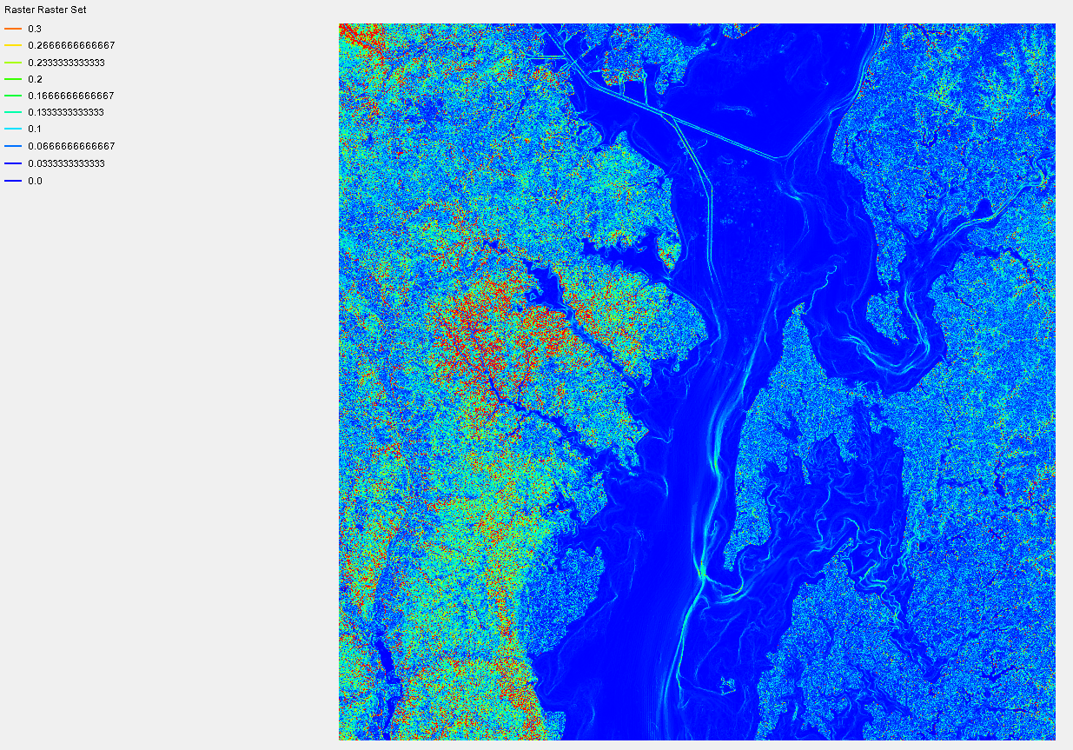
Bathymetry errors
Type I: survey errors; morphology; finite resolution errors → can be reduced as the grid is refined
Type II: errors due to artifacts in numerics (e.g. bathymetry smoothing to alleviate PGE etc) →finer grid actually exacerbates
Steep bathymetry is prevalent in real world (and responsible for interesting processes)
Type I error
Original DEM
Slope
Smoothed DEM
Type I error
Notes:
And in particular, we’re interested in these two questions.

Slide 5
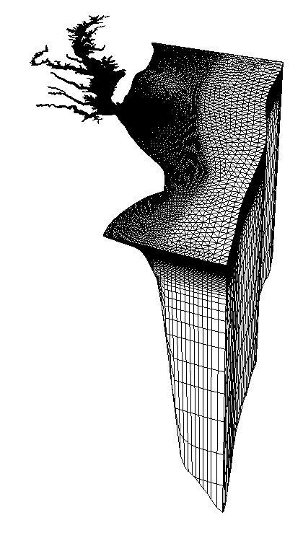
Representation of bathymetry: flexible vertical grid (LSC²)
LSC² grid can be effectively used to resolve important processes (plume, pycnocline…)
It can also be used to alleviate PGE and diapyncal mixing with more horizontal coordinate planes and shaved cells
A judicious combination of horizontal and vertical grids is needed to faithfully represent the complex 3D bathymetry
Steep slopes require a high resolution in both horizontal and vertical grids
Shaved cells are critical for simulating bottom-controlled processes (salt intrusion, gravity overflow…)
Transitional regime (plume) requires smoother horizontal grid and finer vertical grid near surface
A transect from the upper Bay to the shelf break
Refined at surface to resolve plume
Refined at mid-depths to better capture pycnocline
(Zhang et al. 2015)
Notes:
Vgrid is equally important as the horizontal grid
Explain the degenerate prism near bottom

Slide 6
Bathymetry smoothing: why it’s bad
Smoothing in a critical region where the center channel constricts and bends, with multi-channel configurations
Averaged through May-Oct, 2012
Original bathymetry
Low mixing-zone (blue) confined in the main channel
Potomac R.
Rappahannock R.
Smoothed bathymetry
Low mixing-zone (blue) extending to the shoal
York R.
Volume is conserved during smoothing
Physical mixing is under-estimated; as a result, numerical dissipation can be masked
Similar reduction of turbulence is observed near channel constrictions (‘choke points’)
It’s hard to recover the original mixing pattern by tuning the dissipation
Ye et al. (2018)
Notes:
Mention the dash line in (b) is original bathymetry
And some of its steep slopes are removed

Slide 7
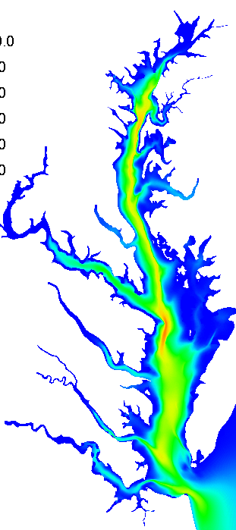
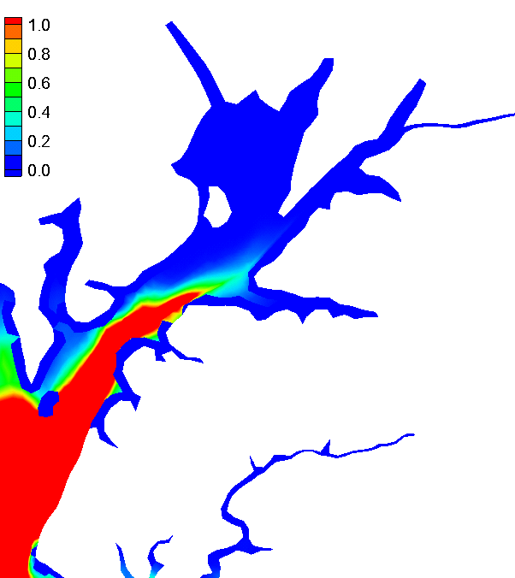
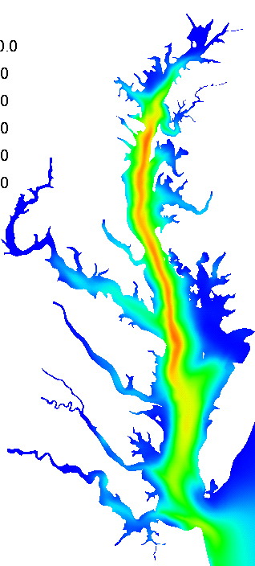
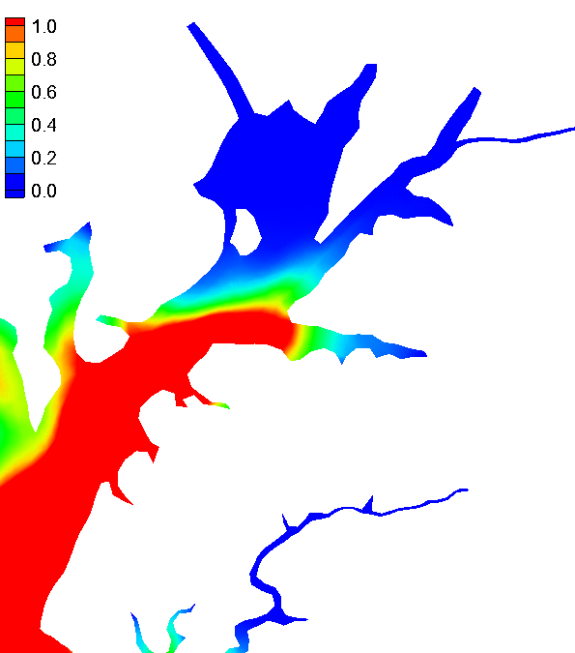

Sensitivity test: salt intrusion
Averaged salinity distribution
Original bathymetry
Original bathymetry
Original bathymetry
Smoothed bathymetry
Smoothed bathymetry
Less channel-shoal difference
Consistent with the change in mixing pattern, the salt intrusion is more uniform (i.e. less channel-shoal contrast) with smoothed bathymetry
Difficult to tune the model to recover this contrast
This has implications for biology (e.g. the hypoxic volume)
Saltier

Slide 8


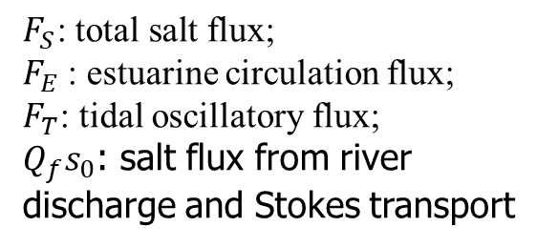
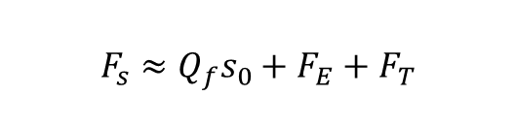
Sensitivity test 2: whole-Bay smoothing
Salt budget
$$F_{s}≈Q_{f}s_{0}+F_{E}+F_{T}$$
$$F_{S}\text{: }\text{total} \text{salt} \text{flux}\text{;}$$
$F_{E}$: estuarine circulation flux;
$F_{T}$: tidal oscillatory flux;
$Q_{f}s_{0}$: salt flux from river discharge and Stokes transport
(Lerczak et al., 2006)
Transect 1
Transect 2
Transect 3
Two threshold of smoothing are compared against original non-smoothed bathymetry
Larger salt flux due to estuarine circulation and tidal oscillation, leading to larger total flux
Total salt flux is off by at least 74% on average even with a generous threshold (r=0.4)
Notes:
Add equation and quote
Why mouth is not changed?

Slide 9
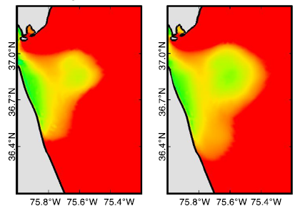
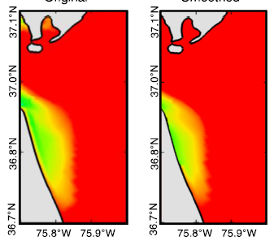

The effect of bathymetry smoothing on plume
Time series of (left) plume volume and (right) percentage difference
2.5
10
100
2
Plume volume (km³)
Original
% difference
Plume volume, area, centroid etc are all altered
Differences are larger during freshets
May be explained from mass conservation point of view
Smoothed
50
1.5
1
0
0.5
0
-50
2
4
6
8
10
12
2
4
6
8
10
12
Months in 2012
Months in 2012
Averaged plume thickness in March, 2012
Averaged plume thickness in September, 2012
Original
Smoothed
Original
Smoothed
Plume
thickness (m)

Slide 10
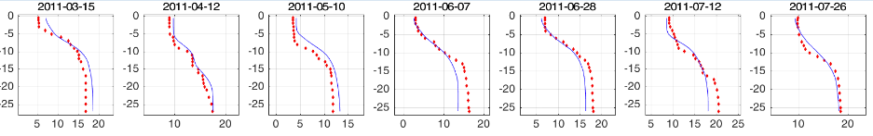
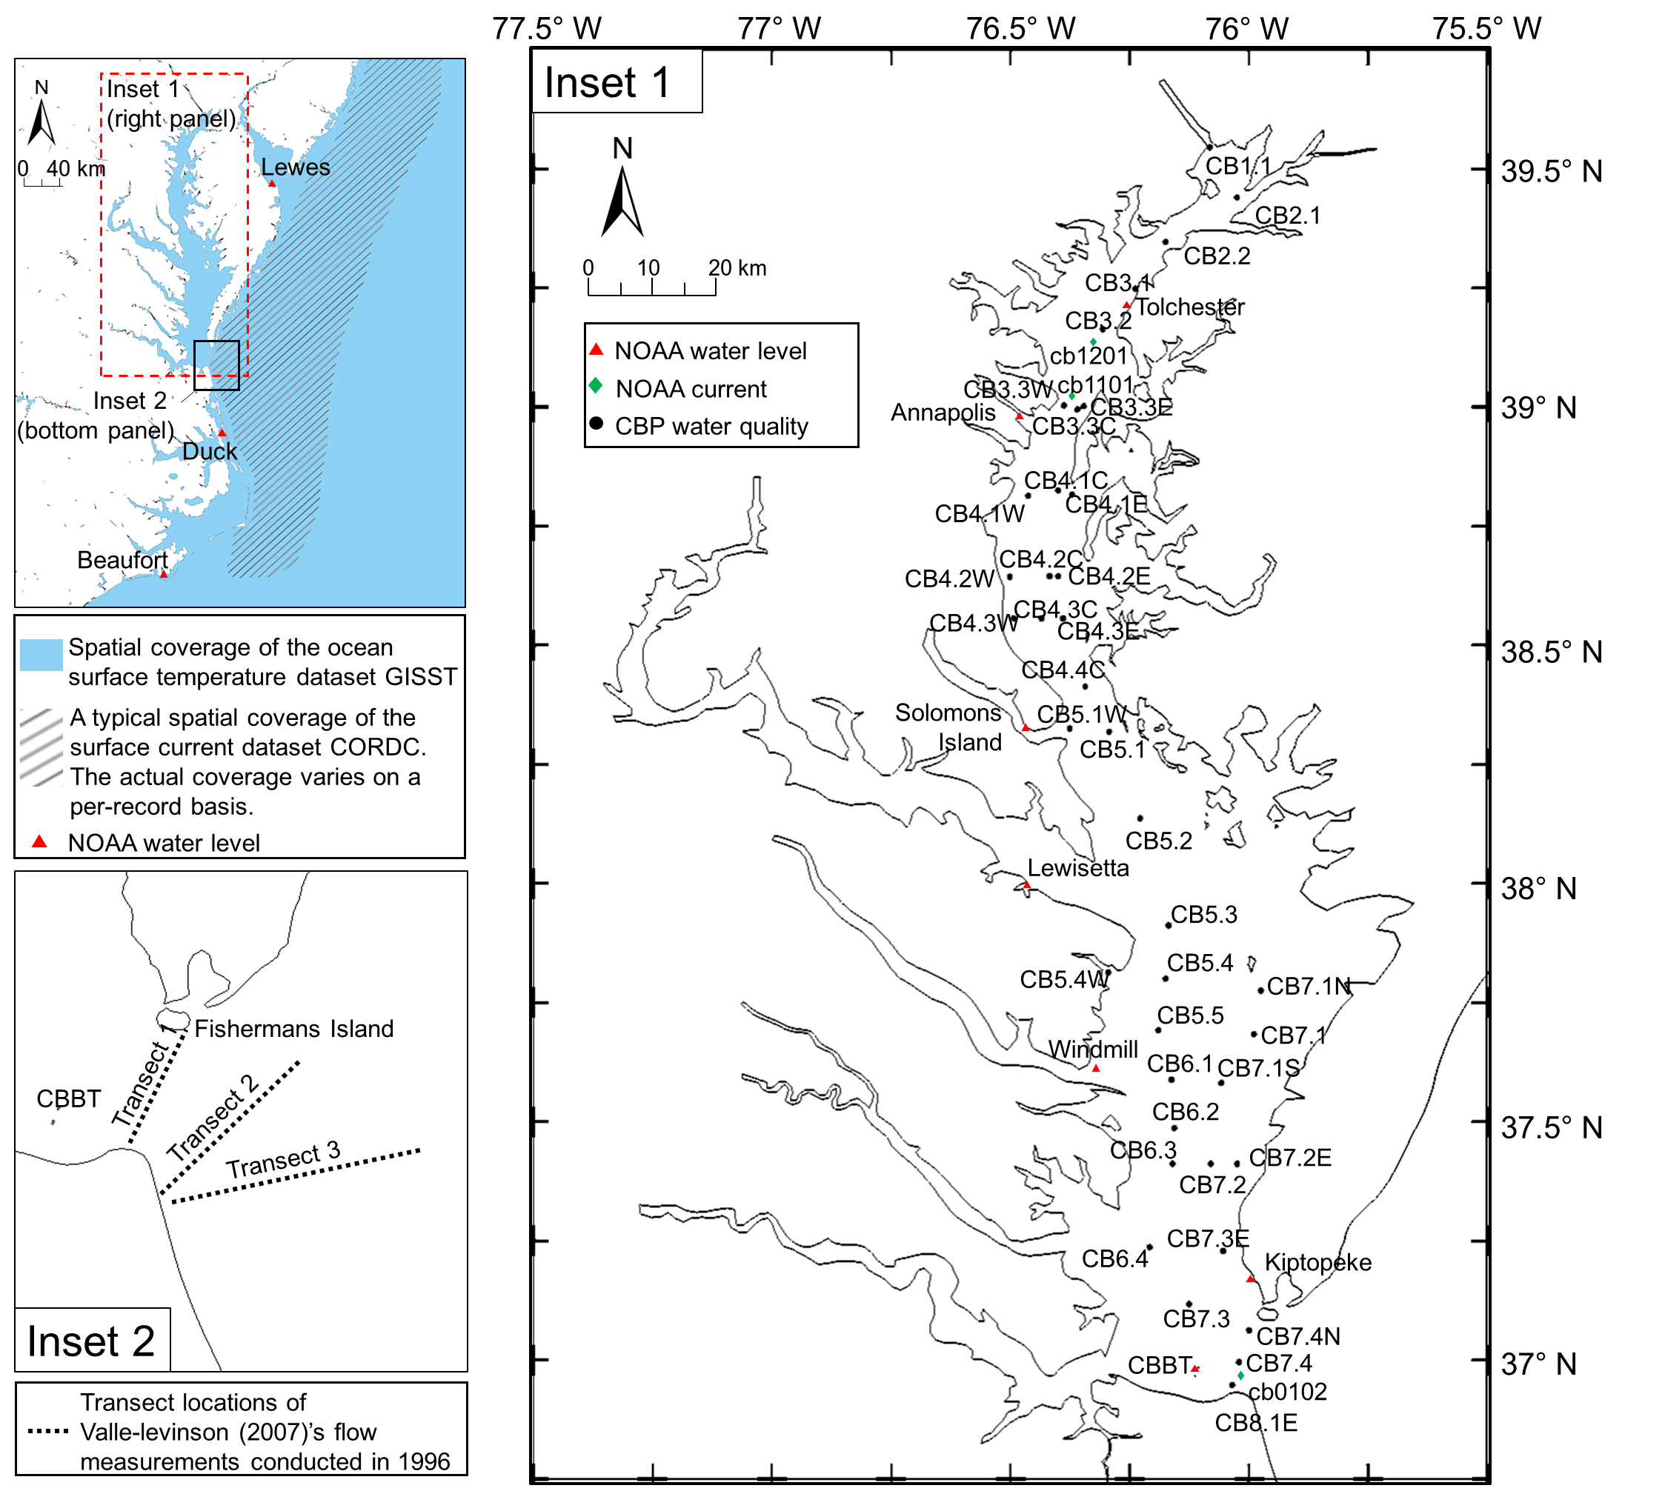
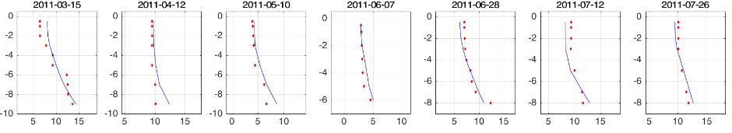
Model skill (Vertical salinity profiles)
Data
Model
Deep channel: CB4.2C (stratified at most times)
Ye et al. (2018)
z (m)
Salinity (PSU)
Shallow shoal: CB4.2E (mixed at most times)
z (m)
Salinity (PSU)
No obvious spatial bias between the deep channel and the shallow shoal
(profiles at all stations/times are included in the supplemental materials of Ye et al., 2018)
Notes:
The model captures this channel-shoal difference, with similar skills in …
Point to the numbers
Add table sensitivity

Slide 11
Stability in shallow region
Shallow waters are usually where the energy is dissipated
Numerically we have to deal with inundation process, which can cause instability if not handled correctly
SCHISM is usually stable even though you may get some large velocity/noise there
A few tips
Use locally 2D config via LSC²
Adjust bottom friction
Recall the differences between 2D and 3D
For locally 2D shallow cells, use a large friction to control large velocity
For locally 3D shallow cells, use a small friction (or even 0) to avoid strong shear
Set parameters to maximize stability

Slide 12
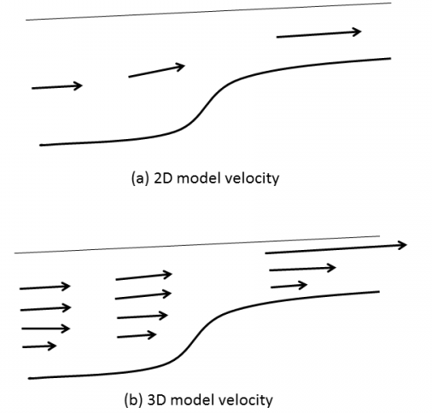
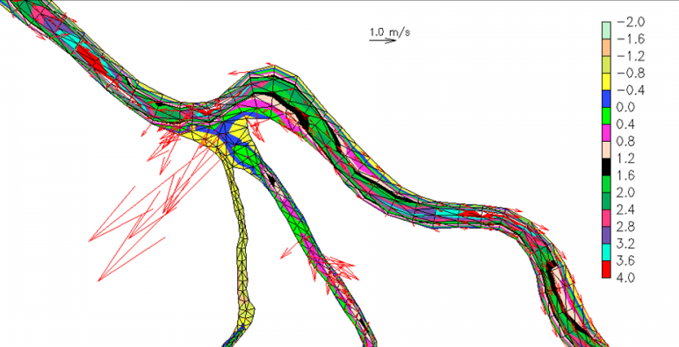
Wet/dry in shallow region (2D vs 3D model)
In 3D, the roughness formulation leads to large Cd in shallow area
Limiting Cd in the shallow helps: 3D model prefers smaller Cd in shallows
Locally 2D configuration (polymorphism) helps and enhances efficiency

Slide 13
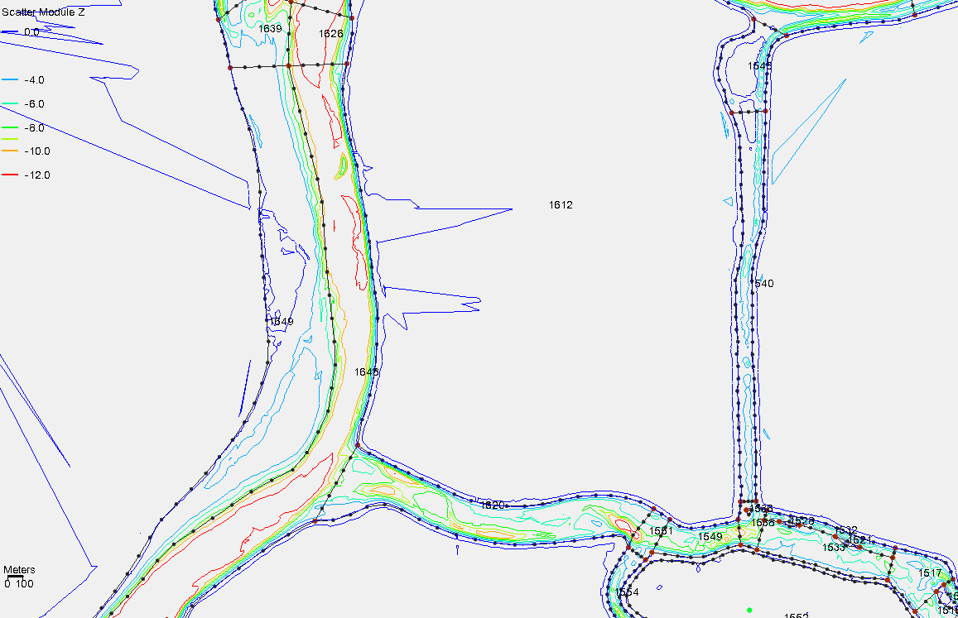
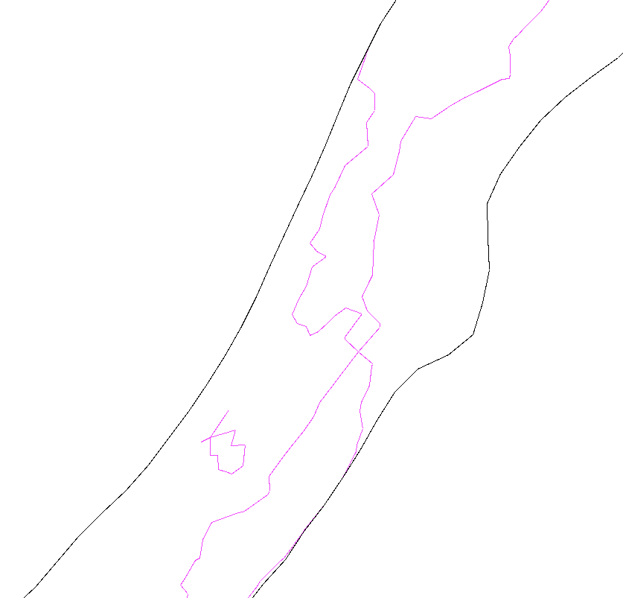
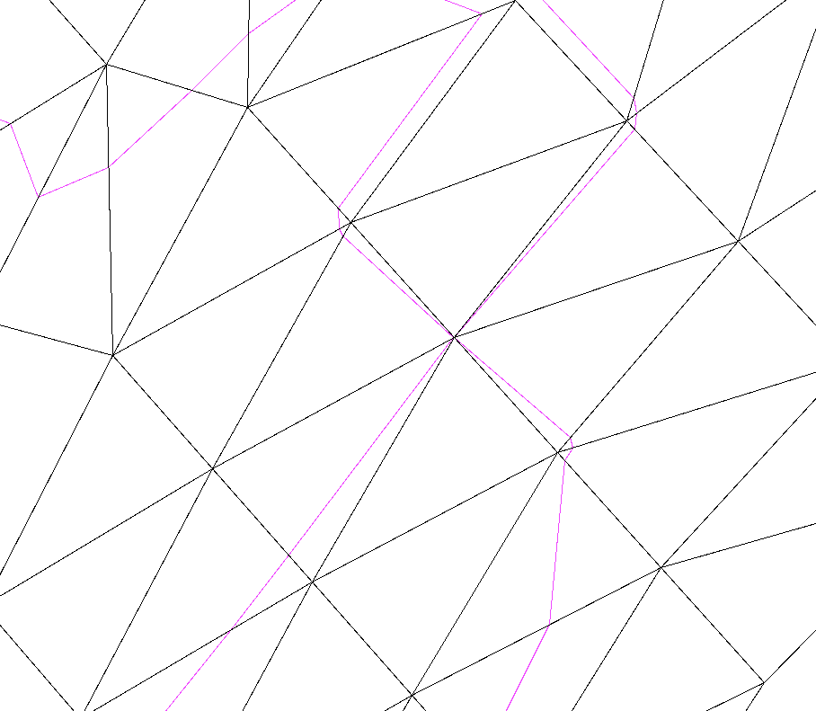
Wet/dry in shallow region
Make sure that channels are not 'blocked‘ by using at least 1 row of always-wet elements
Grid ‘conservatively’ to ensure ‘wet’ most of time
Add more rows of elements if needed
A sub-optimal (but workable) case

Slide 14
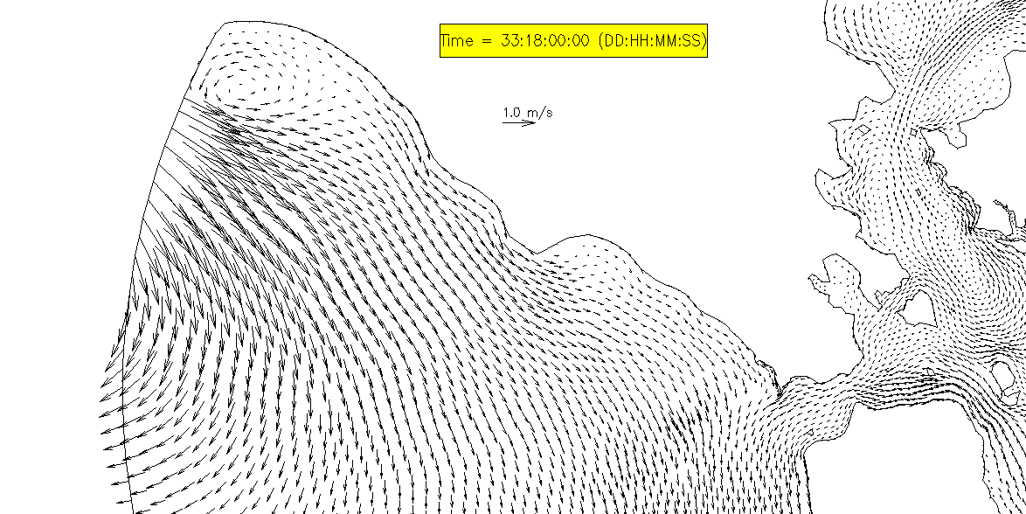
Horizontal b.c. for velocity: uv3D.th.nc
?
What’s wrong with my open boundary
Incoming velocity is required but sometimes unavailable
If no velocity info is available, use 1-way nesting to generate uv3D.th.nc
Use 2D model for the ‘larger-domain’, with most dissipative settings
θ=1
Large Manning’s n near bnd
indvel=1; inunfl=0
Often you can ‘cheat’ by using the same grid for ‘large domain’ and ‘small domain’ if you don’t care too much about accuracy near the boundary
Best approach is to combine tidal database (FES2014) and a non-tidal model (e.g. HYCOM) for velocity b.c.
A new branch supposes to improve this
If you don’t impose vel b.c., the boundary is allowed to go dry!

Slide 15
Parameter setting
Grid resolution needs to be fine enough especially for strong wetting and drying
For fine resolution, inunfl=1 and indvel=0 usually results in smoother inundation
Control bottom friction (2D vs 3D)
IM=1: max dissipation (but in reality, the results are very close to IM=0.51 elsewhere)
indvel
Remember to impose vel b.c. with indvel=0
indvel=0 usually gives good results for inundation, as long as you specify adequate dissipation for momentum (ishapiro, ihorcon)
i.c. for elev (ic_elev)
Reduce time step as last resort (for very strong wet/dry)

Slide 16

param.in
!-----------------------------------------------------------------------
! Bottom friction.
! bfric=0: drag coefficients specified in drag.gr3; bfric=-1: Manning's
! formulation (even for 3D prisms).
! bfric=1: bottom roughness (in meters) specified in rough.gr3 (and in this case, negative
! or 0 depths in rough.gr3 indicate time-independent Cd, not roughness!).
! Cd is calculated using the log law, when dzb>=dzb_min; when dzb<dzb_min,
! Cd=Cdmax*exp[dzb_decay*(1-dzb/dzb_min)], where Cdmax=Cd(dzb=dzb_min),
! and dzb_decay (<=0) is a decay const specified below.
! If iwbl=1, bfric must =1.
!-----------------------------------------------------------------------
bfric = 1 !nchi in code
dzb_min = 0.5 !needed if bfric==1; min. bottom boundary layer thickness [m].
dzb_decay = 0. !needed if bfric=1; a decay const. [-]
!hmin_man = 1. !needed if bfric=-1: min. depth in Manning's formulation [m]
!-----------------------------------------------------------------------
! Coriolis. If ncor=-1, specify "latitude" (in degrees); if ncor=0,
! specify Coriolis parameter in "coriolis"; if ncor=1, model uses
! lat/lon in hgrid.ll for beta-plane approximation if ics=1, and in this case,
! the latitude specified in CPP projection ('cpp_lat') is used. If ncor=1 and ics=2,
! Coriolis is calculated from local latitude, and 'cpp_lat' is not used.
!-----------------------------------------------------------------------
ncor = 1 !must be 1 if ics=2
!latitude = 46 !if ncor=-1
!coriolis = 1.e-4 !if ncor=0
If bfric=1
We always use dzb_decay=0, so Cd<=Cdmax (will remove dzb_decay in the future release)
$$δ_{b}≥\text{dzb}\text{_}\text{min}$$
You can also specify a negative roughness in rough.gr3 – the absolute values there are C_{D}
However, this won’t work for SED3D with roughness predictor

Slide 17
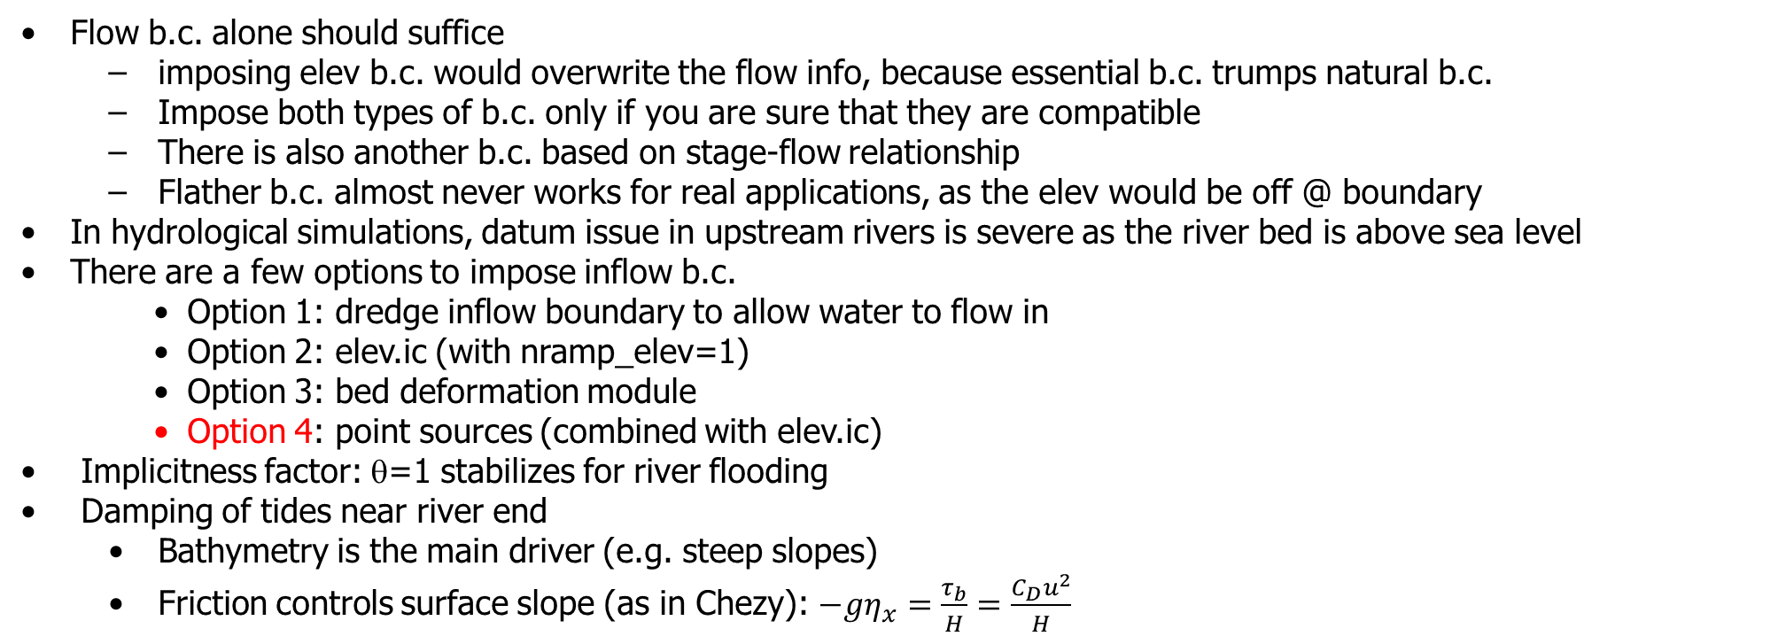
River inflow boundary
Flow b.c. alone should suffice
imposing elev b.c. would overwrite the flow info, because essential b.c. trumps natural b.c.
Impose both types of b.c. only if you are sure that they are compatible
There is also another b.c. based on stage-flow relationship
Flather b.c. almost never works for real applications, as the elev would be off @ boundary
In hydrological simulations, datum issue in upstream rivers is severe as the river bed is above sea level
There are a few options to impose inflow b.c.
Option 1: dredge inflow boundary to allow water to flow in
Option 2: elev.ic (with nramp_elev=1)
Option 3: bed deformation module
Option 4: point sources (combined with elev.ic)
Implicitness factor: θ=1 stabilizes for river flooding
Damping of tides near river end
Bathymetry is the main driver (e.g. steep slopes)
Friction controls surface slope (as in Chezy): $−gη_{x}=\frac{τ_{b}}{H}=\frac{C_{D}u^{2}}{H}$

Slide 18
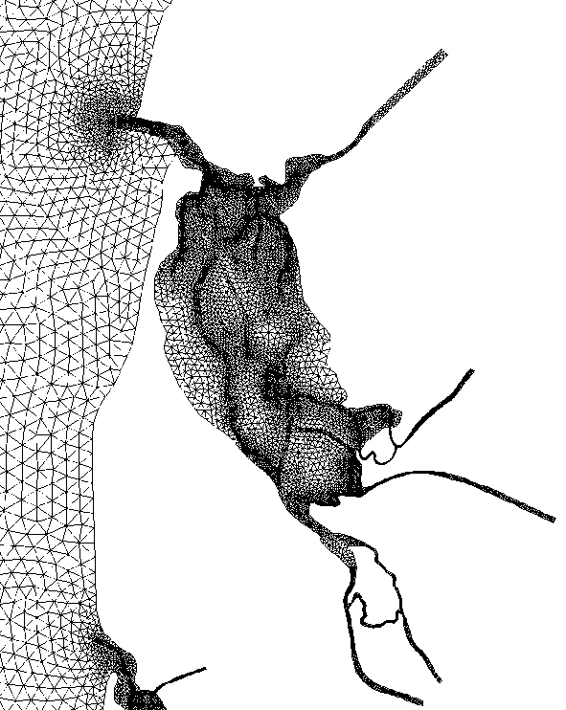
Option 1: open boundary
To prevent drying near the river open boundary, impose a min depth in ~2 rows of elements
The model will flood the dry bed and deliver water downstream
Remember to use negative numbers in flux.th for inflow, positive numbers for outflow!
May add a ‘pseudo channel’ beyond the original open boundary
With proper calibration this approach can give good results for momentum and stage
However, the open boundary can NEVER go dry, and this may be frustrating for drought season or large withdrawal
A new branch by BfG (bndry/) should fix this issue
Min h=1m
river extended

Slide 19

Option 2: specify initial surface elevation
Use open boundary for inflow as in option 1, with original bathymetry
Use elev.ic (ihot=0, ic_elev=1) or hotstart.nc (ihot/=0)
Remember to set nramp_elev=1 so the ramp-up starts from the values in elev.ic or hotstart.nc
The hope is that the river inflow will quickly adjust elev.ic and lead to a stable river flow regime
Needs some care to avoid large oscillations that make the open boundary dry
This option can also be used to adjust vertical datum (e.g. NAVD88)
elev.ic
Final elev
Datum

Slide 20

Option 3: bed deformation
Use open boundary as inflow as in option 1
Start with a dredged inflow boundary as in option 1
As the flow is ramped up, use SCHISM’s bed deformation option (imm=1) to raise the bottom toward the original bathymetry
The bed deformation stops after ibdef steps and the simulation continues with original bathymetry
This option potentially can give best accuracy, but is still subject to the dry boundary issue
Datum
Dredged
Datum
Datum

Slide 21
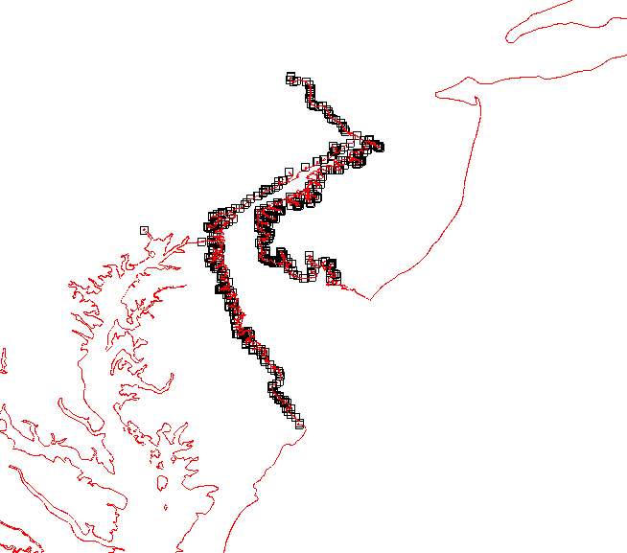
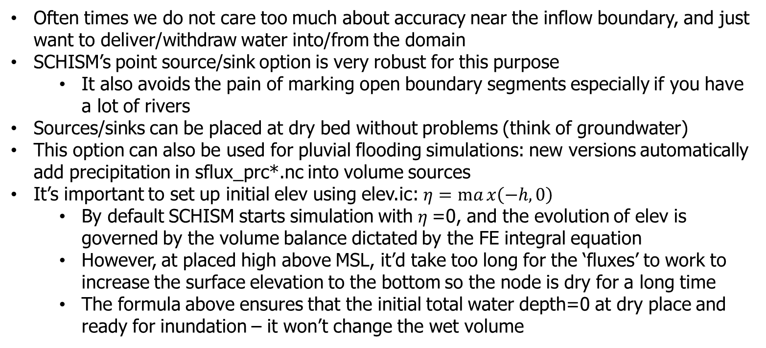
Option 4: point source/sink
Often times we do not care too much about accuracy near the inflow boundary, and just want to deliver/withdraw water into/from the domain
SCHISM’s point source/sink option is very robust for this purpose
It also avoids the pain of marking open boundary segments especially if you have a lot of rivers
Sources/sinks can be placed at dry bed without problems (think of groundwater)
This option can also be used for pluvial flooding simulations: new versions automatically add precipitation in sflux_prc*.nc into volume sources
It’s important to set up initial elev using elev.ic: $η=max\left(−h,0\right)$
By default SCHISM starts simulation with $η$=0, and the evolution of elev is governed by the volume balance dictated by the FE integral equation
However, at placed high above MSL, it’d take too long for the ‘fluxes’ to work to increase the surface elevation to the bottom so the node is dry for a long time
The formula above ensures that the initial total water depth=0 at dry place and ready for inundation – it won’t change the wet volume
DE Bay SCHISM coupled to NWM

Slide 22
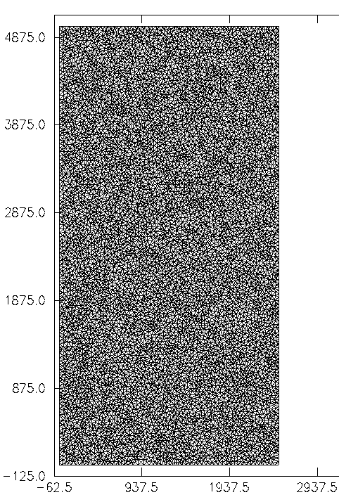
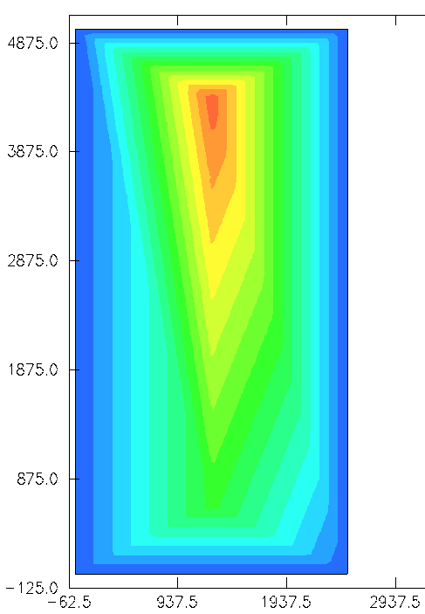

Volume conservation with wetting and drying: Reservoir test
A test for pluvial inundation due to rainfall
Scales resemble most field applications
Depths (m)
y (m)
x (m)

Slide 23
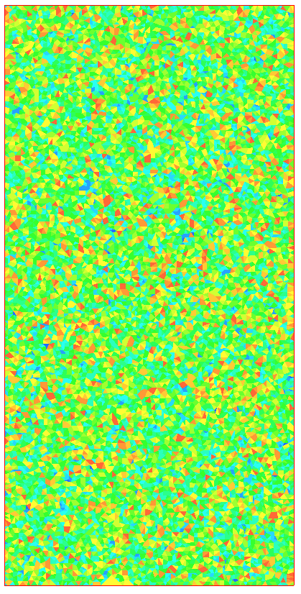
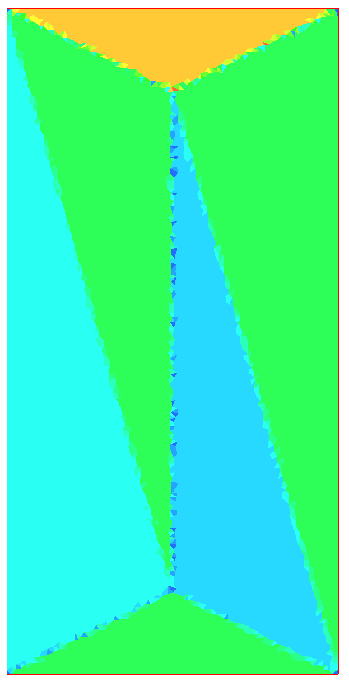


Reservoir test
Bottom slope
Equivalent radius (m)

Slide 24
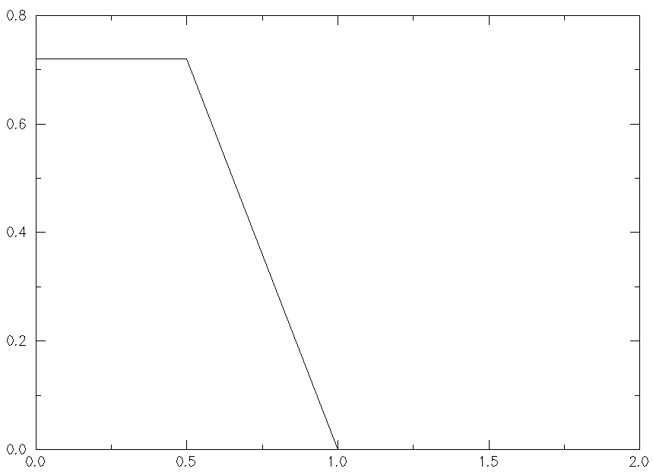
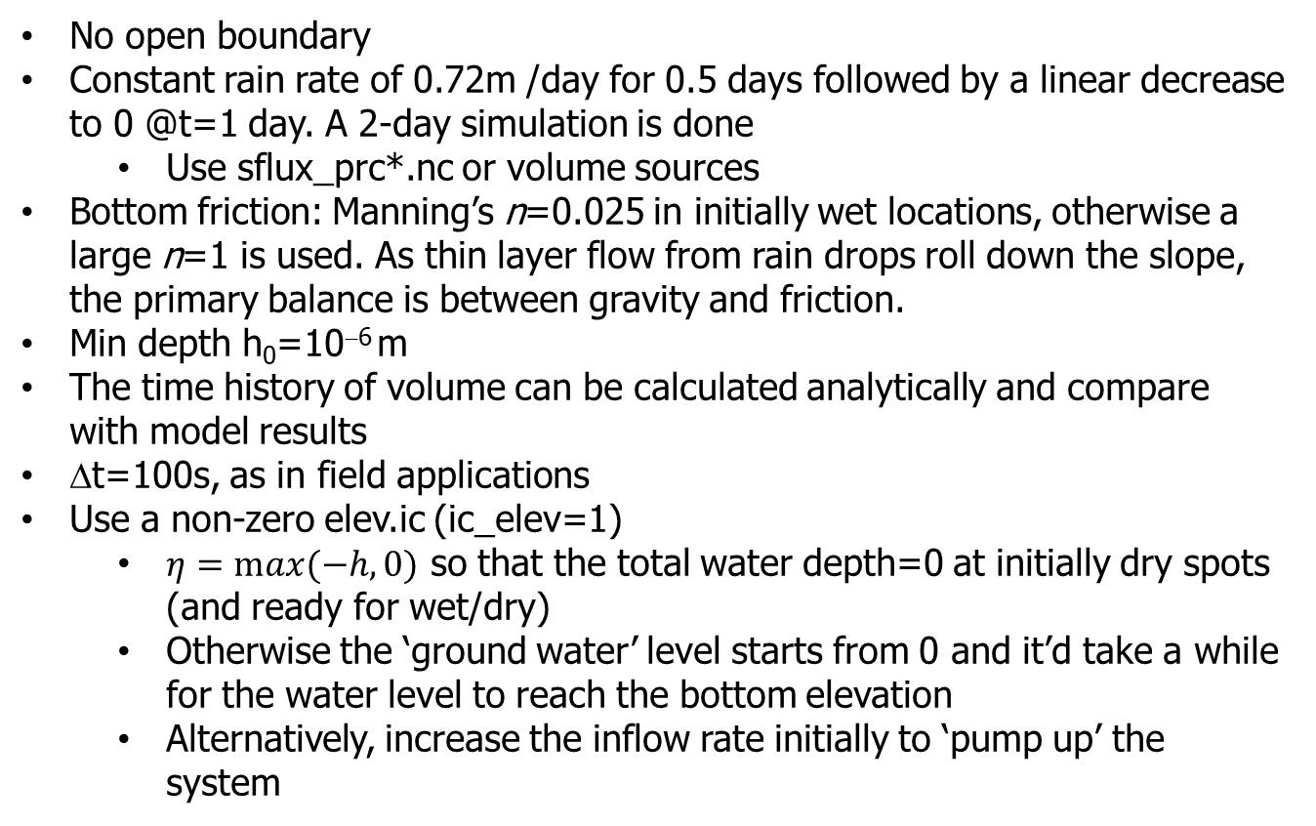
Setup
No open boundary
Constant rain rate of 0.72m /day for 0.5 days followed by a linear decrease to 0 @t=1 day. A 2-day simulation is done
Use sflux_prc*.nc or volume sources
Bottom friction: Manning’s n=0.025 in initially wet locations, otherwise a large n=1 is used. As thin layer flow from rain drops roll down the slope, the primary balance is between gravity and friction.
Min depth h₀=10⁻⁶ m
The time history of volume can be calculated analytically and compare with model results
Δt=100s, as in field applications
Use a non-zero elev.ic (ic_elev=1)
$η=max⁡(−h,0)$ so that the total water depth=0 at initially dry spots (and ready for wet/dry)
Otherwise the ‘ground water’ level starts from 0 and it’d take a while for the water level to reach the bottom elevation
Alternatively, increase the inflow rate initially to ‘pump up’ the system
Rain rate (m/day)
Days

Slide 25
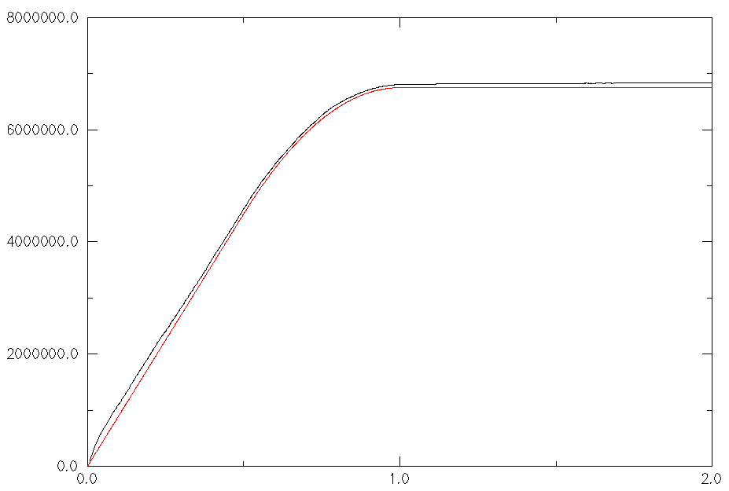
Volume conservation
Volume change is calculated as the difference between the instantaneous volume and initial volume
Error at the end of t=2 day is 1.2%, and it remains low during the 2-day simulation
Volume change (m³)
SCHISM
Analytical
Days

Slide 26
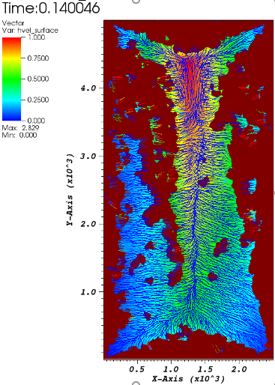
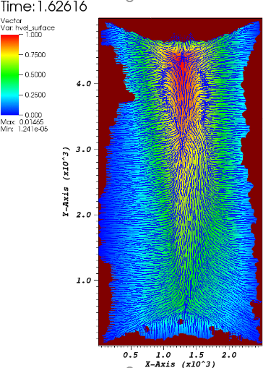
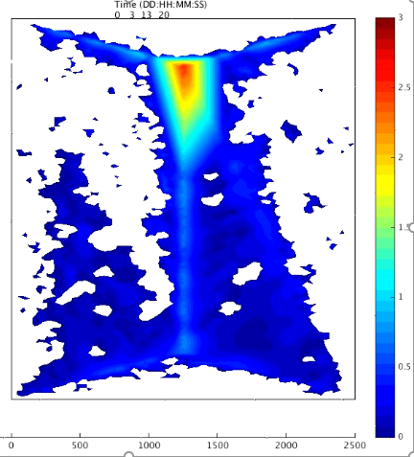
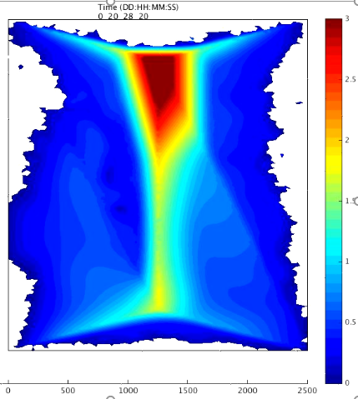
Total depth (m)

Slide 27
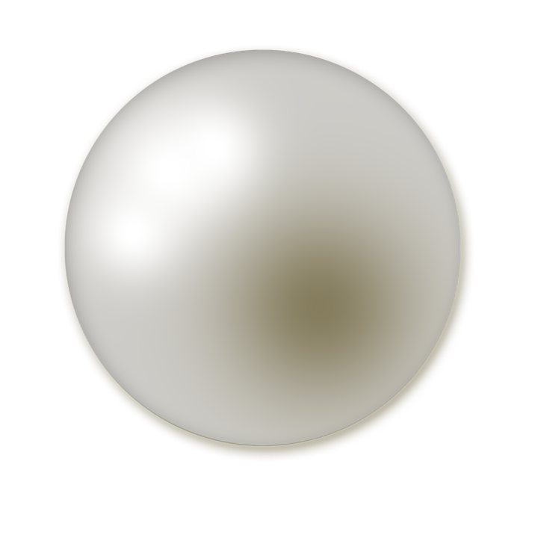
Summary
Bathymetry is a major driver in shallow-water regime
Faithful representation of bathymetry is essential; SCHISM can handle real bathymetry
Hydrological inundation regime needs some care
Best approach is to use SCHISM’s polymorphism with 2D cells applied to all shallow regions
Use appropriate parameterization
hgrid: grid at least 1 row of wet elements in channels to allow water to flow thru
Bottom friction
Set proper init elev: elev.ic, ic_elev
Minimum depth, implicitness factor, indvel
Reduce time step as last resort
Options to impose flow b.c.
Most robust and easy option is to use point sources to handle wet/dry

