Slide 1


Sediment dynamics modeling with SCHISM
SCHISM Workshop -- April 2019 -- Sacramento
MENGUAL Baptiste (baptiste.mengual@univ-lr.fr)

Slide 2
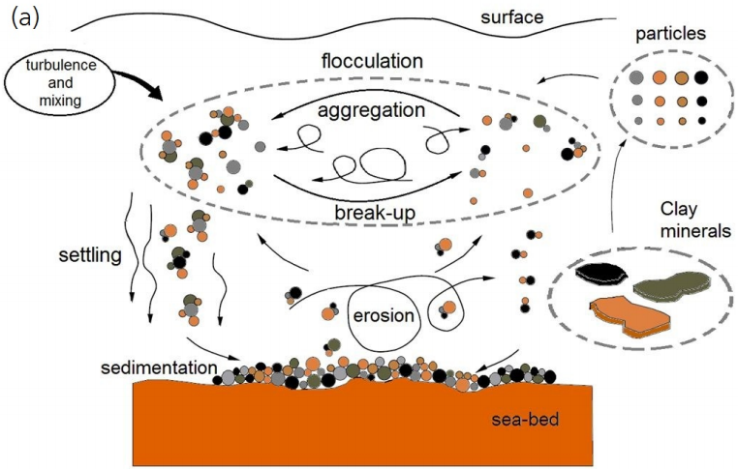
Dynamics of sediments in marine environments
(from Wang and Adutta, 2013)
Focus on sand dynamics (suspended and bedload transport)

Slide 3
2 sediment modules
SED2D
(Fortunato and Oliveira, 2004, 2007; Dodet, 2013; Guérin, 2016)
Based on semi empirical transport formula for suspension and bedload transport
Advection/diffusion not resolved
Only for non-cohesive sediments (sand and gravel)
Fast computation time
SED3D
(Pinto et al., 2012)
Solving both bedload and suspended dynamics → advection/diffusion equation
TVD scheme for tracer advection
Two types of sediment considered: non-cohesive (susp & bedload) and cohesive (susp only)
More time-consuming
For the two models:
Multi-layer/multi-class modules
Benefit of recent improvements in terms of numerical stability → Euler-Weno scheme
to solve Exner equation

Slide 4
OUTLINE
Forcing / key processes
Sediment transport
SED2D/SED3D specificities
Seabed compartment
Applications / Ongoing studies
Perspectives & Conclusions

Slide 5
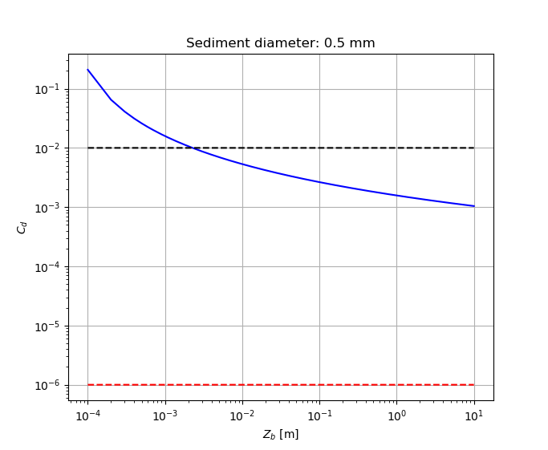
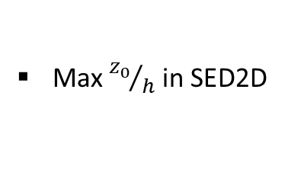







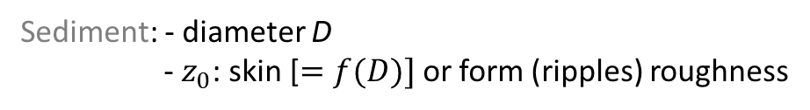

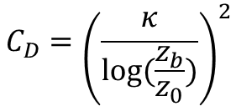



Initiation of motion → Forcing
Bottom shear stress
$$z$$
Current $τ_{c}$
$$C_{D}={\left(\frac{κ}{log⁡(\frac{z_{b}}{z_{0}})}\right)}^{2}$$
$τ_{c}=C_{D}\left|u_{b}\right|u_{b}$ $[N.m^{−2}$]
Water
column
h
$$u_{b}$$
Sediment: - diameter D
- $z_{0}$: skin [$=f(D)]$ or form (ripples) roughness
$$z_{0}$$
$$z_{b}$$
Bottom layer
thickness
$C_{D}$ limiters (drag coefficient)
$$C_{d, max}$$
Min $z_{b}$ in SCHISM
$$C_{d}$$
Max ${z_{0}}/h$ in SED2D
Min/Max $C_{D}$ values in SED3D
$$C_{d, min}$$

Slide 6
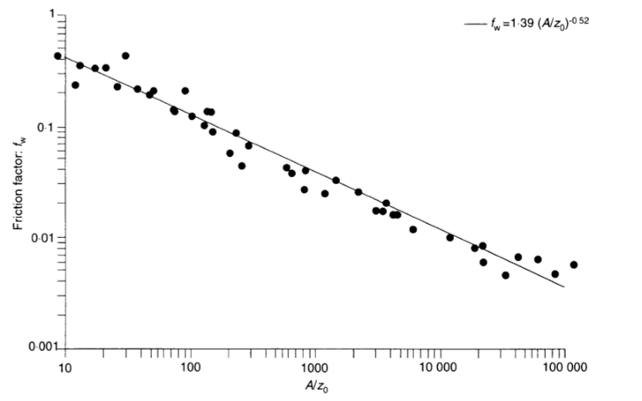


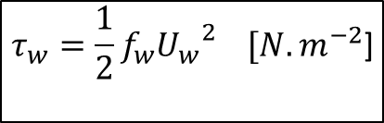


Initiation of motion → Forcing
Bottom shear stress
Waves $τ_{w}$
$$τ_{w}=\frac{1}{2}f_{w}{U_{w}}^{2} [N.m^{−2}\text{]}$$
from Soulsby (1997)
(Jonsson, 1966)
$U_{w}$ : Orbital velocity
$f_{w}$ : Wave friction factor
=f($A, z_{0}$)
Many formulations
Swart (1974)
Nielsen (1992)
Soulsby (1997)
(relative bottom orbital excusion)

Slide 7
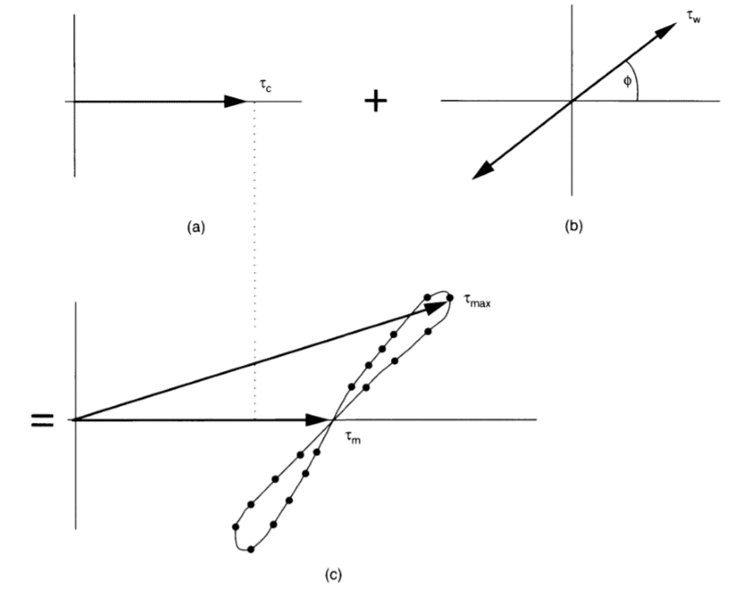
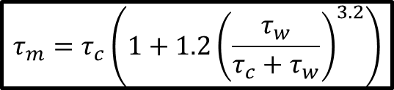

Initiation of motion → Forcing
Bottom shear stress
Waves
Combined waves and current $τ_{m} [N.m^{−2}]$
Current
$$τ_{m}=τ_{c}\left(1+1.2{\left(\frac{τ_{w}}{τ_{c}+τ_{w}}\right)}^{3.2}\right)$$
Total
from Soulsby et al. (1993), Coastal Engineering

Slide 8
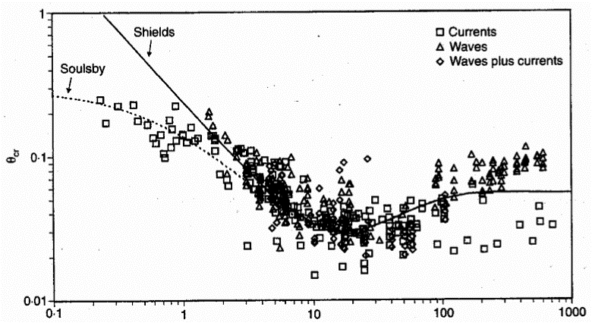

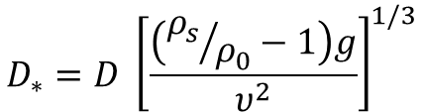




Initiation of motion → Threshold
Critical shear stress
Dimensionless grain size
$$D_{∗}=D {\left[\frac{\left({ρ_{s}}/{ρ_{0}}−1\right)g}{υ^{2}}\right]}^{1/3}$$
from Soulsby (1997)
Mobility parameter [-]
$$θ_{ce}$$
$θ_{ce}$=$\frac{0.3}{1+1.2D_{∗}}+0.055 \left(1−e^{−0.02D_{∗}}\right)$
No motion
Critical shear stress [N.m⁻²]
$τ_{ce}=θ_{ce} g \left(ρ_{s}−ρ_{0}\right)$ $D$
$$D_{∗}$$
Sediment in motion if $τ_{m}>τ_{ce}$

Slide 9
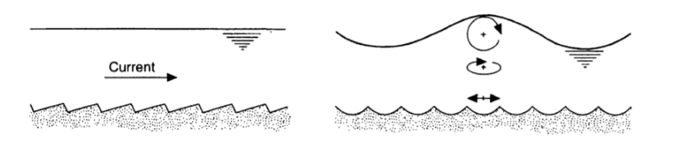






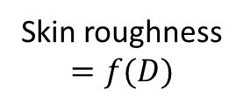




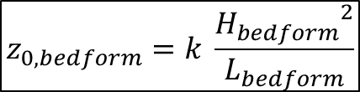



Roughness length $z_{0}$
Hydrodynamics: Bedform predictor → Form roughness sent back to SCHISM for $C_{d}$ estimates
Current
If$τ_{ce}<τ_{c}<τ_{wash}$
Waves
If$τ_{ce}<τ_{w}<τ_{wash}$
$$h_{wat}$$
$$L_{cr}$$
$$L_{wr}$$
$$H_{cr}$$
$$H_{wr}$$
Ripples
$$L_{cr}=1000 D$$
$$H_{cr}=L_{cr}/7$$
Dunes
Sandwaves
$$\left(H_{wr}, L_{wr}\right)=f\left(A, U_{w}, τ_{w}, τ_{ce}, D\right)$$
Grant and Madsen (1982)
Nielsen (1992)
$H_{sw}=f(h_{wat}, τ_{c}, τ_{ce}, D)$
$$L_{wr}=f\left(H_{wr}\right)$$
$$L_{sw}=f(h_{wat})$$
(e.g. Van Rijn, 1984)
$$z_{0, bedform}=k \frac{{H_{bedform}}^{2}}{L_{bedform}}$$
Total form roughness
$$z_{0,f}=Max\left\{ z_{0,s} ;Max\left\{ z_{0,cr} ;z_{0,wr}+ z_{0,bld}\right\}+z_{0,sw}\right\}$$
Skin roughness
$$=f(D)$$
Sediment-transport
component
Roughness length in sediment module: skin ($z_{0,s}$) or form ($z_{0,f}$)

Slide 10


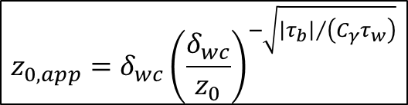

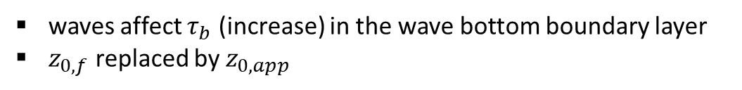
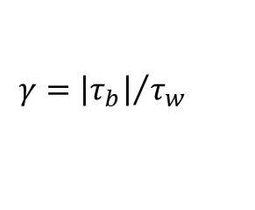
Roughness length $z_{0}$
Apparent roughness length $z_{0,app}$ due to the presence of waves
Shallow waters
waves affect $τ_{b}$ (increase) in the wave bottom boundary layer
$z_{0,f}$ replaced by $z_{0,app}$
e.g. Grant and Madsen (1979)
$τ_{w}=f(f_{w})$ re-estimated iteratively
$$γ={\left|τ_{b}\right|}/{τ_{w}}$$
$$C_{γ}=f(θ_{w},γ)$$
$$f_{w}=f(C_{γ}, ω,U_{w}, z_{0})$$
Wave boundary layer thickness → $δ_{wc}=f(C_{w},τ_{w}, ω,U_{w}, z_{0})$
$$z_{0,app}=δ_{wc}{\left(\frac{δ_{wc}}{z_{0}}\right)}^{−\sqrt{{\left|τ_{b}\right|}/{\left(C_{γ}τ_{w}\right)}}}$$

Slide 11

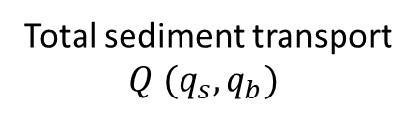


Sediment transport: case of SED2D
Suspended ($q_{s}$) and bedload ($q_{b}$) fluxes based on semi empirical formulations
Engelund and Hansen (1967)
Ackers and White (1973)
Soulsby-Van Rijn (1997)
Van Rijn (2007)
Camenen and Larson (2005, 2008)
Wu and Lin (2014)
Total sediment transport
$Q (q_{s}, q_{b})$
Exner equation
[CL]
$$(q_{s}, q_{b})=f(u,h, D,U_{w},u_{cr}, u_{∗},C_{d},β)$$
[WL]
$$q_{s}=f(C_{ref},W_{s})$$
CL and WL → more sophisticated, e.g:
Asymmetric wave velocity
Angle difference between waves and current
WL: hindering/exposure mechanisms in critical shear stress estimates
+ Possibility to account for bed slope effects (Lesser et al., 2004)

Slide 12
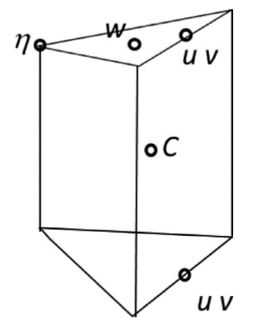

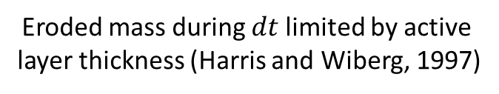




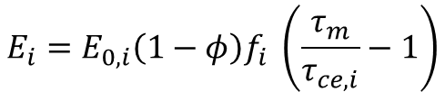


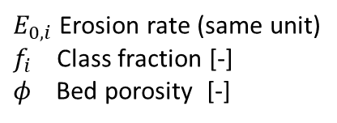
!- BOTTOM BOUNDARY CONDITION OPTION
!- 1 = Warner (2008)
!- 2 = Tsinghua Univ group (under dev)
!------------------------------------------------------------------------------
ised_bc_bot == 1
Erosion/deposition fluxes
Sediment transport with SED3D: I. Suspension
Advection-diffusion equation
For each sediment class $i$
prism
$$\frac{{dC}_{i}}{dt}=−\frac{{duC}_{i}}{dx}−\frac{{dvC}_{i}}{dy}−\frac{{dwC}_{i}}{dz}+\frac{d}{dz}\left(K_{z}\frac{{dC}_{i}}{dz}\right)+\frac{{dW_{s,i}C}_{i}}{dz}+F_{h}+E_{i}−D_{i}$$
Erosion
Deposition
Temporal evolution
of suspended concentration $C_{i}$
Horizontal
advection
Vertical
advection
Turbulent mixing
Vertical diffusion
Settling
Horizontal
diffusion
Erosion
Flux [$kg.m^{−2}.s^{−1}$]
Deposition flux
Settling velocity [$m.s^{−1}$]
$$E_{i}=E_{0,i}\left(1−φ\right)f_{i} \left(\frac{τ_{m}}{τ_{ce,i}}−1\right)$$
$$W_{s,i}=\frac{ν}{D_{i}}\left[{\left({10.36}^{2}+1.049{D_{∗,i}}^{3}\right)}^{0.5}−10.36\right]$$
(Partheniades, 1965)
(Soulsby, 1997)
Flux [$kg.m^{−2}.s^{−1}$]
$E_{0,i}$ Erosion rate (same unit)
$f_{i}$ Class fraction [-]
$φ$ Bed porosity [-]
$$D_{i}=W_{s,i} {. C}_{i, k=1}$$
Bottom computational cell
Eroded mass during $dt$ limited by active
layer thickness (Harris and Wiberg, 1997)

Slide 13
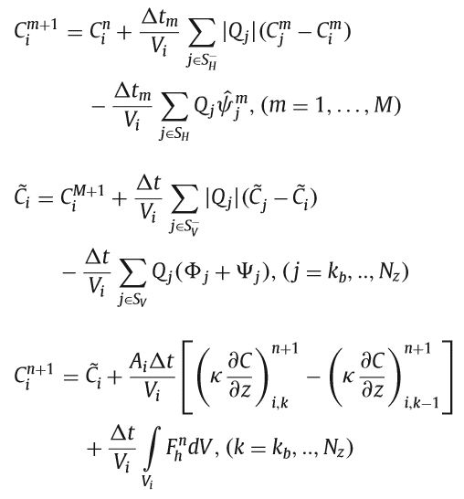

!- BOTTOM BOUNDARY CONDITION OPTION
!- 1 = Warner (2008)
!- 2 = Tsinghua Univ group (under dev)
!------------------------------------------------------------------------------
ised_bc_bot == 1
Erosion/deposition fluxes
Sediment transport with SED3D: I. Suspension
Advection-diffusion equation
For each sediment class $i$
prism
$$\frac{{dC}_{i}}{dt}=−\frac{{duC}_{i}}{dx}−\frac{{dvC}_{i}}{dy}−\frac{{dwC}_{i}}{dz}+\frac{d}{dz}\left(K_{z}\frac{{dC}_{i}}{dz}\right)+\frac{{dW_{s,i}C}_{i}}{dz}+F_{h}+E_{i}−D_{i}$$
Erosion
Deposition
Temporal evolution
of suspended concentration $C_{i}$
Horizontal
advection
Vertical
advection
Turbulent mixing
Vertical diffusion
Settling
Horizontal
diffusion
New tracer advection scheme: TVD²
FVM formulation with 3 sub-steps
1- Horizontal advection
2- Vertical advection
3- Remaining terms
Sub-time step
for CFL crit
vertical level
index
Implicit → remove constraints due to high
$$W_{s,i}$$

Slide 14
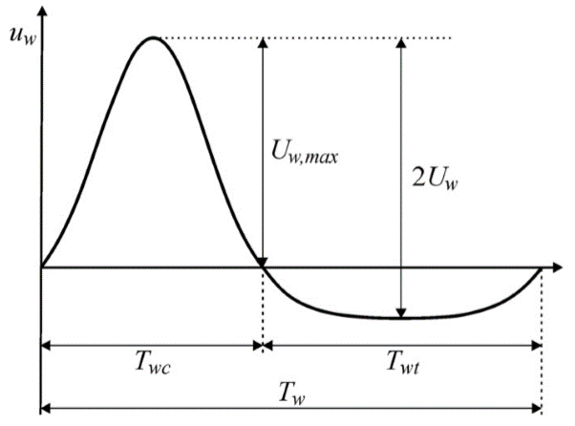
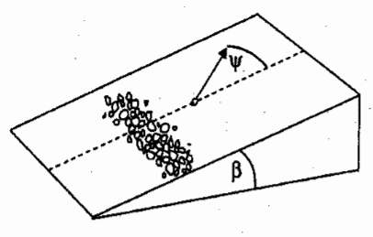
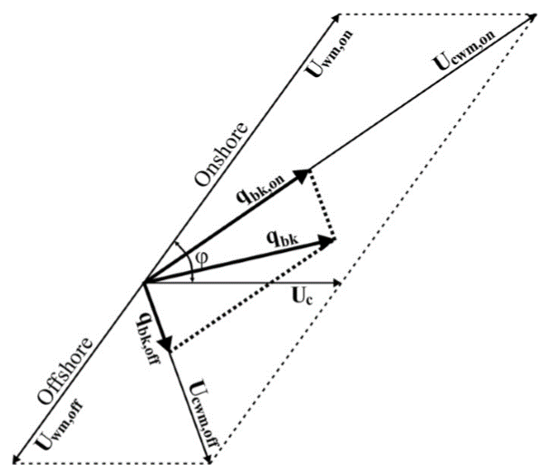


Sediment transport with SED3D: II. Bedload
Bedload flux ($q_{b}$) based on semi empirical formulations
[SD]
Soulsby and Damgaard (2005)
Van Rijn (2007)
Wu and Lin (2014)
$$q_{b}=f\left(u,h, D,U_{w},u_{cr},C_{d}\right)$$
[WL]
accounts for
Angle between waves/current $φ$
SD &
WL
Asymmetric waves (Elfrink et al.,
2006)
Bed slope effect (Lesser et al., 2004)
Fluxes modulated depending on longitudinal
and transversal slopes
(from Wu and Lin, 2014)
(from Soulsby, 1997)

Slide 15
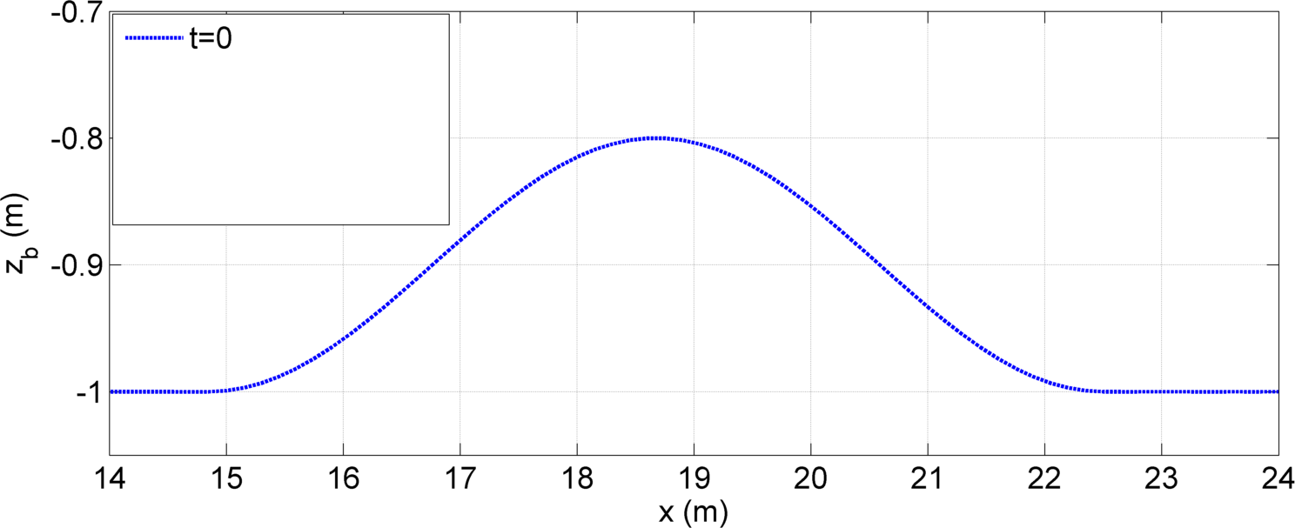
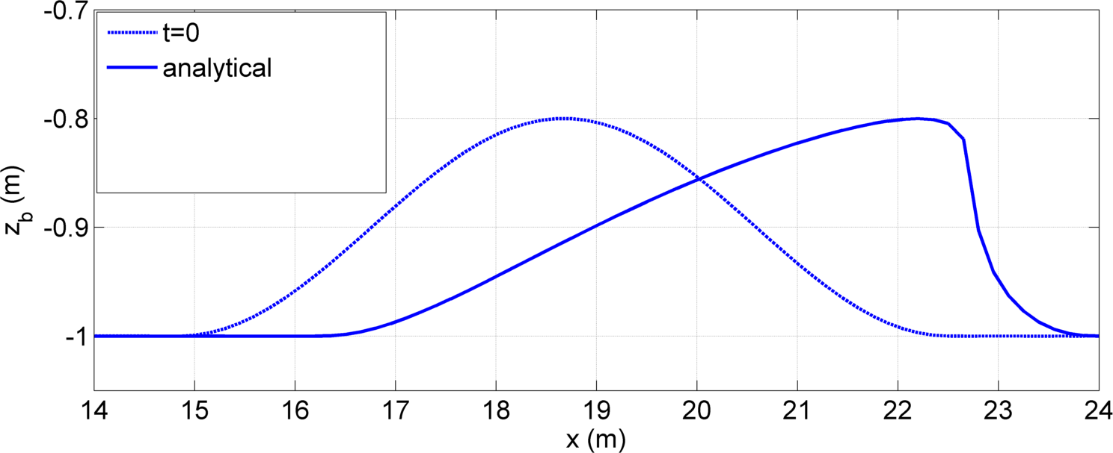
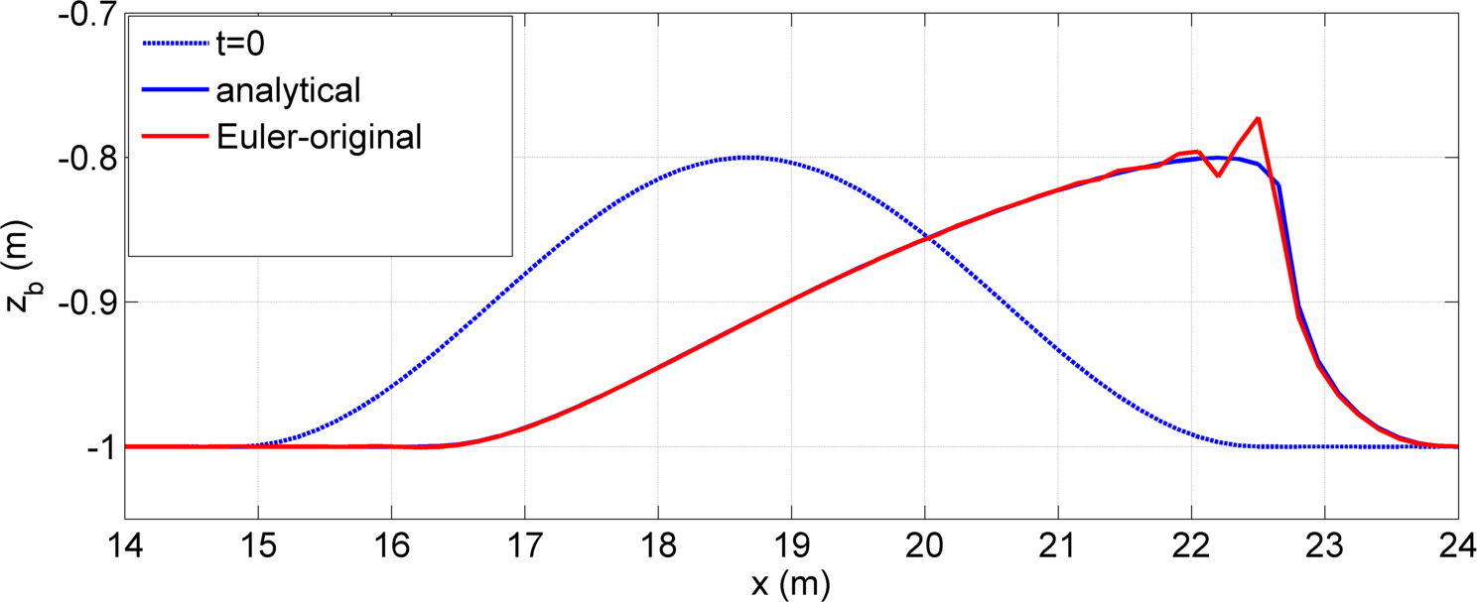
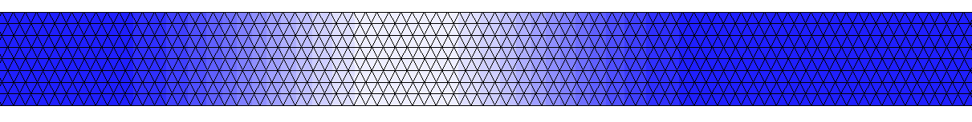
Sediment transport with SED3D: II. Bedload → Bed changes
Exner equation
Basic method
Node-centered control volume with constant sediment flux
inside each element
Numerical oscillations
Conditions : Δt = 2 s ; Δx = 0.15 m (CFL<1) ; Q_{x} = 0.001.u³
(Guérin et al., 2016)

Slide 16
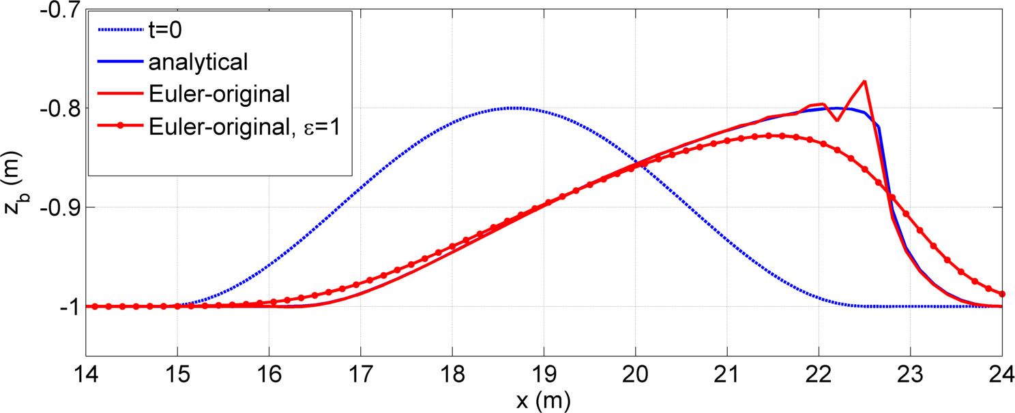

Sediment transport with SED3D: II. Bedload → Bed changes
Exner equation
Basic method
Node-centered control volume with constant sediment flux
inside each element
Conditions : Δt = 2 s ; Δx = 0.15 m (CFL<1) ; Q_{x} = 0.001.u³
(Guérin et al., 2016)
Adding artificial diffusion in transport :
Bathymetric filter
→ drawbacks: methods based on arbitrary thresholds

Slide 17
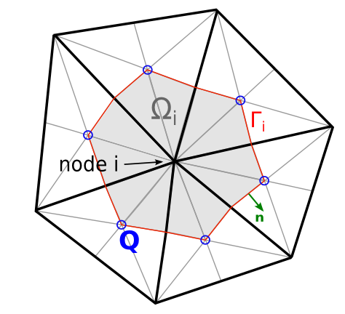

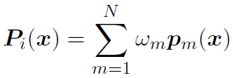
Sediment transport with SED3D: II. Bedload → Bed changes
New numerical scheme to solve the Exner equation
Finite volume formulation
Main characteristic of the new scheme:
Q(x) is interpolated along Γ_{i} following a WENO method (Liu et al., 1994)
(Weighted Essentially Non-Oscillatory)
Q(x) is replaced by:

Slide 18
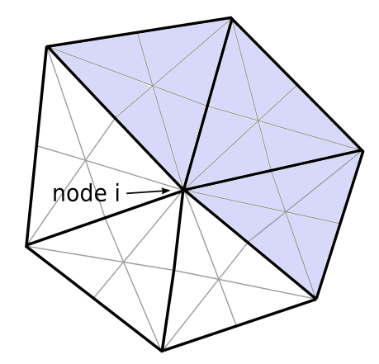


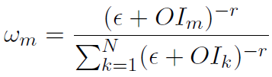
Sediment transport with SED3D: II. Bedload → Bed changes
New numerical scheme to solve the Exner equation
Stencil m
Polynomial
Q_{x,1}
Q_{x,2}
Oscillating
Indicator
Q_{x,3}
Weight
Main characteristic of the new scheme:
Q(x) is interpolated along Γ_{i} following a WENO method (Liu et al., 1994)
(Weighted Essentially Non-Oscillatory)
Q(x) is replaced by:
→ Exner finally resolved using Jacobian Conjugate Gradient method

Slide 19
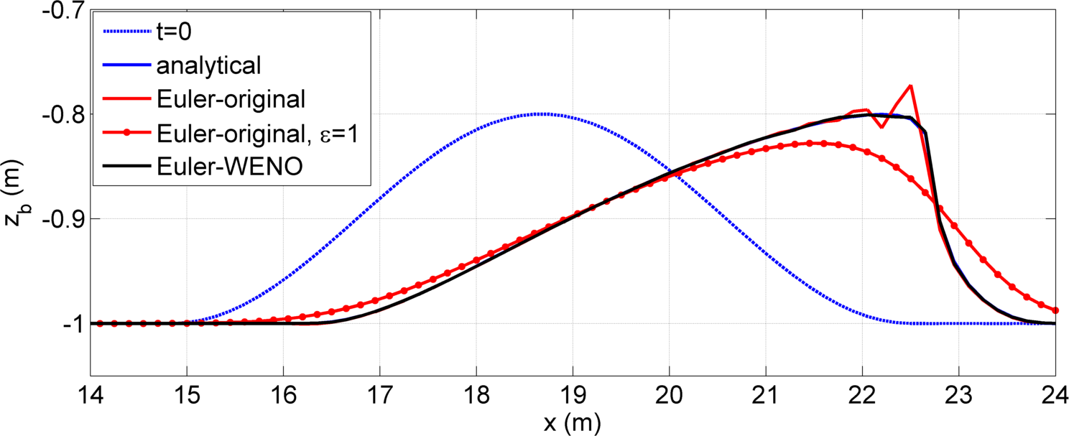
Sediment transport with SED3D: II. Bedload → Bed changes
New numerical scheme to solve the Exner equation
Conditions : Δt = 2 s ; Δx = 0.15 m (CFL<1) ; Q_{x} = 0.001.u³
(Guérin et al., 2016)
Higher accuracy without additional diffusion or bathymetric filter

Slide 20
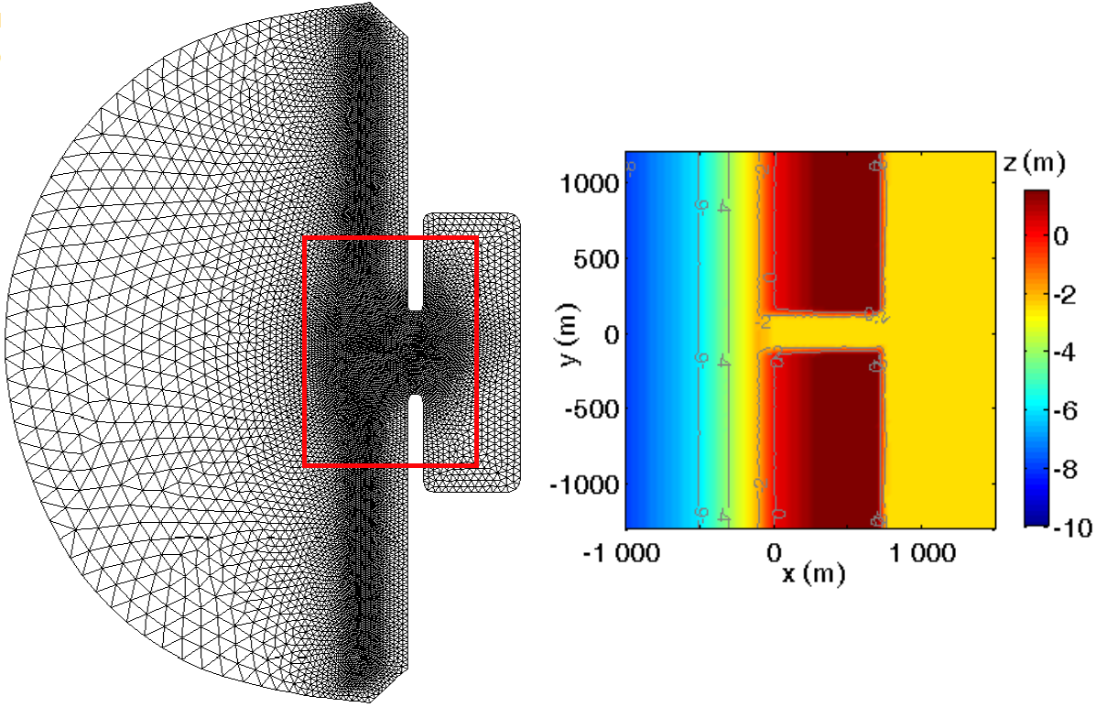
Improvement due to the WENO scheme
Morphodynamic application using SED2D: idealized inlet test case
Tide:
M2 constituant
(Guérin et al., 2016)
Waves:
H_{s} = 1.5 m
T_{p} = 10 s
Dir_{moy} = N290°
Zoom on mouth
Grid
Conditions : Δt = 30 s ; Δx = 25 - 300 m (CFL<1) ; d50 = 0.5 mm ; Q following van Rijn (2007)

Slide 21
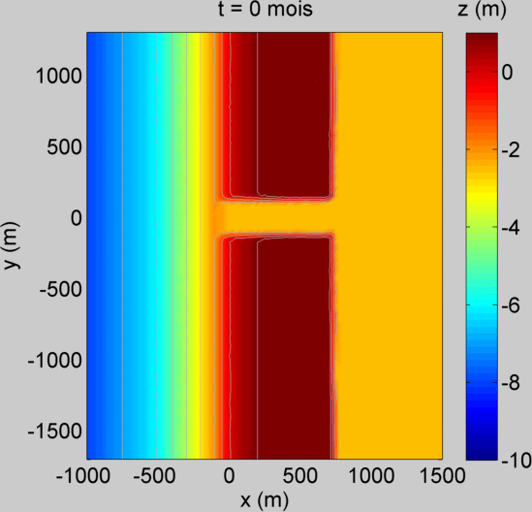

Improvement due to the WENO scheme
Morphodynamic application using SED2D: idealized inlet test case
bathymetry
Old scheme
(with diffusion et filter)
WENO method
(Guérin et al., 2016)

Slide 22
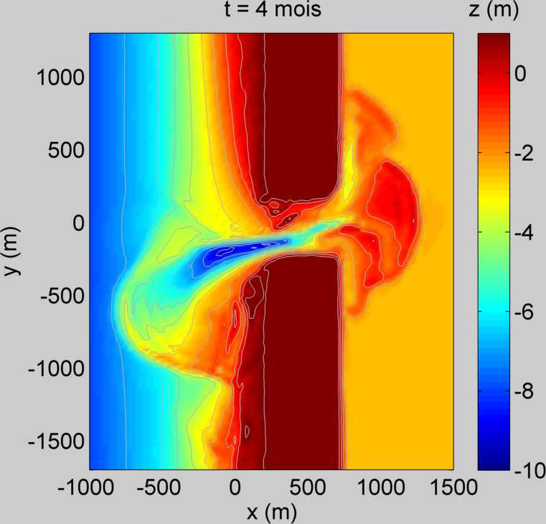
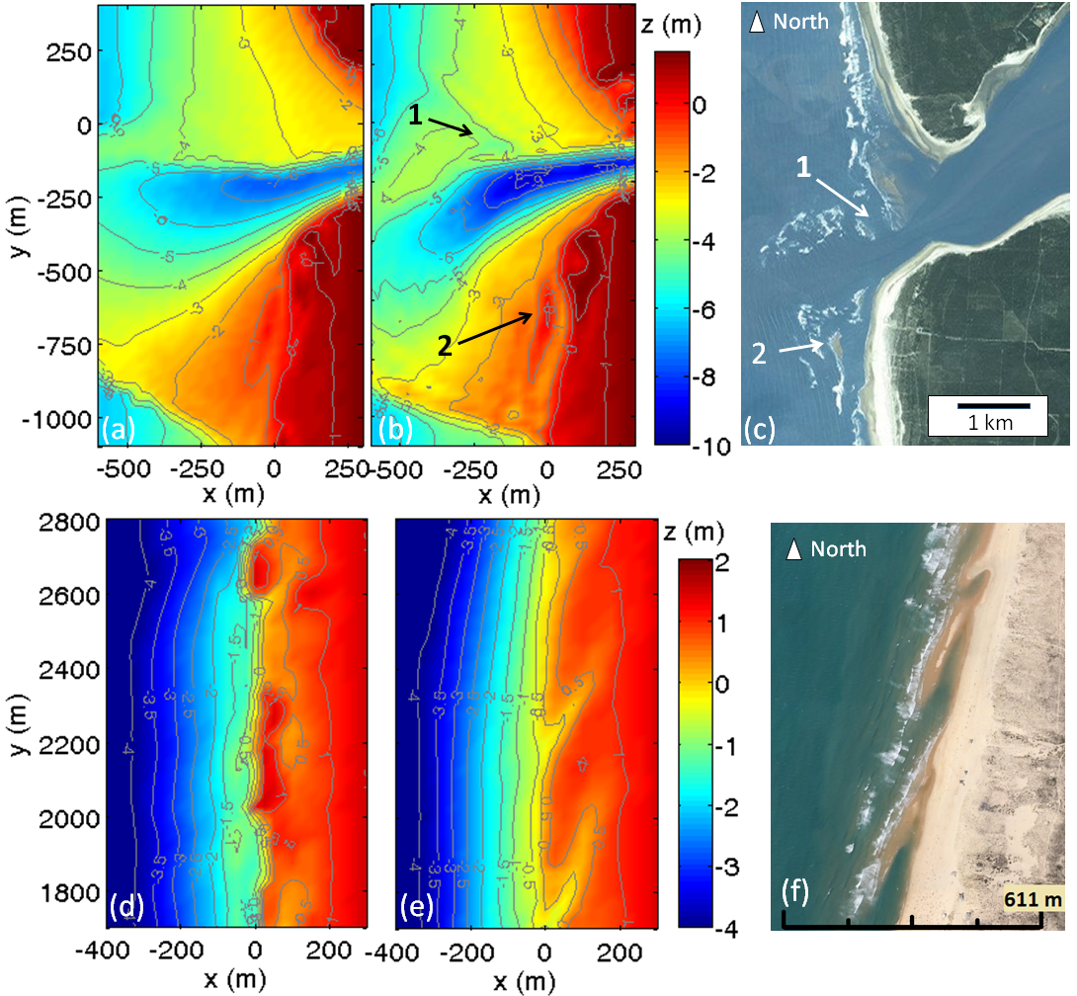
Improvement due to the WENO scheme
Morphodynamic application using SED2D: idealized inlet test case
bathymetry
1
2
Maumusson mouth
(Charente-Maritime, France)
WENO method
Typical flood secondary channel (Bertin et al., 2009)
(Guérin et al., 2016)

Slide 23
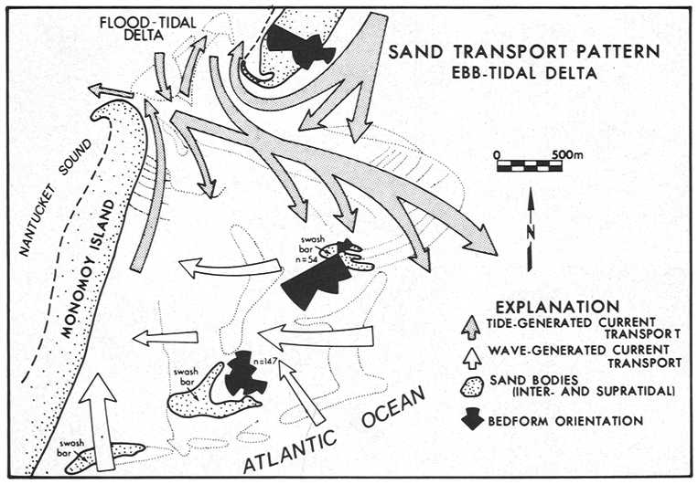
Improvement due to the WENO scheme
Morphodynamic application using SED2D: idealized inlet test case
bathymetry
2
Figure from Hayes (1980)
WENO method
Average migration rate ≈ 1.5 à 3 m/day (consistent with Pianca et al., 2014)
(Guérin et al., 2016)

Slide 24
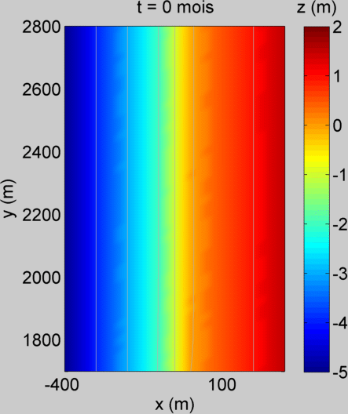
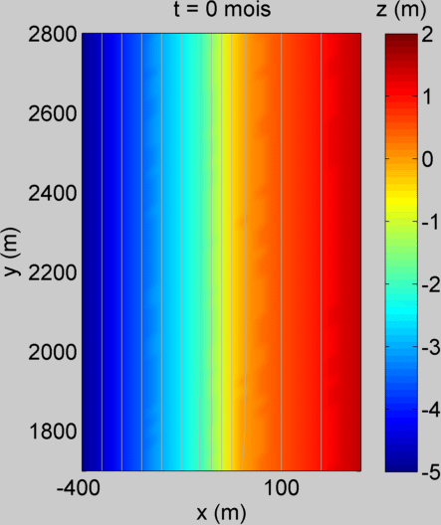
Improvement due to the WENO scheme
Morphodynamic application using SED2D: idealized inlet test case
bathymetry
Adjacent beach
evolution
Old scheme
(with diffusion and filter)
WENO method
(Guérin et al., 2016)

Slide 25
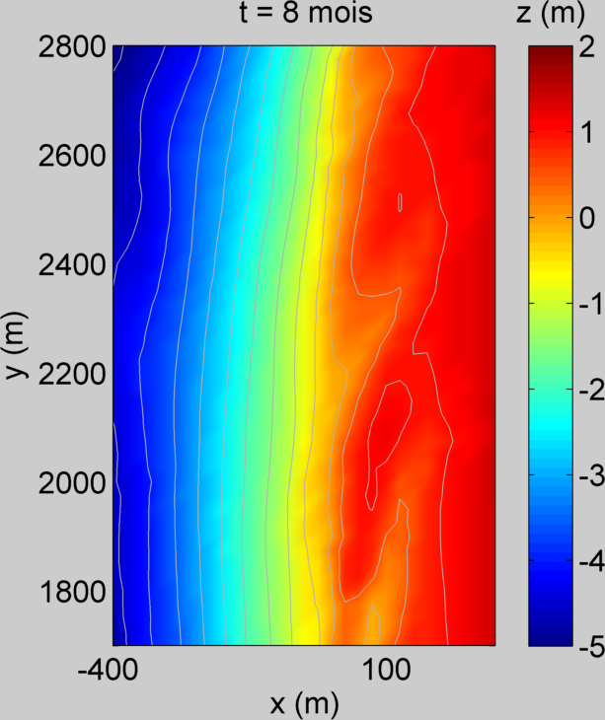
Improvement due to the WENO scheme
Morphodynamic application using SED2D: idealized inlet test case
bathymetry
Adjacent beach
evolution
Cap Ferret (Gironde)
WENO method
Wavelength ≈ 350 to 500 m (consistent with Castelle et al., 2007)
(Guérin et al., 2016)

Slide 26
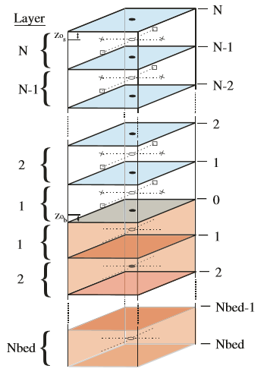


Managing bed compartment → SED3D
Variables describing bed properties in SED3D (each element)
All layers $k$
Water
column
Thickness, age and porosity
Fraction of each class
Mass of each class
Layer $k$
Surficial layer only ($k=1$) → Mean properties over all sediment classes
$D, ρ_{s}, W_{s}, τ_{ce}, AL, z_{0,cr},z_{0,sw},z_{0,wr}, z_{0,bld}, z_{0,s}, z_{0,app}$
Sediment
compartment
Many other variables are defined at nodes, but only for coupling or output purposes

Slide 27
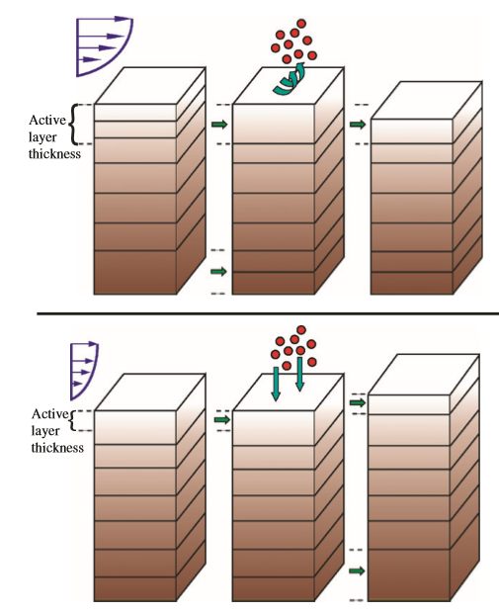
Managing bed compartment → SED3D
Update of sediment layer characteristics
following
bedload transport
vertical exchanges at water/sediment interface
Water
column
Case 1: Residual erosion
Merging surficial layers until satisfying
active layer criterion
Split bottom layer to keep Nbed layers
Layer $k$
Case 2: Residual deposition
Create new layer if surf. lay. > user defined thickness
Mixing surficial layers until satisfying
active layer criterion
Combine/Split bottom layer to keep Nbed layers
Sediment
compartment
(Warner et al., 2008)
Nbed layers always conserved
Morphodynamic coupling → morphological factor can be applied
→ bathymetry update according to bed thickness changes

Slide 28
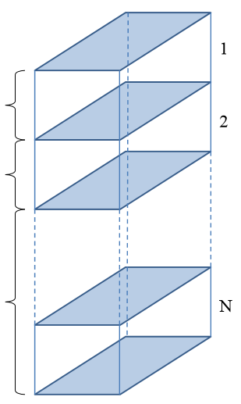
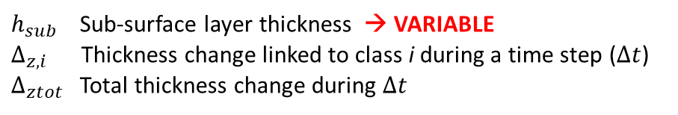
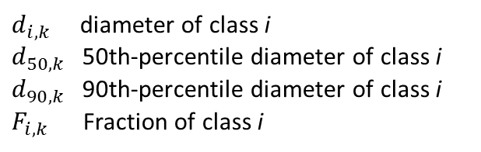



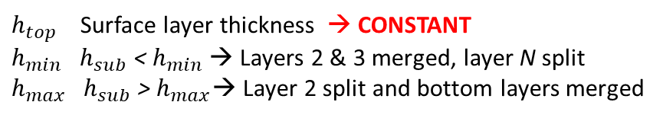
Managing bed compartment → SED2D
Variables describing bed properties in SED2D
All layers $k$ (at each node)
Layer $k$
$d_{i,k}$ diameter of class i
$d_{50,k}$50th-percentile diameter of class i
$d_{90,k}$90th-percentile diameter of class i
$F_{i,k}$ Fraction of class i
$$h_{top}$$
Surficial
layer
$$h_{sub}$$
At each node
Sub-surface
layer
$h_{sub}$Sub-surface layer thickness → VARIABLE
$∆_{z,i}$ Thickness change linked to class i during a time step ($∆t$)
$∆_{ztot}$Total thickness change during $∆t$
Fixed parameters
$h_{top}$Surface layer thickness → CONSTANT
$h_{min} h_{sub}$ < $h_{min}$ → Layers 2 & 3 merged, layer N split
$h_{max} h_{sub}$ > $h_{max}$→ Layer 2 split and bottom layers merged
N layers always conserved

Slide 29







Managing bed compartment → SED2D
$F_{i,k}$ Fraction of class i in layer k
$h_{top}$Surface layer thickness → CONSTANT
$h_{sub}$Sub-surface layer thickness → VARIABLE
$∆_{z,i}$ Thickness change linked to class i during a time step ($∆t$)
$∆_{ztot}$Total thickness change during $∆t$
Update of sediment layer characteristics (following transport)
Layer $k$
Thickness: only $h_{sub}$
$$h_{top}$$
$∆_{ztot}<0$ → erosion
$∆_{ztot}>0$ → deposition
$$h_{sub}\left(t+∆t\right)=h_{sub}\left(t\right)−∆_{ztot}$$
Surficial
layer
$$h_{sub}$$
Sub-surface
layer
Sediment fractions
$$F_{i,1}\left(t+∆t\right)=\frac{\left(h_{top}+∆_{ztot}\right)F_{i,1}\left(t\right)−∆_{z,i}}{h_{top}}$$
Deposition case
→update in k=1 and 2
$$F_{i,2}\left(t+∆t\right)=\frac{h_{sub}\left(t\right)F_{i,2}\left(t\right)−∆_{ztot}F_{i,1}\left(t\right)}{h_{sub}\left(t\right)−∆_{ztot}}$$
Erosion case
→update in k=1 only
$$F_{i,1}\left(t+∆t\right)=\frac{h_{top}F_{i,1}\left(t\right)+∆_{ztot}F_{i,2}\left(t\right)−∆_{z,i}}{h_{top}}$$
N layers always conserved
(Reniers et al., 2013)

Slide 30
Applications / Ongoing studies

Slide 31






Available test cases for sediment dynamics (http://columbia.vims.edu/schism/schism_verification_tests/)
(Test_SED_Trench_Migration/
Test_Sed2d_Trench_Migration/)
Trench migration under a constant current
$$d_{50}=0.14 mm$$
$$W_{s}=11 mm.s^{−1}$$
$$E_{0}=0.0035 kg.m^{−2}.s^{−1}$$
$$τ_{ce}=0.11 Pa$$
$$U=0.5 m.s^{−1}$$
dx=0.1m dt=0.1s
After 15 h
Morphological development of riverine meander (Test_SED_meander_2/)
Initial time
After 50 days
5 sediment classes
Elevation boundary condition only
Lateral migration enabled by
sediment avalanching

Slide 32



Morphodynamic application: idealized inlet test case
Ongoing work with SED3D
Bedload + Advection/diffusion for suspended sediment transport
3D circulation with wave/current interactions
Z [m]
Waves: Hs=1.5m / Tp=10s
B
A
d50=0.5mm (1 class)
MF=6
10 $σ$-levels
A
Final profile
Initial profile
Sandbar formation
B

Slide 33



Sandbar migration due to wave non-linearity
Bedload transport caused by wave acceleration
Hoefel and Elgar (Science, 2003)
Model accounting for fluid accelerations in waves → Application at Duck Beach (North Carolina, USA)
Bedload term $Q_{acc}$
Onshore migration reproduced
during mild wave conditions

Slide 34








21 Sep
24 Sep
30 Sep
Sandbar migration due to wave non-linearity
Bedload transport caused by wave acceleration
Setup of a configuration for Duck Beach
(realistic)
Implementation of $Q_{acc}$ term in SED3D
(formalism of Dubarbier et al., 2015)
Observed beach profiles
Model without $Q_{acc}$
A
B
Model with $Q_{acc}$
A
B
Importance of $Q_{acc}$
for 3D morphodynamic application

Slide 35
Future developments / Perspectives

Slide 36











Future developments: Bed compartment
Porosity of non-cohesive sediment mixtures $φ$
$$φ$$
Geometric standard deviation (Cui et al., 1996)
Wooster et al. (2008)
= 2^{-φ}
$$φ=0.621 {σ_{sg}}^{−0.659}$$
$D_{j}$ diameter of sediment class $j$ [mm]
$F_{j}$ fraction of sediment class $j$ [-]
Geometric standard deviation
Example with 1 gravel
and 2 sands
$$φ$$
Influence on bed layer
thickness
Gravel (%) 8 mm

Slide 37


Future developments: Bed compartment
Bed armouring
Protection of underlying sediments by surficial coarser particles
Garcia and Parker (1991) → Modulation of erosion rates for class i depending on mixture heterogeneity
$E_{0,i,new}=\frac{D_{j}}{D_{50}} {λ_{E}}^{5} E_{0,i,ref}$
with
$$λ_{E}=1−0.29 σ_{sg}$$
Standard deviation of sediment distribution

Slide 38




Future developments: Bed compartment / Water-sediment interface
Cohesive sediments and sand/mud mixtures
Time
Z
C
Accounting for consolidation (Grasso et al., 2015)
Influence on critical shear stress for erosion
(from Grasso et al., 2015)
Including porosity modulation by cohesive sediments
(Wu and Li, 2017)
Sediment concentration
1 sand: D₁ = 280 µm, $φ_{1}$ = 0.4
1 mud: D₂ = 2 µm, different $φ_{2}=f(consolidation state)$
φ₂
Relative mud
concentration [kg/m³]
Porosity $φ$
φ₁
Mud fraction

Slide 39








Future developments: Bed compartment / Water-sediment interface
Cohesive sediments and sand/mud mixtures
Critical mud fractions concept
$$τ_{ce}$$
Interaction with non-cohesive sediments
(from Le Hir et al., 2011)
consolidation
proxy
Change in erosion behaviour of non-cohesive
sediments trapped in cohesive matrix ($E_{0},τ_{ce}$)
Mud fraction
No interactions
Transitional behaviour
→ Interactions start
Pure mud behaviour (sand matrix trapped)
Independent
$E_{0}$ and $τ_{ce}$
for each class
Sediment eroded as a mixture
$E_{0}$ and $τ_{ce}$= f(mud fraction)
Same for all classes

Slide 40
Future developments
Towards a fusion of the two sediment modules ?
Gathering key concepts from each module
Computation times for advection/diffusion of sediments → strong increase/class added
Specific time step for advection/diffusion?

Slide 41
Conclusions
2 sediment modules with different advantages/drawbacks
SED2D
Total transport
→ semi empirical
Fast computation times
SED3D
Transport more sophisticated
→ bedload + advection/diffusion
Time-consuming
SCHISM+WWM+SED3D: exciting perspectives dealing with morphodynamics!
Future improvements:
Bed compartment / Water-sediment exchanges (processes, sediment interactions)
Computation times

