Slide 1
SCHISM on Azure Cloud
Kijin Nam
Bay-Delta Office
California Department of Water Resources
Notes:
ALIGNMENT
GOOD
RIGHT JUSTIFIED TO A GRID LINE

Slide 2

SCHISM
From SCHISM Web: http://ccrm.vims.edu/schismweb/ SCHISM (Semi-implicit Cross-scale Hydroscience Integrated System Model) is an open-source community-supported modeling system based on unstructured grids, designed for seamless simulation of 3D baroclinic circulation across creek-lake-river-estuary-shelf-ocean scales. It uses a highly efficient and accurate semi-implicit finite-element/finite-volume method with Eulerian-Lagrangian algorithm to solve the Navier-Stokes equations (in hydrostatic form), in order to addresses a wide range of physical and biological processes.

Slide 3
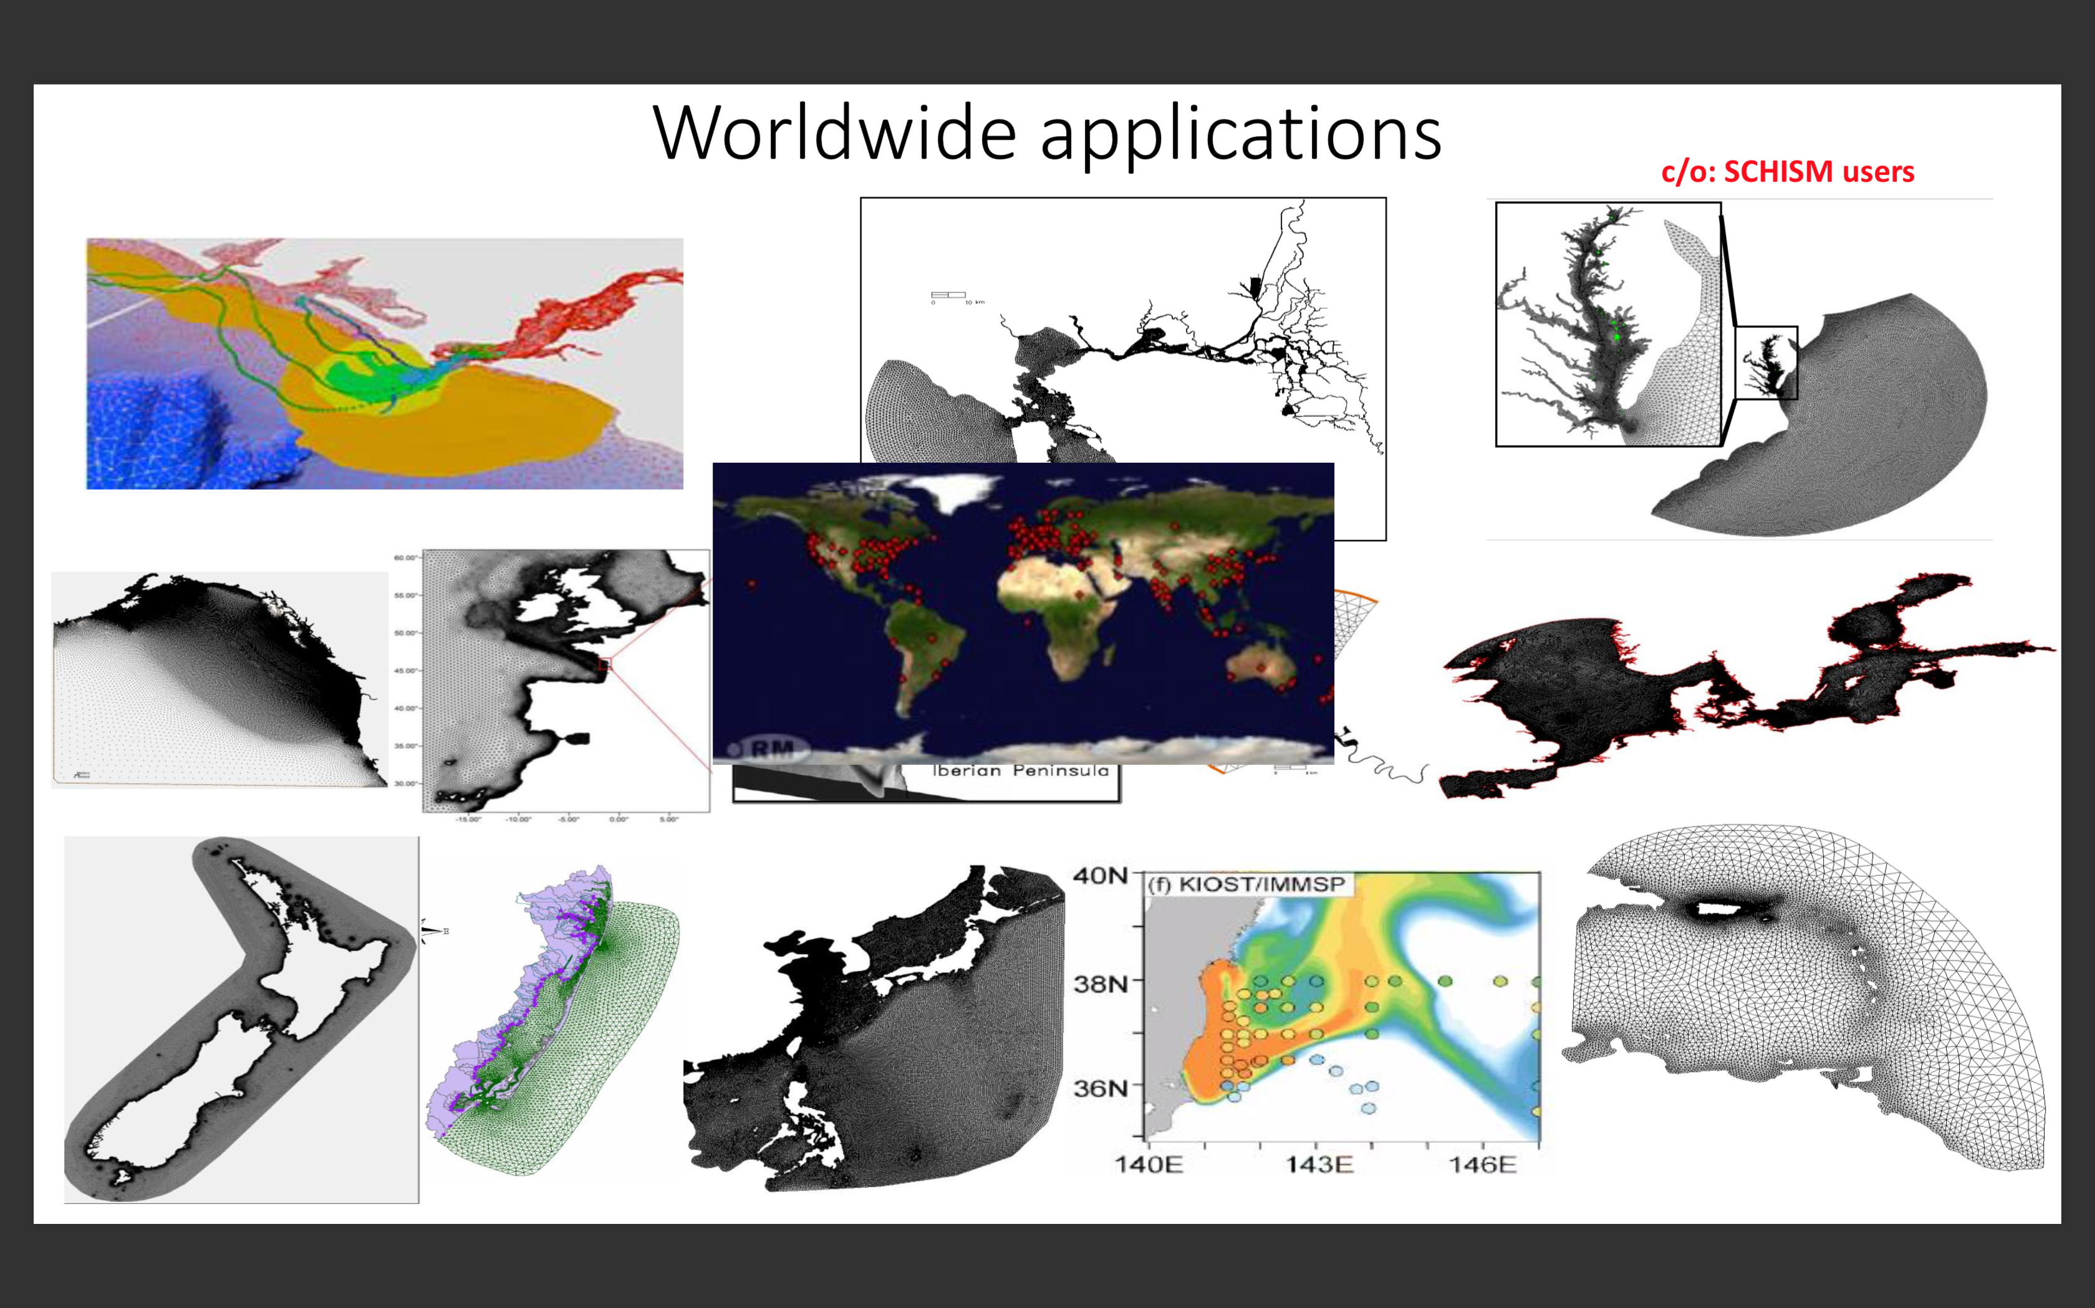

Slide 4
SCHISM

Slide 5
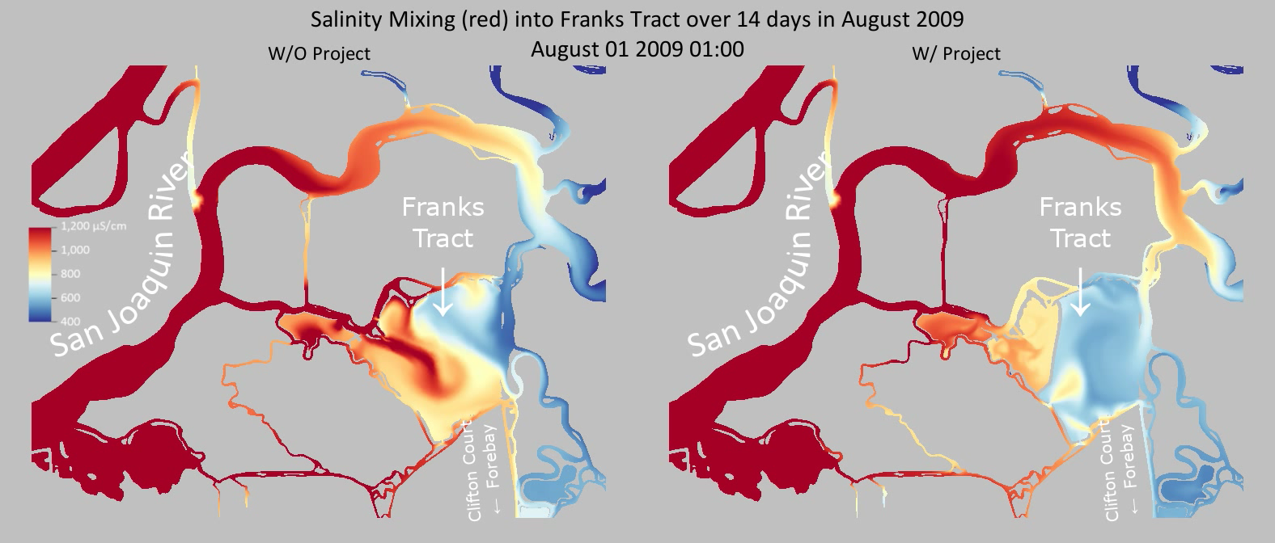
SCHISM Salinity Example

Slide 6

SCHISM
Can run massive grids
Parallel computing
  Using multiple nodes (or computers)
  High Performance Computing (HPC), Cluster
  Message Passing Interface

Slide 7
Cloud Computing
Cloud computing makes computer system resources, especially storage and computing power, available on demand without direct active management by the user. (From Wikipedia)
  Readily available, No upfront cost, No maintenance.
  Flexible and elastic
Amazon (AWS/EC2), Microsoft Azure, etc.

Slide 8

Azure CycleCloud
Azure CycleCloud is a tool for creating, managing, operating, and optimizing HPC & Big Compute clusters in Azure. With Azure CycleCloud, users can dynamically provision HPC Azure clusters and orchestrate data and jobs for hybrid and cloud workflows (from https://docs.microsoft.com/en-us/azure/cyclecloud/overview)

Slide 9
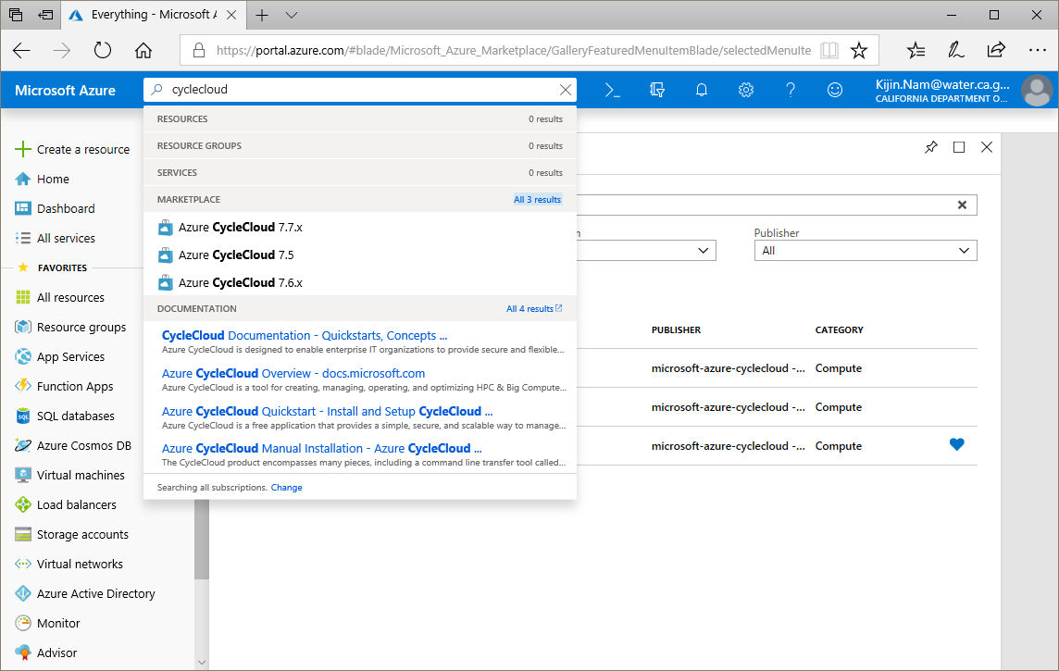
Azure CycleCloud

Slide 10
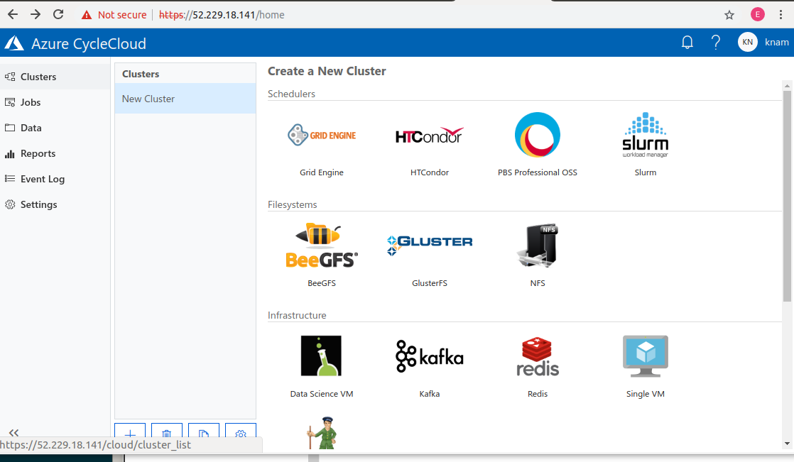
Azure CycleCloud

Slide 11
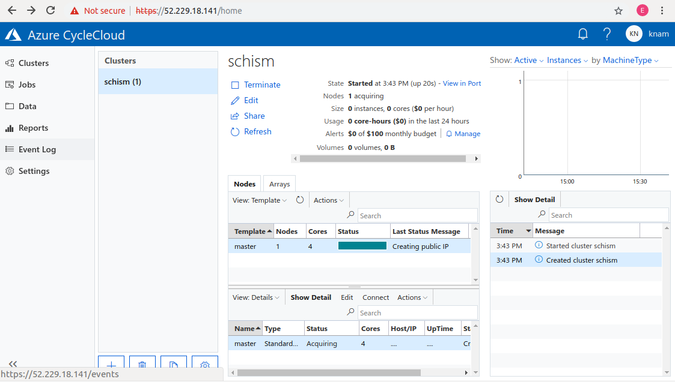
Azure CycleCloud

Slide 12
Azure CycleCloud
Multiple clusters can be created easily.
  No need to set up network, storage, etc. one by one.
Creates and destroys execute nodes dynamically when a job is submitted and finished.
Resources can be monitored.
A custom template and project can be created and shared.

Slide 13
Azure CycleCloud Benchmark
 | Node | Total # of cores
DWR | Dual Sandy Bridge 2.6GHz | 128
CycleCloud | H16r, Dual Haswell 3.2GHz | 128

Slide 14
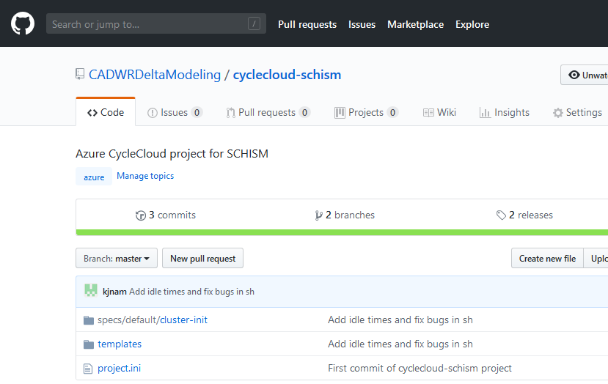
CycleCloud-SCHISM
A project (template) to create a ready-to-use cluster for SCHISM.
  No need to compile, just use.
  Shared on GitHub

Slide 15
CycleCloud-SCHISM
Respond to peak demands of studies
  Flexible with low cost
Increase adoption of the model
Share tools and data more easily and transparently

