Slide 1

SUMMIT 2019
OPENCoastS
An open-access service for on-demand coastal forecasts
A. Oliveira, André Fortunato, J. Rogeiro, J. Teixeira, A. Azevedo, M. Rodrigues, P. Lopes (LNEC)
J. Gomes, M. David, J. Pina (LIP)
X. Bertin, L. Lavaud (Univ. La Rochelle)
S. Castanedo, F. Méndes (Univ. Cantabria)

Slide 2
Content
Motivation
The OPENCoasts platform
Concept
Interface components
Example
Summary and perspectives

Slide 3
Forecast systems
Forcings
Operational forecasts
Post-processing and archiving
Visualization and comparison with real-time data

Slide 4
Forecast systems: present difficulties
The development requires mixed teams, with expertise in both numerical modeling and information technologies
Significant effort for development and maintenance
Computational resources must be available every day

Slide 5
Forecast systems: present challenges
Develop forecast systems as a service, available to all
Make the service flexible in the choice of forcings and processes
Take advantage of available online data and model results
Provide computational resources
Make the development quick and easy

Slide 6
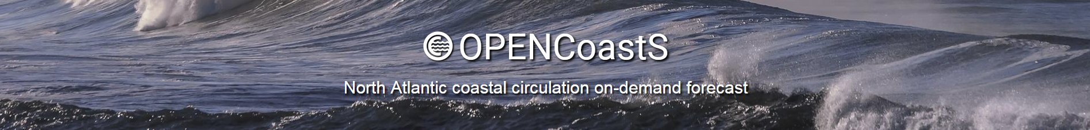
The OPENCoastS platform: concept
Implements forecast systems through a browser
Allows the choice of the processes and forcings
Provides the required computational resources through the European Open Science Cloud (EOSC)
Takes advantage of available online data and model results
Avoids the need of a large team to generate forecast systems
Makes the development quick and easy

Slide 7




The OPENCoastS platform: information requirements
OCEAN
ATMOSPHERE
DATA
FES2014
NOAA / GFS
EMODnet Physics
CMEMS
METEO-FRANCE / ARPEGE
DGT
PRISM2017
USER
Grid
Parameters
River flow

Slide 8
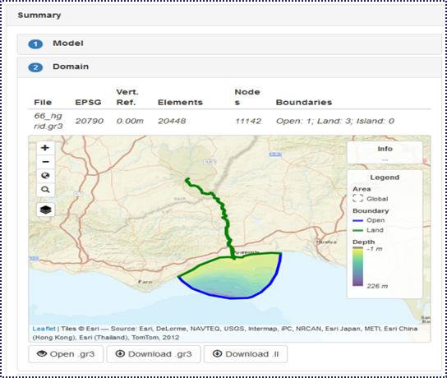

The interface components
Configuration assistant: builds a deployment step by step
Outputs viewer:
Download results
View maps and time series
Compare results from several deployments
Forecast manager: check status and details, clone, stop & restart, delete,…

Slide 9
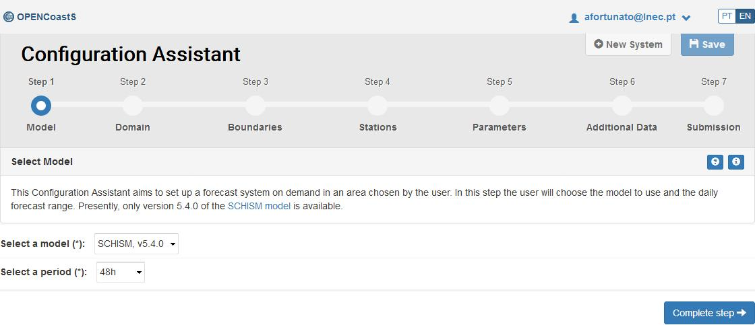
Generating a forecast system
Step 1: Select the model and the duration

Slide 10
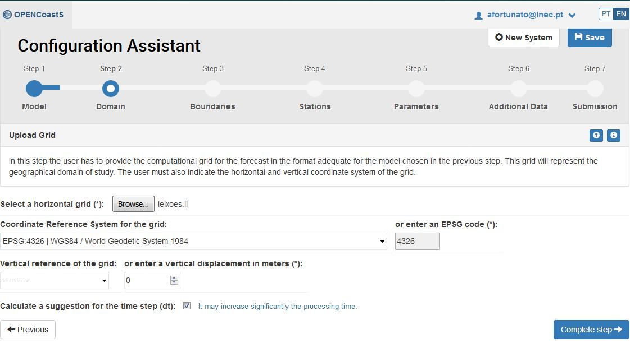
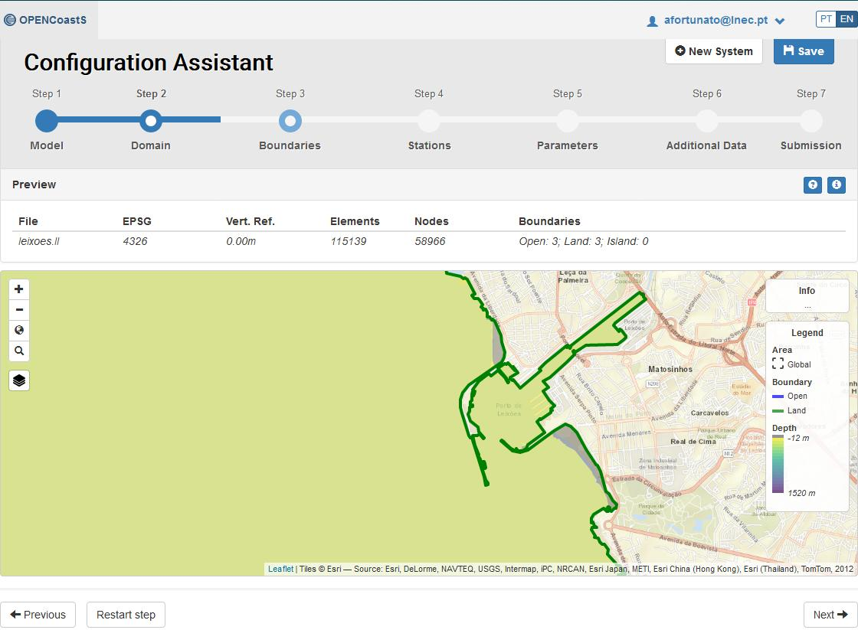
Generating a forecast system
Step 2: Upload and verify the grid

Slide 11
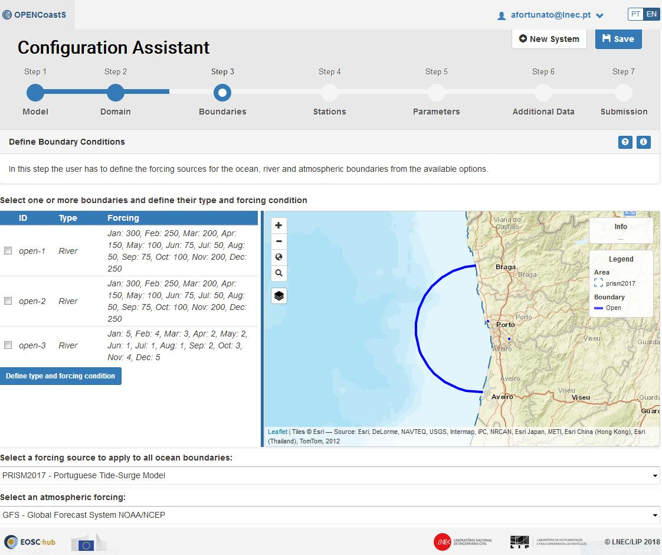
Generating a forecast system
Step 3: Specify boundary conditions

Slide 12
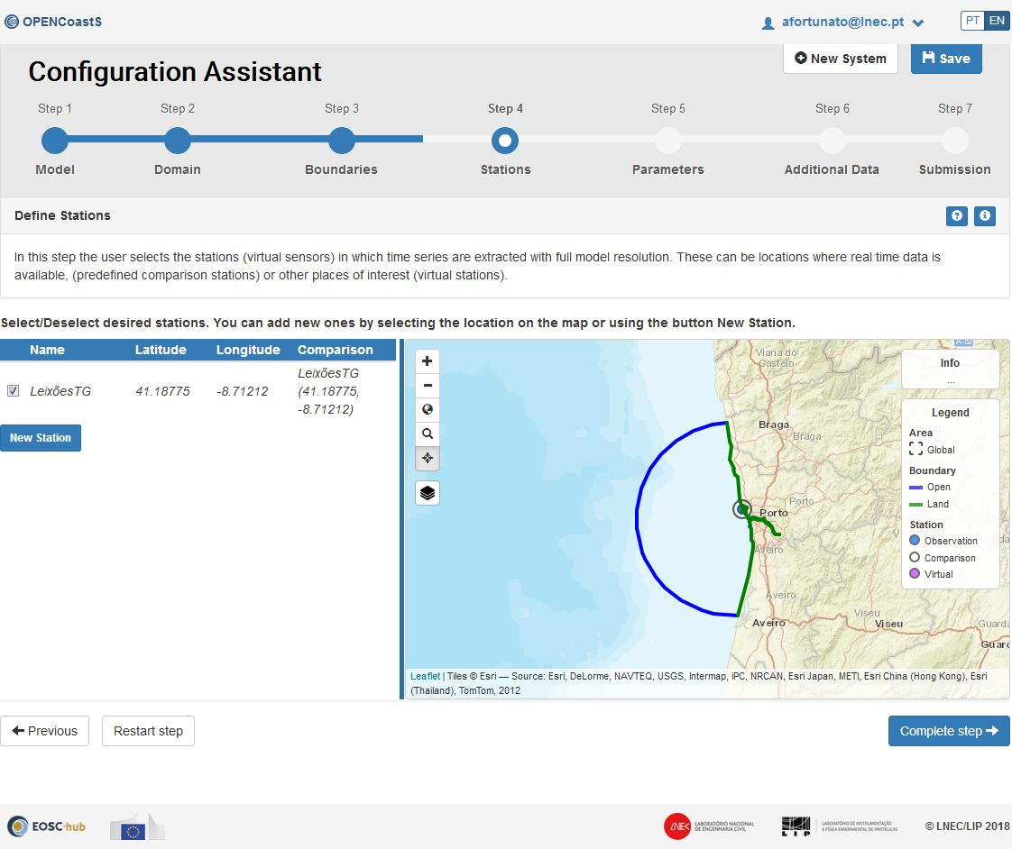
Generating a forecast system
Step 4: Define output stations

Slide 13
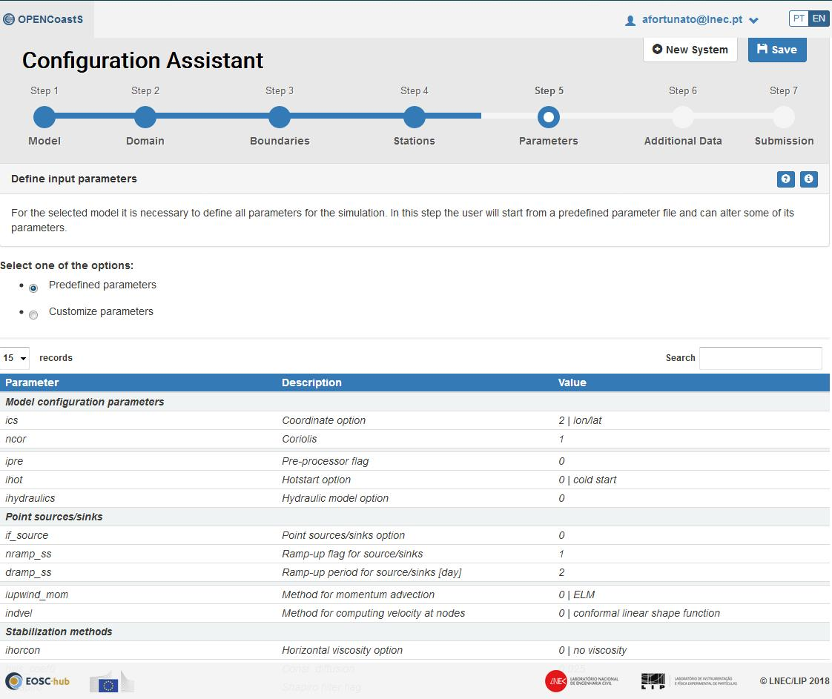
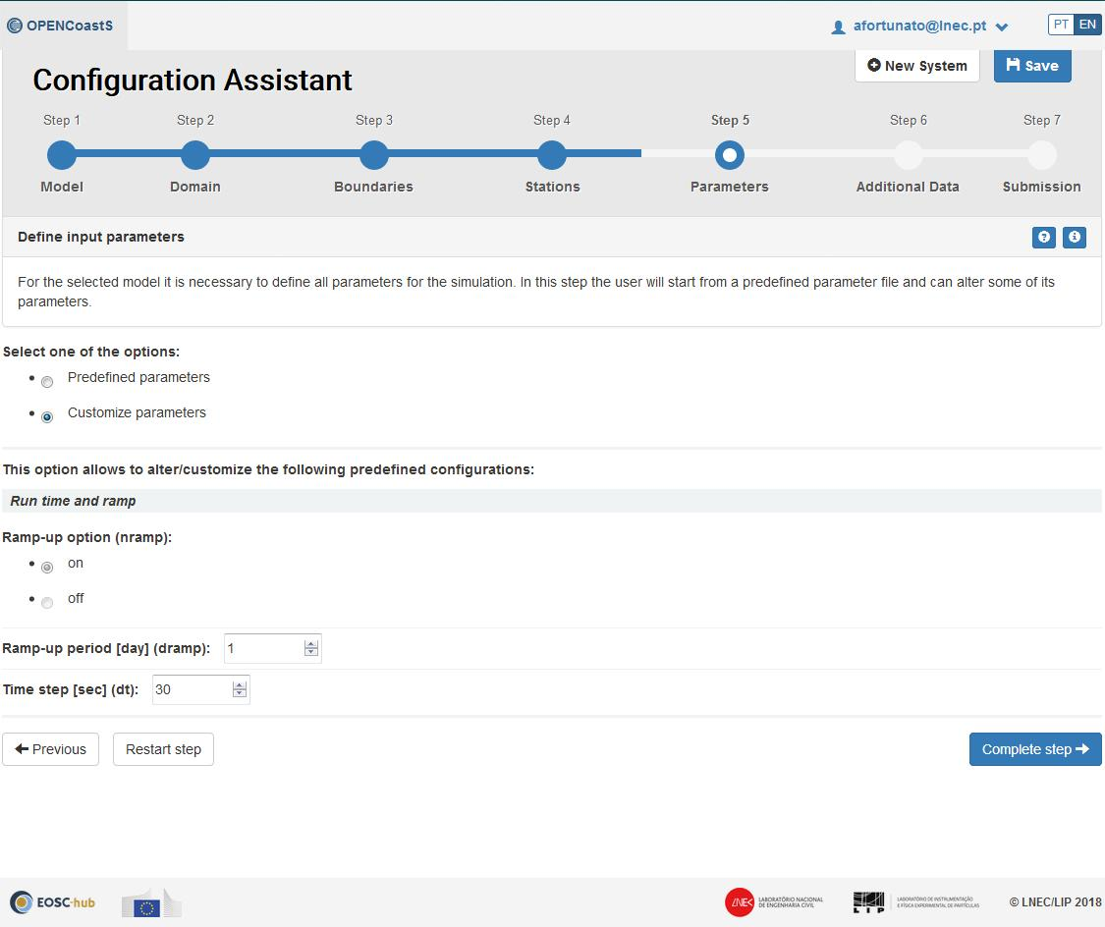
Generating a forecast system
Step 5: Define physical and numerical parameters

Slide 14
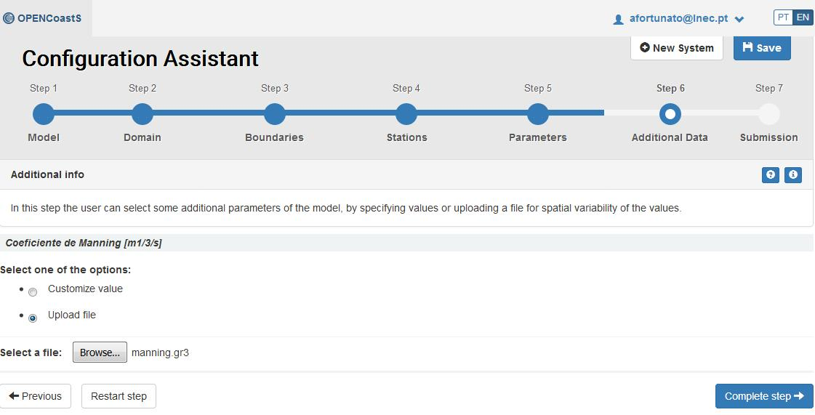
Generating a forecast system
Step 6: Define space-dependent parameters

Slide 15
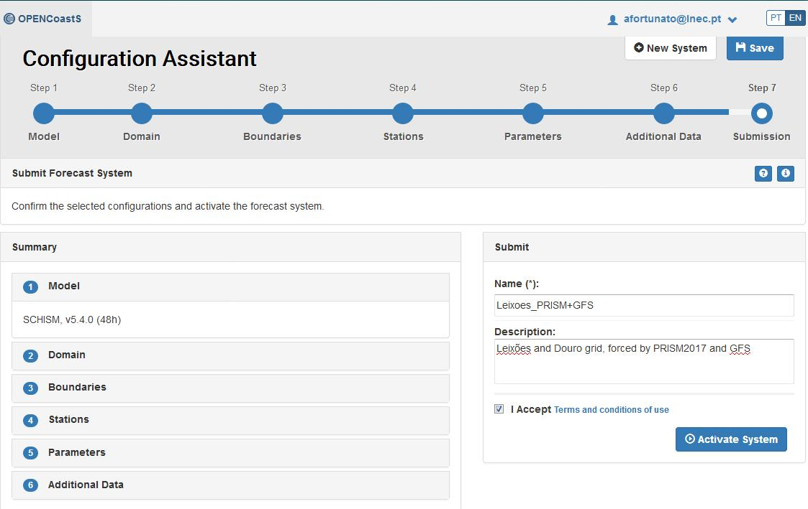
Generating a forecast system
Step 7: Review and submit

Slide 16
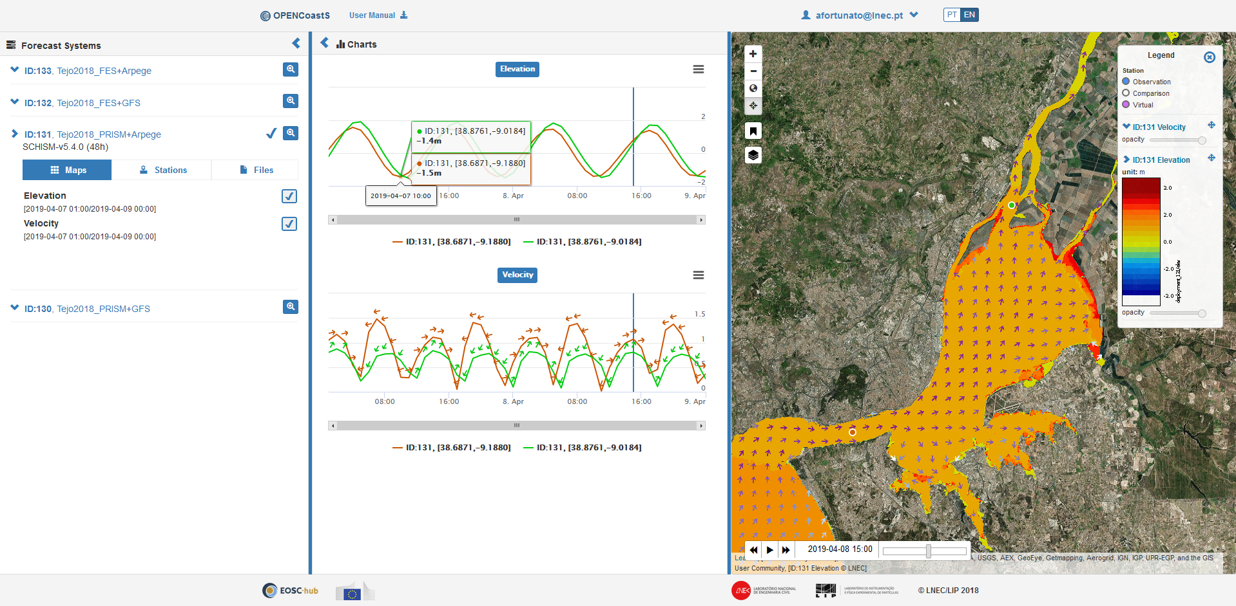
Example: flow, elevation and time series in the Tagus Estuary

Slide 17
Summary
Innovative platform to generate on-demand ocean forecasts is publicly available (opencoasts.ncg.ingrid.pt)
Training and documentation:
Podcast: http://opencoasts.lnec.pt/index_en.php#eventos
User’s manual: http://opencoasts.lnec.pt/OPENCoastS_manual.htm
Forcings (FES2014, CMEMS and GFS) allow worldwide applications
Limited physics: 2D barotropic shallow water flows

Slide 18
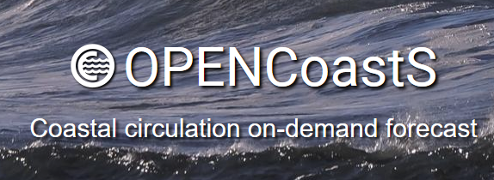
Perspectives
3D baroclinic physics (April, 2019)
Migrate to larger computational resources
Coupled waves and currents model (SCHISM-WWM), including forcing by WW3
Improved viewer
Perform 72 hour forecasts
Open code at the end of the project (2021)
2D circulation
(operational)
3D circulation
(release in 1-2 weeks)
2D circulation with waves and currents
(release planned for June)
3D circulation with waves and currents
(beyond EOSC-hub)

Slide 19
Contact:
Anabela Oliveira, aoliveira@lnec.pt
Acknowledgments:
SCHISM community (model)
NOAA, METEO-FRANCE (atmospheric predictions)
FES2014 (tidal predictions)
CMEMS (oceanographic predictions)
EMODnet (oceanographic data)

Slide 20
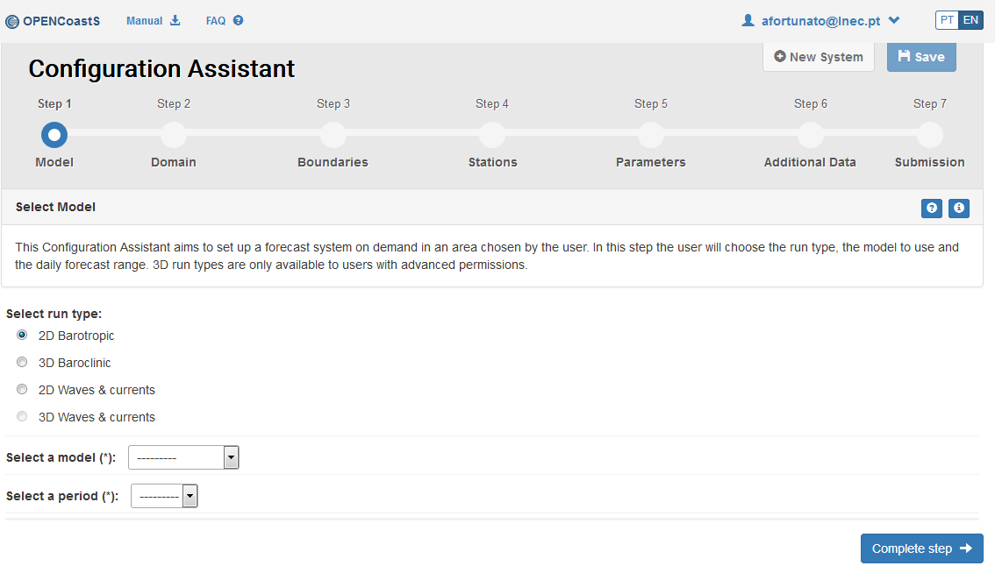

Slide 21
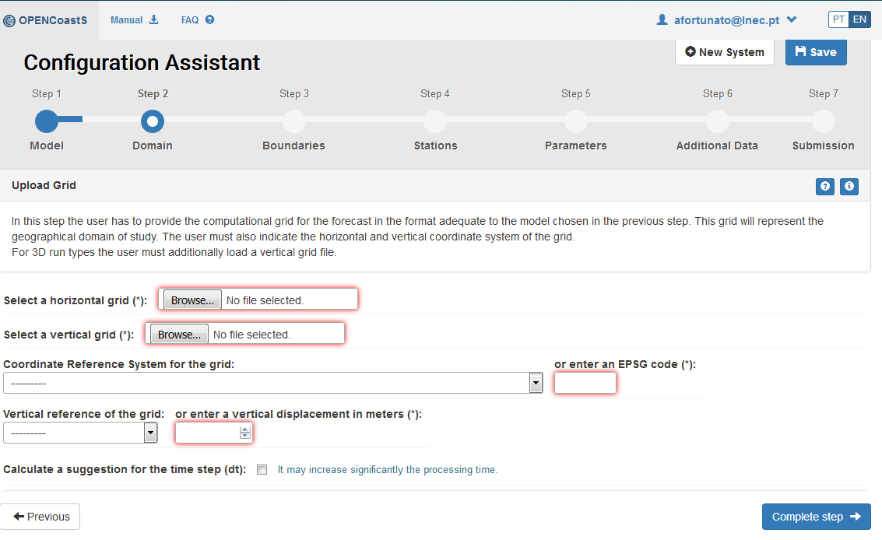

Slide 22
