Slide 1


Updates from a humbling benchmark
Modeling highly stratified regimes in the Columbia River estuary
Charles A. Seaton, Paul J. Turner, António M. Baptista
Oregon Health & Science University
SCHISM Workshop Apr 2019
Notes:
<number>

Slide 2
Virtual Columbia River (river-to-ocean modeling)
Recent history:
  Switch from SELFE to SCHISM (Baptista et al. 2018 @ NSF Workshop)
  Optimization of SCHISM (the battle against over-diffusion)
  TVD²
To note:
  Observation set: Endurance stations (since 1996); select AUV tracks (2012)
  Two multi-year (1999-2017) reference simulation databases: DB33 (SELFE) and DB34 (SCHISM): same settings, different models
  Select benchmark period (period with highly stratified regime)
Today’s focus:
  Discretization
  Handling velocity conversions

Slide 3
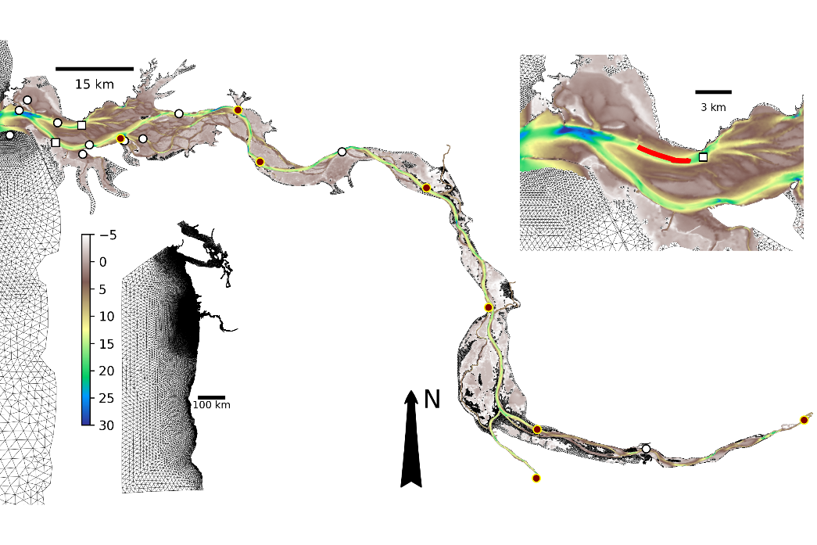
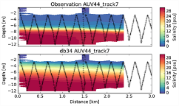

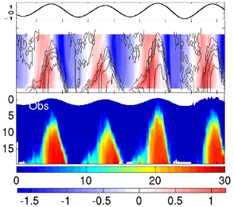
Broad context
AUV
Jetty A
AUV
SATURN-01
Beaver Army
May 2, 2012
BC
WA
SATURN-01
OR
Time step: 36s
Hor. grid resolution:
Tens of meters to 3km
~180m in estuary channels
Ver. grid:
37 S levels
17 Z levels
Baptista et al. 2015
Bonneville Dam
CA
Willamette River Falls
Notes:
<number>

Slide 4

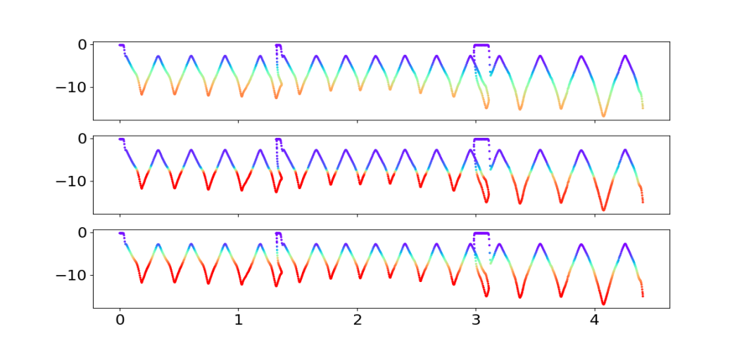
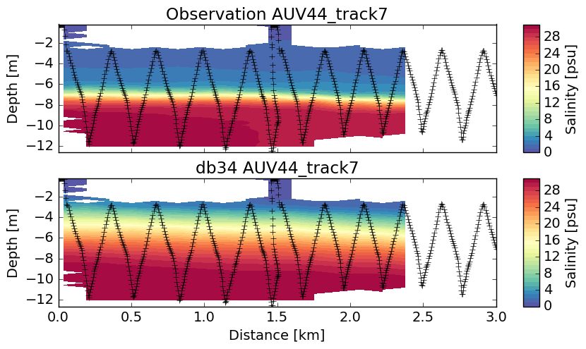
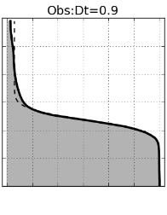
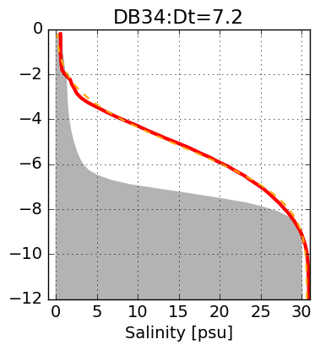
AUV
AUV data (May 2, 2012)
DB33
AUV
DB34
Along-track distance (Km)
Notes:
Dashed line is Gaussian error function fit to model or observations
<number>

Slide 5
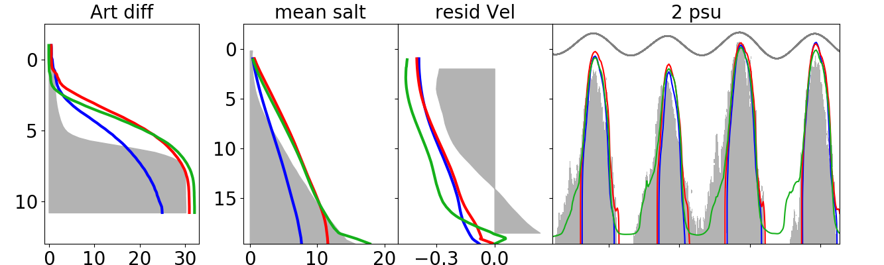
Brief review (from DB33 to modestly beyond DB34)
SELFE 11.3
SCHISM 7.2
Opt 1 5.0
DB33
DB34
Best of triang
First quadrang (SHO21d)
Obs 0.9
Changing from Upwind (SELFE) to TVD² (SCHISM) transport makes a transformative difference on vertical diffusion
Parameter optimization within the same grid and algorithm can provide meaningful, but insufficient, additional improvement
Notes:
Images need work, better colors, larger fonts, remove 2 psu isoline panel
Opt 1 is SHO053, which has the Richardson stability constant in GOTM changed to 0.001, and has Z0 = (H/16)/30
Quads is hbf009, which is the third iteration of the quad grid (which was the best for salinity)
SELFE is db33, SCHISM is db34
<number>

Slide 6
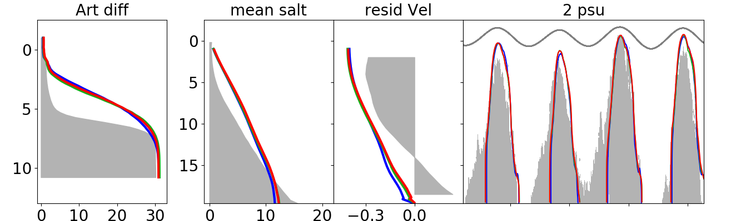
Effect of quadrangles
Triang 7.2
Quad1 5.0
Quad2 6.0
DB33
DB34
Best of triang
First quadrang (SHO21d)
Obs 0.9
Hybrid grids with extensive use of quadrangles provide many local improvements (not shown), but—within a range of roughly equivalent resolution—are not on themselves transformative of skill.
Notes:
Images need work, better colors, larger fonts
Tri is db34
Quad1 is hbf009 is the best quad grid for salinity (not the one we’re currently using)
Quad2 is hbf023b (the one we are currently using: much better elevation performance upriver)
<number>

Slide 7
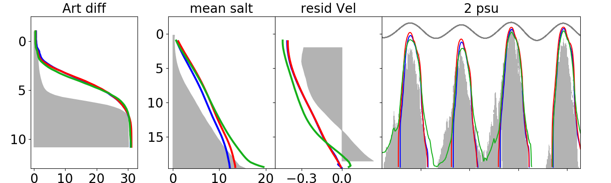
Effect of vertical discretization
54 SZ 6.0
68 SZ 5.5
LSC² 4.3
Standard layers
68 layers (020?)
LSC² (025)
Vertical resolution is much cheaper to vary than the horizontal one, can strongly impact residuals and local retention
LSC² achieves improves skill better than adding SZ layers (shown), or extensive parameter optimization on a 54 SZ grid (shown earlier)
Notes:
54SZ is hbf023b (grid used in 024-030
68SZ is hbf030
LSC1 is HBF025
<number>

Slide 8
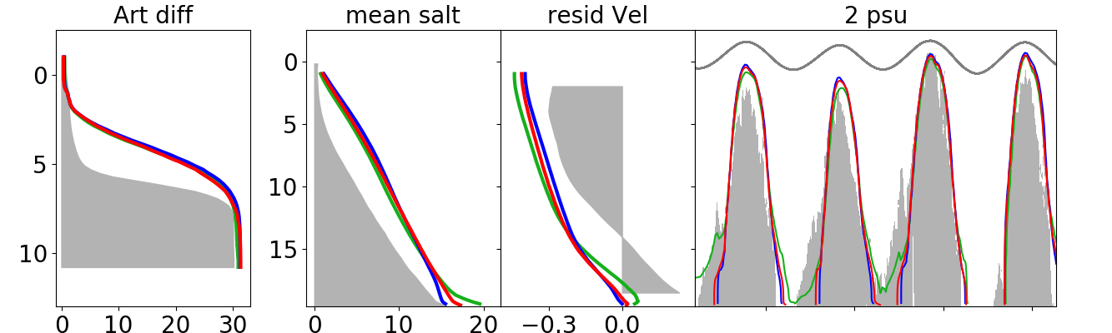
Sensitivity to LSC² choices
θ_{b}=3 4.3
θ_{b}=6 4.6
θ_{b}=6 alt 5.2
025
025a
025b
Obs 0.9
How to construct an effective LSC² grid, particularly across the scales variability of river-to-ocean grids, remains an open question.
We are just scratching the surface towards LSC² guiding principles for the Columbia River
Notes:
LSC1 hbf025: theta_b = 3, 21 - 85 levels
LSC2 hbf025a: theta_b = 6, 35-101 levels
LSC3 hbf025b: theta_b = 6-9, 21-87 levels
<number>

Slide 9
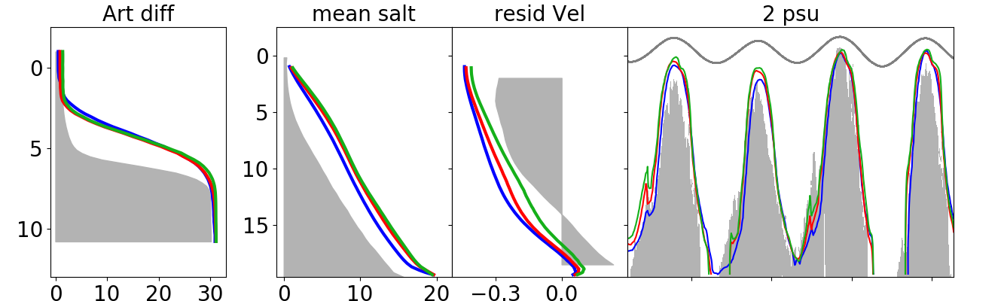
Conversion to nodal velocities
MA 4.3
MB1 3.4
MB2 3.0
025
026
027?
028?
Obs 0.9
Minimizing diffusion through a MB velocity conversion coupled with a Shapiro filter, reduces vertical diffusion and improves residuals
Filtering can still be optimized (including hybrid diffusion/filtering methods in the eddying/non-eddying regimes)—after recalibration
Notes:
MA = hbf025
MB1 = hbf026
MB2 = hbf028
<number>

Slide 10
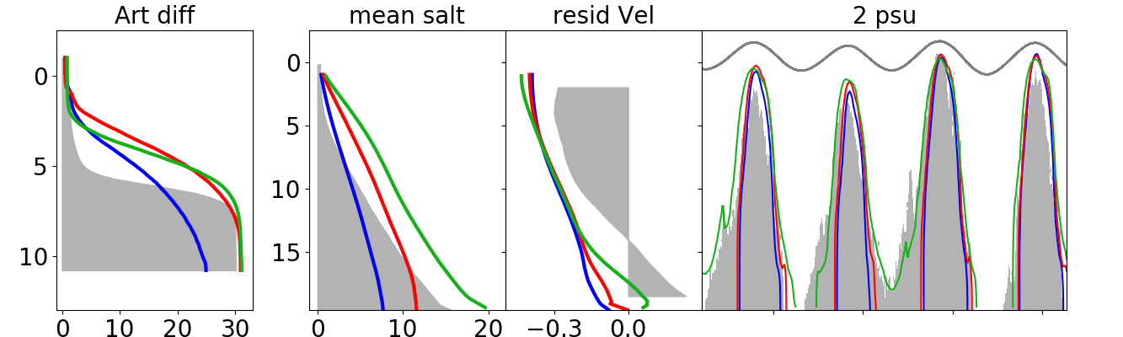
Conclusions
SELFE 11.3
TVD² 7.2
LSC²+MB 3.4
025
026
027?
028?
Obs 0.9
Simulation skill has substantially improved with SCHISM
TVD² was the most transformative factor
LSC² and MB are also significant factors
Notes:
Change to DB33
<number>

Slide 11
Conclusions
Quadrangular/hybrid grids are useful, but (short of higher resolution) not transformative
Parameter optimization around core choices (TVD²+LSC²+MB, on quads) will likely further improve skill
Artificial vertical mixing remains an essential limitation in representing highly stratified estuarine regimes
Needed in the SCHISM tool set: An embed (space-time) calculation of numerical diffusion (a la Hans Burchard)
Notes:
<number>

Slide 12
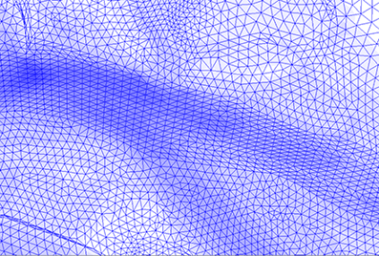
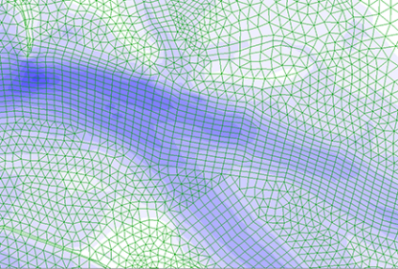
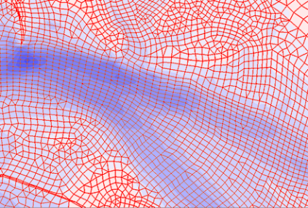
Caveat …
Triang (DB34)
QUAD 1
Jetty A
Jetty A
QUAD 2
The grids we tested resolve some critical regions for salt propagation (as the one shown, where important mixing occurs) in an only modestly different manner.
Jetty A
Notes:
Add labels
Mark Jetty A
Mention that this is a critical area for mixing
<number>

Slide 13
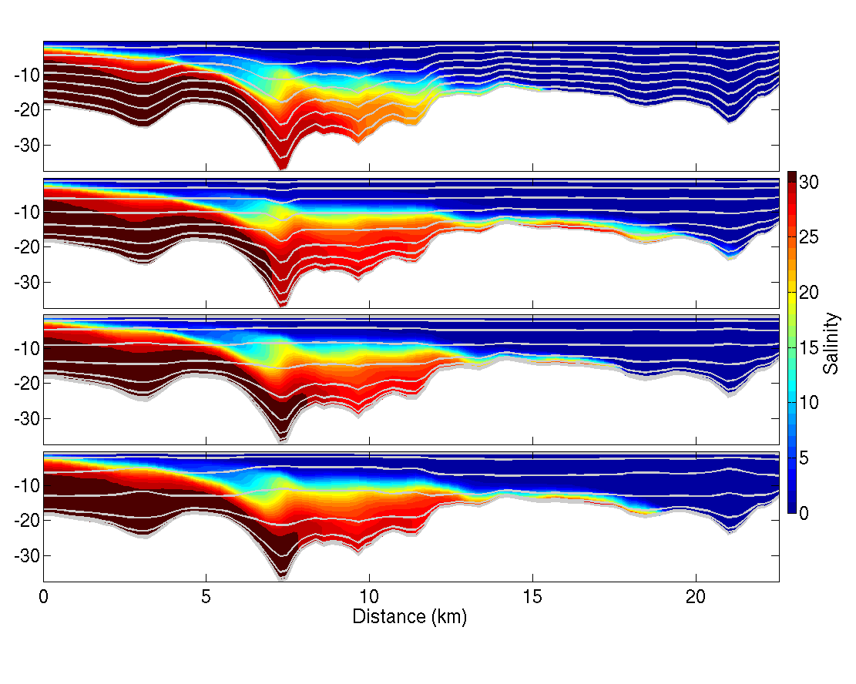
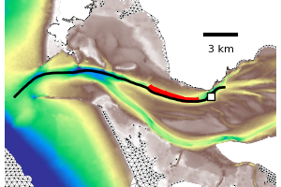
Early flood salinity
Vertical layers (in grey) shown every fifth level
54SZ
θ_{b}=3
θ_{b}=6
θ_{b}=6 alt
Jetty A
AUV
SATURN-01
Notes:
<number>

Slide 14
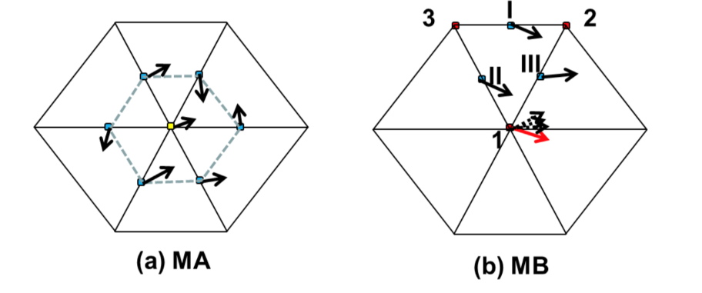
Velocity conversion & filtering
No filtering
Diffusion or
filtering required
Notes:
MB uses the shape function within each element
MA uses inverse distance weighting
<number>

Slide 15
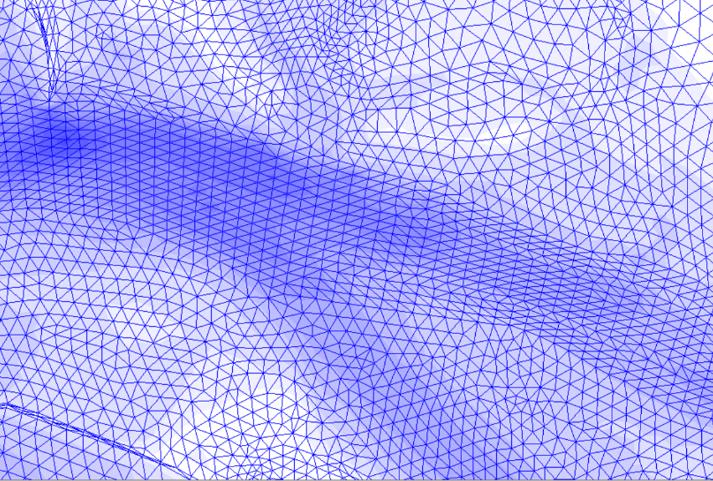
H-grids
Tri (DB34)
Jetty A

Slide 16
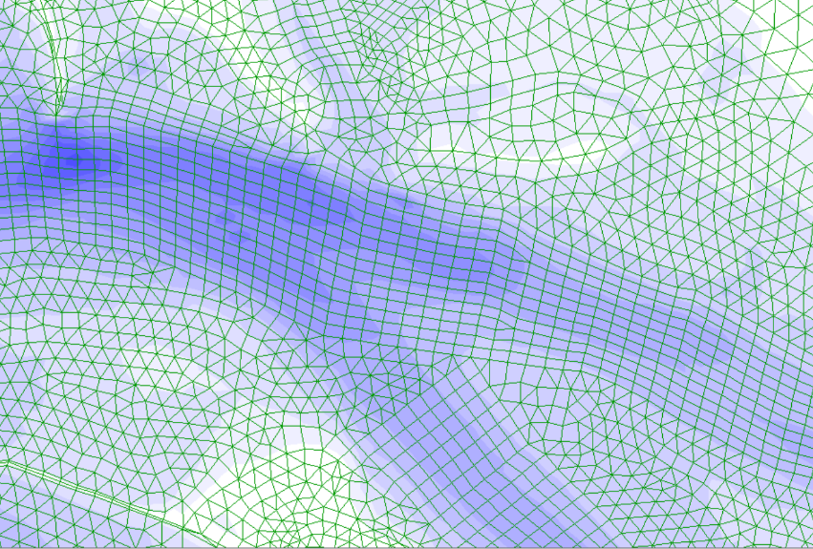
H-grids: Redesigned quads
QUAD 1
Jetty A
Zoomed H-grid comparisons?

Slide 17
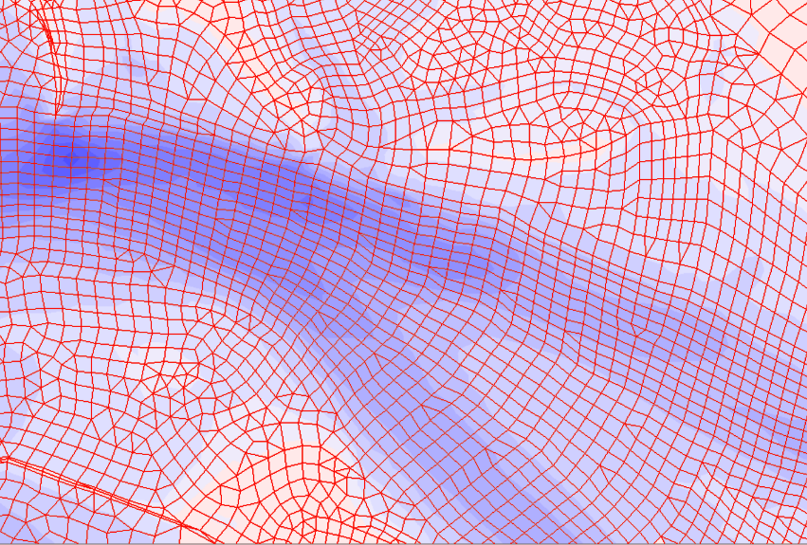
H-grids: Final quad grid
QUAD 2
Jetty A

