Slide 1
An operational forecast system applying SCHISM
Phellipe Couto
Notes:
Introduce myself.. Oceanographer – working for metocean over the last 3 years - - has recently become a division of MetService, the meterological agency of NZ…
Work in a group of 13 – 2 IT specialist + 11 ocean scientists that share some good background in computational systems and programming – forming the MetOcean Research and Development group which our main responsabilities are to provide Hindcasts often used for consultancy and for running an operational forecast system.

Slide 2



General tech principles
1
Microservices (modular) architecture
2
Collaborative development and platforms
3
Open source and community code
Notes:
. The main technical principles adopted for the development of our operational system are:
Micro services: The collection of loosely coupled services, each responsible for a single feature within the system, enables:
> Scientist or developer to develop, maintain, and deploy each microservice independently
> to be more resilient - better failure tolerance – because it is easier to maintain and debug lightweight micro service than complex applications
collaborative dev and platform:
> sharing and replicability across members
Open source and community code: Using open source as much as possible
Means we can easily share development between different partners in the project
Benefit from community effort and feedback development done internally
These enable us to efficiently identify needs across our system, design optimal approach to tackle problems and, foremost, develop and implement solutions to common challanges we all face
Scientist or developer can conduct the end-to-end dev-test-deploy cycle
Minimal interdependencies
Continuous integration with quick and safe deploys
Easy modular maintainability
Sacalability
Easy to plug and play new MOS systems and third party systems

Slide 3
Challenges + solutions
Challenge | Solution
Reliability | Clustered architecture. Cloud services. Rapidly deployable.
Monitoring | Monitoring infrastructure and interface
Scheduling | Scheduling infrastructure and interface
Compatibility and collaboration | Docker and Github
Rapid deployment | Model interfaces and unified data architecture
Large compute requirements | Clustered and flexible compute platform
1000s of datasets | MetaDataServer
TBs of data | Data APIs
Notes:
These challenges usually relates to;

Slide 4
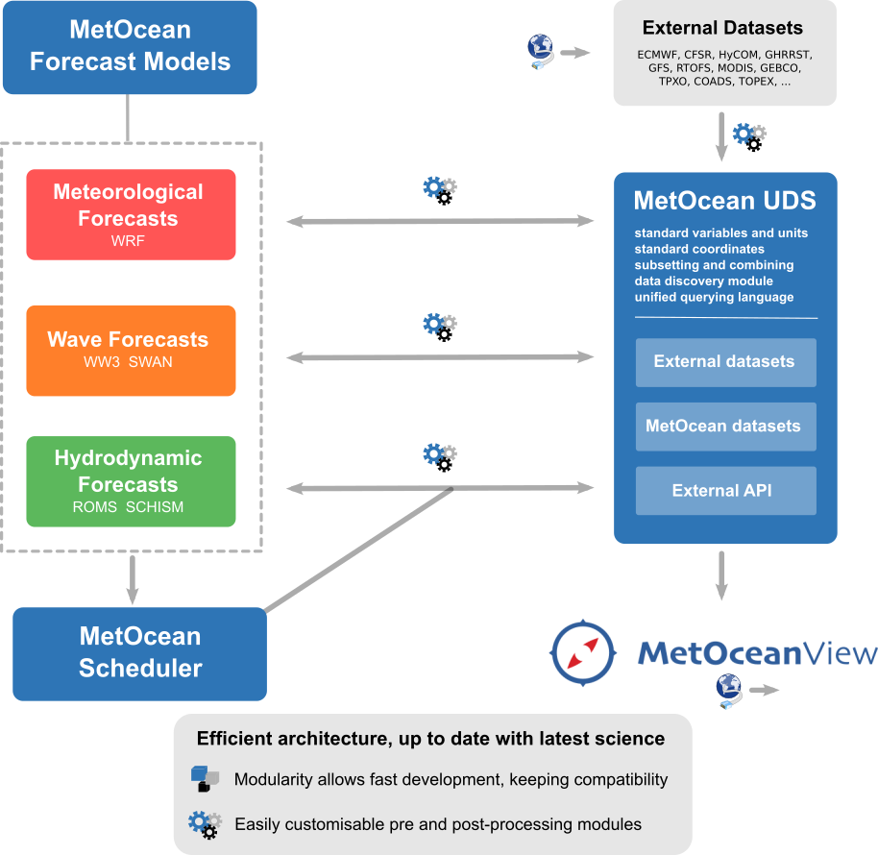
Operational forecast workflow

Slide 5
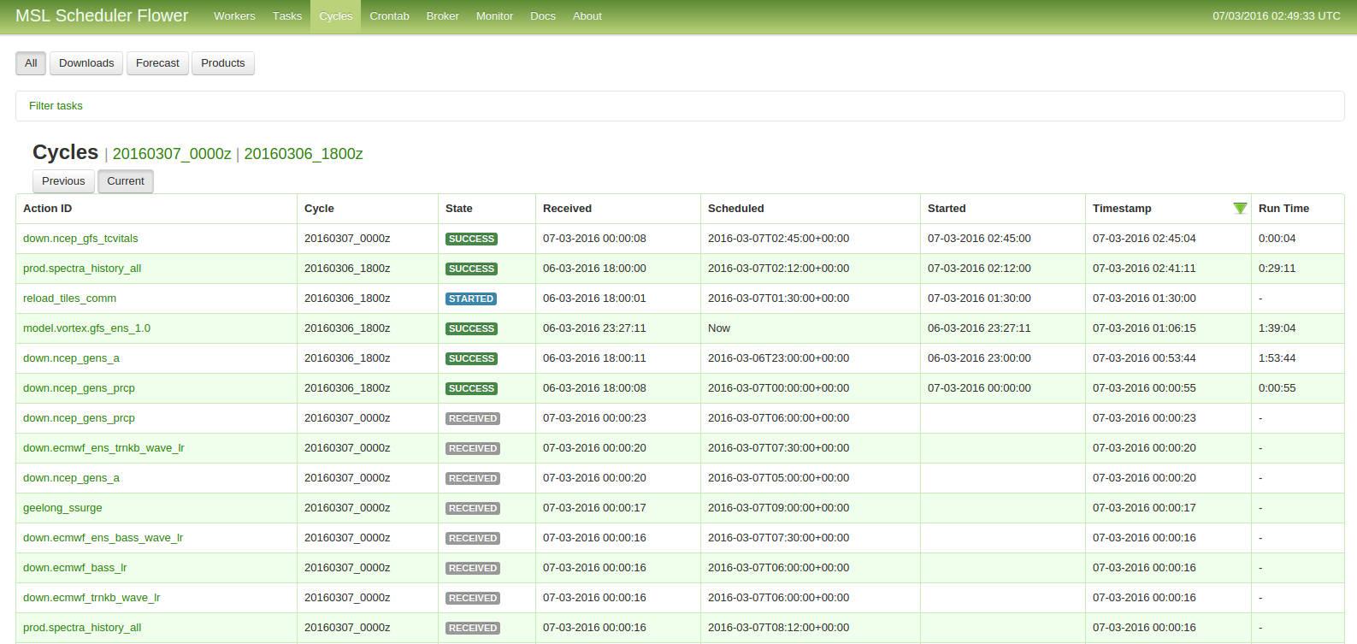
Operational Scheduler
Notes:
Scheduling system based on time- and task- dependency
Based on Celery a python task-queue system that handle distribution of tasks (asynchronously or synchronously)
- 500 tasks running daily (downloads, models, products) - ~ 200 swan nests (multi-guidance)

Slide 6
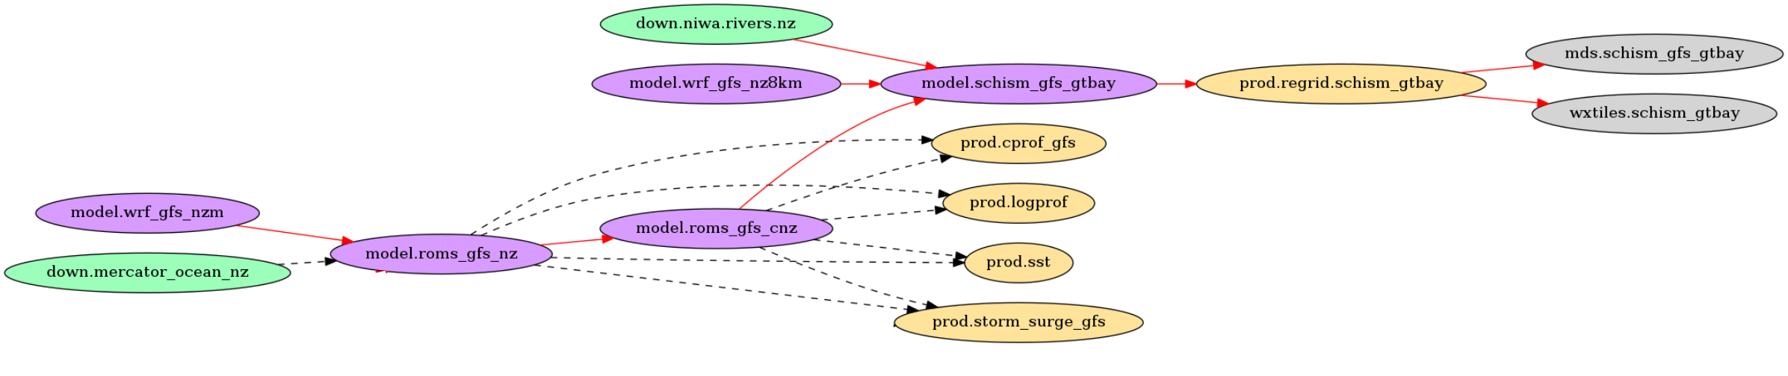
SCHISM forecast workflow
Notes:
Schism workflow

Slide 7
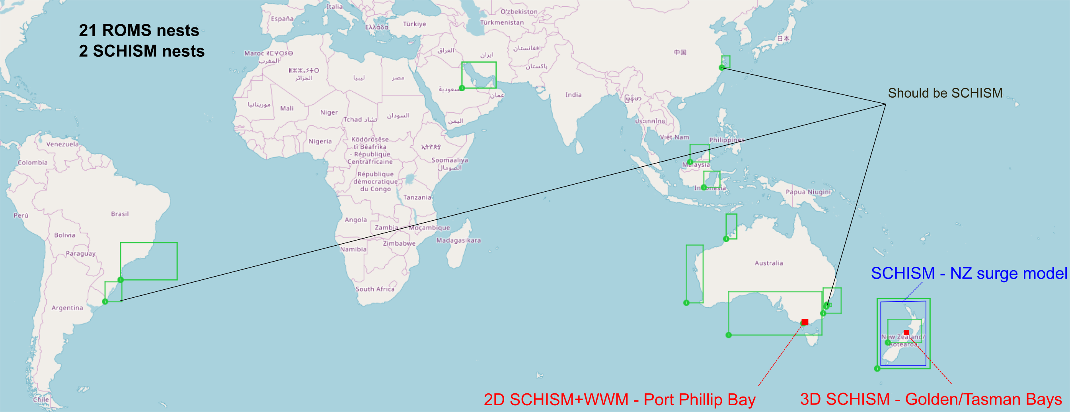
Hydro forecast models
Notes:
23 hydro models (including multi-guidance)

Slide 8




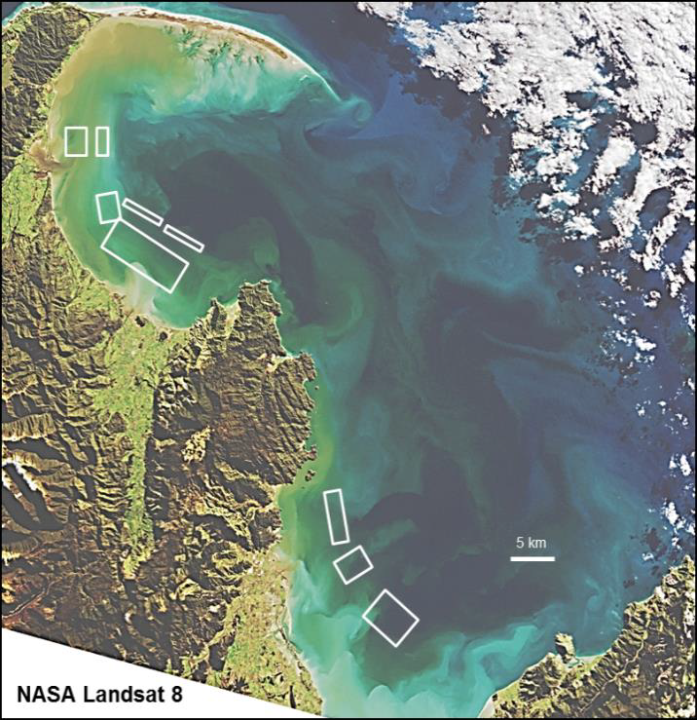
Near Real-time forecasting of contamination risks to shellfish harvests and Beaches
Tasman and Golden Bays – South Island NZ
The problem: closure criteria for aquaculture harvests are largely based of river flows – this likely leads to overly conservative closures.
And: Councils have similar problems and currently maker closure decisions based on limited or delayed information.
Forecast components
Develop an operational catchment model to predict river flows
Combined with bacterial loading model
Integrate into a high-resolution hydrodynamic model
Provide forecasts daily
A solution: Develop a dynamic management tool that enables and underpins refined harvest criteria.
Tasman and Golden Bays following flooding; existing and proposed aquaculture areas shown in white
Notes:
The project is a collaborative effort of experts from the Cawthron Institute, NIWA and MetOcean Solutions. A project to build connected land-river-sea models and provide a timely risk assessment of contamination to beaches and shellfish growing areas.
Forecast System components

Slide 9
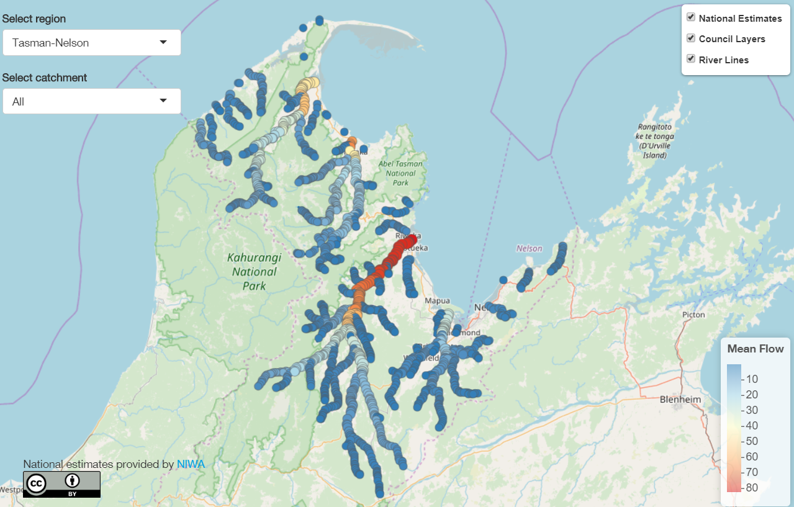
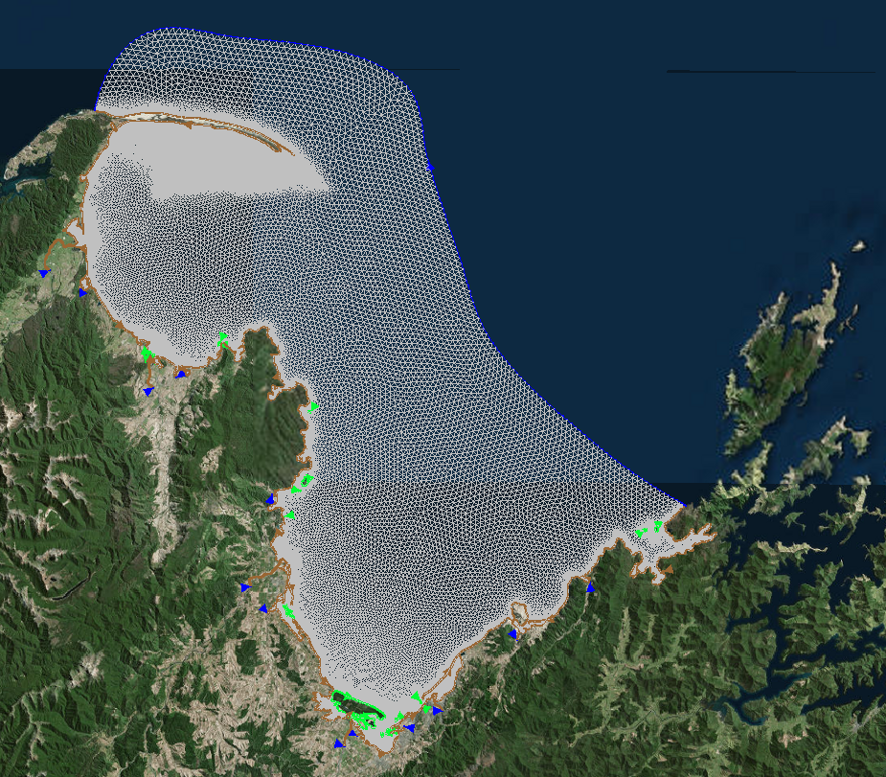
3D model set-up
Grid resolution from ~10 m nearshore to ~1.5 km offshore.
Defines estuaries, intertidal areas, rivers and streams.
Boundary conditions from 3km regional ROMS
Atmospherics from 4km WRF model
11 freshwater discharge sources
Bacterial load/decay as GEN tracer (aiming FIB in the future)
Model runs twice a day (00z, 12z) out to 48 hours forecast horizon
https://shiny.niwa.co.nz/nzrivermaps/
Catchment model and fluvial inputs (TOPNET)
11 fluvial inputs into the nearshore marine environment.
Each draining a unique catchment.
Assimilates observational data
Fifty different ensembles out to two days (48 hours)
Notes:
SCHISM model
Potentially two different ensembles for the offshore ROMS data
We carried model development, operationalising and downstream data delivery

Slide 10
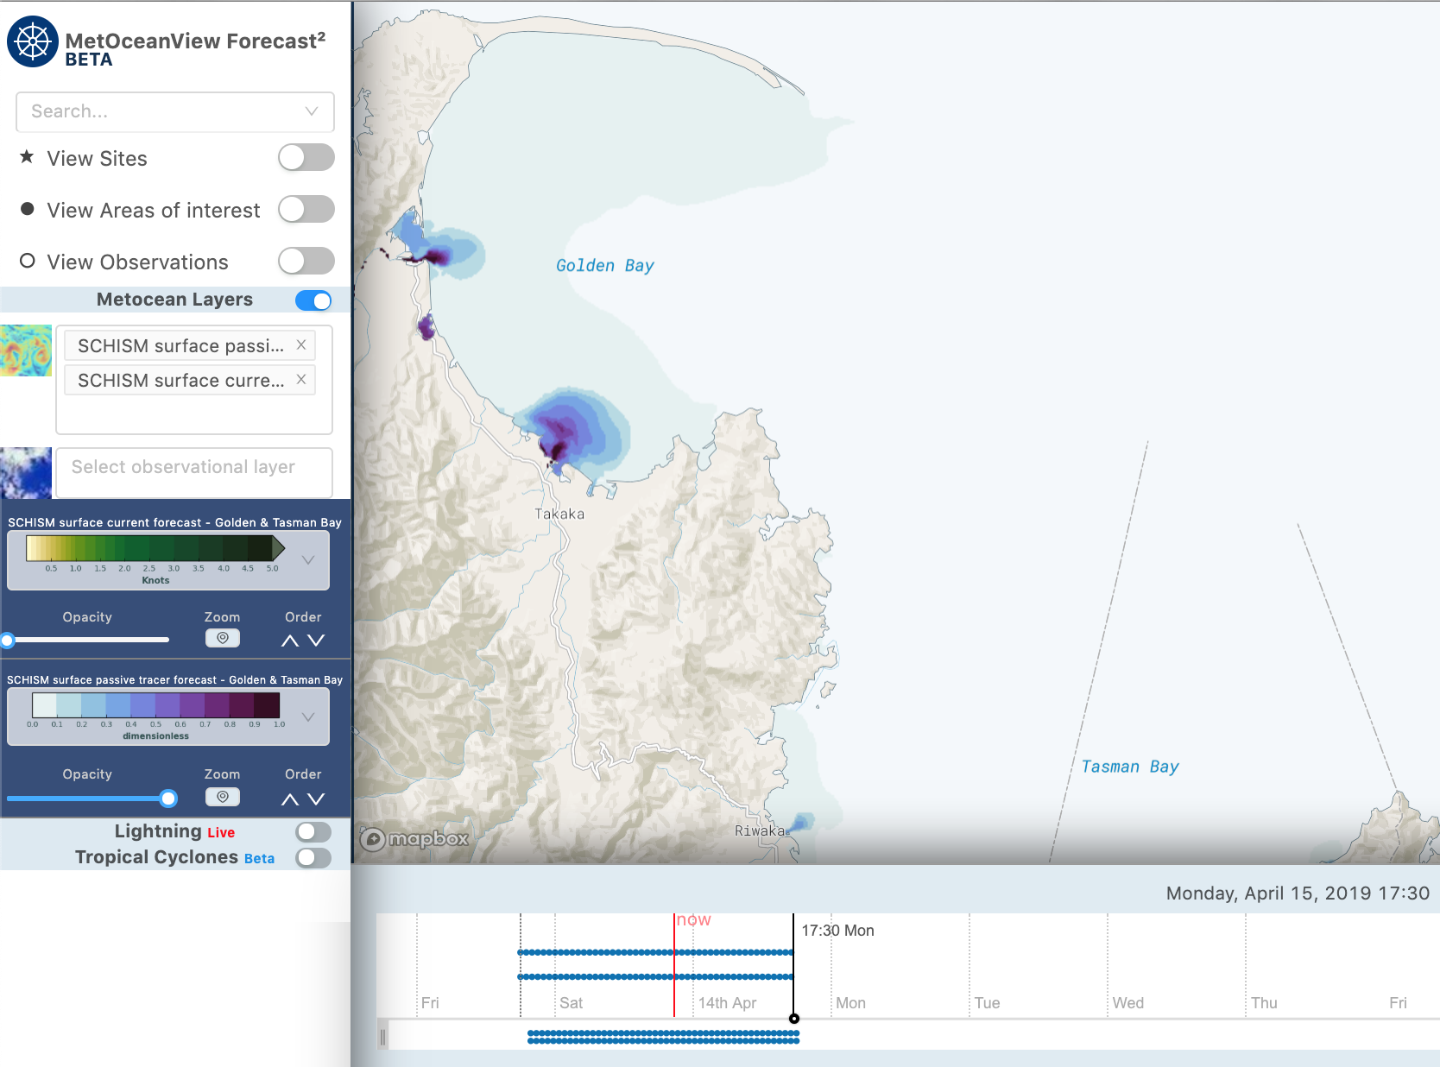
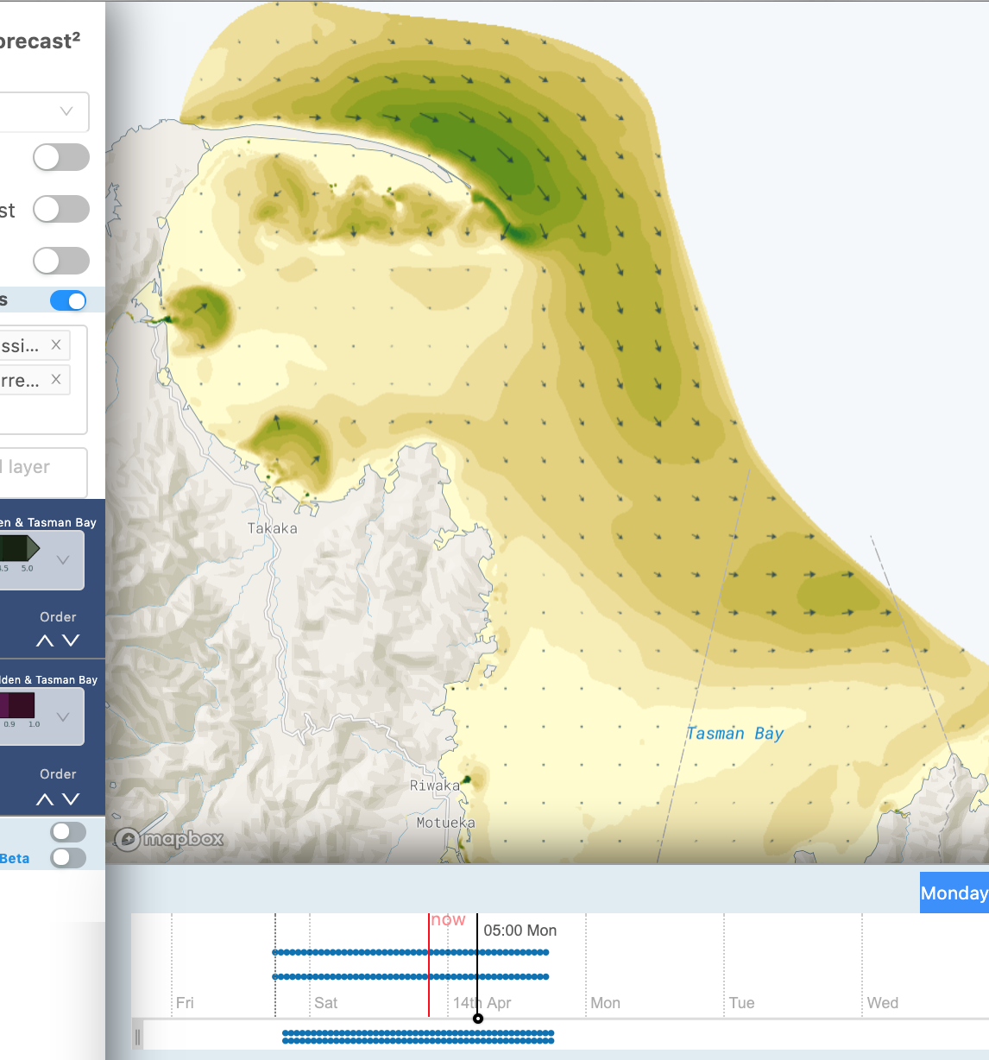

Slide 11
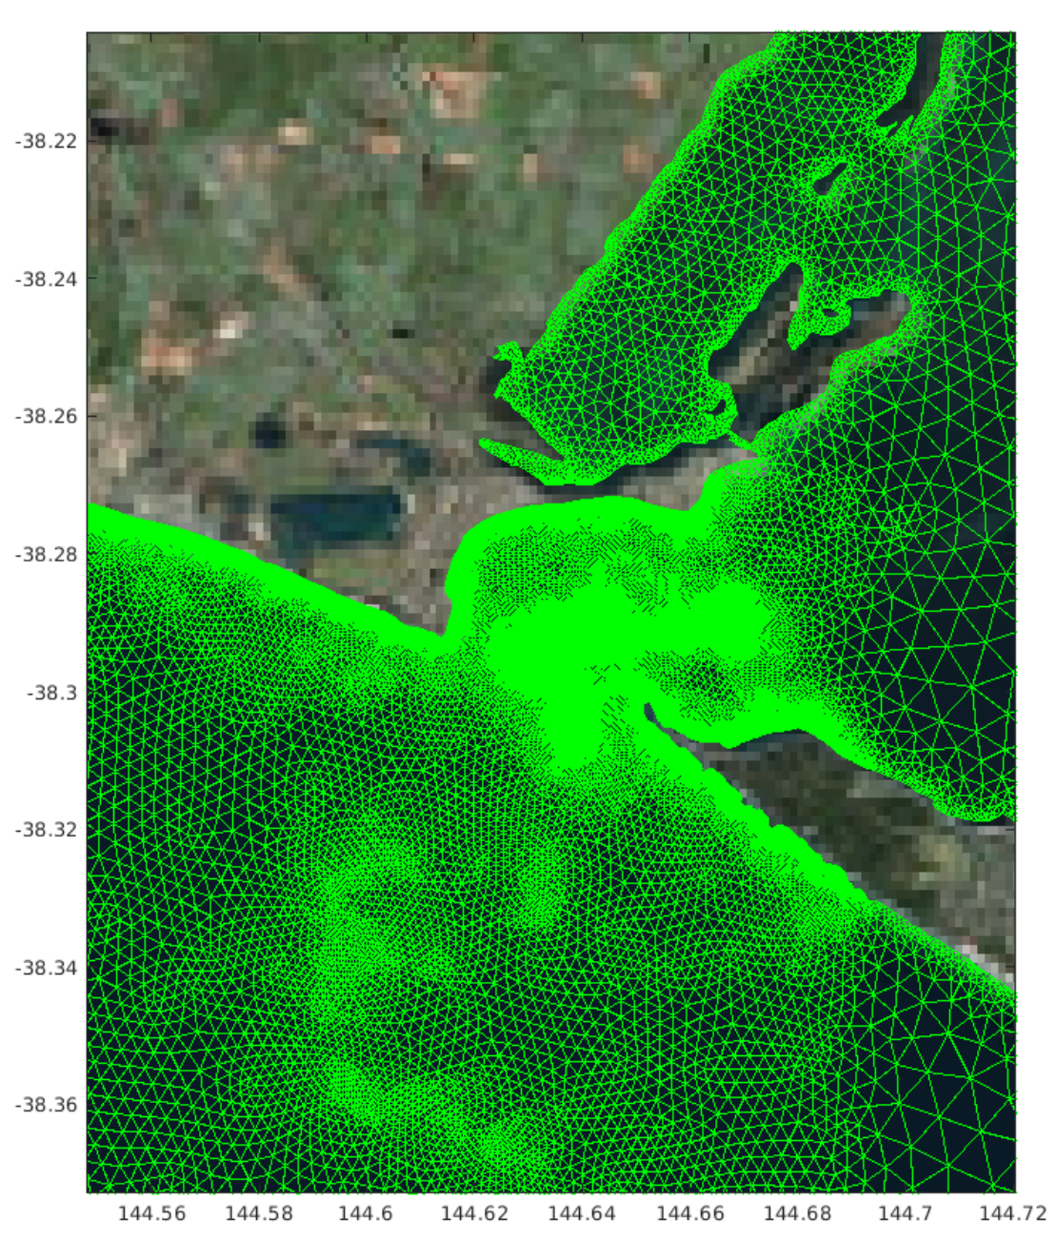




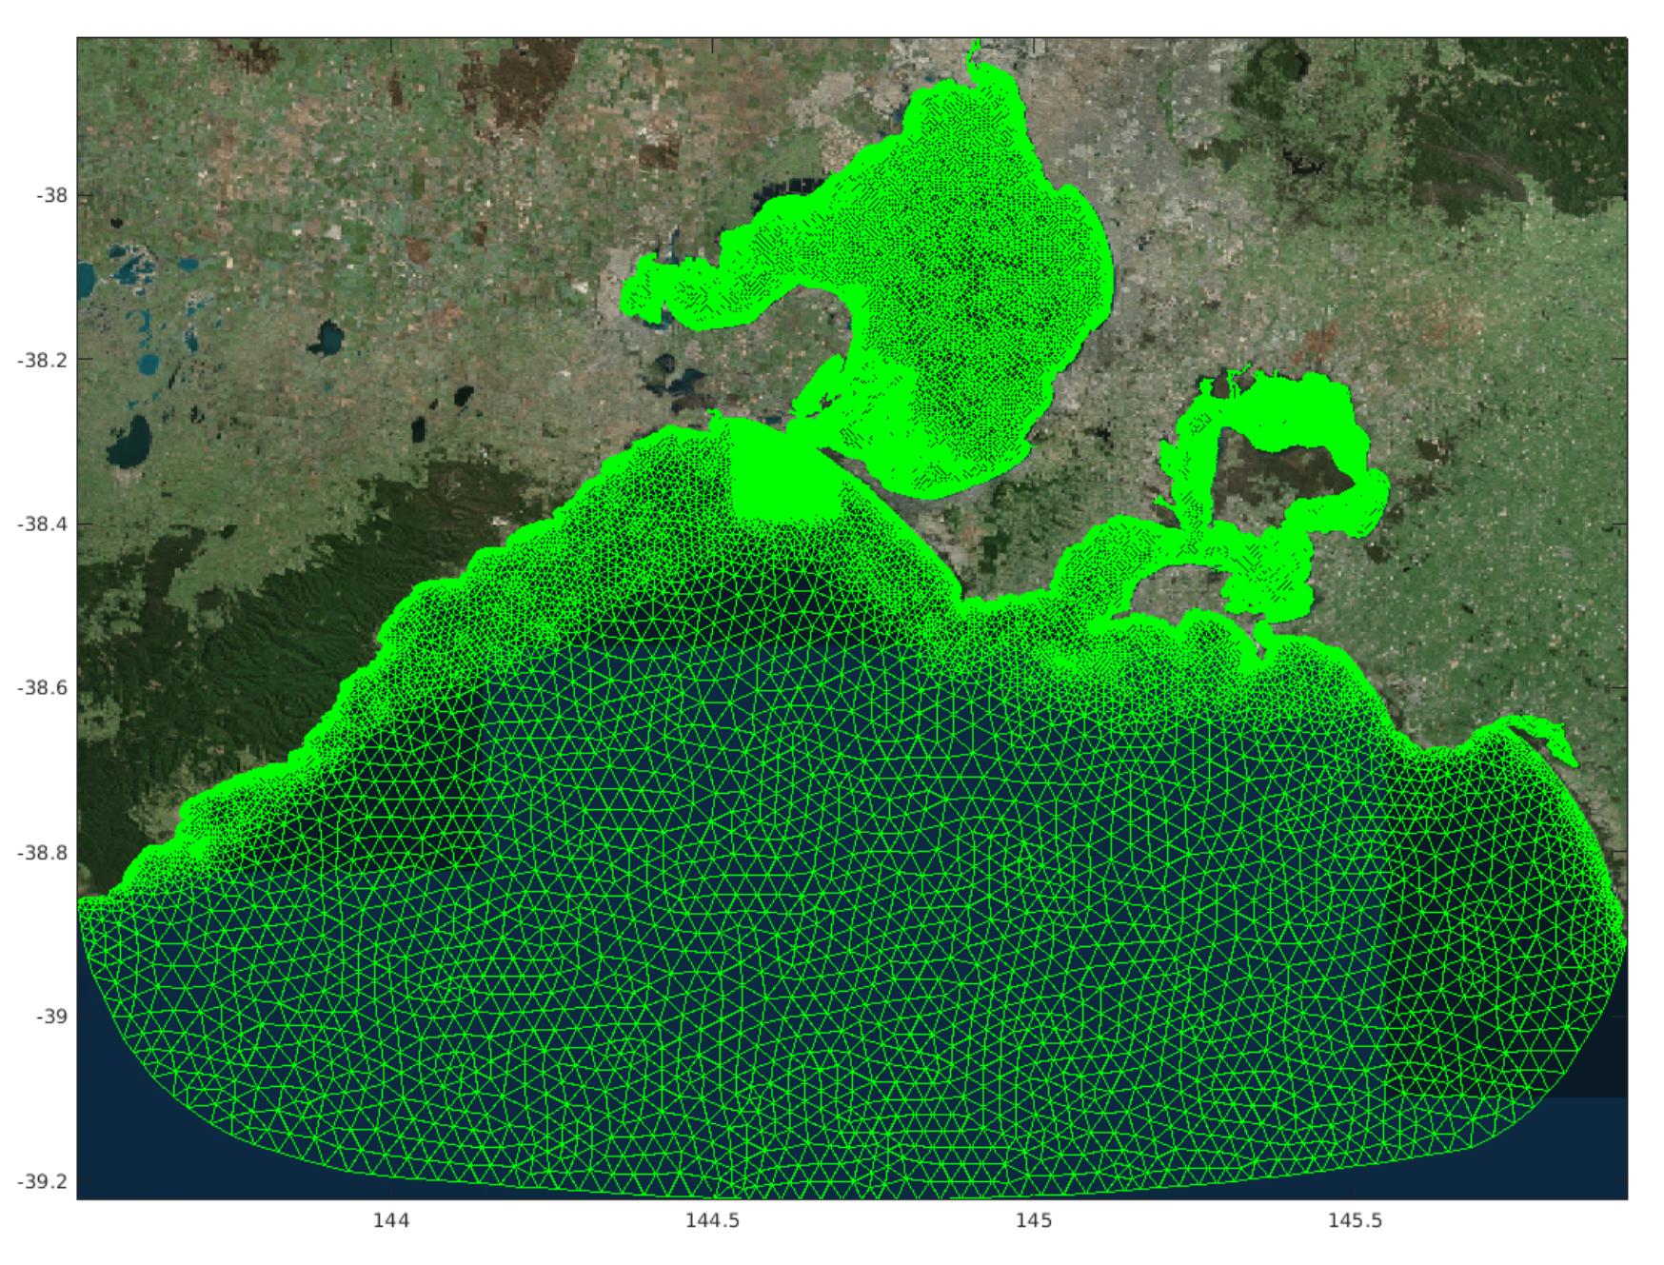
Coupled current-wave model for under-keel clearance prediction
2D model set-up
Developed in collaboration with Huy’s team
Grid resolution from ~10 m nearshore to ~3 km offshore.
Defines navigational channel and intertidal areas.
Boundary conditions from regional ROMS and SWAN (~4km)
Atmospherics from 8km WRF model
Model runs 4x a day out to 48 hours forecast horizon
Notes:
This new capability was developed as part of a larger project funded by the Australian Cooperative Research Centres Projects initiative. The project, a partnership between OMC International, Pivot Maritime International, University of Melbourne and MetOcean Solutions will provide an integrated modelling system for predicting under-keel clearance to support port and shipping services in tidal inlets.
The operational high resolution hydrodynamic forecast model developed will provide input into the under keel clearance system operated by OMC international, strengthening the offerings available through the Metocean Solutions and OMC partnership (find more information here).

Slide 12
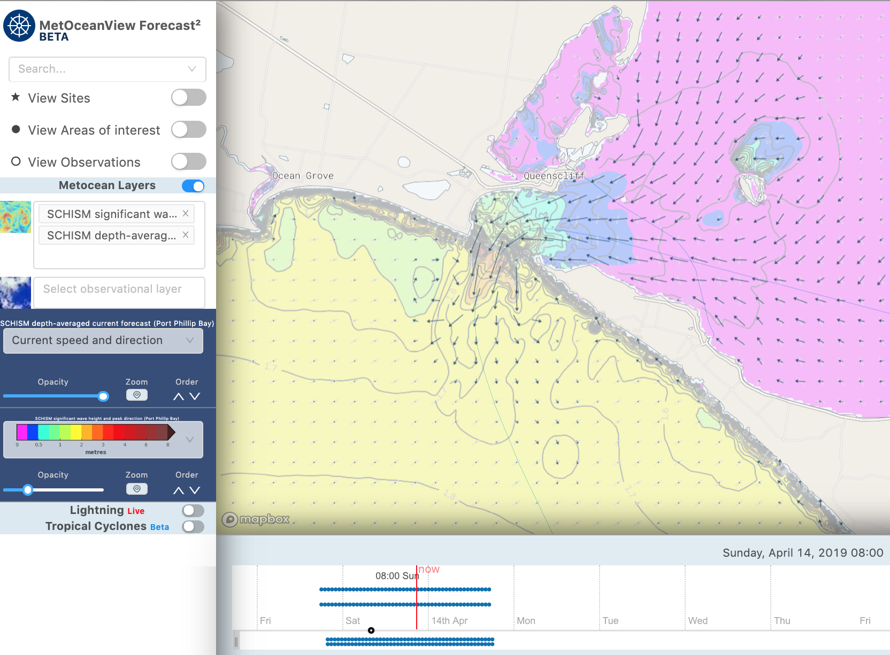

Slide 13
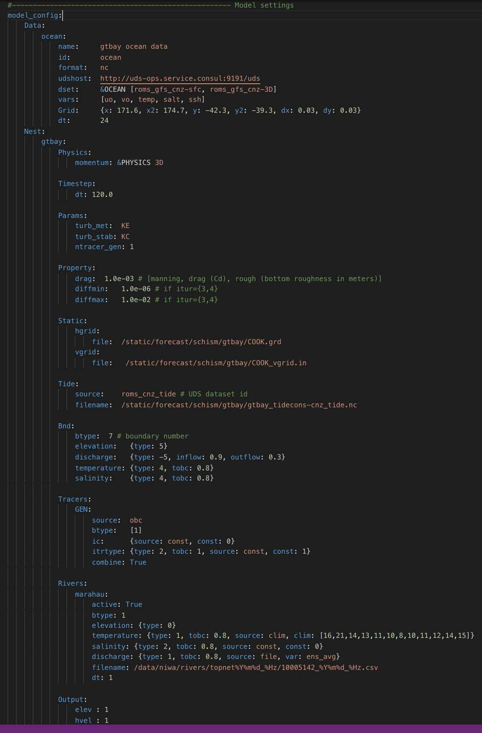
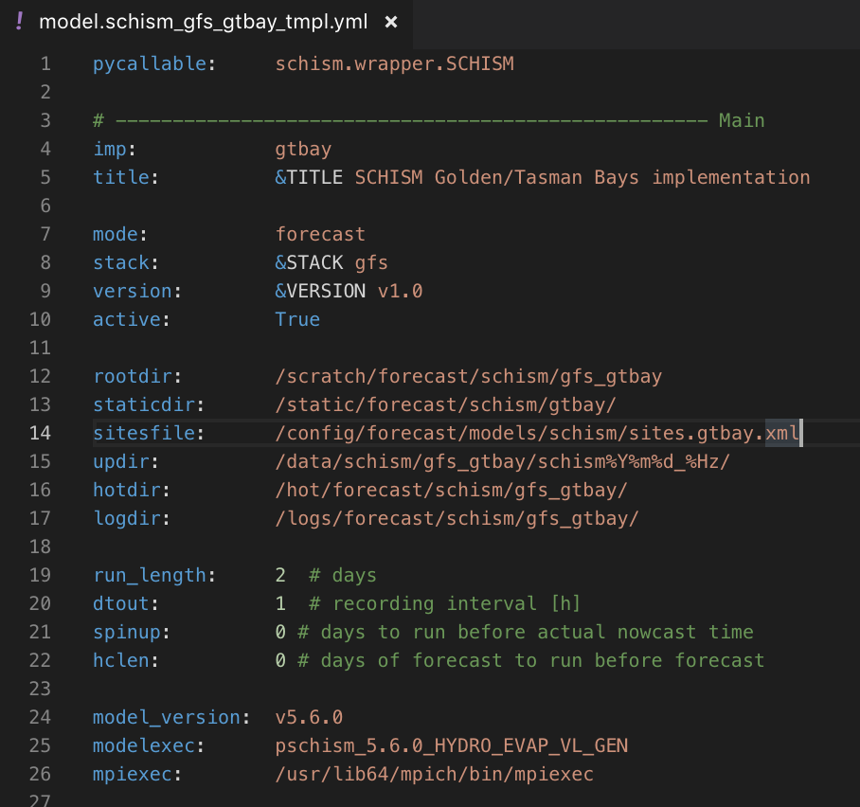
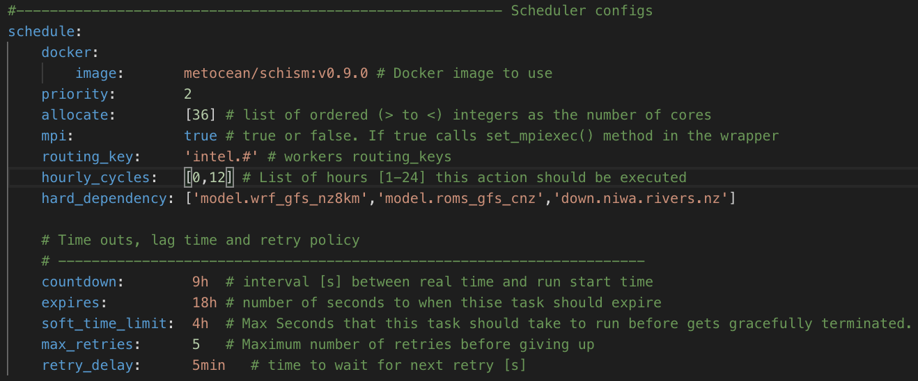
So what it takes to get a SCHISM implementation operationalized?
1. Model implementation config.:
Application specific
Sys environment settings
Input data definition
Model param. Specifications
Feeds into model “wrapper” code
Scheduler settings
Dataset registration
Notes:
So what it takes to get a SCHISM (or any other model) implementation operational…

Slide 14
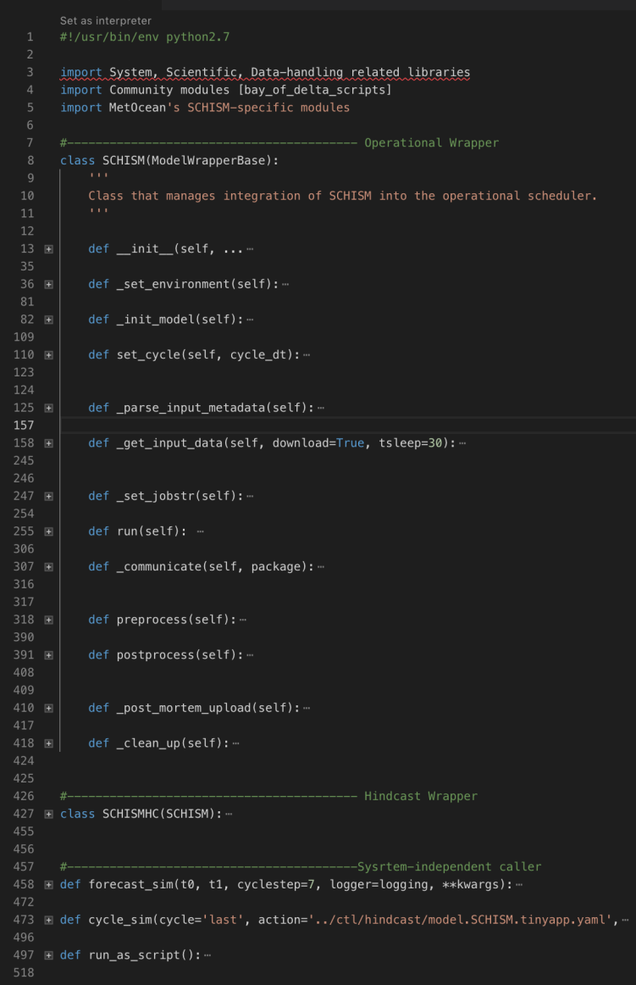
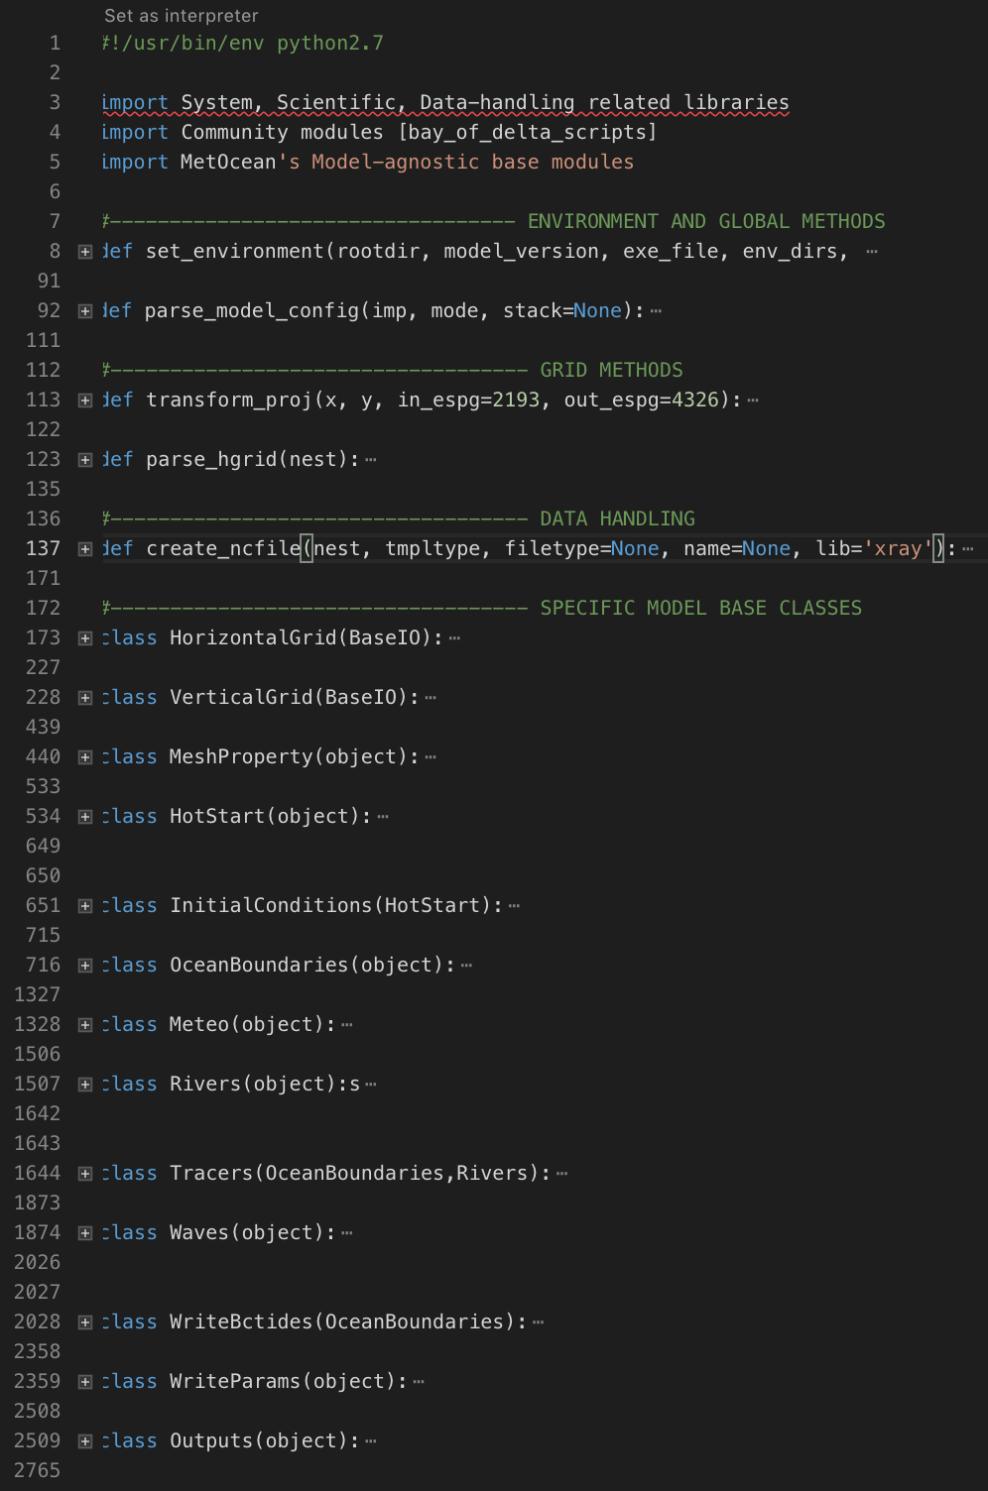
2. Model wrapper
Core module:
Model specific
Comprehensive code follows model structure
Interacts with native model config templates behind-the-scene
Relevant code compartments are called based on model configs
‘Wrapper’ module:
Streamlines model set-up steps
Performs integration with OPS and Hindcast systems
Can run standalone as well
Notes:
- Add schism to hydro models box

Slide 15
Key points
Prospects for New Zealand national storm surge / inundation modelling system
Prospects for several current-wave coupled applications at regional and port scales
New developments around SCHISM coming along with Moana Project
Engaged In open-sourcing tools (Wavespectra)
Engaged in multiple cross-institutional research project collaborations
Notes:
From Brett’s summary slide:
Multiple agency approach working together
Several forecast projects aligned to start in the near-future
Operational storm surge / inundation model New Zealand
Open sourced Wave spectra library:
https://github.com/metocean/wavespectra

