Slide 1
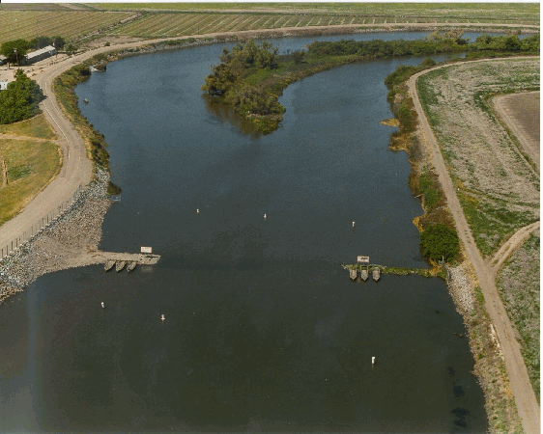
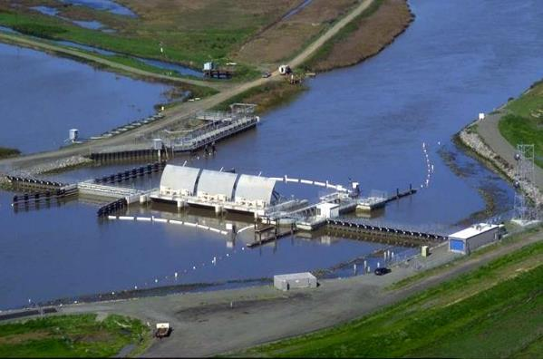
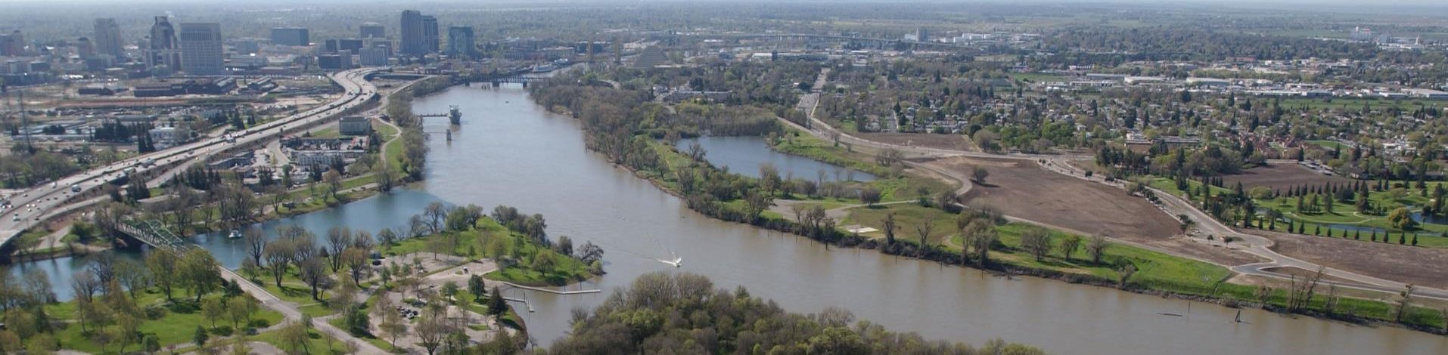
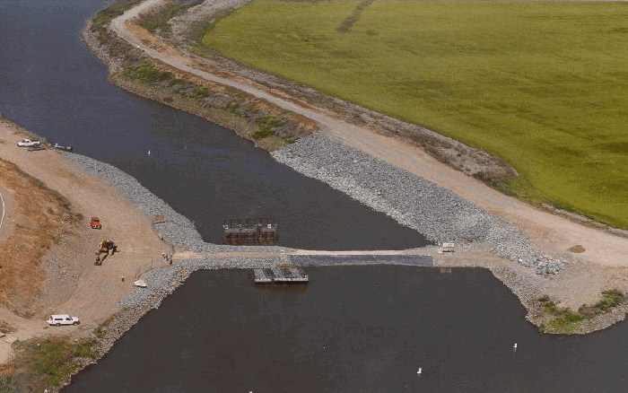
Hydraulic Structures
CALIFORNIA DEPARTMENT OF WATER RESOURCES
Concepts and configuration
Eli Ateljevich, Bay Delta Office

Slide 2
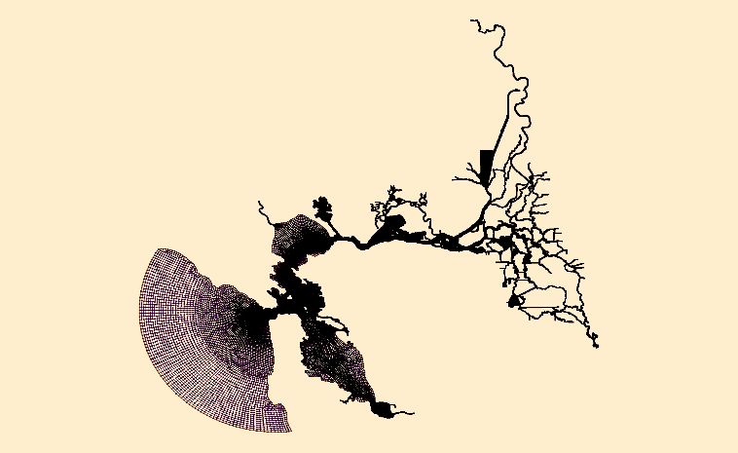

Types of structures
Transfers of (pumped) water
Weir
Culvert
Generic orifice equation
Radial Gate
  2 parameterizations
Weir/culvert combo
Removal
Structure

Slide 3
Implementation
Engineering hydraulic/orifice equations
  Modulated by directional operating coefficient
  Head difference assessed at reference nodes
  Prescribed flow (transfer) also possible
Similar to paired flux boundary
  Flows distributed uniformly over cross-section (1D)
  Required to not go dry locally … could change?
  Nudging factor is applied 0 < nu < 1
Structures can be “uninstalled” in time series
  Revert to normal hydrodynamics
Time series (th) multivariate, irregular
Examples: Wahl 2005, HECRAS

Slide 4
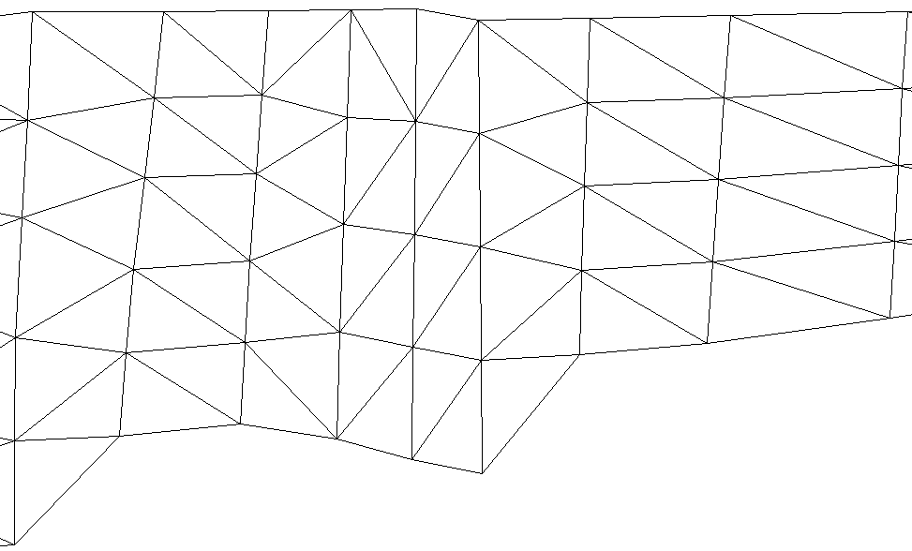
Defining Structures
Upstream
Downstream
Reference nodes
“hydraulic head”
Paired nodes
Defined land-to-land
1
1’
2
2’
3
3’
4
4’
5
5’
Structure location
Structure
Reference node

Slide 5
Steps Configuring the Structure
Prep mesh: node pairs, straight
Enable in param.in: ihydraulics=1
Geometry and parameters: hydraulics.in
Time series control: my_gate.th
See doc: Hydraulic Structures in SCHISM
******************************************
Preprocessor (BayDeltaSCHISM yaml-based system)
  Locations are physical (line segment)
  See preprocessor document or BayDeltaSCHISM examples

Slide 6
hydraulics.in
3 struct_three ! block number, name
6 976 994 ! # node-pairs, 2 ref. nodes (global indices)
984 990 !node pair
983 989
982 988
981 987
980 986
979 985
weir ! struct type
! nduplicate
-1.0 10.1 ! invert elevation, width per weir
0.75 0.5 ! coef, op_downstream, op_upstream
0 ! time series parameter entry

Slide 7
Structure Time Series
#datetime install ndup op_down op_up elev width height
1999-11-26T08:24 1 2 1.0 1.0 -3.42 18.29 0
1999-12-14T09:24 1 2 1.0 1.0 -3.42 18.29 10
1999-12-14T14:25 1 2 1.0 1.0 -3.42 18.29 0
1999-12-15T09:22 1 2 1.0 1.0 -3.42 18.29 10
-4263060.0 1 2 1.0 1.0 -3.42 18.29 0
8762400.0 1 2 1.0 1.0 -3.42 18.29 10
9113400.0 1 2 1.0 1.0 -3.42 18.29 0
9368640.0 1 2 1.0 1.0 -3.42 18.29 10
install = 0 reverts to normal hydrodynamics
Series are multivariate
  Columns needed vary
  Documented in manual
Series are irregular
  Entry at 0. or negative required
BayDeltaSCHISM model_time.py to_elapsed utility used for translation

Slide 8
Extension
See hydraulic_structures.F90
Straightforward for new formulations based on water levels
  If velocity component of energy is important, need to work out message passing
  Please create matching unit test executable

Slide 9
do istruct = 1,nhtblocks
struct => structures(istruct)
SCHISM_ASSERT_EQUAL(struct%struct_type, istruct)
SCHISM_ASSERT_EQUAL(struct%nduplicate,mod(istruct,2)+1)
if (istruct == PIPE) then
SCHISM_ASSERT_CLOSE(struct%width,2.0d0,epsilon)
SCHISM_ASSERT(struct%height > 1.d6)
else if(istruct == WEIR) then
SCHISM_ASSERT_CLOSE(struct%width,10.1d0,epsilon)
…

Slide 10
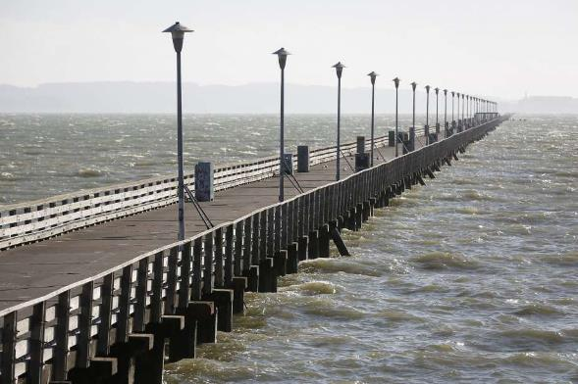
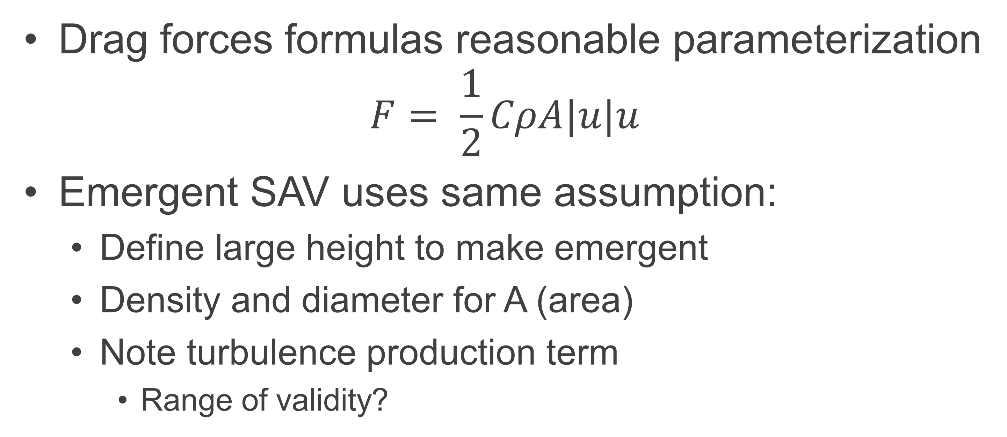
Piers and Drag-inducing Structures
Drag forces formulas reasonable parameterization
$$F= \frac{1}{2}CρA|u|u$$
Emergent SAV uses same assumption:
  Define large height to make emergent
  Density and diameter for A (area)
  Note turbulence production term
    Range of validity?

Slide 11

Questions?
Eli.Ateljevich@water.ca.gov
Structure

Slide 12




Follow us on social media
CADWR
CA_DWR
calwater
cadepartmentofwaterresources
Notes:
NEGATIVE SPACE
GOOD

